Slide 1
Topic 8 – Freight Distribution Systems
A – Distribution Facilities
B – E-commerce
C – Cold Chains
D – Green Logistics

Slide 2
A – Distribution Facilities
Read section 2

Slide 3



Warehouses versus Distribution Centers
Warehouse
Storage
Distribution Center
Throughput
Supply-driven (storage).
Buffer related function (inventory holding).
Inventory stored for weeks or months.
Cargo ownership usually by supplier / producer.
Consolidation of cargo.
Limited added value outside storage.
Coping with unforeseen demand.
Demand-driven (throughput).
Fulfilling orders (processing and fulfillment).
Inventory stored for days or weeks.
Cargo ownership usually by distributor / customer.
Consolidating, deconsolidating, sorting a cargo load or changing the load unit.
Assembly, packaging and light manufacturing.
Coping with stable and predictable demand.

Slide 4




Types of Freight Facilities
Read this content
Facility
Fabrication
Storage
Distribution
MANUFACTURING
Heavy Manufacturing
Raw materials inputs
Bulky outputs
Storage of raw materials and parts
Light Manufacturing
Parts inputs, Parts or finished goods output
Storage of parts and inventory holding of outputs
Inventory management
TERMINALS
Bulk or transload
Port industrial complex
Storage of raw materials
Bulk inventory management
Intermodal
Inventory at terminal
Container logistics
STORAGE
Bulk warehouse
Single-purpose storage
Inventory management
Warehouse
Multi-purpose storage
Inventory management
Multitenant facility
Light manufacturing
Multi-purpose storage
Inventory management
DISTRIBUTION
Assembly, packaging, labelling
Distribution center
Short-term storage
Inventory replenishment
Cross-docking facility
Sorting inventory
Urban logistics depot
Specialized inventory
Last-mile logistics
PARCELS
E-fulfillment center
High rack inventory
Packing parcels
Sortation center
Sorting parcels

Slide 5
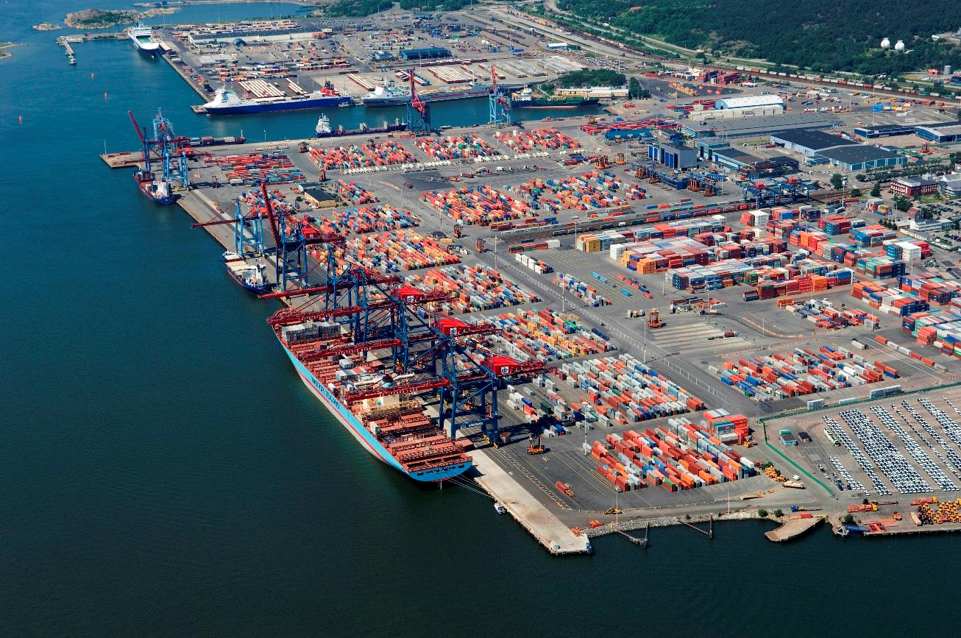
Container Terminal, Port of Gothenburg, Sweden
Intermodal

Slide 6
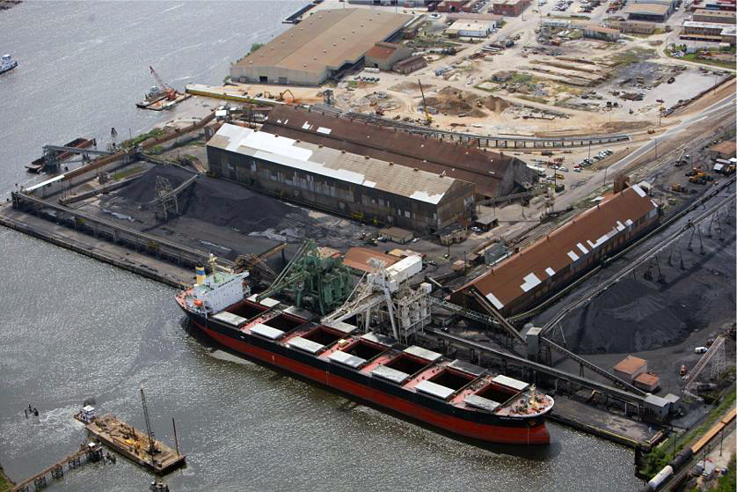
Coal Bulk Facility, Mobile, Alabama
Bulk or transload
Notes:
Source: Port of Alabama Authority.

Slide 7
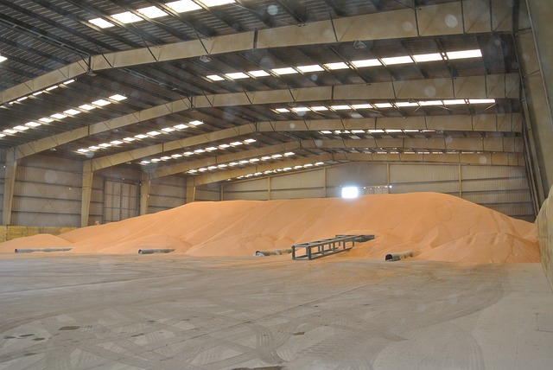
Bulk Warehouse (Corn)
Bulk warehouse

Slide 8
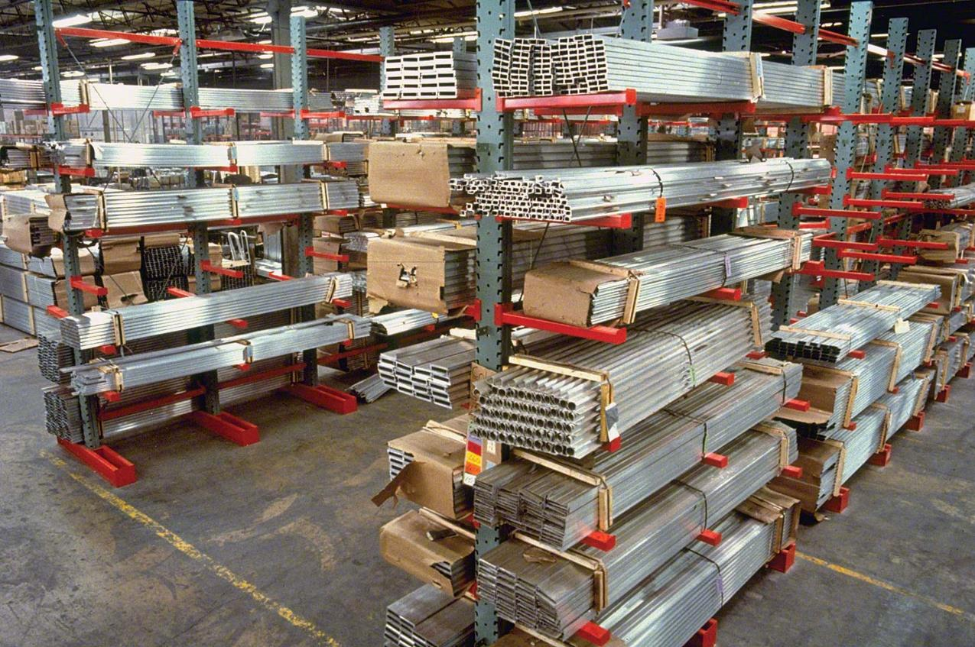
Aluminum Parts Warehouse
Warehouse

Slide 9
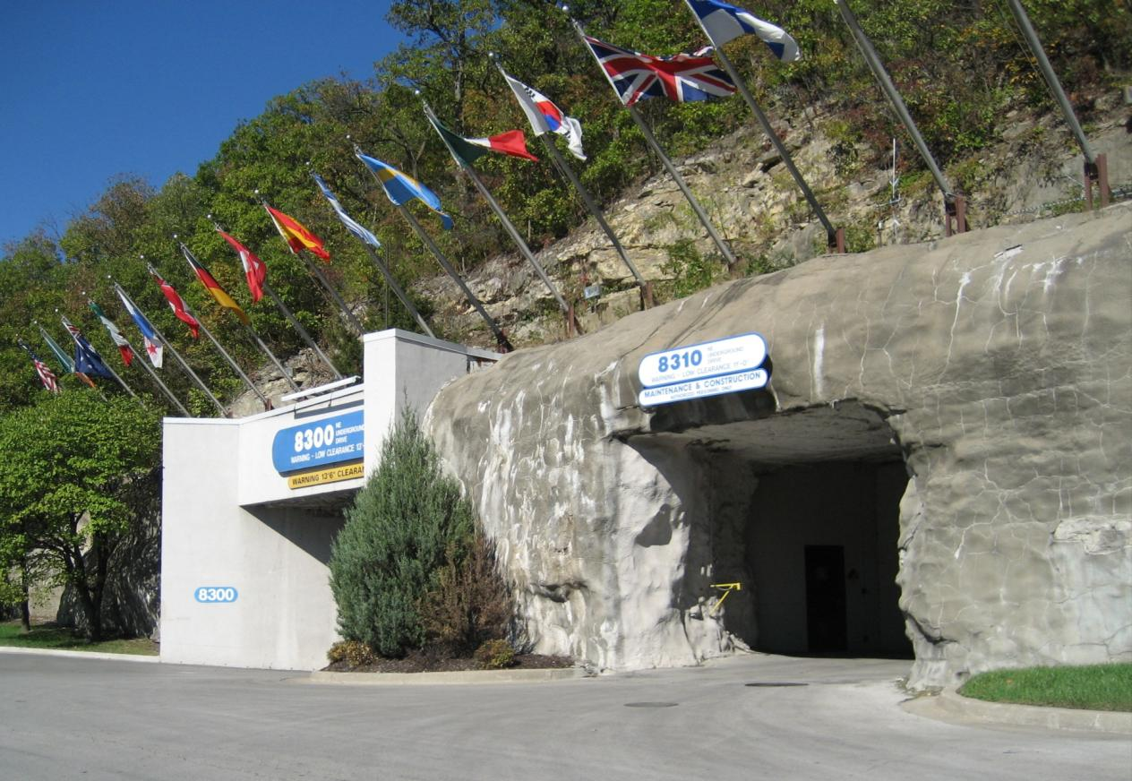
Subtropolis Distribution Center, Kansas City
Read this content
Multitenant facility
4.5 square km.
FTZ.
Data server storage.
Postal stamps storage.
National Archives and Records Association (Federal records).
Film archives
Specialty food packaging.
Food warehouse.
Notes:
Source: https://huntmidwest.com/industrial-space-for-lease/what-is-subtropolis/

Slide 10
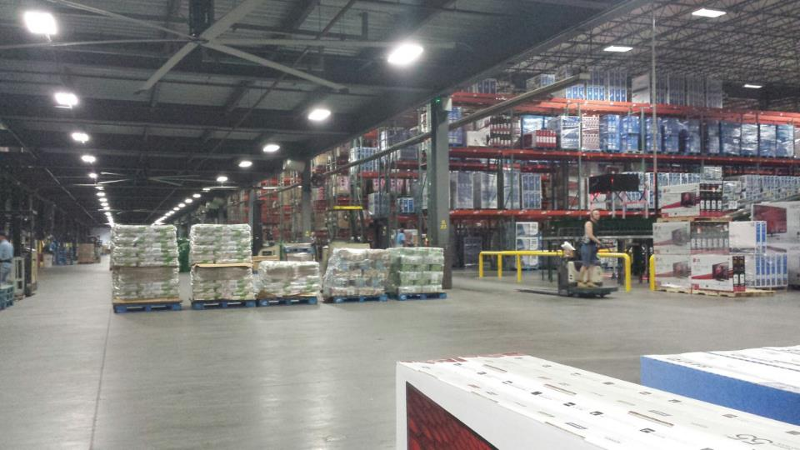
Walmart Distribution Center
A look inside the McLane Ozark Distribution Center
Distribution center

Slide 11
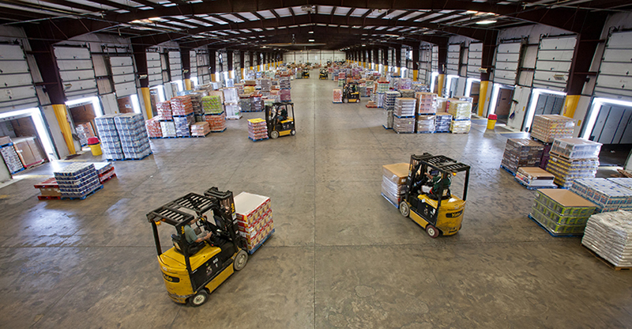
Cross-Docking Facility
Cross-docking facility

Slide 12
Cross-Docking Distribution Center
Read this content
Distribution Center
Before Cross-Docking
Suppliers
Suppliers
LTL
Receiving
Customers
Sorting
After Cross-Docking
Shipping
FTL
Cross-Docking DC
FTL
Customers
© GTS

Slide 13
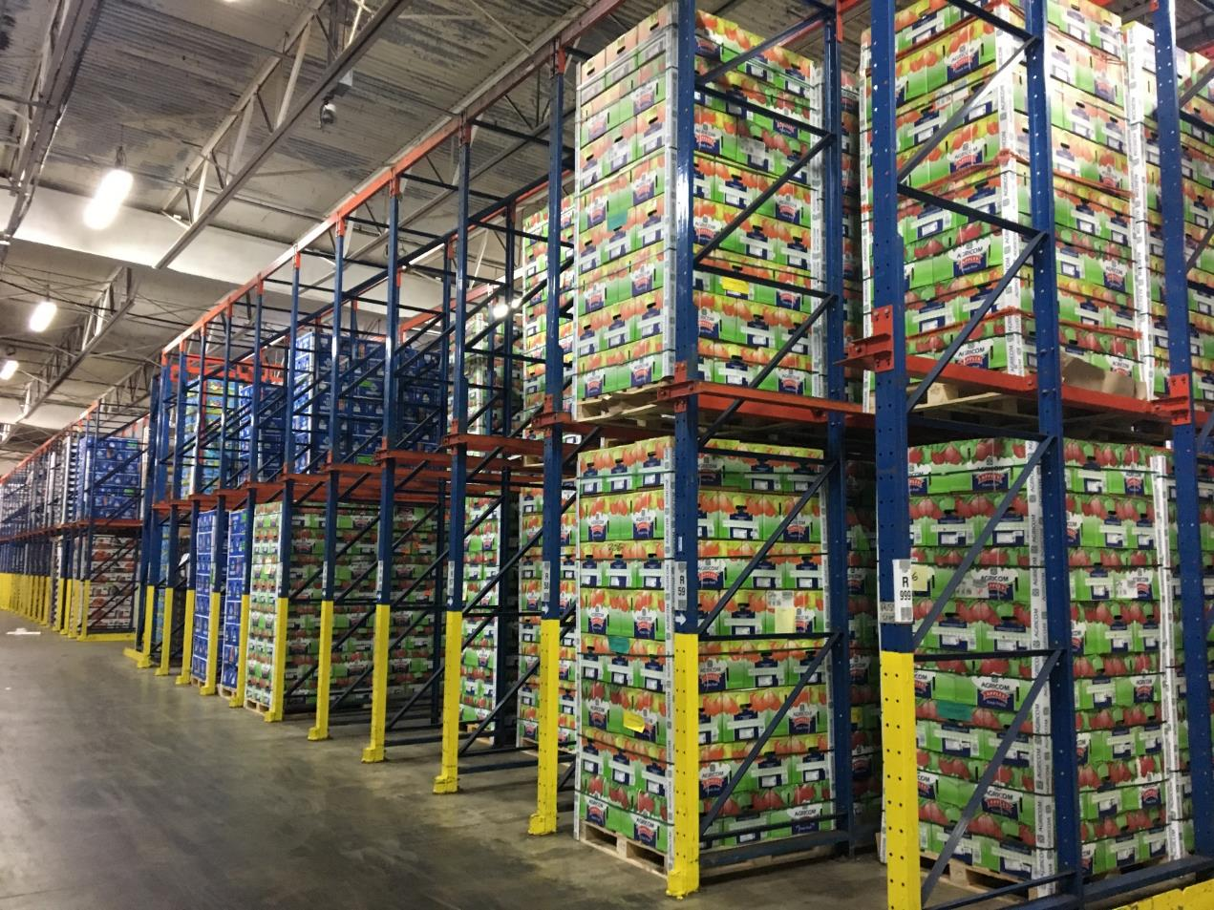
Cold Storage Facility
Cold storage facility

Slide 14
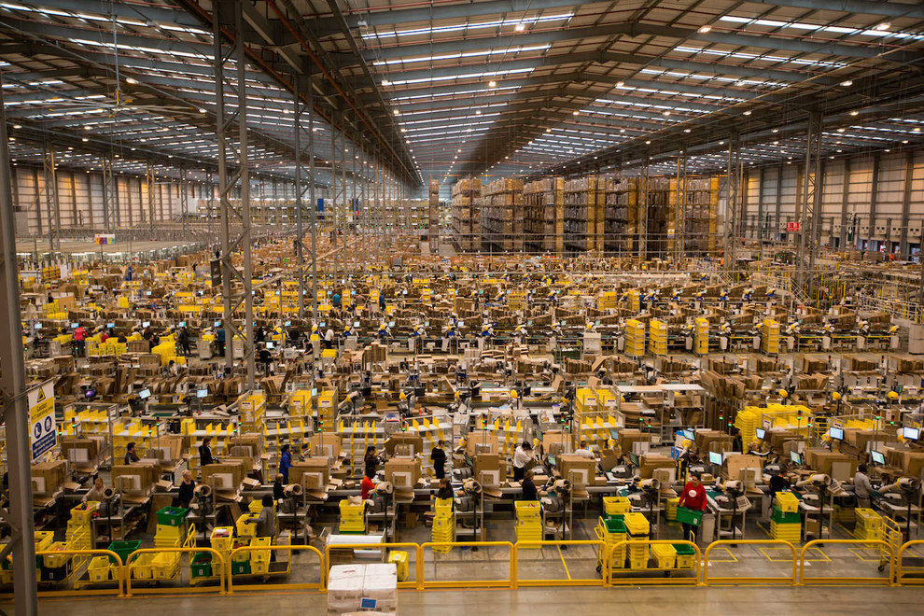
Amazon E-Fulfillment Center
E-fulfillment center

Slide 15
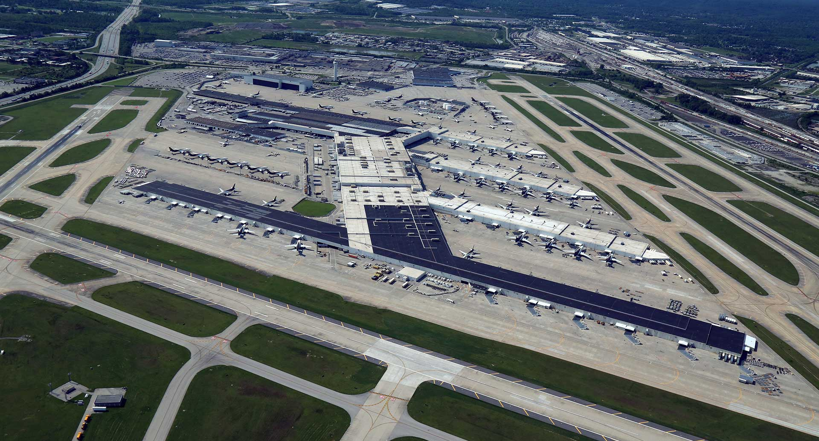
UPS Worldport, Louisville, KY
Sortation Center

Slide 16
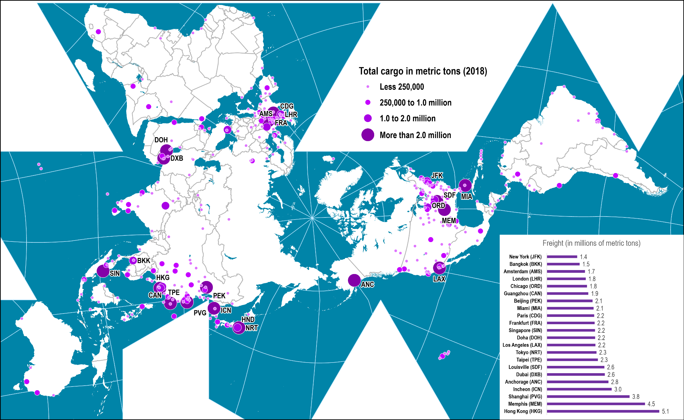
Freight Traffic at the World’s Largest Airports, 2018
Read this content
Notes:
Source: Airport Council International, http://www.airports.org

Slide 17
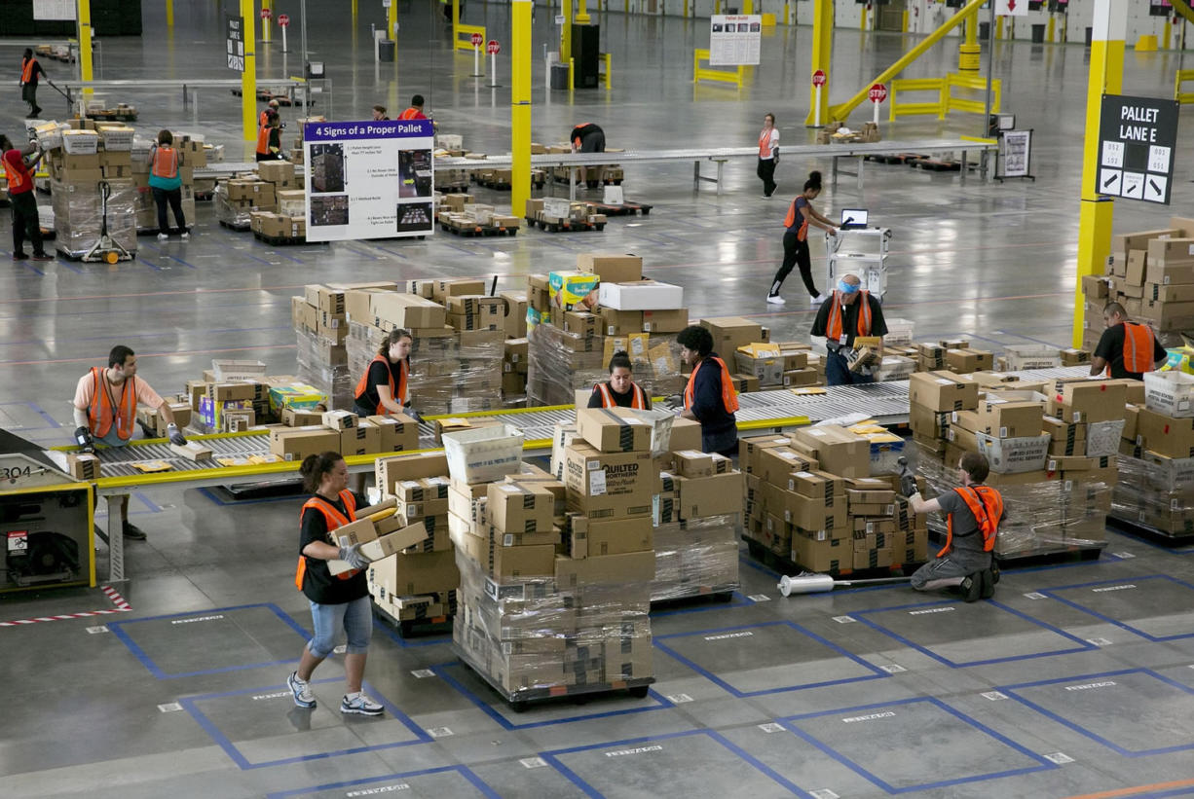
Amazon Sortation Center
Sortation Center

Slide 18
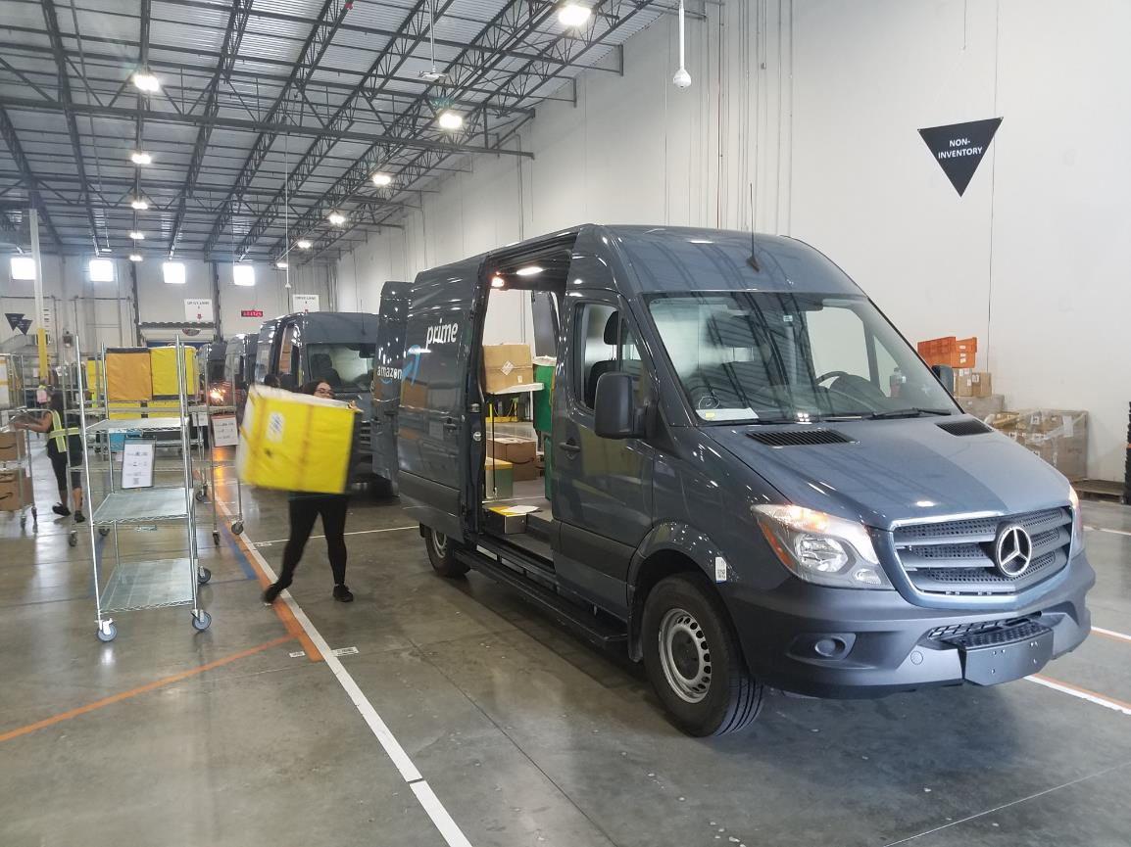
Amazon Delivery Station
Urban logistics depot
Notes:
Jacksonville Florida, Opened in 2017

Slide 19
Main Warehousing Operations
Deliveries
Pick Ups
Put away
Order-picking
15%
55%
Receiving
Storage
Picking
Shipping
10%
Sortation
Packing
Operating Hours of Distribution Centers

Slide 20
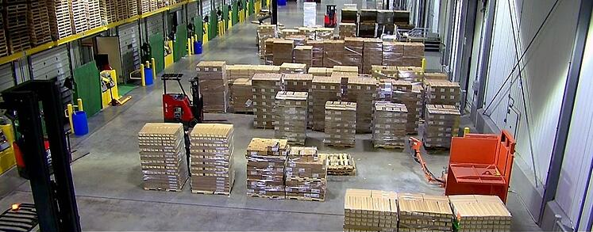
Warehousing / Distribution Center: Receiving

Slide 21
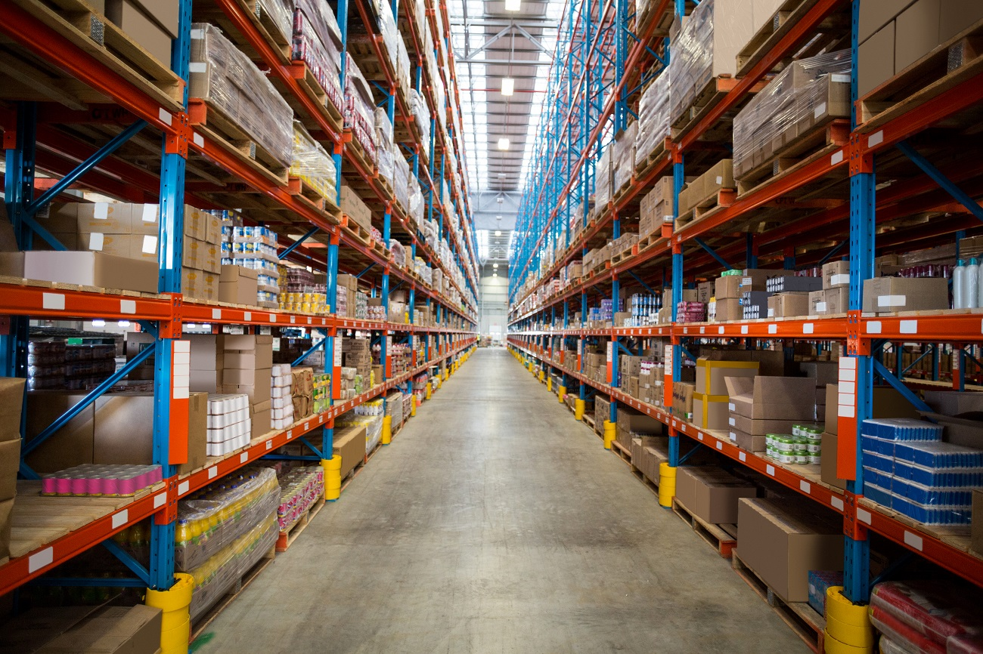
Warehousing / Distribution Center: Storage

Slide 22
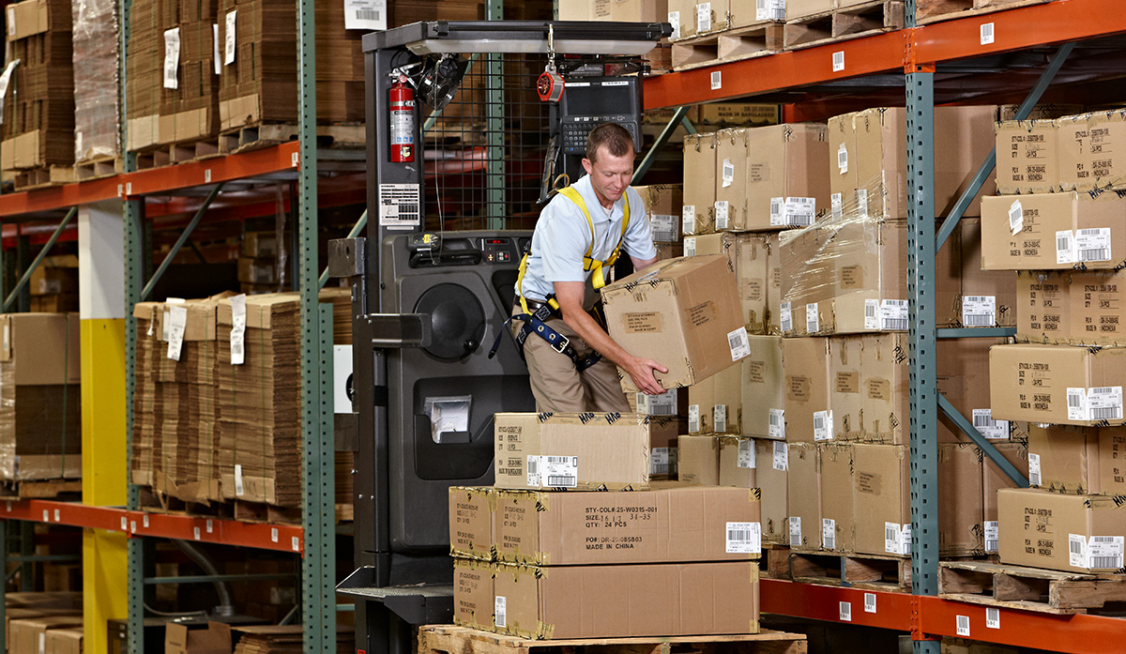
Warehousing / Distribution Center: Order Picking

Slide 23
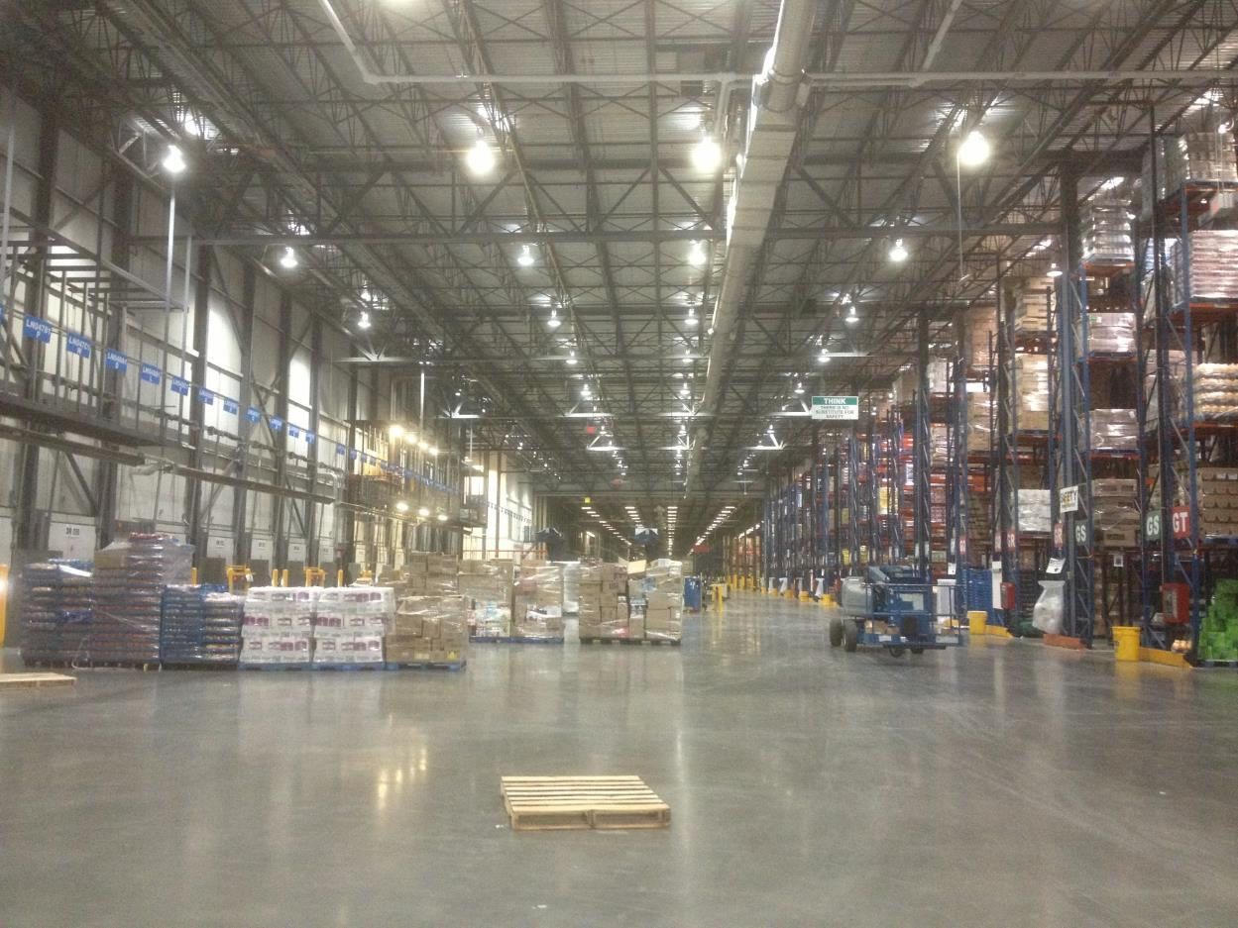
Warehousing / Distribution Center: Shipping

Slide 24

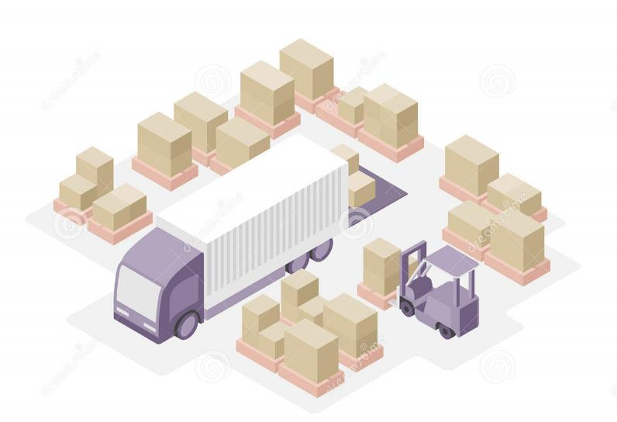
Short Assignment: Distribution Facilities
Explain what are the main types of distribution facilities and the role they each play

Slide 25
B – E-commerce
Read section 3

Slide 26
The Evolution of Retail Logistics
Read this content
1970s
Suppliers / Wholesalers
Stores
Direct Replenishment
1980s
Distribution Centers
Rationalization
1990s
Overseas suppliers
Import Centers
Domestic suppliers
Distribution Centers
Global Sourcing
2000s
E-fulfillment centers
Parcel hubs
Parcel delivery centers
Customer home
Suppliers
Sortation centers
Collection point
E-commerce
Local depots
Delivery point
Notes:
Source: Adapted from: Jones Lang Lassalle (2013) E-commerce boom triggers transformation in retail logistics: Driving a global wave of demand for new logistics facilities.
http://www.jll.com/Research/eCommerce_boom_triggers_transformation_in_retail_logistics_whitepaper_Nov2013.pdf

Slide 27
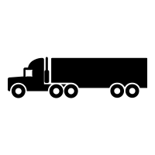



Distribution Channels for E-commerce
Read this content
Distribution Centers
Store
Collection Points
Home
DC
Store purchase
Store delivery
FC
Home delivery
Pick up
Locker
Collection point
DC
Urban Distribution Center

Slide 28







Impacts of E-commerce on the Retail Sector
DEFLATIONARY IMPACTS
DISCREMINATORY IMPACTS
Information asymmetry
Price discrimination
Removal of process layers responsible for intermediary steps in a value chain.
Selling similar goods to different targeted groups at different prices.
Search costs
Dynamic pricing
Effort to find suitable products (e.g. driving, shopping).
Price varies depending on the demand characteristics or the available supply.
Transaction costs
Disintermediation
Cost of participating in a market (low entry barrier).
Removal of process layers responsible for intermediary steps in a value chain.
Menu costs
Costs of changing prices and inventory.

Slide 29
Mail Carried by USPS and Parcels Carried by Major Carriers, United States, 2004-2021 (in billion units)
Read this content
Notes:
Sources: USPS. UPS and FedEx, Annual Reports. Packages shipped by FedEx ground and FedEx express. UPS involves US domestic parcel operations.

Slide 30
Retail Logistics and E-commerce
Read this content
Explain the main logistical differences between standard retailing and e-commerce
Conventional Retail Logistics
E-commerce Retail Logistics
Suppliers
Procurement
Suppliers
Platform
Procurement
Regional
Distribution
Center
Inventory Mgmt
E-Retailer
Inventory Mgmt
RDC
Order Processing
EFC
EFC
Storage (Backend)
Store Deliveries
B2B Deliveries
Orders
Order Processing
Retailer
(In-store
inventory)
Retrieval and packaging (Frontend)
Online
purchases
Parcel Delivery
Company
Home
Deliveries
B2C Deliveries
Travel to
store
Tracking
(Home, work or collection point)
Customers
Customers
EFC: E-fulfillment center
Notes:
UPS handles 9 million parcels per day created by e-commerce. Reduce costs, such as process and transaction. Could reduce the cost of making a car by 14%. Paradox of trimming of the supply chain. Complexity of distribution.

Slide 31
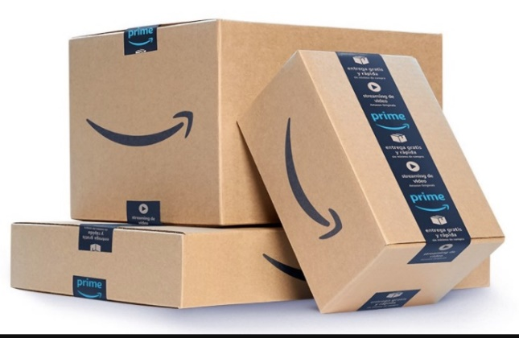
The Impacts of E-commerce on Freight Distribution
Read this content
1
2
Distribution Pattern
Real Estate Footprint
Distributional consumption.
Growth in B2C deliveries.
Changes in last mile logistics.
Shift of the real estate footprint from retail to distribution.
Changes in locational dynamics.
3
4
Logistical Facilities
Vertical Integration
New logistical facilities (E-fulfillment, Sortation center, Urban logistics depot).
Automation of fulfilment and inventory management.
Development of 3PL and 4PL services.
Dedicated carrier services (truck, air, non-vessel operating common carrier).
Welcome to the carboard box era
The digitalization of retail

Slide 32
The Retail Apocalypse: Reassessing the Retail Footprint
Notes:
Source: Goldman Sachs for store closures.

Slide 33
Comparison Between Retail and E-commerce Cost Structures for a $150 Apparel Piece
Read this content
Notes:
Source: Adapted from the Wall Street Journal and Onestop Internet Inc.

Slide 34

The E-Commerce Supply Chain of Amazon: Internalizing Parcel Deliveries
Inbound Cross Dock
Procurement &
Fulfillment
E-Fulfillment Center
USPS
3PL
Distribution
Air Hub
Sortation Center
Post Office / SCF
Fast Delivery Hub
Last Mile
Delivery Station
Delivery point (Locker)
Customer home
Notes:
Three distribution channels used by Amazon.
A sectional center facility (SCF) is a processing and distribution center (P&DC) of the United States Postal Service (USPS) that serves a designated geographical area defined by one or more three-digit ZIP Code prefixes. A sectional center facility routes mail between local post offices and to and from network distribution centers (NDCs), which form the backbone of the network.

Slide 35
Annual Footprint added in Amazon Distribution Facilities
Vertical integration of e-commerce
4
Horizontal integration
3
Diversification into an e-commerce platform
Niche e-commerce
2
1

Slide 36


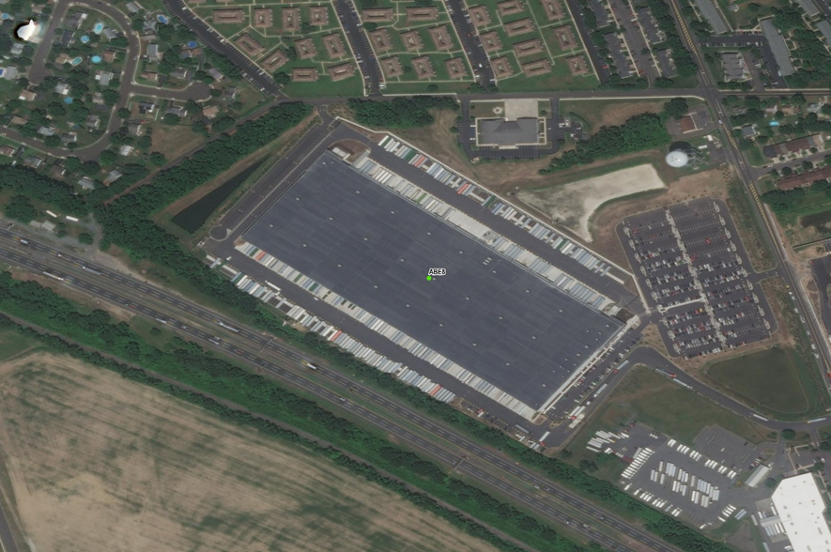

Inbound Cross Dock Facility
Cross-docking configuration for loading trucks.
Large-sized (around 600,000 sq ft).
Close to major intermodal terminals.
Retail import centers.
Receiving (destuffing) foreign containers and holding inventory.
Also receives domestic deliveries (FTL/LTL).
Florence, NJ (613,900 sq ft)

Slide 37
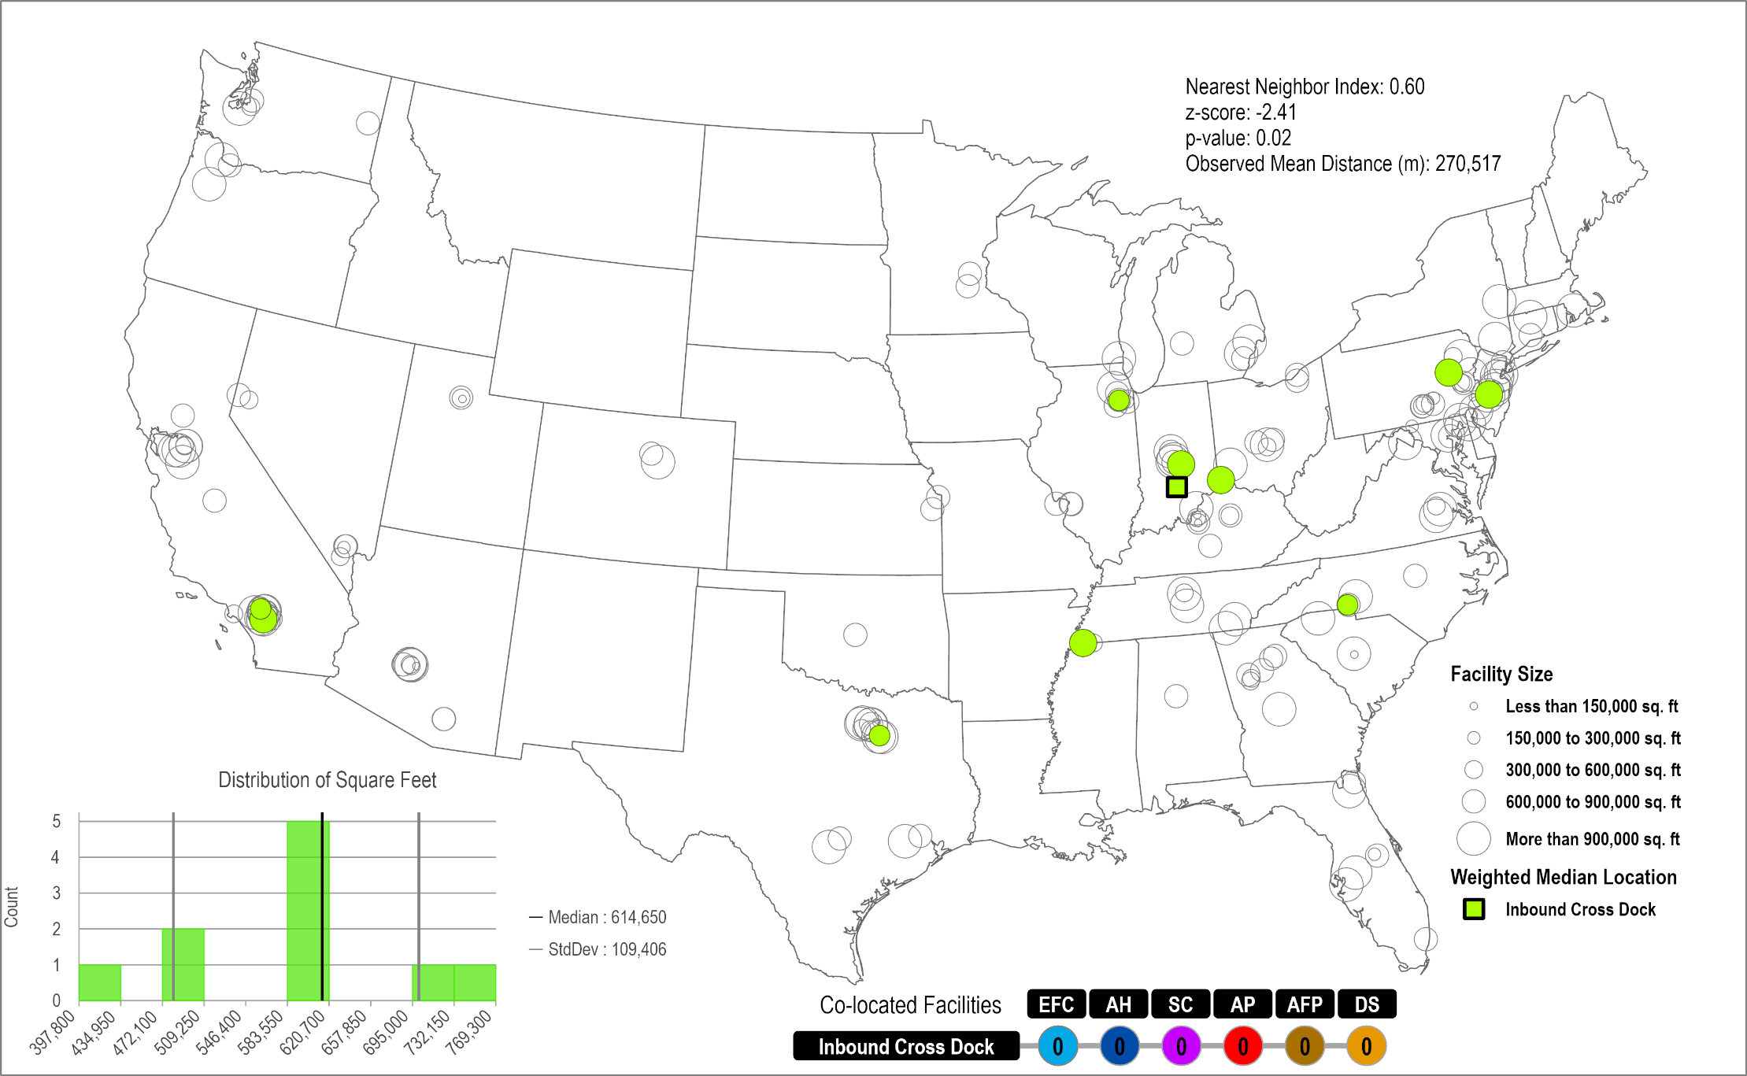
Amazon Inbound Cross Dock Facilities Network
Read this content
10 Facilities
Clustered
Random
0.60

Slide 38
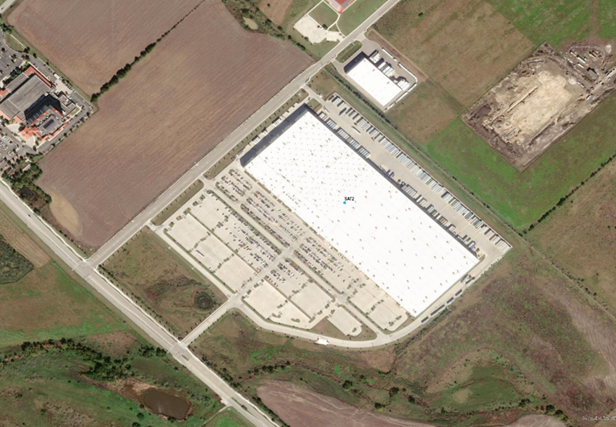
E-Fulfillment Center
Large-sized (avg 800,000 sq ft).
Single side cross-docking configuration common.
Suburban (exurban) locations with highway accessibility.
Access to a major parcel hub.
Item specialization (electronics, apparel, jewelry, perishables).
Item size specialization:
  Small sortable (items fit in a small box; < 10 kg).
  Large sortable (items fit in a large box; <25 kg).
  Large non-sortable (items too large for a box; e.g. furniture, tv, printers).
San Marcos, TX (855,000 sq ft)

Slide 39
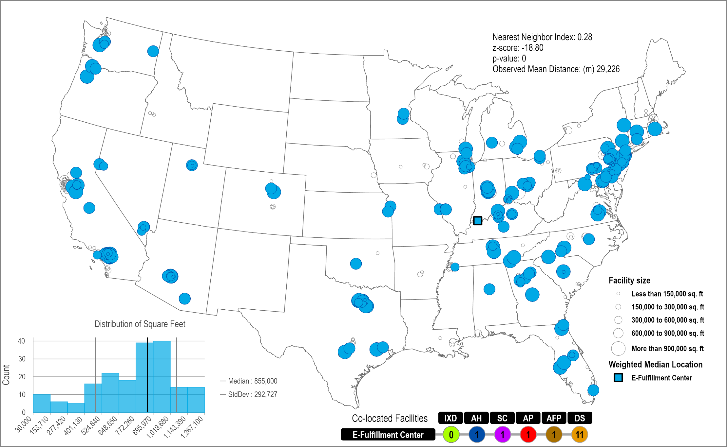
Amazon Fulfillment Centers Network
Read this content
187 Facilities
Clustered
Random
0.28

Slide 40
Amazon E-Fulfillment Centers by Item (N=187)
Read this content
(Footwear, Apparel, Jewelry, Electronics)
Notes:
More large sortable facilities because of the weight and bulk of the shipments.

Slide 41

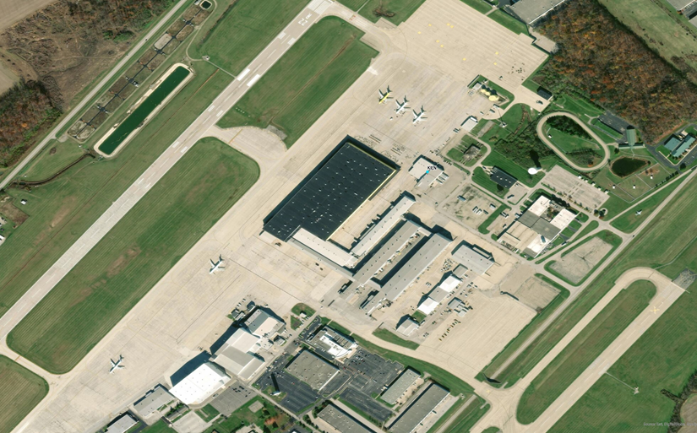
Amazon Air Hub
Two facility classes (avg 435,667 sq ft).
Setting of two mega hubs of 3.5 M sq ft.
Transfer parcels between air cargo services and regional fulfillment and sortation centers.
Adjacent (co-located) to airports.
Services organized as a hub-and-spoke network.
Near a concentration of FCs.
Wilmington Air Park, OH (1,100,000 sq ft)
Third-party logistics service providers (Fedex, UPS or DHL) usually providing air cargo services.
Amazon starting in 2018 to take control of domestic air cargo (Amazon Air).

Slide 42
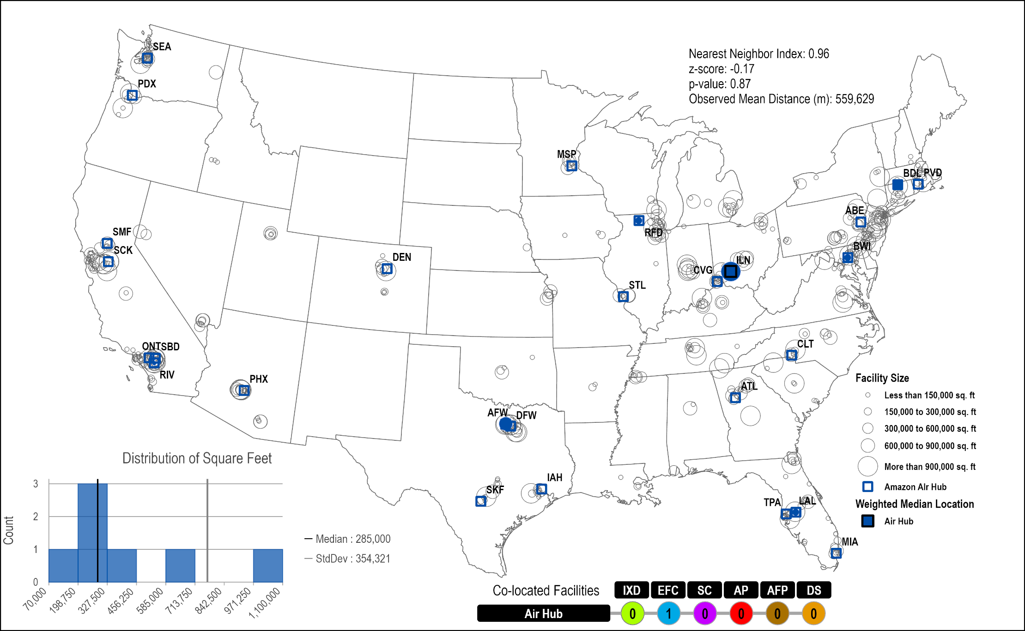
Amazon Air Hubs Network
Read this content
7 Facilities; 29 airports serviced
Clustered
Random
0.96

Slide 43
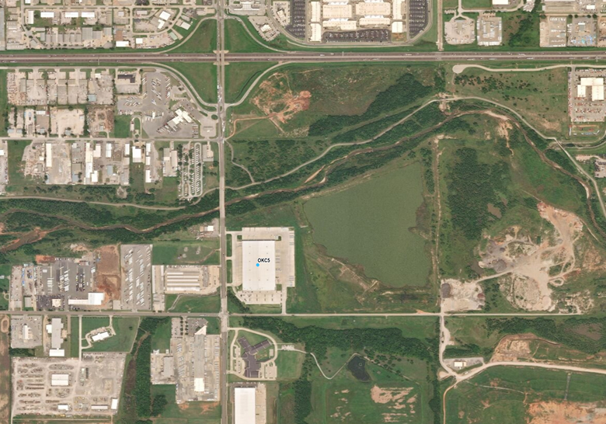
Amazon Sortation Center
Cross-docking configuration for loading trucks.
Large-sized (avg 335,102 sq ft).
Accessibility to regional distribution.
First layer in city logistics.
Automated and semi-automated sortation.
Sorted by ZIP code.
Sent to local postal offices, delivery stations or third-party delivery companies.
Oklahoma City, OK (300,000 sq ft)

Slide 44
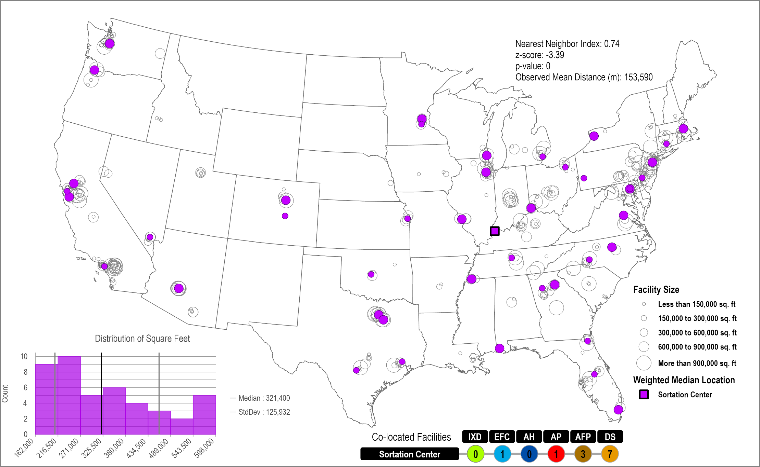
Amazon Sortation Centers Network
Read this content
47 Facilities
Clustered
Random
0.74

Slide 45
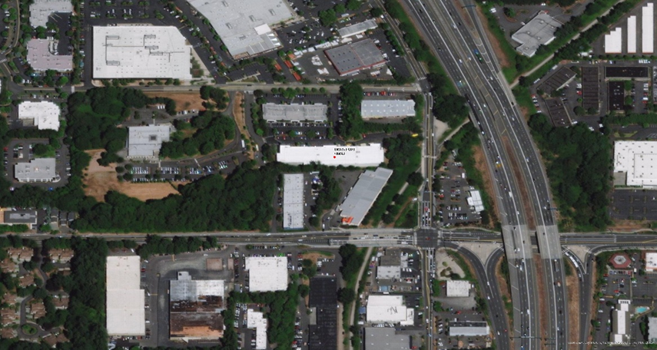
Fast Delivery Hub (Prime Now Hub & Amazon Fresh)
Prime: Small to medium-sized (avg 43,989 sq ft.)
Fresh & Pantry: Medium-sized (avg 216,155 sq ft.)
Direct to delivery vans, sortation centers or delivery stations.
Within large metropolitan areas.
First layer in city logistics.
Intersection between fulfillment, distribution and last mile logistics.
Limited inventory of high demand items (Prime).
Large inventory of specialized items (Fresh)
Kirkland, WA (38,300 sq ft)

Slide 46
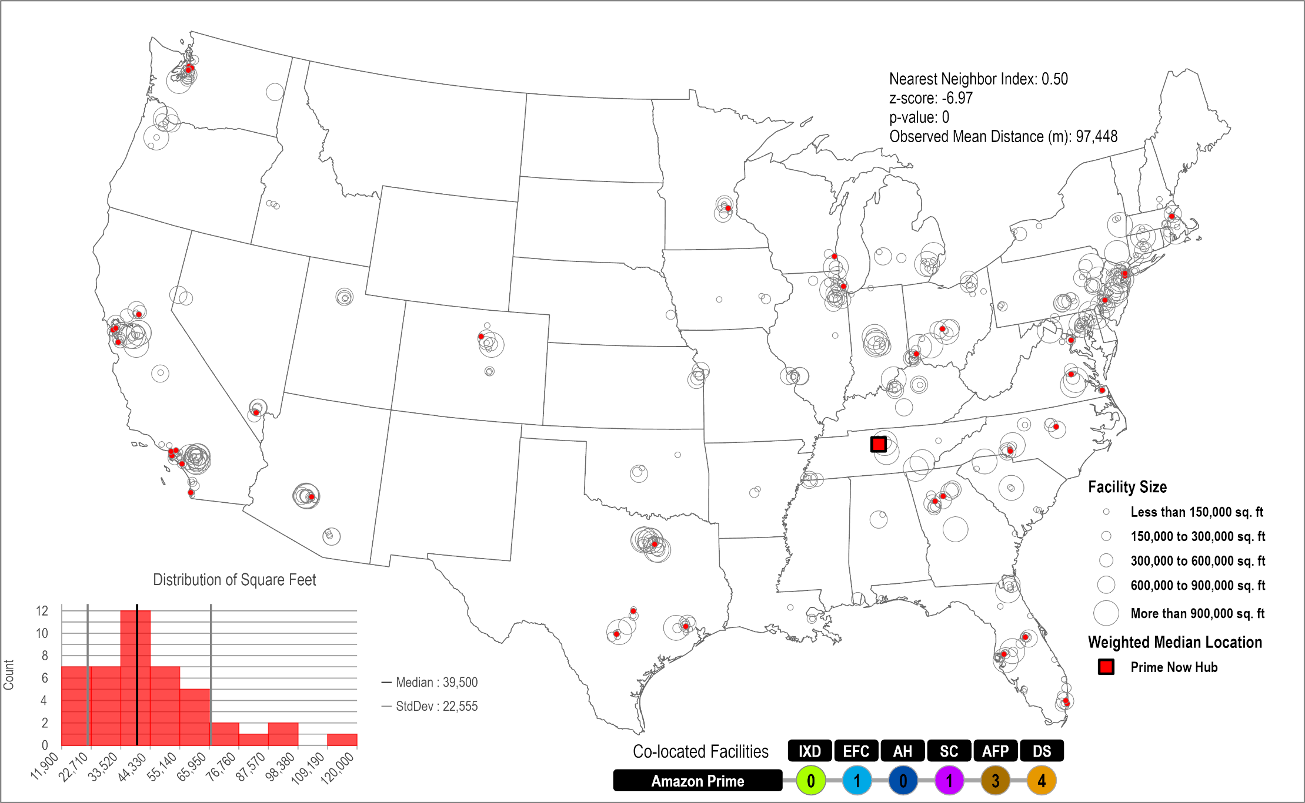
Amazon Fast Delivery Hubs Network
Read this content
53 Facilities
Clustered
Random
0.50

Slide 47
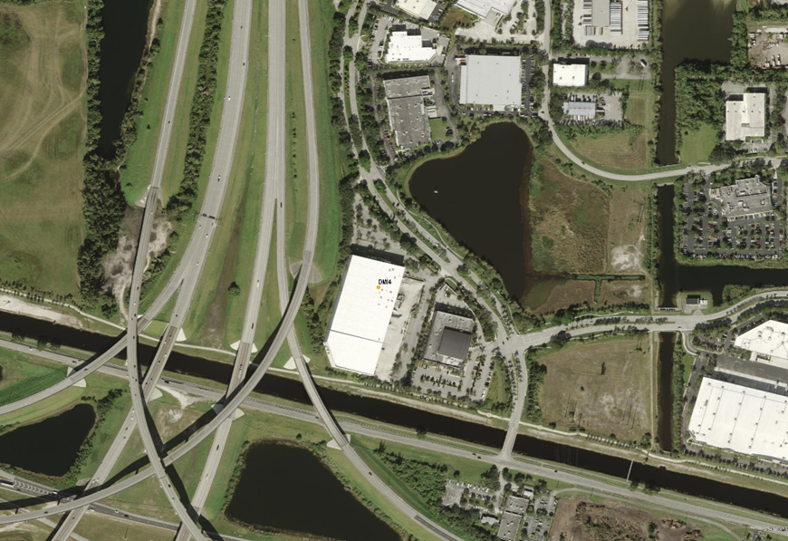
Delivery Station
Cross-docking configuration for loading delivery vans.
Medium to small-sized (avg 89,685 sq ft).
Periphery of metropolitan areas.
Second layer in city logistics.
Supplied by sortation centers and fast distribution hubs.
Organizing last-mile deliveries.
Parcels placed on delivery routes.
Sunrise, FL (178,800 sq ft)

Slide 48
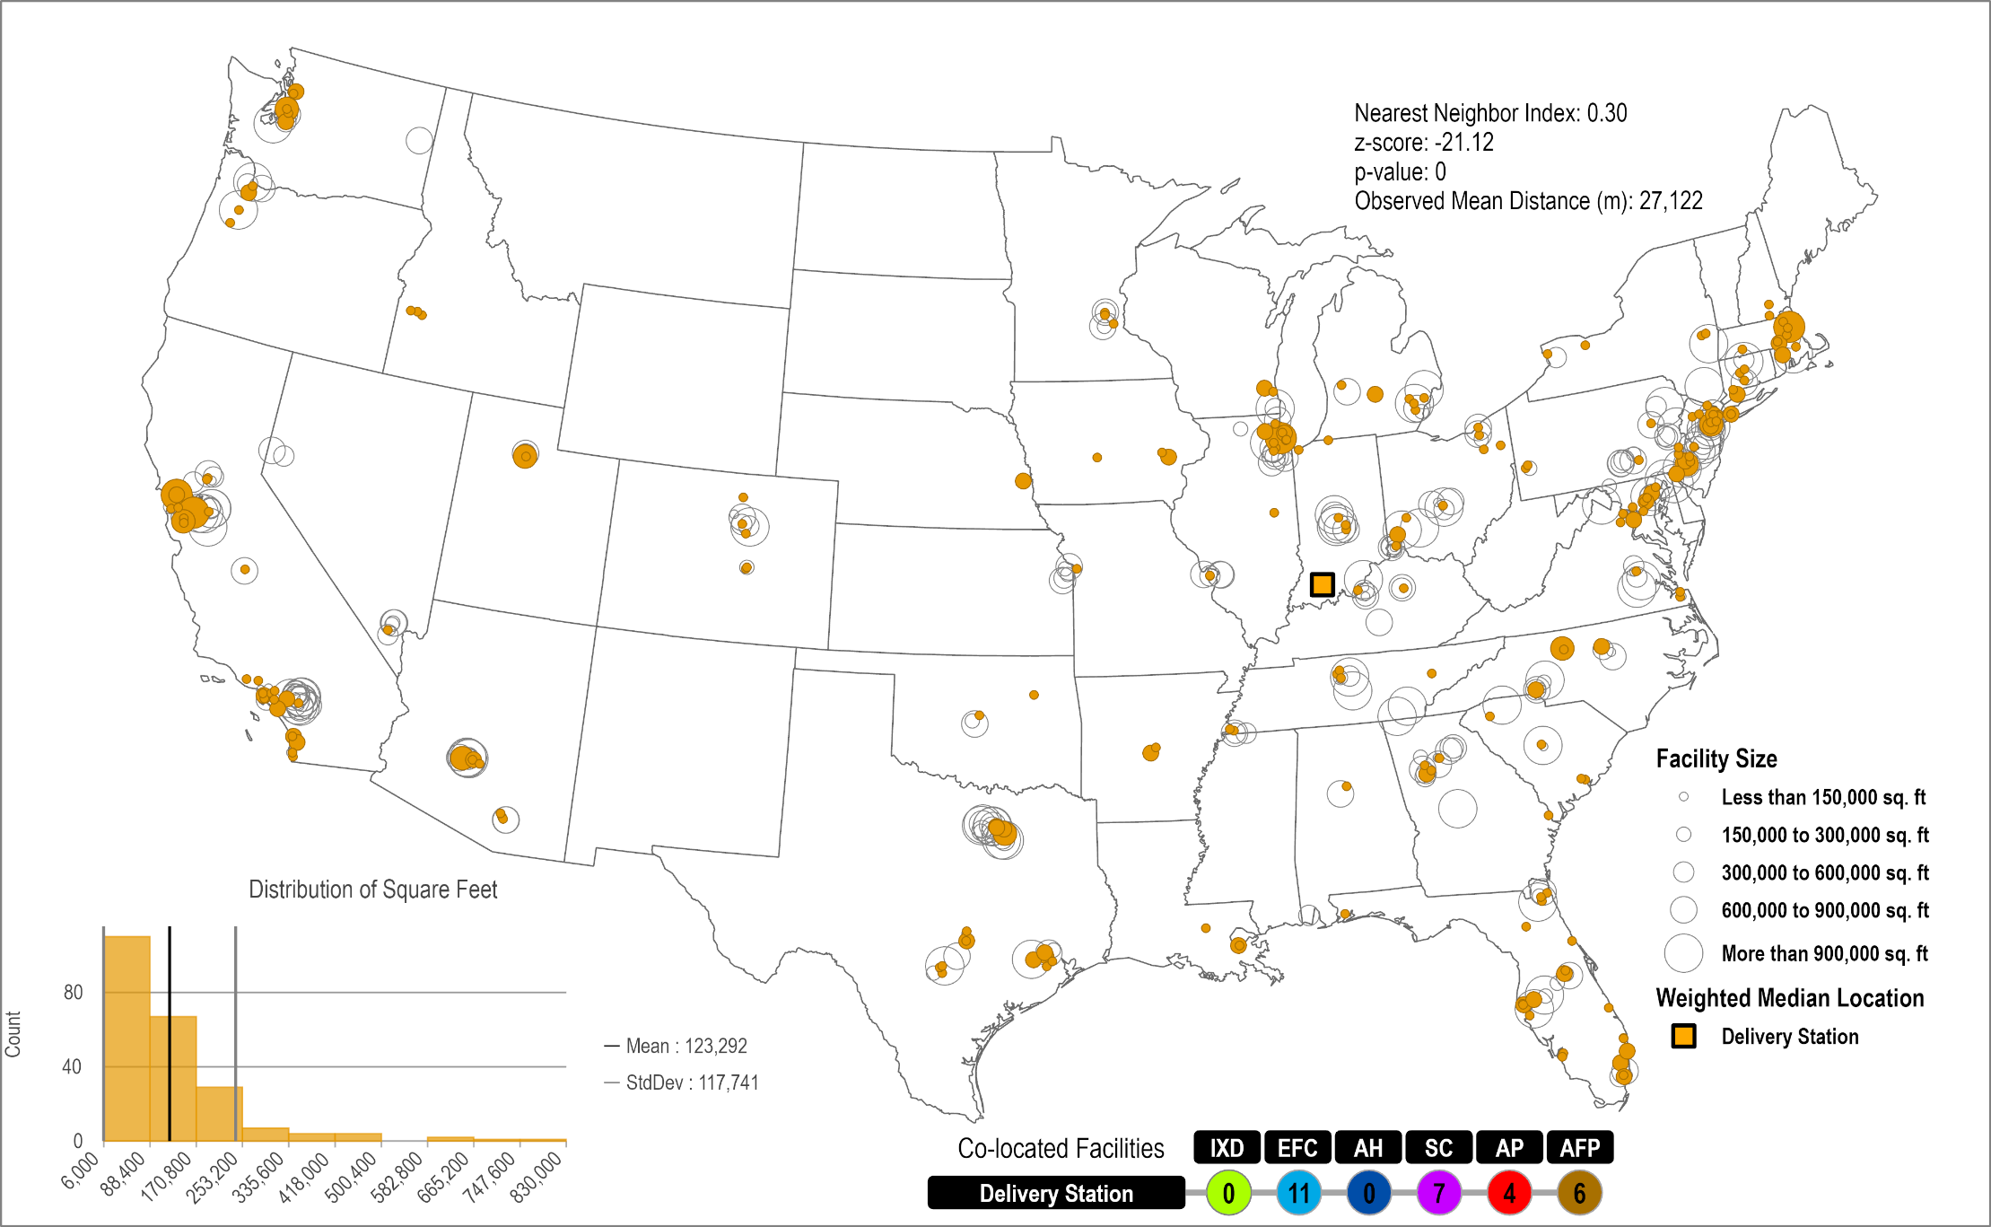
Amazon Delivery Stations Network
Read this content
250 Facilities
Clustered
Random
0.30

Slide 49

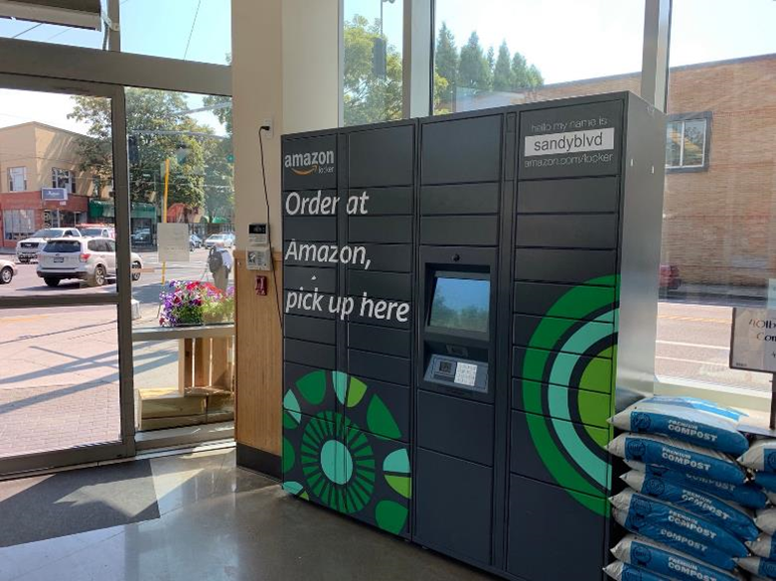
Local Freight Station
Store-like facility (pickup location).
Small or micro-sized.
High density neighborhood locations.
Third layer in city logistics.
Locker banks (freight station; 2011).
Amazon Lockers:
  900 cities in the United States.
  More than 3,000 lockers.
Amazon Hubs:
  Available to property managers.
  Accept all parcels.

Slide 50
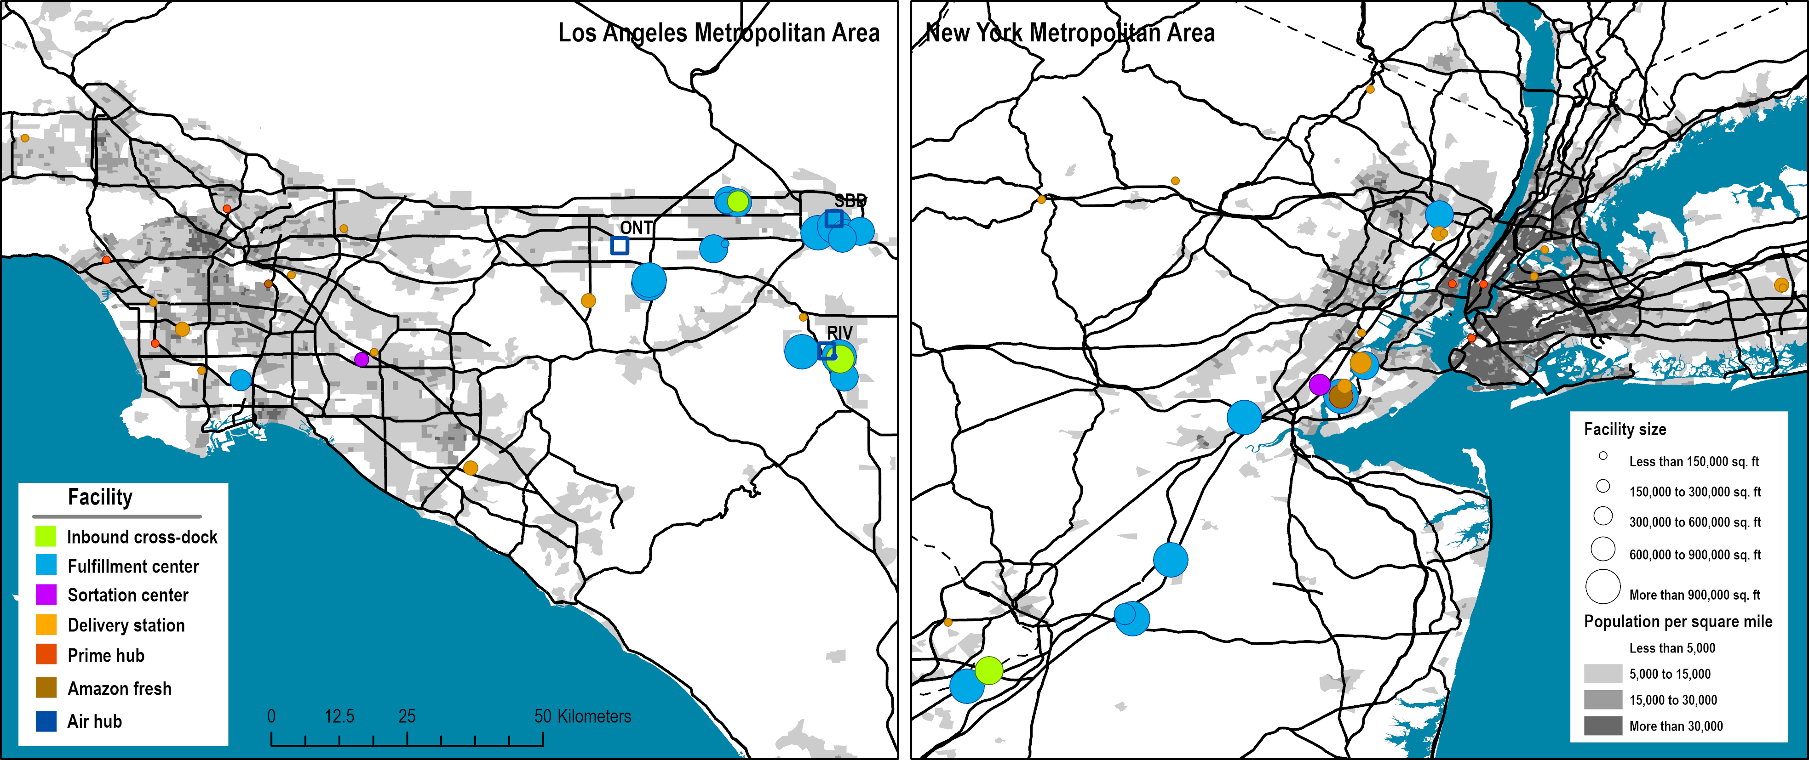
Location of Amazon’s E-Commerce Facilities in the Los Angeles and New York Metropolitan Areas
B
A
B
A
A: Fulfillment cluster; IDX & EFC (75 km from CBD)
B: Last-mile cluster; PH, AFP, DS

Slide 51
Average of Daily Parcel Deliveries, 2019
“Cyber Monday”
Xmas
New Year
Memorial
Day
Fourth
of July
Thanksgiving
Valentine Day
Easter
Labor Day
Notes:
Source: Based on a survey of parcel deliveries in a large apartment complex. 7 days moving average.

Slide 52
E-commerce and Consumer Culture
Consumptive holidays
  Usually associated with a form of consumption, such as gift-giving.
  Thanksgiving and Xmas are the two main holidays, followed by Valentine Day.
  Surge in deliveries in the preceding days as consumers purchase gifts beforehand.
Celebrative holidays
  Not particularly associated with a form of consumption.
  Delay in the latent consumption in the days surrounding the holiday, resulting in a surge afterward.
  New Year, Memorial Day, the Fourth of July, and Labor Day are the most notable celebrative holidays in the United States as millions undertake out of home activities.

Slide 53
Weekly Delivery Frequency of Parcels, 2015-2019
Notes:
Source: Based on a survey of parcel deliveries in a large apartment complex.

Slide 54
Parcel Delivery and Pickup Time, 2019
64.4% (10AM – 2PM)
42.7% (4PM – 8 PM)
Notes:
N (delivery)=27398
N (pickup)= 26021

Slide 55
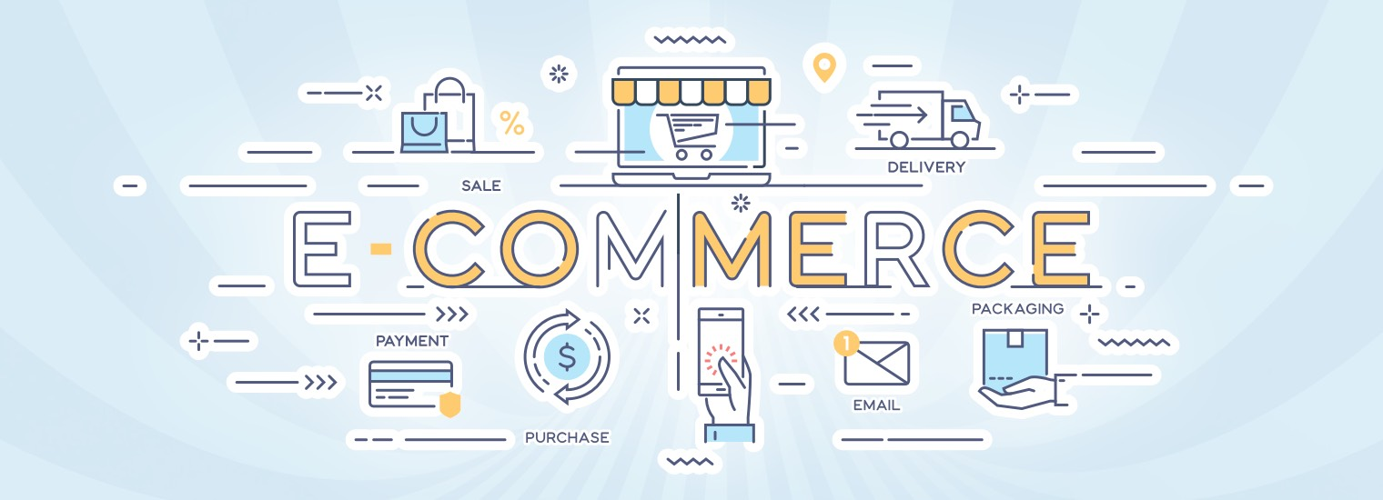
Short Assignment: E-commerce
Explain the main characteristics of the distribution system of e-commerce using the example of Amazon.

Slide 56
C – Cold Chains
Read section

Slide 57
The Cold Chain: A Definition
The cold chain
  The transportation of temperature-sensitive products along a supply chain.
  Using thermal and refrigerated packaging methods.
  The logistical planning to protect the integrity of these shipments.
  Several means of transportation: refrigerated trucks and railcars, refrigerated cargo ships, reefers, and air cargo.

Slide 58
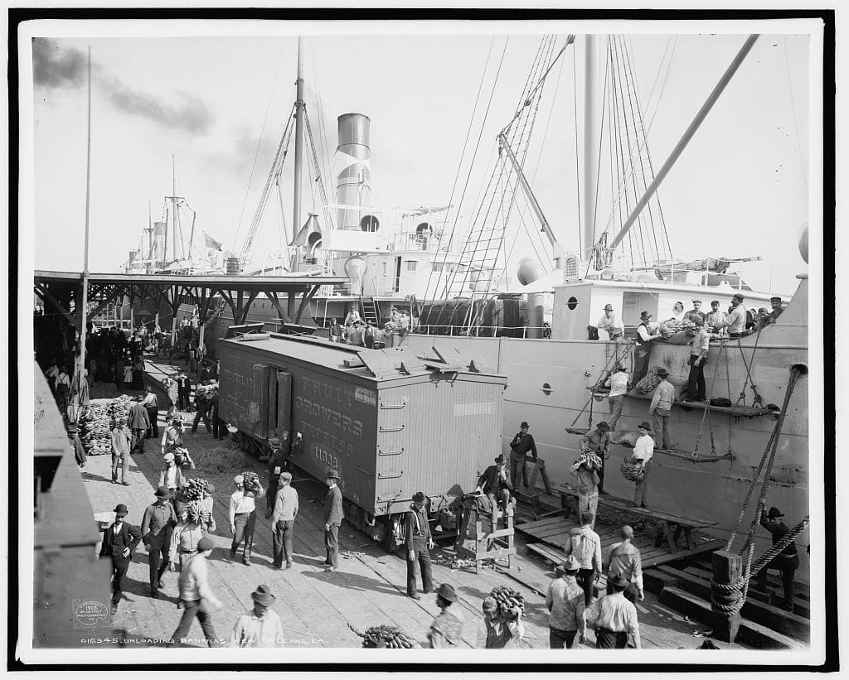
Unloading a Banana Ship, New Orleans, 1903
Read this content
Notes:
Source: Library of Congress LC-D4-16345.

Slide 59
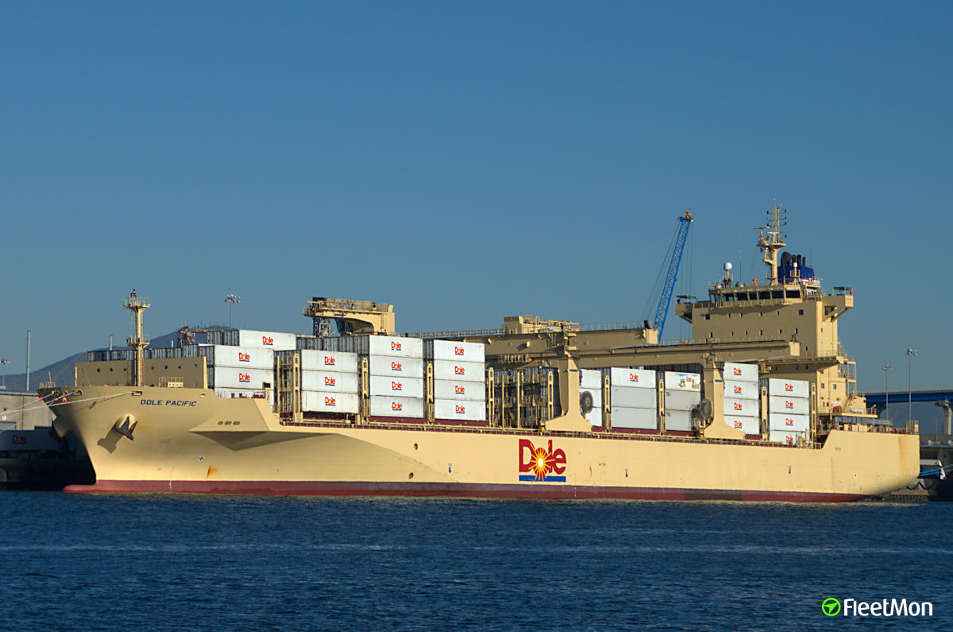
Banana Ship, 21st Century

Slide 60


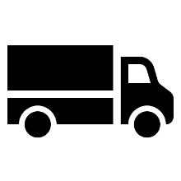
Operational Conditions of Cold Chain Logistics
Read this content
Conditional Demand
Each product has a perishability level.
Shelf life and revenue.
Demand conditional to qualitative attributes.
Load Integrity
Packing, packaging and preparation.
Reefers as the common load unit.
Empty backhauls.
Transport Integrity
Uninterrupted integrity of the transport chain (modes, terminals and distribution centers).
Specialized modes (speed) and terminals.
Explain the main elements of a cold chain

Slide 61
The Cold Chain Technology
Read this content
Monitoring
Sensors. Monitors and recorders (e.g. Partlow recorders).
Fabrication
Preparation methods
Packing
Blast freezers. Insulated containers. Vacuum packing. Crates. Perforated plastic containers. Perforated boxes.
Storage
Warehousing
Distribution center
Refrigerated warehouses. Refrigerated distribution centers. Loading / Unloading bays.
Terminal
Reefer storage
Reefer storage areas. On-dock refrigerated warehouses.
Refrigerated trucks. Refrigerated railcars. Refrigerated ships. Reefers. Reefer clips. Rail gensets. Refrigerated bins. Refrigerated unit load devices. Source loading.
Transport
Reefers
Power generators

Slide 62
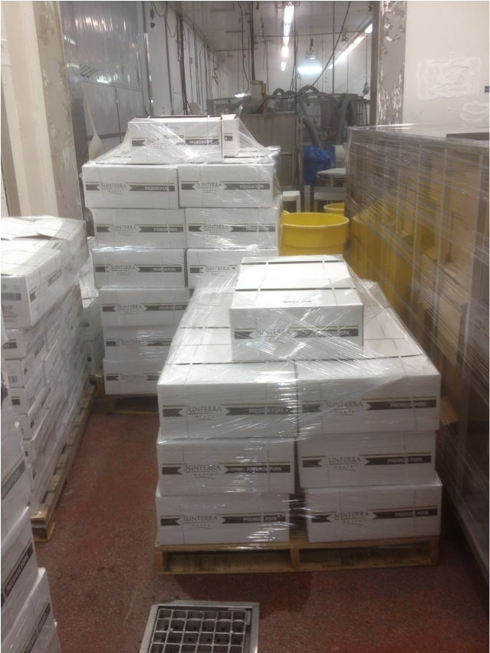
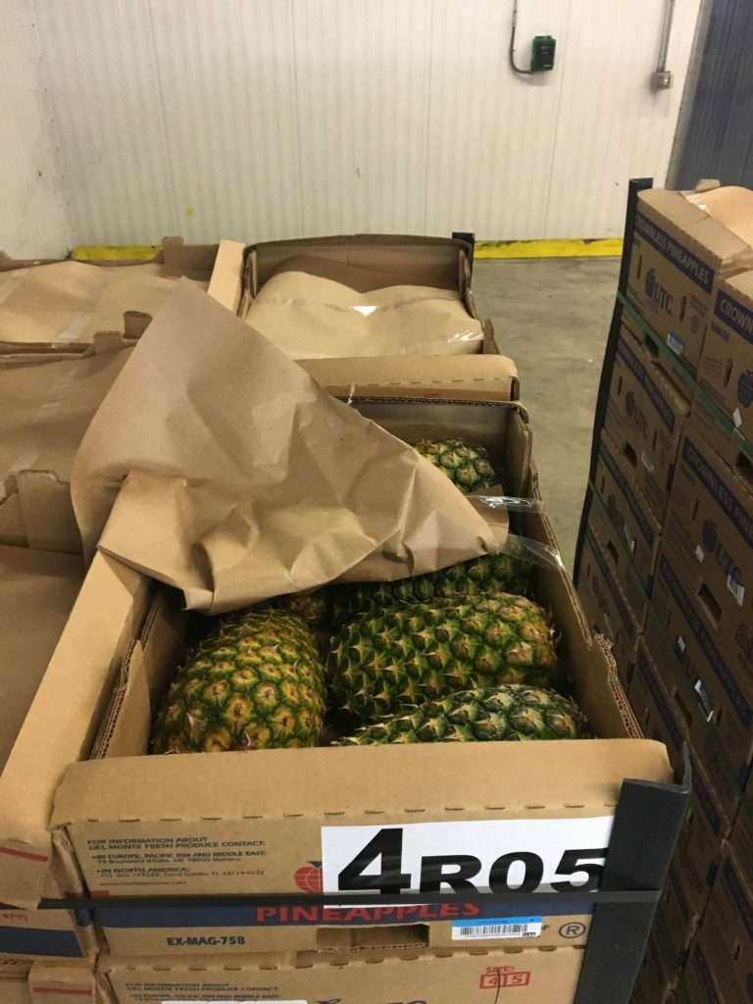
Cold Chain Technology and Processes
Source Loading of Chilled Meat in a Reefer
Crownless Pineapples in Cold Chain Inspection Room

Slide 63
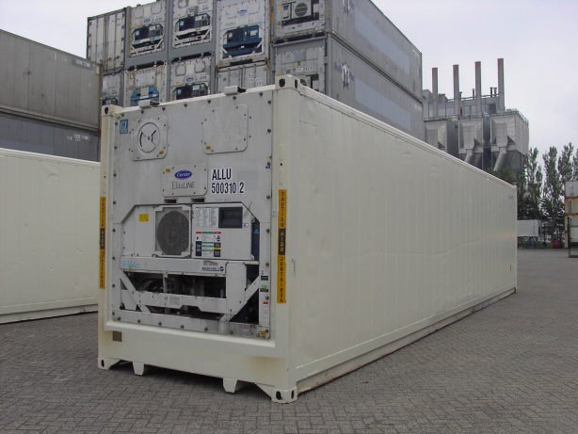
A Focus on the Maritime Reefer: Basic Facts and Figures
2.9 M TEUs of reefers (2018); 5% of the global capacity.
Dominance of the 40-foot-high cube container.
$5,000 regular container; $30,000 for a reefer.
12% less volume than a similar sized container.
Cold chain products usually heavier.
FCL use for point-to-point trade.
White paint for higher albedo.

Slide 64
Seaborne Reefer Trade, 2008
Read this content
Notes:
Source: Drewry Shipping Consultants (2010), Reefer Shipping Market 2010/11, Drewry Publishing, London

Slide 65
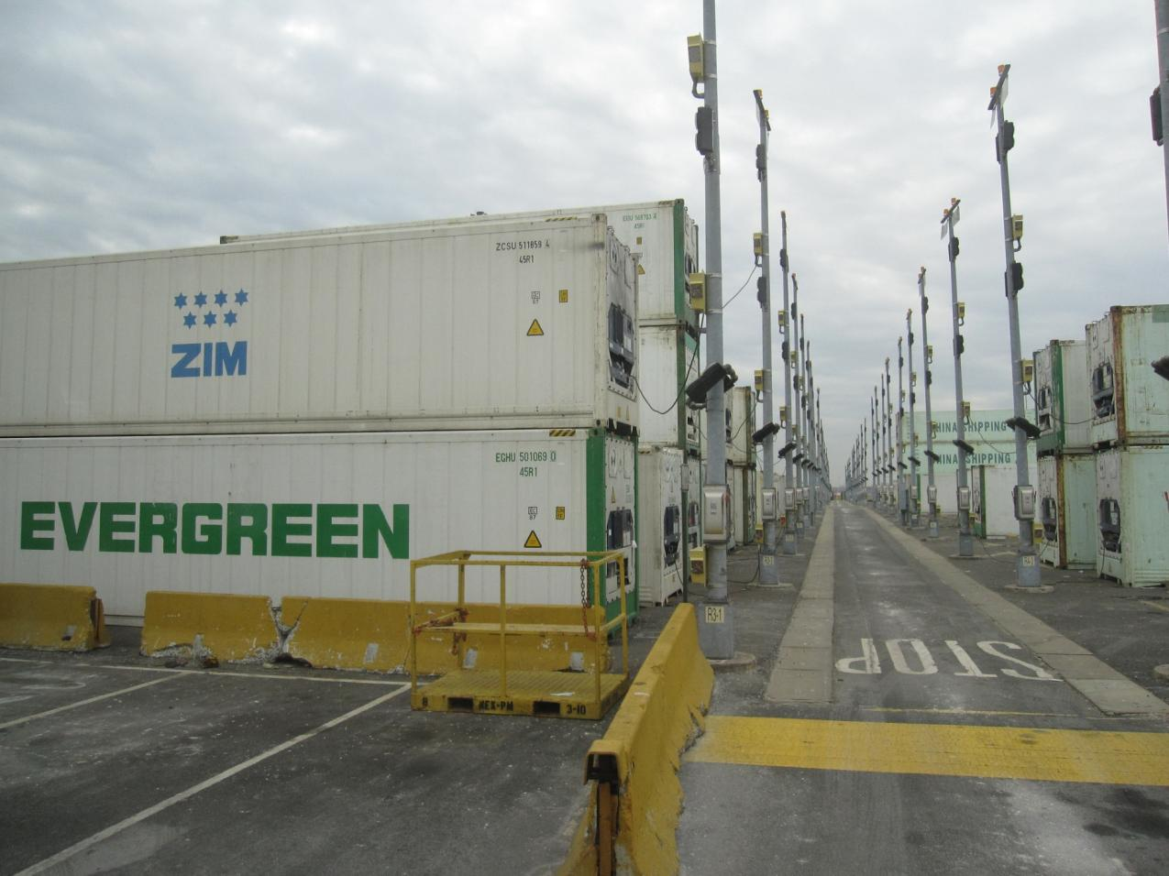
Reefer Stacking Area, Maher Terminal, Newark
Read this content

Slide 66
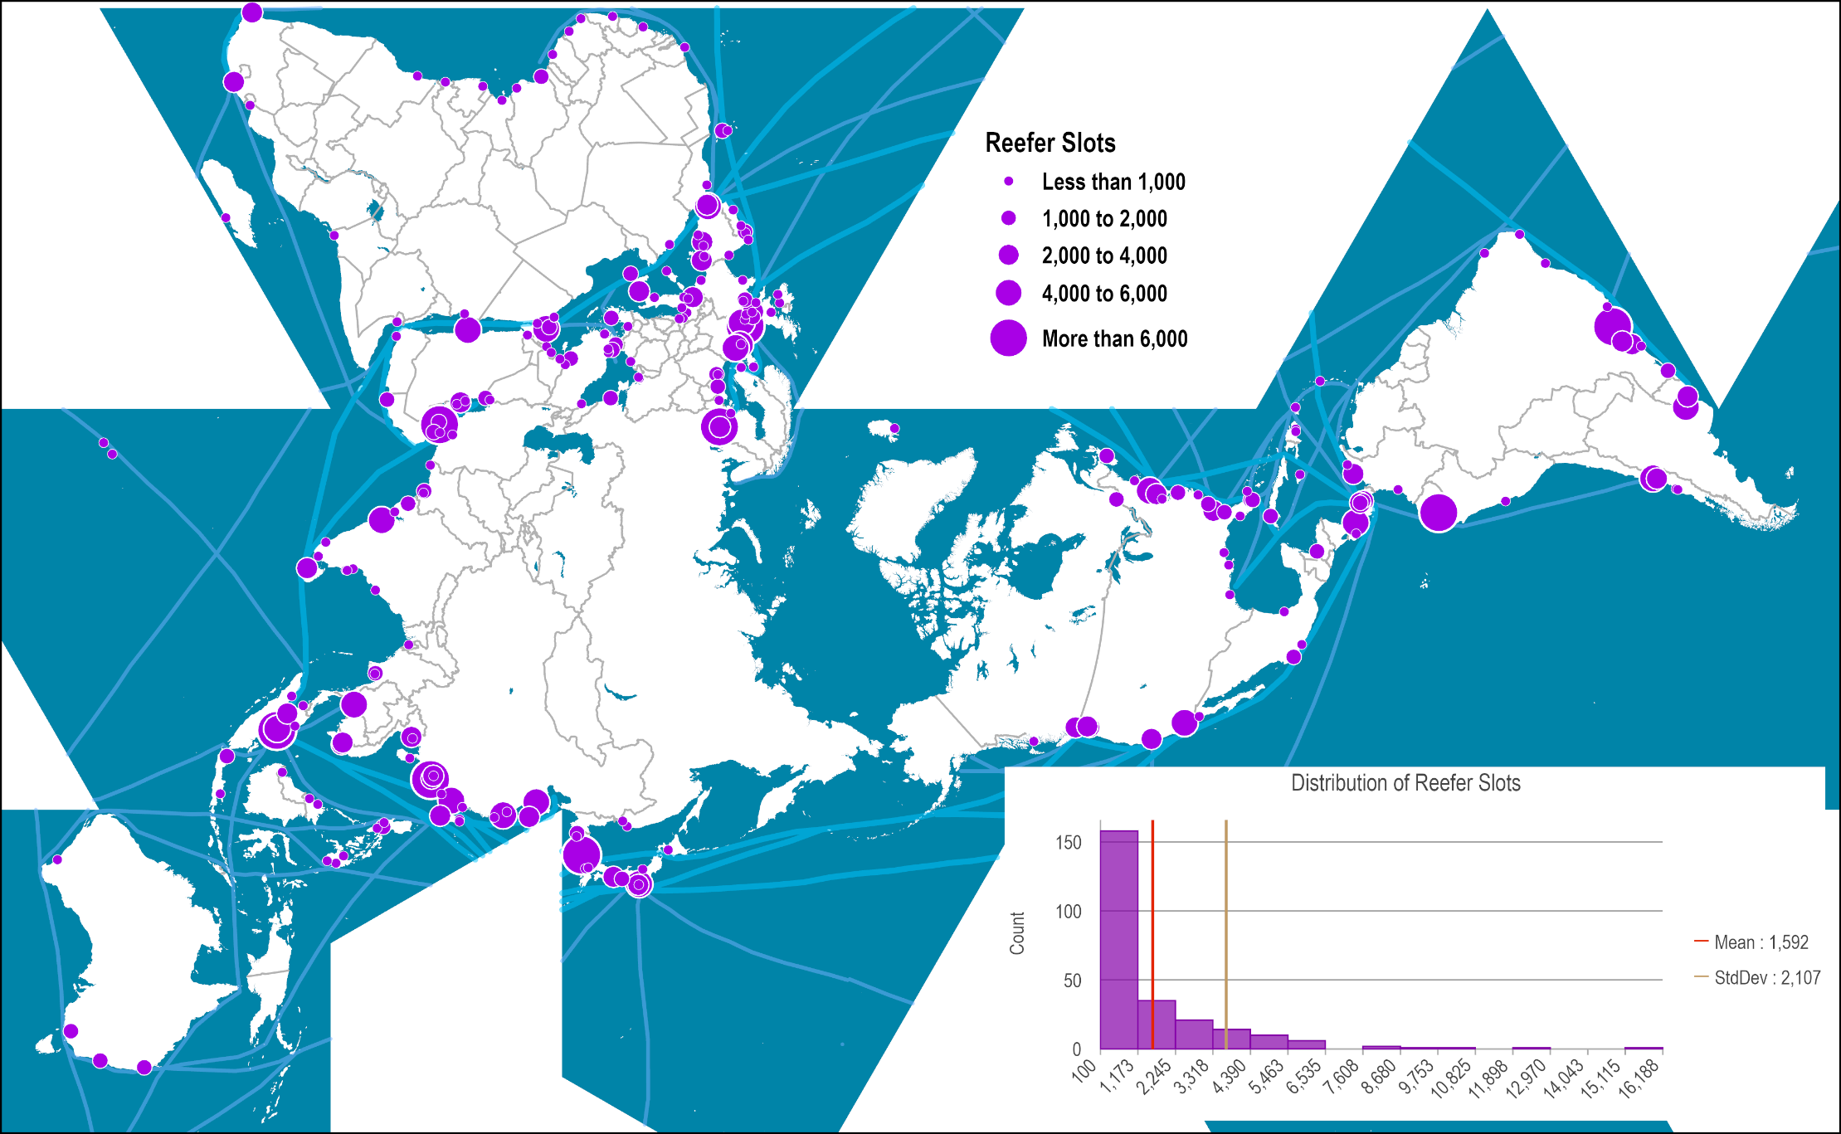
Number of Reefer Slots per Container Port
Read this content
Notes:
Source: Web sites of port authorities and terminal operators.
Map location: Global Container Ports

Slide 67
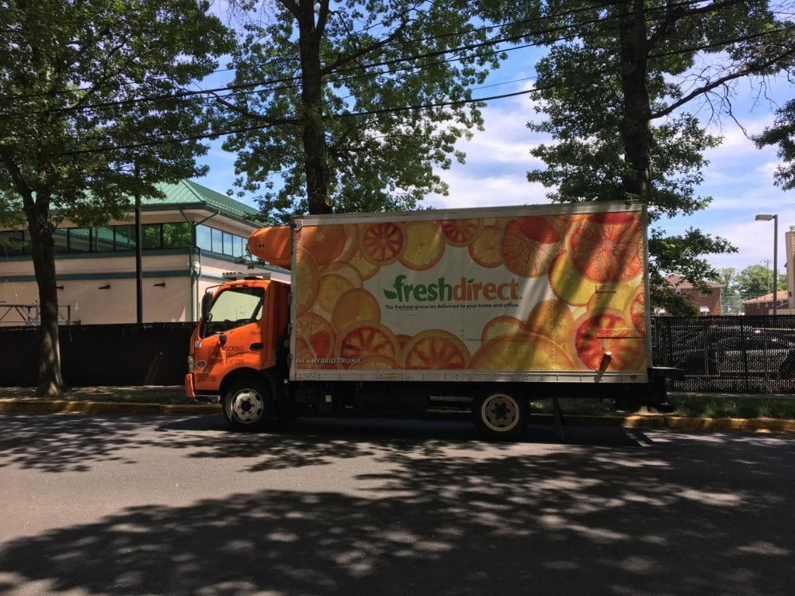
Refrigerated Urban Delivery Truck
Read this content

Slide 68
Availability of Fresh Produce by Season and Region
Read this content
JAN
FEB
MAR
APR
MAY
JUN
JUL
AUG
SEP
OCT
NOV
DEC
Argentina
Apples
Chile
New Zealand
United States
United States
Citrus
Chile
Peru
Australia
Chile
Avocados
Peru
Mexico
Bananas
Ecuador, Costa Rica, Colombia
Pineapples
Costa Rica, Ecuador, Philippines
Brazil
Chile
Chile
Grapes
Mexico
Peru
Peru
United States
Notes:
Source: Adapted from the Oppenheimer Group.

Slide 69
Temperature Standards for the Cold Chain
Read this content
Deep Freeze
Frozen
Chill
“Banana”
-30
-25
-20
-15
-10
-5
0
+5
+10
+15
Degrees Celsius
Notes:
Source: Gesamtverband der Deutschen Versicherungswirtschaft e.V. (GDV), Berlin 2002-2007. http://www.tis-gdv.de/tis_e/ware/inhaltx.htm

Slide 70
Shelf Life of Selected Perishable Food Products
Read this content
Product | Shelf Life (Days) | Optimum Temperature (Celsius)
Apples | 90-240 | 0
Bananas | 7-28 | 13.5
Bell Peppers | 21-35 | 7
Cabbage | 14-20 | 1
Eggs | 180 | 1.1
Onions | 30-180 | 1
Lettuce | 12-14 | 0.6
Fresh Meat (beef, lamb, pork, poultry) | 14-65 | -2
Oranges | 21-90 | 7
Pears | 120-180 | -0.6
Potatoes | 30-50 | 10
Seafood (shrimp, lobster, crab) | 120-360 | -17.8
Strawberries | 5-10 | 0.6
Tomatoes | 7-14 | 12
Notes:
Various other factors are also at play in addition to temperature, including moisture and ethylene sensitivity.
Source: adapted from APL and http://www.completeproduce.com/html/shelflife.html

Slide 71
Lettuce Shelf Life by Storage Temperature

Slide 72
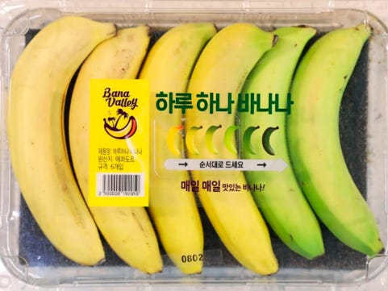
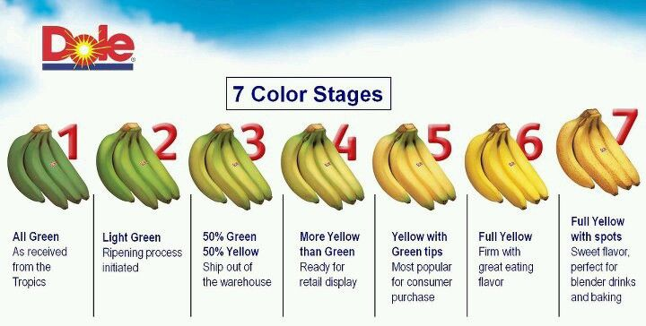
Packaging Bananas with a Sequential Shelf Life

Slide 73
D – Green Logistics
Read section 3

Slide 74









Logistic Activities and their Green Dimensions
Read this content
Materials Management
Forward and Reverse Supply Chains
Product design
Suppliers
Disposal
Near sourcing
Sustainable sourcing
Packaging and packing
Circular material use
Manufacturers
Recyclers
Physical Distribution
Demand responsive systems
Distributors
Collectors
Load consolidation
Alternative modes and fuels
Certification of carriers and distribution facilities
Consumers
Consumers
Shipping scheduling and routing
How can logistics help promote sustainability?

Slide 75
Logistics-Related Greenhouse Gas Emissions by Activity
Notes:
Source: Freightera

Slide 76
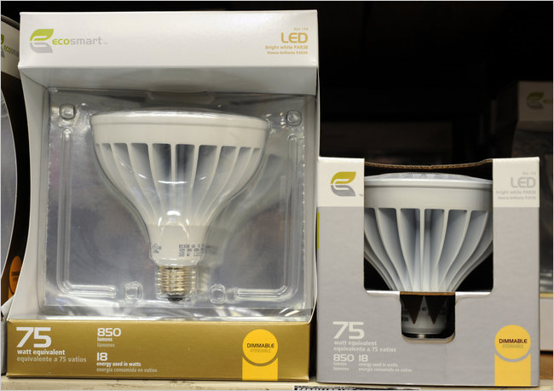
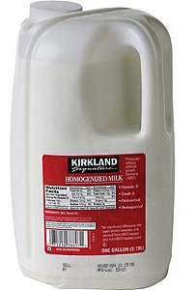
Packaging with Less Footprint
Notes:
The containers for 75-watt EcoSmart LED bulbs have been redesigned to use less packaging.

Slide 77
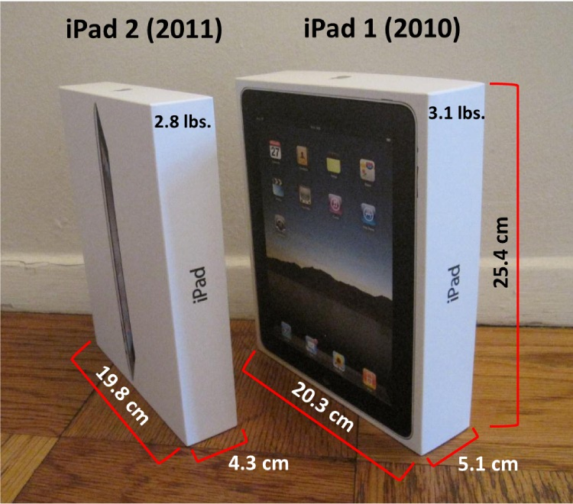
iPads: Qualitative and Quantitative Product Improvements
Read this content

Slide 78
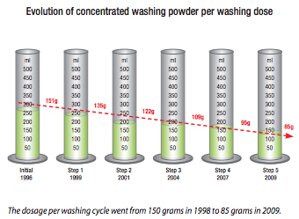

Concentrated Detergent

Slide 79

Packed Memory Foam Mattresses

Slide 80

Electric Delivery Van
Notes:
Source: UPS

Slide 81
The Circular Economy and Supply Chains
Read this content
Materials
Biological Goods
Technical Goods
Harvesting
Suppliers
Recycle
Biosphere
Manufacturers
Remanufacture
Fertilizers
Biogas
Distributors
Reuse
Biochemical
processing
Maintenance
Consumer
User
Collection
Collection
Leakage
Burning / Disposal
Notes:
Source: Adapted from the Ellen MacArthur Foundation.

Slide 82

Final Essay: Transport, Logistics and Globalization
Define iGlobalization…

