Slide 1
Topic 7 – Logistics and Supply Chain Management
A – The Role and Function of Logistics
B – Value Chains

Slide 2
A – The Role and Function of Logistics
Read section 1

Slide 3
Logistics
Is there a difference between logistics and supply chain management?
  Yes and no…
  A wide set of activities dedicated to the transformation and distribution of goods, from raw material sourcing to final market distribution as well as the related information flows.
Physical distribution
  Activities involved in the movement of goods from points of production to final points of sale and consumption.
Materials management
  Activities involved in the manufacturing of commodities in all their stages of production along a supply chain.

Slide 4

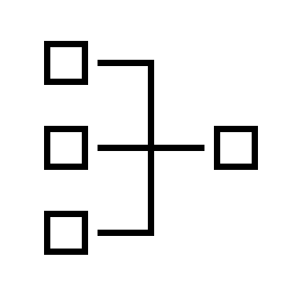
The Concept of Logistics
Read this content
Derived Demand
Logistics
Materials Management
Physical Distribution
Manufacturing
Transportation
Sourcing
Warehousing
Induced Demand
Inventory
Wholesale
Packaging
Retail
Recycling/Reusing
What is Supply Chain Management?

Slide 5

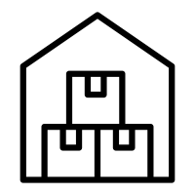
Logistics Goals and Operations
Read this content
Fulfillment (Goals)
Demand (Operations)
Order
  Right product
  Right quantity
Transportation
  Handling
  Packaging
Delivery
  Right location
  Right time
Inventory
  Production
  scheduling
  Warehousing
Quality
  Right condition
Orders
  Sales
  Purchase
Cost
  Right price
Logistics has several goals. Explain what they are and how they are achieved.

Slide 6
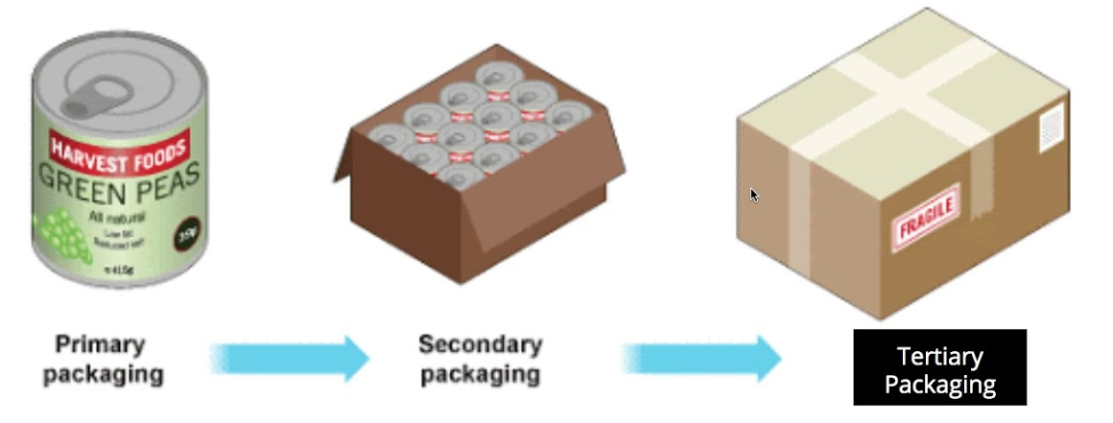
Types of Packaging
Primary Packaging
Secondary Packaging
Tertiary Packaging
Packaging touching the product.
Boxes and wraps.
Designed for individual items.
Designed for shelf storage/display of single item.
Packaging bundling items of a product.
Boxes and wraps.
Designed for shelf storage/display.
Packaging bundling products for transport.
Boxes, pallets and containers.

Slide 7
The Supply Chain and its Cycles
Read this content
Supply Chain
Customer
Retailer
Distributor
Manufacturer
Supplier
Information Flow
Customer Order Cycle
Replenishment Cycle
Manufacturing Cycle
Procurement Cycle
Inventory
Time
Explain supply chain cycles and the “bullwhip effect”.

Slide 8
The “Bullwhip Effect” in Supply Chains
Supplier
Manufacturer
Wholesaler
Customer
Retailer
Customer Order Cycle
Replenishment Cycle
Manufacturing Cycle
Procurement Cycle
Order 10 units
Order 12 units
Order 15 units
Order 20 units

Slide 9
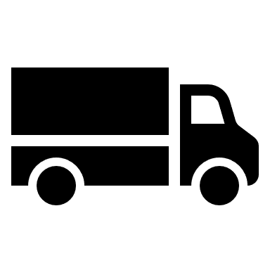
Distribution and Related Logistics Activities
Read this content
Inventory
Inventory
Truckload
Supplier
Customer
Quote price
Receive order
Item price list
Place order
Pay invoice
Shipper
Receiver
Tender shipment
Schedule shipment
Prepare shipment
Load shipment
Trace shipment
Issue invoice
Carrier
Schedule dock space
Receive shipment
Unload product
Unpack shipment
Receive freight bill
Pay freight bill
Dispatch truck
Trace shipment
Collect delivery receipt
Send billing
Collect payment
Rates
Information flow
Physical flow
Notes:
Source: Adapted from P.O. Roberts (2003) Supply Chain Management: New Directions for Developing Economies, PSD Professionals’ Forum.

Slide 10
The Evolution of Logistics
Read this content
1960s
1980s
1990s
2000s
2010s
Fragmentation
Consolidation
Integration
Value Capture
Automation
Demand Forecasting
Sourcing / Purchasing
Materials Management
Requirement Planning
Production Planning
Manufacturing Inventory
Warehousing
Warehousing
Logistics
Supply Chain Management
Materials Handling
Materials Handling
Packaging
Packaging
Goods Inventory
Information Technology
Distribution Planning
Marketing / Sales
Physical Distribution
Order Processing
Strategic Planning
Transportation
Finance
Customer Service

Slide 11
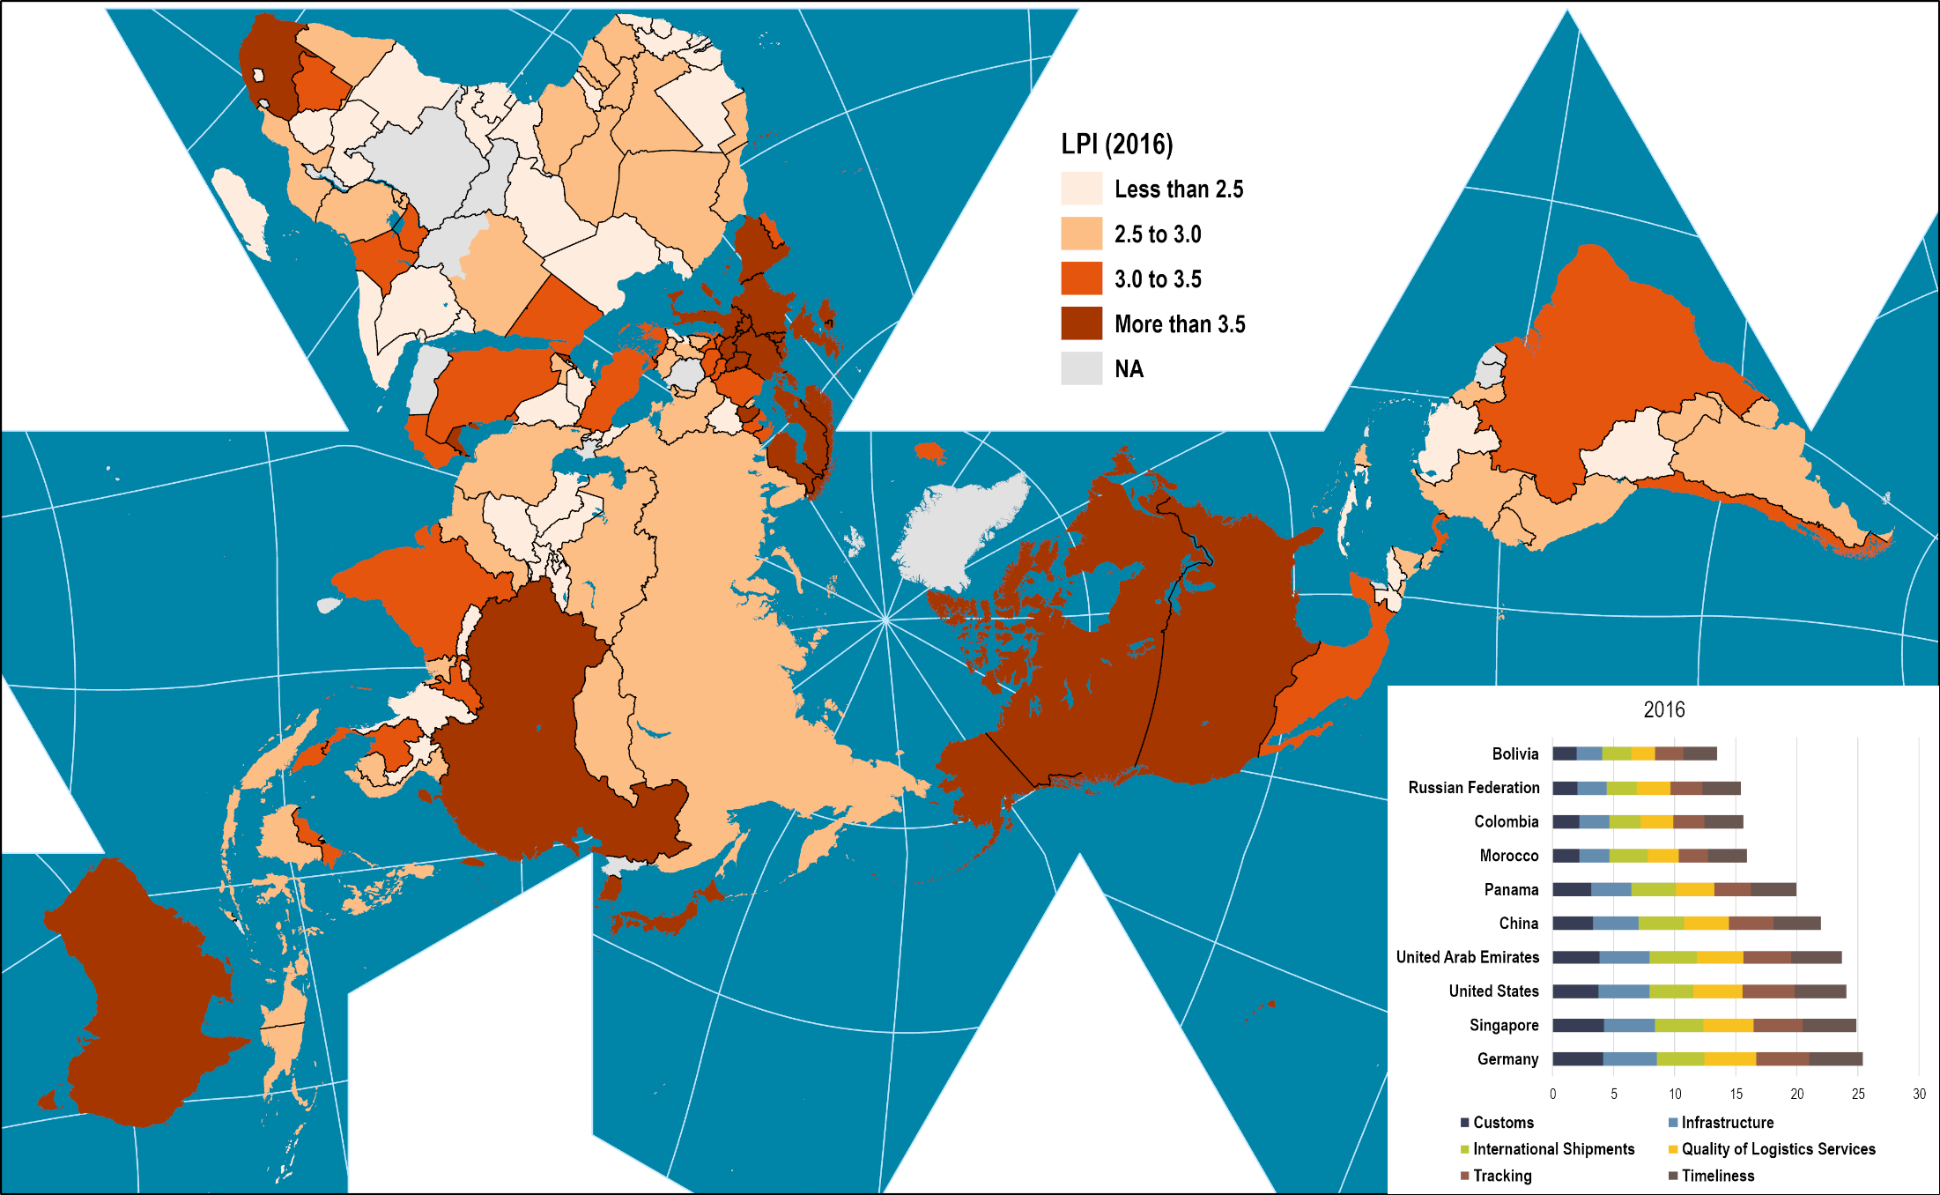
Logistic Performance Index, 2016
Read this content

Slide 12
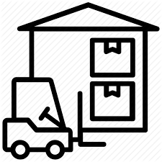
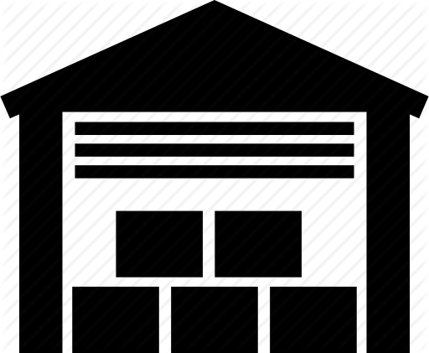
Two Important Logistics Costs
Warehousing costs:
  Fixed costs of owning or leasing warehousing space.
  Vary according to the number and the size of facilities.
  Irrespective of the amount of inventory being handled.
Inventory carrying costs:
  Variable costs of maintaining and processing inventory in a warehouse (utilities, insurance, taxes, labor costs).
  Vary according to the volume handled.

Slide 13
Global Logistics Costs by Function and Mode, 2018
Read this content
Rail
Air
Maritime
Trucking
What are the main components of logistics costs and what do they mean?
Notes:
Source: Adapted from Armstrong & Associates Inc.

Slide 14
Logistics Costs and Economic Development
Read this content
Notes:
Source: World Bank for GDP data (in current dollars). Various sources for logistics costs.

Slide 15
Logistics Costs, United States, 1980-2020 (in billions of $)
Read this content
Notes:
Source: Council of Supply Chain Management Professionals, State of Logistics Report, (after 2012). Logistics Management & Distribution Report (before 2012).
https://leanlogisticsblog.files.wordpress.com/2012/06/logistics-system-cost.png

Slide 16
From Push to Pull Logistics
Read this content
Push Logistics
Pull Logistics
Supplier
Supplier
Supplier
Supplier
Supplier
Supplier
Supplier
Supplier
Supplier
Supplier
Freight flow
Manufacturer
Manufacturer
3PL
Distributor
Returns / Recycling
Distributor
Customer
Point-of-sale data
Customer
Manufacturing: Push or Pull?

Slide 17

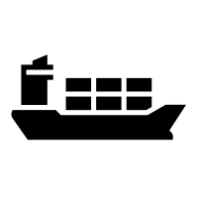




Logistical Activities Related to Containerization
Read this content
Container Management
Container Transportation
Cargo Handling
Container Maintenance
Broking/Leasing.
Inventory management.
Transport routing.
Container tracking.
Maritime shipping (Routing, Scheduling).
Terminal operations (Transshipment, Storage/Stacking, Gate access).
Inland transportation (Rail operations, Drayage, Repositioning).
Loading (Packing, Palletizing and Bundling).
Transloading (Re-bundling).
Unloading (Unbundling, de-palletizing and Unpacking).
Empty stacking.
Inspection.
Cleaning & Repair.

Slide 18
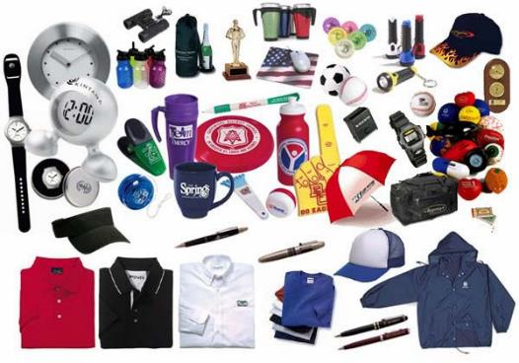
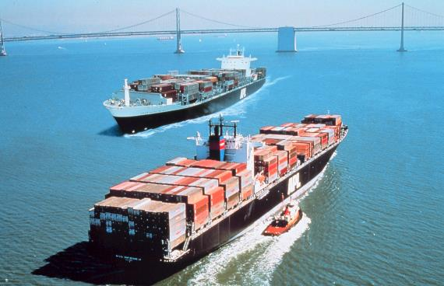
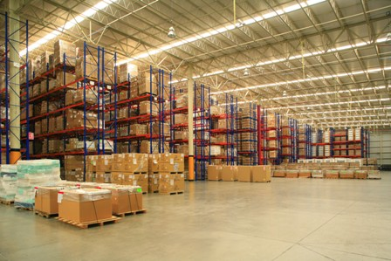

Main Actors of the Logistics Chain
Cargo owners
Carriers
Logistics service providers
Lead logistics providers & consultants

Slide 19
Layers to Logistics Services
Read this content
Actors
Services
1PL
Manufacturing,
Wholesaling, Retailing
Cargo owners
2PL
Carriers
Transportation
Service integration
Logistics service
providers
3PL
Logistics
Lead logistics providers
& consultants
4PL
Supply chain
management
Supply chain integration

Slide 20
B – Value Chains
Read section 1

Slide 21
Value Chains
Definition
  Functionally integrated network of production, trade and service activities.
  Covers all the stages in a supply chain:
    Transformation of raw materials.
    Intermediate manufacturing stages.
    Delivery of a finished good to a market.
  A series of nodes, linked by transactions, such as sales and intra firm transfers.
  Each successive node involves the acquisition or organization of inputs for the purpose of added value.

Slide 22
The Commodity Chain (or Value Chain)
Read this content
Stages
1. Commodities
2. Intermediate Goods
3. Final Goods
Raw Materials
S
Manufacturing and Assembly
WH
Distribution
DC
Market
Storage
Warehouse
Distribution center
Attributable to climatic (agricultural products, forestry products) or geological (ores and fossil fuels) conditions.
Transformation conferring added value. Materials and parts used to make other goods.
Goods shipped to large consumption markets (cities). Flow and inventory management.
Flows
Bulk Shipping
Unit Shipping
LTL Shipping
Market
Transport Chain
High volumes
Low frequency
Average volumes
High frequency
Low volumes
High frequency
Explain the three main stages of a value chain

Slide 23
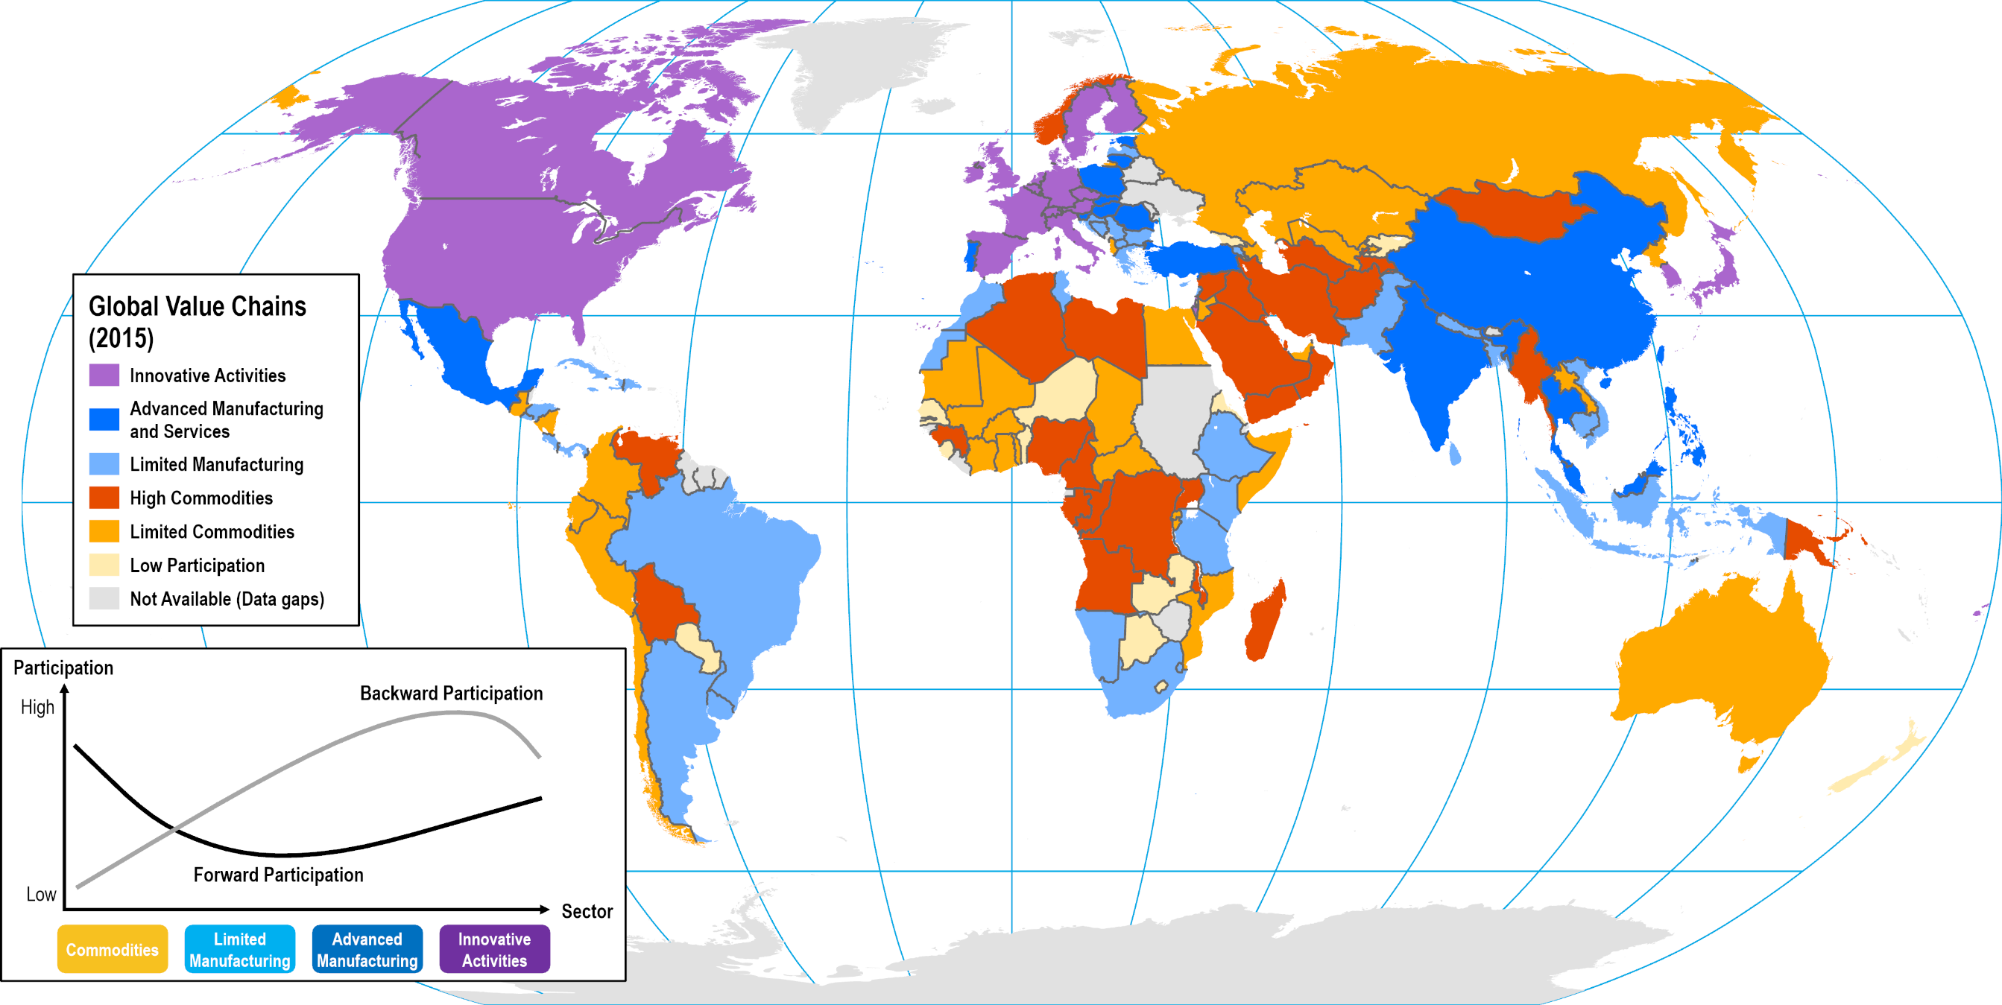
Participation Level in Global Value Chains
Notes:
Source: World Bank (2020) World Development Report 2020: Trading for Development in the Age of Global Value Chains, Washington: World Bank.
Map location: logistics_performance

Slide 24
Commodity Chains and Added Value
Read this content
Concept
Fabrication
Logistics
1. R&D
High
1
7
2. Design / Branding
3. Procurement
2
6
4. Manufacturing
Added Value
5. Distribution
3
5
6. Marketing
7. Sales / Services
4
Low
Pre-Production
(Intangible)
Production
(Tangible Activities)
Post-Production
(Intangible)
Value Chain
Notes:
Source: Adapted from the Stan Shih “Smile Curve” concept.

Slide 25


The Configuration of Value Chains
1. One-to-one
2. One-to-many
Energy and mining
Heavy manufacturing
Retail
Massification
Deconsolidation
3. Many-to-one
4. Many-to-many
Assembly manufacturing
Manufacturing districts
Consolidation
Distribution

Slide 26
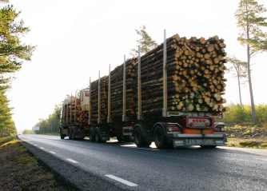
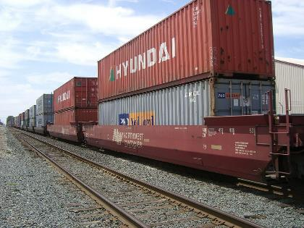
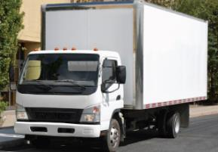
Value Chains and Types of Transported Freight
Read this content
Raw materials
Semi-finished products
Manufactured goods
Extraction
Intra-industrial linkages
Transfer
Processing
Distribution
Manufacturing
Retailing
Extraction areas, heavy industry clusters & port industrial complexes
Manufacturing clusters
Logistics zones

Slide 27
Types of Manufacturing Clusters
Read this content
MARSHALLIAN INDUSTRIAL CLUSTER
Small and medium-sized firms mostly locally owned.
Temporal development of skills and techniques around a specialization.
High level of inter-firm competitiveness and complementarity.
Enduring through time (proto-industrialization, industrial revolution, global economy).
Suppliers
Customers
Small local firm
Large firm
HUB-AND-SPOKE CLUSTER
Large driving firm(s) with several suppliers and service providers.
Economies of scale allowing large outputs.
Cooperation by driving firm(s).
Late industrial revolution and with Fordism.
Branch plant
SATELLITE PLATFORM CLUSTER
Medium and large-sized branch plants and distribution centers.
Transport and market accessibility.
Limited cluster interactions (internal to the supply chains of each plant).
Globalization, outsourcing and offshoring.
Notes:
Source: adapted from Markusen, A. (1996) “Sticky Places in Slippery Space: A Typology of Industrial Districts,” Economic Geography, Vol. 72, No. 3, pp. 293-313.

Slide 28
Value-added Activities Performed at Freight Distribution Clusters
Freight Distribution Cluster
Warehousing
Inventory Management
Inspection / Testing
Terminal
Terminal
Transloading
Packing / Packaging
Labeling / RFID
Pickup
Delivery
Assembly / Customizing
Suppliers
Reverse Distribution
Customers
Specialized Storage
Read this content

Slide 29
Energy and Minerals Supply Chains
Fuel for road transport (50-70%)
Construction
Iron Ore
Transport equipment
Fuel for airplanes (5-10%)
Steel Production (30%)
Scrap
Durable consumer goods
Crude Oil
Oil Refinery
Fuel for ships (10-15%)
Coal
Industry (40%)
Storage
Storage
Energy Production (70%)
Chemical industry (5-15%)
Residential and commercial (60%)

Slide 30
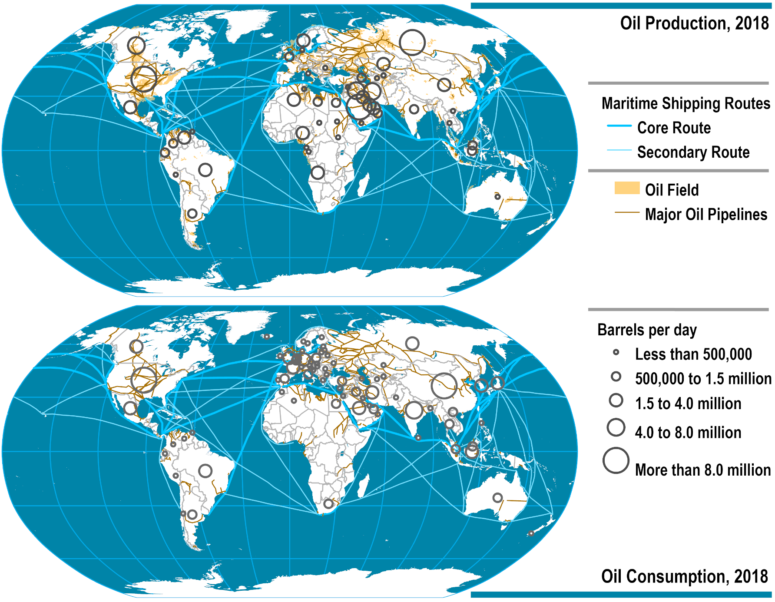
Global Oil Market
Read this content
Notes:
Source: BP Statistical Review of World Energy

Slide 31
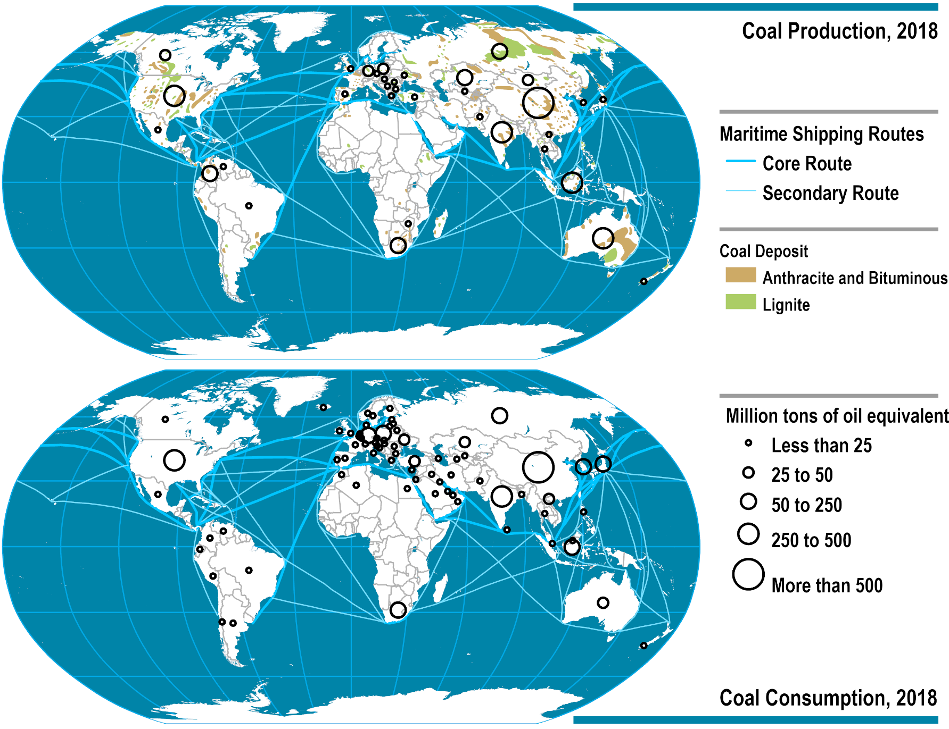
Global Coal Market
Read this content
Notes:
Source: BP Statistical Review of World Energy

Slide 32
The Automobile Supply Chain
Supplying
industries
Bodies
Manufacture and stamping of body panels
Body assembling and painting
Steel and other metals
Rubber
Components
Manufacture of mechanical and electrical components (wheels, tires, seats, braking systems, windshields, exhausts, etc.)
Final Assembly
Consumer market
Electronics
Plastic
Glass
Engines and transmissions
Forging and casting of engine and transmission components
Machining and assembly of engines and transmissions
Textiles
Notes:
Source: adapted from P. Dicken (2003) Global Production Networks In Europe And East Asia: The Automobile Components Industries, GPN Working Paper 7, University of Manchester, http://www.sed.manchester.ac.uk/geography/research/gpn/gpnwp7.pdf

Slide 33
Cereals Supply Chain
Extraction
Manufacturing
Farm
Grain
Processing Facility
Cereal
Distribution and Retailing
Packaged Cereal
Converter
Packaging
Distributor
Store
Paperboard
Wood Pulp
Packaged Cereal
Wood Pulp Mfg
Wood Pulp
Label Mfg
Labels

Slide 34

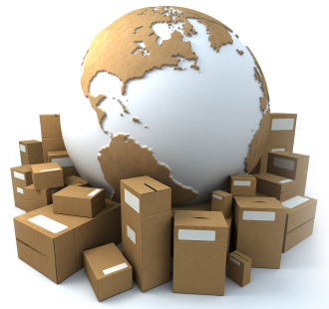
Short Assignment: Logistics Goals and Operations
Logistics has several goals. Explain what they are and how they are achieved.

