Slide 1
Topic 6 – Intermodal Transportation and the Container
A – Intermodalism
B – Containerization

Slide 2
A – Intermodalism
Read section 1

Slide 3
Intermodalism and Transmodalism
Read this content
Origin
Terminal
Destination
Road
Rail
Maritime
Intermodalism
Carrier
Ticket / Contract
Ticket / Contract
Ticket / Contract
Multimodalism
Ticket / Contract
Rail
Rail
Transmodalism

Slide 4
Integrated Freight Transport Systems: Intermodal and Transmodal Connectivity
Read this content
Transloading facility
Road
Distribution Center/ Cross-docking
On-dock
rail
Rail
Thruport
Maritime
Port container yard
Transshipment Hub
Intermodal Connectivity
Transmodal Connectivity
What are the fundamental differences between intermodal and transmodal transportation?

Slide 5
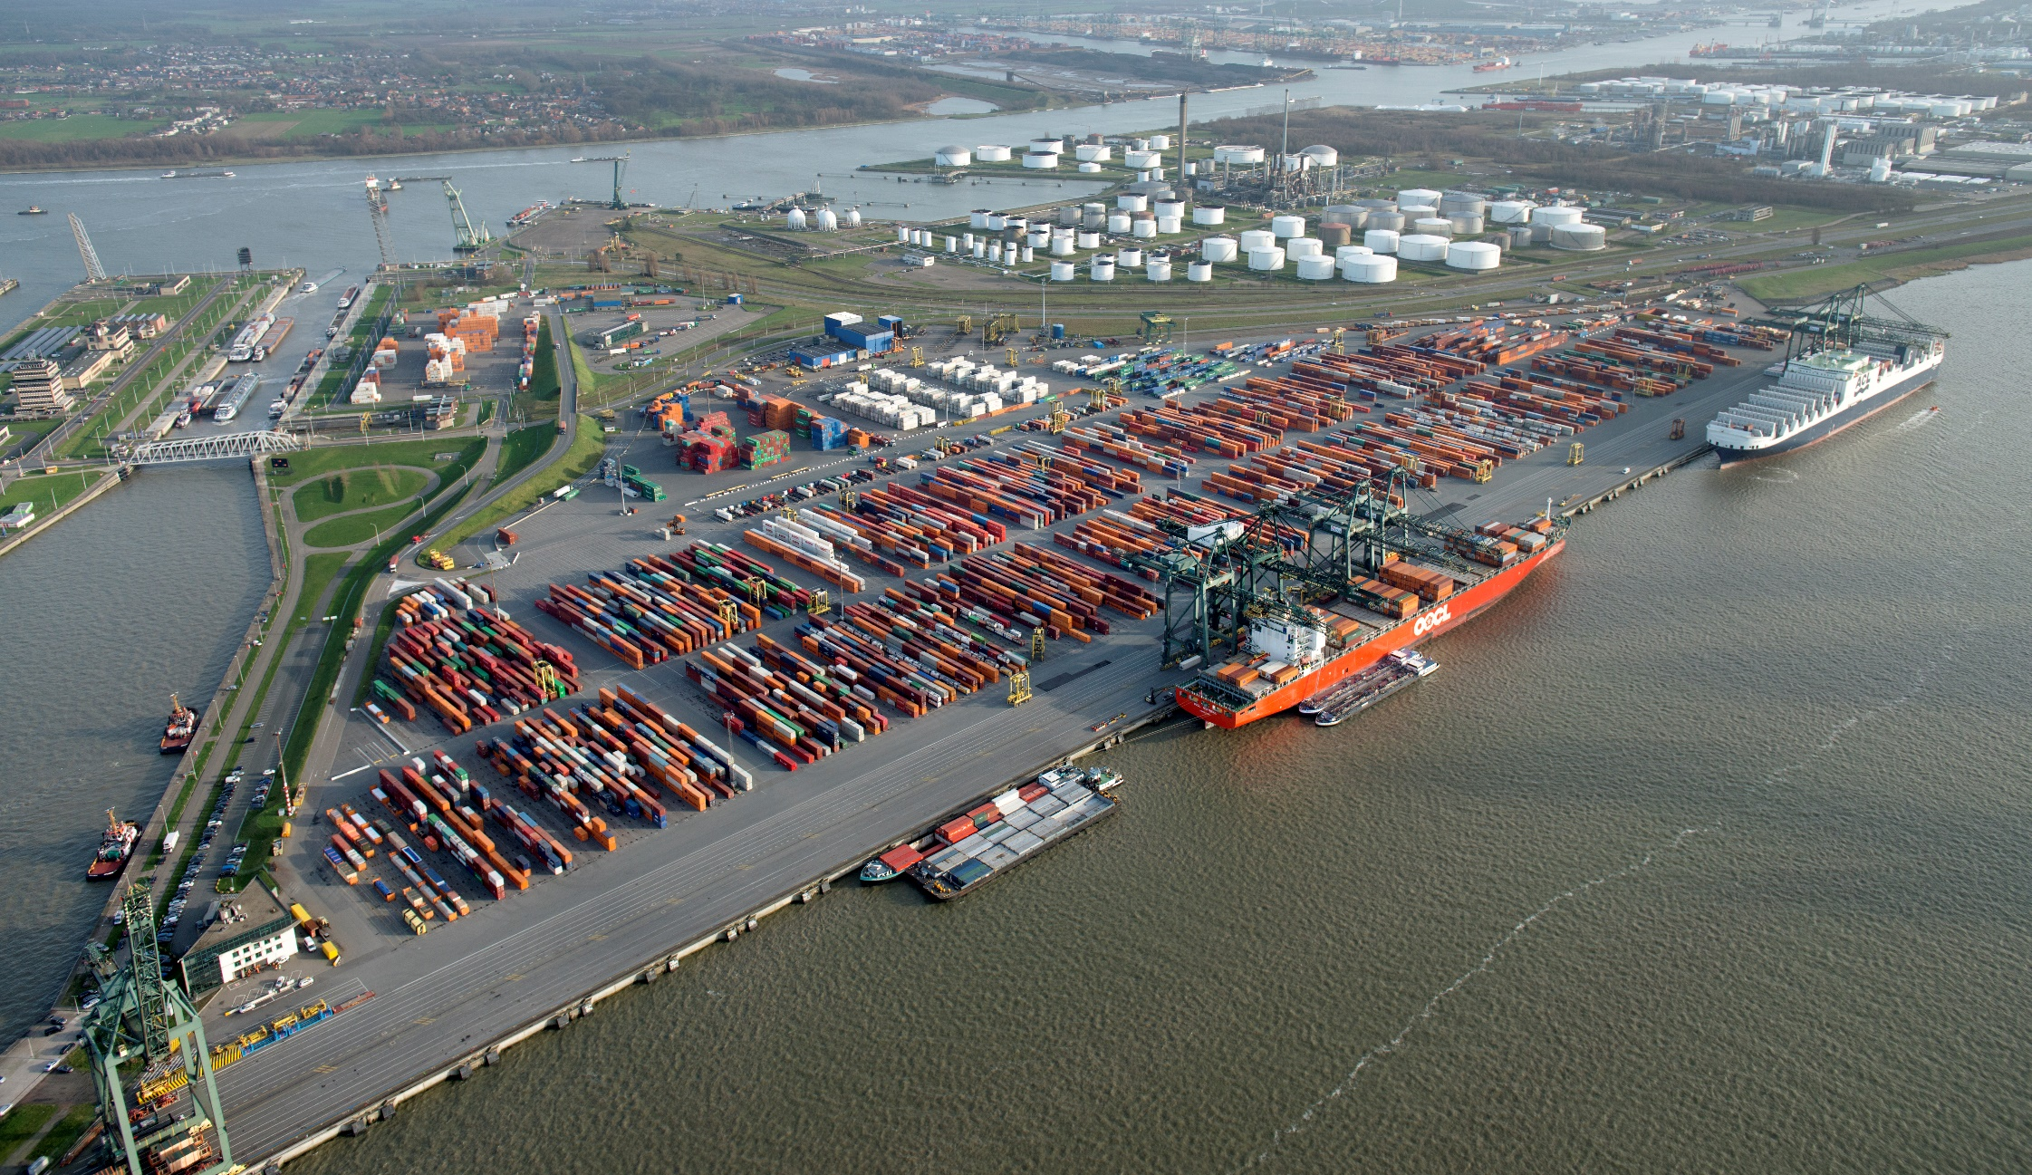
Modal Separation in Space: Europa Terminal in Antwerp
Read this content
Barges
Rail
Trucks
Deepsea services
Notes:
Source: Terminal photo from PSA Antwerp.

Slide 6
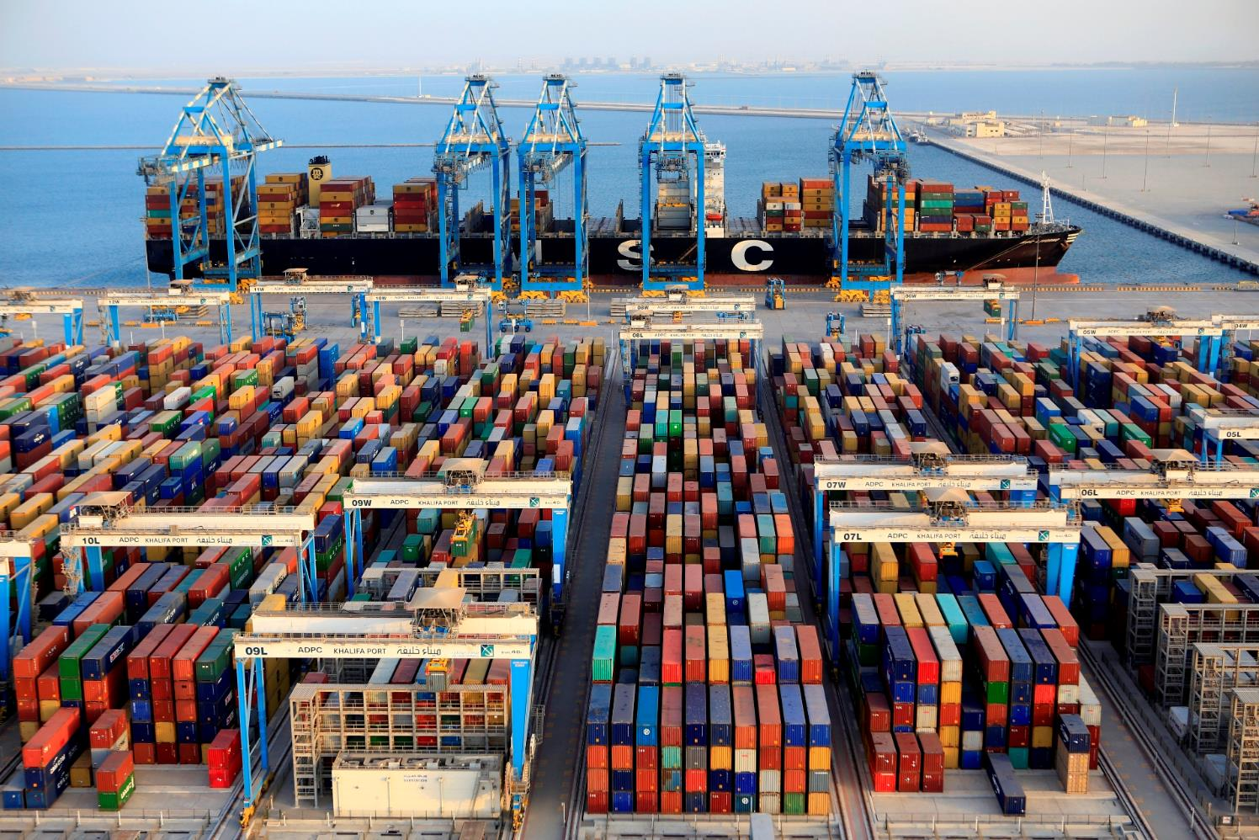
Abu Dhabi, Major Transshipment Hub

Slide 7
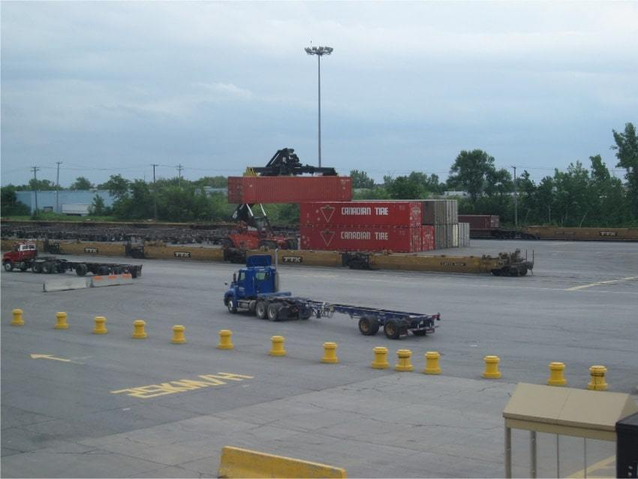
Rail / Road Transloading
Read this content

Slide 8
Major Steps in Intermodal Integration
Inventing Intermodalism
Intermodal Standards
Operationalization
Massification and Automation
1930s
1940s
1950s
1960s
1970s
1980s
1990s
2000s
2010s
Pallets
Forklifts
TOFC (1952)
Rail deregulation
Rubber-tired gantry (1985)
Reachstacker (1985)
Doublestacking (1985)
New-Panamax (2014)
Blockchain (2015)
MGX-24 (2019)
Container (1956)
Container terminal (1962)
Container standardization (1965)
Transatlantic services (1966)
COFC (1967)
Cellular containership (1968)
Electronic bill of lading
Advanced container
Container gantry crane and
straddle carrier (1959)
Satellite terminals
Inland container depots
Automated terminal (1995)
Post-Panamax ship (1996)
Read this content

Slide 9
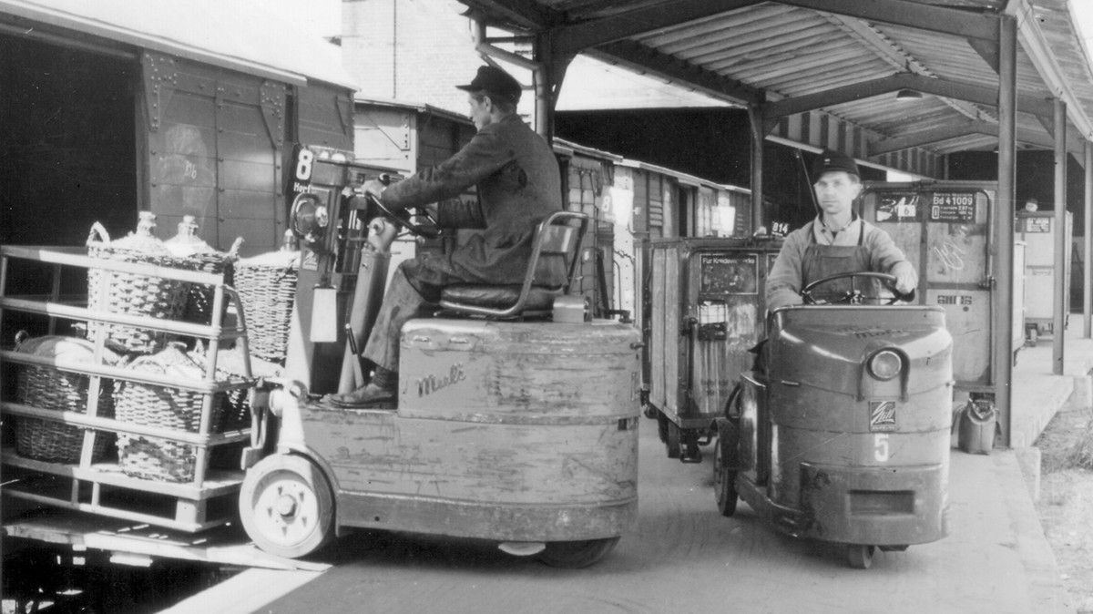
Pallets Loaded into a Train by a Forklift, 1940s

Slide 10
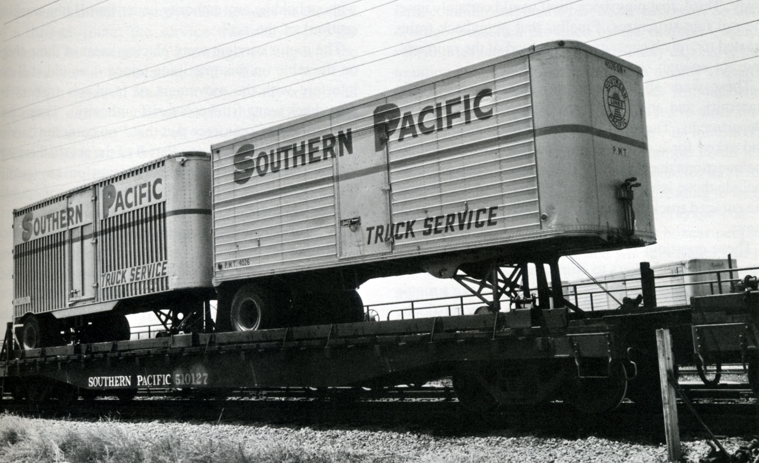
Trailers on Flatcars (TOFC), 1950s

Slide 11
What is a Container?
A standard metal box (ISO 668 standard)
  20-foot box of 20 feet long, 8'6" feet high and 8 feet wide (One TEU; Twenty Foot equivalent Unit).
  40-foot box (equals two TEU).
  40-foot ‘high cube’ box. 9’6” feet high (often counted as two TEU).
Using common handling equipment
  Moving between ships, railcars, trucks and barges.
The container is a load unit
  Can be adapted to carry different cargoes.
  Standard: General dry cargo.
  Tank: Liquid cargo (fuel and chemicals).
  Reefer: Refrigerated cargo (food).

Slide 12
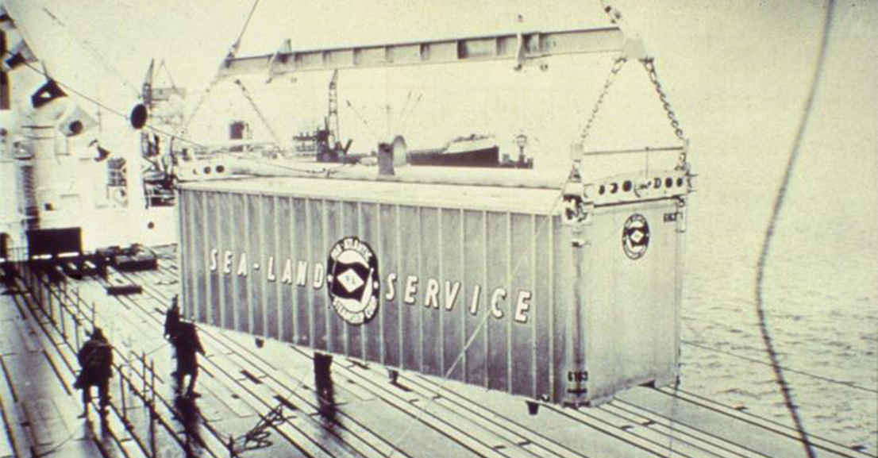
First Containership, Port Newark, 1958

Slide 13
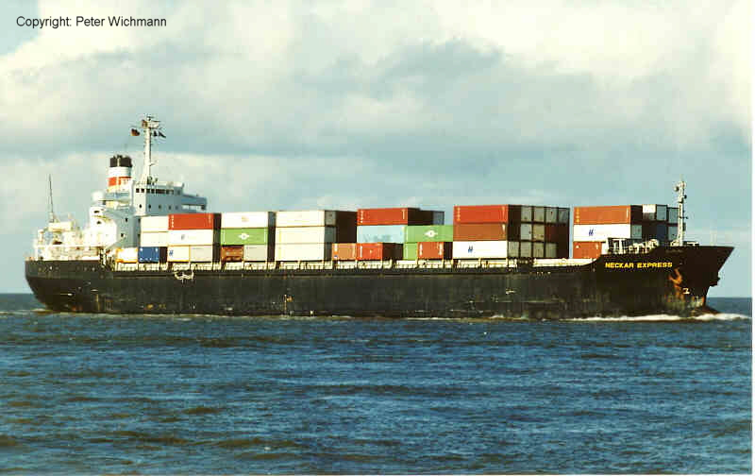
Cellular Containership, 1970s

Slide 14
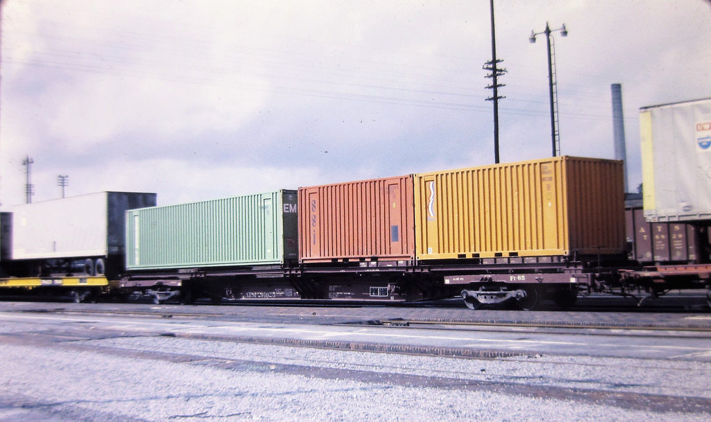
Containers on Flatcars, 1978
Doublestacking

Slide 15
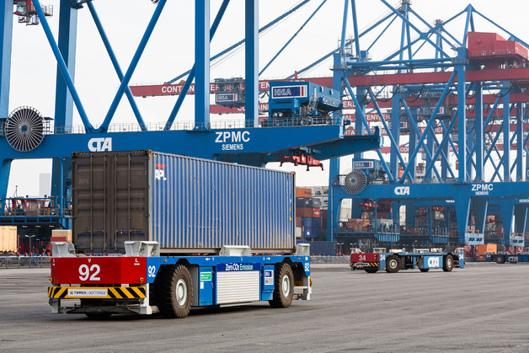
Automated Guided Vehicles, Container Yard, HHLA Container Terminal Altenwerder (CTA), Hamburg

Slide 16
Conditions for Intermodal Transport
Read this content
CONDITIONS
OUTCOMES
Load unit
Intermediate and finished goods in load units of less than 25 tons.
Total transport costs
From economies of scale and the use of more effective modes and intermodal operations.
Modal continuity
Sequence of connected infrastructure; an intermodal transport chain.
Modal shift
Each mode according to their respective time and cost advantages.
Transport distance
Distances above 500 km (longer than one day of trucking) usually require intermodal transportation.
Consolidation
Requirement to consolidate and deconsolidate load units at intermodal terminals.
X
Cargo Value
Suitable for intermediate cargo values. Low and high value shipments are usually less suitable.
Higher load factor
Less LTL and more TL. Better utilization of existing capacity.
Frequency of shipments
Cargo flows need to be continuous and in similar quantities.
Less empty backhauls
Less vehicle-km of empty backhauls due to modal shift, higher load factor and consolidation.
Explain under what conditions intermodal transportation is used.

Slide 17
Unimodal and Intermodal Transportation
Read this content
Unimodal Point-to-Point Networks
Intermodal Integrated Network
C
C
A
A
B
B
Transshipment
Rail
Road
D
D
Transshipment
F
F
E
E
Explain how an integrated intermodal network can be a more efficient form of transportation.

Slide 18

Distance, Modal Choice and Transport Costs
C1
C2
ROAD
C3
Transport costs per unit
RAIL
MARITIME
D1
D2
Distance
Read this content

Slide 19
Freight Transport Revenue per Ton-Mile (in 2006 dollars)
Read this content
Notes:
Source: U.S. Department of Transportation, Bureau of Transport Statistics, National Transportation Statistics, 2009.

Slide 20
Average Length of Haul, Domestic Passenger and Freight Transport, United States, 1960-2019 (in miles)
Read this content
Freight
Passengers
Notes:
Source: RITA/BTS. Table 1-38: Average Length of Haul, Domestic Freight and Passenger Modes.
http://www.rita.dot.gov/bts/sites/rita.dot.gov.bts/files/publications/national_transportation_statistics/html/table_01_38.html

Slide 21
Modal Share of Freight Transportation, Selected Countries, 2008 (in % of ton-kms)
Read this content
Why Europe, the US and Japan have different composition of transport modes?
Notes:
Source: AT Kearney
https://www.atkearney.com/documents/10192/295992/Russian_Rail-Containers-and_Growth.pdf/010bafbb-54d6-46d0-9ff9-25b53c27645c

Slide 22
Intermodal Transport Chain
Read this content
Composition
Decomposition
Interchange
‘Last mile’
Transfer
‘First mile’
Local / Regional Distribution
National / International Distribution
Transport Terminal

Slide 23
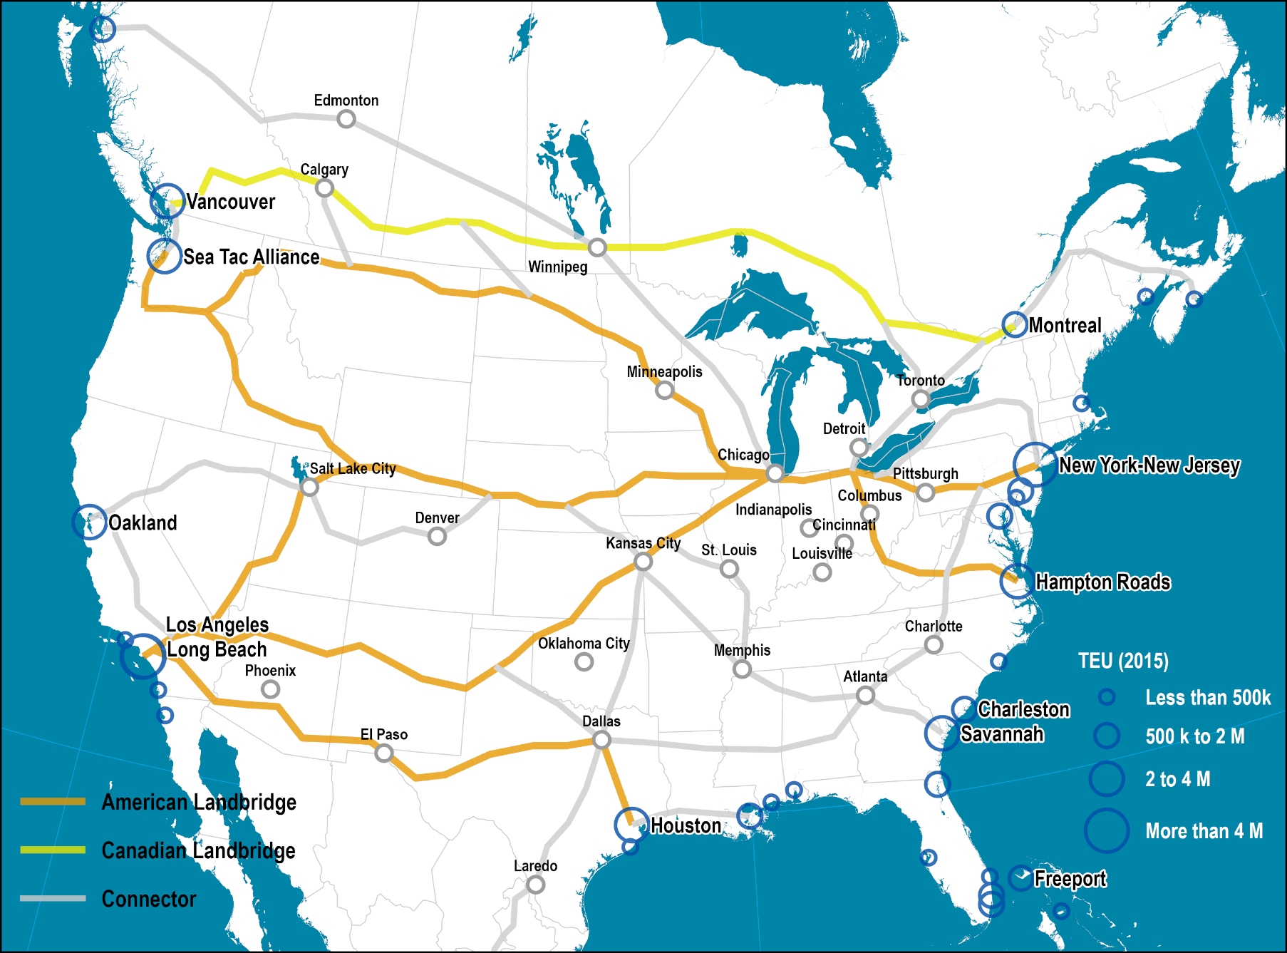
The North American Landbridge
Read this content

Slide 24
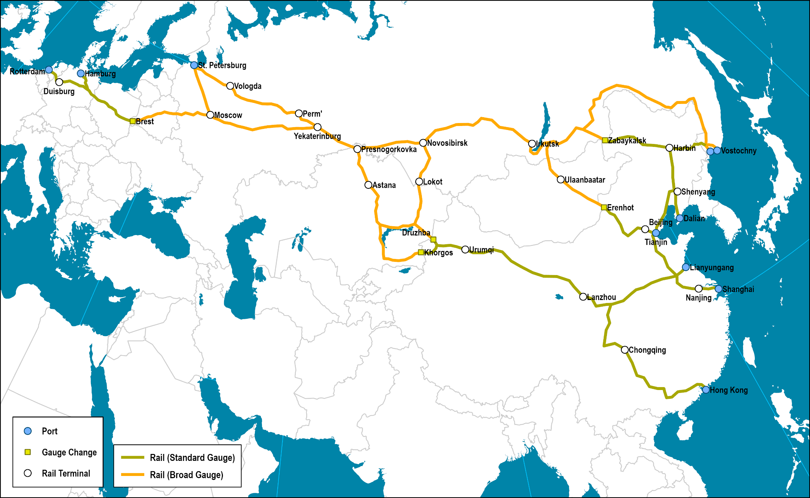
The Eurasian Landbridge
Read this content
Explain how the North American and Eurasian Landbridge are examples of intermodalism.
Notes:
Source: International Union of Railways (2004) The Northern East West (N.E.W.) Freight Corridor, Transportutvikling AS.

Slide 25

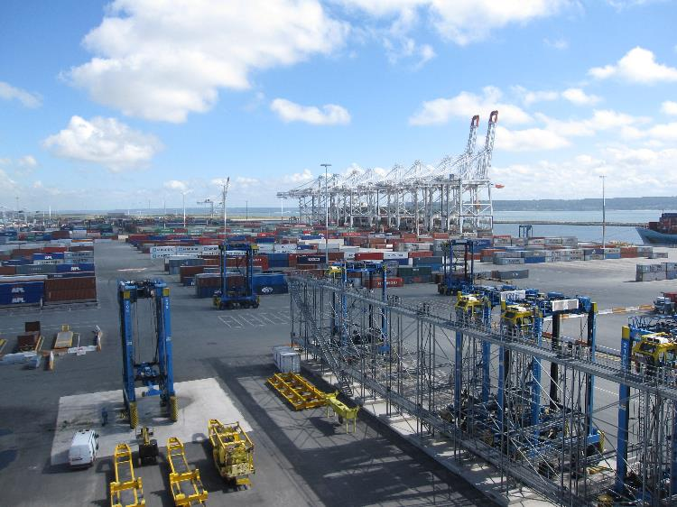
Short Assignment: The Choice of a Transport Mode
Explain how distance and cost are factors in selecting a specific transport mode.

Slide 26
B – Containerization
Read section 3

Slide 27

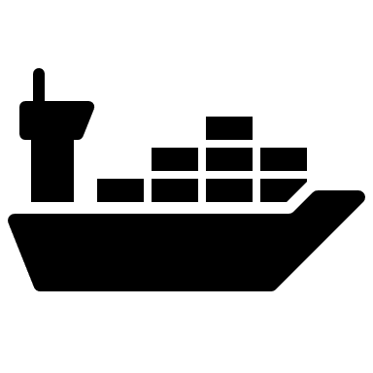
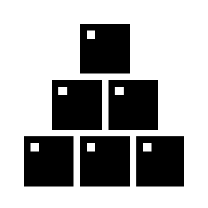
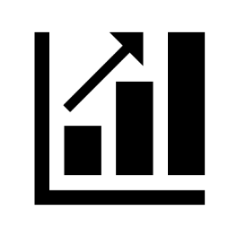
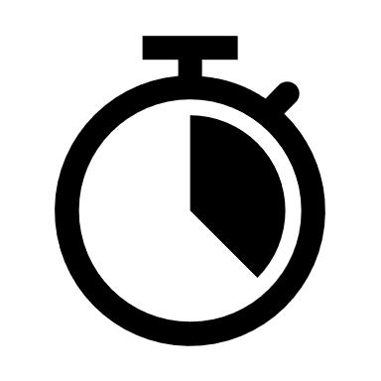
The Benefits of Containerization
What is containerization
Read this content
Transportation Costs
Inventory Costs
Service Level
Lower freight rates.
Lower insurance rates.
Minimal load unit.
Lower storage costs.
Lower packing and packaging costs.
Faster inventory turnover.
Time reliability.
Higher frequency.
The container has become a dominant mode of global freight transportation. Explain the main reasons why.

Slide 28
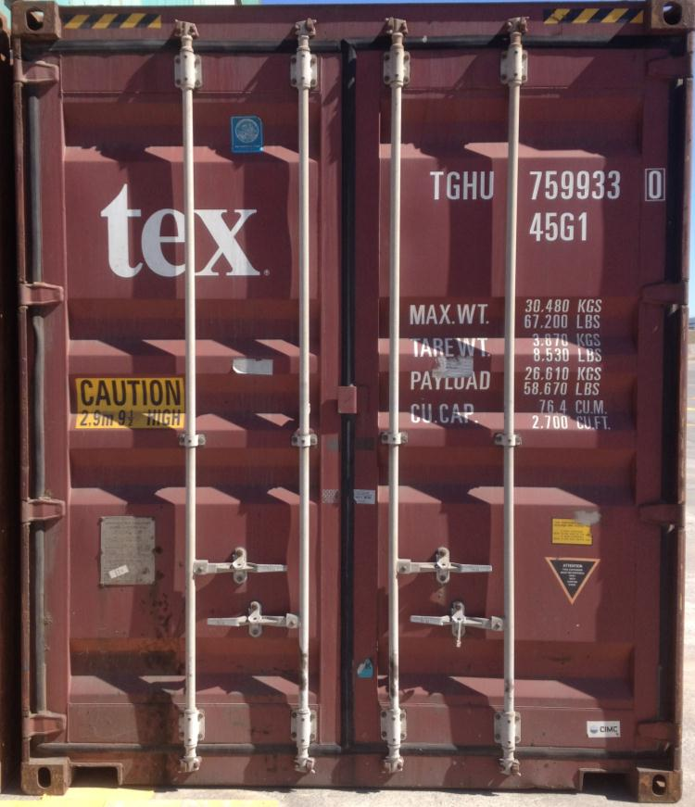
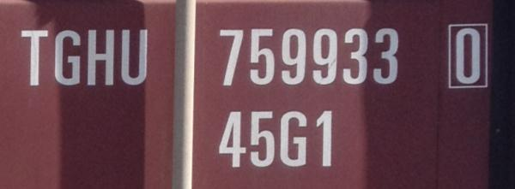
Container Identification System
Read this content
Check digit calculator
3
2
1
4
5
1
Owner Code (3 letters): TGH
Product Group Code (1 letter): U
Registration Number (6 digits): 759933
Check Digit (1 digit): 0
Size & Type Code (4 digits/letters): 45G1
2
3
4
5
Operational Characteristics
Maximum weight: 30,480 kg
Container weight: 3,870 kg
Payload weight: 26,610 kg
Cubic capacity: 2,700 cubic feet

Slide 29
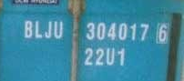
Common ISO Container Size and Type Codes
Length
Height
Type
2
20 feet
2
8 feet 6 inches
G1
General purpose container
4
40 feet
5
9 feet 6 inches
R1
Refrigerated container
L
45 feet
“High cube”
U1
Open top container
M
48 feet
P1
Platform container
T1
Tank container
Read this content
Notes:
1995 ISO standard

Slide 30
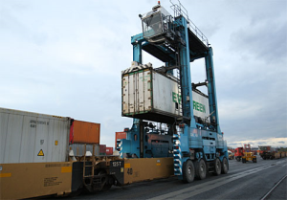
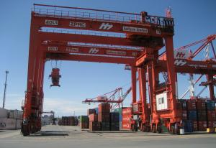
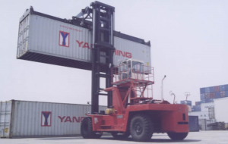
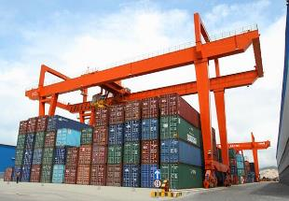
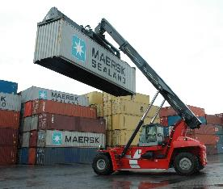
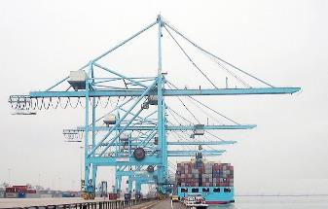
Conventional Intermodal Terminal Equipment
Read this content
Straddle Carrier
Rubber-tired Gantry
Circulate over container piles. Can go over stacks up to 3 in height. Density of 500 to 700 TEU per hectare.
High storage densities (1,000 TEU per hectare). Difficult to move from one stack to the other. High acquisition but low operating costs.
Straddle Carriers at ECT Delta Terminal Rotterdam
Rubber Tire Gantry Cranes working at Dublin Port
Front-end Loader
Rail-mounter Gantry
Use container top anchor points. Handle most containers. Can reach stacks up to 3 in height.
Highest storage density (wide span; +1,000 TEU per hectare); mostly used at port terminals. Lowest operating costs. Fixed to rail tracks.
Reach Stacker
Portainer
Flexible side loaders. Can reach stacks up to 3 full or 5 empty containers in height. 500 TEU per hectare.
Load and unload containerships.
Various sizes (Panamax and Super-Panamax).

Slide 31
Composition of the Global Fleet of Containers, 2012
20 Foot Containers
  Carry heavier goods.
  Running out on weight before run out of volume.
40 Foot Containers
  Carry more volume than weight.
40 Foot High-Cube
  Highest volume available in maritime shipping.
Reefer
  Carry refrigerated goods.

Slide 32
Number of Units and Weight of Standard Consumption Goods that Can be Carried by a 20 Foot Container
Read this content
Weight Limit
What is the difference between “weighting out” versus “cubing out” in containerized transportation?
Notes:
Source: adapted from T. Toikka (2006) “The Real Price for Container Transportation between Asia and Europe”, Lappeenranta University of Technology,
Department of Industrial Engineering and Management.

Slide 33
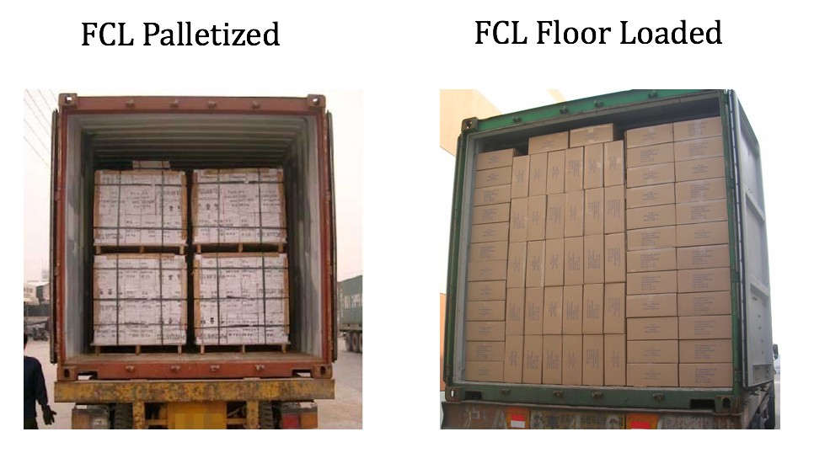
Palletized versus Floor Loaded Container

Slide 34
Containerization as a Diffusion Cycle: World Container Traffic (1980-2020)
Diffusion Level
Niche markets
Maturity
Peak Growth
Maturity
2002-2008
2009 -
Peak Growth
Massive diffusion
Network complexities
New (niche) services
Productivity gains
Acceleration
Network development
Productivity multipliers
Adoption
Time
Adoption
1966-1992
1993-2001
Read this content
© GTS
Acceleration

Slide 35



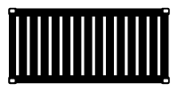
Containerization Growth Factors
Read this content
Growth
Decline
Derived
Economic and income growth
Outsourcing and offshoring
Complex supply chains
Economic recessions
Trade protectionism
Automation
Substitution
Capture of bulk and break-bulk markets
New niches (commodities and cold chain)
Peak substitution
Composition of container fleet
Incidental
Trade imbalances
Repositioning of empty containers
Trade protectionism
Automation
Induced
Transshipment (hubbing, relay and intersection)
Changes in shipping networks (more direct services)

Slide 36
Containerized Cargo Flows along Major Trade Routes, 1995-2020 (in million TEUs)
Read this content
Why container flows are imbalanced and what happens with empty containers?
Notes:
Source: UNCTAD, Review of Maritime Transport, various years.

Slide 37
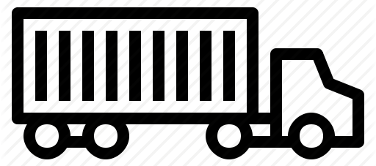
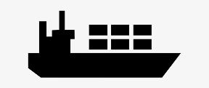

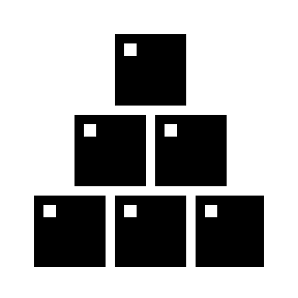
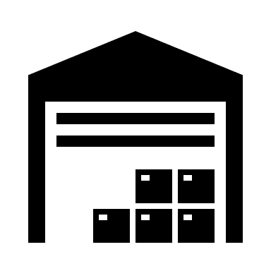
The Container as a Transport, Production and Distribution Unit
Read this content
TRANSPORT
Modes and terminals.
Intermodal and transmodal operations.
PRODUCTION
Synchronization of inputs and outputs (batches).
Manufacturing cycles.
DISTRIBUTION
Flow management (time-based).
Inventory in transit (warehousing unit).
Notes:
Source: Notteboom, T. and J-P Rodrigue (2009) "The Future of Containerization: Perspectives from Maritime and Inland Freight Distribution", Geojournal, Vol. 74, No. 1, pp. 7-22.

Slide 38
Advantages of Containerization
ADVANTAGES
Standardization
ISO standard (modes and equipment). Unique identification number and size type code.
How a container is made
Flexibility
Commodities, manufactured goods, liquids and refrigerated goods.
Costs
Low transport costs. Economies of scale at modes and terminals.
$
Velocity
Fast transshipment operations.
Low terminal turnaround times.
Loading containership
Warehousing
Own warehouse; simpler and less expensive packaging. Stacking capability.
Security & Safety
Contents unknown to carriers. Reduced spoilage and losses.
Read section 4

Slide 39
Drawbacks of Containerization
DRAWBACKS
Site constraints
Large consumption of terminal space. Draft issues with larger containerships.
Capital intensiveness
Container handling infrastructures and equipment are important investments.
$
Stacking
Complexity of arrangement of containers, both on the ground and on modes.
Repositioning
Divergence between production and consumption; repositioning. 20% of all containers.
Theft and losses
High value goods vulnerable to thefts, particularly between terminal and final destination.
Illicit shipments and the response of the Container Control Programme
Illicit trade
Illicit trade of goods, drugs and weapons, as well as for illegal immigration.

Slide 40
Container Usage during its Life-Span
Read this content
Notes:
Source: adapted from Crinks, P. (2000) Container Usage Asset Management in the Global Container Logistics Chain, International Asset Systems. http://www.interasset.com/docs/AssetManagementWP.pdf

Slide 41
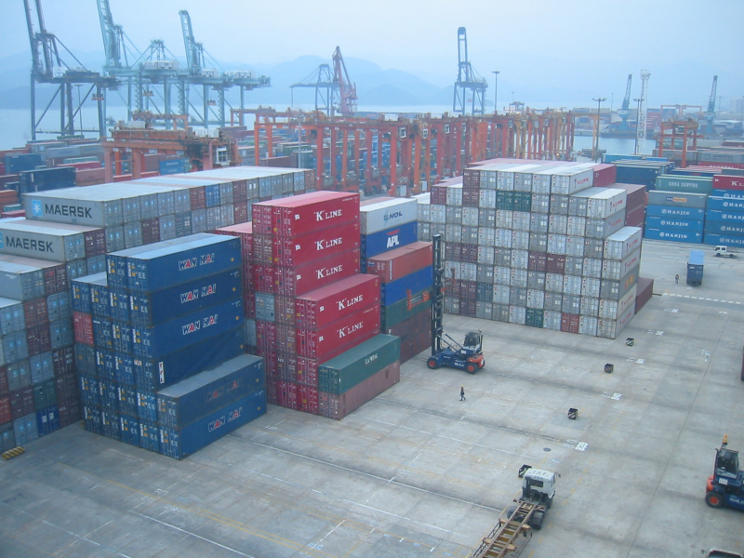
Stacked 40-Foot Containers, Port of Yantian, China
Read this content

Slide 42
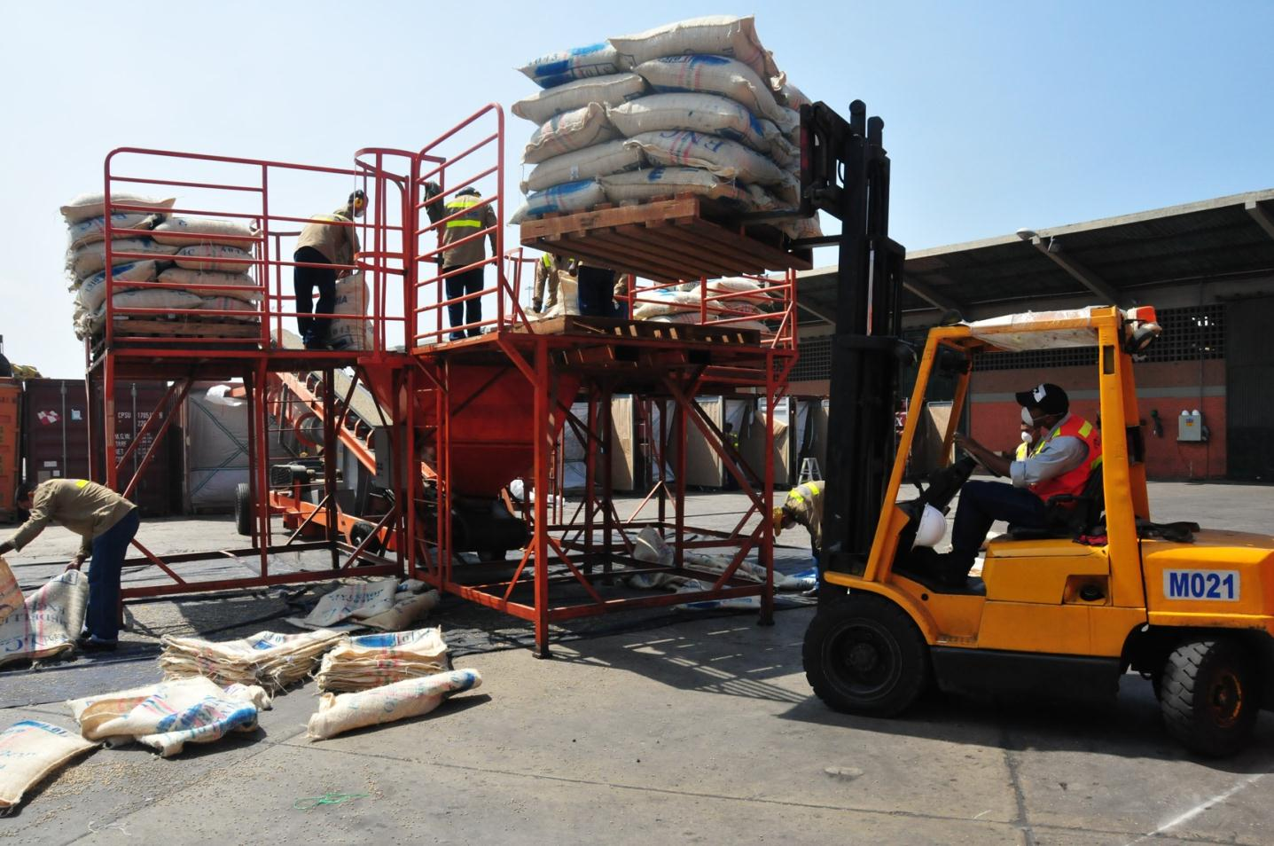
Loading Coffee into Containers, Cartagena, Colombia
Read this content
Why a commodity such as coffee is carried in containers?
Notes:
Source: Cartagena Port Authority.

Slide 43
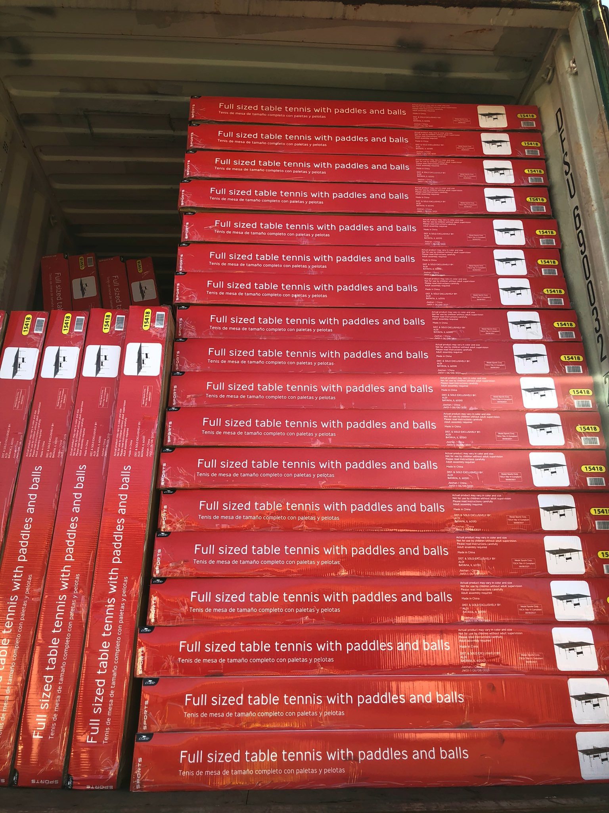
Floor Loaded Container with Chinese Retail Goods

Slide 44
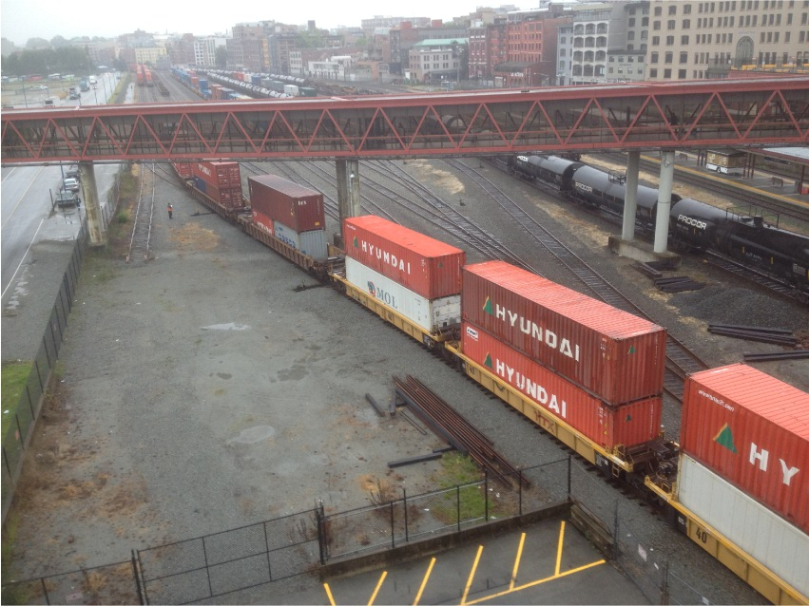
40-Foot Containers Doublestacked on a Rail Car
Read this content
Notes:
Source:

Slide 45
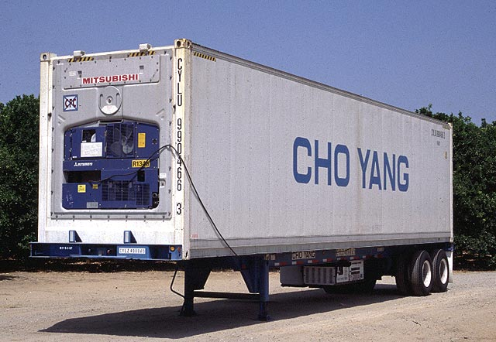
40’ Reefer Container

Slide 46
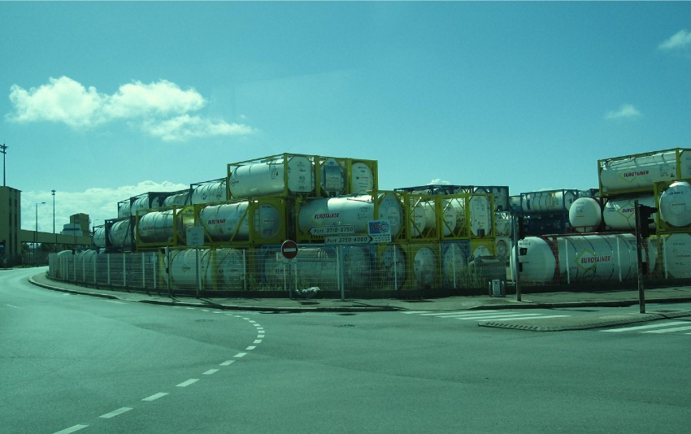
20-Foot Tank Containers
Read this content
Notes:
Photo: Dr. Jean-Paul Rodrigue, 2010

Slide 47
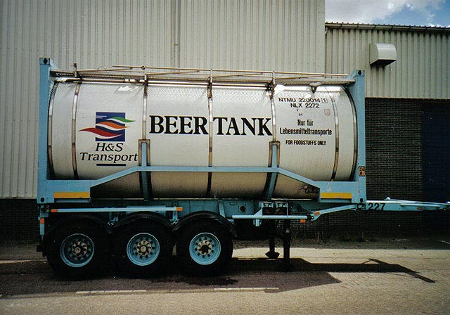
The Ultimate “Kegger”

Slide 48
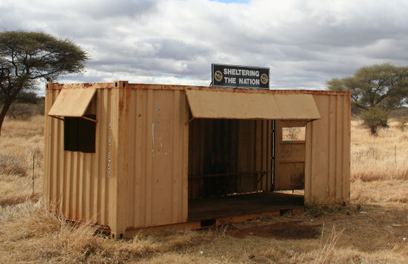
Reuse of a Discarded Container (South Africa)
Read this content
Discarded containers have many uses. Searching to web, provide some examples about how containers can be reused.

Slide 49
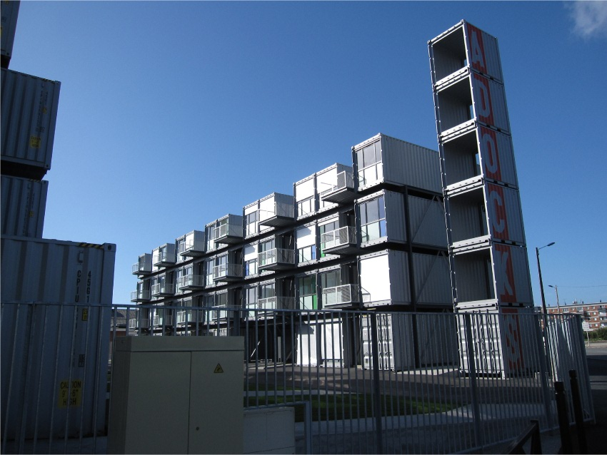
Containerized Housing Units, Le Havre, France
Read this content

Slide 50
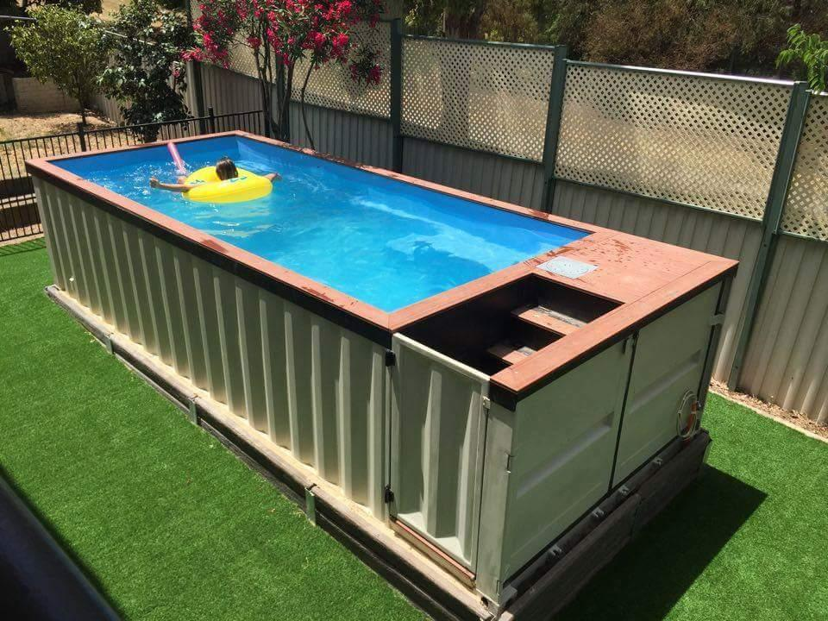
Container Turned in a Swimming Pool…

Slide 51
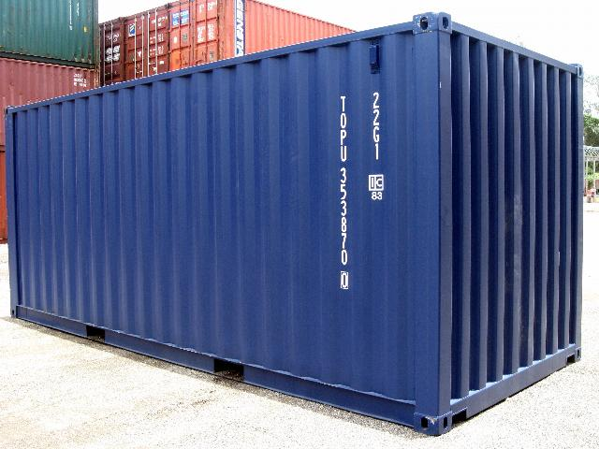
Short Assignment: “The World in a Box”
The container has several advantages and drawbacks. Provide a succinct explanation of the advantages and drawbacks you think are the most important.

