Slide 1
Topic 3 – Trade and the Global Economy
A – International Trade
B – Trade Facilitation
C – Global Trade Flows

Slide 2
A – International Trade

Slide 3



International Trade: A Definition
Read part 1 (The Flows of Globalization)
EXCHANGE
Exchange of goods or services across national jurisdictions.
Trade between US states is not international trade.
DIRECTIONAL
Inbound trade: imports.
Outbound trade: exports.
REGULATORY OVERSIGHT
Customs and tariffs.
States control what crosses their borders.

Slide 4
The Rationale for Trade
Read this content
SUPPLY
SCARCITY
ABUNDANCE
A necessity or a convenience?
Paradoxically both.
Many nations can technically produce a wide array of goods and services.
Less efficient to do so (degrees of convenience).
Some goods, such as energy and resources, can be lacking.
Limited availability
Concentration
Wide availability
Dispersion
Trade
NECESSITY
Cannot be substituted
Absolute advantage
DEMAND
Strategic resources
Common resources
CONVENIENCE
Can be substituted
Comparative advantage
Explain the economic rationale of international trade such as if it is a convenience or a necessity
Skills, technology, manufacturing clusters
Labor, parts and finished goods

Slide 5



The Benefits of Trade in a Global Economy
ECONOMIC EFFICIENCY
Sell what is produced in surplus and acquire what is lacking.
Lower productions costs (cheaper inputs).
Achieve economies of scale (larger markets).
ACCESSIBILITY
Large variety of resources being made accessible.
Raw materials, energy, goods, food and labor.
Exchanges of capital, goods, raw materials and services.
INTERDEPENDENCIES
Spatial interdependencies between elements of the world-system.
The more integrated economies are, the more they trade.
Promote harmonious relations / Risk of dependency.

Slide 6
Economic Rationale of Trade
Read this content
Country 1
Country 2
Country 1
Country 2
Country 3
Country 4
Country 3
Country 4
Without Trade
With Trade
Small national markets.
Limited economies of scale.
High prices and near monopoly.
Limited product diversity.
Different standards.
Increased competition.
Economies of scale.
Specialization.
Lower prices and more output.
Interdependencies.

Slide 7
The Main Theoretical Foundations of International Trade
Neomercantilism
Establishing a positive trade balance to meet economic development goals.
Tariff and non-tariff measures regulating trade and protecting national commercial sectors.
Absolute advantages
Produce more effectively in an economic sector while using less resources.
A nation can focus on its absolute advantages, trade its surplus and import what it lacks.
Comparative advantages
A nation can focus on the sectors it has the highest comparative advantages.
A nation having no absolute advantages can focus on sectors where the total productivity gains are the most significant.
Factors Endowments
Trade related to endowments such as capital, land and labor.
Export goods to which it has notable factor endowments and imports goods in which it has scarce factor endowments

Slide 8
Favorable and Contentious Factors in International Trade
Explain the main criticism international trade has been subject to.
Factor Substitution
Comparative Advantages
Openness
Interdependencies
Specialization promotes national productivity.
Increases the quantity of goods and lowers their cost.
Lower prices for consumers because of lower tariff and non-tariff barriers.
Promotes collaboration, standards and technology exchanges.
Labor and capital cannot be easily reconverted.
Some nations have limited advantages and resources.
May impact national industries and employment.
Protectionism.
Dependency on foreign goods and resources. Vulnerability to disruptions.
Read this content

Slide 9




Trends Shaping International Trade
Volume
Support
Actors
Geography
Peak growth
Multinational Corporations
Export-Oriented Economies
Containerization
1980-2015:
Growing proportion of global trade.
Intermodal transport chains.
Transnational production networks.
Outsourcing and offshoring.
Focus on exports to promote economic growth.
Imbalances in trade relations.
Population: 1.8 times.
GDP: 22 times.
Exports (value): 48 times.

Slide 10
World Merchandise Trade, 1960-2020
Read this content
Notes:
Source: WTO and World Bank. Current USD.
Merchandise Exports : http://data.worldbank.org/indicator/TX.VAL.MRCH.CD.WT
GDP: http://data.worldbank.org/indicator/NY.GDP.MKTP.CD?locations=1W

Slide 11
Global Trade and Container Throughput (1970=100)
Read this content
20x
Container Throughput (TEU)
8.9x
Exports (current USD)
7.5x
GDP (current USD)
1.7x
Population
© GTS
Notes:
Source: Population and GDP from World Bank, World Development Indicators. Exports from World Trade Organization. Container port throughput compiled from Containerization International.

Slide 12
Services Supporting International Trade
Read this content
Service
Actors
Transportation
Cr
TO
Distribution
Carrier
CO
Terminal
Operator
Cargo owners (manufacturers, retailers, wholesalers)
Warehousing
Cargo Owner
3PL
Procurement
FF
Freight Forwarder
Customs
4PL
Transactions
Finance
IB
Investment Bank
Trade regulations
Ins
Insurance
Insurer
Banking
CB
Commercial Bank

Slide 13
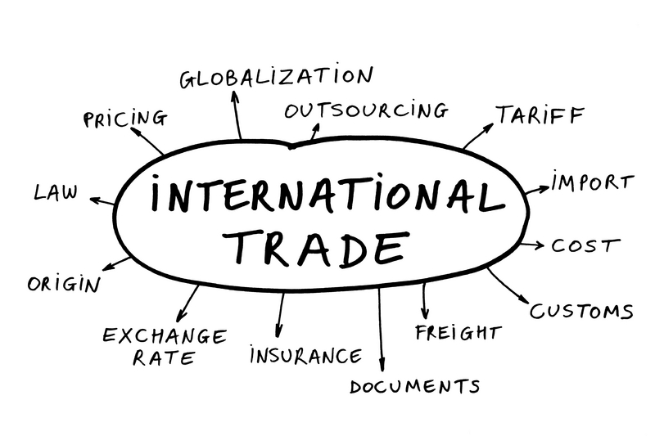

Short Assignment: The Drivers of Global Trade
Explain the main drivers of global trade growth such as why it has been growing faster than GDP and population

Slide 14
B – Trade Facilitation
Read part 2 (Trade Facilitation)
What factors promote trade?

Slide 15
International Trade, Transportation Chains and Flows
Read this content
International Trade
Origin
Destination
A
B
Custom Procedures
Transport Chain
Decomposition
Rail
Maritime
Road
A
B
Composition
Transshipment
Customs
Physical Flows
Port
Distribution Center
A
B
Rail Yard
Transshipment Hub
Notes:
Source: Rodrigue, J-P (2012) "Supply Chain Management, Logistics Changes and the Concept of Friction", in P.V. Hall and M. Hesse (eds) Cities, Regions and Flows, London: Routledge. ISBN 978-0-415-68219-0.

Slide 16

The “Four Ts” in International Trade
Transaction costs
Separation Factors
Exogenous
Distance, transportation costs, travel time.
Part of a trade agreement.
International
Trade
Tariff and non-tariff costs
Transport costs
Country Specific Factors
Endogenous
Customs procedures.
Performance of national transport and logistics.
Time costs
Read this content

Slide 17
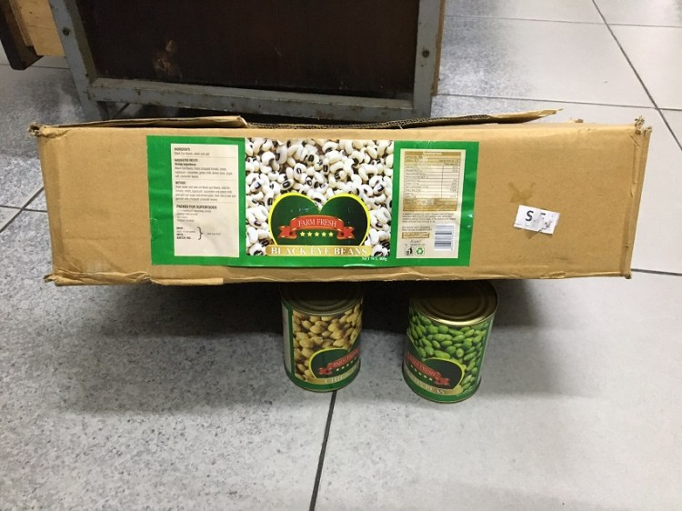
Customs Fraud by Misclassification of Goods
Undervaluation of goods
Inaccurate marking of the country of origin
Misclassification of goods
Failure to pay in full or in part customs duties
Read this content

Slide 18

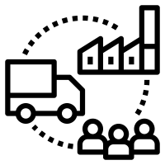



The Main Dimensions of Trade Facilitation
Read this content
Integration-Based
Distribution-Based
Transactions-Based
Nature
Compliance to rules and regulations.
Physical capacity to support trade.
Setting transactions and receiving compensation.
Customs procedures, regulations and handling of trade documentation.
Multimodal and intermodal freight transport systems. Modes, infrastructures and terminals.
Banking, finance and insurance activities where accounts can be settled.
Activities
Explain the main dimensions of trade facilitation and how they impact trade.

Slide 19
Regional Averages in Trading Across Borders, 2012
Read this content
Notes:
Source: IFT/World Bank (2013) “Trading across borders”, Doing Business database. www.doingbusiness.org

Slide 20
Levels of Economic Integration
Read this content
High
Political
Union
Common government
Economic
Union
No barriers for internal trade, free movement of labor, harmonized tax rates, common monetary and fiscal policy: EU (partial)
Common
Market
Free movement of capital and services. Different national regulations.
Level of integration
Customs
Union
Common external tariffs.
Free
Trade
Reduction of tariffs between members: NAFTA, Mercosur, ASEAN (partial)
Low
Low
Complexity
High

Slide 21
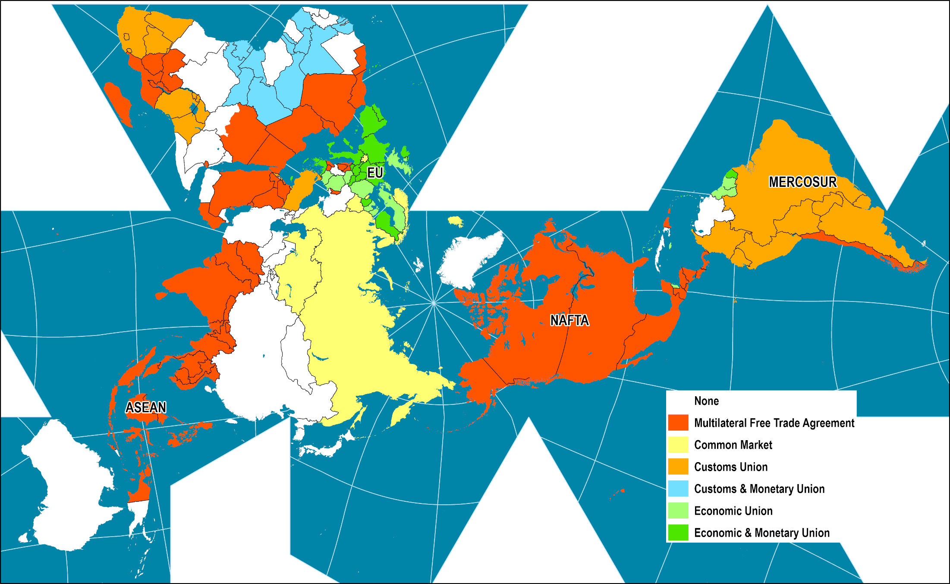
Economic Integration Levels, 2015
What is NAFTA and which level of economic integration it involves?
Read this content
Notes:
Map location: global_socioeconomic

Slide 22
Merchandise Exports by Trade Agreement, 2015 (in billions USD)
Read this content
Notes:
Source: WTO.

Slide 23
Types of Free Zones
Read this content
Free Port
Free Trade Zone
Export Processing Zone
Special Economic Zone
International
Domestic
International
Domestic
International
Domestic
International
Trade and logistics platform
Trade support with entrepots and trade-related activities
Develop manufacturing and processing
Attract foreign direct investments
Port cities or connected locations
Ports of entry
Usually close to a major transport node
Commercial gateways
Domestic, internal and export markets
Domestic and re-exports
Exports and domestic
Exports and re-exports
Notes:
Source: adapted from World Bank (2008) Special Economic Zones: Performance, Lessons Learned, and Implications for Zone Development, Washington, DC: The World Bank.

Slide 24
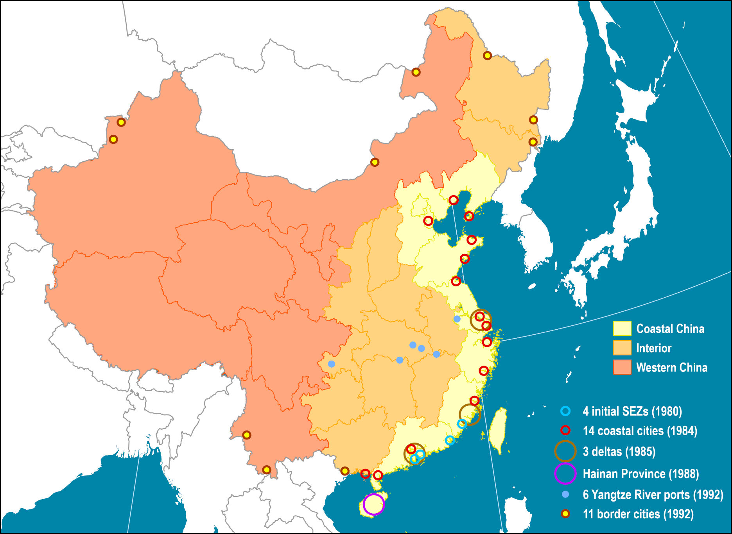
China’s Special Economic Zones: An Export-Oriented System
Read this content
Notes:
Source: adapted from World Bank (2009) World Development Report 2009: Reshaping Economic Geography.

Slide 25
Yuan Exchange Rate (per USD), 1981-2021 (Monthly)
Read this content
Explain how the change rate of the Yuan is a trade facilitation factor for China.
Notes:
Source: http://research.stlouisfed.org/fred2/series/EXCHUS/downloaddata?cid=95

Slide 26
C – Global Trade Flows
How global trade is currently organized?

Slide 27




Main Trends in the Structure of Global Trade
Read part 4 (Global Trade Flows)
GLOBAL VALUE CHAINS
Trade in intermediary goods (parts) increasing.
Growing share of developing economies.
MANUFACTURED GOODS
Growing share of manufactured goods, including parts.
Trade cycles impacted by recessions.
REGIONALISM OF TRADE
The dominance of the “triad” (USA / Western Europe / Japan).
The rise of China.
NEO-MERCANTILISM
Export-oriented strategies.
Trade imbalances.

Slide 28
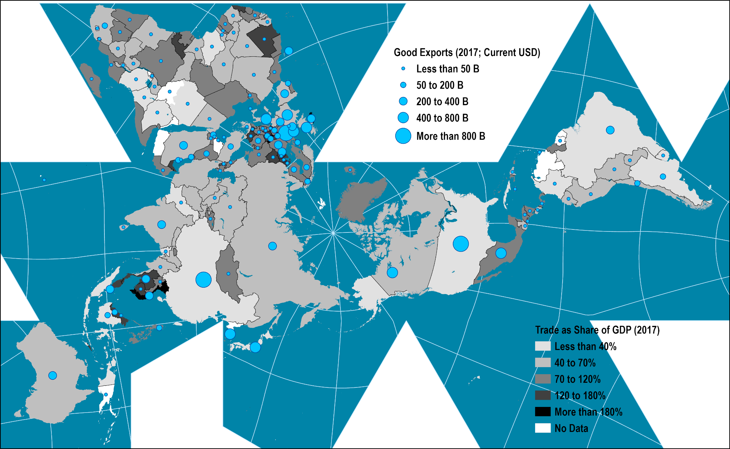
Global Trade, 2017: The Importance of the “Triad”
Read this content
Notes:
Source: World Bank.
Map location: global_socioeconomic
European Union: 5.9096
North America: 1.96712
China, Japan, Korea, Taiwan: 2.26335 + .698131 + .573694
World 17.8456

Slide 29
Share of Product Groups in World Merchandise Trade, 1900-2020
Read this content
Notes:
Source: adapted from WTO, World Trade Report 2010.

Slide 30
World’s Most Traded Goods, Lead Exporter and Concentration, 2016
Concentration Level of Top-5 Countries
Imports
Share of activity by product
Exports
Low
Concentration level
High
Read this content
Notes:
Source: Observatory of Economic Complexity, Massachusetts Institute of Technology. https://www.teletracnavman.com/infographics/top-imports-exports
OECD (2021), “Global value chains: Efficiency and risks in the context of COVID-19”, OECD Policy Responses to Coronavirus (COVID-19), OECD Publishing, Paris.

Slide 31
Share of World Goods Exports, Leading Exporters, 1950-2020
Read this content
What is the nature of the changes in global trade this graph reveals?
Notes:
Source: WTO.
https://data.worldbank.org/indicator/TX.VAL.MRCH.CD.WT

Slide 32
Global Trade Patterns
Negative trade balances
  Are negative trade balances harmful for an economy?
    Trade is not a zero-sum game.
  Positive trade balances are sought by many export-oriented nations:
    Economic growth (produce more than consume).
    Accumulation of capital (balance of payments).
  Negative trade balances:
    Can be profitable if the balance is compensated by higher productivity levels and/or cheaper goods.
    Can be negative if too imbalanced.
    Result in an accumulation of debt (financed by trade partners).
    Until this debt is defaulted on.

Slide 33
World’s 20 Largest Exporters and Importers of Goods and Services, 2018
Read this content
Notes:
Source: WTO
https://data.worldbank.org/indicator/NE.EXP.GNFS.CD

Slide 34
Monthly Trade between China and the United States, Billions of USD (1990-2021)
Notes:
Source: http://www.census.gov/foreign-trade/balance/c5700.html

Slide 35
American Foreign Trade by Maritime Containers, 2017 (in TEUs)
Read this content
Notes:
Source: Journal of Commerce.
https://www.joc.com/regulation-policy/trade-data/united-states-trade-data/tariffs-trucking-top-threats-top-100-us-importers-and-exporters_20180521.html

Slide 36
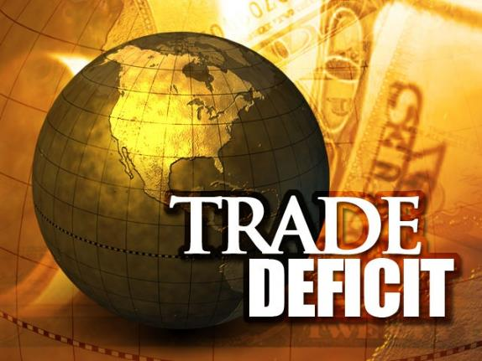
Short Assignment: American Trade Imbalances
The US trade deficit is a recurring issue. Using the last three slides as background material, explain what the main causes of American trade imbalances are.

