Slide 1
Topic 5 – China and the Challenges its Geography
A – The Chinese World
B – The Path to Chinese Development
C – Selected Problems and Issues

Slide 2
Conditions of Usage
For personal and classroom use only
  Excludes any other form of communication such as conference presentations, published reports and papers.
No modification and redistribution permitted
  Cannot be published, in whole or in part, in any form (printed or electronic) and on any media without consent.
Citation
  Dr. Jean-Paul Rodrigue, Dept. of Global Studies & Geography, Hofstra University.

Slide 3
C. Selected Problems and Issues
1. Family Planning
  What was the One Child Policy and how it impacted the Chinese society?
2. Modernization
  What are the challenges of modernization in China?

Slide 4
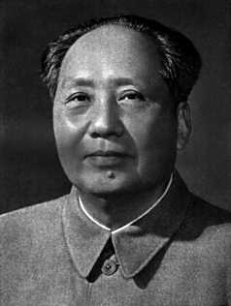
1. Family Planning
“A big population is a very good thing … even if China’s population multiplies many times, we are fully capable of finding solutions.” Mao Zedong, 1949
“With every mouth comes two hands”
“Bear as many children as possible to make China stronger.”
Notes:
Mao encourage

Slide 5
1. Family Planning
Early 1970s
  Known as the “later-longer-fewer program”.
  Authorized age of marriage 25 for men and 23 for women.
  Wait later to begin their families, allow for longer spacing in between children, and have fewer children overall.
  Began to reduce fertility levels.
  Not fast enough to really slow down population growth due to the demographic momentum that had already developed.
End of 1970s
  Government began to promote the two-child family throughout the country.
  Slogan “One is best, at most two, never a third”.
  Contributed to fertility decline but, again, not rapidly enough.

Slide 6
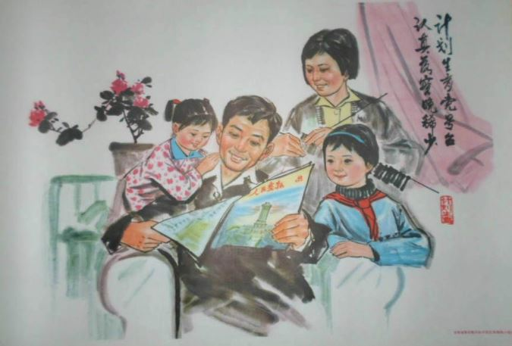
“Later-Longer-Fewer” Family Planning Program Poster

Slide 7
1. Family Planning
One Child Policy
  Launched in 1981 when the population reached 1 billion:
    Initial goal: Stabilize China’s population at 1.2 billion by 2000 (actual figures of 1.27 billion in 2000).
    Revised goal: Keep China’s population under 1.4 billion until 2010.
    Population expected to stabilize around 1.6 billion by 2030.
  Under the responsibility of the State Family Planning Commission (SFPC):
    Population control perceived from a strategic point of view.
    Employers and neighborhood committees had to enforce guidelines.
  Possible to enforce in China (totalitarian).
  Would have been impossible in most other places.

Slide 8
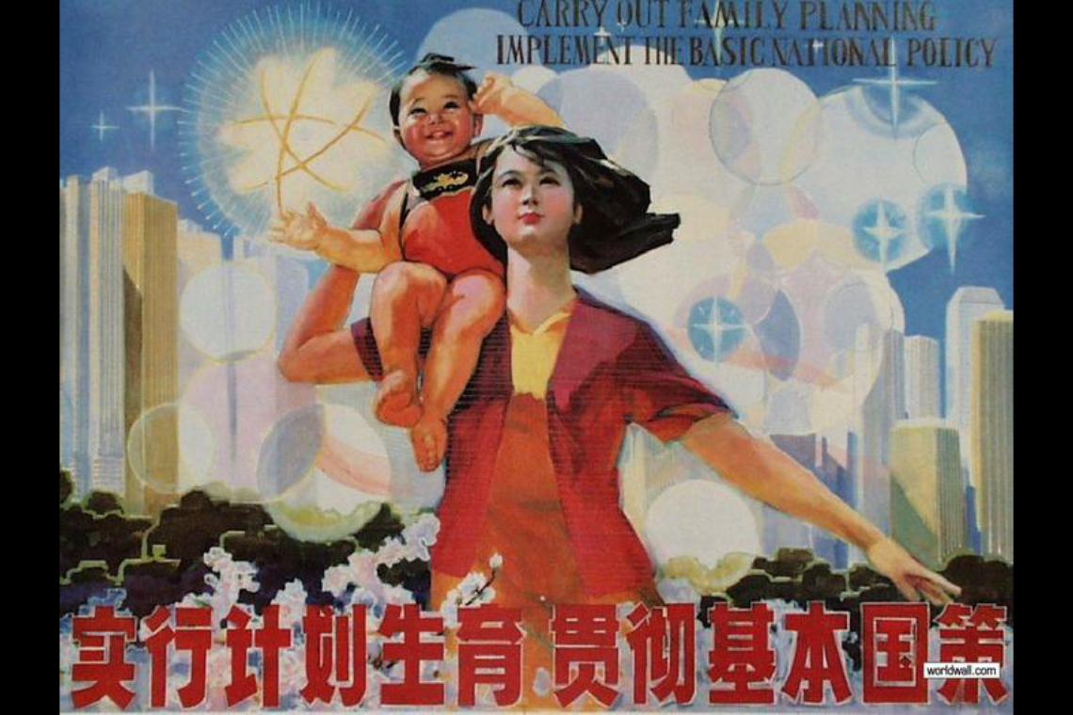
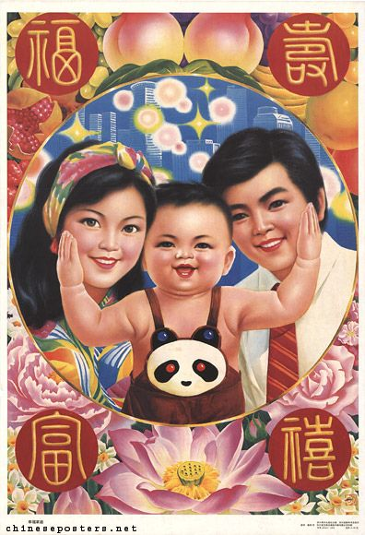
One Child Policy Propaganda Posters

Slide 9




Regulation of the One Child Policy
Authorization for marriage
25 years for male and 23 years for female.
Students and apprentices not allowed to marry.
Monitoring menstrual cycles
Monitored by the work unit.
Contraceptive use mandatory
IUD used for women with already one child.
Incentives for sterilization after the birth of the first child.
Couples with two or more children had to have one partner sterilized (women 80% of the time).
All pregnancies must be authorized
Unauthorized pregnancies had to be aborted.
7th, 8th or 9th month abortions are legal.

Slide 10
1. Family Planning
“Carrot and stick approach”
  Rewards for one child: higher wage, interest free loans, more support for retirement, priority access to housing and schooling.
  Penalties for more than one child: fines, pressure for abortion, confiscation, being fired.
Exemptions
  Rural areas (permitted a second child if first child is a girl).
  Children born outside China.
  Minorities.
  Children with disability.
  Parents in hazardous occupations.

Slide 11
1. Family Planning
Variations in performance between the country’s urban and rural areas
Urban areas
  Small sized apartments.
  Improving one’s status and level of consumption.
  Easier control from the government.
Rural areas
  Families want more children to work the family plots and sustain parents in old age.
  Want sons who will continue the family line and provide ritual sacrifices to their ancestors after they die.
  Daughters are leaving their family once they marry.
  Girls are accounting for only 20 to 30% of a new demographic class in some areas.

Slide 12
Percentage of Women Having More Than One Child, 1998
Fertility reduction
  Prevented about 400 million births between 1979 and 2011 (claimed by Chinese governments).
  When the program began (1970), Crude Birth Rate was 34 and TFR was around 6.
  Been brought down to 10 (CBR) and 1.7 (TFR).
  About 40% of Chinese women have been sterilized.
  About 5% of women have more than one child.
Notes:
Source: China Population Information and Research Center, 2000.
http://www.cpirc.org.cn/e-police3.htm

Slide 13
1. Family Planning
Fluctuations of fertility
  Fertility has declined substantially before the OCP.
  Increased from the mid 1980s to the early 1990s:
    Relaxation in enforcement in rural areas.
    In 1986, 2 children per couple were allowed in rural areas.
    In 1995, the restriction was lifted for urban areas.
    Reductions in the authority of local officials responsible for implementing the program.
  Sizeable age cohort in their reproductive years:
    Baby boom of the early 1960s (about 40% of the increase was due to this).
    A decline in the age of marriage explained the other 60%.
    Nearly 75% of this increase was offset by declines in the age-specific fertility rates.

Slide 14
Chinese Fertility Rate, 1949-2021
Notes:
Source: China Population Information and Research Center, 2000. WHO. World Bank Data.
https://data.worldbank.org/indicator/SP.DYN.TFRT.IN

Slide 15
1. Family Planning
Imbalanced sex ratio
  Male children are more valued.
  1995: 120 boys for 100 girls (national average).
  2007: 117 boys for 100 girls.
  2015: 115 boys for 100 girls.
  2021: 110 boys for 100 girls.
  Global rate of 105 boys for 100 girls.
  Abandon or abortion of females:
    11 million abortions a year (in 2000s); 1 out of 2 live births.
  “Missing female population” as girls are not declared.
  2000: About 900,000 girls were missing (0 to 4 years group).
  Only 1% of females are unmarried by the age of 30.

Slide 16
1. Family Planning
Psychological consequences
  Currently around 70 million single children.
  Most children with no sisters/brothers or aunts/uncles.
  4-2-1 syndrome (4 grandparents – 2 parents – 1 child):
    “Little emperors” or “little empresses”.
    Self-centrism.
    Pressure to succeed.
Impacts on social relations
  Significant rise in child abandonment and abduction during the One Child Policy.
  Abandoned children were girls and the majority of abductions were boys.
  Limited expectations for children to take care of parents/grandparents (inverted support system).
  “Four grandparents policy” induces even higher savings levels.

Slide 17
Males minus Females per Age Cohort, China, 2000
Notes:
Source: US Census Bureau, International Database

Slide 18
1. Family Planning
Government’s response du gender imbalances during the one child policy
  Well aware of the situation, but limited range of options.
  Laws giving girls and women equal rights with males.
  Propaganda and consciousness-raising slogans about the equal value and contributions of females and males.
  Laws outlawing infanticide, prenatal sex identification, and sex-selective abortion.
  Policies in most provinces allow rural couples to have two children, or a second child if the first is a girl.

Slide 19
1. Family Planning
The Population and Family Planning Law
  One-child policy was “a policy for one generation”.
  Relaxed in the mid 1980s: 2 children permitted in rural areas.
  A new family planning law introduced in 2002.
  Same goal as the One-child policy, but offer more flexibility:
    One child, but permission may be granted for a second under specific circumstances.
    Late marriage and childbearing.
    More flexibility for provinces, autonomous regions and minorities.
    People of reproductive age must use contraception.
    Provisions for sex-determination and sex-specific abortions.
  One Child Policy formally abandoned in 2015.
  In 2021, the government started encouraging young families to have 3 children.
    “High home prices, heavy education costs and the impenetrable class hierarchy are the best contraceptives at the moment”.
10 China's One-Child Policy Facts

Slide 20
Chinese Live Births, 1950-2022
The One Child Policy is one of the most extensive population control attempts in history. Explain its causes, methods and consequences.
2 Children in Rural Areas
Great Leap Forward
One Child Policy
End of One Child Policy
Enforcement Gap
Demographic Echo (25 years)
3 children incitement
Notes:
Source: National Bureau of Statistics.

Slide 21
2. Modernization
Why modernization is so important for China and provide some examples.
The appeal of modernization
  For the last 500 years, China developed an inferiority complex:
    Decline of China’s status as a global power.
    Humiliation by foreign powers (e.g. Opium Wars, Japanese invasions).
    Collapse of the imperial government (1912).
  Strong pressure to portray China as a modernizing nation.
  Large investments in grandiose projects:
    Largest dam; Three Gorges Dam (2005).
    Largest shopping mall; The South China Mall.
    Highest railway in the world (Tibet).
    First maglev train in Shanghai (2003).
    Space program; First Chinese in space (2003); spacewalk (2008); space station (2021-2022).
    New international airports (Beijing, Shanghai, Guangzhou).
    2008 (Summer), 2022 (Winter) Olympics.
    High-speed rail (2008).
    Belt and Road Initiative (2013).

Slide 22
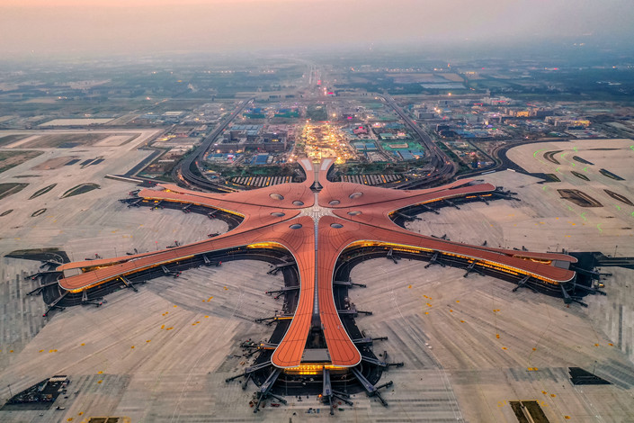
Beijing Daxing International Airport (Opened in 2019)

Slide 23
2. Modernization
Development of the telecom market
  Easier and cheaper to switch to the latest technology.
  World’s largest mobile phone market:
    From 376 million cell phone subscribers in 2005 to 1.1 billion in 2018.
    Chinese telecom companies such as Huawei are becoming among the world’s largest.
  World’s largest online user:
    21% of the world’s internet users.
    73% of the population uses the internet.
    Surpassed 1 billion users in 2021.
  Using the internet as a tool for social control:
    The “Great Firewall of China”.
    Social credit system.
    Surveillance of online behavior.
    A large ecosystem of online influencers.

Slide 24
Chinese Internet Market, 2000-2021
Notes:
Source : https://www.internetlivestats.com/internet-users/china/

Slide 25
2. Modernization
Industrial development problems
  Pulling millions of Chinese out of poverty.
    Justifies any policy and project.
    Inequality is rising.
  Industrial overcapacity:
    Over investments.
    Over supply of consumption goods, driving prices down.
    Limited profits.
  Quality issues:
    Counterfeited and fake goods.
    Several companies are starting to move away from China.
  Rising labor and transportation costs.

Slide 26
2. Modernization
The “business environment”
  The rule of law is not well applied.
  State enterprises and cronyism.
    Government contracts and support.
  Corporate fraud:
    Exaggerated sales figures (to boost stock prices and compensation).
    Fake products (small businesses).
  Abuses and racketing:
    Local government seizing and selling land to special interests.
    Different price systems.
  Good Guanxi enables to bend most of the rules.

Slide 27
2. Modernization
Environmental degradation
  Limited attention placed on the protection of the environment.
  Development is a priority over the environment.
  Serious degradation of environmental conditions.
  Air pollution:
    China is the largest CO2 emitter in the world (30% in 2020).
    60% of the energy supplied by coal.
    16 of the world’s 20 worst polluted cities.
    2/3 of Chinese cities have pollution levels well above national criteria.
    75% of the urban population suffering from health problems.
  Water pollution:
    20% of rivers in China are severely polluted.
    80% cannot sustain commercial fishing.
  Energy efficiency issues.

Slide 28
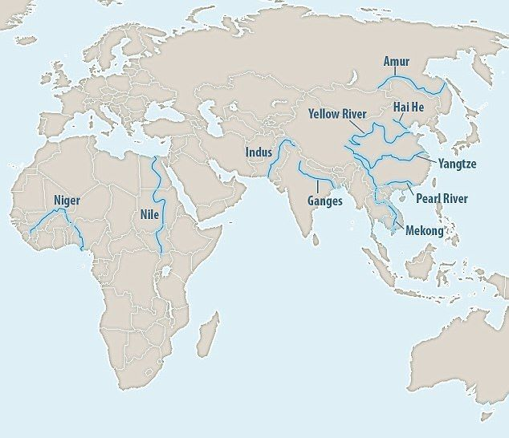
Ten Rivers Accounting for 95% of River Plastic Oceanic Releases
Notes:
Source: Scientific American.
https://www.scientificamerican.com/article/stemming-the-plastic-tide-10-rivers-contribute-most-of-the-plastic-in-the-oceans/

Slide 29
Share of CO2 Emissions, 2018-2020
Notes:
Source: https://www.statista.com/statistics/271748/the-largest-emitters-of-co2-in-the-world/

Slide 30
2. Modernization
Counterfeiting and intellectual property
  The world’s largest producer of counterfeited goods (about 62%).
  A large “industrial subsidy”.
  Failure to protect intellectual property rights.
  Technological expropriation:
    Copy a well-known product without paying any royalties or R&D costs.
    Copy a technology or production technique and use it to compete on global markets.
  Illegal copies:
    Apparel and luxury goods (social status).
    Electronics (10% of smartphones are counterfeit).
    Pharmaceutical products.
    Media (movies, music and software).
    Toys.
We Went To The Fake Sneaker Capital Of China (HBO)

Slide 31
2. Modernization
Speculation
  Short term perspectives of investments.
  Real estate, not production, is the favored sector:
    Real estate development as the dominant source of municipal government revenue.
    Oversupply of office space and residential housing in many cities.
    Vacancy rate of more than 25%; large non-performing assets.
    Real estate becomes speculation based solely on appreciation (not rent seeking).
    Large real estate projects for a customer base that does not exist.
    Most people’s assets are in real estate.
    Poor quality of several construction projects (“Tofu dreg” projects).
  Stock markets:
    Limited investment tradition and low level of education of shareholders.
    The notion of “investment” is not well understood (perceived as a “sure-winning” lottery.
    The stock market has been declining due to low profits, until 2006.
    Bubble of 2006-2007; and then a crash (70% drop in 2008).
Why 50 Million Chinese Homes are Empty

Slide 32
Number of Foreclosures in China
Notes:
Source: Bank of China

Slide 33
Shanghai Composite Index, 2000-2023 (Monthly)
Notes:
Source: https://finance.yahoo.com/quote/000001.SS?ltr=1

Slide 34
2. Modernization
Consumerism
  Symbol of modernity and social status:
    Mass consumption and mass media created needs while the employment market offered limited opportunities to many.
    Access to new sources of information providing a globalized culture.
    Mass media is new to China and there is no tradition of consumer behavior.
  Development of Western consuming behavior:
    Fashion and beauty products.
    Weddings.
    Christmas (the consumption segment of it).
    New housing complexes and home decoration.
  Emergence of a middle class:
    A fast rise.
    About 150-200 million in 2010.
    About 400 million in 2018.
    A tool of social change, but also instability.

Slide 35
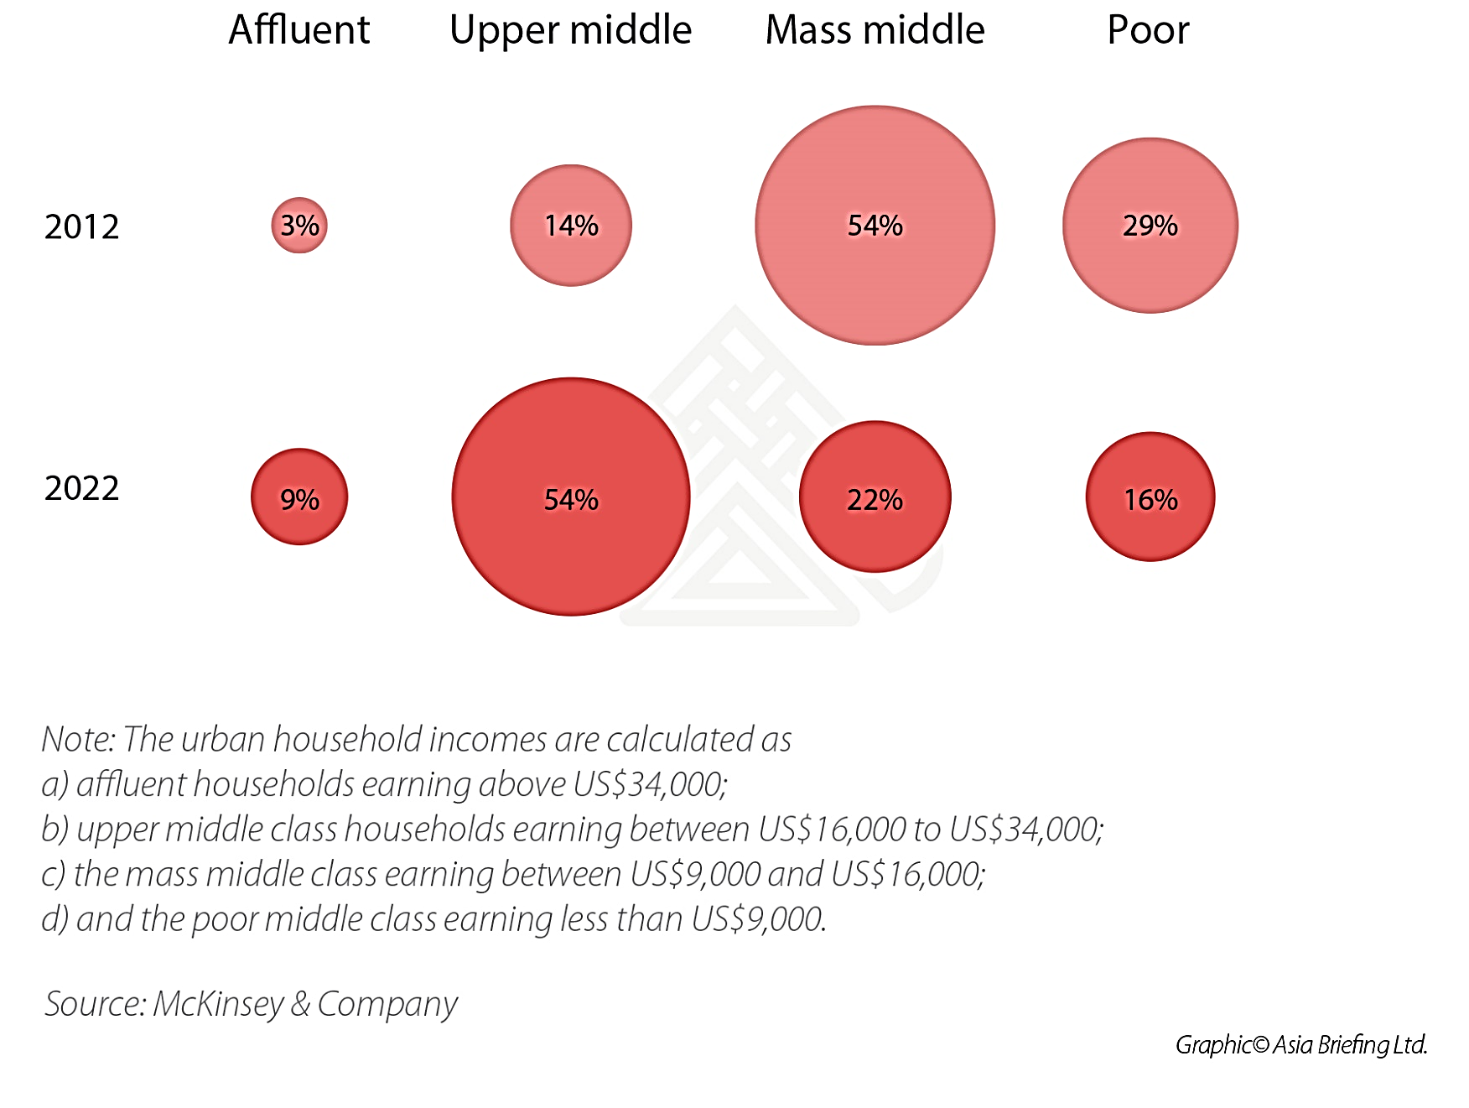
Distribution of Urban Households Incomes
Notes:
Source: McKinsey.

Slide 36
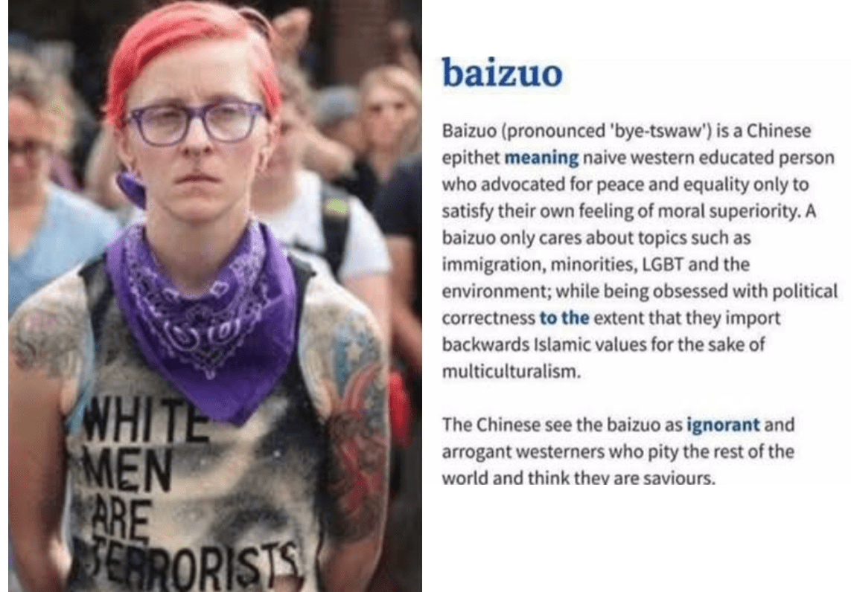
2. Modernization
Baizuo (White Left/Woke)
  Growing level of contempt towards the West, particularly progressivism (+ LGBTQ+).
  A critique of Western standards that discriminate against Asians (e.g. university admissions).
  Mostly based on China’s experience with Marxist ideology and the associated identity politics.
  Lessons from the Cultural Revolution (Cultural Marxism).

Slide 37
2. Modernization
E-commerce in China
  Largest e-commerce market in the world (3 times the size of the US market).
  E-commerce accounted for 24.6% of retail sales in 2020.
  High smartphone penetration used for transactions:
    80% of all purchases generated from mobile phones.
    One of the world’s highest share of mobile payments (80%).
  Conventional retail infrastructure lacking in smaller urban centers.
  High population densities.
  Rising cost of labor and retail rents makes conventional retail less competitive.
  Cross-border e-commerce allowed:
    E-commerce providers allowed to sell several types of foreign goods.
    Access to genuine goods and brand names.
    Domestic manufacturers and retailers allowed to sell on foreign e-commerce platforms such as Amazon.
    AliExpress the most popular (owned by Alibaba).

Slide 38
2. Modernization
China’s high-speed rail system
  Political support and lower construction and operating costs (scale).
  Network of large cities.
  Urban corridors (cities less than 1 hour apart; faster than air).
  Constraints in the capacity of air transportation.
  Some lines in remote areas designed for political purposes (Xinjiang, Tibet).
  Using viaducts:
    Lessen the rail footprint (50% less).
    Lower constructions costs.
    Accelerate construction time.
    90% of the Beijing-Tianjin line above ground.
    Danyang-Kunshan Bridge (165 km in Jiangsu province; 2011) is the longest in the world; part of the high-speed rail link between Beijing and Shanghai.
  Now offers express package delivery services.
  Massive debt and operating losses.

Slide 39
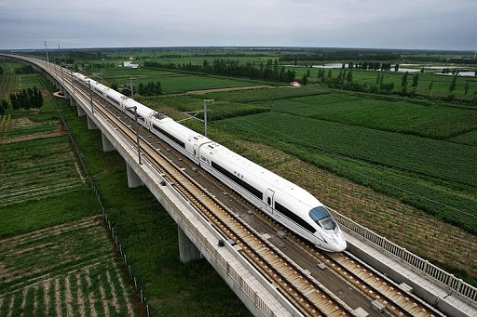
Elevated High-Speed Rail Section

Slide 40
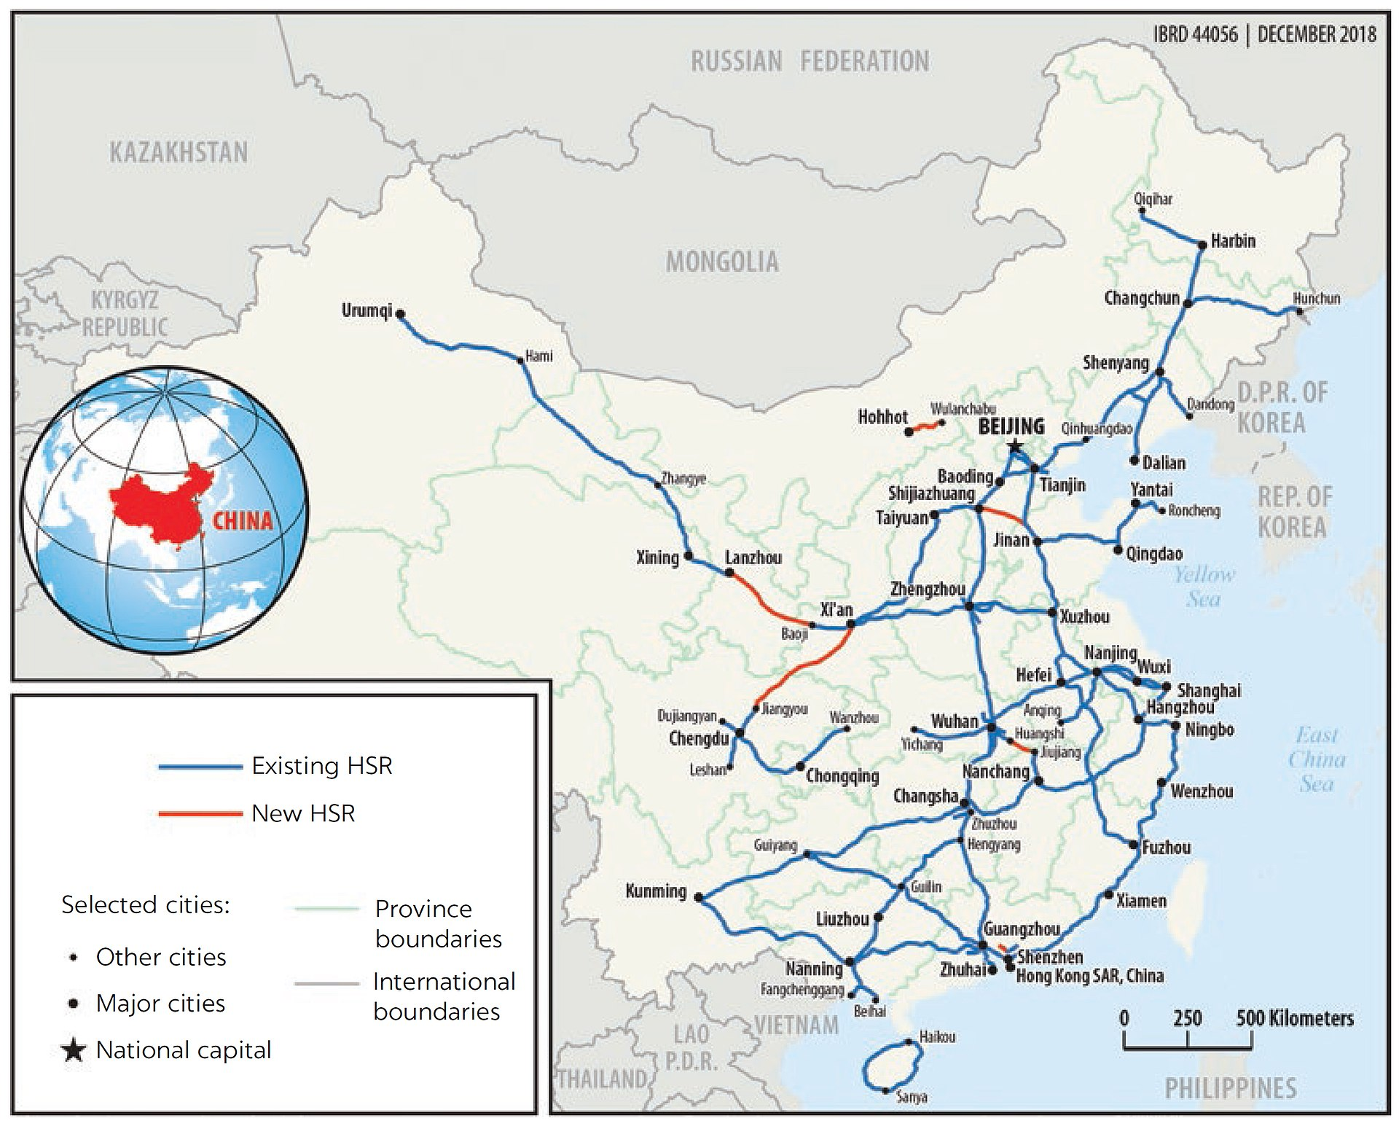
Why China Is so Good at Building Railways

Slide 41
2. Modernization
China and pandemics
  Many infectious diseases and epidemics originate from China.
    Plague (bacteria) and flu (virus).
  Large rural and urban populations.
  Proximity to pigs, cows, water buffalo, and chickens.
  Paddy fields.
  Internal and external trade networks (Silk Road).
Antiquity pandemics
  (1st and 2nd centuries).
  Opening of the first durable trade relations across Central Asia.
  Epidemic diseases from Asia spread into the Roman world.
Middle Ages pandemics
  Justinian Plague (6th Century) (25 to 50 million killed).
  Black Death (14th century) (75-200 million killed).
Notes:
Bacteria are one-celled organisms that can be found throughout the environment.
Viruses cannot live without a host, or another living creature to help them multiply. Viruses are smaller than bacteria and they attach themselves to another living cell and use that cells' genetic material to reproduce themselves.

Slide 42
2. Modernization
Why China has a close association with pandemics and provide some examples?
Contemporary pandemic situation
  Spanish Flu (Asian origin uncertain; 20 to 50 million deaths).
  Asian Flu (1957) (1 to 2 million deaths).
  Hong Kong Flu (1968) (1 million deaths).
  SARS (Severe Acute Respiratory Syndrome 2002-2003):
    Originated in Guangdong province.
    8,500 people infected (5,300 in China). 800 deaths (350 in China).
  African Swine Fever (2019-20):
    Killed two-third of the pork herd.
    Soaring pork prices (3 times the early 2019 price).
  Coronavirus Pandemic (2020-22; Above 6.2 million deaths):
    Began in December 2019 in Wuhan.
    High connectivity (land and air) aided quickly spread the disease around the world.
    The standard approach of the government is to try to cover up epidemics.
    Closed system blocked the flow of information and thwarted the spontaneous alarm systems that open societies have.

