Slide 1
Topic 5 – China and the Challenges its Geography
A – The Chinese World
B – The Path to Chinese Development
C – Selected Problems and Issues

Slide 2
Conditions of Usage
For personal and classroom use only
  Excludes any other form of communication such as conference presentations, published reports and papers.
No modification and redistribution permitted
  Cannot be published, in whole or in part, in any form (printed or electronic) and on any media without consent.
Citation
  Dr. Jean-Paul Rodrigue, Dept. of Global Studies & Geography, Hofstra University.

Slide 3
B. Chinese Development
1. Rural Development
  What is the structure and challenges of Chinese agriculture?
2. Urbanization
  What is the nature and extent of urbanization in China?
3. Industrialization
  How China was able to industrialize?
4. China and the Global Economy
  How is China becoming a leading element of the global economy?

Slide 4
Challenges for Chinese Agriculture
Challenge | Issues
Agricultural productivity | Consolidation of agricultural plots (economies of scale); Better irrigation; Appropriate storage and transport
Agricultural output | Coping with population growth (10 million per year); Coping with changes in the Chinese diet (more meat)
Urbanization, industrialization and transport | Decreased agricultural land in the most productive areas; Development (land use changes) around cities.
Environmental degradation | Contamination of soils and water supply.
Food security | Half the world’s pig population (Swine fever crisis of 2019).
Dependency | China is a net importer of grain; Finding reliable suppliers.
Notes:
China has not much applied techniques learned during the “green revolution”. 65% of all the water used for irrigation is lost. Putting this ratio only to 50% could increase water resources by 40% without taping on new sources. Approximately 25% of the grain is lost due to improper warehousing and transport infrastructure (eaten by rodents). Farm size is too small (less than 1 hectare per household in coastal areas).

Slide 5
Production and Yield of Paddy Rice in China, 1961-2021
Notes:
Source: FAO Database. www.fao.org

Slide 6
Production and Yield of Wheat in China, 1961-2021
Notes:
Source: FAO Database. www.fao.org

Slide 7
Meat Production, United States and China 1961-2021 (in tons)
African Swine Fever
Why a Third of China’s Pigs Are Dying
Notes:
Source: FAO Database.
https://ourworldindata.org/meat-production

Slide 8
1. Rural Development
Rural-Urban Migrations
  Conventional situation:
    China fixed its population to its place of work and residence.
    Food tickets were only valid at the place of residence.
    Residence permit necessary to obtain food (permit not transferable).
  New situation:
    Possible to transfer the residence permit if a sum is paid.
    Food and housing can be available on the private market.
    Surplus labor in the countryside moved to cities in order to occupy low wages jobs (construction, manufacturing and services).
    Migrants around 100-120 millions (about 10% of the population).
    20% of agricultural workers take at least of month off per year to work outside the farm.
    About 250-300 million peasants have left the countryside by 2010.

Slide 9
2. Urbanization
Urbanization concern
  Historically underrepresented:
    Most of the labor in the countryside.
    Communist policies prevented urbanization.
    Urbanization accelerated only after 1978.
  Fast urbanization.
  32% urbanization level (2000), or 452 million urban residents.
  New urban residents:
    Between 1990 and 2000: 152 million.
    Between 2000 and 2010: 205 million.
    Between 2010 and 2018: 165 million.
  50% reached in 2011.
  60% reached in 2019.
  Urbanization occurred at the expense of highly productive agricultural areas.
Notes:
Source: United Nations, World Population Prospects, 1999.

Slide 10
Urban and Rural Population in China, 1961 - 2022
Notes:
Source: World Bank
https://data.worldbank.org/indicator/SP.RUR.TOTL
https://data.worldbank.org/indicator/SP.URB.TOTL

Slide 11
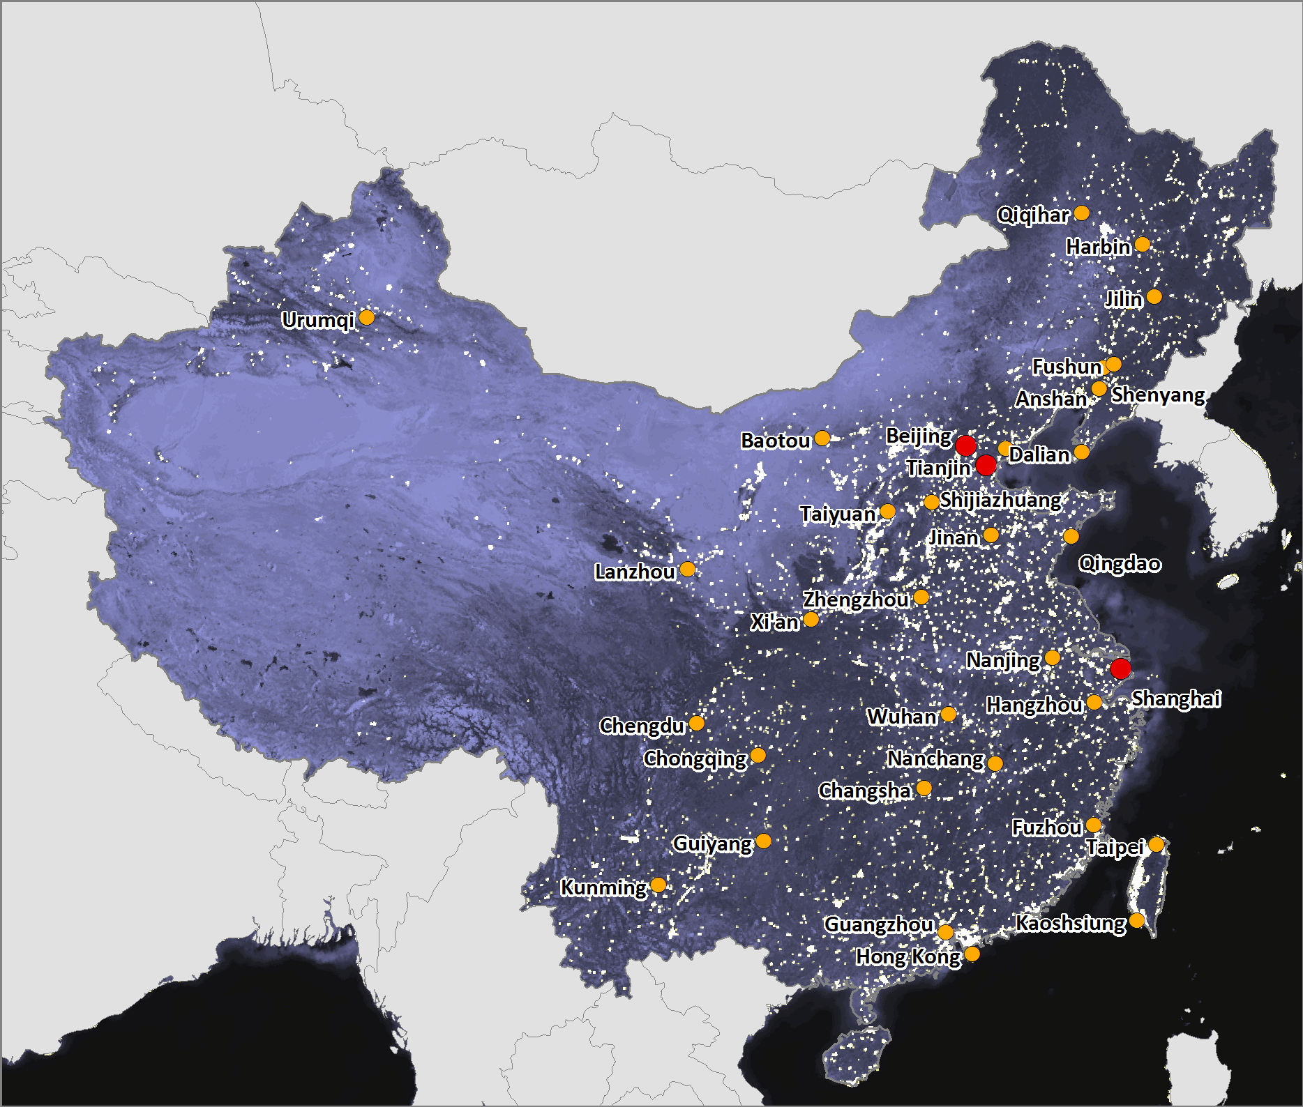
2. Urbanization
Beijing
The political center.
Imperial capital transformed into a national capital.
Shanghai
The head of the dragon (Yangtse).
The industrial center.
The new financial center.
Gateway to Central China.
Guangzhou
Old commercial city.
New industrial center (Pearl River Delta).
Gateway to South China.

Slide 12
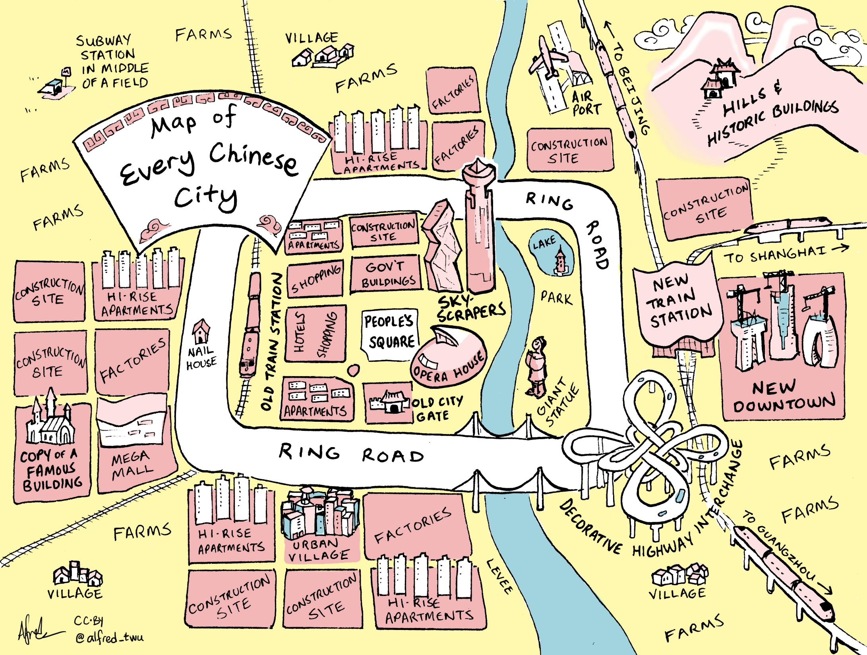

Slide 13
3. Industrialization
Urban industrial economy (1950-1980)
  Creation of vast administrative units.
  The work unit (Danwei):
    In industry, services and administration.
    Controlling the population through geographical fixation.
    Stability and material security provided.
  Workers class is the outcome of the communist government:
    Regrouping of labor in industrial units.
  Employment was guaranteed for life:
    Employees have a set of social benefits.
    Health, retiring, housing, education, vacations, preferential prices on food.
    Transmission of the job to a member of the family.
    Promotions were done by the social position and respect of ideology.
    Having a job in a State enterprise was to possess an “iron rice bowl”.

Slide 14
3. Industrialization
Open Door Policy and economic development (1980-)
  Employment problems:
    Increasing since the 1960s because of demographics.
    The State sector was not capable to absorb all the new workers.
    Inefficiency of the State sector with diminishing returns (classic central planning conundrum).
  Collective and private enterprises:
    Growth occurring in the labor-intensive light industrial sector.
    Private enterprises account for growing share of the industrial output.
  Growth factors:
    Large capital investments (domestic savings and foreign investments).
    Rapid productivity growth (implementation of foreign technologies).
  1978-2015: 850 million Chinese have been lifted out of absolute poverty.
  The poverty line is $350 per year (low cost of living in many parts of China).

Slide 15
4. China and the Global Economy
Integration to the global economy
  Economic growth is mainly driven by exports:
    China contributed to 20 to 25% of the world’s GDP growth.
    With no welfare state, no labor unions and an enormous supply of both labor and savings, “communist” China is a capitalist's paradise.
  Lessons from the past:
    Each time China opened to the outside; a period of relative prosperity resulted.
    Each time China closed to the outside world (e.g. the Great Leap Forward and the Cultural Revolution) was a period of instability.
  The CCP is embracing this form of development:
    Insuring improvements in the population’s welfare.
    Insuring the growth of the economic power of China.
    Insuring technological development.
    Insuring their own survival / legitimacy.

Slide 16
4. China and the Global Economy
Growing consumption of resources
  Economic growth has increased China’s consumption of resources:
    “The Dragon is hungry”.
    Second largest consumer of oil after the United States.
    Energy supply problems with increasing blackouts.
    Completion of a natural gas pipeline in 2004 (Tarim Basin to Shanghai).
    Belt and Road Initiatives building energy pipelines to Russia.
  Driving up global commodity prices:
    Increased global competition caused by China.
    China has become a large buyer of resources.
    Fear that China may “export inflation”.
  China may hit a “resource wall” inhibiting future developments.

Slide 17
Share of the World Commodity Consumption, China and United States, c2020
Notes:
Sources: United States Geological Survey, BP Statistical Review of World Energy, Food and Agriculture Organization of the United Nations, International Monetary Fund, United States Department of Agriculture.
http://www.fas.usda.gov/psdonline/psdHome.aspx

Slide 18
Crude Oil Production and Consumption, China, 1965-2020 (in 1,000 of barrels per day)
Notes:
Source: BP Statistical Review of World Energy.

Slide 19
4. China and the Global Economy
Growth of international trade
  Tremendous growth of China’s involvement in international trade over the last 25 years.
  Exploitation of comparative advantages.
  Export oriented (neo-mercantilist) “strategy”:
    China is the world’s largest exporter.
    Exports account for 40% of the GDP while this share was 5% in 1978.
    90% of exports are by foreign-owned factories.
  United States:
    Most important trading partner.
    Account for 40% of China’s exports and 10% of its GDP.
    American corporations benefit tremendously from low costs.
  The European Union the second.
  Japan the third.

Slide 20
Monthly Trade between China and the United States, Billions of USD (1985-2022)
Notes:
Source: http://www.census.gov/foreign-trade/balance/c5700.html

Slide 21
4. China and the Global Economy
Shifts in international trade
  Decrease of raw materials:
    From 50% of exports in 1985 to 15% in 1995 to 2.5% in 2005.
  Increase in manufactures:
    97% of the value of exports.
    Consumption goods (shoes, toys).
    Textiles and clothes.
    Furniture.
    Low level electronics.
  Energy and raw materials imports.

Slide 22
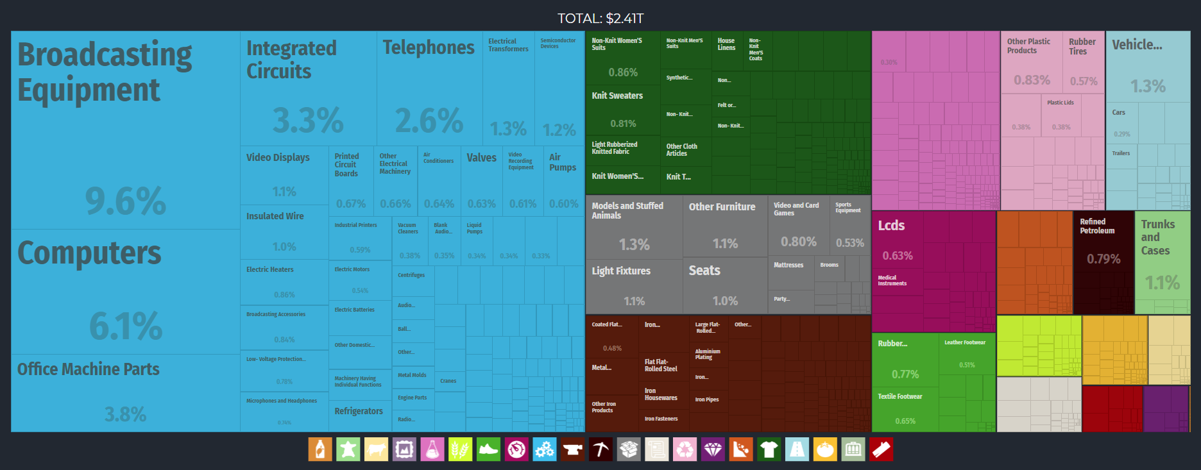
China Export Treemap, 2017
TEXTILES
PLASTICS
MISC
MACHINES
INSTRUMENTS
METALS
FOOTWARE
Notes:
Source: Economic Complexity Observatory, MIT Media Lab and the Center for International Development at Harvard University.
https://oec.world/en/profile/country/chn/

Slide 23
4. China and the Global Economy
World dominance in manufacturing
  Two processes:
    Addition of new manufacturing activities either the outcome of FDI or internal investments (modern facilities).
    The closing down of many manufacturing activities, mainly the outcome of Chinese competition and/or comparative advantages.

Slide 24
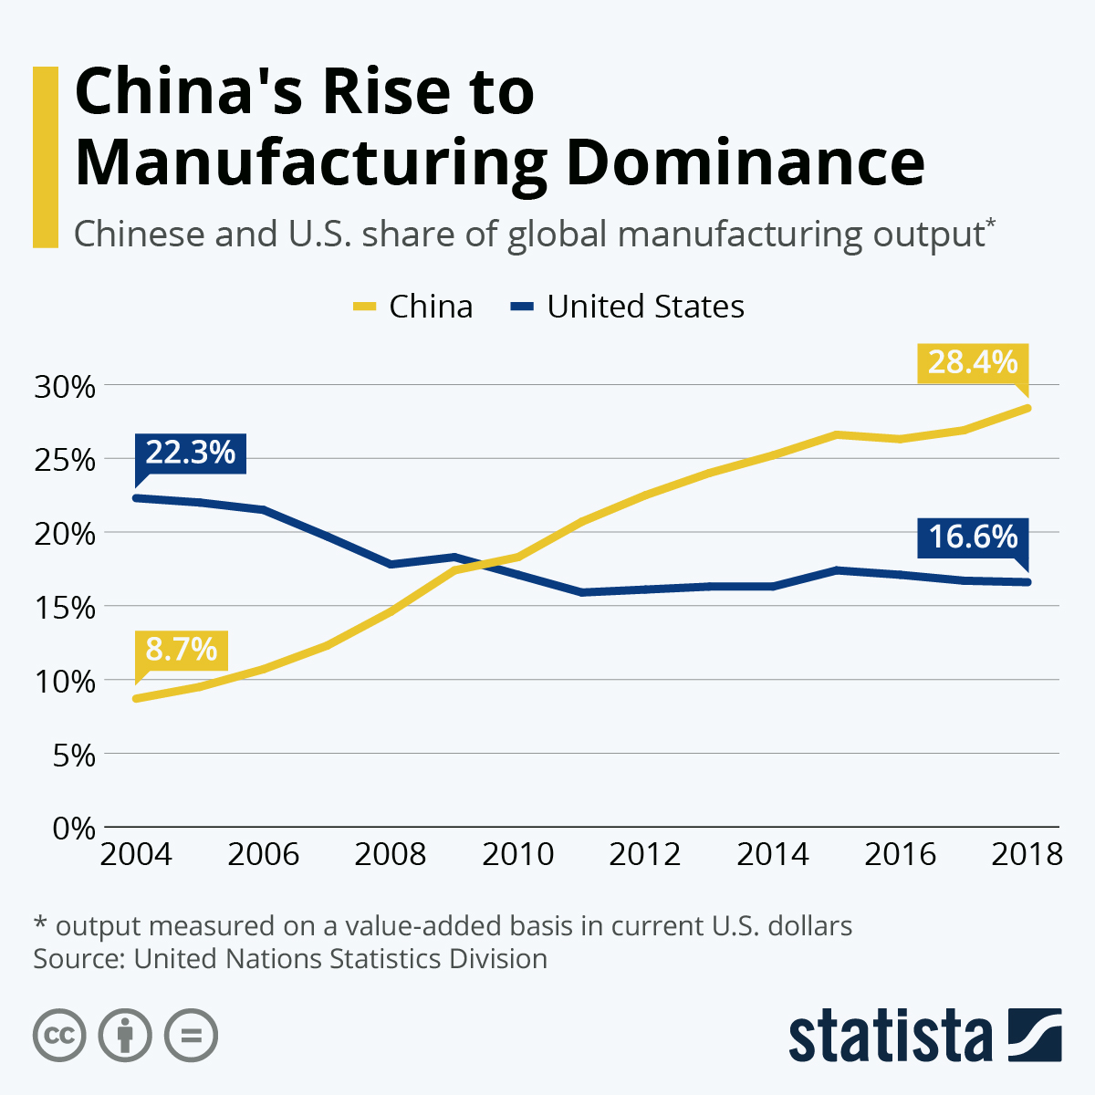
Share of World Manufacturing Accounted by China

Slide 25
4. China and the Global Economy
Labor issues
  China supplies a gigantic quantity of labor.
  Constant flow from the interior (poorer provinces).
  Often woman to work in factories for about 3 years.
  Come back to their villages/towns to marry or start businesses.
  Flows of capital that is used for familial capital investments (housing, agriculture).

Slide 26
4. China and the Global Economy
Wages
  Low wages that were kept low because of rural to urban migration and population growth.
  The rest of the developed world could not compete.
  Many factories offer room and board as part of employment package.
  By 2015 the Chinese wage advantage was eroded.
  Inflationary pressures having an impact on wages:
    Rising cost of living in manufacturing (coastal) regions.
    Rising energy and food prices.
    The same basket of goods can be as expensive in China as in the United States.
    Relocation of some manufacturing activities in Vietnam.

Slide 27
Average Monthly Wages for China, Mexico and Vietnam, 1990-2018 (in USD)
Notes:
Source: Economist Intelligence Unit

Slide 28
4. China and the Global Economy
Mechanisms for opening to the outside world
  Rely on extraterritoriality and Foreign Direct Investments (FDI).
  Gain capital and investment.
  Using the Chinese diaspora:
    Chinese living abroad with substantial business experience.
    About 75% of FDIs initially came from Hong Kong and Taiwan.
    Facing high wages, high land values and scarcity of available space for development.

Slide 29
4. China and the Global Economy
FDI Phases
  1st phase (1978-1995):
    Labor-intensive / low technology sectors.
    Comparative advantages of China.
    China received 4.1% of the world’s FDIs in 2000 (ranked 6th).
    Often used to develop joint ventures / subcontracting.
  2nd phase (1995-):
    Shift towards added value goods is observed.
    Basic to intermediate electronics (keyboards, mice, etc.).
    An expertise in many sectors has been developed.
    Integration in global commodity chains.
    World’s largest manufacturer of consumer electronics.
    About half of the world's DVD players were made in China.
    Emergence of a knowledge industry.

Slide 30
Value of Chinese Exports and FDI, 1983-2020 (Billions of $US)
Read this content
Notes:
Source: WTO and UNCTAD.

Slide 31
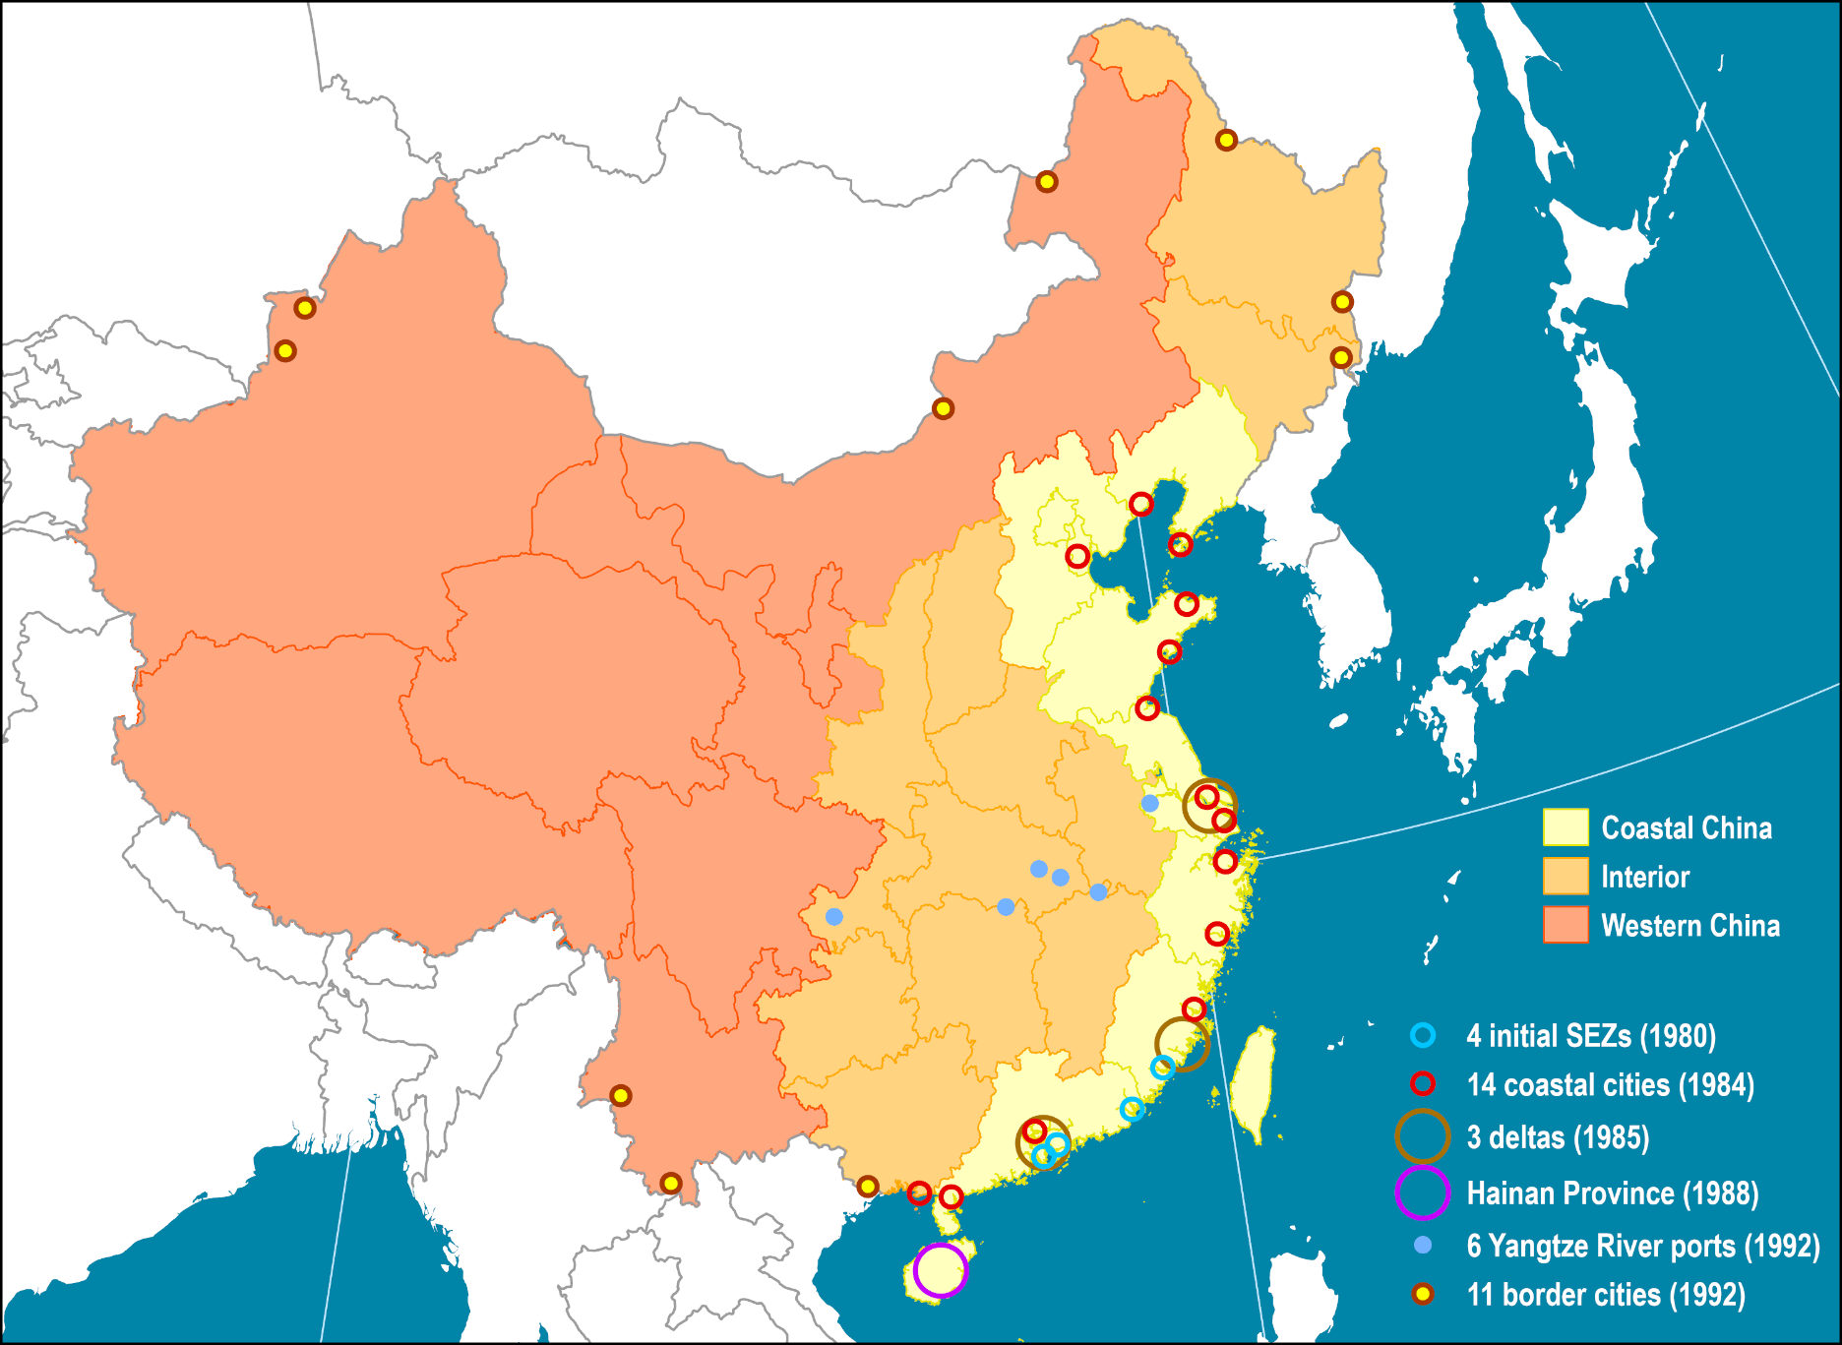
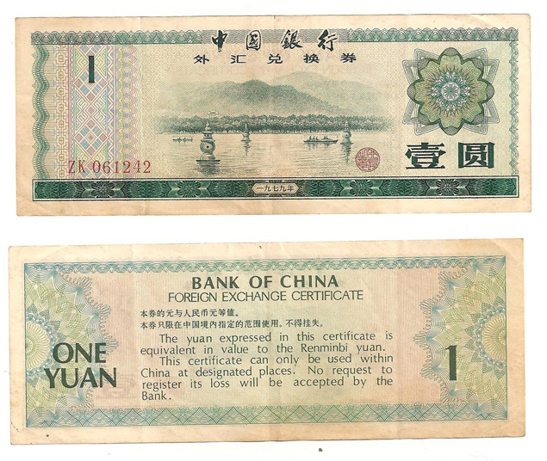
China’s Special Economic Zones
Read this content
Zones in which laws are different from China’s economic laws.
The goal is to increase foreign investments.
Subject to a different taxation regime; little or no taxes on exports
Foreign Exchange Certificate
(1980-1994)
Notes:
Source: adapted from World Bank (2009) World Development Report 2009: Reshaping Economic Geography.
Map location: china

Slide 32
4. China and the Global Economy
Purchase of foreign assets
  Accumulation of gigantic foreign reserves.
  Recycling income from exports.
  Initially involved mainly in T-bills and debt instruments.
  Move to secure strategic resources:
    Oil, mines, lumber, food supply.
    Chinese presence in Latin America, Africa and Southeast Asia.
  Purchase of foreign technology and brand names:
    Lenovo acquired IBM personal computing division (2004).
    Little known Chinese manufacturers seeking an international recognition.

Slide 33
Acquisitions by Chinese Oil and Gas Companies, 2008-2009
Year | Company | Acquisition | Value ($ billion)
2008 | Sinopec | 60% of AED Oil Ltd, Australia | 0.56
2008 | CNOOC | 100% of Awilco Offshore | 2.5
2008 | Sinopec | 100% of Tanganyika Oil, Syria | 1.8
2009 | Sinochem | 100% of Emerald Energy, Syria and Columbia | 0.88
2009 | CNOOC, Sinopec | 20% of Angola’s Bloc 32 from Marathon Oil | 1.3
2009 | Sinopec | 100% of Addax Petroleum, Calgary | 7.2
2009 | CNPC, PetroChina | 96% of Singapore Petroleum | 2.0
2009 | CNPC, KazMunaiGaz | 50% of MangistauMunaiGaz, Kazakhstan | 3.3
2009 | CNPC, PetroChina | 60% of Athabasca Oil Sands, Mackay River, Dover Projects, Canada | 1.9
Notes:
Source: FACTS Global Energy

Slide 34
4. China and the Global Economy
Trade and tourism
  Very difficult for a Chinese to go outside China prior to 2001.
  Closed under communism (1949-1978):
    Only 210,000 Chinese people could go abroad.
    About 7,000 a year.
    Mainly diplomatic personnel.
  Open door (1979-1985):
    50,000 per year in the 1979-1985 period.
    Students and trade personnel.
  Economic reforms (1986-2001):
    18.1 million people were approved to go outside China.
    Average of 1.13 million annually.
    Mainly for educational and business purposes.

Slide 35
4. China and the Global Economy
  A maturing industry (2001-2020):
    Emerging middle class allowed to travel with a visa.
    Proximity effect.
    30-50% go to Hong Kong or Macao.
    Travel mostly organized as scheduled tour groups.
    Europe the most popular foreign destination.
    100 million outbound tourists benchmark surpassed in 2014.
  Covid-19 (2020-):
    Inbound and outbound tourism stopped.
Wealth migration
  Very rich leaving the country to gain foreign citizenship.
  Protection of assets, quality of education, more than one child (during the One Child Policy).
  Some are corrupt public officials (offshoring embezzled money).

Slide 36
Outbound Chinese Tourists (millions)
Notes:
https://www.travelchinaguide.com/tourism/2019statistics/

Slide 37
4. China and the Global Economy
Over optimistic views on China?
  Analogies with Japan during the 1980s.
  National inequalities (civil unrest).
  Belief that the central government is the core driver of economic growth.
  Over dependence on foreign markets for exports:
    Incite protectionist forces.
    Low profit margins (less than 5%).
  Large misallocations of capital (export based / real estate).
  Large debt by state enterprises:
    Non-performing loans.
    Fiscal irresponsibility.
    Little profits in spite are massive investments.
  The Yuan is a fiat currency like many others:
    Money printing (inflation) by the government is rampant.
  De-industrialization of some manufacturing clusters.
China is playing a growing role in the global economy. Using examples discussed in class, provide an overview of these roles and the related challenges.

Slide 38
The Path to Chinese Development
1953-1957: First 5-Year Plan
  Boost industrialization.
  Steel production grew four-fold in four years.
  Agricultural output rose.
1958-1962: Great Leap Forward
  Emphasized rural to industrial transformation.
  Communal farming system.
  Failed, causing an economic breakdown and the deaths of tens of millions.

Slide 39
The Path to Chinese Development
1980-1984: Special Economic Zones (SEZs)
  Major economic reforms.
  Several coastal cities were designated as open to foreign investments.
  Tax incentives to attract foreign investment.
  SEZ like Shenzhen have grown to rival the GDP of entire countries.
1981: National Household Responsibility System
  Agricultural production given back to individual families (as opposed to the collective).
  Lifting of quotas and setting of market forces.
  Increased the standard of living of many farmers.
  Led to de-collectivization in other sectors such as manufacturing and retail.

Slide 40
The Path to Chinese Development
2013: Belt and Road Initiative
  Ambitious plans to develop road, rail, and sea routes across central Asia.
  Setting of trade corridors to improve access to foreign markets.
2015: Made in China 2025
  Transition from low to high added value goods.
  Leaving behind the world’s “factory” status.
  Focus on high-tech fields like pharmaceuticals, aerospace, and robotics.
  China expected reach the high-income threshold.
2020: The Covid effect
  Massive lockdowns and population control mechanisms.
  Several manufacturers considering new alternatives (e.g. Vietnam, India).
  Collapse of the real estate and the financial sectors.
What is the Belt and Road initiative?

Slide 41
