Slide 1
Topic 5 – China and the Challenges its Geography
A – Geography of the Chinese World
B – The Path to Chinese Development
C – The Perils of Modern China

Slide 2
Conditions of Usage
For personal and classroom use only
  Excludes any other form of communication such as conference presentations, published reports and papers.
No modification and redistribution permitted
  Cannot be published, in whole or in part, in any form (printed or electronic) and on any media without consent.
Citation
  Dr. Jean-Paul Rodrigue, Dept. of Global Studies & Geography, Hofstra University.

Slide 3
A. The Chinese World
1. Unity and Diversity
  What characterizes Chinese geography and in which way it has been a factor of unity and diversity?
2. Chinese Demography
  How does China cope with its huge demography?
3. Communist China
  How communism changed the Chinese society?

Slide 4
1. Unity and Diversity
A change in emphasis
  Conventional perspective:
    China was presented mainly from a political and historical perspective.
    Imperial history.
    Communism (Maoism); a centrally planned economy.
    Political movements that impacted society (e.g. Great Leap Forward, Cultural Revolution, Open Door Policy).
    A poor rural society isolated from the outside world.
    In today’s China, this perspective has almost become irrelevant.
  New perspective:
    Economic forces at play.
    A China that has become the industrial motor of the global economy.
    Unique social issues linked with modernization.
    Growing player in regional geopolitics; new forms and partnerships and conflicts.

Slide 5
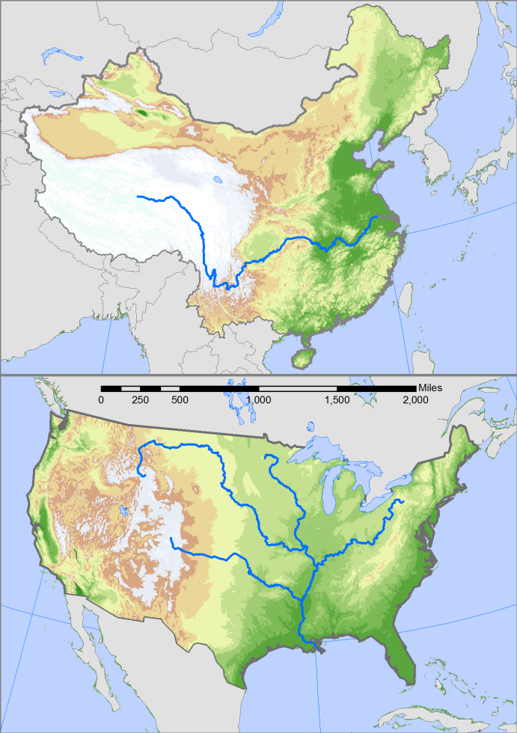
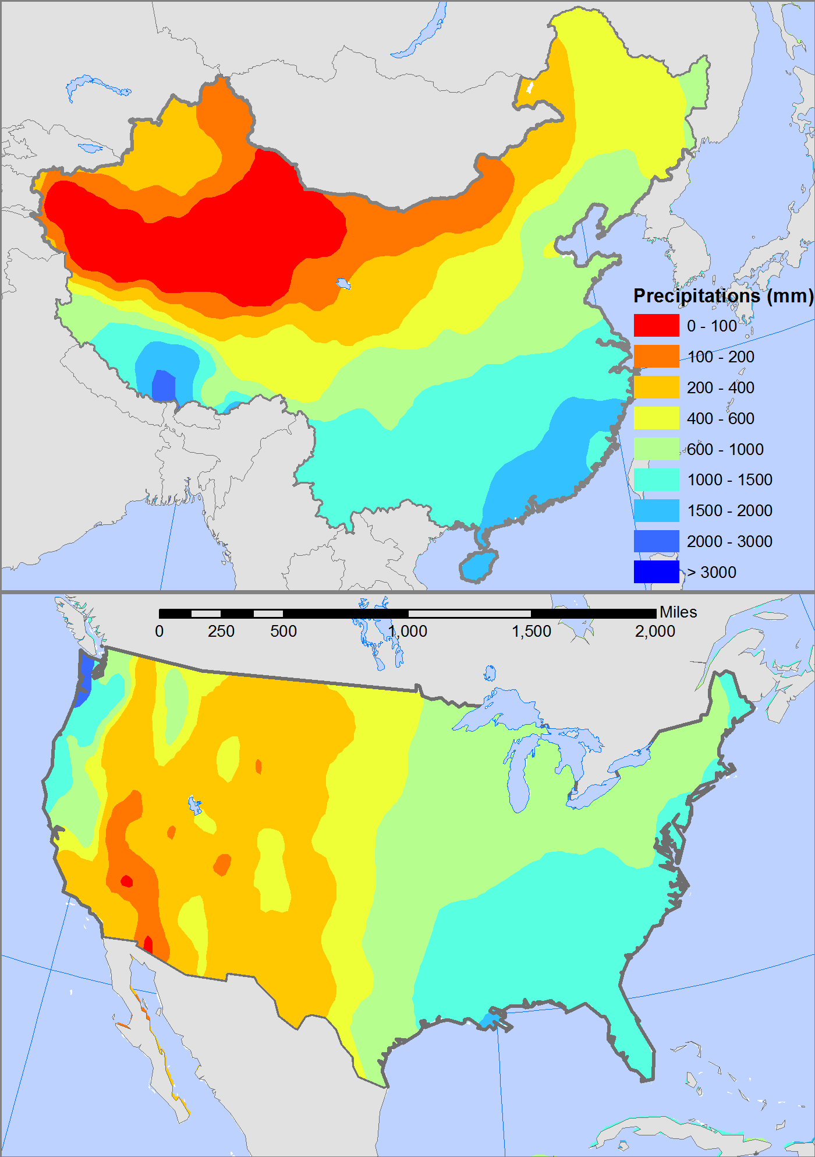
1. Unity and Diversity
China: 3.7 million square miles
Gobi Desert
65% mountainous
25% mountainous
USA: 3.6 million square miles

Slide 6
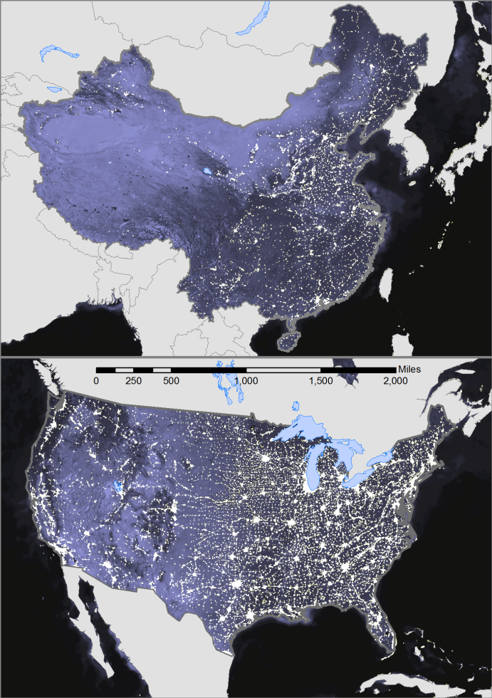
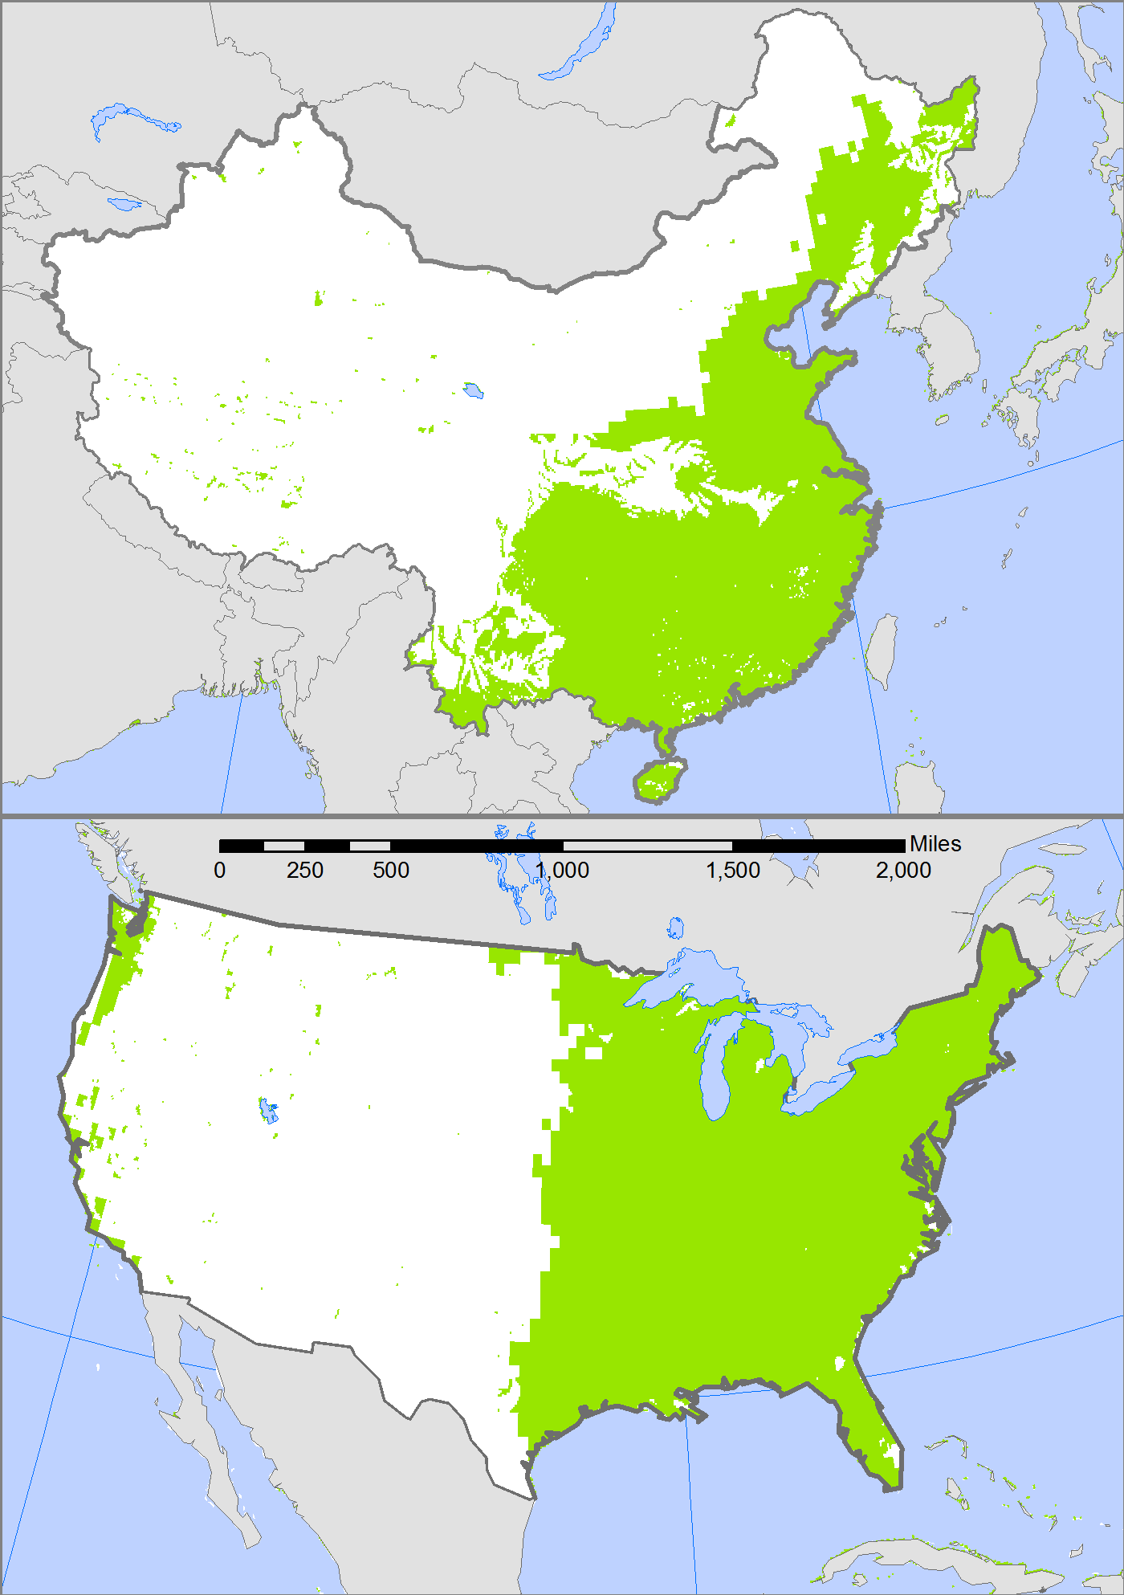
1. Unity and Diversity
Which geographical similarities and differences China share with the United States?
Arable land: 12%
Arable land: 25%

Slide 7
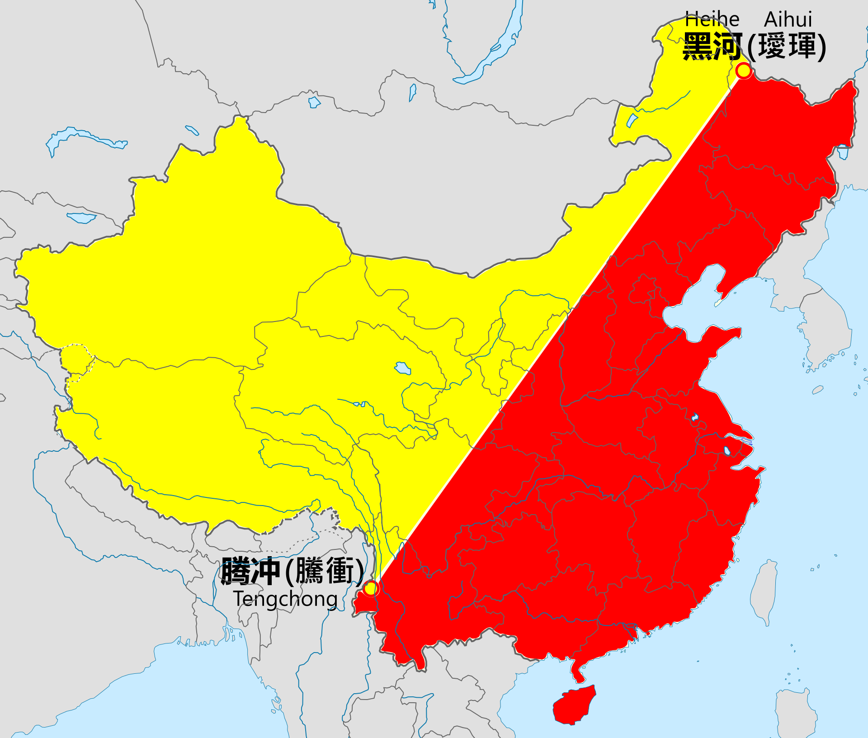
Arid China
Wet China
Notes:
Arid Versus Wet China

Slide 8
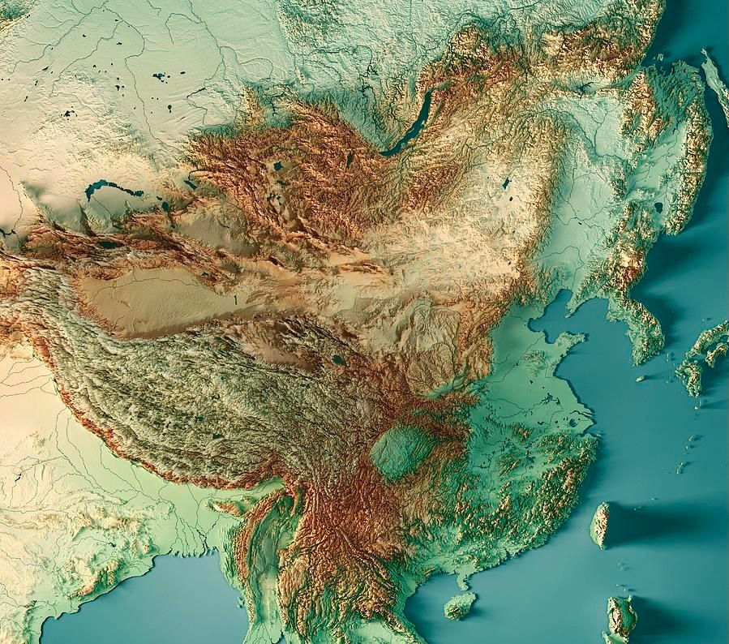

Slide 9
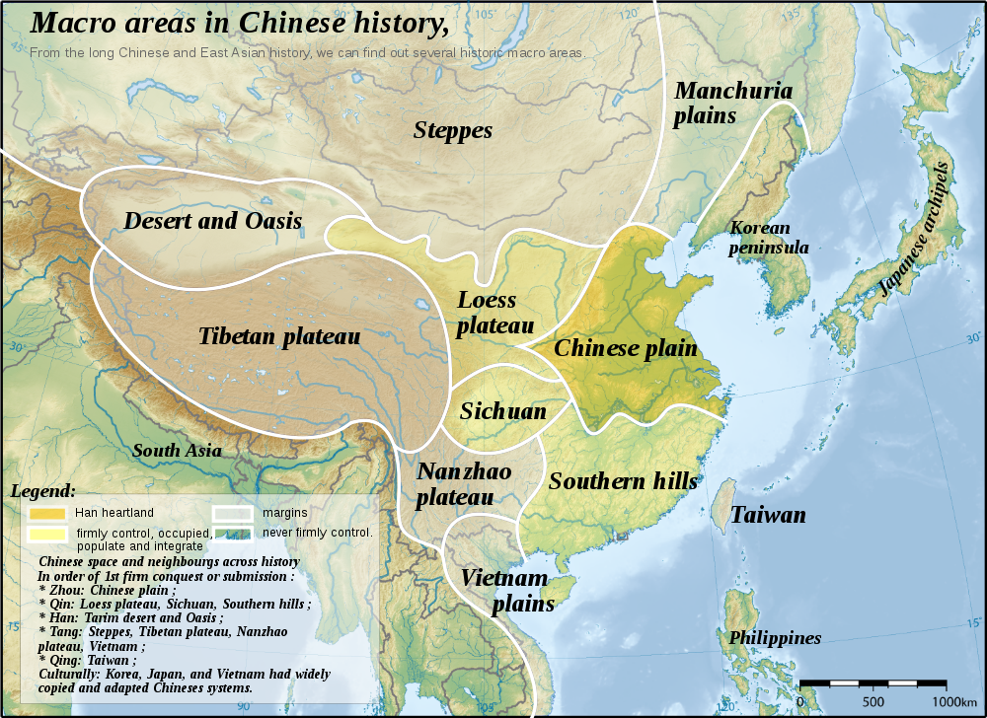

Slide 10
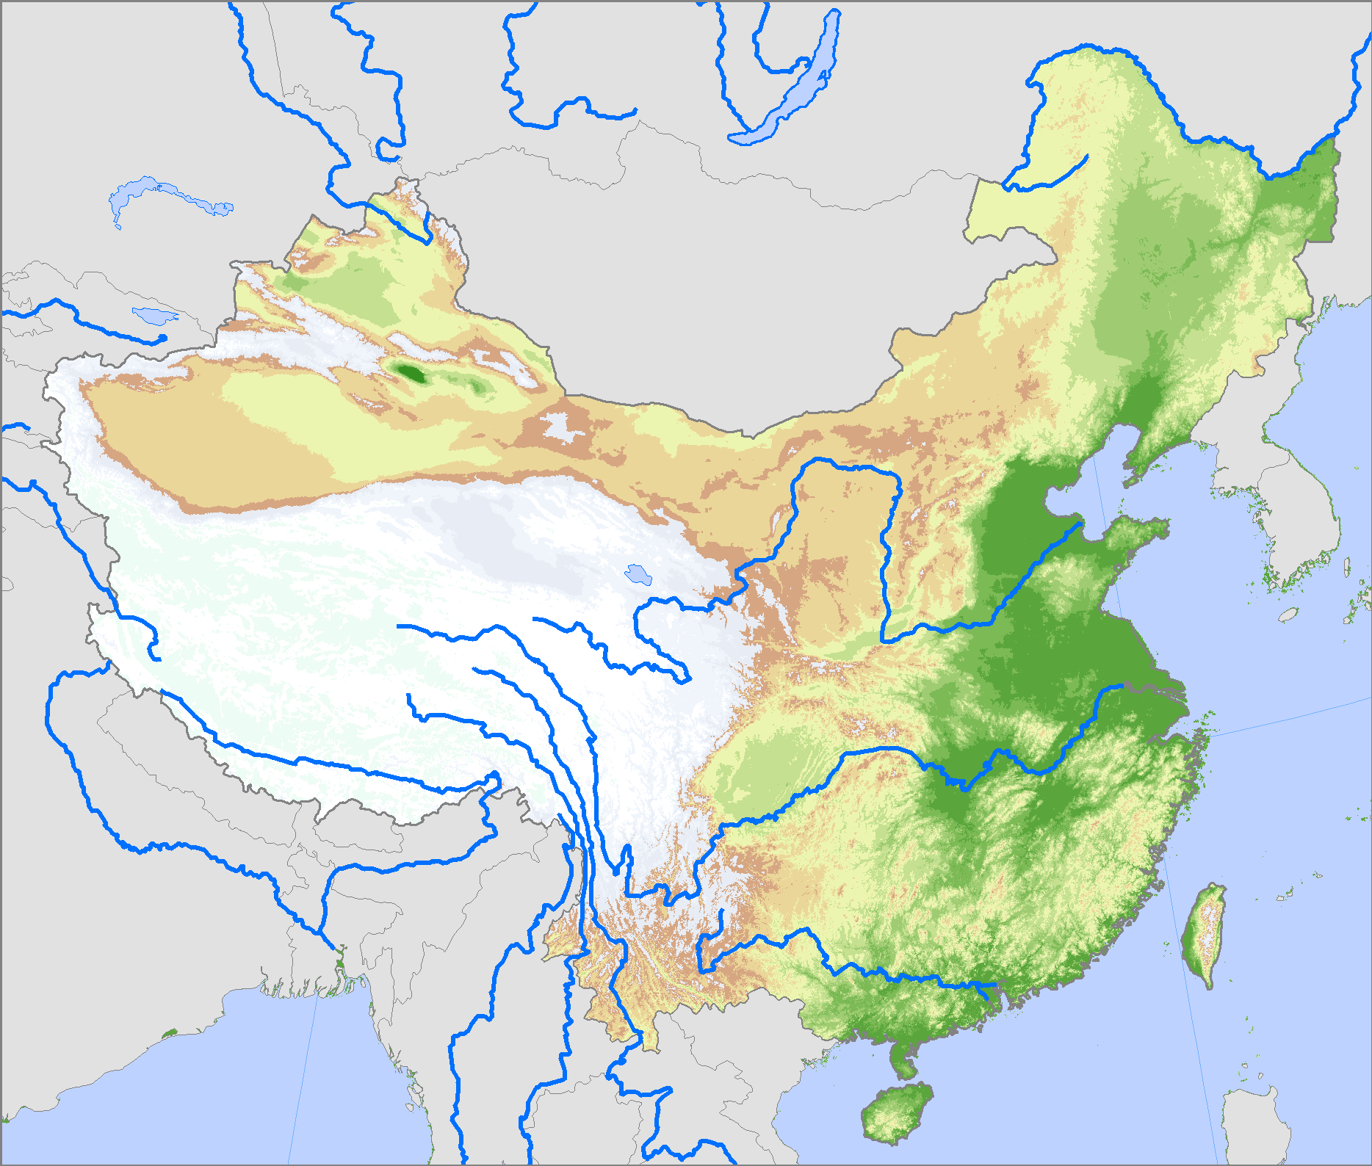
Main Rivers of China
Heilong Jiang (Amur)
China's border with Russia
Huang He (Yellow River)
Can carry up to 40% sediment weight (highest in the world).
Subject to flooding, especially in its delta.
Changed course many times.
Chang Jiang (Yangtze)
Longest river, China’s main street (6,300 km).
Pearl River delta system
Most productive and sustainable ecosystem in the world.
Rice paddies and fishponds.

Slide 11
1. Unity and Diversity
Read this content
Beijing
The Grand Canal
  Achievement of Imperial hydrological engineering.
  First segments completed around 602 AD (Sui Dynasty).
  At its peak during the Ming dynasty (1368-1644 AD).
  Totaled about 2,500 kilometers, 1,700 still in use today.
  Grain distribution through the empire, notably its capitals.
Tonghui Canal
(Yuan)
Yongji Canal
(Sui and Yuan)
Yellow Sea
Old course of
the Yellow River
(Song)
Jiao-Lai Canal
(Yuan)
Yongji Canal
(Sui)
Jizhou Canal
(Yuan)
Tongji Canal (Sui)
Jizhou
East China
Sea
Luoyang
Kaifeng
Bian Canal
(Song)
Huaiyin
Chuzhou
Yangzhou Canal
(Song and Yuan)
Yangzhou
Jiangnan Canal
(Sui, Song and Yuan)
Suzhou
400 km
Hangzhou

Slide 12
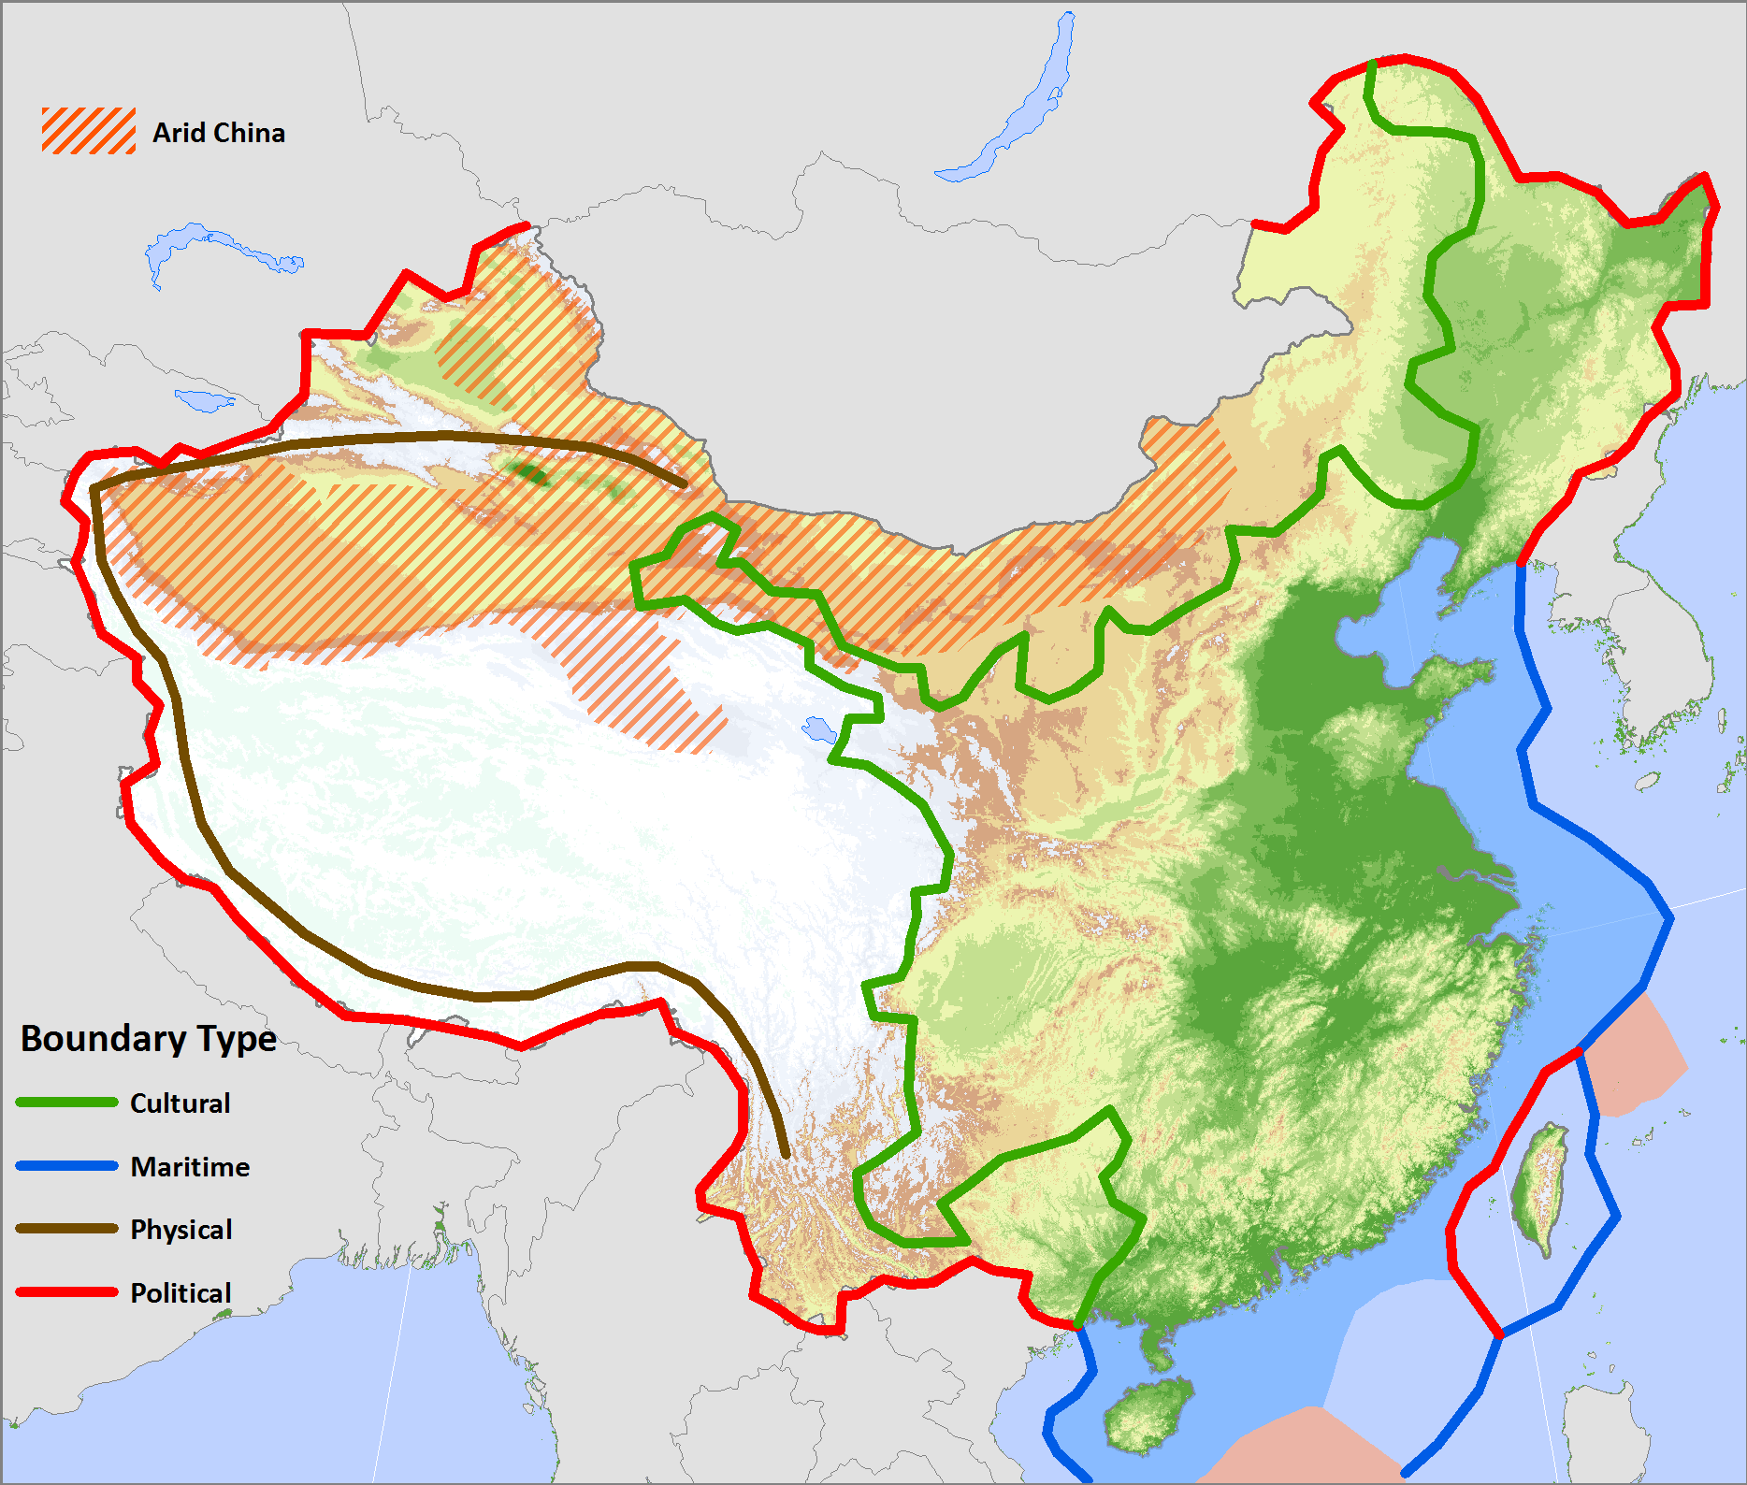
The Chinese Realm
53% of the population speaks Mandarin.
Han China: 92% of the population
Minorities dominantly live in mountainous or arid regions.
Turkic
China's Geography Problem
Mongols
Takla Makan
Gobi
Koreas
Highland China
Tibetan
Han
Tai
Miao-Yao
Taiwan
Explain what are China’s major realms and the issues they involve.

Slide 13
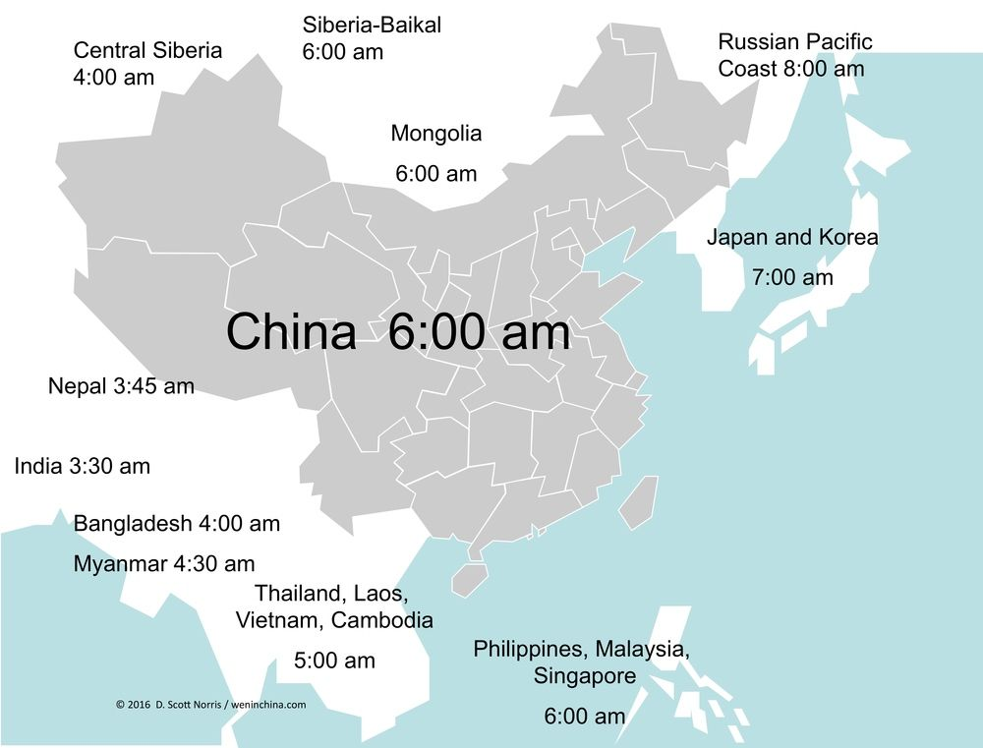

Slide 14
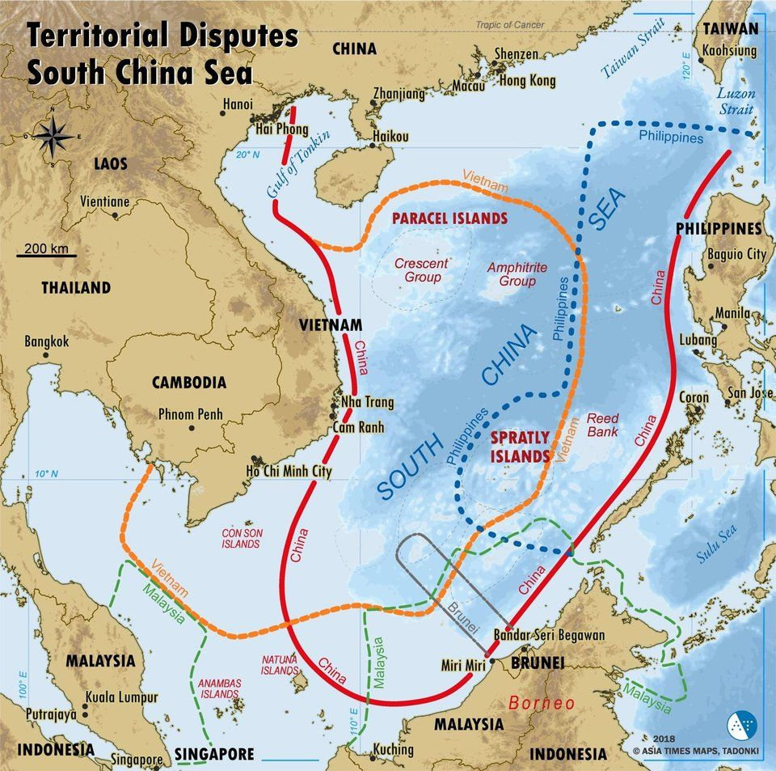
The South China Sea – A Contested Area of the Chinese Realm
Important shipping lanes.
Oil and natural gas reserves.
Fishing areas.
High biodiversity (coral reefs)
The South China Sea dispute explained

Slide 15
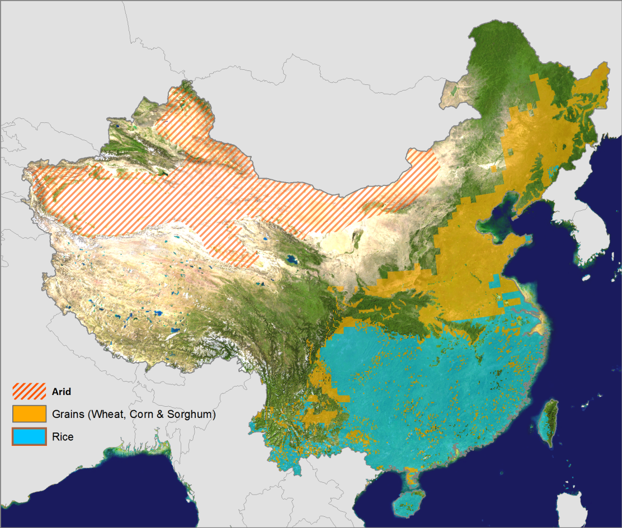
1. Unity and Diversity: Main Agricultural Regions
China feeds approximately 22% of the world’s population with about 7% of the world’s arable land.
North: continental climate growing wheat, sorghum and corn.
Wheat Dominant
Pasture and oasis
Rice Dominant
Double-crop rice
South: subtropical climate growing rice.

Slide 16
1. Unity and Diversity
Chinese Cuisine
  Food and tastes are a cultural expression.
  Reflects the complexity of the country.
  Diversity of the climate, products and customs:
    Each cuisine has its own set of base elements (grains, meats, vegetables, oils and spices).
    Strive for harmony of sight, smell, taste and texture.
  8 regional / provincial cuisines:
    Shandong, Sichuan, Guangdong, Fujian, Jiangsu, Zhejiang, Hunan and Anhui.
    Two main local cuisines (Beijing and Shanghai).
    Many minorities' cuisines.
  Long history of famines and food shortages:
    Anything edible will be used.
    Parts of animals that are often discarded will be used (feet, head, tendons, tripes).
    The wok: a fuel-efficient form of fast cooking.
The Five Major Cuisines of China
Notes:
Potatoes, Sweet Potatoes and chili brought by the Portuguese in the 16th century.

Slide 17
Types of Chinese Tea
Type | Nature | Producing Region
Black tea | Fermented. 22% of production. | Central China (Anhui, Yunnan, Jiansu, Sichuan, Hunan).
Green tea | Non-fermented. Most popular. 44% of production. | Central East China (Zhejiang, Anhui, Jiangsu).
Brick tea | Fermented tea compressed into brick. 25% of production. | Central China (Hubei, Hunan, Sichuan, Yunnan)
Wulong tea | Semi-fermented, orange in color. | Southern China (Guangdong and Fujian).
Perfumed tea | Different types of flower-scented tea (Jasmine and magnolia)
Notes:
Note: First cultivated around 206 B.C.

Slide 18
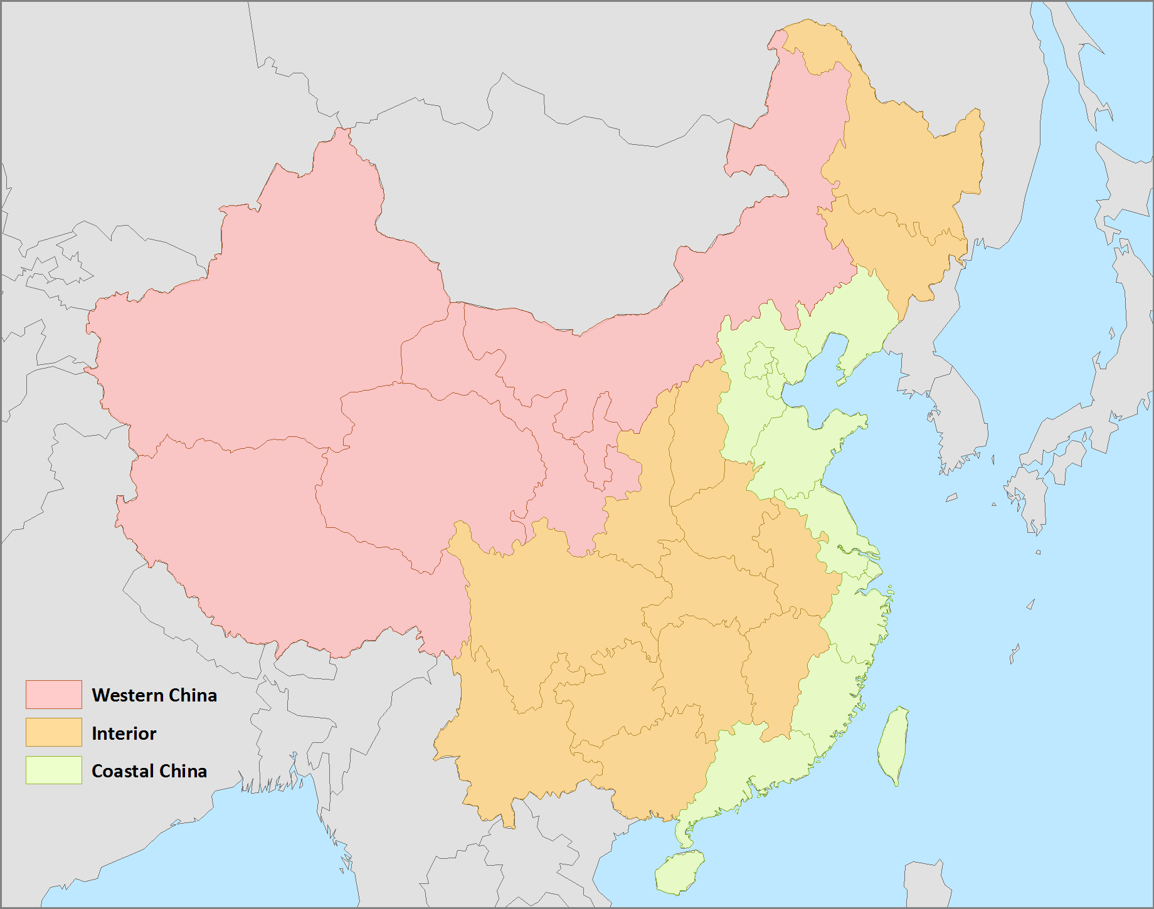
1. Unity and Diversity: The Three Chinas
Western China
Sparsely populated.
Region of minorities.
Most mineral resources
The Interior
Agricultural and demographic hearth.
Poor and rural China.
Coastal China
Forefront of modernization.
Political and economic center.
Rich, urbanized and open to the world.

Slide 19
1. Unity and Diversity: China’s Main Contrasts
Geography
Rural Interior / Urbanizing Coast.
Economy
Command economy versus market forces.
Society
Inward-Looking History / Outward-Looking Future
Politics
Authoritarian Government / Opening of the Economy.
Wheat Growing North / Rice Growing South.
Hans / Minorities.
Isolation versus openness.
Notes:
Some are the outcome of endogenous processes.
Some are imposed or exacerbated by external forces.
Authoritarian Government / Opening of the Economy.
Inward-Looking History / Outward-Looking Future.
Rural Interior / Urbanizing Coast.
Wheat Growing North / Rice Growing South.
Hans / Minorities.
Mandarin Hans / Non-Mandarin Hans (Cantonese, Wu, Hakka, etc.).

Slide 20
2. Chinese Demographics
Demographics
  More people than the combined population of Europe, the Americas, and Japan.
  Any change has global ramifications.
  The demography of China is a powerful trend:
    1.402 billion in 2020.
    About 14-17 million people were added each year in the 1980s.
    Average of 13 million people per year in the 1990s.
    10 million people per year in the 2000s.
    Peaked at about 1.41 billion by 2021.
  Massive recent urbanization:
    64% of the population urban in 2021.

Slide 21
The Population of China, 0-2060
The population exploded after 1949.
Population control was secondary.
Mao Zedong saw numbers as a workforce and a way to fight the Soviet Union and the United States.
Calls for women to “breed for the motherland”.
Notes:
Source: adapted from Zhao, 1994. FAO Database.

Slide 22
Comparison between the Population of China and Europe
Notes:
Source: Heilig, G.K. www.iiasa.ac.at

Slide 23
Chinese Population, 1949-2022 (in millions) (projections to 2050)
Notes:
Source: China Population Information and Research Center, 2000. FAO Database.
Source: https://databank.worldbank.org/China-Population-Projection-15-50/id/61621b1c#
http://www.cpirc.org.cn

Slide 24
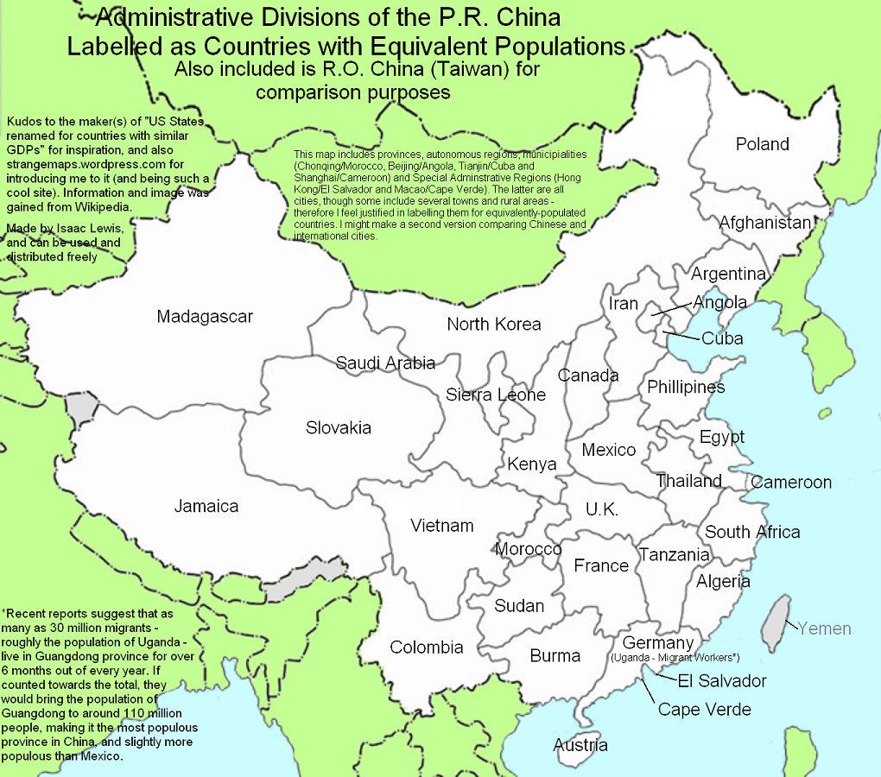

Slide 25
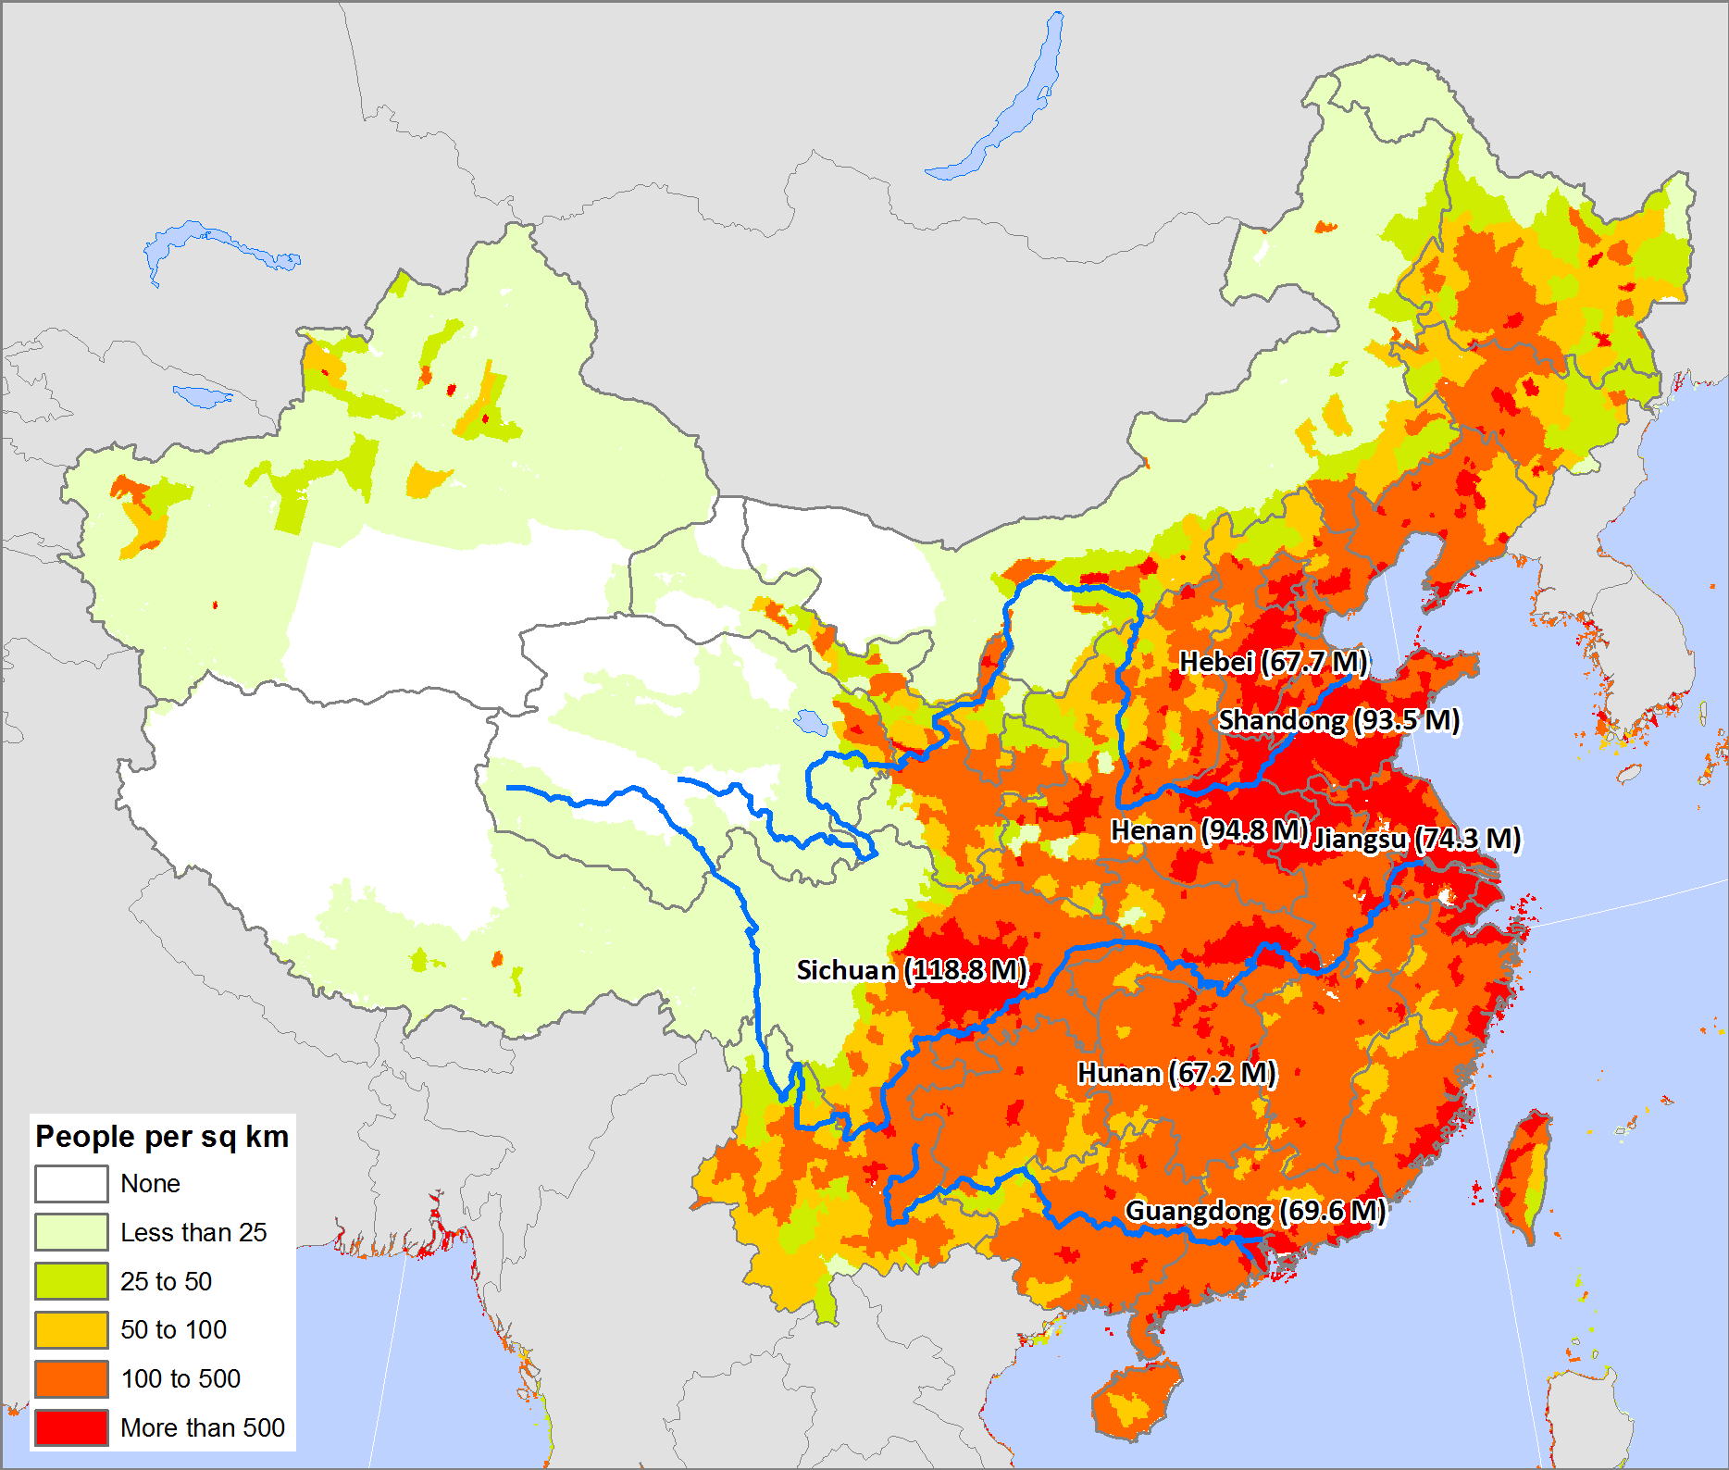
Population Density of China and Most Populous Provinces
Excessive concentration: 50% of the population lives on 8.2% of the land.
Bulk of the population along the coast.
East China accounts for 90% of the population.
56%, about 728 million, are living in mountainous areas.
High density rural areas.

Slide 26
2. Chinese Demographics
Current issues
  Population growth is seen as a challenge to Chinese development (education, health, energy, food, transportation).
  The peaking of the population
  Increasing ethnic diversity:
    The government had not enforced the One Child Policy among the country’s 55 recognized minority groups.
    They had increased their share of still predominantly Han population to 9.4% in 2005 from 6.7% in 1982.
  Missing female population.
  Sustaining agriculture.
  Coping with huge urban growth.
  Nutrition transition: growth of “western diseases” (obesity, diabetes).

Slide 27
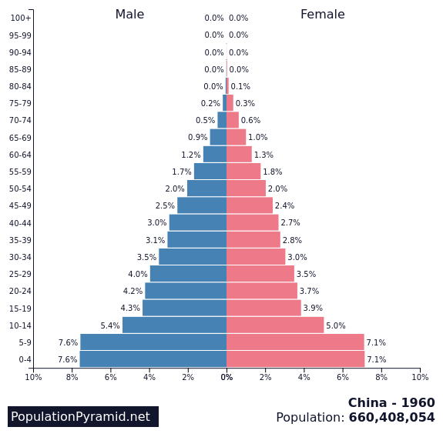
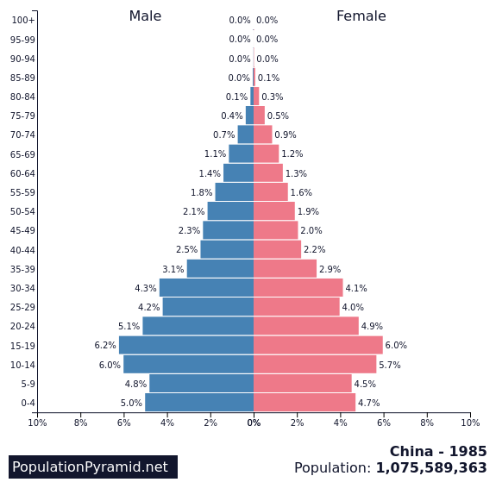
Population Pyramid of China

Slide 28
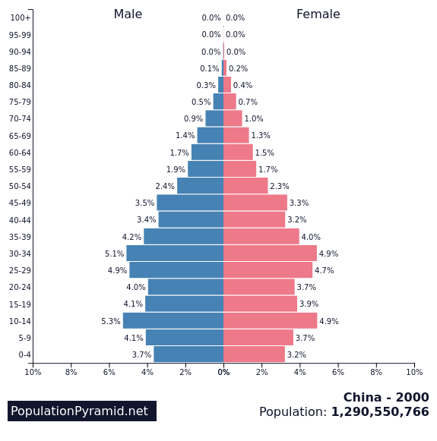
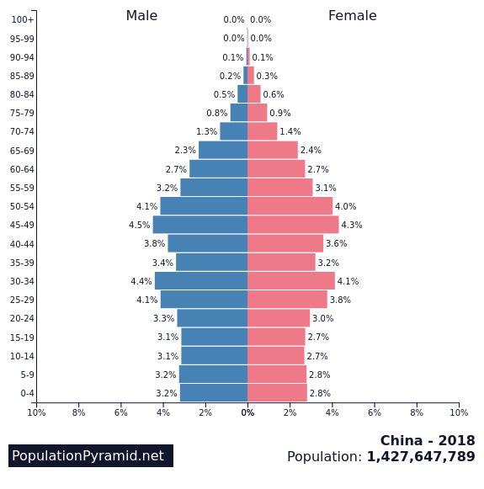
Population Pyramid of China

Slide 29
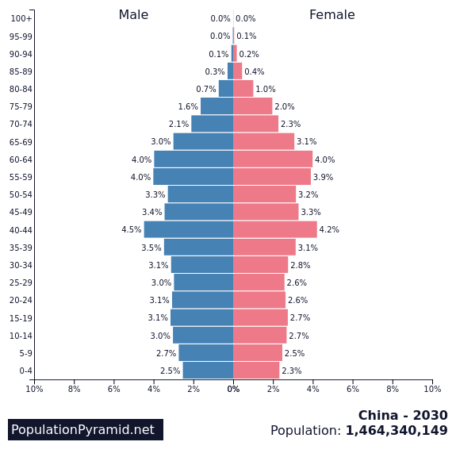
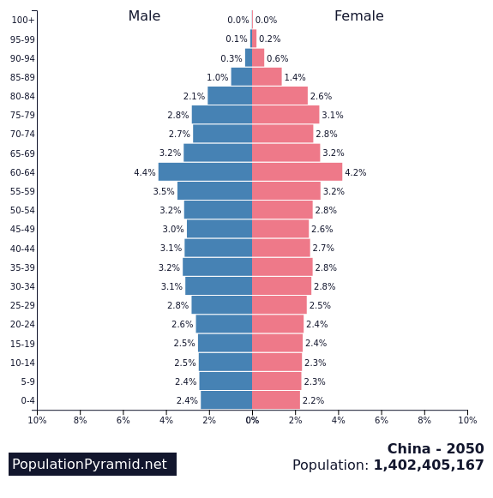
Population Pyramid of China

Slide 30
2. Chinese Demographics
Education
  Traditionally perceived as a path to self improvement (Confucianism).
  30.2 million university students enrolled in China (2019).
  14.5 million in the United States.
  College attendance: 1.4% in 1978, 20% in 2005, 51.6% in 2019.
  Produces 500,000 engineers per year (10 times more than the US).
  The world’s largest provider of foreign students.
    360,000 Chinese students in the US in 2017.
Why So Many Chinese Students Come to America

Slide 31
2. Chinese Demographics
Surplus labor in rural areas
  Development of the rural economy and the higher rate of birth.
  Large numbers of surplus rural labor:
    Many rural provinces have an excess population they cannot sustain.
    Difficult situation in the countryside as China is running out of land.
    Need to transfer from the agricultural to a non-agricultural sector.
  About 20 million people per year migrated from the interior to the coastal areas.
  This migration is coming to an end:
    Demographic transition.
    Increased urbanization.
    Economic development in interior provinces.
    Less job opportunities in coastal provinces.

Slide 32
2. Chinese Demographics
Aging of the population
  China was in its peak active population years until 2015.
  Rapid shift ongoing.
  65 years old or older:
    87 million in 2000.
    112 million in 2010.
    340 million in 2050.
  Providing social security and services to a huge elderly population.
  High savings rate a positive factor.
The population of China has grown substantially over the last 50 years. Explain what types of problems this has involved and the main reasons behind its future decline.
Notes:
Source: U.S. Bureau of the Census, International Database. www.census.gov

Slide 33
3. Communist China: the Path to the PRC
 | Event | Implications
Geography | Large country; development of a canal system | Large internal market; central government; self sufficiency
Political and social system | Unified since 221 BC; Civil bureaucracy and meritocracy; Cultural superiority complex (sinocentrism) | National identity; Self-improvement; Unwilling to trade
Technological innovation | Leader up the to 15th century; Lagging until the late 20th century | Possibility of an industrial revolution; Economic opportunities missed
Foreign relationships | Core civilization of the region; Never colonized; Forced to open port cities after 1842 | Foreign nations as vassals; Hostile relationships with foreign powers
Key events | 1433 – Ming Emperor ends international trade; 1839-1842 – First Opium War; 1910-1949 – Civil Wars; 1949 – PRC founded | Isolation of China; Forced to open markets; Adoption of Marxism.

Slide 34
3. Communist China
Chinese flag
  Red: the color of revolution.
  One large star: communist party.
  Four stars: four classes : the workers, the peasants, the petty bourgeois, and the “patriotic capitalists”.
Communism and China
  The Marxist ideology is of western origin.
  Leninism (Soviet Union after 1917):
    Compatible with the Chinese ideology.
    Absolute central power.
    Bureaucracy.
    Social division of the society.
    Economic and social control.

Slide 35
3. Communist China
Decline of imperial rule
  From the 19th century, the Chinese empire was declining.
  Civil wars triggered by bad governance (e.g. Taiping Revolution).
  Refusal of political and economic reform.
  Technological and military obsolescence in view of Europe and Japan.
Destruction of the ethnocentric vision
  Invasions from abroad (Europeans and Japanese).
  Colonies (Hong Kong and Macao) and Treaty Ports.
  A sense of humiliation and strong references to a glorious past.

Slide 36
3. Communist China
The Opium War (1838-1842)
  England had difficulties to balance its trade with Asia:
    Increase in the consumption of goods such as tea.
  Rectifying the trade deficit:
    Britain tried to sell more of its own products to China.
    Limited success as the Chinese had limited interests in foreign goods.
    The item provided to China was Bengal opium, despite repeated prohibitions by the Chinese government.
  Consequences:
    Enormous socioeconomic costs for China.
    About 10% of the population used opium by the late 19th century.
    Silver began to flow out of the country to pay for opium.
  Intervention:
    In 1838, China started to directly intervene against the British merchants.
    Seizure and destruction of opium stocks in Guangzhou.

Slide 37
3. Communist China
  Treaty of Nanjing (1842):
    The first of the “unequal treaties”.
    Opened China to the West and marked the beginning of western infringement on the nation.
    Opened several port cities (Hong Kong & Shanghai); extraterritoriality.
Second Opium War (1856-1858)
  British and French alliance (plus Russia and the United States).
  Treaty of Tientsin (1858):
    Opened ten more Chinese ports to trade.
    Permissible for foreign ships (including warships) to navigate the Yangtze River.
    Allowed Chinese workers the right to work overseas.
    Gave foreigners the right to travel inside China.
    Granted Christians the right to own property and proselytize.
The Two Coasts of China

Slide 38
Empire, Decline and Collapse
Reform failures
  China, unlike Japan, was refusing to reform itself.
  In 1911, a revolution proclaimed the Republic of China, ending more than 2,000 years of Imperial Government (led by Sun Yat-Sen; the founder of modern China).
  Did not prevent foreign interests to occupy China.
  By 1916, the country fractured in several regions controlled by warlords.

Slide 39
Empire, Decline and Collapse
A politically divided China
  From the 1920s, two factions disputed the control of China:
    Nationalists (Kuomintang), led by Chiang Kai-shek.
    Communists, led by Mao Zedong.
    Nationalist government in Nanjing with modernization programs that won him support in the cities.
    Communists believed that the key to revolution lay in the countryside, where most of China’s people lived.
  Chinese Civil War (1930s):
    Mao moved to Jiangxi Province and set up a Communist base to test his theories.
    The Nationalists forced the Communists into flight (1934; the Long March).
    Nearly 87,000 Communists, including Mao Zedong, were forced out of Jiangxi on retreat.

Slide 40
3. Communist China
Maoism
  Mao (1893-1976) had evolved a Chinese Communist alternative that reflected China’s different demography.
  One of the founders of the Chinese Communist Party (CCP) in 1921.
  Core goals:
    Economic self-reliance.
    Power derived from numbers.
    Labor-intensive rather than technologically advanced development.
    Local community effort.
  Concept of “mass-line” leadership:
    Integrated intellectuals with peasant guerrilla leaders as a fundamental economic and social strategy.
    Launched programs of industrialization and collectivism.

Slide 41
3. Communist China
The Japanese occupation (1937-1945)
  The Nationalists and the Communists agreed about a truce to fight the Japanese invader.
  Nationalists received the bulk of the foreign (American) aid.
China’s Civil War (1945-1949)
  China was liberated in 1945, but escalating tensions between the Nationalists and the Communists soon erupted into civil war.
  The peasants supported the Communists who promised land reforms.
  The People’s Republic of China was proclaimed October 1st, 1949.
What led to the creation of communist China?
China In Revolution 1911 1949

Slide 42
3. Communist China: Maoist Movements
Movement | Nature | Impact
The “Hundred Flowers” (1956) | Intellectuals invited for constructive criticism. Some party leaders criticized for corruption and incompetence. | Followed by repression, with many intellectual labeled as “rightists”. No tolerance of dissent or criticism.
The “Great Leap Forward” (1957-59) | Supposed to industrialize the countryside. Over-inflated industrial and agricultural quotas. | Forgery and exaggerations of agricultural production figures. Resulted in the largest famine in human history. About 30 million died of starvation.
Sino-Soviet Break (1960) | Ideological differences. | Removed Soviet aid and technical personnel. Increasing border clashes. No global “unified” communist bloc.
The “Great Proletarian Cultural Revolution” (1966-1976) | Ideological demagogy by Mao to maintain power. Millions of youths (the Red Guards) were mobilized. | Plunged the country in a turmoil. Factions fought to control the government. Party-state machinery was crippled, and many Party veterans were purged.
Communist China - The Great Leap Forward
What was China's Cultural Revolution?

Slide 43
3. Communist China
Development strategies
  Based on the Soviet model.
  Collectivization.
  Setting of five-year plans.
  Emphasis on “heavy industry” and as source of employment:
    Redistribution of economic activities in the interior.
    Fear of war and vulnerability of the coast.
  Dramatic social changes:
    Education: formal state education (politically-oriented).
    Religion: abolition but some level of tolerance to traditional religions.
    Population growth: favorable policies.

Slide 44
3. Communist China
Collectivization
  Collectivization of the economy:
    Creation of work units.
    State-owned communal enterprises.
    Difficult to move to another unit.
    Immobility of the population.
  Urban growth:
    Controlled by preventing the mobility of the population.
    Latent urbanization.
  Rural landscape:
    Modified by collectivization.
    From family farms to large-scale collectives.
Collectivization
No mobility
Redistribution
No trade

Slide 45
3. Communist China
Reforming China (Deng Xiaoping, 1904-1997)
  Joined Mao and participated in the war against the Japanese and the Liberation War (1949).
  The Cultural Revolution turned against him; Imprisoned (1966 to 1973).
  After the death of Mao, established at the head of the CCP (1977) and controlled the Chinese politburo (1980).
  Initiated important agricultural and industrial reforms (1978).
  Opened China to the outside world for trade and technology:
    Different from Mao’s view of self-determination.
  Characterized by pragmatism:
    “It is not important if the cat is black or white, as long as it catches mice”.
    Establishment of “socialist market economy” to help China’s development.

Slide 46
3. Communist China
Decollectivization (1978-)
  Decollectivization:
    Many farms reverted to families.
    Land leased.
  Growth in Coastal zones:
    Major cities.
    Special economic zones.
  Most important migratory movement from the countryside to the cities in history.
  Increasing participation of China to the global economy.
  Assertion of China in regional affairs, mainly in Central Asia and in the South China sea.
Decollectivization
Mobility permitted
Urbanization
Migration
Trade

Slide 47
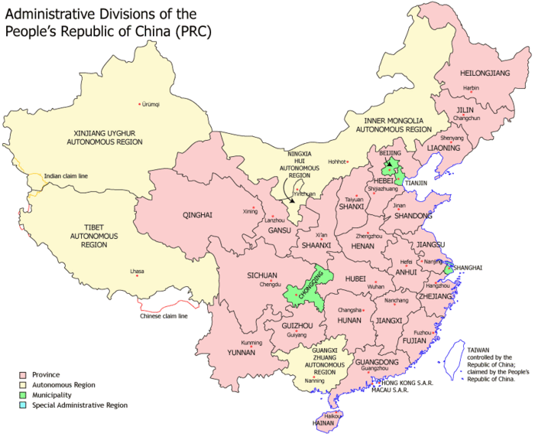
Administrative Divisions of China
5 Autonomous Regions
Recognition of minorities.
Buddhist Tibetans (Xizang).
Muslim Uygurs (Xinjiang).
Mongols (Inner Mongolia).
4 Municipalities
Beijing, Tianjin, Shanghai and Chongqing; China’s most prominent cities.
22 Provinces
7-100 million people.
Similar to US states.
2 Special Administrative Regions
Hong Kong and Macao.
“One country, two systems”.
Taiwan
“Rebellious
Province”

