Slide 1
Topic 4 – Japan and its Corporate Hegemony
A – Geography and the Insularity of Japan
B – Japanese Development
C – The Corporate and Industrial Hegemony

Slide 2
Conditions of Usage
For personal and classroom use only
  Excludes any other forms of communication such as conference presentations, published reports and papers.
No modification and redistribution permitted
  Cannot be published, in whole or in part, in any form (printed or electronic) and on any media without consent.
Citation
  Dr. Jean-Paul Rodrigue, Dept. of Global Studies & Geography, Hofstra University.

Slide 3
C. The Corporate and Industrial Hegemony
1. Corporate System
  What is the nature and structure of the Japanese corporate system?
2. Labor and Technology
  What is specific to the Japanese workforce?
3. Trade and the Financial System
  What is the commercial and financial strength of Japan?
4. Mega-Urban Regions: Tokaido
  How Japanese urbanization is structured?

Slide 4
1. Corporate System
Political Economy
  Government / Keiretsus dualism.
  Economic power is concentrated in a limited number of corporations.
  Corporatism and society:
    Difficult to separate the corporation and the society as they are embedded.
    Corporations are part of important economic and political decisions in Japan.
    Dualism between the government and the corporations.
  Bank of Japan (BOJ): Providing loans and monetary policy.
  Ministry of Finance (MOF): Taxation.
  Ministry of Economy, Trade and Industry (METI): Trade and industrial policy.
BOJ
Government
MOF
METI
Keiretsus
Notes:
The MITI (Ministry of International Trade and Industry) was the main force articulating Japan’s economic policy, notably its export oriented economy. In 2001, its role was taken over by METI (Ministry of Economy, Trade and Industry).

Slide 5
1. Corporate System
The Keiretsu
  “Group of leaders”.
  Complex structure of linked corporations.
  Vertically and horizontally organized.
  Six main horizontal conglomerates (keiretsu):
    Mitsubishi.
    Mitsui.
    Sumitomo.
    Fuyo.
    Dai-Ichi Kangyo (DKB).
    Sanwa.
  The first five conglomerates account for about 25% of the Japanese GDP.

Slide 6
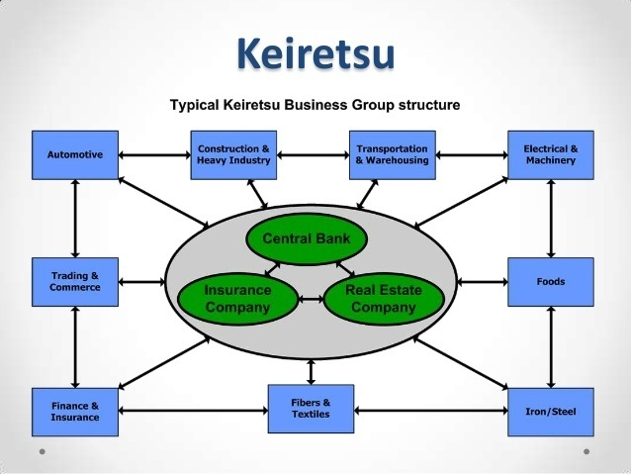
1. Corporate System
Horizontal Keiretsu
  Highly diversified function.
  A core:
    Finance: A bank, insurance / real estate company.
    A trading company: conducting trade on behalf of the group.
    A manufacturer or heavy industry.
  Cluster of affiliates and subsidiaries:
    From related and unrelated industries and services.
    Major manufacturers.
    Large service providers like life insurance companies.
    2-6% equity ownership.
    Prevents takeovers.
  Interlocking directorates:
    Leaders meeting to discuss strategy.

Slide 7
Major Keiretsus
Industry | Mitsui | Mitsubishi | Sumitomo | Fuyo | Sanwa | DKB
Banking | Sakura Bank (1990-2001) Sumitomo Mitsui Bank (2001-) | Bank of Tokyo- Mitsubishi (1996-2005) Bank of Tokyo-Mitsubishi UFJ (2006– ) | Sumitomo Bank (-2001) Sumitomo Mitsui Bank (2001– ) | Fuji Bank (-2000) Mizuho Bank (2000– ) | Sanwa Bank (-2002) UFJ Bank (2002–2006) Bank of Tokyo-Mitsubishi UFJ (2006– ) | Dai-ichi Kangyo Bank (-2000) Mizuho Bank (2000– )
Finance | Mitsui Trust & Banking Mitsui Mutual Life Mitsui Real Estate Mitsui Marine & Fire | Tokio Marine and Fire Insurance Mitsubishi Trust & Banking Meiji Yasuda Life (2004-) | Sumitomo Trust & Banking Sumitomo Mutual Life Sumitomo Marine & Fire Sumitomo Real Estate | Yasuda Trust & Banking Meiji Yasuda Life (2004-) Marubeni Yasuda Marine & Fire | Toyo Trust & Banking Orix | Fukoku Mutual Life Asahi Mutual Life Nissan Marine & Fire Taisei Marine & Fire
Industrial and Manufacturing | Fuji Photo Film Mitsukoshi Suntory Toshiba Toyota Mitsui Bussan Japan Steel Works Mitsui Toatsu Chemical | Kirin Brewery Mitsubishi Electric Mitsubishi Fuso Mitsubishi Motors Nippon Yusen (NYK) Nippon Oil Nikon Mitsubishi Shoji Mitsubishi Steel Mitsubishi Gas | Asahi Breweries Hanshin Railway Keihan Railway Mazda Nankai Railway NEC Sumitomo Metal Industries Sumitomo Chemical | Canon Hitachi Matsuya Nissan Ricoh Tobu Railway Yamaha Kureha Chemical Industries | Hankyu Railway Keisei Railway Kobe Steel Konica Minolta Kyocera Shin-Maywa, Takashimaya Toho Nissho Iwai Nakayama Steel Works Nisshin Steel Sekisui Chemical | Fujitsu Hitachi Isuzu Itochu Tokyo Electric Power Kawasaki Steel

Slide 8
1. Corporate System
Vertical Keiretsu
  Centered around a major manufacturer that is often part of a horizontal keiretsu.
  Consist primarily of suppliers and distributors relationships.
  Service the large manufacturer at the core of the keiretsu.
  The Automobile Industry:
    Toyota Group, Nissan Group, Honda Group, Daihatsu Motors, Isuzu.
  Electronics:
    Hitachi, Toshiba, Sanyo, Matsushita, Sony.
Suppliers
Manufacturer
Wholesaler
Retailers

Slide 9
Some Firms within the Toyota Group
Company | Sector
Toyota Loom Works | Engines
Aichi Steel Works | Steels
Toyota Machine Works | Machine tools
Toyota Auto Body | Vehicle assembly
Toyota Gosei | Resin & rubber parts
Toyota Boshoku | Air filters
Toyota Central R&D Laboratories | Research & development
Toyota Tsucho Corporation | Wholesaling
Towa Real Estate | Real estate
Nippondenso | Electronics
Aisin | Auto parts

Slide 10
Global Motor Vehicle Production per Manufacturer, 1998-2017
35% of global car production by Japanese car manufacturers
Notes:
Source: International Organization of Motor Vehicle Manufacturers, http://www.oica.net

Slide 11
Automobile Production, Selected Countries,1950-2022 (in millions)
12.5% of global car production takes place in Japan
Notes:
Source: Worldwatch Institute; International Organization of Motor Vehicle Manufacturers, Only includes automobile, not commercial vehicles. http://www.oica.net

Slide 12





1. Corporate System
Explain what are Keiretsus and how they reflect the corporate structure of Japan.
United States
Japan
Structure
Quasi independent enterprises
Quasi-independent enterprises
Diversity
Limited (specialization)
Diversified (specialized components)
Competition
Intense domestic and foreign competition
Little domestic, high foreign competition
Labor relations
Contractual and firing during downturns
Lifetime employment (large companies)
Suppliers
Many (contractual)
Many (long term)

Slide 13
1. Corporate System
Advantages
  Specialization and economies of scale.
  Stable linkages.
  Privileged customers.
  Reciprocal monitoring.
  Sharing market and R&D information.
  Access to financing.
  Low contestability (competition) from exiting companies and new entrants.
Drawbacks
  Complex structure.
  Imposed partnerships and customers.
  Low performance incentives.
  Difficult to share information with outside firms.
  Low responsiveness to market changes.
  Easy access to capital and moral hazard.

Slide 14
2. Labor and Technology
Research, Development and Labor
  Technology is of strategic importance to increase productivity:
    About 3.6% of the GDP as compared to 2.5% for the United States.
    25,000 patents per year compared with 50,000 for the United States.
  Priority to scientific and technological research:
    110 scientists and technicians per 1,000 people.
    Only 55 per 1,000 in the U.S.
    Much of this research is funded by the private sector, usually by the industry, rather than by the government.
    Far more emphasis placed on applied research than on basic research.
    Must generate income for the corporation.

Slide 15
Labor and Technology
Lower unemployed rate than many other economies
  2 to 3% unemployment rate on average.
  Hides underemployment problems.
  Massive sub-contracting to absorb market fluctuations.
  Women labor absorbs most of the fluctuations.
  Strict employment hierarchy.
  Secure employment for large corporations
Notes:
Source: Statistical handbook of Japan, 2007

Slide 16
2. Labor and Technology
Lifetime Employment System
  A company guarantees its new employees a job until retirement.
  Recruitment takes place directly after education:
    Training is provided on the job.
    May take a few years for the employee to become productive.
  Most characteristic of large firms and government agencies.
  About one-third of the workforce:
    Workers called “salaryman”.
  Raises:
    Mainly a function of seniority.
    Usually given to a whole level or group at the same time.
    Especially at the lower ranks where there are more employees and less distinction between them.
Day in the Life of an Average Japanese Salaryman in Tokyo

Slide 17
2. Labor and Technology
  Flexibility:
    Strict prohibitions against firing except under extreme circumstances.
    Recessions; across-the-board salary cuts rather than downsizing.
  Quitting:
    A company is seen as a family and close relationships of trust must be built with co-workers.
    Disgrace and dishonor to quit a company.
    “Letting down” or “betraying” the family.
Labor changes
  The rise of temporary workers.
  1/3 of the workforce.
  Benefit: less demanding than a full-time job.
  Drawback: quick to be laid off during a recession.

Slide 18
2. Labor and Technology
Automation
  The Japanese economy relies heavily on mechanization:
    In the 1990s, Japan accounted for more than 60% of all industrial robots.
    327 robots per 10,000 employees (91 Asian average).
  Accumulation of equipment goods.
  Main reasons:
    Save costs (high Japanese labor costs).
    Increase productivity.
    Raise quality (commitment to total quality; Kaizen system).
    Remain competitive in a global market.
    Transfer dangerous and laborious work.
    Aging of the population.
  Mostly in the automotive sector.
  The growth of service robots.
Catch Japan: On the Front Lines of Robotics
What is automation and why Japan has a high reliance on it?

Slide 19
Annual Installation of Industrial Robots, 2020
Notes:
Source: International Federation of Robotics; http://www.ifr.org/
https://www.ifr.org/free-downloads/

Slide 20
3. Trade and the Financial System
International trade
  Very important for Japan:
    Japan is the 4th largest trader in the world (supplanted by China in 2004).
    Fills the needs of the Japanese economy in raw materials and energy.
  Trade system:
    Import fuels. raw materials, foodstuff and parts.
    Perform value-added activities (notably technology-related).
    Export at competitive prices.
    Cars and electronics are the two key main exports.
  Systematic positive trade balance of Japan that turned slightly negative.
  Increasing importance of the national market and relocation of some industries abroad.
  Japanese economy is increasingly linked with the Chinese economy (outsourcing and offshoring of production).

Slide 21
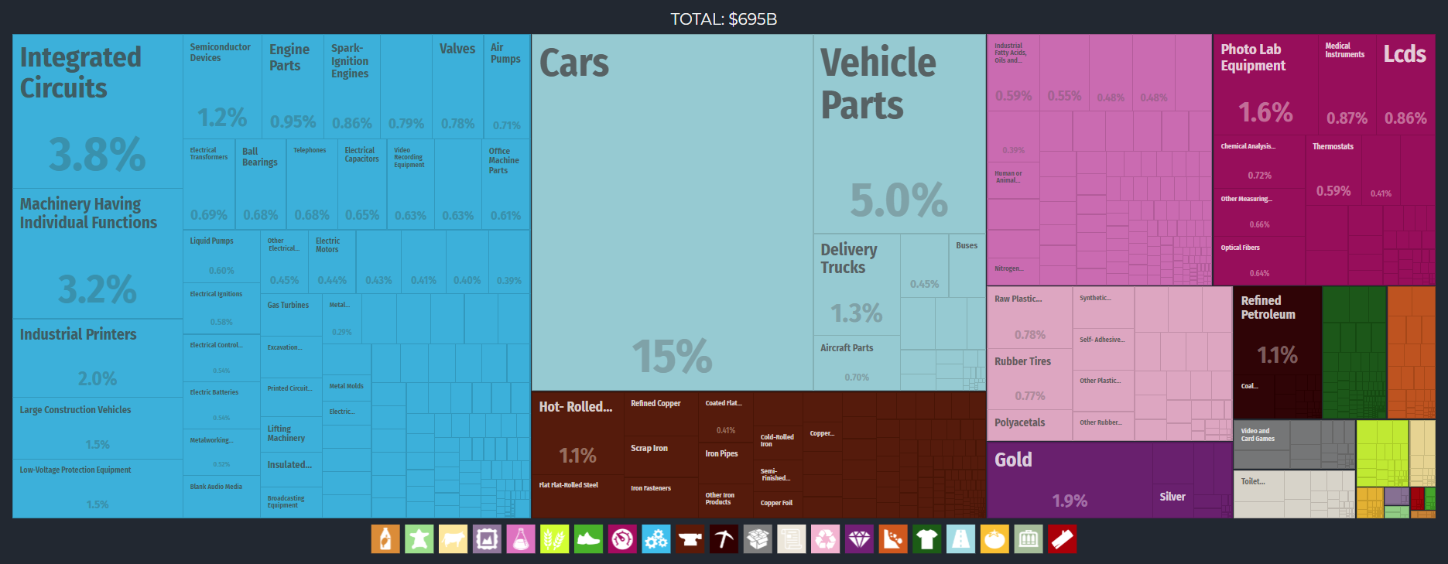
Japan Export Treemap, 2017
Notes:
Source: Economic Complexity Observatory, MIT Media Lab and the Center for International Development at Harvard University.
https://oec.world/en/profile/country/jpn/

Slide 22
World’s 20 Largest Exporters and Importers of Goods and Services, 2018
Notes:
Source: WTO
https://data.worldbank.org/indicator/NE.EXP.GNFS.CD

Slide 23
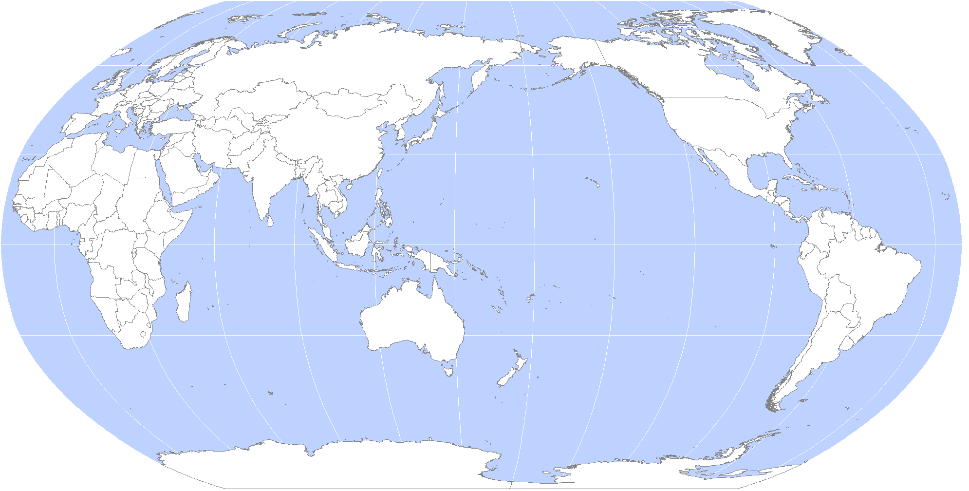
Japan’s Trading Partners
Coal, Iron ore, Grain
Market
Offshoring
Market
Oil
LNG, Lumber
Coal, Iron ore, Grain

Slide 24
4. Tokaido
Tokaido
  Imperial road that linked Edo (Tokyo) to Kyoto.
  Urban region accounting for more than 90 million people, 70% of the Japanese population.
    Tokyo: 31 million population.
    Nagoya and Osaka (9 and 16 million population).
    Several cities are over 1 million (Kobe, Kyoto and Yokohama).

Slide 25
4. Tokaido
Functions and specialization of Tokaido
  Tokyo:
    Tertiary and quaternary functions.
    70% of wholesaling, finance and insurance.
    Head offices of several conglomerates.
    1990: between 45 and 50% of the global financial capitalization.
  Nagoya and Osaka:
    Industrial, financial and port centers.
  Massive accumulation of multimodal transport infrastructures.
  Support the external dependency of Japan.
  Several large airports supporting the trading and financial network.
Shinkansen
  High-speed train network.
  Opened in 1964.
  Operates at speeds of more than 200 km/hr.
  300 km/hr trains are now entering service.
  Moves one million passengers per day.

Slide 26
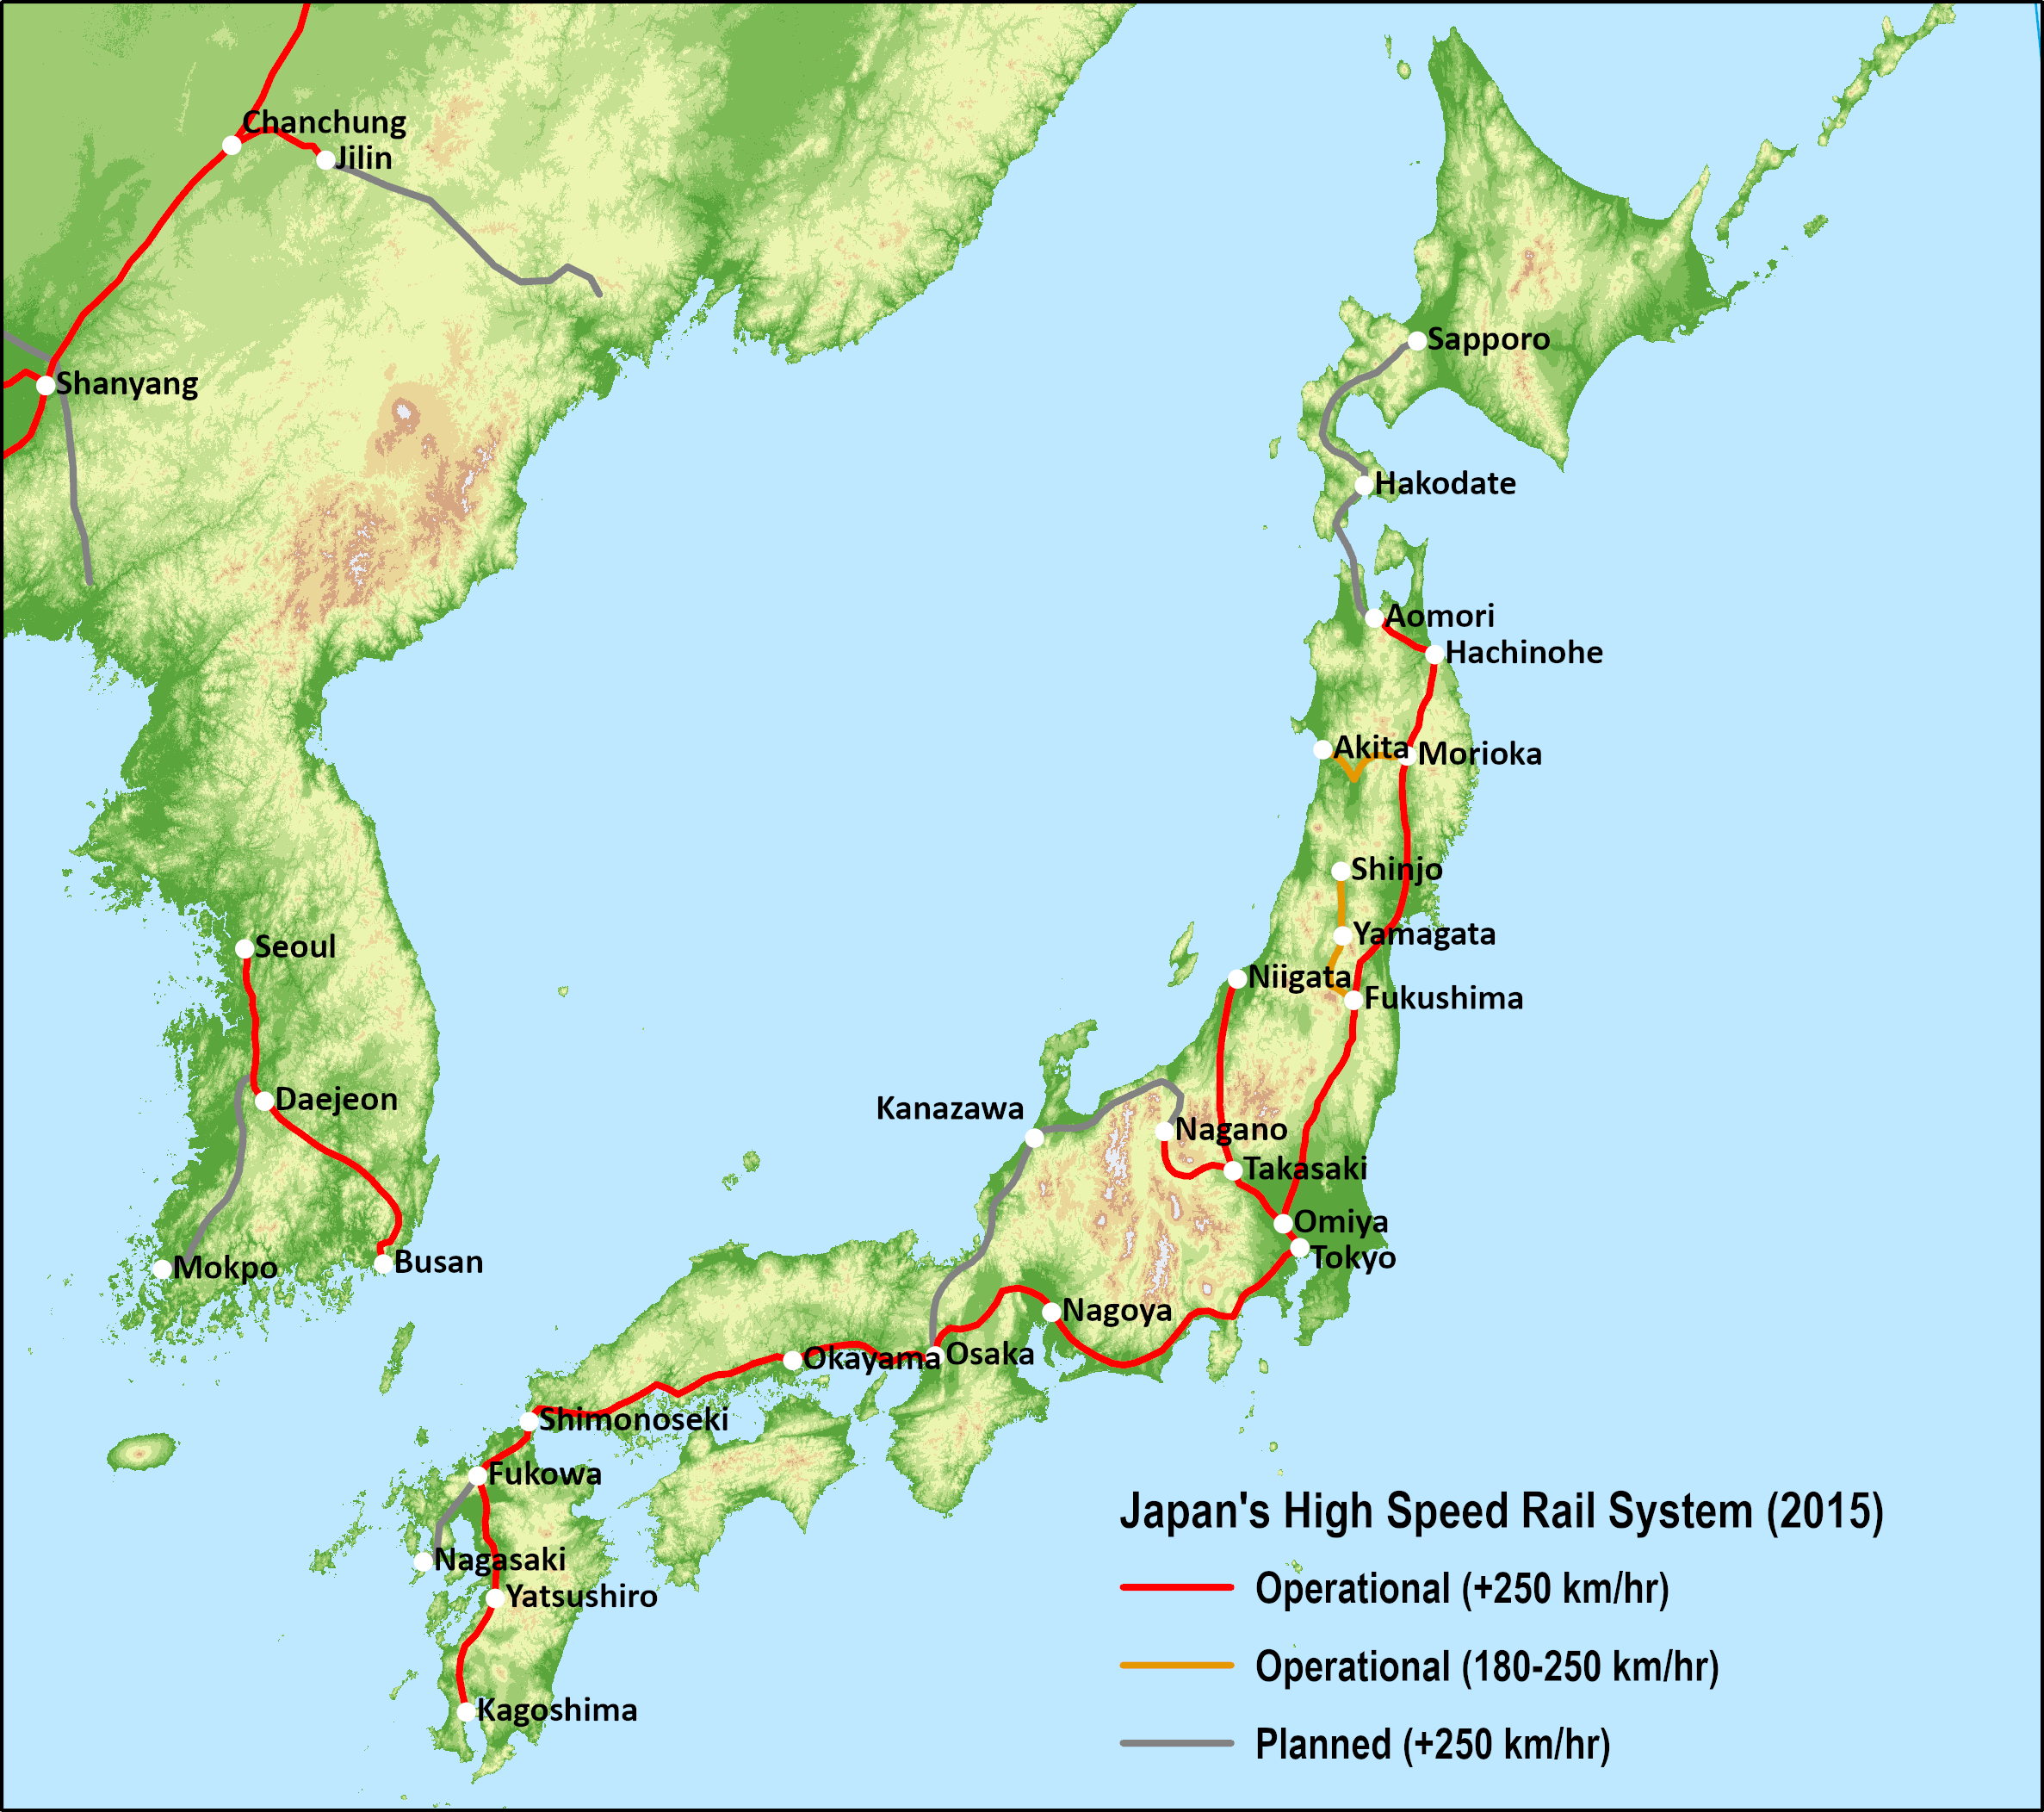
The Shinkansen High Speed Rail Network
Why This Train Is The Envy Of The World: The Shinkansen Story
Notes:
Source: adapted from Dave Fossett, Byun Byun Shinkansen. http://www.h2.dion.ne.jp/~dajf/byunbyun/index.htm

