Slide 1
Topic 4 – Japan and its Corporate Hegemony
A – Geography and the Insularity of Japan
B – Japanese Development
C – The Corporate and Industrial Hegemony

Slide 2
Conditions of Usage
For personal and classroom use only
  Excludes any other forms of communication such as conference presentations, published reports and papers.
No modification and redistribution permitted
  Cannot be published, in whole or in part, in any form (printed or electronic) and on any media without consent.
Citation
  Dr. Jean-Paul Rodrigue, Dept. of Global Studies & Geography, Hofstra University.

Slide 3
B. Japanese Development
1. Feudal Japan (before 1868)
  What characterized the Japanese society before its modernization?
2. Japan’s First Transformation (1868-1945)
  How Japan was able to become an industrial power while most Pacific Asian countries failed?
3. Japan’s Second Transformation (1946-1989)
  How Japan was able to become a global economic power?
4. The Lost Decades (1989-)
  Why Japan has recently been facing economic difficulties?

Slide 4
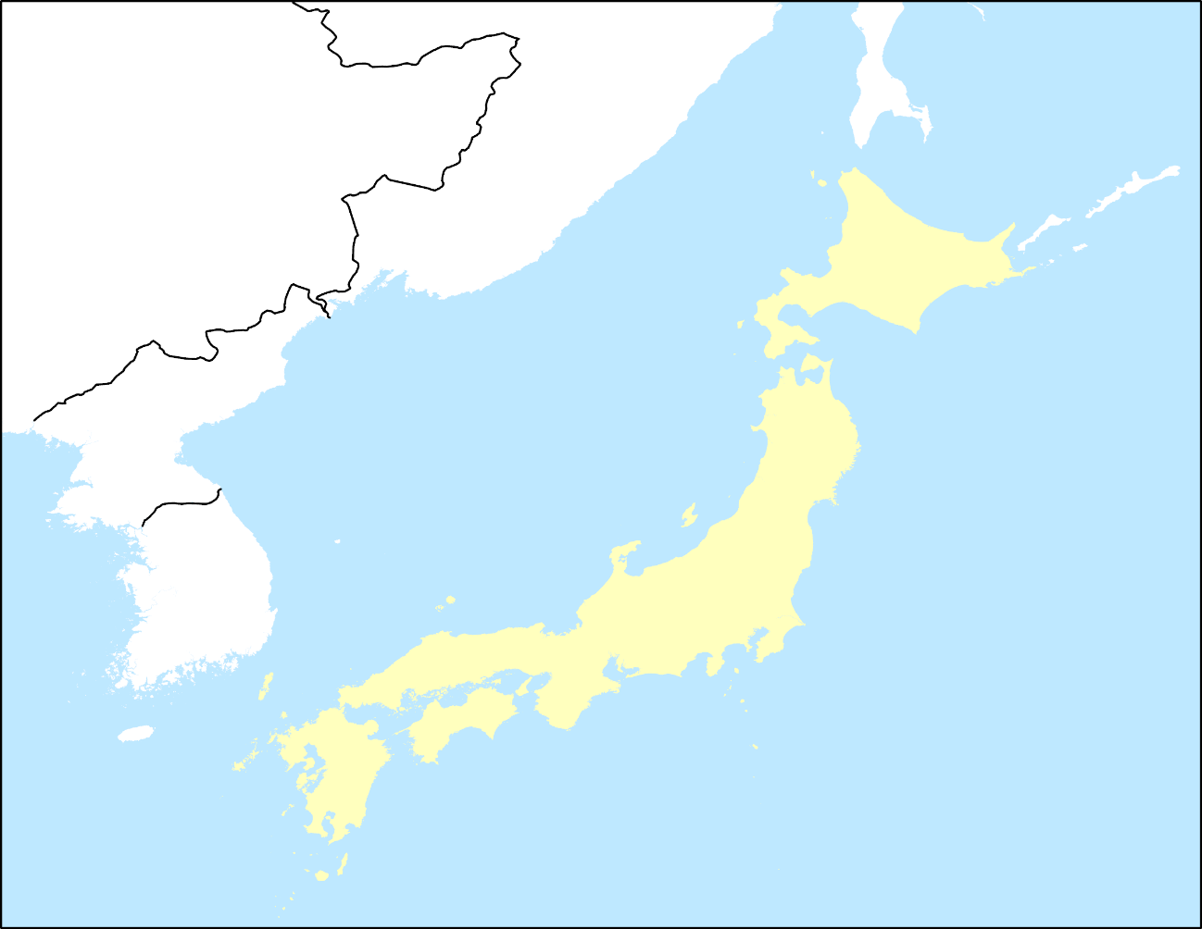
1. Feudal Japan
Mythical origins
  Japanese are descendants of the Sun Goddess Amaterasu (660 B.C.)
  Major Kami (divinity) of Japan.
  Mother of the first emperor (so divine origin).
  The emperor: symbol of the people and the unity of the nation.
Archeological origins
  Migration from the Korean peninsula around 400 B.C.
  Brought rice culture from China.
  Overthrown Ainu tribes present since the Neolithic era.
  Fragmented country that took a long time to be unified (1603).
Yamato Plain
Core area

Slide 5
1. Feudal Japan
Shintoism
  “The Way of the Kami (Gods/divinity)”:
    A combination of two Chinese words: Shin, meaning “divinity”, and Tao, meaning “the way” or “the path”.
    Founded around 500 B.C.
    Mixture of many tribal religions, each having had their own Kami, or god.
    A Kami is anything that can be viewed with awe or reverence (natural objects or creatures); a physical and conceptual representation of a spirit.
  Purpose:
    Celebration and enrichment of life.
    Sacredness of the whole universe and that man can be in tune with this sacredness.
    Respect for the authority of the state (Emperor), the employer, and the family.
  Worship:
    Act of purification; offering is presented to the kami, (money or food); and a prayer or petition is made.

Slide 6
1. Feudal Japan
The Tokugawa era (1603-1868)
  Brought stability and ended civil wars.
  Unified Japan in a strong feudal system.
  Strict partition of the society in social classes:
    Samurai; warriors and administrators.
    Peasants.
    Workers in crafts.
    Merchants.
  Rise in the population and cultivated land.
  Heavy taxes:
    Peasants forced to give about 50% of the harvest to the landlord (Daimyos).
    Wealth mainly measured by rice production.

Slide 7
1. Feudal Japan
Isolation
  Self-imposed isolation (until the 19th century):
    Sakoku (closed country).
    Ethnocentrism.
    Xenophobia; travel abroad subject to the death penalty.
    Strict gender roles.
  Closed to foreign trade (1630-1854):
    Trade allowed with China (Nagasaki) and the Netherlands (Dejima; 1651-1854).
  Christian religion implemented by Portuguese missionaries from the 16th century:
    About 500,000 adherents.
    Failed as 100,000 Christian Japanese were killed in 1612 by repression.
    Felt as a tool of foreign control.
  Very strict social and political regime with almost no mobility.
  Isolation was a way to maintain the regime.

Slide 8
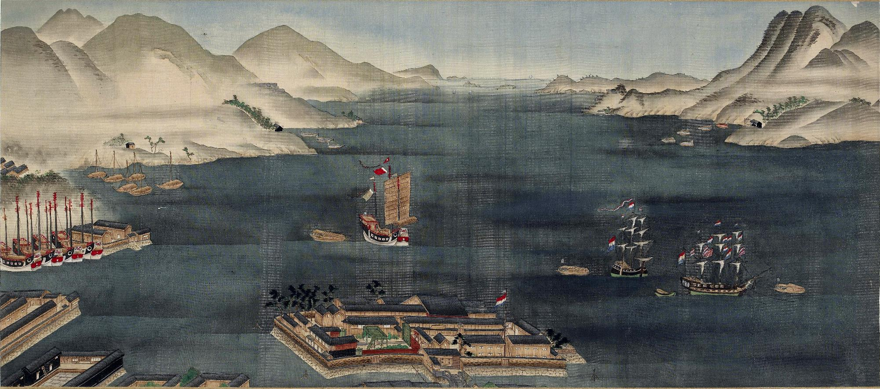
Dejima and Nagasaki Bay, circa 1820
Chinese Junk
Dutch ships
Dejima Enclave

Slide 9
1. Feudal Japan
Feudal Economy
  Power measured by rice production:
    Rights to a share of the crops.
  Large cities:
    Edo (imperial capital that will become Tokyo)
    Osaka (merchant city).
  Powerful merchant families:
    Such as in Europe, merchants were becoming powerful actors.
    Large commercial houses such as Mitsui and Sumitomo.
    These houses will become Japanese conglomerates.
  Several factors favorable to industrialization:
    High urbanization: 16% by 1850.
    Strong fiscal income.
    Active internal trade.
    High literacy (25%) of the population (40% for males).
    Economic specialization of regions.

Slide 10
1. Feudal Japan
The end of feudalism
  Intervention of the United States in 1853 (Commodore Perry).
  Increased European military presence in the region:
    England just won the Opium War with China.
    Considerable technological advances prevented Japanese opposition.
  Unequal trade treaties signed (1858):
    With the United States, Russia, Netherlands, England and France.
    Unequal because it confers advantages only to one side (no reciprocity).
    Commercial privileges, extra-territoriality for Western residents, presence of diplomatic representatives, low tariffs set by treaty, opening of new ports.
  A sense of humiliation arose:
    The Shogun was not able to rectify the situation.
    Chinese proverb: “Change in dynasty occurs when there are interior problems and threats from the outside”.

Slide 11
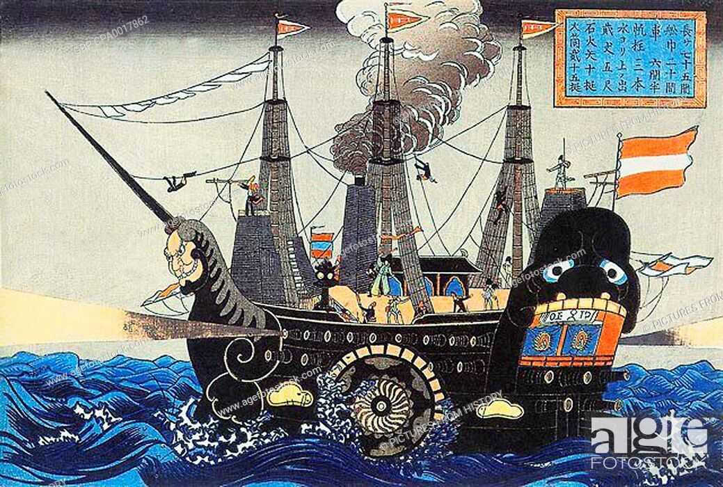
Depiction of an American Steamship (Black Ship), 1853

Slide 12
2. Japan’s First Transformation
Context
  End of the Tokugawa period (1603-1868):
    Overthrowing the Shogun with a civil war (Boshin Civil War; 1868-69).
    Internal rebellion to change Japan in order to survive.
  New emperor ended 250 years of military regency (1868):
    Meiji stands for “enlightened government”.
    From feudal to industrial society in less than 40 years.

Slide 13
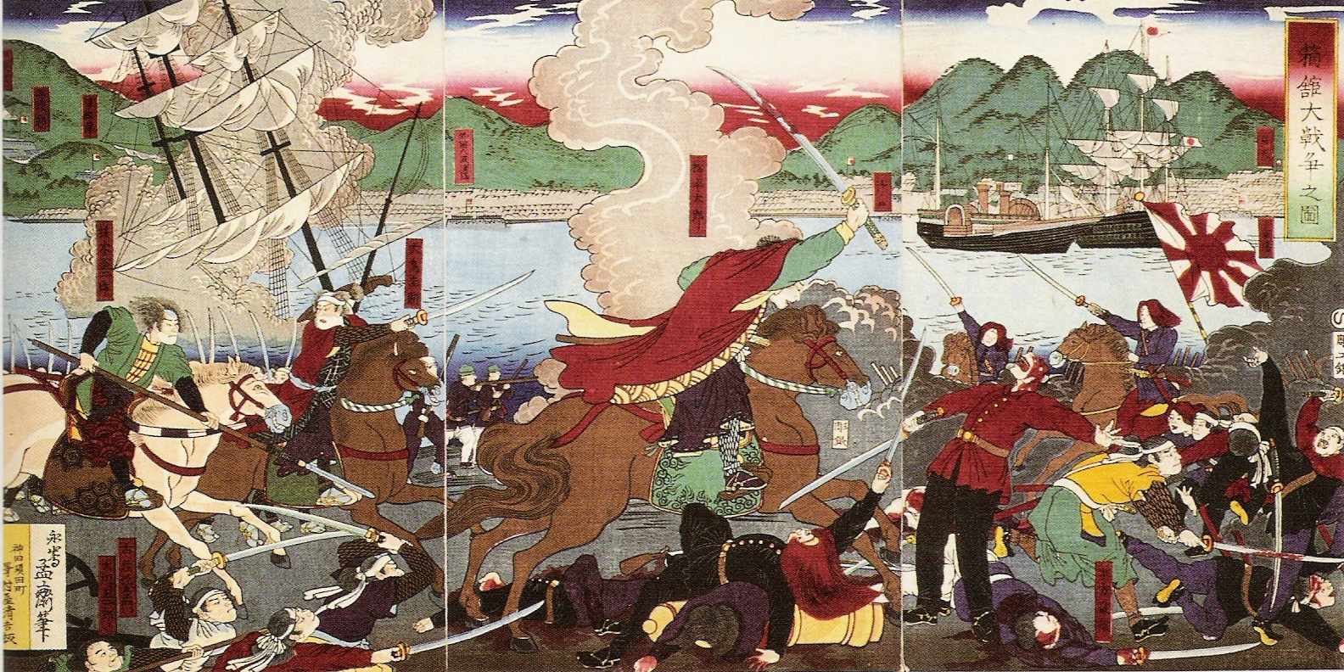
Last Stand of the Shogunate: Battle of Hakodate (Hokkaido), 1869

Slide 14








2. Japan’s First Transformation: Meiji Reforms
Meiji Restoration
Feudal System
Abolition of the Feudal System. Country divided into prefectures (1872).
Land redistribution
Right to private land ownership. Taxation system.
Public education system from France and Germany. Hiring foreign teachers. Western curriculum.
School System
Army & Navy
Samurai class disappeared. Conscription formed a civilian army along the Prussian model. Modern navy from the British model.
Parliamentary monarchy formed (1889). Capital relocated from Kyoto to Tokyo; Easier access to the ocean.
Constitution
Emperor
Divinity of the Emperor. Symbol and unifying figure of Japan.
Banking
Formation of the Bank of Japan (1882). Single currency.
Civil liberties
Independent judiciary. Civil rights and religious freedom allowed but restricted.

Slide 15
2. Japan’s First Transformation
Indigenous modernization
  Acquisition of western technologies and ideas:
    “Japanese spirit, Western science”.
    More than 3,000 foreigners invited to teach science, mathematics, technology, and foreign languages.
  Urbanization, transport and communication:
    Rail system (1872).
  Market economy.
  Formal schooling.
    Literacy rate of 90% in 1900.
  Also a few wrong ideas:
    German theories of racial purity.
    European rationale for colonialism (manifest destiny, moral superiority).
    Christian single deity: The Emperor.
Explain the main driving forces behind the first transformation of Japan.

Slide 16
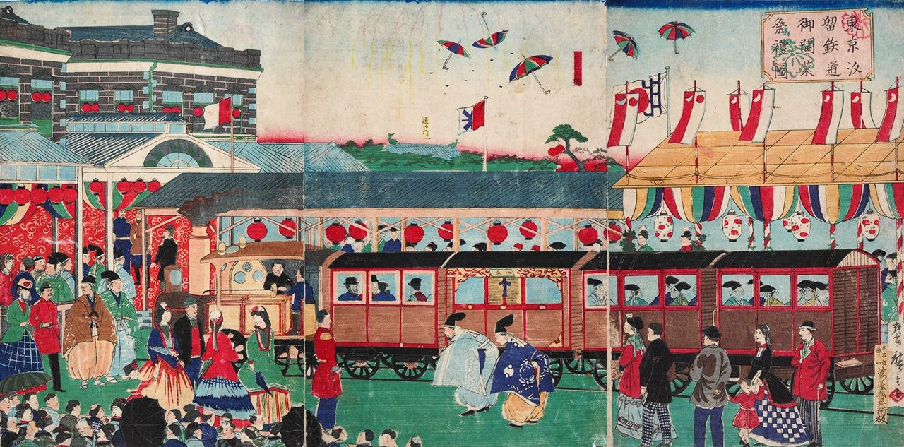
Japan First Rail Service, Tokyo to Yokohama (1872)

Slide 17
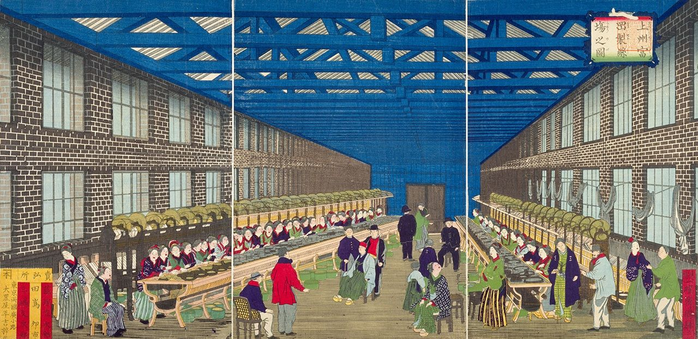
Tomioka Silk Mill, 1873
Notes:
300 silk reeling machines of the latest design, imported from France. Paul Brunat headed a team of French technicians, mainly female, who oversaw operations and trained Japanese workers. In their turn, these workers passed their knowledge on at mills across the country.

Slide 18
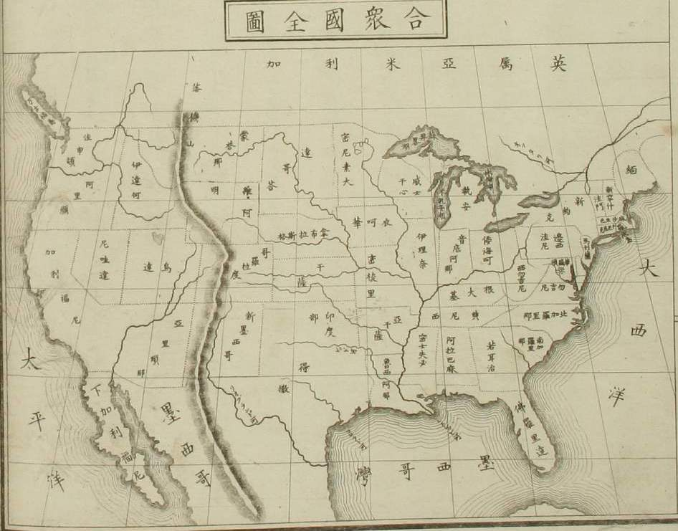
Japanese map of the United States (circa 1870), Uchida Masao, Atlas of World Geography

Slide 19
2. Japan’s First Transformation
Territorial expansion and resources acquisition
  Japan solved its problems by territorial expansion.
  Limited raw materials and internal market.
  Taiwan annexed (1879) after the Sino-Japanese war (1894-95).
  Victory in the Russo-Japanese war (1904-1905):
    Korea annexed (1910).
    Access to Manchuria (Port Arthur; Dalian).
  Manchuria (1932):
    Vast supplier of resources, especially minerals.
  Vast weapon construction programs.
  Transformation of colonies (Korea and Taiwan) to produce agricultural commodities needed in Japan.

Slide 20
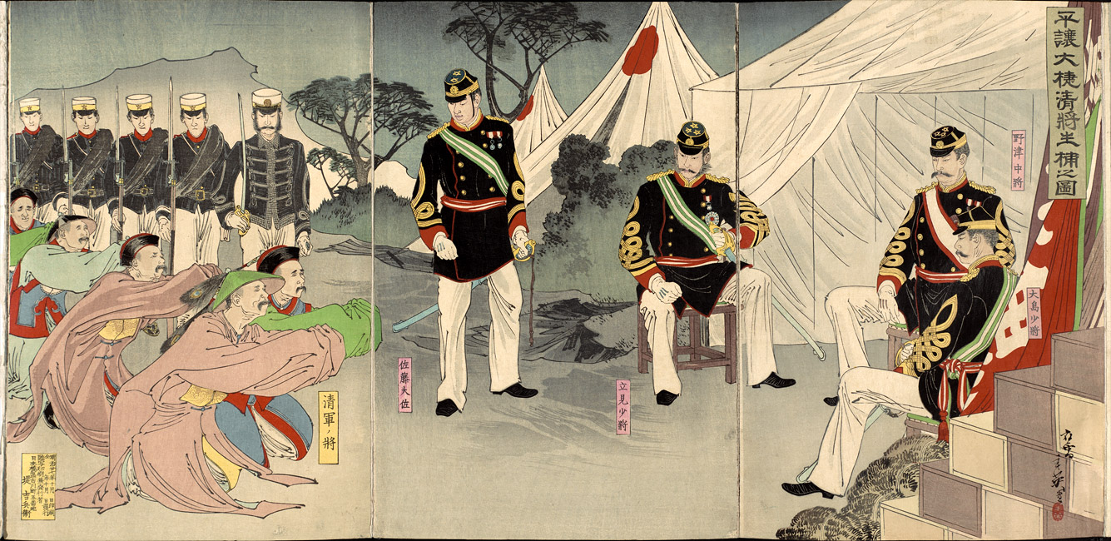
Chinese Surrender at Pyongyang, 1894

Slide 21
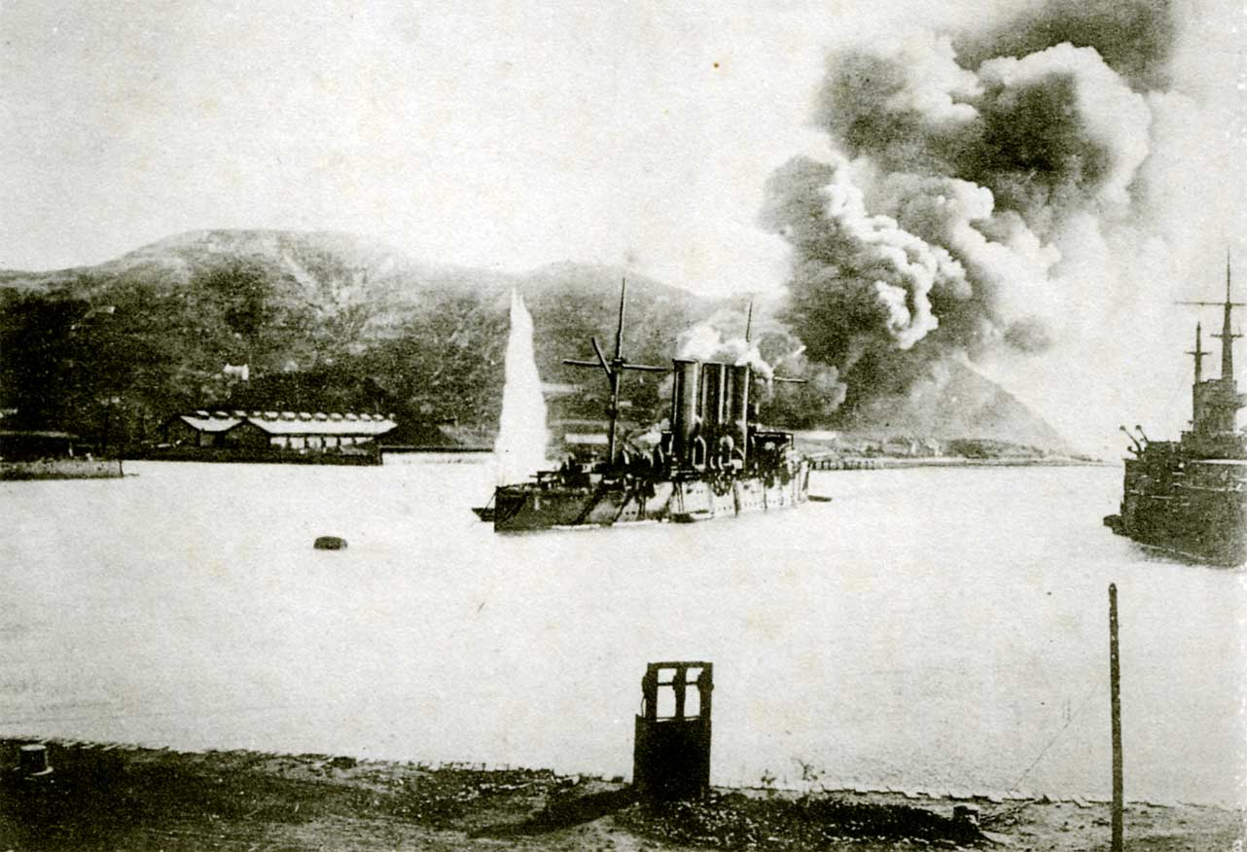
Siege of Port Arthur (near Dalian), 1904
Russian cruiser bombarded by Japanese artillery

Slide 22
2. Japan’s First Transformation
Government / corporate dualism
  The cession by the state of large industrial infrastructures.
  Concentration of economic power in the hands of large conglomerates.
  National achievements, private profits:
    The creation of the military / industrial complex.
  Zaibatsu (financial cliques) emerged:
    Controlled by merchant families:
    Mitsui (16th century).
    Mitsubishi (1873).
    Sumitomo (16th century)
    Notable Japanese conglomerates that gained tremendous power during the Meiji era.
  Supported the establishment of the emperor.

Slide 23
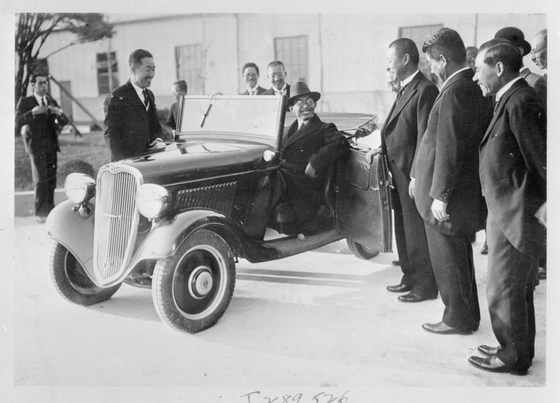
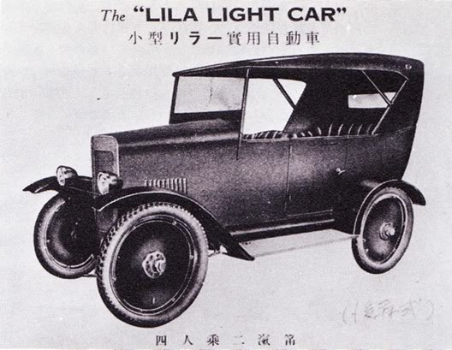
Datsun car, Nissan manufacturing, 1934

Slide 24
2. Japan’s First Transformation
Imperialist Japan
  New Emperor, Hirohito (1926):
    Showa period “enlighten peace”.
  Government dominated by the military.
  Japan as the dominant race of Asia.
  Territorial expansion:
    Government: Establish a political control zone in the Pacific zone.
    Military: Reinforce Japanese power and prestige.
    Zaibatsus: External markets for Japanese goods facing Western protectionism.

Slide 25
2. Japan’s First Transformation
Territorial expansion during WWII
  Look at the outside to solve internal problems.
  War declared in 1941 against the Allies.
  Initial successes in 1941-1942 gave to Japan a large economic sphere of influence.
  Several new raw material sources:
    Indonesia: oil.
    Malaysia: rubber and tin.
    Lacking for the Japanese economy.
  Access to a vast market and labor pool.
  The industrial organization of conquered countries was done by the zaibatsu.

Slide 26
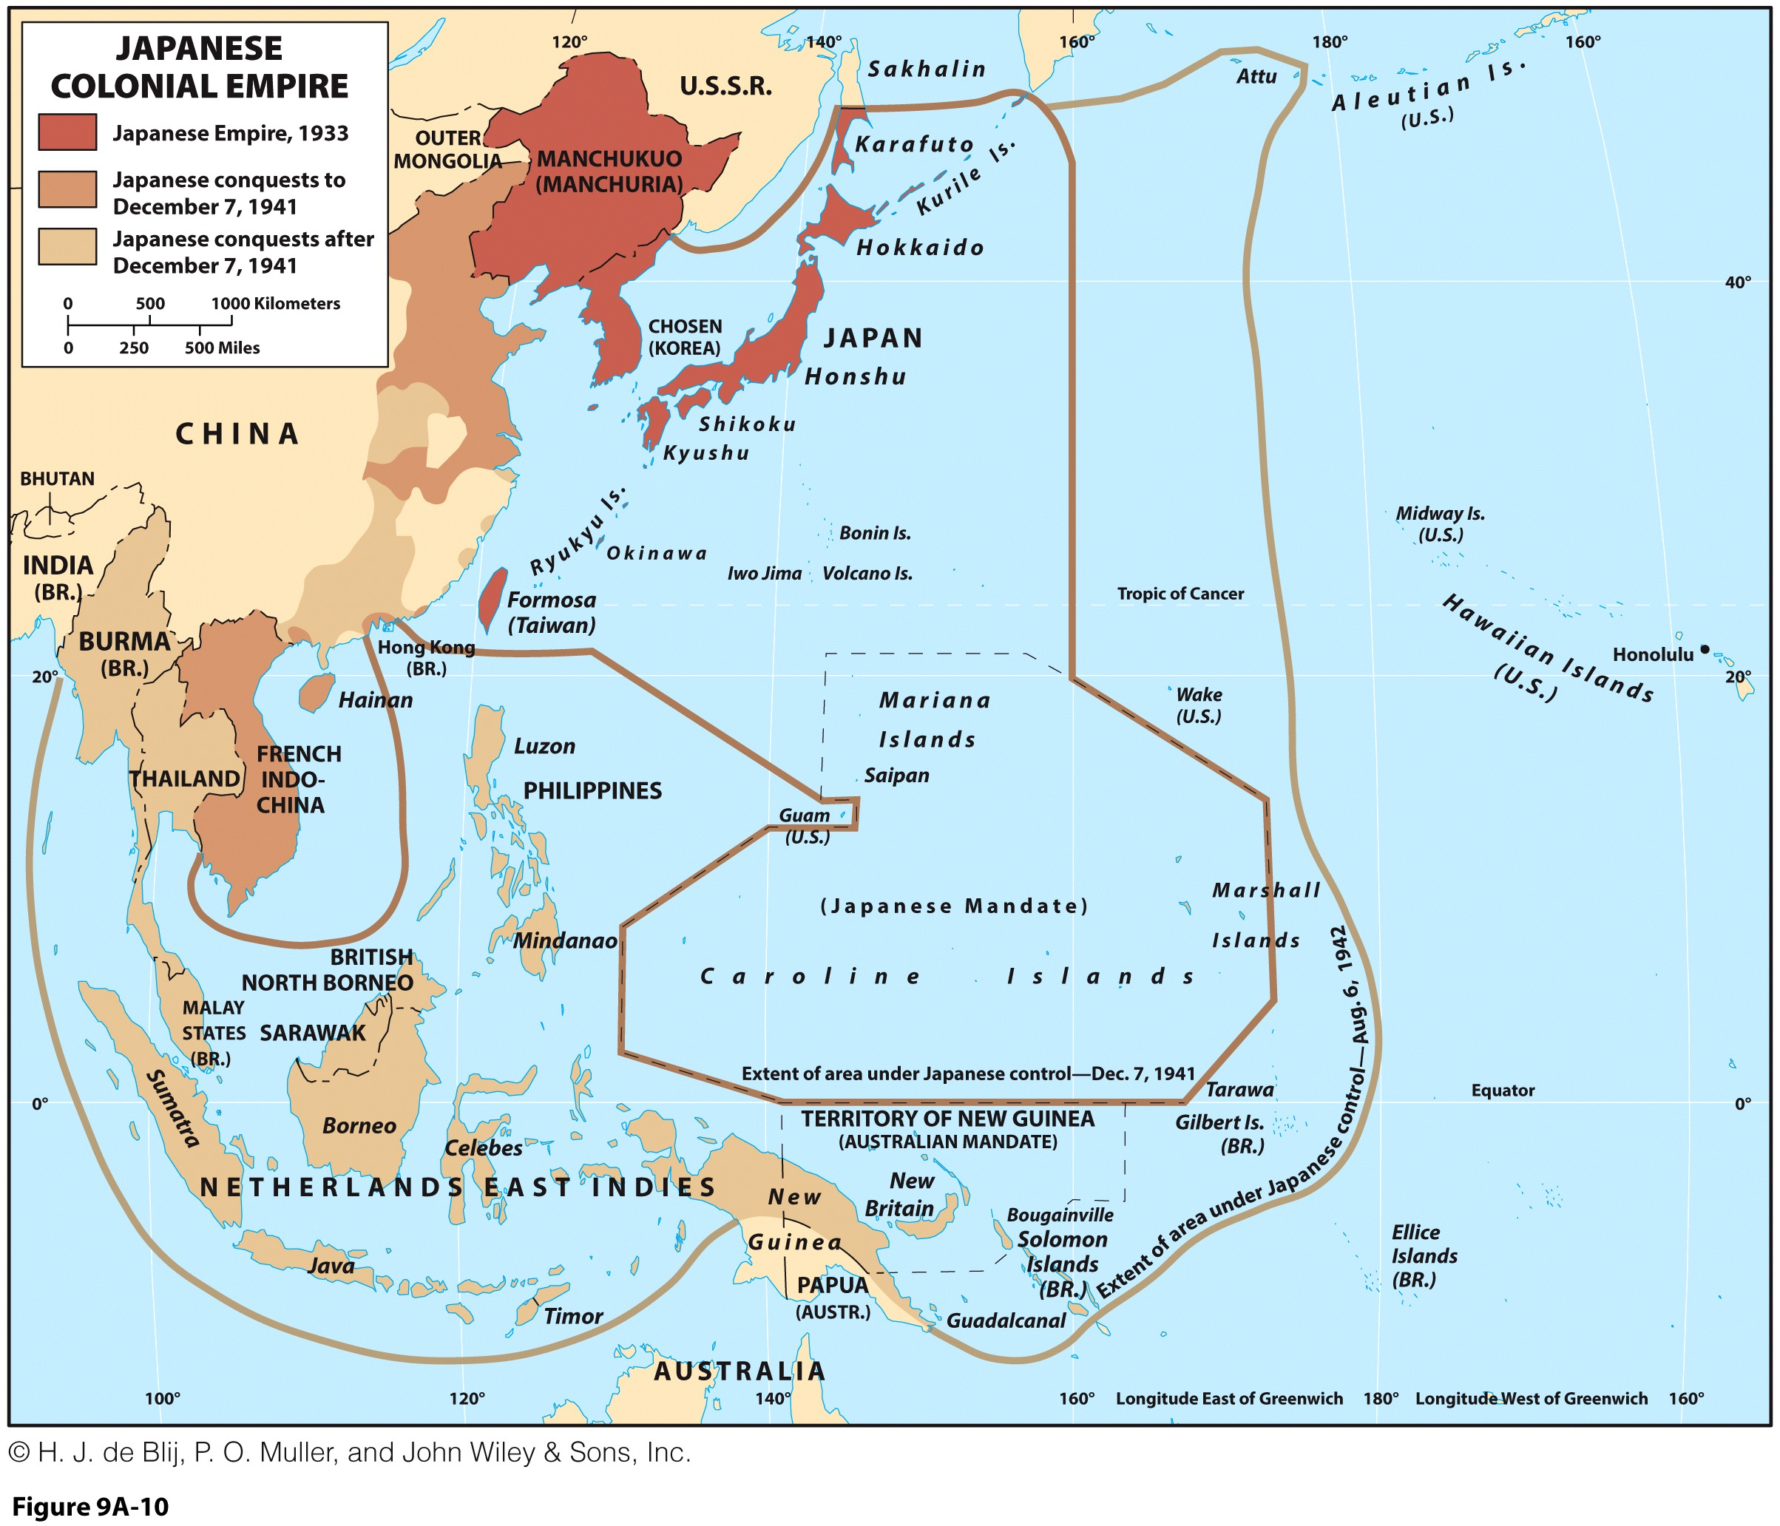
2. Japan’s First Transformation

Slide 27
2. Synopsis: Japan’s First Transformation
Isolationism
Technology assimilation
Military
Taiwan (1879)
Korea (1910)
Manchuria (1932)
Feudal Japan
Imperial Japan
Expansion
Social stratification
Govt. / corp. dualism
Resources / Markets
Zaibatsus
Southeast Asia (1941)
United States (1853)
Unequal Treaties (1858)
Civil War (1868)
Explain the main driving forces behind the first transformation of Japan.

Slide 28
3. Japan’s Second Transformation
Defeat of 1945
  Ended Japanese imperialism in Pacific Asia.
  The Japanese economy was in shambles.
  Territory:
    Lost all its conquest of the last 60 years.
    Parts of its national territory was occupied for the first time in history (American bases at Okinawa).
  Casualties:
    7.1 million deaths.
    4 million workers of weapon industry were laid off.
    2.6 million people moved abroad (Korean and Chinese workers).
    1.2 million Japanese were repatriated (military personnel, administrators, traders, industrialists).
Archive footage of Hiroshima bombing

Slide 29
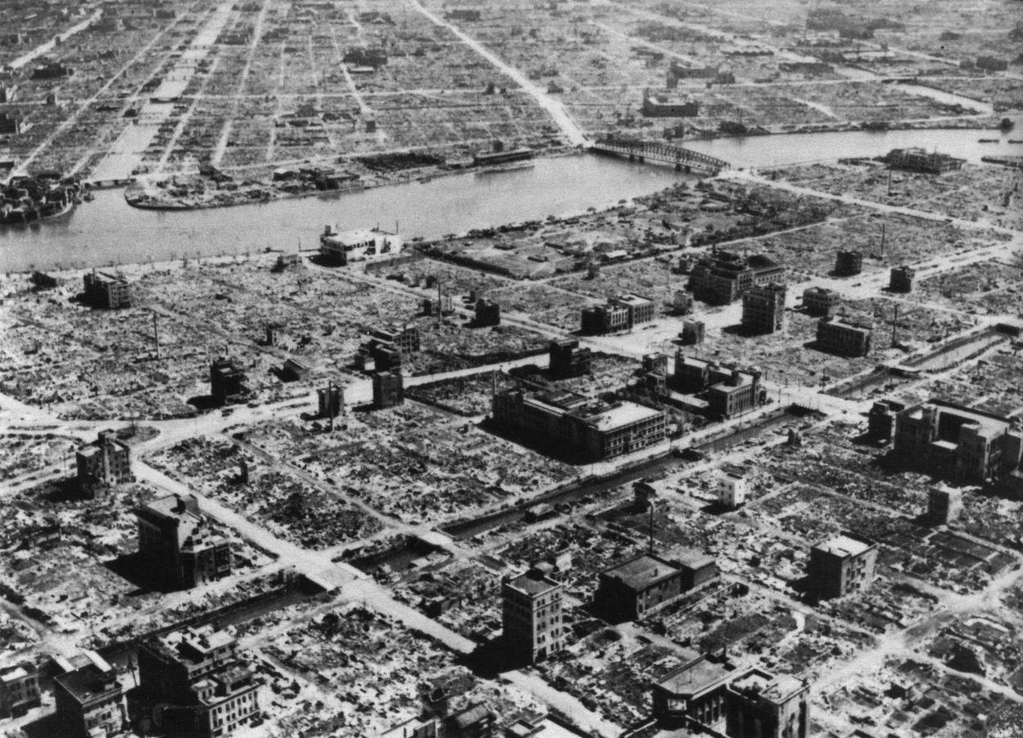
Tokyo, After bombing raids of March 1945

Slide 30
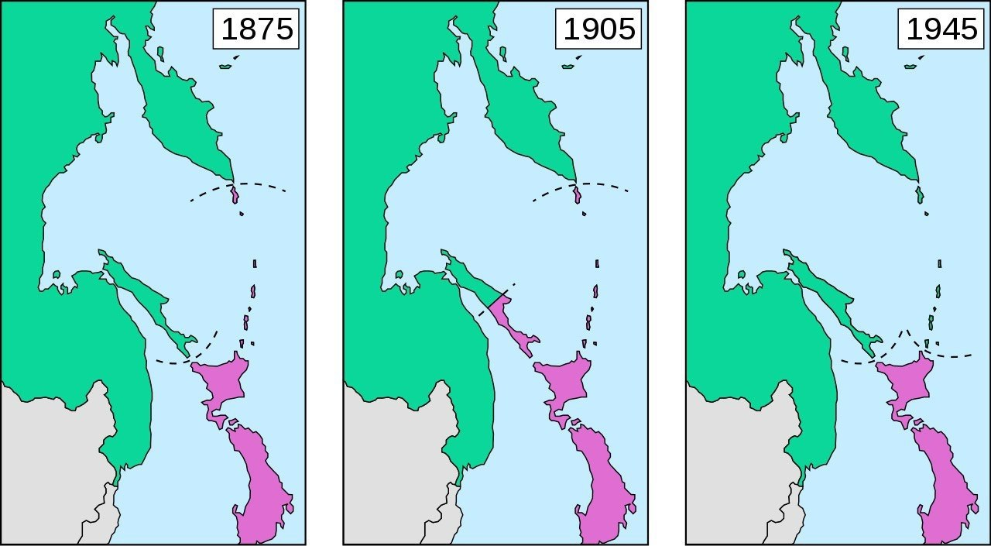
Changes in the Border between Japan and Russia (1875-1945)
Kuril Islands
Sakhalin Peninsula

Slide 31
3. Japan’s Second Transformation
Economic damage of WWII
  Main cities (Kobe, Tokyo and Osaka) were destroyed over more than 50% of their surface.
  Hiroshima and Nagasaki were a total loss.
  25% of housing was destroyed, 75% of oil refineries.
  90% of the merchant fleet and 30% of roads and railways.
  The industrial capacity was at 60% of if 1935 level.
  13 million unemployed.
  Material losses estimated at 25% of GDP.

Slide 32
3. Japan’s Second Transformation
Marshall plan (1948)
  The United States established an aid plan to help the Japanese economy recover.
  Fear about instability promoting civil unrest.
  About 2 billion dollars of aid:
    Sony started with American financial help.
Political and Economic Changes
  Political:
    The emperor became again a symbol.
    Adoption of a constitution like the United States.
    No involvement in foreign wars permitted.
  Economic:
    Break-off of the Zaibatsus.
    Advantageous parity of the yen (1 dollar for 360 yen).

Slide 33
3. Japan’s Second Transformation
The Korean War (1950-1953)
  Benefited the Japanese economy.
  Japan served as a depot for the UN army:
    Only allied country in the region.
  Subcontracting to the American army:
    More than 1 billion in contracts for the national industry.
    Mazda started as a jeep manufacturer for the US army.
    Related industries (energy, steel and chemistry) benefited.
  Japan recovered its sovereignty (1951).
  Several Zaibatsus reformed as Keiretsus (groups of bosses).
  Mutual defense treaty signed with the United States (1954).
  Growth was based by imitating western technologies and exports.

Slide 34
3. Japan’s Second Transformation
1) Geographical context of Japan
  Paradox in itself.
  Small-sized country (very little available space).
  Average-sized population (126 millions).
  Very limited array of resources.
  “Creative pressure” perspectives:
    Incitements at miniaturization.
2) Promotion of exports
  The world economy entered in a period of post-war expansion.
  Important growth of international trade.
  Japan entered the GATT (1955).
  Development of the national market and of the promotion of exports.

Slide 35
Share of World Goods Exports, Selected Countries, 1950-2020
Notes:
Source: WTO.

Slide 36
3. Japan’s Second Transformation
3) Labor
  Good labor relations in the Japanese economy:
    Post war hardships.
    Good management.
    A consensus was reached in the early 1950s.
    Strikes are virtually unheard of.
  Highly skilled, disciplined and trained.
  Continuous improvement in qualifications, part of the corporate experience.
  Longer weeks, weekdays and more overtime.
  More willing to avoid conspicuous consumption.
  Less space (housing) for the accumulation of consumption goods.

Slide 37
Hours Per Day by People Aged 15-64, 1998-2009
Notes:
Source: OECD.

Slide 38
3. Japan’s Second Transformation
4) Technology
  Imports, notably from the United States.
  Licensing, patent purchases, and imitation and improvement.
  Imitation of successful technologies.
  Japan then became an innovator (1980s).
5) Consumption and wages
  Internal demand growth because wages were growing faster than inflation but less than productivity growth.
  Fast adoption by the market:
    Preferences on national products.
    Short product life cycle.
    Exports can occur over economies of scale.
  Spread the gains in the society.
1970s Japan, Women Shopping, Consumerism, Shops, Color Archive Footage

Slide 39
Adoption of Consumption Goods by Japanese Consumers, 1970s

Slide 40
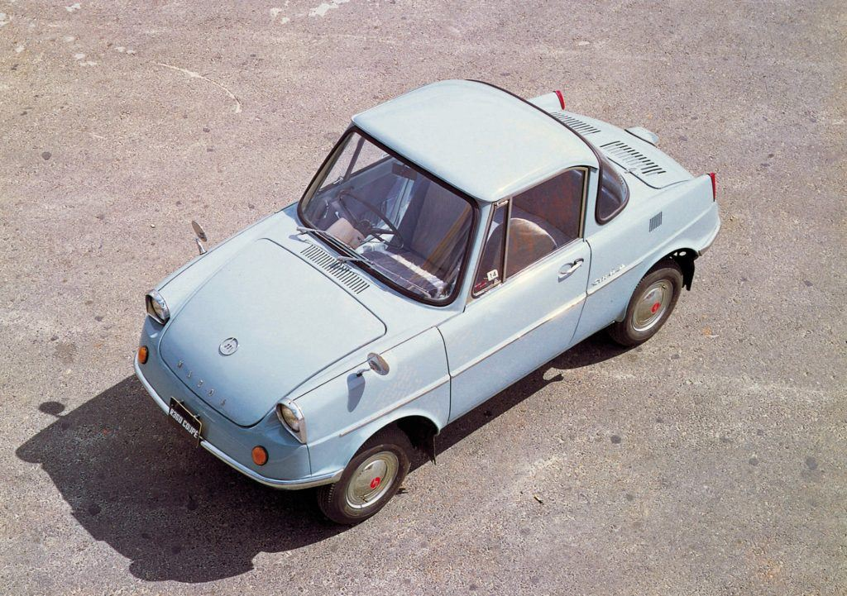
Mazda first mass-produced car, Mazda R360, 1960

Slide 41
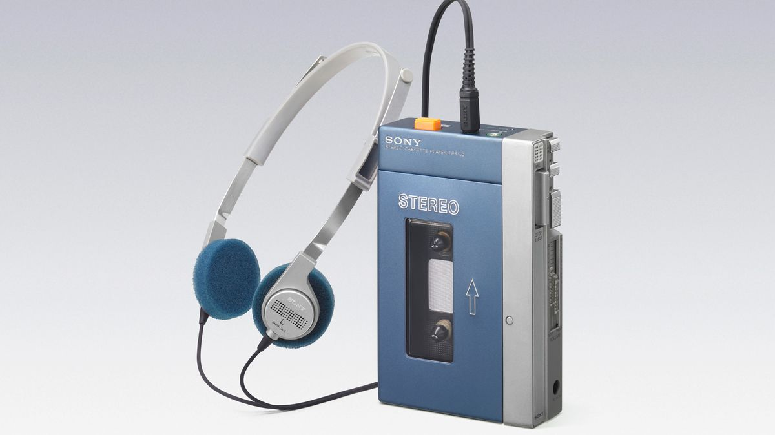
Sony “Walkman”, 1979 (First portable cassette player)
200 million cassette units sold
400 total units sold (+CD)

Slide 42
3. Japan’s Second Transformation
6) Investments
  Done in productive forces instead of consumption.
  High technology and heavy capital investment:
    20% of GDP.
    Steel, petrochemicals, cameras, televisions, motorcycles and automobiles.
  Saving rates:
    Between 15 and 25% of income compared to less than 3% in the United States.
    13% of GPD in 1970 as opposed to 6% for the United States
    Policies to favor savings, unlike borrowing for the US.
    Decline in savings due to aging of the population.
  The government provided financial assistance to banks and invested in infrastructures such as road and railways.
  Investment needs came from 90% of national capital:
    No vulnerability to currency fluctuations.

Slide 43
3. Japan’s Second Transformation
7) Educational system
  Longer schooling year.
  Very competitive system.
  High level of discipline.
  Emphasis of technical issues.
8) Military expenses
  Much smaller than most countries.
  Security guaranteed by the United States.
  Japan has however a significant defense force.
  Resources can be allocated elsewhere.

Slide 44
3. Japan’s Second Transformation
9) The role of corporations (Keiretsus)
  High level of loyalty to corporations and other institutions.
  Cradle to grave employment:
    Once graduated from school, a person's position with a corporation may last for life.
    Corporations often provide housing, recreational opportunities, vacation travel, and, sometimes, even marriage opportunities.
  Japanese corporate strategies:
    Coordination of investments, production and exports.
    Unwillingness to buy from abroad even when the price is lower.
    Spends a great deal on research and development to keep at the cutting edge of new technologies.
    Corporations somewhat replaced the government for foreign policies.

Slide 45
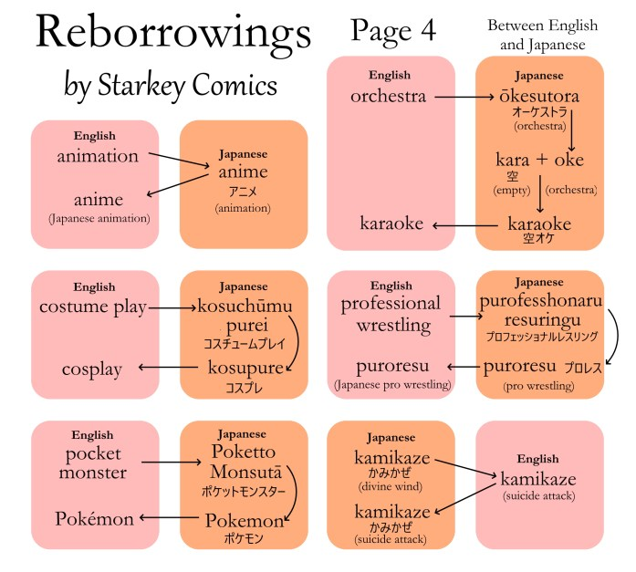
3. Japan’s Second Transformation
10) Adaptation and ambivalence
  Tradition since the Meiji restoration.
  Able to borrow ideas and technologies and incorporate them into society.
  Celebration of Christian holidays, such as Christmas.
  Favorite drinks are Sake and Scotch.
  Favorite sports and Sumo wrestling and golf.

Slide 46
3. Synopsis: Japan’s Second Transformation
Government
Imports
Geography
WWII
Corporate Japan
Trade
Labor / Education
Keiretsus
Exports
Technology
Added Value
Investments
Military occupation
Political changes
Economic changes
After WWII Japan undertook its second transformation. Explain its main driving forces.

Slide 47
Japan’s First and Second Transformation
 | First Transformation (1868 – 1945) | Second Transformation (1945-1990)
Political System | Parliamentary Monarchy (Emperor / Military / Industry) | Democracy (Government / Industry)
Foreign Policy | Imperialism | Trade / Investment / Aid
Corporate System | Zaibatsu (strong linkages) | Keiretsu (weaker linkages)
Technology | Assimilating and adapting Western technology | From adaptation to innovation
Quick Recap about the History of Japan

Slide 48
4. The Lost Decades (1989-)
The “Bubble Economy”
  Period of fast growth in the late 1980s.
  High confidence and high expectations.
  Evaluation of the yen after 1985 (3 times its 1971 value).
  Asset prices inflation (stock and real estate):
    Real estate as the guarantee to borrow for stock market investment.
    Peak of the bubble (1990); Japanese real-estate was worth four times the value of all property in the US.
  Unsustainable process.

Slide 49
4. The Lost Decades (1989-)
Factors
  Speculation:
    Real estate and stock market.
    Growth expectations and risk-taking.
    Many loans could not be paid back.
  Relocation of several factories to cheap labor nations:
    15-20% of the manufacturing of Japanese corporations is done abroad.
    The high value of the yen favors imports more than exports.
    China, Vietnam, the Philippines, etc.
    Competing directly with Japan.
    Relocation to Mexico, Canada, and the USA (NAFTA).

Slide 50
4. The Lost Decades (1989-)
  High production costs:
    Undermines international competition.
    Difficulties to adapt to the information society.
  Opening of the internal market to foreign competition:
    Trading partners asking for a more open Japanese market.
    Less pricing power in the Japanese market.
  Ageing of the population:
    Less workforce.
    Less demand for consumer goods.
    High social costs.
The 1990s and 2000s are considered lost decades for Japan. Explain why.

Slide 51
Nikkei Index, 1980-2023 (Monthly); Two Decades Lost
Pop!
Lost two decades
Notes:
Source: https://finance.yahoo.com/quote/%5EN225?ltr=1

Slide 52
4. The Lost Decades (1989-)
Economic and financial crisis
  Began in the 1990s; a period of stagnation.
  In 1990, the Nikkei lost 38% of its value (2 trillion $US).
Consequences
  Since 1991, 2.5 million manufacturing jobs have disappeared (25% decline).
  Mergers and acquisitions in the banking sector.
  The keiretsus are now less dominant as independent entities.
  1990s and 2000s labeled as “Japan’s lost two decades”.
  Crony capitalism with “too big to fail” corporations.

Slide 53
GDP of Japan and the United States, 1960-2020 (current prices)
Notes:
Source: World Bank
https://data.worldbank.org/indicator/NY.GDP.MKTP.CD?most_recent_value_desc=true

