Slide 1
Topic 4 – Japan and its Corporate Hegemony
A – Geography and the Insularity of Japan
B – Japanese Development
C – The Corporate and Industrial Hegemony

Slide 2
Conditions of Usage
For personal and classroom use only
  Excludes any other forms of communication such as conference presentations, published reports and papers.
No modification and redistribution permitted
  Cannot be published, in whole or in part, in any form (printed or electronic) and on any media without consent.
Citation
  Dr. Jean-Paul Rodrigue, Dept. of Global Studies & Geography, Hofstra University.

Slide 3
A. Geography and the Insularity of Japan
1. Location
  In which way the location of Japan is unique?
2. Maritime Orientation
  How is the ocean influencing the Japanese society?
3. Demography
  What characterizes the Japanese population?
4. Resources
  Is Japan lacking resources?

Slide 4
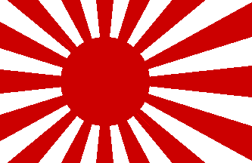
1. Location and Insularity
Location
  “jih-pen” in Chinese (sun’s origin):
    Since Western civilizations encountered China before Japan, the name “Japan” stuck.
  Nihon (or Nippon), meaning “Source of the sun”.
  Hinomaru: “sun disc”.
  Relative isolation in Pacific Asia:
    Insularity.
    Do not share a land border with any country.
    Helped shape Japanese culture and identity.
  Maritime access:
    Shimaguni (island country) / insularity.
    Labeled as the Great Britain of the Pacific.
Contemporary Flag
Imperial Flag

Slide 5
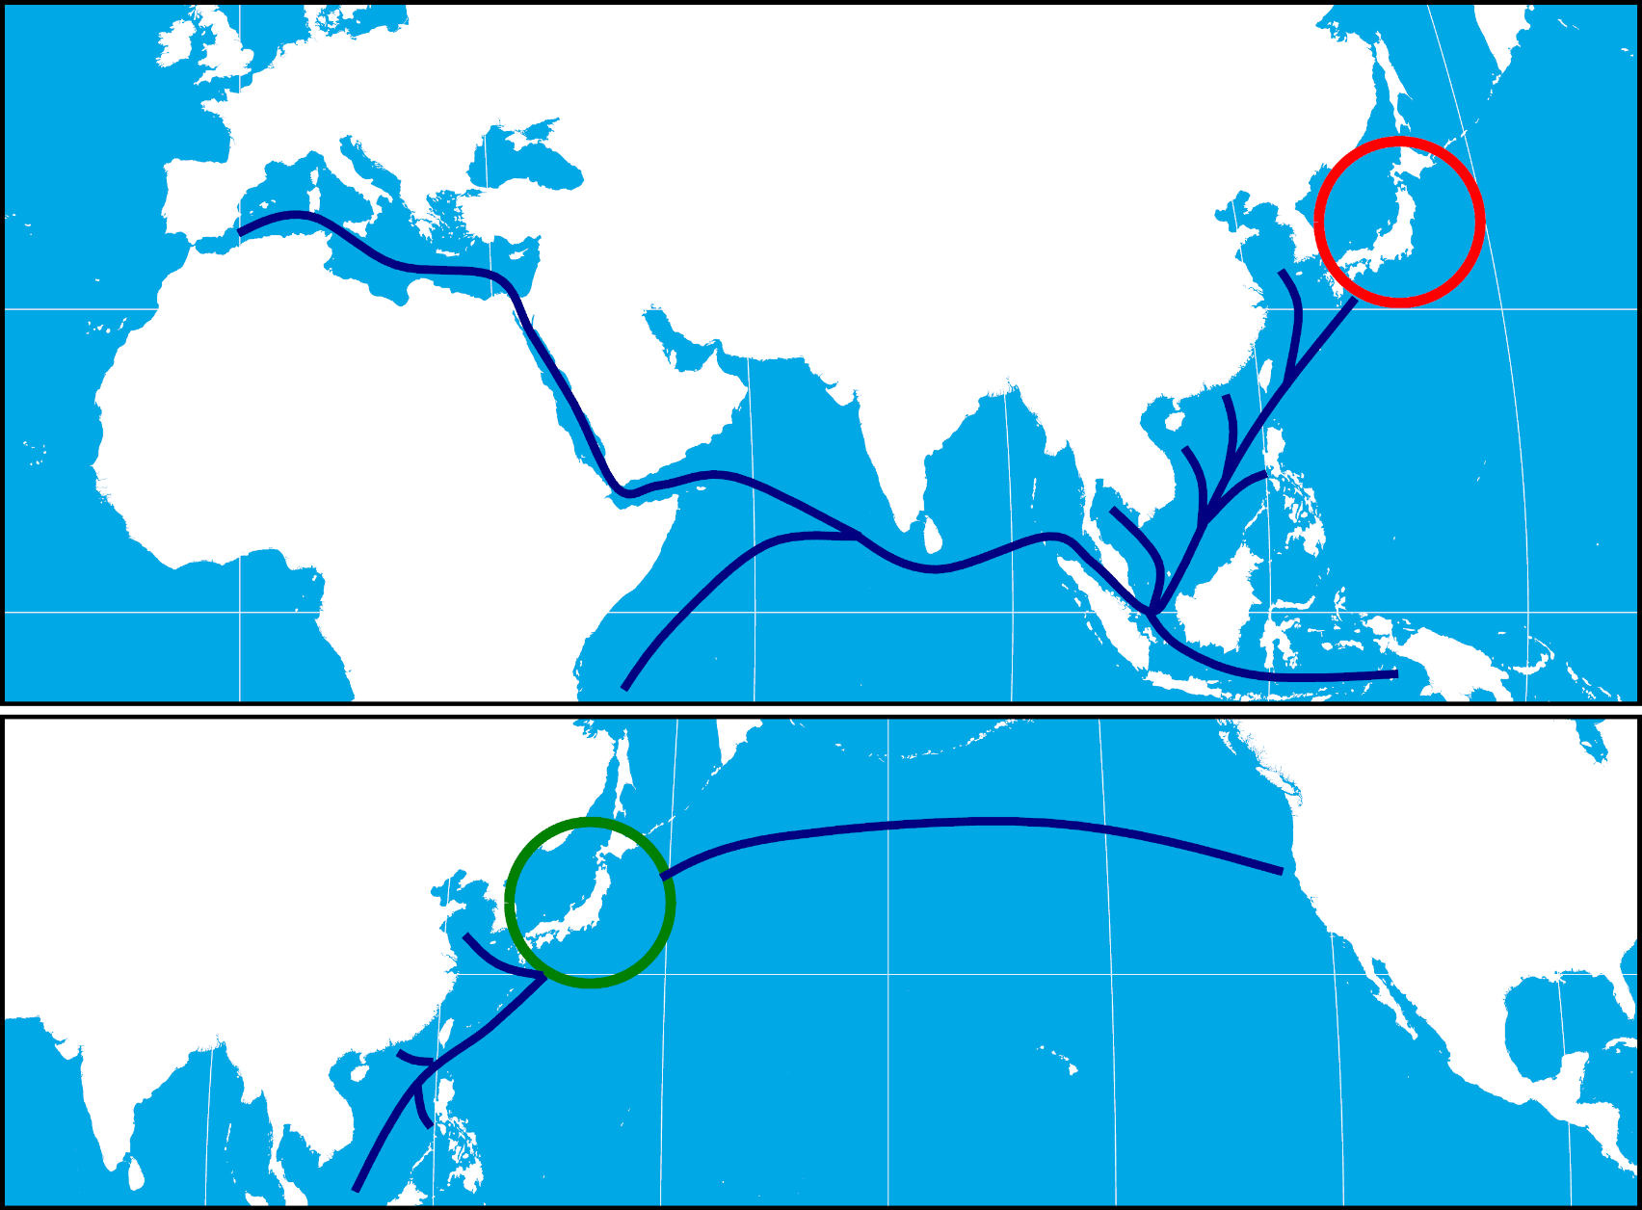
Changes in Japan’s Relative Location
Limited outside influence (insularity).
Writing, Buddhism and Confucianism came from China, via Korea.
Protected from Chinese (Mongol) and Korean invasions.
End of maritime roads from Europe.
From Terminus…
Closest Asian country from North America.
Core of the transpacific trade.
… To Hub
Notes:
The concepts of absolute and relative location.
Changes in relative location.
During the 20th century, the position of Japan was modified.
From a peripheral to a central position.
Trade became trans-pacific and Japan was a hub of the America-Pacific trade.

Slide 6
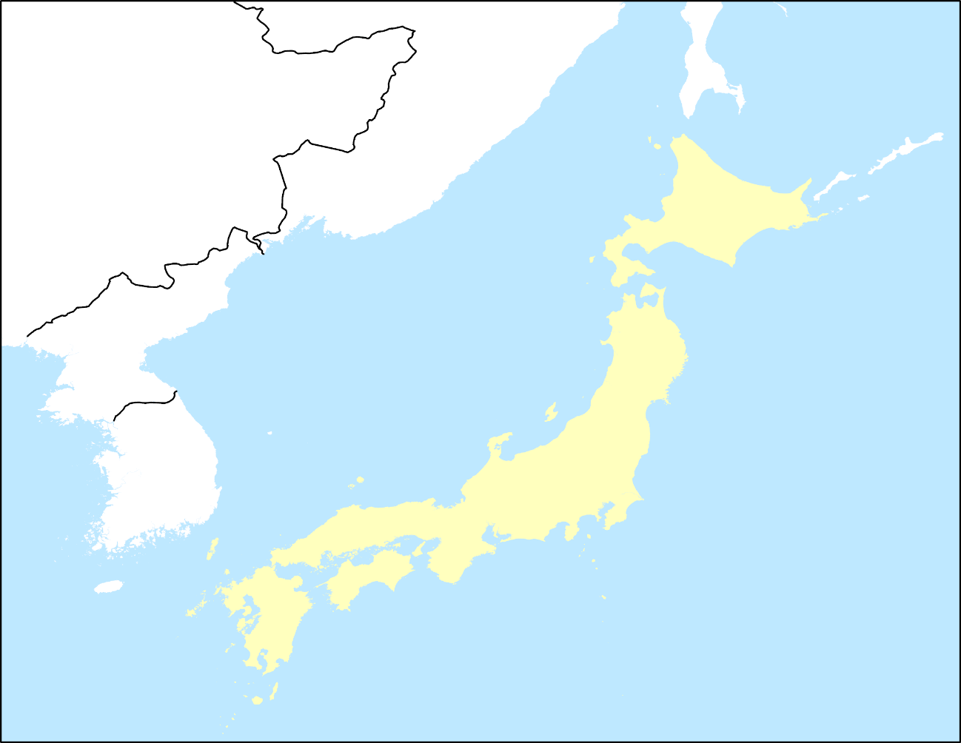
2. Maritime Orientation
Maritime space
  4 islands; 98% of the land mass:
    Honshu (231,100 km2); 80% of population .
    Kyushu (42,100 km2); 10% of population.
    Hokkaido (83,400 km2); 4% of population.
    Shikoku (18,700 km2); 3% of population.
  3,500 islands in two major groups (Ryukyu and Bonin).
  Several large bays:
    Tokyo, Nagoya and Osaka.
    Important concentration of port infrastructures and urban regions.
  Arc of over 1,700 miles.
  Coastline:
    19,000 miles.
    3rd in the world behind Russia and Australia.
Russia
Russia
China
Hokkaido
Sea of Japan
North Korea
South Korea
Honshu
Tokyo Bay
Kyushu
Shikoku
Nagoya Bay
Osaka Bay

Slide 7
2. Maritime Orientation
Linking the main Japanese islands
  Required the construction of bridges and tunnels.
  Impressive engineering achievements.
  1) Seto-Ohashi bridge (1988):
    Shikoku/Honshu.
    Naruto Strait.
    Road (upper deck) and rail (lower deck).
  2) Kanmon bridge (1973):
    Strait of Shimonoseki.
    Kyushu/Honshu.
  3) Seikan tunnel (1988):
    Tsugaru Strait (Honshu/Hokkaido)
    33 miles, longest in the world.
Hokkaido
3
Honshu
2
1
Shikoku
Kyushu

Slide 8
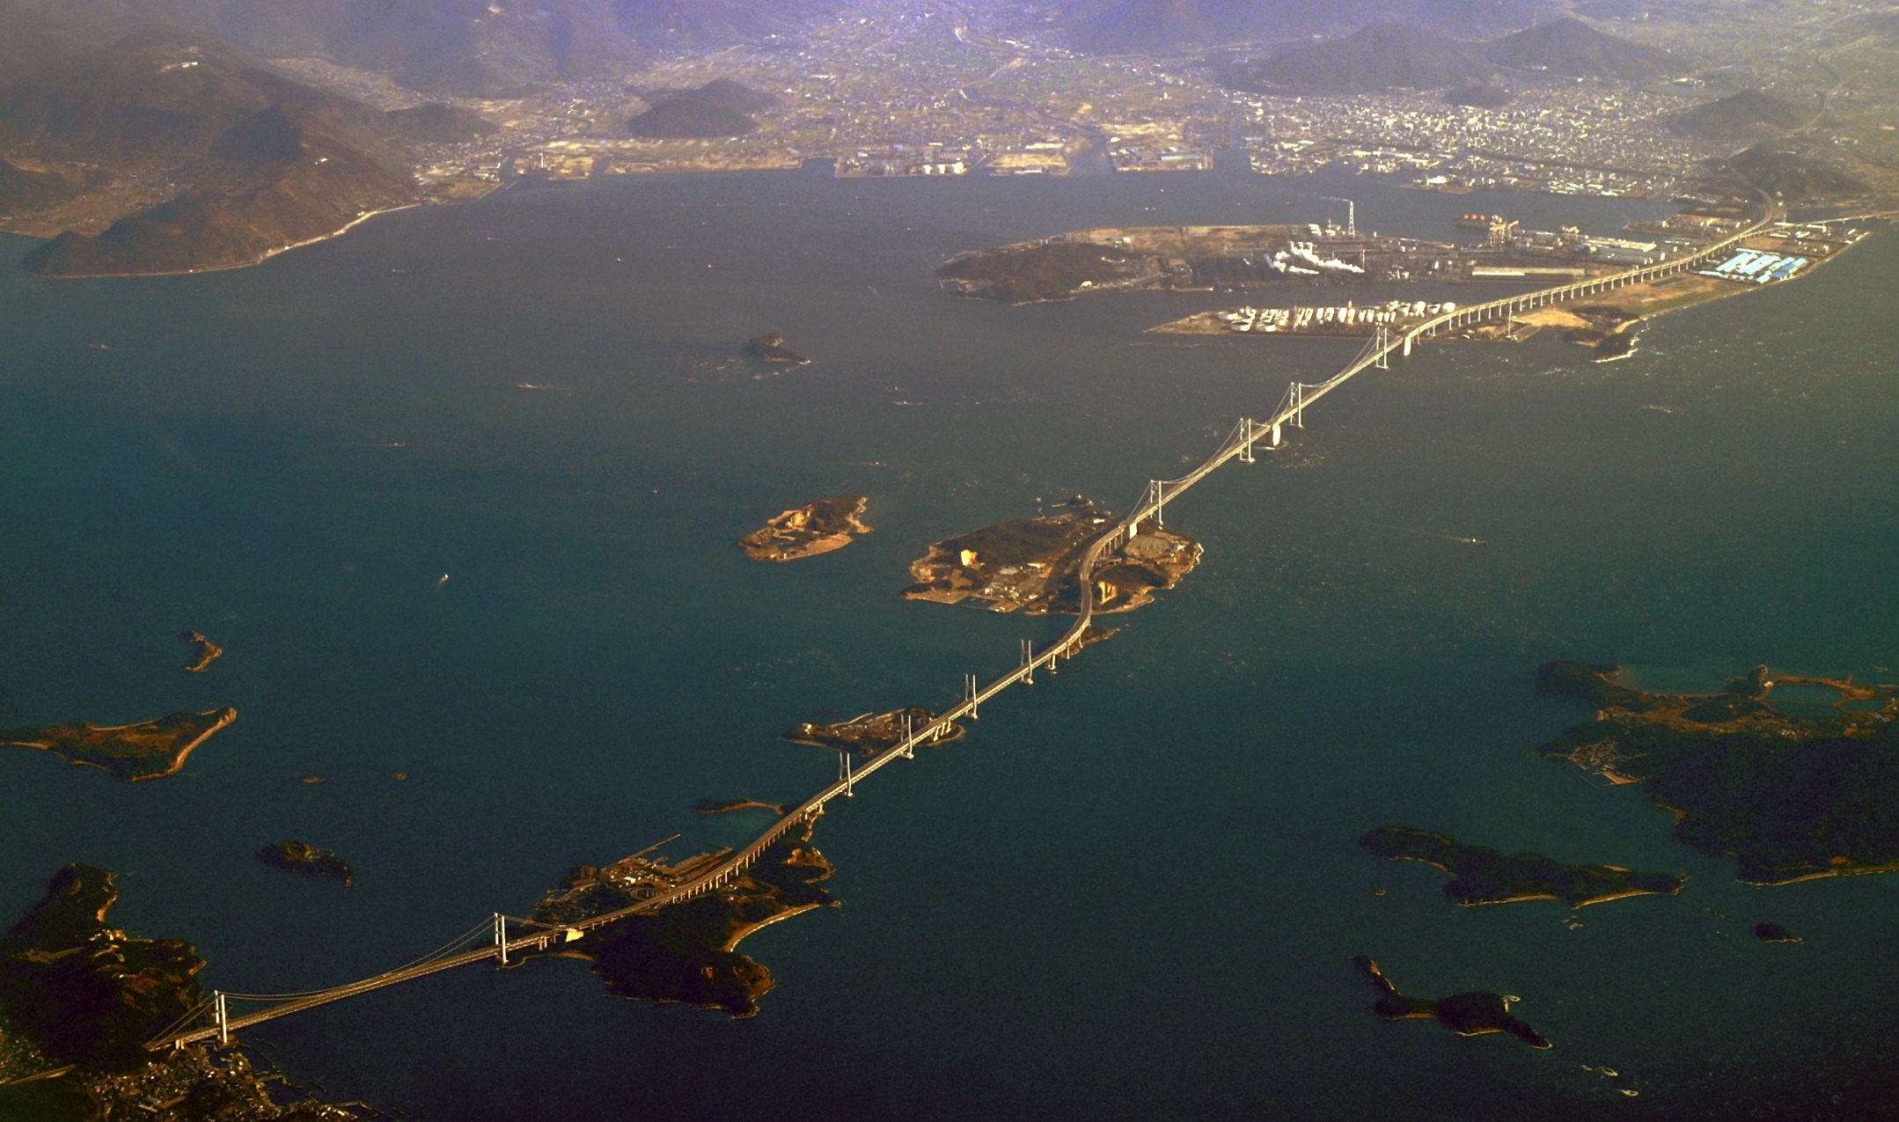
Seto-Ohashi bridge (13 km)

Slide 9
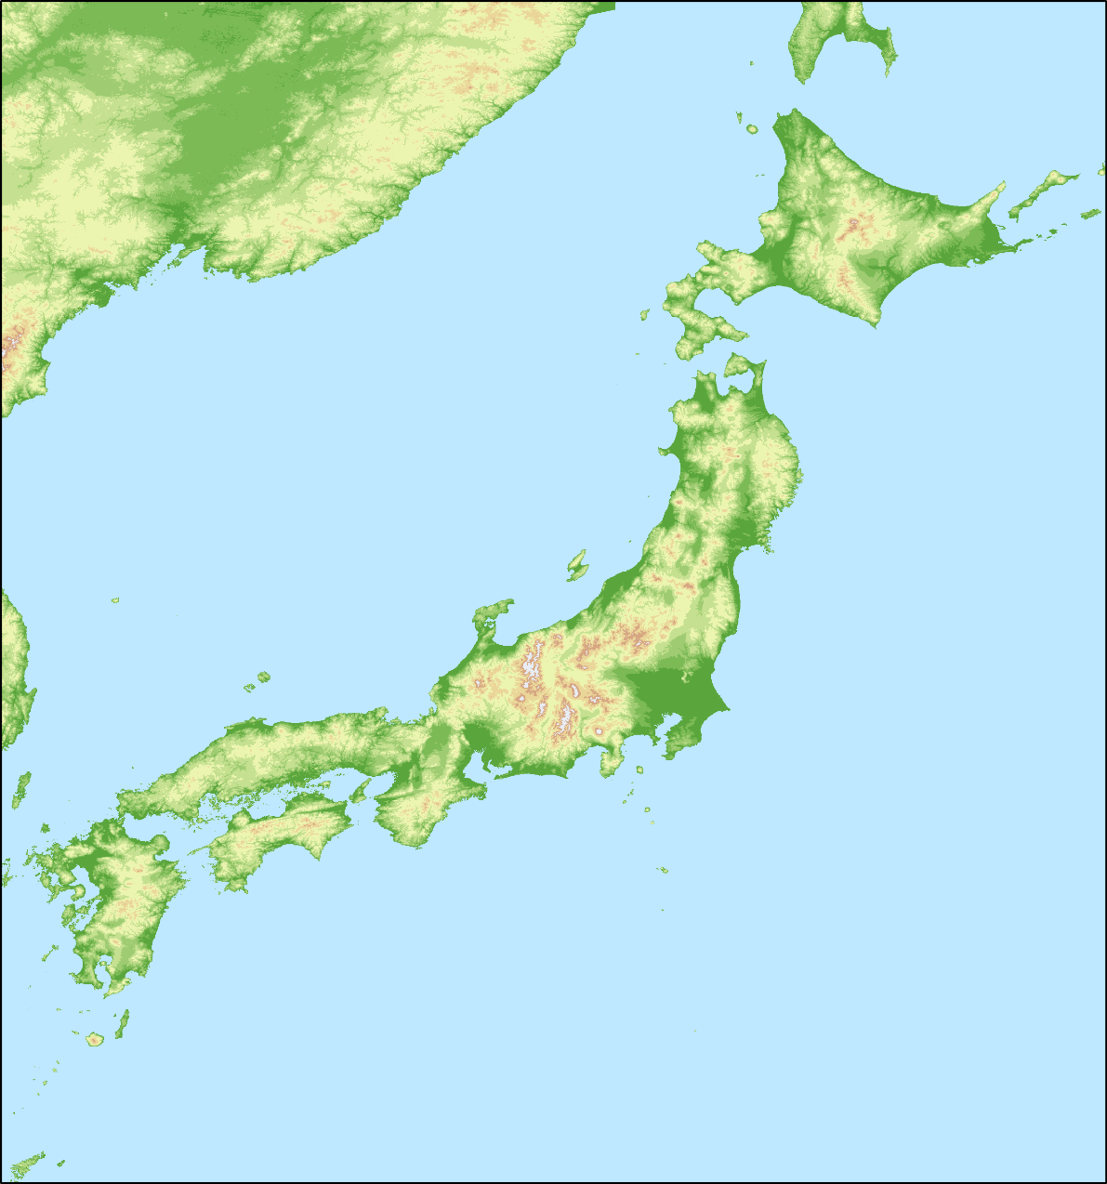
2. Maritime Orientation
Physical constraints
  Physical geography increases the territorial exiguity:
    75% of the surface composed of mountains.
  An “empty” country:
    65% forested (among the highest in the world).
    16% of the land is habitable.
    Most of the population lives on 0.3% of the territory.
  Kanto plain:
    30.5% of the population.
    8.3% of the surface of Japan.
    50% of the flat territory.
Hokkaido
Honshu
Kanto Plain
Yamato Plain
Nobi Plain
Shikoku
Kyushu

Slide 10
2. Maritime Orientation
Fight against the scarcity of space
  Long narrow valleys.
  Concentration of agricultural productivity.
  Efficient management of existing agricultural land.
  The surface of Japan is increasing because of volcanic activity, but mainly because of land reclamation.
  0.5% of the surface.
  Massive land reclamation around coastal areas, particularly large cities such as Tokyo, Nagoya and Osaka.

Slide 11
2. Maritime Orientation
Fishing
  Insularity and fishing have influenced Japanese food supplies:
    25% of protein coming from fishes (6% world average).
    China and Taiwan (60% of the demand of water-fishing activity).
    Japan, South Korea, and Spain (10 % each).
    Massive usage of aquaculture (shrimp, oysters, seaweed).
  Fishing is favored by the meeting of two currents:
    Kuroshio (warm and salty).
    Oyashio (cold).
    Enabling better plankton growing conditions.
Diet
  Unique diet the outcome of geography.
  Rice is the main staple food:
    Soybean as a source of protein (tofu, shoyu).
    Meat not part of the diet until 20th century.

Slide 12
Evolution of the Japanese Diet (kg / capita / year)
Notes:
Source: MAFF, 1996 Food Charts, p. 64-68, Japan's Census Statistics, 97/98 CD-ROM

Slide 13
2. Maritime Orientation
Climate
  Japan is the meeting place of the important weather patterns.
  Temperate.
  Monsoons warm air masses from the south.
  Siberian cold air masses from the north.
  High precipitations.
Three major climate regions
  North: temperate climate with cold winters and important snowfalls (winter monsoon).
  Center: east/west variation.
  South: subtropical climate.
Oyashio
Cold
Cold winter winds
Hokkaido
Honshu
Shikoku
Kyushu
Kuroshio (Black current)
Warm and salty.

Slide 14
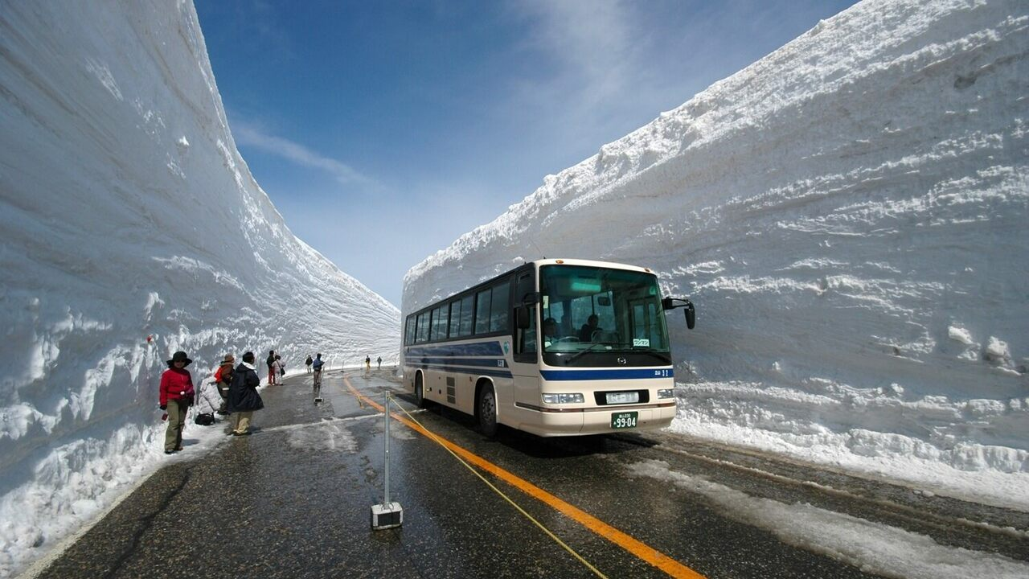
Winter Monsoon, Nagano Prefecture

Slide 15
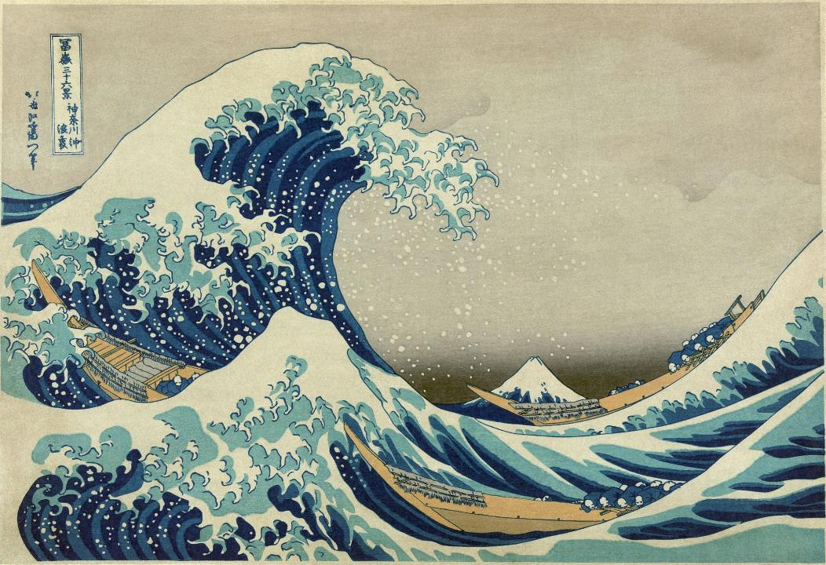
2. Maritime Orientation
Typhoons
  “Divine Winds”; cyclones/hurricanes.
  The Pacific Northwest is the most active basin on earth.
  2.6 typhoons reach the main Japanese islands each year.
  More prevalent in southern Japan.
  Okinawa (southern islands) has 7 storms per year.

Slide 16
Tropical Storms and Typhoons in the Northwest Pacific, 1959-2019
Notes:
Source: Joint Typhoon Warning Center, Annual Tropical Cyclone Report, 2019.

Slide 17
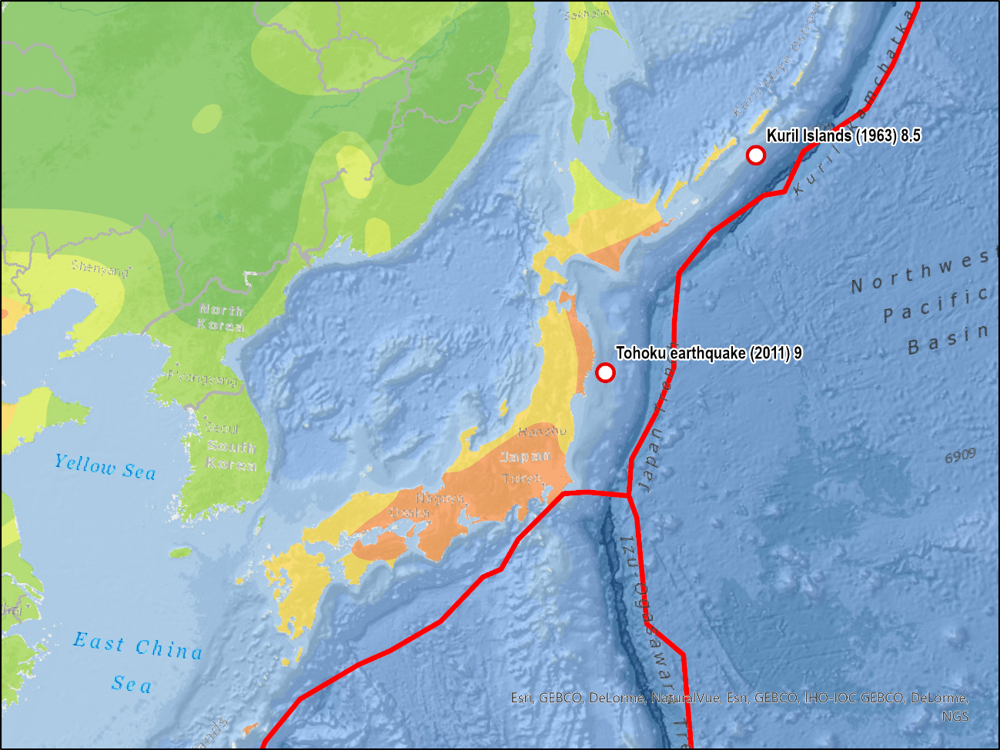
2. Maritime Orientation
Seismic activity
  Meeting of 3 tectonic plates
  Most active in the world.
  1,500 earthquakes a year (about 30 are felt).
  Process of subduction.
Volcanic activity:
  10% of the world’s active volcanoes.
  About 108 volcanoes are currently active.
  Mount Sakurajima (Kyushu) erupted more than 5000 times since 1955.
  Mount Fuji last erupted in 1707.
  Numerous hot springs.
Eurasian Plate
Pacific Plate
Philippines
Plate

Slide 18
2. Maritime Orientation
Earthquakes
  Influence construction materials, construction techniques and lifestyle.
  The 70 years rule:
    Tokyo affected by a major earthquake every 70 years (1633, 1703, 1782, 1853, 1923, 2011).
  Great Kanto earthquake (1923):
    8.3 MMS (moment magnitude scale).
    100,000 – 140,000 deaths.
  Kobe 1995:
    6.8 MMS.
    6,400 deaths and 250,000 made homeless.
    30,000 damaged buildings.
    Reconstruction costs: between 2 and 3% of GDP.
Japanology Plus - Earthquake resistant Architecture

Slide 19
2. Maritime Orientation
Discuss some of the unique characteristics of the physical geography of Japan.
2011 Sendai earthquake and tsunami
  9.0 MMS.
  Largest in recorded history to hit Japan.
  4th largest in recorded history.
  Triggered a 10 meters tsunami.
  The island of Japan moved by 2.4 meters.
  The earth axis shifted 10 centimeters.
  10,000 deaths.
Tsunami in the Sendai Airport area, Miyagi Prefecture, helicopter view

Slide 20
2. Maritime Orientation
The “Triple Disaster” of 2011
  The shockwave of the earthquake (First):
    Can damage buildings and infrastructure.
    Impact strongly mitigated by construction codes.
  10 to 23 feet tsunami (Second):
    Destruction and damage of several coastal areas.
  Nuclear disaster (Third):
    Problems with three nuclear reactors at Fukushima plant that were tested to withstand a 7.9 scale earthquake.
    Destruction of parts of the electric power grid.
    Radioactive leaks forced the evacuation of 200,000 residents.
    Abandonment of nuclear energy.

Slide 21
3. Demography
Demographic and cultural homogeneity
  125 million.
  99% of the population is of Japanese ethnicity.
  99% of the population speaks Japanese.
  Foster national identity and unity (nationalism).
  Issue of conformity.
  “Yamato people” (plain around Kyoto).
  Distrust of foreigners.
  Literacy rate of 99%.
Immigration
  Ethnic homogeneity does not favor immigration.
  Would need 400,000 immigrants a year to stabilize the population.

Slide 22
Population of Japan, 1870-2050

Slide 23
3. Demography
Aging
  Population peaked at 128 million in 2010.
  Declined after 2010, for the first time since census was held (1899).
  125 million as of 2022.
  Highest life expectancy in the world:
    86 years for females.
    79 years for males.
    More people over 65 than children under 15 (30,000 people more than 100 years).
  Older age of marriage, around 27 years.
    Many Japanese women do not marry (subservient relation).
    Low fertility rate, about 1.3 children per woman.
  Net decline of the active age population since 1997.
  Decline in saving rates.
  From net savers to net borrowers.
Notes:
Source: Government of Japan, Ministry of Internal Affairs and Communications. http://www.stat.go.jp/english/data/handbook/c02cont.htm

Slide 24
Population Pyramid of Japan
Notes:
Source: US Census Bureau, International Database

Slide 25
Life Expectancy at Birth, 1910 and 2015
Explain some of the demographic challenges that Japan is facing.

Slide 26
4. Resources
Small resource base
  Limited quantities of minerals and fossil fuels.
  Japan needs to import most of its resources:
    Favored the development of trade.
    Industrial corporations and banks are controlling a significant array of foreign resources.
  Small territory makes agricultural self sufficiency difficult:
    One of the highest agricultural productivity.
    60% of all food is imported.
  Issues:
    Stability and reliability of partners.
    Price fluctuations.
    Must produce something in exchange.

Slide 27
4. Resources
Energy
  Dependence on fossil fuels.
  Hydroelectricity and geothermal energy have good potential.
  Japan relies on nuclear energy.
  Issue of energy security:
    Imports 84% of its energy.
    Diversify energy supplies notably from new regional producers (Indonesia, Brunei).
  Sharp drop in the use of nuclear energy (Fukushima).
Notes:
Statistical Handbook of Japan 2001. http://www.stat.go.jp/english/data/handbook

Slide 28
Dependency of Japan on some Raw Materials and Agricultural Goods, 1992

