Slide 1
Topic 3 – Pacific Asian Economy and Society
A – The Social Landscape
B – Pacific Asian Development

Slide 2
Conditions of Usage
For personal and classroom use only
  Excludes any other form of communication such as conference presentations, published reports and papers.
No modification and redistribution permitted
  Cannot be published, in whole or in part, in any form (printed or electronic) and on any media without consent.
Citation
  Dr. Jean-Paul Rodrigue, Dept. of Global Studies & Geography, Hofstra University.

Slide 3
B. Pacific Asian Development
1. From Ashes to Riches
  How does Pacific Asia compare economically with other regions of the world, now and then?
2. Development Factors
  What were the major reasons behind the success of many Pacific Asian countries?
3. Development Problems
  What are some specific development problems the region is facing?

Slide 4
1. From Ashes to Riches
Geopolitical instability
  Around 1950, Pacific Asia was in ruins with limited development prospects.
  Almost the whole continent was at war, revolution or under famine between 1930 and 1960.
China: A Difficult Start
  Wars:
    20 million Chinese killed during the war with Japan (1937-45) and the civil wars (1920-37; 1945-49).
    China tried to invade Vietnam in 1979.
    China - USSR border clashes (1965-1985).
  Demagogy:
    40 million died of starvation during the “Great Leap Forward” (1958-62).
    Around 10 million killed during the Cultural Revolution (1967-76).

Slide 5
1. From Ashes to Riches
Southeast Asia
  Indochina War (1945-76):
    Involved guerrilla between Communists and non-Communists, including France and the United States.
    France pulled out in 1958.
    United States pulled out in 1973.
    Hundred of thousands of refugees.
  Indonesia:
    Invasion of East Timor in 1975.
    Ethnic clashes:
      Around 500,000 ethnic Chinese were killed in 1965 during a failed coup in Indonesia.
  Genocide:
    About 1 million Cambodians (15-20% of the population) were killed by the Khmers Rouges between 1975 and 1978.

Slide 6
1. From Ashes to Riches
Why economic development in Pacific Asia was facing a difficult start?
Regional conditions (1960)
  Low levels of development:
    Limited infrastructures (WWII, Civil/Liberation Wars, Colonialism).
    Political instability (e.g. Cold War).
    Low educational levels.
    Limited capital.
  Comparisons:
    Africa might have been better off than Pacific Asia.
    Japan had per capita income 1/8 of the US.
    South Korea and Taiwan as poor as Sudan and Zaire (DR Congo).
    In 1960, South Korea's average income was $1,102. In Ghana: $1,053.
    By 2015 Korea reached $25,022, while Ghana's was only $1,696.
    China was three times poorer than Taiwan.
    Hong Kong was a struggling, cheap labor-oriented colony facing massive influxes of refugees from China.

Slide 7
1. From Ashes to Riches
Accelerated development
  From the 1950s, economic development accelerated:
    Led to the biggest accumulation of wealth in human history.
    Fastest rise in incomes for the largest number of people ever recorded.
  Divergence in the development paths between Africa and East Asia in the late 1970s.
  Labeled “The Asian Miracle” by the World Bank.
  Between 1970 and 1990:
    Number of very poor persons fell from 400 million to 180 million in East Asia.
    Population climbed by 425 million.
    Around 650 million people escaped poverty.
  Africa failed (delay):
    Its combined GDP in 2000 was less than Switzerland.

Slide 8
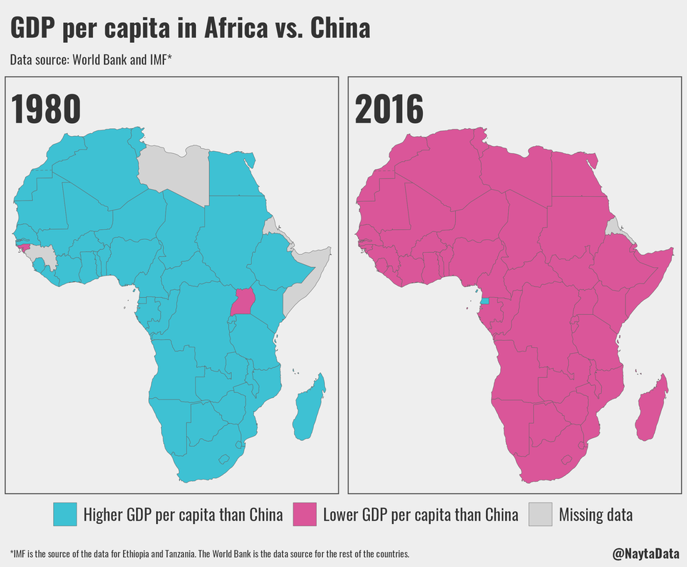
1. From Ashes to Riches
Core factors
  Accumulation of Physical Capital (Savings).
  Hard work (Labor Supply).
  Improving Human Capital (Education).
  Social Capital (Harmony-not confrontation, Law and Order, Lack of Corruption).
  Sound Government Policies.
Notes:
Only exception is Equatorial Guinea because of oil revenue.

Slide 9
1. From Ashes to Riches
Waves of Pacific Asian Development
  First Wave, 1950s (Japan).
  Second Wave, 1960s (The Four Dragons; Hong Kong, Singapore, Taiwan, South Korea).
  Third Wave, 1970s (Malaysia, Thailand, China and Indonesia).
  Fourth Wave, 1980s (The Philippines and Vietnam).
  Fifth Wave, 1990s (Growth and recession).
China reclaiming its historical share
  25-30% of global GDP.
1940
WWII
1950
Korean War
Japan
Great Leap Forward
1960
Four Dragons
Vietnam War
Cultural Rev.
1970
China, Malay., Thai., Indo.
1980
Philippines, Vietnam
1990
AFTA
Asian Crisis (1997)
2000
China joins WTO

Slide 10
Industrial Revolution and Time to Double National Income

Slide 11
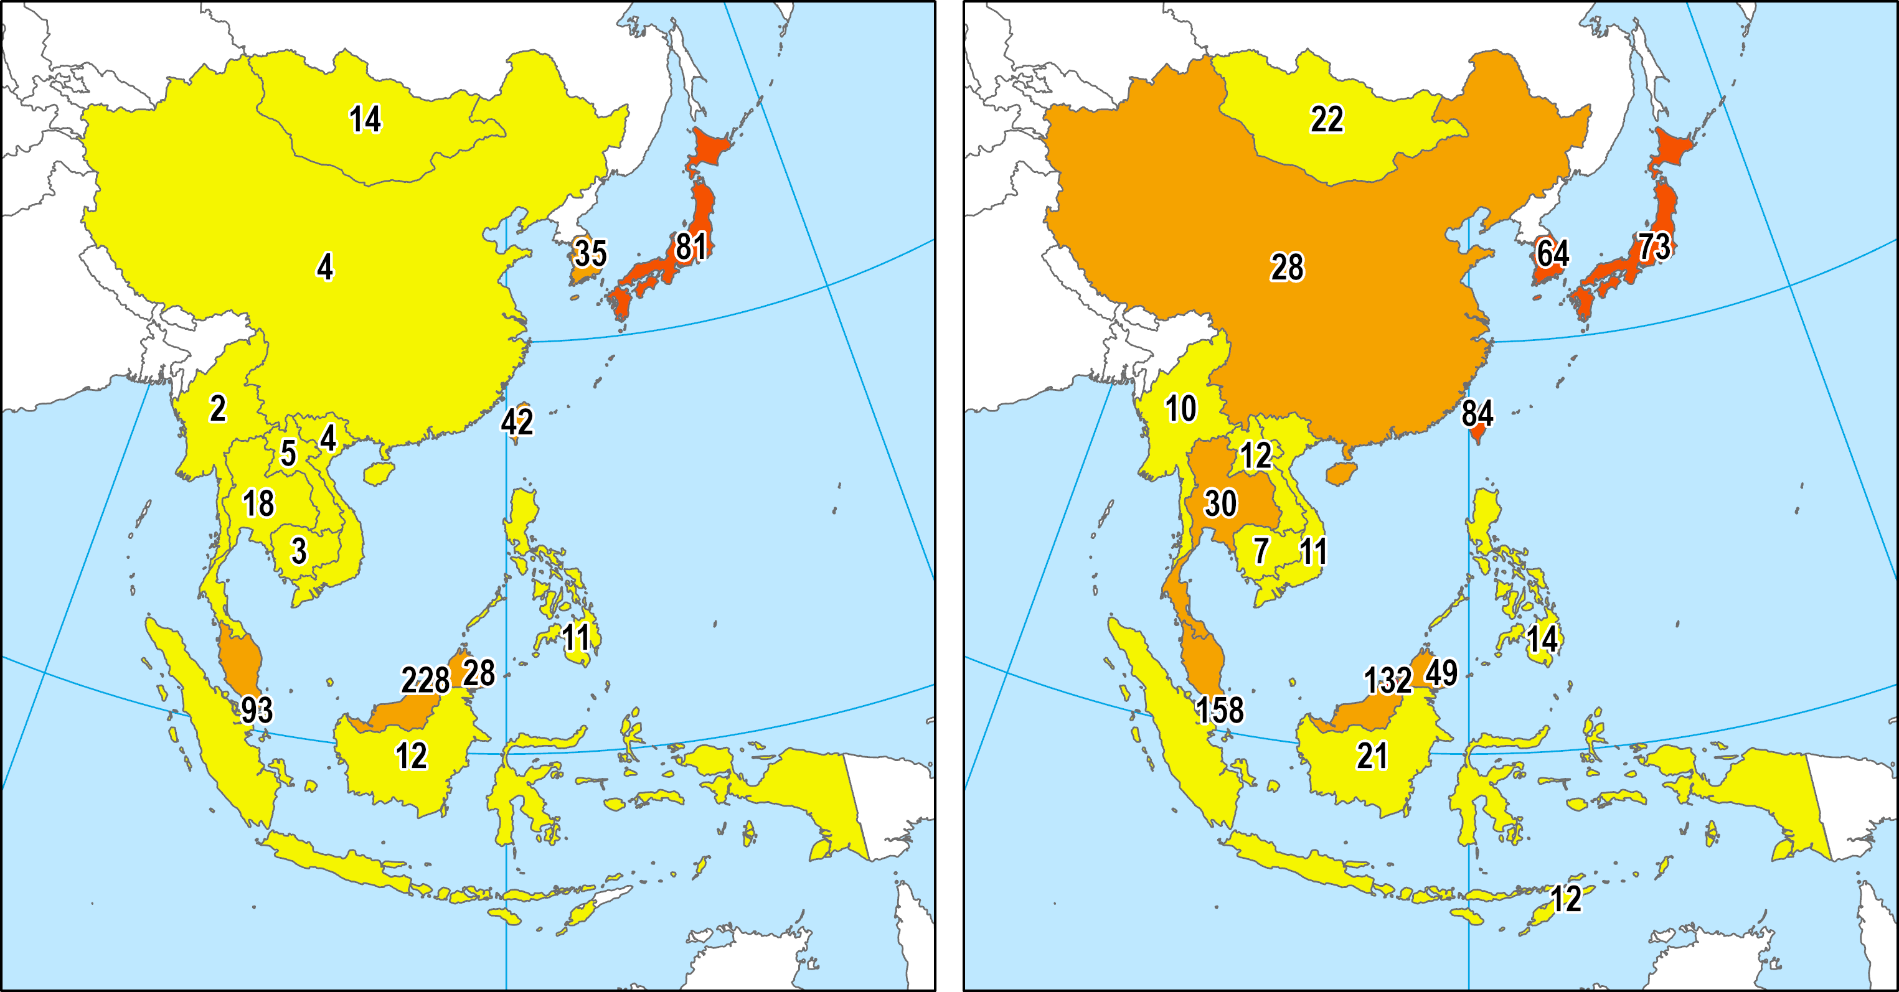
1. From Ashes to Riches
GPD per Capita (PPP) as % of the USA
1990
2017

Slide 12
World GDP, 1CE - 2020
Notes:
Note: In 1990 Dollars, purchasing power parity.
Source: Data compiled by A. Maddison, University of Groningen.

Slide 13
World Nominal GDP, 2007, 2018 (in billion USD)
Notes:
Source: World Bank.

Slide 14
1. From Ashes to Riches
Key elements of economic growth
  Growth driven by trade and investment.
  Collective growth, not isolated or random.
  Staggered participation in regional production network.
  Region as an enabling environment for catching up (model and pressure).
The ‘Flying Geese’ Analogy
  Geographic diffusion of industrialization in a sequential manner.
  Industrialization proceeds from low-tech to high-tech.
  Clear order and structure.

Slide 15





Structural Transformation in East Asia
International Division of Labor
3
TV
2
Garment
Steel
Video
HDTV
Garment
Latecomers
Competitiveness
1
Time
China
Japan
NIEs
China
ASEAN4
Latecomers
2
ASEAN4
TV
NIEs
Garment
Steel
Video
HDTV
Japan
3
Japan
1
Garment
Steel
TV
Video
HDTV
Time
Latecomers
ASEAN4
Japan
China
NIEs
Notes:
Source: The East Asian Experience of Economic Development and Cooperation. Kenichi Ohno, National Graduate Institute for Policy Studies
http://www.grips.ac.jp/forum-e/slide/EAsia3.ppt

Slide 16
2. Development Factors
United States
  Initial role:
    Marshall Plan also applied in Asia after WWII.
    South Korea and Taiwan would not have survived without the support of the United States.
    Between 5 and 10% of the GDP in foreign aid in the 1950s.
    Direct aid ended at the beginning of the 1960s.
    Freed internal financial capacity and promoted savings.
  Contemporary role:
    The United States has become an important market for Asian products.
    Supporting of the export-oriented development.

Slide 17
2. Development Factors
High savings rates
  Related to the availability of local investment capital.
  Savings were preferred over consumption.
  Ranges around 20 to 30% of GDP.
  Many societies offer little if any social security:
    Responsibility of the individual / family to cover expanses such as health care, education and retirement.
    Government mandatory saving and insurance policies.
  The average American has an income of about $40,000 a year:
    The personal savings rate is about 1% (negative in 2006).
  The average Chinese earns around $1,500 per year:
    The personal savings of 45% of his income.
    A poor Chinese saves more than a wealthy American.

Slide 18
Personal Savings Rate, United States and China, 1970-2022
Notes:
Source: U.S. Department of Commerce: Bureau of Economic Analysis.
https://fred.stlouisfed.org/series/PSAVERT

Slide 19
National Savings Rates (as % of GDP), 1975-2018
Notes:
Source: World Bank.
https://data.worldbank.org/indicator/NY.GNS.ICTR.ZS

Slide 20
2. Development Factors
Abundance of labor
  Numbers do not guarantee industrialization, but an advantage in labor-intensive activities.
  Demographic growth helped maintain low labor costs:
    Exports are more competitive.
    Foreign investment is attracted.
  Productivity often grows faster than wages.
  Female labor:
    In the manufacturing sector.
    Notably 15-25 years old.
    Often account between 40 and 50% of workforce.
    Lower wages and more disciplined.

Slide 21
Hourly Compensation in Manufacturing, 1997-2010 ($US)
Notes:
Source: US Dept. of Labor, Bureau of Labor Statistics. http://www.bls.gov/fls/home.htm#compensation

Slide 22
2. Development Factors
Globalization
  Development models vary greatly in the region.
  Diversity of economic and political systems.
  Convergence towards the capitalist model.
  Pacific Asia took advantage of the emerging global economy:
    Opening of foreign markets.
    Liberalization of trade.
  Export-oriented development.
  Significant improvements in the welfare of the population.
  Development of international transportation:
    Pacific Asia accessible at lower costs.
    Containerization.

Slide 23
Share of World Goods Exports, Selected Countries, 1950-2022
Notes:
Source: WTO.

Slide 24
2. Development Factors
Foreign Direct Investments (FDI)
  Capital investments by foreign interests (mostly private).
  Related to the speed of development.
  Massive transfers of technology and investment.
  FDI are mostly undertaken as joint-ventures:
    The foreign firm often provides capital and technology.
    The Asian firm provides labor and raw materials.
  About 60% of FDIs are occurring in the manufacturing sector.
  United States and Japan:
    Account for more than 50% of FDIs.
    Japan massively investing in China; lower production costs.
  China accounts for 50% of all FDIs going to developing countries.

Slide 25
Value of Chinese Exports and FDI, 1983-2021 (Billions of $US)
Notes:
Source: WTO and UNCTAD.

Slide 26
2. Development Factors
Outsourcing
  High production / labor costs in developed countries:
    Corporations looking at ways to reduce costs and compete.
    An increasing share of production is done by sub-contracting.
    Transfer of a manufacturing process.
Technology transfers
  Mostly done by licensing (Taiwan, South Korea):
    A firm is authorized to use a technology.
    Pays a royalty.
  Several technologies “stolen”.
    Software and industrial process piracy.
  Asian countries have become innovators:
    Japan and the Tigers first.
    China: substantial potential for innovation with emerging clusters (Pear River Delta).

Slide 27
2. Development Factors
Government and industrial development
  Asian governments tend to be of small size but have strong influence on economy:
    Lower taxation on the society; less social safety nets.
    Notable exceptions; China, Vietnam (large bureaucracies).
    Often account for less than 20% of GDP (about 45-50% for the US).
  Involvement of the government:
    Defines the strategic orientation of the economy; Favor export-oriented strategies.
    Developing projects and providing financing (preferential loans).
    Favor trade-related infrastructure projects.
    Significant regulatory involvement (misallocations and some corruption).
  Special economic zones / Export processing zones:
    Enclave where foreign corporations are given specific privileges (mainly taxation).
    Attract foreign investments, new industrial activities and technologies.
    Hong Kong has been a free trade zone since 1841.
    China opened several SEZs in the 1980s.

Slide 28
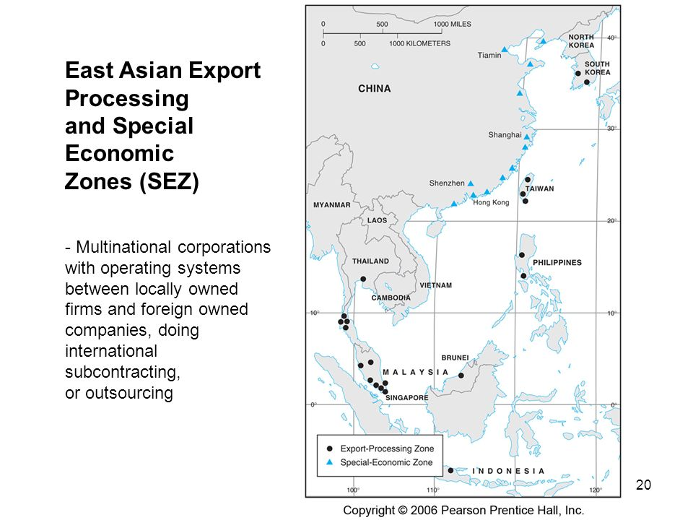

Slide 29
2. Development Factors
Confucianism
  Important imprint in most Pacific Asian societies.
  Basis of most social structures, especially in the Chinese world.
  Main values:
    Hard work as a symbol of achievement.
    Thriftiness.
    Well defined family structures.
    Obedience to authority and respect of hierarchy.
    Benevolent leadership.
    Consensus, harmony and common interest.
    Education as a tool of social promotion.
  Possible to make accept difficult living conditions to justify future development.
  Its importance is argued.

Slide 30








Development Factors (Synopsis)
Discuss the main factors that have favored economic development in East and Southeast Asia after the Second World War
Initial role (1950s). Marshall Plan. Financial support. Military protection (Japan, South Korea, Taiwan). Major market outlet.
United States
Savings
High saving rates (about 30% of GDP). Availability of national capital.
Large labor pool. Wages kept relatively low. Reliance on women. Development of skills through education.
Labor
Globalization
Increased participation in international trade. Lower tariffs. Lower transport costs.
Foreign direct investments. Transfers of production and manufacturing capacities. Mainly from Japan and the United States (initially). Joint ventures. Transfer of technology.
Investments
Outsourcing
Access to foreign markets and global supply chains.
Policy
Special economic zones. Export-oriented development strategies. Mandatory savings.
Culture
Confucianism. Social order. Work ethics. Consensus. Respect for authority. Its role is argued.

Slide 31
3. Development Problems
Questioning the “Asian Miracle”
  Used to be called “Miracle Economies” by the World Bank.
  Two crisis:
    Financial crisis of 1997-98.
    Financial crisis of 2008-09
The Asian Financial crisis of 1997-98
  The bursting of a bubble, mainly based on real estate.
  Exacerbation of social problems; Inequalities.
  Loss of spending power.
  Especially true in countries depending on imports (Indonesia).
  Political unrest (fall of the Suharto government in 1998).

Slide 32
3. Development Problems
The role of governments
  Governments regulate massively their economy:
    Industrial control; the appeal of an export-oriented strategy.
    Preferential loans.
    Informal “Black” market: Avoid government regulation creating artificial scarcity.
  Corruption:
    Corruption is a form of misallocation (using public power to regulate, coerce and confiscate).
    Corruption becomes a source of income for low-paid bureaucrats.
    Cronyism (favoritism shown to friends and associates).
    Lack of transparency.
    “Hidden clauses” often account for up to 30% of the amount of a contract.
    Weak legal systems leaving limited recourse.
  Institutions did not develop with the economy.

Slide 33
Corruption Perception Index, Selected Countries, 2006, 2019 (10 = the least corrupt)
Notes:
Source: Global Corruption Report 2006.
http://www.transparency.org/publications/gcr

Slide 34
3. Development Problems
Currency leverage
  Systematic positive export balance:
    Increase of the value of a national currency.
    Eventually exports slow down has they become more expensive.
    Asian currencies should have increased substantially.
  Maintaining the exports:
    Continue the export-oriented system.
    Japan and Korea bought large amounts of US securities to recycle their foreign reserves (T-bills, bonds, stocks, etc.).
    China pegged its currency (Yuan) to the US dollar at 8.2 and purchased US securities.
  Inflated US assets (housing) and kept consumers buying.
  Transfer of wealth from the West to the East.

Slide 35
Yuan Exchange Rate (per USD), 1981-2023 (Monthly)
Export Oriented
Debasement
Discount Window
Closing of the
Discount Window
Notes:
Source: http://research.stlouisfed.org/fred2/series/EXCHUS/downloaddata?cid=95

Slide 36
Ownership of US National Debt, 2018 (in Trillions)
Notes:
Sources: U.S. Treasury http://www.treas.gov/
http://www.treas.gov/tic/mfh.txt

Slide 37
3. Development Problems
Discuss some of the flaws of the ‘Asian Economic Miracle’.
The limits of the export-oriented model
  Pacific Asian development strongly dependent on exports to North American and European markets:
    A form of “neo-mercantilism”.
  Correlated (“coupled”) with the dynamics of these markets.
  Decoupling thesis:
    Development of an internal market.
    Less dependency on North America and Europe.
  “Friend-shoring”.
  The export-oriented model is being questioned by major importers.
  United States imposed several tariffs on Chinese goods in 2019.

