Slide 1
Topic 3 – Pacific Asian Economy and Society
A – The Social Landscape
B – Pacific Asian Development

Slide 2
Conditions of Usage
For personal and classroom use only
  Excludes any other form of communication such as conference presentations, published reports and papers.
No modification and redistribution permitted
  Cannot be published, in whole or in part, in any form (printed or electronic) and on any media without consent.
Citation
  Dr. Jean-Paul Rodrigue, Dept. of Global Studies & Geography, Hofstra University.

Slide 3
A. The Social Landscape
1. Religions
  What are the major religions of Pacific Asia?
2. Rice
  What is the economic and cultural importance of rice?
3. Demography
  What are the major demographic characteristics and issues of the region?
4. Social Problems
  What are the major regional social problems?
5. Urbanization
  What is the extent of urbanization?

Slide 4
1. Religions
Religions
  Influence culture and behavior.
Religious hearths
  4 of the world’s most important religions originated in Asia.
  Hinduism, Buddhism, Islam and Christianity.
  Diffusion factors:
    Born into the religion.
    Conquest.
    Voluntary conversion.
    Migration.
    Proselytization.
  Two major religions have their hearths close to Pacific Asia:
    Hinduism.
    Buddhism.
Notes:
Source: adherents.com

Slide 5
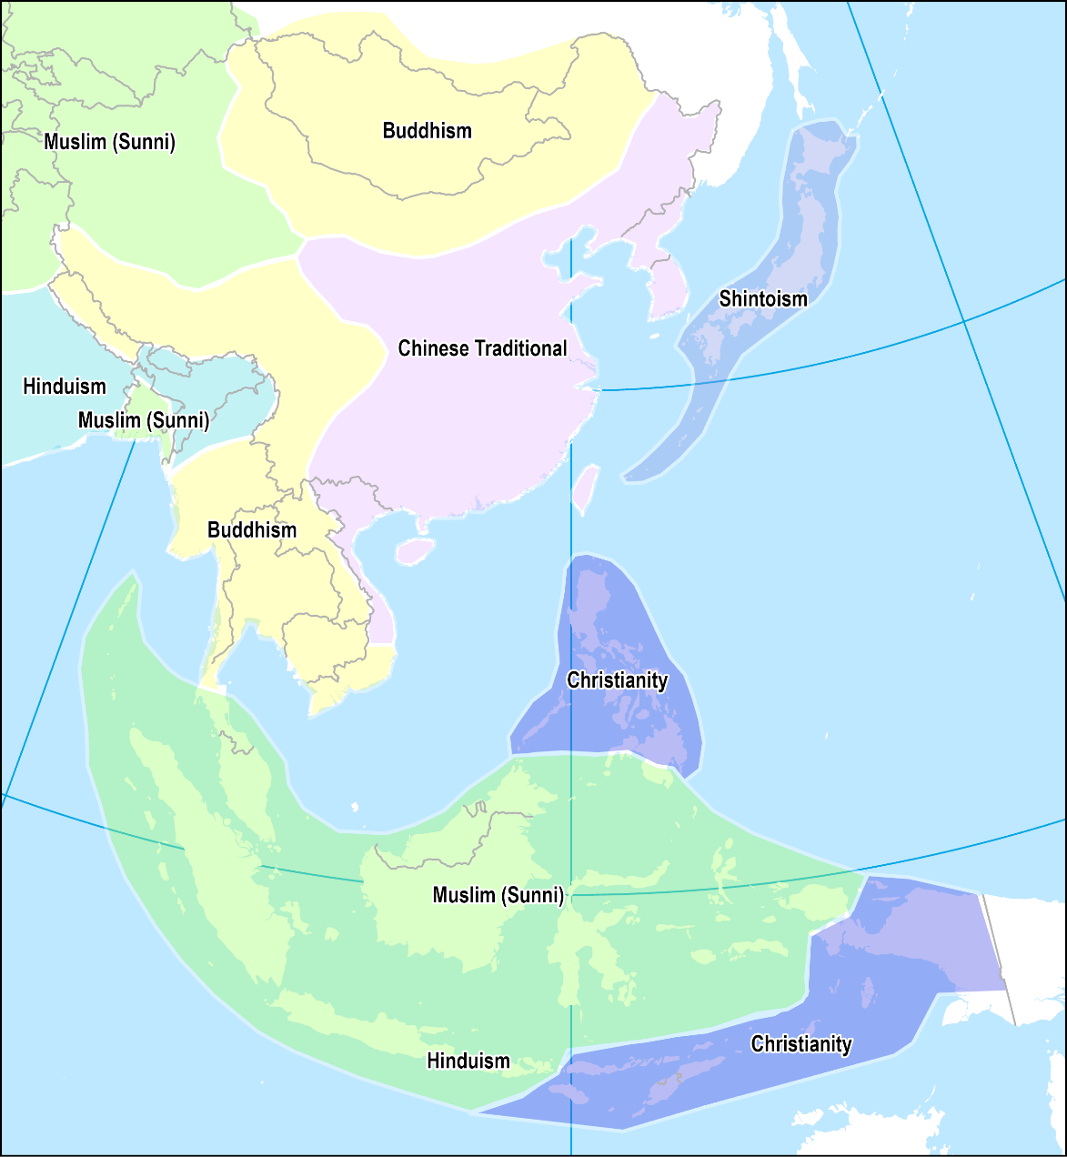
1. Religions
Religious diversity
  Simplistically: Buddhism in the north and Islam in the south.
  The outcome of endogenous and exogenous influences.
  Hinduism, Buddhism, Islam and Christianity are of external origins:
    Less the case for Hinduism and Buddhism.
    Diffused the region under different eras and circumstances.
    Conquest, conversion and proselytization.
  Traditional Chinese (Confucianism) and Shinto:
    Indigenous religions with adaptations from Buddhism.
Notes:
Re. Judaism. Mostly an ethnically based religion. Extension through reproduction. Limited proselytization.

Slide 6
1. Religions
Hinduism | Buddhism | Islam | Christianity
Polytheistic; more than 333,000 gods (Devas): Part of Brahman; one ultimate reality. Trinity of Brahma (creator), Vishnu (preserver of good and order) and Shiva (destruction and creation). | Reform of Hinduism; a religion, a philosophy, an ideology. | Monotheistic religion; “submission to God”. A Muslim is a “believer”. Word of Allah contained in the Koran (recitation). | Monotheistic faith: Jesus Christ as the Son of God. The Holy Bible contains the teachings of God, Jesus Christ and His followers.
Northern India. Oldest religion. (3,000-4000 BC); no specific founder. | Northern India (563 BC). Siddhartha became the first Buddha, or “Awakened One”. | Emerged in Saudi Arabia in the 7th century (Mecca). | Emerged in Israel in the 1st Century.
Karma: Your deeds, good or bad, will return to you. Reincarnation: You are the sum of numerous past existences. Dharma: Individual ethics, duties and obligations. | Four Noble Truths: Suffering is universal and inevitable. The cause of suffering is desire and ignorance. A way to dispel ignorance and relieve suffering; The eightfold path; achieving Nirvana. | Five Pillars of Islam: One God (Allah) and Mohammad as His prophet. Prayer five times a day. A month of daytime fasting (Ramadan). Giving of alms. One pilgrimage to Mecca (The Hajj). | Salvation is achieved in faith and adherence to the teaching of the Holy Bible.
Caste system reflecting one’s position in the ladder. About 1 billion followers (India and Indian communities). | Mahayana and Theravada Buddhism. | Came through trade. Conversion of local populations. | Through missionaries during the colonial era. Spain and Portugal being its strongest advocates.

Slide 7
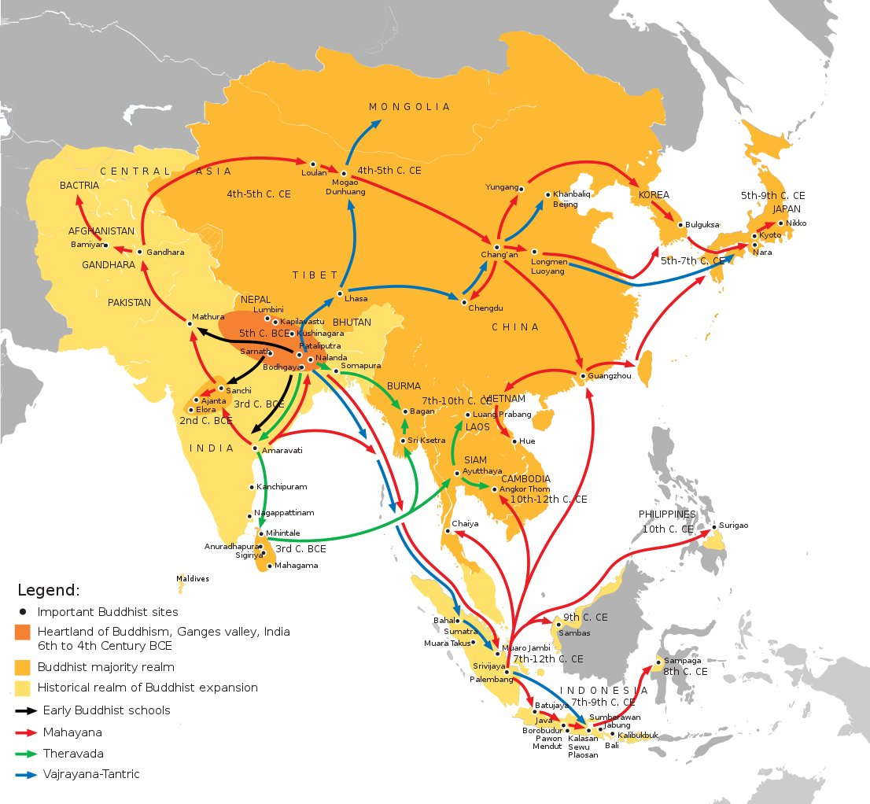

Slide 8
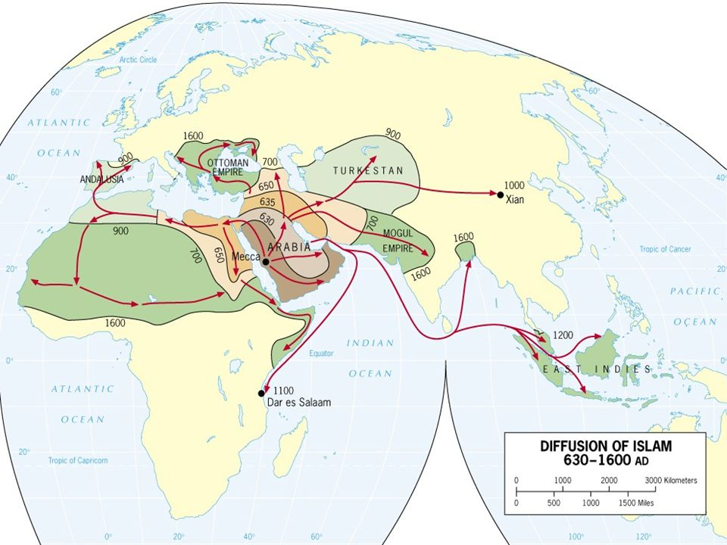

Slide 9
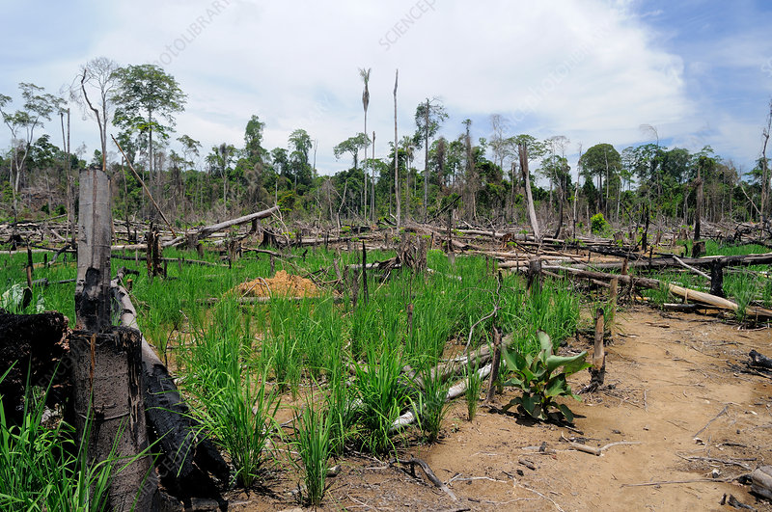
2. Rice
Major farming and settlement patterns
  Swidden in the uplands:
    Shifting agriculture or “slash and burn”.
    Vegetation burned to transfer nutrients to the soil.
    Plots are planted in until soil nutrients are exhausted.
    Plots are abandoned and vegetation returns to its original form (takes at least 10 years).
    Sustainable when populations are small and stable.
Swidden dry rice cultivation in Indonesia

Slide 10
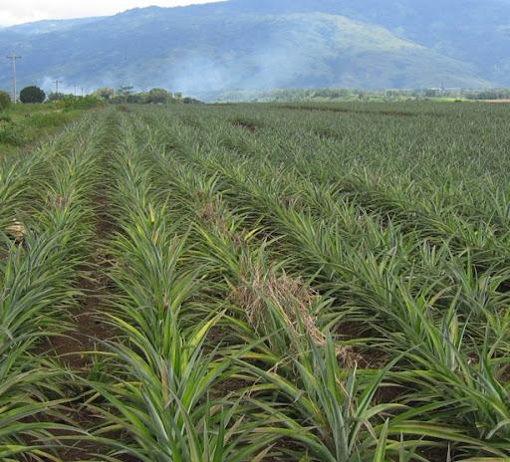
2. Rice
  Rice in the lowlands:
    Irrigation systems.
    Fixed large quantities of labor in the countryside.
  Plantation agriculture:
    Began with European colonization.
    More prevalent in Southeast Asia.
    Coastal locations to transport overseas.
    Products like rice, rubber, cane sugar, tea, pineapple, and copra.
Pineapple plantation in the Philippines

Slide 11
2. Rice
Rice and society
  Deep economic, cultural and social influence.
  Why rice in Asia?
    Rice originates in Southeast Asia.
    Most productive form of agriculture; almost 3 times of wheat.
    Rice: 11 million calories per acre; wheat: 4 million calories per acre.
    Limited amount of flat land.
  Asia produces about 90% of all the rice in the world:
    China and India: 50%.
    Asia’s top 10 produce 86%.
  Staple food of several cultures:
    Cultural and religious significance.
    Many cultures have legends where rice is linked with their creation.
    Chinese: “she fan” means “to eat” as well as “to eat rice”; “Fan Dian” means “restaurant” is well as a “place where rice is served”.
    Japanese: “Gohan” means “rice” as well as a “meal”.

Slide 12
World’s Largest Rice Producers and Exporters, 2018 (in million metric tons)
Notes:
Source: FAO

Slide 13
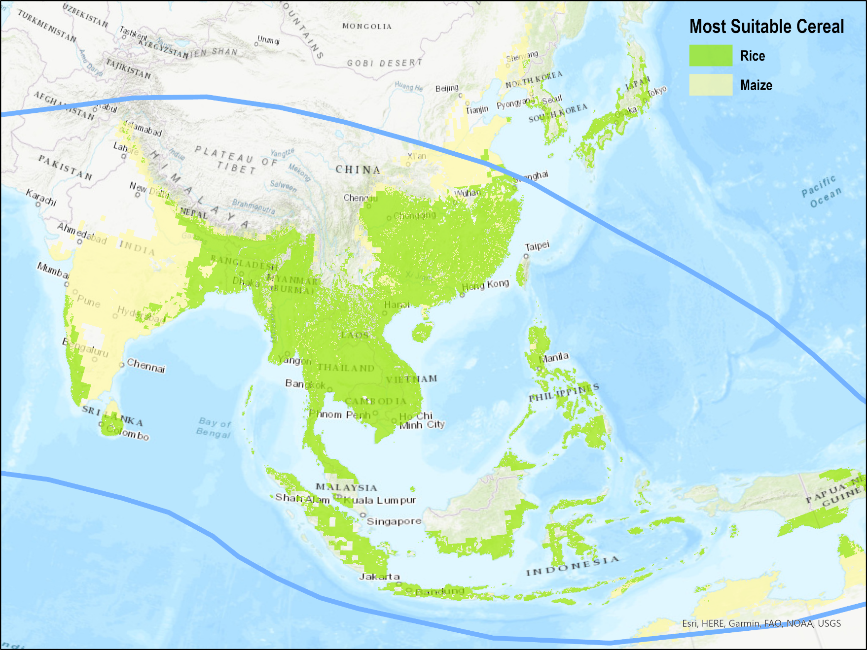
Land Suitable for Rice Production, Pacific Asia
Irregular water flow; discrepancies in rice cultivation.
Notes:
Source: FAO.

Slide 14
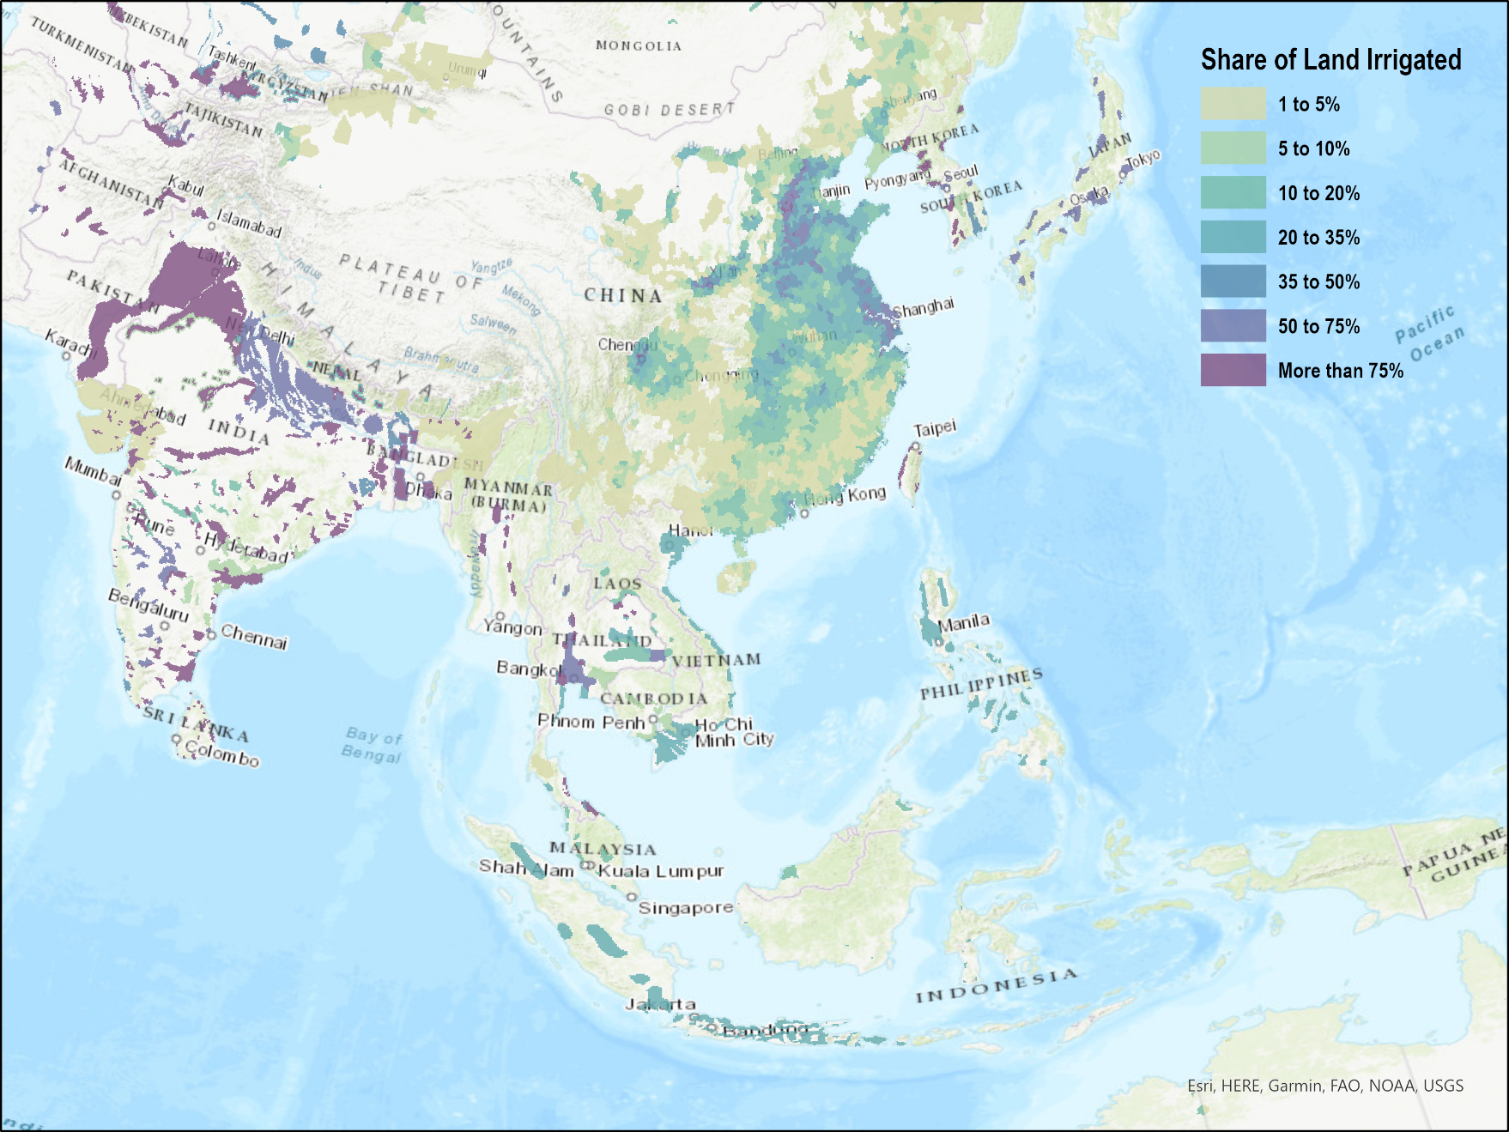
Share of Agricultural Land Irrigated
Storage and distribution of surpluses. Irrigation canals, reservoirs and terrace paddy fields.

Slide 15
2. Rice
Paddy fields
  85% of all the rice produced in the world is in paddy fields:
    From the Malay word “padi” which means “rice”.
  Massive amount of labor required:
    1,000 hours of work per hectare.
    Field preparation, dike mending, transplanting, weeding and harvesting.
    Terrace paddy fields.
  Flooded fields enclosed by small walls.
  Highly productive because nutrients dissolved in water:
    5,000 liters of water to produce one kilogram of rice.
    50% of paddy fields are irrigated by rainfall.
    35% of paddy fields are irrigated artificially.
  Possibility of 1, 2 or 3 crops of rice per year:
    Depending on rainfall and temperature.
    Alternance wheat (winter) and rice (summer / monsoon).
  Also used as fishponds.

Slide 16
2. Rice Growing Cycle
1. Sowing seeds
  In small seedbeds (avoid weeds) for about 60 days.
  Prepare (plow) the fields.
2. Transplantation
  Hand transplant the seedlings into flooded fields.
  Rice grains are ready for harvest in 3 to 6 months.
3. Harvest
  Dry the field.
  Harvest rice with sickles or knives, tie it in bundles, and let it dry in the field.
4. Grain preparation
  Remove the grain from the plant.
  Dry the grain.
1
2
3

Slide 17
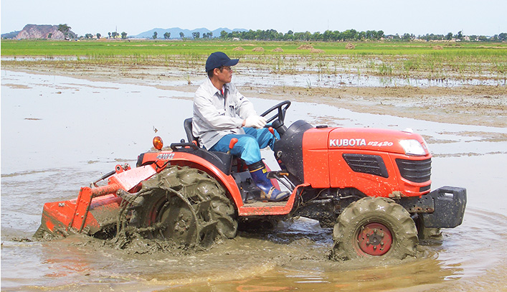
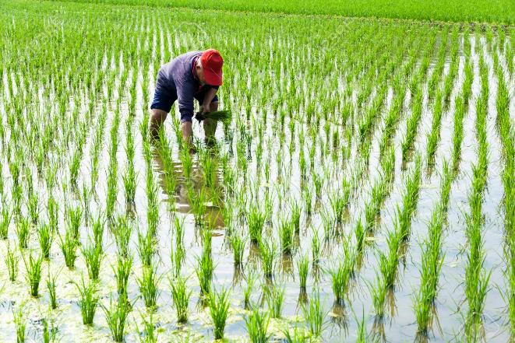
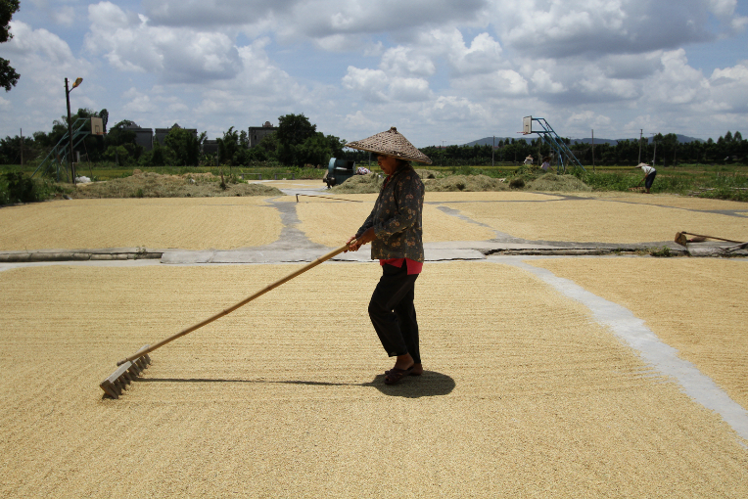
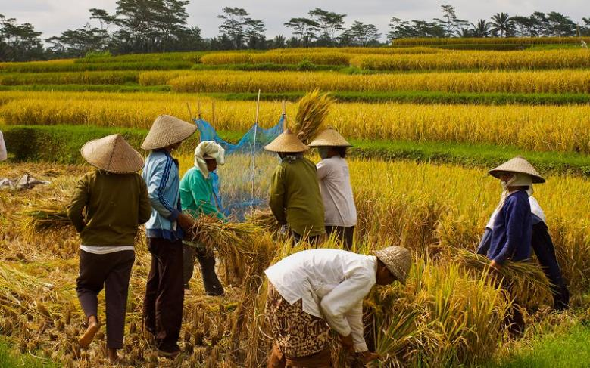
2. Rice
1
2
3
4

Slide 18
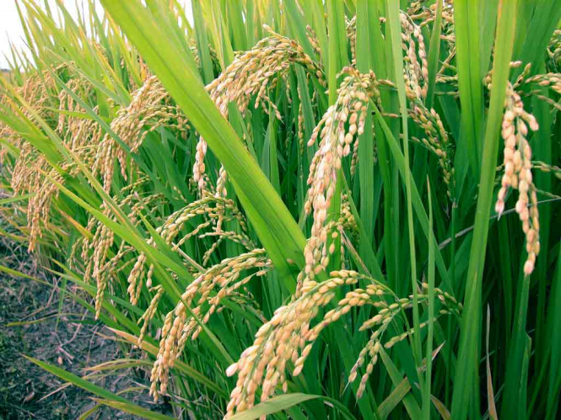
2. Rice
Explain the nature of rice cultivation and its importance in Pacific Asian societies
Part | Usage
Grain | Cooked and served with vegetables or meat. Fermented into wine or brewed into beer. Animal feed. Cosmetic powders.
Straw | Animal feed. Crafted into rope, hats, shoes, etc. Molded in bricks and made into paper.
Bran | Pressed into oil to make soap and cosmetics. Nutritional additive (fiber).
Hull | Packing and insulation. Fuel.

Slide 19
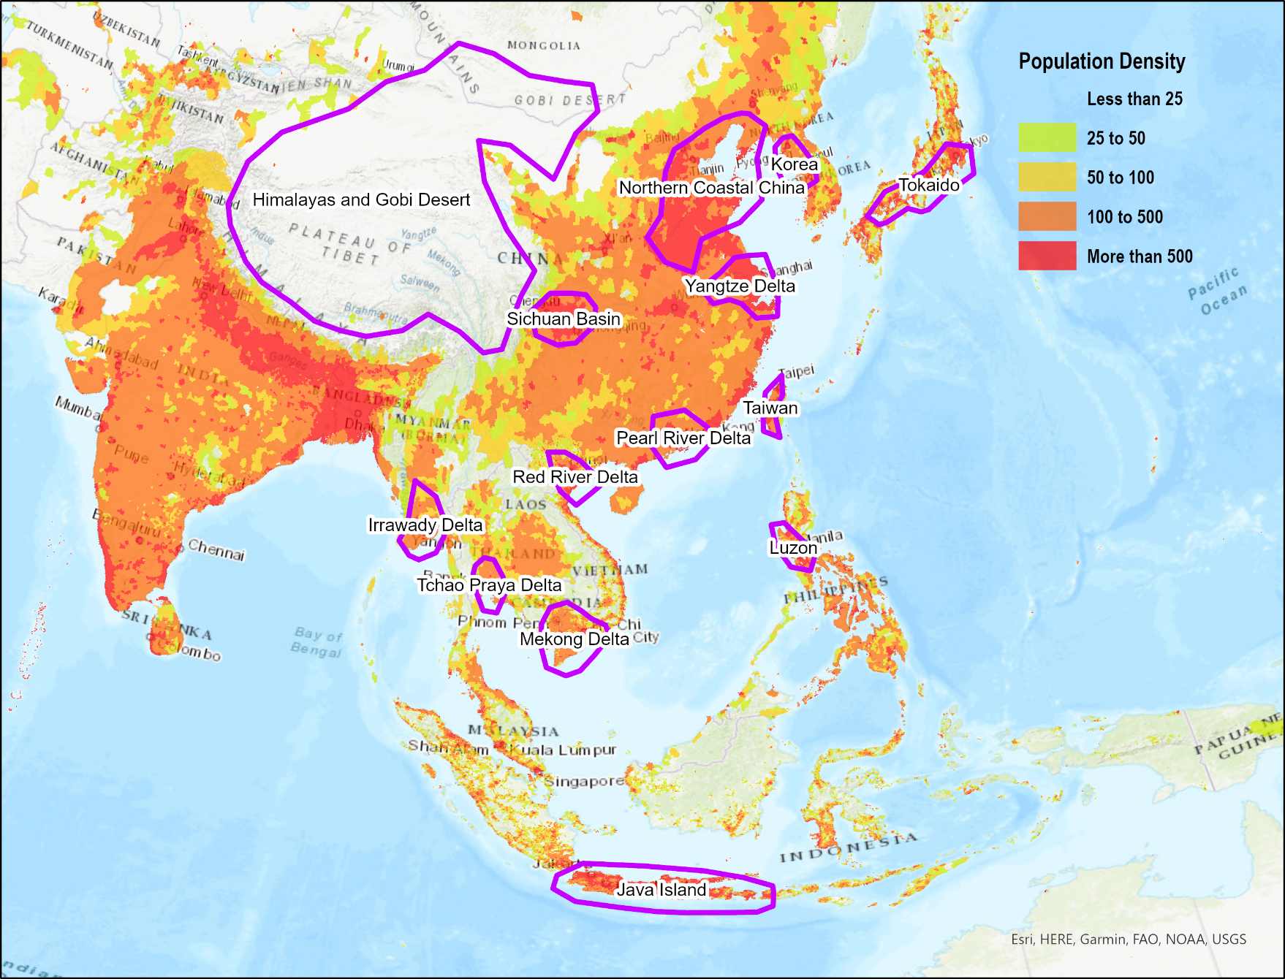
Population Density and Ecumene
East Asia: Coastal plains. Ethnic homogeneity.
Southeast Asia: Separation of communities by mountain ranges. Ethnic diversity.
Minorities often living in higher and less fertile locations.
Very high density; wet rice cultivation. Limited ecumene (continuously settled area).
Distribution along river deltas and irrigated areas.

Slide 20
Conventional Cycle of Population Growth
High infant mortality rate
Preference for sons
Population
Support for population growth
Cycle
More labor for rice production
Rice Production
Wet rice agriculture
Irrigation

Slide 21
3. Demography
Minorities present in remote peripheries:
  Uplands or dense forests.
Altitudinal ethnic stratification
  Prevalent in Monsoon Asia, especially Southeast Asia.
  Fertile / flatland occupied by the dominant ethnic group; higher populations.
  Marginalization increases with altitude; isolation and lower populations.
Mekong
  Lowlands: Vietnamese / Khmer.
  Midlands: Lao.
  Highlands: Hmong.
Minorities
Minorities
Dominant ethnic group
Lowlands
Midlands
Highlands
What is altitudinal ethnic stratification and provide some examples.

Slide 22
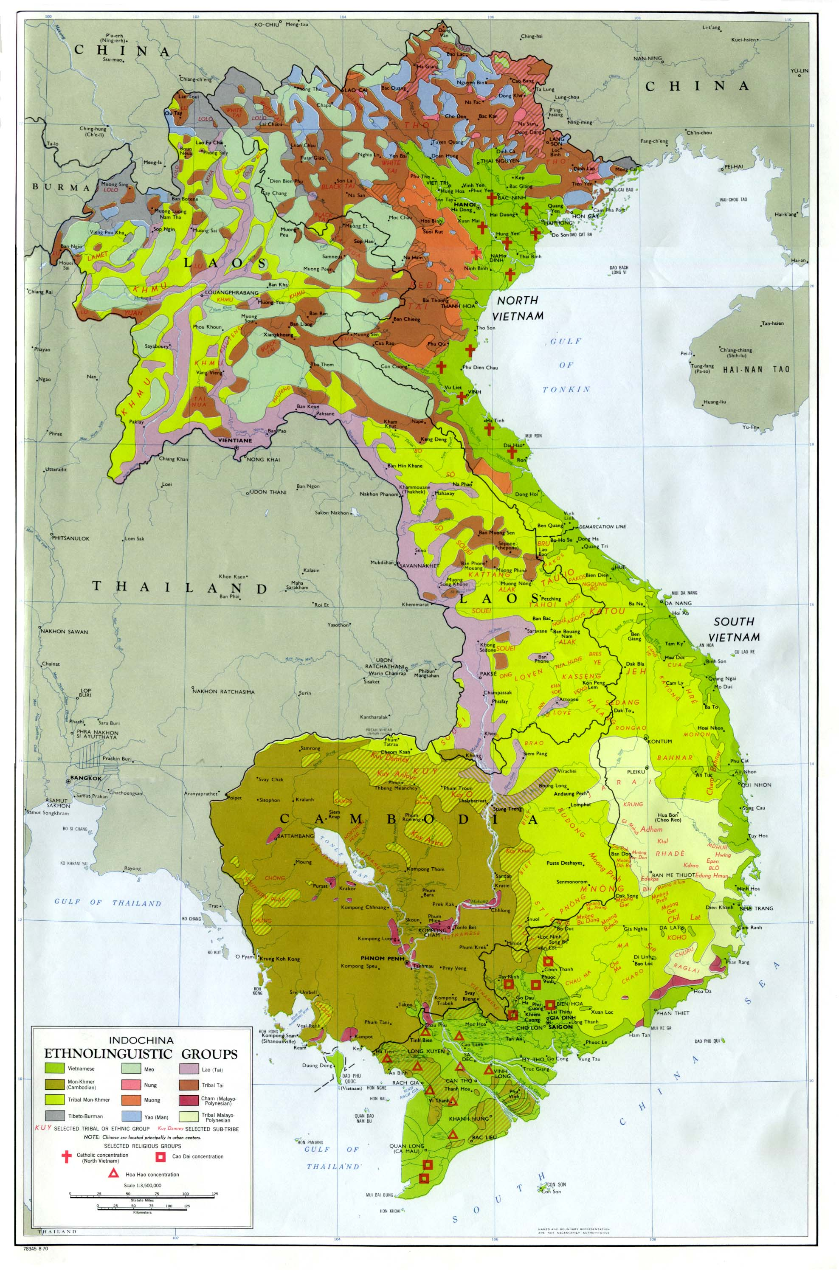
Ethnic Composition in East and Southeast Asia
East Asia | 90% | 80% | 60% | 40% | 20% | 10% | 5%
China | Han |  |  |  |  |  | 55 minorities such as Uygur and Tibetan
Japan | Japanese
Koreas | Koreans
Taiwan |  |  | Taiwanese |  | Chinese | Hakka
Southeast Asia | 90% | 80% | 60% | 40% | 20% | 10% | 5%
Burma |  |  | Burmese |  |  |  | Karen Shan Chinese
Cambodia |  | Khmer |  |  |  |  | Vietnamese
Indonesia |  |  | Javanese |  |  | Sudanese | Madurese Chinese
Laos |  |  | Lao Loum |  | Lao Theung | Lao Sung
Malaysia |  |  | Malay |  | Chinese |  | Indian
Philippines |  |  |  |  | Cebuano Tagalog | Iloko Panay- Hiligaynon | Bikol Bisaya Chinese
Singapore |  |  | Chinese |  |  | Malay | Indian
Thailand |  | Thai |  |  |  |  | Chinese
Vietnam |  | Vietnamese |  |  |  |  | Lao Montagnard Chinese

Slide 23
3. Demography
Demographic transition
  Process of demographic growth:
    Particularly after WWII.
    Huge increase in population.
  Demographic growth is slowing down:
    Significant declines in fertility observed across the board.
    Economic and social modernization of the region (age of marriage).
    Various population planning policies.
  Korea, Taiwan, Singapore, and Hong Kong:
    Currently experiencing great decreases in their birth rates.
    Their fertility rates are below replacement rate.
    South Korea has the lowest fertility in the world (by 2005).
  People’s Republic of China:
    Government policy has incited lower birth rates.
    Imposed a “One Child Policy” (1981-2015).

Slide 24
Demography of the Three Largest Nations of Pacific Asia (1961-2022) (in millions)
Notes:
Source: World Bank.
https://data.worldbank.org/indicator/SP.POP.TOTL?locations=1W

Slide 25
Fertility Transition in some Asian Countries, 1960-2021
Many Pacific Asian countries are facing a fast demographic transition. Explain what this can imply for their demographic future.

Slide 26
Average Age of Marriage, Women, 1970-2018
Notes:
Source: Asia Research Institute

Slide 27
3. Demography
Agriculture and collectivism
  Asian societies tend to have a higher degree of collectivism.
  A major explanatory factor is the intensity of agriculture:
    Requires cooperative land management, notably irrigation systems.
    Settlements tend to be nucleated with villages surrounded by fields.
    Cooperation at its peak during planting and harvesting.
    Multigenerational families living in the same house.
  This social structure pervades today:
    The needs of the collectivity surpasses the needs of the individuals.
    Social order with duties.
  Urbanization is associated with increasing individualism.

Slide 28
Employment in agriculture (% of total employment)
Notes:
Source: World Bank.
https://data.worldbank.org/indicator/SL.AGR.EMPL.ZS

Slide 29
3. Demography
Role of children
  A reflection of traditionally rural societies.
  Multidimensional role:
    Continuity of the family name (males).
    A direct link to ancestors.
    Inheritance of family property, notably farmland.
    Agricultural labor (in the field by the age of 7 or 8 years).
    Take care of parents in old age (limited social security).
  Rural areas tend to have high levels of fertility:
    Maximizes the chances of having a son and of survival.
    Daughters are increasingly sent to the cities to work in factories.
  Child labor:
    15% of 7-14 years old work in fields or factories.

Slide 30
Percentage of Economically Active Children Aged 7-14
Notes:
Source: World Bank

Slide 31
4. Social Problems
Gender issues in rural areas
  Acute gender differences in rural societies.
  Unequal access to education, health care and employment.
  Women’s work:
    Usually around the house.
    Small animals of low value (chickens, goats and pigs).
    Vegetables and roots.
    For subsistence.
    Plant, weed and harvest.
  Man’s work:
    Usually in the field.
    Large high value animals (horses and cattle).
    Grains and tree products.
    For cash.
    Prepare fields for cultivation.

Slide 32
Percentage above 15 years Literate, 2018
Notes:
Source: www.unfpa.org. State of the World Population 2000.

Slide 33
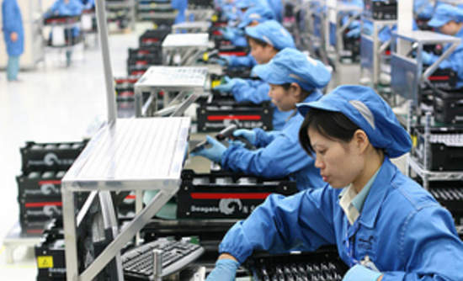
4. Social Problems
Gender issues in urban areas
  Majority of recent migrants are women.
  Left the countryside to work in manufacturing and service industries (particularly in China):
    Send remittances back home.
    Often more an asset than the son.
  Transposition of gender issues in the modern workplace:
    Even in advanced societies (Japan, Korea).
    Woman fulfilling clerical functions.
    Expectation to work until getting married and then assume the traditional child raising function.

Slide 34
4. Social Problems
“Mail-order bride” or “Passport bros”
  Women who advertise themselves for foreign marriage.
  Men who travel abroad to find a wife.
  Easiest way to get a travel visa.
  Mainly from Southeast Asia and Russia.
  Factors:
    Countries where jobs and educational opportunities for women are scarce and wages are low.
    Countries where women are focusing on career, delay having a family and have a misandrist attitude.

Slide 35
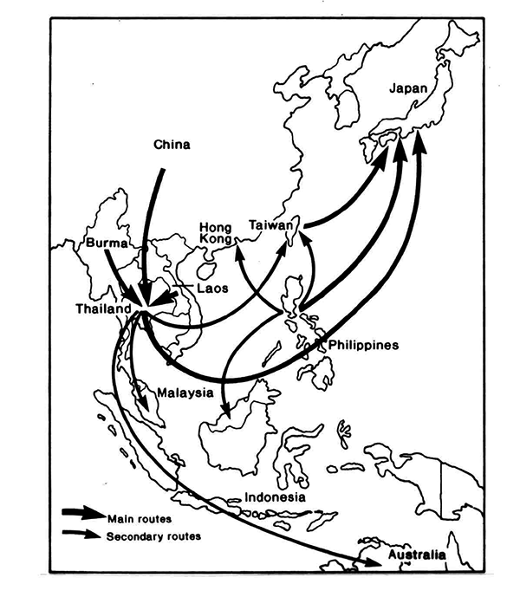
Prostitution in Pacific Asia
Sex cities
  Significant infrastructures of bars, karaoke clubs, hotels, and massage parlors.
  Bangkok, Manila and Saigon as major destinations.
Prostitution and sex tourism
  Mainly Europeans, Americans, Australians, Saudi Arabians and Japanese.
  Either informal or organized by sex travel agencies.
  Seek exotic and feminine women.
Bangkok

Slide 36
4. Social Problems
Missing female population
  About 70 million females are missing from Asian population (2005).
  Normal ratio at birth is about 100 girls to 105 boys.
  Boys are weaker and the ratio evens out after 5 years.
  Since 1900 the ratio has been declining, especially after 1990.
  Particularly the case for China and India (0-4 age group).
  Problems exacerbated by declining fertility and growing standards of living.

Slide 37
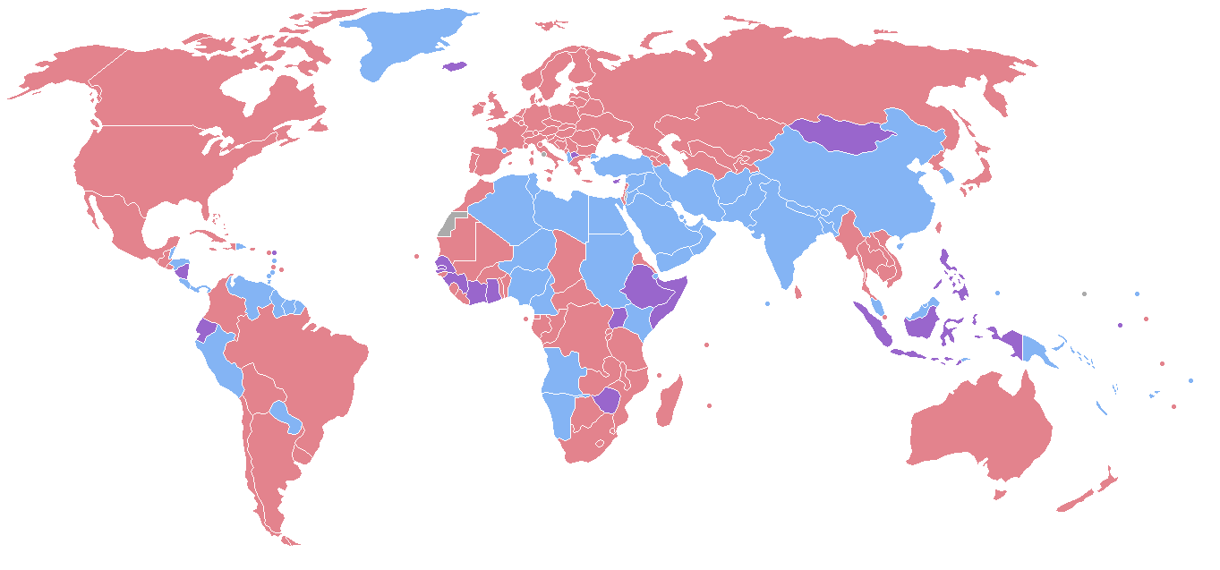
Countries with More Males than Females (Blue)
Red: more females than males
Purple: similar proportions
Blue: more males than females
Related to societies where gender inequality prevails (religious and social causes).

Slide 38
Infant Mortality Rate (per 1000 under age 5), by Sex, Selected Countries, 1990-2018

Slide 39
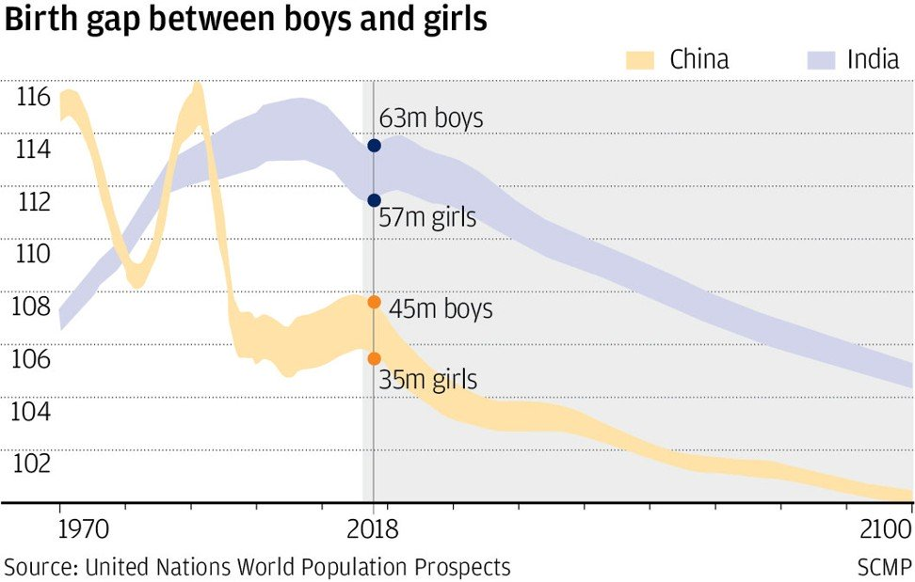
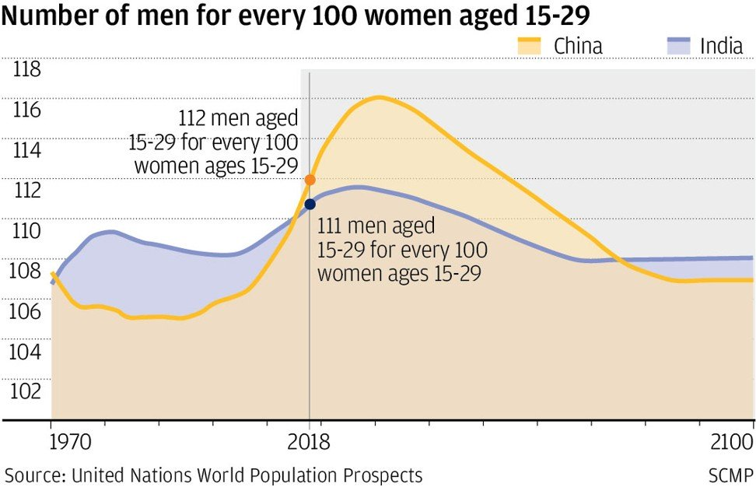
Demographic Gender Differences, China and India

Slide 40
4. Social Problems
Gender roles and the missing female population
  Sons are perceived as an asset:
    Farm work.
    Security for old age (limited social security in several countries).
    Take over the family name.
    Sons get better health care, food and schooling.
    100% of them must find a bride and produce an heir.
    One of the greatest Confucian sins is not to have male descendants.
    In China, the birth of a boy is labeled as “big happiness” while the birth of a girl is labeled as “small happiness”.
  Daughters are perceived as a liability:
    Marry and leave home to provide labor to another family.
    Dowries are often to be paid.

Slide 41
4. Social Problems
Causes of the missing female population
  High female mortality in infancy or childhood:
    Preferential treatment for boys; better food and health care.
    Infanticide.
  Excess female mortality in utero:
    Sex-selective abortion.
  Net out-migration of female children:
    International adoptions.
  Sex-selective undercount of children:
    Daughters are not declared.
    No education provided by the state.
  One Child Policy (1979-2015).
Explain the causes and potential consequences of the missing female population

Slide 42
Official Adoptions from China to the United States, 1985-2016
Notes:
http://www.fwcc.org

Slide 43
4. Social Problems
Consequences of the missing female population
  Demographic “backlash”:
    May help achieve demographic stability.
    Fast decline in fertility.
    Fast decline of population growth and then of absolute population.
    About 34 million men forced to be bachelors by 2020 (25 million in India); “bare branches”.
  Labor market distortions.
  Drives savings rates up and consumption down.
  Inflate property values.
  The “value” of females has increased dramatically:
    Millions of men will not be able to find a wife.
    Changes in the economics of marriage.
    Inverted dowry; “Bride prices” are becoming more common.
    Daughters increasingly an asset for industrial work.

Slide 44
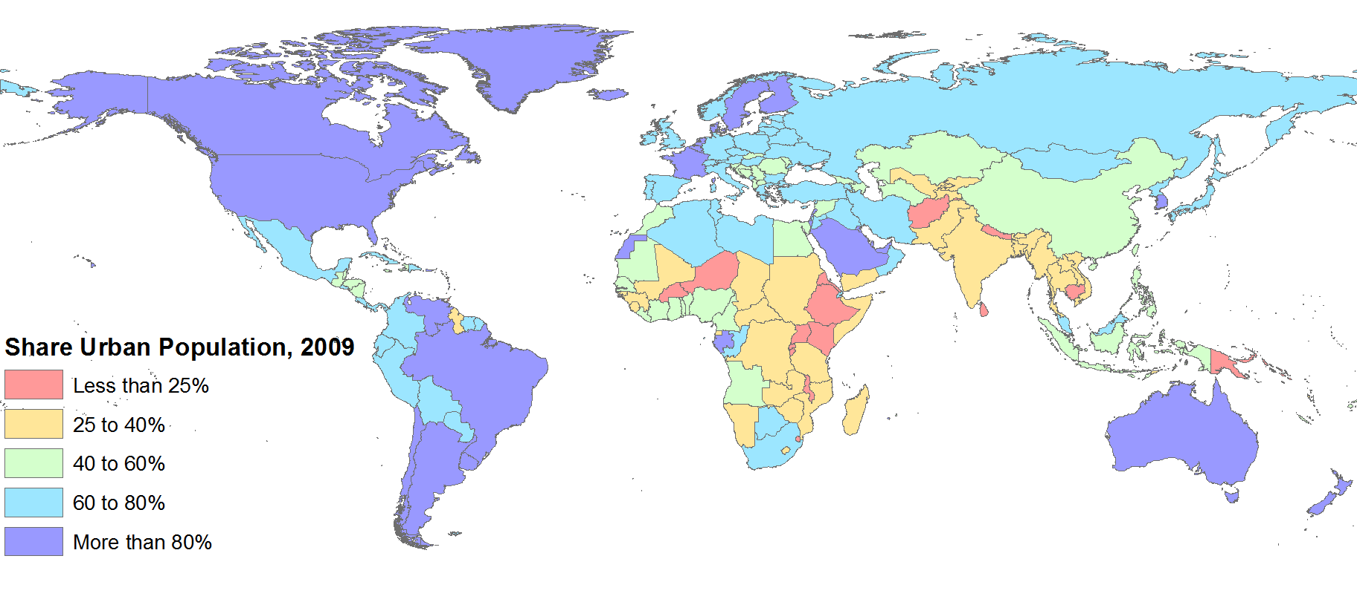
5. Urbanization
Causes
Consequences
Natural increase (ongoing demographic transition).
Rural to urban migration.
Modernization and globalization.
Fast urbanization.
Mega-cities.
Shantytowns.
Environmental degradation.

Slide 45
Cities of More than 10 Million Inhabitants, 1950-2015
Notes:
Source: United Nations, Department of Economic and Social Affairs, Population Division (2006). World Urbanization Prospects: The 2005 Revision. New York: United Nations.

Slide 46
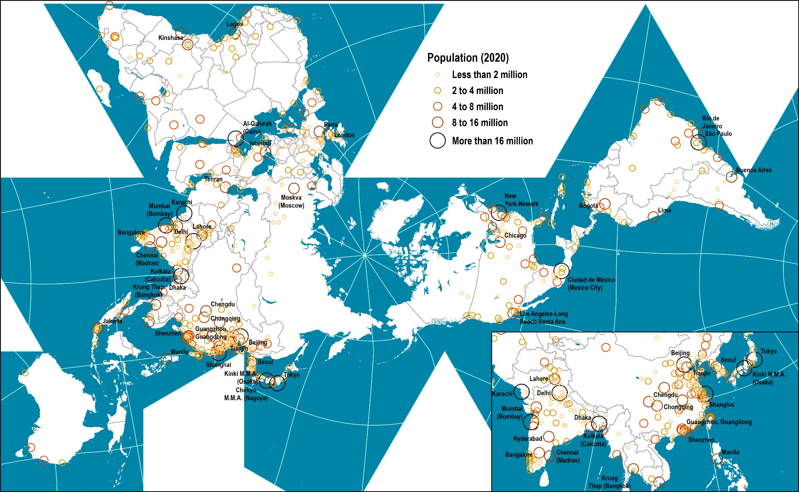
World’s Largest Cities, 2020
Notes:
Source: United Nations, World Urbanization Prospects 2018
https://population.un.org/wup/Download/
Map location: world_cities

