Slide 1
Introduction to World Regional Geography

Slide 2
NOTICE
Most of the material, including graphics, are derived from:
  Jan Nijman, Peter O. Muller, Harm de Blij (2017) Geography: Realms, Regions and Concepts, 17th Edition, New York: Wiley.
  The above owns the copyrights of this material.

Slide 3
Some Starting Questions
Are we living in a single world or a world composed of parts?
Is the world getting more unified or fragmented?
To what extent geography can explain the regional differences of the world?
The world is a complex place
  Several aspects can be objectively analyzed: landscapes, climate, ecosystems.
  Several aspects are much more subjective: economy, society, culture, politics.

Slide 4
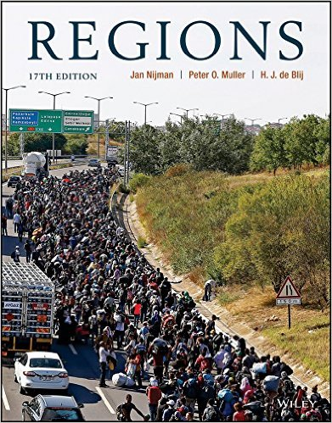
Geography: Realms, Regions, and Concepts, 17th Edition
Available at Amazon
Ebook purchase: $60

Slide 5
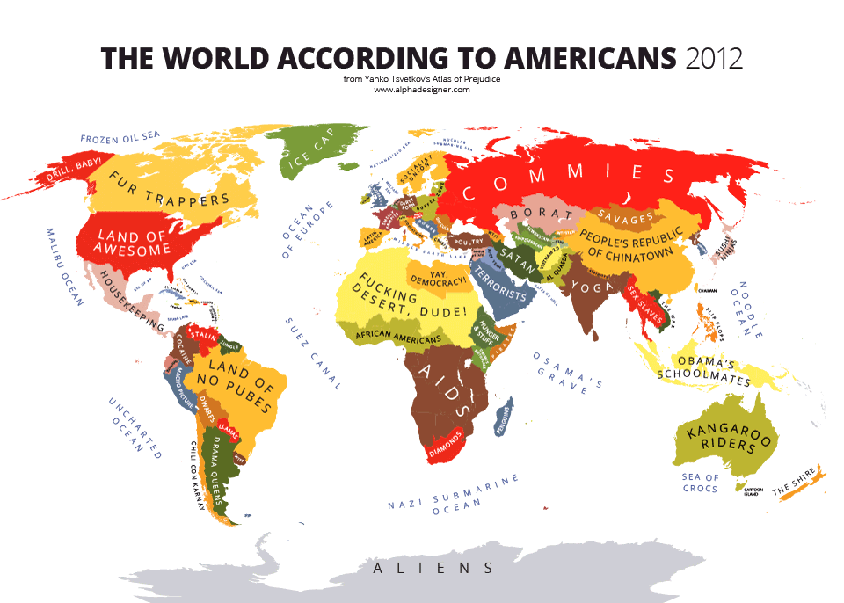


Slide 6
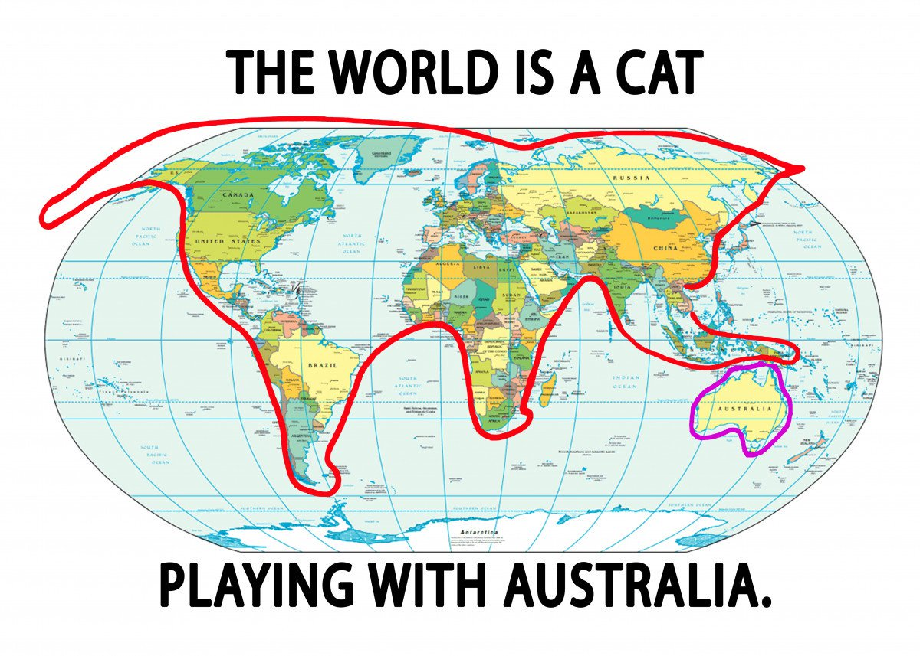

Slide 7
Geography’s Perspective
Geography
  Often called the most interdisciplinary of disciplines.
A Spatial Perspective
  Key theme: space on Earth’s surface and its organization.
  Patterns and processes that organize social and natural spaces.
  Geography’s consideration that spatial patterns are crucial to how societies are organized.

Slide 8
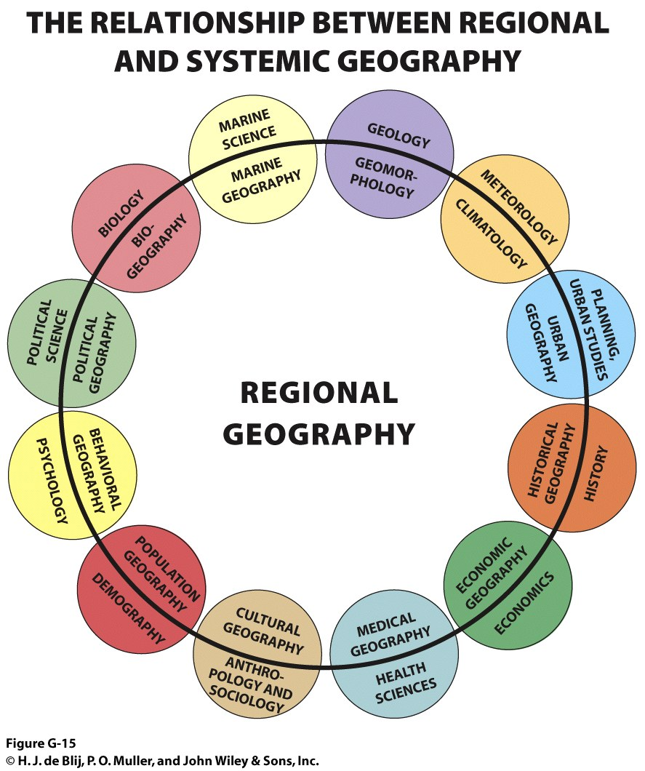
Realms and Regions: Geography is both a social and physical science
Types of study:
  Regional geography is an all-encompassing study of the world by its regions, which uses…
  Systematic geography and its research in systematic fields that relate to other disciplines but uses its unique spatial perspective.
© H.J. de Blij, P.O. Muller, and John Wiley & Sons, Inc.
Explain and provide some examples of how regional geography is built from systematic geography

Slide 9
Geography’s Perspective: Environment and Society
Intersection
  Between social and natural sciences.
  Integrates each perspective.
Relationship between human societies and natural (physical) environment is reciprocal
  Human transformation of the environment.
  Human dependence on the environment and behavior a product of it.
Anthropocene
  Era of geological and environmental conditions impacted by human activities.
  Biodiversity, climate, biogeography, geomorphology.

Slide 10
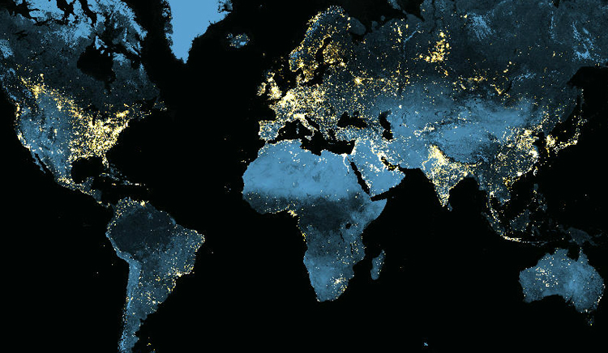
The Anthropocene: The World at Night
Explain what is the Anthropocene and how human activities are shaping it.
Notes:
Source: NASA.

Slide 11
Geography’s Perspective: Spatial Patterns
Spatial patterns
  Necessary knowledge of location and distribution of significant features of Earth’s surface.
  Both human and natural worlds.
  Also incorporates a temporal (historical) perspective.
Geography’s comprehensive spatial vocabulary
  Extensive and meaningful terms describe patterns and processes from past, present, and into the future:
    E.g.: Area, region, scale, boundary, location.
  Some definitions become more specific and complex in their usage by geographers.

Slide 12
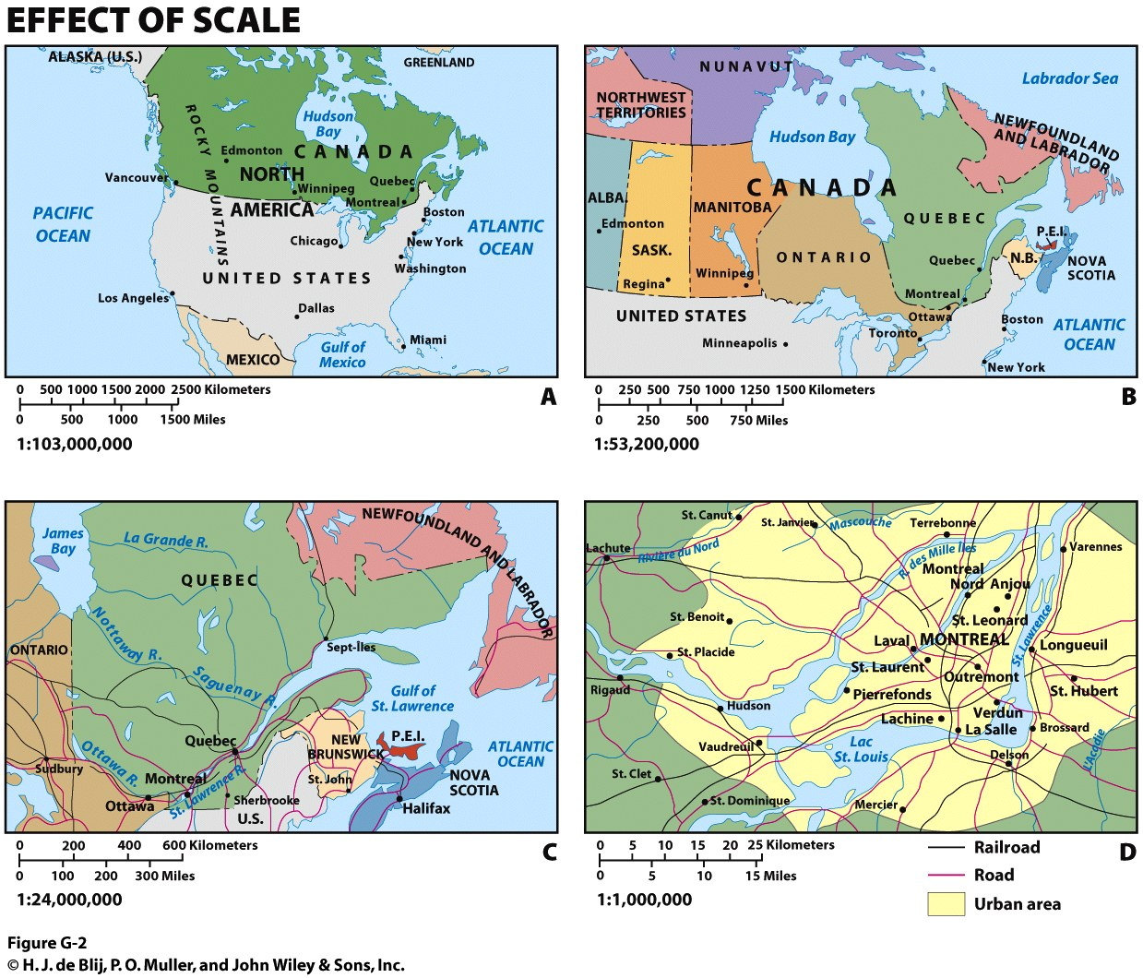
Small Scale
Large Scale
Map scale: compares the area and detail on the ground with on the map

Slide 13
World Geographic Realms
Geographic realms
  Global neighborhoods/regions with combinations of environmental, cultural, economic and political properties.
Criteria for Geographic Realms
  Physical and human: define broad areas (e.g. climate or language).
  Functional: interaction within the area (e.g. economic bloc).
  Historical: above criteria interrelated over time (e.g. Europe in the 20th century).
Explain what are geographical realms and how they are delimitated.

Slide 14
World Geographic Realms: Two Varieties of Realms
Monocentric
  Realms are dominated by a single major political entity, by either its territorial or population size.
  Ex: North America (United States).
Polycentric
  Appearance, functioning, and organization are dispersed among equally influential regions or countries.
  Ex: Europe.

Slide 15
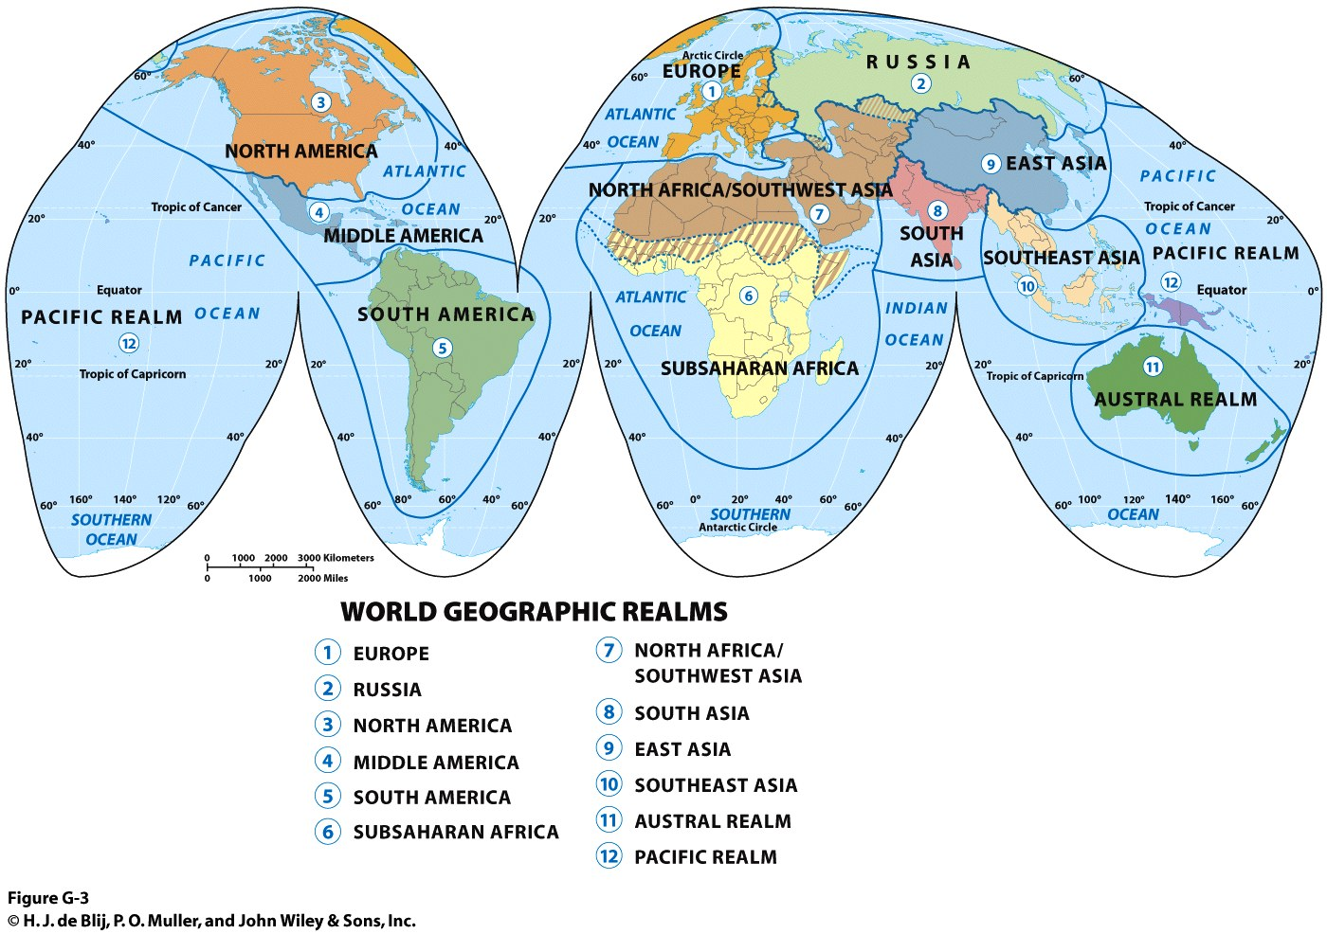
World Geographic Realms

Slide 16
World Geographic Realms
Delineating Realms: Boundaries and Transition Zones
  Beyond common natural boundaries that separate world realms (e.g., oceans and seas).
  Transition zones: where two geographic realms meet are not sharp boundaries:
    Represent ever-changing zones of regional interaction and change.
    Vary in size: most are narrow; a few can be broad.
  Reality of contested, shifting boundaries, and changing geographic fortunes in the world.
Geographic Realms: Dynamic Entities
  Temporal change affects realms’ criteria.
  Between 1945 and 1985, country borders changed little, but since 1985, far-reaching realignments have been occurring again.

Slide 17
Regions within Realms
Regional concept
  Refined level of spatial classification requiring more specific criteria.
  Often employed as part of everyday communication (e.g. media).
  Often easy to imagine and describe, but difficult to outline on the map (e.g. Midwest, Middle East).
    Different criteria can be identified or prioritized, thus changing the delimitation (e.g. Middle East and Arab World).
  Use of spatial generalizations and selective criteria.
    Depends on the purpose for creating the region.

Slide 18

Regions within Realms: Criteria for Regions
Five sets of criteria
  Area: space occupied on Earth’s surface
  Boundaries: using specific criteria to divide (natural or artificial)
  Location:
    Often a region’s name contains a locational clue.
    Absolute location: area’s extent defined by the geographic grid.
    Relative location: referenced against other regions.
  Homogeneity or sameness:
    Human (cultural), physical (natural), or both.
    Formal regions: areas with a measureable or visible internal homogeneity.
  Regions as systems marked by functional integration:
    Spatial Systems: components and interactions within an areal extent, known as a functional region.
    Core, as center of activity with a surrounding zone of interaction, or hinterland.

Slide 19
Regions within Realms: Interconnections
All human-geographic regions are more or less linked to other regions.
Globalization
  Causing ongoing integration and connections.
  Sometimes blurs regional identities.
  Sometimes paradoxical:
    Some regions become more alike.
    Some regions develop stronger contrasts.

Slide 20
The Physical Setting
The role of natural environments in how people make their living:
  Patterns of opportunity are favored areas with opportunities for plant and animal domestication:
    Followed continued adaptation and invention.
    Led to the development of villages, towns, and cities.
  People in other environments found it harder without such favored opportunities.
Modern map carries these imprints of the past.

Slide 21
The Physical Setting: Natural (Physical) Landscapes
Natural landscapes:
  Array of landforms constituting Earth’s surface, including the physical features that mark them.
Landform types: mountains, hills, plains, plateaus.
Physical features: water bodies, soil, vegetation.
Influence human activity and movement
  Arable land, resources, ease of transportation (e.g. river system).
  Each geographic realm has its distinctive combination of natural landscapes

Slide 22
The Physical Setting: Geology and Natural Hazards
Tectonic plates
  Lighter rock continents float atop heavier rock plates that move by magma circulation cells within the Earth.
  Collision of tectonic plates cause earthquakes and volcanoes.
Continental drift
  Landmasses were once pieces of a supercontinent, Pangaea, that broke up and continues to drift apart.
Pacific Ring of Fire
  Zone of crustal instability along plate boundaries ringing the Pacific Ocean Basin.
  Marked by earthquakes and volcanic activity.

Slide 23
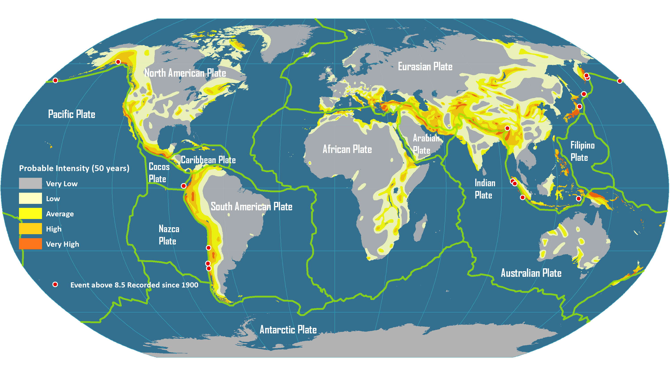
Global Plate Tectonics and Seismic Activity

Slide 24
The Physical Setting: Climate
Climate Regions
  A region having a common climate.
Weather vs. Climate
  Weather: immediate state of the atmosphere.
  Climate: aggregate, total record of weather conditions at a place or region over time.
  Radiation and absorption of heat energy determine climatic variations.
  Regions have relatively similar weather.
  Patterns with latitude.
  Lower the latitude, the more solar energy received.

Slide 25
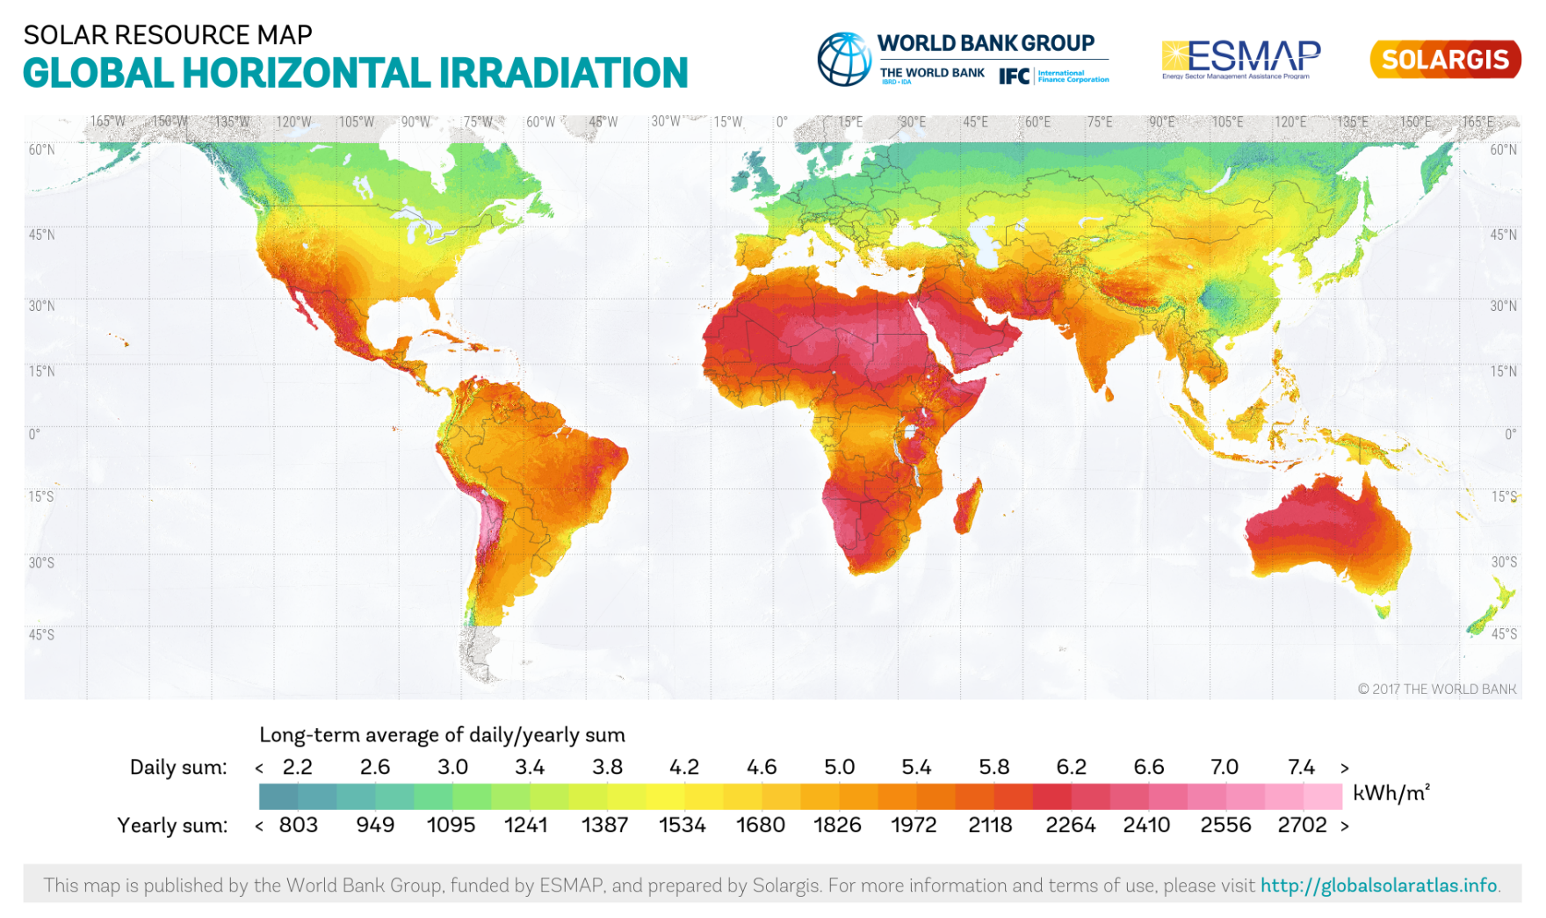
Sum of direct and diffuse (scattered by the atmosphere) components of solar radiation [kWh/m²].
Notes:
Source: https://globalsolaratlas.info/downloads/world

Slide 26
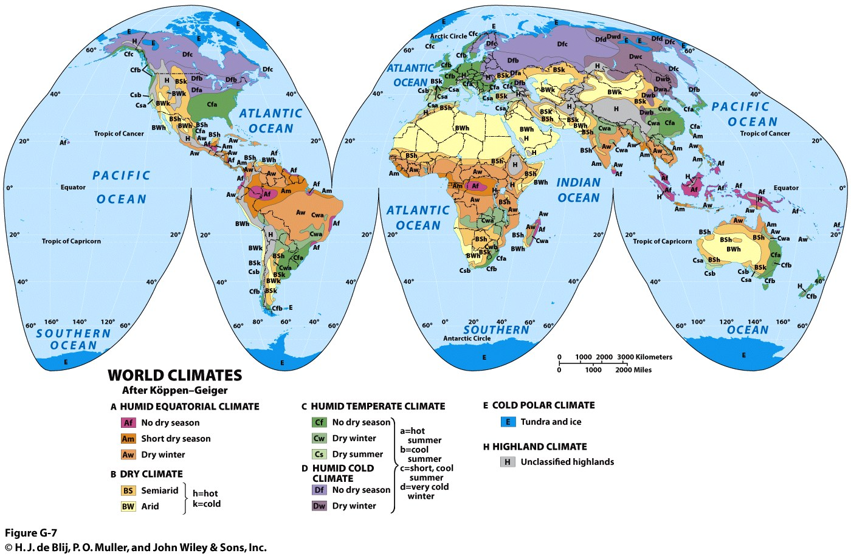
The Physical Setting: Climate
© H.J. de Blij, P.O. Muller, and John Wiley & Sons, Inc.

Slide 27
Realms of Population
World population: 7.7 billion (2019)
  Occupying less than 30% of Earth’s surface.
  Three major world population clusters = 4 billion people.
  Urbanization varies among the world’s realms and regions.
A: South Asia
  Centered on India, including Pakistan and Bangladesh.
  World’s largest cluster made up mostly of farmers.
B & C: East Asia
  Centered on China, including coastal zone.
  Rapid change from rural-to-urban life and development.
D: Europe
  European continent, including Western Russia.
  Among the world’s most urbanized and industrialized realms.

Slide 28
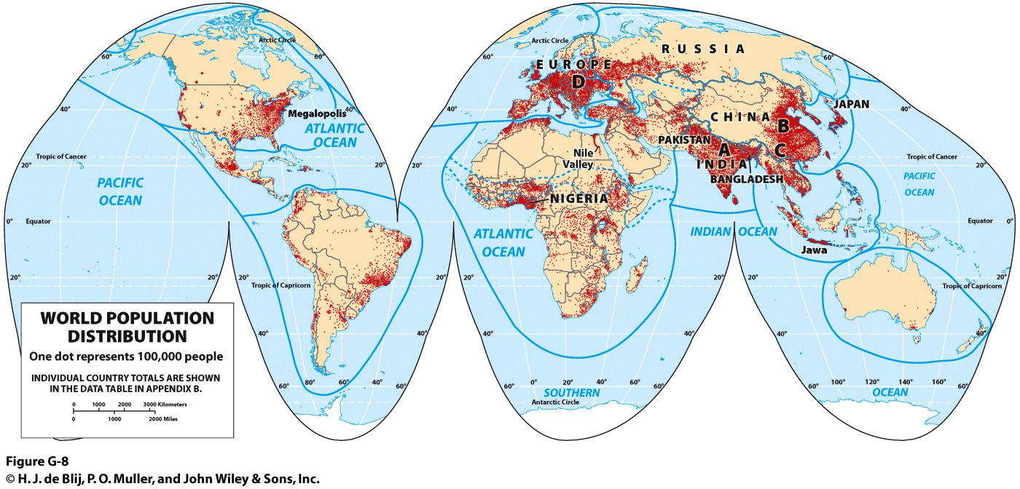
Realms of Population: Major Population Clusters
© H.J. de Blij, P.O. Muller, and John Wiley & Sons, Inc.
What relationship is seen between climate and where people are clustered and what about where people are not clustered?

Slide 29
Realms of Culture
Cultural landscape
  Distinctive attributes of a society imprinted on its portion of the world’s physical stage.
  People start with their physical environment and use their culture to create a multilayered landscape.
  The cultural landscape can be read for clues about the relationship of people to their environment.
  No realm has a single cultural landscape.
  Variations help to define the world’s regions.

Slide 30
Realms of Culture: The Geography of Language
Language as the essence of culture
  Linguistic diversity in the face of English primacy.
  Language lifespan: emerge, thrive, and die out.
Language tree
  15 language families: shared, but distant, origins.
  Several language subgroups under a family.
Lingua franca
  A common second language used in government, commerce, or higher education.
  English primacy a result of colonization and globalization.
Languages evolve over generations

Slide 31
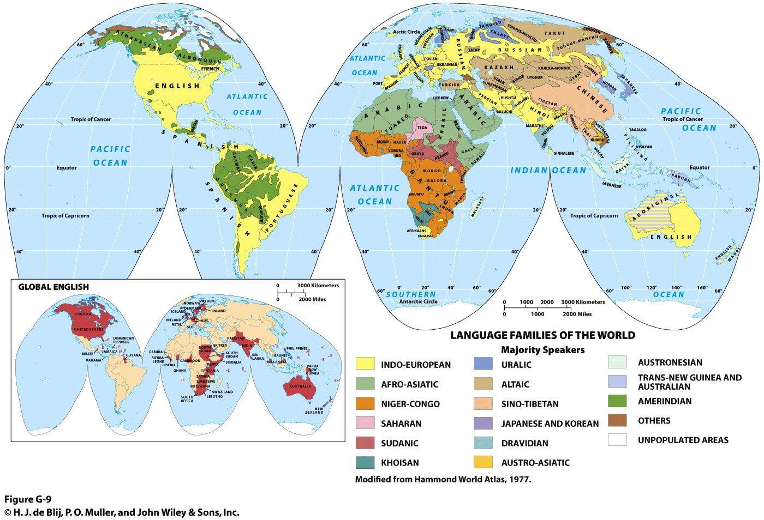

Slide 32
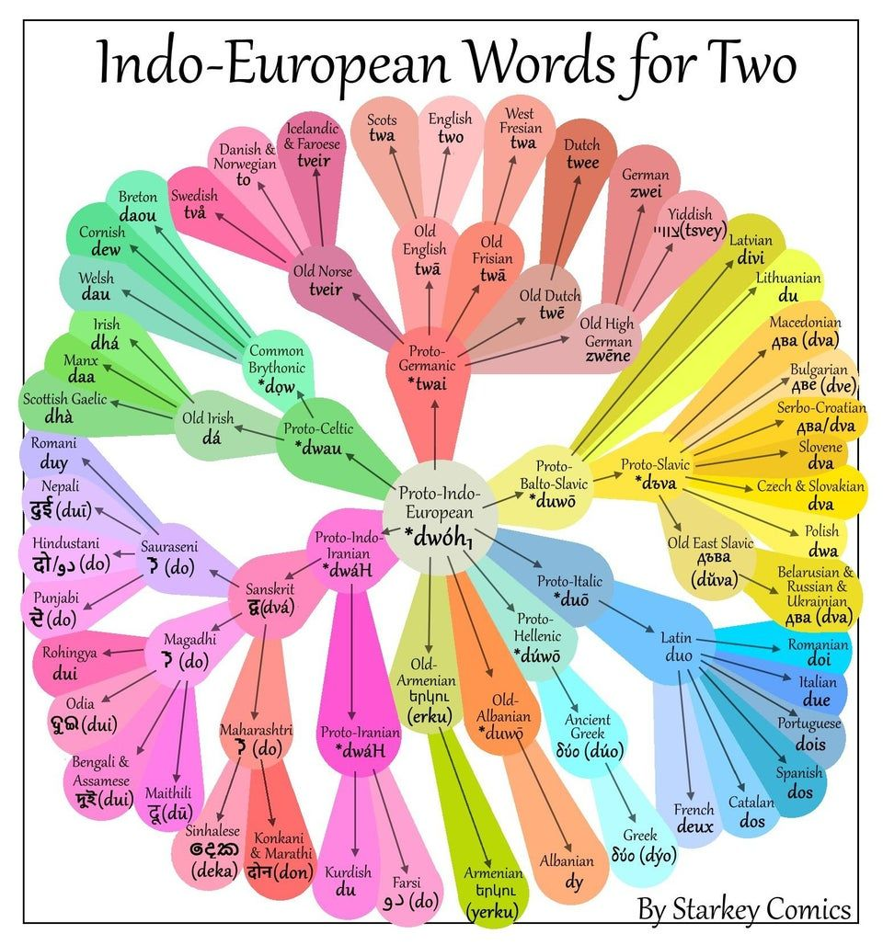

Slide 33
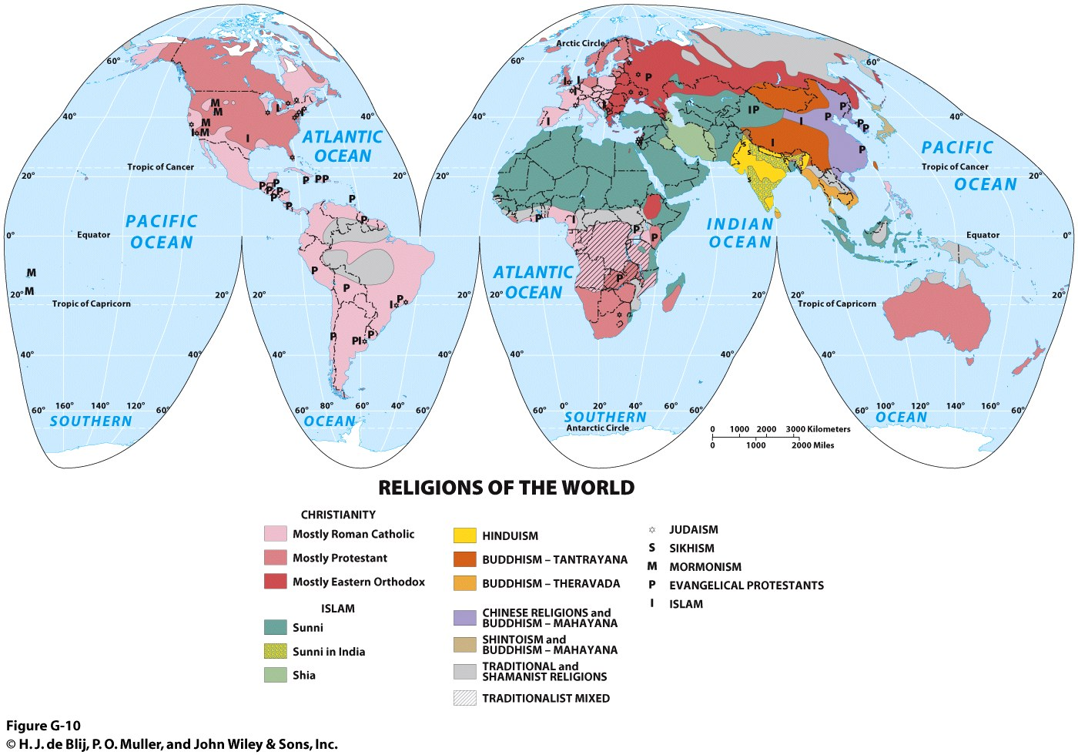
Which realms seem to be dominated by a single religion and language and which realms have the greatest religious and linguistic diversity?

Slide 34
A World of States
States
  Geographic term for political entities, also known as countries.
  Size is not a dependable criterion of importance.
Sovereignty
  Government of a state rules within its borders.
  Essential to the world’s territory organized into a system of states.
  Sovereignty is usually recognized by other states.
  However, recognition can be mired in conflict and war.

Slide 35
A World of States: The Modern State
Emergence of the modern state
  Ancient “proto-states” origins (e.g. kingdoms and empires).
  European state model: assumed a political entity (state) would territorially match a cultural entity (nation) as a nation-state.
  Notion of the modern state is challenged…
    “from below” by ethnic minorities.
    “from above” by international integration.
Subdivisions of the State
  Subnational political units:
    e.g., states, provinces, regions, federal districts, etc.
Geopolitics and the State
  Global influence often relates to a state’s geographic attributes.
  Physical geography, cultural, or economic factors.
  Significance of attributes does change overtime.

Slide 36
A World of States
States, Realms, and Regions
  State borders often help bound realms and regions:
    North America (US / Mexico border considered a realm boundary).
    Russia (A single realm).
  Realm and region boundaries can cut across states:
    The boundary between North Africa and Sub-Saharan Africa is within several states (e.g. Sudan, Niger, Mali).
    Parts of Indonesia considered in the Austral Realm.
Political Geography
  Shapes world-scale geographic regions.
  Global boundary framework also changes.

Slide 37
Geographies of Development
Economic geography
  Spatial aspects of economic activities and the patterns of production, distribution, and consumption.
Development
  Gauges a state’s economic, social, and institutional growth.
Statistics: A Caution
  Data reflect state-scale totals and averages.
  Data can conceal regional and local variability.

Slide 38
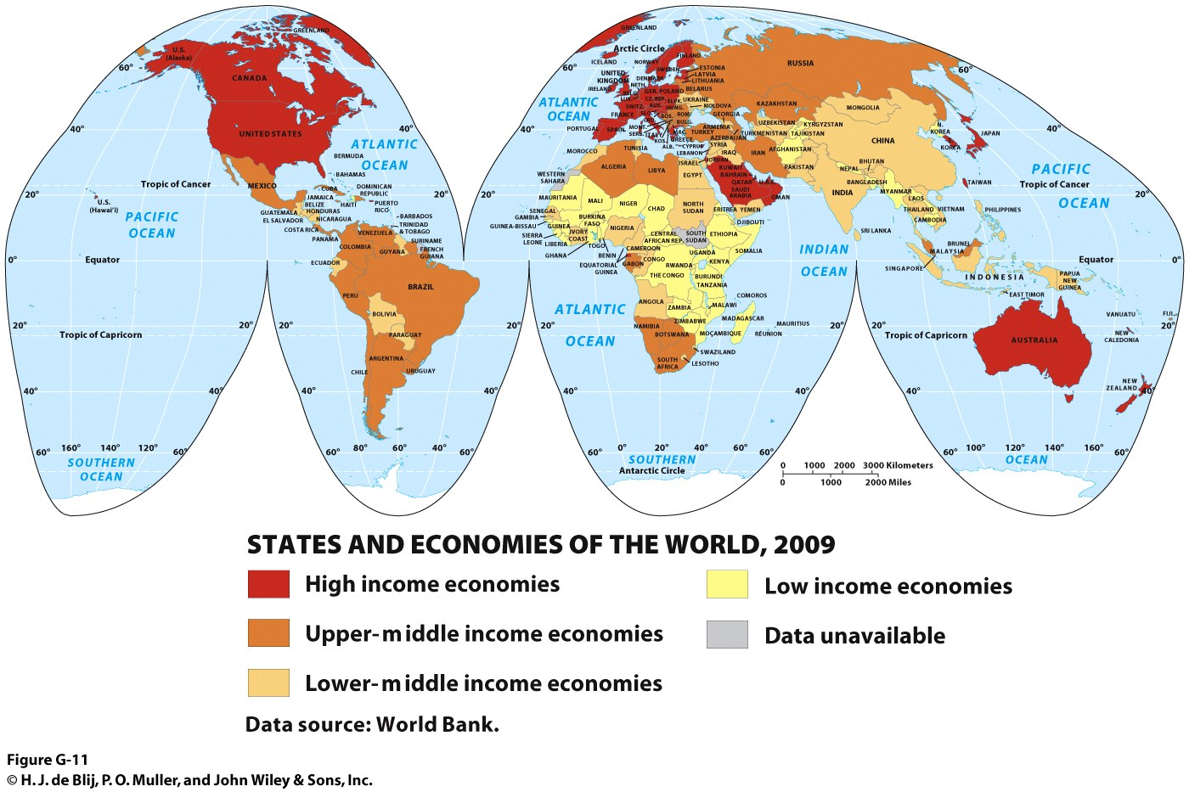

Slide 39
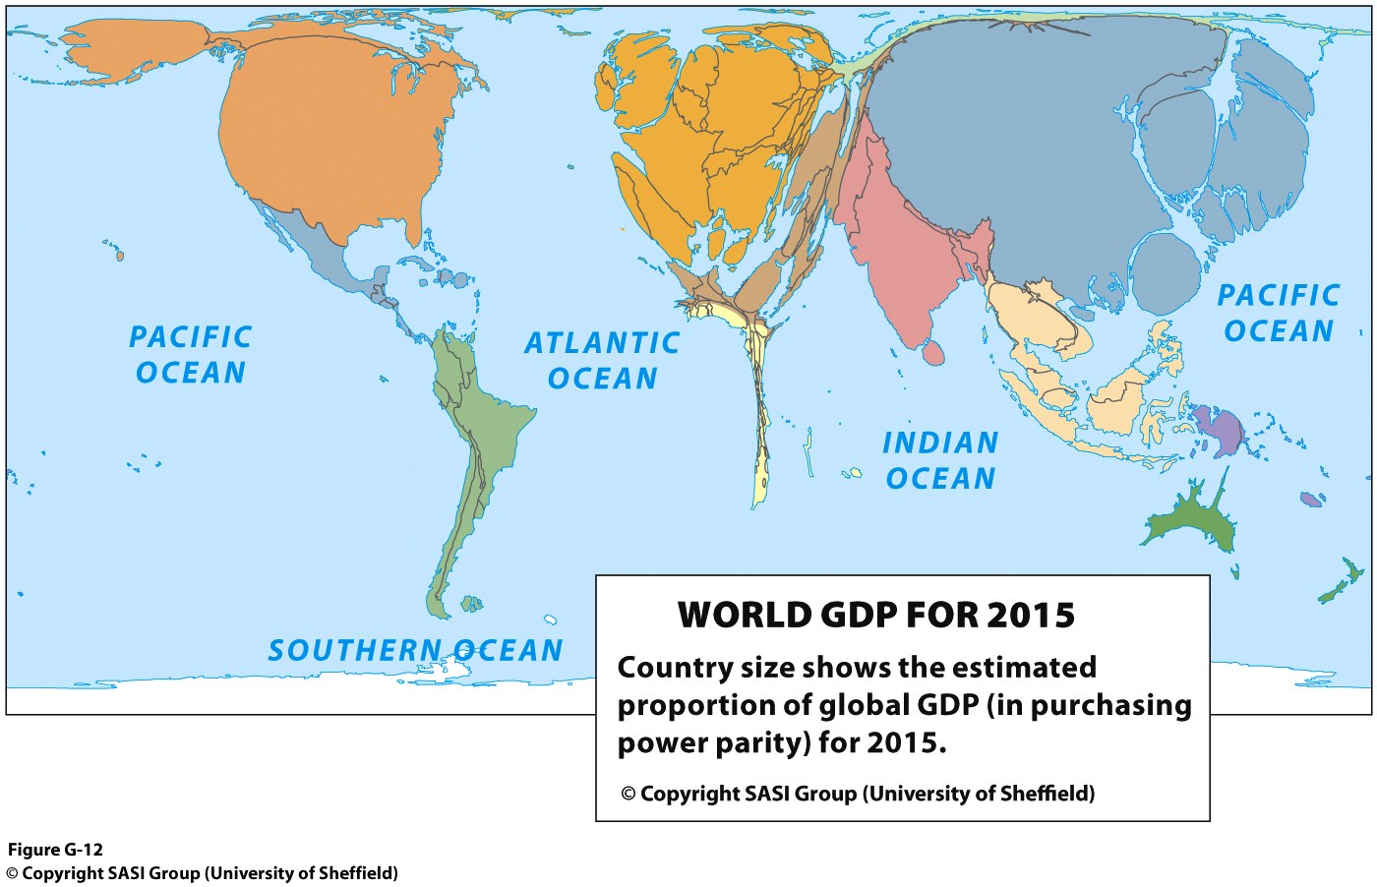
Economic development at substate scales is geographically complex and uneven.
Within high- and middle-income economies, there are still people in poverty.
Global influence does rely on economic prowess and relative size.

Slide 40
Geographies of Development: Development in Spatial Perspective
Uneven Development
  Human success has been focused on certain areas and has bypassed others.
  Core areas: places of dominance that exerted power over surroundings, near and far.
  Periphery: created through one-sided interactions to sustain the core.
Core-periphery interactions
  Usually meant wealth for the core and enforced stability in the periphery.
  Spatial networks have nodes or intersections of various centrality and importance.

Slide 41
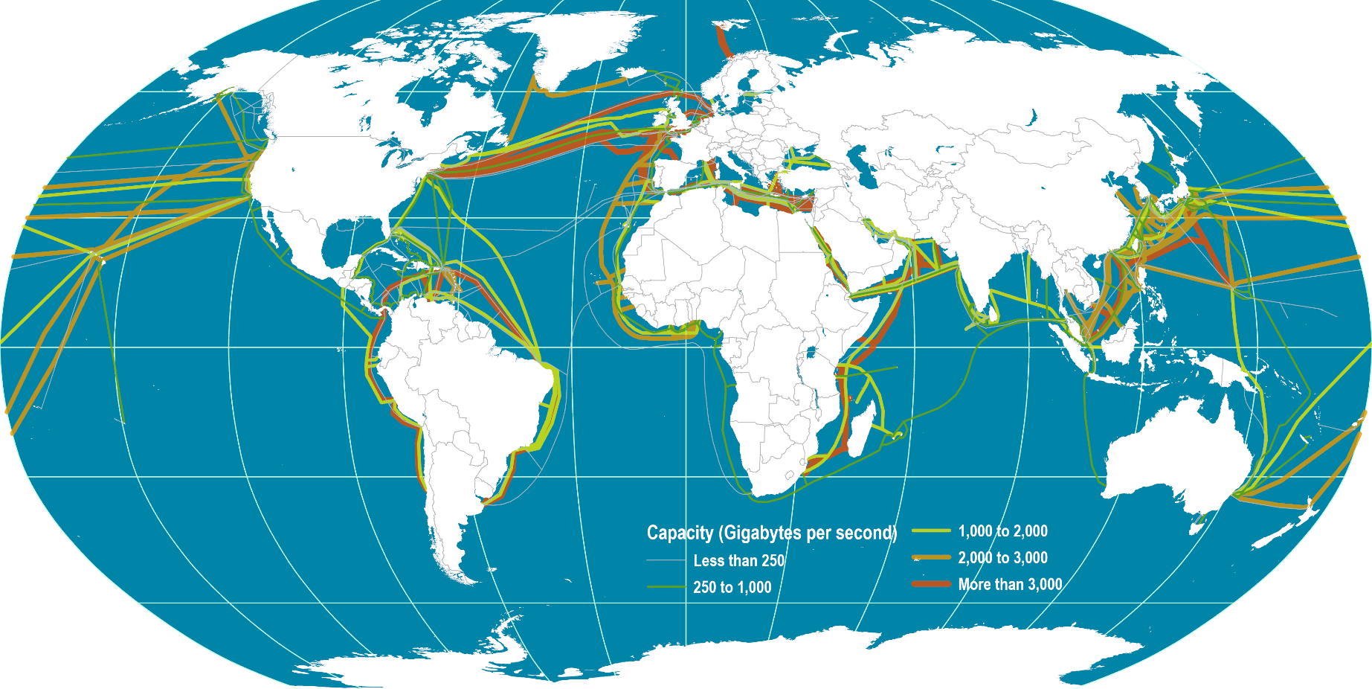
Global Submarine Cable Network
Read this document
What relationships can be seen in the map of World GDP for 2015 and the map of Submarine Fiber-Optic Cables?
Notes:
Source: Dataset encoded by Greg Mahlknecht, http://www.cablemap.info/

Slide 42
Globalization
Globalization
  A geographic process in which economic, cultural, and political relations shift to ever-broader scales.
  The world is integrated and interconnected in a global village.
  Driven by rapid advances in communication and transportation technologies.
  Not entirely new: historical globalization processes of the mid- and late-nineteenth century.

Slide 43
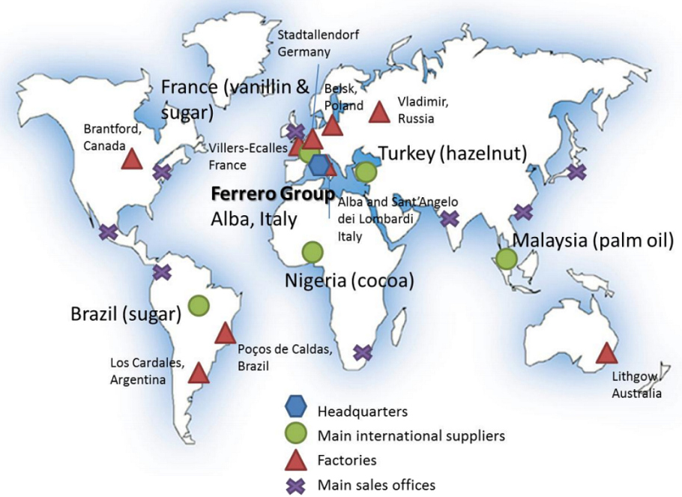

Global Production Network

