Slide 1
Chapter 9: The East Asian Realm

Slide 2
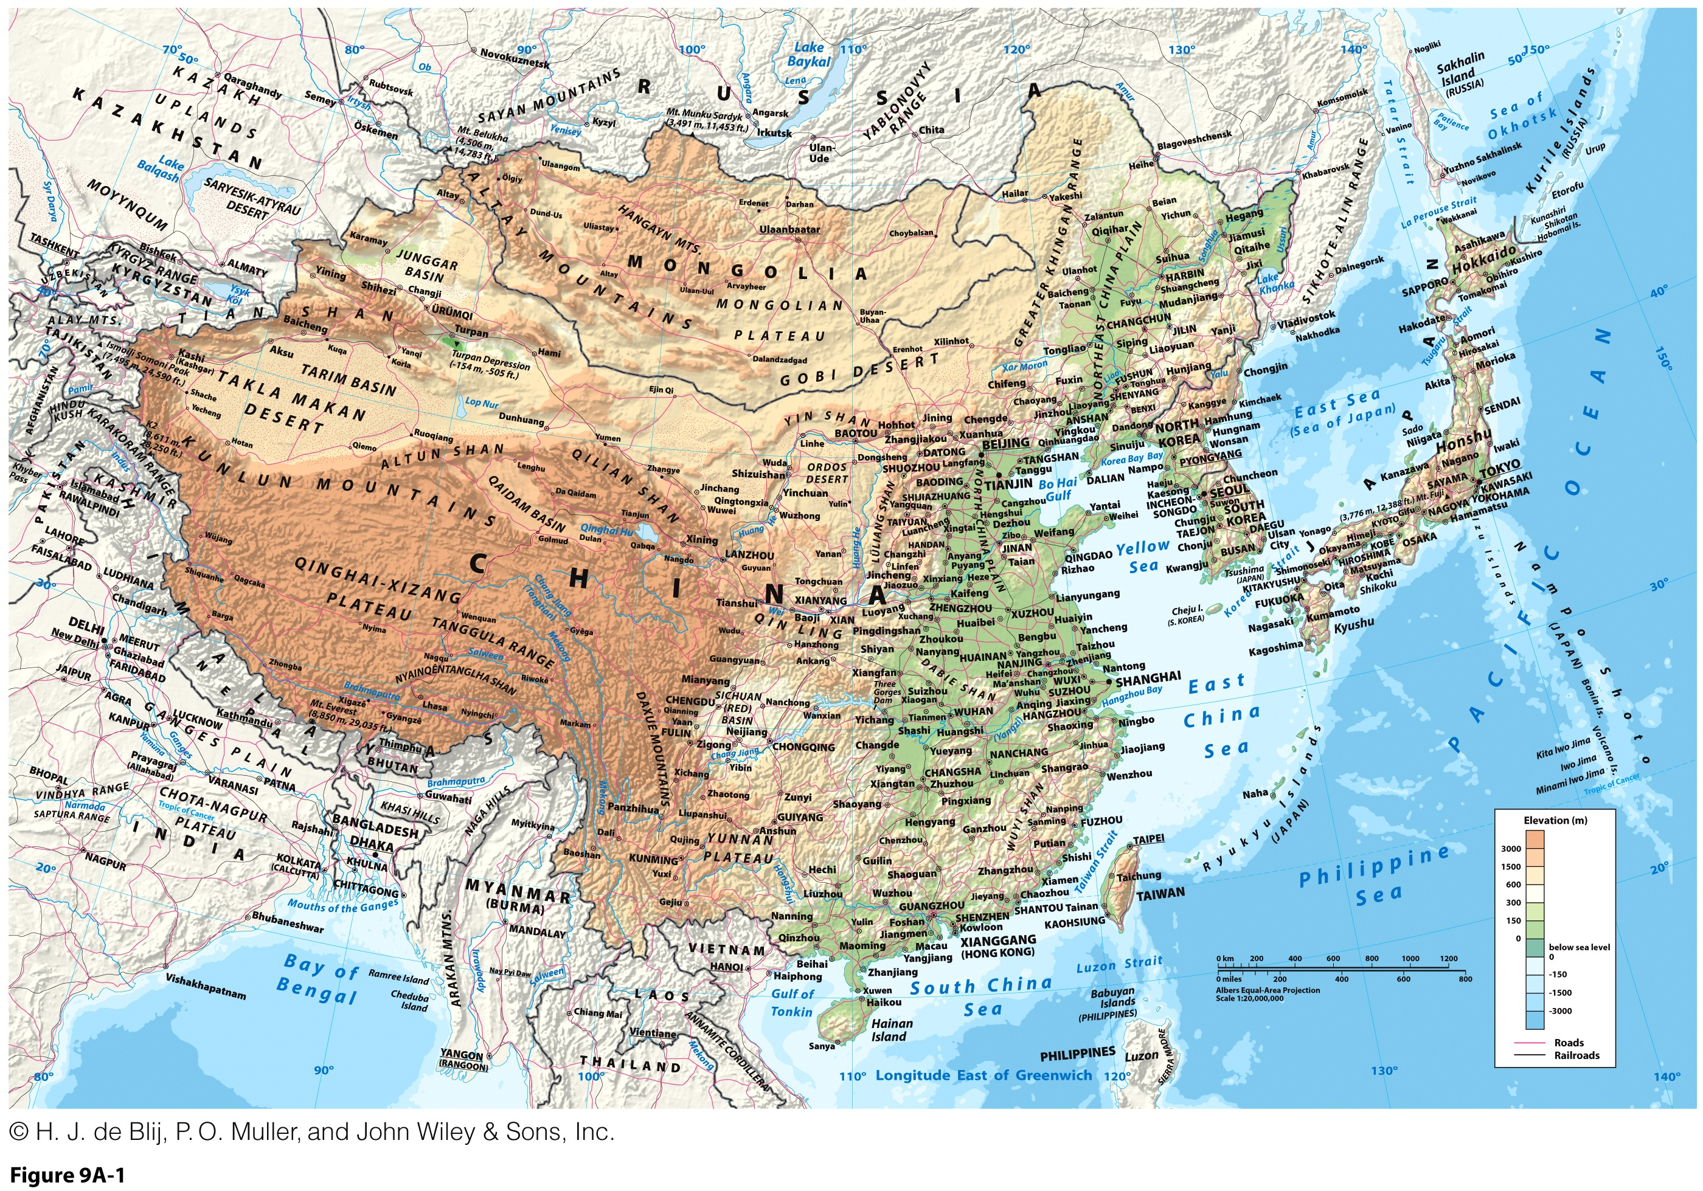

Slide 3
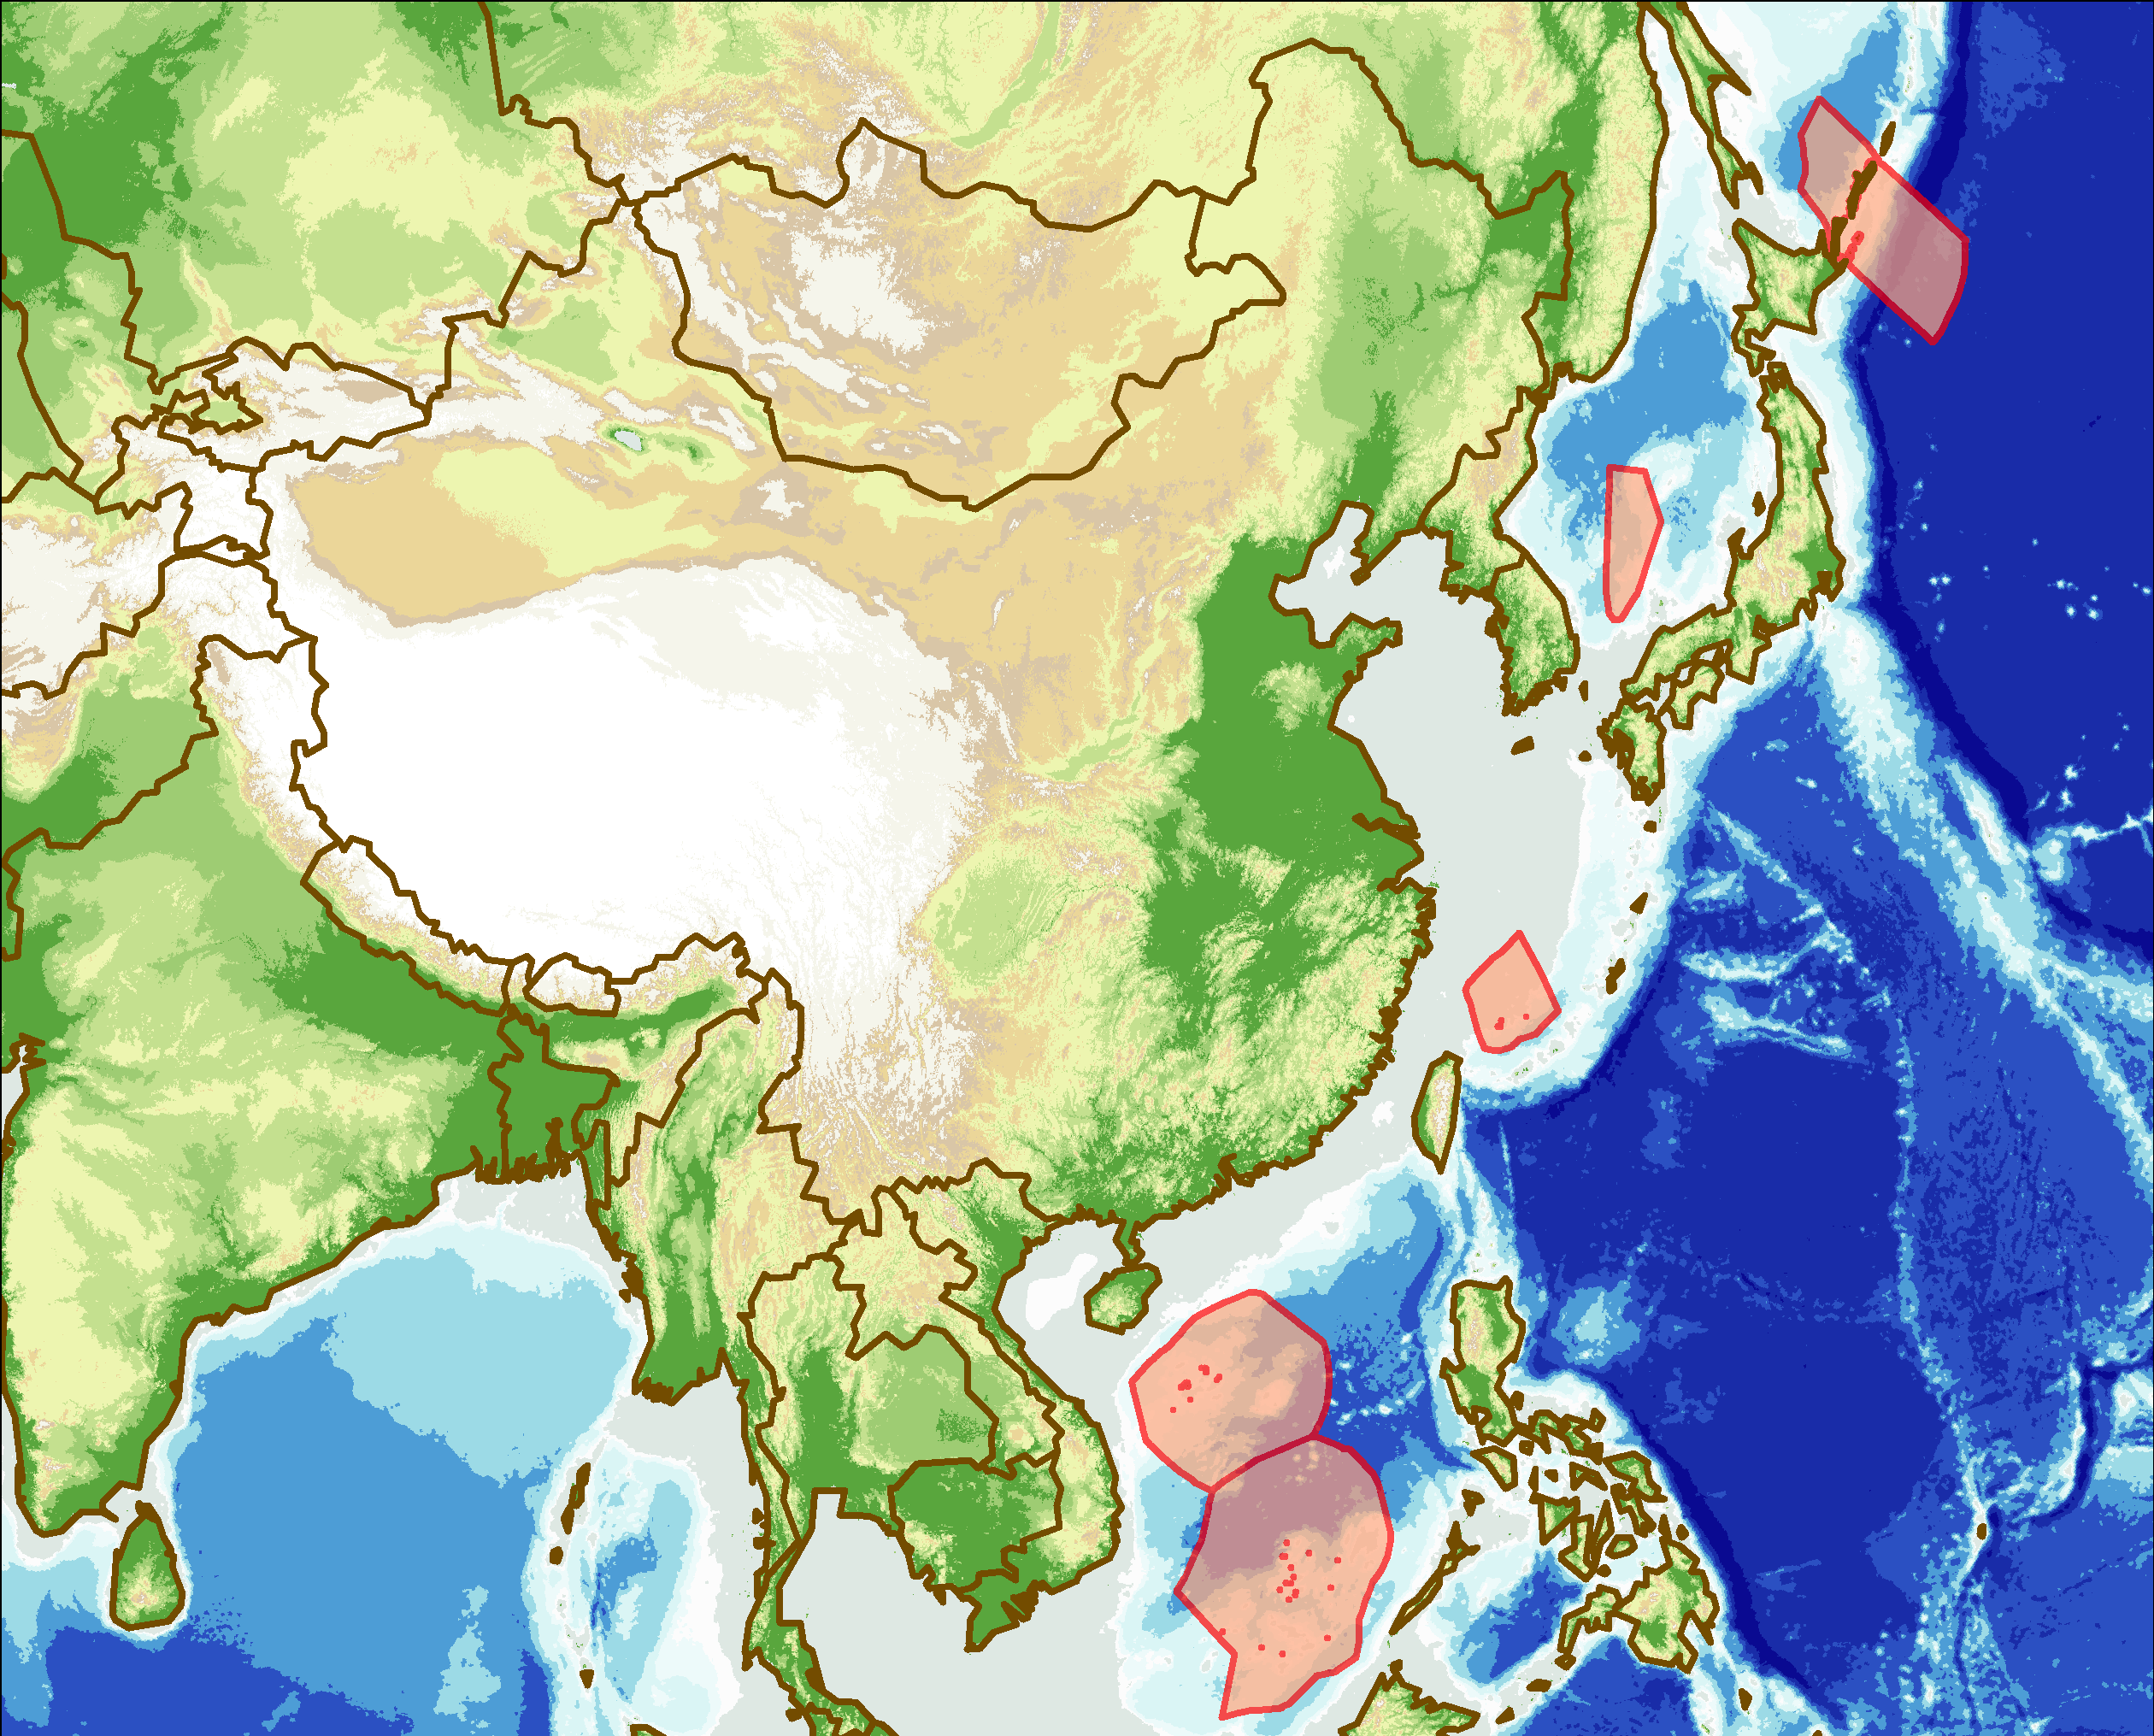
The East Asian Context: Triangular wedge between Russia, South, and Southeast Asia
Mongolia
N. Korea
China
S. Korea
Himalayas
and Tibetan Plateau
Sichuan
Basin
Coastal
Plains
Growth and development.
Imbalances in the regional distribution of wealth.
Food supply.
Resources hungry China and Japan
Pacific Ocean
Taiwan
Guangdong
Plains
Korea and its re-unification.
China and Taiwan.
Maritime Exclusive Economic Zone disputes (e.g. The South China Sea).
South
China Sea

Slide 4
Places and Names…
Languages
  Ideographic writing: form of writing in which symbol represents primarily an idea or thing rather than a sound.
  Disadvantage: difficult to learn large number of characters.
  Advantage: speakers of different languages can use the same writing system.
  Japan and Korea modified the Chinese ideographic system.
European colonists and phonetic errors:
  Wade-Giles System: Peking, Canton, Tientsin.
Communist regime’s replacement of foreign version of place names with pinyin system:
  Based on Chinese character pronunciation in Northern Mandarin.
  Became the standard: Beijing, Guangzhou, Tianjin.

Slide 5
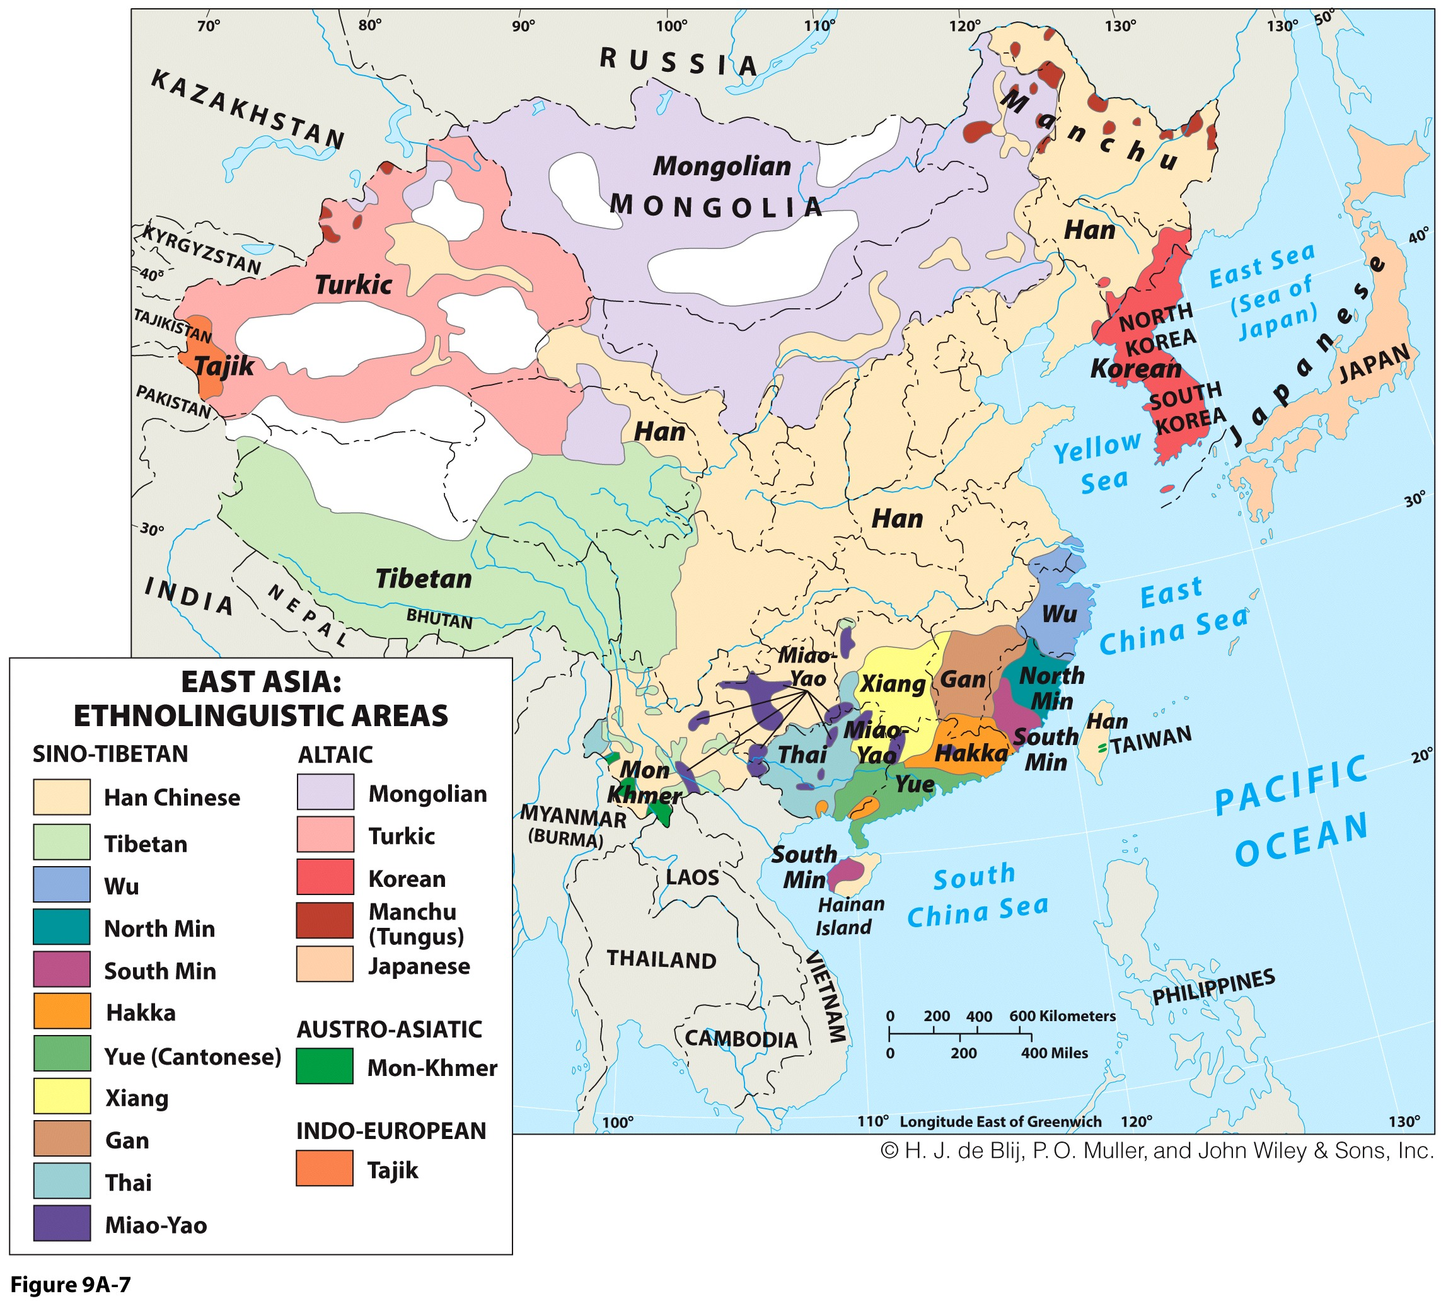

Slide 6
Political Geography
China: From isolation to integration
  Natural protective barriers and a single ocean.
  Inward looking (central kingdom) with minor incidences of external cultural influences.
  A history of emperors who restricted use of the coastline and trade.
  Borders a legacy of external forces.
  Humiliated when the British, French, Russians, Germans, and Japanese took control of large regions.
  Trade is now playing a major role in the economic (and cultural) transformation of coastal China.
Dominant China:
  Area, population, economically and politically.
  Chinese linguistic diversity: many languages and dialects.

Slide 7
Gambling with Nature…
Frequency of earthquakes in the realm:
  Pacific plate subducting beneath the North American Plate.
  Japan sits atop the tip of the Pacific Plate.
  “70-year rule”: Tokyo affected by a major earthquake every 70 years (1633, 1703, 1782, 1853, 1923, 2011).
  Earthquake in the subduction zone released an enormous amount of energy that lifted seawater into a tsunami.
Coast of Japan: danger zone
  Vulnerability: presence of important economic and population cluster.

Slide 8
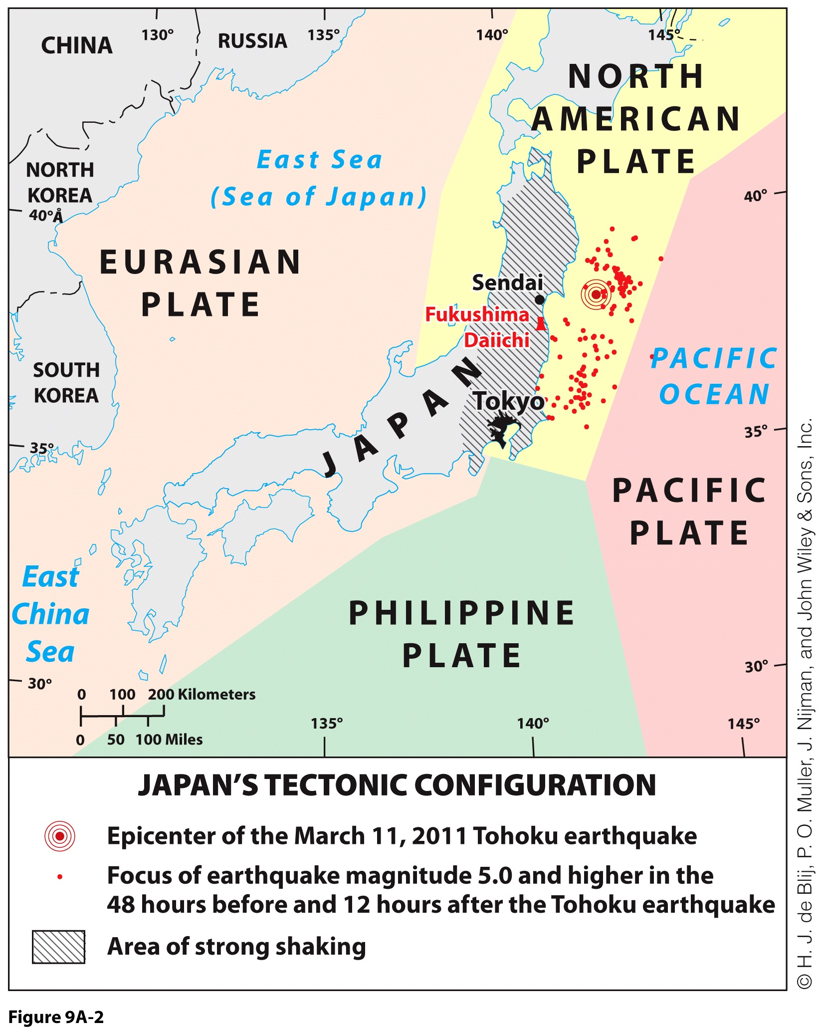
Environment and Population
Tectonic risks to populations
  Tectonics and earthquakes:
    Himalayan interior.
    Pacific Ring of Fire.
  Japan’s earthquake and tsunami, or seismic sea wave:
    Destroyed densely populated coastal plains.
Explain the tectonic risks Japan is facing and its impacts

Slide 9
Environment and Population
Climate and population:
  Western and northern sectors do not support substantial population clusters.
  Large area gives it large regional climatic variability.
  Similar latitude extent to U.S.
  Climate of southern China like Florida; climate of northern China like Canada.
Most of East Asia’s people found in easternmost third of the realm’s territory:
  Most densely populated cluster on Earth.
  Rice dominant in the south; wheat, millet, sorghum in the north.
  North China Plain is one of the most thoroughly anthropogenic landscapes in the world.

Slide 10
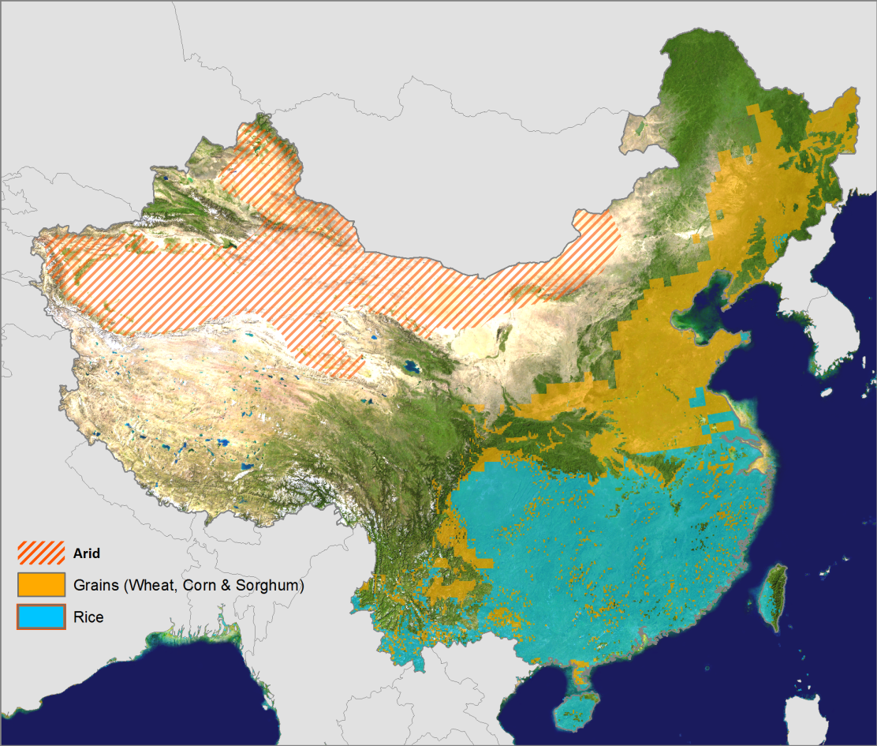
China’s Main Agricultural Regions
China feeds approximately 25% of the world’s population with about 7% of the world’s arable land.
North: continental climate growing wheat, sorghum and corn.
Wheat Dominant
Pasture and oasis
Rice Dominant
South: subtropical climate growing rice.
Double-crop rice

Slide 11
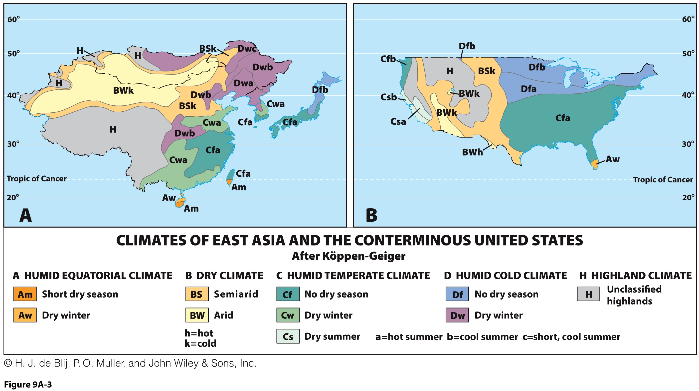
Comparing China’s Climate with the United States
Cold
Dry
Wet
Warm

Slide 12
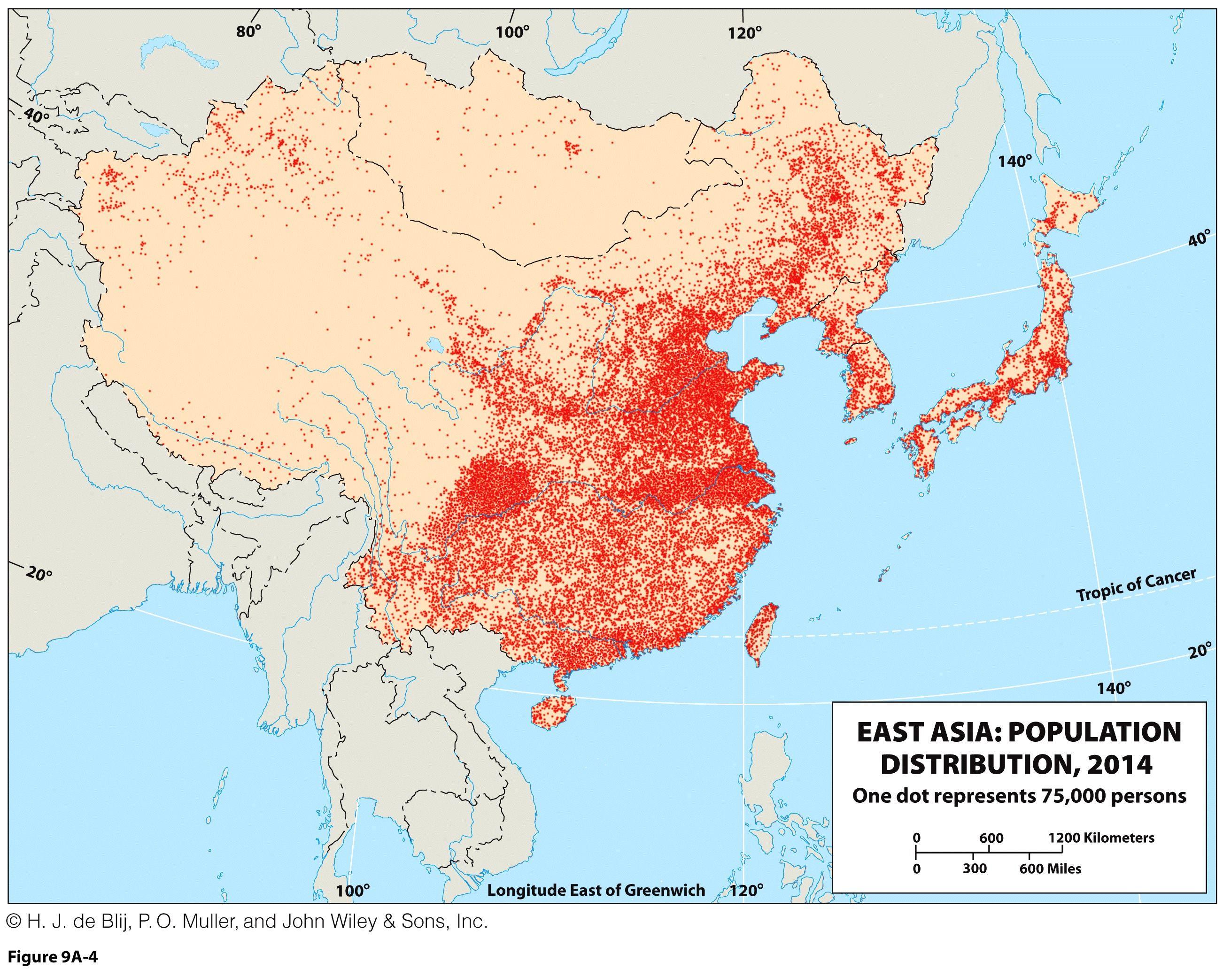
Population Density of East Asia
Excessive concentration: 50% of the population lives on 8.2% of the land.
Bulk of the population along the coast.
East China accounts for 90% of the population.
56% are living in mountainous areas.
High density rural areas.
Huang He Delta
Sichuan Basin
Yangtze Delta
Pearl Delta

Slide 13
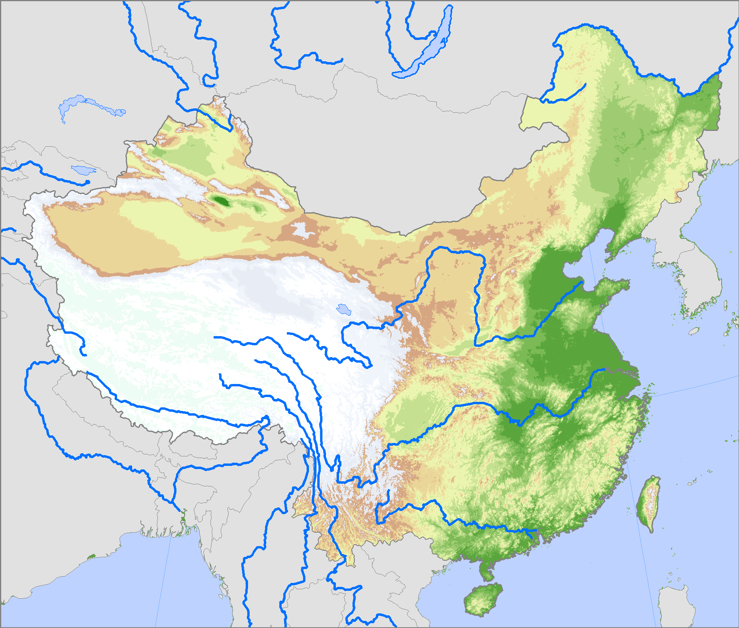
Environment and Population: The Great Rivers
Heilong Jiang (Amur)
China's border with Russia
Liao
Mining and industry more than agriculture.
Huang He (Yellow River)
Can carry up to 40% sediment weight (highest in the world).
Subject to flooding, especially in its delta.
Changed course many times.
Chang Jiang (Yangtze)
Longest river, China’s main street (6,300 km).
Pearl River delta system
Most productive and sustainable ecosystem in the world.
Rice paddies and fish ponds.
Massive industrialization.

Slide 14
Environment and Population: Along the Coast
Pacific margin
  In contradiction to the pronounced continental orientation of China.
  Peninsulas:
    Korean Peninsula as near-bridge.
    Liaodong and Shandong peninsulas of China.
  Islands:
    Japan.
    Taiwan.
    China’s Hainan.
    Myriad smaller islands of East and South China seas.

Slide 15
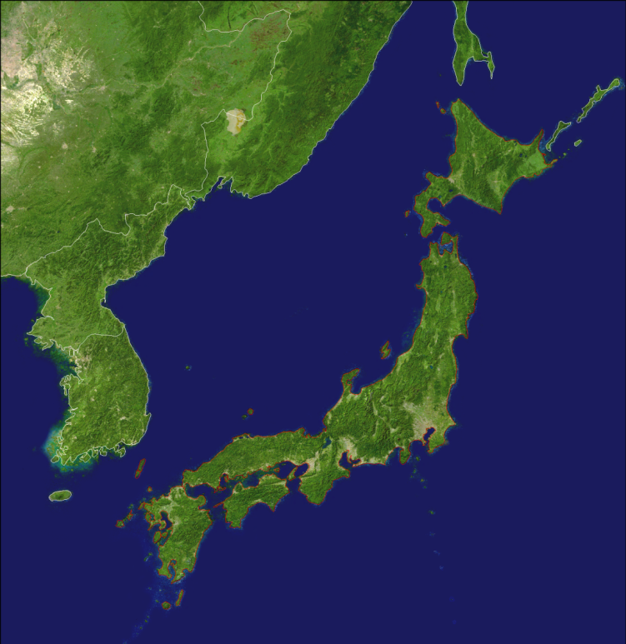
Environment and Population: Along the Coast
Maritime orientation of Japan
  4 islands; 98% of the land mass:
    Hokkaido (83,400 km2).
    Honshu (231,100 km2).
    Shikoku (18,700 km2).
    Kyushu (42,100 km2).
  3,500 islands in two major groups (Ryukyu and Bonin).
  Several large bays:
    Tokyo, Nagoya and Osaka.
    Important concentration of port infrastructures and urban regions.
  Arc of over 1,700 miles.
  Coastline:
    19,000 miles.
    3rd in the world behind Russia and Australia.
Russia
Russia
China
Hokkaido
Sea of Japan
North Korea
South Korea
Honshu
Tokyo Bay
Shikoku
Nagoya Bay
Kyushu
Osaka Bay

Slide 16
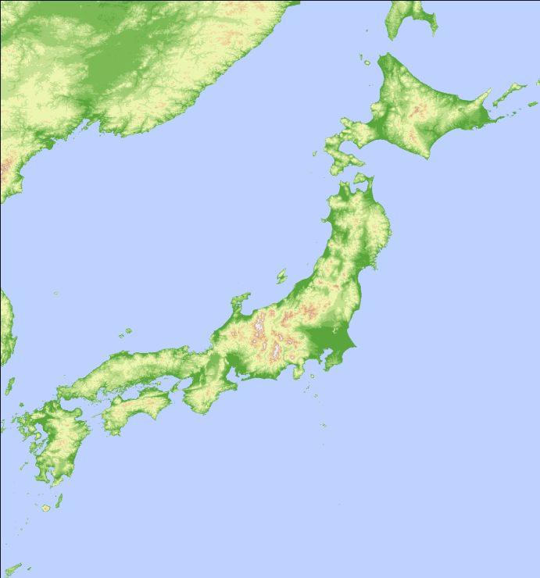
Environment and Population: Along the Coast
Physical constraints of Japan
  Physical geography increases the territorial exiguity.
  An “empty” country:
    16% of the land is habitable.
    Most of the population lives on 0.3% of the territory.
  Fight against the scarcity of space:
    Long narrow valleys.
    Concentration of agricultural productivity.
    Efficient management of existing agricultural land.
  Kanto plain:
    30.5% of the population.
    8.3% of the surface of Japan.
    50% of the flat territory.
Hokkaido
Honshu
Kanto Plain
Yamato Plain
Nobi Plain
Shikoku
Kyushu

Slide 17
Natural Resources
Scale of population and its demands on resources:
  Provision of food (land).
  Nutritional transition (demand for more meat).
  Provision of energy (coal).
Industrialization in Japan, then China, resulted in :
  Commodity needs from all over the world.
  China opening its doors becoming the world’s largest customer and exporter.
  High environmental costs.

Slide 18
Share of the World Commodity Consumption, China and United States, c2009/10
Notes:
Sources: United States Geological Survey (2009), BP Statistical Review of World Energy (2010), Food and Agriculture Organization of the United Nations (2008), International Monetary Fund (2010), United States Department of Agriculture (2010).
http://www.fas.usda.gov/psdonline/psdHome.aspx

Slide 19
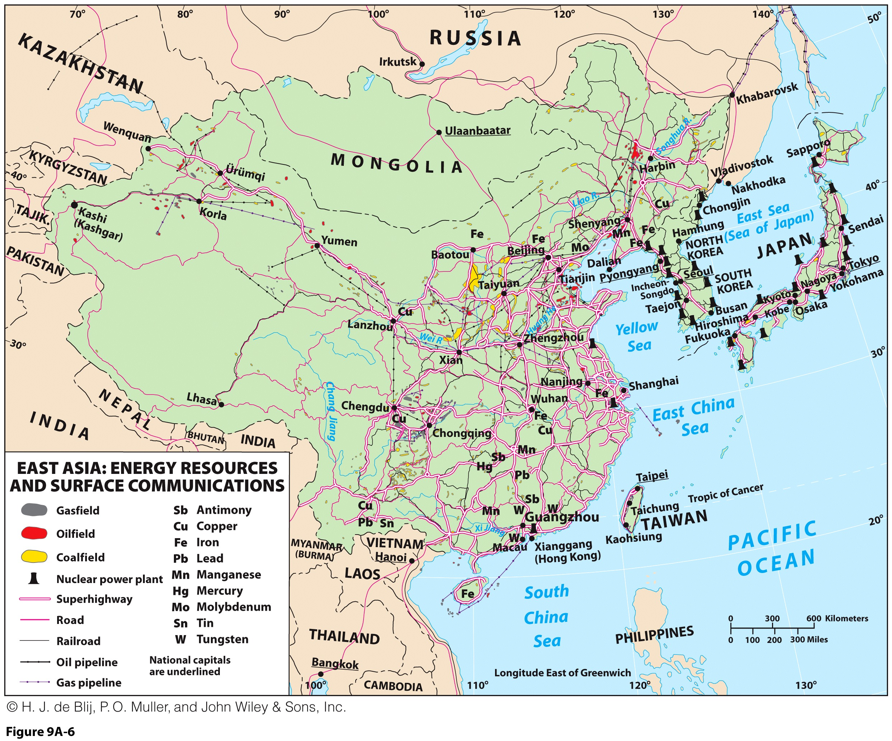

Slide 20
Historical Geography: Ancient China
An independent culture hearth and location of state formation:
  Ancient China: its plains and rivers:
    Political history of dynasties, as rulers came from same line of male descent.
    Not the product of one dominant culture, but forged from numerous cultures in several areas.
    Neolithic period cultures specialized in skills and arts that diffused.
Cultural diversity of the realm:
  Shaped by expansion and contractions of empire.
  Chinese core, surrounded by numerous others.
  Misleading Mandarin:
    Language of the elites and educated.
    United by standard Chinese writing.

Slide 21
Historical Geography: Peoples of the East Asian Realm
North China Plain: diffusion of influence
  Korean Peninsula:
    Chinese and Koreans formed political partnership.
    But China also imposed its regional supremacy.
    Authority was undermined by European and Japanese interests.
  Japan:
    Borrowed heavily from Chinese culture:
    Architectural styles, planning, legal and writing systems came from China.
  Confucianism:
    The philosophy developed by Confucius has a strong influence on the region.
    Human virtues, rather than godly connections, should determine a person’s place in society.
    Obedience to authority; authority figures must act in a caring manner; education also important (meritocracy).

Slide 22
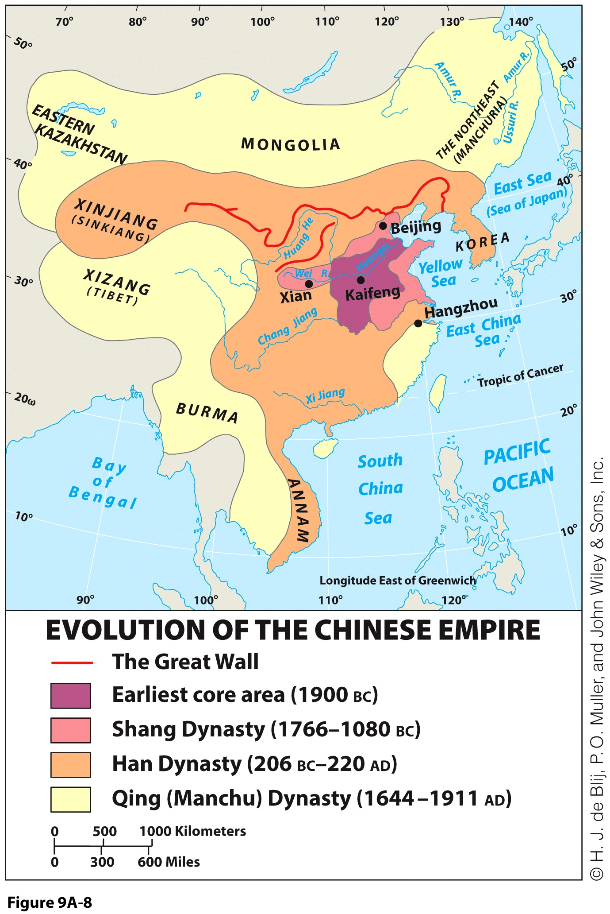
China’s Historical Role in East Asia: Chinese Empires and Dynasties
Zhou Dynasty:
  Arrival of Buddhism, Confucius.
  Start of the Great Wall, chopsticks.
Han Dynasty:
  Chinese as People of Han.
Yuan Dynasty of Mongol rule:
  Sinicization or Hanification: adopted many ways of the Han.
Ming Dynasty and Qing Dynasty:
  Expansion, environmental change.
  Manchu invaders and then collapse.

Slide 23
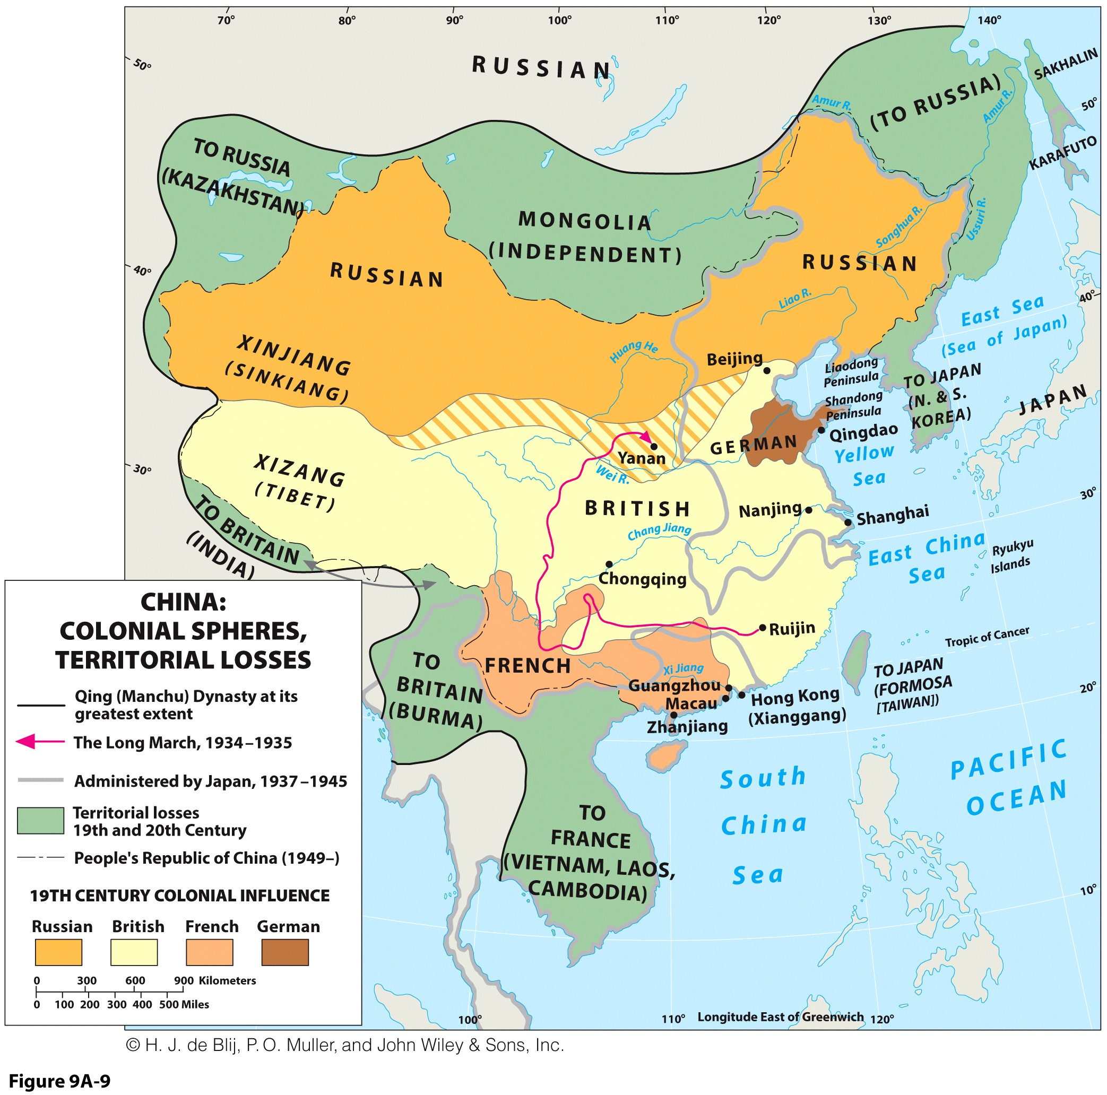
China’s Historical Role in East Asia: China in Disarray
Arrival of colonial powers:
  Economic disintegration via cheap European goods.
  Destruction of Chinese cultural life with opium.
  Forced concessions and leases for Europeans.
  Extraterritoriality in effect.
Boxer Rebellion (1899-1901):
  First anti-imperialistic revolt in China.
  Roaming revolutionaries killed foreigners and collaborators.

Slide 24
Extraterritoriality…
Europeans forced China to accept European doctrine of international law:
  Extraterritoriality.
  Foreign states and representatives are immune from the jurisdiction of the country in which they are based.
European, Russian, and Japanese invaders established treaty ports:
  Extraterritorial enclaves under unequal treaties were enforced by gunboat diplomacy and were exempt from Chinese law.
  Best areas were made inaccessible to Chinese citizens.
What were the consequences of colonialism for China?

Slide 25
China’s Historical Role in East Asia: Revolutionary China
Nationalist movement:
  Overthrew the weak Qing Dynasty.
  Difficulty in imposing new order on chaos.
Cooperation with communists in 1920s:
  Turned against one another.
  Long March: formative event in communist Chinese memory.

Slide 26
Japan’s Historical Role in East Asia: From Isolationism to Imperialism
Japan’s isolationism policy:
  No foreign influence, no foreign travel, and no foreigners.
Meiji Restoration and change in foreign policy:
  Aimed at rapid modernization based on Western model.
  Looked to Britain for guidance:
    Changed capital to Edo, renamed Tokyo.
    Modernization built on Japanese cultural traditions with new technologies, not Westernization exactly.

Slide 27
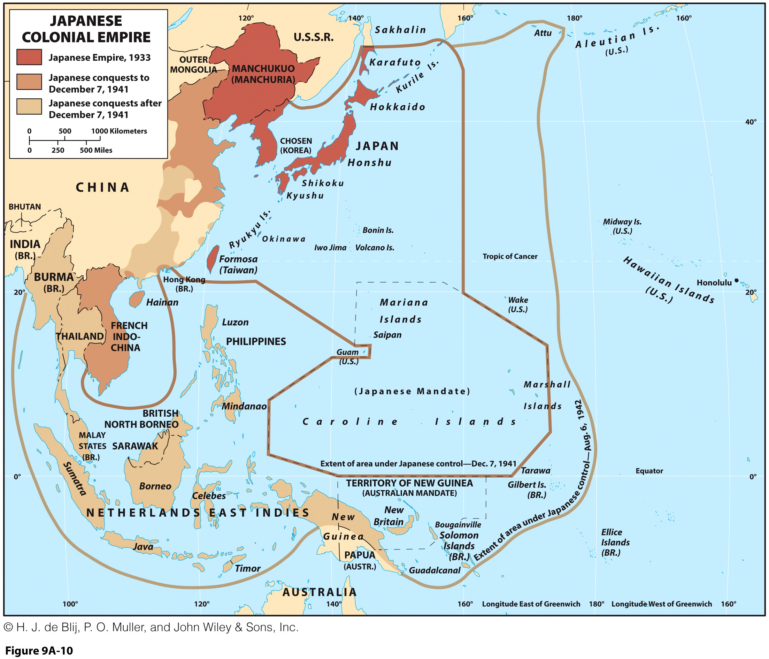
Japan’s Historical Role in East Asia: Japan in China
Japanese Imperialism followed modernization:
  Territorial expansion and annexation until its height in World War II.
East Asian imperial struggles:
  Japan exposed Chinese weakness, which fueled a drive for change within.
  Led to war with China, which split China further.

Slide 28
Post-World War II East Asia: Communist China
Post-World War II:
  Resumption of Chinese civil war.
  Eventually, Nationalists fled to Taiwan and Communists “won.”
Communist overhaul:
  Targeted weaknesses: built dams and levees; reduced hunger; improved health; encouraged literacy.
Great Leap Forward: colossal error
  Labor-intensive industrialization led to mass starvation, murders, or forced labor exhaustion.
  Lack of population policy led to population explosion.

Slide 29
Post-World War II East Asia: Communist China
Great Proletarian Cultural Revolution: calamity
  Campaign against elitism.
  Youth organized into Red Guards:
    Ordered to attack “bourgeois” elements and “opponents” of the system
  Led to anarchy, terror, and economic paralysis.
  China’s intellectuals, elderly, moderate leaders, teachers, and older revolutionaries were killed or tortured.

Slide 30
Post-World War II East Asia: Japan’s Defeat and Recovery
World War II expansion stopped by U.S. nuclear bombs.
Japanese surrender:
  Japan forced to accept a new constitution.
  Emperor had to step down.
Efforts to constrain Japanese expansion urged:
  Territorial adjustments imposed.
  Could not spend more than 1 percent of GDP on military.
  Japan forced to accept U.S. troops on its soil.
Constraints induced a shift in focus to economic prowess.

Slide 31
East Asia’s Economic Transformation: Japan’s Postwar Transformation
Accelerated economic recovery:
  Took place from the 1950s with the development of an export-oriented economy.
  Industrial giant, technological pacesetter.
  Fully urbanized and affluent society.
  Political power.
Stalled economy:
  Lost its dynamism and momentum.
  China became a major competitor and the point of relocation of Japanese manufacturers.
Adept at emulating the West:
  Automobiles, consumer electronics, and high-technology products.

Slide 32
East Asia’s Economic Transformation: The Asian Tigers
Asian Tigers:
  Hong Kong, South Korea, Taiwan, and Singapore.
Similar strategies as Japan:
  Rapid industrialization, foreign investment, and export processing zones for high value-added goods.
Became trading nations oriented to rich Western markets and now have some of world’s largest ports

Slide 33
East Asia’s Economic Transformation: China’s Economic Miracle
Pragmatists:
  Politically and administratively communist but open economically to free-market forces.
  Foreign investment, manufacturing and exports, low wages, and workforce training.
  Political stability with tight government control.
Remarkable growth with a country of more than 1 billion people
Why economic development in East Asia has been often been referred to as a “miracle”?

Slide 34
Geopolitics in East Asia: The Korea Factor
Korean peninsula
  North Korea: 55% of the land, 1/3 of the population, extremely rural.
  45% of the land, 2/3s of the population, highly urbanized.
Cold War division into North and South:
  Different sides that grew apart over the intervening years.
  The setting of a demilitarized zone.
  North Korea followed a strict form of nationalistic communism aiming at self reliance.
Wider dimensions:
  North Korea’s nuclear capability.
  Japan and South Korea opposed to North Korean regime.
  Repeated threats of “thermonuclear war” against South Korea.

Slide 35
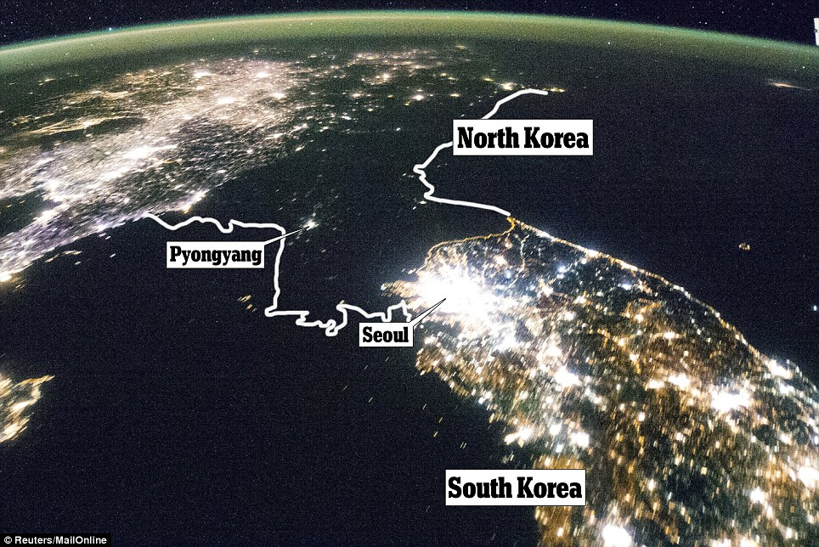
The Korean Peninsula Seen from Space

Slide 36
Geopolitics in East Asia Taiwan: The Other China
“Republic of China” as China’s “legitimate” government:
  Received aid from the United States and a seat in the UN.
  Achieved economic growth.
Political changes:
  U.S.-China relations affected by Taiwan’s status.
  Countries have made pragmatist economic moves.
Contentious integration:
  Growth and geographic adjacency demand cooperation.
  Many Taiwanese live and work in China for Taiwanese businesses.

