Slide 1
Chapter 8: The South Asian Realm

Slide 2
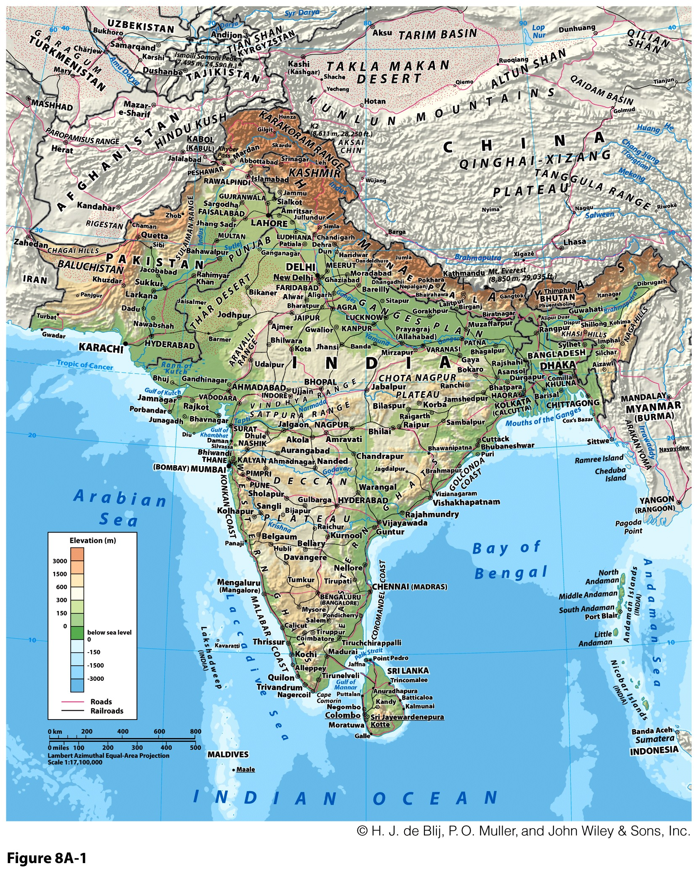
The most populous realm (1.64 billion)

Slide 3
The Geographic Panorama
Subcontinent
  Divides oceans.
  Divided by mountains, deserts, and fertile valleys.
Cultural diversity
  Influenced by environmental diversity.
  Unified by British colonial period:
    Wanted to relinquish the region as a whole.
  Religious partitions: Muslim, Hindu, and Buddhist.
Pakistan’s place in the region
  Could be considered as part of North Africa / Southwest Asia.
  Pakistan and India linked culturally and in fight over Kashmir.

Slide 4
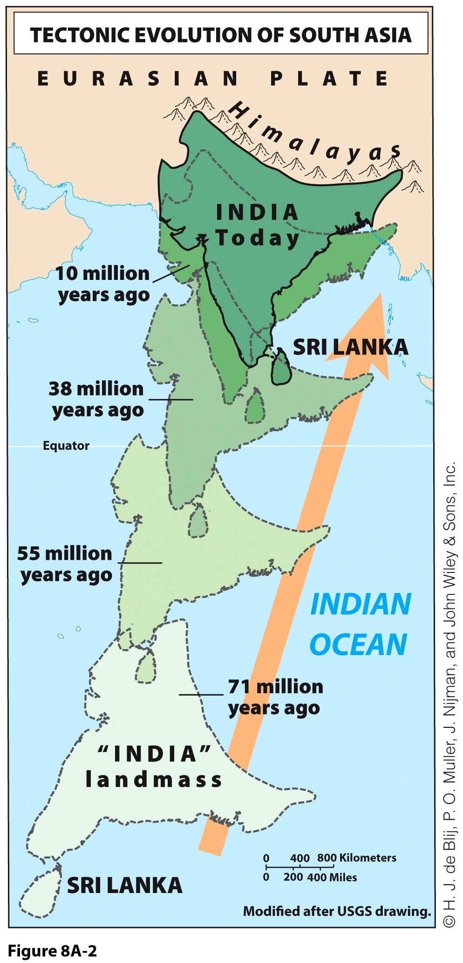
South Asia’s Physiography: A Tectonic Encounter
Tectonic collision:
  Indian Plate and Eurasian Plate:
    5 mm per year.
  Accordion-like crust deformation.
Himalaya Mountains:
  High elevation conditions.
  Permanent snow and ice provide melt waters.
  Headwaters of great rivers:
    Ganges River, Indus River, and
    Brahmaputra River.

Slide 5
South Asia’s Physiography: The Monsoon
Monsoons
  From the Arabic word “mausim” which means season:
    Annual weather cycle within the tropical and subtropical continents of Asia, Australia and Africa and the adjacent seas and oceans.
  Most vigorous and dramatic cycles of weather events on earth:
    Torrential rains.
    Floods.
    Tropical cyclones.
  Blow from the southwest from April to October:
    Wet season.
    India gets more than 80% of its rainfall during the monsoon.
  Blow from the northeast from October to April:
    Dry season.
  Blocked and directed by Himalayas; Lasts for weeks.

Slide 6
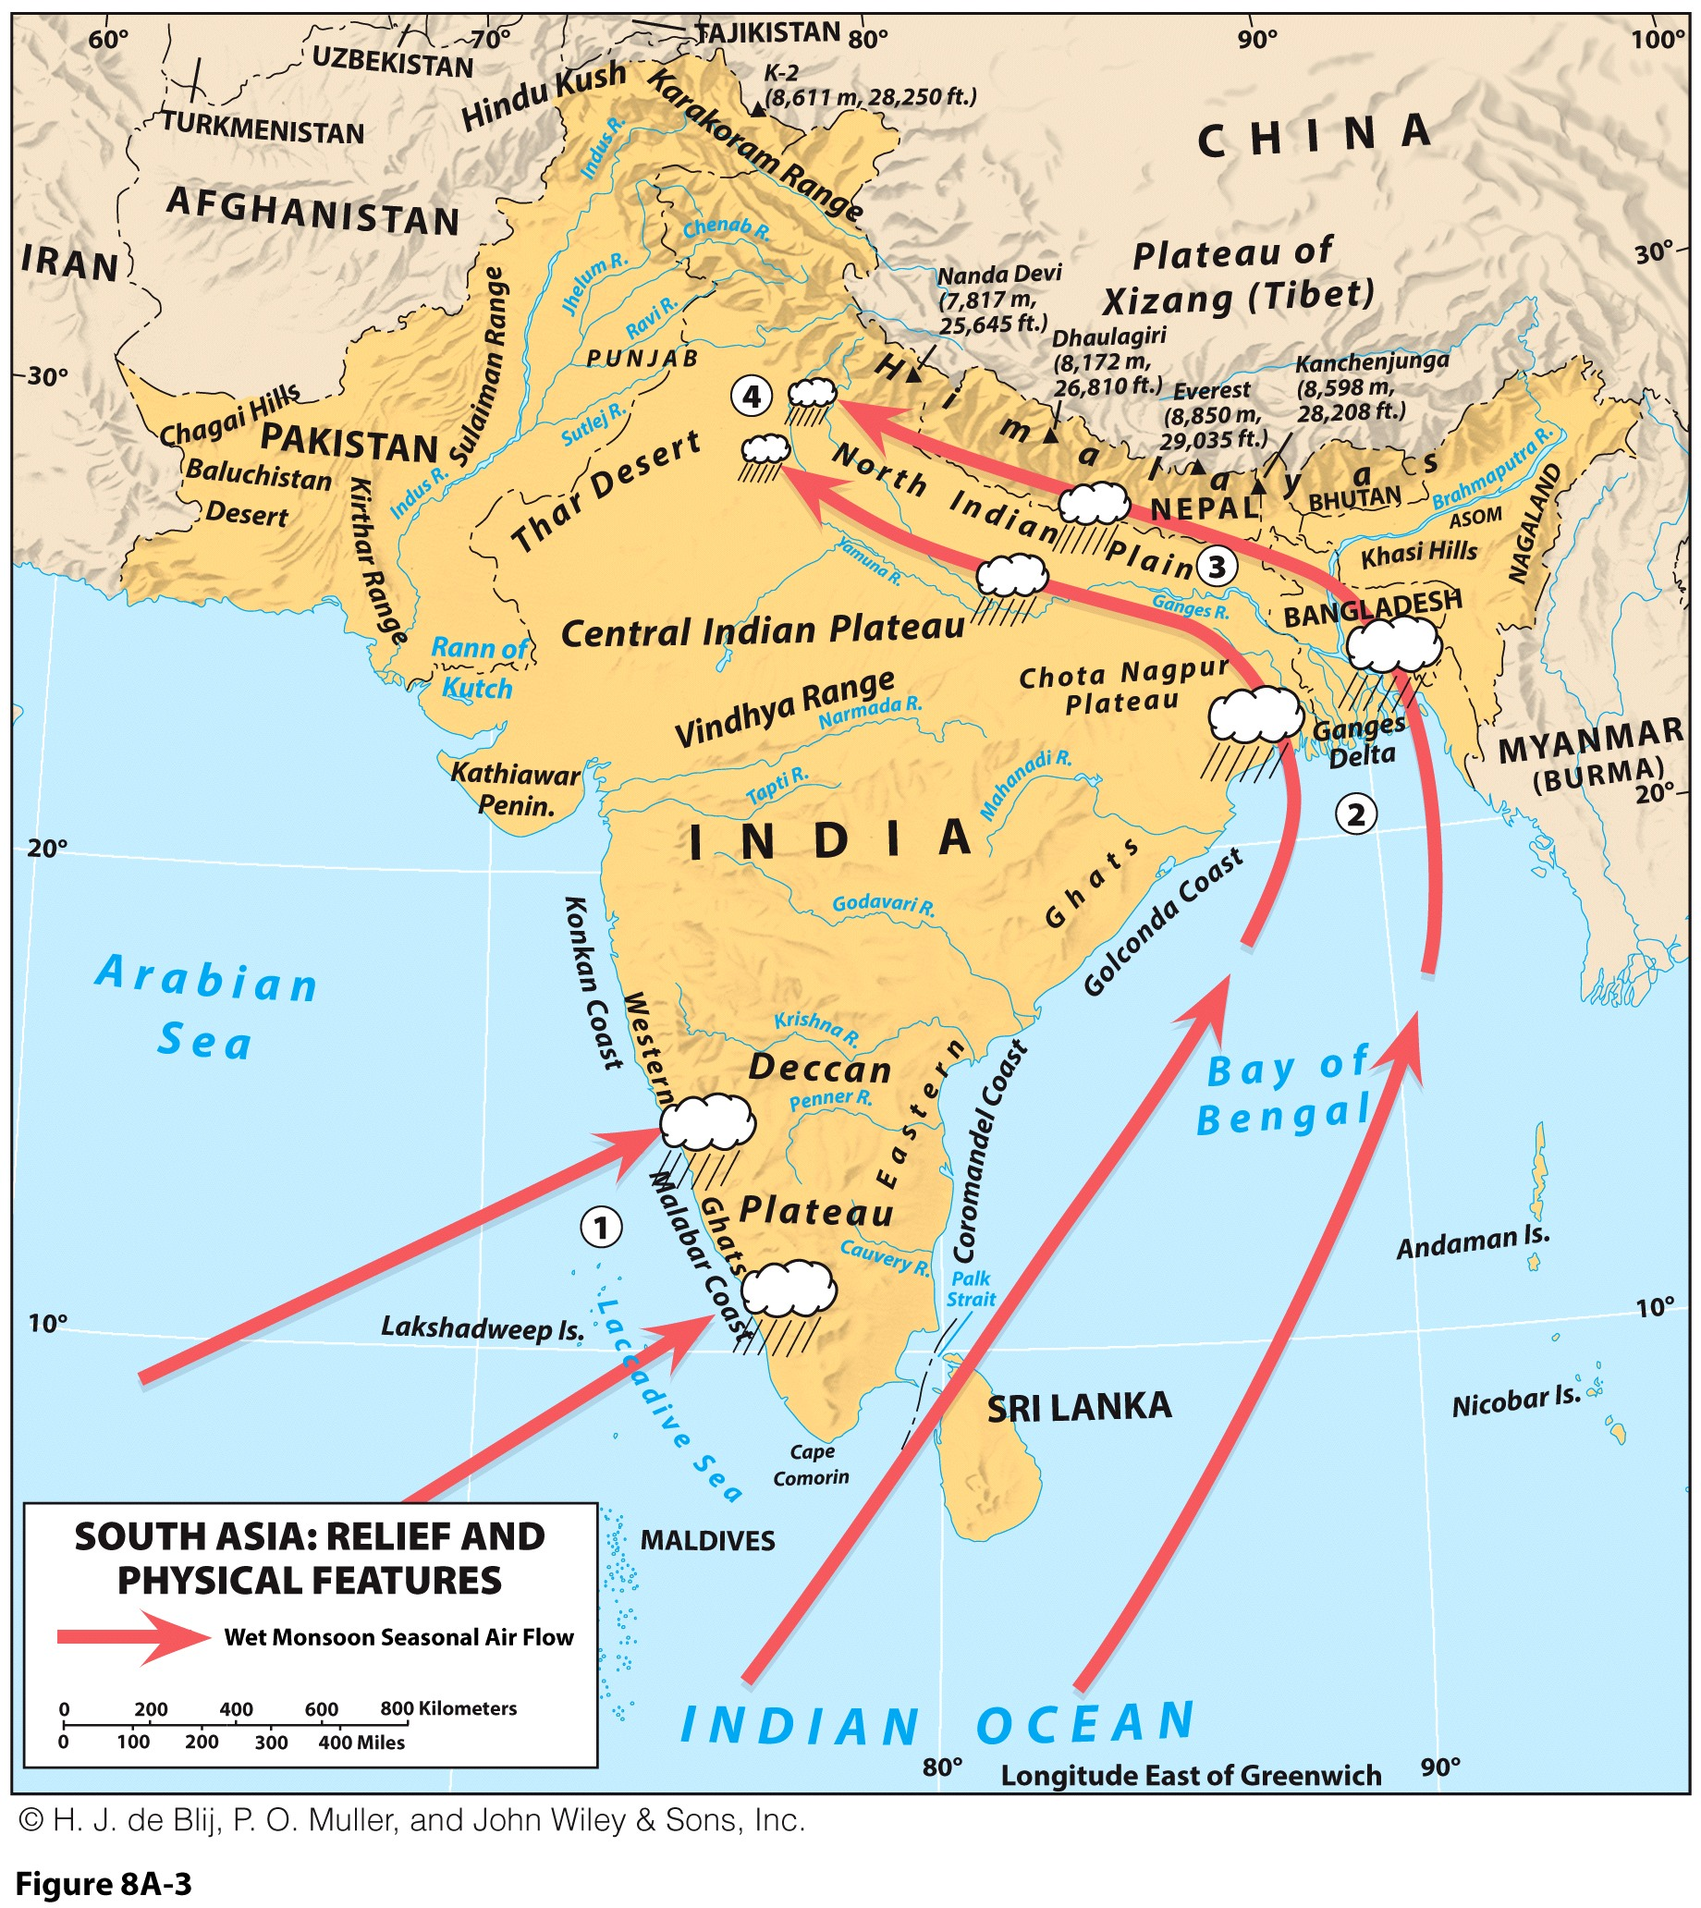
South Asia’s Physiography: The Monsoon

Slide 7
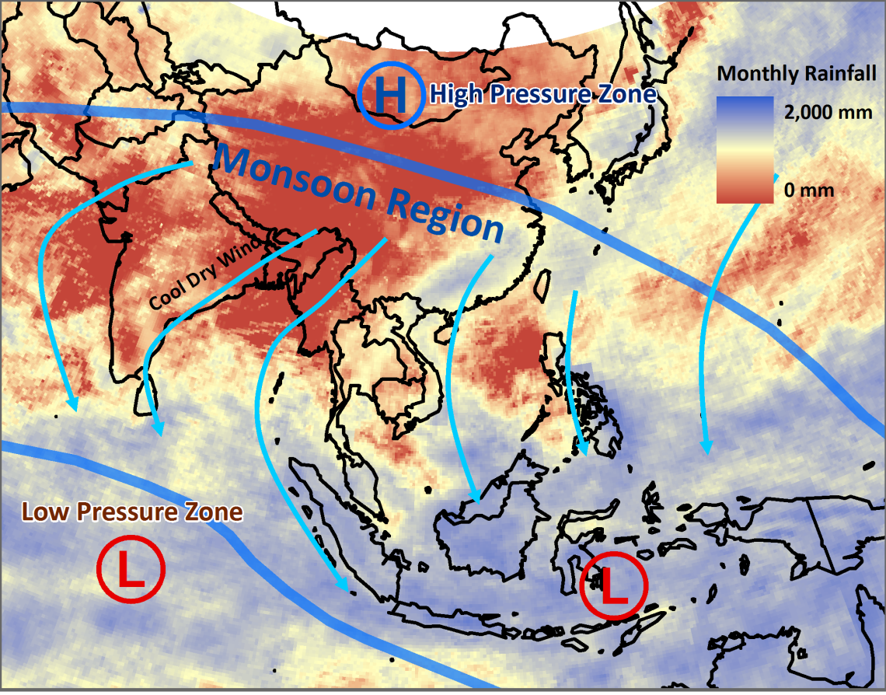
Dominant Wind Patterns in the Winter (October to April) – Dry Season
Notes:
Source: Rainfall dataset: NASA Earth Observations; http://neo.sci.gsfc.nasa.gov/Search.html

Slide 8
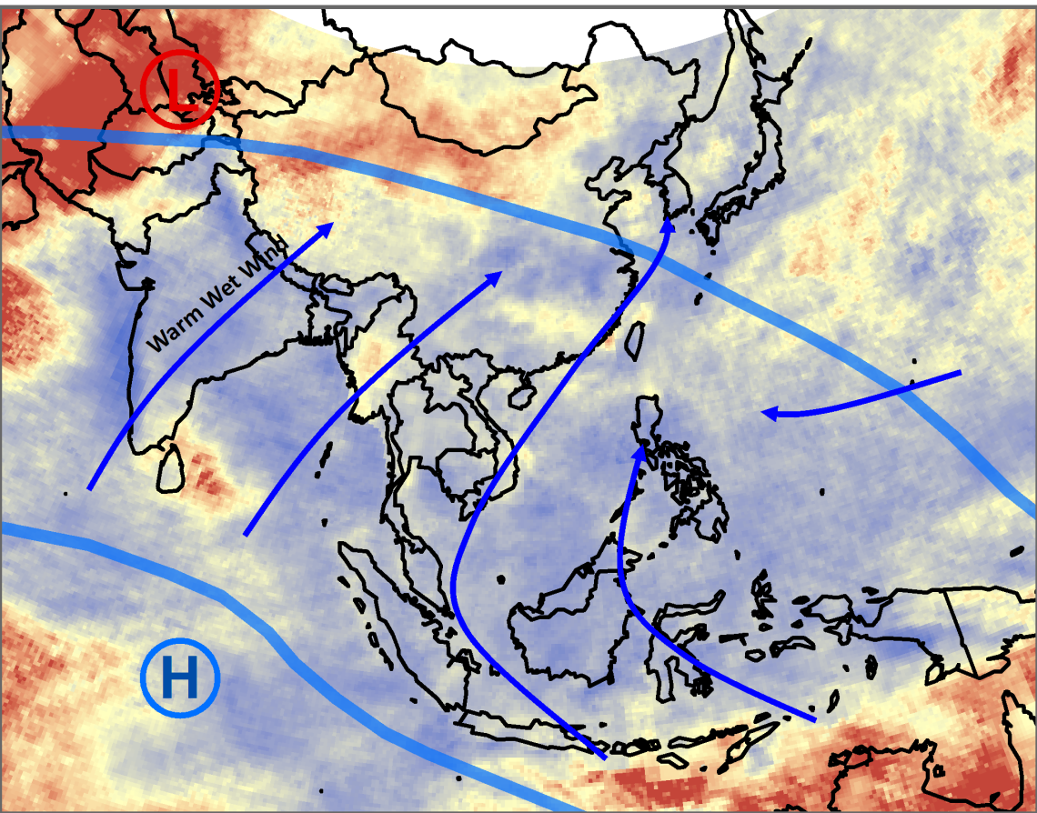
Dominant Wind Patterns in the Summer (April to October) – Wet Season

Slide 9
Average Annual Precipitations (in millimeters)
Dry continental
Driest desert on earth
Gobi Desert
Ganges Delta
Mawsynram, India (467” of rain per year; 11860 mm). Most precipitation on earth
Monsoon east
Borneo
Raining every day with no dry season
What are the physical and economic impacts of the monsoon?

Slide 10
Monthly Precipitations (in mm)

Slide 11
Storms and Flooding
Bangladesh delta
  Because of the rich soil on the delta formed by the Ganges and Brahmaputra Rivers.
  One of the most densely populated nations in the world.
  Land is barely above sea level; seasonal flooding is common.
  Tropical cyclones sweep in from the Bay of Bengal every five to seven years.
  Storms have a devastating effects:
    Flooding.
    Destruction of fields and property.
    Linked with food insecurity.

Slide 12
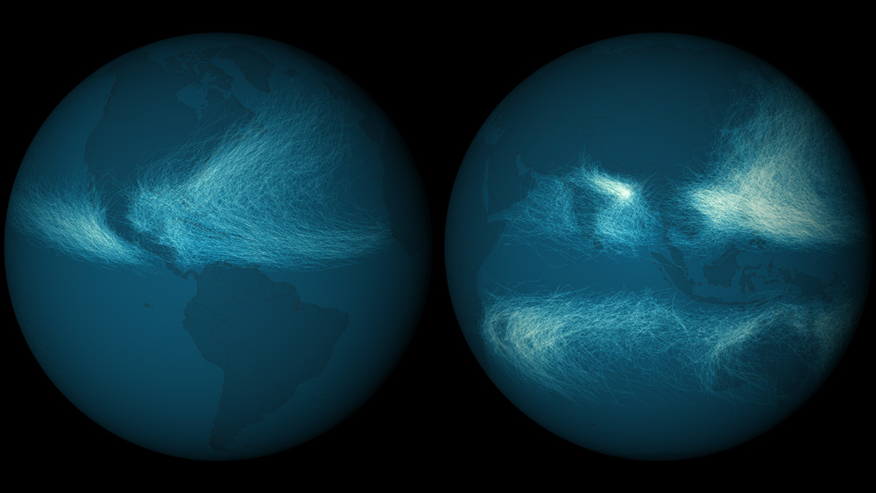
Cyclone Paths Since 1842
Notes:
Source: NOAA, National Climatic Data.

Slide 13
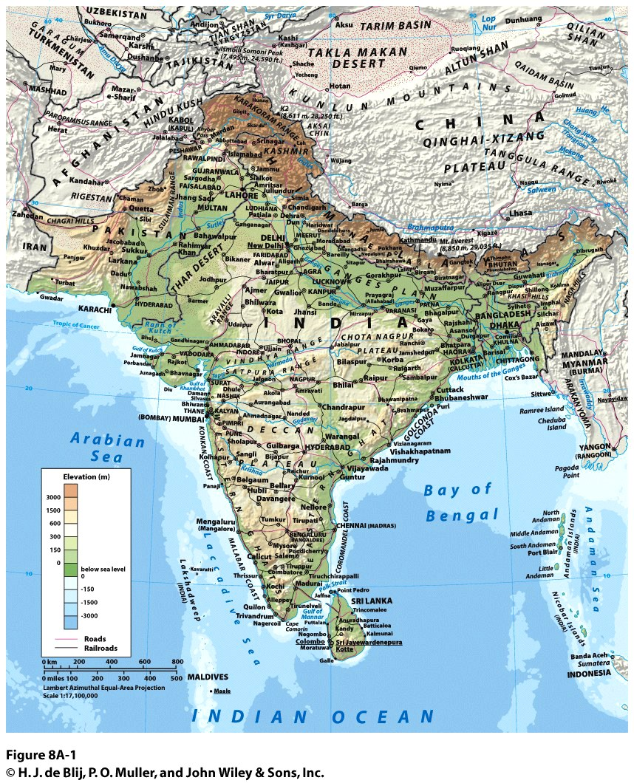
South Asia’s Physiography: Physiographic Regions
Northern mountains
  Hindu Kush and Karakoram ranges in west.
    Dry and barren.
  Himalayas in center
    Mount Everest (Nepal and China).
  Ranges of Bhutan and Arunachal Pradesh in east
    Green and forested.
  Transitional foothills.
    Valleys cut by meltwater.

Slide 14
South Asia’s Physiography: Physiographic Regions
River lowlands:
  Pakistan’s Lower Indus River Valley:
    Punjab = “land of five rivers”.
  North Indian Plain:
    Ganges River plain.
    Double delta of Ganges and Brahmaputra Rivers.
Importance of meltwater
  About 20% of the water.
  Impact of global warming.

Slide 15
South Asia’s Physiography: Physiographic Regions
Deccan plateau: Basalt tableland from Pangaea
  Highest in the west.
  Rivers flow eastward to Bay of Bengal.
  Eastern and Western Ghats (steps) descend from plateau to narrow coastal plain.
  Malabar Coast: orographic rainfall makes this part the most arable of Southern India.

Slide 16
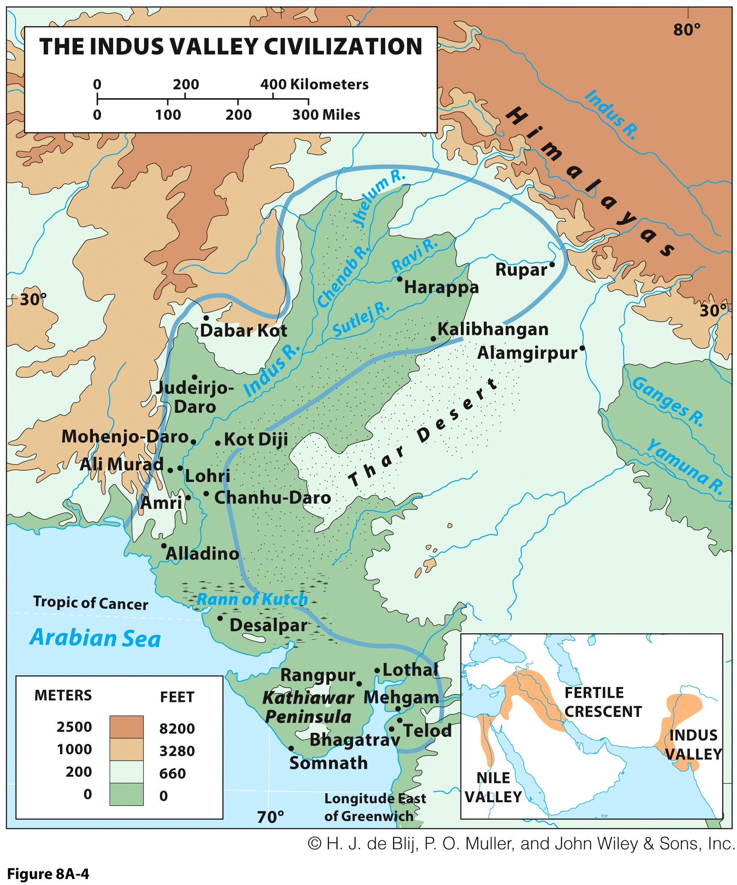
Birthplace of Civilizations: Indus Valley Civilization
Sindhu
  circa 2500 BC.
  Two major capitals
  100 + smaller urban settlements.
  Influence extended eastward to Delhi.
Decline due to:
  Environmental change.
  Shift of political center to the Ganges Basin.

Slide 17
Birthplace of Civilizations: Aryans and the Origins of Hinduism
Arrival of Aryans in northern India, circa 1500 BC:
  Peoples speaking Indo-European languages.
  Mostly coming from Persia.
  Organized the isolated tribes and villages.
  Resurgence of urbanization.
Aryan cultural influence:
  Sanskrit language.
  New social order.
  Vedism: polytheistic religious belief system.
Hinduism
  Emerged out of Vedism texts and local beliefs.
  The world’s most constant and enduring belief system.
  81% of the population of India.

Slide 18
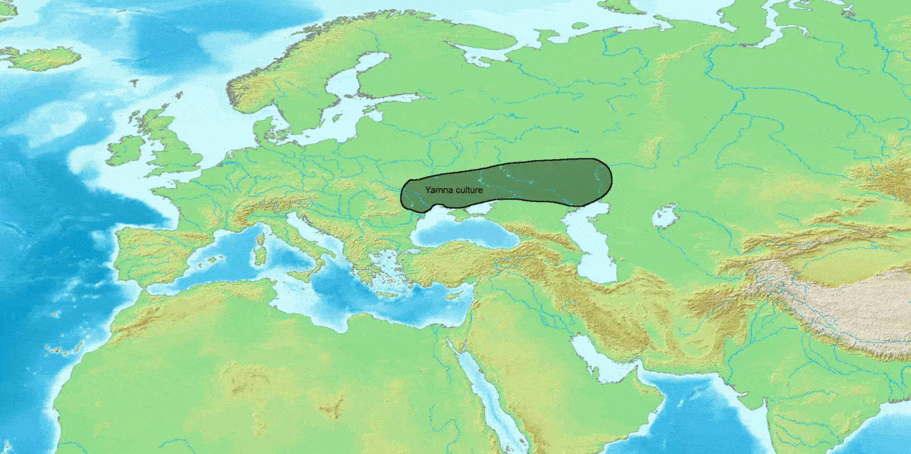
Indo-European Migrations (From 3500 BCE)

Slide 19
Birthplace of Civilizations: Aryans and the Origins of Hinduism
Caste system:
  Social stratification: Hierarchy of power among peoples.
  Solidified powerful position of Aryans.
  Legitimized through religious belief system.
  There are four castes:
    Brahmins (priests), Kshatriyas (warriors), Vaishyas (farm owners, merchants, artisans), and shudras (menials, laborers, serfs).
    Below are the untouchables, a group so low that they are completely outside the caste system, composed of non-Aryan aborigines and workers such as street-sweepers, tanners, corpse-handlers.
  Lower castes determined by past lives.
  Adds to the divisiveness of India.
  Have been made illegal but persist today.

Slide 20
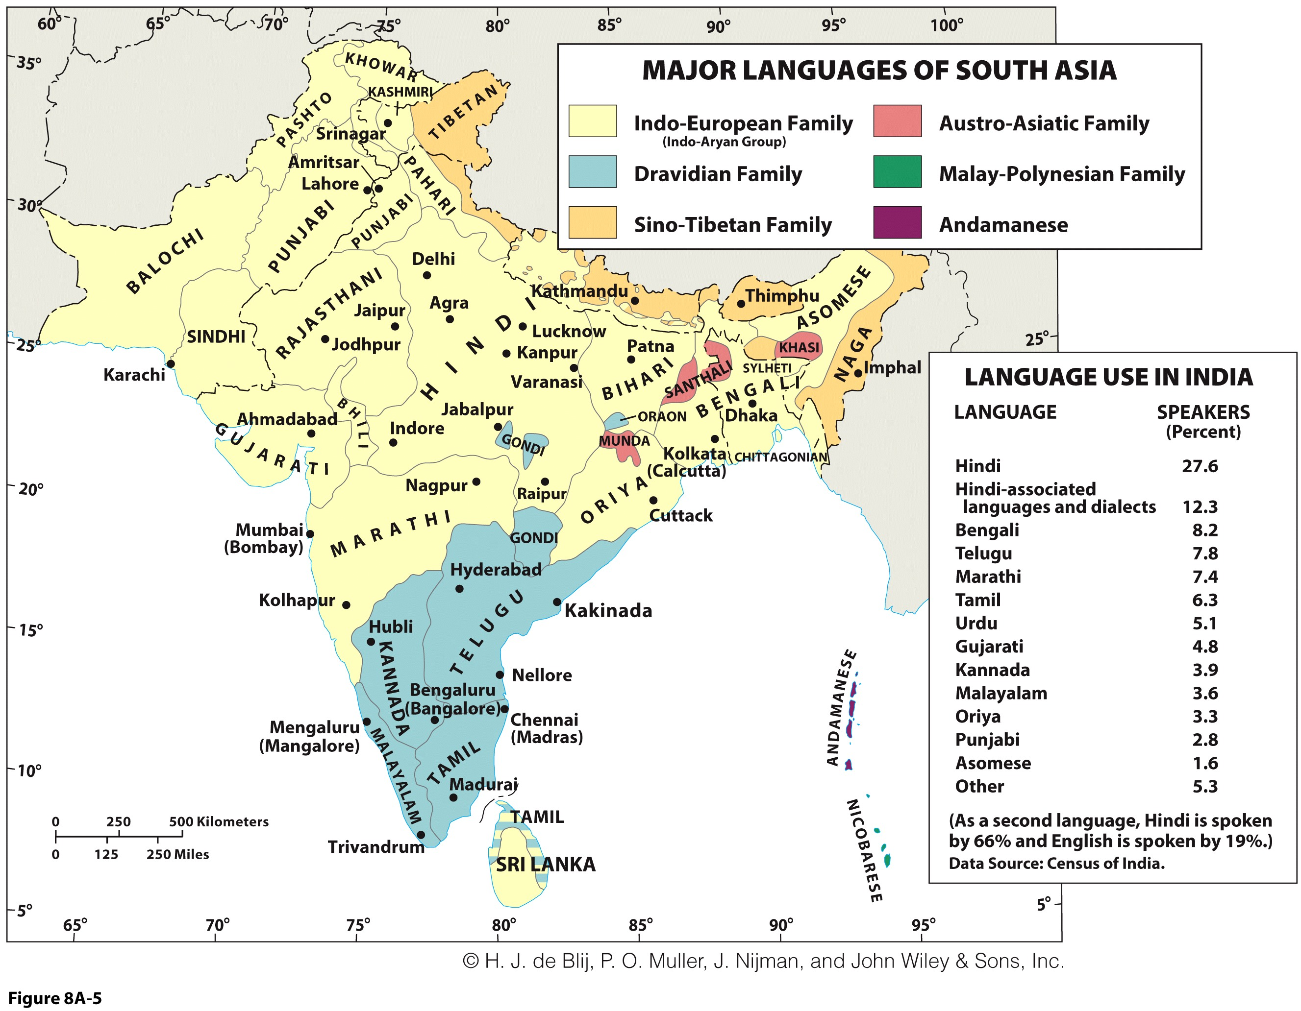
Birthplace of Civilizations: Aryans and the Origins of Hinduism
Indo-European languages:
  Rooted in Sanskrit.
  Dominate western and northern parts.
Dravidian languages:
  Indigenous languages.
  Dominate in the South.
Other languages:
  Sino-Tibetan.
  Austro-Asiatic.
Political subdivisions follow linguistic lines

Slide 21
Birthplace of Civilizations: Buddhism and Other Indigenous Religions
Buddhism: circa 500 BC in eastern Ganges Basin
  Under 1% in India; strong in Bhutan and Sri Lanka (70%).
  Weak in India but influence greater in Southeast Asia and East Asia.
Jainism: emerged alongside Hinduism
  Purist, deeply spiritual form of Hinduism.
  Stance on non-violence and vegetarianism.
  Under 1% of population.
Sikhism: circa AD 1500, following Islam’s arrival
  Blend of Islamic and Hindu beliefs.
  About 2% of population.

Slide 22
Foreign Invaders: The Reach of Islam
Waves is Islamization
  10th century arrival:
    Overland into the Indus Valley (today’s Pakistan).
  13th century establishment of Delhi Sultanate:
    Expansion over northern tier of the subcontinent.
    By sea: Arrival at Ganges-Brahmaputra Delta (today’s Bangladesh).
  16th century Mughal (Mogul) Empire:
    Centered in Afghanistan, ousted the Delhi Sultanate.
    An outcome of the Mongol empire.
    Mughal Empire expanded Islam with tolerance to Hindus; built Taj Mahal.

Slide 23
Foreign Invaders: The Reach of Islam
Appeal of Islam:
  Hindu princes choose cooperation over annihilation by Islamic armies.
  Welcome alternative for low-caste Hindus (like Buddhism).
  Millions of Hindus converted.
Decline of Islam:
  18th century Mughal Empire in decline.
  Resurgence of Hindu religion.
  Left India culturally and politically fragmented.

Slide 24
Foreign Invaders: The European Intrusion
18th century East India Company:
  EIC represented the British empire.
  British controlled most of trade in South Asia and between South Asia and Southeast Asia.
  “Indirect rule” took advantage of fragmentation:
    Local maharajas were left to rule but were forced to make trade concessions.
    Many became wealthy and built impressive palaces.
  In 1857, “East India” officially became part of the British Colonial Empire.

Slide 25
Foreign Invaders: Colonial Transformation
Economic restructuring:
  Corresponded to the industrial revolution.
  Export raw materials to European factories:
  E.g. cotton and tea plantations.
Import European manufactured goods:
  Decline of local industries and loss of markets.
Infrastructure development:
  Extensive transport network.
  Irrigation system (increase in agricultural land).
  Urban network; India’s largest cities (Bombay, Calcutta and Madras).
Social restructuring:
  New elite of South Asians.
  Educated; led to self rule demands.

Slide 26
The Geopolitics of Modern South Asia: Partition and Independence
Partition: New cultural and geo-political landscape
  British India could not survive self-rule as a single political entity.
  Tensions between Hindu and Muslim interests.
  Based on geography of Hindu and Muslim majorities.
  Groups did coexist in some areas.
  New boundaries caused displacement:
    The largest in history (1947-1950).
Comparing before and after geographies:
  Muslim exodus out of Hindu India.
  Hindu migration out of West and East Pakistan (Bangladesh).
Refugee migrations:
  “Forced” or “voluntary”?

Slide 27
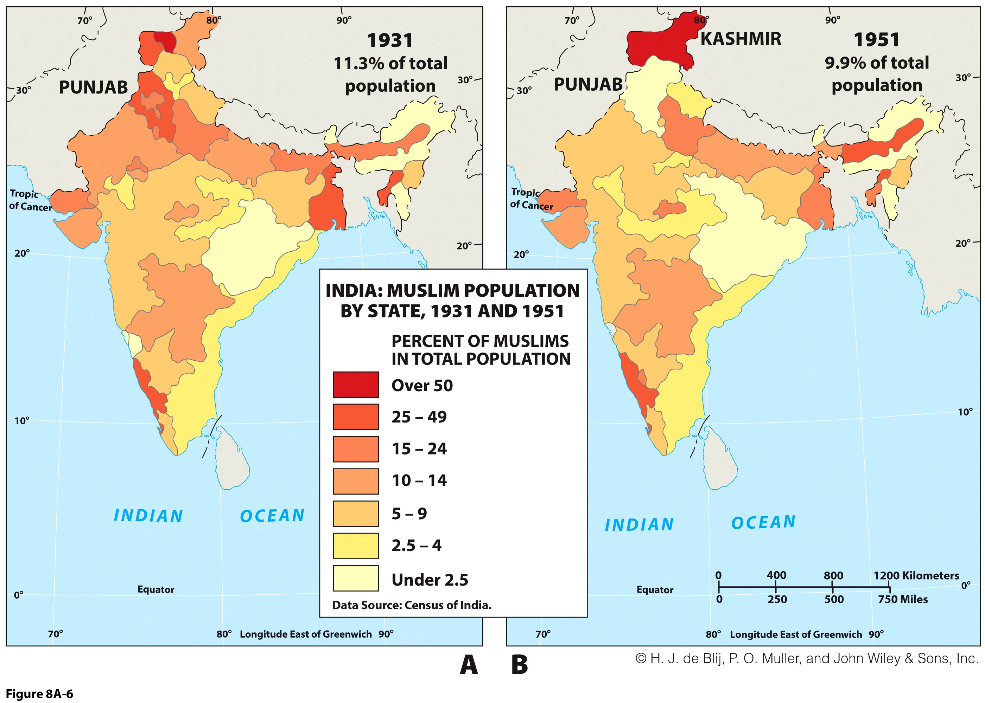
South Asian Partition and Migration
1931 and 1951
Distribution of Muslims
Explain the partition of South Asia and its consequences.

Slide 28
The Geopolitics of Modern South Asia: India-Pakistan
Tenuous relationship:
  War in 1965.
  India supported East Pakistan’s secession (became Bangladesh).
  Conflict over Jammu and Kashmir.
  Cold War: India towards USSR and Pakistan towards the United States.
  Arms race led to both becoming nuclear powers.
  Muslims in India: world’s largest cultural minority.
  As much Muslims in India (180 million) than the population of Pakistan (193 million).
  Complicates geopolitics between the two countries and within India (clashes between Indus and Muslims).

Slide 29
The Geopolitics of Modern South Asia: Fundamental Cultural Differences
Hindus:
  Tend to be vegetarians (ahimsa and reincarnation beliefs foster this).
  Cows are sacred animals.
  Believe in reincarnation.
  Brahman, if it is God, is an impersonal one.
  Follow caste system – no social or religious mobility within one lifetime.
Muslims:
  Hindus as polytheistic infidels not to be tolerated.
  Muslims eat meat (cows) – not pork.
  Muslims are strict monotheists.
  Muslims believe in a personal God.
  Muslims reject the concept of castes – equality of believers.
  Reject reincarnation.

Slide 30
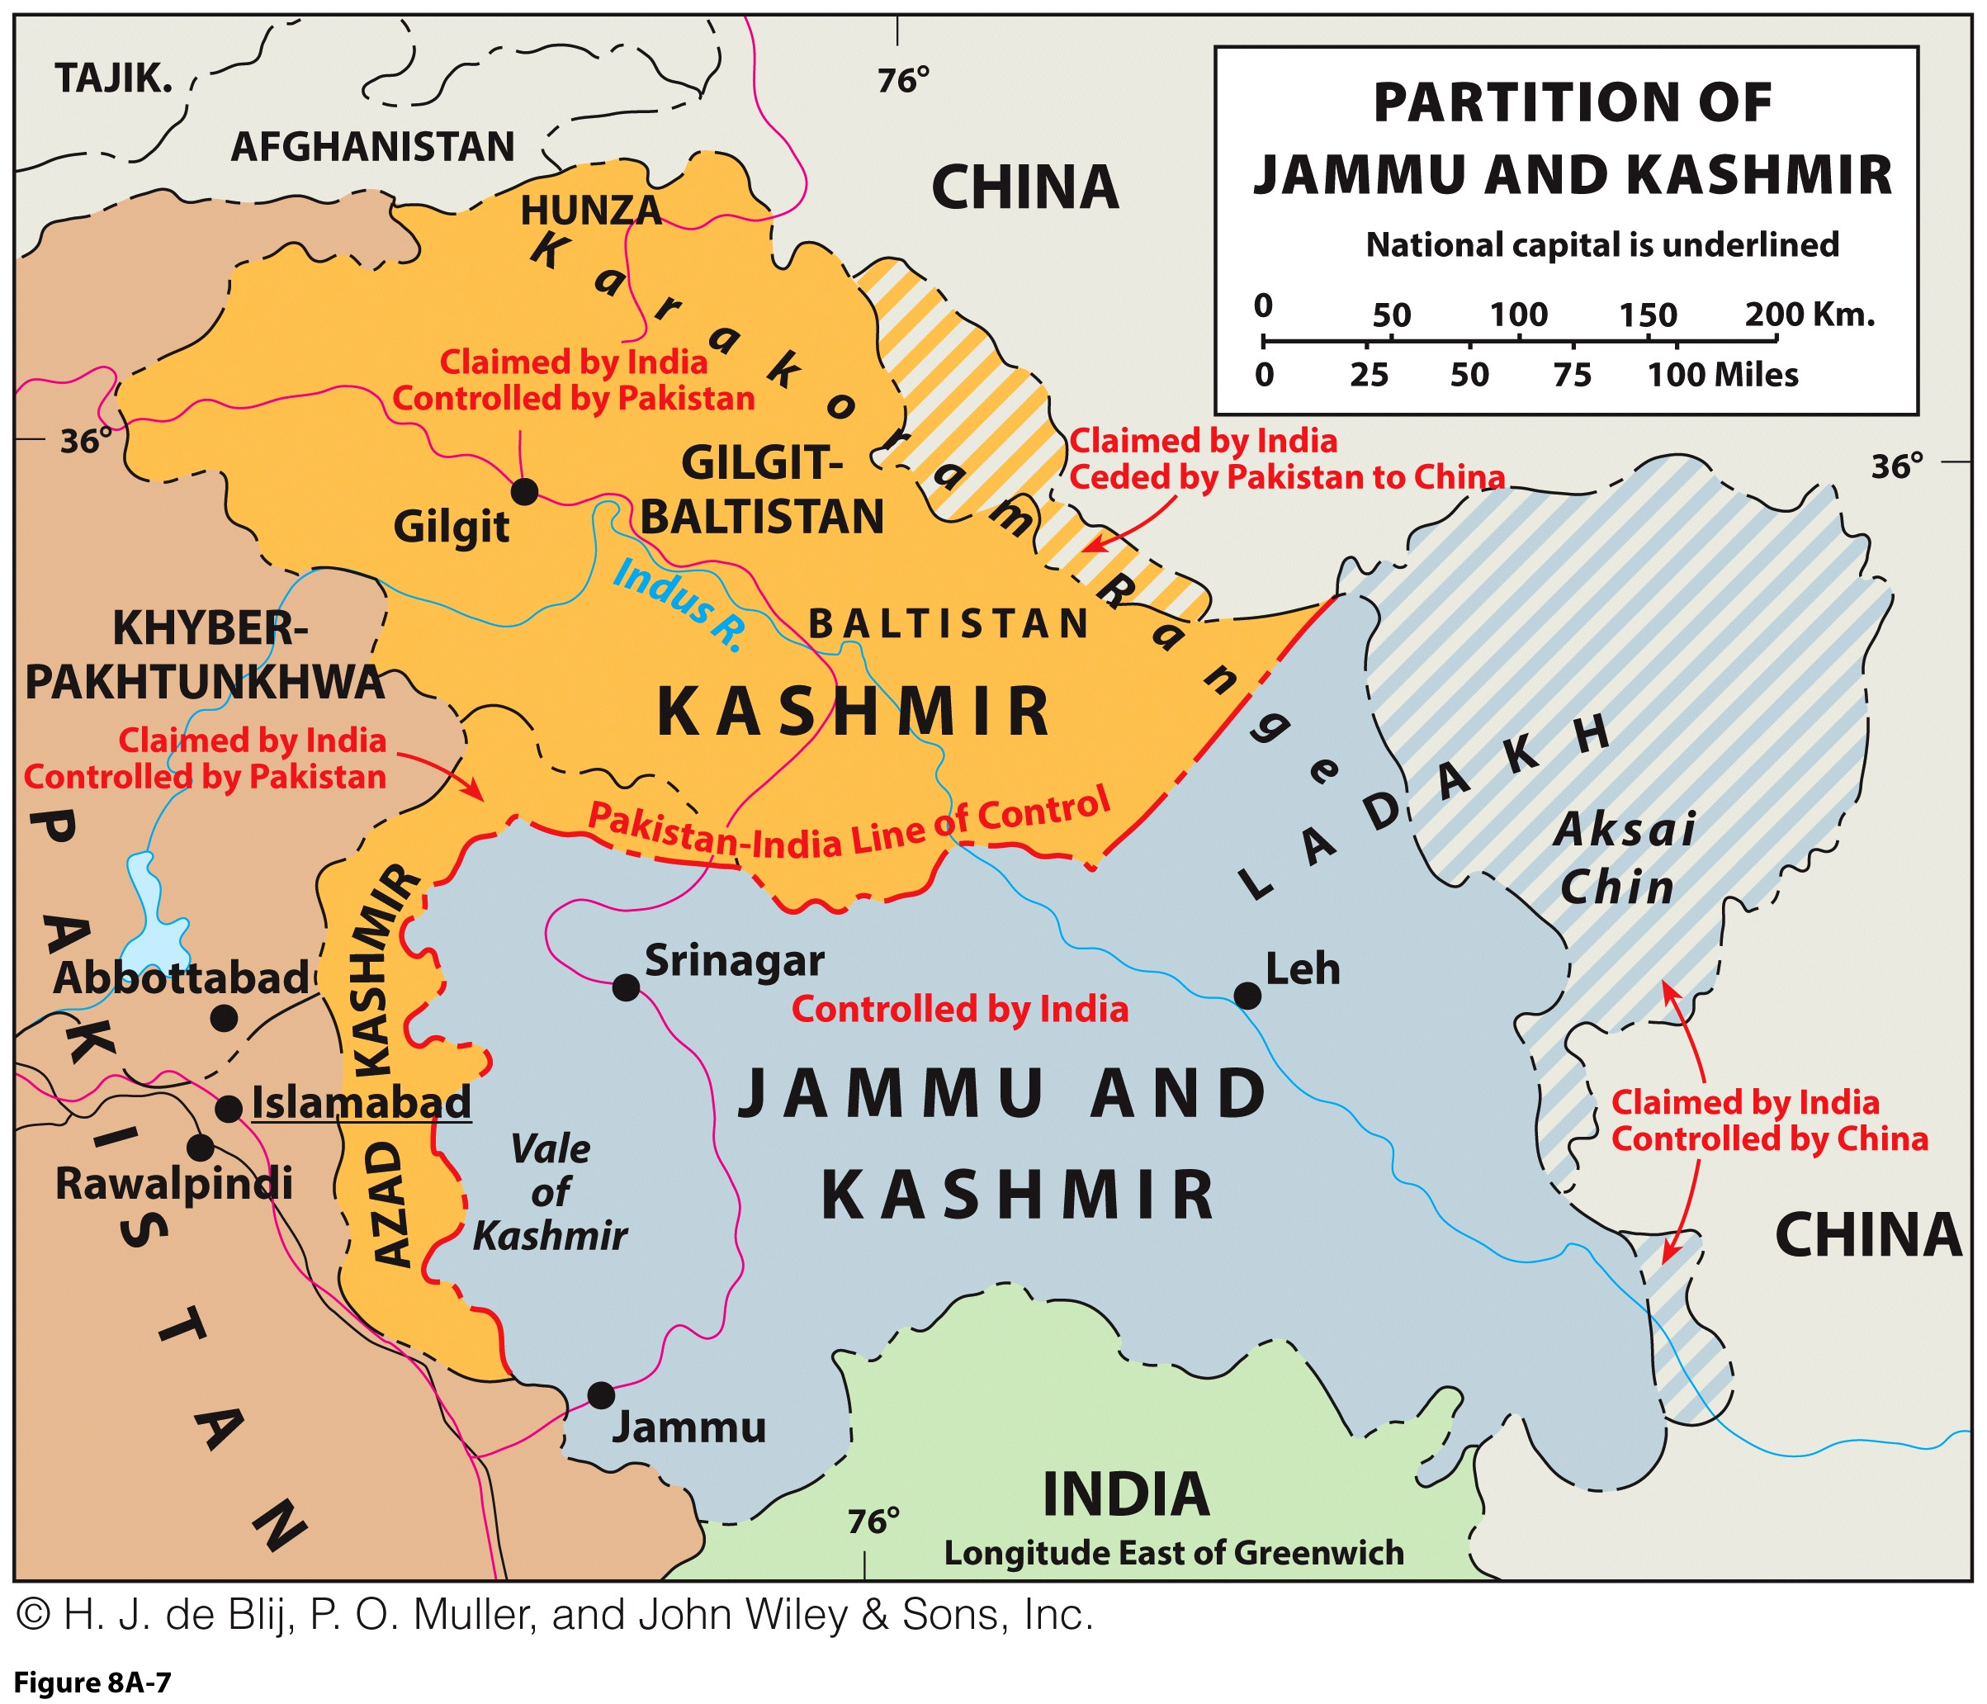
The Geopolitics of Modern South Asia: Contested Kashmir
Forward capital:
  Islamabad’s placement in the embattled interior as a claim to northern frontiers.
Kashmir and partition:
  Maharaja was Hindu, ruled over mostly Muslims.
Decided not to join Pakistan:
  Muslim uprising and India’s intervention.
  Line of control became de facto boundary.

Slide 31
Regional Issue: Who Should Govern Kashmir?
KASHMIR SHOULD BE PART OF PAKISTAN!
  Everywhere else, Muslims went to Pakistan and Hindus to India.
  Why doesn’t “democratic” India allow a referendum?
  Muslims unfairly accused of terrorism for fighting to unite with Pakistan.
KASHMIR BELONGS TO INDIA!
  Kashmiri maharaja wanted autonomy from “extremist” Pakistan.
  In Pakistan, non-Muslim minorities are not tolerated, and it’s a failed democracy.
  The quality of life for people in India is much better than in Pakistan.
Should Kashmir remain partitioned or handed to India or Pakistan?

Slide 32
The Geopolitics of Modern South Asia: The Specter of Terrorism
Indian terrorist attacks
  Roots in Pakistan.
  Lashkar-e-Taiba: aims to return Kashmir to Islamic rule.
  Most of India’s Muslims are uninvolved in extremism.
Pakistan and terrorist groups
  Border with Afghanistan is out of government’s control.
  Pakistan is under U.S. pressure to secure border.
  Unwilling to alienate its Islamic support base.
  Geopolitical chess game between India, Pakistan, and the United States.
Both India and Pakistan are nuclear powers.

Slide 33
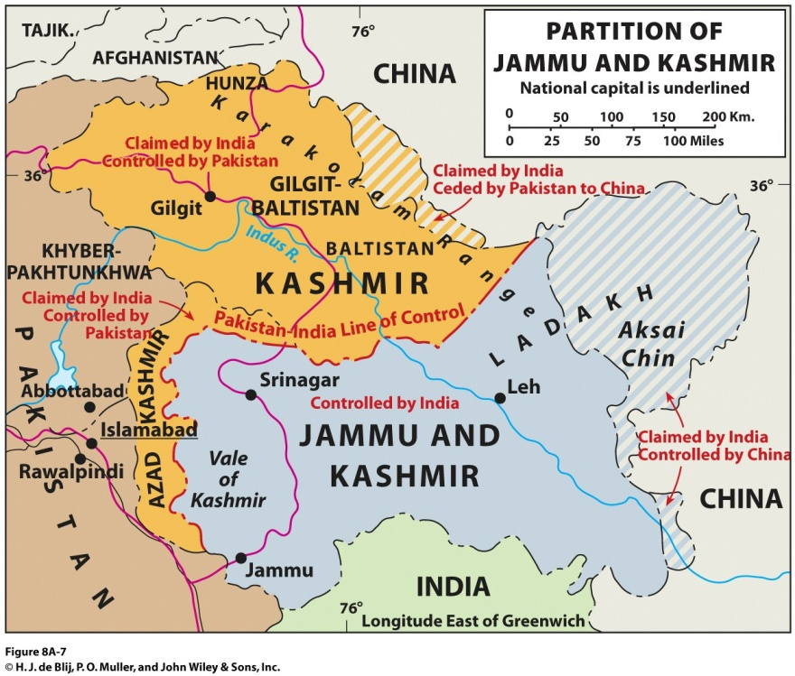
The Geopolitics of Modern South Asia: Chinese Border Claims
Jammu and Kashmir:
  Northeastern extensions are claimed by China.
  China offers strategic support for Pakistan versus India.
Arunachal Pradesh:
  China claims most of territory.
  Border agreed by Tibet, pre-Chinese control.
  War in 1962 was fought over border.
  Borders are unresolved.

Slide 34
The Geopolitics of Modern South Asia: Indian Ocean Geopolitics
Control of Indian Ocean Basin:
  China needs access to markets and is building military bases.
  India responds by building alliances in Southeast Asia.
  United States is balancing between the two.
Economic interdependence:
  Terms of trade are currently to China’s advantage (India has a trade deficit with China).
  China-India trade is growing.

Slide 35
Emerging Markets and Fragmented Modernization
Staggering growth:
  “India Shining” and the new era for India is considered key:
    Rising economic growth rates.
    Due to globalization and modernization.
    Increasing integration into global economy.
    E.g. IT and call centers.
  Dramatic unevenness:
    Poverty: over half of people in India, Pakistan, and Bangladesh live in poverty.
    Benefits of economic growth are not spread around.

Slide 36
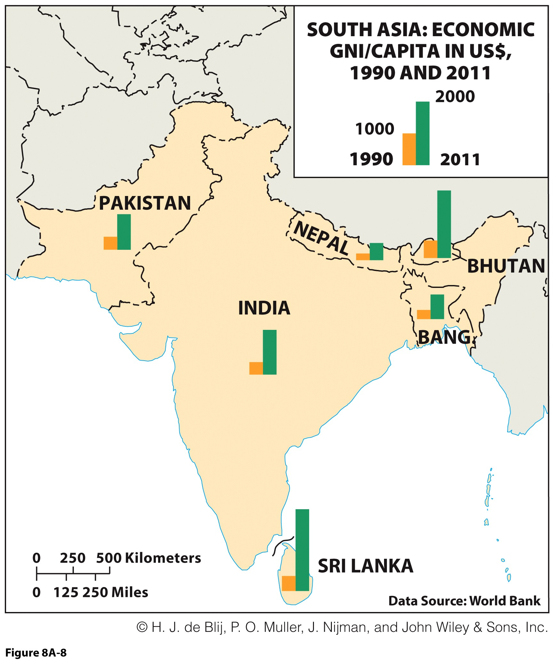
Emerging Markets and Fragmented Modernization: Economic Liberalization
Neoliberalism:
  Privatization of largely state-managed economies.
  Support from IMF required such structural reforms.
Economic growth:
  New industries.
  Led to new, urban middle class and consumer market.
  Uneven as many are still impoverished and rural.

Slide 37
Emerging Markets and Fragmented Modernization: The Significance of Agriculture
More than half of entire South Asian workforce:
  Low productivity and economic contribution.
  Rural areas with lower incomes and standard of living.
Millions depend on good harvest each year:
  Influenced by topography and rains.
  Rice in wetter areas and wheat in drier areas.
Government needs to create rural policy:
  To increase agricultural productivity and standard of living.

Slide 38
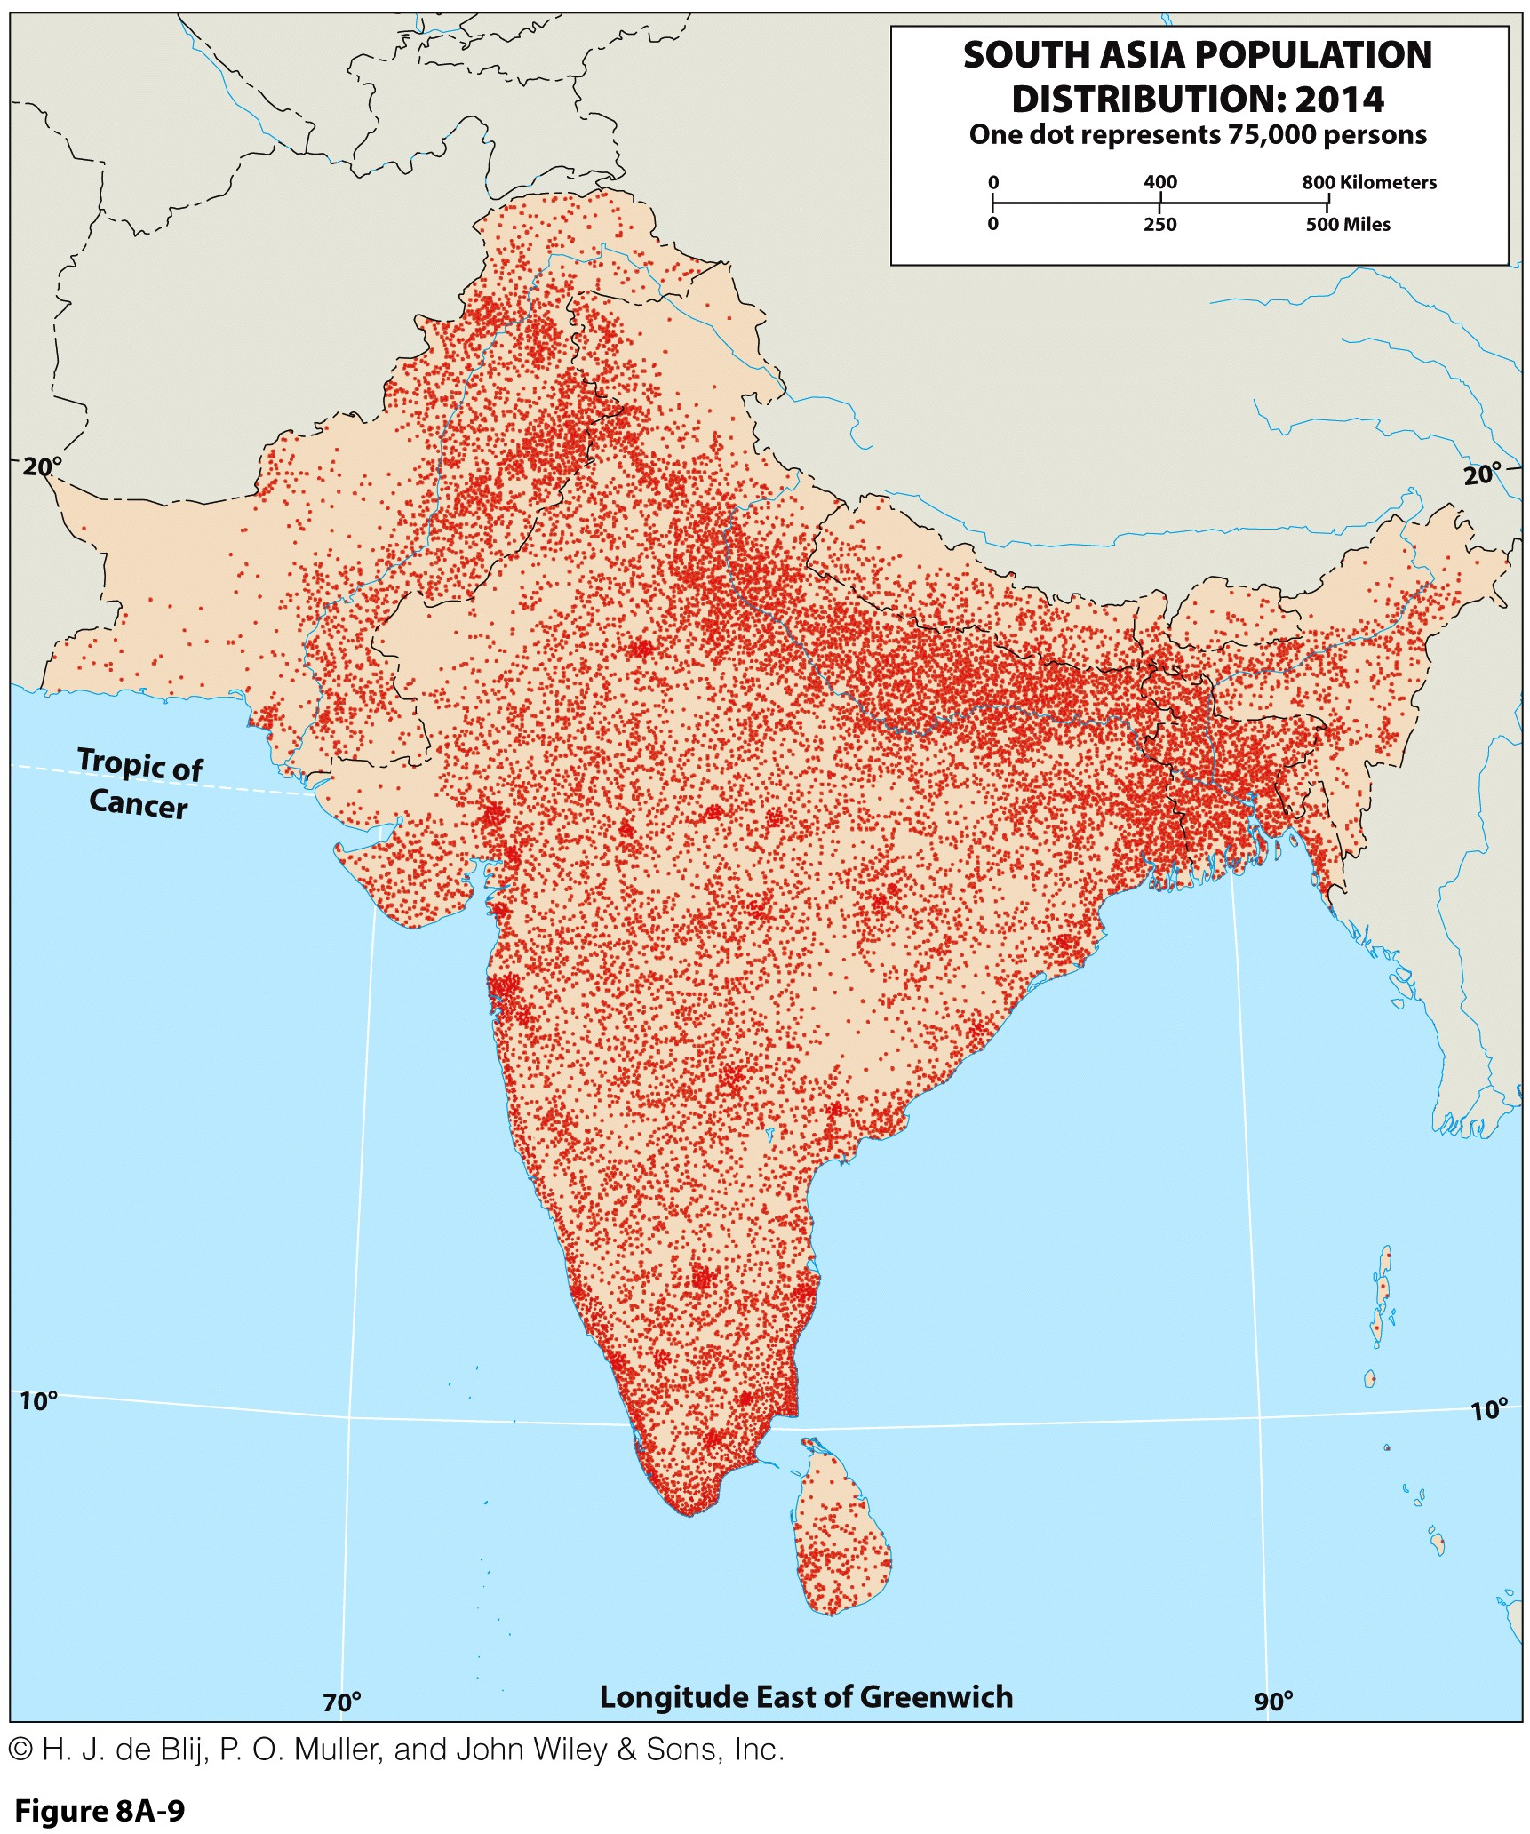
South Asia’s Population Geography
Population geography focuses on spatial demography.
Relative sizes of South Asia’s area and population:
  Two-fifths the size of East Asia and equally as populous.
  Sub-Saharan Africa is five times as large, with less than half of South Asia’s population.

Slide 39
South Asia’s Population Geography: Population Density
Population density is number of people per unit area.
  Arithmetic density is number of people per area.
  Physiological density is number of people per unit of arable (agricultural) land:
    More meaningful measure for understanding the ability of a country to support its population size.

Slide 40
South Asia’s Population Geography: The Question of Overpopulation
Overpopulation and “carrying capacity”
  High population growth and densities unsupportable.
Depends on circumstances:
  Not all high-density countries are struggling.
  Human resources: productivity, education, or technology help use natural resources efficiently.
  South Asia’s large population has a large share which is illiterate, undereducated and not productive:
    A burden rather than a resource.
    Too many that are insufficiently productive.

Slide 41
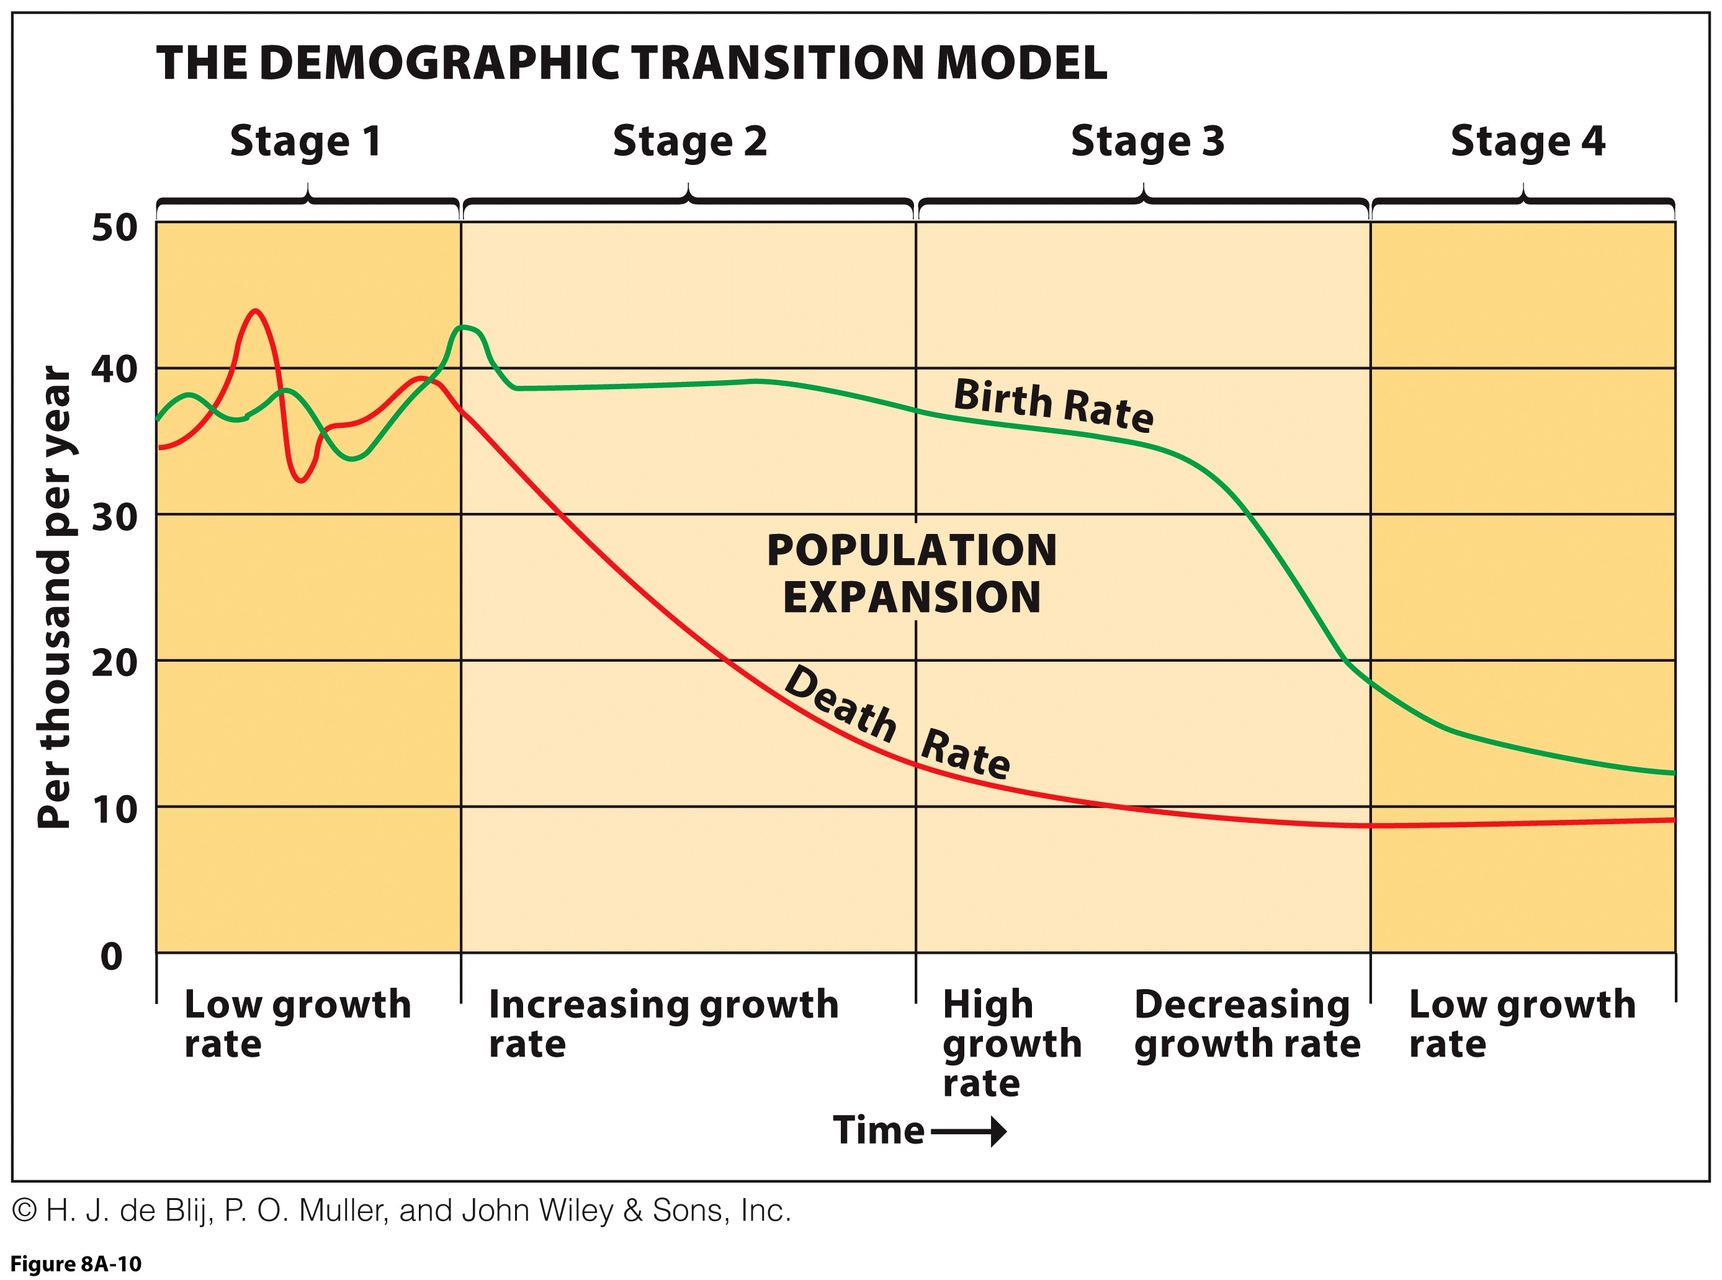
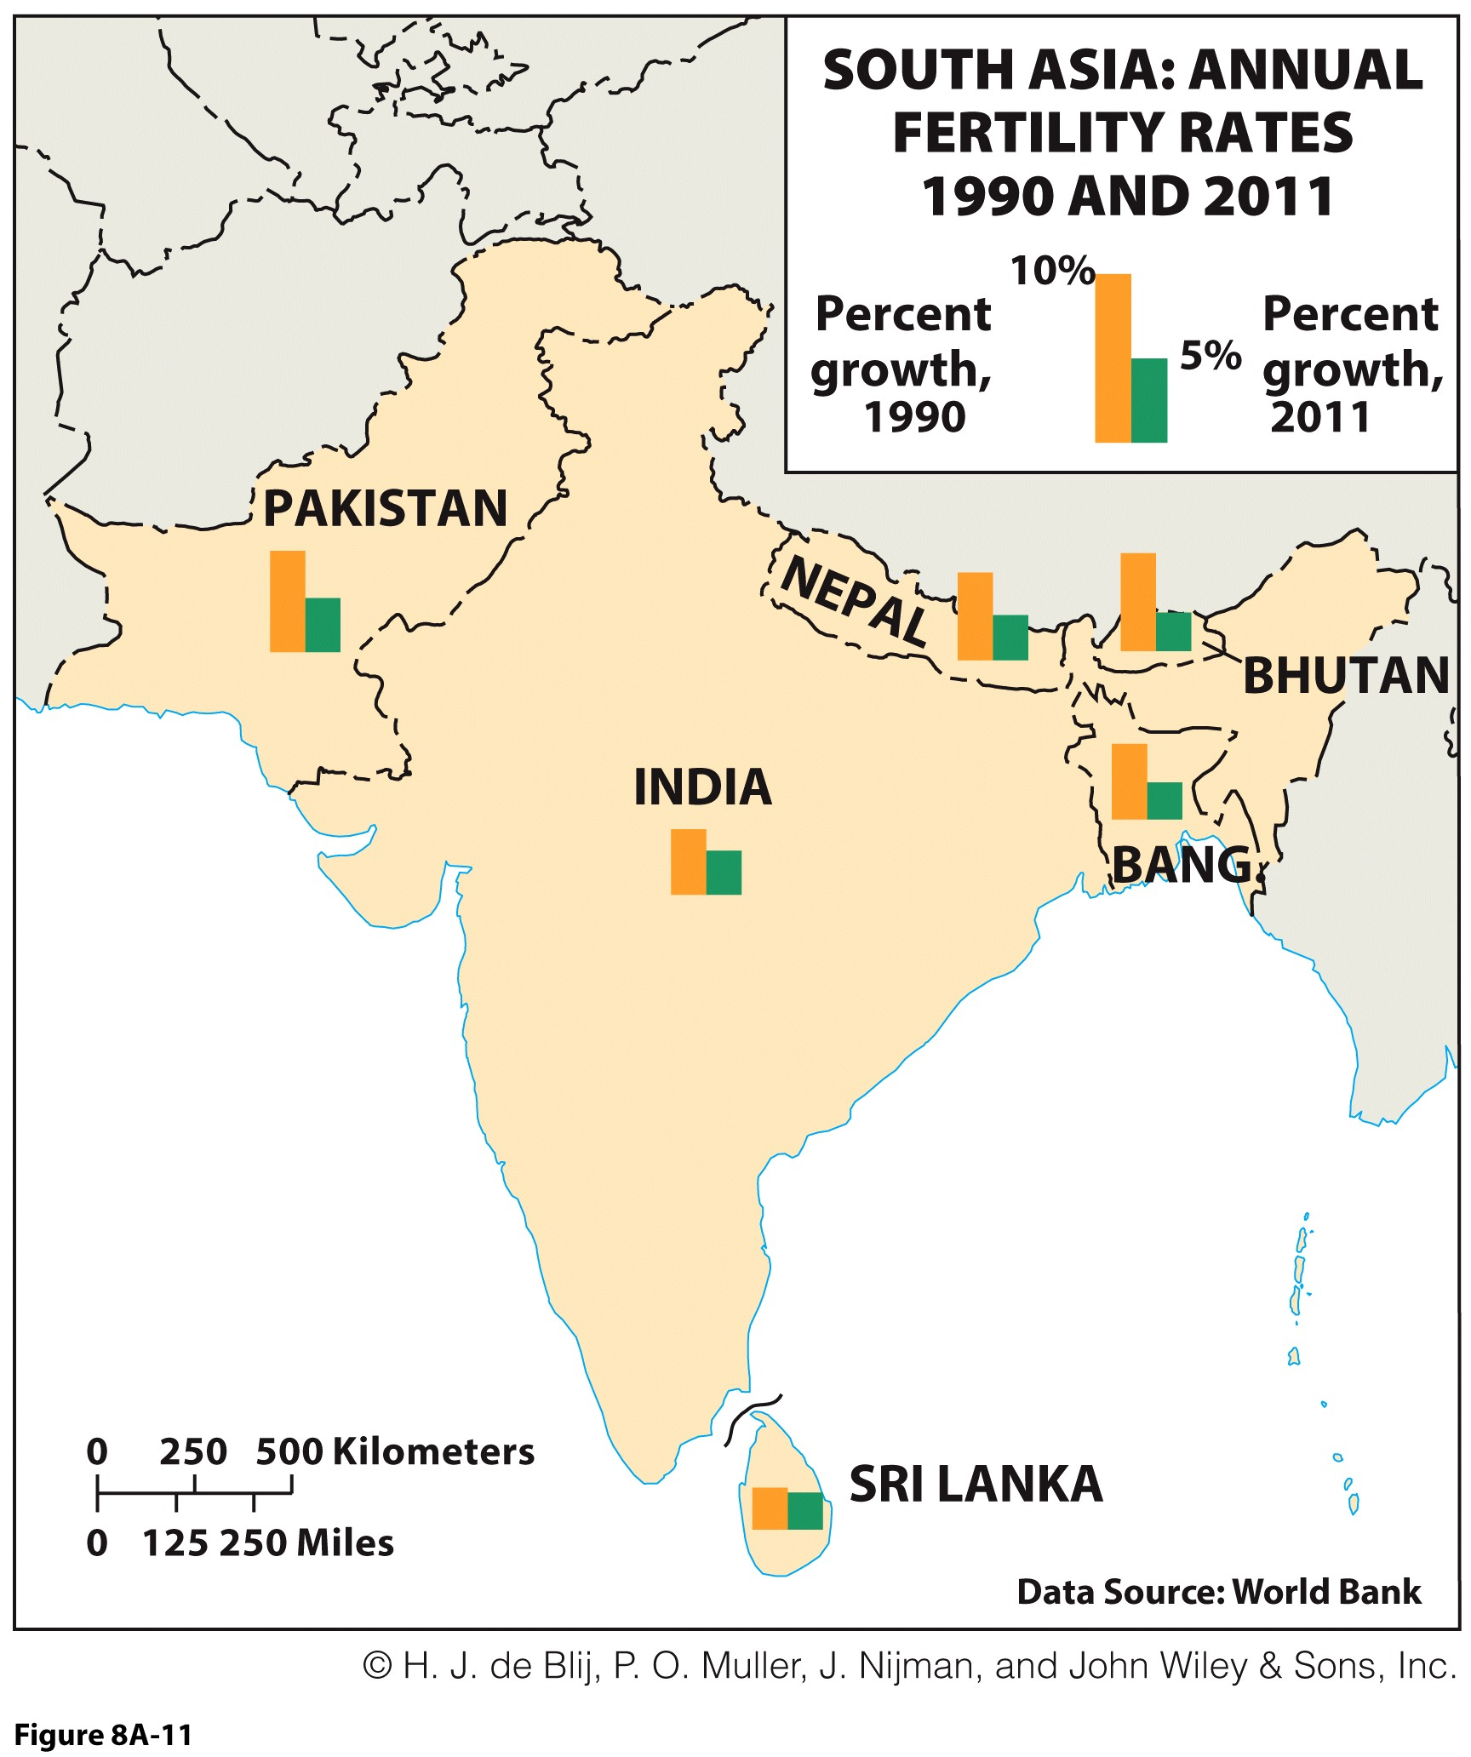
South Asia’s Population Geography: The Question of Overpopulation
Structural change in birth and death rates:
  Rapid population increase
  Decline in growth rates
  Stable population
Stage 2:
  Birth rates stabilize; deaths decline due to medical advances.
South Asian birth rates need to drop for population to stabilize.

Slide 42
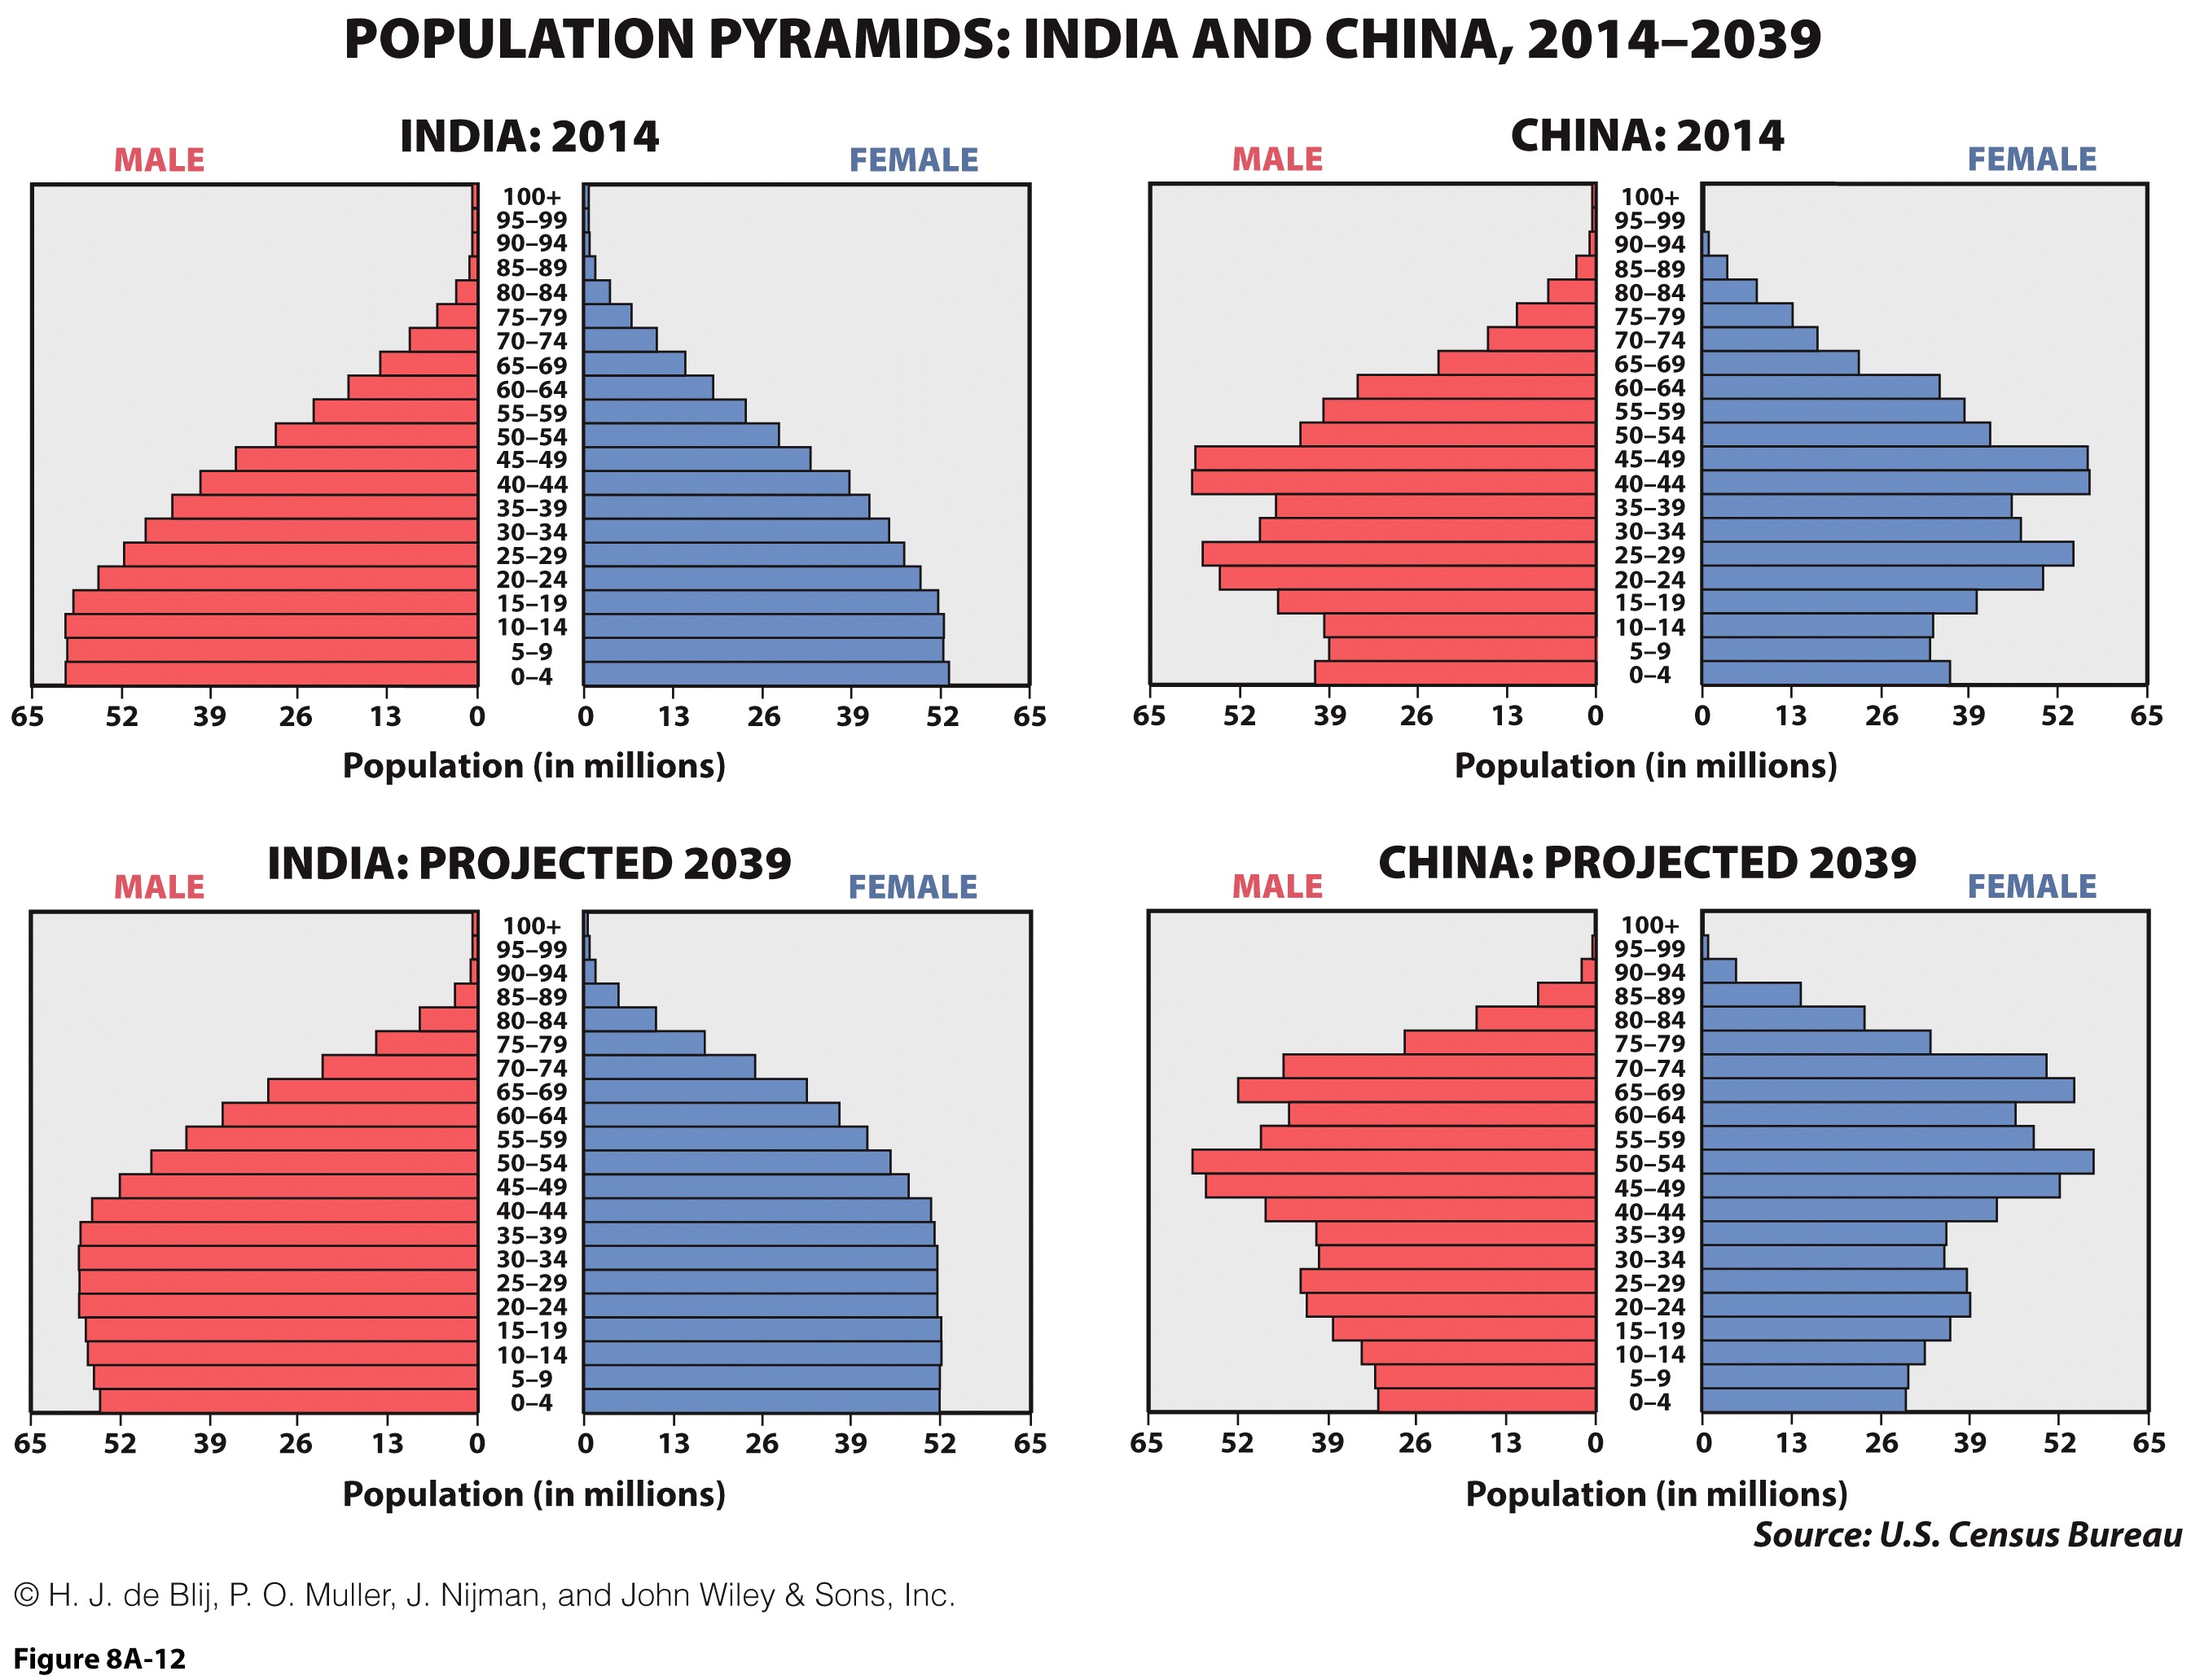
South Asia’s Population Geography: Demographic Burdens
Demographic burden
  Proportion of population that is too old or too young to be productive and must be cared for by productive population (ages 20 to 50).
  Low death rates and high birth rates will have large share of young and old.
  High demographic burden.
Population Pyramid graphic of age-sex structure
  India’s burden greater today and less in future.

Slide 43
South Asia’s Population Geography: The Missing Girls
Sex ratio
  Skewed ratio of girls and boys.
Gender bias:
  Higher value on boys: more productive and support parents.
  Female infanticide.
  Abortion of females: ultrasounds and rising incomes.
  “Bachelor angst” leading to change in attitudes.

Slide 44
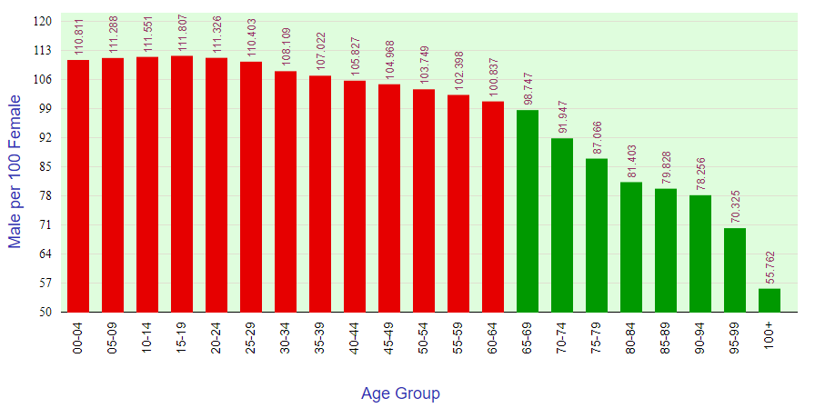
Sex Ratio of India (Males per 100 Females)

Slide 45
Infant Mortality Rate (per 1000 under age 5), by Sex, Selected Countries, 1990-2018

Slide 46
Future Prospects
Realm in transition
  Politically…
    India-Pakistan relations, specter of terrorism, and religious movements engagement of politics.
  Economically…
    India’s rise in global economy, its growing middle class, and its advantages.
  Demographically…
    Pass through demographic transition and lower fertility.
Discuss some major demographic challenges that South Asia is facing.

