Slide 1
Chapter 7: North African and Southwest Asian Realm

Slide 2
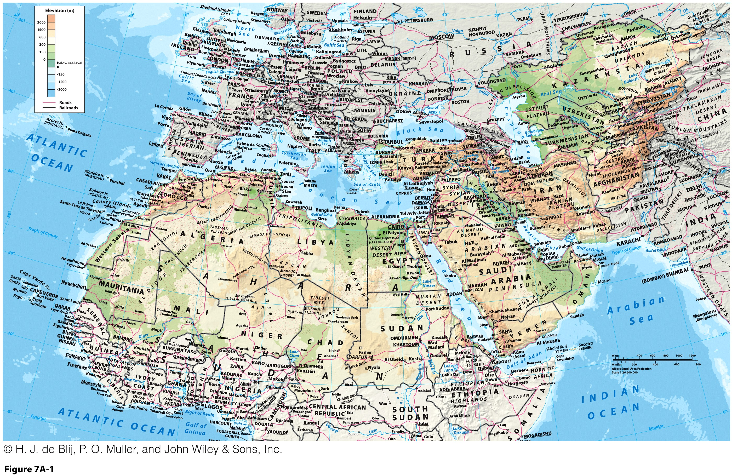

Slide 3
Naming This Pivotal Realm: A “Dry World”?
A “Dry World”?
  Dominance of aridity:
    Along the northern “dry band”.
    10 to 30 degrees north.
  Much of the land is unsuitable for cultivation:
    Pastoralism, particularly nomadic pastoralism.
  Most of the realm’s people cluster near fresh water sources:
    River valleys, basins, and deltas.
    Moist coastlines.
    Well-watered mountain basins.
    Groundwater sources (oases).

Slide 4
North Africa / Middle East, Mean Annual Precipitation (mm)
Sahara

Slide 5
Naming This Pivotal Realm: A “Dry World”?
Water and Life: Rural Settlement Patterns
Oasis Life
  Areas where high groundwater or deep-water wells provide reliable moisture.
  Small agricultural settlements.
  Serve as trading centers as well.
Exotic rivers
  River that comes from a humid area and flows into a dry area that otherwise lacks streams, can support irrigation.
  Nile River Valley.
The Challenge of Dryland Agriculture
  Depends on seasonal moisture (associated with Mediterranean regions)
  Includes tree crops, livestock, grains, and illegal hashish.

Slide 6
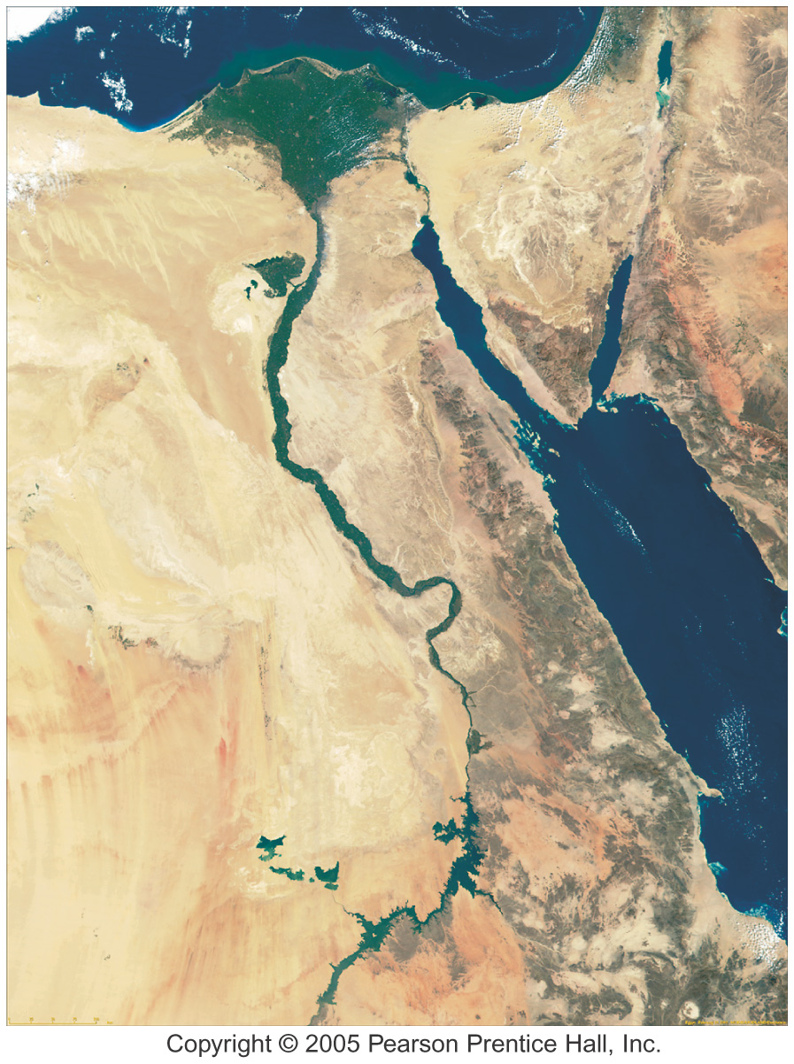
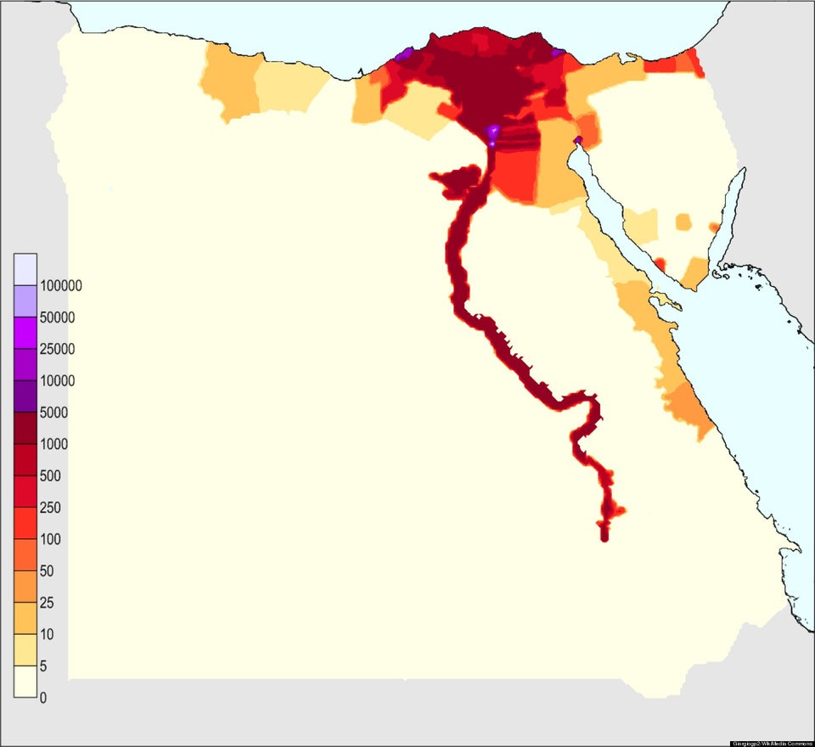
The Nile River System

Slide 7
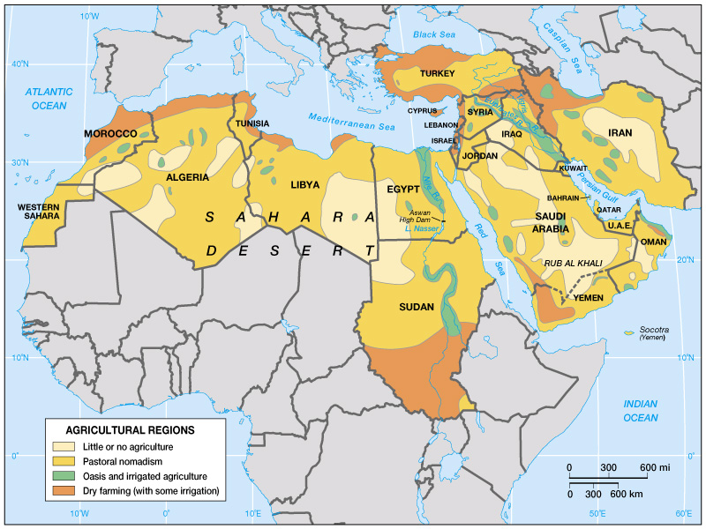
Agricultural Regions of SW Asia & N Africa
Notes:
Source: Globalization & Diversity: Rowntree, Lewis, Price, Wyckoff

Slide 8
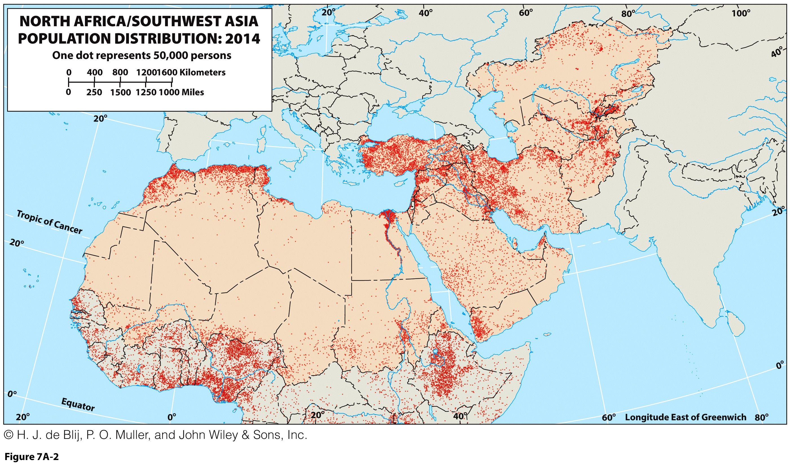
Naming This Pivotal Realm: A “Dry World”?
How might population distribution patterns indicate a society’s economic and technological development?

Slide 9
Naming This Pivotal Realm
Is this the “Middle East”?
  Reflects biases of the Western world.
  From the European perspective:
    Realm was between the Near East in Turkey and the Far East of China and Japan.
An “Arab World”?
  Implies ethnic and linguistic uniformity that does not exist.
  Turkey, Iran, and Israel are just a few that are distinctly not Arab.

Slide 10
Naming This Pivotal Realm: An “Islamic World”?
Contested geographies beyond the realm:
  Today, the largest Muslim state is Indonesia.
  Suggests that there is no Islam beyond the realm’s borders, when the Islamic faith extends far outside it.
Contested geographies within the realm:
  Christian minority populations in all the realm’s regions.
  Judaism has its base in the realm.
  Smaller religious communities abound.
  Islam has a wide-ranging impact on the realm’s cultural geographies.

Slide 11
Naming This Pivotal Realm: States and Nations
Despite some cultural similarities:
  Islam and its expressions dominate.
Fractious political and social geographies exist:
  Internal divisions.
  Nations without states (Palestinians, Kurds).
  Territories in progress.
  Boundary framework from the colonial era.
Populations unevenly dispersed in countries, regions, and the realm overall.

Slide 12
Hearths of Cultures: Dimensions of Culture
Realm of cultural crossroads, exhibits
  Cultural geography:
    Wide-ranging and comprehensive field studying spatial aspects of human cultures.
  Culture hearths:
    Crucibles of civilization and sources of dynamic ideas, innovations, and ideologies.
  Cultural diffusion:
    Set of processes that extended the spread ideas and innovations far and wide.
  Sphere of interaction:
    Area of influence of a culture.
  Cultural landscapes:
    The forms and artifacts placed on the natural landscape by sequential human occupants.

Slide 13
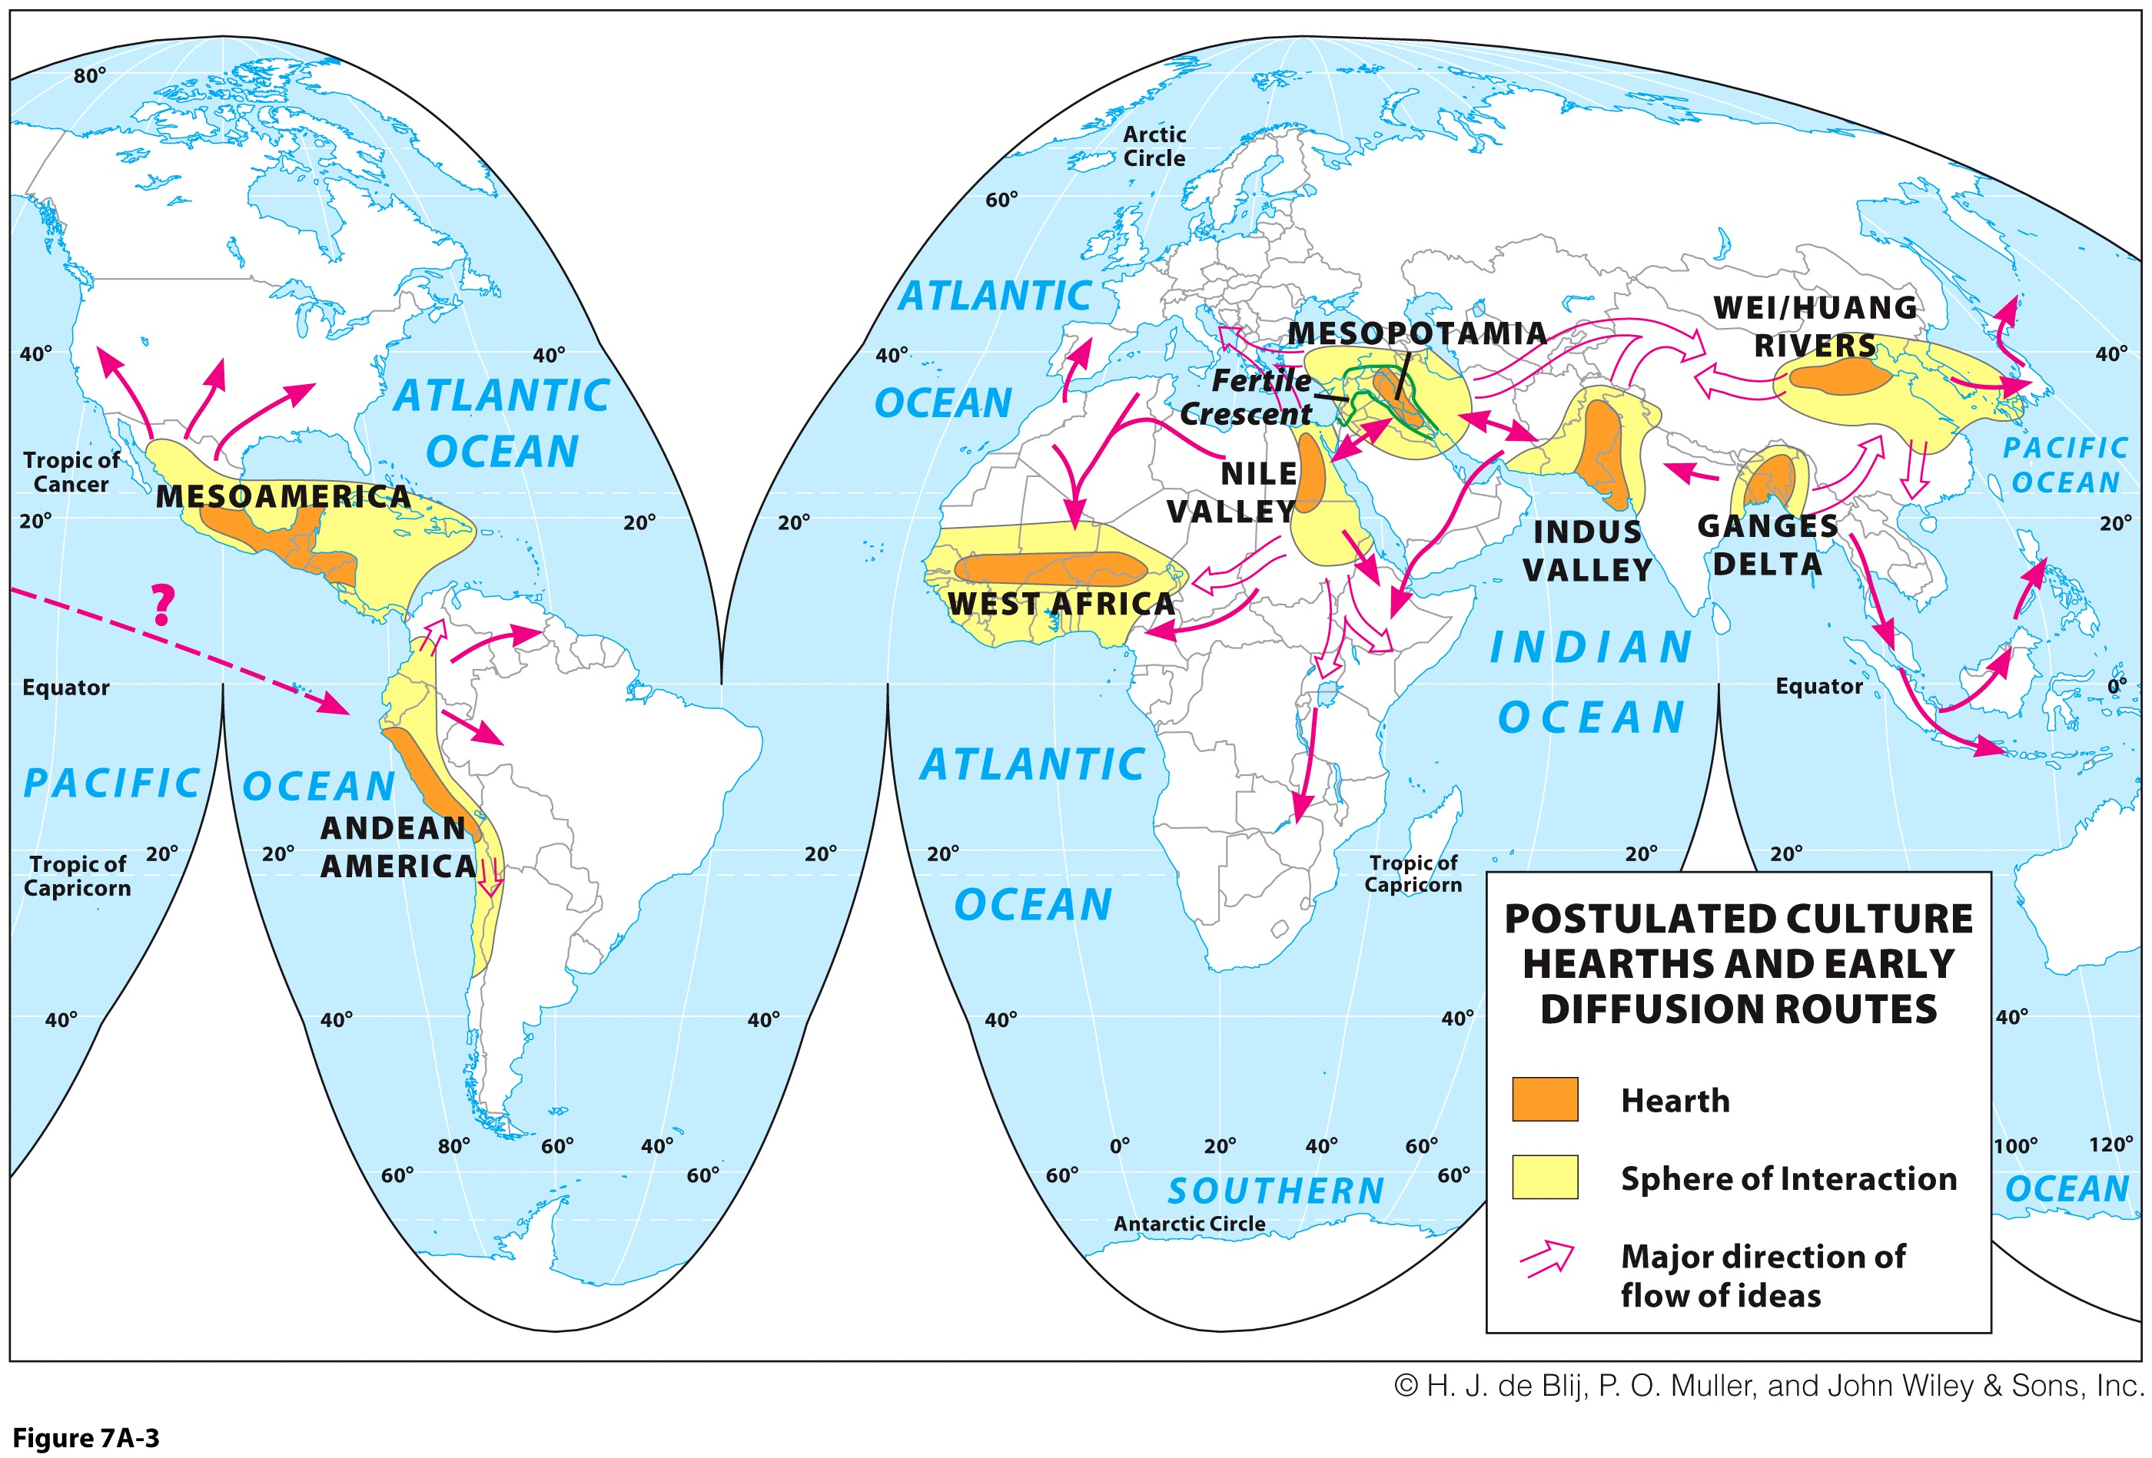
Map Analysis Activity: Humanizing Map Representations
Explain each of the features: Hearth and Sphere of Interaction. What do each imply? How do ideas really flow over distances and even oceans?

Slide 14
Hearths of Cultures: Rivers and Communities
Mesopotamia
  Fertile Crescent: region of significant agricultural productivity.
  Knowledge of crop and animal domestication.
  Hydraulic civilization theory: urban control over irrigated hinterland meant power over others and food as a weapon
Irrigation was key to prosperity and power
  Successful settlements developed into cities.
Egypt and the Nile
  Cultural evolution with the Nile River’s environmental security.
  Surrounded by inhospitable desert.
  River was highway for trade and interaction.
  River provided irrigation with predictable rhythms.
  Advanced urban civilization.

Slide 15
Hearths of Cultures: Decline and Decay
Another theory for decline of civilizations
  Climate change and shifting environmental zones:
    Along with overpopulation and human destruction of natural vegetation.
    Agricultural planning and irrigation technology were not innovations, as much as they were survival tactics for changing environmental conditions.
  As old societies disintegrated, power emerged elsewhere and came to imperialize the area:
    Persians, Greeks, and Romans ruled at various time periods.

Slide 16
Stage for Islam: The Faith
Unifying monotheism
  Islam shares precepts with Judaic and Christian beliefs.
  Brought new set of values and new way of life:
    Islam requires Five Pillars of observance.
    Proscribed alcohol, smoking, and gambling.
    Mosques became places for social gathering.
    Mecca became the spiritual center for a divided, widely dispersed people.
  Collective focus on Islam was new.

Slide 17
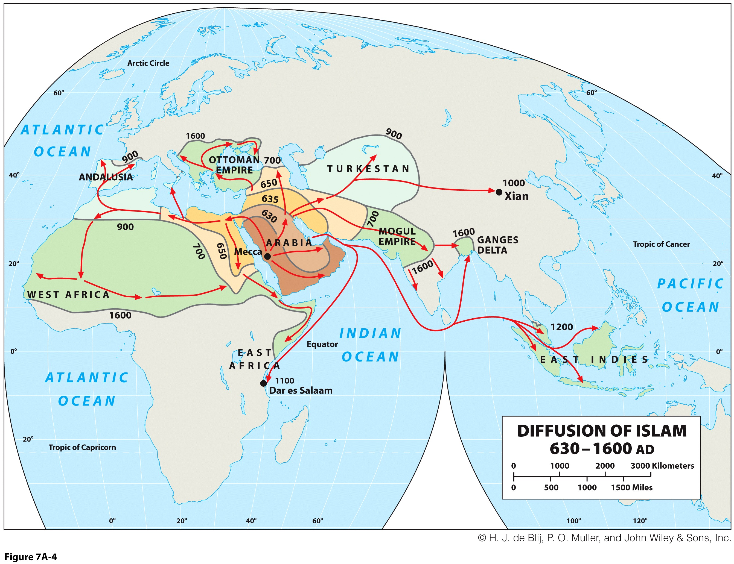
Stage for Islam: The Arab-Islamic Empire
  Formation of Arab armies that invaded, conquered, and converted Islam’s vast reach.

Slide 18
Stage for Islam: Routes of Diffusion
Spread of Islam
  Spatial diffusion as the way ideas, inventions, and cultural practices spread over space and time.
Took place in two forms
  Expansion diffusion: propagation waves originate in a strong and durable source area, spreading outward.
    This mostly explains Islam’s spread.
  Relocation diffusion: migrants carry an innovation, idea, or object from the source to distant locations and it diffuses from there.
Expansion diffusion types
  Contagious diffusion as a person-to-person.
  Hierarchical diffusion from higher orders, like kings, down to their subjects.
  Today relocation diffusion continues Islam’s expansion.

Slide 19
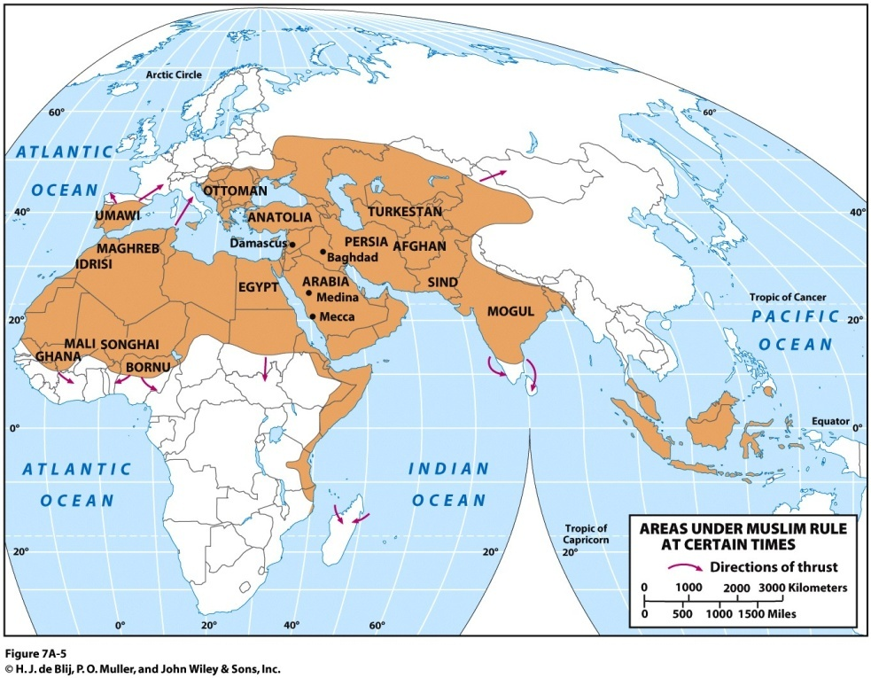
Stage for Islam: Islam on the March

Slide 20
The Flowering of Islamic Culture…
Expansion of Islamic culture
  Science, art, architecture, and other fields.
Wave of Islamic diffusion into the Maghreb and into Iberia
  Moorish invasion of Spain.
  Controlled most of southern Iberia.
  Al-Andalus:
    Islamic castles, mosques, schools, gardens, and public buildings.
  Pushed out by Catholic armies eventually.

Slide 21
Stage for Islam: Islam and Other Religions
Levant is source area of major faiths
  Area extends from Greece eastward along the Mediterranean coast to northern Egypt.
  Mostly Syria, Israel, Cyprus, Jordan and Lebanon.
  Older Christianity and Judaism came from the area.
Conflict between faiths
  Islam submerged some Jewish communities.
  Christians waged “holy wars” against Muslims during the Crusades.
  Christians are minorities in the region.
  Jewish state in conflict with Muslim neighbors.

Slide 22
Islam Divided
Division of the faith
  Two branches, Orthodox Sunnis (85%) and Shiites (15%).
  Sunni: Succession from Muhammad did not depend on hereditary decent from his son-in-law Ali.
  Shiite: Muhammad’s genuine successors descended from his son-in-law Ali.
The Strength of Shi’ism
  After vigorous promotion, the Persian kingdom made Shi’ism the only legal religion in its empire.
  Created a large culture region for the sect.
  Schism between sects underlies many of the realm’s conflicts.

Slide 23
Islam Divided: The Ottoman Empire and Its Aftermath
Ottoman Empire in Turkey:
  Pushed into southeastern Europe, Persia, Mesopotamia, and North Africa.
Eventually taken over by Europeans:
  Laid out boundaries without regard to cultural or physical features of the landscape.
  Some boundaries were poorly defined causing later conflict.
Armenian Genocide (1915-1923)
  Christian group within the Ottoman Empire (about 2 millions).
  First modern genocide (organized extermination by a government entity).
  Turkey an ally with Germany during WWI.
  Blamed for defeats against Russians in the Caucasus and the collapse of the Empire.
  About 1.5 million deaths through forced labor, starvation and death marches.
  Property confiscated (Armenians on average wealthier).

Slide 24
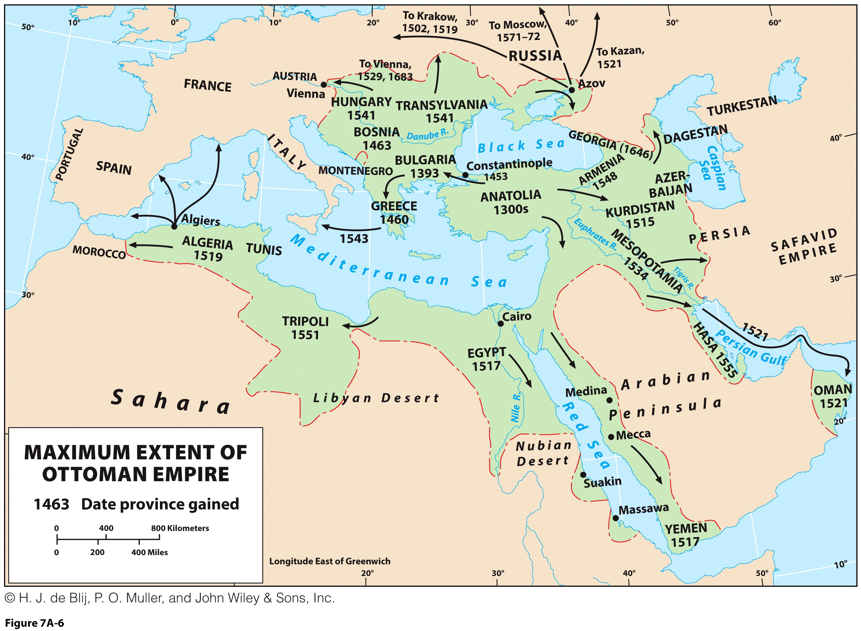
Islam Divided: The Ottoman Empire and Its Aftermath

Slide 25
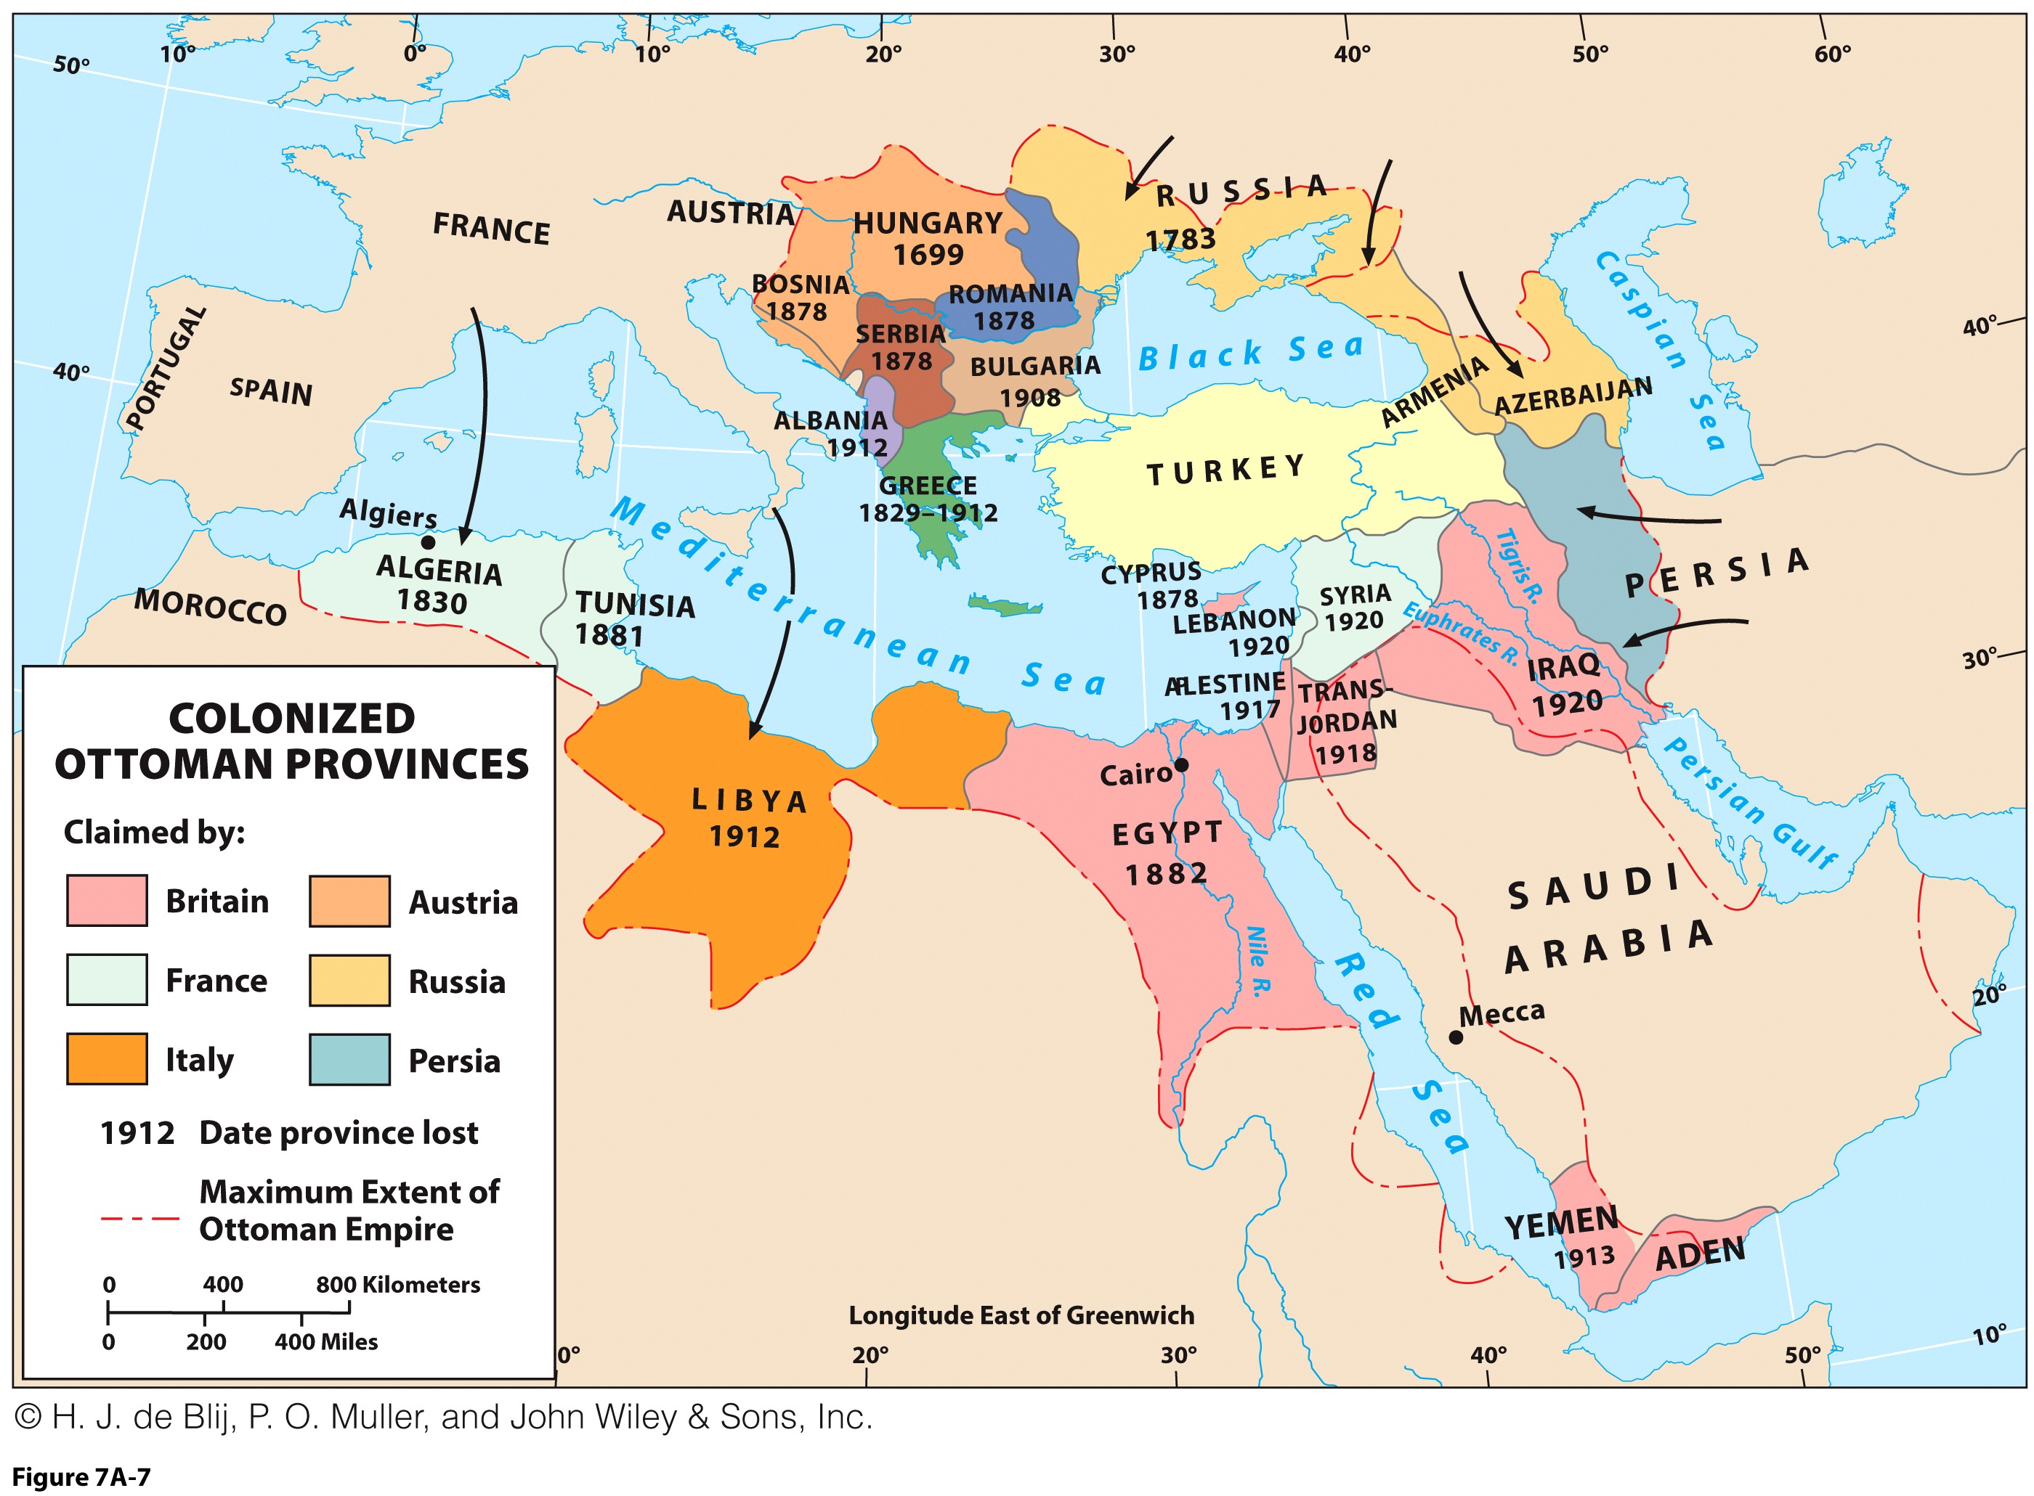
Islam Divided: The Ottoman Empire and Its Aftermath

Slide 26
A Future Kurdistan?
At the intersection of Turkey, Iraq, and Iran:
  Fractured and fragmented nation.
  Occupied that isolated, mountainous frontier zone for over 3,000 years.
  Kurdistan was a province of the Ottoman Empire.
  Kurds as a stateless nation, a peoples without control over their territory:
    An ethnic group of Iranian origin.
    Mostly Sunni, but many practice other religions.
    A divided people whose disunity has thwarted their dream of a nation-state.
    Will likely be without a territory for economic productivity into the future.

Slide 27
The Power and Peril of Oil
Big Five all located in the realm:
  1. Saudi Arabia 2. Iran
  3. Iraq 4. Kuwait
  5. United Arab Emirates
Realm’s three discontinuous zones of oil and natural gas:
  North Africa
  Persian Gulf
  Around the Caspian Sea

Slide 28
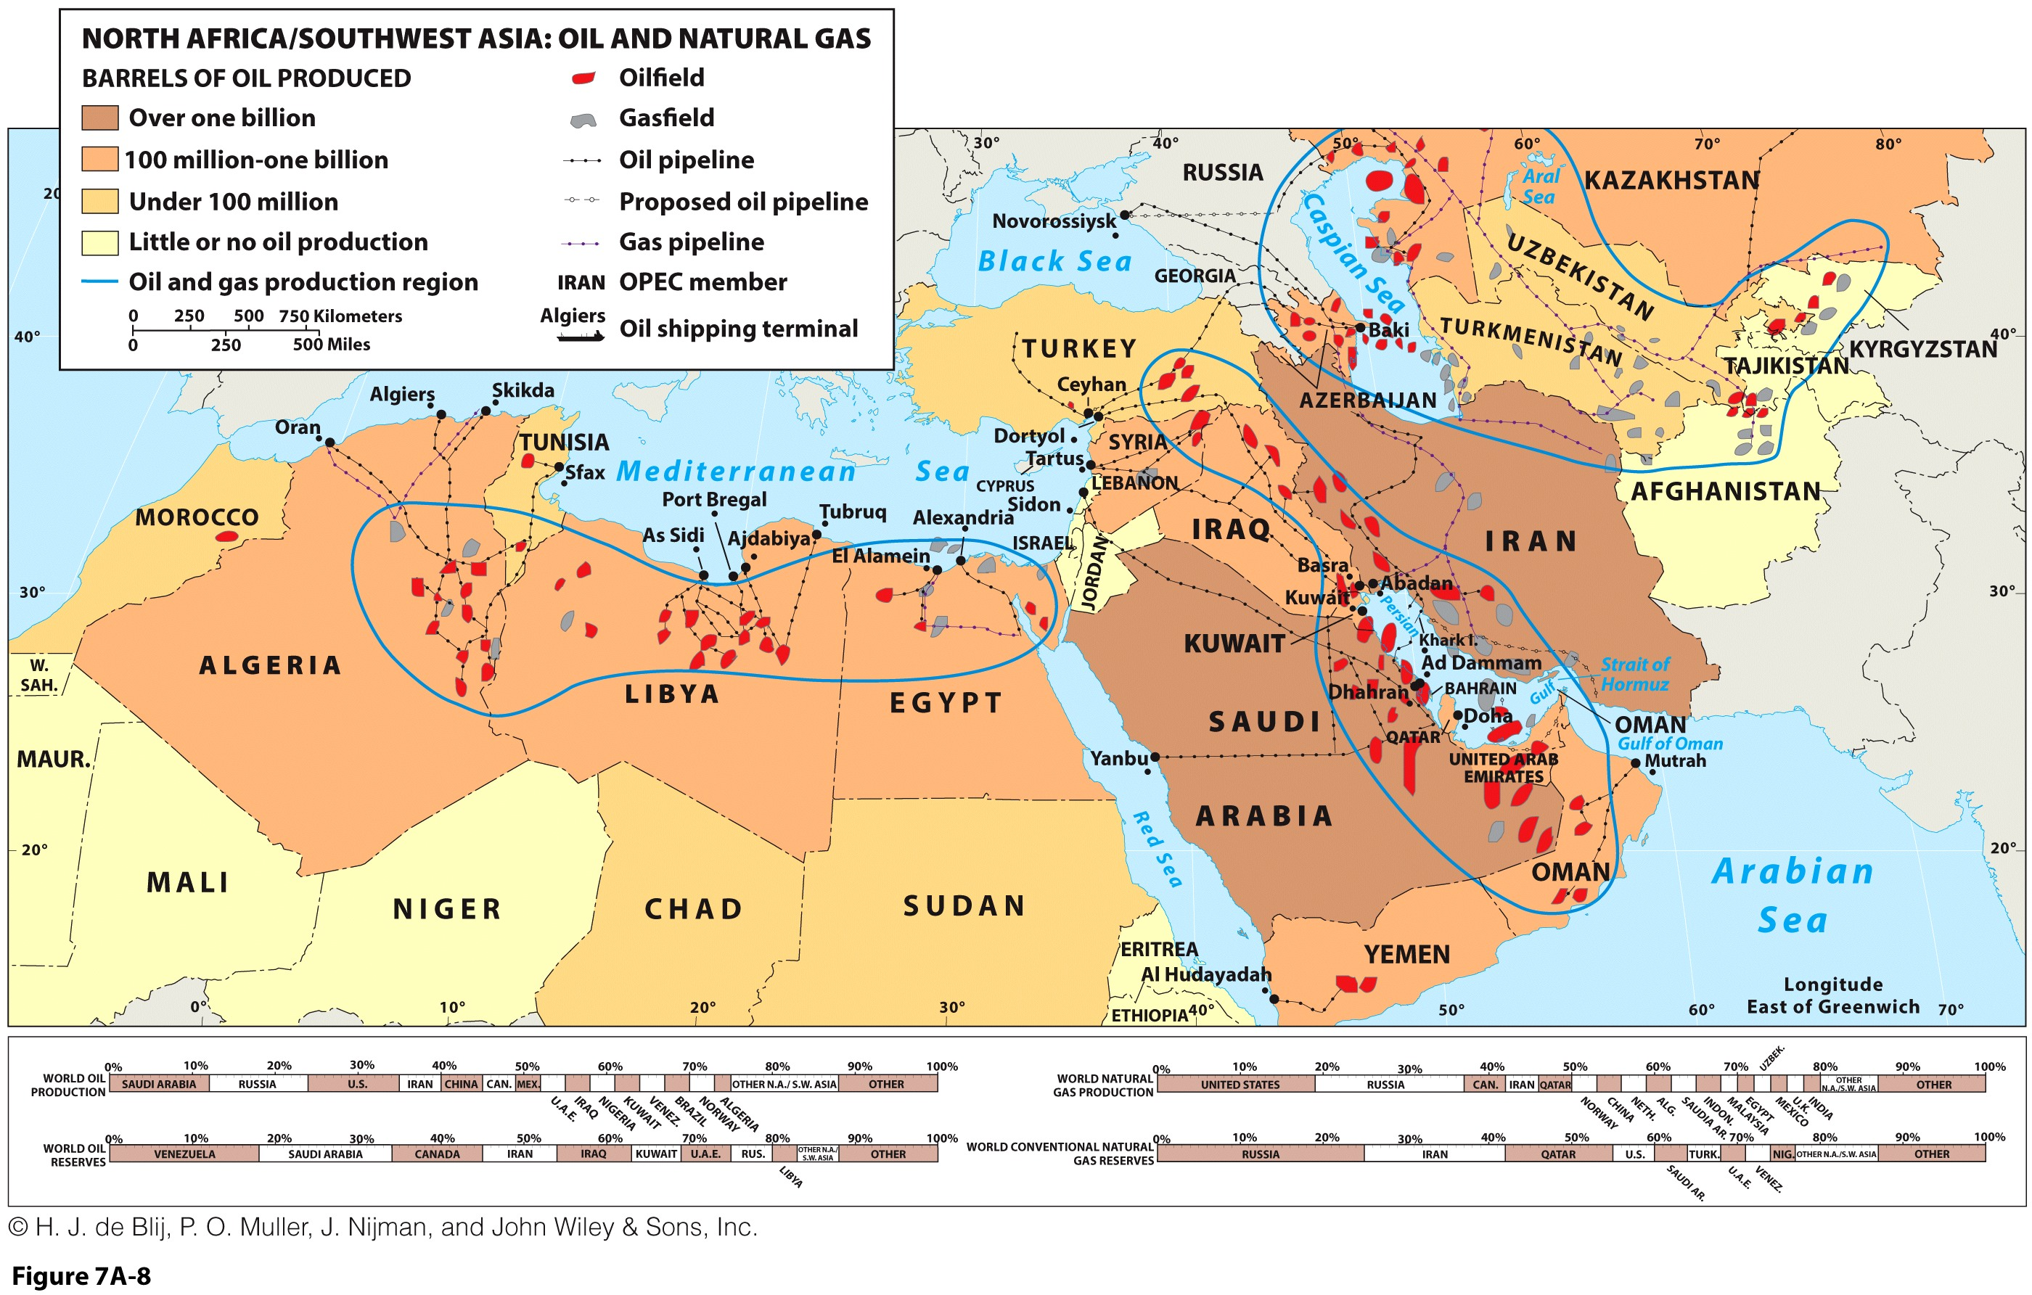
The Power and Peril of Oil

Slide 29
Major Crude Oil Reserves, 2009-2015 (Thousand Million Barrels)
Notes:
Source: BP Statistical Review of World Energy

Slide 30
The Power and Peril of Oil: Producers and Consumers
Global oil production:
  Saudi Arabia is world’s largest oil exporter.
  Realm’s production exceeds all other global sources.
Effect of oil revenues:
  Has elevated some into the higher-income category.
  Has also made them all globally interdependent.
The Colonial Legacy
  Colonial boundaries laid without knowledge of underlying resource geographies.
  Another source of division and distrust among neighbors.

Slide 31
The Power and Peril of Oil: Producers and Consumers
Discovery of oil necessitated a foreign presence:
  Realm’s states in need of skills, capital, and equipment.
  Transporting oil abroad required strategic arteries.
Effects of foreign intervention:
  Intervention in economic activities and political affairs.
  Penetration of Islamic society by Western norms.
Intensification of contrasts:
  Traditional vs. modern and rich vs. poor.
  To some, this violated the basic tenets of the Islamic faith.

Slide 32
Choke Points: Danger on the Sea Lanes
Choke point: narrowing of an international waterway causing marine traffic congestion:
  Essential routes for cheaper and more efficient trade.
  May be natural or artificial narrowing.
  Also increases risks and vulnerabilities.
Scourge of piracy on global trade:
  Reduced speeds allow pirates to board vessels.
  Plundering and ransoms.
Least-safe waterways:
  Strait of Hormuz.
  Strait of Malacca.
  Bab el Mandeb Strait.

Slide 33
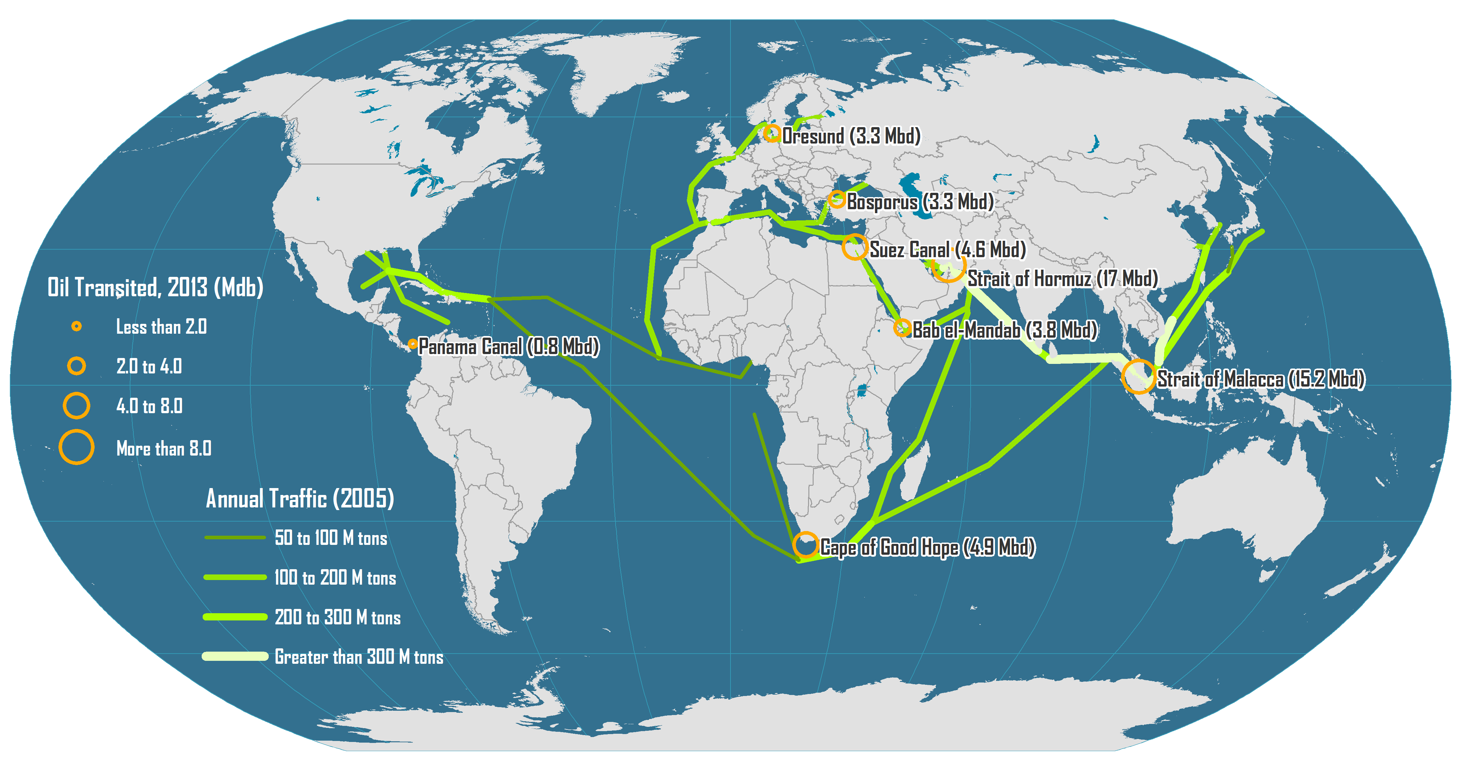
Major Oil Flows and Chokepoints
Notes:
Source: Adapted from The International Tankers Owners Pollution Federation Limited & Energy Information Administration, World Oil Transit Chokepoints.

Slide 34
The Power and Peril of Oil: The Geography of Oil’s Impact
Urban Transformation
  Most visible manifestation is urban modernization.
  Glass skyscrapers are engineering marvels.
  Air conditioning allowed a fast urban expansion.
Variable Incomes
  Fluctuating petroleum prices create states with vacillating income levels.
  Many oil-exporters stay in upper-middle-income category.
Infrastructure
  Money available for transportation and governance structures.
  Stark differences between oil-haves and oil-have-nots.
  Spending creates an image of comfort and affluence.

Slide 35
The Power and Peril of Oil: The Geography of Oil’s Impact
Industrialization
  Some far-sighted governments are investing oil revenues back into the economy.
  Building industries that will outlast oil exports:
  Manufacturing and high-technology.
Regional Disparities
  Strong contrasts within and among countries.
  Subsidies for the nationals, including health care, education, housing and government employment.
Foreign Investment
  Realm’s governments and private entrepreneurs have invested oil wealth in other countries:
    Development of sovereign wealth funds.
    Creates a network of international links between economies and Islamic communities abroad.W

Slide 36
The Power and Peril of Oil: The Geography of Oil’s Impact
Foreign Involvement
  Oil industry relies on foreign input and exports.
  To some, this is an unwelcome byproduct.
Intra-Realm Migration
  Oil production requires additional labor inputs.
  The first order of migrants are from the realm itself.
  Migration from Other Realms
  Not all inputs can meet by intraregional migrants.
  Also driven by difference in wages between realms.
Diffusion of Revivalism
  Oil revenues as investment into Islamist communities and structures throughout the world.
  Relocation diffusion of revival of Islam.
Explain what have been the main economic and social consequences of the exploitation of oil in the Middle East.

Slide 37
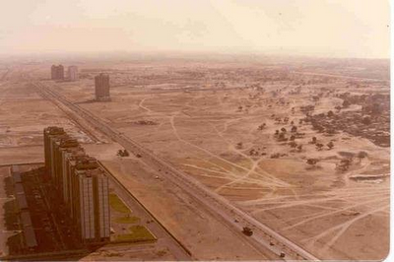
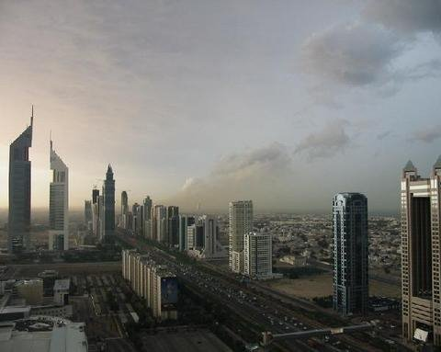
Dubai (1990 vs. 2007)

Slide 38
Share of Foreign Population and Workers in Persian Gulf States, 2015
Notes:
Source: https://www.pewresearch.org/global/2016/10/18/economic-growth-attracts-migrants-to-persian-gulf/

Slide 39
Fragmented Modernization: The Uneven Impact of Oil
The “Resource Curse”
  Prone to authoritarian rule, slow growth, corruption and conflict.
  Resources used to finance armies, corruption and patronage.
  Oil is a good example.
Fragmented modernization
  Pattern where a few regions experience most of the development while the rest are left unaffected.
Cultural-geographic forces in the realm have greater influence than economic-geographic:
  Realm of great degree of existing variety and diversity.
  Oil has amplified inequalities and disparities both within and between countries.

Slide 40
Fragmented Modernization: Autocratic Regimes
Colonial legacy on governance:
  European rule endorsed by the League of Nations, the forbearer of the United Nations.
  Europeans were determined not to let go and eventual independence was earned through conflict.
  None of the formerly European administered areas were prepared to function as democracies.
Autocratic default:
  Newly independent and autocratic states were then cemented by foreign geopolitical plots.

Slide 41
Fragmented Modernization: Autocratic Regimes
Foreign support of autocratic regimes in the realm to secure access to oil supplies:
  Elsewhere, regimes part of Cold War alignments.
Varying politics of government:
  Republics or monarchies.
  Secular or Islamic.
Autocratic common denominator:
  Long “top-down” rule of some political leaders.
  Sometimes violence, repression, and economic disenfranchisement.

Slide 42
Fragmented Modernization: Religious Revivalism
Religious revivalism
  Religious movements with objectives to return to foundations of its faith.
  Fundamentalists wish to affect state policy and society.
  A return to religion is a way to regain hope and dignity.
Often a product of several viewpoints:
  Traditional Islamic values are eroding.
  Society is being corrupted by foreign presences.
  Islamic power is declining in secular states.
Revivalism into fanaticism: a step further:
  Pits Muslim against Muslim in areas of the realm.

Slide 43
Fragmented Modernization: Terror in the Name of Islam
Essential awareness
  Most Muslims are not fundamentalists.
  Not all fundamentalists are militants.
  Not all militants are terrorists.
  Terrorism as a tool of war is not exclusive to Islam.
Jihad, or “holy war,” is a deeply reactionary movement looking at the past not the future
  Pursued by some Muslim militants with an extreme fundamentalist interpretation of the Quran.
  Used as a vehicle for political power.

Slide 44
Fragmented Modernization: Terror in the Name of Islam
Organizing militant Islam
  Taliban in Afghanistan is a kind of Islamic militia:
    Follow Wahhabism, an orthodox form of Sunni Islam.
    Have a rigid view of Islamic law.
    Seek to return to an essentially premodern society.
  al-Qaeda in parts of northern Pakistan have a global agenda:
    A multinational network with a tightly knit core.
    Establish Islamic rule across the realm and banish all foreign influence.
    Lost its importance after constant interventions from the USA and the death of its leader in 2011.
  ISIL (Islamic State of Iraq and the Levant):
    Separation from al-Qaeda in 2014.
    Claiming significant territory in Iraq and Syria.
    Extension into other countries (e.g. Libya, Nigeria).
    Collapse in 2018.

Slide 45
The Popular Uprisings of 2011-12: An Arab Spring?
Arab Spring:
  Desire for democracy and end to cronyism, corruption, repression, and economic mismanagement
  From Tunisia to Egypt, Libya, Syria, Yemen, and Bahrain.
Revolutionary Dominoes
  Spread of political destabilization rapidly to parts of the realm with similar conditions
  Ruled by long-established autocratic regimes.
  Failure to bring economic progress.
  Repression of their people.
  Had lost touch with the people, especially the youth.
  Aided by modern communication systems: TV and the Internet

Slide 46
The Popular Uprisings of 2011-12: An Arab Spring? A New Generation
Youthfulness of the realm’s populations:
  Many state population have more than half under 25.
  Contrast to archaic nature of realm’s governments, and many have known only one leader in their lifetime.
Uprisings predominately led by youths:
  Used Internet’s social networks to organize protests.
Uncertain future:
  Lack of suitable social and political structures for the transition.
  Varying role of some countries’ Shi’ite minority.

Slide 47
The Popular Uprisings of 2011-12: An Arab Spring? A Turbulent Outcome
Post-Arab spring crisis for Egypt, Libya, Tunisia, and Yemen
Syria has fared the worst and is considered a failed state.
In the Arabian Peninsula, only in Yemen did serious government challenge take place.
Elsewhere the impact was far less significant.
  It did produce regional destabilization.

Slide 48
Regional Issue: Religious Revival or Democratic Reform?
ISLAMIC REVIVAL IS THE ONLY WAY
  The Islamic faith took root throughout the world, now outnumbering Christians.
  Muslims brought science and enlightenment, but this has lost momentum.
  “Whoever supports the infidel against Muslims is himself an infidel.”
  Salvation lies in a return to the strictest rules of Islam.
ISLAMIC COUNTRIES NEED DEMOCRATIC REFORM
  Socioeconomic indicators of Muslim-dominated countries are low ranking.
  Lack of innovation.
  Realm’s Muslims are caught between despotic regimes and extremist revivalists in a downward spiral.
  In need of freedom with both political and religious reform.

Slide 49
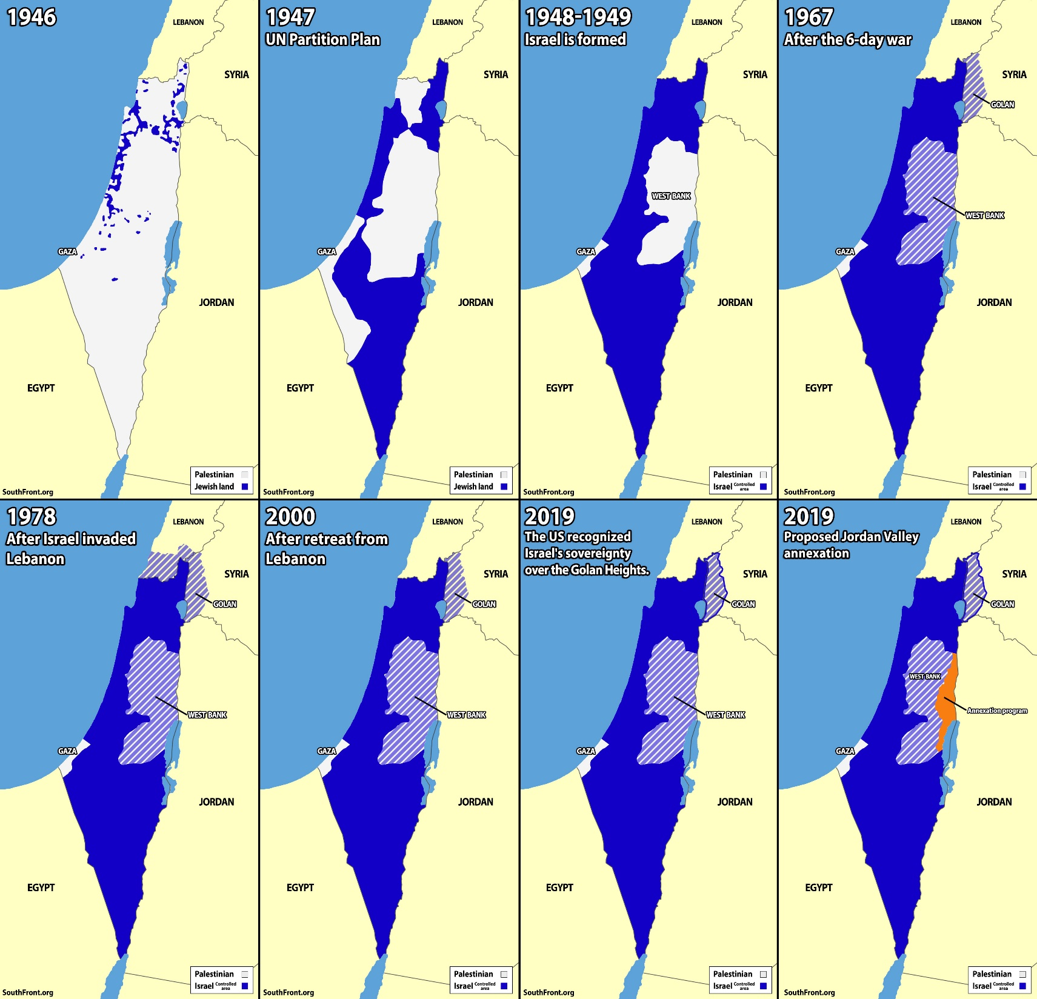

Slide 50
Conclusions
Southwest Asia and North Africa played critical role in world history and globalization
Important culture hearth and religious center at the intersection of three continents
The discovery of oil changed economics and geopolitics substantially
Political conflicts disrupt economic development
Tension between modern ways and fundamentalist traditions

