Slide 1
Chapter 3: The North American Realm

Slide 2
NOTICE
Most of the material, including graphics, are derived from:
  Jan Nijman, Peter O. Muller, Harm de Blij (2017) Geography: Realms, Regions and Concepts, 17th Edition, New York: Wiley.
  The above owns the copyrights of this material.

Slide 3
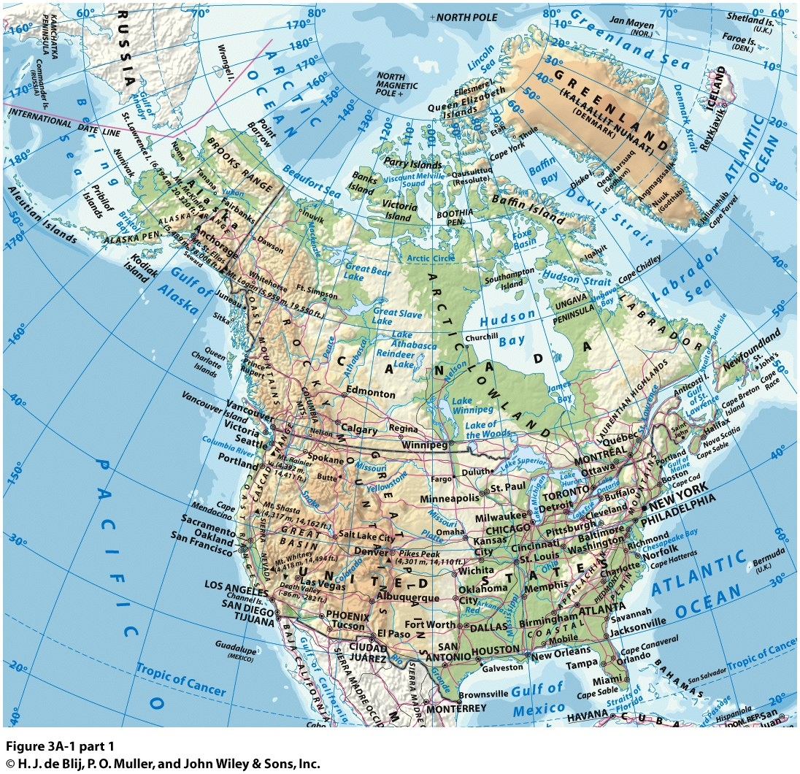

Slide 4
The Landscape
Continentalism
  High urbanization and mobility levels.
  Cultural pluralism, or cultural diversity:
    Linked with historical immigration from different regions of Europe.
    Reinforced after the 1970s with immigration from Latin America and Asia.
  Canada:
    Second largest country in the world.
    The longest non-militarized border in the world (8,900 km).
    Trade agreement since 1989.
    Several similarities but different societies.
  US:
    Fourth largest country in the world.
    48 continental (conterminous or contiguous) states.

Slide 5
Regions of the Realm
The Continental Interior
  Dominance of agriculture:
    Constitute a tremendous agricultural resource for a sparsely populated population.
  Spring wheat in the north:
    Planted in the early Spring and harvested in the early Fall.
  Winter wheat in the south:
    Planted in the Fall and harvested in the Spring.
  Corn / soybean in the middle:
    Soybeans are the cheapest source of protein.
    Rotated with corn production.
  Urban centers linked with agricultural processing:
    Indianapolis, Chicago, Kansas City.

Slide 6
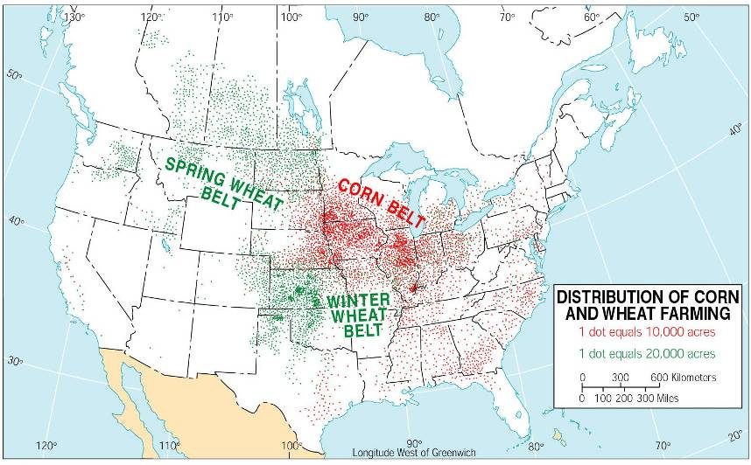
North American Regional Agricultural Specialization

Slide 7
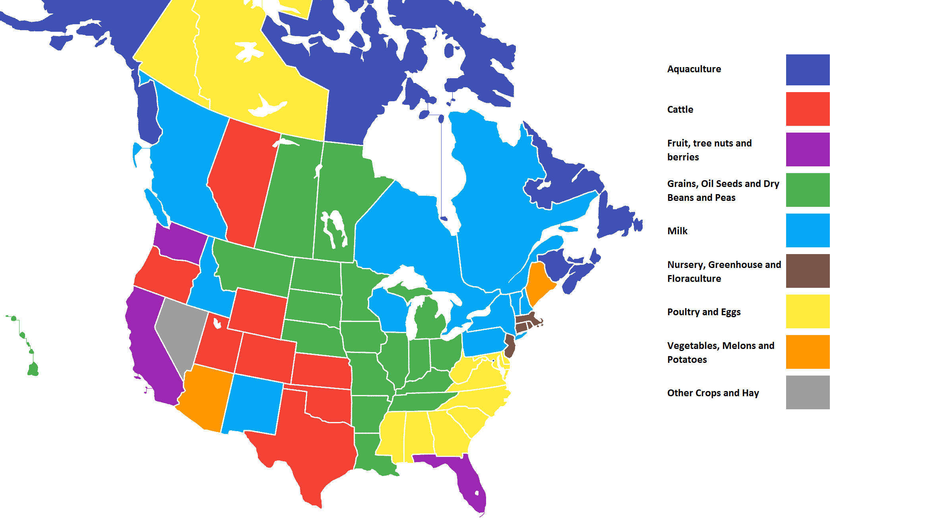
Most Valuable Agriculture by State / Province in North America

Slide 8
The Landscape
Population clusters
  Urbanization, immigration and cultural pluralism.
  Smaller US territory but greater environmental range.
  320 million “dispersed” population with concentrations along the East and West Coasts.
  Most of the Canadian population (35 million) lives 300 km from the border.
  The continental population living east of the realm’s middle line.

Slide 9
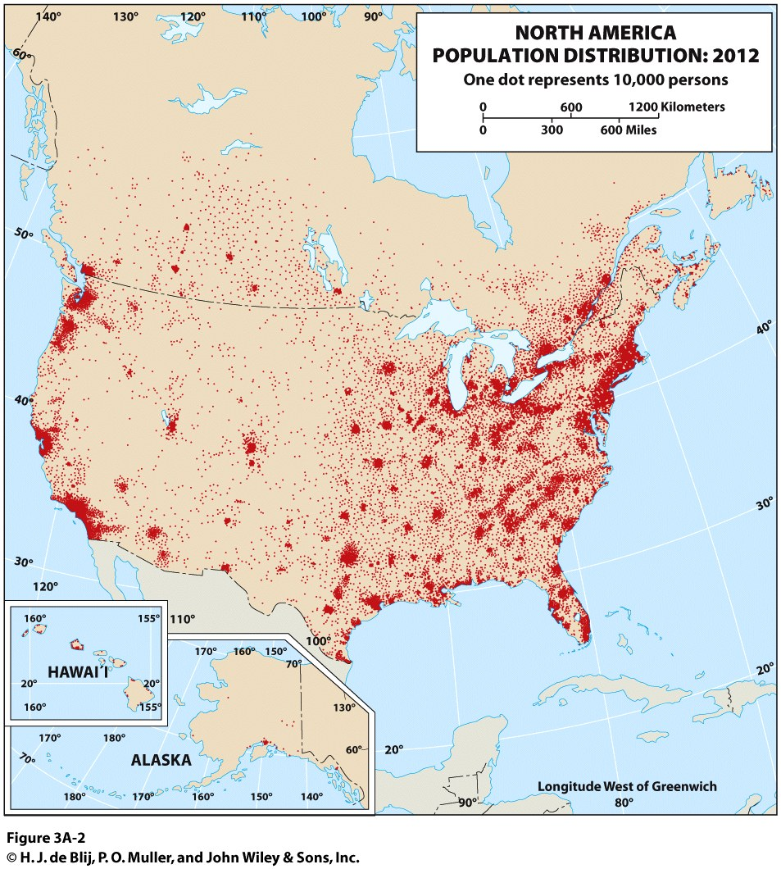
Explain the distribution of the North American population

Slide 10
North America’s Physical Geography: Physiographic Regions
Diverse physiographic regions
  Each exhibit natural landscape homogeneity.
  Well defined.
Some high-relief regions:
  Pacific Mountains.
  Rocky Mountains.
  Appalachian Mountains.
Some lowland regions:
  Great Plains.
  Interior Lowlands.
  Various Coastal Plains.

Slide 11
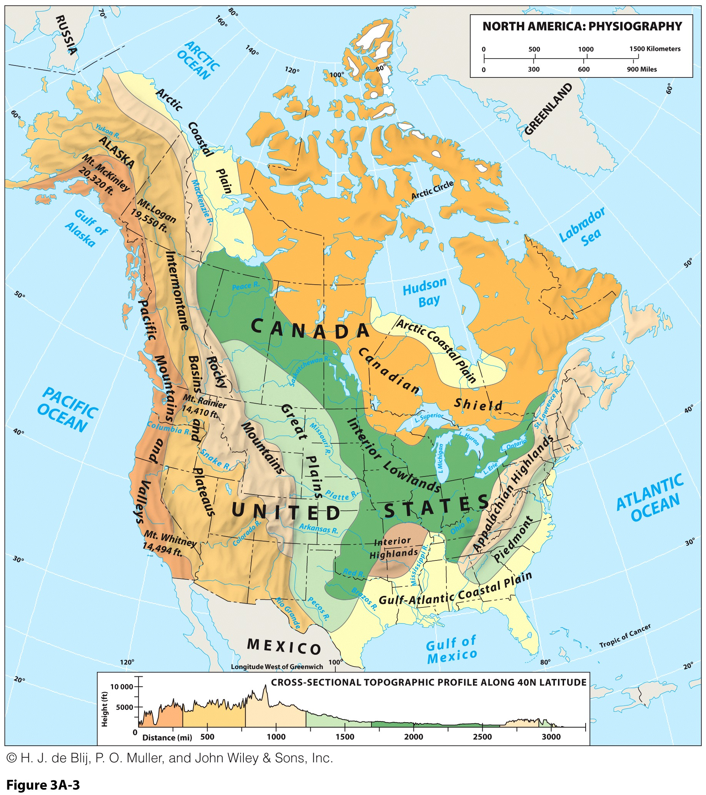

Slide 12
North America’s Physical Geography: Physiographic Regions
Gulf-Atlantic Coastal Plain
  Drained by many short rivers which flow from the interior to the coast.
  Some areas barely above sea level (Florida, Gulf Coast).
Piedmont
  Foothills to the east of the Appalachian highlands.
  Early settlements often were made at the fall line to take advantage of water power & because it was a break-in-bulk point.
Appalachian Highlands
  Low, old mountain range.
  No major impediment to transportation.
  Resource area – coal, iron ore etc.
Interior Highlands
  A dissected plateau known as the Ozarks.

Slide 13
North America’s Physical Geography: Physiographic Regions
Interior Lowlands
  Much of the best agricultural land.
  Parent material for the soil for much of the area is glacial till.
Canadian Shield (encircles Hudson Bay)
  The oldest rock formations in North America.
  The “anchor” of the North American continent.
  Very thin soil – developed after the last glacial advance.
Arctic coastal Plain (south coast Hudson Bay)
  Cold area – difficult to develop.
  Permafrost.

Slide 14
North America’s Physical Geography: Physiographic Regions
Great Plains
  Semi-arid area – gets drier from east to west.
  Wheat growing areas of U.S. and Canada.
Rocky Mountains
  North-South orientation affects climate.
  Storehouse of many minerals.
  Lumbering & winter-sport tourism.
  Younger mountains than Appalachians, therefore more of an impediment to transportation.

Slide 15
North America’s Physical Geography: Physiographic Regions
Intermontane Basins & Plateaus
  Rather dry area.
  North/south oriented – Between the Rockies and Sierra Nevada/Cascade ranges.
Pacific Mountains and Valleys
  First interruption of westerly winds (orographic precipitation) – north-south orientation.
  Three large, useful valleys:
    California’s Central Valley.
    Cowlitz-Puget Sound lowland of Washington and Oregon.
    Lower Fraser Valley in British Columbia.

Slide 16
North America’s Physical Geography: Climate
Climate
  North America is under the influence of Pacific, Arctic and Tropical air masses.
  Very diversified, ranging from continental humid to sub tropical.
    Distribution of land, sea and mountains produces a highly variable weather.
    From one day to another, mild, sunny air from the Rocky Mountains may replace moist, warm, cloudy tropical air and then give way to cold Arctic air.
  Large tracks of land are suitable for agriculture.
  Relatively simple weather system:
    Varies from west to east.
    Influenced by air masses moving from the arctic (cold and dry) and from the gulf of Mexico (hot and wet).
    Humid east experiences weather extremes due to frigid Arctic and subtropical seasonal air masses.
  The southeast section of the United States:
    A high precipitation level.
    Result of movements of air masses from the gulf of Mexico.
    Subject to tropical storms coming from the South Atlantic.

Slide 17
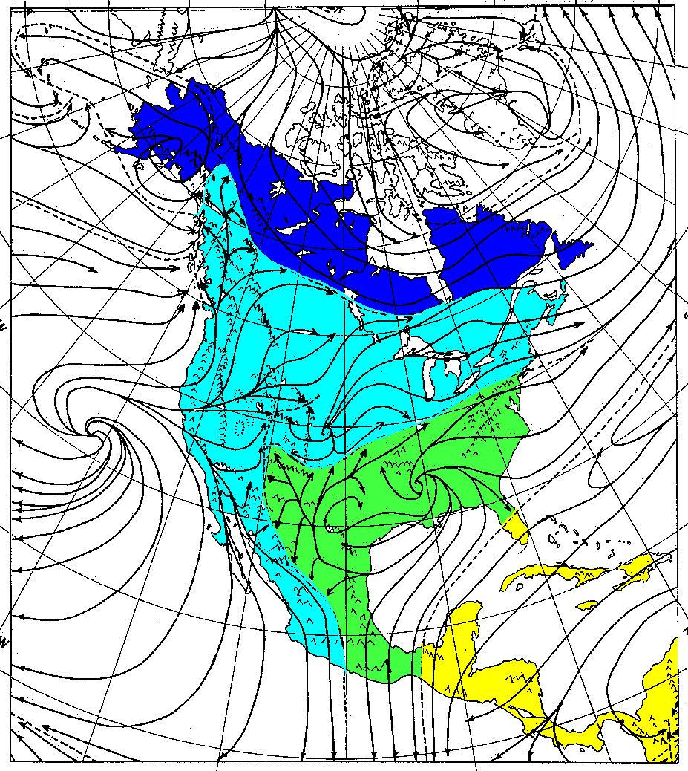
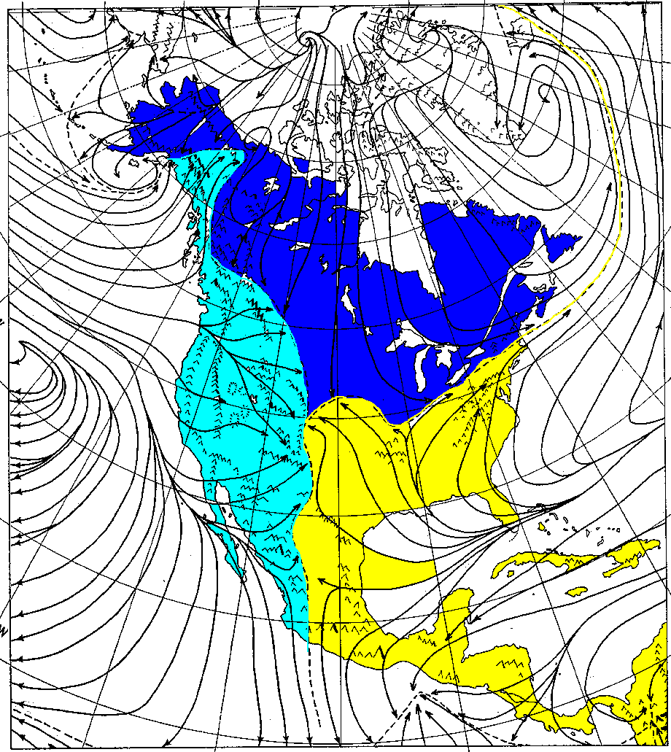
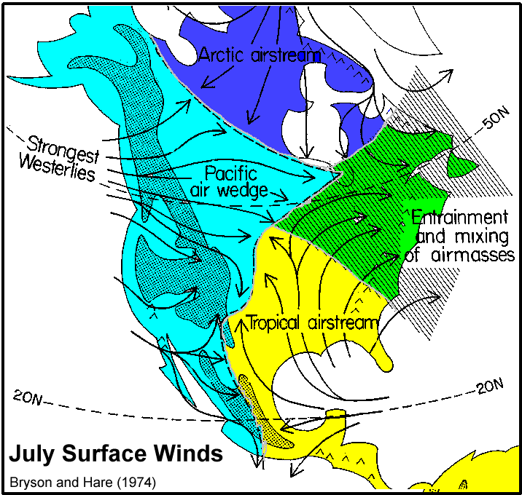
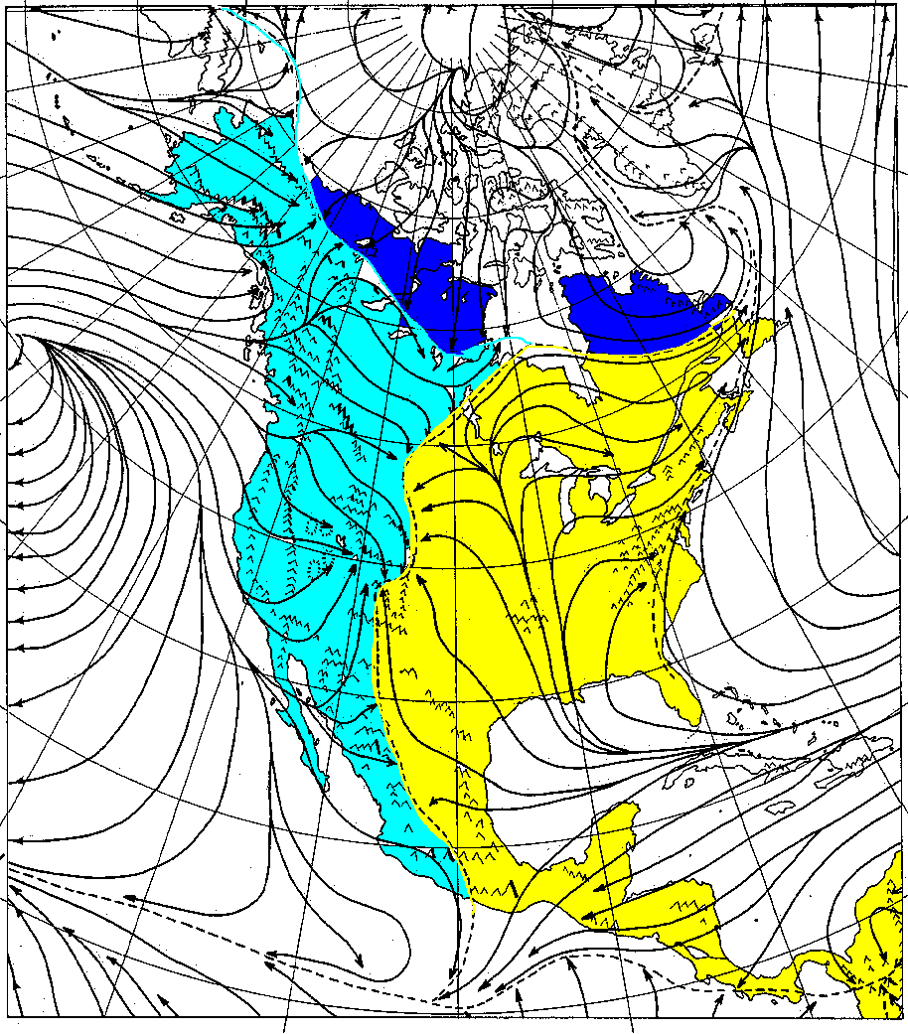
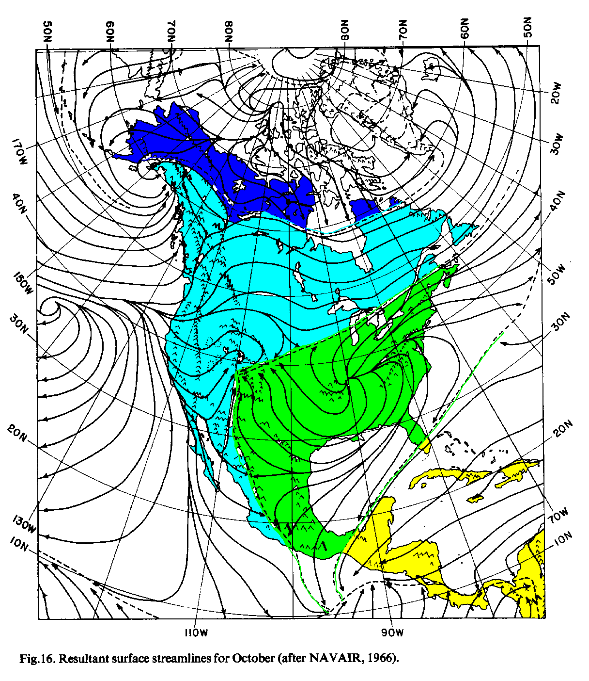
Seasonal Air Flow over North America
January
April
July
October
Notes:
NAVAIR, 1966

Slide 18
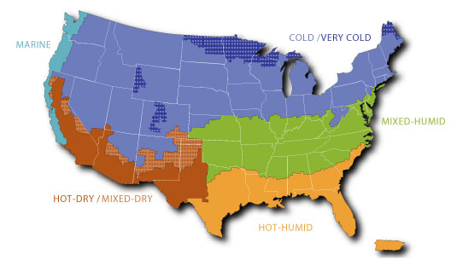
Share of Homes Having Air Conditioning Equipment by Climatic Region
38.1%
83.8%
96.0%
80.1%
98.4%
Notes:
Source: US Department of Energy. https://www.eia.gov/consumption/residential/reports/2009/air-conditioning.php

Slide 19
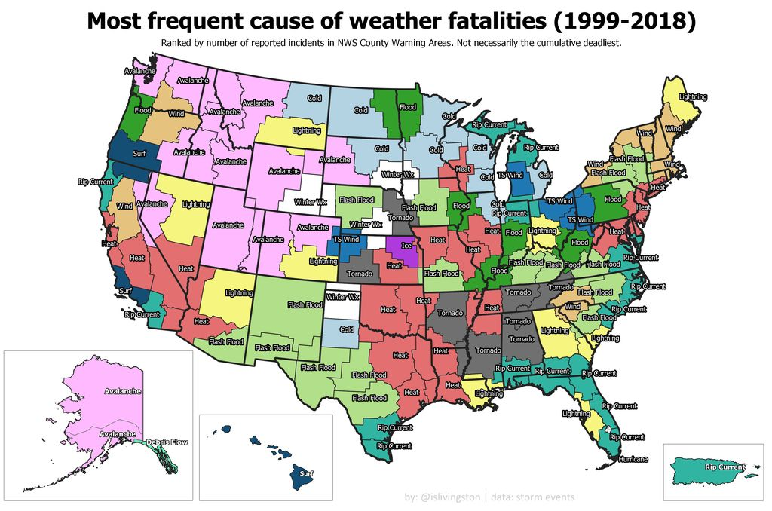
90% of the world’s tornadoes occur in the United States

Slide 20
North America’s Physical Geography: Climate
East/west gradient in precipitation
  Wet air from the Pacific.
  When reaching the coastal chain and the Sierra Nevada is forced to gain altitude.
  Air cooling process forces precipitation over the West Side of these mountain chains.
  Once the ridges passed over, the air becomes dryer.
  Rainshadow effect of the western mountains:
    The dry area on the lee side of a mountain range (away from the wind).
    The mountains block clouds, casting a dry “shadow” behind them.
    Blocks moisture to the Great Plains.
    Low level of rain falling over the high plateaus and the western part of the Great Plains.
  As it moves east, air masses gain in humidity through land evaporation and precipitation levels rise.

Slide 21
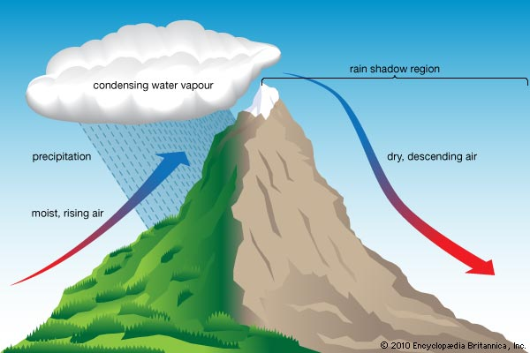
Rainshadow Effect

Slide 22
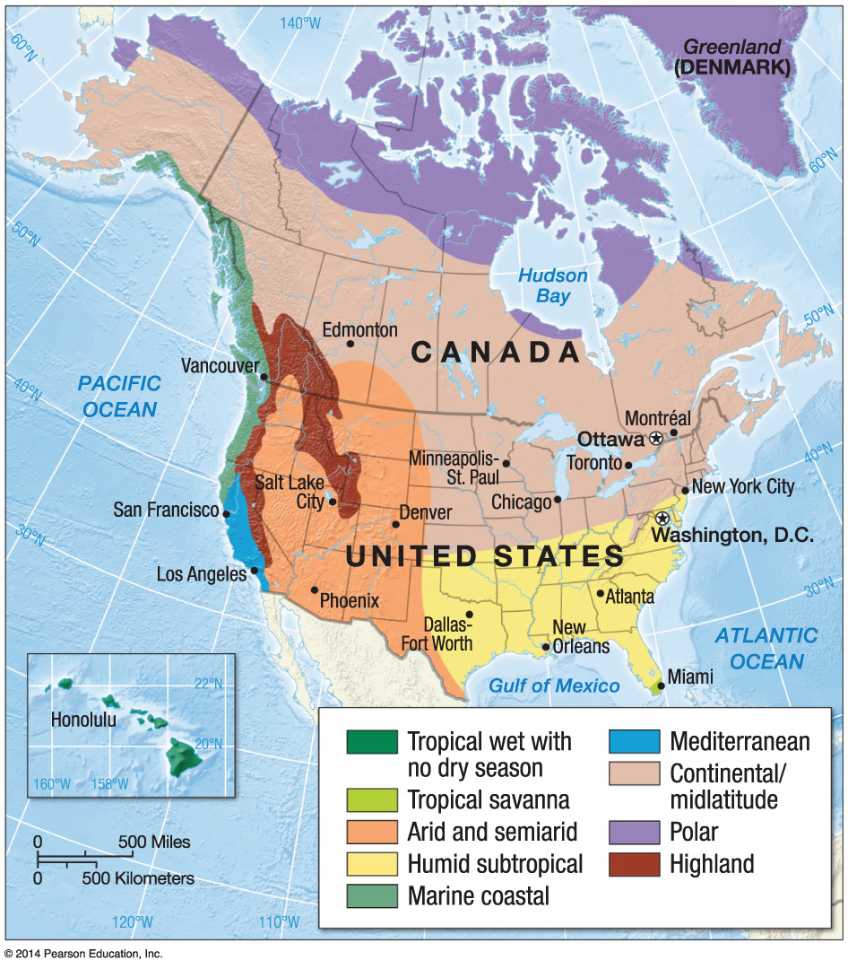
Precipitation in North America
Explain the North American climate system
Cold
Temperature
Precipitation
Hot & Dry
Hot & Wet

Slide 23
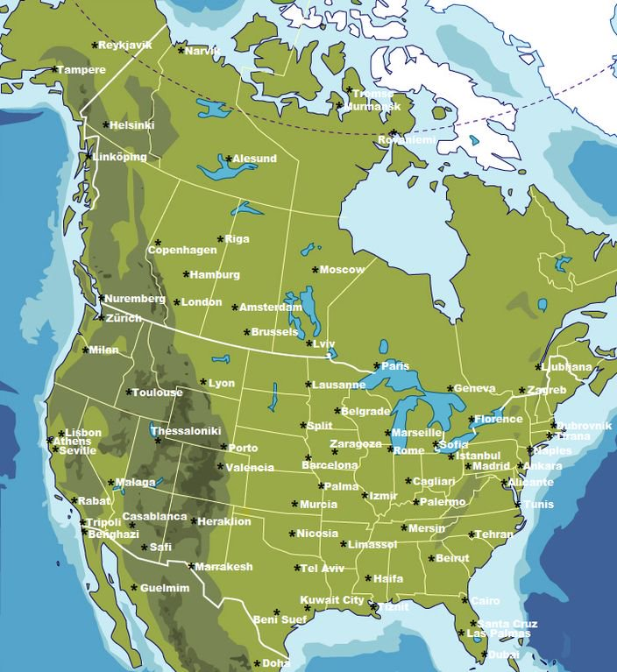

Slide 24
North America’s Physical Geography: Great Lakes and Great Rivers
Two great drainage systems between the Rockies and Appalachians:
  Great Lakes and St. Lawrence River into the northern Atlantic.
  Mississippi-Missouri Rivers into a delta on the Gulf of Mexico.
  Both have been modified by human engineering:
    Dams (hydroelectricity and flood control).
    Canals (navigation; St. Lawrence Seaway).
    Irrigation.

Slide 25
European Settlement and Expansion
Indigenous North Americans
  Known as Native Americans or First Nations.
  Settled North America more than 14,000 years ago through the ‘landbridge’.
  Formed hundreds of nations living in adaption with their physiographic regions.
  Limited technological development and settled agriculture.
  Devastated by arrival and expansion of Europeans.
  Displaced from their homelands.
  Native American nations relegated to impoverished and isolated reservations.

Slide 26
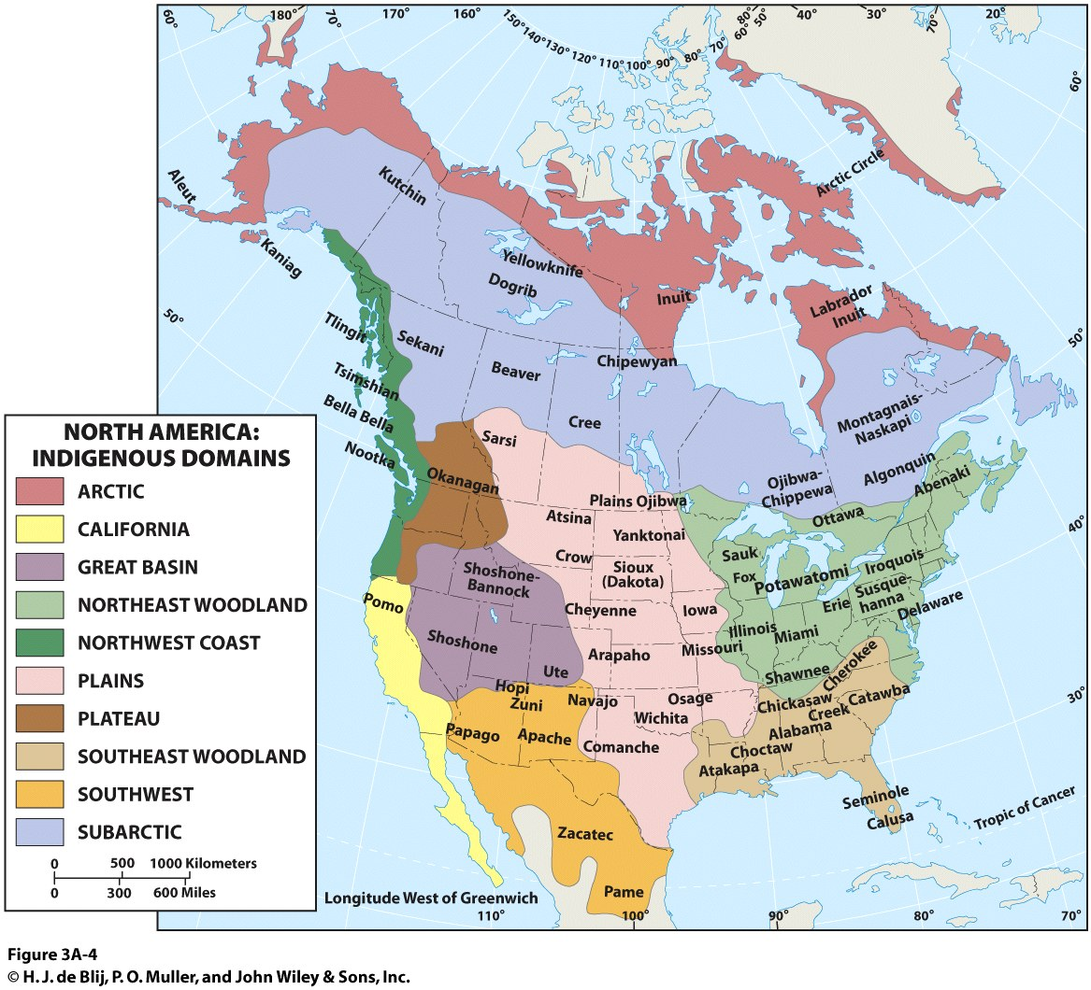

Slide 27
European Settlement and Expansion
European colonies
  Current population geography a legacy of French and British settlement.
  Diversified local economies (e.g. plantation system in the south).
  American Revolution and opening of the West.
  Interior lowlands favorable to farming and settlement.
  Political acquisition of western territories made by new state by purchase or concession.

Slide 28
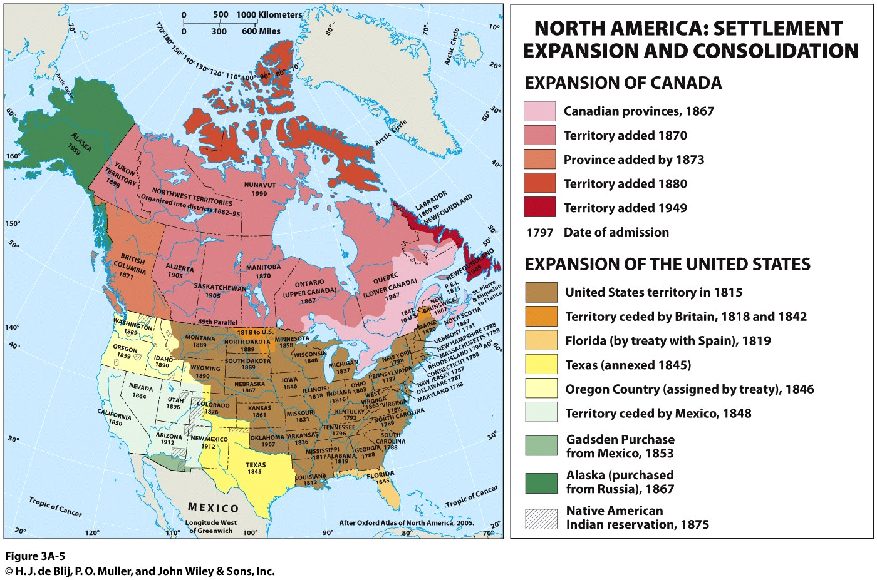

Slide 29
Territorial Definition
The Anglo-American cultural space
  Prominence of English institutions.
  Latin America (Spanish and Portuguese cultural origin).
  A few exceptions:
    French Canada, Hawaii, US/Mexico border regions, southeast Florida, First Nations and the Black population.
  Immigration is changing this space.
  English remains the language of government and business.
    Facilitates mobility.
Religion
  Christianity dominant in the U.S.
  Regional denomination diversity.
  Religious tolerance for most.

Slide 30
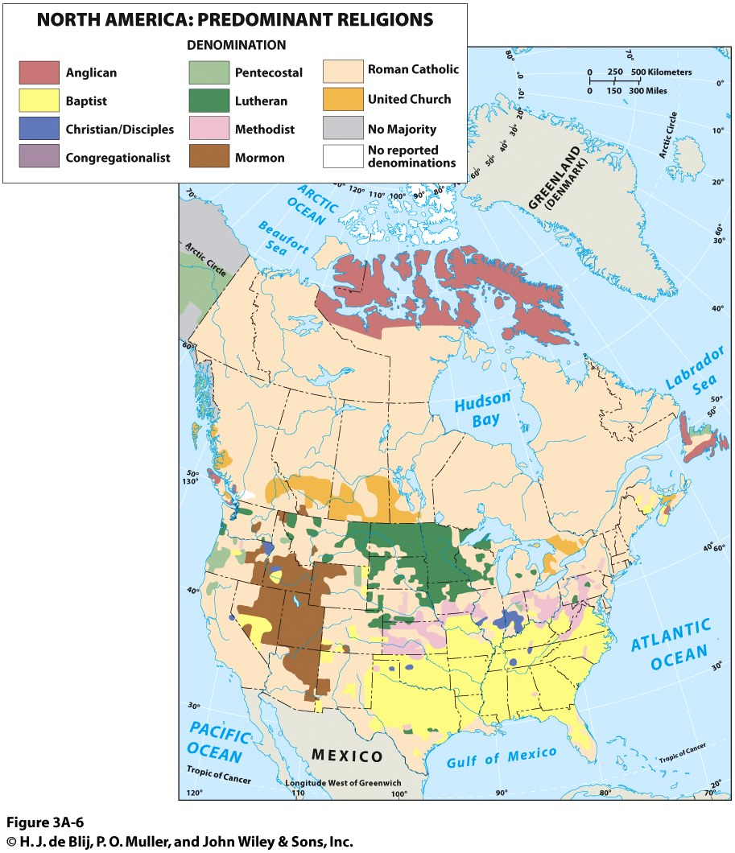

Slide 31
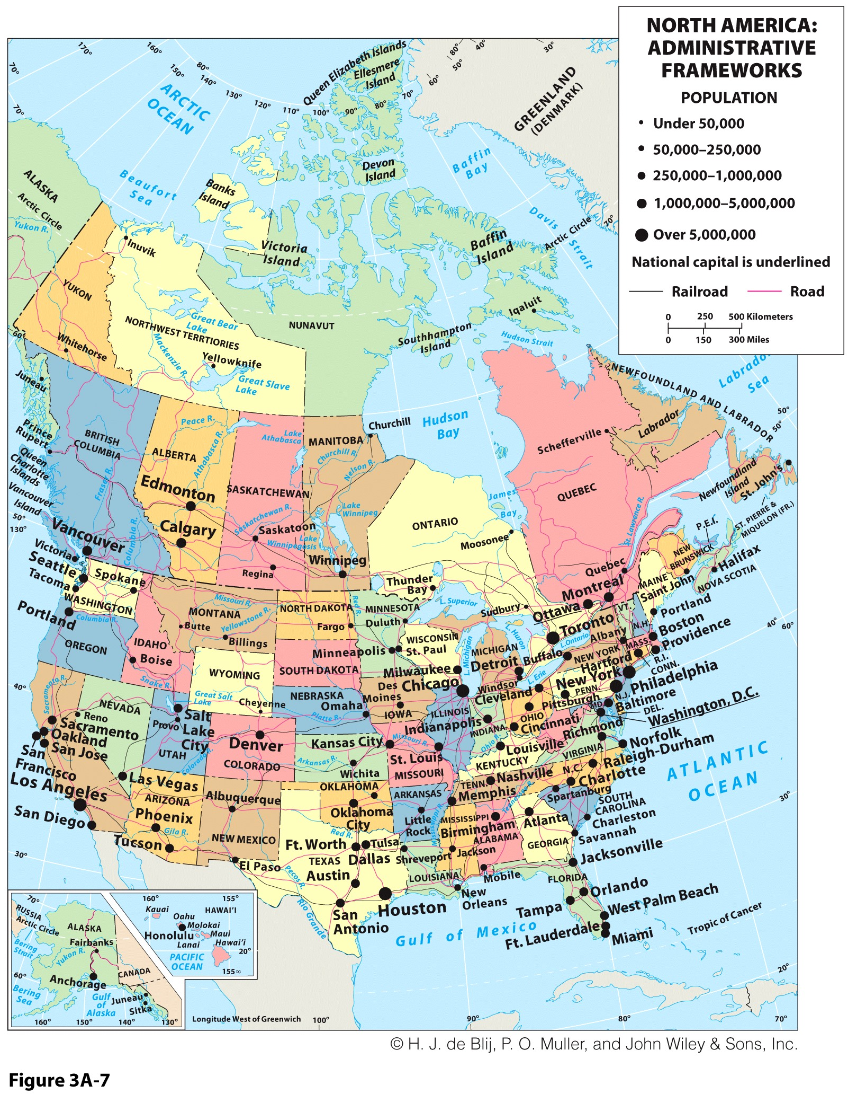
The Federal Map of North America
Similarities between US and Canada
Internal political geographies
  Dominated by straight-line boundaries.
  Elsewhere, physical features mark boundaries.
  Result delimiting prior to settlement.
  The Canada US border:
    Settlements and natural features in the east (e.g. St. Lawrence / Great Lakes).
    Straight line in the west (49 degrees north latitude line).
Federal state structures
  Each country’s subdivisions vary in their significance.
  Provinces (Canada) and States (US).

Slide 32
The Distribution of Natural Resources
Uneven distribution of natural resources
  Resource rich states benefit from high commodity prices while other may be negatively impacted.
  E.g. Texas / Alberta vs California / Ontario.
  The situation reverses during a commodity bust.
Water
  Relatively well-supplied.
  Water based vs irrigation-based agriculture.
  Concerns for future supply:
    Arid Southwest and Great Plains rely on other areas for water.
    Overuse of ground water aquifers lowers water table.

Slide 33
The Distribution of Natural Resources
Abundant mineral reserves
  Fossil fuels or oil, natural gas and coal energy sources.
  Oil:
    Not enough to satisfy demand, so imports are necessary.
    Oil dependence has been an enduring national policy issue.
    Substantial growth in domestic supply due to new technologies such as tar sands and oil shale.
    Alternative energy sources, especially nuclear power, are not well-developed, but growing fast.
  Natural gas:
    Usually associated with oil.
    Mainly used for power generation.
  Coal:
    Among the world’s largest reserves.

Slide 34
Petroleum Production, Consumption and Imports, United States, 1949-2018
Notes:
Source: US Energy Information Agency, International Energy Annual Report. http://www.eia.gov/petroleum/data.cfm

Slide 35
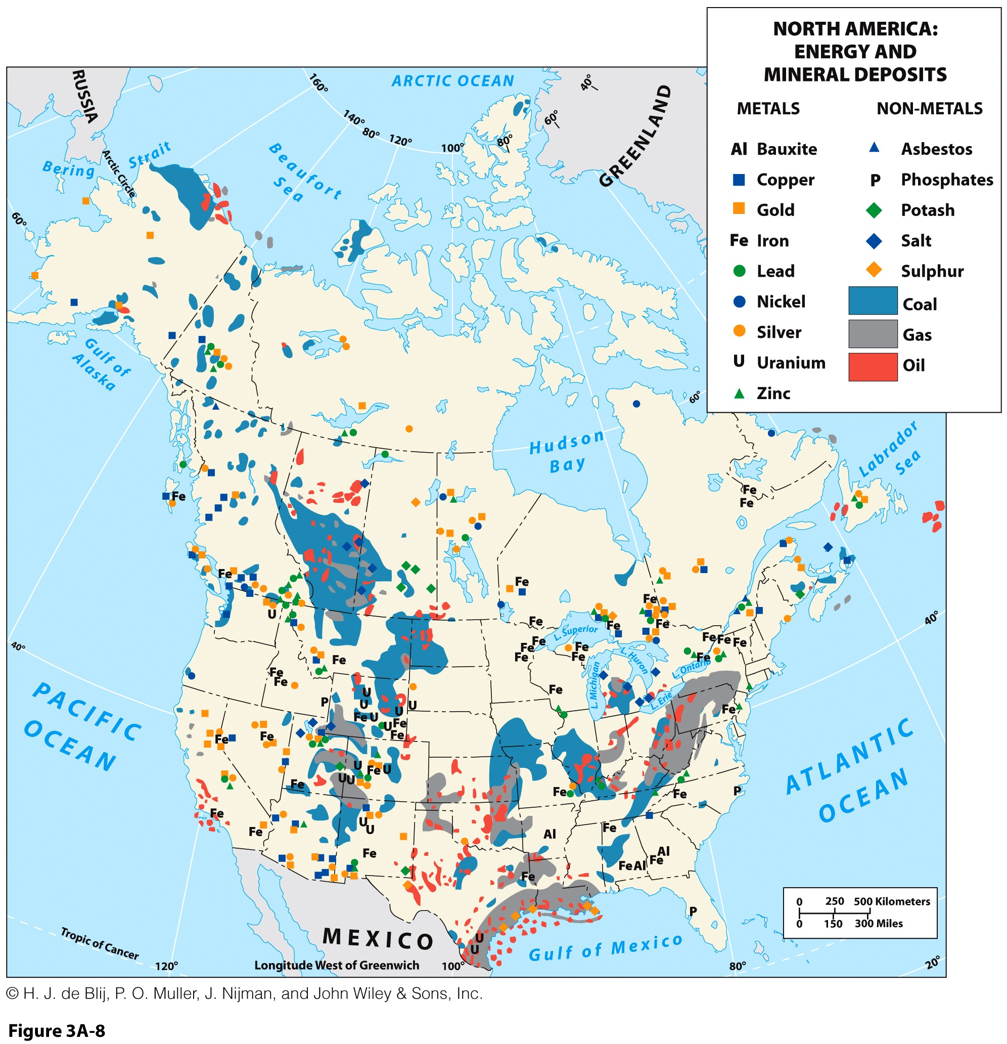
What is observed in the locations of North America’s natural resources and its population distribution?

Slide 36
Urbanization and the Spatial Economy: Industrial Cities
Industrialization and urbanization in tandem
A new urban system
  Cities specialized in raw materials or manufacturing.
  Interconnected by growing transportation network.
  American Manufacturing Belt:
    Emerged as foundation of the North American Core.
    Mostly linked with steel and the automotive sector.
Shifting spatial economy
  Primary sector in decline due to mechanization.
  Secondary sector growth and decline.
  Tertiary sector expansion.

Slide 37
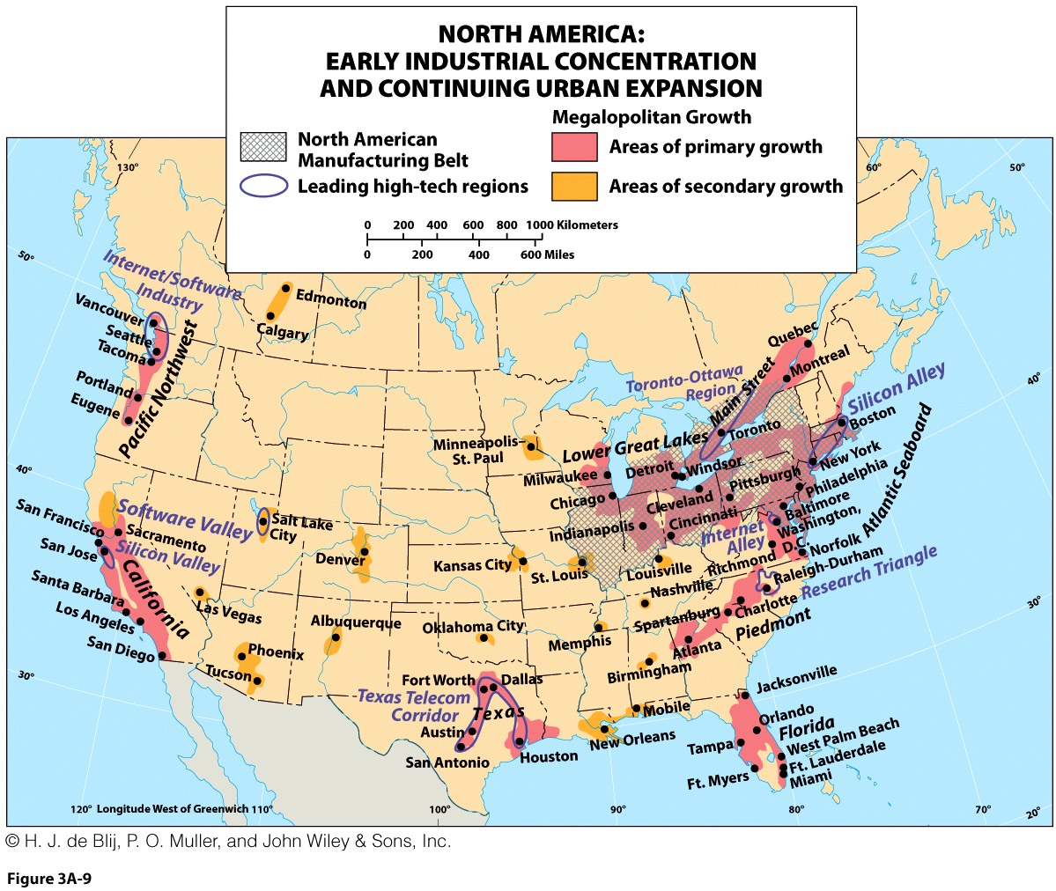
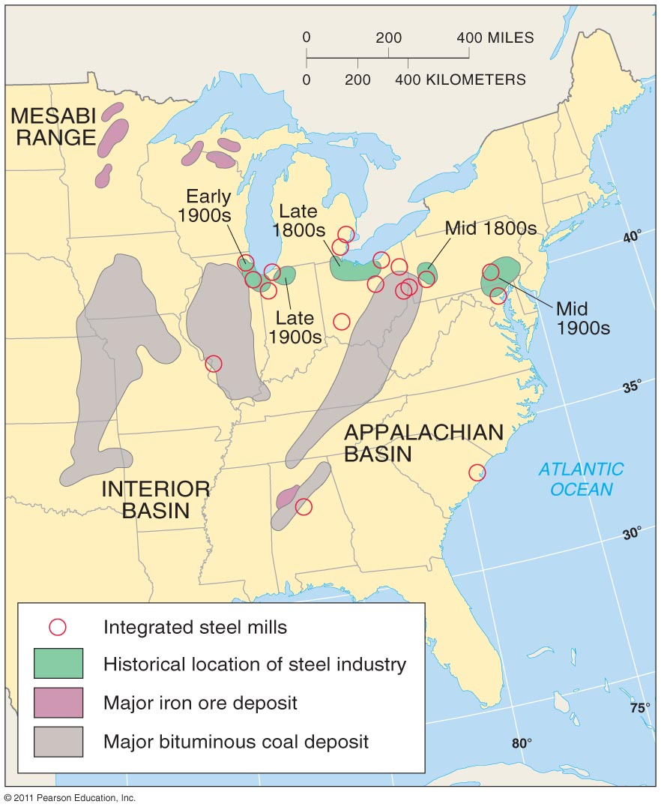

Slide 38
Urbanization and the Spatial Economy: Realm of Railroads
Rail transportation
  Initiated an integrated continental-scale economy.
  Rail predominantly for cargo, not passengers.
  Intermodal cargo from ships to trucks and rail.
Transcontinental (completed in 1869)
  From New York to San Francisco.
  Journey was reduced from 6 months by trail to 1 week by train.
  The industrial East could access to the resources of the West.
Decline and revival
  Strong decline from then 1950s; competition from the Interstate.
  Revival since the 1980s with intermodal cargo.
  Revival as shipping costs decline and international trade grows.
  New boom requires adding to the rail system.

Slide 39
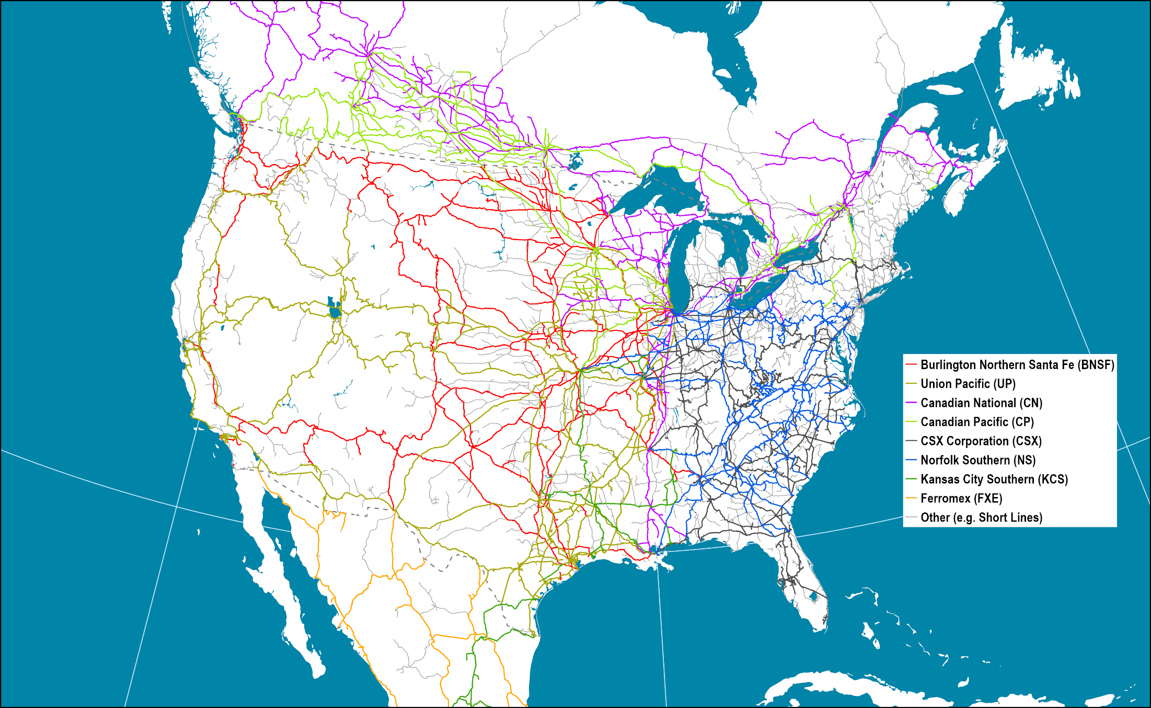
Ownership of Major North American Rail Lines, 2017
Notes:
Source: Oak Ridge National Laboratory

Slide 40
Urbanization and the Spatial Economy: Deindustrialization and Suburbanization
Transportation and communication innovations increased interconnectedness and mobility.
Evolution of the outer city
  Residential suburbia had its own businesses and industries, entertainment, and other amenities.
  Relative decline in the central city.
  Car dependent suburbs.
Coincided with deindustrialization
  Loss of manufacturing jobs meant opportunities were found in suburbia.
  Those who could, moved out of the inner city.

Slide 41
Urbanization and the Spatial Economy: The Information Economy and City Regions
Information economy
  For some cities, helped recovery from deindustrialization and high employment.
  Rising employment in tertiary and quaternary service-based sectors.
  Information-based economic activity is found in established CBDs, on urban fringes or in suburbs.
  Silicon Valley: world’s leading center for computer research and development.
  Favorable combination of locational dynamics:
    Amenities (quality of life).
    Research institutions.
    Telecommunications.

Slide 42
Urbanization and the Spatial Economy: Polycentric Cities
Multiple centers
  CBD still at the center.
  Outer city’s have their own CBDs.
Gentrification
  Land-use changes and urban neighborhood restoration.
  Raises property values and taxes.
  Displaces former low-income residents with newer more affluent ones.
Megaregions
  A system of connected cities.
  Often along a corridor.

Slide 43
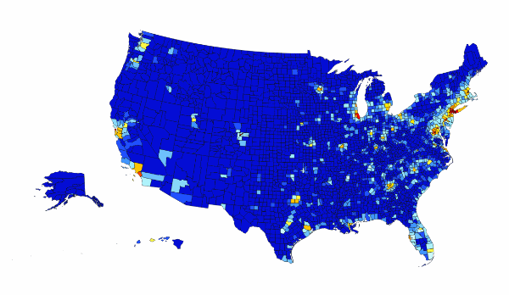
Area Size According to GDP

Slide 44
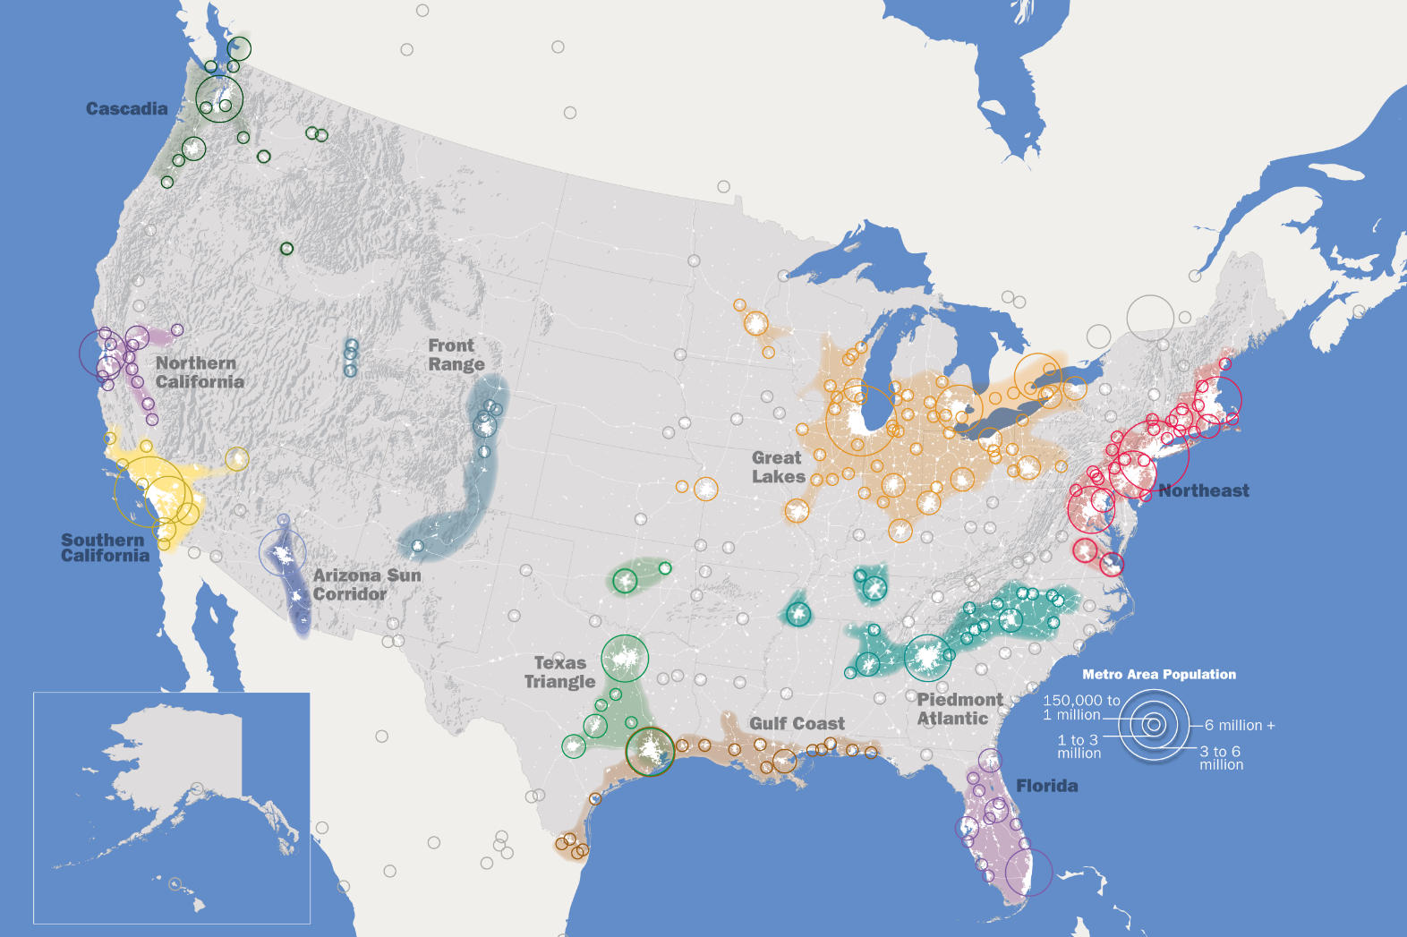
Notes:
Source: Regional Plan Association.

Slide 45
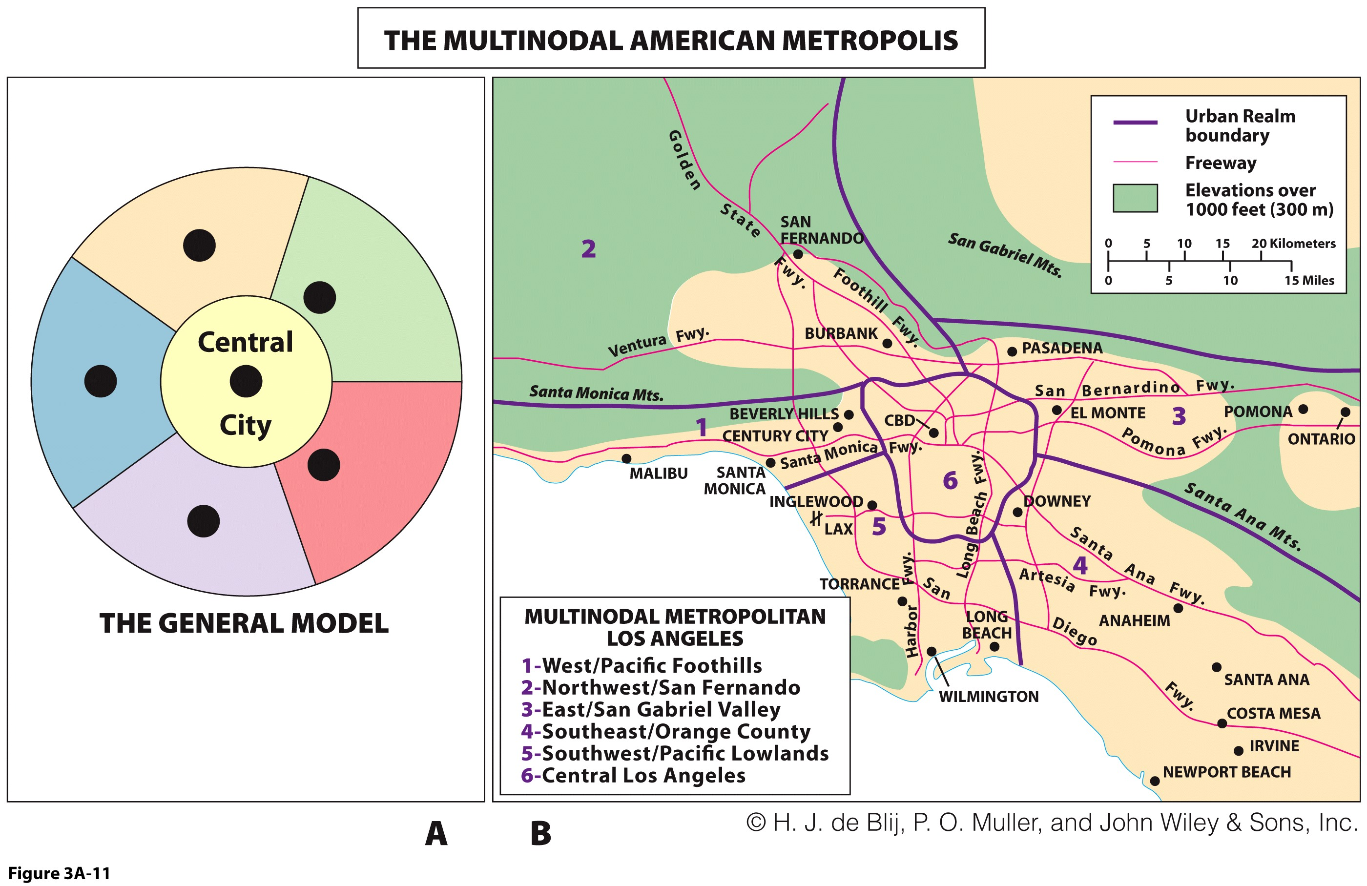

Slide 46
The Making of a Multicultural Realm: The Virtues of Mobility and Immigration
Changing population distribution and character:
  Center of gravity of U.S. population is moving southward to the Sunbelt, aided by air conditioning.
Other major migrations:
  Urbanization.
  Rural to urban movement of African Americans.
  Suburbanization and beyond.
  Return of African Americans to southern cities.
  Steady influx of global immigrants to gateway cities.

Slide 47
The Migration Process…
Both United States and Canada are products of international migration, or permanent relocation
Migration decision
  Depends on perception, information, and distance.
  Push and pull factors motivate or attract.
Destination
  North America is a “land of opportunity.”
  Immigration is 40 percent of growth.

Slide 48
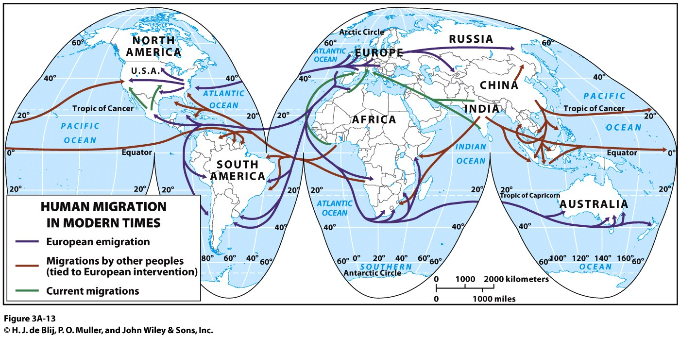

Slide 49
Immigration to the United States, 1820-2017 (Millions)
Southeast
Europe
Latin America
Asia
Germany
Scandinavia
British
Isles
Notes:
Sources: U.S. Department of Homeland Security

Slide 50
The Making of a Multicultural Realm: The Challenge of Multiculturalism
Growing pluralism
  Transnationalism and beyond national borders:
    The Hispanic population in the US is half of Mexico.
    More African Americans than in Kenya.
    Miami: second largest Cuban city after Havana.
    Montreal: second largest French city after Paris.
Melting pot
  Blended cultures.
  Contested by increasing ethnic and cultural complexity.
Mosaic culture
  Heterogeneous complex of separate, distinct groups.
What type of society results from multiculturalism? Melting pot or mosaic culture or both?

Slide 51
The Making of a Multicultural Realm: The Challenge of Multiculturalism
In the United States…
  Sufficient immigrant numbers allow the creation of a durable society within the national society.
  Challenge of “undocumented” immigration and debate over border security are political hot topics.
In Canada…
  Critical labor shortages provide context for immigration policies.
  No border with a developing economies; migration must either go through the USA or arrive by air travel.
  Policy is balanced according to employment and demographic needs in various regions.
Notes:
People and Place Video Clip

Slide 52
Immigrants: How Many Can North America Accommodate?
Benefits
  Part of the region’s history; the “melting pot”.
  Fuels economic growth.
  Not just unskilled, but also skilled and educated.
  Native population is aging, and immigration brings youth.
  Illegal immigration should be curbed.
Limitations
  High level of legal immigrants is unsustainable.
  Demands for social services strain state budgets (welfare).
  Immigrants displace working class Americans by accepting lower wages.
  Amnesty for illegal immigrants attracts more; a security issue.
Write a short essay depicting your views on the immigration debate.

