Slide 1
Chapter 2: The Russian Realm

Slide 2
NOTICE
Most of the material, including graphics, are derived from:
  Harm de Blij, Peter O. Muller, Jan Nijman (2014) Geography: Realms, Regions and Concepts, 16th Edition, New York: Wiley.
  The above owns the copyrights of this material.

Slide 3
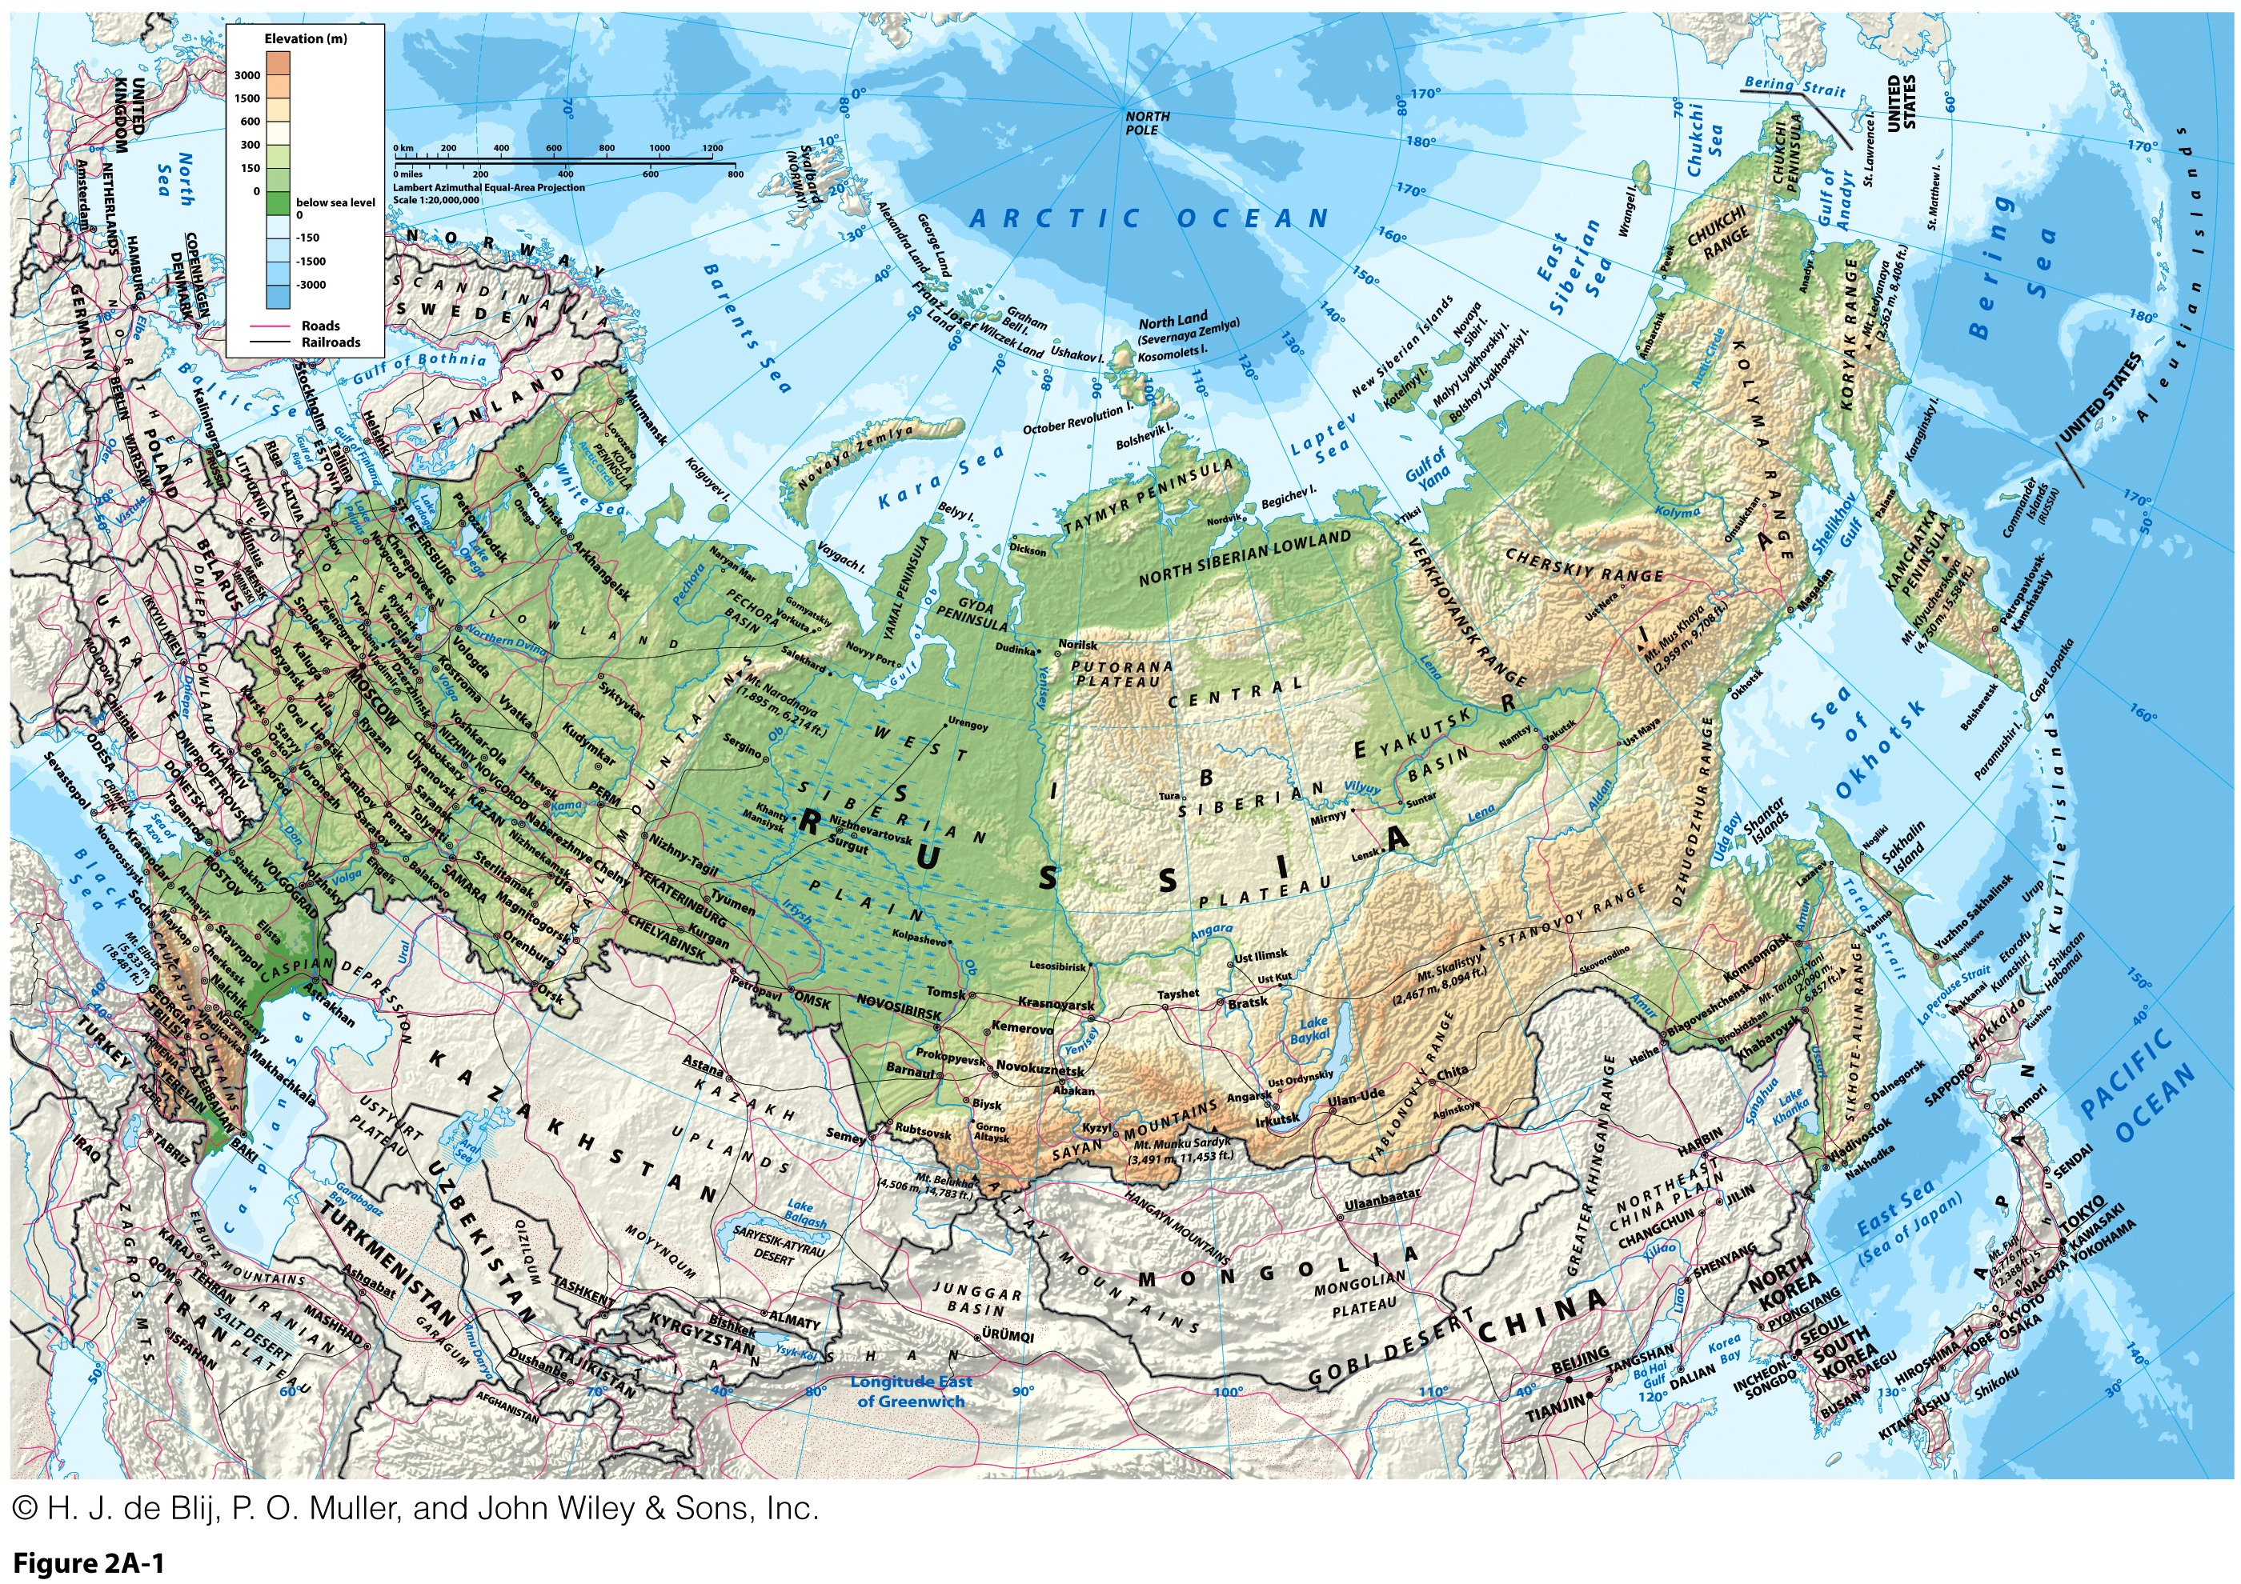
Crimea annexed in 2014

Slide 4
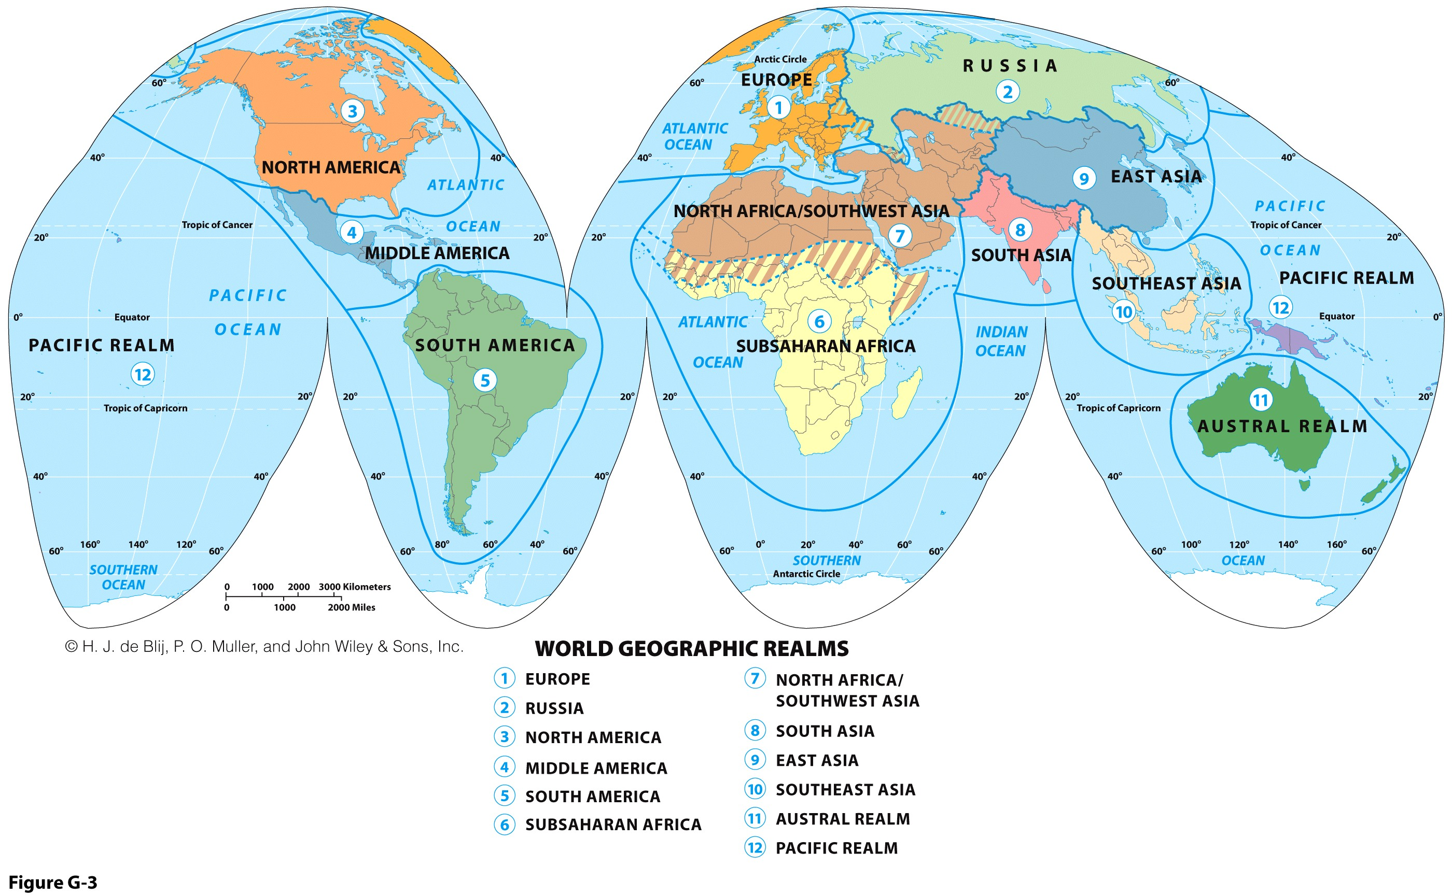
The Russian Realm
The world’s widest realm.
The only realm accounted by a single country.
Three transition zones mark the margins (Central Asia, Caucasus & Ukraine).

Slide 5
A Constraining Physical Geography
Geographic attributes
  Immense territorial state; a continental power.
  Northernmost largest and populous country in the world.
  A former world colonial power.
  A comparatively small (<146 million) and concentrated population.
  Concentrated development west of the Urals.
  Multicultural state (Russians and numerous minorities).
  Limited access to a warm water masses:
    Arctic ports seasonally closed (e.g. Murmansk).
    Baltic Sea ports constrained access to the Atlantic.
    Black Sea ports constrained access to the Mediterranean.
    Pacific ports far from centers of economic activity (e.g. Vladivostok).

Slide 6
A Constraining Physical Geography
Dimensions
  Spans 11 time zones.
  Gulf of Finland to Alaska (west to east), and well above the arctic circle to Salt Lake City (north to south).
  Twice the size of the US or China.
  Siberia: “sleeping land”.
  Russia makes up 76.6% of the total territory of the former USSR (17,075,400 km).

Slide 7
Russia - US Size Comparison

Slide 8
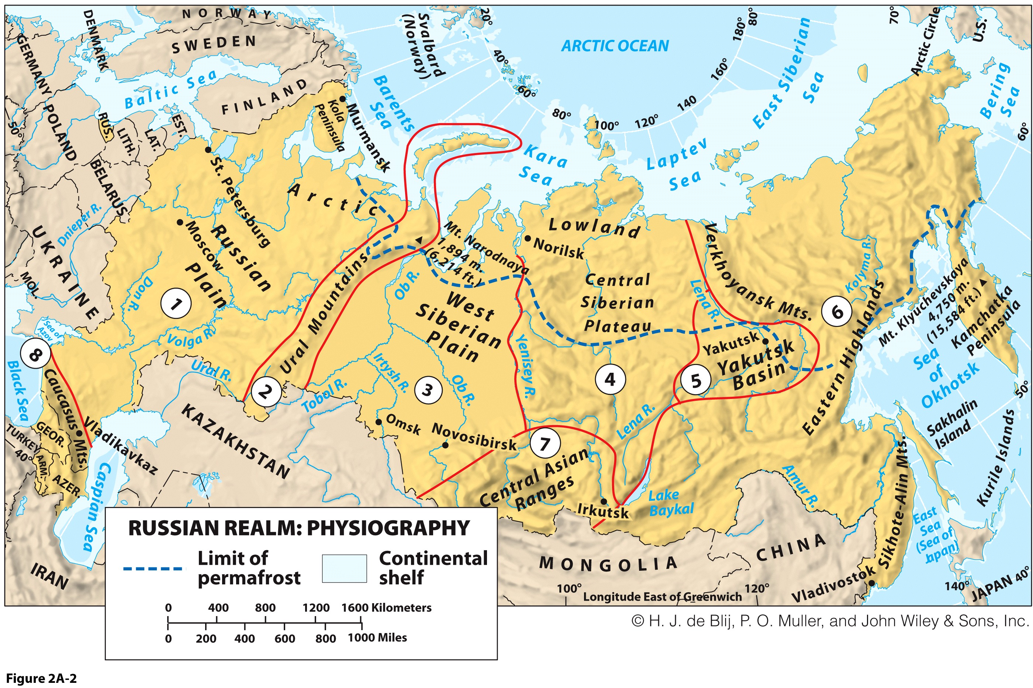

Slide 9
Physical Geography of the Russian Realm: Physiographic Regions
The Russian Plain (1)
  Continuation of North European lowland.
  Russian Plain as the Eurasian heartland:
    Center of great landmass.
    Major influence on history.
    Potential vulnerability (encirclement).
Ural Mountains (2)
  North-south mountains not tall enough to hinder transportation.
  Boundary between Europe and Asia.
  Divides Russia in two vast expanses of low relief:
    Russian Plain to the West.
    Siberia to the East.

Slide 10
Physical Geography of the Russian Realm: Physiographic Regions
West Siberian Plain (3)
  World’s largest unbroken lowland where rivers flow northward, like the Ob River.
Central Siberian Plateau (4)
  East of the Yenisey River.
  Higher relief.
  Most sparsely populated areas in the habitable world.
Yakutsk Basin (5)
  Moderate topography drained by the Lena River.

Slide 11
Physical Geography of the Russian Realm: Physiographic Regions
Eastern Highlands (6)
  Remote jumble of ranges.
  Kamchatka and Sakhalin.
  Pacific Ring of Fire.
  Volatile volcanism.
  Prevalent earthquakes.
  Oil and gas reserves.
Central Asian Ranges (7)
  With the Caucasus, forms the Southern Perimeter.
  High relief location of Lake Baykal (deepest in the world; 1.6 km).
  Holds almost 20% of the world’s supply of unfrozen freshwater.
Caucasus Mountains (8)
  Barrier and zone of conflict for Russia and neighbors.

Slide 12
A Constraining Physical Geography
Russian Climate
  Russia plagued by long distances and harsh environment.
  Affected by 3 natural conditions.
  Latitudinal position:
    Colder climate with increasing latitude.
    60o North latitude line; split the country in half.
  Continental position:
    Dryer air.
    Inland climatic environment remote from moderating and moistening maritime influence.
  Altitudinal effect:
    Colder climate with increasing altitude.
    Location of major mountains.
    Limited impact for Russia.

Slide 13
Physical Geography of the Russian Realm: Harsh Environments
Environmental effect
  Permafrost:
    Water in the ground permanently frozen.
    Unsuitable for cultivation.
    Difficult to build over (roads, rail, pipelines).
  High latitude ecology.
  Tundra:
    Bare ground and rock with lichen, mosses and low grass.
  Taiga:
    “snow forest” of coniferous trees.
    Commercial potential, but slow to grow.

Slide 14
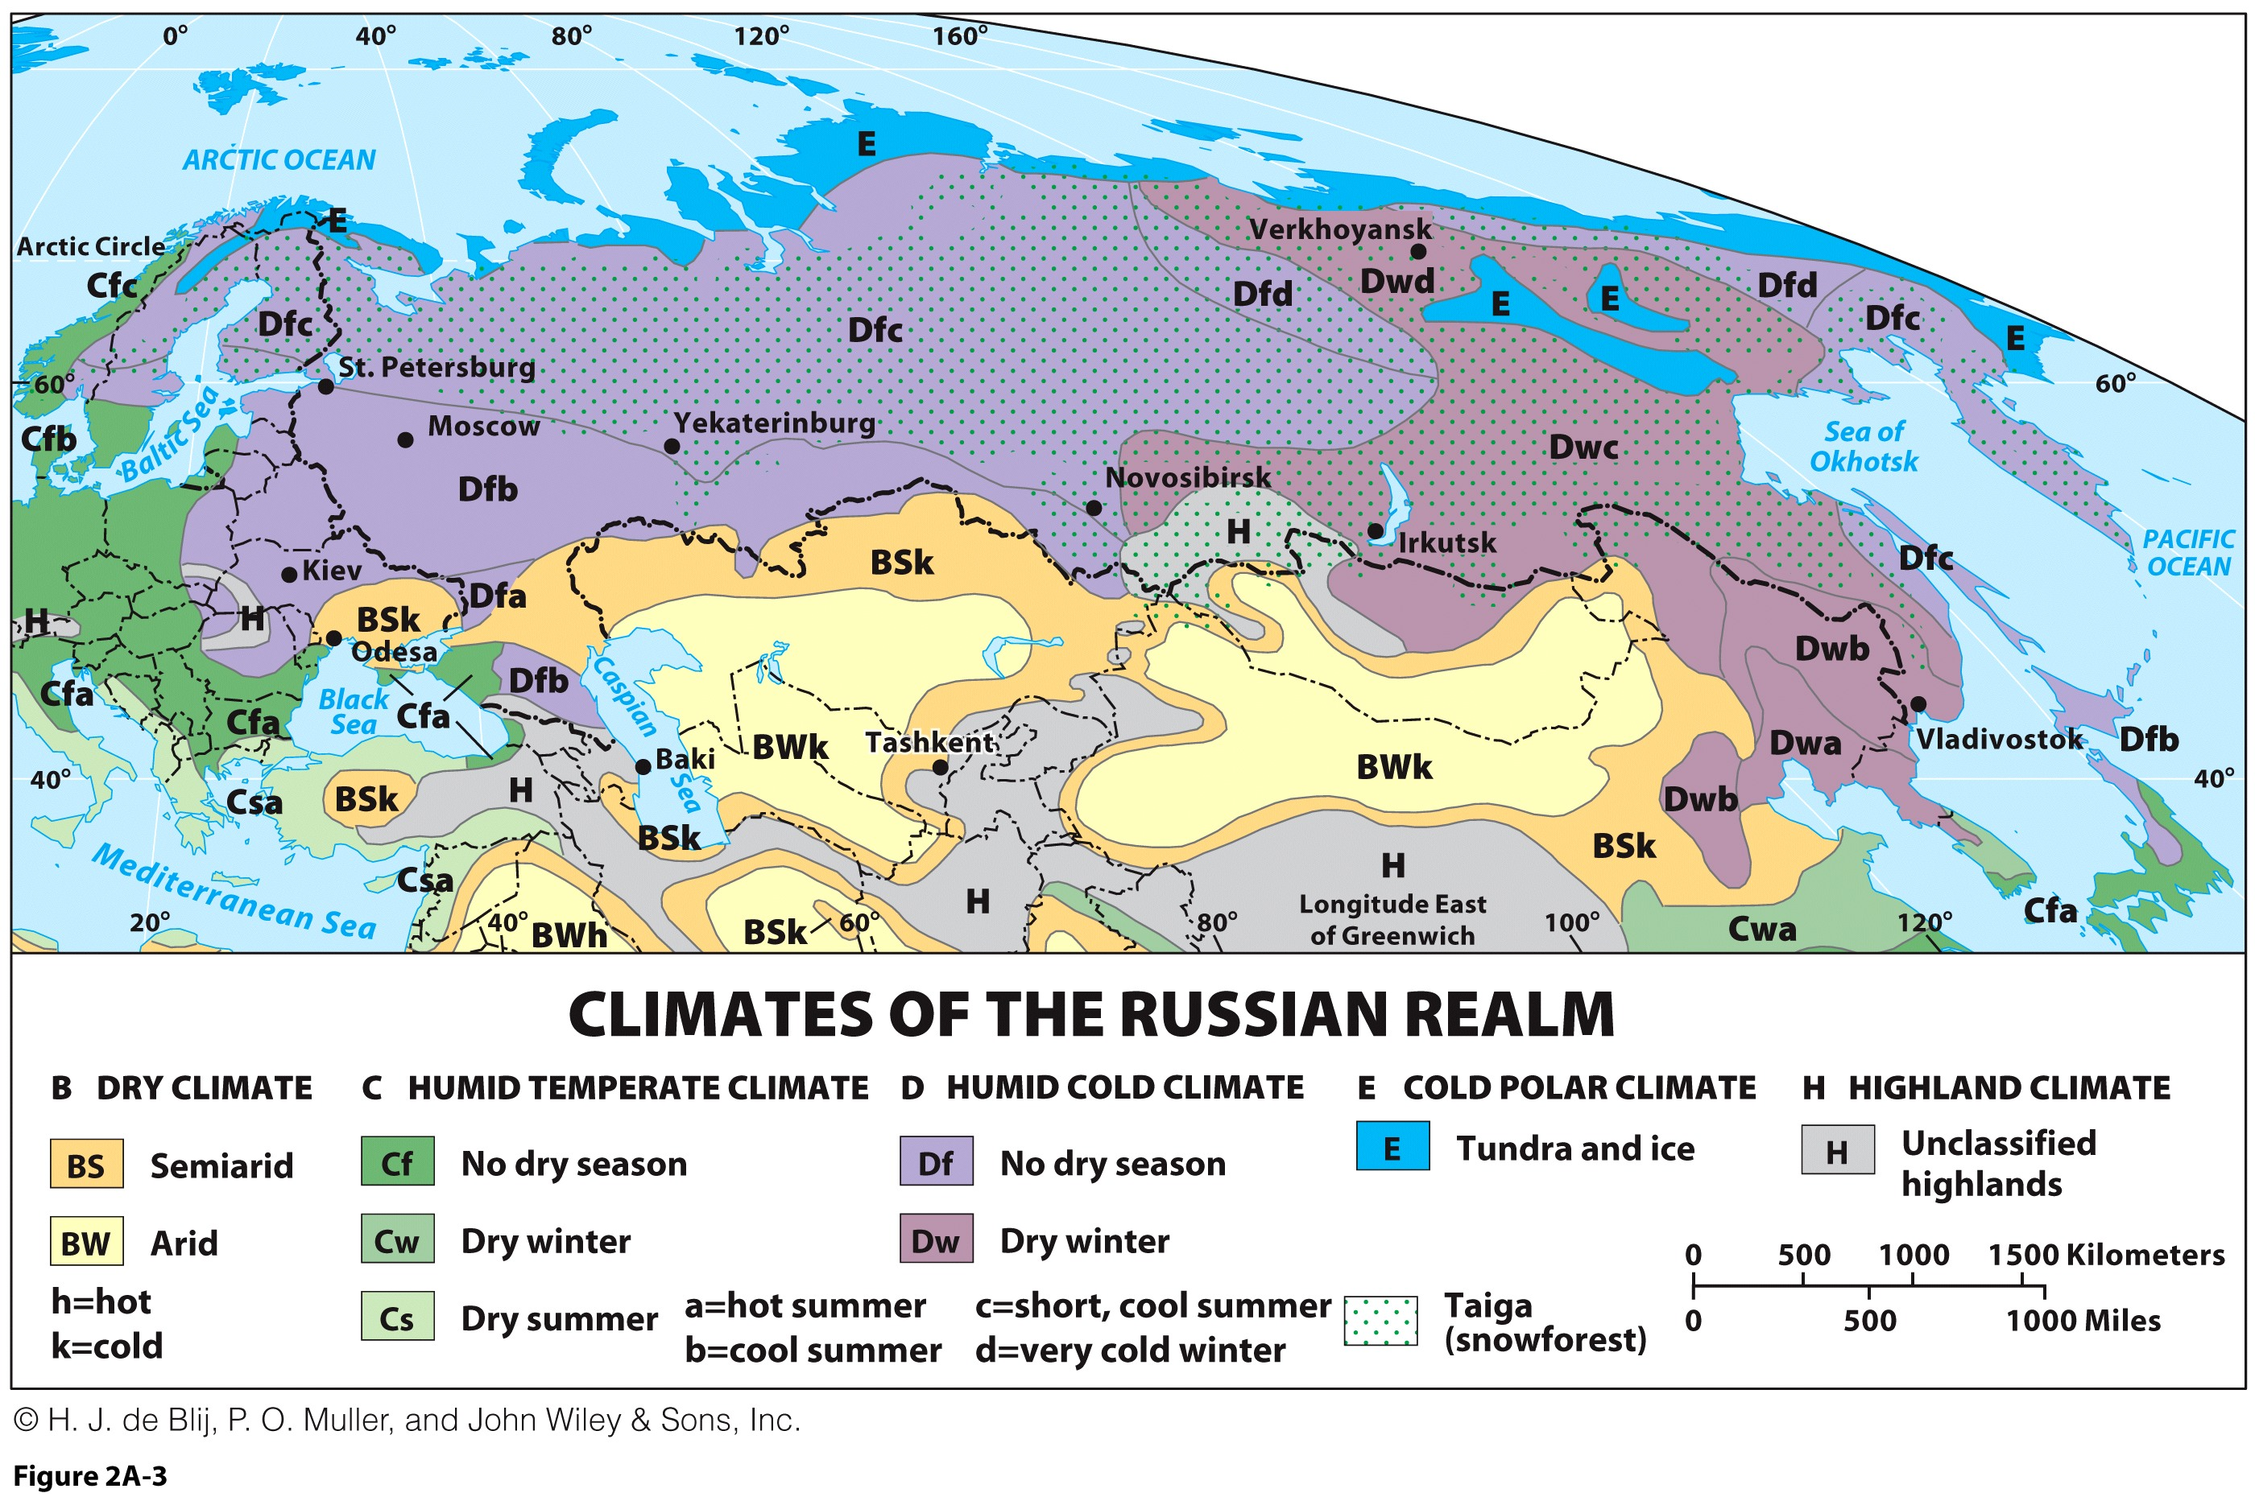

Slide 15
A Constraining Physical Geography
Mountain Effect
Continental Effect
-90º F (-68º C)
Artic Circle (66.5o N)
Latitudinal Effect
60o N

Slide 16
Zones of Artic and Sub Arctic Vegetation
Tundra
Taiga

Slide 17
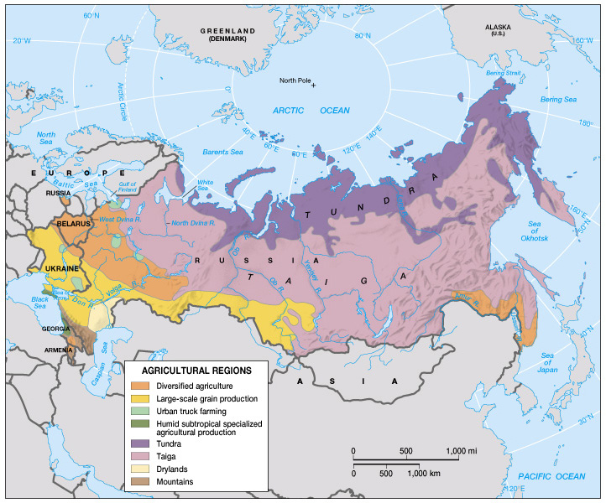
Main Agricultural Regions of Russia

Slide 18
A Constraining Physical Geography
Climate as a restrictive element
  Agriculture; Short undependable growing seasons.
  Russia remains a net importer of grain.
  Drought prone (thawing season and main river flows).
  Erosion (accelerated via snow melt).
Settlements
  Collective oriented (lower heating costs).
  Limited outdoor activities.
Transportation
  Higher construction costs.
  Maintenance costs.
  Significant damage done by freezing and thawing cycles.
  Rail is a more privileged mode of transportation.
  Limited highway infrastructures.

Slide 19
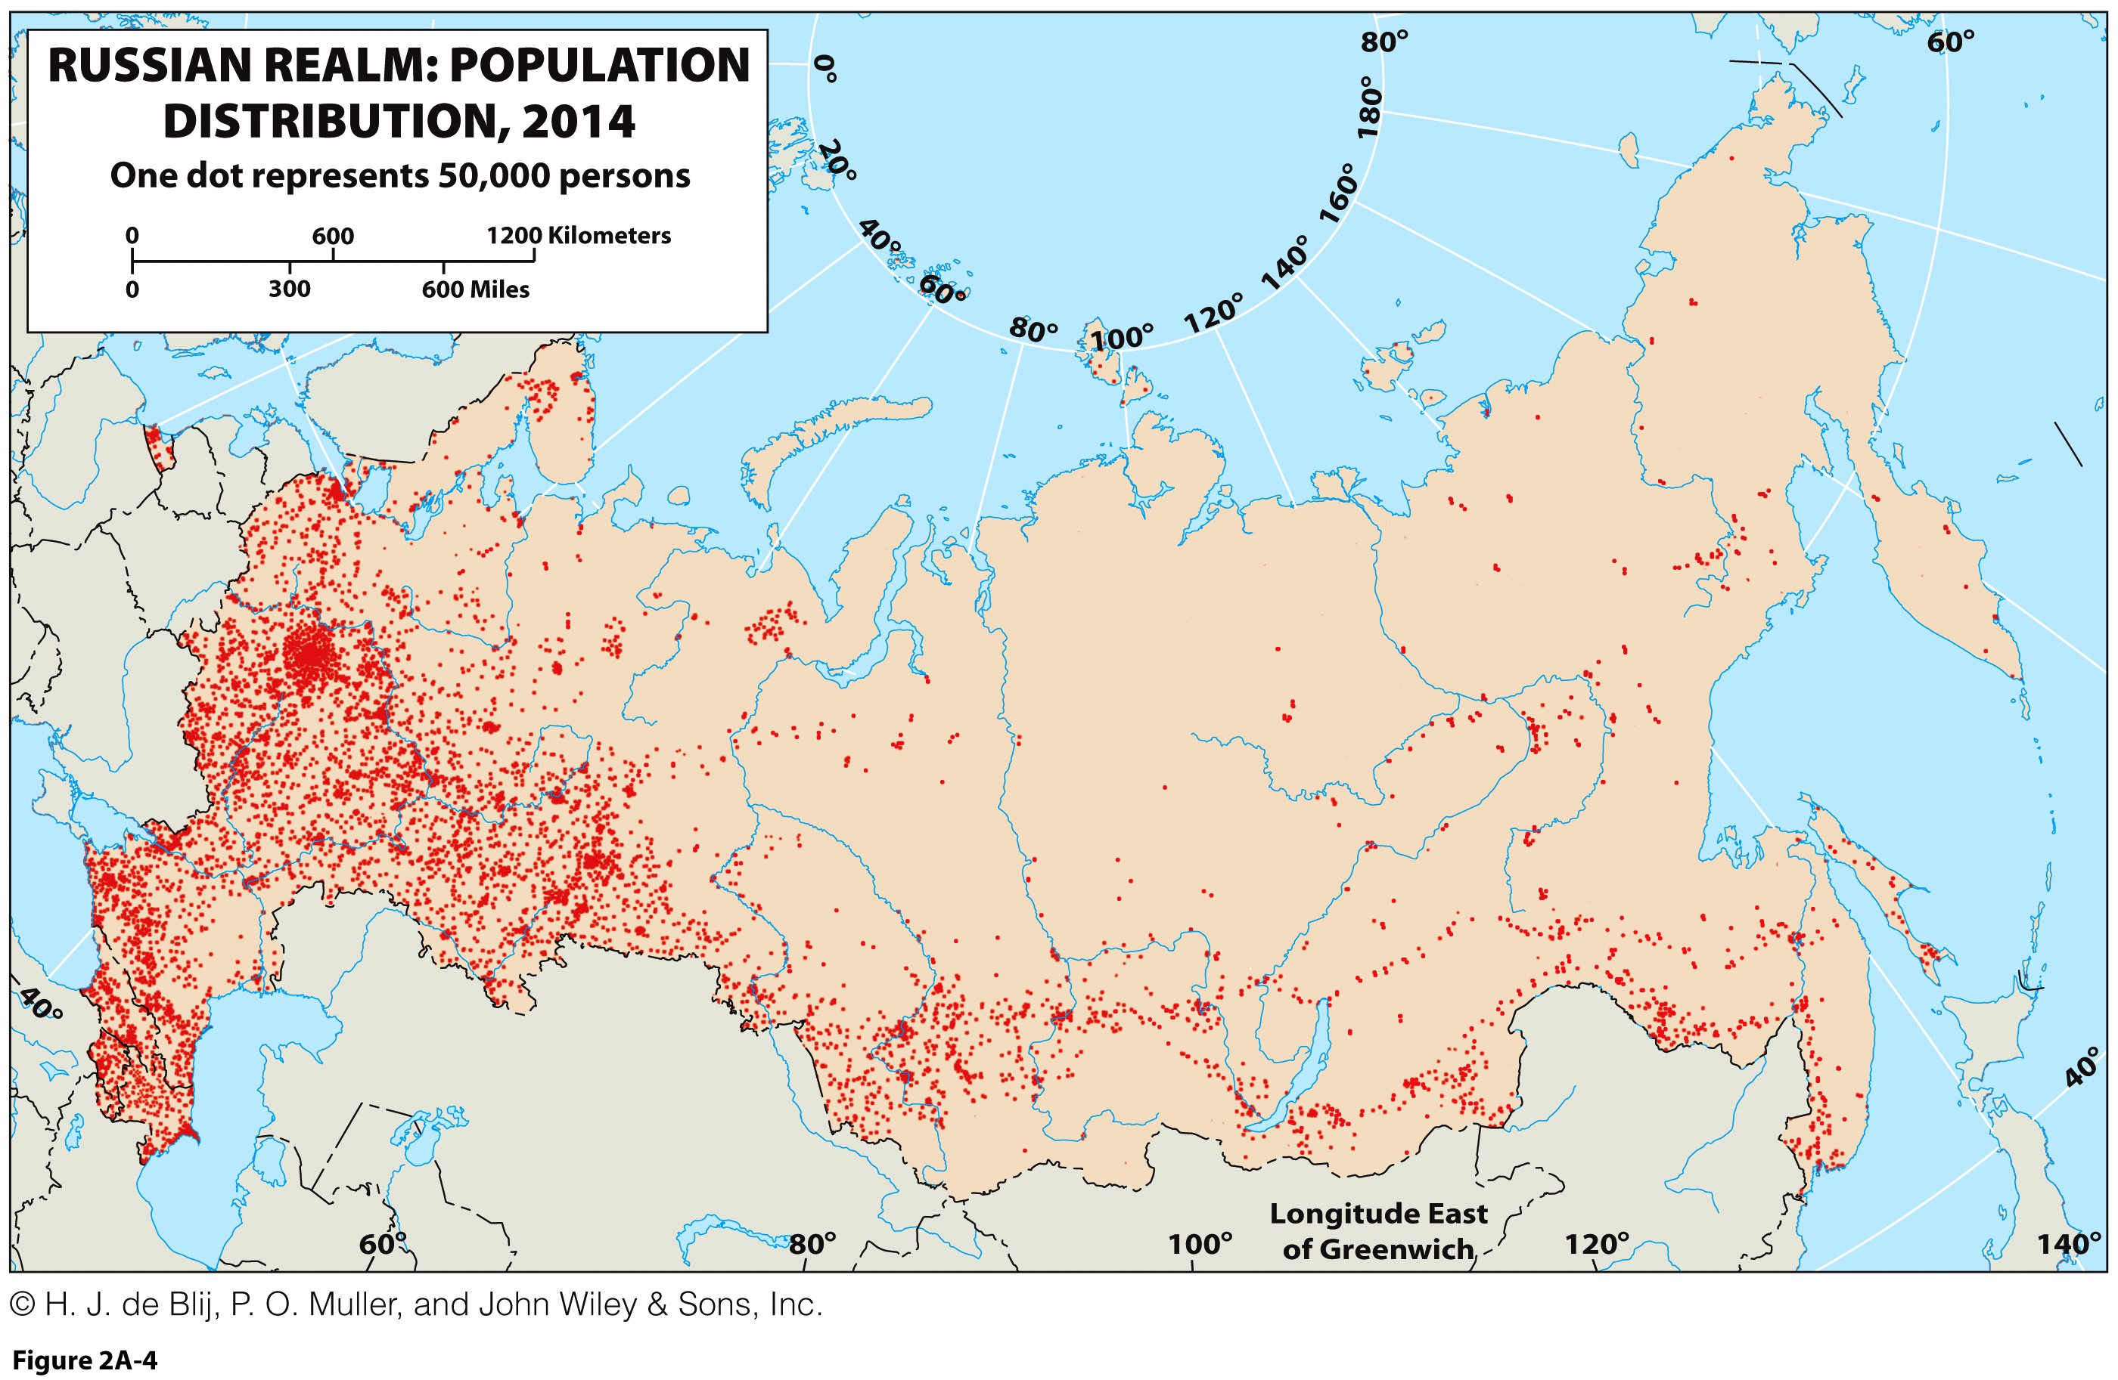
To what physical and anthropogenic factors correspond the distribution of the Russian population?

Slide 20
Physical Geography of the Russian Realm: Harsh Environments
Climate Change and Arctic Prospects
  Lengthy northern coastline on the Arctic Ocean.
  Mostly frozen throughout the year.
  Global warming and possibilities for the future:
    Melting of Arctic Ocean’s ice cover, opening of Arctic ports and even passage through the Bering Strait.
    Shrinking the area of permafrost.
    Improvement of agriculture on the Russian Plain.
    New oil and gas reserves.
    Expanding the Russian geographic realm northward.

Slide 21
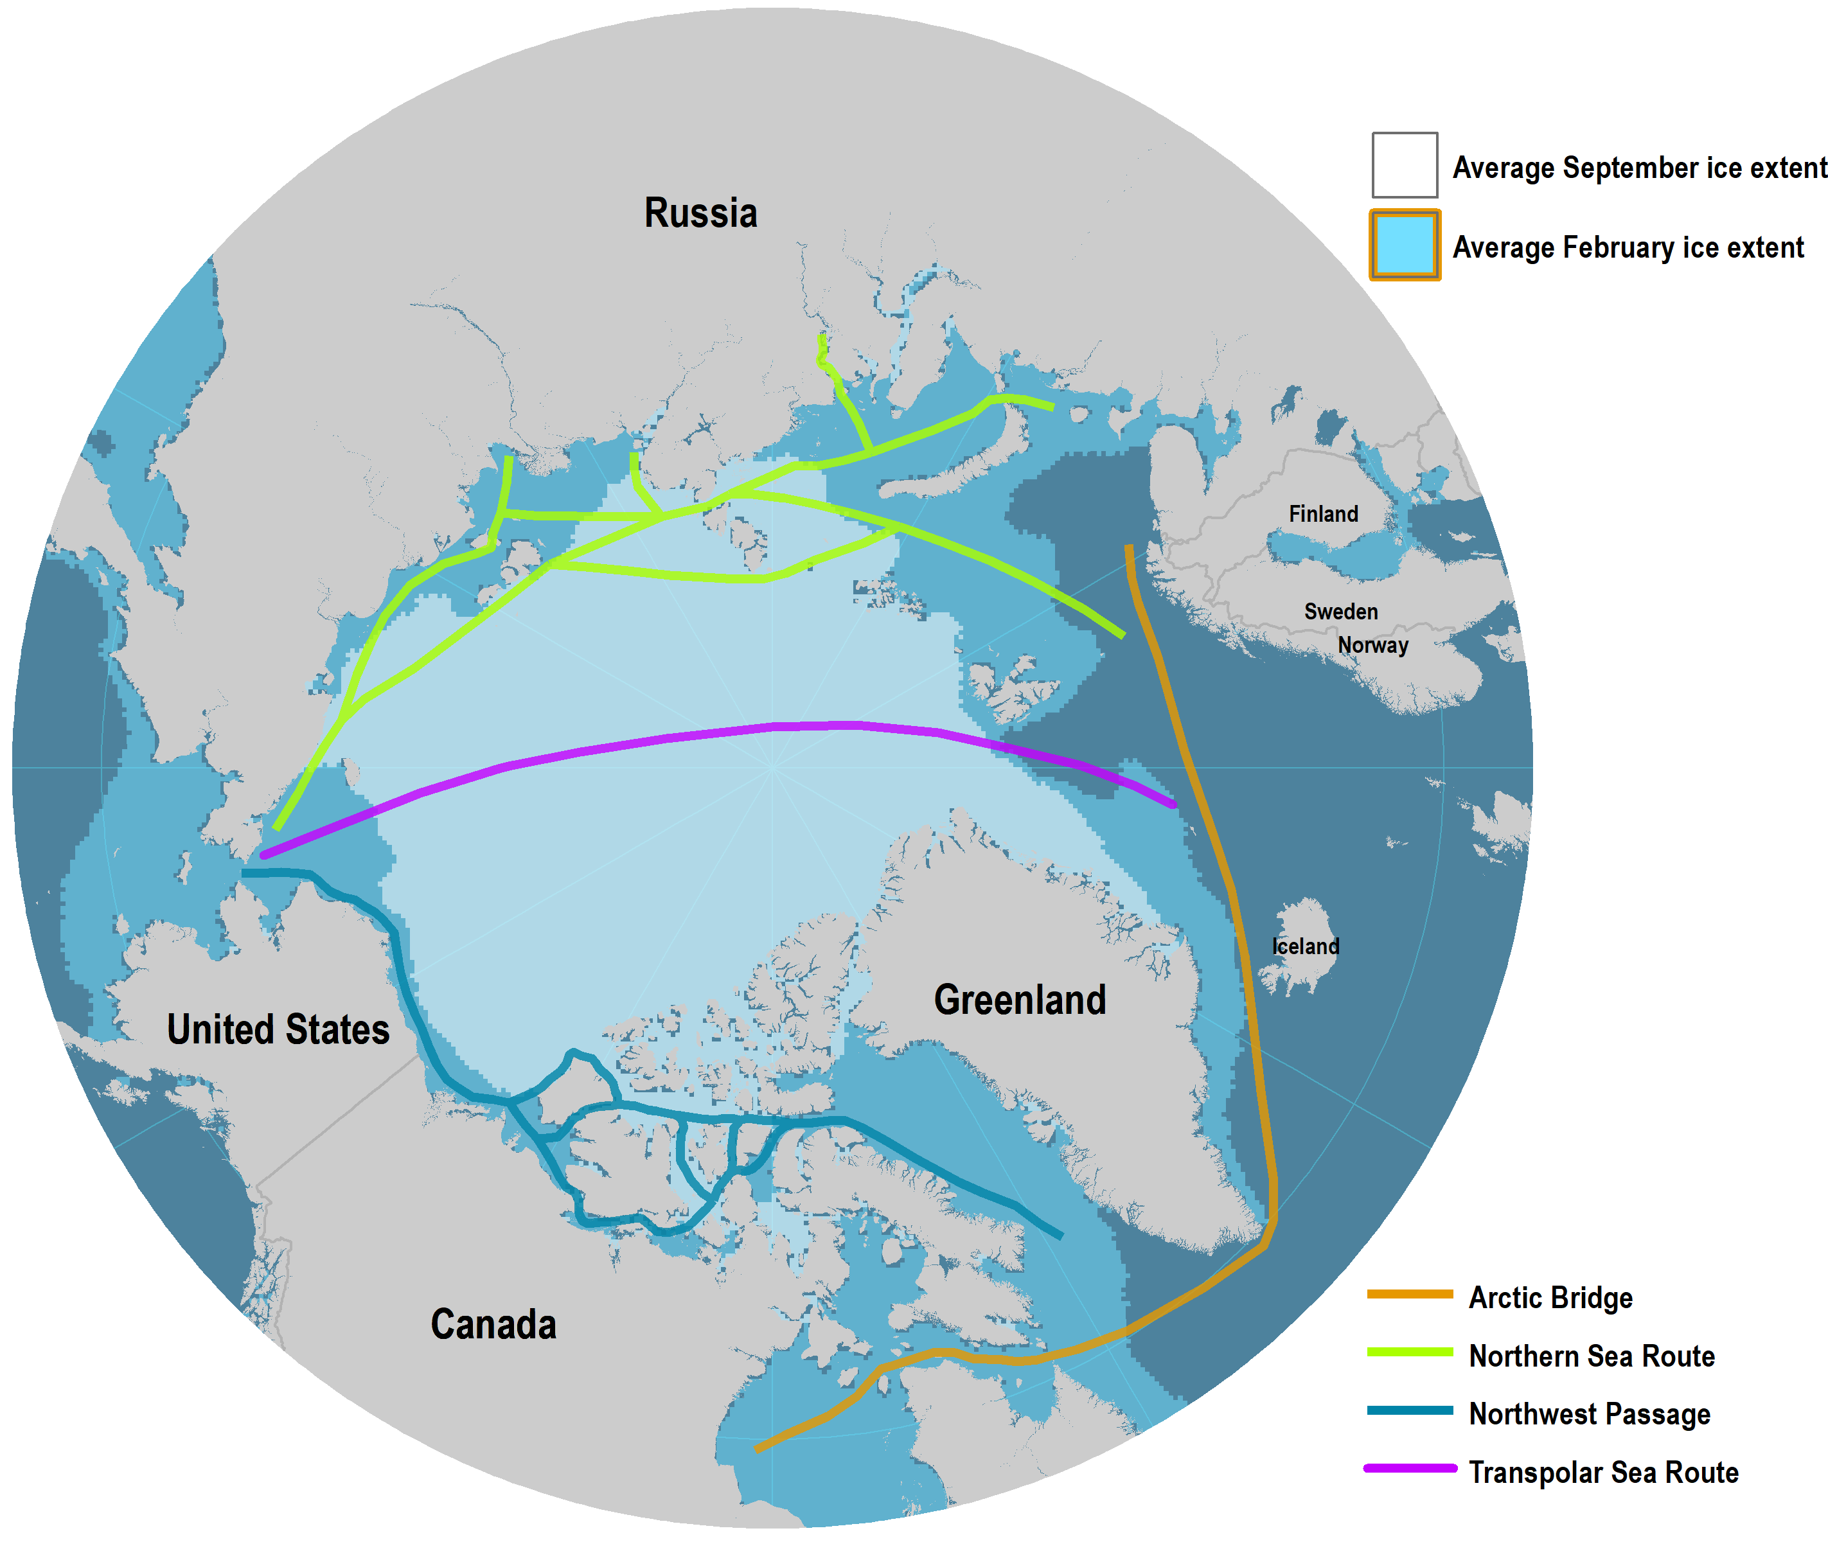
Polar Shipping Routes
Read this information

Slide 22
Physical Geography of the Russian Realm: Harsh Environments
Ecologies at Risk
  Global warming and environmental disruption:
    Animal and human communities have adapted to the harsh prevailing climate conditions of the arctic.
  New oil and natural gas exploration:
    Offshore environments could also face dangers as these new resources become exploited.
    Globalization forces are infiltrating a part of the world long protected by distance and nature.
Nearly all raw materials required by modern industry are present:
  Oil and natural gas.
  Coal, iron ore, and other metals.
  Much of the realm is yet to be fully explored.
  The challenge of accessing and developing the resources.

Slide 23
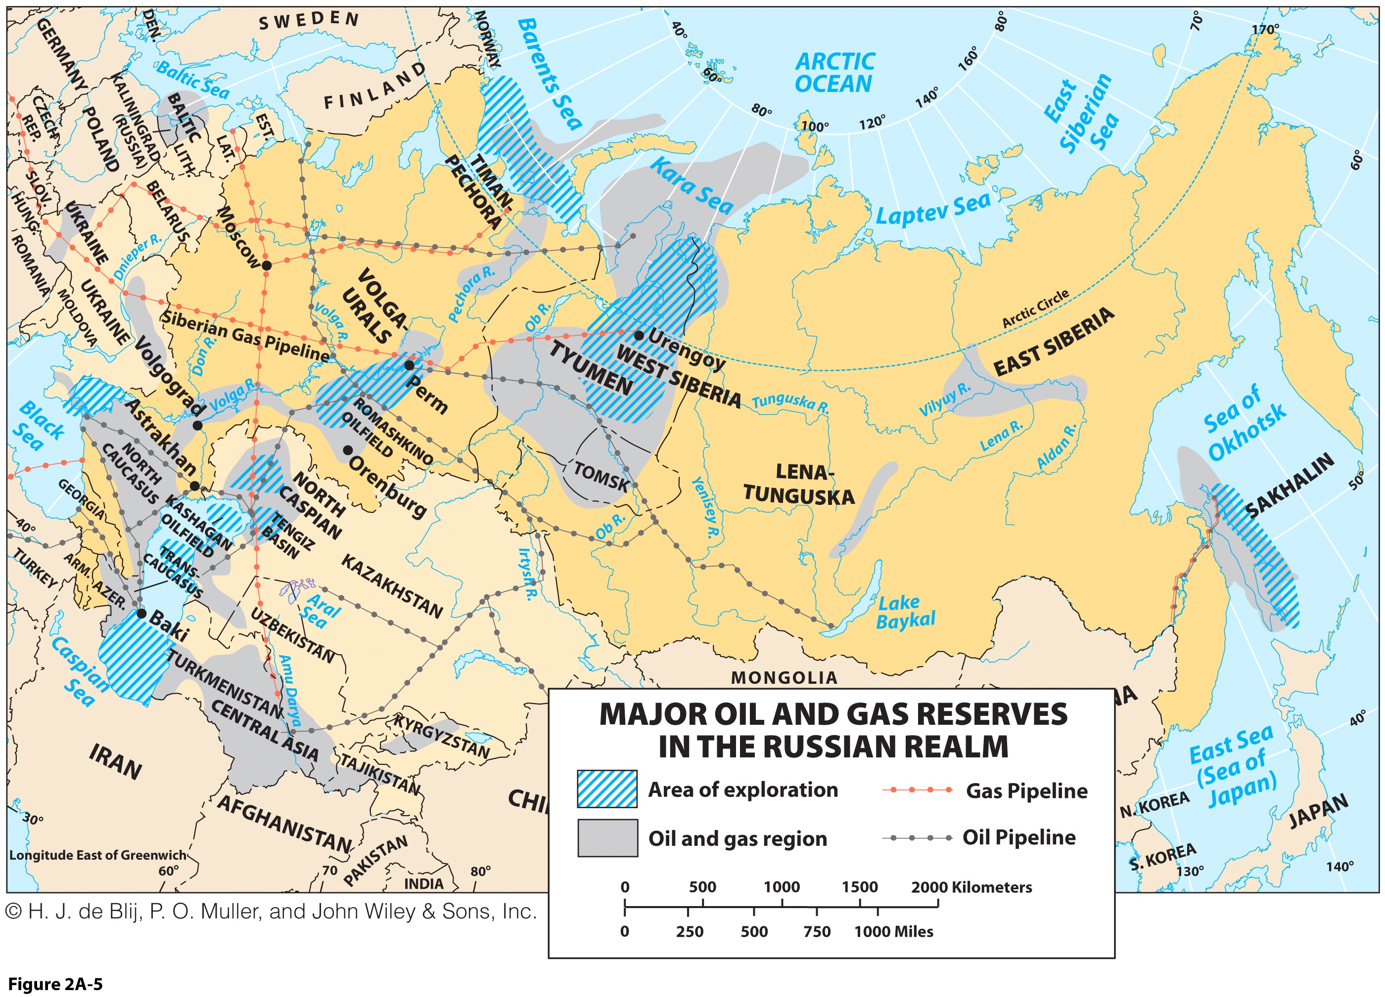

Slide 24
Russian Roots
The Rus
  1000 years ago: Slavic settlement, or Rus.
  Established in present-day Ukraine and southwestern corner of the Russian Plain.
  Location had physical landscape favorable to settlement and agriculture.
  Many “Russians” today see Ukraine as their historic heartland.
  Eventually spanned ecological regions, of northern forests and southern steppes, or semiarid grasslands.
  The Russian peoples divided into three distinctive, but closely related groups:
    Russians (Russians of central Russia).
    Belorussians (Belarus; Russians of the West).
    Ukrainians (Russians of the South).

Slide 25
Russian Roots
The Mongol Invasion
  Mongol-Tatar horse armies were sent to conquer Russes.
  Russian Plains Russes were vulnerable on open steppes.
  Forest Russes were able to fend off the Tatars.
  Russes paid tribute to the Mongol-Tatar invaders.
  Moscow established trade with other Russes.
  Mongols attacked Moscow again and failed.
  Some Tatars stayed in the periphery of the realm.
  Many eventually converted to Islam.

Slide 26
Russian Roots
Grand Duchy of Moscow (Moscovy)
  Formation of the modern Russian state (1462).
  Expansion in the Volga basin.
  Fall of Kazan (1552), held by the Tatars.
Three centuries of territorial growth
  Was a military power in nearly constant warfare.
  Was an imperial state with centralized administrative control.
Cossacks
  Semi-nomadic group mainly responsible for the settling of the Russian Far East from the 16th century.
  Expanded mainly through sparsely populated Siberia.
  Pacific was reached by the mid 17th century.
  Moved into Alaska in the late 18th century (1784).
  Settled north of San Francisco (1812).

Slide 27
Russian Roots
Czarist Russia
  The formation of a large continental empire.
Colonialism outside the Russian core:
  Overland expansion instead of maritime expansion.
  Annexed and incorporated many nationalities and cultures.
    Russia controlled as much as 100 different nationalities.
  Foundation of St. Petersburg, a forward capital (1703):
    A symbolic relocation of a capital city.
    Developed as Russia’s leading port for trade.
  Conquest of Muslim areas in the Caucasus and Central Asia.
  Southern expansion halted by the Turks and the British.
  Vladivostok founded in 1860.
Trans-Siberian Railroad and occupation of Manchuria:
  Threatened Japan and sparked war in 1904.
  Defeated by Japan, losing some territory.

Slide 28
Russians in North America
Russians were the first white settlers in Alaska:
  Fur traders, in search of sea otter pelts.
  From Siberia, crossing the Bering Strait.
  Moved south along the Pacific coast, stopping just north of San Francisco.
Russian departure:
  Competition with American, Canadian, and British hunters who were destroying sea otter populations.
  Alaska sold to the United States for $7.2 million (1867).

Slide 29
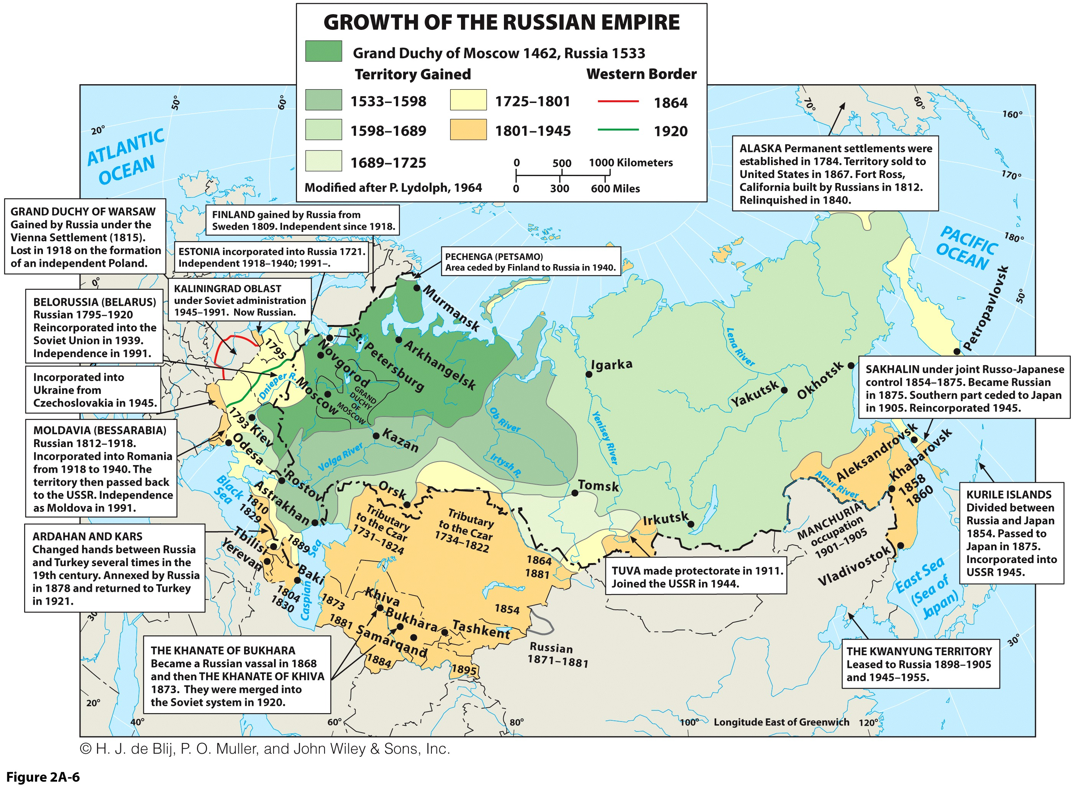

Slide 30
The Soviet Union
Causes of the Soviet Revolution
  Outcome of the abuses of czarist Russia; Detached ruling class (e.g. palaces such as the Hermitage).
  Serfdom of peasants; country remained mainly feudal despite European political modernization.
  Emergence of a workers’ class during the Russian industrial revolution (late 19th century).
  No democratic revolution; no channel for grievances.
Revolution (1905-1917)
  Capital: Petrograd to Moscow (1918).
  Several republics declared independence (e.g. Ukraine) but were forcefully reintegrated in the Federation.
  Federation/federal structure:
    USSR (Union of Soviet Socialist Republics) -1924.
    Colonized people were given autonomy and identity, yet strengthened political and economic subjugation.

Slide 31
The Soviet Union: The Political Framework
Union of Soviet Socialist Republics (USSR)
  A “fathom federation”; a pretense of representativeness.
  Based on ethnic identities.
  Divided into 15 Soviet Socialist Republics (SSRs).
    Broadly corresponded to a major nationality’s territory.
    Within the SSRs, smaller minorities were designated Autonomous Soviet Socialist Republics (ASSRs).
    Below that were Autonomous Regions.
  Complicated, cumbersome and poorly designed political framework.
Difficulty of multinational federation
  Forced relocation of ethnic minorities in the east.
  Russification saw the settlement of ethnic Russians throughout the Russian SSR and non-Russian SSRs.

Slide 32
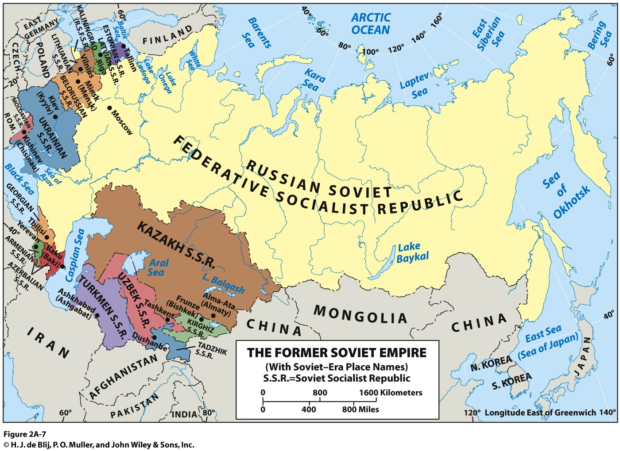
On what foundations the USSR and its Republics were established?

Slide 33
The Soviet Union
Centrally planned (command) economies:
  Do not allow free market mechanisms (economic laws of supply and demand) to dictate economic policy making.
  Advocate government intervention at virtually all levels of the economy.
  Co-ordinates activities of different, if not all, economic sectors.
  Fix the price and the quantity of what is being produced.
  Establish a long-term perspective on the distribution of goods, capital and resources with “five-year plans”.

Slide 34
The Soviet Union
Features of the soviet economy
  Focus on accelerated industrialization and collectivization of agriculture.
  Production of particular manufactured goods to particular places.
  Unnecessary movements leading to delays and shortages.
  Economic interdependence as a tool of national unity.
  State subsidy of uneconomic industries also furthers the goal of state security.
Labor
  Compensation not based on productivity.
  Forced migration, often through purges.
  Went hand-in-hand with the Russification process and attempted to better integrate the entirety of Soviet society.

Slide 35
The Soviet Union
Five-year plans
  No thought to existing or efficient economic geographies.
  Expensive manufacturing with no competition.
  Emphasized quotas for production at all levels and were often poorly conceived.
  Compartmentalization of economic decisions.
  Bureaucracy:
    A tool of government control.
    Centralized administration of its economy.
  Removed decision-making from the local, factory or farm level.
  Lacked flexibility to take account of changes.
  Synchronization of different parts of the economy suffered.
  Many inefficiencies in the production, assembly, and distribution of goods.

Slide 36
The New Russia
Demise
  The centrally planned economy failed; little economic returns.
  Cold War arms race drained resources.
  USSR depended on its ideological enemies for currencies (sell of resources) and for grain supply.
  Russification fueled drive for independence by ethnicities of the non-Russian SSRs
Implosion of the Soviet Union: 1991
  Last Soviet president resigned.
  SSRs declared their independence, depriving Russia of crucial agricultural and mineral resources.
  Loss of Eastern European satellite states under Soviet political dominance and former Republics.

Slide 37
Population of Russia, Japan Italy, 1950-2050 (in millions)
Notes:
Source: United Nations Population Division

Slide 38
The New Russia: A Complex Cultural Mosaic
Russian dominance
  Majority of realm’s population (80%).
  Most widely dispersed.
Non-Russians
  Along realm’s borders.
  Other Slavic peoples (12% of the population is Muslim).
  Several ethnic groups want to form their own country.
Beyond the Caucasus Mountains
  Turkic people from Central Asia.
  Chechens (Chechnya) involved in conflicts to found their own nation since the collapse of the Soviet Union (two wars).
Near Abroad
  Former Soviet Republics and a new Russian sphere of influence
  Russia’s policy of intervention in any threat along its borders or against Russian minorities.

Slide 39
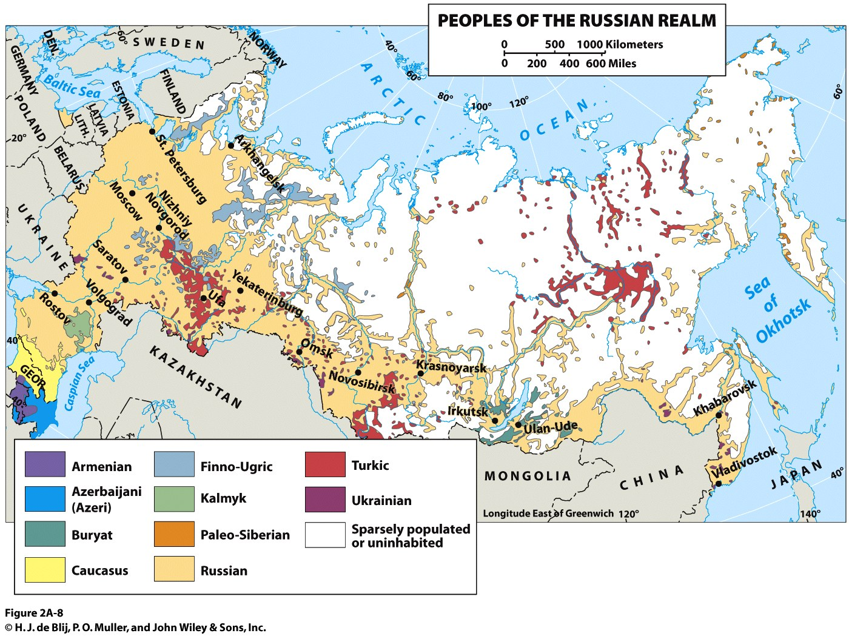

Slide 40
The New Russia: Cities Near and Far
Low rates of urbanization
  73% compared to Europe (85%).
  Transcaucasus region even less urbanized.
Urban network
  Moscow and St. Petersburg anchor the Russian core.
  Historic urban centers located to take advantage of geographical factors (access to arable land).
  Post-czarist industrial cities along the Volga River.
  East of the Urals, cities thin out.
  Russian Far East: past naval power.
  Kamchatka Peninsula: urban desertion.
  Capitals of Transcaucasia.
  Potential of high-speed train systems, but only one city pair serviced so far (Moscow – St. Petersburg).

Slide 41
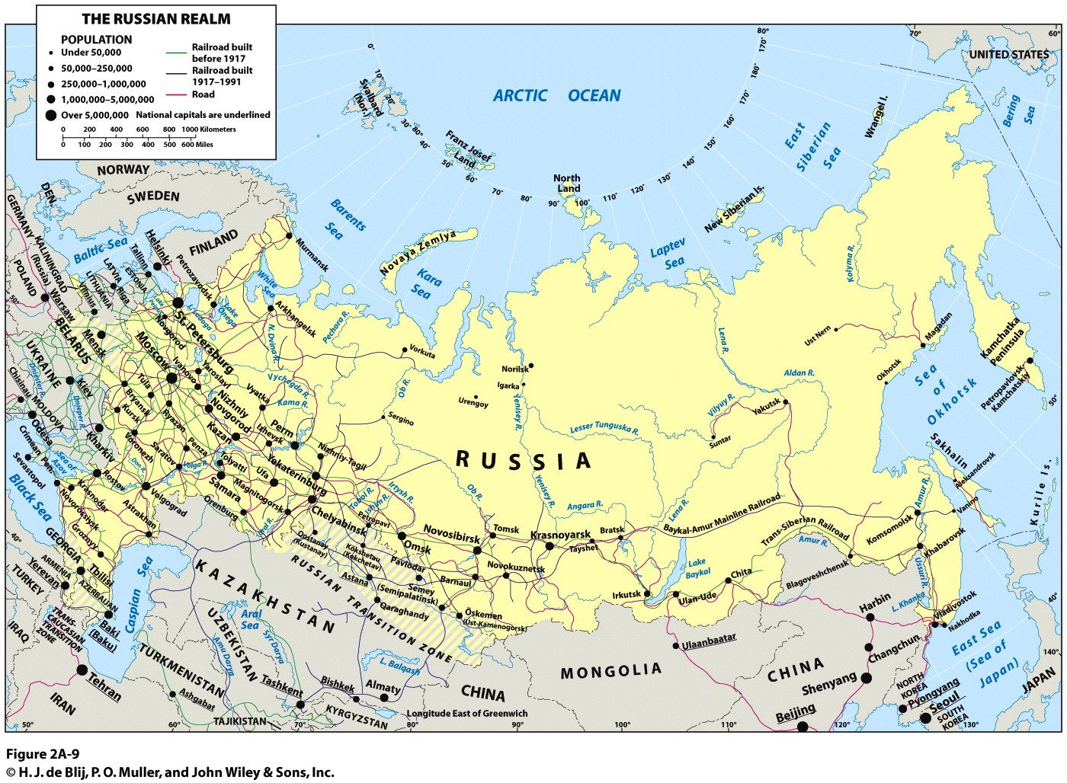

Slide 42

A Realm in Transition
Russian Federation:
  Still bears the marks of the Soviet era.
  Strives for good relations with the Near Abroad.
  Maintains cohesion and further economic well-being.
Challenging future of the Russian Federation:
  A state that borders 14 other countries and 4 other realms.
  Challenges to manage its massive territory and diversity.
  Annexation of Crimea in 2014 (after referendum).
  An autocratic past and weak democratic institutions.
In light of Russia’s history and geography, what role it is bound to play in the global economy?

