Slide 1
Chapter 11: The Austral and Pacific Realms

Slide 2
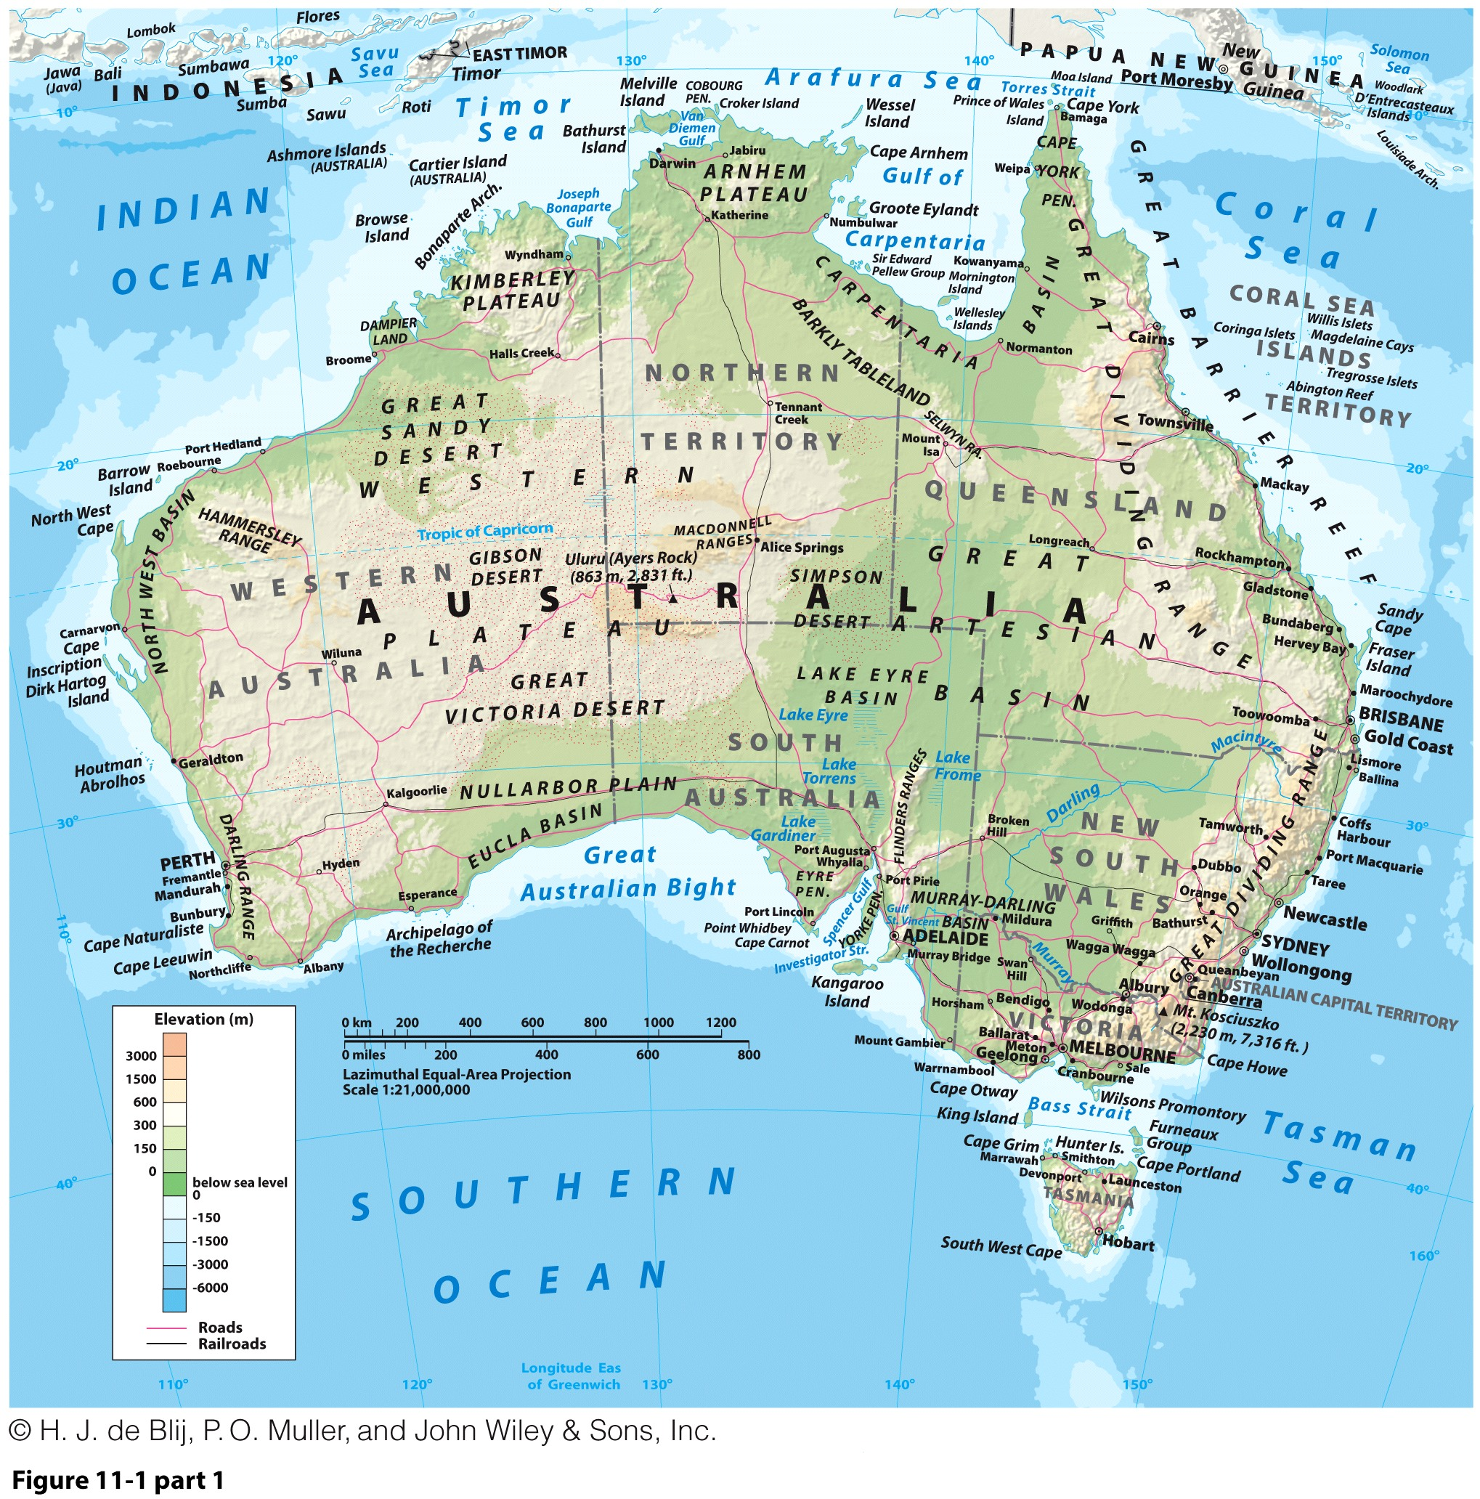

Slide 3
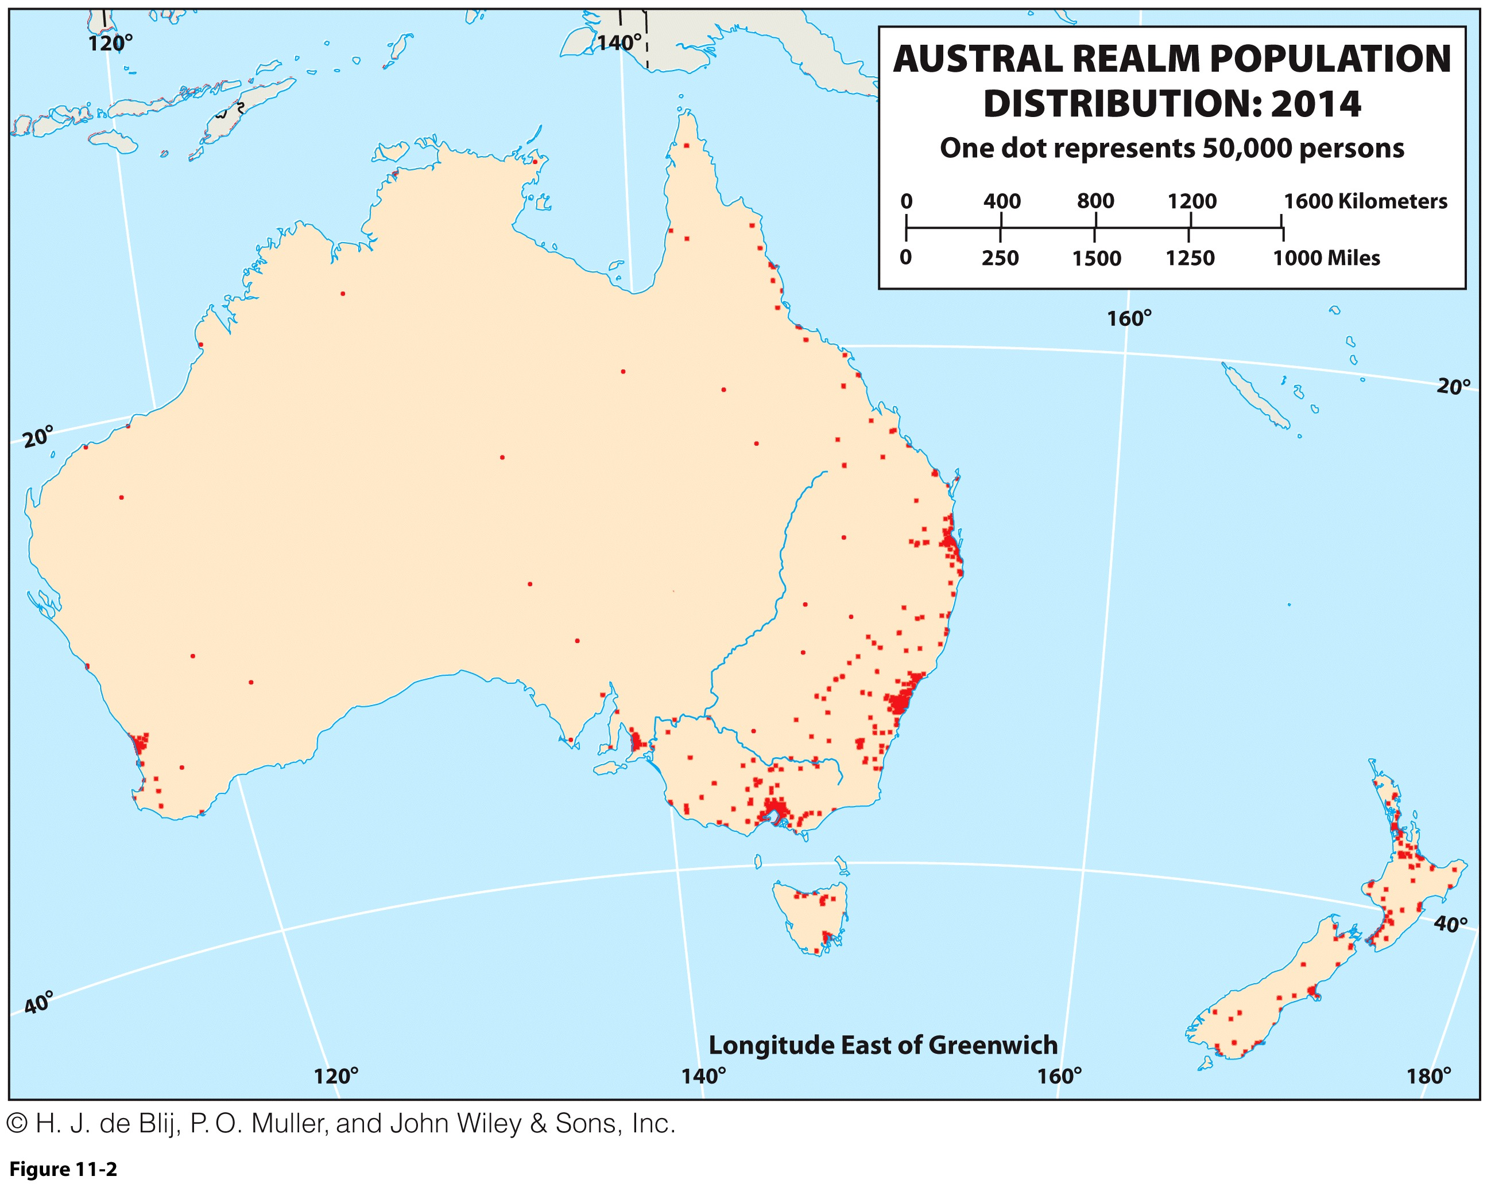
Defining the Austral Realm
Two countries:
  Dominant Australia.
  Smaller New Zealand.
Realm at a crossroads:
  Strains of diversity (Maori in NZ and Aborigines in Australia).
  Economic connections (Raw materials towards East Asia; Tourists).
  Political debates (Immigration, Indigenous land rights).

Slide 4
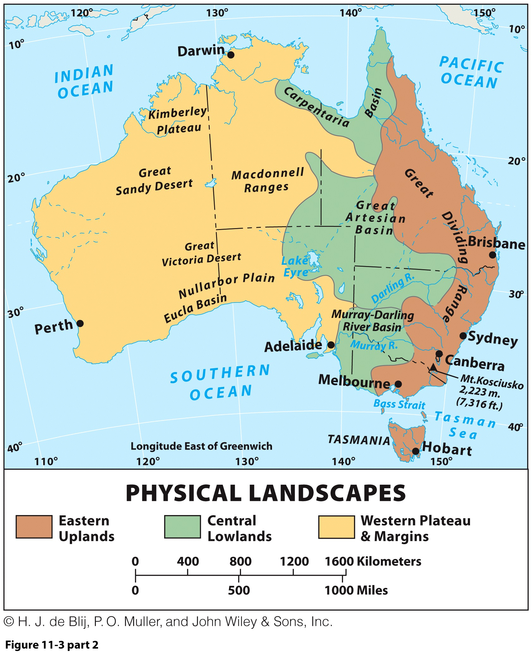
Land and Environment
Physiographic contrasts related to tectonics:
  Australia at the center of its own tectonic plate:
    Tectonic stability.
    Little difference in relief.
  New Zealand at the border of the Australian and Pacific plates:
    Common earthquakes.
    Mountainous.

Slide 5
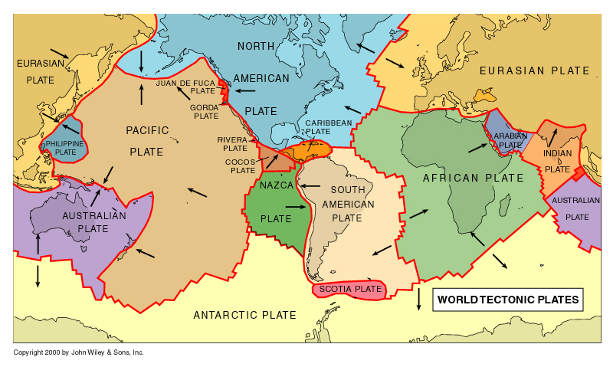
World’s Main Tectonic Plates

Slide 6
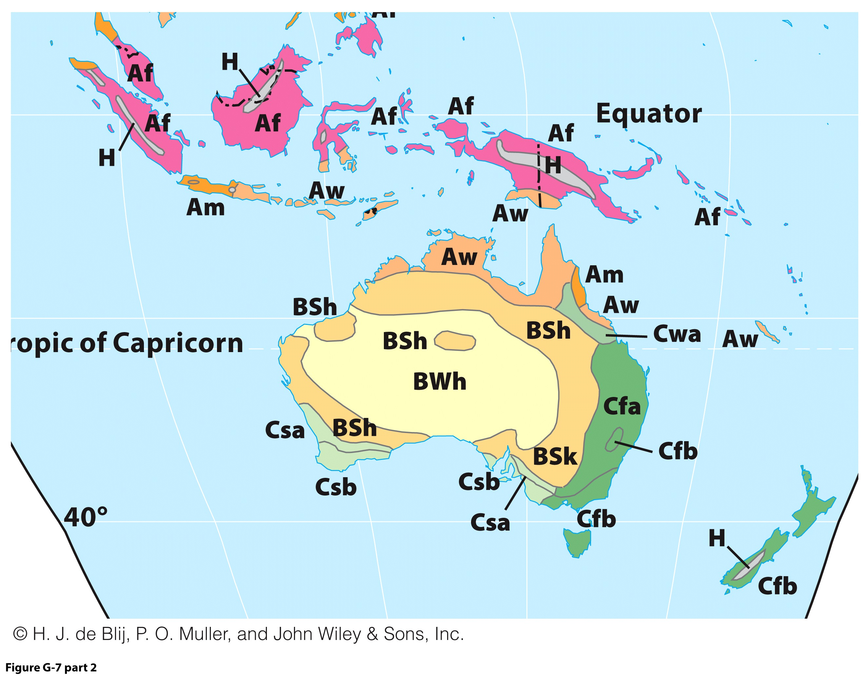
Land and Environment Climates
Australia:
  Latitudinal position.
  Tropical in the north.
  Eastern humid temperate.
Interior isolation:
  Mediterranean in the south.
  Desert and steppe interior (Outback).
New Zealand:
  Wholly under influence of Southern and Pacific oceans.
  Moderate, moist conditions.

Slide 7
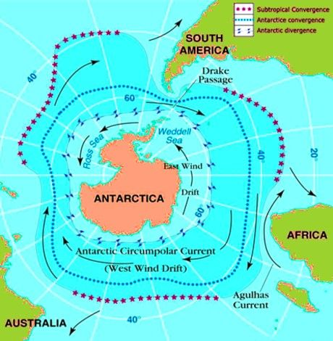
Land and Environment: The Southern Ocean
Southern Ocean surrounding Antarctica:
  Bounded by a marine transition known as Subtropical Convergence.
  Cold, dense waters meet warmer waters of other three oceans.
  Change in temperature, chemistry, salinity, and marine fauna.
Also known as the West Wind Drift, as the body of water circulates clockwise around Antarctica

Slide 8
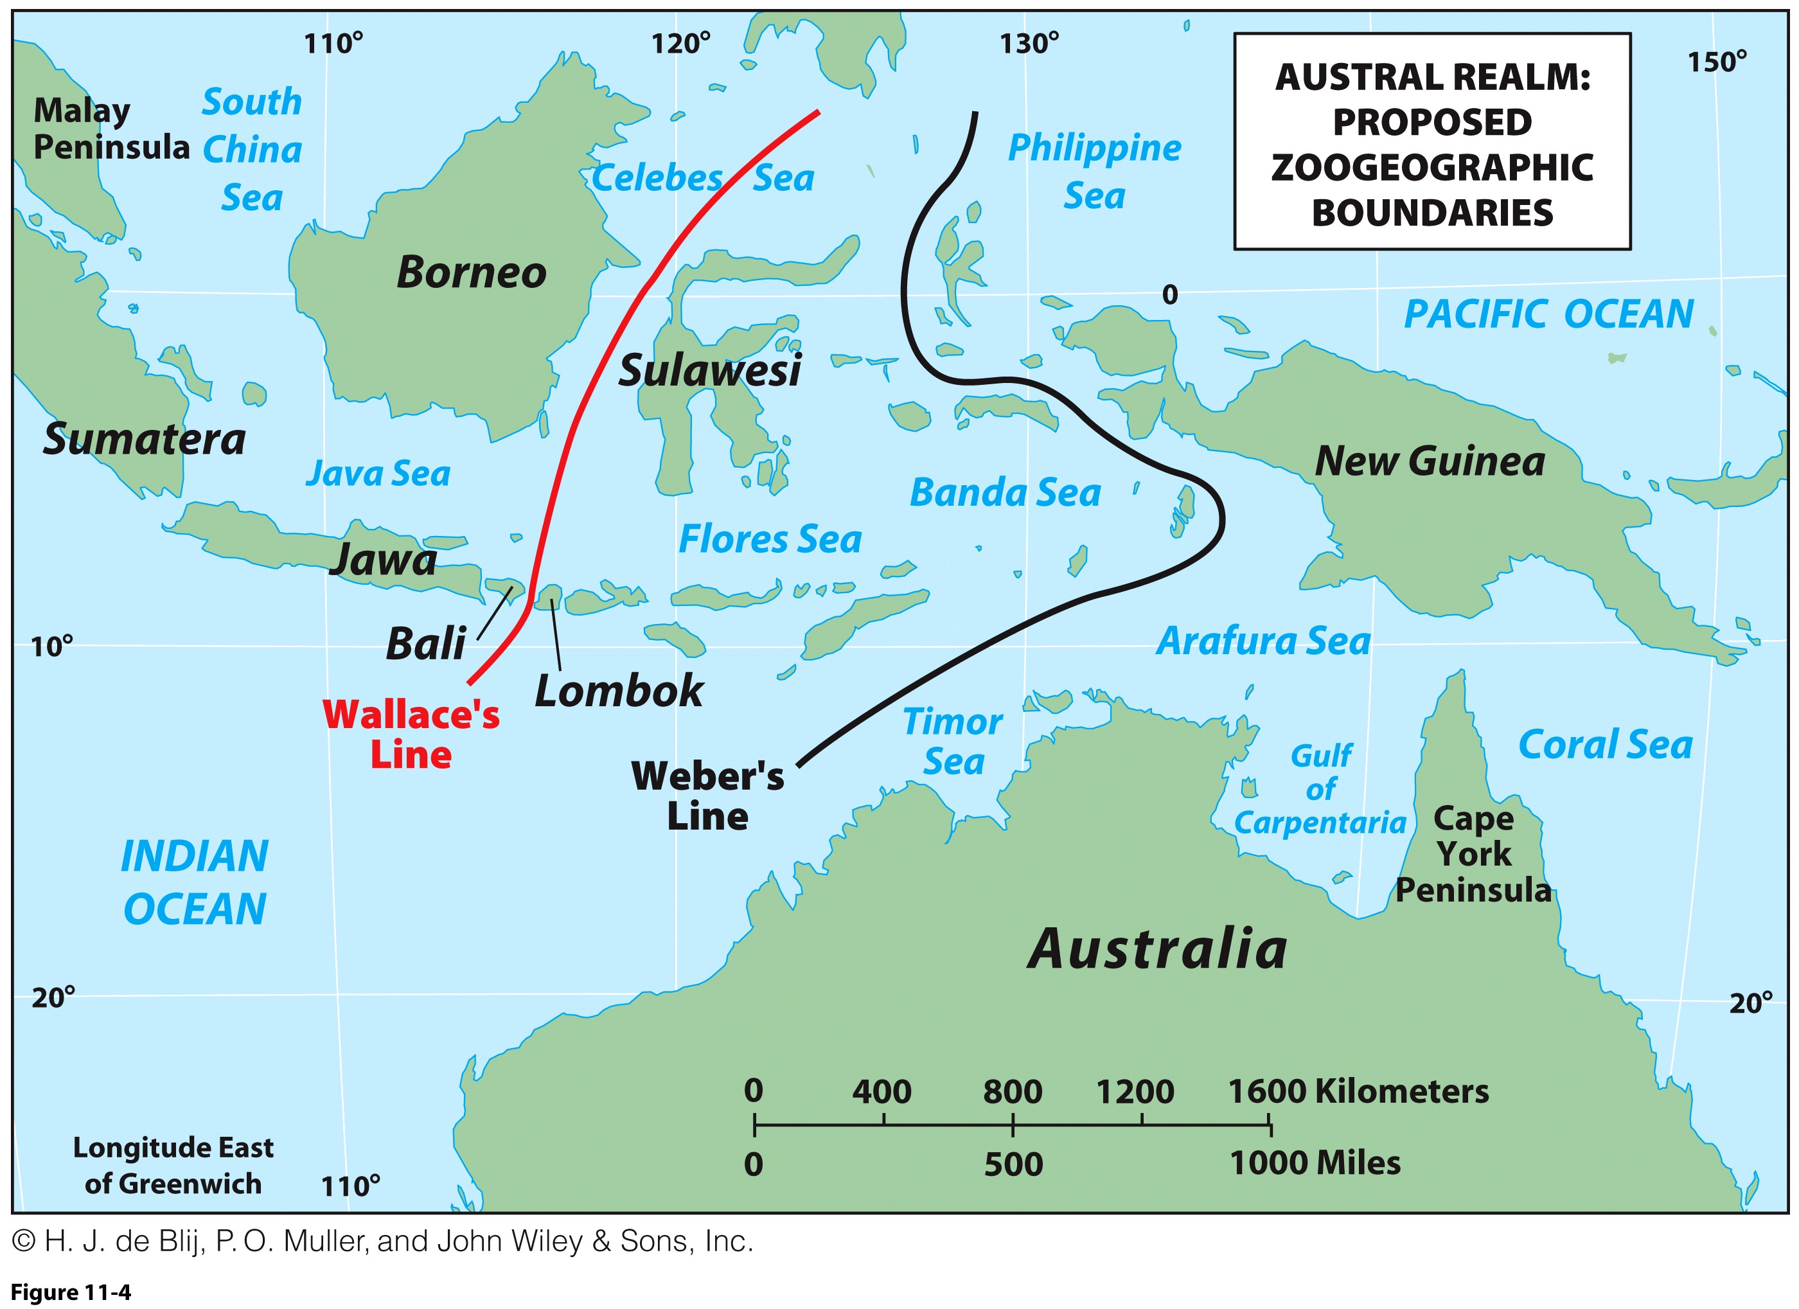
Land and Environment: Biogeography
From Wallace’s Line to Weber’s Line:
  Proposed the boundary line of Australia’s fauna.
  Challenged and replaced.
Distinctive Australia:
  Land of marsupials (offspring are birthed into a pouch).
  Early separation of Australian landmass; unique branches in biological evolution.
  Vegetation:
    Species diversity.
    Specialized climactic adaptations.
Biogeography: study of fauna and flora in a spatial perspective
What is particular about the physical geography and biogeography of the Austral realm?

Slide 9
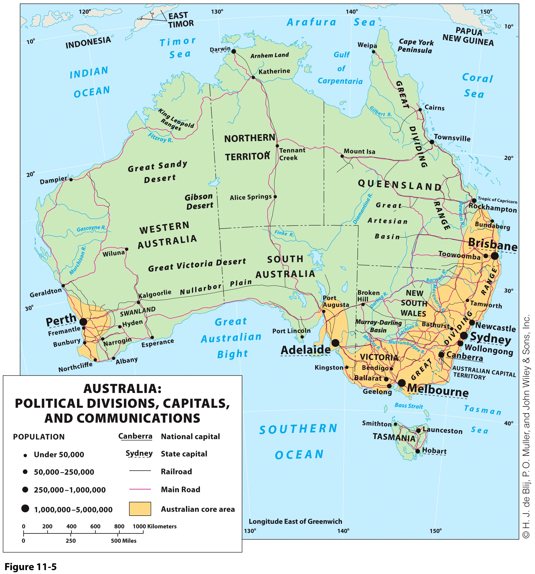
Australia: Historical Geography
Early Aboriginal societies were doomed by the arrival of Europeans.
Coastal settlements as centers of seven colonies:
  Straight-line delimitation.
  Surviving Aboriginals located in Northern Territory.

Slide 10
Australia: Historical Geography
Successful Federation
Commonwealth of Australia, 1901
Six States and two Federal Territories:
  Northern Territory to protect the interests of Aboriginals there.
  Australian Capital Territory around Canberra.
Federation
  A communal association among territories sharing autonomy with a central government.
  In contrast to the unitary state, where power is concentrated in a strong, central government.

Slide 11
Australia: Sharing the Bounty
Distance
  An imposed remoteness from without and a divisive part of life within:
    Expense of travel and shipping in and out of Australia.
    Expense of traveling within and around Australia.
  Economic and social self reliance.
Immigrants
  New immigration policy focused on skilled immigrants and relatives of earlier immigrants.
  Quota on asylum-seekers, but diversity is a contentious issue.
  Immigrants account for most of the population growth.

Slide 12
Australia: Sharing the Bounty
Core and Periphery
  Population is concentrated in the eastern and southeastern core area:
  Secondary core area in the southwest
  In between is the vast periphery called the Outback.
  Spatial arrangement is a result of physiography.
Urban culture
  82 percent urban.
  Coastal orientation.
The Cities
  Australian cultural identity and sameness of urban/rural landscapes:
    Clean and orderly.
    High-quality urban public infrastructure.

Slide 13
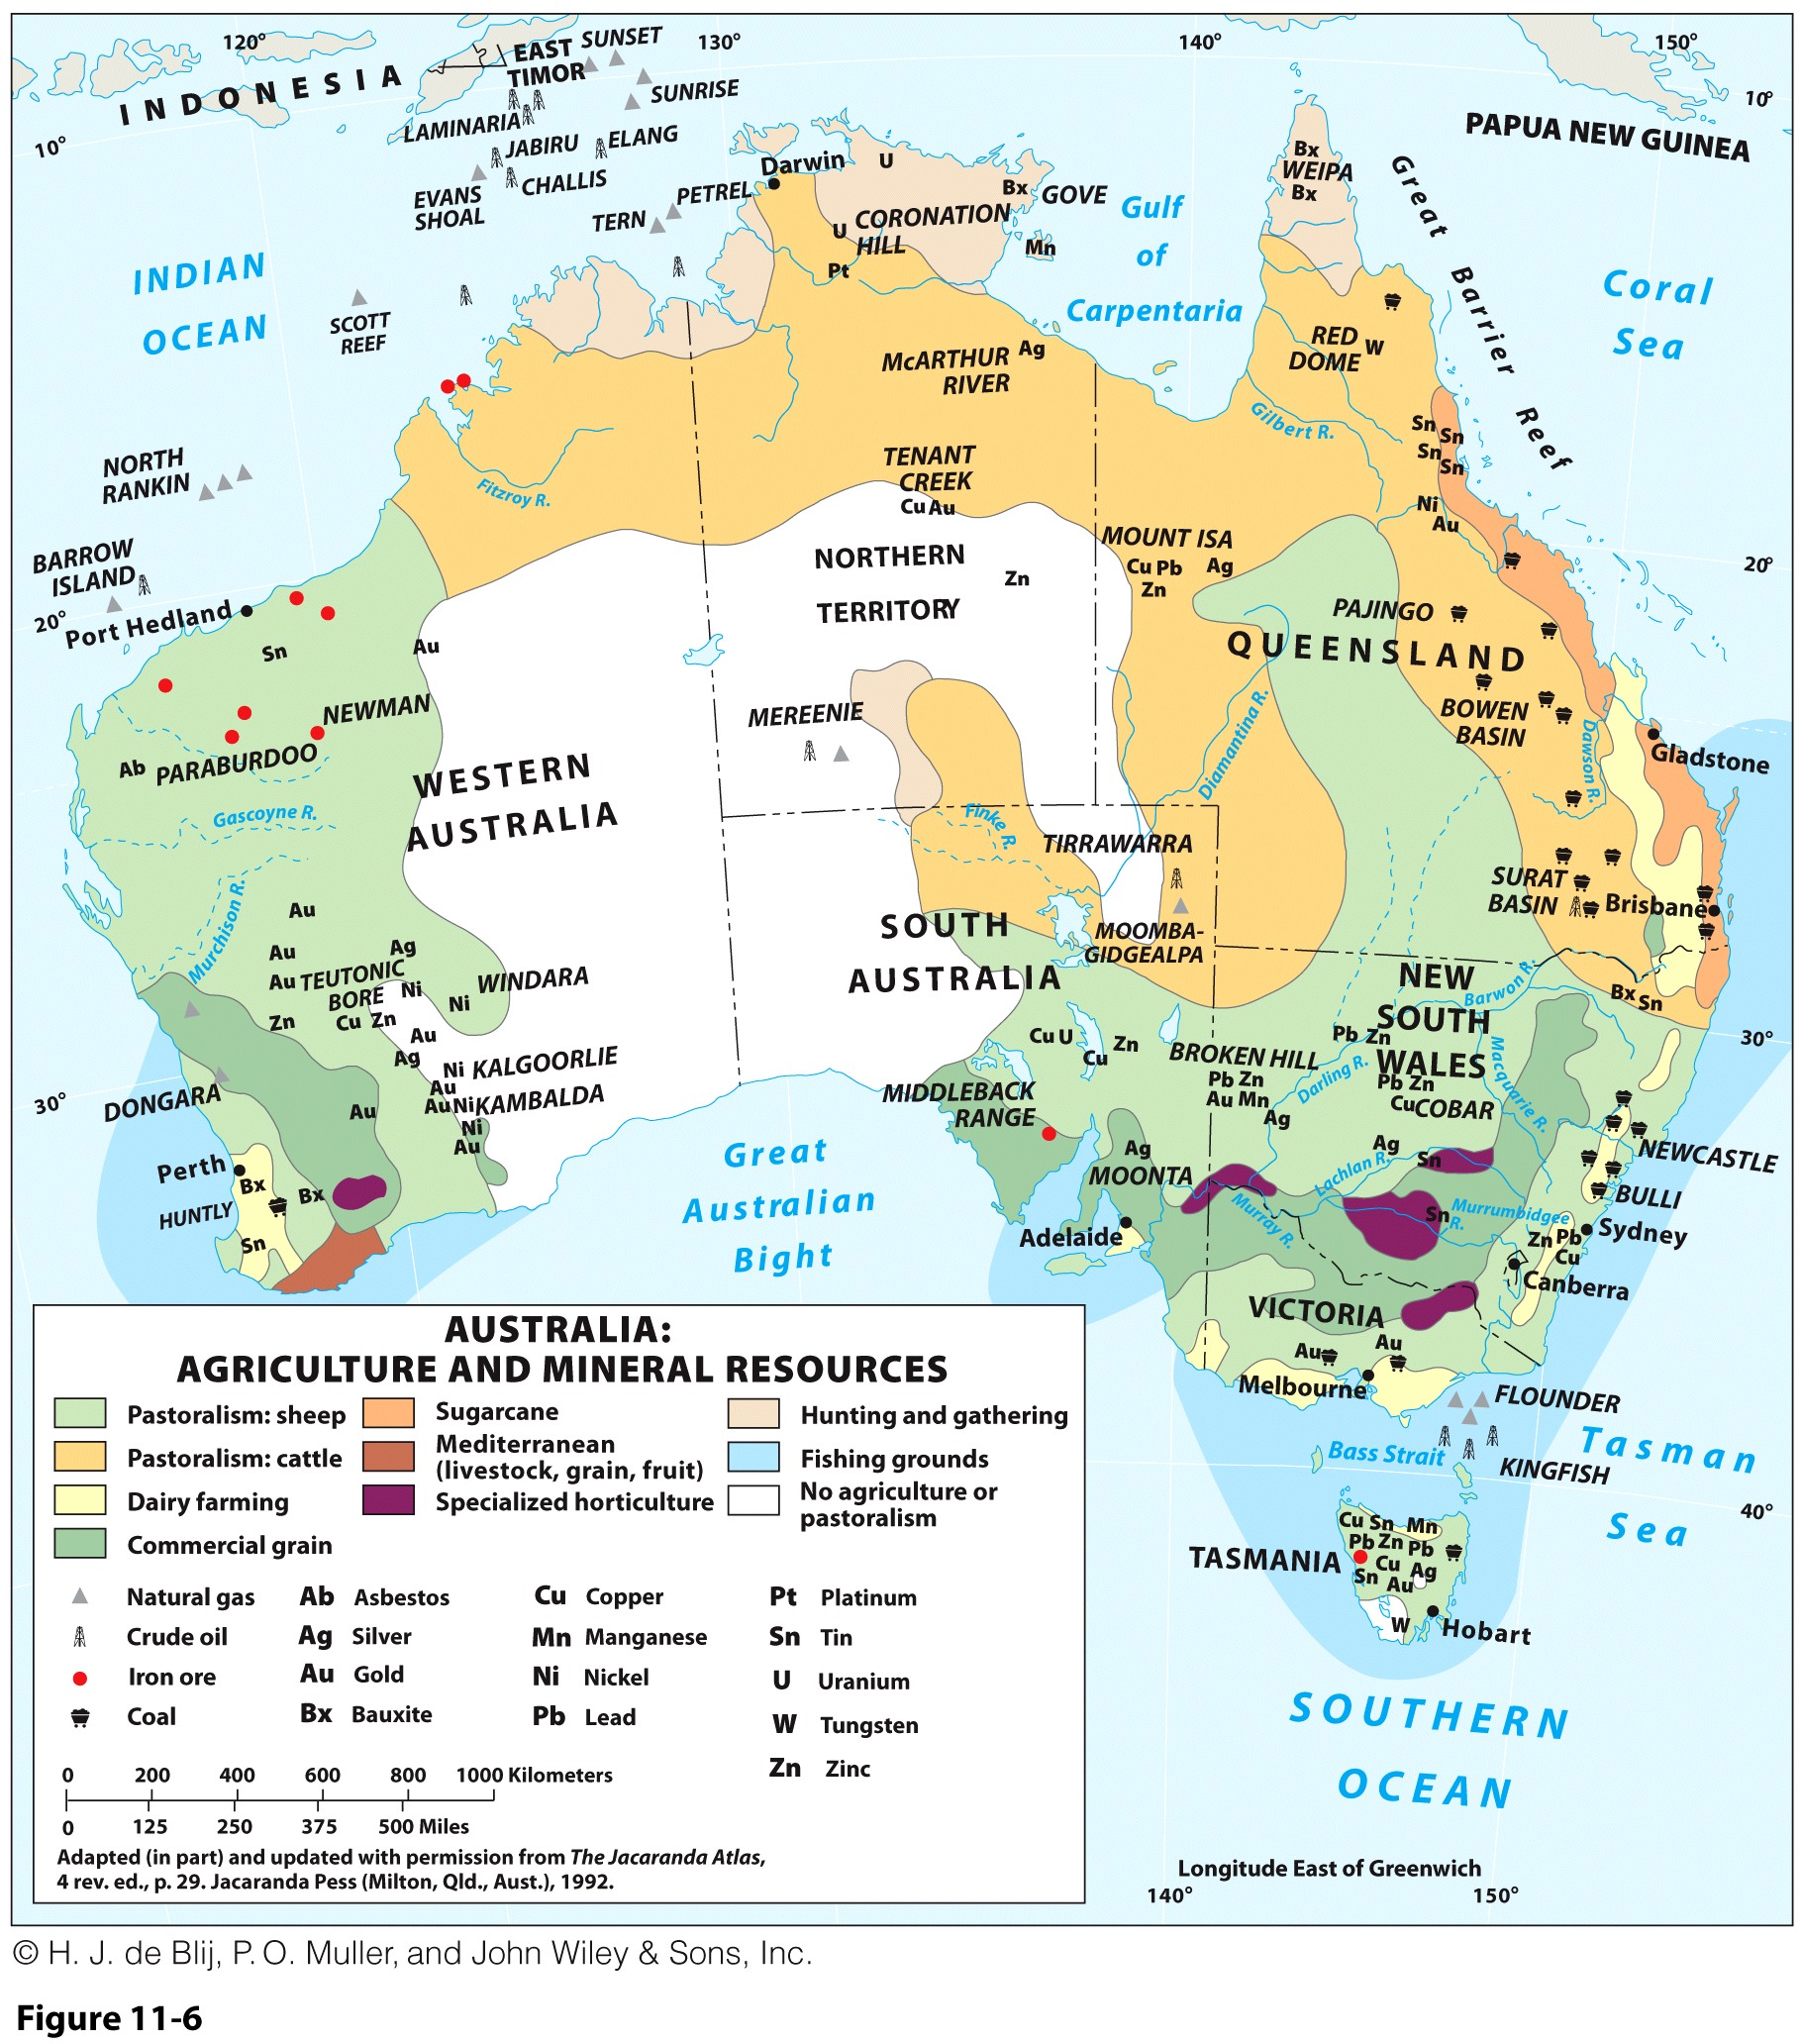
Australia: Economic Geography
Agricultural Abundance
  Livestock:
    Sheep-raising and wool.
    Beef products, along with refrigeration.
    Dairying near urban areas.
  Crops:
    Commercial grain farming.
    Sugarcane in warm, humid coastal areas.
  Mediterranean crops.
  Diverse crops in irrigated areas.

Slide 14
Australia: Economic Geography
What characterizes the economic geography of Australia, particularly the effects of distance?
Mineral Wealth
  Diverse and abundant mineral resources:
    New finds are still being made.
  Economic focus / dependency on exporting raw materials.
  Largest mineral port in the world (Port Hedland).
Manufacturing’s Limits
  Historical import-substitution industries:
    Local entrepreneurs encouraged to set up their own industries to produce goods cheaper than they could be exported, largely due to transport costs.
  Diversified, yet domestic orientation.
  Dwarfed by primary sector prominence.
Australia’s economic mainstays:
  Services, like tourism, then, commodity exports.
  Growth and affluence are paid for by mines and farms.

Slide 15
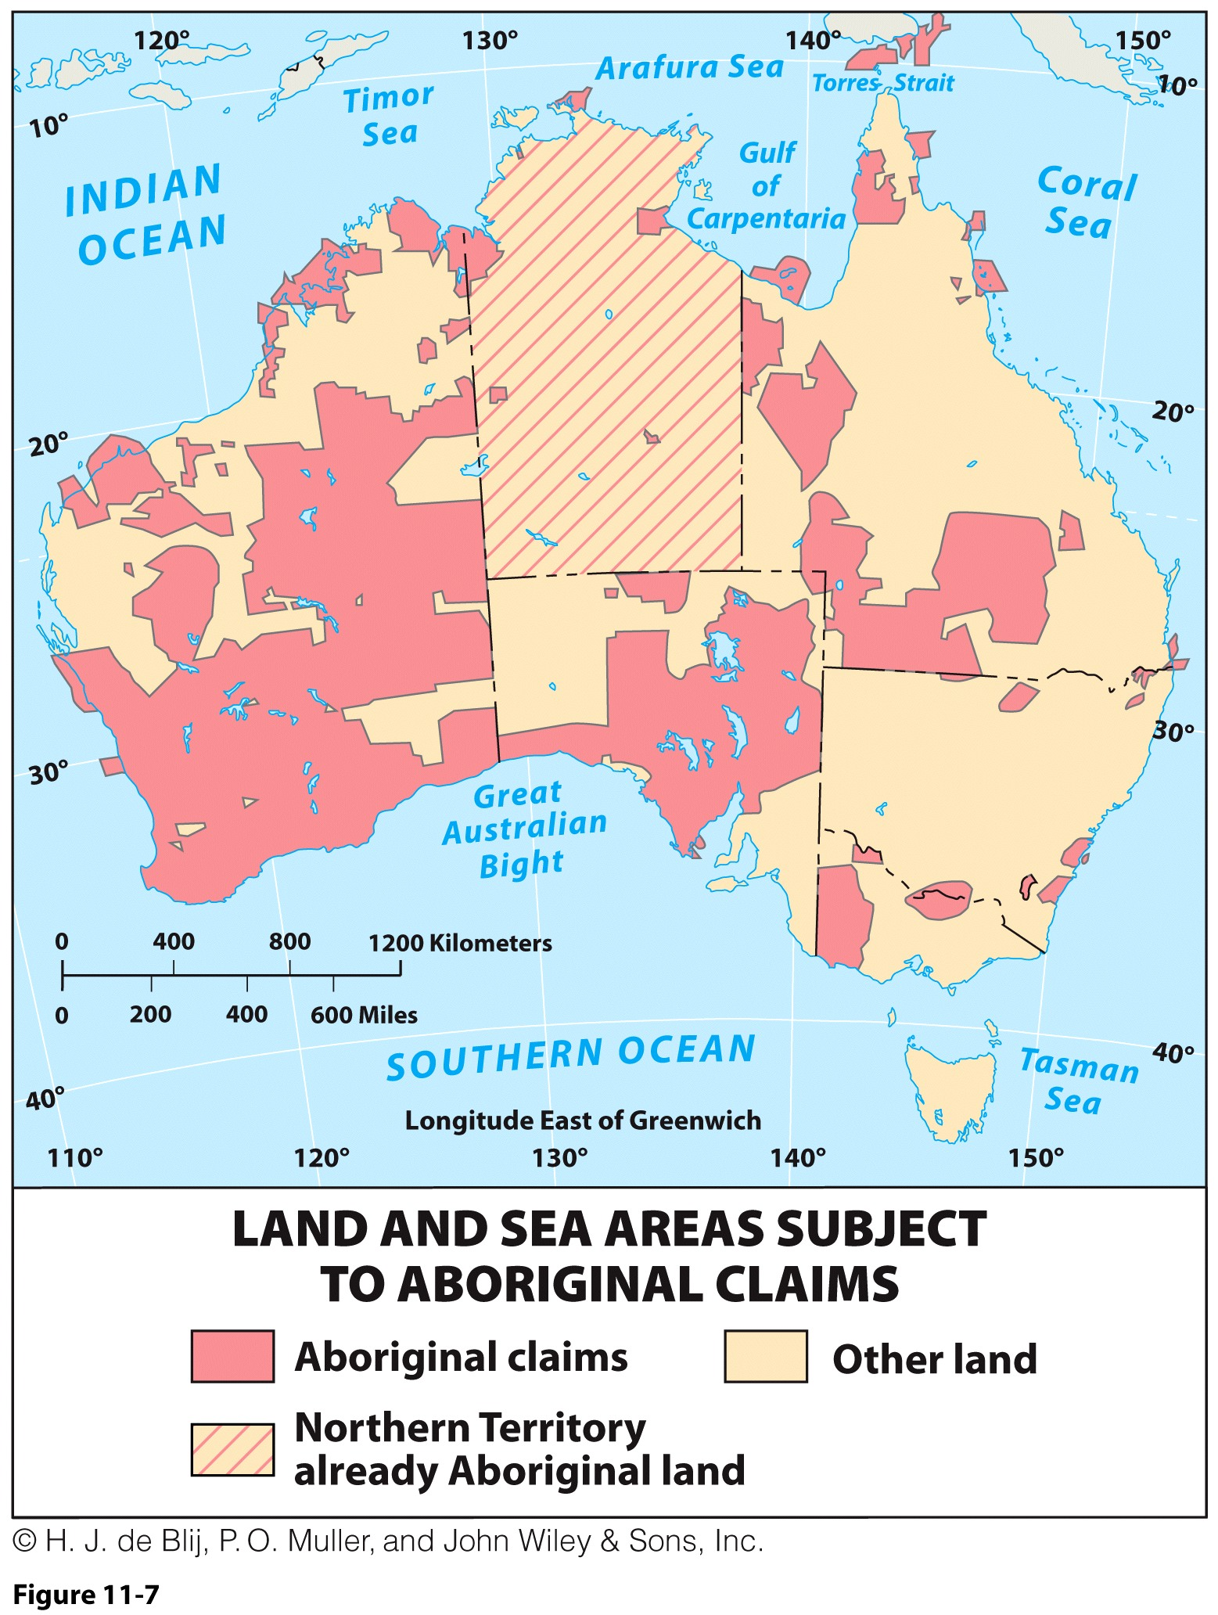
Australia: Australia’s Challenges
Aboriginal Issues
  In 2008 formal apology was issued for mistreatment of Aborigines.
Aboriginal land issue:
  Major geographic implications.
  Vast areas potentially subject to Aboriginal claims.
  Mainly, not solely, an Outback issue.
Land-rich Aboriginals are dirt poor:
  Complex issues involving the role of government, tribal councils, or private enterprise.

Slide 16
Australia: Australia’s Challenges
Immigration Issues
  Immigration has been an issue since the beginning.
  95 percent European ancestry; eugenic immigration policies kept it this way until 1970s (White Australia Policy).
  Change in policy permitting larger numbers of non-European immigrants.
  Today, East and South Asian immigrants outnumber both European immigrants and natural increase.
  25% of Australia’s population is now foreign born.
  Fickle changes in immigration quotas.
  Immigration needs continue for skilled-labor demands.
Notes:
Discussion questions: How do immigrants benefit Australia?
What kinds of problems come with immigrants?
Do you think Australia is better “equipped” to handle immigrants than other regions of the world? Why or why not?

Slide 17
Australia: Australia’s Challenges
Environmental degradation of Australia:
  Both Aboriginal and European damage.
  Deforestation.
  Extinction, endangered, and threatened ecologies.
  Introduction of invasive species had very negative impacts (e.g. rabbits and cats).
  Climatic variability:
    Arid dominance.
  Vulnerability to seasonal or permanent climate changes.
Growing awareness:
  Tempered by those who fear environmentalism will be an obstacle for economic growth.

Slide 18
Australia’s Place in the World
Australia as a republic?
  Ending its status as a British Commonwealth.
Relations with:
  Indonesia and East Timor
    Australia’s self-serving diplomatic maneuverings.
  Papua New Guinea (PNG)
    A projected pipeline plan causes questions of motive.
Australia’s global identity:
  Wider global presence or just within Asia and Pacific Rim?
  Growing connections with Asian and Pacific Rim.

Slide 19
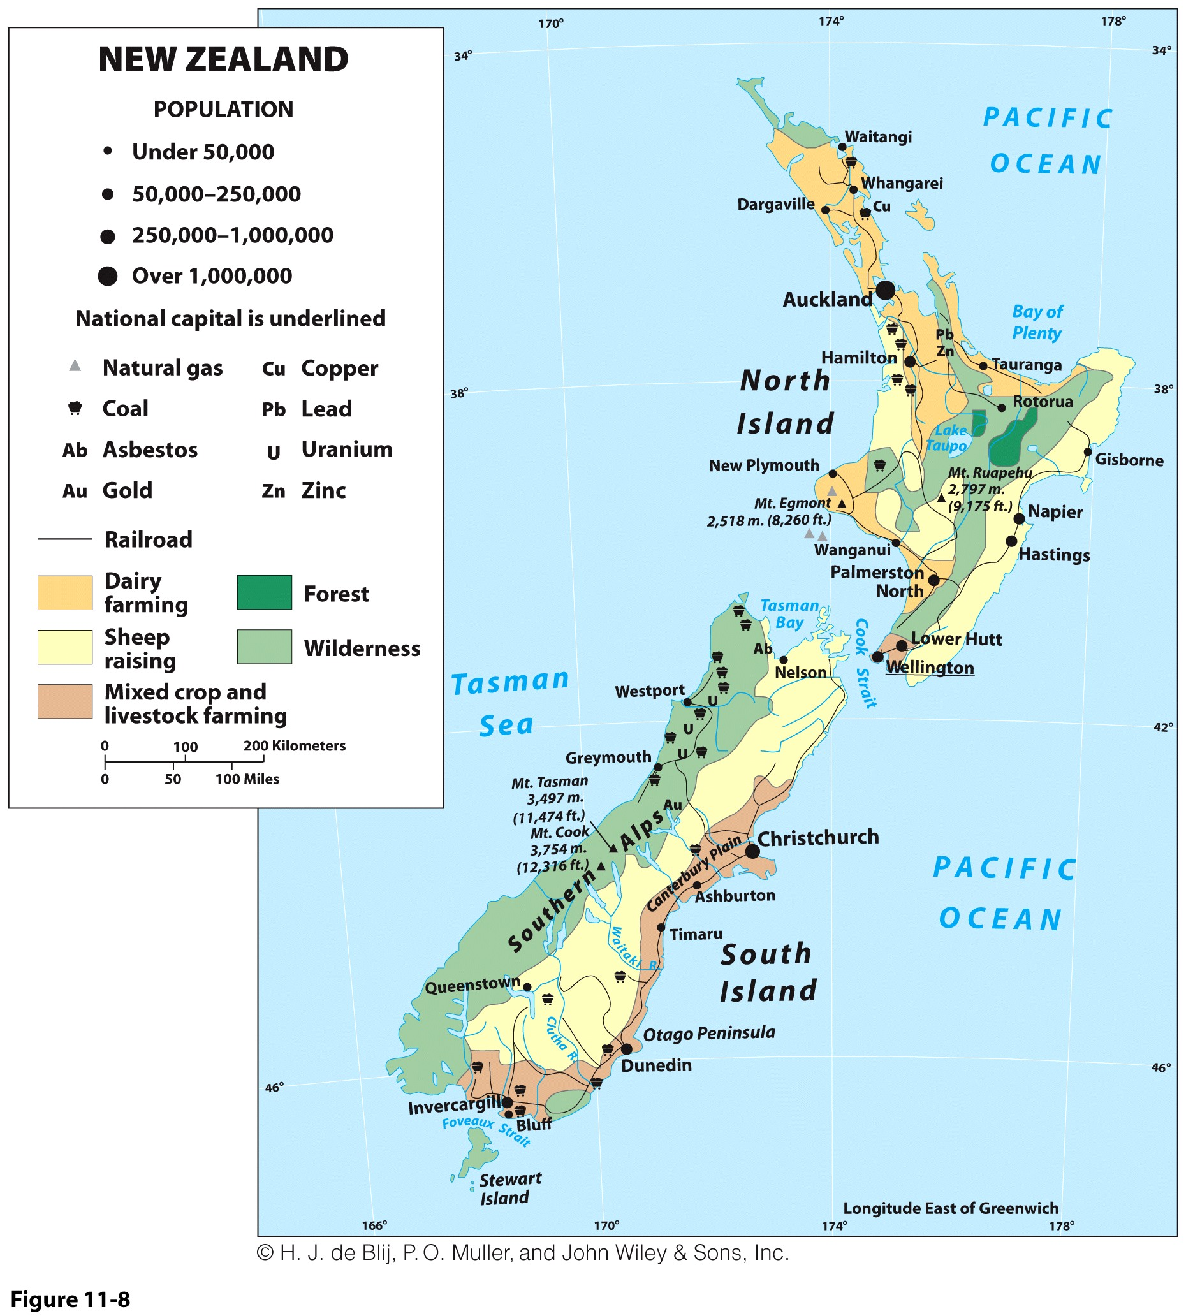
New Zealand
New Zealand’s Polynesian Maori would have been a part of the Pacific realm:
  But for European colonization.
Two large mountainous islands, surrounded by scattered smaller islands:
  Combined territory larger than Britain.
  Prone to volcanoes and earthquakes.

Slide 20
New Zealand
One of the leading “green” societies in the world:
  Long-active Green Party; country has an established environmental conservation program.
  New Zealand is ranked first in the world on a range of environmental indices.
  Approximately 30 percent of its land is protected.
  More than 70 percent of its energy is from renewables:
    Nuclear-free country.
  Environmental courts hear cases involving environmental decisions.

Slide 21
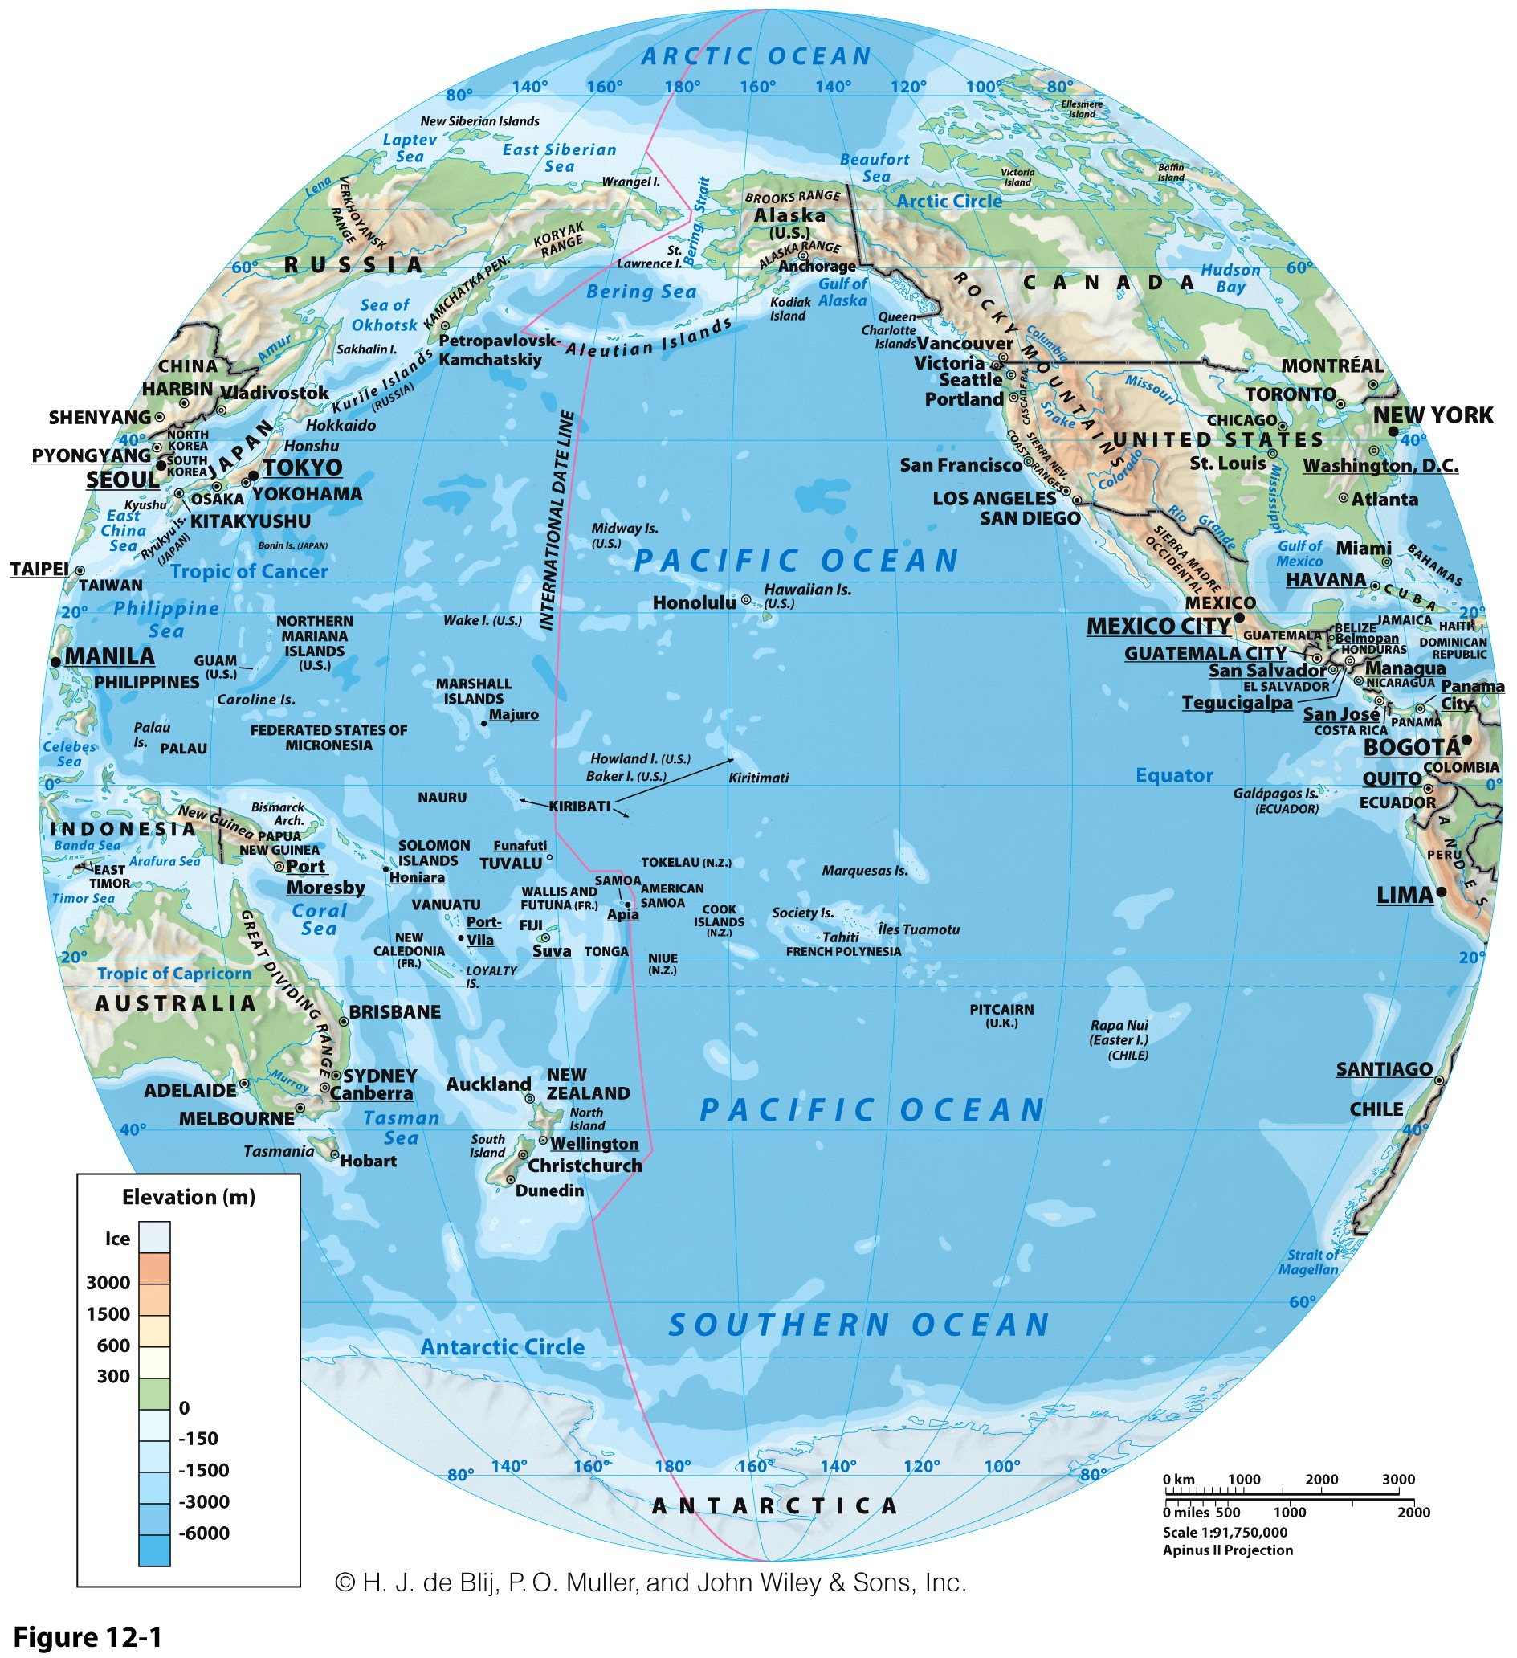

Slide 22
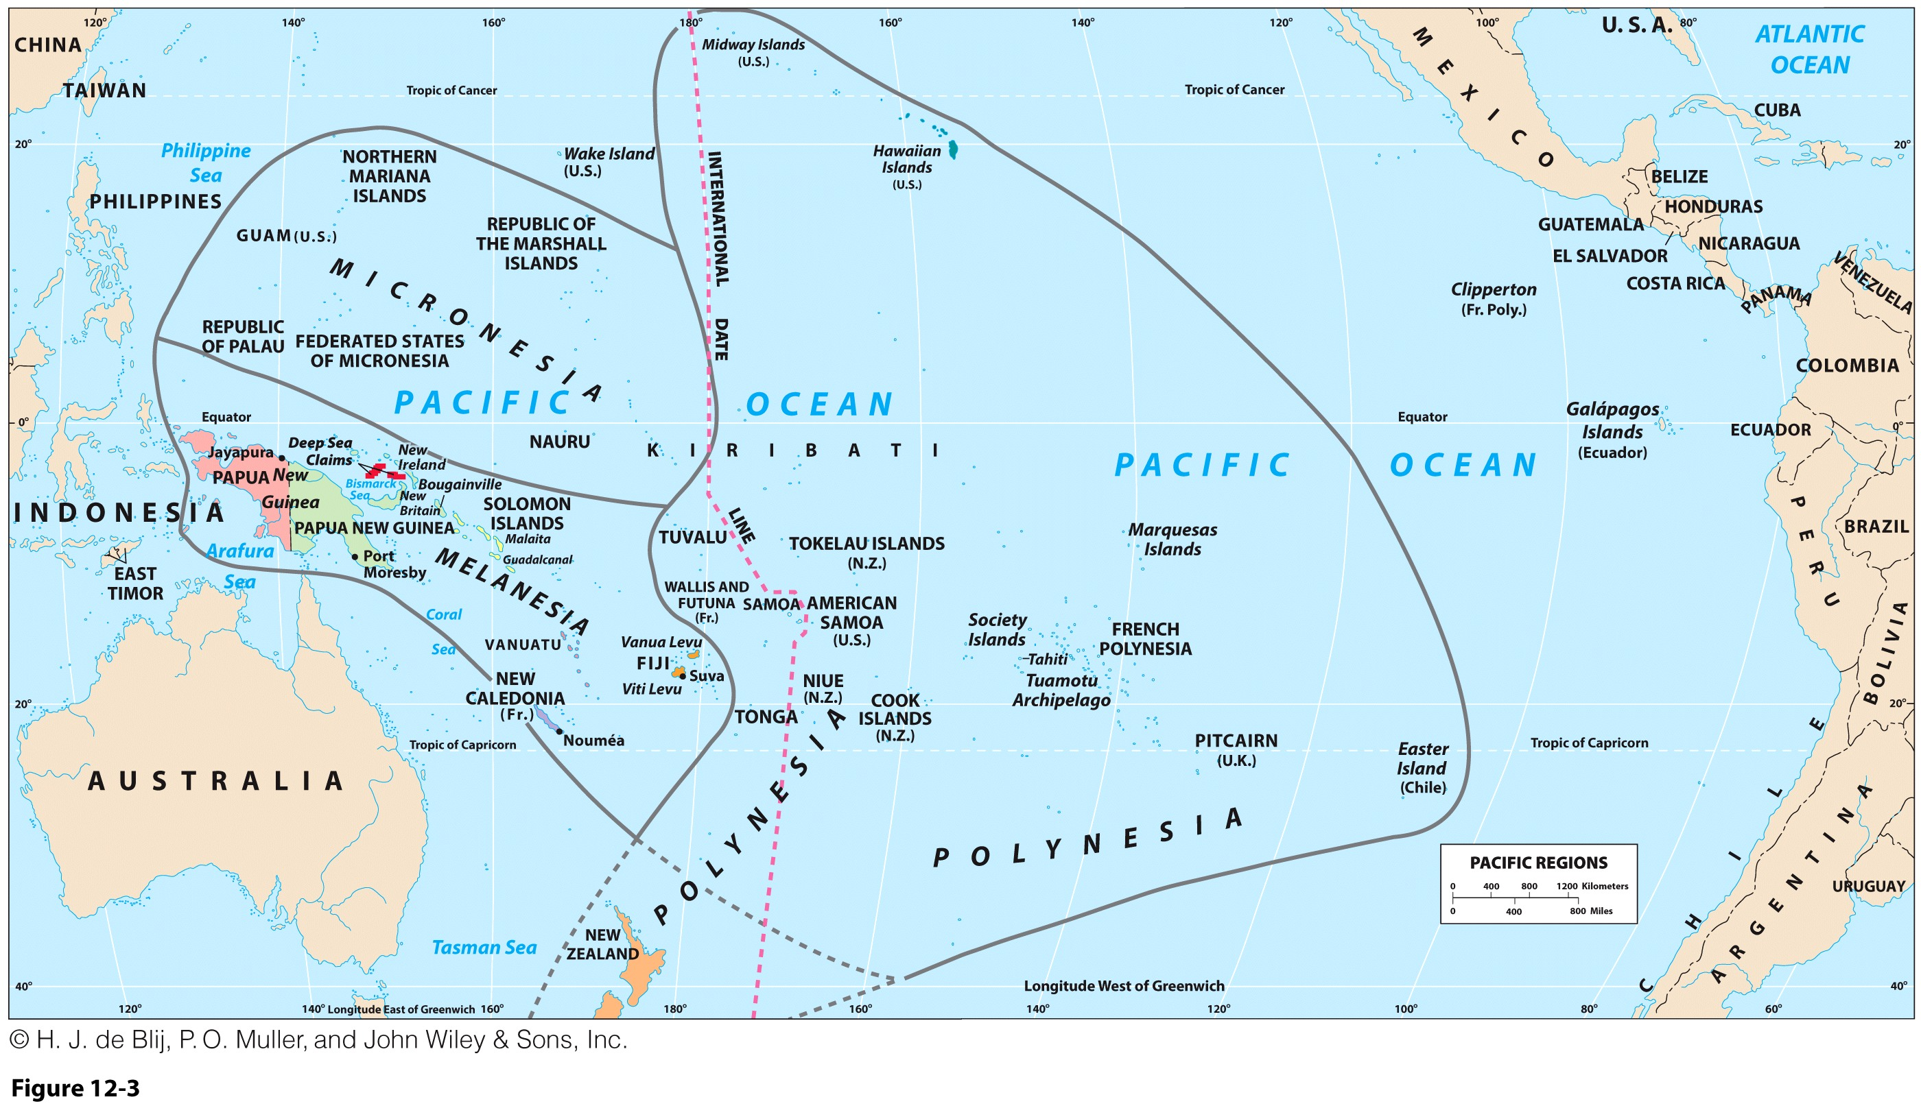

Slide 23
Defining the Realm
Sea Hemisphere:
  Seas cover nearly an entire hemisphere.
  Fragmented, culturally complex realm.
  Total land area:
    Roughly equal to Texas and New Mexico.
    But 90 percent of land is Island of New Guinea.
Outside the realm:
  Indonesia, Philippines, Australia, and New Zealand.

Slide 24
Defining the Realm: High and Low Islands
High islands
  Volcanic origins.
  High elevations/rugged relief.
  Well-watered (rain shadow).
  Good soils, some agriculture.
  Tend to have larger populations; (New Caledonia, Hawaii).
Low islands
  Majority of realm’s islands.
  Small populations (e.g. Marshall Islands, Kiribati).
  Coral formation (atolls) thus little fresh ground water.
  Low elevation/relief.
  Vulnerable to drought and sea level rise/tsunami.
  Fishing, coconut palm, no minerals.
  Tourism and internet domains.

Slide 25
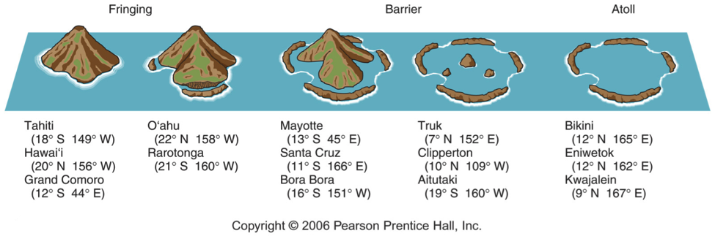
Atoll Formation

Slide 26
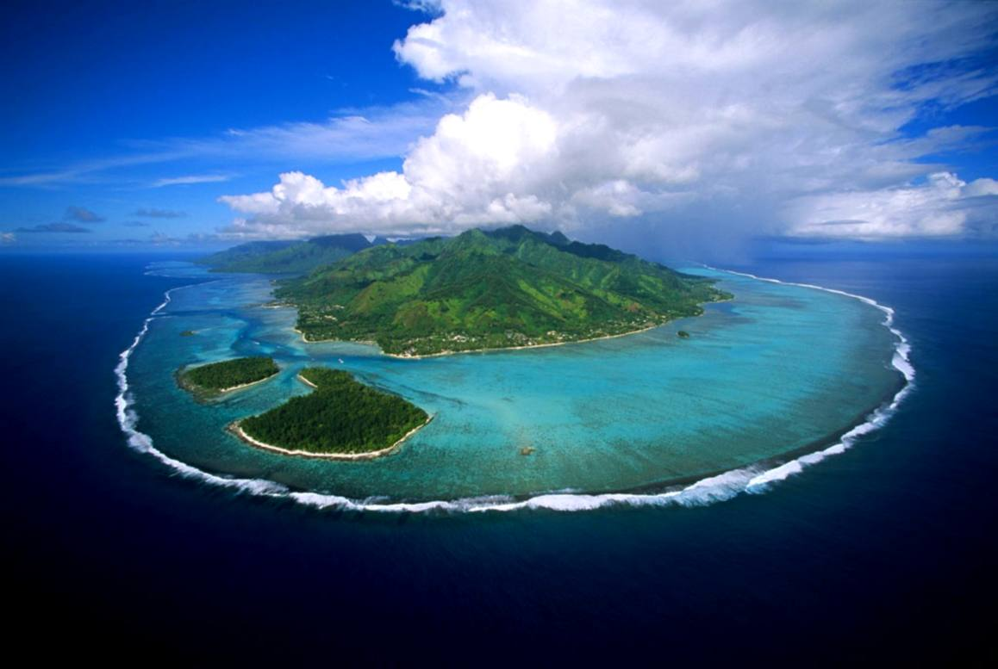
Barrier Island (Osprey Reef)

Slide 27
Colonization and Independence if the Pacific Realm
Most have been colonized or annexed.
Changing politics:
  Some have stayed colonies.
  Some have become independent.
  Some are somewhere in between.
Island nations are rather disadvantaged in a world of large area states.
‘Nuclear isolation’:
  The United States (Marshall Islands) and France (French Polynesia) conducted hundreds of nuclear tests from the 1950s to the 1990s.
  Lead to a sharp increase in cancer prevalence.

Slide 28
The Pacific Realm and its Marine Geography
Marine geography is a field encompassing a variety of approaches to studying the oceans and seas.
Vast Pacific Ocean:
  Where Pacific waters meet surrounding shores.
  Incorporates several seas:
    Sea of Japan.
    East China.
    South China Seas.
  Pacific coastal countries compete for jurisdiction over the waters that bound them.
The Pacific Realm is an oceanic realm. Explain what it entails.

Slide 29
The Pacific Realm and Its Marine Geography: The State at Sea
Territorial sea: the ocean area where all the rights of a coastal state would prevail:
  Beyond that lay the high seas as the free and open seas unfettered by national interests.
  Continental shelves, as the offshore continuation of coastal plains, became a new littoral frontier to establish boundaries.
Scramble for the Oceans
  Precipitated by the claims of jurisdiction over the continental shelf.
  Political claims were then issued for territorial seas without a significant continental shelf to base them.

Slide 30
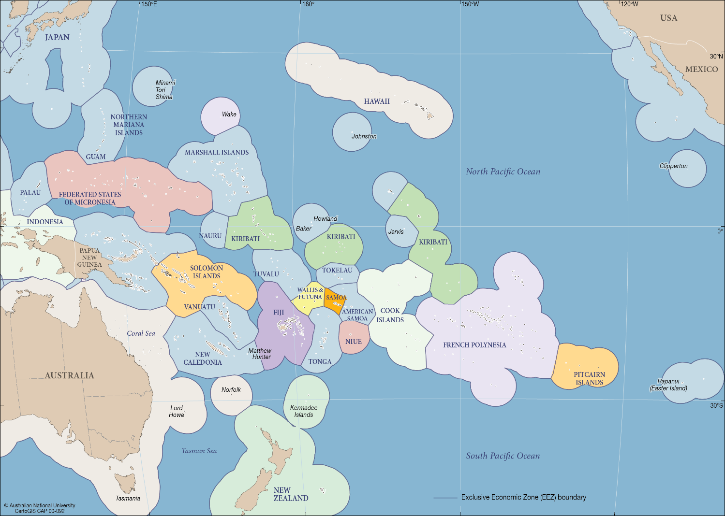
Exclusive Economic Zones in the Pacific

Slide 31
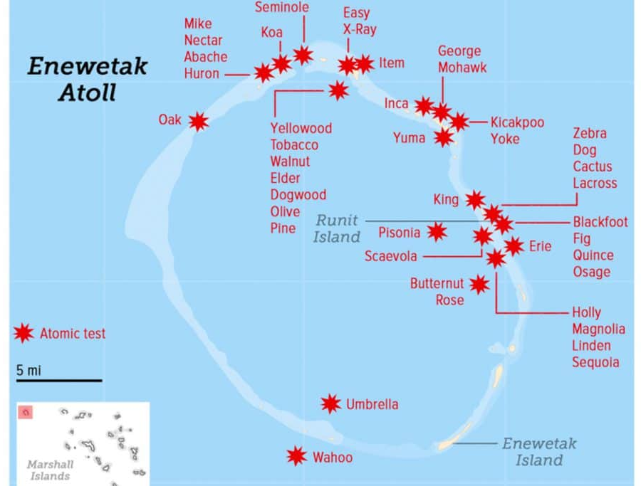
The Pacific Realm: The Risk of Climate Change
Marshall Islands
  29 coral atolls totaling 180 square kilometers of land mass.
  Japanese dependency from 1914.
  Administered by the UN (United States) since 1945.
  Nuclear tests from 1946 to 1962.
  Independence in the 1990s.
  Regional rise of sea levels of 1 feet since 1985.
  Risk of relocating a population of 70,000.

Slide 32
Antarctica
Ice dome – 3.2 km thick at pole
5.5 million square miles (compare North America 7.7 million)
Multiple Claims
The Antarctic Treaty, 1961
  Promotes scientific collaboration.
  Prohibits military activity.
  Territorial claims are held in abeyance.

Slide 33
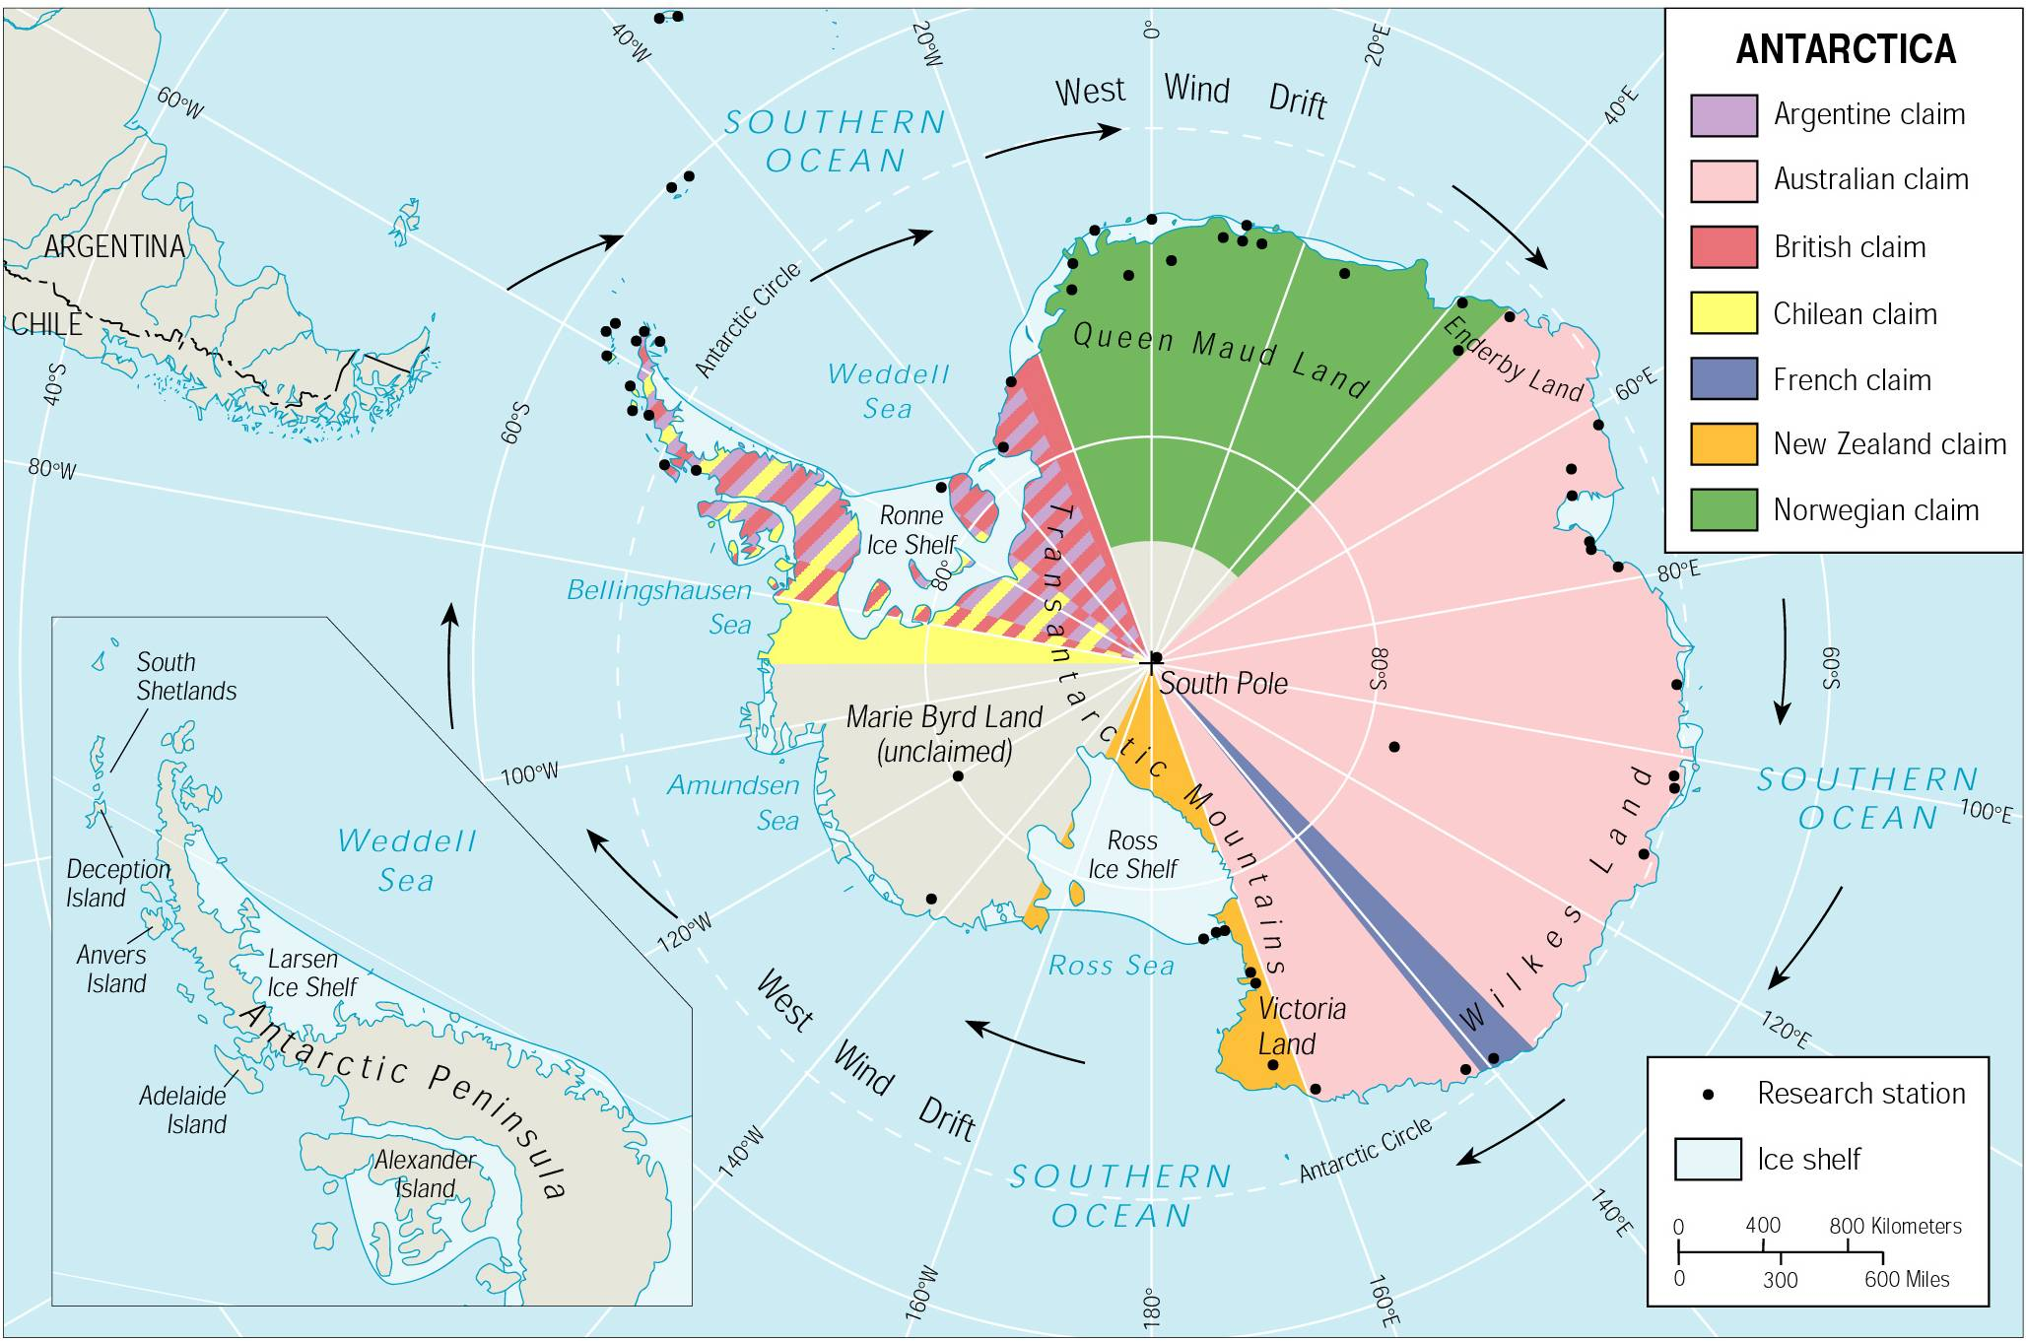

Slide 34
Conclusion: Five Challenges of World Regional Geography
Economic
  Economic development and regional disparities; an enduring uneven world?
Demographic
  Regional differences in population growth and decline. The pressure of migration (and refugees).
Political
  New regional political agreements? Devolution? Enduring regions of political instability?
Environmental
  Resource depletion and climate change. Regions of environmental stress.
Cultural
  The loss of regional identities? Cultural mosaics?

