Slide 1
Topic 6 – Population and Resources
A – Malthusianism
B – Neo-Malthusianism
C – Creative Pressure

Slide 2
A. Malthusianism
1. Demographic Capacity
  What are the principles of Malthusianism?
2. The Malthusian Crisis
  What does a Malthusian crisis involves?
3. Contemporary Issues
  To what extent Malthusianism applies today?

Slide 3

1. Demographic Capacity
How many people can be sustained by the Earth?
  Based on human choices and natural constraints.
  Maximum density.
  Quantity of arable land.
  Agricultural technology.
  Harvesting the ocean.
  Human facilities.
  Availability of resources (energy, construction materials, etc.).
Space
Technology
Consumption
Resources

Slide 4
1. Demographic Capacity
Demographic capacity
  Studies about nature’s capacity to support human life go back many centuries.
  Leeuwenhoek (1679) extrapolated densities for Holland to the whole planet (13.4 billion capacity).
  Focus:
    Space.
    Energy requirements.
    Non-renewable resources.
    Photosynthetic potentials.
  All are based on the same principle:
    Tracing resource and energy flows through the human economy.

Slide 5
1. Demographic Capacity
Ravenstein in 1891
  Concept of carrying capacity.
  Focused on the earth’s cultivable areas, and their potential productivity given increases in yields over time:
    Fertile: 200 people / km2.
    Steppe: 10 people / km2.
    Desert: 1 person / km2.
  Figure of 6 billion people as the number Earth could sustain without lowering living standards.
  Reached this number in 1999.
Arable land
X
Agricultural
technology
/
Consumption
per capita

Slide 6
1. Demographic Capacity
Contemporary issues
  Events such as the Green Revolution were not foreseen by Ravenstein.
  Managed to increase agricultural yields in many areas by quantities far greater than he had anticipated.
  Efforts to calculate carrying capacity have largely failed.
  Too many variables.
  Value ranges between 4 and 16 billion.
Explain the concepts of demographic capacity and the debate about if the world is exceeding its demographic capacity.

Slide 7
1. Demographic Capacity
Level of consumption
  Alternative perspective.
  The issue is not resource supply, but resource demand.
  The world is producing only a finite number of resources for consumption.
  Demographic capacity is linked with level of resource consumption.
American (lifetime)
  1 million kg of atmospheric waste.
  10 million kg of liquid waste.
  1 million kg of solid waste.
  700,000 kg of minerals.
  24 billion BTU of energy.
  25,000 kg of plants.
  2,000 animals (28,000 kg).

Slide 8
1. Demographic Capacity
Ecological footprint and biocapacity
  Try to assess the demand of human activities on the environment.
  Transformed over an unit of surface.
  Footprint (2003): 2.2 hectares per capita.
  Biocapacity (2003): 1.8 hectares per capita.
  Net deficit, in theory.
  May be overestimating the footprint because of CO2 sequestration assumptions.
Area
Population
X
X
Consumption per person
Bio-productivity
X
Footprint intensity
=
=
Biocapacity
(Supply)
Ecological Footprint (Demand)

Slide 9
2. The Malthusian Crisis
Context
  Thomas Malthus (1766-1834) in his book “Essays on the Principle of Population” (1798).
  Relationships between population and food resources (area under cultivation).
  Growth of available resources is linear while population growth is often non-linear (exponential).
  Written during a period of weak harvests.
  Took notice of famines in the Middle Ages, especially in the early 14th century (1316).
  From the data he gathered, population was doubling every 25 years.
  Over a century’s time, population would rise by a factor of 16 while food rose by a factor of 4.
Deficit
Demographic
growth
Resource
growth

Slide 10
2. The Malthusian Crisis
The “Malthusian trap”
  Available agricultural spaces are limited.
  Technical progresses (machinery, irrigation, fertilizers, and new types of crops) are slow to occur.
  Increasing incapability to support the population.
  If this persists, the population will eventually surpass the available resources.
  The outcomes are “Malthusian crises”, or “positive checks”:
    Food shortages.
    Famines.
    War and epidemics.
  “Fix” the population in accordance with available resources.
  Necessity of a “moral restraint”, or “preventive checks” on reproduction.

Slide 11
“The Malthusian Trap”
Subsistence Economy
New Technology
Return to Subsistence
Equilibrium (Births = Deaths)
Higher incomes, higher births and
lower deaths
Populations growth, pressures on
resources less births and
more deaths
Death Rate
Births
Birth Rate
Deaths
Low
Income
Subsistence
Income
High
Income
Low
Income
Subsistence
Income
High
Income
Low
Income
Subsistence
Income
High
Income
Notes:
Source: New York Times, August 7 2007, “In Dusty Archives, a Theory of Affluence”

Slide 12
2. The Malthusian Crisis
t3
Quantity
t2
Technological Innovation
t1
Resources
Population
Overexploitation
Time

Slide 13
2. The Malthusian Crisis
The Malthusian Crisis has not occurred
  Malthus has been criticized on several accounts during the last 200 years.
  Religious view (Protestantism), racist and elitist.
  Did not foresee the demographic transition:
    Changes in the economy that changed the role of children in the industrializing societies.
  Failed to account for improvements in technology:
    Enabled food production to increase at rates greater than arithmetic, often at rates exceeding those of population growth.
    Enabled to access larger amounts of resources.
    Enabled forms of contraception.

Slide 14
Global Growth in Population and Grain (Wheat and Rice) Production, 1961-2014
Notes:
Source: FAOSTAT
http://www.fao.org/faostat/en/#data/QC

Slide 15
3. Contemporary Issues
The Malthusian crisis today
  Demographic growth:
    Between 1960 and 2012, four billion persons were added to the global population.
    To sustain this growth, agricultural resources had to be doubled.
    Required housing space surpassed all that was constructed since the beginning of mankind.
  Agricultural growth:
    Between 1960 and 2014, grain yields has increased by 200% while cultivated surfaces have only increased by 10%.
    Foresee a limit to growth in agricultural production.
  Consumption growth.
  Environmental degradation.

Slide 16
3. Contemporary Issues
Relevance of the Malthusian theory
  Was Malthus right or the trend in agricultural production will again increase to surpass population growth?
  Are improvements in agricultural techniques enough to answer demand?
  The next 25 years will be crucial and will bring forward answers to these questions.
  The work of Malthus continues to be important to demographers:
    Influence of many contemporary theorists from various academic disciplines.
    Built upon Malthus’s ideas and linked them to modern sciences.
Explain the core elements of the Malthusian perspective about the relationship between population and resources.

Slide 17
B. Neo-Malthusianism
1. Neo-Malthusian Concepts
  How can the Malthusian theory be adapted to the current situation?
2. The Commons
  In which way common resources are used?
3. Neo-Malthusianism and Human Reproduction
  Is reproduction a right or privilege?

Slide 18
1. Neo-Malthusian Concepts
Look in details at the carrying capacity
  Issue linked with the carrying capacity of land.
  Limits to absorb ever-greater numbers of people.
  Population growth has environmental impacts.
  Support of family planning, contraception and abortion.
  Population problems cannot be addressed through technology beyond the short term.

Slide 19
1. Neo-Malthusian Concepts
Population bomb
  Brought forward by Paul Ehrlich in the late 1960s.
  Fast population growth seen as a threat:
    The word “bomb” refer to the perceived lethal character of the problem.
    Most Third World countries were in the middle of their demographic transition at the time.
  Ehrlich and others continued the basic Malthusian numbers game in which population growth outstrips food production.
  Moved Beyond Malthus in their consideration of many environmental issues.
  Predicted that the population of the United States would shrink to 22.5 million in 1999 due to resource shortages.
  Estimates turned out to be completely inaccurate.

Slide 20
1. Neo-Malthusian Concepts
Limits to growth
  “Club of Rome”, 1972
  Scientific report on the limits to growth.
  Used computer models for the first time:
    Population growth, food per capita, industrial output, resources and pollution.
  Blaming huge waste of resources by developed economies.
  Supporting a zero growth policy.
  Main arguments:
    Resources are in finite number.
    An accounting system.
    Demographic growth cannot occur indefinitely.
    Must stop at some point.
Population
Industrial output
Resources

Slide 21
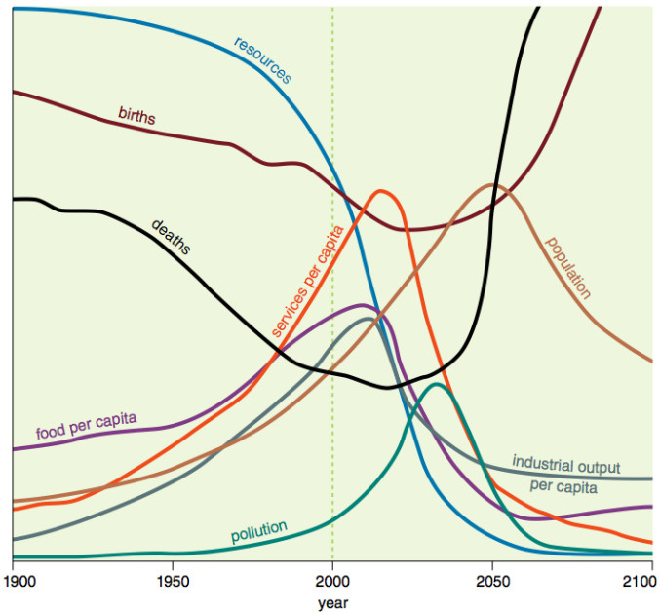
Global Model of the Club of Rome

Slide 22
2. The Commons
Definition
  Resources that we share as a population:
    Land and other inputs into the food production process.
    Oceans and their contents, particularly fish as a food source.
    The atmosphere.
    Sources of energy.
    Landscape for recreational purposes.
  Resources of the commons are in finite quantities while access is free (in theory).
  The world is finite and can support only a finite population:
    Population growth must eventually equal zero.
    Otherwise we have to abandon certain freedoms of access to the Commons.
    The only way freedoms can be saved is by relinquishing the freedom to breed.

Slide 23
2. The Commons
Example of using the commons
  Decision on whether to increase the size of herd that grazes on common lands.
  A rational being seeking to maximize his gain:
    Positive component of adding animals is additional income from additional animals.
    Negative component is the overgrazing caused by the additional animals.
    The costs are shared by those using the common grazing lands.
    Decision to add the extra animals to his herd.
    Unfortunately, all of the other villages will arrive at the same conclusion, do the same thing.
  The outcome is the ruin to the environment.

Slide 24
2. The Commons
Village | 1 | 2 | 3 | 4
Cattle | 3 | 3 | 3 | 3
Commons | 14 – 12 = 2
Cattle | (+1) 4 | (+1) 4 | (+1) 4 | (+1) 4
Commons | 14 – 16 = -2 (overgrazing)
Village
4
1
Commons
(sustain 14)
3
2
Cattle (grazing)
Benefits: +1 each
Costs: -1 each

Slide 25
2. The Commons
The tragedy of the commons
  Freedom in a commons brings ruin to all.
  All the resources will be used.
Solutions
  Private property:
    Removes some of the Commons from access.
    Encourages conservation and wise management.
    Vested interest in maintaining it for future use.
  Collective property:
    Parts of the Commons not possible to divide into private segments - atmosphere, oceans, etc.
    Collective (global) ownership.
    Taxation and coercive laws as the primary means of preservation.
Explain what are the commons and how this concept applies to global environmental issues.

Slide 26
World Fish Catch per Capita, 1950-2001
Notes:
Source: FAO.

Slide 27
Commercial Harvests in the Northwest Atlantic of Some Fish Stocks, 1950-95 (in 1,000 metric tons)
Notes:
Commercial Harvests in the Northwest Atlantic of Some Important Fish Stocks, 1950-95
According to an FAO analysis, based on fish harvest records from 1950 to 1994, 35 percent of the most important commercial fish stocks show a pattern of declining yields and require immediate action to halt overharvesting. Another 25 percent show steady yields but are being fished at their biological limit and are vulnerable to declines if fishing levels increase. For more information see http://www.wri.org/wri/trends/fishloss.html.
Source: Food and Agriculture Organization of the United Nations (FAO), Fishstat-PC (FAO, Rome, 1997).

Slide 28
Average Global Temperature and World Carbon Emissions From Fossil Fuel Burning, (in millions of tons) 1800-2013
Notes:
Source: Earth Policy Institute, http://www.earth-policy.org/data_center

Slide 29
3. Neo-Malthusianism and Human Reproduction
Human reproduction
  Malthus was advocating “moral restraint”:
    A religious bias.
  Modern contraception:
    A tool of population control (state perspective).
    A tool of freedom in reproductive choice (market perspective).
  Against subsidizing reproduction:
    Welfare state.
    Many international aid programs.
    Remove the punishment (such as children starving to death) from having too many offspring.

Slide 30
3. Neo-Malthusianism and Human Reproduction
Freedom to breed
  Clashes between neo-Malthusianism and human rights.
  Can human population control be achieved through voluntary means?
  UN’s Declaration of Human Rights:
    Defense of the individual family’s right to determine family size.
    Support the freedom to breed for political reasons.
    Few governments are able or willing to enforce restrictions on the reproduction of their populations.
  With freedom to breed comes equal obligations:
    Responsibility to the welfare of the children.
    Difficult concept to grasp, especially by an uneducated population and with welfare systems.
  Each new individual competes with other for resources.
Is reproduction a right or a privilege?

Slide 31
C. The Creative Pressure
1. Concept and Issues
  What does the creative pressure theory imply?
2. Limits to Productivity
  What may be the limits to productivity?
3. Creative Pressure vs. Neo-Malthusianism
  Can Neo-Malthusianism and creative pressure be reconciled?

Slide 32
1. Concept and Issues
Concept
  Opposed to the Malthusian and Neo-Malthusian perspectives.
  Often labeled as the economic optimistic view.
  Brought forward in the early 1960s.
  Population has a positive impact on economic growth.
  Resources limited by humanity’s potential to invent.
  “Necessity is the mother of all inventions”.
  Scarcity and degradation are the sign of market failures.
  Population pressure forces the finding of solutions.
Demographic growth
Problem
Higher occupation
densities
?
Pressures to increase
productivity
Solution
Innovations
Productivity growth
Outcome

Slide 33
1. Concept and Issues
Types of innovations
  Discovery:
    An entirely new class of resources is made available.
    Often adds to existing resources.
    Offers new economic opportunities.
    E.g. the usage of oil as a source of energy.
  Productivity gains:
    Existing resources are used more effectively.
    Often implies using less of the same resource.
    Developing a more efficient engine.
  Substitution:
    An alternative resource is used.
    Often because the existing resource becomes too expensive / scarce.
    Using ethanol.

Slide 34
1. Concept and Issues
Technological innovation and agriculture
  Intensification of agriculture.
  New methods of fertilization.
  Pesticide use.
  Irrigation.
  Multi-cropping systems in which more than one crop would be realized per year.
Creative pressure and global population growth
  Would lead to new productivity gains.
  Humans don’t deplete resources but, through technology, create them.
  Resources will become more abundant.
  Help overcome shortage in food production and employment.

Slide 35
Global Rice and Wheat Yield, 1961-2014

Slide 36
2. Limits to Productivity
Limits of food production by environmental factors
  Substitution is not possible for many resources.
  Soil exhaustion and erosion.
  Evolutionary factors such as the development of greater resistance to pesticides.
  Climate change could reduce yields.
  Loss of productive soils due to land use conversion to other purposes, such as urbanization.
  Water shortages and pollution.
Limits by technology
  May be available but not shared.
  Maybe too expensive for some regions (e.g. desalination).

Slide 37
2. Limits to Productivity
Resources capture
  As a resource become scarcer frictions and competition for access to key resources.
  Eventually, a group secure / capture the resource and makes it unavailable to others.
  This capture either takes place through legislation and / or force.
  Leads to marginalization and risks of conflicts.
The potential for conflicts
  The risks that marginal nation states break down.
  Fall down to warlordism.
  Large migration pressures towards more stable parts of the world.

Slide 38
3. Creative Pressure vs. Neo-Malthusianism
Carrying capacity
Environmental
degradation
Neo-Malthusianism
21st century
Creative
pressure
Resources
Malthusianism
19th-20th century
Population
Demographic transition

Slide 39
3. Creative Pressure vs. Neo-Malthusianism
Neo-Malthusianism
  Population consumes resources.
  Population growth has environmental consequences.
  Notion of carrying capacity.
  Population should be controlled by strict family planning policies.
  Overpopulation linked with levels of consumption.
Creative Pressure
  Population induces the creation of resources and the substitution to alternative sources.
  “Necessity is the mother of all inventions”.
  Population will adjust itself to the quantity of available resources.

Slide 40
3. Creative Pressure vs. Neo-Malthusianism
High fertility lessens the growth of GDP per capita
  Healthcare and education costs.
  Labor markets unable to provide enough jobs.
High fertility compounds poverty
  Limited wage growth.
High fertility limits savings
  Basic consumption patterns.
High fertility reduces education
  Less average level of schooling.
High fertility puts pressures on resources
  Lead to environmental degradation.

Slide 41
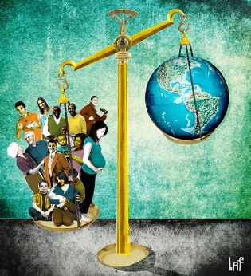
Essay: Future population geographies
The world is at a turning point with an uncertain future. Based upon what has been covered this semester, provide a demographic perspective of what the world may look like by 2050. The main issues to be addressed relate to fertility, mortality and migration.

