Slide 1
Topic 4 – Migration and Refugees
A – Internal Migration
B – International Migration
C – Refugees
D – Urbanization

Slide 2
Conditions of Usage
For personal and classroom use only
  Excludes any other form of communication such as conference presentations, published reports and papers.
No modification and redistribution permitted
  Cannot be published, in whole or in part, in any form (printed or electronic) and on any media without consent.
Citation
  Dr. Jean-Paul Rodrigue, Dept. of Economics & Geography, Hofstra University.

Slide 3
C. Refugees
1. Definition
2. Contemporary Evolution
3. Internally Displaced Persons
4. Future Considerations

Slide 4
1. Definition
The United Nations definition
  The 1951 Convention Regarding the Status of Refugees and the 1967 Protocol on the Status of Refugees:
    “..... any person who, owing to a well-founded fear of being persecuted for any reasons of race, religion, nationality, member of a particular social group or political opinion, is outside the country of his nationality, and is unable or, owing to such fear, is unwilling to avail himself of the protection of that country.…” .
  The problem lies in the definition of who is a refugee.
  What is ‘fear’?
  There are no international agreements to protect people who cross boundaries for their economic survival.

Slide 5
1. Definition
Conditions to qualify for refugee status
  Political persecution must be demonstrated:
    Clouded by the ideology and politics.
  An international boundary must be crossed:
    Domestically displaced persons do not qualify.
  Protection by one’s government is not seen an alternative:
    The government may be the persecutor.
    Could be incapable of protecting its citizens from persecution.
  A refugee has the right of not be returned to his/her country of origin against his/her will and without due process.
  Refugees are entitled to basic civil rights such as medical care, schooling and even housing.
  In cases of large refugee influxes, the HNHCR (United Nations High Commission for Refugees) can intervene.

Slide 6
2. Contemporary Evolution
Origin of refugees
  The first recorded refugees were the Protestant Huguenots who left France to avoid religious persecution.
  Edict of Nantes of 1685 revoking rights for Protestants to freely practice their religion
  About 200,000 fled at the end of the 17th century.
  Went to England, Germany, the Netherlands, Switzerland, and the English colonies in North America.

Slide 7
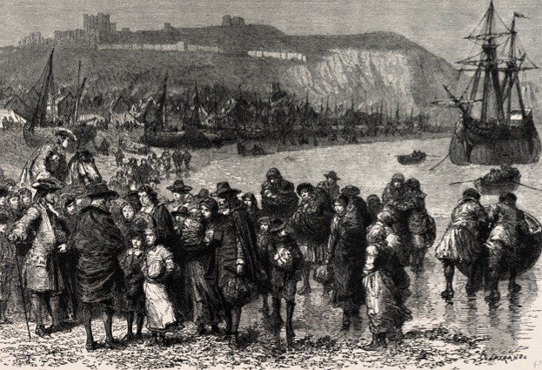
Huguenots Refugees Arriving in England, Late 17th Century

Slide 8
2. Contemporary Evolution
Pre-WW II and during WW II
  Primarily political elites:
    Fleeing repression from the new government, which overthrew them.
    Usually small in number and often had substantial resources available to them.
  War-driven refugees:
    Jewish and other minorities trying to flee Germany before WWII.
    About 12% of the European population displaced.
    Usually could be expected to repatriate after the war ended.

Slide 9
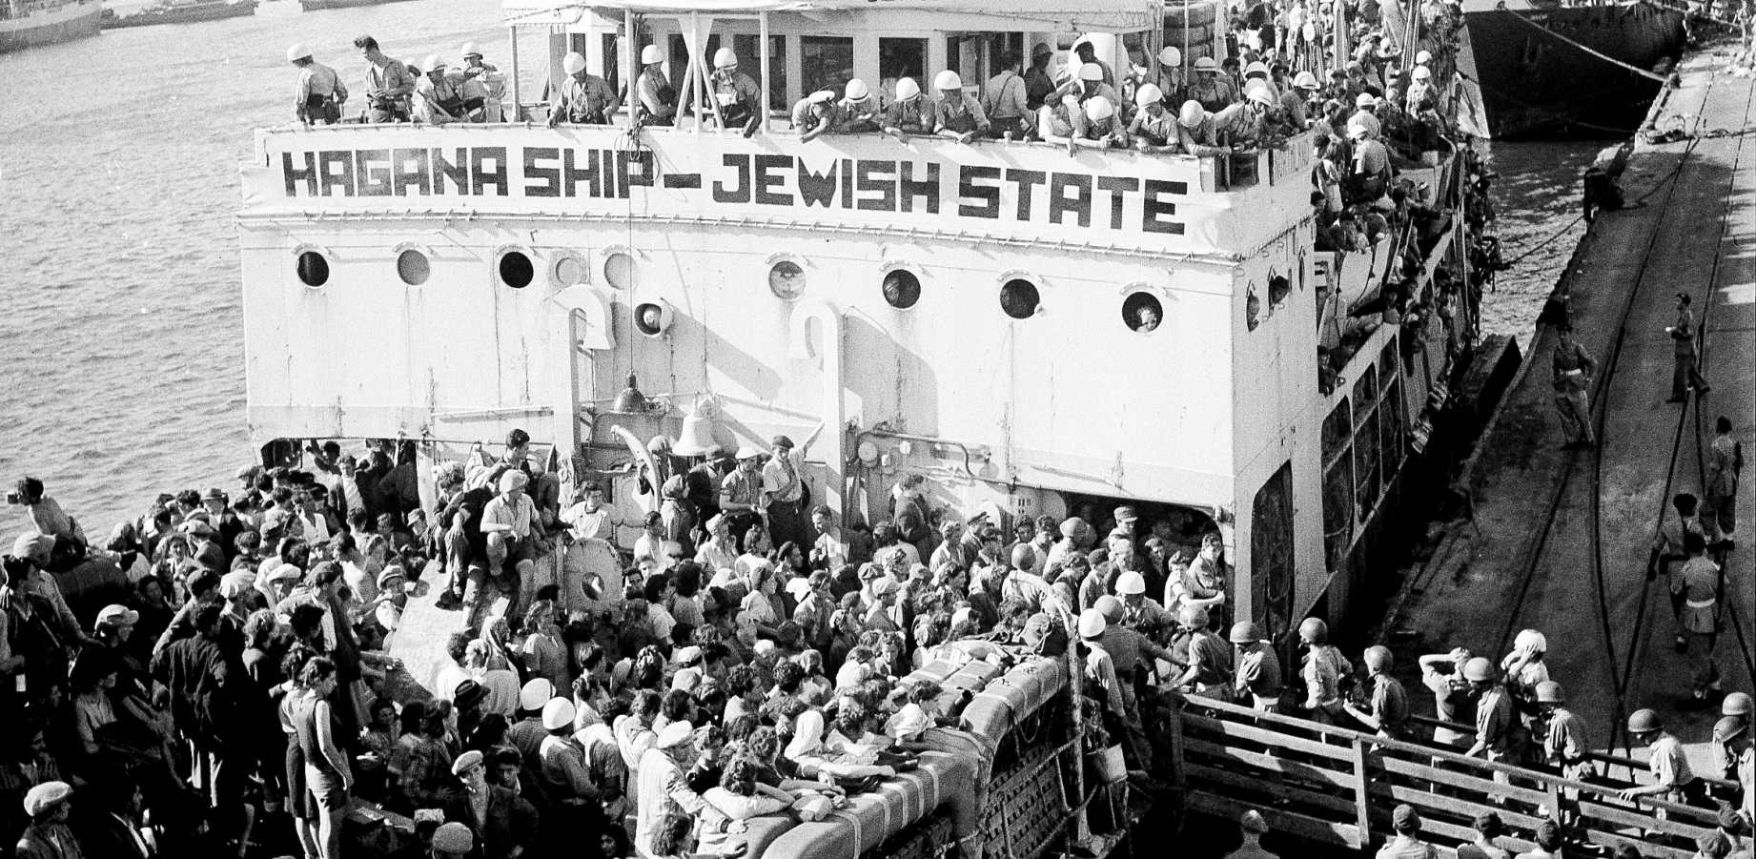
Jewish Refugee Ship Heading to Israel, 1947

Slide 10
2. Contemporary Evolution
Post WW II
  Change in the patterns of refugee flows:
    The majority of refugees are now coming from the developing world.
  De-colonization in Asia, Africa, and the Caribbean:
    Political unrest in many newly independent states.
    Multi-ethnic nature of those states.
    The result of the drawing of colonial boundary lines by Europeans.
  The Cold War:
    Confrontations backed by superpowers.
    Increased political instability in a number of countries (e.g. Sub-Saharan Africa and Southeast Asia).
    Political instability in Latin America increased due to the vast social inequalities existing in that region.
  New kind of refugee flow:
    Large and of long (or permanent) duration.

Slide 11
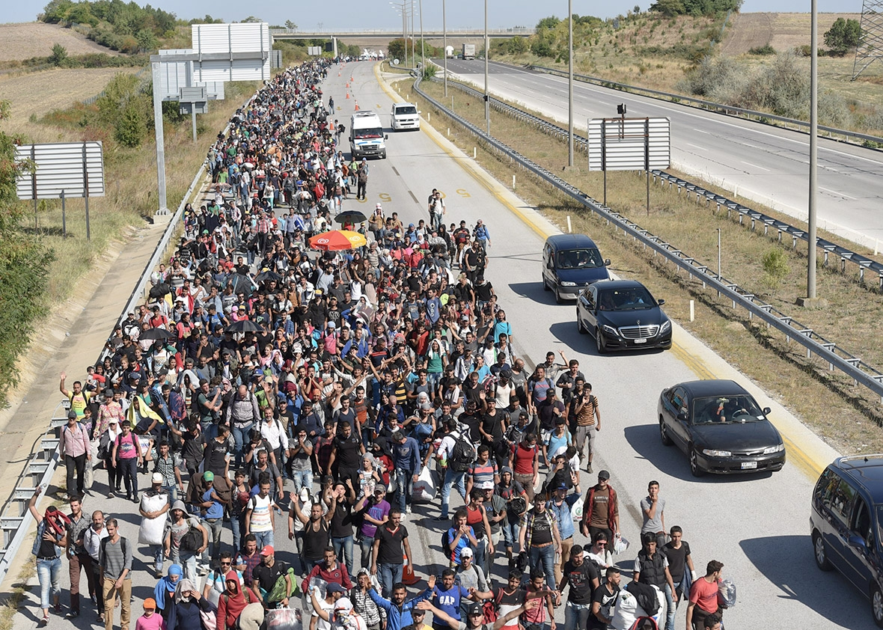
Syrian Refugees Marching Towards the Greek Border, 2015

Slide 12
Refugees and Internally Displaced Populations, 1951-2015
Explain how the status of refugees has evolved in time and what is particular to the current global context.
Notes:
Source: UNHCR. http://popstats.unhcr.org/en/overview

Slide 13
2. Contemporary Evolution
Avoiding responsibilities
  Economic and political obligations linked with accepted refugees.
  Governments often dispute the refugee claims.
  Particularly over environmental and economic refugees.
  Fear of opening up a massive wave of immigrants.
  Subsidiary protection is often offered:
    Less constraining than refugee status.
    Those seeking asylum but not qualifying as refugees.
    There are simply at a risk of being harmed because of the unstable conditions of their country of origin.
    Often granted a one years residency permit.
  Refugees are often the least successful type of migrants:
    Regular migrants are usually ‘self selected’.
    Refugees encompasses all the segments of society.

Slide 14
2. Contemporary Evolution
Outcomes for the refugee situation
  Return to the country of nationality:
    The most preferred outcome, including for the refugee.
    Requires a normalization of conditions in the country of origin.
  Settlement in the country of asylum:
    Often the only practical alternative.
    If involving a developing country, work opportunities may be limited.
    Create national identity challenges, particularly if refugee population is substantial.
  Resettlement to a third country:
    A small share of total refugees (1 to 5%).
    Mostly concern the US, Canada and Australia and a few Northern European countries).
    Resettling countries have a choice in terms of the profile of the refugees they are willing to accept.

Slide 15
Refugee Population by Territory of Asylum
Notes:
Source: UNHCR.

Slide 16
Countries of Origin and Destination of Refugees, 2014-15
Notes:
Source: UNHCR.

Slide 17
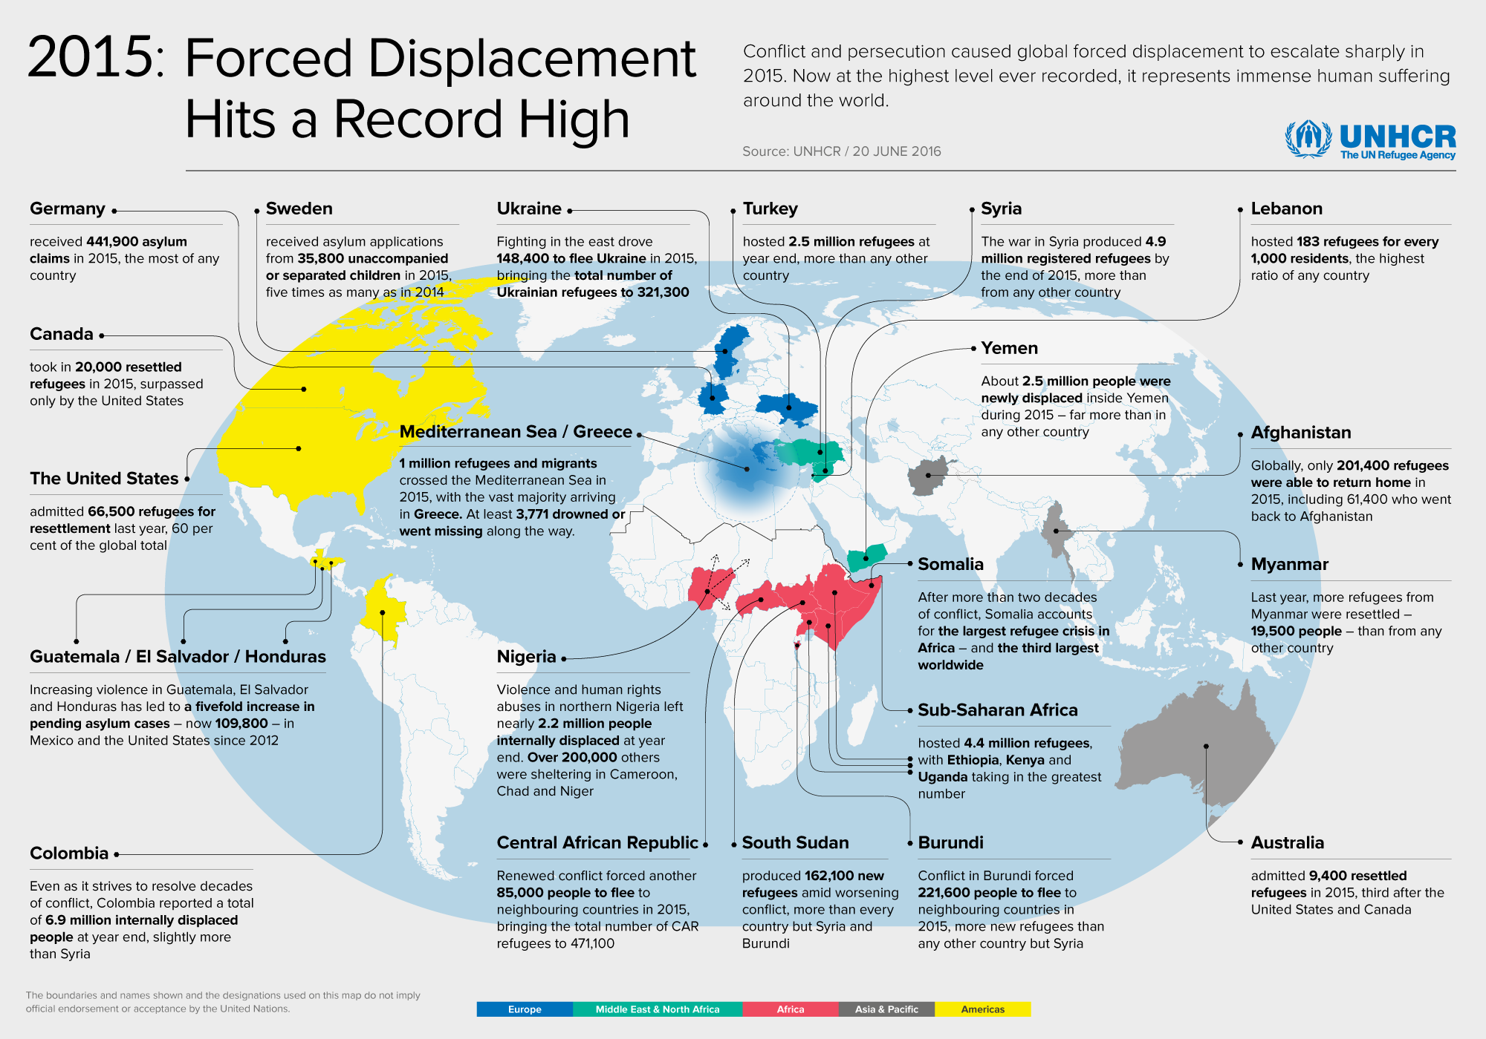

Slide 18
3. Internally Displaced Persons
Unable to leave their country of origin
  Cannot available themselves for international refugee assistance.
  Usually account for 2/3 of the refugees.
  At high risk since close to zones of conflicts and an ineffective central government.
  Cannot be assisted effectively for UNHCR, unless given consent by concerned state.

Slide 19
Internally Displaced Populations, 2015

Slide 20
4. Future Considerations
Closing the door
  Changes in the dynamism of conflicts:
    Internal struggles based upon political, religious and ethnic ideologies.
    Enduring turmoil providing an ‘endless’ supply of refugees.
  Refugees are a controversial issue:
    Especially in the developed world.
    From compassion to fatigue.
    Difficult to differentiate economic refugees.
    Only a small share of the asylum seekers are granted the refugee status.
    Less than 5-10% for the European Union.
    Increasingly, refugees are no longer accepted.
    Economic refugees resorting to asylum as the only way to get a legal status.
    Rejected refugees often slip into illegal immigration (and the underground) due to lack of deportation.

Slide 21
4. Future Considerations
Smuggling networks
  Lucrative business due to high demand.
  Creates a system of debt, bondage and abuse (prostitution).
  Blocking routes, usually result in traffic diversion to other routes and points of entry.
  Usage of high risk routes (e.g. crossing the Mediterranean).
The doors are closing for refugees. Explain what are the main reasons why states are less willing to accept refugees.

Slide 22
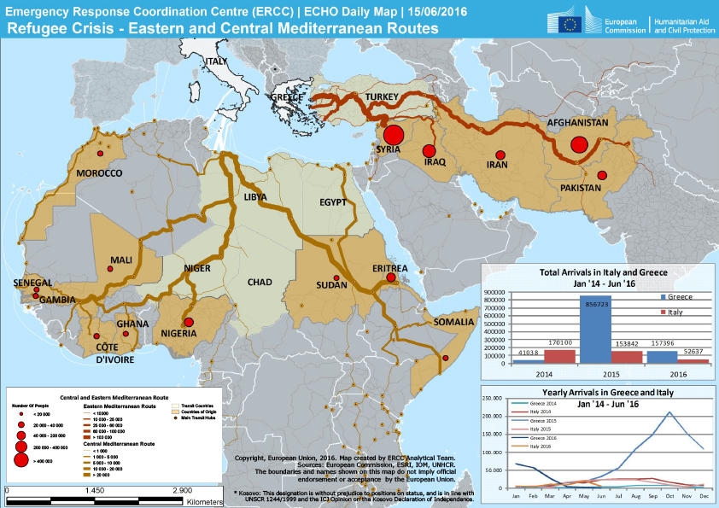
African and Middle Eastern Land Migration Routes to Europe
Notes:
Source: European Commission

Slide 23
4. Future Considerations
Environmental and economic refugees
  People who can no longer gain a secure livelihood in their homelands because of what are primarily environmental or economic factors of unusual scope.
  Sources:
    Natural disaster.
    Human alterations to the environment; climate change.
    Contamination (pollution) of the environment.
    Lack of development and opportunities.
  Render continued residence in that particular location unsustainable.
  Have limited alternatives to seek sanctuary elsewhere.
  Allowing environmental and economic refugees would essentially legalize all forms of migration.

Slide 24
D. Urbanization
1. Cities and Urbanization
2. History of Urbanization
3. The Functions of Cities
4. Megacities and Shantytowns

Slide 25
1. Cities and Urbanization
Demographic Process
Growth of the proportion of the population living in cities.
Urban population growth (natural increase or migration).
Infrastructure Process
Expansion of urban infrastructures and land use.
Socioeconomic Process
Creation of secondary, tertiary and quaternary sectors.
Creates a society where values and lifestyles are urban.

Slide 26
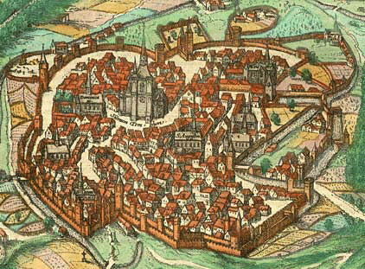
1. Cities and Urbanization
Causes of urbanization
  Historical:
    “Civis”.
    Defense.
    Trade routes.
  Social:
    Increased social interactions.
    Institutions representing a society (government, religion & education).
  Economic:
    Linked with agricultural surpluses.
    Increased economic opportunities (the most successful cities tended to be the most open to entrepreneurship).
    Access to labor.
    Specialization.
    Economies of scale and of agglomeration.
Notes:
The very terms “civilization” and “civilized” come from the Latin civis, which refers to a citizen living in a city. In Roman times civitas was concerned with the political and moral nature of community, while the term urbs, from which we get urban, referred to the built form of the city.

Slide 27
1. Cities and Urbanization
Causes of contemporary urban population growth
  Natural population increase:
    Births minus deaths.
    Demographic transition provided momentum.
  Migration from rural areas:
    Notably in countries with large rural populations.
  Immigration (international):
    Notably in Europe and North America.
    Concerns gateway cities.
  Reclassification of urban boundaries:
    Encompass other cities and towns.
    Encompass formerly rural areas.

Slide 28
1. Cities and Urbanization
Why People Move to Urban Areas?
  50 million new urbanites each year.
  1 million new urbanites each week.
  About 155,000 new urbanites each day.
  About 75,000 rural poor migrate to cities each day.
  Major changes in the developing world.
  Migration:
    Makes a significant contribution to the growth of urban areas.
    Accounts for between 40% and 60% of annual urban population growth in the developing world.
    Huge rural-to-urban migration potential in areas having a large rural population.

Slide 29
1. Cities and Urbanization
Push-Pull considerations
  Both are affecting rural-urban migrations.
  “Pull” of the cities may determine the destination.
  Migrants are pulled toward cities:
    Prospect of jobs and higher incomes.
    Most early urbanization was the result of pull considerations.
  Pushed out of rural areas:
    “Push” factors predominate as the motivation to move.
    Poverty, lack of land, declining agricultural work, war, and famine.
    Play more importance today than push considerations.

Slide 30
Push - Pull Factors for Urbanization in the Third World
PUSH
PULL
Rural
Urban
Instability
Rural structures
Low employment
Demographic pressure
Employment market
Better services
Low barriers
Modernity
Migration
18-35

Slide 31
1. Cities and Urbanization
Factor | Condition | Issues
Instability / Disasters / Wars / Famines | Push | Creation of refugees. Cities as safe heavens.
Expectation of jobs | Pull | Higher wages but higher living costs. Large labor markets. Informal sector dominant.
Deterioration of rural life | Push | Demographic growth. Land tenure (landless peasants). Mechanization (surplus labor).
Transportation | Intervening opportunities | Increased mobility. Lower costs. Construction of roads and rails. Access to rural markets.
More and better services | Pull | Better schools and health services. Access to water and electricity. Overcrowding and pollution.

Slide 32
1. Cities and Urbanization
Urbanization and economic survival
  Decision to move to an urban area:
    Part of a complex survival strategy.
    Families minimize risk by placing members in different labor markets.
    Largest labor market maximizing the chances of employment and survival.
  Cities are the largest labor markets.
  Favelas (squatter settlements) of Rio de Janeiro:
    Cannot be understood without reference to the latifundia land system in rural Brazil.
    Characterized by large landholdings owned by a limited elite.
    Peasants as contract labor with no ownership.

Slide 33
Historical Urban Location Factors
Discuss the historical factors behind the location of cities.
Defense
Commerce
River-meander site
River-island site
Bridge-point site
Confluence site
Rapid or
waterfall
Portage site
Peninsula site
(or offshore island)
Sheltered harbor site
Head of navigation site
City
Fortifications
Road
Read this content
Notes:
Source: Adapted from M. Domosh, R.P. Neumann, P.L. Price and T.G. Jordan-Bychkov (2009) The Human Mosaic: A Cultural Approach to Human Geography, 11th Edition, Cranbury NJ: W.H. Freeman.

Slide 34
2. History of Urbanization
Era
Antiquity (Rome) | Cities as the nexus of civilizations (monuments, markets). Development of urban infrastructure (pavement, aqueducts).
Middle Ages (Avignon) | High density fortified cities. Mostly city-states. Little specialization. Church (cathedral) as the core.
Industrial Revolution (Manchester) | Cities within nation-states. Industrialization. Migration from rural areas. Regional specialization (city as part of a national market). Transport terminal (rail, port) often the core.
Post-Modern (Hong Kong) | The global city. Functional specialization (cities as elements of global value chains). The commercial and financial district often the core.

Slide 35
2. History of Urbanization
Initial Stage
Transition Stage
Terminal Stage
100
Demographic transition
Rural to urban migration
Developed countries
80
Rural
Society
Developing
countries
Urban
Society
60
Urban Population
40
Least developed
countries
20
Urbanization
0
Time
Notes:
Source: Adapted from Peters and Larkin, 1999.

Slide 36
2. History of Urbanization
First Wave (1750-1950):
  Began in Europe and North America in the early 18th century.
  First demographic transition:
    Importance of natural population increase both in cities and rural areas.
  First industrialization:
    Incited the first significant rural to urban migrations.
  International migration:
    Important for gateway cities in North America.
  Produced the new urban industrial societies.
  Gradual process that involved a few hundred million people:
    Europe, North America, Australia and Japan; 75% to 80% urban.
  By the end of the first wave, the beginning of a new process; suburbanization.

Slide 37
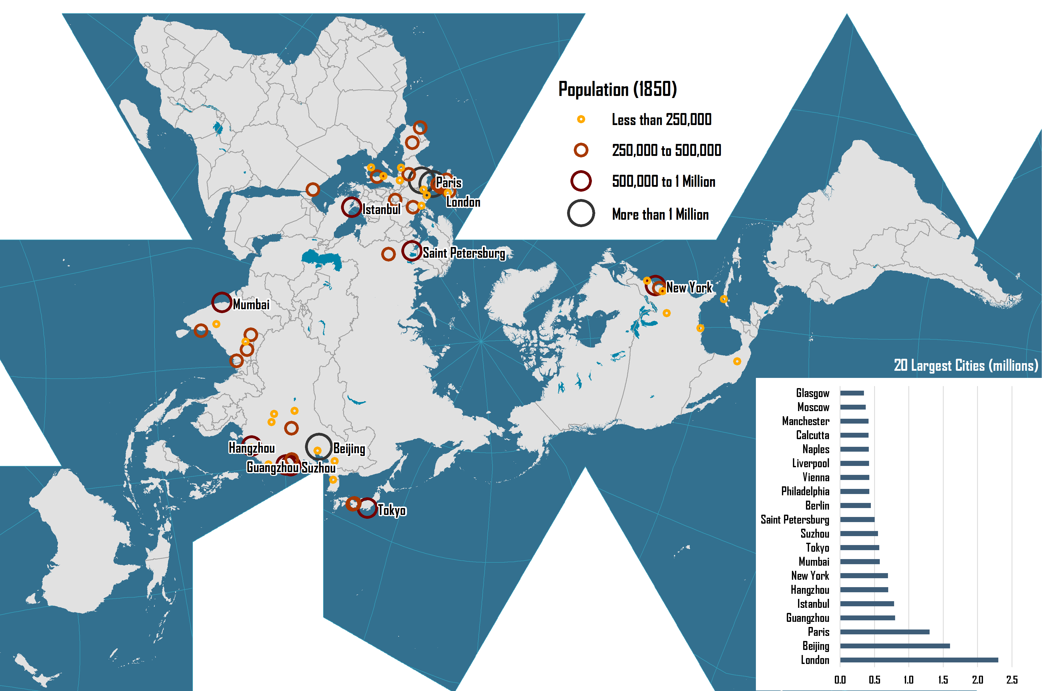
World’s Largest Cities, 1850

Slide 38
First Wave Urbanization: World’s Largest Cities, 1900
Notes:
Source: Four Thousand Years of Urban Growth: An Historical Census by Tertius Chandler.

Slide 39
2. History of Urbanization
Second Wave (1950-2050):
  Concern less developed regions of the world.
  Rapid growth.
  Demographic impacts much greater.
  Will account for 93% of the 2 billion increase in the global urban population between 2000 and 2030.
  Limited recourse to migration.

Slide 40
Second Wave: World Urban Population, 1950-2010 with Projections to 2020 (in billions)
Notes:
Source: Source: United Nations, Department of Economic and Social Affairs, Population Division (2012). World Urbanization Prospects: The 2011 Revision.

Slide 41
Annual Growth of World and Urban Populations, 1950-2030 (in millions)
Notes:
Source: United Nations, World Urbanization Prospects (1999).

Slide 42
2. History of Urbanization
Developed countries
  Developed countries are already urbanized.
  Passed through the rural - urban migration process.
  Concurrent with demographic transition and industrialization.
Developing countries
  Going through a major phase of urbanization.
  Urbanization mainly occurs in developing countries:
    Will account for 93% of the 2 billion increase in the global urban population between 2000 and 2030.
    Latin America and East Asia is farthest along.
    The rest of Asia is a little further behind.
    Africa is urbanizing more slowly than the other world regions.

Slide 43
% of Urban Population, 1950-2030
Notes:
Source: United Nations Population Program.

Slide 44
3. Functions of Cities
Economic Activities
Transportation/Port Cities
Commercial Centers
Government Centers
Cultural Centers
Education Centers
Religious Functions
Entertainment
Cities can serve many functions. Provide some examples.

Slide 45
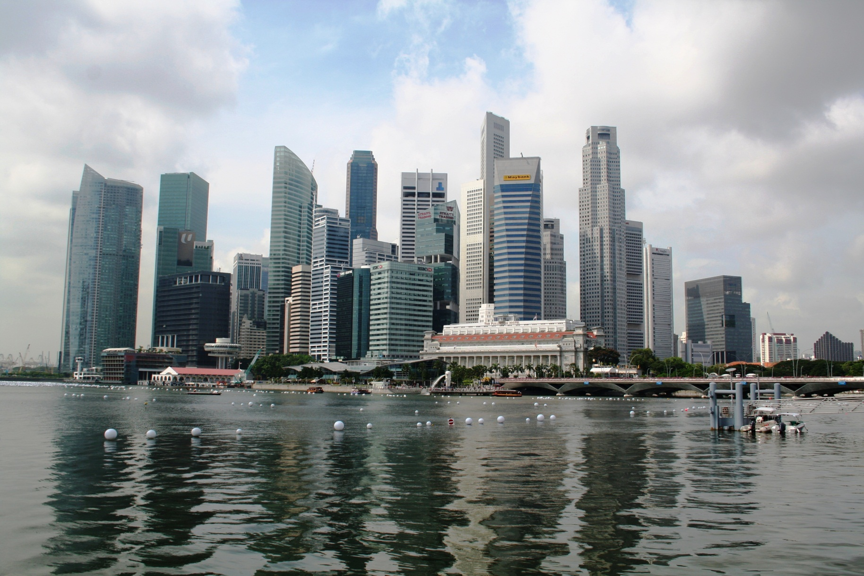
Financial Centers: Singapore C.B.D.

Slide 46
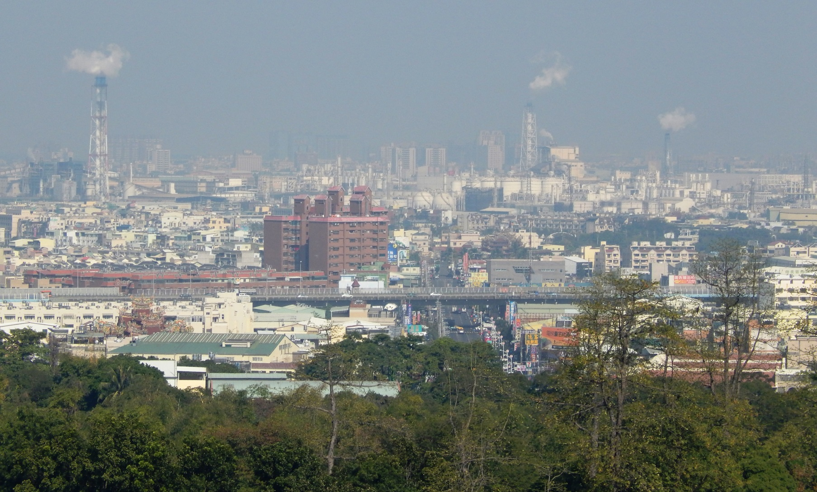
Industrial Centers: Kaohsiung, Taiwan

Slide 47
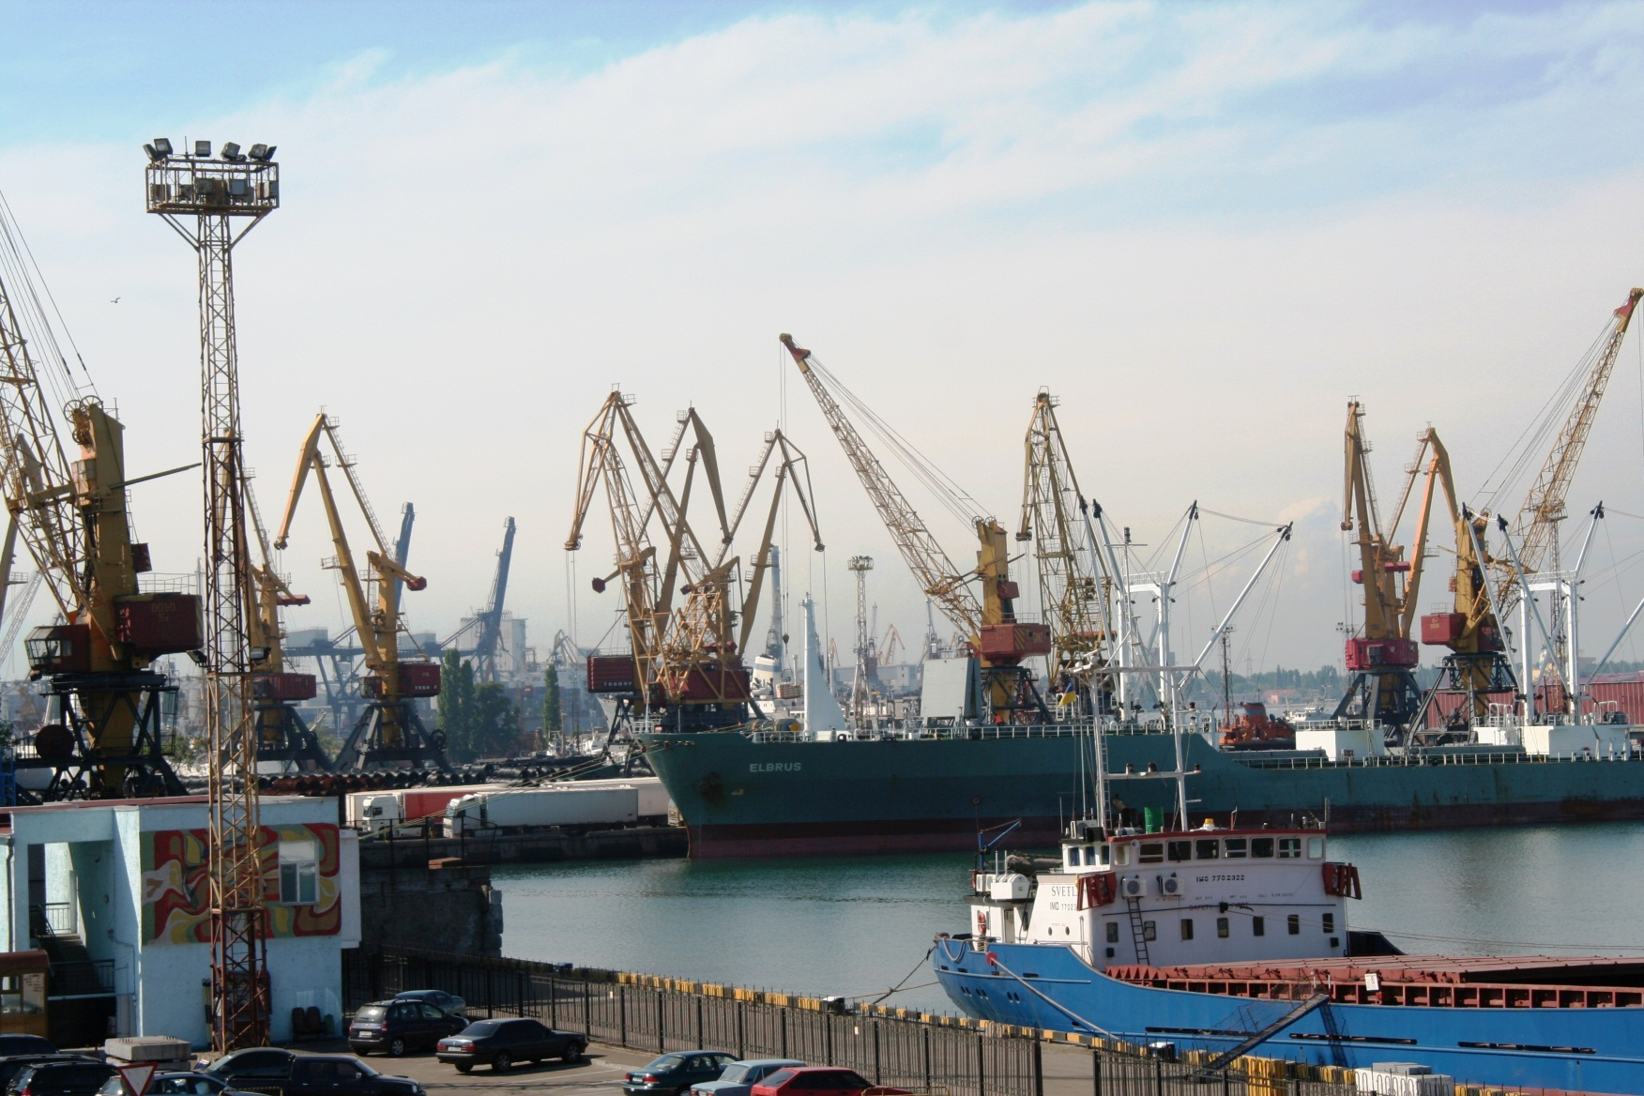
Transportation Centers: Port of Odessa, Ukraine

Slide 48
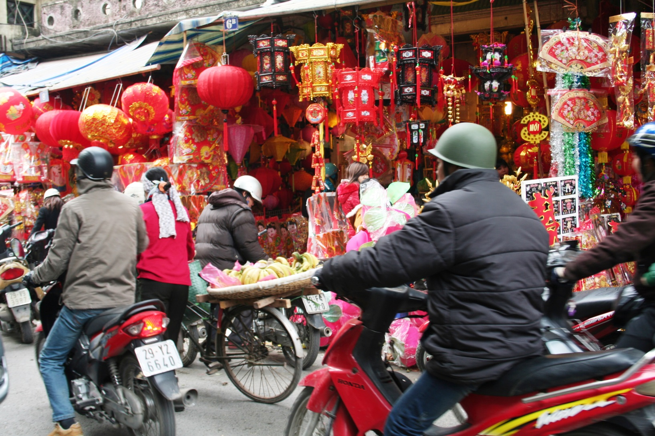
Retail Commercial Centers: Hanoi Shops During Tet Shopping Season

Slide 49
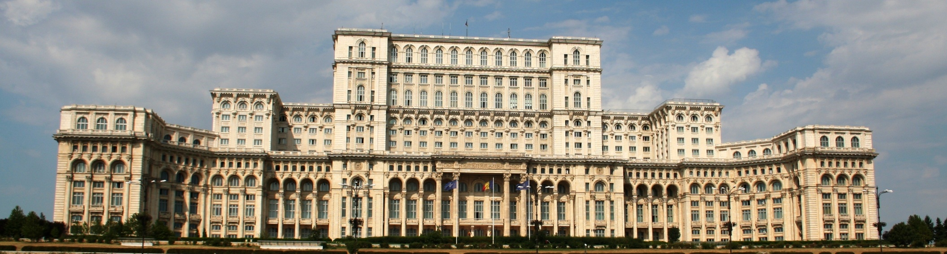
Government: Palace of Parliament, Bucharest, Romania

Slide 50
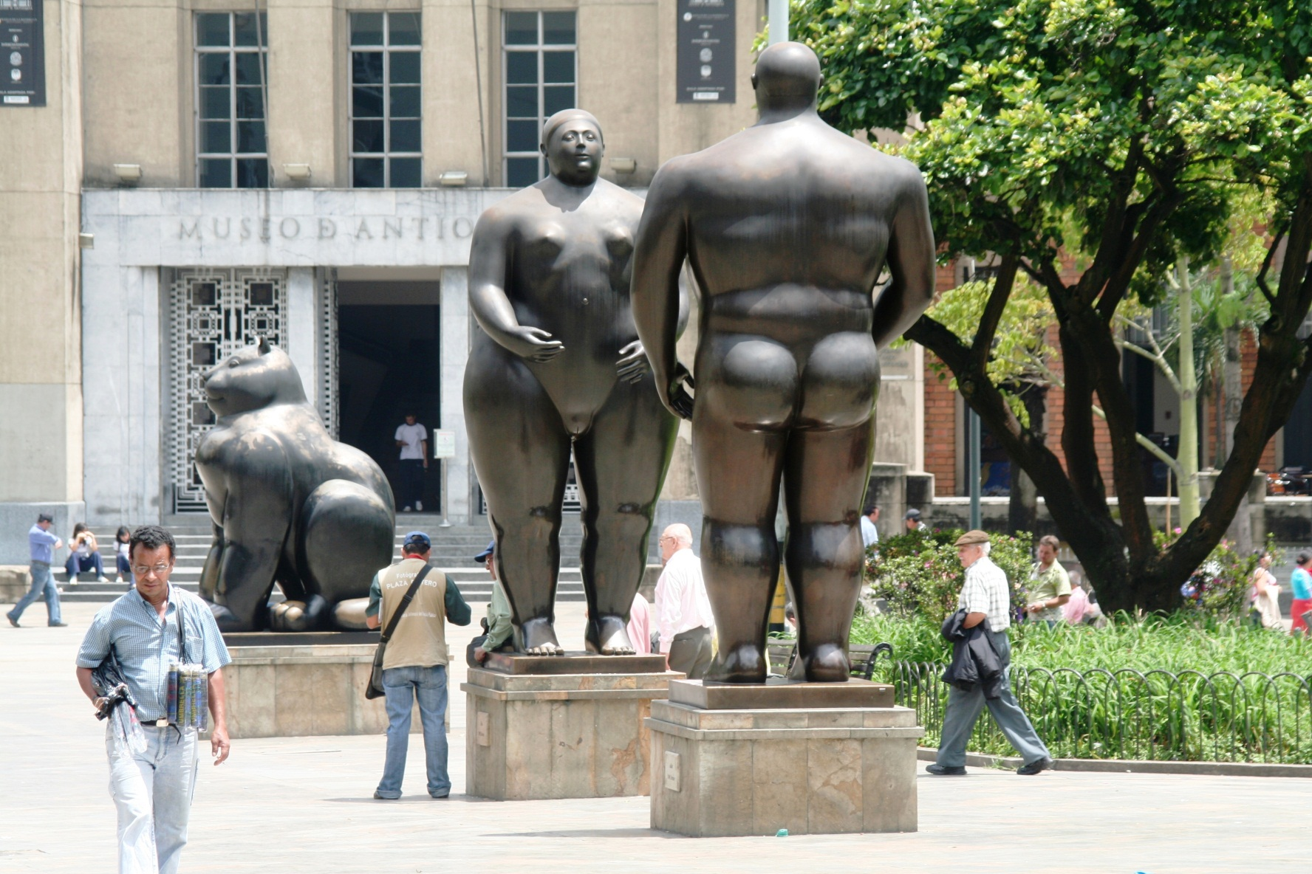
Centers of Culture: Museo De Antioquia, Medellin, Colombia

Slide 51
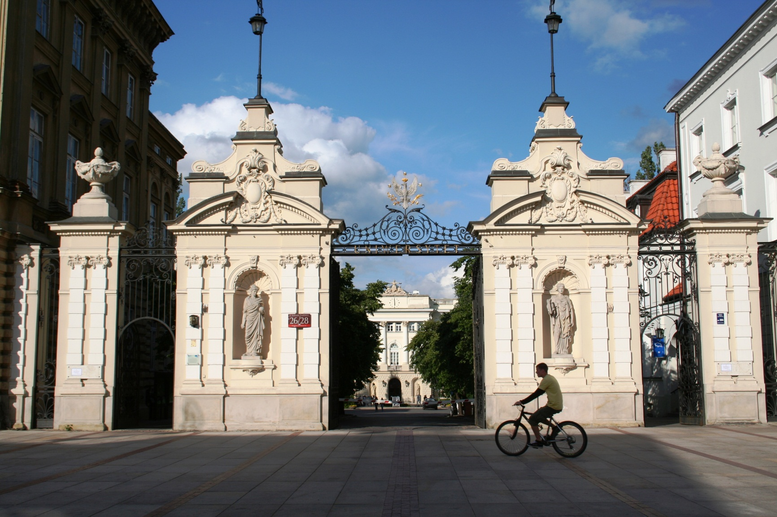
Education Centers – University of Warsaw

Slide 52
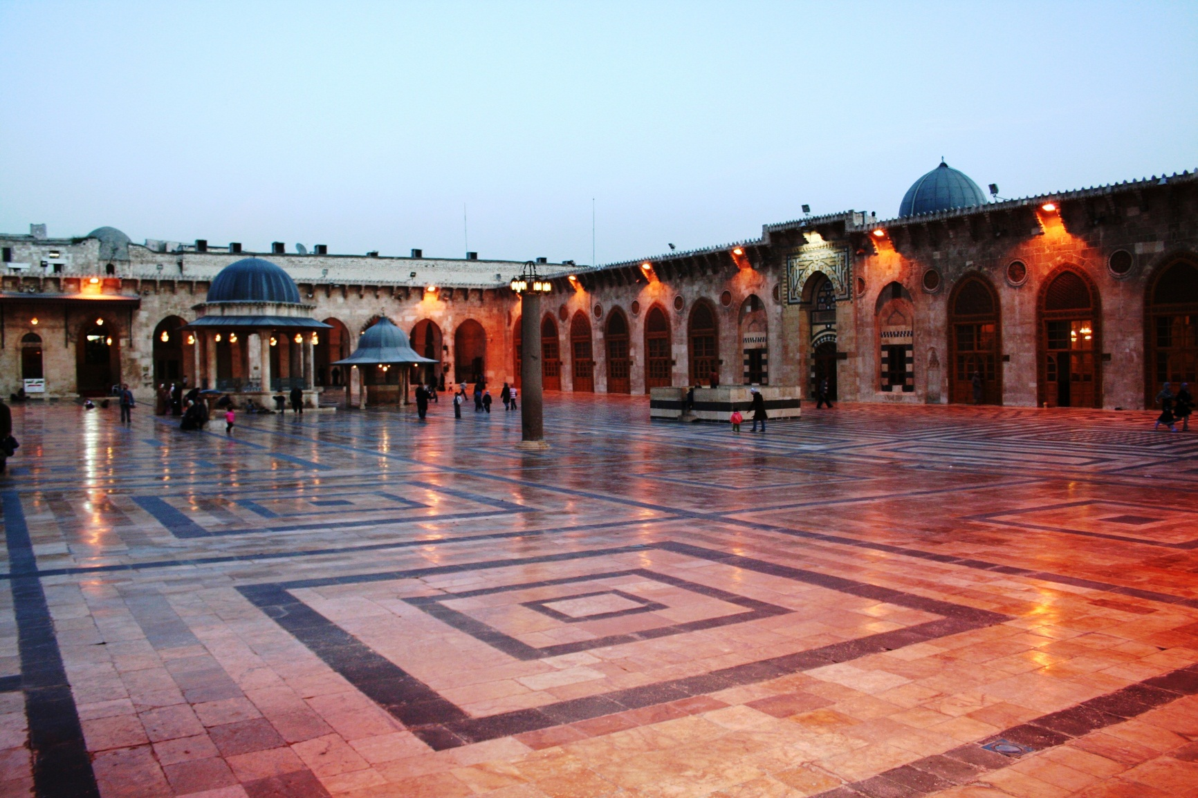
Religious Functions: Great Mosque, Aleppo, Syria (Destroyed)

Slide 53
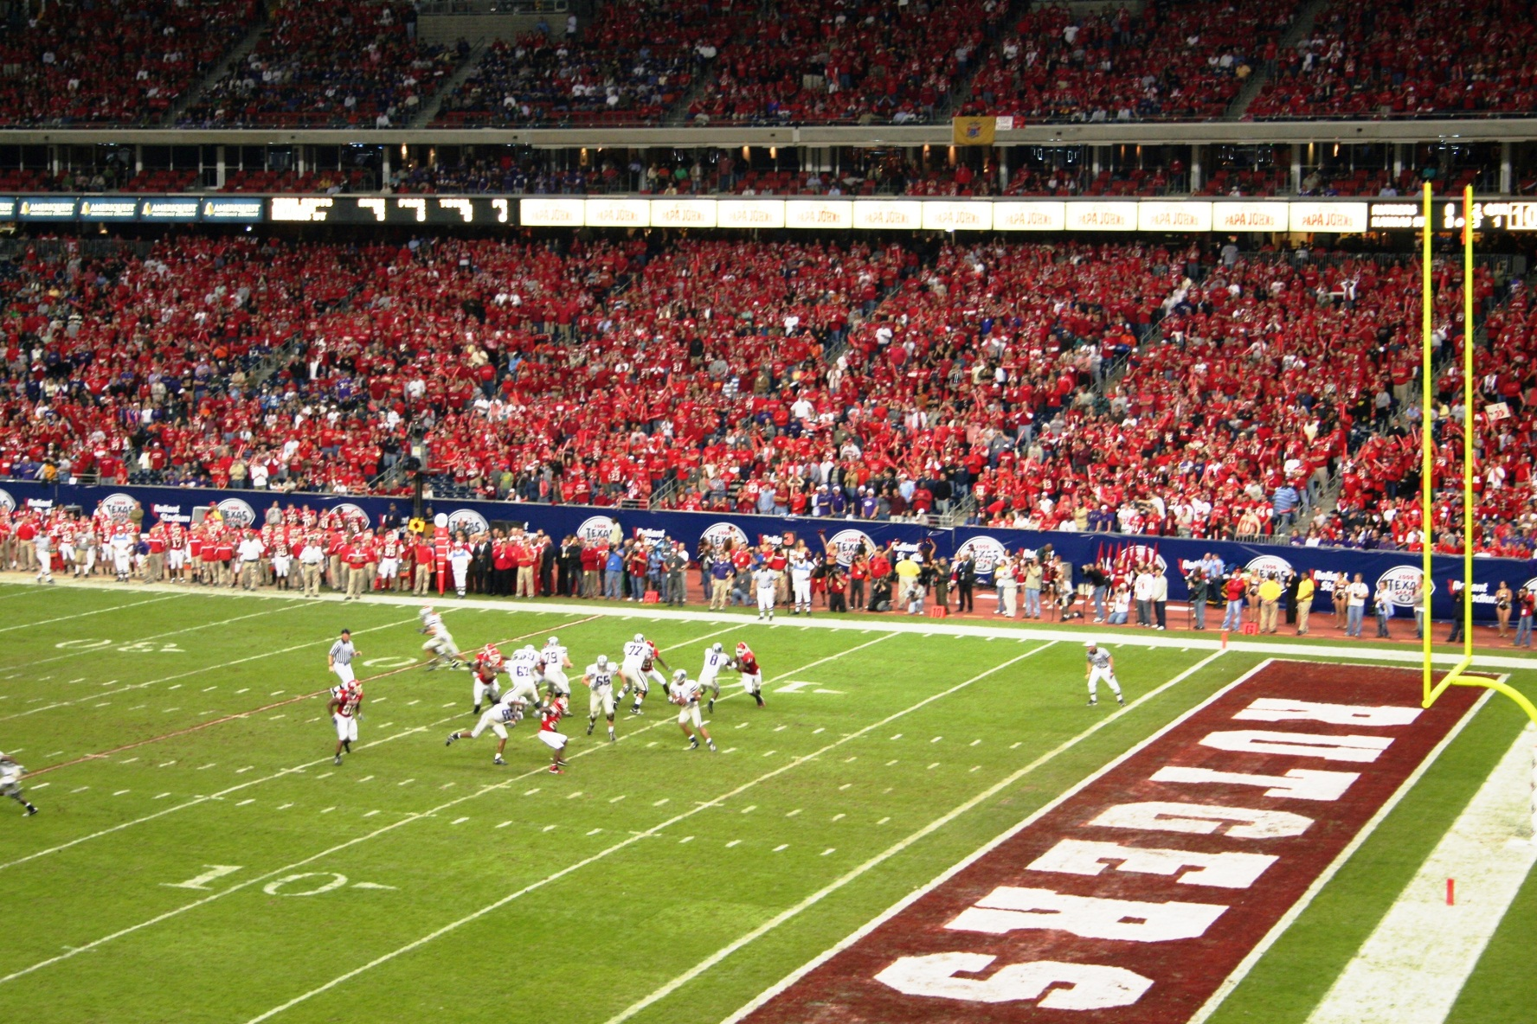
Entertainment: Sports – Reliant Stadium, Houston, Texas

Slide 54
4. Megacities and Shantytowns
Concentration in mega cities
  An increasing share of the global population lives in megacities:
    First modern megacity, Beijing 1770.
  1900:
    233 million urbanites (14% of the global population); 20 megacities.
  1950:
    83 megacities.
    34 cities in developing countries.
  2010:
    3.8 billion urbanites (54%); 433 megacities.
    37% reside in cities of at least 1 million.
    All new millionaire cities are in developing countries.
    11 of the 15 largest cities are in developing countries.

Slide 55
Metropolitan Areas of More than 10 Million Inhabitants, 2010
Notes:
Source: United Nations, Department of Economic and Social Affairs, Population Division. World Urbanization Prospects: The 2011 Revision. New York: United Nations.

Slide 56
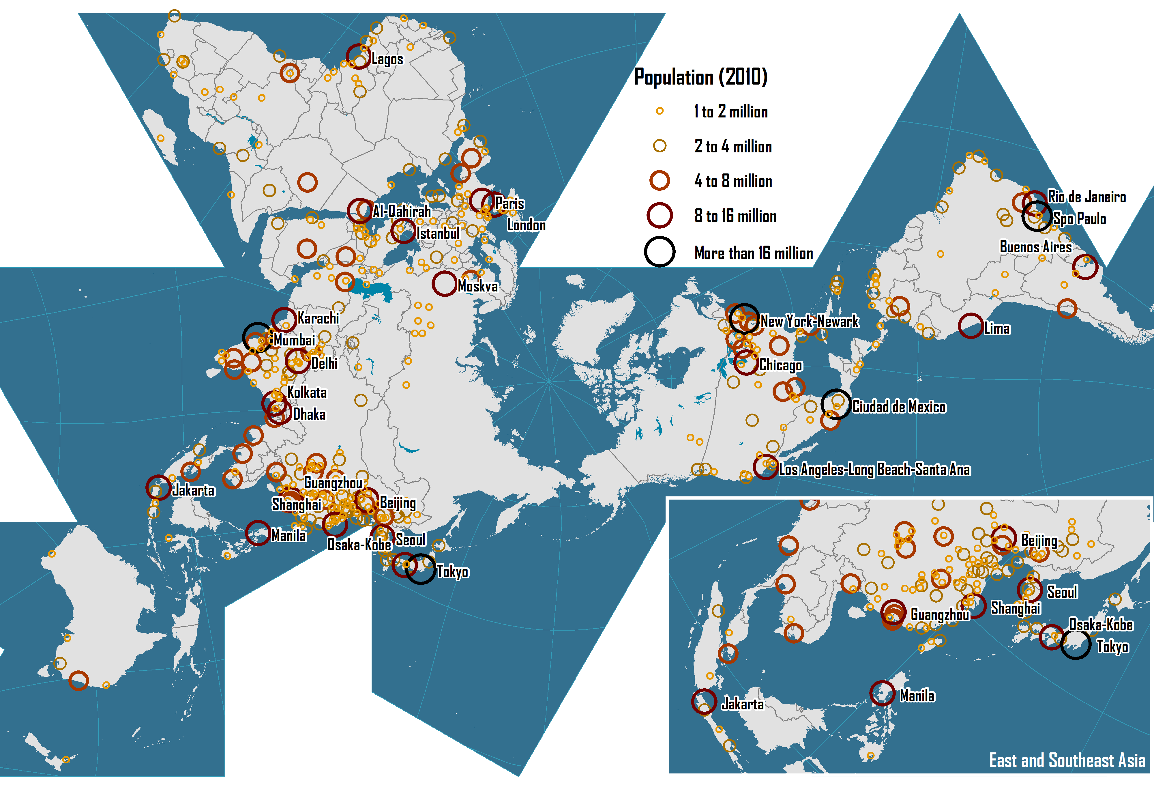
World’s Largest Cities, 2010

Slide 57
4. Shantytowns
Context
  Some cities are growing without much capital accumulation.
  Difficulty to access housing:
    Economic costs.
    Availability.
    100 million people are homeless.
    928 million live in precarious housing conditions (slums).
  Shantytowns; informal habitat or squatter housing:
    Slums (North America and Europe).
    Favelas (Brazil).
    Pueblos jovenes (Young towns).
    Asentamiento irregulares (Irregular settlements).
    Villas miserias (Miserable villages, Argentina).
    Jughi Jopri (India).
    Gecekondu (Turkey).

Slide 58
Shantytowns
Mostly in developing countries:
  Following the demographic explosion.
  Now the norm more than the exception.
  Perhaps the most visible sign of widespread poverty.
  About 25% of the surface of cities in developing countries is covered by shantytowns.
  30-60% of the urban population.
Inability of the formal private and public sector:
  Provide low price housing for those in needs.
  The private sector seeks to maximize revenue.
  The State more concerned about providing housing for its public servants and its middle class.

Slide 59
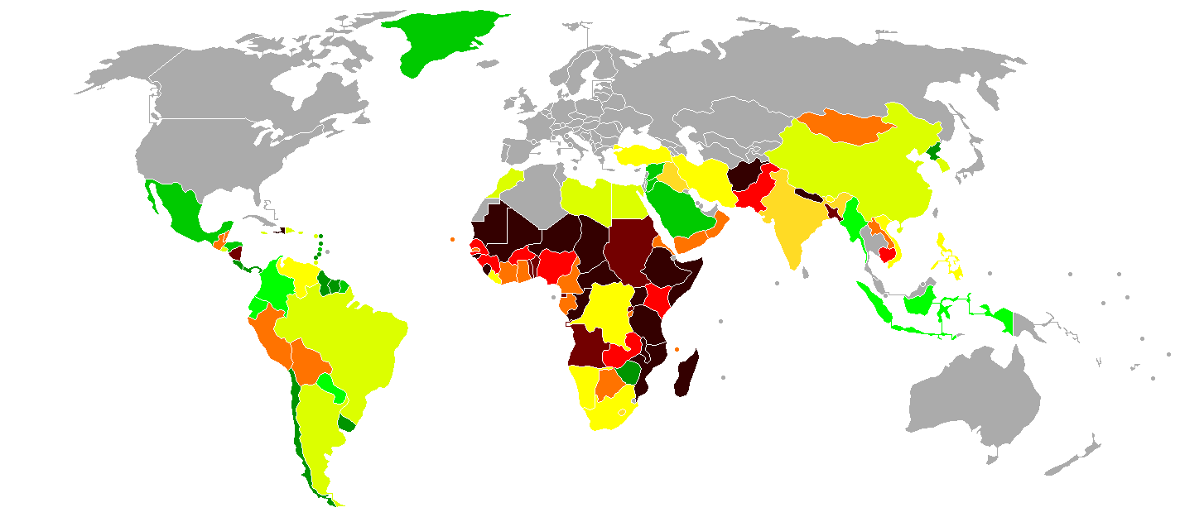
Share of the Urban Population Living in Shantytowns (2001)
0-10%
10-20%
20-30%
30-40%
40-50%
50-60%
60-70%
70-80%
80-90%
90-100%
No data
Notes:
"Urban population living in slums" by user:Fabienkhan & user:Korrigan - Map background from Image:BlankMap-World-v5.png.Data from UN-HABITAT, Global Urban Observatory, 2001 estimates (source).. Licensed under Public Domain via Commons - https://commons.wikimedia.org/wiki/File:Urban_population_living_in_slums.png#/media/File:Urban_population_living_in_slums.png

Slide 60
Shantytowns
Informal dwellings and occupation of urban land
  Dwellings are built by the current or original occupant or by the informal sector.
  Rudimentary construction materials.
  Did not receive a construction permit.
  Do not follow norms in terms of housing and sanitation.
  Located in marginal (sometimes unsafe) sites.
Often vague and unclear land ownership:
  Most inhabitants have no legal title to the land.
  Most are located in areas being declared inhabitable.
  Owned by the municipality.
  Abandoned private land.
  Exploiting a legal vacuum of land ownership.

Slide 61
Shantytowns
Lack of urban services:
  Generally not well serviced by public utilities.
  Water supply, sanitation, roads, drainage, solid waste management, street lighting, public transportation and sewage.
  Utilities often controlled by local organized crime groups and sold to local occupants.
A transient population:
  Many residents recently moved in the city.
  An active rental market.

Slide 62
Shantytowns
Very high densities:
  Not in height but in the subdivisions of dwellings.
  Sites need to be close to employment areas.
  Limited mobility so proximity a very important factor.
  Rents per square foot are often as high as developed countries.
  Incites additional subdivisions and densification.

Slide 63
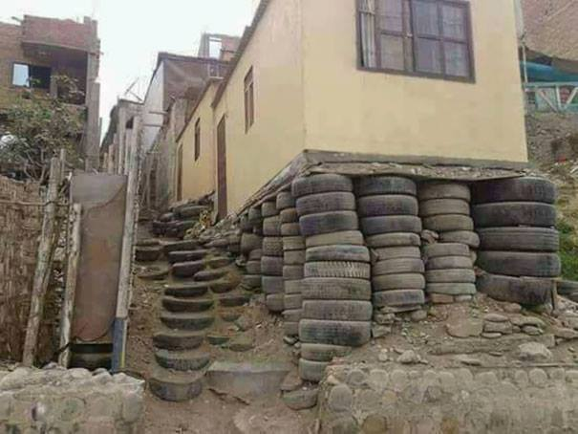
Informal Housing
Notes:
Source: Uncknown.

Slide 64
Shantytowns as Share of the Total Population
Notes:
Source: World Population Crisis Committee, Washington

Slide 65
4. Megacities and Shantytowns
Growth process
  People expelled from gentrification in downtown areas.
  Inflow of people expelled from poverty in rural areas.
The future of shantytowns
  Housing has always been a priority for investment.
  As the population gets higher incomes, the priority will be improving their housing conditions.
  On the long run, shantytowns are likely to disappear (or at least become less significant).
  Shantytowns controlled by landlords and cartels have limited incentive to upgrade since they are rent seeking structures.
  Improvements brought by aid agencies are often vandalized by cartels since they reduce their revenue.
Why some megacities have shantytowns while others do not?

