Slide 1
Topic 3 – Fertility and Mortality
A – Fertility Patterns
B – Mortality Transition
C – Life Expectancy
D – Infectious and Parasitic Diseases

Slide 2
Conditions of Usage
For personal and classroom use only
  Excludes any other form of communication such as conference presentations, published reports and papers.
No modification and redistribution permitted
  Cannot be published, in whole or in part, in any form (printed or electronic) and on any media without consent.
Citation
  Dr. Jean-Paul Rodrigue, Dept. of Economics & Geography, Hofstra University.

Slide 3
C. Life Expectancy
1. Defining Life Expectancy
2. Temporal and Geographical Variations
3. Extending Life Expectancy

Slide 4
1. Defining Life Expectancy
Definition
  Number of years a person is expected to live.
  Based on current death rates.
  It is an average.
  Does not necessarily apply to current generation.
  May change due to ameliorations in standards of living.
Context
  Strong geographical variations in life expectancy.
  Half a century ago, most people died before the age of 50.
  Global average life expectancy reached 71 years in 2014.
  Several achievements and failures:
    Economic development has benefited human health.
    Improvement in diet and sanitation.
    Urbanization may have adverse effects.
Notes:
Countries with high infant mortality rates have a strong impact on life expectancy. Sometimes, to filter this impact life expectancy after the age of 5 is used.

Slide 5
1. Defining Life Expectancy

Slide 6
1. Defining Life Expectancy
Probability of survival
  65 years old male, United States.
  Life expectancy: 85+
  52% will survive to 85.
  13% will survive to 95 .
Notes:
Based on the SOA's RP2000 mortality table for healthy retirees (i.e. not disabled at the time of retirement), which used experience from major pension plans.
Also used the recommended projection scale AA to bring the year 2000 up to 2011, and then used this same scale to project mortality improvement going forward.
These results add 2 to 3 years to the average longevity we have seen reported in the popular press, and we believe more accurately represent what can be expected from financial planning clients.
A further adjustment could be made to reflect the above average incomes of financial planning clients. There is evidence of higher mortality rates (and thus shorter life expectancies) among lower income people. http://www.medscape.com/viewarticle/585103_5

Slide 7
1. Defining Life Expectancy
Probability of survival
  65 years old female, United States.
  Life expectancy: 87+.
  59% will survive to 85.
  20% will survive to 95.
Explain what is life expectancy and how the probability of survival varies by gender.
Notes:
Based on the SOA's RP2000 mortality table for healthy retirees (i.e. not disabled at the time of retirement), which used experience from major pension plans.
Also used the recommended projection scale AA to bring the year 2000 up to 2011, and then used this same scale to project mortality improvement going forward.
Ask how many in room know someone who lived to be 100. They were 65 35 years ago

Slide 8
2. Temporal and Geographical Variations
Era | Life expectancy
Neanderthal (350,000 – 25,000 BC) | 20
Upper Paleolithic (40,000 – 10,000 BC) | 33
Neolithic (8,500 – 3,500 BC) | 20
Bronze Age (3,500 – 1,200 BC) | 18
Classical Greece and Rome (500 BC – 400 AD) | 28
Medieval Britain (400 – 1500 AD) | 33
Late 19th Century in Western Europe | 37
Average Global Life Expectancy (2006) | 66

Slide 9
Life Expectancy at Birth, 1910 and 2015

Slide 10
World Average Life Expectancy, 1960-2014
Notes:
Source: World Bank
http://data.worldbank.org/indicator/SP.DYN.LE00.IN

Slide 11
Life Expectancy in Selected Countries, 2015
Notes:
Discussion / teaching points: Why might life expectancies be low in some countries? What are the prospects for changes to life expectancy among any of these countries? Will they continue to improve? Will countries on the lower end of the spectrum “catch up”?
Source: Data derived from PRB. Reprinted from Bruce Newbold, Population Geography: Tools and Issues (Rowman & Littlefield 2017). All rights reserved.

Slide 12

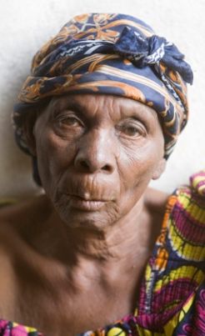
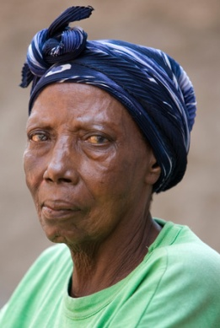
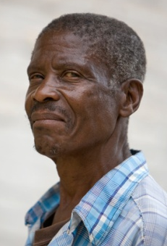
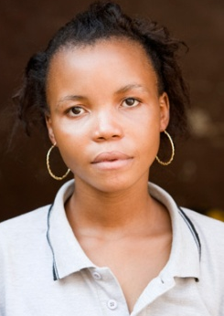
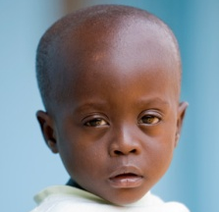
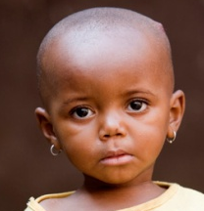
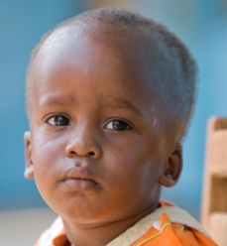
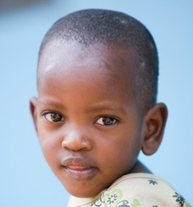
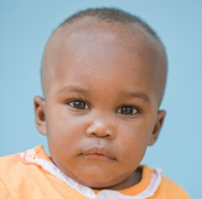
100
Burundi
2007
84
80
72
Age (years)
57
60
50 years
36
40
20
1
0
Pierre
Liz
Jean
Ann
Sarah
Notes:
Source: www.gapminder.org/downloads/life-expectancy-ppt

Slide 13




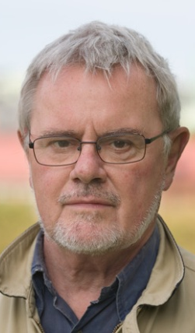





100
93
Sweden
88
2007
84
81 years
77
80
63
Age (years)
60
40
20
0
Per
Lisa
Jan
Anton
Sara

Slide 14
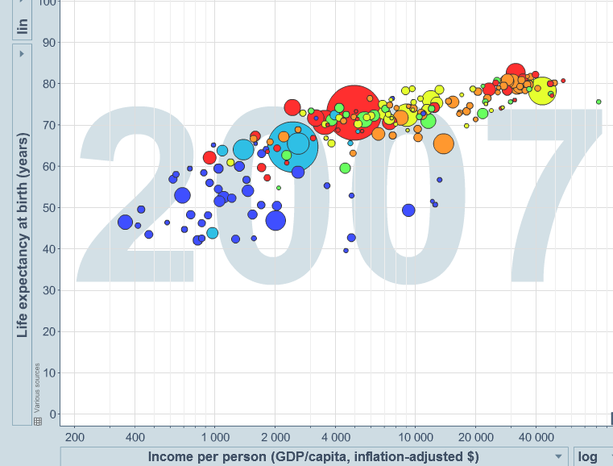
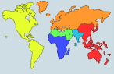
100
Sweden
Life expectancy (years)
81 years
80
60
Burundi
50 years
40
Population
(millions)
1
20
100
1000
0
200 $
2000 $
20 000 $
Income per person (comparable dollars per year)

Slide 15
3. Extending Life Expectancy
Factors behind higher life expectancy
  About 40 years was gained in the 20th century.
  90% of the reduction in the death rate occurred before the introduction of antibiotics or vaccines.
  Major factors (33 years):
    Improved sanitation (for food and water).
    Reduction in crowding.
    Central heating.
    Sewer systems.
    Refrigeration.
  Improved health (7 years):
    Mainly medical technology.
    Small share attributed to drugs.
  Modern medicine: a sham?

Slide 16
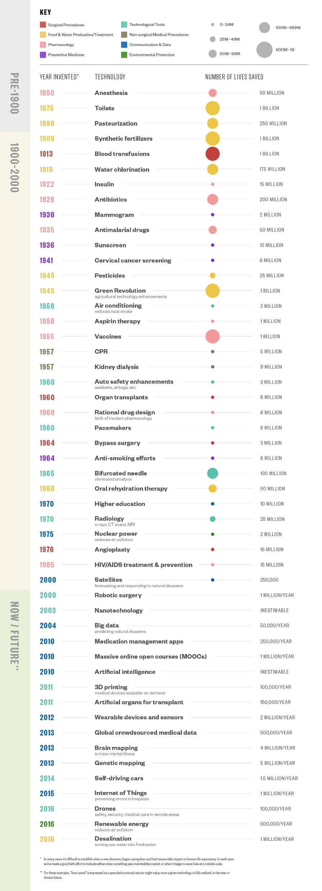
Notes:
http://www.visualcapitalist.com/50-important-life-saving-breakthroughs-history/

Slide 17
Life Expectancy and Health Care Expenditure per Capita, PPP, 2014
Notes:
Discussion / teaching points: What does this relationship say? Can students identify where their country is? What countries are at the lowest (highest) end of the spectrum in terms of PPP and life expectancy?
Source: Author. Data derived from The World Data Bank. Reprinted from Bruce Newbold, Population Geography: Tools and Issues (Rowman & Littlefield 2017). All rights reserved.

Slide 18
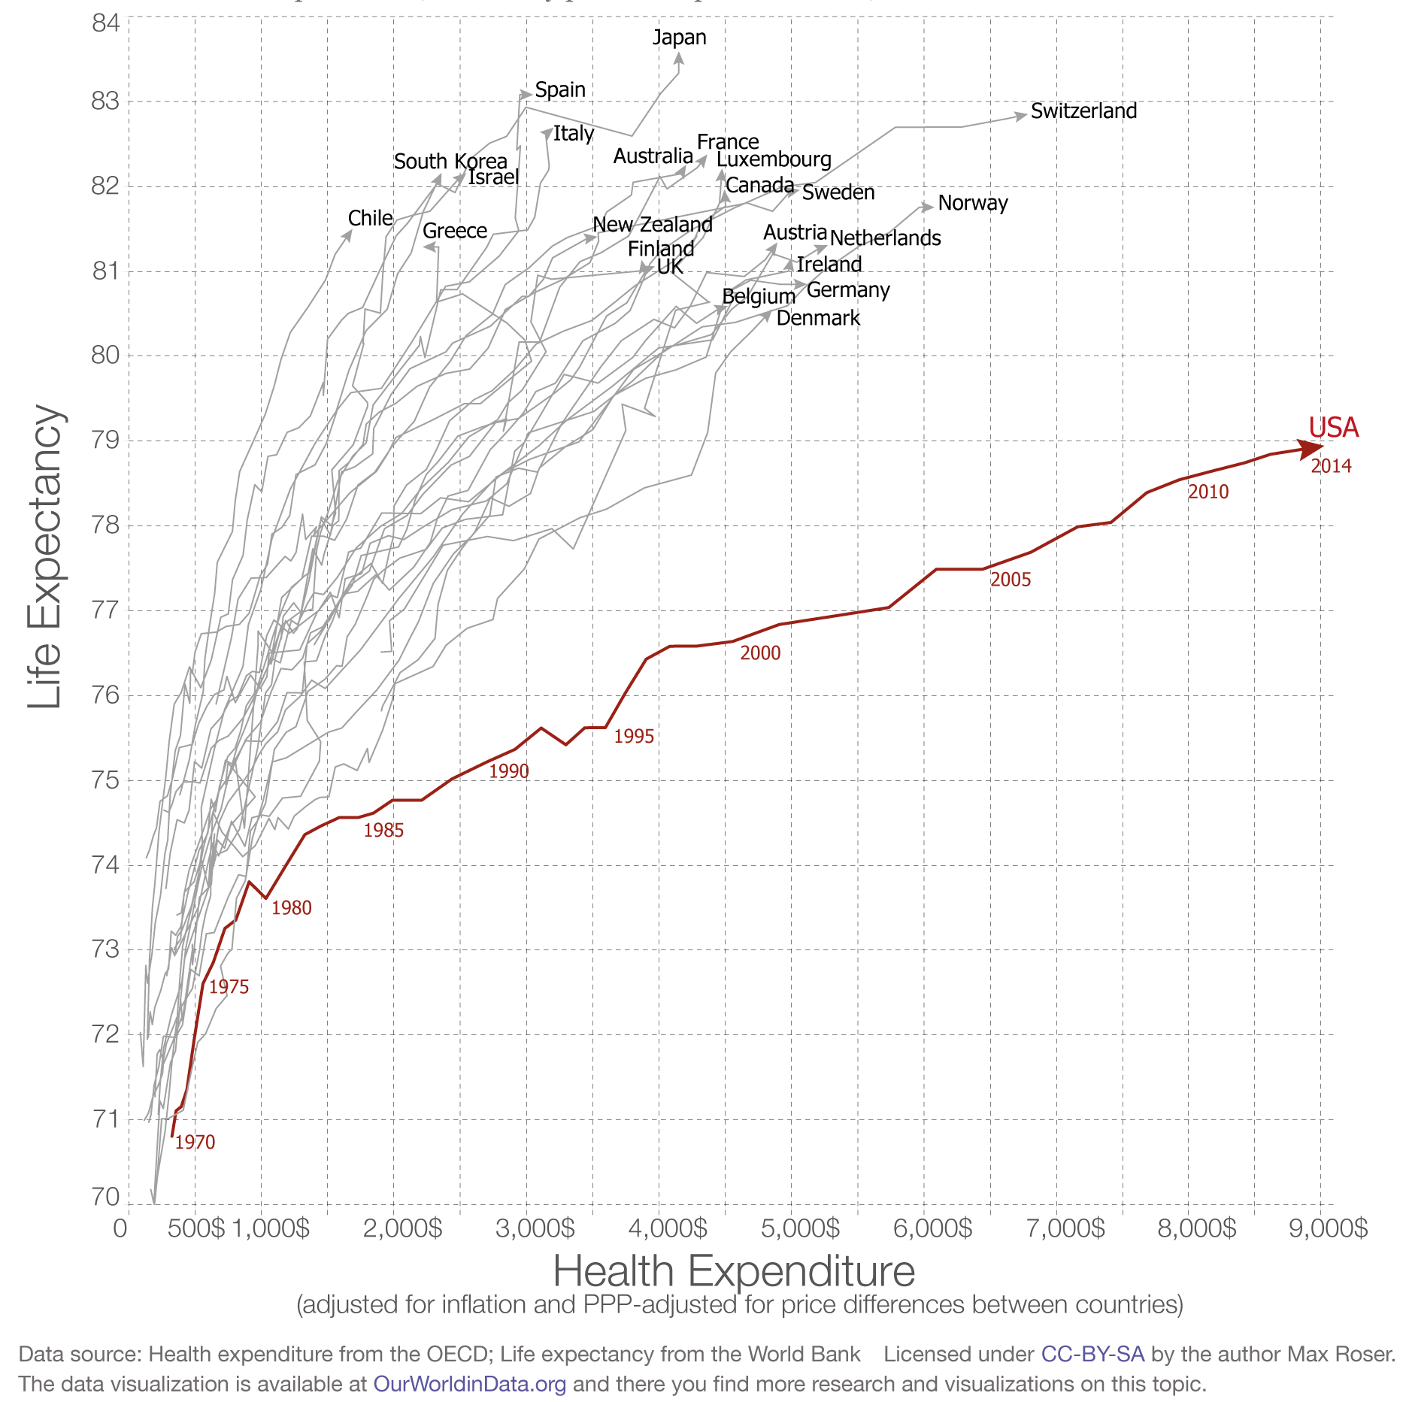
Life Expectancy and Healthcare Expenses

Slide 19
% of Men and Women Expected to Survive to Age 80, by Region (Among people born 1995-2000)
Notes:
Source: United Nations Population Division, 2000

Slide 20
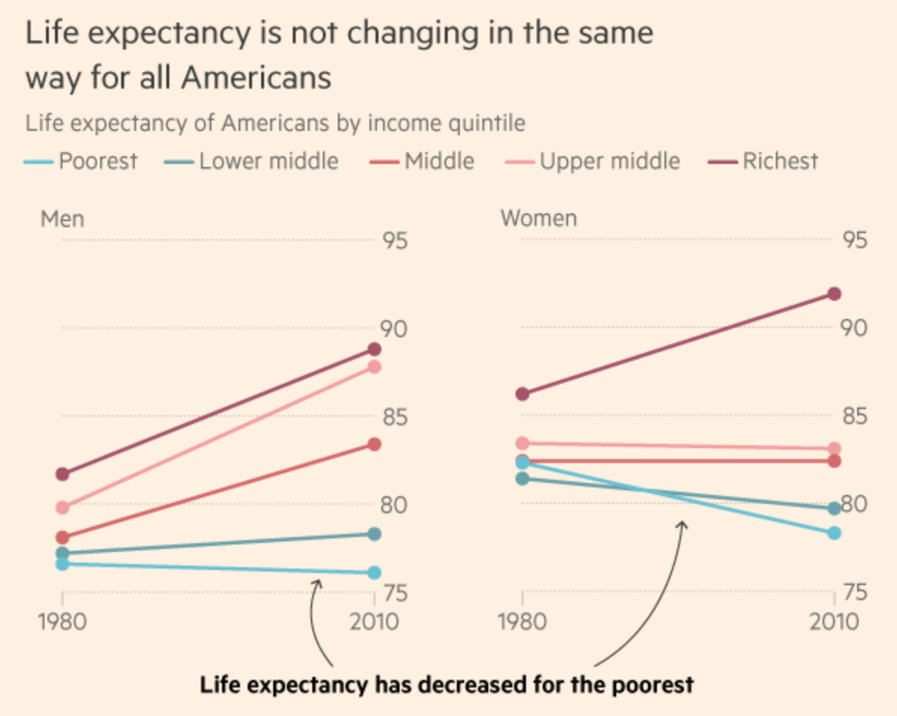

Slide 21
3. Extending Life Expectancy
Society and individuals not well prepared to assume the consequences of extended life expectancy
  People commonly underestimate both life expectancy and how long they will live.
  Longevity is variable and averages can mislead.
  Variability of longevity implies that most couples will become singles.
  In many couples one spouse will live past age 90.
  Disability is being shifted to older ages.
  Longevity is expensive since it is funded from a mix of personal and societal resources.
  People will speed a greater amount of years in poor health.

Slide 22
Monthly Rate of a $1M Life Insurance Premium, 2013
Using the example of a life insurance premium across age and gender groups, explain how it reflects the concept of life expectancy and how life expectancy challenges society.
Notes:
Source: https://www.northerninsuranceagency.com/rates.html

Slide 23
3. Extending Life Expectancy
Optimum life expectancy
  Life expectancy is ultimately dictated by human physiology:
    At some points, organs cease to function properly.
    Limit on the lifespan of non-cancerous human cells.
  Nearing life expectancy limits:
    Even if age-related diseases such cancer, heart disease, and stroke were eradicated, life expectancy would only increase by 15 years.
    Currently around 76 years.
    Expected to reach 85 years in most developed countries by 2030.

Slide 24
D. Infectious and Parasitic Diseases
1. The Burden of Diseases
2. Major Epidemics
3. The Threat of Pandemics

Slide 25
1. The Burden of Diseases
Burden of disease
  Measurement of the gap between the current health of a population and an ideal scenario where everyone completes their full life expectancy in full health.
Disability Adjusted Life Years (DALY)
  DALY=YLL + YLD (Lost years of healthy life).
    YLL=Years of life lost to premature mortality.
    YLD=Equivalent years of healthy life lost due to disability.
  Provide an appropriate attention to the effects of non-fatal as well as fatal diseases on overall health.
  Inform on priorities for health service delivery, research and planning.

Slide 26
1. The Burden of Diseases
Burden of disease
  Potential life years were lost due to premature death, disease and disability.
  The global burden of disease was 34.2% in 2013.
  More than a third of potential healthy life years were lost.

Slide 27
Top 10 Causes of Death
Notes:
http://who.int/mediacentre/factsheets/fs310/en/

Slide 28
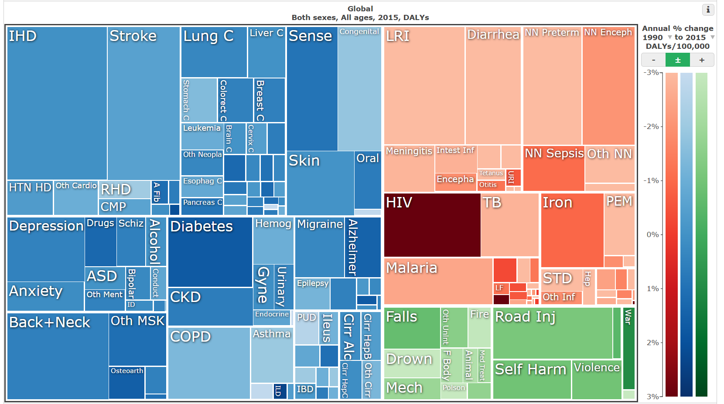
1. The Burden of Diseases
Notes:
Source: The Lancet
http://thelancet.com/gbd/gbd-compare-visualization

Slide 29
1. The Burden of Diseases
The Burden of major infectious diseases
  Respiratory infections:
    Pneumonia affects mainly children under 5.
    Mainly linked to deteriorating air quality.
  Tuberculosis:
    30% of humanity carry the TB bacteria.
    Growing resistance to antibiotics.
  Diarrheal diseases:
    Improper sanitation of drinking water.
    Mainly affect young children.
  AIDS:
    Variety of factors linked with reproductive behavior.
  Malaria:
    Growing because of resistance to antimalarial drugs and to insecticides.
    Related to mosquito prevalence.
    Linked to urban areas (stagnant water).
Notes:
Source: Brown, Gardner and Halweil, 1999.

Slide 30
1. The Burden of Diseases
Obesity
  At least one third of the world's adult population are either overweight or obese (“Globesity”).
  Increased intake of energy-dense foods that are high in fat.
  Increase in physical inactivity:
    Sedentary nature of many forms of work, changing modes of transportation, and increasing urbanization.
  Increase risk:
    Cardiovascular diseases (mainly heart disease and stroke).
    Diabetes.
    Musculoskeletal disorders (degenerative disease of the joints).
    Some cancers (breast, ovarian, prostate, liver, gallbladder, kidney, and colon).
    Could reduce life expectancy by 2 to 5 years.

Slide 31
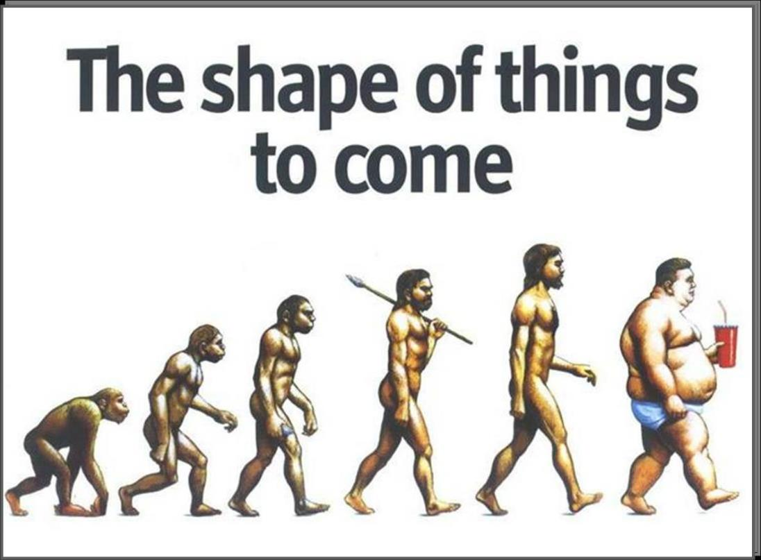
1. The Burden of Diseases
Explain what is the burden of disease and the major contributing factors.

Slide 32
Cigarette Consumption per Person, 1960-2002
Notes:
Source: Worldwatch Institute.

Slide 33
2. Major Epidemics
Endemic | Epidemic | Pandemic
Many diseases (Flu) exists in a state of equilibrium within a population. Do not need to spread from an outside source. Many develop an immunity. Saps energy, lowers resistance, shortens lives. | Sudden outbreak at local, regional scale. More cases than would normally be expected. Generally short lived (until all the potential population is infected). | Worldwide spread through trade routes.
Explain the differences between, endemic, epidemic and pandemic

Slide 34
Fatality Rates per Type of Disease
Notes:
MRSA: Methicillin-resistant Staphylococcus aureus
SARS: Severe acute respiratory syndrome
AIDS: Acquired Immune Deficiency Syndrome

Slide 35
2. Major Epidemics
Black Death
  Europe, 14th century (the Plague)
  Bacteria (Yersinia pestis) originating in Asia.
  Moved through the trade routes.
  Entered Europe in 1347.
  Transmission by rats, fleas and coughing / sneezing:
    Debate between bubonic (lymphatic system) and pneumonic (respiratory system) plagues.
  90% death rate of those infected:
    Death between 4 to 7 days.
  20 million deaths; 25-33% of the European population.
    May have killed 70% of the population of England.
  75 million deaths in Eurasia out of a population of 300 million.

Slide 36
Estimated Population of Europe, 1000-1500

Slide 37
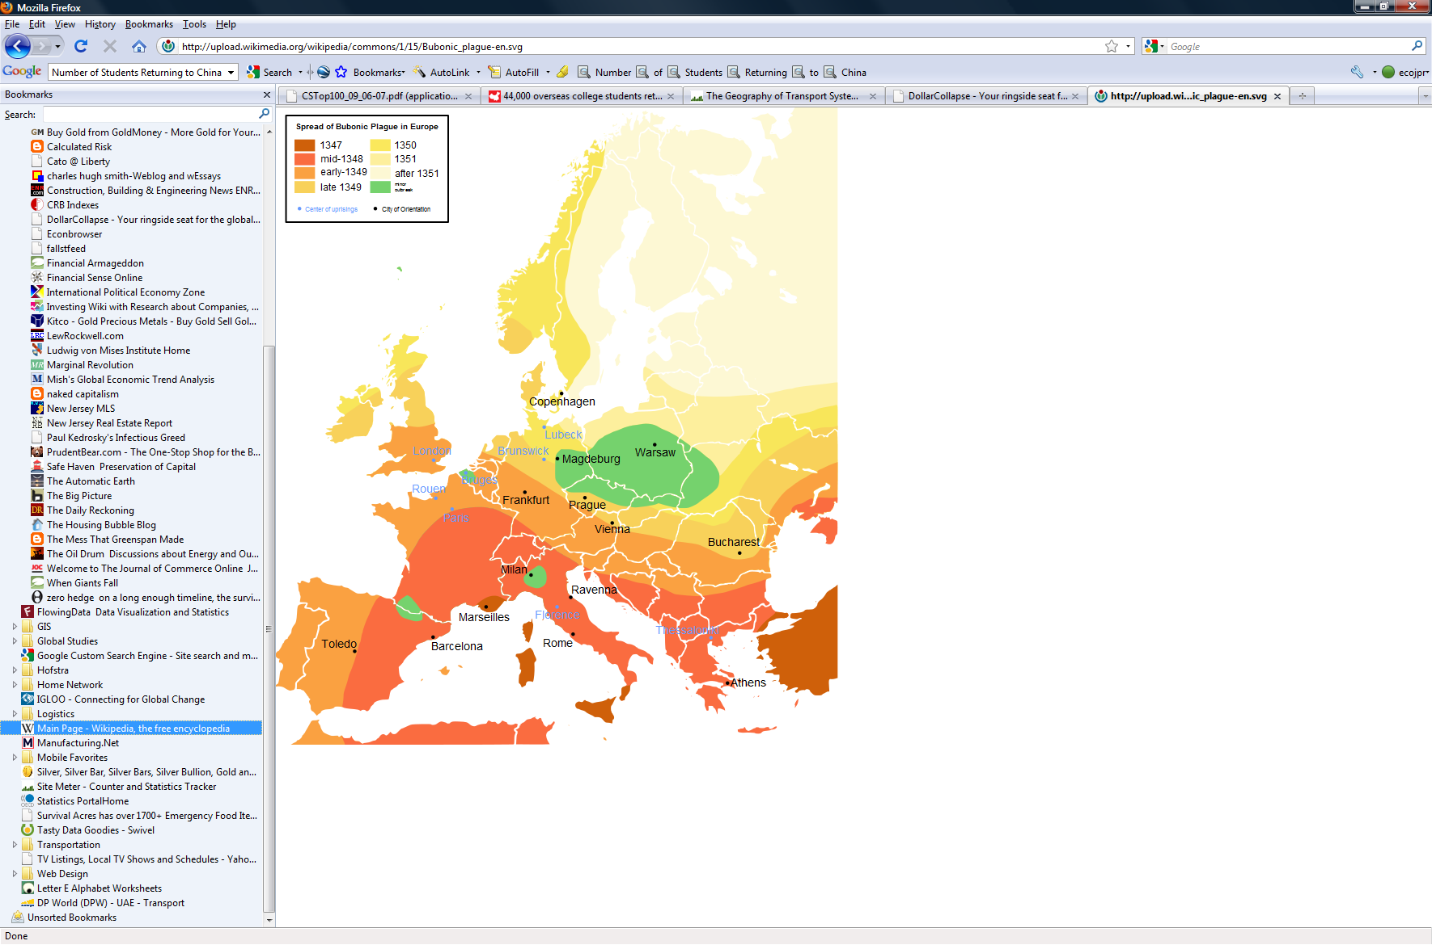
Spread of the Bubonic Plague in Europe, 1347-1351
Notes:
Source: Wikipedia

Slide 38
2. Major Epidemics
Smallpox
  Virus commonly resulting in blisters; highly contagious.
  Spread through respiratory system and physical contact.
  Endemic in Eurasia:
    400,000 people per year killed in Europe in the 18th century.
  New World, 16th Century:
    Virus introduced by Spanish conquistadors and European colonists.
    Between 10 and 20 million killed.
    Decimation of the Inca, Aztec and Native American civilizations.
  Was officially eradicated in 1979 (Only infectious disease completely eradicated).

Slide 39
2. Major Epidemics
Influenza
  Global, 1918-1919 (Spanish Flu).
  A strain of H1N1; (H: Hemagglutinin, N: Neuraminidase).
  Virus brought by troops; spread through transport routes.
  Lethality:
    Transmission through respiratory channels.
    Lethality by a cytokine storm.
    2-20% of those infected died (normal rate 0.1%).
    Between 25 and 40 million killed (1.2-2.2 % of the global population).
    WWI (1914-1918) killed 9 million people.
  Bird Flu (H5N1):
    Limited human-to-human transmission potential.
  Swine Flu (H1N1; April 2009):
    New strain contains genes coming from 5 different viruses.

Slide 40
Influenza and Pneumonia Mortality per 100,000 Persons per Age Group, United States, 1911–1918
Notes:
Source: Taubenberger JK, Morens DM. 1918 influenza: the mother of all pandemics. Emerg Infect Dis [serial on the Internet]. 2006 Jan. Available from http://www.cdc.gov/ncidod/EID/vol12no01/05-0979.htm

Slide 41
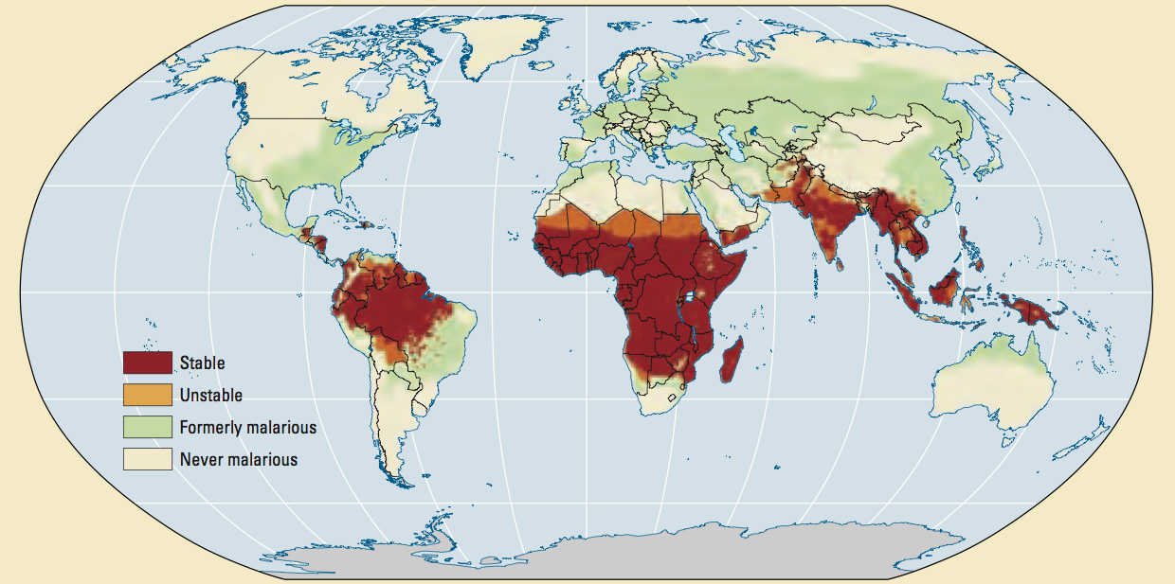
Areas Where Malaria is Prevalent
Notes:
Malaria is a parasitic disease mostly transmitted by mosquito bites.

Slide 42
2. Major Epidemics
HIV/AIDS
  HIV (Human Immunodeficiency Virus) is the virus that causes AIDS (Acquired Immune Deficiency Syndrome).
  Global (Pandemic), 1980 to present.
  Originated in Central Africa; mutation of a primate virus to infect humans (early 20th century).
  Transmission by body fluids.
  34 million deaths (2014).
  1.0-1.3% of the global population has been infected (37.6 million).
  2 million new cases per year (2014).
  Major prevalence in Sub-Saharan Africa:
    More than 60% of HIV positive global population.
    More than 20% of the population infected in several African countries.

Slide 43
Global Population with HIV and AIDS Related Deaths, 1990-2014
Notes:
Source: UN AIDS

Slide 44
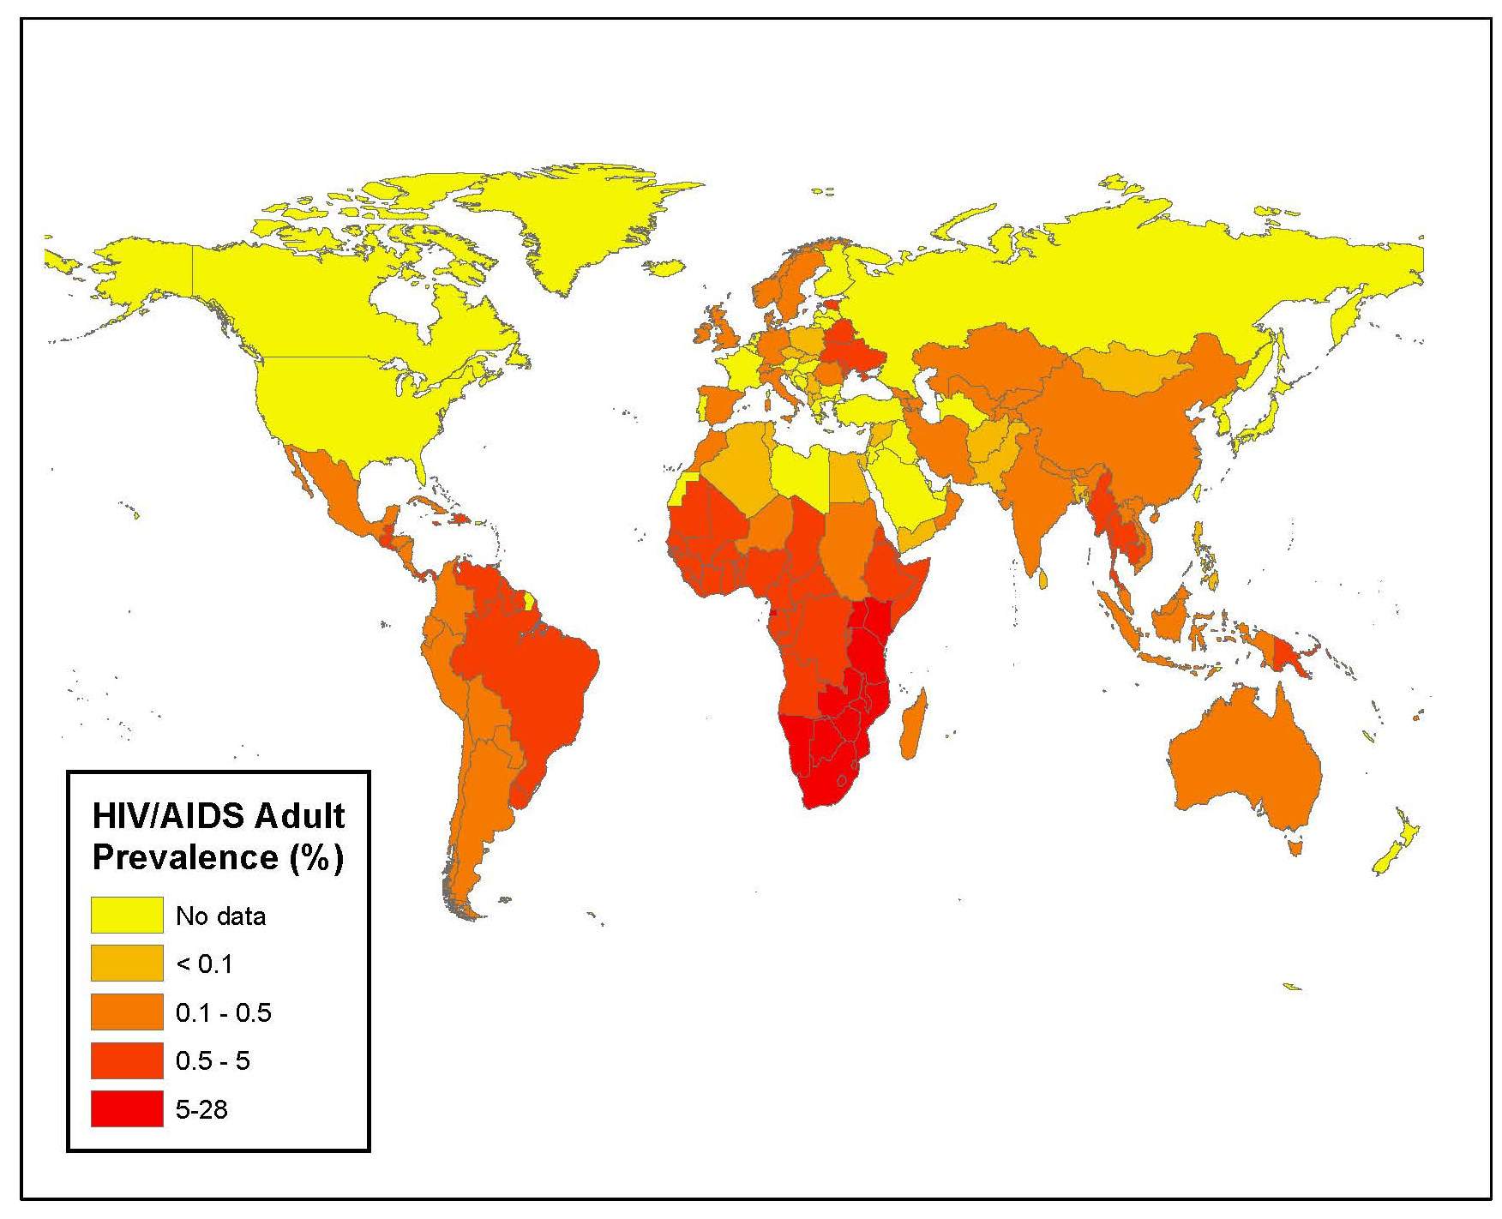
HIV Prevalence Rates, 2015
Notes:
Discussion / teaching points: Use this figure to discuss overall prevalence and geographic patterns associated with HIV. What accounts for this?
Source: Data Data derived CIA Factbook.

Slide 45
The Effect of HIV/AIDS on Life Expectancy in Sub-Saharan Africa, 1960-2015
Notes:
Discussion / teaching points: The impact of HIV/AIDS is clearly visible in this image, with some rebound among these countries. The scale (i.e., difference from pre-HIV/AIDS to depth of HIV/AIDS crisis) can be pointed out. Will countries continue to rebound? That is, will life expectancy continue to improve in these countries? Why?
Source: World Bank, http://data.worldbank.org/indicator/SP.DYN.LE00.IN/countries/IW

Slide 46
AIDS Diagnoses and Deaths in the United States, 1981-2013
Notes:
Source: http://www.avert.org/usastaty.htm

Slide 47
3. The Threat of Pandemics
The potential of a new global pandemic?
  Risk factors:
    Influenza impacts 5 to 15% of the global population each year (kills 250,000 to 500,000).
    New strains of influenza could affect 20% of the global population.
    Some scenarios account for 1 billion deaths in less than 6 months.
    Dominantly urbanized population (proximity).
    Fast global transport systems (diffusion).
  SARS (Severe Acute Respiratory Syndrome Conovirus; 2003):
    Infected more than 8,400 (874 died).
    Declared eradicated in 2005.
  Ebola (2014-15)
    Endemic in Western Africa.

Slide 48
Some Factors behind the Global Spread of Diseases
Factor
Global travel | People as the vector (e.g. Flu, West Nile Virus, SARS). The most common vector.
Global trade | Cargo as the vector (e.g. Mad Cow Disease).
Wars and conflicts | Destruction / damaging of healthcare systems and public utilities (aqueduct / sewage). Displacement of populations (refugees).
Migration | Migrants dominantly responsible to bring endemic diseases in developed countries (e.g. tuberculosis).
Poverty | Overcrowding, malnutrition, lack of healthcare and unsanitary conditions.
Medical practices | Pathogenic natural selection. More virulent and resistant diseases.
Read this content (sections 1 & 2)

Slide 49
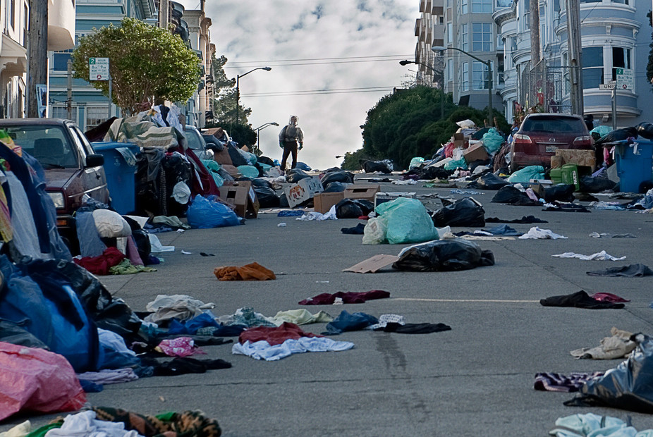
Future Pandemics
Based upon past epidemic and pandemic experiences, discuss the challenges and the risks brought by future pandemics.

