Slide 1
Topic 3 – Fertility and Mortality
A – Fertility Patterns
B – Mortality Transition
C – Life Expectancy
D – Infectious and Parasitic Diseases

Slide 2
Conditions of Usage
For personal and classroom use only
  Excludes any other form of communication such as conference presentations, published reports and papers.
No modification and redistribution permitted
  Cannot be published, in whole or in part, in any form (printed or electronic) and on any media without consent.
Citation
  Dr. Jean-Paul Rodrigue, Dept. of Economics & Geography, Hofstra University.

Slide 3
A. Fertility Patterns
1. Fertility Measures
2. Biological Determinants of Fertility
3. Social Determinants of Fertility
4. Economic Determinants of Fertility

Slide 4
1. Fertility Measures
Substantial changes in fertility patterns
  Ongoing decline; this decline has not been uniform.
  Variation in demographic transition from high fertility to low fertility.
  This theory does not necessarily explains the reasons behind declining fertility patterns.
  There are short term changes, such as the “baby boom” generation born between 1946 and 1964.

Slide 5
1. Fertility Measures
Maximum fertility
  Fecundity: Physiological ability to have children.
  Assume female fecundity from age 15-49:
    35 years of assumed fertility.
  Assume 9 months of pregnancy.
  Assume 18 months of breast feeding.
  Result: 1 child every 2.2 years.
  Maximum fertility rate is 18 children per woman.
  This is a theoretical maximum for a population.
Natural fertility
  The level of reproduction that exists in the absence of deliberate fertility control.
  The outcome of economic and social factors.
  ‘Natural’ Fertility is much lower than ‘Maximum’ fertility.

Slide 6
1. Fertility Measures
Crude Birth Rate (CBR) or General Fertility Rate (GFR)
  Number of live births per year per 1000 population.
  Both males and females are considered.
  All the population is considered, even the non-reproductive segment (children, elderly).
  Numbers like 10, 20, 40, etc.
25 males of any age
25 females of any age
10 children born that year
1,000
30
CBR = 30

Slide 7
1. Fertility Measures
Total Fertility Rate (TFR)
  Number of live births per female of reproductive age (15-49).
  Indicates population change over a long period of time.
  Instructive about societal norms in any given culture.
  2.1 is considered as being the replacement birth rate.
  Lower than 2.1 yields population decrease while rates greater than 2.1 yields population increase.
  2.5 to 3.3 in least developed countries.
  Improvements in medical conditions lower the replacement rate (below 2.06 in many countries).
25 females between 15-49
10 children born that year
1,000
60
TFR = 2.04
= (60/1,000) * (49-15)

Slide 8
Total Fertility Rate, Selected Countries, 1995-2014
Replacement rate (2.1)
Notes:
Source: World Population Prospects, the 2010 Revision

Slide 9
TFR among Developed Countries, 2005-2014
Notes:
Source: World Population Prospects, the 2010 Revision

Slide 10
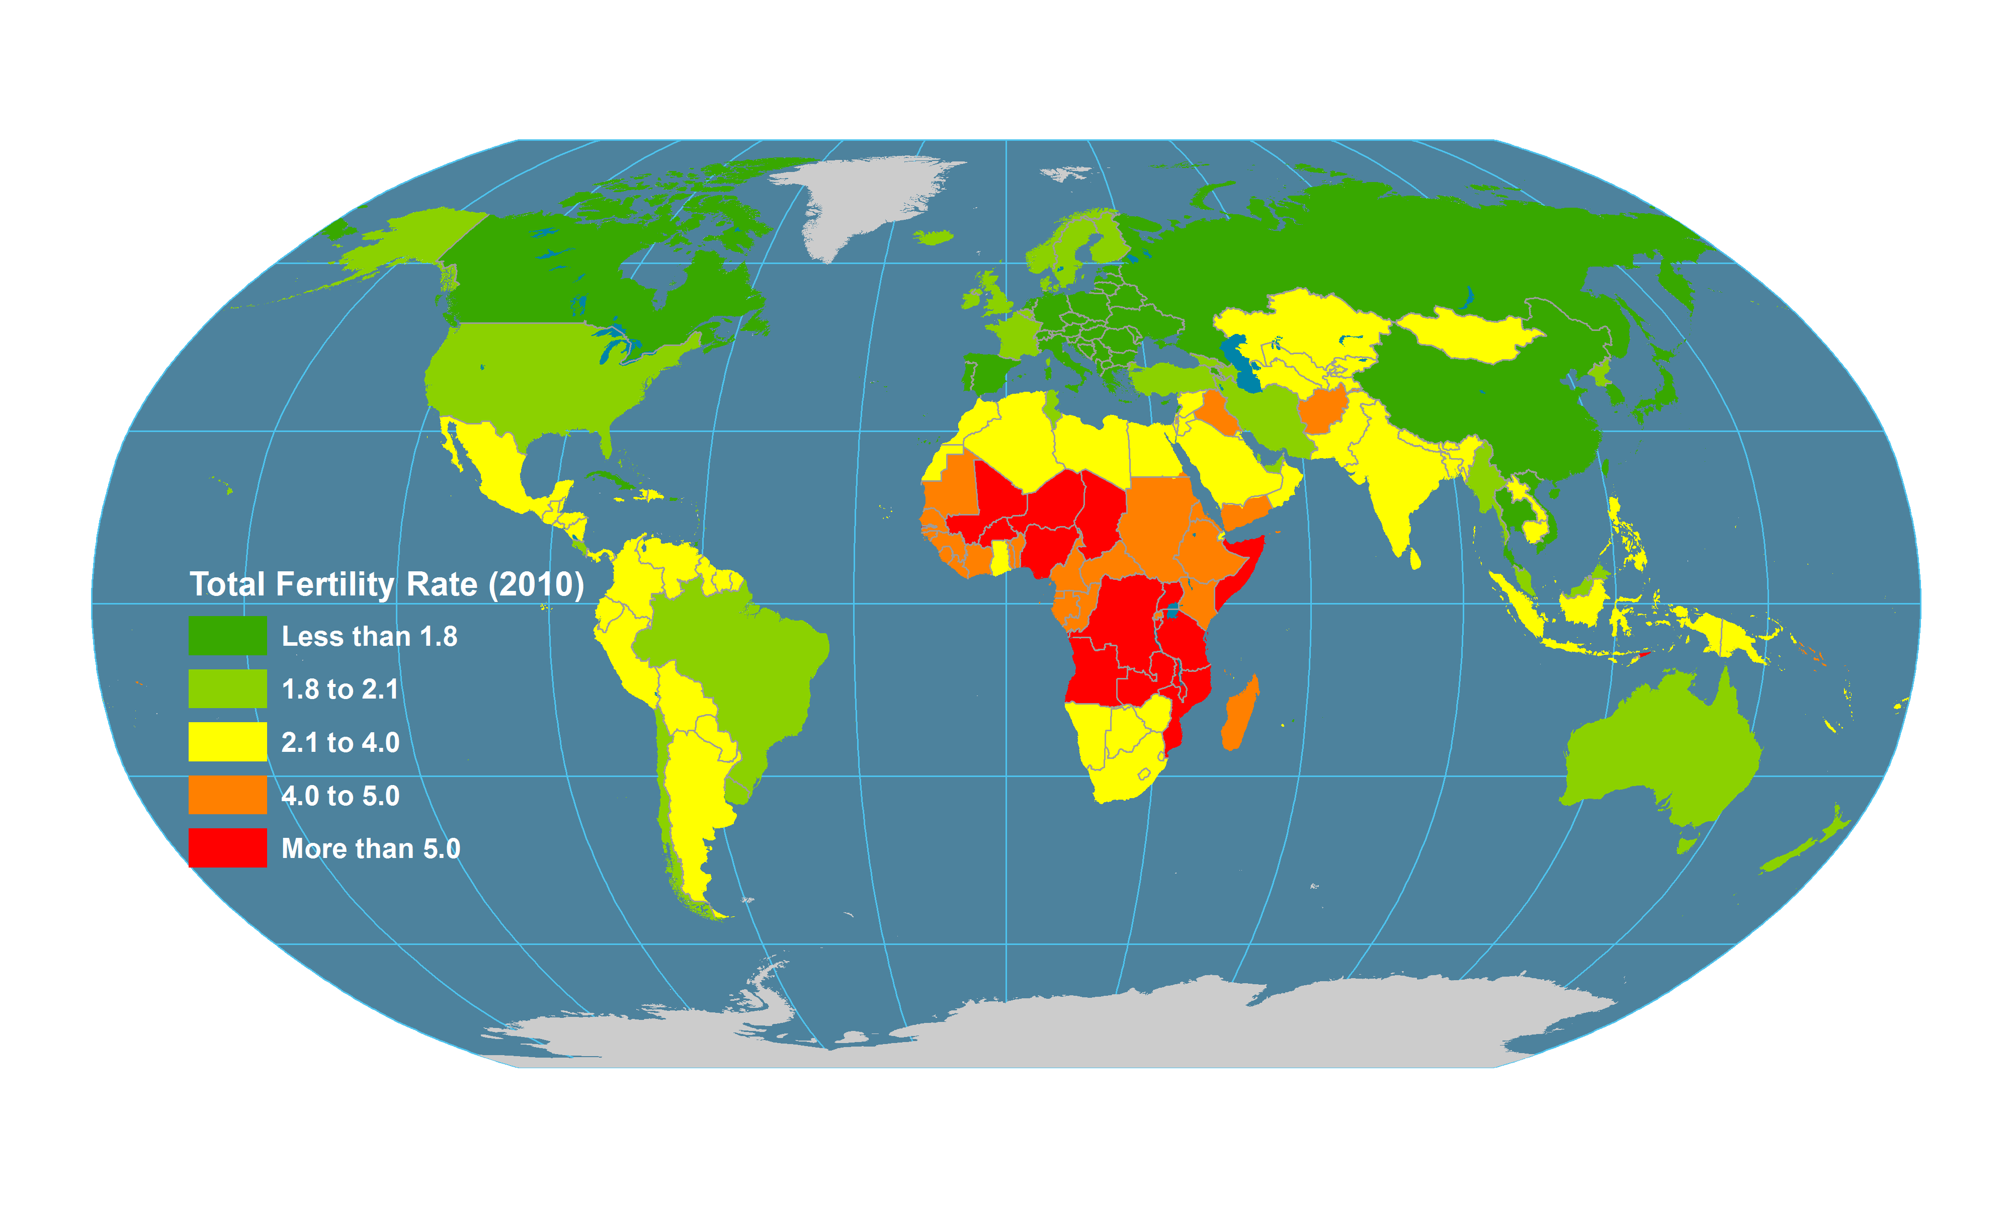
World Total Fertility Rate, 2010
High-fertility countries are increasingly concentrated in sub-Saharan Africa,.
What are the main fertility measures and some of their geographical characteristics?
Notes:
Source: UNEP (2015): The UNEP Environmental Data Explorer, as compiled from World Population Prospects, the 2012 Revision (WPP2012), United Nations Population Division . United Nations Environment Programme. http://ede.grid.unep.ch.

Slide 11
3. Factors Influencing Fertility
Biological
Determinants
Social
Determinants
Fertility
Economic
Determinants

Slide 12
2. Biological Determinants of Fertility
Age:
  Reproductive age of women ranges from 15-44 or from 15-49.
  Men: 13-??
Health and nutrition:
  Poor health and/or nutrition can reduce fertility.
  Linked with underweight children.
  Linked with child mortality rates.
Environment:
  Represents an undocumented impacts on fertility.
  Stressed populations tend to have less males than females.
  Possible correlation between sperm count and pollution.

Slide 13
Birth Rate per Age Group, United States, 1965, 1990, 2002, 2015 (per 1,000 women)
Notes:
Source: Center for Disease Control. http://www.cdc.gov/nchs/datawh/statab/unpubd/natality/natab99.htm

Slide 14
Average Sperm Count of Americans, 1938-98 (per ml)
Notes:
“Another sign of deteriorating human health is a fall in sperm counts. Among men in the United States, average sperm counts per milliliter of semen have dropped from 120 million in 1940 to just under 50 million in 1998. Counts in the European countries indicate a similar decline. The principal explanation for this is the so-called endocrine disruption hypothesis, namely that chemicals in the environment act as "environmental estrogens." These imitators of this basic female hormone-found in plastics, pesticides, and industrial pollutants-may adversely affect male reproductive functioning, among other things.” Quoted from a Saturday, May 29, 1999 press release.
Source: Worldwatch Institute.

Slide 15
3. Social Determinants of Fertility
Social determinants
  The social norms and acceptance of practices affecting fertility.
  Differ from society to society.
Marriage
  Particularly the average age of marriage.
  Percentage of people never married varies spatially and affects fertility rates.
  Late marriage age generally involves less children.
  Female mean age at first birth has increased in both low-fertility and high-fertility countries.
  In low-fertility countries, there has been an increase in childlessness among women aged 40-44 years, especially in Eastern Asia and Europe.

Slide 16
Girls between 15 and 19 who are Married, Divorced or Widowed, 2004
Notes:
Source: United Nations, Department of Economic and Social Affairs, Population Division. World Fertility Report. New York: UN (2004).

Slide 17
Average “Personal Ideal“ Number of Children, 2001 and 2006, Females Ages 15 - 24
Notes:
Source: Eurobarometers, 56.2 and 65.1

Slide 18
Completed Fertility: Women Aged 40-44 Childless and With Three or More Children
Notes:
Source: World Fertility Report 2013

Slide 19
3. Social Determinants of Fertility
Contraception
  Used by 30-50% of all married couples.
  Can go as high as 70% in advanced economies (Europe and North America).
  Availability of contraceptive devices and social attitudes toward their use affect fertility rates.
  Sharp differences exist between DCs and LDCs.
  Some notable exceptions, such as China and Cuba.
  Recent increase in contraceptive use in high fertility countries.

Slide 20
3. Social Determinants of Fertility
Education
  Particularly women.
  Higher educational attainment linked with lower fertility levels.
  Completion of education may also delay entry into marriage.
  Education linked to higher employment opportunities.
  May defer having children.

Slide 21
Female Primary Education Completion Rate and TFR by Region, 2014
Notes:
Discussion / teaching points: What is the relationship between education and fertility rate? What can help explain this?
Source: Data derived from World Bank, http://data.worldbank.org. Reprinted from Bruce Newbold, Population Geography: Tools and Issues (Rowman & Littlefield 2017). All rights reserved.

Slide 22
Total Fertility Rates by Race: United States, 1940-2014
Notes:
Discussion / teaching points: There has been some convergence in fertility rates by race in the United States over the past two decades. Why?
Source: Author. Data derived from US CDC National Vital Statistics Reports. Reprinted from Bruce Newbold, Population Geography: Tools and Issues (Rowman & Littlefield 2017).

Slide 23
3. Social Determinants of Fertility
Abortion:
  Last resort measure when contraception failed (or was not used).
  Its legality is not universal and under challenge in some countries where it is permitted.
  Global figures (2014):
    210 million pregnancies.
    25% of all pregnancies end up in a abortion.
    56 million abortions, of which 20 million procedures are obtained illegally.
  Illegal abortions are common in most societies where it is prohibited.
  Culture plays an important determining role in the impact of abortion.
  United States: 49% all pregnancies unwanted and about half of unwanted pregnancies ended in abortion (1.4 million abortions per year).

Slide 24
Pregnancies and Abortions per Women Aged 15-19 Years, 1998
Notes:
Source: Durex Global Survey.
Source: The Alan Guttmacher Institute.
Nearly 1.4 million abortions in a year, with nearly half of all pregnancies unwanted.
https://data.guttmacher.org/regions

Slide 25
Abortion Rates (per 1,000 females) Aged 15-19, 1991-2011
Notes:
Source: http://www.childtrends.org/indicators/teen-abortions/

Slide 26

3. Social Determinants of Fertility
Political setting
  Communist countries were proactive.
  Prior to revolution high infant mortality rates (50%)
  Women were involved more in industrial labor.
  “Down with kitchen slavery!”

Slide 27

3. Social Determinants of Fertility
Rapid Decline of Fertility after Bolshevik Revolution
  Slogan: “Liberated woman – Build Socialism!”
  After the revolution Bolshevik government allowed abortions
  Sex was considered a natural need (compared to ‘glass of water’)
Explain the main impacts of social determinants on fertility.

Slide 28
3. Social Determinants of Fertility
Dysgenics
  The “Idiocracy” Syndrome; controversial concept.
  In the past, successful individuals were “rewarded” with more descendants:
    Evidence that in England, up to the 1850s, wealthy individuals had more children.
  The welfare state appears to have reversed the situation:
    The poorest and the least successful tend to have more children.
    Some negative correlation between fertility and IQ has been observed.
  At the global level:
    The poorest societies tend to have the highest fertility.
    International aid enables dysfunctional economies to endure.

Slide 29
3. Economic Determinants of Fertility
Economic determinants
  The role of children, or their “value” affects fertility.
  Inverse relationships:
    Fertility and income per capita.
    Fertility and urbanization.
  Traditional rural societies:
    Children still play an important economic role and contribute to family wealth.
    Fertility is likely to remain higher.
  Industrial and post-industrial societies:
    Costs tend to increase with the development level of the society.
    Deflate the fertility rate since parents must consider the direct and opportunity costs of bearing additional children.

Slide 30
3. Economic Determinants of Fertility
Direct costs lost
  For the support of children.
  Food, clothing, housing, education, etc.
  Estimated to be between $150,000 and $300,000 from birth to 18.
Opportunity costs lost
  Lower standard of living.
  Reduce the ability to save and invest.
  Labor force participation of women is affected by child-bearing.

Slide 31
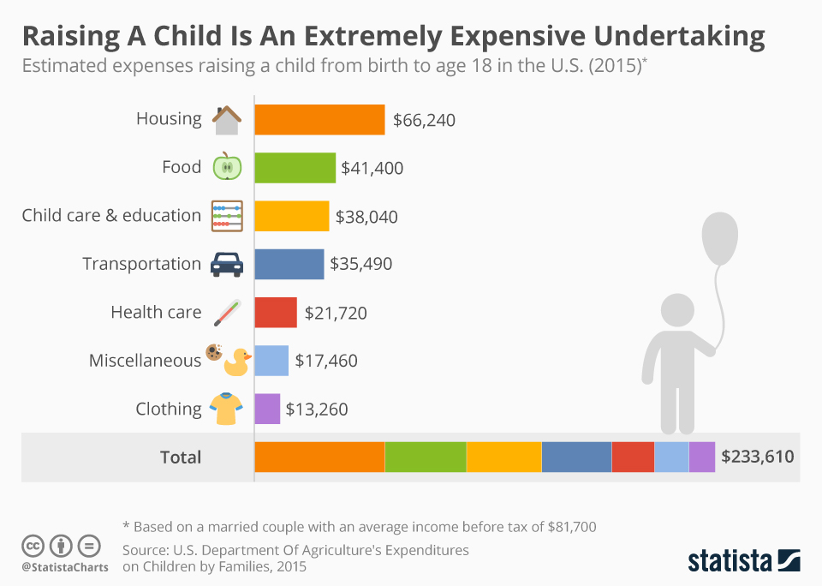

Slide 32
3. Economic Determinants of Fertility
Relationship between inflation and fertility?
  Increase in the cost of living may have an impact on fertility.
  Particularly if both parents must work to support the family.
  In the United States, the costs that have increased the most:
    Housing.
    Professional services (e.g. healthcare and education).
    Energy.
  Older generations delay retirement.
  Younger generations may further delay having children.

Slide 33
Relationship Between Fertility and GDP per Capita, Selected Countries, 2007
Notes:
Source: www.gapminder.org

Slide 34
3. Economic Determinants of Fertility
Implications of high fertility
  In some countries it places strains on infrastructure.
  Inadequate provision of health care and education.
  Impairs economic development.
Implications of declining fertility
  Aging of the population.
  Less consumption.
  Smaller labor pool.
  May impair economic development.
Explain the impacts of main economic determinant on fertility.

Slide 35
B. Mortality Transition
1. Crude Death Rate
2. Infant Mortality Rate
3. Epidemiological Transition

Slide 36
1. Crude Death Rate
Causes of death
  Throughout most of history famine, epidemics, and wars have been the leading causes of death.
  Primary causes of death began to shift to degenerative problems related to aging.
  These include such factors as heart disease and cancer.
  Three major causes (groups) of death.

Slide 37
1. Crude Death Rate
Group I includes communicable, maternal, and perinatal causes and nutritional deficiencies.
Group II includes the non-communicable causes including cancers, diabetes, cardiovascular disorders and chronic respiratory diseases.
Group III includes unintentional and intentional injuries.

Slide 38
1. Crude Death Rate
Death rate
  Easiest of the variables to consider.
  Occurs just once per person and is the most recorded.
Crude Death Rate (CDR)
  Annual number of deaths per 1000 population (all ages included).
25 males of any age
25 females of any age
10 people who died that year
1,000
30
CDR = 30

Slide 39
1. Crude Death Rate
Death and welfare
  Death rates used to be considered a sign of the health of a population.
  Different age structures among the populations of different countries.
  Possible for a nation with high living standards to have a higher death rate than a poorer nation.
  Reason: overall older population.

Slide 40
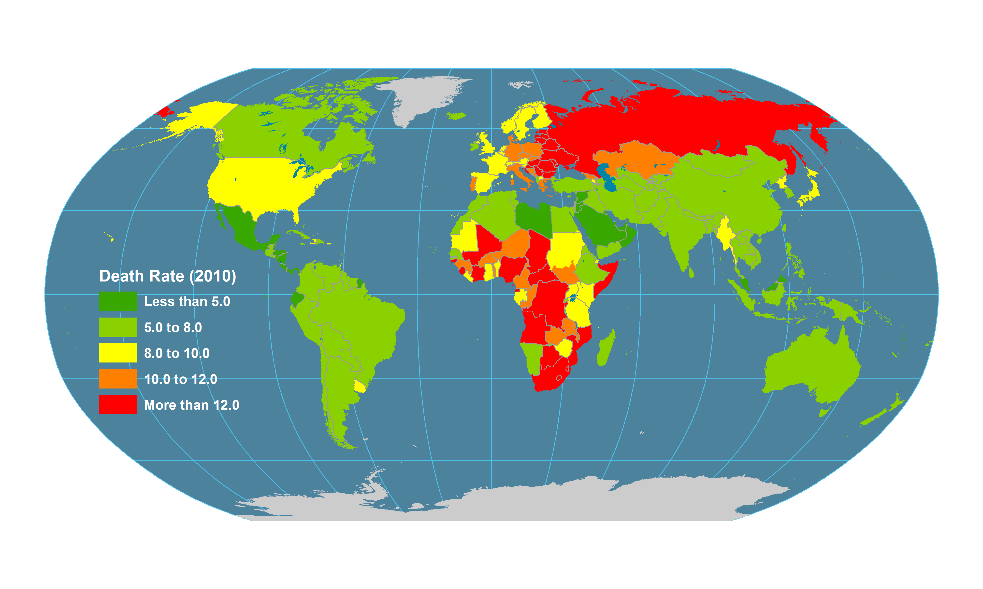
World Crude Death Rate, 2010
Notes:
Source: UNEP (2015): The UNEP Environmental Data Explorer, as compiled from World Population Prospects, the 2012 Revision (WPP2012), United Nations Population Division . United Nations Environment Programme. http://ede.grid.unep.ch.

Slide 41
Fertility and Mortality in the United States, 1950-2014 (in 1000s)
Notes:
Source: Center for Disease Control.

Slide 42
2. Infant Mortality Rate
Definition
  Expressed in numbers of deaths of infants under one year per 1000 live births of the same year.
  Also considers the death of children under 5 per 1000 in their cohort.
  High levels of infant mortality pull down life expectancy rates.
  Reflects the quality of the health system.
  Very strong differences between developed and developing countries.
  Often measured in terms of peri-natal (less than 1 month) and infant (under 5 years).

Slide 43
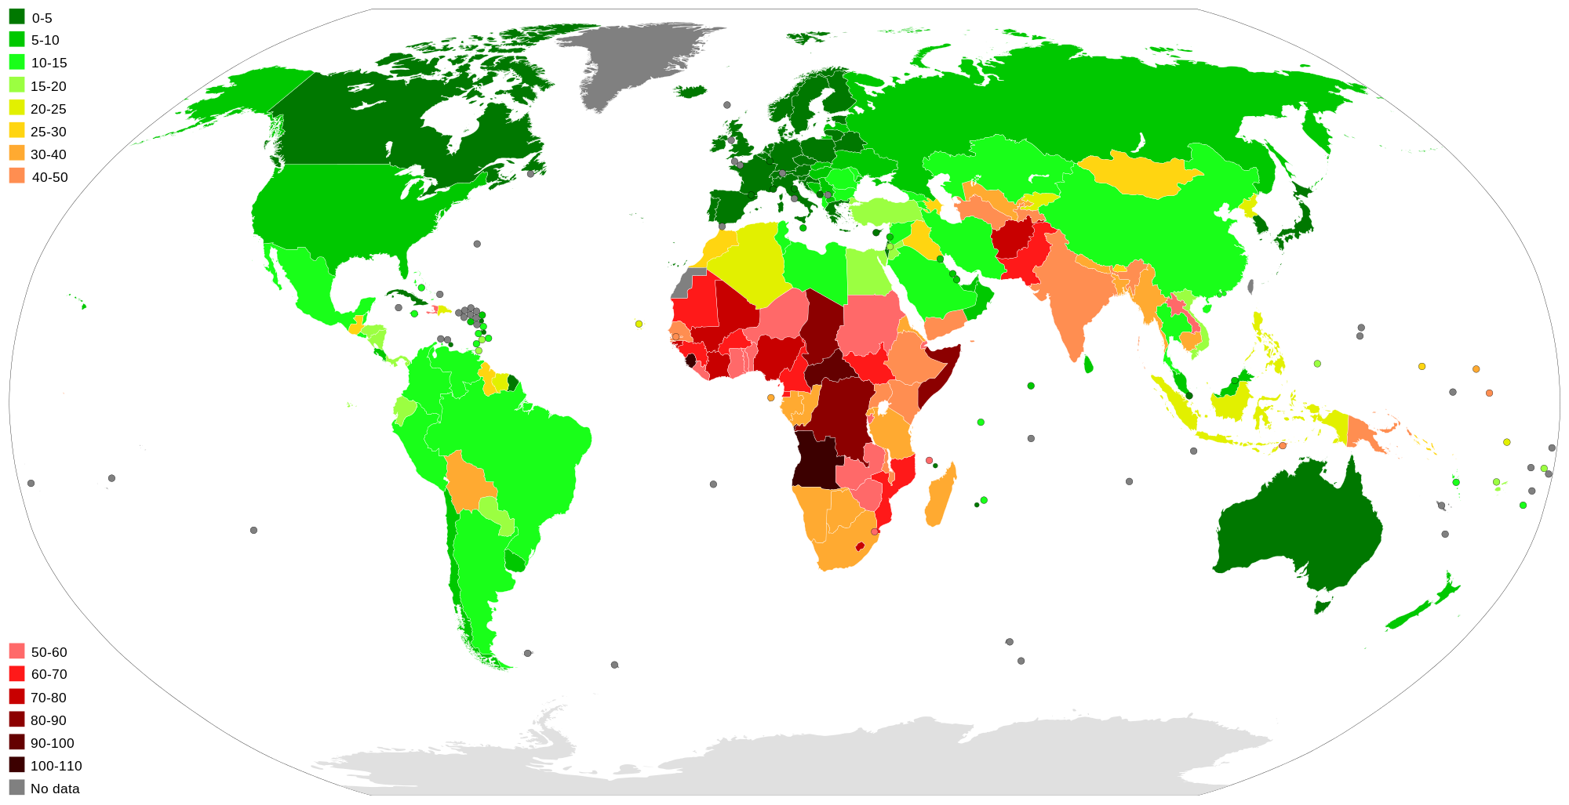
Infant Mortality Rate, 2013
Explain the patterns of global mortality.

Slide 44
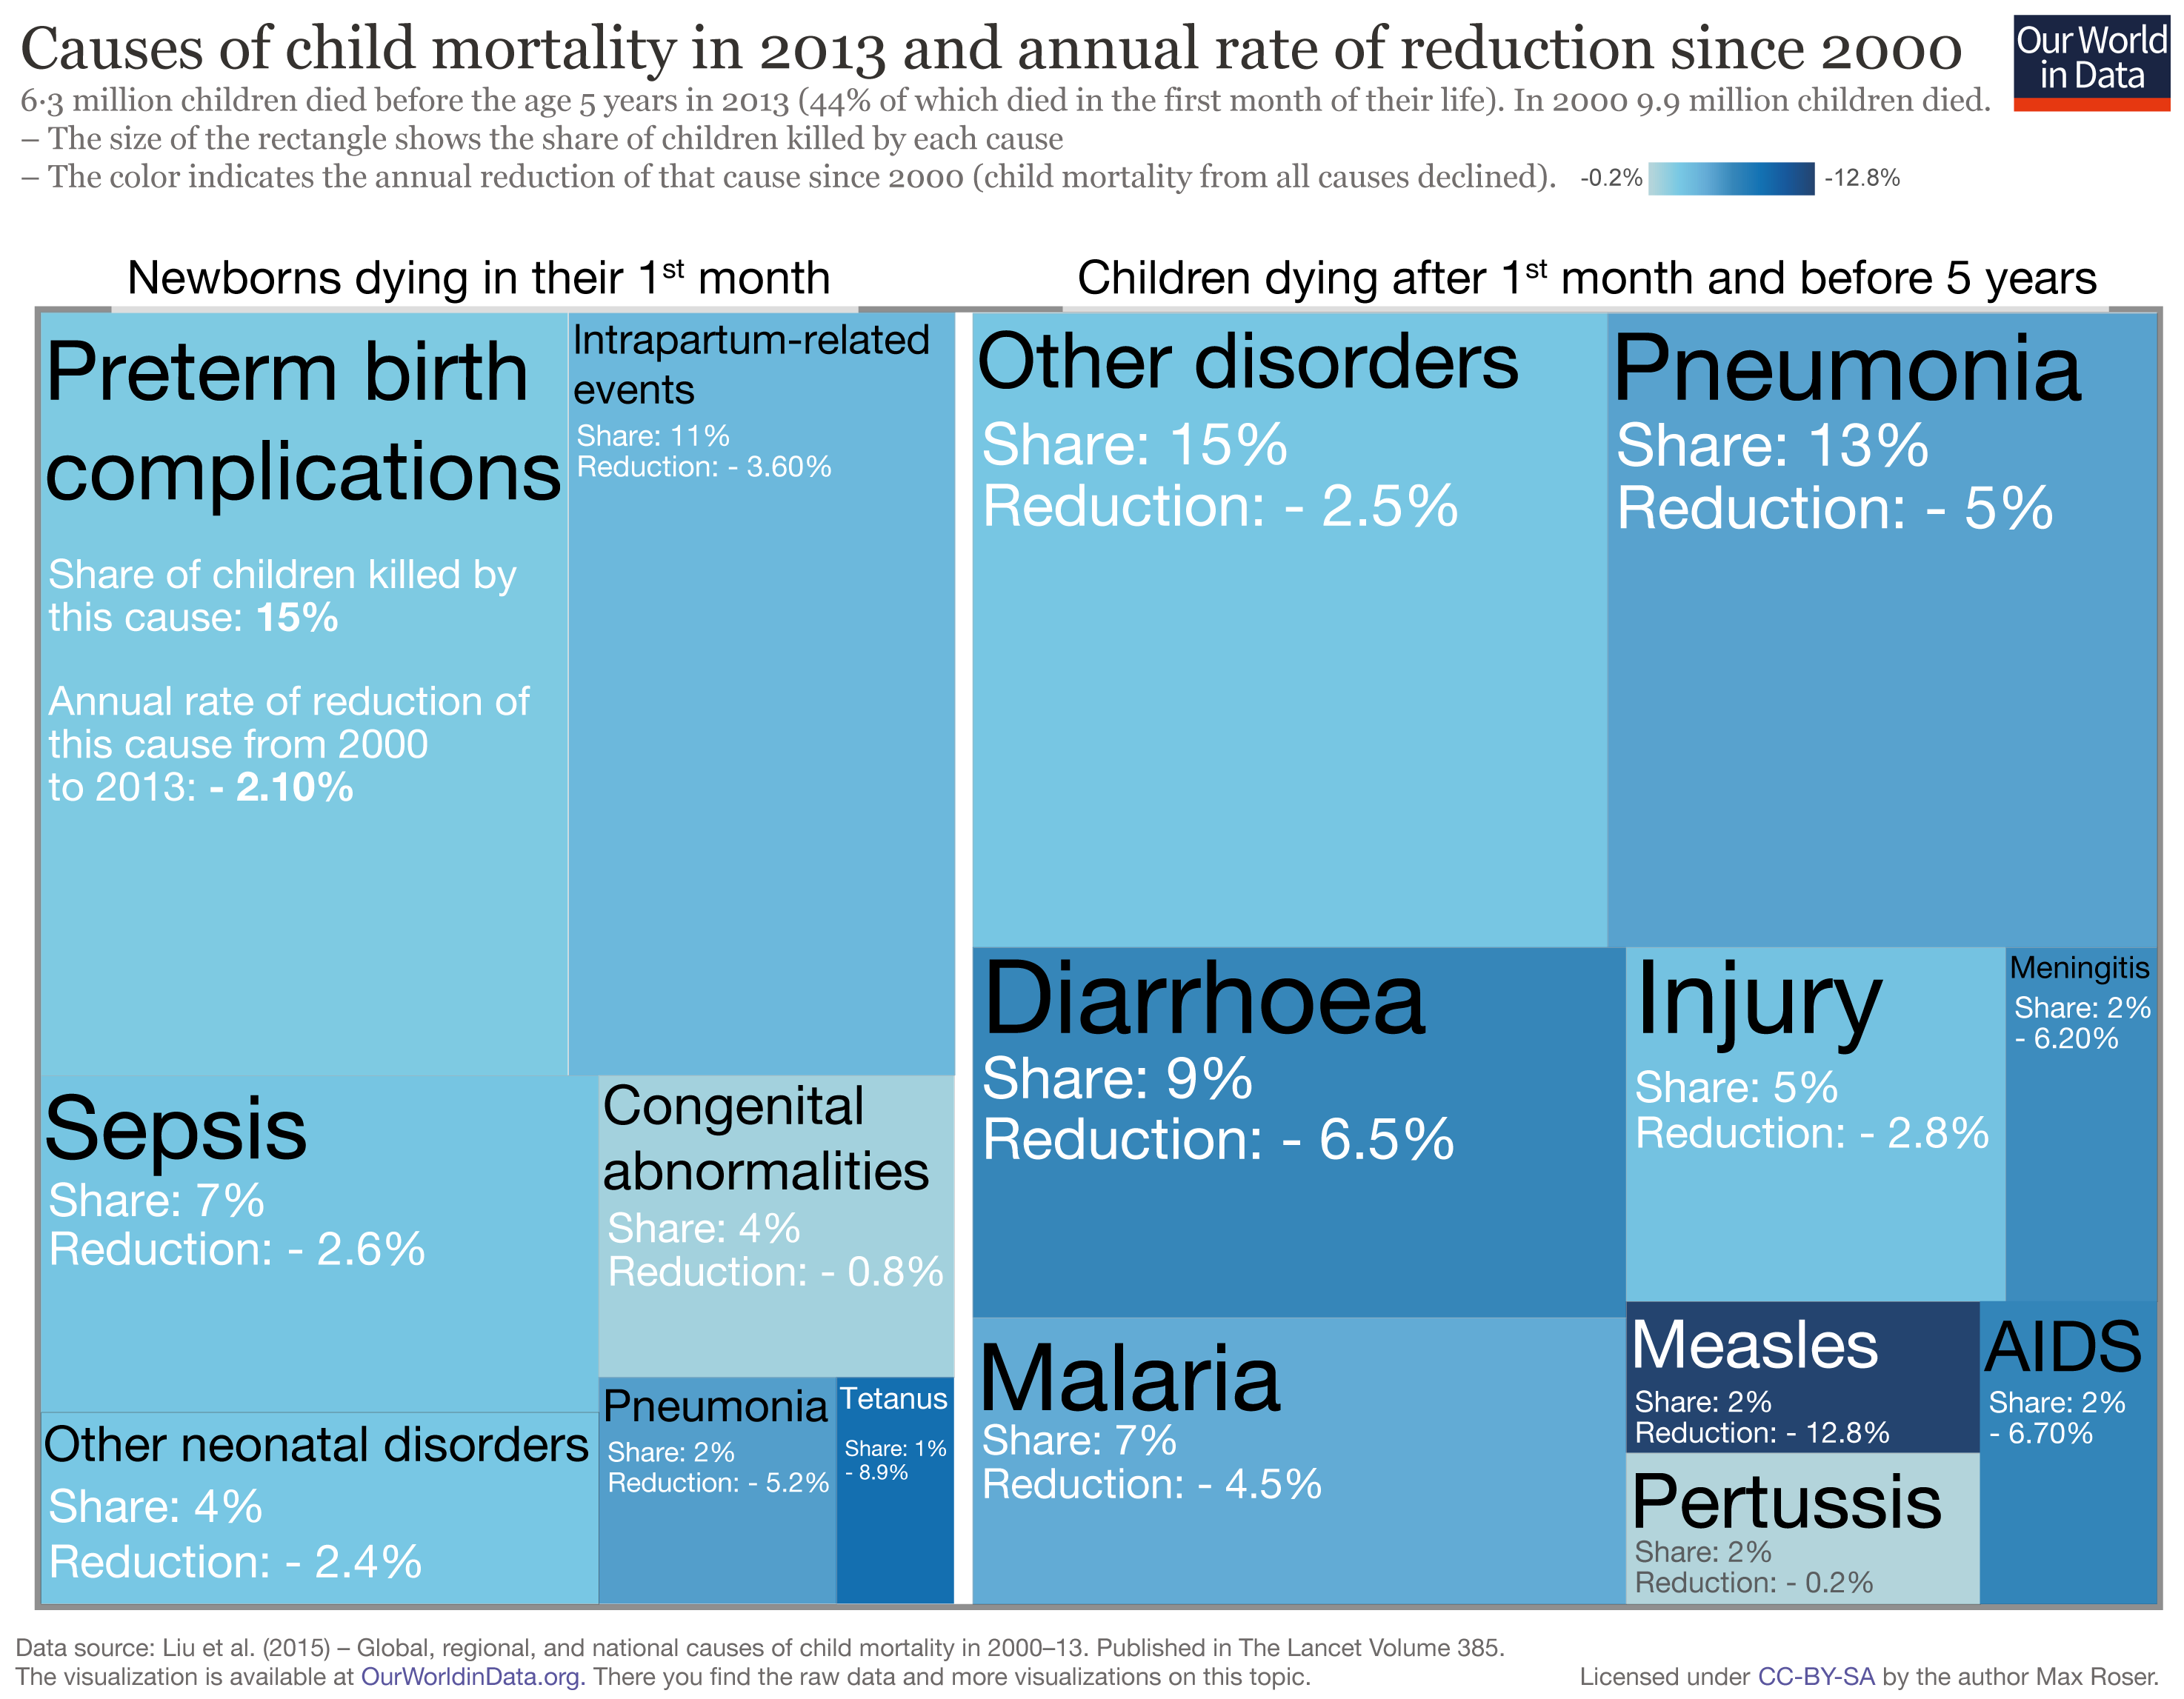
Notes:
Sepsis: serious reaction to an infection.
Pertussis (whooping cough)

Slide 45
3. Epidemiological Transition
Concept
  Long-term shift in mortality and disease patterns.
    Through history, most people were expected to live 20 to 30 years.
  Focuses on changes over time in the causes of mortality affecting certain populations:
    Health conditions.
    Disease patterns.
  The society goes through a transition from communicative diseases to degenerative diseases.
  Result in a decline in death rates and an increase of life expectancy:
    Earlier effects due to improvements in economy and public health.
    Later the outcome of improvements in medical and biological sciences.
  Three major transitions were advocated.

Slide 46
3. Epidemiological Transition
Age of communicative diseases
Age of receding pandemics
Age of degenerative and man-made diseases
Degenerative diseases
Tuberculosis, cholera, diarrhea, influenza
Cancer, diabetes, cardiovascular, neurological
Share of mortality
High Fertility
High Mortality
Low Fertility
Low Mortality
LI=70 years
LI=30 years
LI=50 years
High Fertility
Decreasing Mortality
Communicative diseases
Time

Slide 47
3. Epidemiological Transition
 | First transition | Second transition | Third transition
Timeframe | Up to the mid 19th Century (later for developing countries) | Mid to late 20th century | Late 20th century onto the 21st century
Demographic features | High mortality High fertility Large population | Low mortality Declining fertility Large population | Low mortality Low fertility Large or declining population
Nutritional features | Crops, undernutrition | Varied diet, overnutrition | Varied diet + processed food, overnutrition
Epidemiologic features | Infectious diseases | Chronic diseases | Chronic diseases + reemerging infectious diseases

Slide 48
Survivorship of the British Population, 17th and 20th Centuries
Notes:
In the United States, by the 1850s, half the children did not reach the age of 5.

Slide 49
3. Epidemiological Transition
Delayed degenerative
  Life expectancy of older people is extended through medical advances.
  Cancer medicines, bypass surgery, better diet, reduced use of tobacco and alcohol.
  Consumption of non-nutritious food and sedentary behavior have resulted in an increase in obesity.

Slide 50
3. Epidemiological Transition
Reemergence of infectious and parasitic diseases
  Diseases thought to have been eradicated or controlled return.
  Emergence of new diseases.
  Warmer climates create favorable environments for the cholera bacteria.
  New strains due to drug resistance (malaria).
  More infections due to unsanitary conditions, such as mosquitoes.
  Increased connections:
    Spread through relocation diffusion (H1N1/swine, severe acute respiratory syndrome (SARS).
What is the epidemiological transition and its future potential developments?

Slide 51
3. Epidemiological Transition: The Case of the United States
Age of receding pandemics (1900)
  Influenza and pneumonia.
  Measles and other communicable diseases also significant killers.
Age of delayed degenerative diseases (early 21st century)
  60% die from heart disease and cancer.
  Stroke is also an important killer.
  The growth of Alzheimer.
  Tobacco: Decline in smoking.
  Poor diet / lack of exercise: 400,000/year.
  Alcohol: 75,000/year, including 40,000 from auto accidents where drunk driving was involved (2.5 million worldwide).
  Firearms: 29,000 / year (more than 12,000 murders + 16,000 suicides.

Slide 52
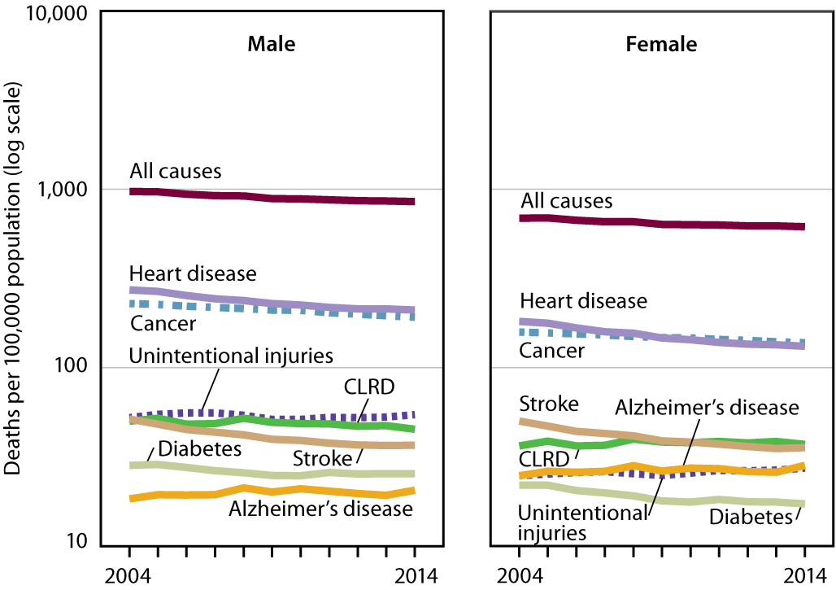
Selected Causes of Death, United States
Notes:
NOTES: CLRD is chronic lower respiratory diseases. A change in the coding rules for nephritis, nephrotic syndrome and nephrosis caused an increase in the number of deaths attributed to diabetes beginning with 2011 data. Thus, the trend for diabetes death rates should be interpreted with caution.
SOURCE: CDC/NCHS, Health, United States, 2015, Figure 2 and Table 17. Data from the National Vital Statistics System (NVSS).

Slide 53
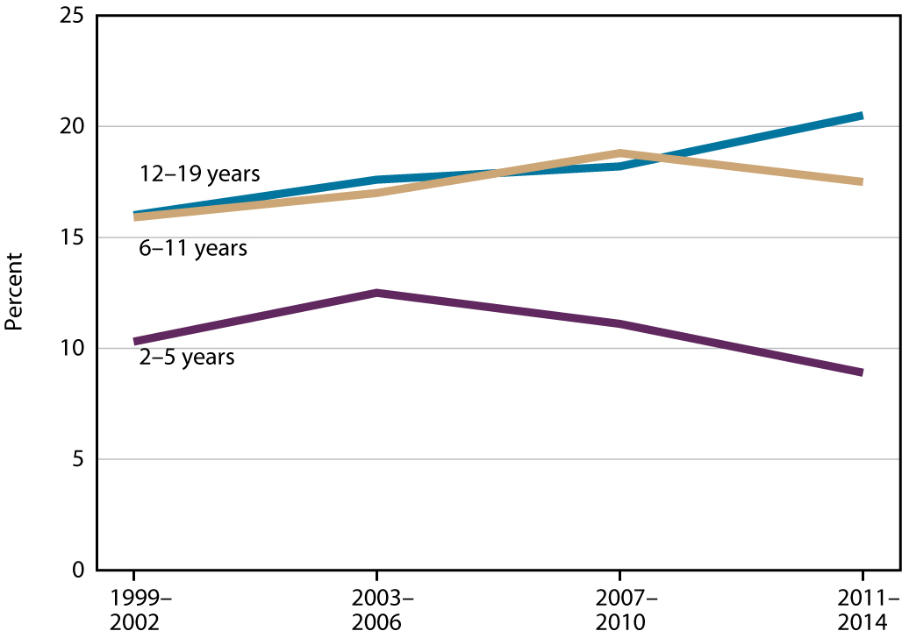
Children and Adolescents with Obesity, United States
Notes:
SOURCE: CDC/NCHS, Health, United States, 2015, Figure 8 and Table 59. Data from the National Health and Nutrition Examination Survey (NHANES).
NOTE: Obesity is body mass index (BMI) at or above the sex- and age-specific 95th percentile BMI cutoff points from the 2000 CDC Growth Charts.

Slide 54
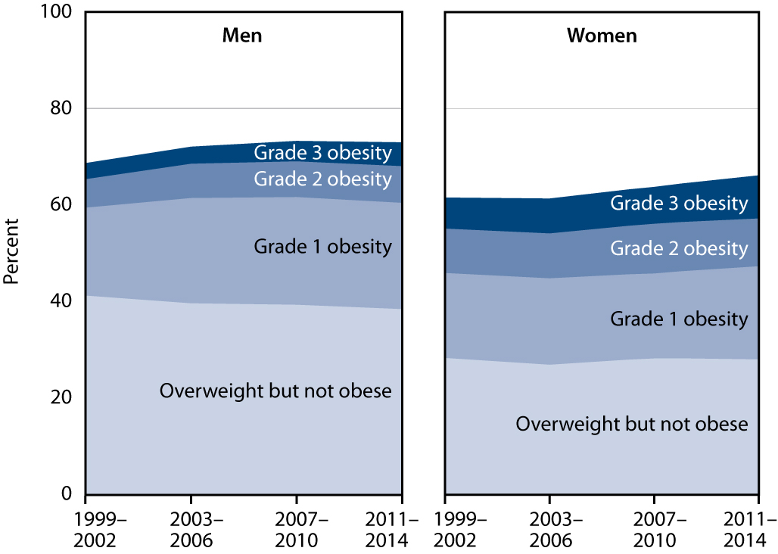
Adults with Overweight and Obesity: Aged 20+, United States
Notes:
NOTES: BMI is body mass index. Overweight but not obese (25 ≤ BMI < 30); Grade 1 obesity (30 ≤ BMI < 35); Grade 2 obesity (35 ≤ BMI < 40); Grade 3 obesity (BMI ≥ 40).
SOURCE: CDC/NCHS, Health, United States, 2015, Figure 9 and Table 58. Data from the National Health and Nutrition Examination Survey (NHANES).

Slide 55
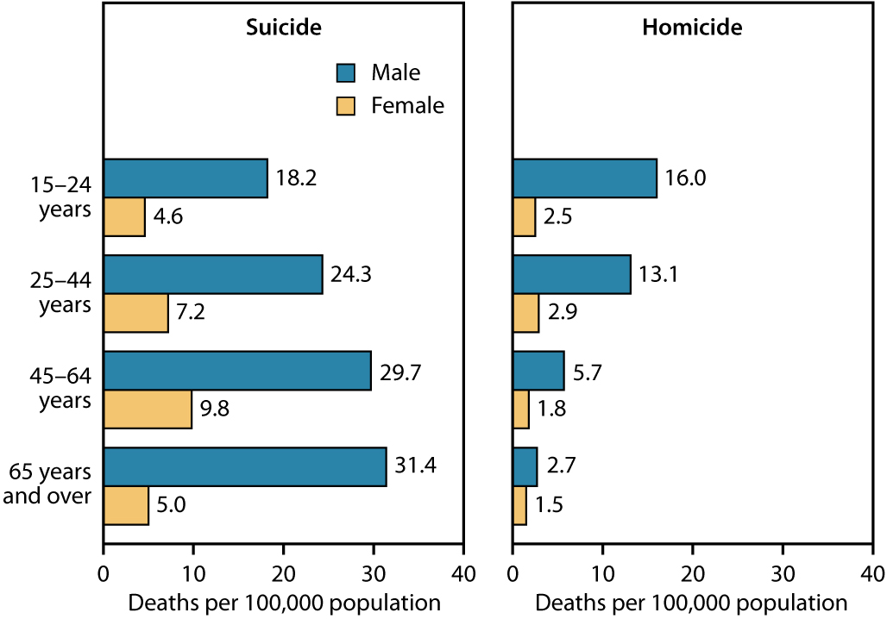
Suicide and Homicide Death Rates, United States 2014
Notes:
SOURCE: CDC/NCHS, Health, United States, 2015, Figure 3 and Tables 29 and 30. Data from the National Vital Statistics System (NVSS).

