Slide 1
Topic 1 – Introduction to Population Geography
A – Population Geography
B – Population Growth
C – Demographic Transition

Slide 2
Conditions of Usage
For personal and classroom use only
  Excludes any other form of communication such as conference presentations, published reports and papers.
No modification and redistribution permitted
  Cannot be published, in whole or in part, in any form (printed or electronic) and on any media without consent.
Citation
  Dr. Jean-Paul Rodrigue, Dept. of Global Studies & Geography, Hofstra University.

Slide 3
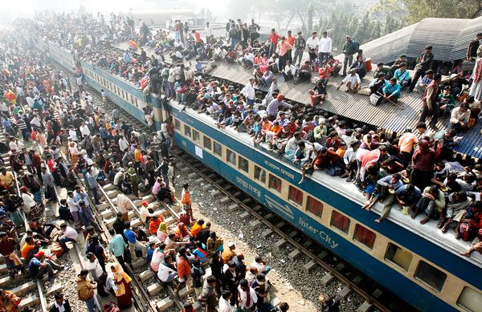
Goal of this course: expose students to the many issues related to population and migration in our contemporary world

Slide 4
Some Basic Questions
Is the world overpopulated?
Is migration a right or a privilege?
What level of involvement a society should have in reproduction?

Slide 5
A – Population Geography
1. Demography and Population Geography
2. Global Demographic Trends
3. A Changing World

Slide 6
1. Demography and Population Geography
Population processes
  Group living in a particular areas capable of interbreeding.
Key characteristics
  Fertility: the rate of reproduction.
  Mortality: the rate of removal from population.
  Migration: mobility between geographical areas.
Some salient issues
  Significant differences in growth rates.
  Health and quality of life.
  Illegal migration and refugees.

Slide 7
1. Demography and Population Geography
Demography | Population geography
Systematic analysis of population phenomena through empirical, statistical and mathematical methods. | Spatial variations in the distribution, composition, migration, and growth of populations.
Interested about changes in the population size and composition. | Description of the location of the population. Explanation of its spatial pattern and distribution. Geographical analysis (processes such as urbanization and migration).
Emphasizes on time. | Emphasizes on space.
Explain the fundamental differences between demography and population geography

Slide 8
1. Demography and Population Geography
Main research areas in population geography
  Internal migration and residential mobility:
    Migration and economic cycles.
    Demographic cycles (population cohorts).
  International migration:
    Causes and consequences.
  Immigrant assimilation and ethnic enclaves.
  Regional demographic characteristics:
    Fertility and mortality patterns.
  Social theory and population:
    Race and gender issues.
  Public policy:
    Redistricting. Public health. Family planning.

Slide 9
1. Demography and Population Geography
Evolution of the world’s population
  Long historical process:
    Has been very slow up to recently.
    300 million people around year 0.
    Remained small until the last 250 years.
  A new growth trend:
    Has increased almost exponentially.
    From 1.6 billion in 1900 to 7 billion in 2012.
    To what it can be linked?

Slide 10
Diffusion of Homo Sapiens Around the World
Origins:
7 million BC
By 500,000 BC
By 11,000 BC
By 2,000 BC
By 10,000 BC
By 1,000,000 BC
By 20,000 BC
By 12,000 BC
By 40,000 BC
AD 500
33,000 BC
AD 1,000
1,200 BC

Slide 11
2. Global Demographic Trends
Population “explosion”
  Defines a process of strong demographic growth.
  Started after the Second World War.
  About 80 million people added each year.
  Major concern for the future of humanity.

Slide 12
World Population, 1000BC-2015AD (in billions)
Notes:
Source: The data for the period before 1900 are taken from the History Database of the Global Environment (HYDE). The data for the World Population between 1900 and 1940 is taken from the UN puplication 'The World at Six Billion'. The annual data for the World Population between 1950 and 2015 is taken from the UN's World Population Prospects: The 2015 Revision.

Slide 13
Population Added to the Global Population, 1950-2015
Notes:
Source: Worldwatch Institute.

Slide 14
Major Phases of Demographic Change
Agricultural Revolution
  Feudal society.
  Wealth from agriculture and land ownership.
  Slow demographic growth.
Industrial Revolution
  Wage labor society.
  Wealth from industry and capital ownership.
  Fast demographic growth.
Post-Industrial Revolution
  Information society.
  Wealth from technological development.
  Slow demographic growth.
Agricultural
Revolution
12,000 years
Industrial
Revolution
200 years
Post-Industrial
Revolution

Slide 15
2. Global Demographic Trends
Overpopulation
  A relative concept; not an absolute number.
  An area with a small population could be overpopulated while an area with a large population could not be overpopulated.
  Relationship between population and available resources:
    Usually related to the ecological footprint of the population.
    How much resources required per unit of population (food, energy, water, etc.).
    The level of consumption.
  At some population level additional numbers become a cause of declining standards of living and environmental degradation.

Slide 16
The Concept of Overpopulation
Unsustainable
>1
Overpopulation
1
Sustainable
Population / Resources
0
Explain what is overpopulation

Slide 17
3. A Changing World: The Decline of Poverty
Notes:
Extreme poverty is less than one dollar per day.
Source: Max Roser based on World Bank and Bourguignon and Morrisson (2002).

Slide 18
3. A Changing World: The Rise of Literacy
Notes:
This data was calculated by Max Roser for Our World In Data using the following source:
– World population from https://ourworldindata.org/world-population-growth/ (based on HYDE and UN)
– Literacy rates for 1800 to 1990 from OECD (2014) – How Was Life? – Global Well-being since 1820. The observation for 1820 is used for 1800 and 1820.
– Literacy for 2004 to 2014 from UNESCO (this is adult (15 and older) literacy rate for both sexes). Online here: http://data.uis.unesco.org/index.aspx?queryid=166&lang=en

Slide 19
3. A Changing World: The Decline of Child Mortality
Notes:
The World series for 1800 to 1960 was calculated by Max Roser on the basis of the Gapminder estimates of child mortality and the Gapminder series on population by country. For each estimate in that period a population weighted global average was calculated.
The recent annual observations of the World series (1960 and later) is taken from the World Bank (http://data.worldbank.org/indicator/SH.DYN.MORT).

Slide 20
3. A Changing World: The Rise of Democracy
Anocracy: unstable and ineffective government.
Closed anocracy: ruling class comes from an elite.
Open anocracy: ruling class comes form the population.
Autocracy: Power in one person (authoritarian; king, leader).
Notes:
Max Roser based on Polity IV data, and data from Wimmer and Min (2006), Gapminder.org, UN Population Division (2015 Rev), and Our World In Data

Slide 21
B. Population Growth
1. Fertility, Birth and Death Control
2. Population Growth Rates
3. Doubling Time

Slide 22
1. Fertility, Birth and Death Control
Definition
  Process during which the population of an area increases.
  Related to a complex economic, cultural and social environment.
  Two factors:
    (1) Number of births exceeds the number of deaths.
    (2) Migration flow is positive.
    Over 70% of the United States annual population growth results from immigration.
  Expressed in percentages.
  Birth rate of 20 per 1000 people.
  Death rate of 10 per 1000 people.
  Growth rate of 10 people per year per 1000 population, or 1%.
Births minus Deaths
Positive migratory balance
Population Growth
Society
Economy
Culture

Slide 23
1. Fertility, Birth and Death Control
Society
  The “room” available for additional members.
  The age structure influence fertility.
  An aging population has lower levels of fertility.
  Longer life expectancy negatively impact fertility.
Economy
  Employment and resources available.
  Paradoxically, poor countries have high levels of fertility.
Culture
  Values placed on children and the role of woman.
Explain and provide examples how societal, economic and cultural factors influence fertility

Slide 24
World Population 1804-2048 (in billions)
20 years
15 years
13 years
12 years
13 years
15 years
37 years
118 years
Notes:
Source: United Nations (1995b); U.S. Census Bureau, International Programs Center, International Data Base and unpublished tables.

Slide 25
15 Largest Countries, 2005, 2050 (in millions)
Notes:
Source: FAO Statistical Database

Slide 26
Population of Russia, Japan Italy, 1950-2050 (in millions)
Notes:
Source: United Nations Population Division

Slide 27
1. Fertility, Birth and Death Control
Achieved “death control” more effectively then birth control
  Major factor behind the growth of the global population in recent decades.
  Modern medicine:
    Vastly decreased the number of deaths from many diseases (malaria, yellow fever, etc.).
  Famine:
    Reduced through better agriculture, distribution, storage and by international aid mechanisms.
  Infant mortality:
    Decreased in most areas.
  Improvement in the availability and quality of the water supply:
    Improved hygiene conditions.
    Decreased deaths caused by water borne diseases.

Slide 28
1. Fertility, Birth and Death Control
Birth control has been more difficult to achieve
  Reproduction cannot be effectively “planned” by the state.
  Religious beliefs.
  Cultural traditions.
  The importance of children as help, labor and security.
  The role of women is very limited in many societies.

Slide 29
2. Population Growth Rates
 | High Growth (2% and above) | Characteristic of many Third World countries.
 | Average Growth (Between 1 and 2%) | Much of Latin America and parts of Asia.
 | Low Growth (Between 0 and 1 %) | Europe, the United States and Canada. China.
 | ZPG (Zero Population Growth) (Less than 0%) | Most East European countries. Japan.
High
2.0%
Average
1.0%
Low
0.0%
ZPG

Slide 30
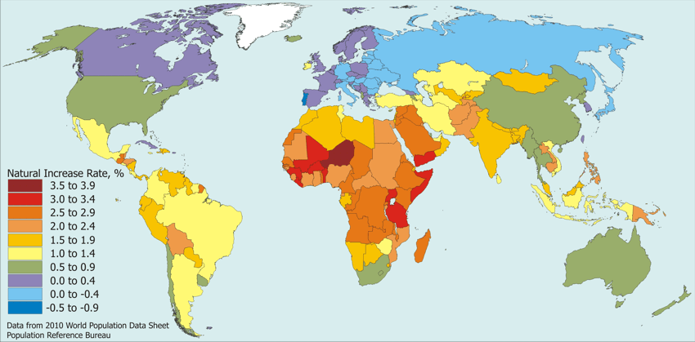
Population Growth Rate, 2010
Why the population of some areas of the world is growing fast while other areas have negative growth rates?

Slide 31
3. Doubling Time
Definition
  Length of time necessary for an area (usually a nation) to double its population.
  The mathematics of population work very much like compounding interest.
  Percentage of increase is applied to an ever-increasing base.
  Simple equation: 70 / Growth rate.
Implications
  The faster the growth rate the lower the doubling time:
    1% growth rate: 70 years.
    3.5% growth rate: 20 years.
    Infinite doubling time: no growth or negative growth.

Slide 32
Doubling Time as of 2000

Slide 33
Doubling Time of Some Countries
China (0.5%)
USA (0.75%)
Brazil (0.9%)
India (1.26%)
Nigeria (2.7%)
Congo (3.17%)

Slide 34
C. Demographic Transition
1. Demographic Transition Theory
2. Stages in Demographic Transition
3. Geographical Variations
4. Future Population Growth

Slide 35
1. Demographic Transition Theory
Overview
  A “social modernization” of the reproduction process:
    Improved health care and access to family planning.
    Higher educational levels, especially among women.
    Economic growth and rising per capita income levels.
    Urbanization and growing employment opportunities.
  Involves moving from one equilibrium to another:
    Initial equilibrium: High birth and death rates.
    Final equilibrium: Low birth and death rates.
  Theory backed by solid empirical evidence.
  Involves four phases.

Slide 36
1. Demographic Transition Theory

Slide 37
2. Stages in Demographic Transition
Stage I: Preindustrial Society | Stage II: Early Industrial Society | Stage III: Late Industrial Society | Stage IV: Postindustrial Society
High birth rates | High birth rates | Falling birth rates | Low birth rates
No or little Family Planning. Parents have many children because few survive. Many children are needed to work the land. Children are a sign of virility. Religious beliefs and cultural traditions encourage large families. |  | Family Planning. Lower infant mortality rates. Industrialization means less need for labor. Increased desire for material possessions and less desire for large families. Emancipation of women. | Children as liabilities instead of assets (no economic contribution as labor).
High death rates | Falling death rates | Low death rates | Low death rates
Disease and plague (e.g. bubonic, cholera, kwashiorkor). Famine, uncertain food supplies and poor diet. Poor hygiene, no clean water or sewage disposal. | Improved medicine. Improved sanitation and waters supply. Improvements in food production in terms of quality and quantity. Improved transport to move food. Decrease in child mortality. |  | Modern medicine. Optimal life expectancy.

Slide 38
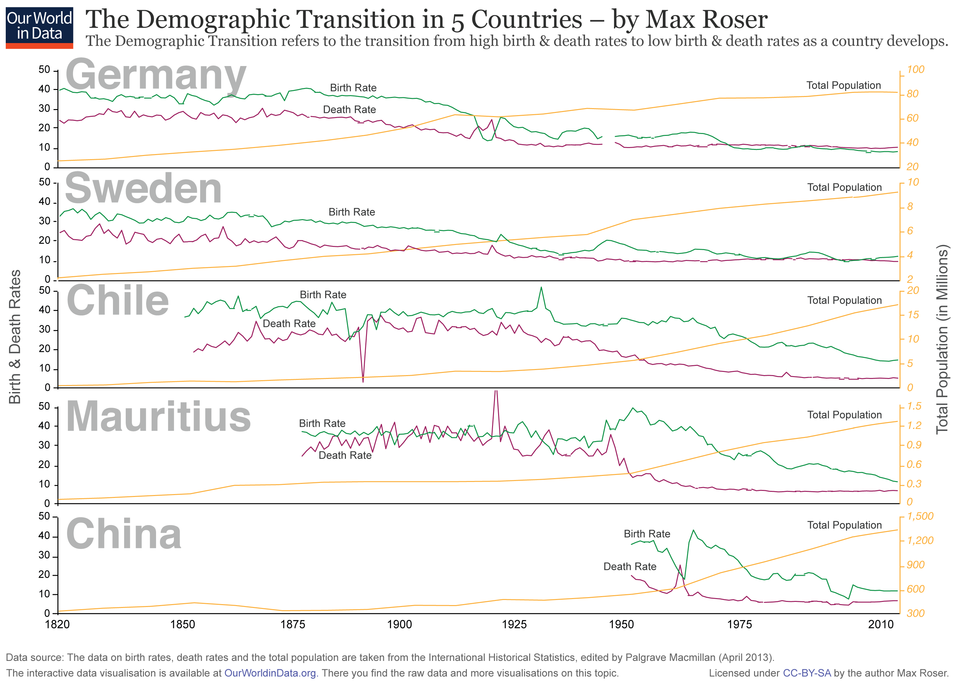
Fertility, Mortality and Demographic Transition

Slide 39
3. Geographical Variations
Developed countries
  Took 250 years for most developed economies to go through their own demographic transition (from 1750 to 2000).
  Population growth never surpassed the capacity of these economies to accommodate it.
Developing countries
  Demographic transition started in the 20th century:
    The most advanced segment after WWI.
    The least advanced segment after WWII.
  Very few have went trough the transitory mutation.
  Most of them have a type III demographic transition.
  By the time they reach type IV, a huge amount a population will be added to their populations.

Slide 40
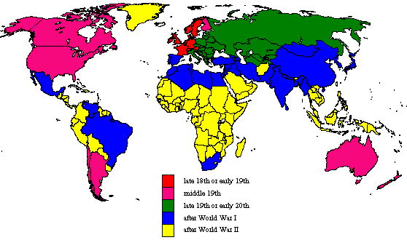
Beginning of Demographic Transition
What is the demographic transition theory and why different parts of the world are undergoing their transition differently?

Slide 41
4. Future Population Growth
Fertility
  Most important factor.
  Total fertility rate expected to drop from 2.5 in 2010 to 2.1 in 2050 (from 5.0 in 1950).
Life expectancy
  Expected to increase from 69 to 76 years.
Age structure
  Increase in the average age from 28 to 37 years.
Religion
  Muslims have the highest fertility level.
Migration
  Does not change the total population, but the demographic composition of countries.

Slide 42
Global Population (1950-2010) and Growth Scenarios, 2010-2050
Notes:
Source: Population Division of the Department of Economic and Social Affairs of the United Nations Secretariat,
World Population Prospects: The 2010 Revision, http://esa.un.org/unpd/wpp/index.htm

Slide 43
4. Future Population Growth
Poverty / Population
More children to compensate high mortality.
Population / Environment
Pressures over marginal land, overexploitation, and deforestation.
More children to help as labor.
Children seen as a form of social security.
Lack of education plays against family planning.
Unemployment and low incomes, dilution of gain.
Division of property among several children (or primogeniture).
Overburden of healthcare, social services and utilities.
Erosion and floods.
Increase use of fertilizers, pesticides and irrigation.
Migration to shantytowns.
Erosion, salination and floods lower agricultural yields.
Overpopulation increases health problems and lowers productivity.

Slide 44
4. Future Population Growth
Poverty / Environment
Short term needs are a priority and forbids environmental protection.
Instability
Fall back of democracy, repression and dictatorship.
Development wins over environmental issues.
Usage of cheapest fuel alternatives (e.g. coal).
Lack of capital available for more environmentally efficient facilities.
Security takes most of public spending.
Bad investment environment, loss of tourism incomes.
Disorganization of health and education services.
National and international resources towards urgencies.
Social divisions and political problems.
Refugees and potential for terrorism.

Slide 45
4. Future Population Growth
“The fewer forks school”
  Environmentalist argument.
  Rapidly decrease population growth and consumption patterns.
  Which constraining policies to implement?
“The bigger pie school”
  Optimistic economic view.
  Technology will increase the amount of resources.
  What are possible technological improvements?
“The better manners school”
  Humanitarian view.
  Reduce inequality in income and consumption.
  Which incentives to provide?

Slide 46
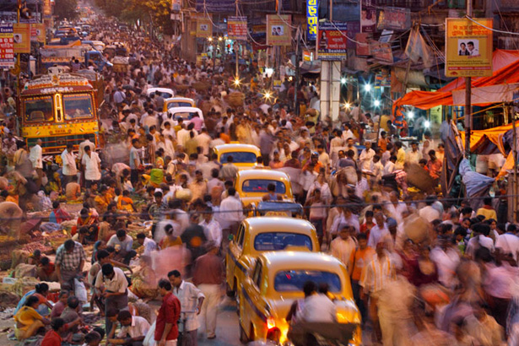
Future Population (Group Assignment)
Global population growth has been significant and ongoing. The class is divided in 3 groups. Each group is to take one scenario (fewer forks, bigger pie and better manners) and build arguments supporting the scenario and also criticizing it. How could the scenario be implemented (conditions)? How the characteristics of the global population are going to change if the scenario is successful?

