Slide 1
Topic 7 – Southeast Asia
A – Maritime Southeast Asia
B – Continental Southeast Asia

Slide 2
Conditions of Usage
For personal and classroom use only
  Excludes any other form of communication such as conference presentations, published reports and papers.
No modification and redistribution permitted
  Cannot be published, in whole or in part, in any form (printed or electronic) and on any media without consent.
Citation
  Dr. Jean-Paul Rodrigue, Dept. of Global Studies & Geography, Hofstra University.

Slide 3
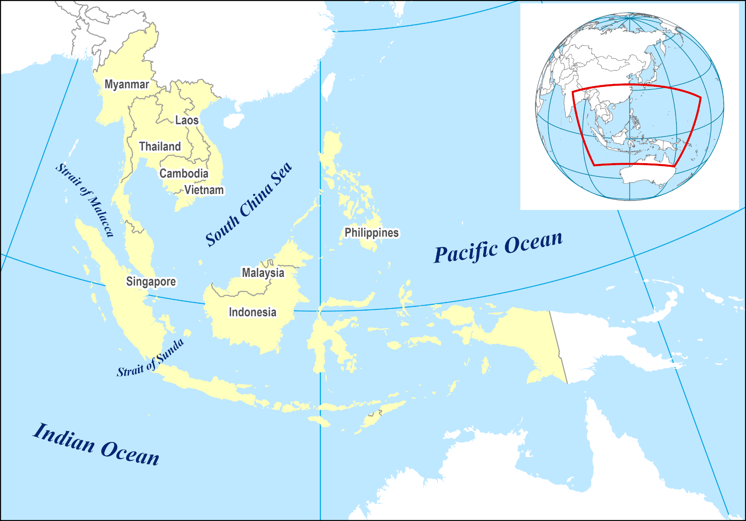

Slide 4
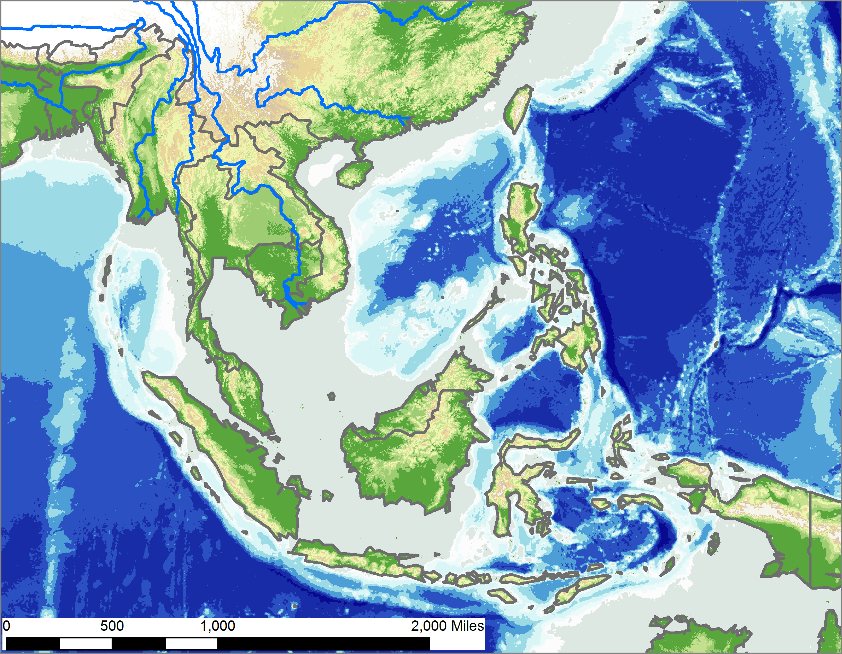
Landforms of Southeast Asia
Arakan Yoma
Shan Highlands
Mountain chains and valleys
Red River
Irrawady
Annamite Chain
Chao Phrya
Mekong
Pegunungan
Archipelagos
Barisan
Maoke

Slide 5
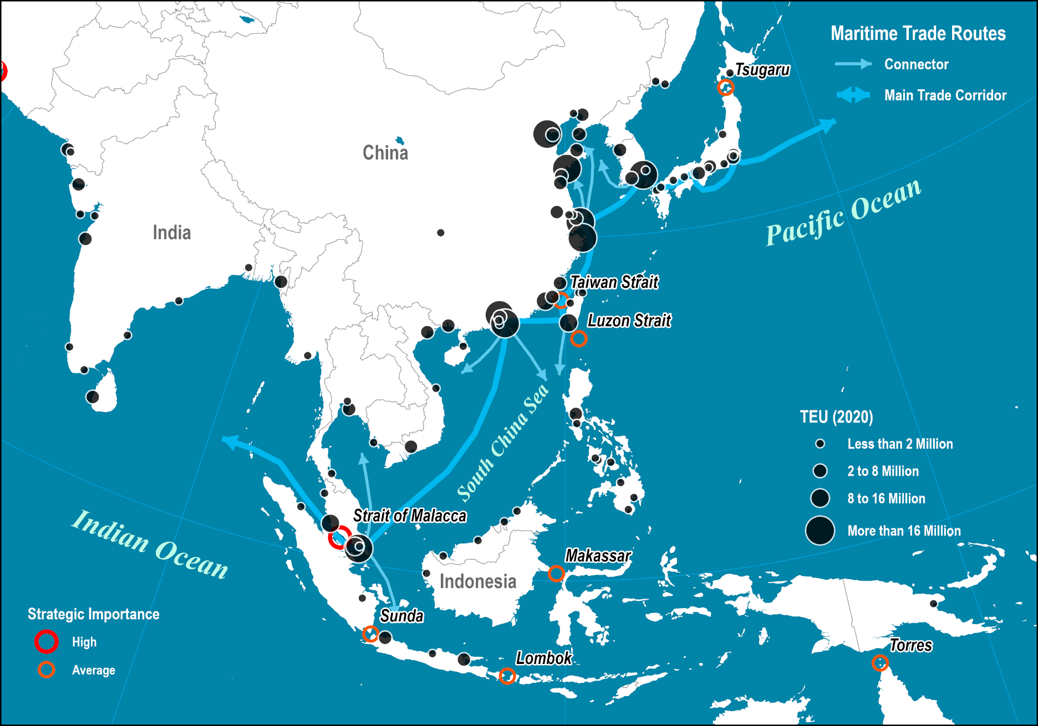
Shipping Lanes and Strategic Passages in Pacific Asia

Slide 6
Southeast Asia
Buddhism
  Mahayana Buddhism (185 million adherents):
    Great vehicle.
    Mostly practiced in East Asia (and Vietnam).
    Salvation can be achieved through the intervention of deities.
    Bodhisattva are people who postpone entry to nirvana to save other beings.
  Theravada Buddhism (124 million adherents):
    Lesser vehicle.
    Mostly practiced in Southeast Asia (Indochina and Thailand).
    Individual is responsible for salvation.
    Achieved through good deeds and religious activity.
    Importance of monastic orders.
Theravada and Mahayana Buddhism

Slide 7
A. Maritime Southeast Asia
1. The Hub: Singapore
2. The Physical Geography of Archipelagoes
3. The Core versus the Periphery
4. The Benefits and Perils of Resources

Slide 8
Maritime Southeast Asia: A Comparative Framework
Singapore | Malaysia | Indonesia | Philippines
5.6 million | 31.5 million | 267.6 million | 106.6 million
Multicultural 75% Chinese, 14% Malays and 8% Indians | Multicultural. 51% Malays (mostly Muslim), 24% Chinese (mostly Buddhist, Confucian or Taoist) 7% Indian (Hindu). 18% Indigenous and others. | Multicultural. 87% Muslim, Christian 9%, Hindu 2%. World’s largest Muslim population. 350 tribal and ethno-linguistic groups. More than 500 different languages and dialects. | Fusion culture (Malay, Hispanic and American). Christian Malay 91.5%, Muslim Malay 4% Chinese 1.5%. 83% Roman Catholic. Muslim minority (Mindanao)
Founded by Britain (1819). Trade and military stronghold. Independence (1958) | Sultanate of Malacca (c1400). Strait Settlements; Penang (1786), Singapore (1819) and Malaka (1824). Trade route to China and access Malaysian resources (tin and rubber). | Hindu and Buddhist states from the 4th century (Sri Vijaya). Islam brought by Arab traders (13th century). Dutch East India Company began colonization in the 16th century; Batavia (Jakarta; 1619). | No kingdom before the Europeans. Territory claimed by Magellan in 1521 and colonized by Spain by 1565. American protectorate (1898).

Slide 9
1. Singapore
Similarities and differences with Hong Kong
  City-state with only 724 square kilometers (about 1,000 for Hong Kong).
    High densities and limited importance of agriculture.
    Singapore is entirely flat.
    Land reclamations are extending the surface of Singapore.
    One of the few city-states left in the world.
  Financial and trade centers.
  Former British colonies.
  Strong rule of law.
  Small populations (5.6 vs. 6.9 million):
    Chinese ethnic dominance.
    Non-residents account for about 25% of the population.
    On occasion (e.g. 2003) non-residents not be allowed to overextend their stay.

Slide 10
Population of Singapore, 1960-2022
Non-residents not be allowed to overextend their stay
Covid-19 (Non-resident not allowed in)
Notes:
Source: World Bank.
https://data.worldbank.org/indicator/sp.pop.totl

Slide 11
1. Singapore
Location, location, location
  Prime factor in the existence of Singapore; the center of Southeast Asia.
  Tropical climate with no temperature variations.
  Located at the outlet of the Strait of Malacca:
    Opening of the Suez Canal (1869) increased the importance of the port.
    The most important trading route in the world.
    About 30% of the world trade transit through the passage.
  Strategic position of Singapore:
    Strongest asset.
    Natural regional trading center.
    Second busiest port in the world.
    Halfway between the Middle East and East Asia.
  Constrained space:
    90% of the population lives in apartments (public housing).
    50% of the water imported from Malaysia.

Slide 12
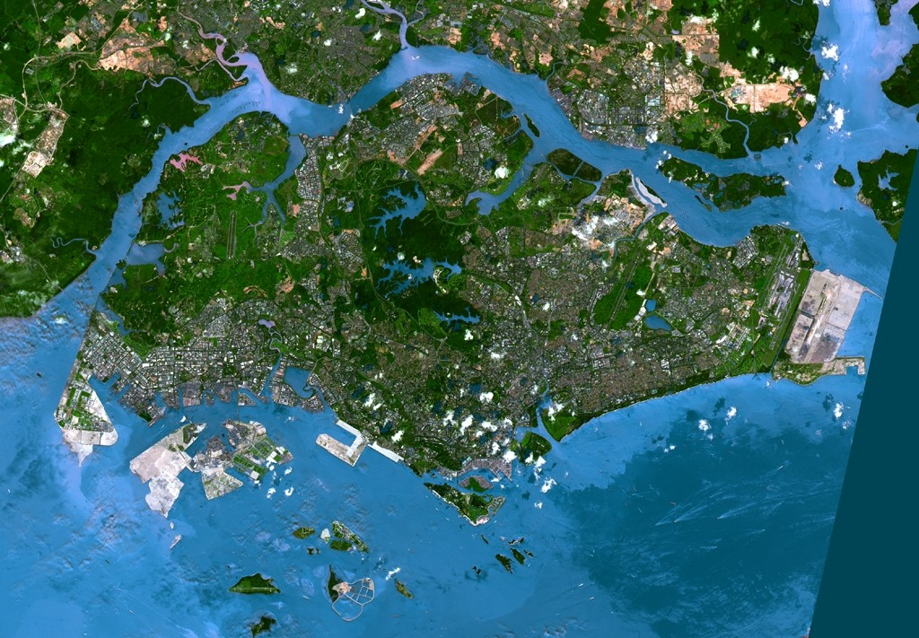
1. Singapore
Malaysia
Airport
New port complex
CBD
Port
Port
Refinery Complex

Slide 13
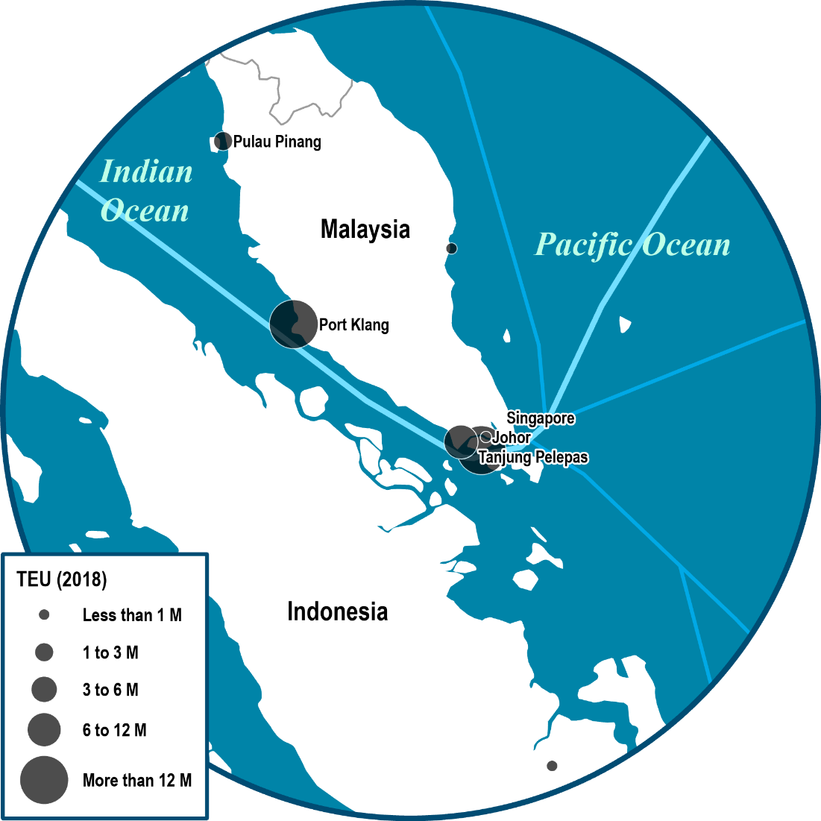
Container Traffic Handled at the Main Ports Around the Strait of Malacca, 1995-2021
© PEMP
Total: 70.3 M TEU
Transshipment Incidence: 80%
Notes:
Map location: Transoceanic Canals

Slide 14
1. Singapore
A highly regulated society
  Importance of British culture and language:
    Mainly among the Chinese and Indians.
  Pragmatic and business-oriented population:
    Contradiction with the surrounding Malay culture (Malaysia and Indonesia).
  Very restrictive public behavior regulations:
    High fines for littering.
    Death penalty for murder, drug and gun use.
    Lashing for robbery, rape and vandalism.
    Illegal to import, sell or chew gum.
  Small size of the city-state enabled efficient government control:
    The least corrupted country in the world.
  Strong mobility control policy:
    Efficient public transit system.
    Car licensing scheme (quotas).

Slide 15
1. Singapore
History
  Colony founded by Britain (1819):
    Britain obtained the right from the Sultan of Johore to establish a commercial counter at Singapura (the City of the Lion).
    Ceded in perpetuity to Britain (1824).
    Became part of the Strait Settlements with Malacca and Penang.
  Free trade port:
    Protected by the British East Indian Company.
    British military stronghold.
    Benefited from growing exports of tin, rubber and timber from Malaysia.
    Chinese population brought in from southern China.
    Transshipment center for commodities and raw materials.
    No manufacturing; 75% of the population in services.
  Crown colony (1867).

Slide 16
1. Singapore
Emergence of a trade center
  Commercial importance:
    Attracted several Chinese merchants and immigrants.
    Changed the ethnic composition of Singapore to its current status.
  Japanese occupation (1942-1945):
    Fell from a Japanese invasion force coming from inland.
    Same effect than in Hong Kong with the disruption of trade and population relocation.
  Independence from Britain (1958).
  Failed integration to the Malay Federation (1963):
    Economic (commerce) and military (protection) reasons.
    Expelled in 1965 (distrust between the Chinese and the Malays).
    Compromised its hinterland.
  The foundation of ASEAN (1967):
    A forum to discuss regional security issues.
    Removed tensions between Malaysia, Singapore and Indonesia.

Slide 17
1. Singapore
Industrialization
  Total lack of resources:
    Almost everything is imported, including water.
    From 1960, the industrial sector started to emerge.
    Free-trade policy to attract multinational corporations and FDIs.
    Small production units requiring limited capital.
    Export oriented because of the small size of the local market.
  Commitment to high technology:
    Shift took place in the 1980s; Loss of comparative advantages.
    From a labor-intensive to a knowledge-intensive economy.
    “Intelligent Island”.
    World’s leading manufacturer of hard disks (40-45%).

Slide 18
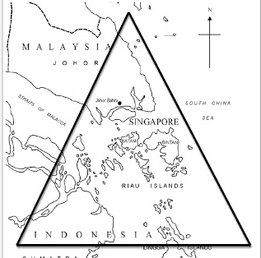
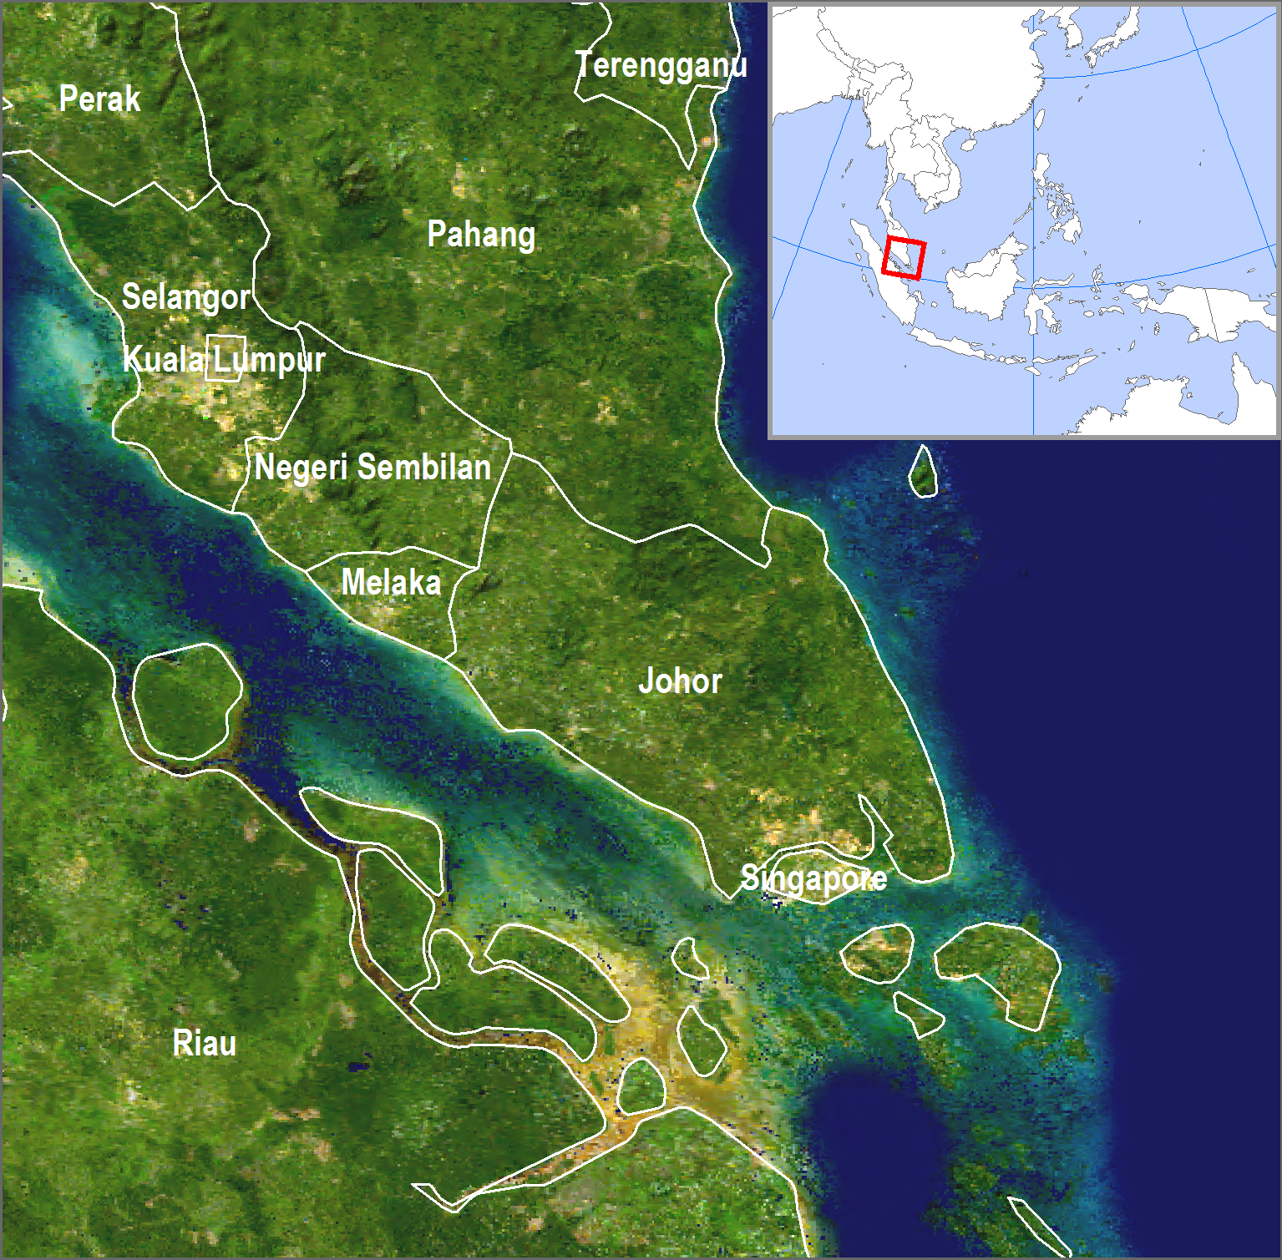
1. Singapore: Sijori Growth Triangle
Relocation and development of activities to Malaysia and Indonesia,
Johor province in Malaysia.
Riau Islands in Indonesia.
Take advantage of cheap labor sources.
Availability of land.
Industrial estates.
Agribusiness estates.
Leisure function (hotels and golf courses) in Riau.
Singapore:
Specializing in management, finance and trade.
The hub of the triangle.

Slide 19
1. Singapore
Port and trade functions
  The world’s second largest container port:
    Major transshipment function in Southeast Asia.
    95% of all container traffic transshipped.
  Important oil processing sector:
    Intermediary point between Middle Eastern oil and Japan.
    The 3rd most important refining capacity in the world.
  Financial capital of Southeast Asia:
    Lack of corruption makes Singapore an excellent location to manage assets in Southeast Asia.
    Always rank among the world’s least corrupted countries (Transparency International).
    About 7,000 multinationals.
In which manner Singapore shares some similarities with Hong Kong in terms of its history and geography?

Slide 20
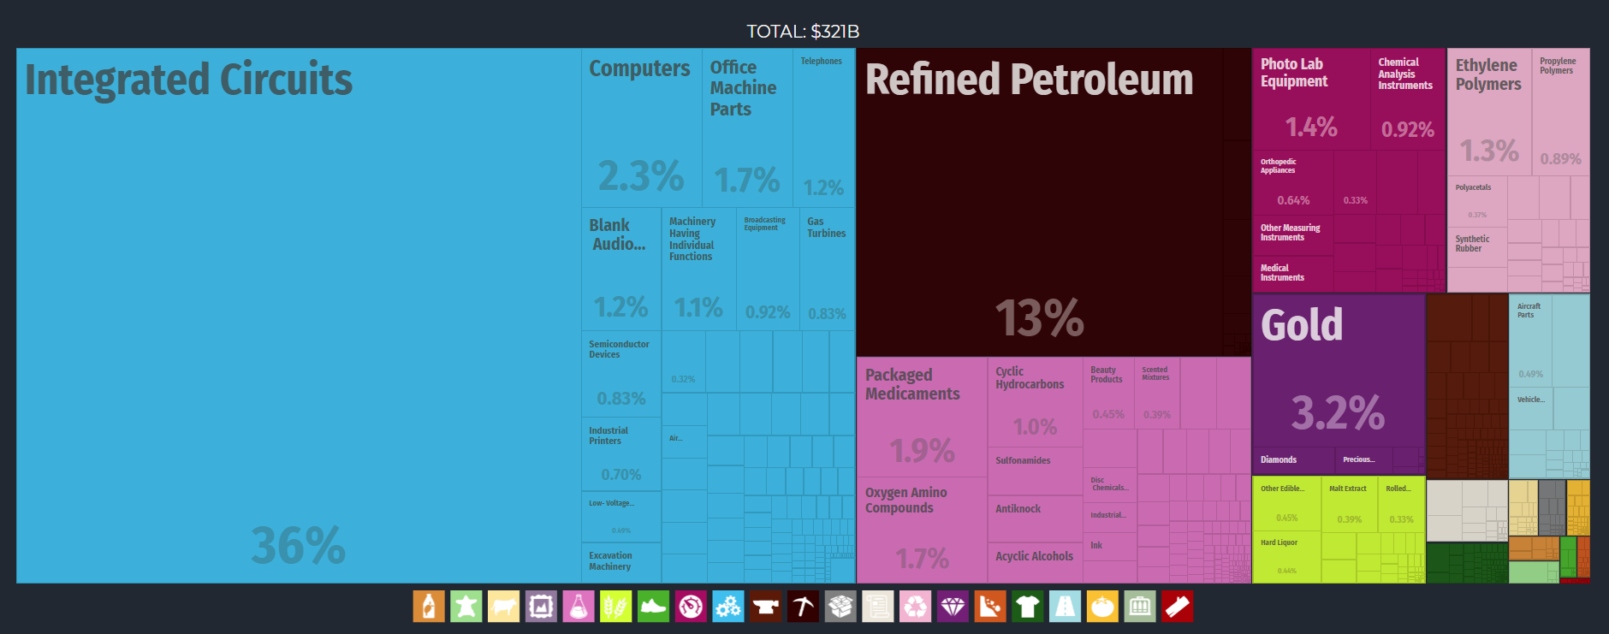
Singapore Export Treemap, 2017
Notes:
Source: Economic Complexity Observatory, MIT Media Lab and the Center for International Development at Harvard University.
https://oec.world/en/profile/country/sgp/

Slide 21

“Crazy Rich Asians”, 2014

Slide 22
2. The Physical Geography of Archipelagoes
Archipelago Nation-States
The tectonic landscape
Territorial waters

Slide 23
The Physical Geography of Archipelagoes
Archipelago Nation-States
  Countries composed of a multitude of islands.
  Usually a central island(s):
    The core.
  Multitude of small islands:
    The periphery.
  Associated with demographic, economic and cultural fragmentation.
Why Malaysia, Indonesia and the Philippines are archipelago countries, and what does this imply?

Slide 24
Malaysia: A “Fake” Archipelago
Cambodia
Vietnam
878 Islands
West Malaysia is a peninsula (40% of the land)
East Malaysia is the northern part of the island of Borneo)
Gulf of
Thailand
Thailand
South China
Sea
Brunei
Sabah
West Malaysia
East Malaysia
Sarawak
Sumatra
Singapore
Borneo

Slide 25
Indonesia: The World’s Most Complex Archipelago Nation-State
Strait of Malacca
Equator
Sumatra
Kalimantan
Sulawesi
Irian Jaya
Jakarta
Sunda Strait
Java
Bali
Timor
From the Greek “Indos” (India) and “Nesos” (Island), literally the “Indian Islands”.
17,500 islands: About 6,000 inhabited. 580 languages and dialects.
Longest coastline in the world; Coastal zones supports approximately 60% of the population.
Three time zones.

Slide 26
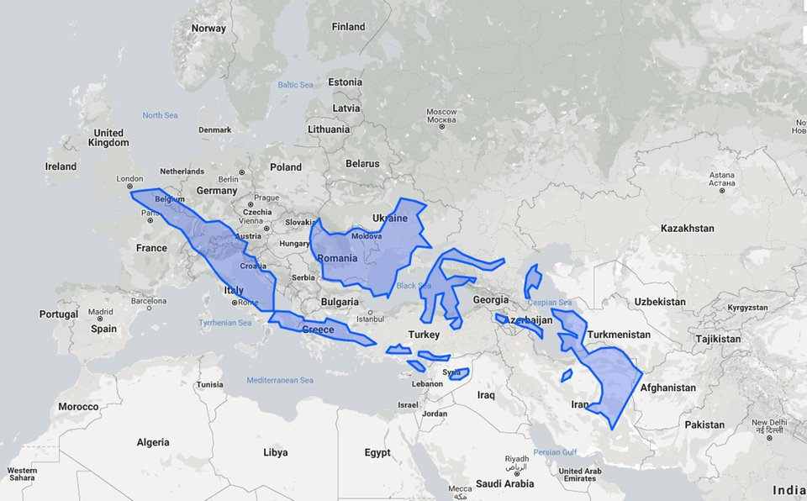
Comparison of Indonesia and Europe

Slide 27
The Physical Geography of Archipelagoes
The Philippines Archipelago nation-state
  About 7,100 islands.
  800 are inhabited.
  Largest islands:
    Luzon and Mindanao.
    66% of the territory.
  80 regional dialects; no majority language.
  Tagalog:
    A language influenced by several others (Malays, Spanish, English and Arabic).
  Mestizos:
    4% of all Filipinos are part-European.
    5% of all Filipinos are of mixed Filipino and Chinese descent.
Taiwan
Luzon
Manila
Muslim Area
Mindanao
Malaysia
Indonesia

Slide 28
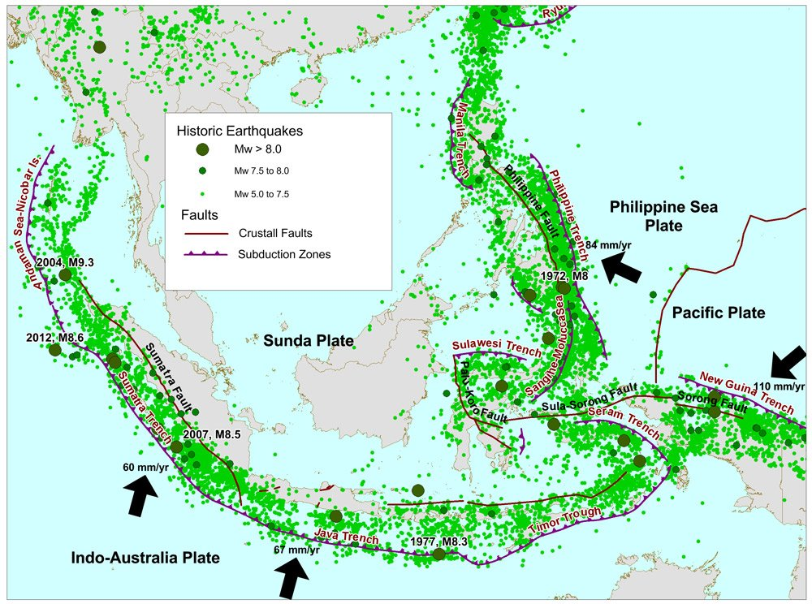
Tectonic Activity in Southeast Asia: Volcanism
Volcanic deposits can develop into rich agricultural lands.
Chemical weathering: The decomposition of volcanic materials and deposits (ash) into materials usable by plant life.
Krakatoa
300 volcanoes of which 200 have been historically active

Slide 29
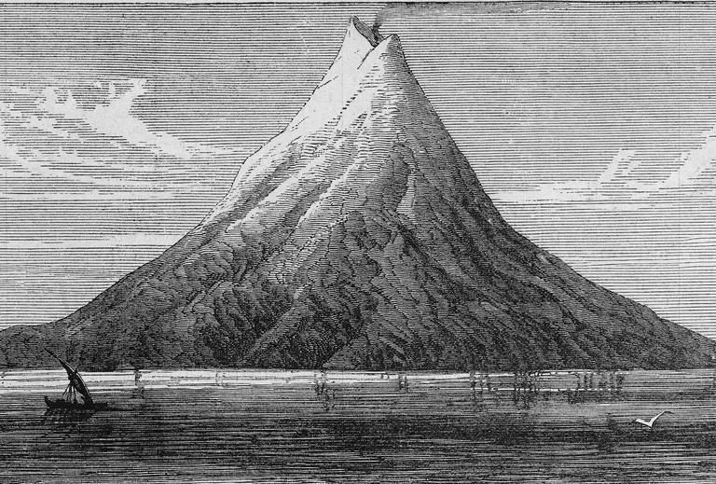
The Tectonic Landscape: Volcanoes
Krakatau/Krakatoa
  In the Sunda Strait between Java and Sumatra.
  1883 eruption one of the largest in recorded history.
  Two third of the island obliterated.
  Release of 20 million tons of sulfur in the atmosphere.
  Drop of 1.2 degrees in global temperatures in the following 5 years.
  120,000 estimated deaths.

Slide 30
Territorial Waters
Territorial waters
  12 nautical miles out to coastline towards the high seas.
  Regarded as the sovereign territory of the state.
  Exclusive right for all the natural resources.
Archipelagic waters
  Territorial waters within islands of an archipelago.
  Archipelagic states can designate sea lanes through these waters (Strait of Malacca).
Exclusive economic zone (EEZ)
  Sea zone over which a state has rights to the exploration and use of marine resources:
    Fishing.
    Oil and mineral extraction.
  200 nautical miles (370 km) out from its coast.
  Cannot prevent free navigation.

Slide 31
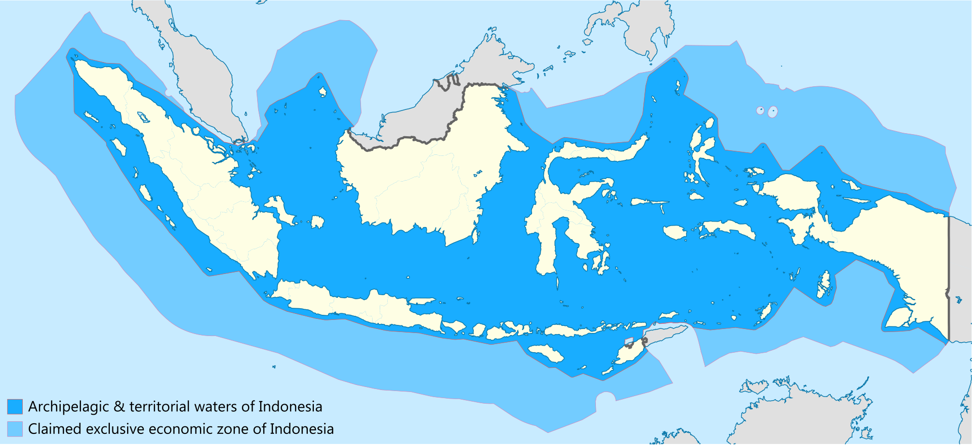
Sea Jurisdiction of Indonesia

Slide 32
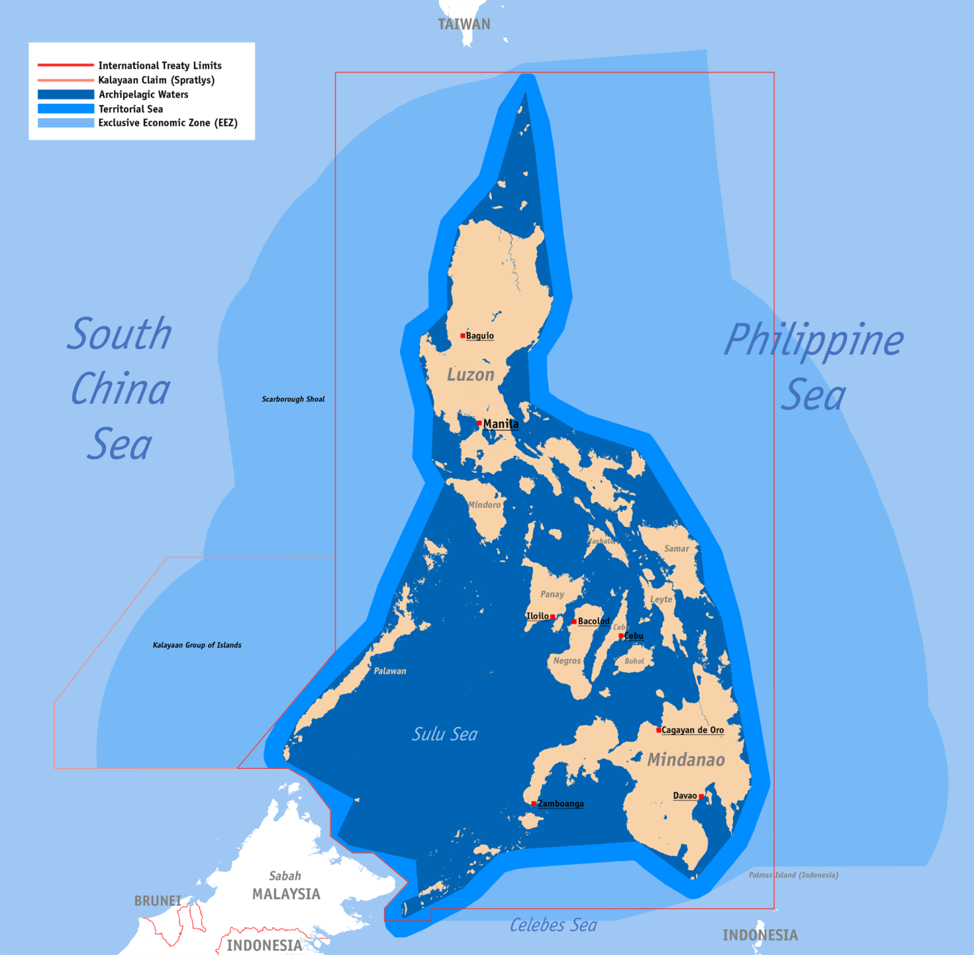
Sea Jurisdiction of the Philippines

Slide 33
3. The Core versus the Periphery
The dominance of the Core
Conflicts between the Core and Periphery

Slide 34
Population of Malaysia, Indonesia and the Philippines, 1960-2022
Notes:
Source: World Bank.
https://data.worldbank.org/indicator/sp.pop.totl

Slide 35
Malaysia: Ethnic Diversity and Geographical Fragmentation
Cambodia
Vietnam
Gulf of
Thailand
Thailand
South China
Sea
Brunei
Sabah
West Malaysia
14% of the population and 60% of the land
86% of the population and 40% of the land
East Malaysia
Core
Sarawak
Sumatra
Singapore
Borneo

Slide 36
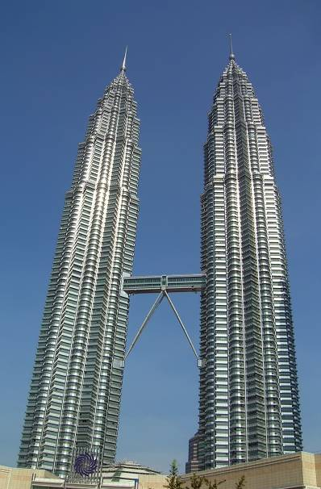
Symbols of the Core
Petronas Towers
  The World’s tallest building (1998-2004).
  1483 feet tall.
  Completed in 1998.
  The new downtown of Kuala Lumpur.
  Symbol of Malaysia’s affluence.
  Petronas is the national oil company.
  Muslim influence in architecture.
  Malaysia’s largest shopping center (Suria KLCC).
  Part of the Multimedia Super Corridor to the international airport.

Slide 37
Indonesia: Core and Periphery
Periphery
Core
Inner islands (Java, Madura and Bali); world’s most populous island.
Fertile land due to volcanic origin and monsoon (among the most fertile land in the world).
80% of the population on 7% of the land.
Mostly Javanese.
Outer islands (Sumatra, Kalimantan, Sulawesi, Irian Jaya)
20% of the population on 93% of the land.
Most of the minorities.
Sparsely populated but abundant in resources.

Slide 38
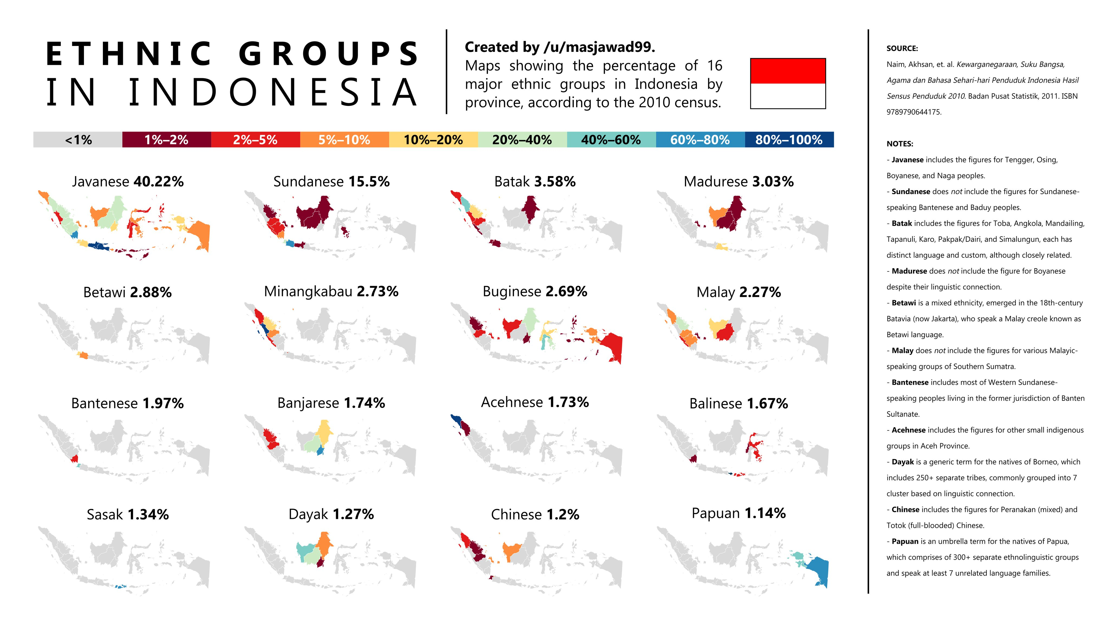

Slide 39
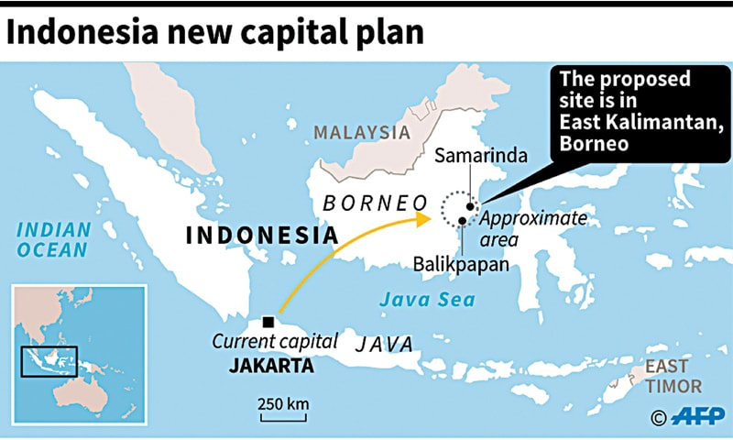
Conflicts between the Core and Periphery
Relocating the capital of Indonesia
  Decision made in 2022 to relocate the capital.
  Currently Jakarta on the island of Java.
  Capital of more than 10 million people, facing acute congestion and environmental problems.
  New capital will be named “Nusantara” (archipelago in Javanese).
  To be on the island of Borneo, 1,300 km away.
  New symbolic site more at the geographical center of the archipelago nation.

Slide 40
Conflicts between the Core and Periphery
Surplus labor force in Indonesia
  40% of the population under 20.
  3 million Indonesians entering the labor force each year.
  Largest labor surplus in Southeast Asia.
  About 40% of the workforce underemployed.
  Strong environmental pressures on inhabited islands (agriculture and urbanization) and remote islands (logging, oil and mines).
  Transmigration program (1969-2001):
    Aim at balancing the location of the population.
    About 6.5 million people voluntarily relocated from Java to the outer islands in 15 years.
    Problems such as deforestation and clashes with local indigenous populations.
    Cultural imperialism.

Slide 41
The Balkanization of Indonesia
Aceth
Mollusks
East Kalimantan
Riau
Aceth: Muslim fundamentalists. Large natural gas deposits.
Riau: 80% of Indonesia’s oil.
Sulawesi
Irian Jaya
East Timor: Christians successfully gained independence (2002).
Irian Jaya: Independence movements.
Lombok
East Timor
Lombock: Christian minority.
Mollusks: Christian majority.

Slide 42
Conflicts between the Core and Periphery
Foreign workers in Malaysia
  Reliance of foreign workers:
    Manual jobs such as construction and manufacturing.
    Many moved from Indonesia (similar language and culture), Myanmar and the Philippines.
    As many as 2 million by the mid-1990s, dominantly illegal.
    160,000 registered Indonesian maids (2003).
  The 1997 crisis:
    Created a lot of unemployment:
    “Operation Get Out” (1998) where about 850,000 foreign workers, mainly Indonesians, were deported.
  New immigration laws (2002):
    Stiff fines, imprisonment, or caning for foreigners caught working illegally.
    Expulsion of 300,000 out of about 600,000 foreign workers.
    Foreigners blamed for Malaysia’s crime problems.
    Foreign workers climbed to about 3 million in 2007 (50% illegal).
    1 million Indonesians were expelled in 2010 after the 2009 financial crisis.
    The Covid-19 pandemic created a similar situation.
Notes:
RELA group. Vigilante actions (500,000 members).

Slide 43
Conflicts between the Core and Periphery
East Timor: an ethnic and religious struggle
  Portion of the island of Timor governed by the Portuguese for 400 years.
  Majority of the population catholic.
  Indonesian invasion (1975):
    Transmigration of Indonesians and creation of militias.
    About 200,000 Timorese died due to violence and famine.
  Referendum held about independence (1999):
    79% of the population voted to secede from Indonesia.
    Retaliation from pro-Indonesia militias; 1/3 of the population displaced.
    UN forces intervened to stop the violence.
  Administered by the UN from 1999 to 2002.
  Attained independence (2002).

Slide 44
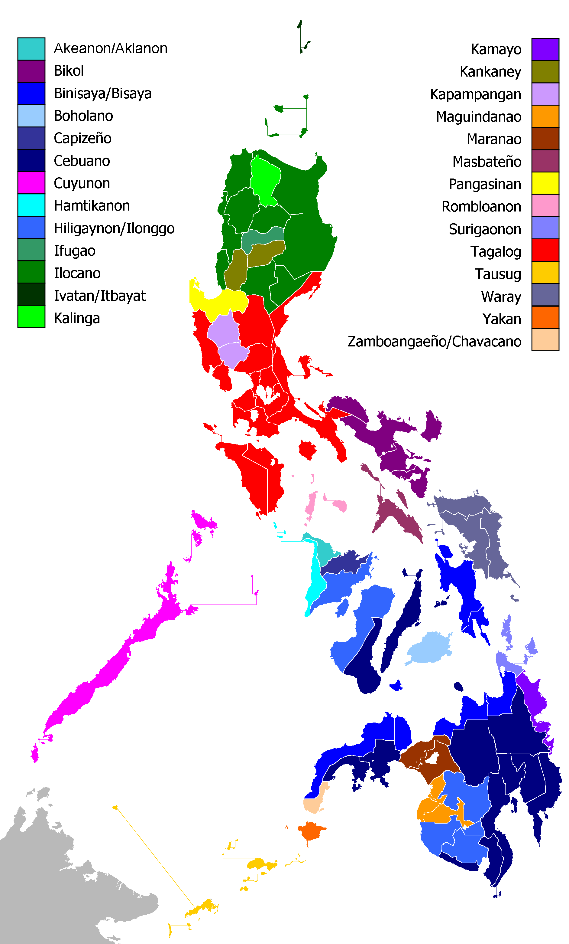

Slide 45
Conflicts between the Core and Periphery
Exporting workers
  About 10% of the population works overseas.
  8 million overseas Filipino workers scattered in about 181 countries.
  Important source of foreign currency through remittances:
    About $US 34.9 billion a year (2020); 9.6% of the GDP.
  Gender specific migration:
    Female contract workers make up as much as 80-90% of the total number of Filipino contract workers.
    Women: maids (domestic help), nurses, or “entertainment workers”.
    Men: construction workers, ship staff. Account for about 30% of the world’s maritime labor (cruise and cargo ships).
    100,000 nurses had left since 1994.
What are the cores and peripheries of maritime Southeast Asia and provide some examples of conflicts between the core and the periphery?

Slide 46
Core versus the Periphery: The Maid Trade
Japan
Rich Persian
Gulf States
HK
India and
Bangladesh
Thailand
Philippines
Malaysia and Singapore
Indonesia
Country of origin
Country of destination
Notes:
Source: Pulsipher, 1999

Slide 47
4. The Benefits and Perils of Resources
The Setting of Plantations from the Colonial Era to the Global Economy
Natural Resources
Environmental Challenges
Resources can both be a benefit and a peril. Provide some examples.

Slide 48
The Setting of Plantations from the Colonial Era to the Global Economy
Plantation system and resources
  Revenues from Indonesia accounted for about 1/3 of the Netherlands's budget.
  Tobacco, rubber and coffee plantations:
    Ottoman Empire forbid trading coffee with Europe in the 17th century.
    The Dutch stole a coffee tree from the port of Mocha (Ethiopia) and implemented its cultivation on the island of Java.
    In the 17th century, most of the coffee coming from Mocha or Java.
  Cultivation System:
    Provided that a village set aside a fifth of its cultivable land to produce export crops.
    These crops were to be delivered to the government instead of taxes.
  Discovery of oil (1920s):
    Permitted the creation of the Royal Dutch Shell multinational.
    Was of strategic importance during WWII.

Slide 49
The Setting of Plantations from the Colonial Era to the Global Economy
Plantations, mines and immigration of labor
  Immigration:
    Between 1880 and 1910, 6 million Chinese went to Malaysia.
    Work in mines and railway construction.
    Indians moved to work in plantations.
    Most of the Malays stayed in the traditional agricultural sector:
      The most educated became civil servants.
    Fusion cuisine.
  Rubber plantations and tin mines:
    Accounted for 85% of the total economic activities in early 20th century.
    Rubber tree introduced from Brazil:
      Trees grows on a narrow band of 1,000 km each side of the equator.
    Natural rubber (latex) accounts for 1/3 of the global production.
    99% of the world’s natural rubber comes form Southeast Asia (Malaysia, Indonesia and Vietnam).
    Natural rubber more flexible than synthetic rubber:
      Aircraft tires entirely made entirely of natural rubber.
Satay & Ayam Percik (Malaysian Roasted Spiced Chicken)

Slide 50
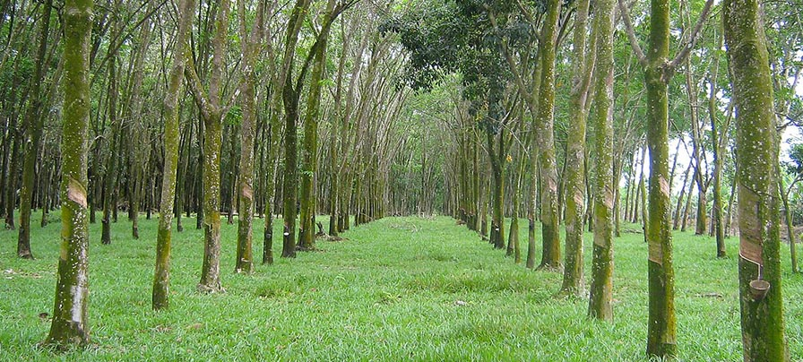
Rubber Tree Plantation, Malaysia
Amazing Asia Natural Rubber Farm - Rubber Harvesting and Processing

Slide 51
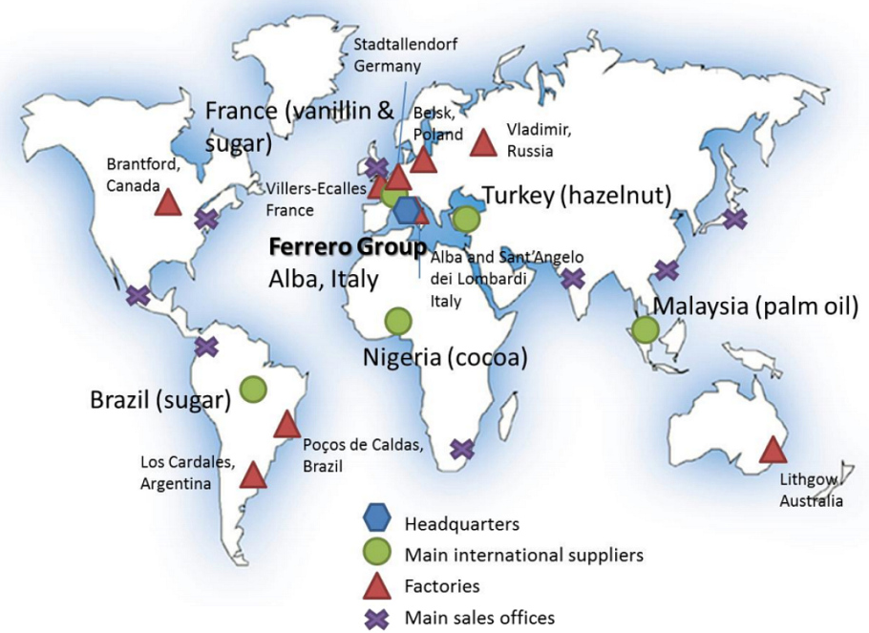
Palm Oil and Chocolate (Nutella) Production

Slide 52
The Setting of Plantations from the Colonial Era to the Global Economy
Colonization in the Philippines
  Easy colonization by Spain (1565):
    Named after King Philip of Spain.
    Capital established at Manila; excellent harbor and agricultural hinterland.
  Major colonial goals for Spain:
    Philippines was the only Spanish colony in Pacific Asia.
    Conversion (baptism) to Catholicism on the island of Luzon; a method to achieve loyalty to the crown.
    Gain access to the spice trade.
    Gain access to the China trade (silver from Mexico).
  Introduction of the plantation system:
    Difficult conditions imposed on the population.
    Creation of a nationalistic elite, the first in colonial Asia.
    Main exports were tobacco, sugar and abaca (to make rope).
    Attempts at revolution (1886-87).
  United States protectorate from 1898 (Spanish / American War).

Slide 53

The Setting of Plantations from the Colonial Era to the Global Economy
Dole in the Philippines
  Philippines is the world second largest producer of pineapples.
  Dole (1851):
    World's largest producer and marketer of fresh fruits.
    Mainly bananas and pineapples.
    Developed the method to process and can pineapples.
    Highly globalized production system with the US as the main market.
    Use a fleet of 40 refrigerated ships (reefers).
  Pineapple cultivation:
    Endogenous to Brazil; grows in tropical climates, preferably with volcanic soils.
    Started in the 1880s in Hawaii; the only tropical climate in the US.
    Declined due to urbanization and growing labor costs.

Slide 54
World Pineapple Production, 2018 (thousands of metric tons)
Notes:
Source: FAO.

Slide 55
The Setting of Plantations from the Colonial Era to the Global Economy
  Relocation of Pineapple production from Hawaii:
    Cutting production costs.
    Strong ties with the United States.
  Took advantage of land reform in the Philippines:
    Standard Philippine Fruit Company (Stanfilco).
    Plantation land given back to peasants.
    Hired as contractors.
    Most contract workers did not understand well production costs and contracts.
    Dole was able to reduce acquisition costs; contract workers earned less.

Slide 56
Natural Resources
Exploitation of natural resources in Indonesia
  Controlled by foreign interests, notably American and Japanese.
  A large energy exporter.
  Resource development:
    Required foreign capital and technology, notably for petroleum, mines and timber.
    10% of the world’s rain forest.
    Joint ventures with foreign multinationals (Japanese and American).
    Japan receives a large share of its energy from Indonesia (natural gas).
  Fluctuation in oil and raw material prices:
    Gained tremendously during the oil shock of 1973 (OPEC member).
    Oil helped shield Indonesia from market realities.
    82% if all exports, and 73% of government tax revenue (1981).
    Competing for several cash crops such as coffee, cocoa and tea.
    Dwindling oil resources; Indonesia became a net importer (2003).
    Left OPEC in 2009.

Slide 57
Shift in the Indonesian Oil Balance, 1965-2018
Notes:
Source: BP Statistical Review of World Energy 2010, http://www.bp.com/productlanding.do?categoryId=6929&contentId=7044622

Slide 58
Shift in the Indonesian Gas Balance, 1970-2018
Notes:
Source: BP Statistical Review of World Energy 2010, http://www.bp.com/productlanding.do?categoryId=6929&contentId=7044622

Slide 59
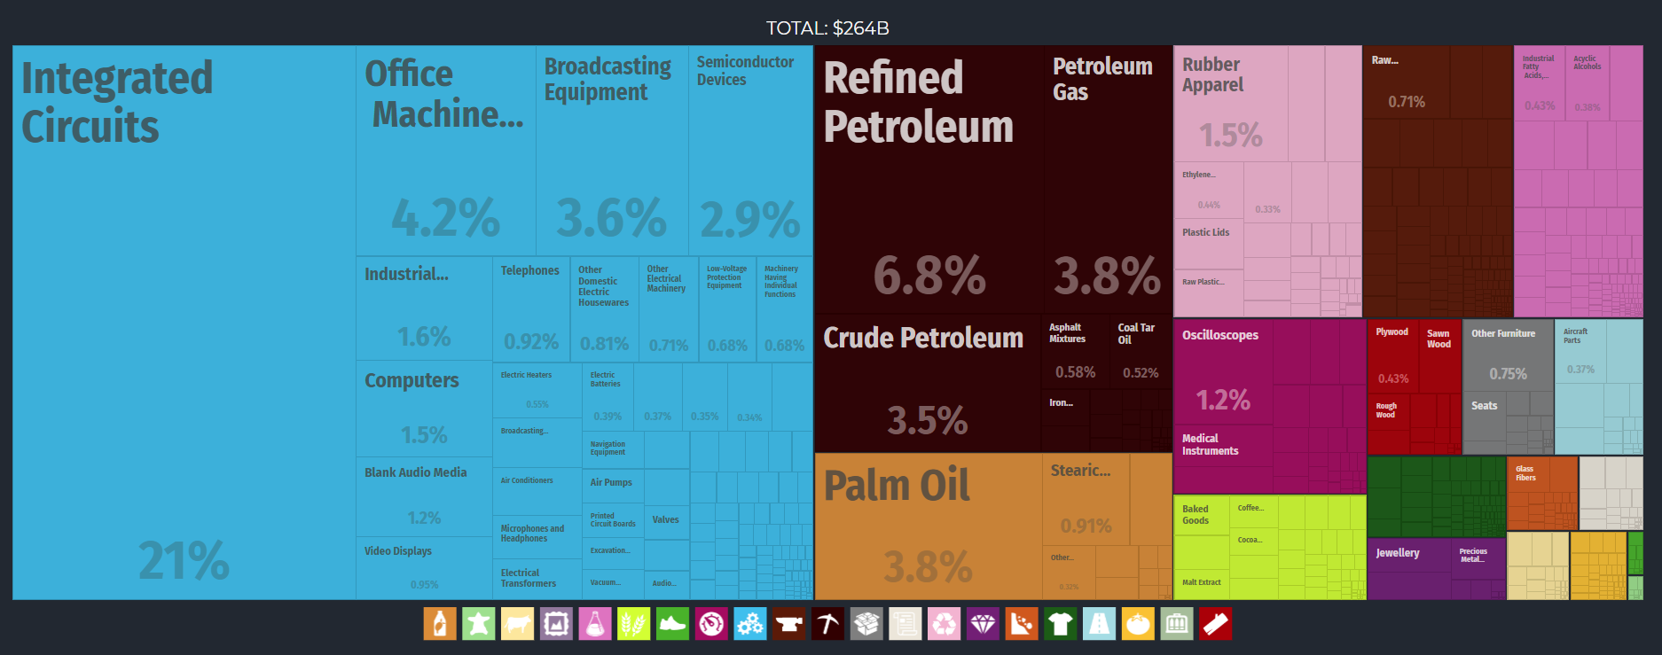
Malaysia Export Treemap, 2017
Notes:
Source: Economic Complexity Observatory, MIT Media Lab and the Center for International Development at Harvard University.
https://oec.world/en/profile/country/mys/

Slide 60
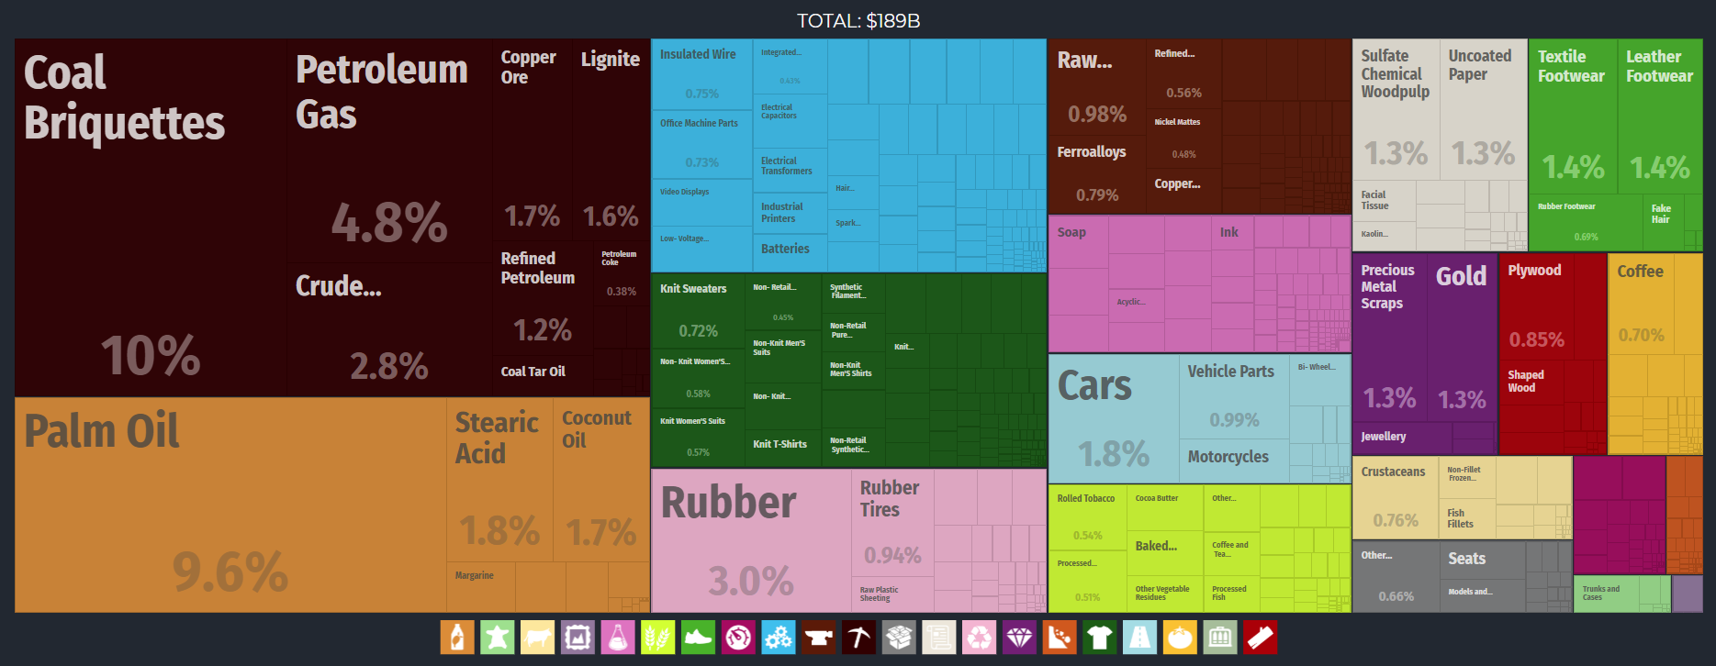
Indonesia Export Treemap, 2017
Notes:
Source: Economic Complexity Observatory, MIT Media Lab and the Center for International Development at Harvard University.
https://oec.world/en/profile/country/idn/

Slide 61
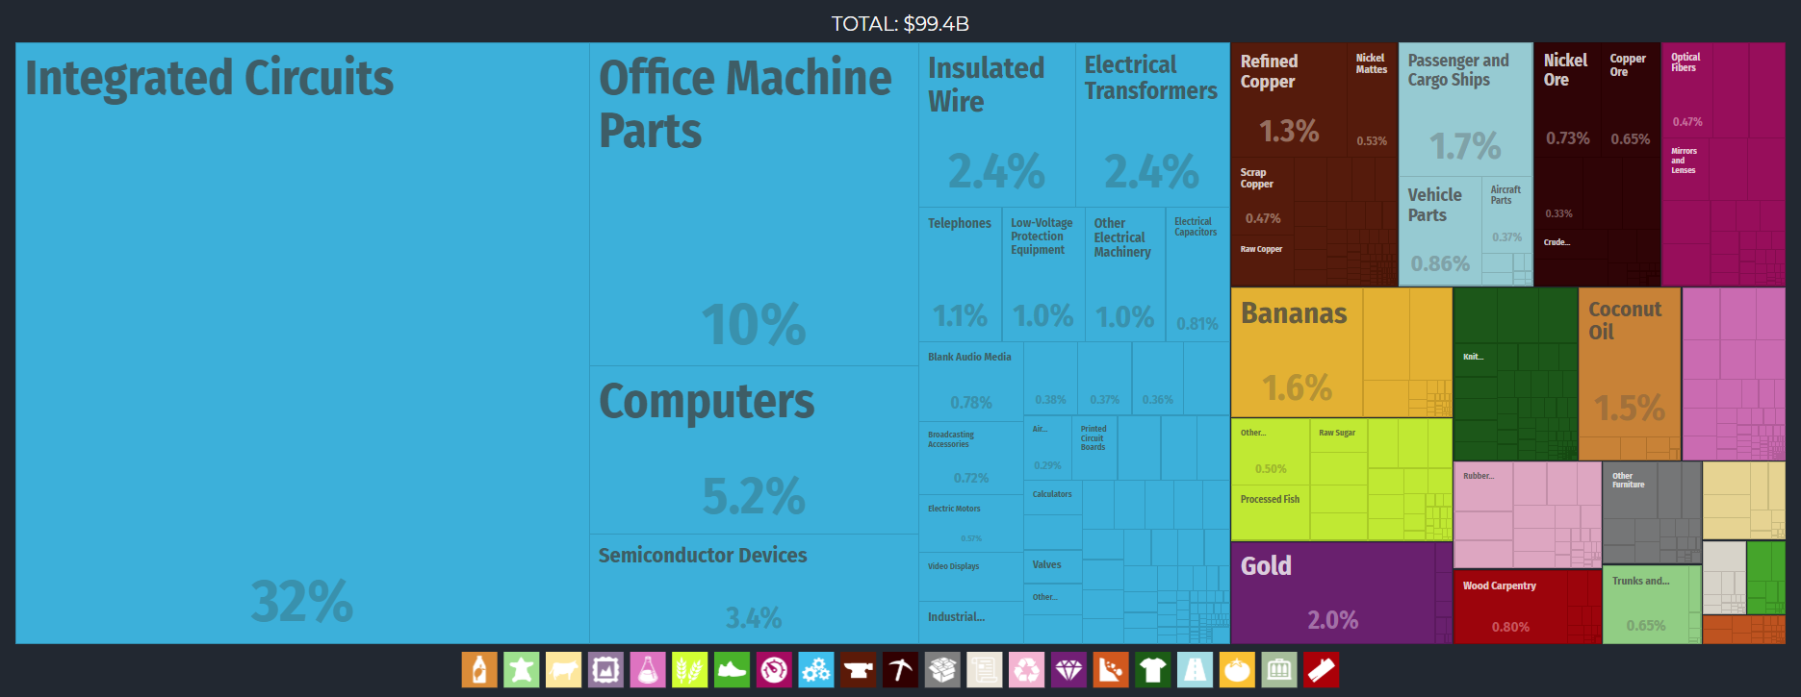
Philippines Export Treemap, 2017
Notes:
https://oec.world/en/profile/country/phl/

Slide 62
Environmental Challenges
Deforestation
  Malaysia used to have one of the most luxuriant rain forest in the world:
    55-60% still forested.
  Intense deforestation:
    Plantations, agriculture and logging.
    Concessions given by the government to companies owned by cronies.
  West Malaysia has lost most of its forest cover.
  The process is accelerating in East Malaysia.
  Asia has lost almost 95% of its frontier forests.

Slide 63
Deforestation, Southeast Asia
Borneo’s burning forests

Slide 64
Environmental Challenges
Coral Reefs: the rainforest of the seas
  The most complex aquatic ecosystem found on Earth:
    Only found between 30 degrees north and south latitude.
    Largest concentration is found between 4 degrees north and south latitude.
    Support greater numbers of fish and invertebrate species than any other ecosystem in the ocean.
    Home to over 25% of all marine life and are among the world’s most fragile and endangered ecosystems.
  Indonesia:
    Most of the country is within 4 degrees north and 10 degrees south.
    18% of the world’s coral reefs are found in Indonesian waters.
    55% of Pacific Asia’s coral reefs.
    Most of the population lives close to the ocean.

Slide 65
Coral Reefs in Pacific Asia (in Square km)
Notes:
Source: WRI. http://wri.igc.org/wri/reefsatrisk/b02_related_ecosystems.html

Slide 66
Destruction of Coral Reefs
Cause | Consequences
Mangrove forest | Replacement with other activities, agriculture and aquaculture (e.g. shrimp).
Sedimentation | Construction, mining or farming upstream, or logging in tropical forests. Causes erosion. Impair photosynthesis
Fishing with Explosives | Reefs are dynamited to harvest small fish. Large explosions which kill all the fish in the surrounding area and reduce nearby coral to lifeless rubble.
Human Run-off | Fertilizers and sewage. Encourage rapid algae growth which chokes coral polyps, cutting off their supply of light and oxygen.
Cyanide Fishing | Method often used to catch tropical fish for aquariums and is now used to capture fish for “live fish” restaurants.
Tin mining destroys forests and coral reefs in Indonesia

Slide 67
Destruction of Coral Reefs
Cause | Consequences
Collection and Dredging | Removing coral to be used for construction material or sold as souvenirs. Dredging and dynamiting of coral for construction
Water pollution | Spills and trash damage coral reefs.
Careless recreation | Careless boating, diving, fishing, and other recreational uses of coral reef areas can cause damage to coral reefs.
Climate change | When ocean temperatures get too high, coral polyps lose the symbiotic algae inside them, causing them to turn white, or “bleach”, and eventually die.

Slide 68
Coral Reefs Threatened, Southeast Asia

Slide 69
Environmental Challenges
Forest fires in Indonesia (1997, 2005, 2015, 2018)
  Released more CO2 in the atmosphere in 6 months than Europe produces in 1 year burning fossil fuels.
  Smoke spread throughout Southeast Asia.
  Causes:
    Forest concessions provided by the government.
    Palm oil, rubber and coffee plantations needing land.
    Burning the forest is the cheapest way to clear it up.
    Soil is fertile for a few years.
    Loses its fertility.
    Forcing the process to begin again.
  Important health consequences:
    Increasing cases of asthma and respiratory problems.
    Especially for young children.

Slide 70
B. Continental Southeast Asia
1. Thailand
2. Vietnam
Cambodia, Laos and Myanmar covered in Topic 8

Slide 71
Continental Southeast Asia: A Comparative Framework
Thailand | Vietnam
71 million. | 98 million.
Thai (75%), Chinese (14%), Hill tribes (11%). Buddhist (94.4%), Islam (4%), Hindu (1.1%), Christian (0.5%). Muslim minority in the south (along the Malaysia border). | “People of the south” Viet (85%), Hill tribes (15%). Buddhist (85%), Christian (8%).
The “Land of the free”; Never colonized by European powers. Kingdom of Siam (1782). Buffer state between France and Britain. Constitutional monarchy (1939). | Province of Imperial China with periods of autonomy. Independence from the 1500s. Between 1884 and 1893 France captured Vietnam, Laos and Cambodia; Renamed Indochina. First Indochina War (1945-1954). Vietnam War (1965-1975).

Slide 72
Population of Thailand and Vietnam, 1960-2022
Notes:
Source: World Bank.
https://data.worldbank.org/indicator/sp.pop.totl

Slide 73
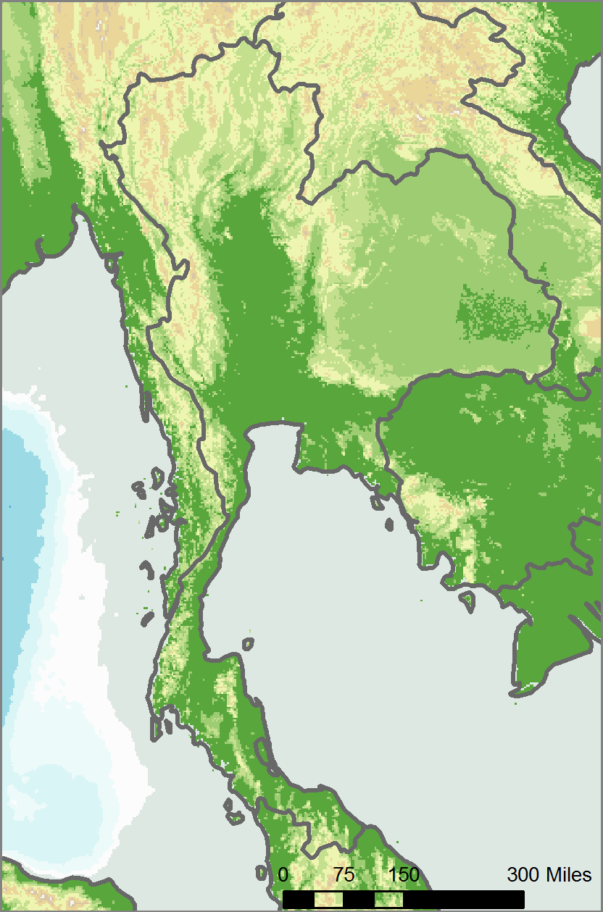
1. Thailand
Profile
  The core along the Chao Phrya Valley.
  Access to the Indian (Gulf of Bengal) and Pacific (Gulf of Thailand) oceans.
  Importance of Buddhism in the landscape:
    Theravada Buddhism.
    Temples and monasteries.
    Time spent as a monk.
Chao Phrya Valley
Bangkok
Indian Ocean
Gulf of Thailand

Slide 74
1. Thailand
A buffer state
  Kingdom of Siam (1782).
  Maintained independence from colonial powers:
    Reforms and concessions.
    Treaty with France and Britain guaranteeing independence (1896).
    Played the game of diplomatic relations.
    Conceded Laos and Western Cambodia to France.
    Conceded the northern states of Malaysia and the Shan state (Burma) to Britain.
  Seen as a buffer state between France and Britain.
  Treaties to guarantee boundaries signed early 20th century.

Slide 75
1. Thailand
Creation of modern Thailand
  Constitutional monarchy:
    Military coup (1932).
    King as the head of state and symbol of unity.
    Siam became Thailand (1939).
  WWII:
    Invaded by Japan and became allied.
    Alliance shifted back to the United States against communism, thus receiving aid.
  Vietnam War:
    Boost for the economy.
    R&R for US troops.
    Refugees from Vietnam and neighbor nations (Laos and Cambodia).

Slide 76
1. Thailand
A diversified economy
  Rice is a primary commodity:
    Feed the neighboring European colonies (plantations).
    Largest rice exporter in the world; change in diet to favor exports.
    25% of the country arable (largest in Asia).
  Agricultural diversification policies:
    Primary an agricultural nation.
    80% of the population living in rural areas, 66% of the workforce.
    Growth of rural population has involved deforestation.
  Manufacturing:
    Accounts for more than agriculture in the GDP (30% against 12%).
    Japan is the major investor (40% of FDI).
  Increased urbanization:
    Notably in Bangkok; primate city.
    10 million population with congestion and overcrowding problems.
    50 times larger than the second largest city.

Slide 77
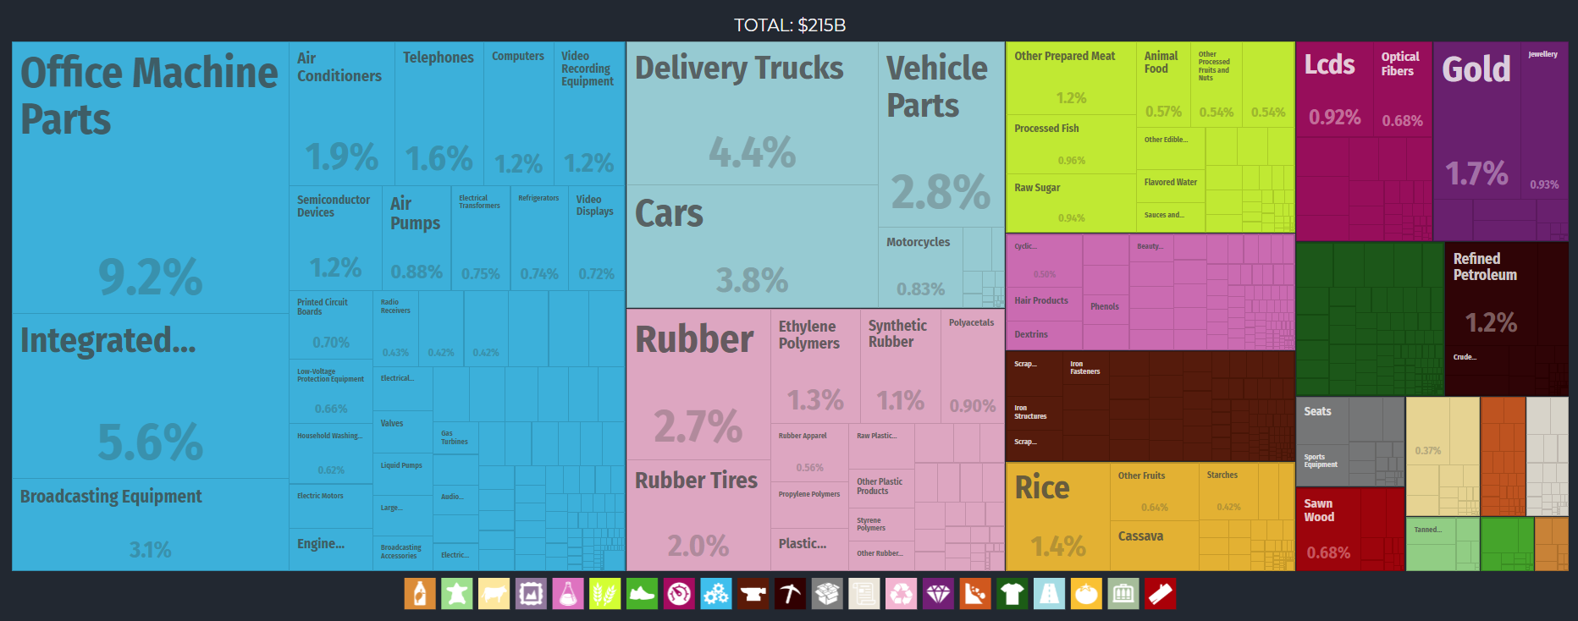
Thailand Export Treemap, 2017
Notes:
Source: Economic Complexity Observatory, MIT Media Lab and the Center for International Development at Harvard University.
https://oec.world/en/profile/country/tha/

Slide 78
1. Thailand
“One night in Bangkok”
  Tourism about 5% of the GDP of Thailand.
  Known for its sex tourism industry:
    Thai culture liberal and tolerant.
    Prostitution culturally accepted.
    Subservient role of women.
    Thailand was a neutral country; among the few safe spots in SE Asia.
  Development of “sex districts”; Patpong:
    Night clubs, bars, massage parlors.
  Prostitutes increasingly coming from outside Thailand:
    “Lack of local supply”.
    From poorer neighboring countries (Burma, Cambodia and Laos).
  Changes:
    Thailand is clamping down on the sex industry to change its image.
    Curfews for bars (Midnight).
Patpong Sex District

Slide 79
1. Thailand
A global health care center?
  Thailand is the world’s largest medical tourism destination.
  More than 3 million visitors/patients per year.
  Socialization of medicine, corporate interests and aging of the population making healthcare unaffordable.
  Medical procedures 80% less costly than Europe and the US.
  Hearth bypass surgery; $100,000 in the US, $20,000 in Thailand.
  World class level of service.
  High grade facilities looking like hotels.
  Bumrungrad International Hospital (Bangkok): 520,000 international patients per year.
  Mixing health care and tourism (post operation).
What is medical tourism and the role of Thailand in this industry?

Slide 80
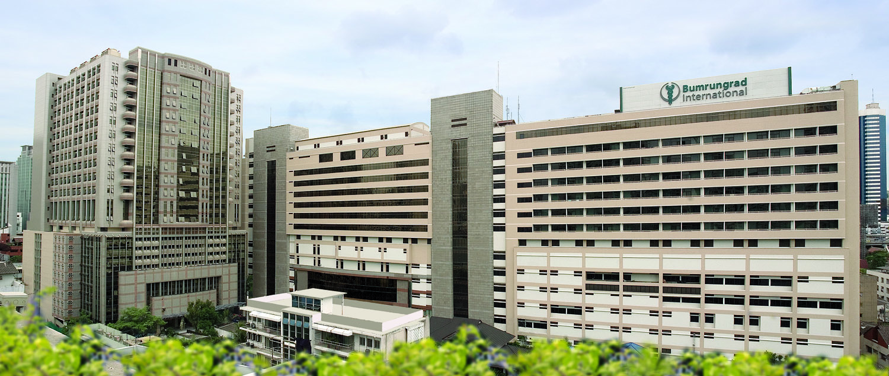
Bumrungrad International Hospital, Bangkok
Bumrungrad International Hospital Tour video

Slide 81
1. Thailand
Shrimp farming
  Thailand is the world’s largest exporter and second largest producer.
  Shrimp is one of the most consumed seafood:
    Cheap; fast growth cycle.
    Can be grown using aquaculture.
  Marine shrimp:
    Southeast Asia very suitable; substantial tropical coastline.
    Grown in ponds along coastal areas.
    Filled with saltwater pumped from the ocean.
    Shrimp ready for harvest in 90 to 120 days.
  Ecological issues:
    Some mangrove forests cleared (Thailand may have lost 50% of its mangrove forests).
    Replace a diverse ecosystem with monoculture.
    Wastewater can be a source of pollution.
The dirty business with the shrimps

Slide 82
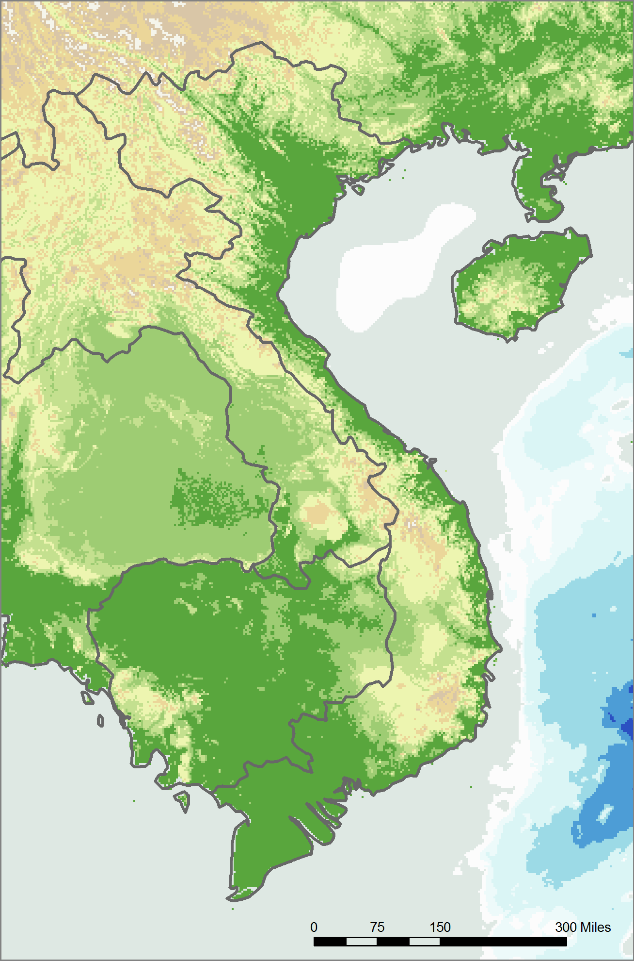
2. Vietnam
An elongated country
  Coastal plain along the South China Sea.
  Stands for “People of the south”.
  Two major deltas: the Red River (Song Koi) and Mekong.
  Natural corridor towards China.
  Only 5% of the territory is mountainous.
  The south is more fertile than the north.
  Most minerals resources are in the north.
Divided into three units
  Tonkin (Hanoi).
  Cochin China (Saigon).
  Annam (Hue).
Hanoi
Red River Delta
Annamite Chain
Ho Chi Min City
(Saigon)
Mekong River Delta

Slide 83
2. Vietnam
Colonial history
  Strong Chinese influence:
    Vietnam was a province of China.
    Unified in the 1700s.
  Moved south and eventually overtook the kingdom of Champa.
    Dissolved in 1832.
  French influence from 1787:
    Between 1884 and 1893 France captured Vietnam, Laos and Cambodia.
    Renamed Indochina.
    “Mission civilisatrice”.
    Difficult colonial ruling because of different ethnic groups such as Thais, Laotians, Khmers and Viets.
  Emergence of nationalism in early 20th century.
  Japanese occupation increased nationalism.

Slide 84
2. Vietnam
Unification of Vietnam: Vietnam War
  Civil War (1945-1954):
    Civil war against the French occupation.
    Ended in 1954 with the division of Vietnam along the 17th parallel.
  Involvement of the United States in the Vietnam War:
    Started in 1950 with military aid to the French.
    After the French defeat, the United States backed the South Vietnam government.
    Strong guerilla warfare; the United States started to send troops in 1963.
    By 1969, 600,000 troops were involved in the Vietnam War.
    Withdrawn in 1973 and in 1975 South Vietnam surrendered.
    3 million Vietnamese killed during the 1965-1975 war.
The First Vietnam War (1945~54)

Slide 85
2. Vietnam
Difficult economic recovery
  Embargo imposed by the United States (1975-1994).
  Conflicts with China (1979).
  The first decade after the Vietnam War:
    Very slow recovery.
    Became a net importer of rice, instead of an exporter.
    Communist style economic planning.
  Liberalization of the economy (mid 1980s):
    Introduction of market principles (Doi Moi).
    Benefited the agricultural sector (world’s second largest rice exporter).
  Among the lowest labor costs in Pacific Asia:
    Good level of education (88% literacy rate).
    Favored foreign investments (1994).
    ASEAN joined (1995).
  Differences between the north and the south, as the south was more exposed to capitalism.

Slide 86
2. Vietnam
The Vietnamese diaspora
  Left during the Vietnam War and after the reunification.
  About 4.5 million left.
  Mainly left to the United States (2.2M), Canada (250K), France (250K) and Australia (350K).
  Similar impacts than China.
  Bring back skills, capital and connections.
  A significant low skilled labor pool.
  60% of the population less than 27 years old.
A new manufacturing cluster
  Competing with China as a low-cost destination.
  Coastal access favors export-oriented strategies.
  High importance of the textile industry.
  Among the world’s fastest growth rates in recent years.

Slide 87
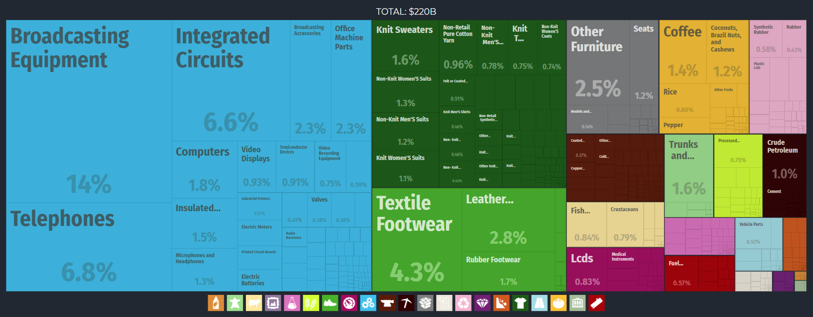
Vietnam Export Treemap, 2017
Notes:
Source: Economic Complexity Observatory, MIT Media Lab and the Center for International Development at Harvard University.
https://oec.world/en/profile/country/vnm/

Slide 88
2. Vietnam
High tourism potential
  Sub-tropical climate.
  Long coastline; beach resorts.
  Subtropical climate.
  Intact coral reefs.
  Political and social stability.
  Original cuisine: often adapting French cuisine.
  Initial lack of development has protected Vietnam's numerous natural resources.
  18 million international tourists in 2019 (10 million in 2016).
Explain why the geography and culture of Vietnam are suitable for the development of its tourism industry.

Slide 89
2. Malaysia
The role of Singapore:
  Financial and transport center.
  Relocation of several labor-intensive activities to southern Malaysia (mainly Johore) in the 1980s and 1990s.
A pluralistic society
  Three major ethnic groups (Malay, Chinese and Indian).
  Each has its own culture and socioeconomic role.
  Ambitious goal to propel Malaysia as a developed economy.
  The risk of Islamization.

Slide 90
3. Indonesia
Colonial History
  Trading area between China and India:
    Cultural and religious influence mainly came from the outside.
    Malayo-Polynesian Animism (ca. 500 BC):
      Mixed with indigenous beliefs.
      Ancestor worship and of nature.
      Sacredness of the earth.
    Early Hindu and Buddhist states from the 4th century (Sri Vijaya).
    Islam religion brought by Arab traders from the 13th century.
    Catholicism came with the Portuguese in the 16th century.
    Jakarta captured by the Dutch in (1619); renamed Batavia.
  Several island groups are multi-cultural:
    Mollusks: “spice islands” brought several external influences.

Slide 91
2. Malaysia
Colonial impact
  Modern Malaysia:
    Foundation of the Sultanate of Malacca (c1400):
      Fragmented history because was initially controlled by several sultans.
    Malacca fell to the Portuguese (1511).
    Taken over by the Dutch (1641).
    Seized by Britain (1824).
  British takeover:
    Political rivalry among Malaysian sultans favored the establishment of British control.
    Formation of the Strait Settlements with Penang (1786), Singapore (1819) and Malaka (1824).
    By 1888 most of the country was controlled by Britain.
    Goal of securing the trade route to China and access Malaysian resources (tin and rubber).

Slide 92
2. Malaysia
Independence
  Japanese occupation (Asia for Asians):
    Decisive factor the emergence of a national identity.
    Put Malays in key political positions.
  Federation of Malaysia (1948):
    Under British supervision.
    Citizenship granted to Chinese and Indian settlers.
    Independence in 1957 by a coalition government between the Malays, Chinese and Indian.
  Federation of Malaya (1963):
    Singapore, Sabah (North Borneo), and Sarawak.
    Singapore expelled (1965).
  Vietnamese refugees (Boat People) from 1978:
    Created ethnic problems since it increased the proportion of Chinese.
    Malaysia refused to accept refugees after 1988.

Slide 93
2. Malaysia
Contemporary economic development
  Significant growth after the 1960s:
    Malays had the political power while the Chinese had the economic power.
    The main reason behind its current stability.
  Abundance of natural resources:
    Minerals such as oil, natural gas, tin, copper, bauxite, coal and uranium.
    Main palm oil producer in the world.
    Half of world’s timber exports.
  New Economic Policy (1970):
    Export-oriented growth with foreign direct investments, mostly Japanese, Taiwanese, Singaporean and American.
    Growth was the result of a government strategy, like Japan.
    Manufacturing accounts for 70% of export.

Slide 94
3. Indonesia
Independence
  Japanese occupation (1942-1945):
    Supported by the local elite but brutality lost their support.
    Declared the Republic of Indonesia (August 1945).
    Rejected by the returning Dutch with 4 years of civil war (1945-1949).
  Republic of Indonesia proclaimed (1949).
  From socialism to dictatorship.
Sukarno’s “Guided Democracy” (1957-65)
  Socialist government.
  Decolonisation idealism.
  Founder of Non-Aligned Countries.
  Economic nationalism:
    Anti-Chinese and anti-colonial attitude.
    Self-sufficiency.

Slide 95
3. Indonesia
Suharto’s “New Order” (1966-1998)
  Military coup (1965):
    Placed Suharto in power.
    More market oriented, but high levels of corruption.
    Destruction of the Indonesian Communist Party (500,000 deaths, mainly Chinese).
  Control of economic sectors by friends and family:
    A government ministry constitutes a kind of fiefdom given by the President to his trusted allies.
    1/3 of Indonesia’s GDP is controlled by the army.
    Mainly involved in resources such as oil, mines and timber.
    In remote and unstable areas.
    The national oil company, Pertamina, as a source of subsidy for the army.
    50% of the budget generated by oil revenues.
  Labeled as the most corrupted country in Pacific Asia.

Slide 96
3. Indonesia
Economic development
  Poor economy as opposed to a rich culture:
    55% of the population is rural.
    40% of the national budget is devoted to pay interests on the foreign debt.
  Uneven distribution:
    Rich in human and natural resources but unevenly distributed.
    Population located in the inner islands (mostly Java) while the resources are on the outer islands.
    The cost of linking more than 6,000 inhabited island is tremendous and inhibits the emergence of economies of scale.
  Tradition of economic nationalism:
    Economic development was a tool to maintain power.
    Capitalism is somewhat equated with colonialism and exploitation.

Slide 97
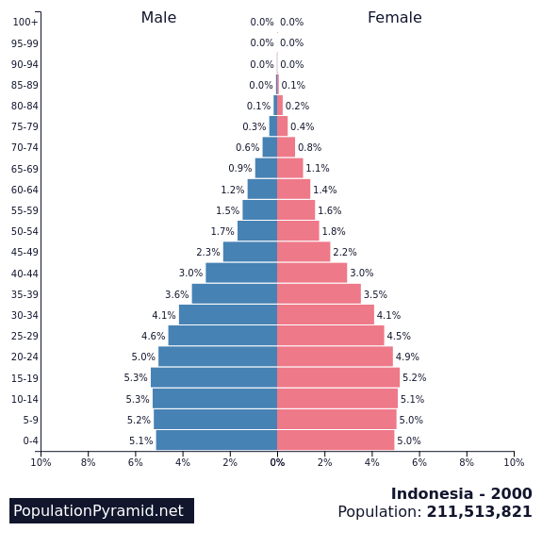
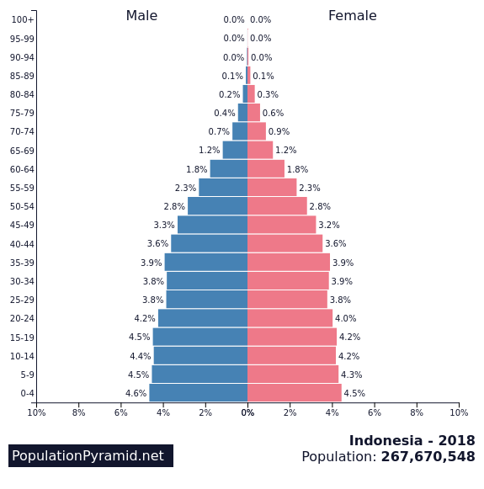
Population Pyramid of Indonesia, 2000-2018
Notes:
Source: US Census Bureau, International Database

Slide 98
4. The Philippines
Independence
  War of Resistance (1899-1901):
    14,000 troops and about 200,000 civilians killed (starvation and diseases).
  Independence:
    In 1934, the United States granted independence to be achieved in 1946.
    Japanese invasion and occupation (1942 - 1945).
    Independence in 1946 but several American military bases remained.
  The Marcos regime (1965-1986):
    Dictatorship.
  Democratic regime since then, but political instability.

Slide 99
4. The Philippines
Economic development
  Marcos government (1970s):
    Maintained power by a system of patronage.
    Ruined by protectionist policies.
    Largest social inequity in Pacific Asia; 78% of the wealth controlled by a few families.
    Huge foreign debt.
  50% in agriculture and 40% below the poverty line.
  Closing of 6 US military bases (1991 - 1992):
    Loss of 15,000 direct and 200,000 indirect jobs.
    Loss of income (3% of the GDP).
    Some military installations reconverted for logistical activities; FedEx Asia hub.
  Negatively impacted by the financial crisis of 1997-98.
  Significant outsourcing destination of business processes (English speaking).

