Slide 1
Topic 6 – The East Asian Tigers: Hong Kong, Taiwan and South Korea
A – Hong Kong: China’s Southern Gateway
B – The Other China: Taiwan
C – South Korea: The Shrimp between the Whales

Slide 2
Conditions of Usage
For personal and classroom use only
  Excludes any other form of communication such as conference presentations, published reports and papers.
No modification and redistribution permitted
  Cannot be published, in whole or in part, in any form (printed or electronic) and on any media without consent.
Citation
  Dr. Jean-Paul Rodrigue, Dept. of Global Studies & Geography, Hofstra University.

Slide 3
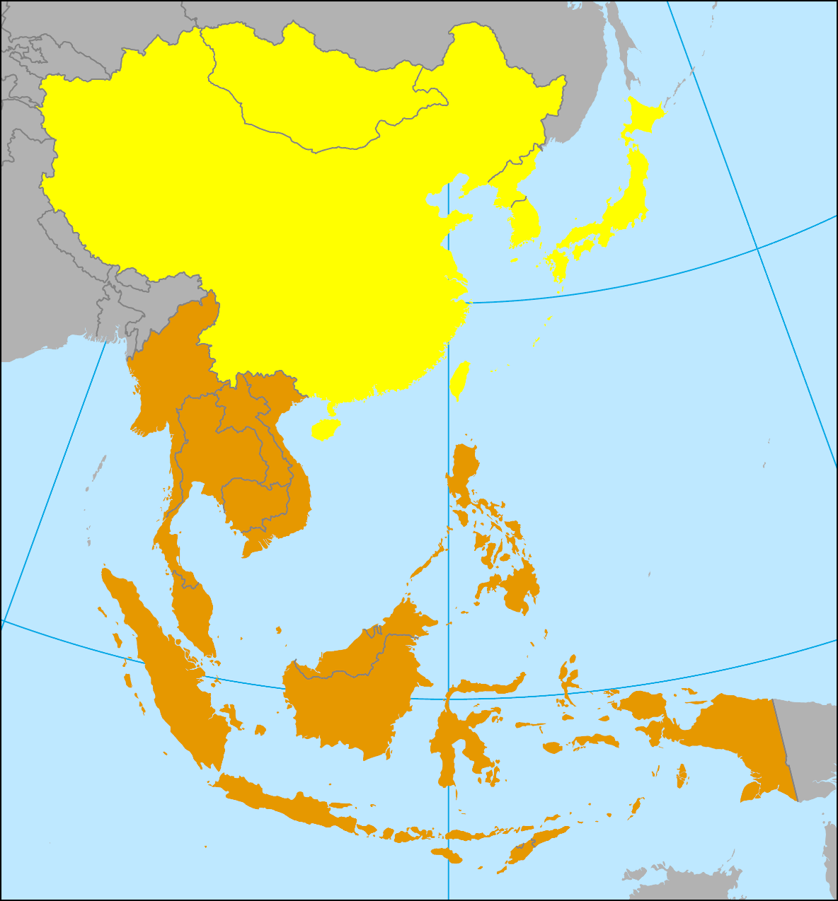
The East Asian Tigers
What the Tigers have in common?
  Small sized with small populations.
  Little or no natural resources.
  Market economies / trade gateways.
  Democracies / Semi-democracies.
  Coastal / Maritime access.
  Chinese dominance (except South Korea; cultural influence).
South Korea
Taiwan
Hong Kong
Singapore

Slide 4
A. Hong Kong: China’s Southern Gateway
1. Geographical and Historical Context
  What is specific about the geography of Hong Kong?
  Why the location of Hong Kong is so important?
  What is the status of Hong Kong within China?
2. Creating a Gateway
  To what extent trade is linked to the dynamism of Hong Kong?
  What are the major economic functions of Hong Kong?
3. Urban Planning in Hong Kong
  How urban planning has adapted to the unique context of Hong Kong?

Slide 5




1. Geographical and Historical Context: Scarcity Issues in Hong Kong
Location
Head of the Pearl River Delta.
Vulnerability to Monsoons and typhoons (hurricanes; June to August).
Rain-induced landslides a risk.
Limited land
About 1,108 square kilometers (400 square miles): 200 islands.
Only 100 square kilometers can be used: 9% of the territory.
Geography is a multiplying constraint.
High densities
The island of Hong Kong, which includes the CBD.
Kowloon, the continental peninsula.
About 5,900 persons per square kilometer, but the real numbers are about 59,000.
Some parts have a density of 250,000 persons per square km (Manhattan has about 33,000).
Expansion
Large labor pool. Wages kept relatively low. Reliance on women. Development of skills through education.

Slide 6
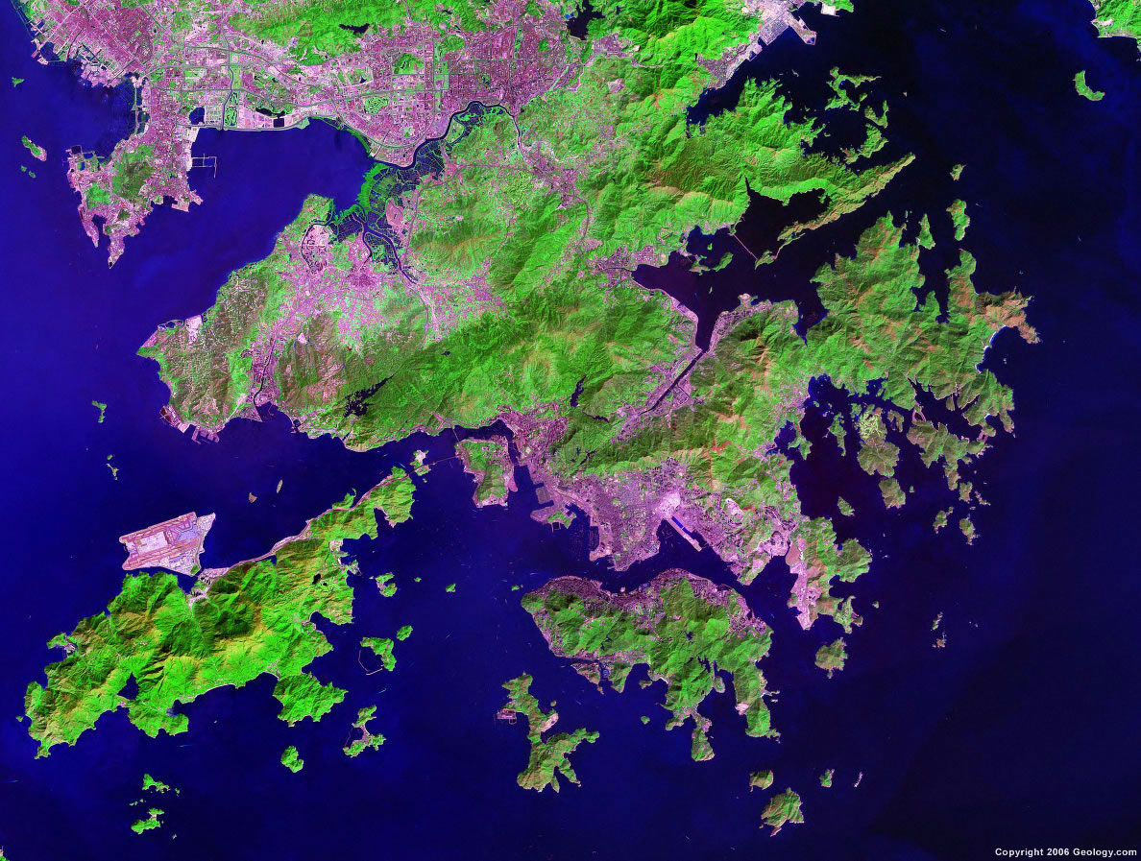
Main Territorial Elements of Hong Kong
China (Shenzhen)
New Territories
Port
Airport
Kowloon
CBD
Hong Kong Island

Slide 7
1. Geographical and Historical Context
Immigration
  Population of 7.3 million (2022).
  About half the population was born in Hong Kong.
  The great majority of the population comes from southern China.
  95% of Chinese ethnic origin.
  Indian and European (expats) minorities.
  Cantonese the main language, with Mandarin growing rapidly since 1997.
Global connections
  A global city.
  A cosmopolitan population (British colony from 1842 to 1997).
  A financial center.
  A first-rate port and airport (new):
    Linked to international trade.

Slide 8
Population of Hong Kong, 1960-2022
Retrocession to China
Protests and Covid
China’s Open-Door Policy
Notes:
Source: World Bank
https://data.worldbank.org/indicator/SP.POP.TOTL?locations=HK

Slide 9
1. Geographical and Historical Context
Cost of living
  One of the most expensive places in the world.
  No income, sales or capital gain taxes.
  Massive intervention of the government in housing:
    Most of the population cannot afford private housing.
    95% of the population lives in apartments.
    49% of the population lived in public or subsidized housing in 2018.
Resources of Hong Kong
  Hong Kong has no natural resources to speak of.
  Strategic location for the China trade.
  Its natural harbor is its most important resource:
    Deep water port.
    5th largest container port in the world (after Singapore and Shanghai).
  Highly integrated in the transpacific trade.

Slide 10
1. Geographical and Historical Context
Colonial history and a regional paradox
  Linked with the British Colonial history in Pacific Asia:
    “Borrowed place living on borrowed time”.
    More than 150 years of British occupation.
  Contradiction with the surrounding environment:
    One of the most liberal market economies next to one of the most hard-liner communist nations.
    7 million people compared to 1.3 billion.

Slide 11
The Foundation of Hong Kong
Event | Consequences
Foundation (1821) | Hong Kong island was occupied by opium dealers; Operation base for the opium trafficking in China.
Opium War (1839-1842) | China forbade opium traffic in 1839. British forces retaliated and won a settlement with China.
Treaty of Nankin (1842) | Opened five Treaty Ports along the Chinese coast. Ceded the island of Hong Kong to England in perpetuity. 6,000 inhabitants lived in Hong Kong.
Treaty of Tientsin, second Opium War, (1860) | Acknowledged the ownership of Kowloon by England.
Bail of 1898 | Bail of 99 years for the New Territories was signed, which expired June 30th 1997. Provided an agricultural hinterland for Hong Kong

Slide 12
1. Geographical and Historical Context
Emergence of an entrepot
  Interface function with Southern China.
  Opium trade was gradually abandoned:
    More “noble” activities appeared in Hong Kong.
    Finance, banks and insurance companies.
    No tariffs on trade applied by the colonial government.
  Political instability in China:
    End of the Qing dynasty (1911).
    Favored the immigration of Chinese merchants.
    Kept their business network with China.
    Provided new trade opportunities for Hong Kong.
  Transplantation of the Chinese merchant and business class to Hong Kong.

Slide 13
War and Crisis in Hong Kong
Event | Consequences
Japanese invasion of Manchuria (1937) | Collapse of the Chinese central government. Most of the coastal regions occupied (1938), including Guangdong province next to Hong Kong.
Japanese occupation (1941-1945) | End of Hong Kong’s commercial role. Massive deportations (about 150,000 people).
Chinese Civil War (1945-1949) | Increased influx of refugees from mainland China. 750,000 between 1945 and 1949. 500,000 between 1949 and 1950.
Korean War (1950) | Trade with China halted. UN embargo and communist / isolationist China. Loss of the commercial hinterland.

Slide 14
1. Geographical and Historical Context
Adaptation and reconversion
  Labor intensive activities (1950s):
    Conversion of the economy towards and export-oriented industrial sector.
    Notably in the light industrial sector (textiles, garments).
  Specialization:
    Industry requiring limited raw materials such as plastics and electronics.
    First global exporter of watches.
  Lack of space:
    Restrained agricultural development and space consuming industrial sectors.
    Reconversion to manufacturing and an export-oriented economy.
  Government incomes through land leases:
    No income taxes, no sale taxes or capital gain taxes.
    Used income to subsidize low-cost housing.

Slide 15
1. Geographical and Historical Context
Spatial problems
  Immigration and refugees:
    Large and continuous influx of low-wage labor coming from China.
    About 25,000 persons per year (1949-1979).
    Immigration fueled by period of crisis in China (Great Leap Forward and the Cultural Revolution).
    Thousands of Chinese refugees from Vietnam (boat people; 1975).
  Housing problems:
    Solved by the government.
    Provide public housing from 1953.
  Competitiveness problems:
    Started to be felt by the 1970s.
    Growing labor and land costs.
    Could not be easily solved.
Kowloon Walled City: Hong Kong's City of Darkness

Slide 16
1. Geographical and Historical Context
Symbiotic relationship Hong Kong / China
  Chinese Open-Door policy (1978):
    Changed considerably the business and industrial context of Hong Kong.
    Relocation of its industrial base to China.
  What Hong Kong had to offer to China:
    Expand its exports with a first-rate port.
    Established business and distribution network with the world.
    Trained managerial capabilities.
    Intermediary function with added value for re-exports.
  What China had to offer to Hong Kong:
    Unlimited supply of labor.
    Resources.
    Land for building modern factories.
    A growing consumption market.

Slide 17
1. Geographical and Historical Context
Reunification
  Retrocession protocol with China:
    Signed in 1984 (Thatcher).
    Respecting the original bail.
    Hong Kong to be a Special Administrative Region (SAR).
    Political, economic and financial management autonomy.
  Tiananmen events (1989):
    Produced a lot of uncertainty about the future of Hong Kong.
    Several residents of Hong Kong started to immigrate abroad.
    Notably in Australia, Canada and the United States.
    About 60,000 per year left between 1990 and 1997.
    Pragmatism: Gained foreign citizenship and came back to do business.

Slide 18
1. Geographical and Historical Context
Hong Kong within China
  “One country, two systems”.
  Level of autonomy for a period of 50 years (2047):
    Economic and financial autonomy.
    Except defense and foreign policy.
    Not to impose communism.
    Remained a free port and kept its currency.
    Could join the WTO.
  Creation of a Special Administrative Region (SAR):
    Called Xianggang by the Chinese.
    Free to establish independent economic relations with foreign countries.
  China now maintains strict border control:
    Prevent immigration from mainland.
History of Hong Kong - From British Colony to Special Administrative Region of China

Slide 19
2. Creating a Gateway
The role of Hong Kong as a nexus
  An intermediate for Southern China trade.
  Transportation nexus:
    The most efficient port and airport of the region.
    A gateway for passengers and freight; global connections.
  Commercial nexus:
    Decisions made about regional production.
    Integration to global supply chains.
    78% of Hong Kong’s exports are re-exports.
  Financial nexus:
    Banking and stock market activities.
    A platform for investments in (Southern) China.
  Tourism nexus:
    More than 65 million tourists per year (about 78% from mainland China).
    Disneyland opened in 2005.
    Large retail sector with a specialization in gold, diamonds and jewelry.

Slide 20
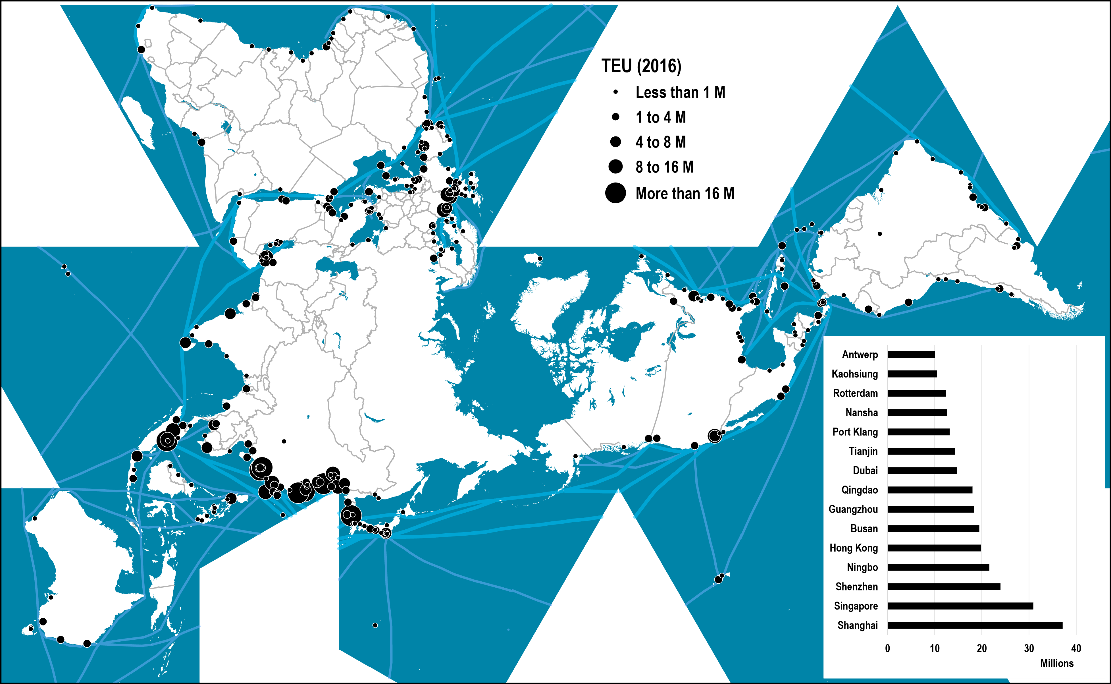
World’s Major Container Ports, 2016

Slide 21
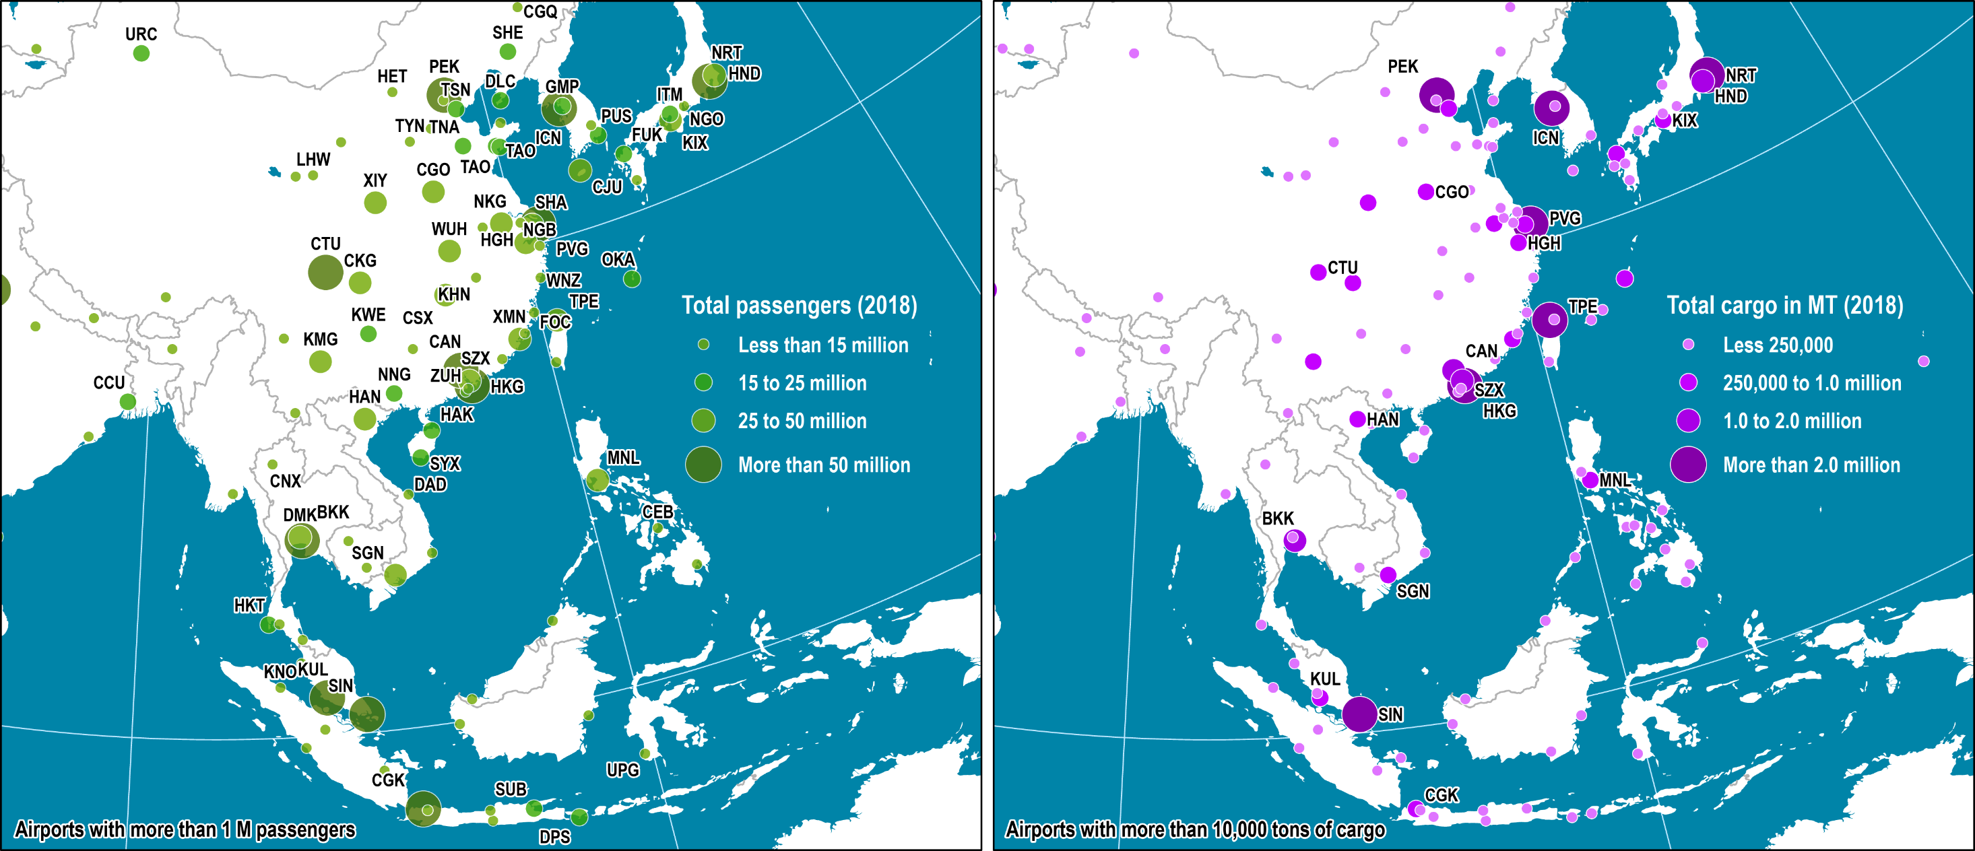
Passenger and Freight Traffic at East and Southeast Asian Airports, 2018
Read this content
Notes:
Map location: airport_terminals

Slide 22
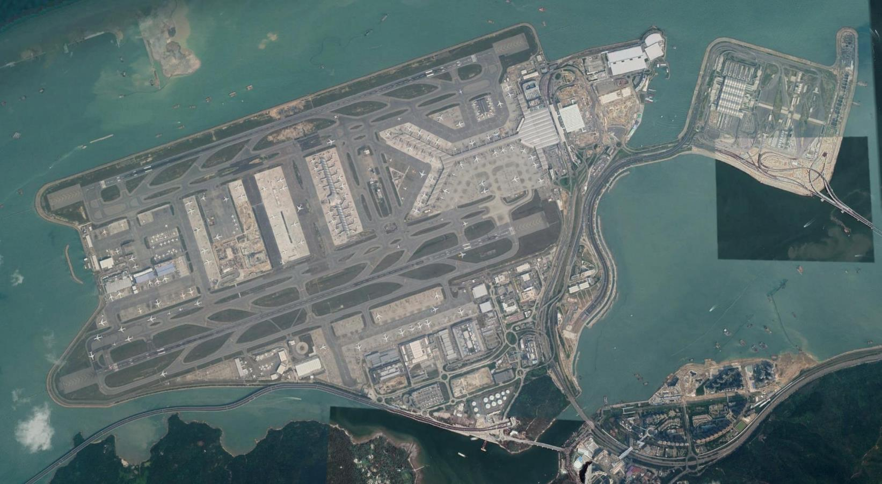
Hong Kong Chek Lap Kok Terminal
Read this content
Building Hong Kong's International Airport
Skycity
25R
North Satellite Concourse
Hong Kong Boundary Crossing Facilities
Main Terminal
07L
Terminal Expansion
(Midfield Concourse)
25L
Logistics and cargo area
07R
To Kowloon
and Hong Kong
Hong Kong–Zhuhai–Macau Bridge

Slide 23
The Pearl River Delta: The World’s Manufacturing Hub
Hunan
Jiangxi
Fujian
Guangxi
Guangdong
Opened in 1978.
Attract investments and technology from Hong Kong.
Tax incentives and collaboration.
Population above 12.5 million.
Pearl River
Guangzhou
Shenzhen Special Economic Zone (SEZ)
Pearl River Delta
Zhuhai
Hong Kong
Includes the whole Pearl River Delta.
Several special economic zones.
The world’s main manufacturing hub.
Emerged as a functional economic entity.
Large transport infrastructures (ports and airports).
Macau
Growth Triangle
South China Sea
Hainan

Slide 24
2. Creating a Gateway
A new mutation towards services
  Decline in manufacturing.
  The main primary activity is quarrying and sand (construction).
  Relocation of labor-intensive industrial activities to nearby China:
    1980: 22% of the GDP in manufacturing.
    2004: less than 5%.
  Knowledge, service and capital-intensive sectors stayed.
  Telecommunications:
    More cell-phones than people (1,227 per 1,000).
    Compact structure easy to service.
  Proliferation of service jobs for the wealthy:
    Cooks, maids, gardeners and chauffeurs.
    Maids in Hong Kong are mostly Filipinas (Less likely to stay).
  Largest concentration of luxury cars in the world:
    In 2019, a single parking spot sold for $969K.

Slide 25
Share of Selected Sectors in the GDP of Hong Kong, 1980-2018
Notes:
Source: Hong Kong, Census and Statistics Department,
https://www.censtatd.gov.hk/home/index.jsp

Slide 26
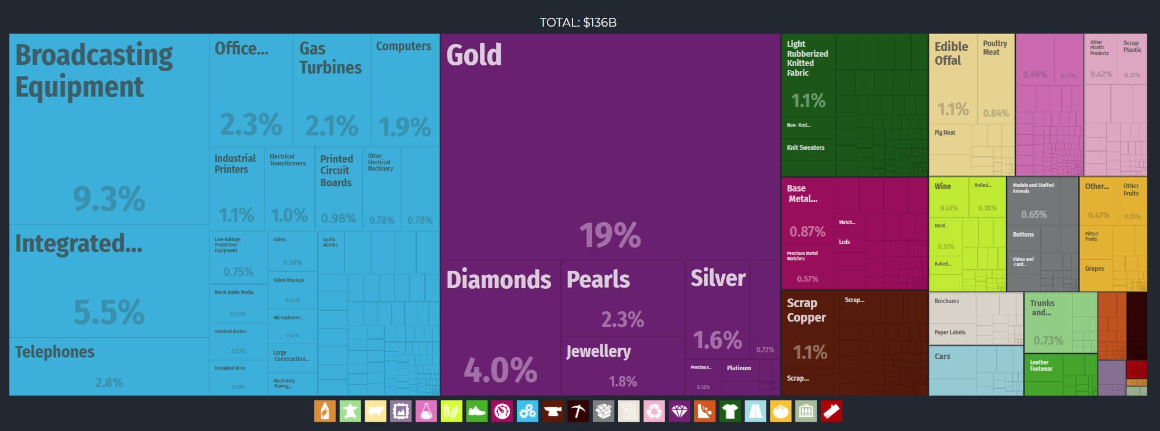
Hong Kong Export Treemap, 2017
Machines
Textiles
Instruments
Precious Metals
Notes:
Source: Economic Complexity Observatory, MIT Media Lab and the Center for International Development at Harvard University.
https://oec.world/en/profile/country/hkg/
Broadcasting Equipment is also known as television, radio broadcasting, antenna, digital, wireless, FM, AM, bluetooth, microwave.

Slide 27

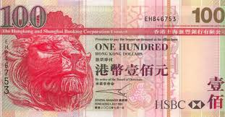
2. Creating a Gateway
Financial center
  10th largest banking center in the world.
  7th largest foreign exchange center in the world.
  Convergence of capital to be invested in China.
  Financial intermediary:
    For investments bound for China.
    From 50 to 70% over the 1980s and mid 1990s.
    An important share of the capital comes from the Chinese diaspora.
  Significant increase of the services and financial sector.
  HSBC (Hong Kong Shanghai Banking Corporation).
    Founded in 1865 to finance trade in Pacific Asia.
    Seventh largest bank in the world (2018).
    One of the three private issuer of currency in Hong Kong (60% of issues).

Slide 28

2. Creating a Gateway
Li & Fung: A proxy for the role of Hong Kong in global manufacturing
  Founded in 1906 in Guangzhou as an exporter of Chinese products (silk, porcelain).
  Moved in Hong Kong in 1949 and developed a manufacturing base.
  Actively expanded in China after 1979.
  One of the world’s leading consumer goods procurement / supply chain company.
  Specialized in the sourcing of time-sensitive mass-market goods.
  Supply many of the world’s largest retailers:
    A network of more than 10,000 factories.
    Garments, fashion accessories, sporting goods, and toys are the most dominant goods.
    Can provide product design, sourcing, distribution, & marketing.
    20,000 employees.
    Moving into digital supply chains.

Slide 29
3. Urban Planning in Hong Kong
Urban Planning
  Urban planning in Hong Kong is the outcome of its geography.
  Design and organization of urban space and activities.
  Land use / zoning:
    What type of activities are permitted in which areas?
    High density.
  Transportation:
    How can transportation bet set to answer mobility needs?
  Architecture:
    How the physical landscape gets constructed to support planning goals?
Provide some examples about why Hong Kong is a unique case for urban planning.

Slide 30
3. Urban Planning in Hong Kong
Land use
  Extreme scarcity:
    Most of the territory is either forests/mountains or high-density urban.
  High land value forces construction to go up:
    “The Manhattan of China”.
  Intense precipitations required massive investments in erosion control projects.
  Land reclamation projects:
    The surface of Hong Kong is growing.
    The new airport created a lot of new land for development.
    Extension of Kowloon and Wanchai (downtown area).
    Enables the government to generate substantial income by selling new land for real estate development.

Slide 31
3. Urban Planning in Hong Kong
Transportation
  Heavy reliance on public transit:
    About 11 million daily journeys.
    The only way to move such a large number of people in such a constrained area.
    The subway handles 5.2 million passengers per day.
    Double deck tramway system in CBD.
  Dominance of walking:
    Compact and high-density city.
    Longest escalator in the world (800 meters).
  Airport train:
    Linking the main terminal to the CBD.
  High-speed rail:
    Connected to China’s HSR system.
  Hong Kong–Zhuhai–Macau Bridge
    55-kilometer bridge opened in 2018.

Slide 32
3. Urban Planning in Hong Kong
Architecture
  Collective architecture:
    Reflects the Chinese culture.
    Apartments and public housing complexes.
    Collective recreational spaces.
  High rises / arcologies:
    Importance of vertical movements.
    Self-contained buildings with all services (250,000 people per sqr mile).
    Separation of commercial activities from roads in central areas.
    International Commerce Center; opened in 2010. Tallest building in Hong Kong; World’s 12th tallest building (multifunctional: offices, hotels, restaurants, shopping).
  Post-modern landscape:
    Buildings an expression of power, wealth and prestige.
    Many buildings are architectural landmarks.
    Impact of culture (Feng Shui; “wind - water”) in setting and design (even superstitions).
    Harmonizing individuals with their surroundings.

Slide 33
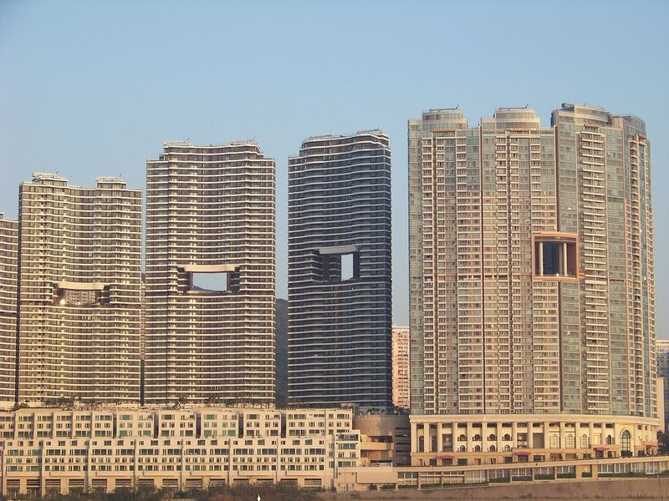
Impacts of Feng Shui on Hong Kong Architecture
How feng shui shaped Hong Kong's skyline
Notes:
This explains why many buildings along the waterline have gaping holes in the middle. These holes provide the dragons an unobstructed path to the water, so that the winds of positive energy continue to flow through the city.

Slide 34
B. The Other China: Taiwan
1. Geography of Taiwan
  What characterizes the geography of Taiwan?
2. The Republic of China
  How the ROC came into existence?
3. ROC vs PRC
  What is the nature of the conflict with China and what are the reunification possibilities?
4. Silicon Island
  What is the contribution of Taiwan to the global IT industry?

Slide 35
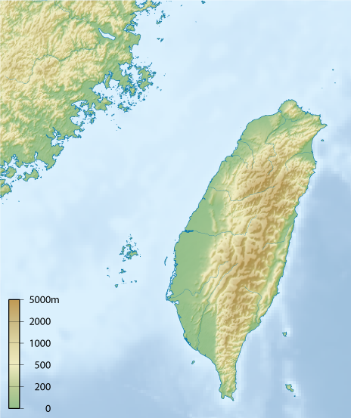
1. Geography of Taiwan
Geographical Context
  About 150 km (100 miles) from the coast of southeast China.
  High proximity favors economic integration.
  Plate tectonics: getting 3.15 inches closer to China each year.
  About the size of Idaho.
  Similar constraints than neighboring countries:
    60% of the territory is composed of mountains.
    Chungyang Range covers about 50% the total land area.
    25% usable for agriculture.
  Bulk of the population lives in the western coastal plain.
  Quemoy and Matsu islands:
    Used for defensive purposes.
Matsu
China
Taiwan
Formosa Strait
Quemoy
Chungyang Range

Slide 36
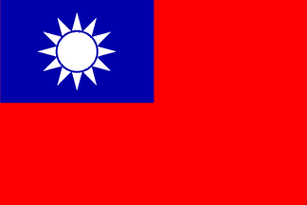
1. Geography of Taiwan
Population
  23.5 million inhabitants (2020).
  Population stabilizing; growth rate close to 0%
  One of the highest population density in the world (1,600 people per square mile).
  75% urbanized.
  Most inhabitants are Chinese or have ancestors coming from mainland China.
Taiwan flag
  Red: the land of China (dominance of the Han).
  White sun: spirit of progress as the twelve points represent the twelve hours of the day (a traditional Chinese hour = two conventional hours).

Slide 37
1. Geography of Taiwan
Early history
  Initially settled by Malay tribes.
  Known to the Chinese as the island of Bao Dao.
  Known to the Japanese as “Tai Wan” (Big Bay).
  From the 7th century, Chinese began to settle the island and became the major ethnic group.
  Named Formosa (“the Beautiful one”) by the Portuguese in 1590.
  Brief Spanish and then Dutch occupation between 1624 and 1661.
  Conquered to the Qing Empire (Manchu) in 1683:
    Received little interest from the imperial government.
    Made a Chinese province in 1887.

Slide 38
2. Foundation of Taiwan
Event | Consequences
Sino-Japanese War (1894-95) | Ceded to Japan in perpetuity by the Treaty of Shimonoseki. Local economy converted to fit the needs of the Japanese economy (food supply). Investment in modern infrastructures such as railways, roads and ports (Keelung and Kaohsiung).
Capitulation of Japan (1945) | Cairo Declaration (1943) promising to restore Taiwan to China. Taiwan ceded back to the Republic of China (ROC).
End of Chinese Civil War (1949) | 2 million Kuomintang (Chinese Nationalists) led by Chiang Kai-shek fled China. ROC government in exile. Continuation of the war with the Chinese communists (martial law).

Slide 39
2. The Republic of China
Two representatives for China
  People’s Republic of China (PRC):
    Considered Taiwan as the 22nd Chinese province.
    Often labeled as “Mainland China”.
  Republic of China (ROC):
    Declared to be the legitimate representative of China.
  Both claimed a “One China” policy.
  Communism has never settled in Taiwan:
    Isolation from the mainland.
    Occupied by the Japanese for 50 years.

Slide 40
2. The Republic of China
International recognition
  Facing the PRC isolationism, the international community recognized Taiwan as the sole representative of China.
  Member of the United Nations.
American Intervention
  Prevented a Chinese invasion by a naval blockade (1950):
    Mutual security pact (1954).
    Taiwan became a protectorate of the United States.
  Anticommunism made Taiwan a natural ally.
  American aid:
    About 4 billion in the 1950s and 1960s.
    Establishment of several industrial sectors and the growth of exports.
    25% of capital formation and 49% of public investments in infrastructure.

Slide 41
3. ROC vs. PRC
Expulsion from international affairs (1960s and 1970s)
  Gradually expelled from international diplomatic relations:
    Increasing pressures from the PRC.
    Expelled from the United Nations to be replaced by the PRC (1971).
    Now called “Chinese Taipei” by the United Nations.
  Normalization of American relations with the PRC (1979):
    Ended their relations with the ROC.
    One could not be done without the other.
Emphasis on trade
  Economic linkages have strongly increased.
  Trade and development to promote Taiwan’s perspective:
    Similar to Japan.
Is Taiwan a country... or part of China?

Slide 42
3. ROC vs. PRC
The integration of the two Chinas
  During the 1980s the PRC offered the ROC reintegration and autonomous status.
  Strong ideological conflicts prevents reintegration.
  Tiananmen massacre (1989):
    Reinforced mistrust towards mainland China.
    Provided additional support by the United States.
  One China Policy:
    Rapprochement with China (1991):
      Declaration of the end of hostilities (Chinese Civil War).
      Recognition of the existence of the PRC by the ROC.
    Taiwan government recognized there is one China and that Taiwan is a province of China (1995).
    Officially gave up its pretension of being the representative government of China.

Slide 43
3. ROC vs. PRC
Towards the first Chinese democracy in history
  40 years of economic growth, independence and a market economy has changed considerably the Taiwanese society.
  Democratization and multiparty system (1987).
  First elections (1989).
Economic Cooperation Framework Agreement (ECFA)
  2010; free trade agreement between mainland China and Taiwan.
  Covers goods but also services (finance, insurance, healthcare).
  Taiwan, SAR?
  Would the Hong Kong model be suitable for Taiwan?

Slide 44
4. Silicon Island
High technology and modernization (1981-1990)
  Restructuration of the economy:
    Supported by the government.
    Towards high technology and R&D.
    Monitors, desktops, graphic cards and motherboards.
  Chinese Open-Door Policy:
    Taiwan was actively involved to the industrial development of the mainland by providing capital and technology.
    Taiwan became an exporter of capital.
Information technologies (1990-)
  Global logistics center:
    Important maritime (Evergreen) and air (Eva) services.
    Kaohsiung: 12th largest container port in the world.
  Information and services economy.

Slide 45
Evolution of Taiwan Exports, 1963-2001
Notes:
Source: WTO. http://www.wto.org/english/res_e/booksp_e/anrep_e/world_trade_report_2003_e.pdf

Slide 46
4. Silicon Island
Direct access to China:
  Direct trade between Taiwan and China was not permitted:
    The bulk of capital and trade was going through Hong Kong.
    Involved supplementary costs and delays.
  Restoring the “three links”: transport, trade and postal services.
    Permitted in 1992 for FDI (4th link).
    Keep open the Taiwanese supply of capital and technology in a post-1997 environment.
    Investment patterns tend to follow family contacts.
    Specific air links permitted in 2003 (for Chinese new year):
      500,000 Taiwanese live in Shanghai.
      Takes 6 hours to fly from Shanghai – Hong Kong – Taipei.
      Cut to an hour and a half.
    More direct regular air services (2008).
    Mainland Chinese tourism in Taiwan permitted as tours (2008).
    Direct maritime shipping links (2009).

Slide 47
4. Silicon Island
“Silicon Island”
  Strategy to promote Taiwan in the IT sector:
    Develop a specialization remaining competitive with China.
    Joint division of production.
  Lower range activities relocated to China:
    60-70% of China’s IT products are made by Taiwanese enterprises.
    Foxconn:
      World’s largest maker of electronic components (iPhones, iPads).
      900,000 employees, largest exporter in mainland China.
  Achievements:
    3rd largest computer hardware manufacturer in the world.
    Manufactured a third of the global laptop production.
    41% of Taiwan’s export related to high tech products.
  Entered the WTO in 2001 (jointly with China).
  Asian Silicon Valley (2016).
Taiwan ASV Asian Silicon Valley

Slide 48
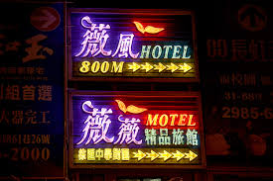

4. Silicon Island
Love hotels: inside Taiwan's crazy and outrageous high-end hotels
“Love Hotels”
  Most young adults stay with their parents.
    Apartments are of small size.
    Limited room or opportunities for intimacy.
  Prevalent in many Asian countries (Japan, Korea, Hong Kong):
    Theme initially developed in Japan.
  Large industry of theme hotels becoming mainstream.
  Rooms rented for a short duration.
  Many designed around a theme:
    Sports, locations (New York, Las Vegas), fantasy (Disney, fairy tales), etc.
    Some themes are more explicit…

Slide 49
C. South Korea: The Shrimp between the Whales
1. The Division of the Koreas
  What were the causes and consequences of the division of the Koreas?
2. The Industrialization of South Korea
  How South Korea was able to develop?
3. South Korean Chaebols
  How South Korea was able to develop?

Slide 50
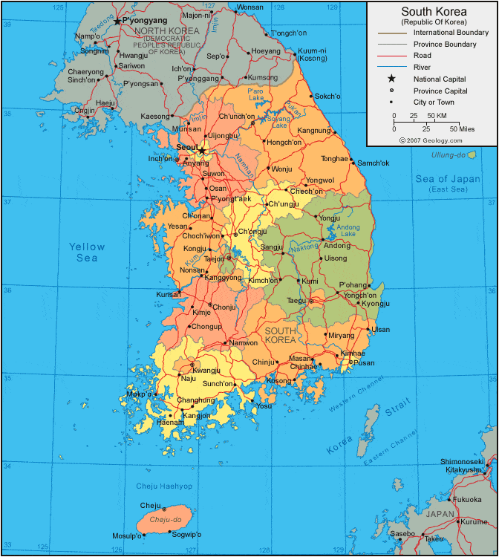
1. The Division of the Koreas
Geography
  “The shrimp between the whales”.
  About the size of Indiana.
  70% mountainous.
  North/South climatic variations.
  Population of 52 million.
  Very low growth rates (less than 1%)
  Highly homogenous ethnicity and linguistically (100% Korean).
  Religiously divided between Christianity (49%) and Buddhism (47%).
  75% urban with 27% of the population living in Seoul (13 million).
  5 million Koreans live oversea:
    1 million in the United States.

Slide 51
Population of the Korean Peninsula, 1960-2022
Notes:
Source: World Bank.
https://data.worldbank.org/indicator/SP.POP.TOTL?locations=KR

Slide 52
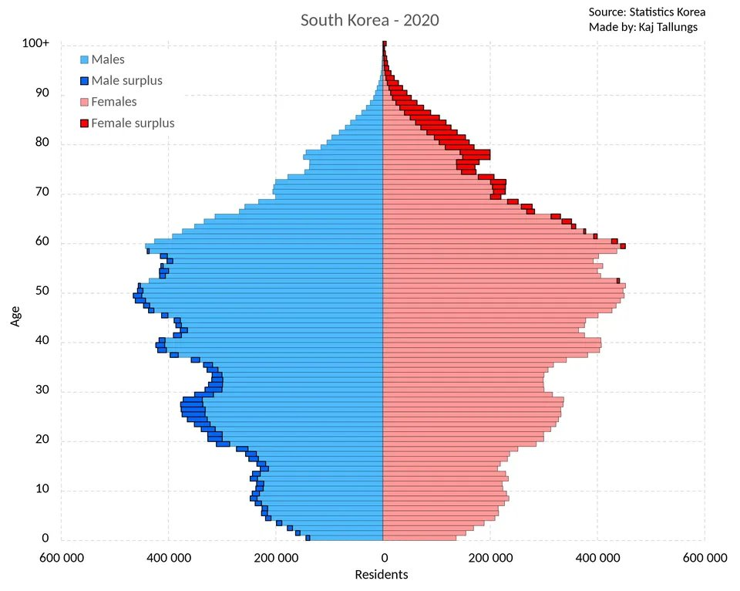
1. The Division of the Koreas
Unfolding demographic crisis
  In 2020 South Korea broke the world record for lowest recorded fertility rate for any country ever.
  TFR of 0.837 children per female.
  Becoming a national crisis having profound economic and social consequences.
  Preferences for sons.

Slide 53

1. The Division of the Koreas
South Korean flag
  Center: Yin-Yang symbol.
  Four elements in the corners (air, water, fire and earth).
Historical perspective
  The history “the calm morning country” is highly turbulent.
  Presence of Korean culture and kingdoms by 1,000 BC.
  Chinese vassal from the 13th century.
  Japanese and Manchu invasions in the 16th and 17th centuries.
  Isolationist policies (18th and 19th centuries; Hermit Kingdom).

Slide 54
1. The Division of the Koreas
Korean Culture
  Ancient identity:
    Very important Chinese influence.
    Cultural bridge between China and Japan.
    Usage of the “ondol” heating system.
  Developed its own writing system:
    Hangul invented in the 15th century.
    Phonetic system using 14 consonant letters and 10 vowels.
    Replaced a system borrowed from Chinese characters.
  Food:
    Usage of fermentation to keep vegetables preserved (Kimchi).
      Chili peppers (New World crop) introduced in the 16th century by Portuguese traders.
    Korean barbecue (Bulgogi).

Slide 55
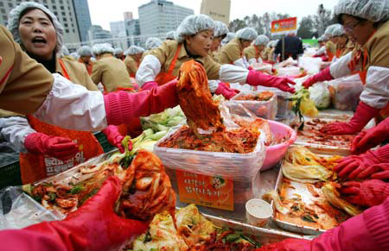
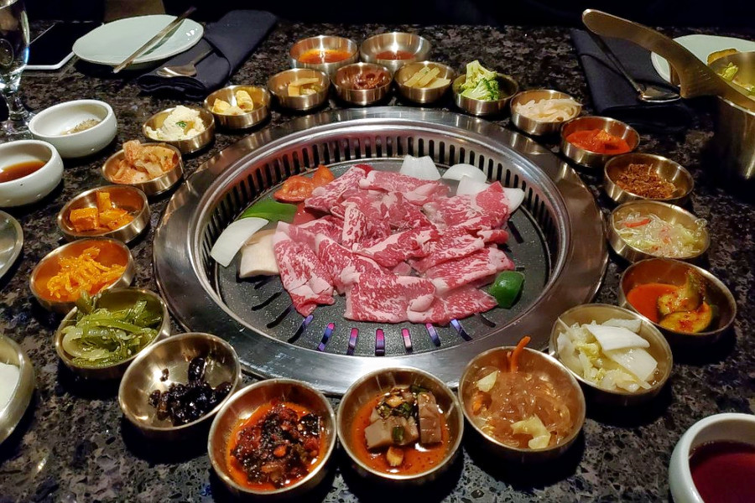
Korean Food Culture

Slide 56
1. The Division of the Koreas
Event | Consequences
Japanese occupation (1868-1945) | Invaded by Japan (1868). Formally annexed (1910). Attempts at complete cultural and political annexation. Supply food and raw materials.
Soviet and American Invasion (1945) | Soviet Union declared war on Japan (8 days before the end of the war). Invaded Korea from the north. American forces occupied the south a month later.
Occupation zones (1945-46) | USSR and USA agreed to divide the country along the 38th parallel. Military administration for a period of 5 years until elections could be held.
Partition of Korea (1948) | People’s Democratic Republic of Korea north of the 38th parallel. The United States, with the United Nations established the Republic of Korea south of the 38th parallel.

Slide 57
1. The Division of the Koreas
The Korean War (1950-1953)
  Antagonism of the two new nations:
    Supported by China and the USSR.
    Invasion of South Korea by North Korea (1950).
  United Nations intervention:
    Multinational force intervened and repelled the invasion (1951).
  Military intervention of China (1952).
  An armistice “ceasefire” was signed (1953):
    Both countries are still technically at war.
    4 million civilians perished.
    Millions of refugees trapped in the division of Korea.
A History Of The Korean War

Slide 58
1. The Division of the Koreas
The consequences of the Korean war
  Division of Korea in two artificial parts.
  The demilitarized zone of the 38th parallel:
    240 km in length and 4 km in width.
    Current border between the Koreas.
    The United States maintains a force of 37,000 to 45,000 troops.
  Social and economic divisions:
    Smaller market.
    Break of economic and social (family) links.
    Destruction of regional complementarity.
  South Korea’s losses:
    Hydroelectric potential.
    Natural resources.
    Heavy industries located in the north.

Slide 59
2. The Industrialization of South Korea
Some advantages of South Korea
  A relatively equal distribution of wealth:
    Due to the Japanese occupation and the Korean war.
  High levels of education.
  A relatively young population:
    10% of Koreans and 20% of Germans are 65 or older.
    Rapidly aging.
  A culture oriented towards hard work (Confucianism).
  A high savings and investment rates.
  Role of governments:
    A tradition of bureaucratic service.
    A concerted effort to stimulate and protect a set of carefully selected manufacturing and technology industries.

Slide 60
2. The Industrialization of South Korea
Export takeoff (1961-73)
  Primary industries initially.
  High savings rate: 25 to 35% of GDP.
  Democracy failed:
    Military dictatorship (1961):
    Government control over industrial development (State capitalism).
  Five-year plans:
    The state started to intervene to favor priority sectors where investments and subsidies were accumulated.
    Development of light industries, notably textiles.
  Establishment of Chaebols:
    Main instruments of Korea’s development.
    Large Korean conglomerates.
    Influenced by the Japanese Keiretsu model.
    Privileged relationships with the government.

Slide 61
2. The Industrialization of South Korea
Heavy industries (1973-79)
  Became the foundation of the Korean industrial development.
  Spin off effects with steel, shipbuilding and machinery.
  Korea specialized in shipbuilding:
    Largest shipbuilder in the world (40%).
    Japan (32%).
  Chemicals and petrochemicals:
    Reinforced industrialization.
    Highly dependent on imports of raw materials and transfers of technology.
  The Korean steel industry became highly competitive:
    Production costs 40% lower than the international average.

Slide 62
2. The Industrialization of South Korea
Market liberalization (1980-1997)
  Civil unrest in 1979 and in 1980:
    New constitution promoting social stability and economic growth (1981).
  Olympics games of 1988.
  New reforms in 1988 and elections in 1993.
  Development of the high technology sector:
    Mainly linked to foreign imports of technology.
    Labor training from foreign enterprises having spin-off effects on the economy.
    Creation of joint-ventures with large foreign electronic firms such as Sanyo, Hitachi and Siemens.
    Purchase of licenses to use foreign technology for production purposes, notably for memory.

Slide 63
2. The Industrialization of South Korea
Financial issues
  Banks:
    Tool of industrial policy.
    Politically oriented loans.
    Forced to loan money to specific industrial sectors at low rates.
    Borrowing foreign capital, since the Won (Korean currency) was high.
  Government / chaebols relationships:
    Corporations were expecting the government to bail them.
    Massively borrow money and invest without much attention.
    Misallocation of capital.
  Financial crisis of 1997-98:
    Underlined corruption between the government and the industry.
    The Won lost half of its value, multiplying the Korean foreign debt.
    Female labor force handling fluctuations: (From 48% of labor force in 1995 to 41% in 1999).

Slide 64
2. The Industrialization of South Korea
Restructuration (1997-)
  Shift from the east (Japan and USA) to the west (China).
  Korea is losing competitiveness.
  50% of Korea’s FDIs went to China (2003):
    Emergence of a China / Korea supply chain.
  High speed train network:
    Seoul – Pusan in 2 hours 30 minutes.
    The second in Asia after Taiwan.
  Ongoing dominance in consumer electronics:
    Flat screen displays (LCD; liquid crystal displays).
    Cell phones.
    Robots.
  Shipbuilding is a powerful industry:
    LNG carriers are the latest boom.
    South Korea manufactures 72% of the world’s LNG carriers.

Slide 65
Share of South Korea’s Exports by Main Trading Partners, 1991-2017

Slide 66
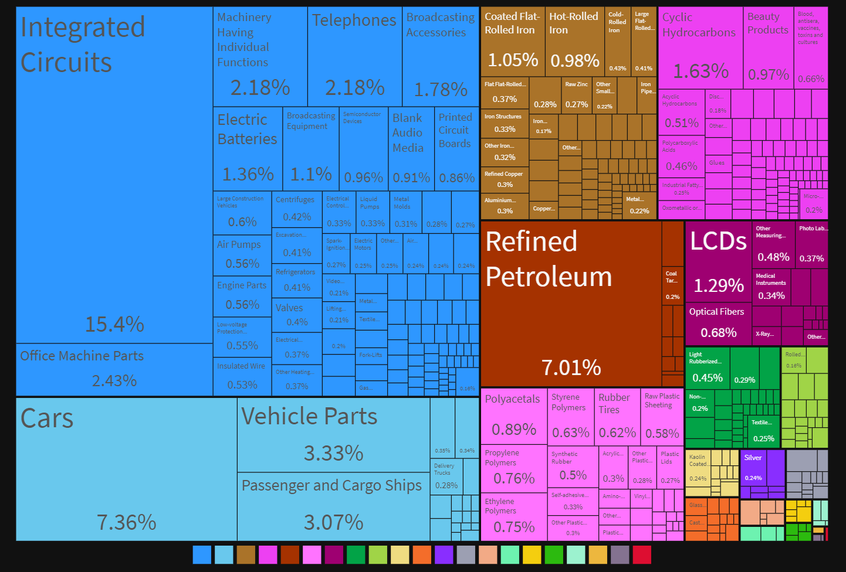
South Korean Export Treemap, 2019

Slide 67
LCD TV Shipments, 2019 (in millions)
Exclusive tour of LG's OLED R&D and manufacturing facilities in South Korea

Slide 68
2. The Industrialization of South Korea
The reunification of the Koreas
  “Sunshine Policy”.
  Summit between North and South Korea first held (2000).
  Acute economic differences between North and South Korea.
  Excessively unlikely unless North Korea collapses.
  South Korean investments in development zones.
  Willingness of South Korea to resolve matters on its own.
  The North / South issue increasingly perceived by the Koreans as an “internal” problem.
  The wish to issue a formal declaration to end the Korean War, which is still considered as a cease-fire.

Slide 69
2. The Industrialization of South Korea
Chaebols and the Korean Economy
  Created during the Japanese occupation.
  Large industrial groups:
    Means “fortune cluster”.
    재 財 chae; wealth, property.
    벌 閥 bol; faction, clan.
    Owned by a shareholder family (more centralized).
    Do not have a bank at their center.
  Korean government has privileged a limited number of corporations.
  Purchased foreign production technologies (patents, licensing).
  Hyundai, Samsung, Daewoo and Lucky Goldstar:
    Represent 45% of the Korean GDP and 60% of exports.
    Samsung accounts for 20% of all exports.
    Bankruptcy of Daewoo in 2006.
    Hanjin shipping bankruptcy in 2016.
    Facing controversy in terms of concentration of power and declining competitiveness.
South Korea’s Family-Run Conglomerates Are Under Pressure

Slide 70
Main Differences between Keiretsus and Chaebols
 | Keiretsu | Chaebol
Ownership | Public (stock) ownership | Mainly family-owned
Business / Government Relations | Weak government influence | Strong government influence
Decision-making | Distributed | Centralized
Capitalization | Mainly internal (bank and financial holdings) | Mainly external (capital markets)

Slide 71

Chaebols and the Korean Economy
- Samsung
Scale and scope
  Samsung means “three stars” in Korean.
  15th largest corporation in the world in 2019.
  131st in 2001; remained around the 20 largest since 2010.
  6th most valued brand in the world.
  Annual sales of 120 billion dollars and more than 309,000 employees across the world.
  Several economic sectors in a conglomerate structure.
  World’s second-largest shipbuilder.
History
  Established in 1938 as a trading company specializing in food exports to Japan.
  After WWII, the trading network shifted to the United States.
  Followed a similar development process to the Korean economy.
How BIG is Samsung?

Slide 72
Chaebols and the Korean Economy
- Samsung
Consumer electronics:
  In the early 1970s, Samsung diversified, notably by establishing Samsung Electronics.
  Made VCRs, integrated circuits, televisions and telephones:
    The largest producer of black and white televisions (1970s) by borrowing Japanese technology.
    In 1994, controlled 47% of the Korean television market.
    The number of workers on a VCR assembly line dropped from 26 to 14.
  1980s: began to specialize in the production of computer memory (64K DRAM).
  1990s: progressively abandoning simple consumption goods such as fans, freezers and tape recorders.
  Capitalization towards productive activities while sub-contracting tasks requiring a low level of technical expertise.

Slide 73
Chaebols and the Korean Economy
- Samsung
Semiconductors
  Manufactured the 64K DRAM (Dynamic Random Access Memory; 1983), 16M DRAM (1991), 256M DRAM (1994), 1GB DRAM (1996), 4GB DRAM (2001), 1GB MDDR (2009).
  The most important manufacturer of memory in the world (40% of the DRAM production).
  The bulk of the production is OEM (Original Equipment Manufacturing) using a foreign license.
  Controlled 15% of the global LCD market in 2018.
  Shift towards OLED technology (Organic Light Emitting Diode).
Car
  Began production in 1994.
  Capitalizing on Asian demand.
  Highly competitive sector with competitors such as Hyundai.
  Saturation of the market.
Notes:
Dynamic Random Access Memory

Slide 74
Main Components of the Samsung Group
Sector
Electronics Industries | Samsung Electro-Mechanics Samsung SDI Samsung Corning Precision Materials Samsung SDS | Samsung Techwin Samsung Mobile Display Samsung Digital Imaging
Machinery & Heavy Industries | Samsung Heavy Industries
Chemical Industries | Samsung Total Petrochemicals Samsung Petrochemicals | Samsung Fine Chemicals Samsung BP Chemicals
Financial Services | Samsung Life Insurance Samsung Fire & Marine Insurance Samsung Card | Samsung Securities Samsung Investment Trust Management Samsung Venture Investment
Affiliated Companies | Samsung C&T Corporation Samsung Engineering Cheil Industries Samsung Everland The Shilla Hotels & Resorts | Samsung Medical Center Samsung Human Resources Development Center Samsung Economics Research Institute Samsung Lions

