Slide 1
Topic 2 – Historical Geography of Pacific Asia
A – Pre-colonial Period
B – The Age of Merchants
C – European Colonial Empires
D – The Collapse of Colonial Empires

Slide 2
Conditions of Usage
For personal and classroom use only
  Excludes any other forms of communication such as conference presentations, published reports and papers.
No modification and redistribution permitted
  Cannot be published, in whole or in part, in any form (printed or electronic) and on any media without consent.
Citation
  Dr. Jean-Paul Rodrigue, Dept. of Global Studies & Geography, Hofstra University.

Slide 3
A – Pre-Colonial Period
1. Origins of Pacific Asian Civilizations
  When, where and how the first civilizations emerged in Pacific Asia?
2. East Asian Empires
  What were the dominant civilizations of East Asia?
3. Southeast Asian Empires
  What were the dominant civilizations of Southeast Asia?

Slide 4
1. Origins of Pacific Asian Civilizations
Origin of agriculture
  Societies draw their origin from mastering agriculture.
  Vegeculture:
    Practiced around 9,000 BCE to 7,000 BCE.
    Cultivation of tubers and tree crops.
    No clearing required.
Rice culture
  Ancient practices:
    7,000 BCE in Southeast Asia (Thailand) and 5,000 BCE. in China:
    Replaced millet as the main staple.
  Wet rice replaced dry rice agriculture:
    High-yield but labor-intensive culture.
    Requires vast quantities of water.
    Terracing and irrigation in several cases.
  Hydraulic civilization:
    Agricultural system depending on a number of centralized waterworks (irrigation and flood control).
    Fixed large amounts of labor to the countryside.

Slide 5
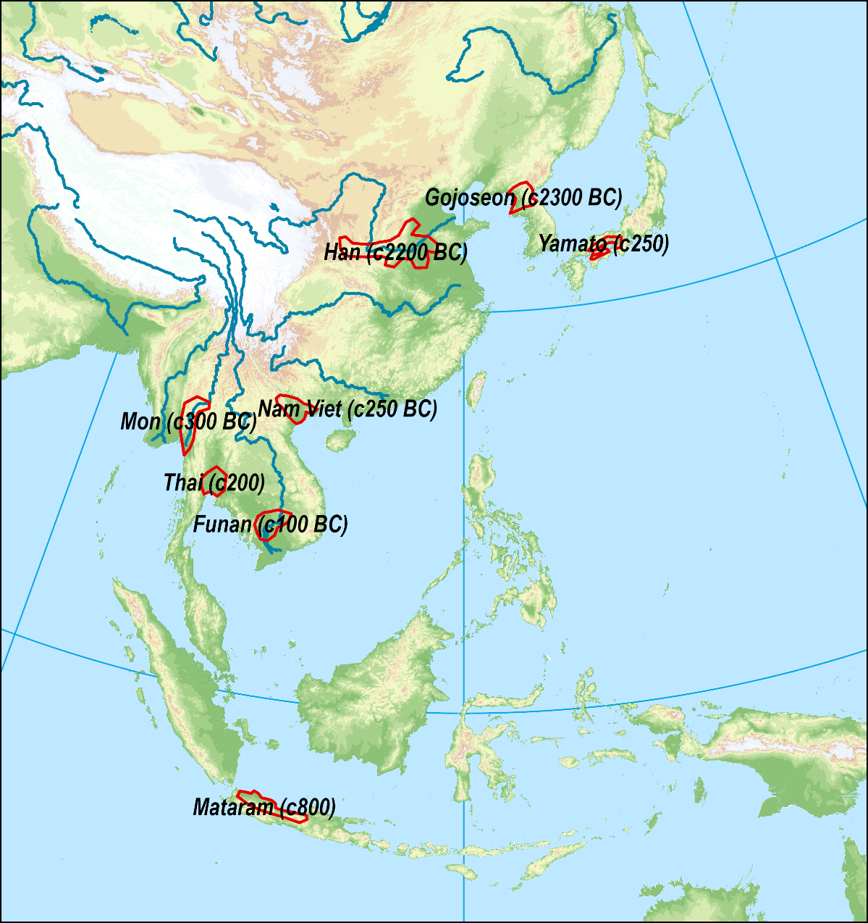
1. Origins of Pacific Asian Civilizations
Core areas
  Most Pacific-Asian civilizations have emerged along a fluvial plain or a coastal gradation.
  Domestication of rice and organization of irrigation work (hydraulic civilizations).
  Power a function of rice production.
  Red River (Vietnamese).
  Mekong River (Khmer).
  Yellow River (Han).
  Irrawaddy (Burmese).
  Chao Phraya (Thai).

Slide 6
2. East Asian Empires
Confucian states
  Stress on loyalty and obedience.
  Hierarchy/social stratification.
  Stability and good governance.
  Power/influence through merit.
State formation
  Strong and enduring states:
    Governmental institutions.
    Endogenous religions.
  Dominant regional powers (China and then Japan).

Slide 7
2. East Asian Empires
The Chinese Civilization
  One of the greatest empire ever established:
    Founded in 221 BCE when the first emperor unified China.
  Supported by the “Mandate of Heaven”:
    Called tianxia “all under Heaven”.
    Confucianism doctrine; Virtuous right to rule.
    The Heaven (Tian) can withdraw its mandate.
  Dynasties:
    Succession of the Chinese imperial government.
    The Han dynasty gave its name to the Chinese population.
  Government:
    First public servants (Mandarins) hired through an examination process.
  Industrial powerhouse:
    Accounted for a third of the world’s industrial output by 1800.

Slide 8
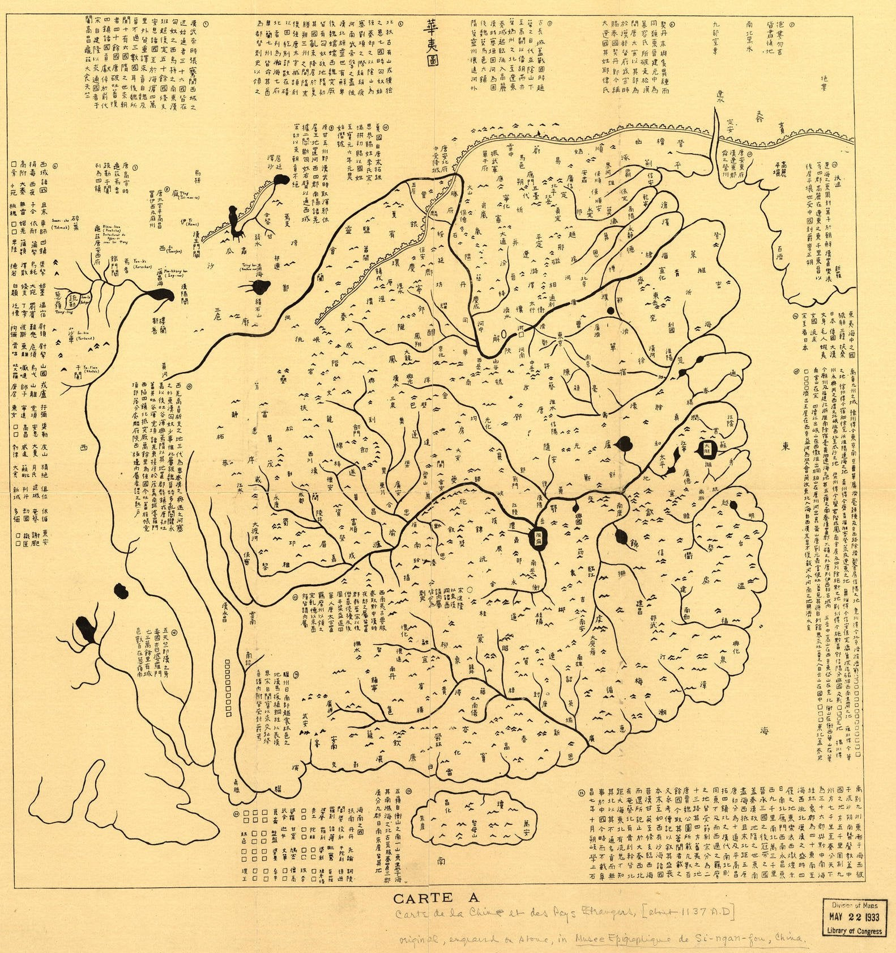
Imperial China, 1137 A.D
(Song Dynasty)

Slide 9
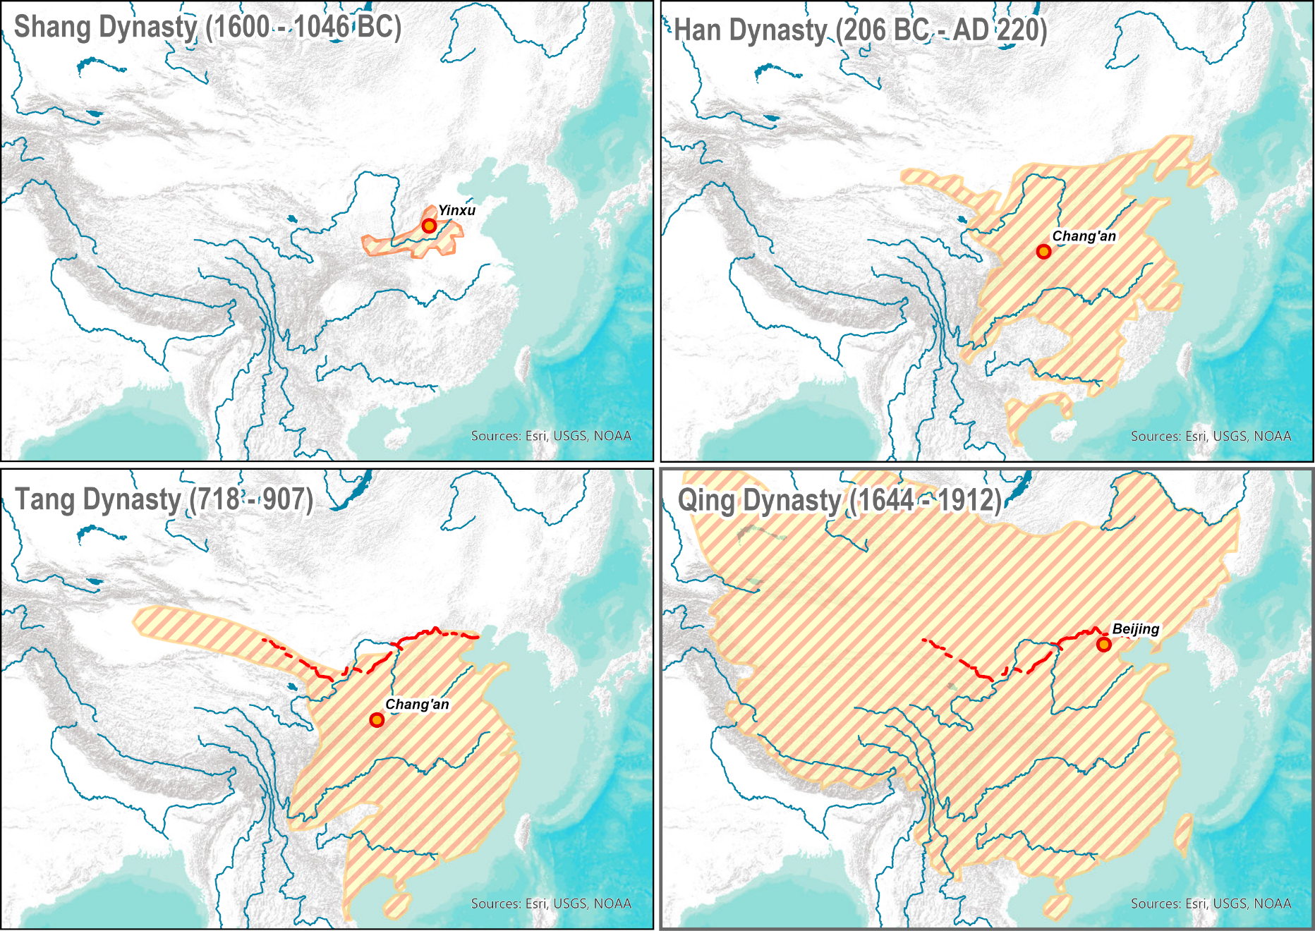
Major Chinese Dynasties
Shang Dynasty
  Earliest recorded dynasty in Chinese history.
  Foundation of writing system.
Han Dynasty
  First unification of China.
  Core foundation of Chinese culture (Confucianism).
Tang Dynasty
  Considered the golden age of Chinese civilization.
Qing Dynasty
  Foremost territorial expansion.

Slide 10
2. East Asian Empires
China and the outside world
  Tradition of self-reliance (vastness of the Empire).
  A world by itself, difficult to reach:
    Circled by seas, mountains and deserts.
  Sinocentrism resulting from a superiority complex.
  Outside states seen as vassals:
    Paid a tribute to China (Korea and Vietnam).
    China also paid tribute to barbarians at the northern frontier (Mongols).
  Foreign invasions (Mongols, 1271 and Manchu, 1644):
    Recurrent fear of invasion from northern nomads (e.g. the Great Wall).
    Reinforced xenophobia.
    Ming Dynasty (1368 - 1644) closed China to the outside.
    The Qing dynasty (1644 - 1911); strong restriction on trade.

Slide 11
2. East Asian Empires
The Mongolian Empire
  Warring state.
  Mongols were nomadic tribes living in Central Asia.
  United by Genghis Khan (1167?-1227) in 1206.
  Creation of a military force based on cavalry to invade neighbors:
    China invaded by 1241; 35 million peasants exterminated.
    Separated in several Khanates.
  Kublai Khan (1215-1294):
    Grandson of Genghis Khan.
    Established the largest empire in human history.
    Established a new dynasty (Yuan), in 1271.
    Permitted trade with Europe (Silk Road).
  Empire collapsed in 1368.
  Many Khanates remained (Golden Horde until 1480).

Slide 12
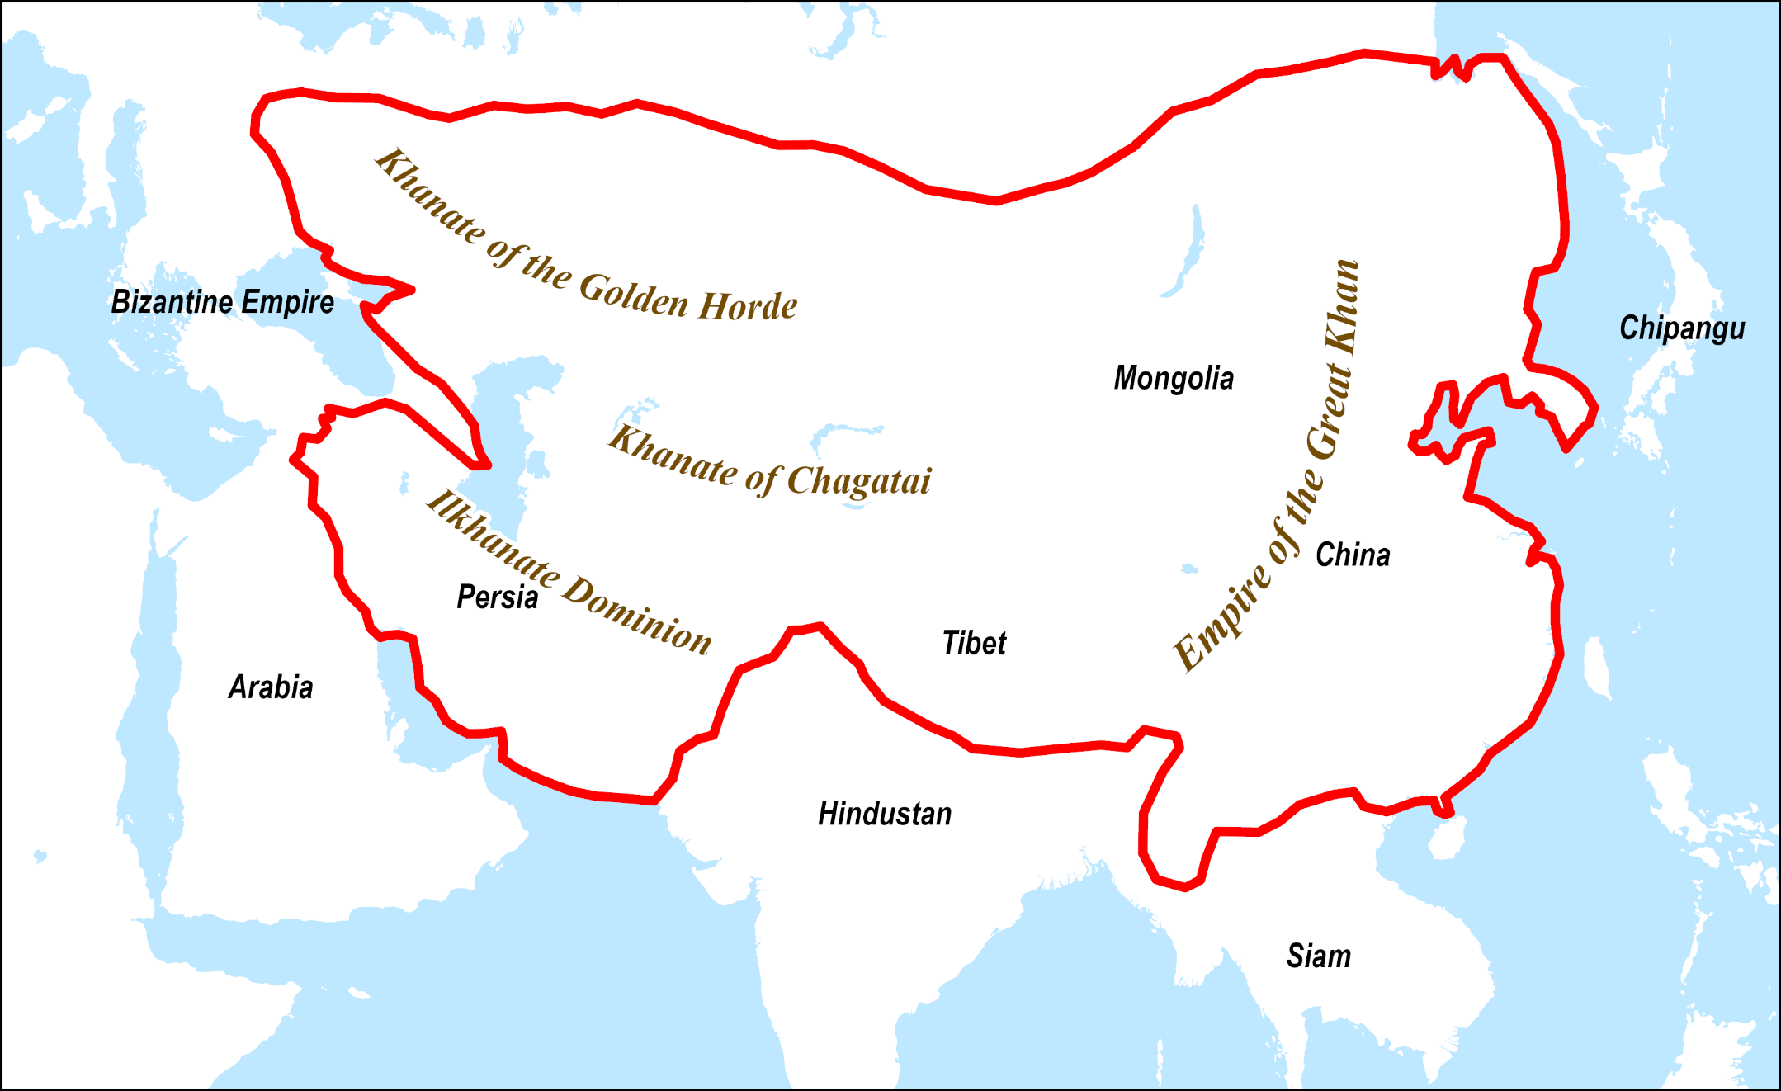
Mongolian Empire, circa 1300 AD

Slide 13
2. East Asian Empires
Imperial Japan
  For most of its history, Japan has been isolated from outside influence.
  Before the Europeans, China was the nation that influenced Japan the most.
  Feudal society where power was measured by rice production.
  The society was very strictly organized but constantly feuding:
    Emperor.
    Daimyos (landlords).
    Samurai (warriors).
    Merchants.
    Peasants.
What were the main characteristics of precolonial East Asian empires such as China and Japan?

Slide 14
3. Southeast Asian Empires
Buddhist states
  Power radiates from the center; diminishes with distance.
  Semi-autonomous provinces.
  Uncertain borders.
  Kings are semi-divine;
    Highly regarded; mystical powers; gain legitimacy through Buddhist faith.
  Bureaucracy is quasi-hereditary, family-based.
State formation
  Small and unstable states:
    Partially linked with the regional geography.
    Fragmentation of maritime Pacific Asia.
    Smaller river systems.
    Powerful neighbors (China and India).
    Looser definition than the European state.
  No dominant regional power.

Slide 15
B – The Age of Merchants
1. The Drive Towards Asia
  Why Europe traded with Asia for thousands of years and how Asia could be reached?
2. Early Expeditions
  How Europe was able to find maritime routes to Asia?
3. Colonialism
  What was the rationale for colonialism?
4. Trading Companies
  How Europe took control of most of Asian territories?

Slide 16
1. The Drive Towards Asia
Asian myth
  A significant share of what is Pacific Asia today was defined from the outside.
  For centuries, Europe traded rare commodities:
    Silk, spices and tea (later).
    Silk was found in Egypt, 1,000 BCE.
    Mainly came from Sina (Cathay; China), “the silk country”.
    First seen in Rome around 1 CE.
    Rome sent an ambassador to China around 100 CE.
  Spices were particularly important:
    Pepper, cloves, nutmeg, mace, cinnamon, ginger.
    Coming mainly from India, Sri Lanka and Southeast Asia.
    Some only available at the “Spice Islands”; Moluccas (today’s Maluku Province of Indonesia):
      The only source of economically significant spices including clove, nutmeg and mace.

Slide 17
1. The Drive Towards Asia
Silk and sericulture
  Silk is made from the cocoons of caterpillars (Bombyx moth).
  Sericulture is the culture of the silkworm:
    Predates recorded history, about 4,000 – 6,000 years ago.
    Feed with mulberry leaves.
    Cocoons plunged in hot water to kill the larva and to loosen the fiber.
  Was kept a secret by Chinese rulers for a long time.
  Han dynasty authorized direct trade with Europe (150 BCE).
  The secret of making silk diffused:
    Around 400 CE several regions were producing silk.
  Raw Silk is now extensively produced:
    China, India, Vietnam, Thailand, Brazil and Japan.
    China still accounts for 71% of the global silk production.

Slide 18
Global Silk Production (in tons), 2018
Notes:
Source: https://inserco.org/en/statistics

Slide 19
1. The Drive Towards Asia
Tea
  Stimulant with caffeine concentrations between 2.5 and 4.5%.
  In use in China at least since 10th century BCE:
    Called “cha” in Chinese.
  Became a commercial commodity by the 6th century:
    Tea comprised 70-90% of all China's exports.
  Introduced in Europe by the Dutch in the 17th century (1610):
    Dutch traders obtained Tea indirectly from Chinese merchants in Java.
    Merchants from Fujian province where Tea is pronounced “T’e”.
    Came into Britain by 1650; cost about $100 per pound.
    Became increasingly used by the aristocracy and later by the general public.
  In 1833 China stopped exporting tea to Europe.
  England introduced tea cultivation in India in 1836:
    A colonial commodity.

Slide 20
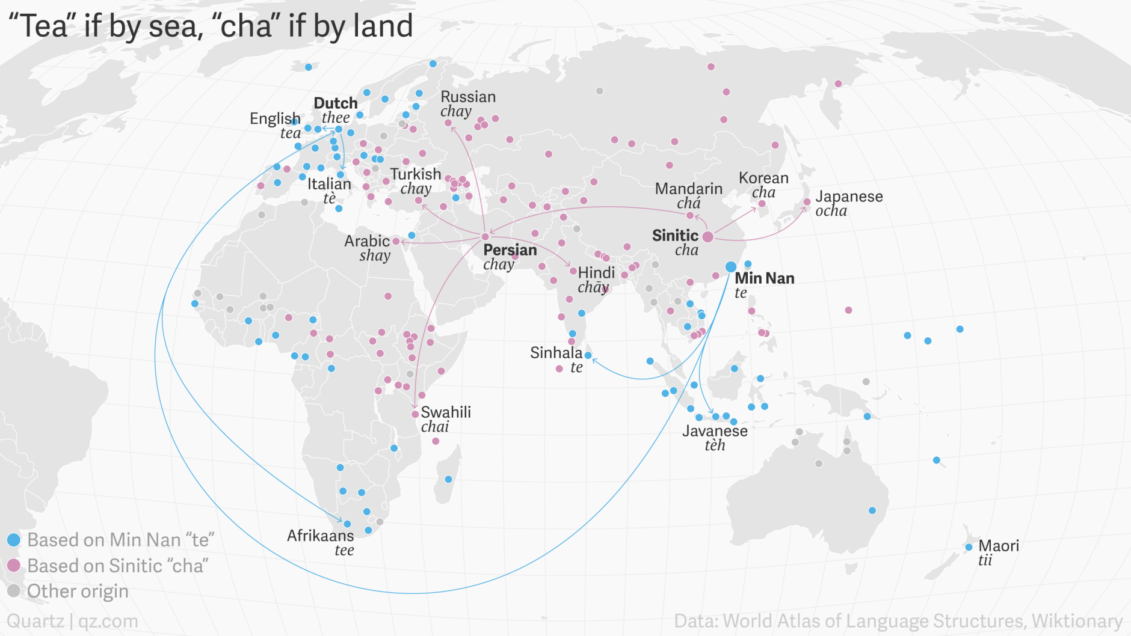
Geo-linguistic map of Tea

Slide 21
Major Tea Producers, 2018 (tons)
Notes:
Source: https://inserco.org/en/statistics

Slide 22
1. The Drive Towards Asia
Silk Road | Arab Sea Routes
Opened around 150 BCE. Succession of trails followed by caravans through Central Asia; 6,400 km-long road. | Opened around 8th century. Coastal shipping routes between the Middle East, South Asia, Southeast Asia and East Asia.
Favored by the presence of steppes. By-passing arid zones (Gobi Desert). | Followed Monsoon winds. Eastbound in the summer (June to September). Westbound in the winter (December to March).
Trade commodities: Silk, gold, jade, tea, spices. Manufactured goods, perfumes, glassware.
Flows of goods from one trading town to the other. Commodities added or removed based upon the local economy. Markup at each stage.
Diffusion of ideas and religions (mainly Buddhism and Islam). Islam as a religion of trade. Conversion of many local merchants; incorporation in the trade network. Foundation of Muslim trading communities through Asia.
Venetians controlled the bulk of the Mediterranean trade. Middle East (Constantinople, Antioch and Alexandria) to Europe. Were thus brokers for several centuries (1200 to 1500).
What was the silk road and what types of relations it enabled?

Slide 23
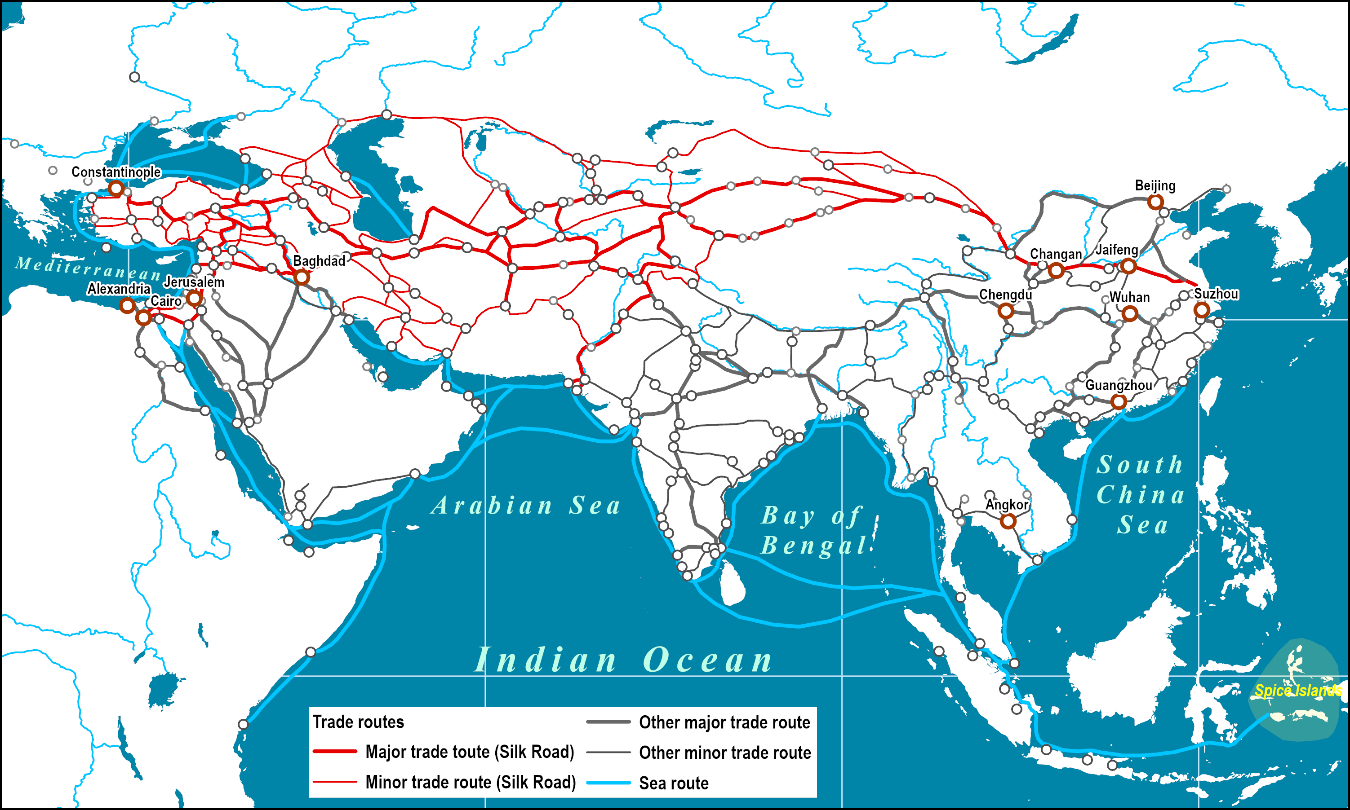
The Silk Road and Arab Sea Routes (8th to 14th Centuries)
Read this document

Slide 24
1. The Drive Towards Asia
European misrepresentations
  Europe had very limited knowledge about the Asian world.
  Arabs served as intermediaries:
    Did not share their trade routes.
    Not to reveal the location of the sources of their trade commodities.
    Often in conflict with European powers.
  Land distances were preventing profitable expeditions.
  Information was sketchy:
    More based upon religion and legends (e.g. Antique authors, Norse Saga) than on empirical evidence.
    The Garden of Eden was said to be located in Asia.
  Marco Polo (a Venetian) visited the region in 1295:
    First European to provide accurate accounts about Asia.
    Came into service of Kublai Khan.

Slide 25
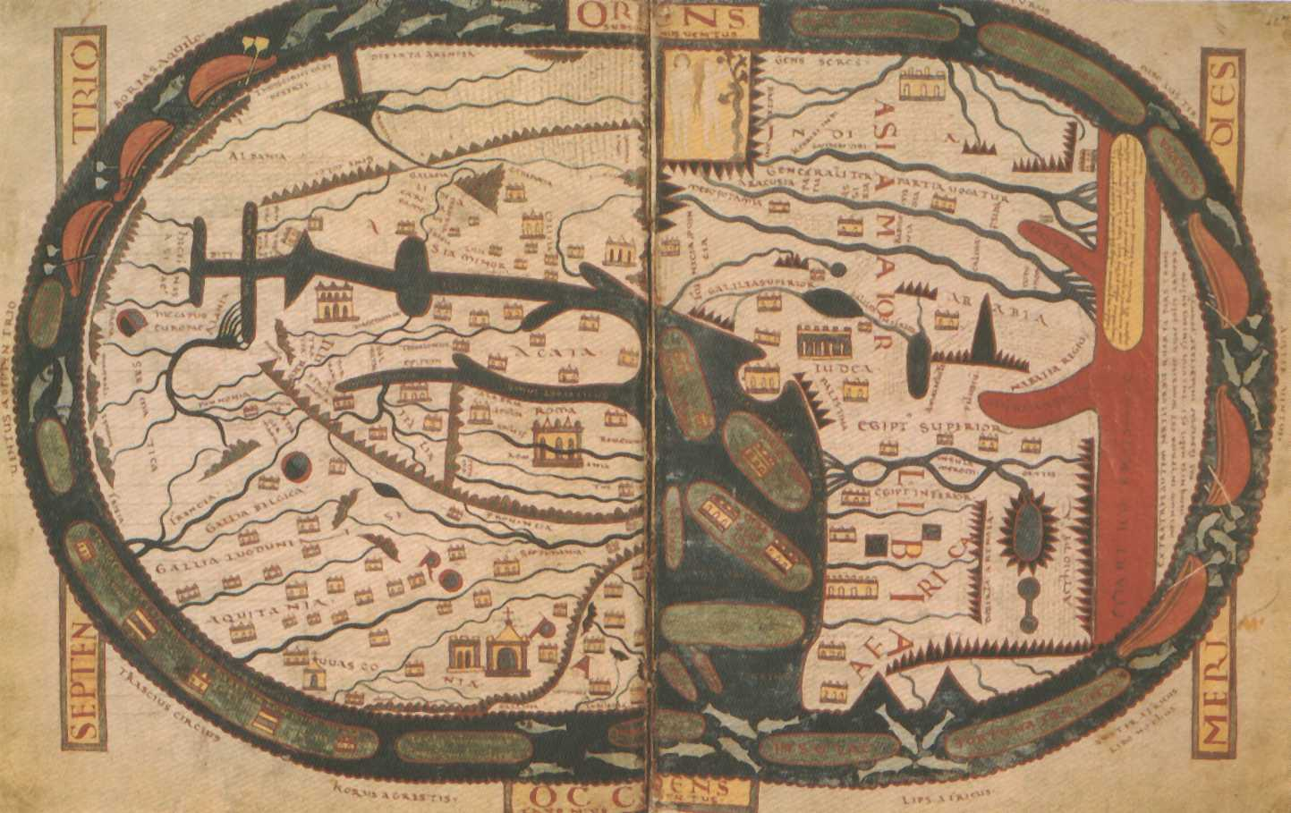
St. Sever World Map after Beatus, 1030 AD

Slide 26
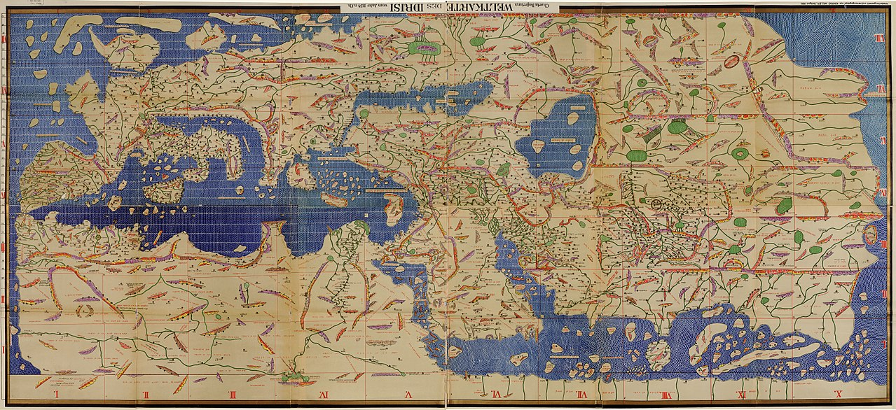
Tabula Rogeriana (Map of Roger); Muhammad al-Idrisi (1154)

Slide 27
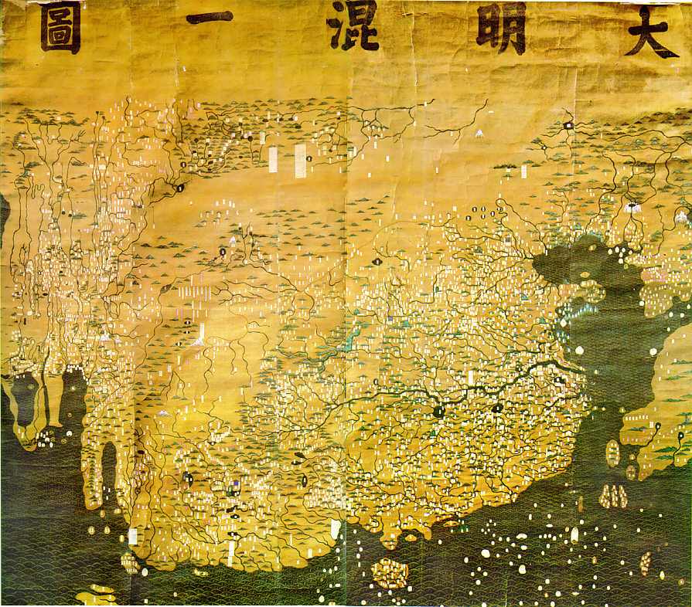
Da Ming Hunyi Tu (Map of the Ming Empire), circa 1389
Arabia
Africa

Slide 28
1. The Drive Towards Asia
The Fall of Constantinople (1453)
  Capital of the Byzantium Empire (Eastern Roman Empire).
  Turkish invasion:
    Expansion of the Ottoman Empire along the Mediterranean Ocean (Eastern Europe and North Africa).
    Closed the land route from Europe to Asia.
    About 200 years of conflicts with the Ottoman Empire (e.g Siege of Vienna, 1683).
  Europe was induced to find an alternate maritime route:
    Maritime exploration could not be done without sufficient knowledge about sailing.
    Discovery of trade winds pattern on the Atlantic Ocean and of monsoon wind patterns on the Indian Ocean.
    Portugal was the first European nation to master sufficiently.

Slide 29
2. Early Expeditions
Mercantilist drive
  The emergence of a merchant class in Europe.
  Wealth of a nation measured in the quantity of gold it holds.
  The only way to be enriched is to have a positive trade balance.
  Lack of gold and silver supplies in Europe.
  Achieved through the control and the monopoly of the trade of commodities.
  Trade is the reason explaining the presence of European powers in Pacific Asia from 1500.
  Early competition between Spain and Portugal:
    Conflicts between Iberians and Muslims.
    Most advanced maritime powers of the 16th century.
    Portugal discovered the eastern maritime route to Asia.
    Spain tried (Columbus) to find the western one.

Slide 30
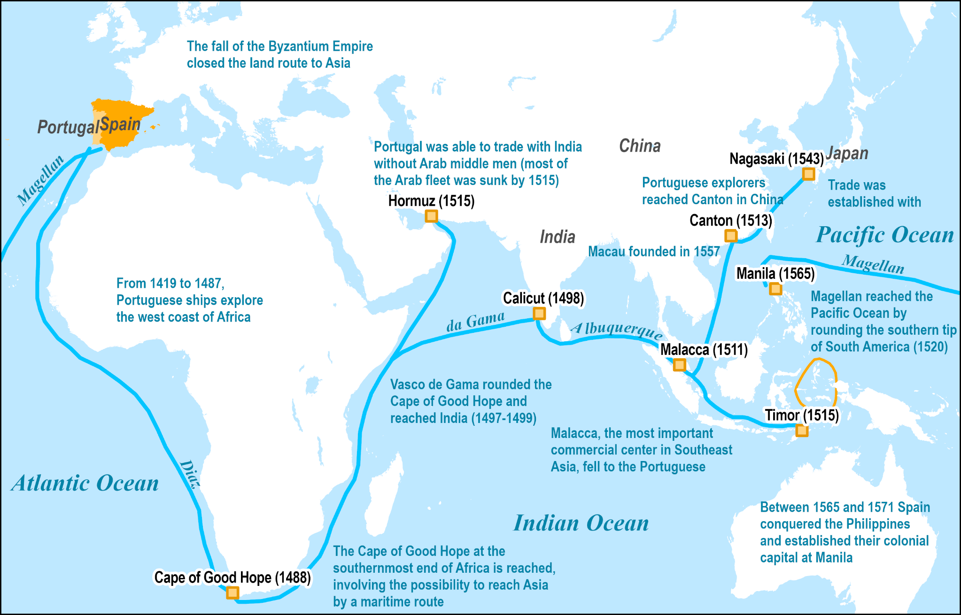
The Eastern and Western Maritime Routes to Asia

Slide 31
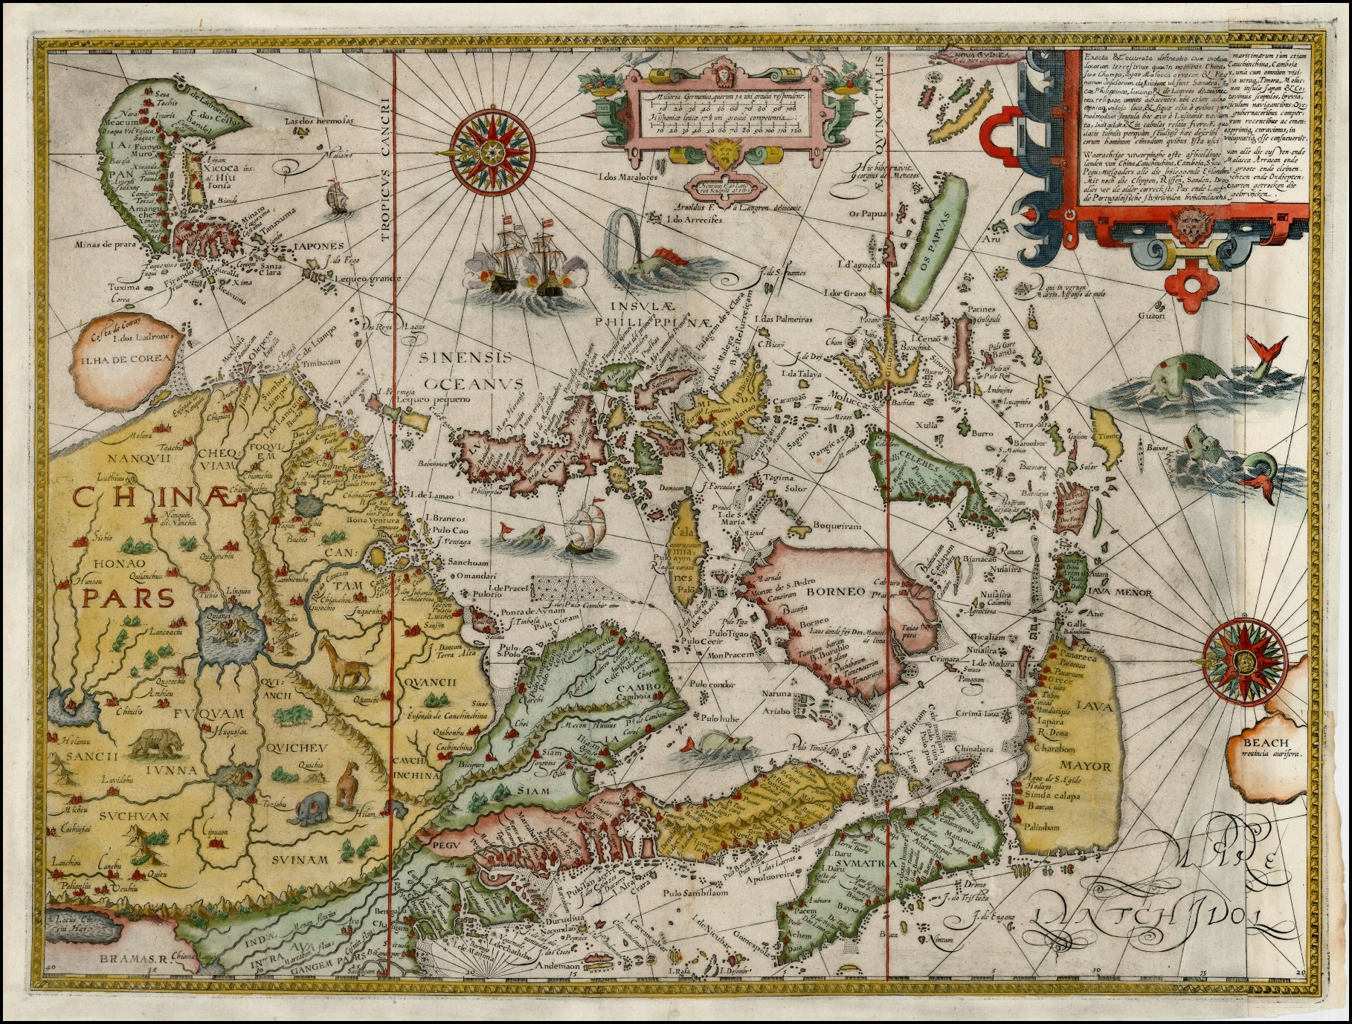
Map of Southeast Asia by Jan Huygen Van Linschoten (1596)

Slide 32
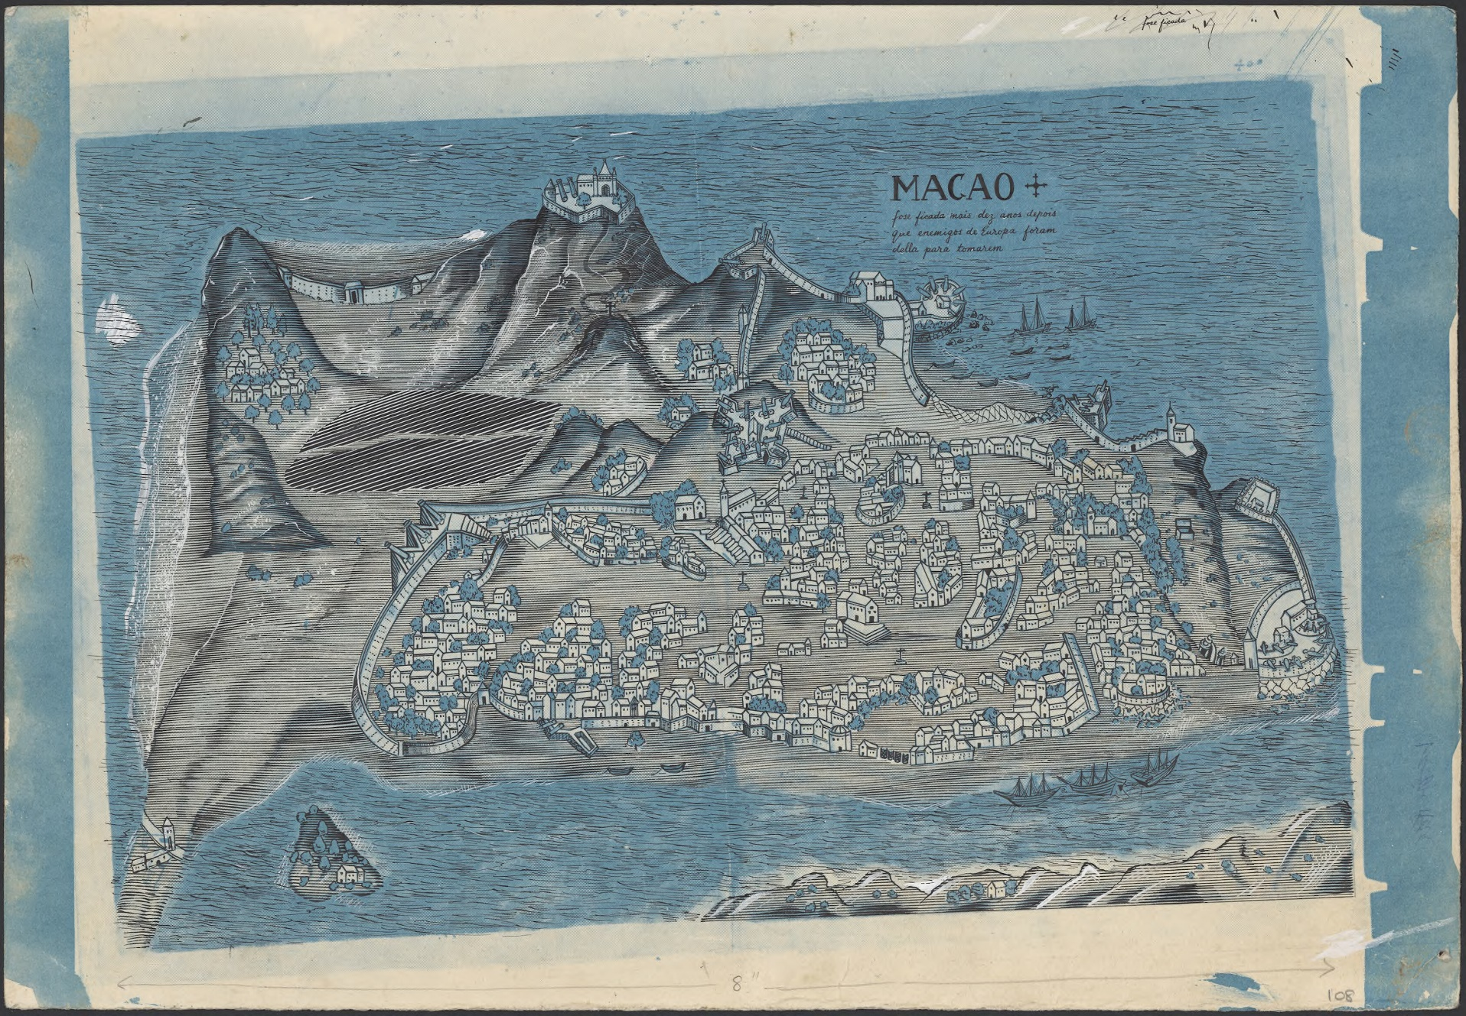
Macau, Mid 17th Century
Notes:
Source: MAP Braga Collection Col./108

Slide 33
3. Colonialism in Pacific Asia
Why colonialism in Pacific Asia?
  As in the Americas and in Africa, Pacific Asia has been shaped by foreign influences.
  Economic incentives:
    Search for raw materials (‘colonial’ commodities; tea, coffee, sugar, cocoa, minerals).
    Expansion of national market into monopolistic areas (large populations).
    New territories for capital investments in infrastructure (ports, railways, roads).
    Territories for European migration (demographic transition; limited importance).
  Political and strategic factors:
    National prestige and manifest destiny (proof of success and power).
    Control of strategic locations for trade benefits (Suez, Malacca, Gibraltar, Malta, Hong Kong).
  Cultural:
    The drive for discovery (territories, biology).
    Spread of religion and culture.
  Technological factors
    Scientific advantages.
    Military superiority.

Slide 34
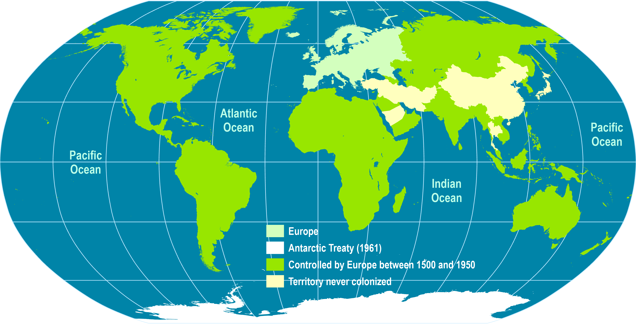
European Control of the World, 1500-1950
1800 (37%)
1878 (67%)
1913 (84%)
40% of the world’s international boundaries traced by the UK and France.

Slide 35
3. Colonialism in Pacific Asia
European strategies in Pacific Asia
  Negotiation:
    Facing powers such as China and Japan:
    China: Negotiated trade depots such as Macao and Canton.
    Japan: Negotiations were very difficult but small counters such as Yokohama and Nagasaki were opened.
  Control and usurpation:
    Replaced Arab merchants as middlemen.
    Took control of the maritime trade due to better ships.
    Building their own colonial ports (Penang, Batavia, Singapore).
    Taking strongholds (Malacca).
    Local collection was left to existing traders that were simply incorporated in the European trading network.
  Conquests were mainly done by charter companies.

Slide 36
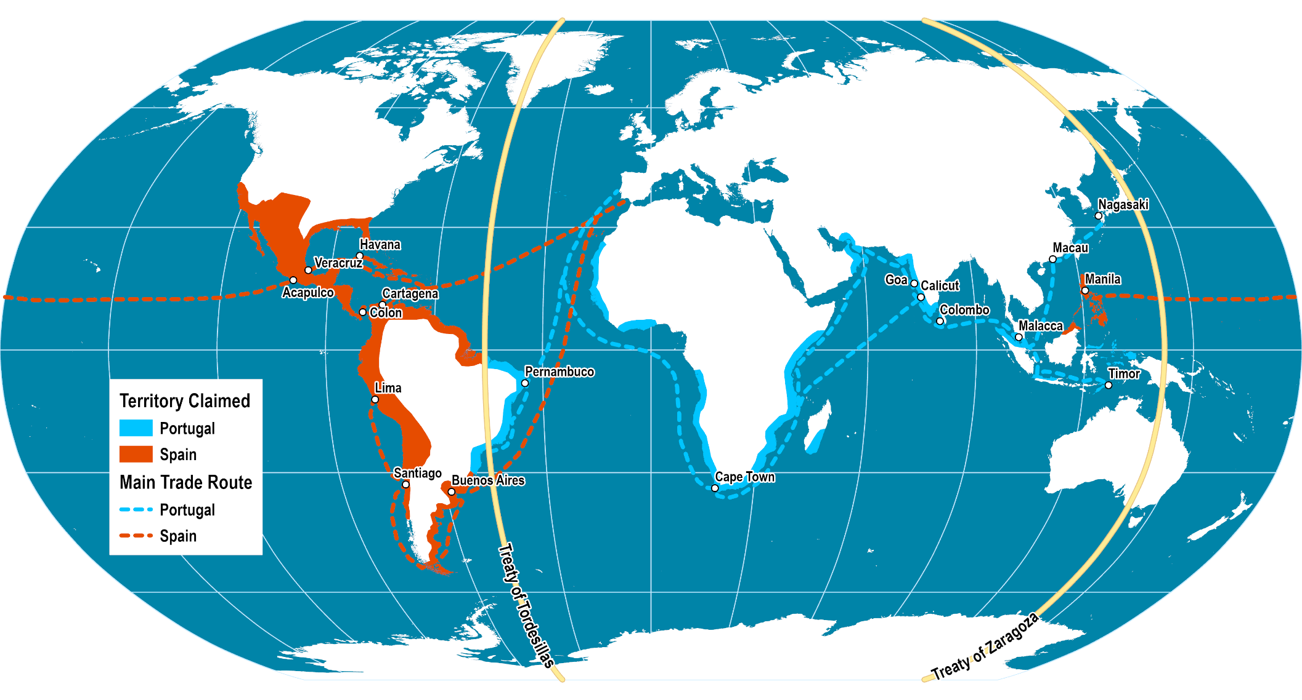
Spanish and Portuguese Empires (1581-1640)
The Treaty of Tordesillas (1494)
Between Spain and Portugal (1,770 km west of Cape Verde).
Separate the newly discovered lands (and those to be discovered) by a demarcation.
Treaty of Zaragoza (1529)
Specified the anti-meridian to the line of demarcation in the Treaty of Tordesillas.
To sort the ownership of the “spice islands”.
Read this document
Notes:
Source: adapted from Historical Atlas by William R. Shepherd, 1911. The Age of Discovery, 1340-1600. University of Texas at Austin.

Slide 37
4. Trading Companies
Private mercantilist tool
  From the 17th to the 18th century trading companies acted on behalf of European governments in East Asia.
  Joint stock companies.
  Guarantied trade monopoly:
    Rights paid to their respective governments.
  Almost states in themselves:
    Had their own ships (military and merchant) and military forces.
    Could acquire and manage a foreign territory.
  Developed trade links for commodities such as pepper.
  Increasingly involved in the control and development of their respective territories.
  Faced lack of interest from European governments.

Slide 38
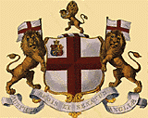
4. Trading Companies
English East Asian Company
  In 1592, a Portuguese ship was captured by England:
    Its cargo contained stores of goods from Asia.
    Triggered the need to establish a lucrative Asia trade.
  EEAC founded in 1599 by British merchants:
    Granted a monopoly to trade with Africa, India and America.
  Trade structure:
    Fill ships with European goods, sail to Asian trade depots.
    Sell the goods in exchange of colonial commodities.
    Sail back to Europe and sell the goods, cash in and pay dividends to the shareholders.
    Dividends were over 10% per year (Sometimes up to 65%).
    25% of the profits coming from the China trade.

Slide 39
4. Trading Companies
  Intense competition with the Dutch East Indian Company:
    Forced withdrawal from Southeast Asian Trade in 1620.
    The company focused on India (Madras, Bombay and Calcutta).
  Constant warfare with French, Dutch and other competitors.
  China trade:
    From the middle of the 18th century, the company became more involved in trade with China.
    European markets needed porcelain, silk and tea.
    The company traded silver in exchange.
    Opium, grown in India, became a substitute for silver, increasing profits.
    Lead to conflicts with China (Opium War of 1844).
  Collapse of the EEAC:
    Facing intense discontent from other British interests, the company gradually lost its monopolies from 1813.
    Dissolved in 1874.
    Holdings transferred to the British Crown which appointed Governors.

Slide 40
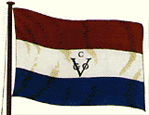
4. Trading Companies
Dutch East India Company
  The first Dutch expedition to Indonesia took place in 1595.
  Founded in 1602 by Dutch merchants.
  The world’s first multinational corporation.
  Conquest:
    Gained a foothold in Batavia (Indonesia; 1610).
    Conquest of most of the island of Ceylon (Sri Lanka; 1640).
    Took Malacca from the Portuguese (1641).
    Sunk all vessels they found in Indonesian waters, removing competition.
  Impacts:
    Replaced local trading networks with their own.
    Established fortified trading posts.
    Founded Cape Town (South Africa; 1650) as a stage for the long Europe-Asia voyage.
    Took advantage of feuding Indonesian dynasties by arming allies and gaining territorial rights.

Slide 41
4. Trading Companies
  Plantations:
    Forced the introduction of new cultures such as coffee in West Java (1711).
    Monopoly on nutmeg (meat preserver) and cinnamon.
    Destroying spice production on uncontrolled islands.
  One of the first true multinational corporations:
    By 1750, employed around 25,000 people.
    Business in 10 Asian countries.
    Built 1,500 ships.
    Made 5,000 voyages to Asia.
  Bankruptcy in 1799:
    Corruption and mismanagement.
    Holdings transferred to the Dutch Crown which appointed Governors.
Explain what trading companies were and how they influenced the development of Pacific Asia.

Slide 42
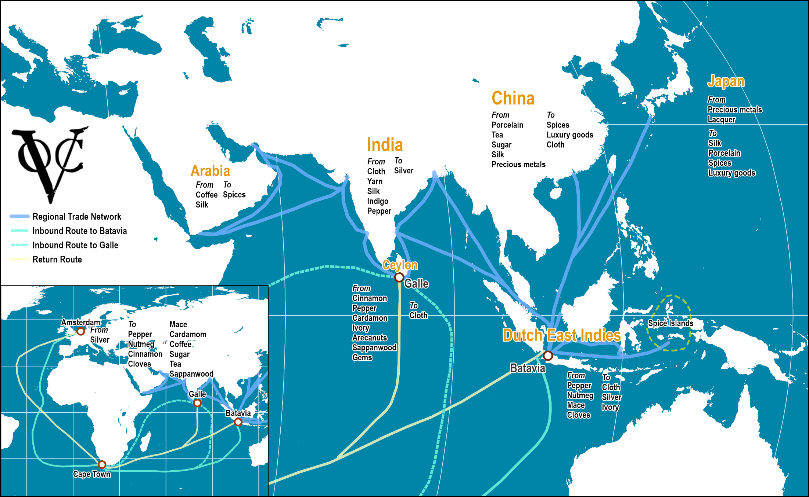
Dutch East India Company, Trade Network, 17th Century
Read this document
Notes:
Source: adapted from: http://cf.hum.uva.nl/galle/galle/voc_shipping.html

Slide 43
Imports from the Dutch East India Company at Amsterdam, 17th and 18th Centuries
Notes:
Source: W. J. Bernstein (2008) A Spendid Exchange: How Trade Shaped the World, New York: Atlantic Monthly Press, p. 244.

Slide 44
4. Trading Companies
Legacies
  Dissolution of numerous Asian kingdoms and empires.
  Left a network of colonial free-trading ports (e.g. Penang, Singapore, Hong Kong).
  Created colonial empires.
  Integrated the region in a global unequal trade pattern.
  Created a demand in Europe for Asian commodities.

Slide 45
C – European Colonial Empires
1. Changes in the Patterns of Territorial Control
  What accelerated colonialism in the 19th century?
2. Colonial Empires in Pacific Asia
  Which colonial empires controlled the resources of Pacific Asia?
3. Chinese Treaty Ports
  How European colonialism impacted with China?

Slide 46
1. Changes in the Patterns of Territorial Control
New colonial powers
  Number of colonial powers:
    Increased from two in the 16th century to five in the 17th century.
    Portugal, Spain, Britain, Netherlands and France.
  Portugal and Spain:
    Held control of Pacific Asia until the 18th century.
    Not enough manpower (military) to maintain their empires.
    Portugal kept Macao (China) and East Timor (Indonesia).
    Spain kept the Philippines.
Reasons for expansion
  Exploit mineral resources and export-oriented agriculture.
  Deny other European powers access to colonies.
  National pride.
  “Manifest destiny”.

Slide 47
1. Changes in the Patterns of Territorial Control
Formal territorial control
  Annexation of most of Pacific Asia in colonial empires:
    Scramble to capture remaining territories.
    Thailand remained independent as a buffer state between French and British colonies.
  Britain:
    Occupied the Malaysian Peninsula and Hong Kong.
    Malacca (1796).
    Singapore (1819).
  The Dutch occupied Indonesia.
  The French occupied Indochina:
    The Seven Year War (1756-1763) between France and Britain ended up French control in North America and India.

Slide 48
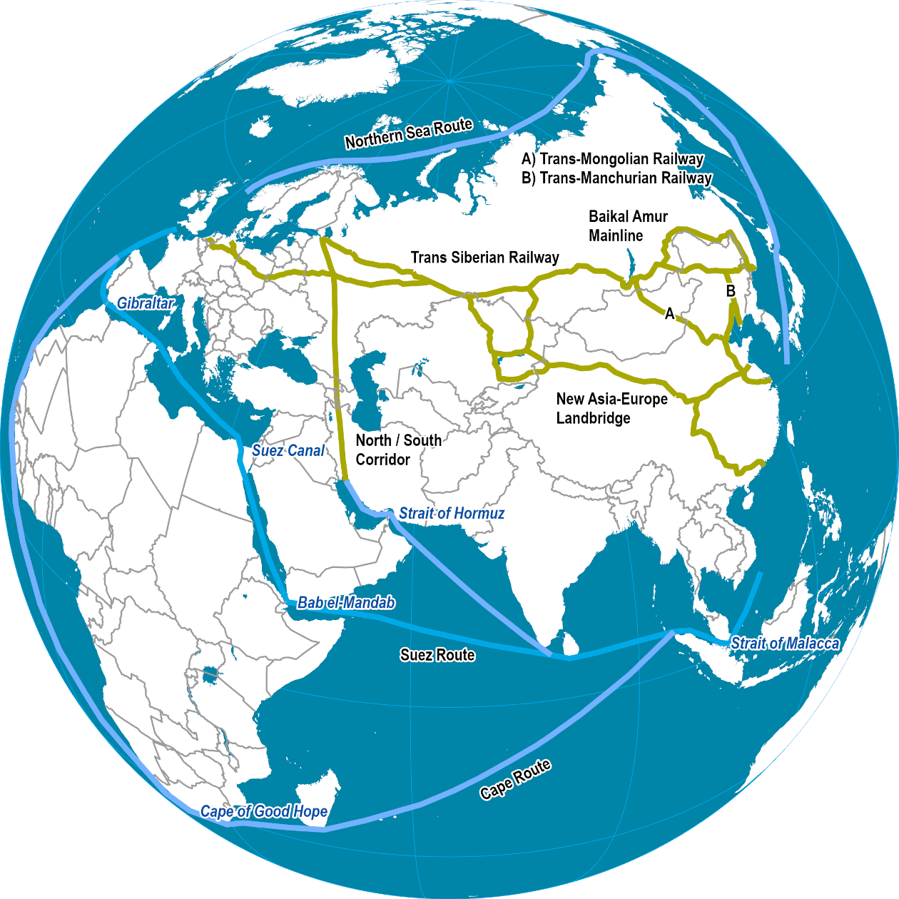
1. Changes in the Patterns of Territorial Control
Suez Canal
  Planned by the French but realized by the British.
  Opened in 1869.
  Brought a new era of European influence in Pacific Asia.
  Cape Route: 10,000 km
  The journey from Asia to Europe was considerably reduced (saved 6,500 km around Africa).
  Increased interactions between Europe and Pacific Asia.
  The region became commercially accessible.

Slide 49
1. Changes in the Patterns of Territorial Control
Industrial revolution in Europe
  Beginning of mass production of consumer goods.
  Sought cheap raw material and foreign markets.
  Cheaper food sources.
  Each colony was consequently the hinterland of its metropolis.
  Extensive organization of the exploitation of resources (e.g. plantations).

Slide 50
2. Colonial Empires in Pacific Asia
Geographical divisions
  The political geography of the region was transformed by European colonial powers.
  Did not took account of existing ethnic and cultural factors.
Different colonial rules
  Britain: Indirect rule with Chinese and Indian middlemen.
  France and Holland: Direct and centralized domination.
Creation of plantations
  Specialization in the production of export commodities such as coffee, rubber, rice, palm oil, tea.
  Monopolistic control (price-fixing).
  The rest was imported (food).
  The benefits were at the hands of import/export firms.

Slide 51
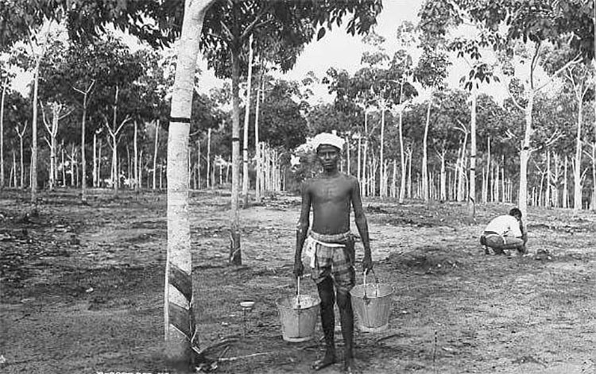
Indian Worker, Rubber Plantation, Malaysia, late 19th Century

Slide 52
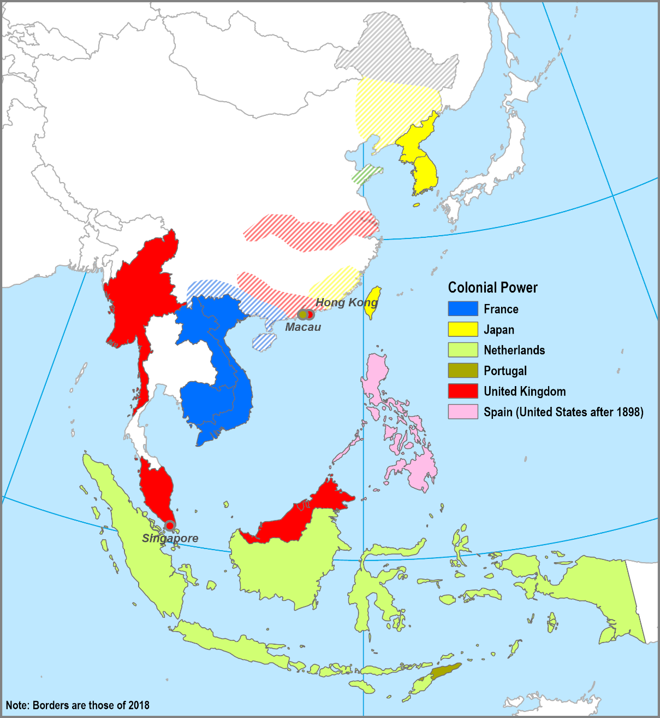
Colonial Territories in Pacific Asia by 1900
Pacific Asia was divided into colonies. What were the consequences of colonialism for the region?

Slide 53
3. Treaty Ports
Definition
  Ports that Asian countries opened to foreign trade and residence in the mid-19th century:
    Especially China and Japan,
  Pressure from colonial powers:
    Britain, France, Germany, the United States and Japan.
  Initial ports were opened to British traders in 1842:
    Following China’s defeat in the Opium War.
    Hong Kong, Shanghai, Fuzhou and Ningbo.
  Development of the principle of extraterritoriality:
    Nationals of treaty nations were subject to the laws of their home nation rather than the laws of China.
  There were about 39 Treaty Ports in China.

Slide 54
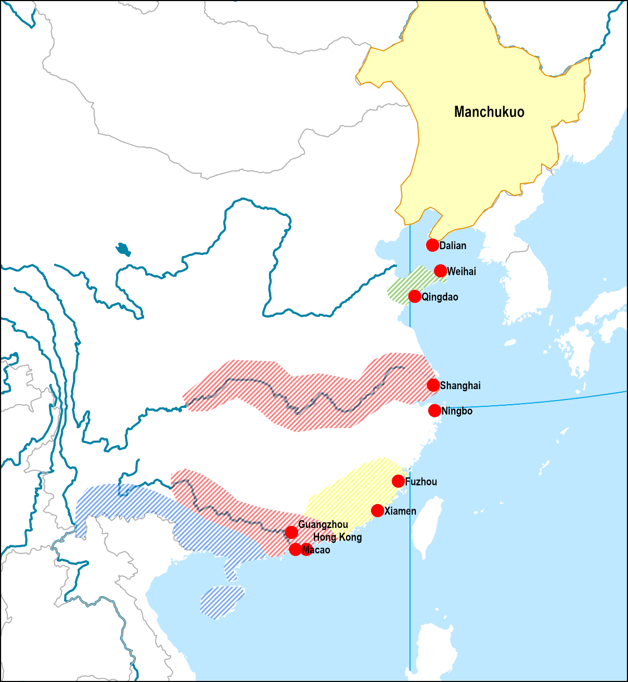
3. Treaty Ports of China
Mongolia
(Russia)
Port Arthur (Dalian) 1898-1905 (Russia) 1905-1945 (Japan)
Weihai 1898-1931 (UK)
Tsingtao (Qingdao) 1898-1914 (Germany)
Shanghai 1843-1949 (Multinational)
Ningbo 1844-1949 (Multinational)
Fuzhou 1842-1949 (Multinational)
Xiamen 1851-1949 (Multinational)
Taiwan,1895-1945 (Japan)
Guangzhou 1859-1949 (Multinational)
Hong Kong 1842-1997 (UK: Formal colony)
Macao 1557-1999 (Portugal: Formal colony)
Korea
(Japan)
German
British
Taiwan (Japan)
French
Indochina
(France)

Slide 55
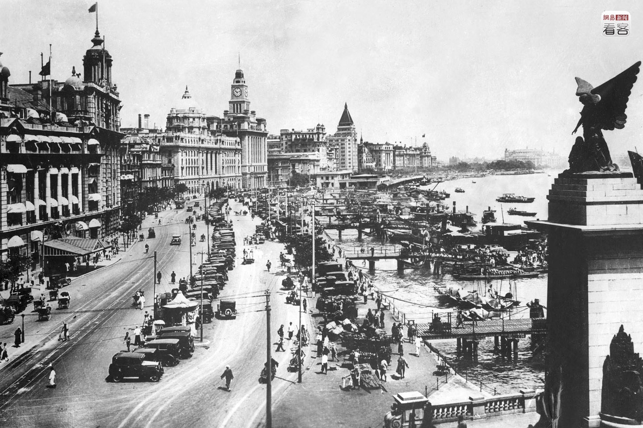
Shanghai, 1930s
Notes:
Relying on its unique political system and advantageous geography, Shanghai, after being opened up as a port, gradually became the most prosperous center of trade in the Far East, regarded as a “paradise for adventurers”, with the people who came all expressing an attitude of “doing business big, or not doing it at all”. Photo is of Shanghai’s riverbank pedestrian street around the 1930s in the 20th century. AFP

Slide 56
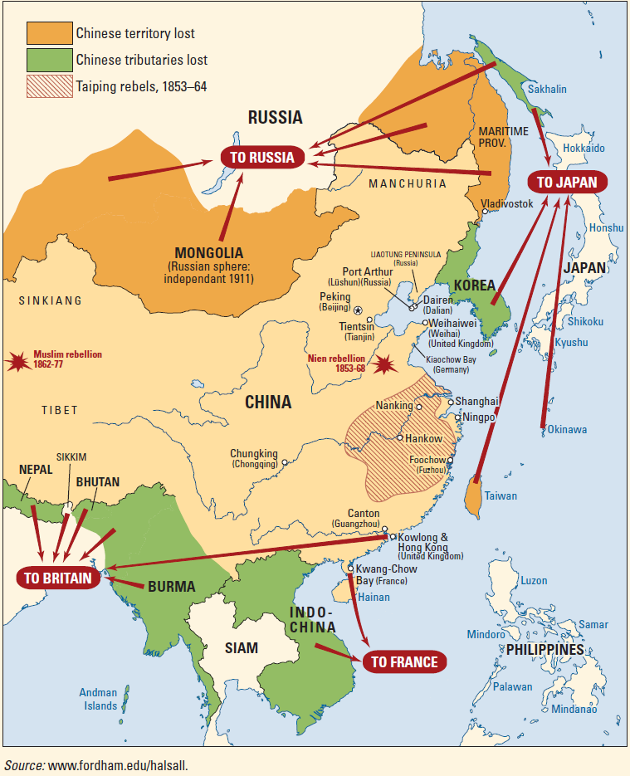
The Taiping Rebellion
Taiping Civil War
  One of the largest civil wars in human history (10 to 30 million deaths).
  Lasted 15 years (1850-64).
  Chinese nationalists against the Qing dynasty.
  Contributed to the decline of China’s economic and military power.
  Inspired further nationalistic ideals.

Slide 57
D – The Collapse of Colonial Empires
1. Japanese Colonialism
  How Japan became a colonial and imperialistic power in Pacific Asia?
2. The Second World War
  What were the consequences of WWII on Pacific Asia?
3. The Colonial Legacy
  How many Pacific Asian countries became independent and what was the impacts of colonialism in the region?

Slide 58
1. Japanese Colonialism
The Britain of the Pacific
  Japan began to industrialize late in the 19th century.
  Needed foreign resources and markets.
  The closest neighbor was Korea (annexed in 1898).
  Taiwan was ceded by China in 1895 (Treaty of Shimonoseki).
  Conflict with Russian interests in the Liaodong Peninsula and in Port Arthur (Dalian).
The victory of Japan against Russia (1905)
  First time a non-European power defeated a European power.
  Took the Liaodong Peninsula, Port Arthur and half the Sakhalin peninsula (Treaty of Portsmouth).
  Confirmed Japanese influence over Korea and halted Russian expansion in the region.

Slide 59
1. Japanese Colonialism
Korea and Taiwan
  Japan invested massively.
  Food production for the Japanese homeland.
  Raw materials and basic transformation industries.
  Markets for Japanese products.
  Major Taiwanese and Korean corporations were initially dealing with Japan.
Regional domination by Japan
  Formation of the League of Asian People (1926).
  “Asia to Asians” became the dominant slogan of Japanese imperialism.
  Setting of the Manchukuo puppet state in China in 1932.
  Japan was at war with China since 1931 (invasion of Manchuria).

Slide 60
2. The Second World War
The geography of WWII in the Pacific
  Japanese plan:
    Neutralizing the Allied Pacific fleets.
    Capturing strongholds (Hong Kong, Singapore, Philippines).
    Access to Southeast Asian resources (Malaysia & Dutch East Indies).
    Dig in and negotiate peace.
  Military constraints:
    No significant landmasses and flat terrain (limited armor forces).
    Supplies moved by ships (fragile supply lines; submarine warfare).
    Importance of combined fleets (battleships and aircraft carriers).
    Amphibious assaults over fortified positions.
    Islands as staging areas, airbases and redoubts.

Slide 61
2. The Second World War
Japanese occupation (1942-1945)
  Major change of the colonial setting of the Pacific Asian region:
    Colonies were cut off from colonial control.
    Under Japanese administration which did its best to destroy the colonial structures.
  Collaboration from local leaders and groups:
    Promise of independence under Japanese tutelage.
  The Tokyo Conference (1943):
    Established the baselines for the future independence of the Philippines, Burma, Indonesia, Malaysia and Singapore.
    Goal: Elimination of occidental influence in Pacific Asia.
    Japan was not willing to support these promises because the war effort demanded a lot of resources.
    Joining the “Asian Co-prosperity Sphere” under the dominion of Japan.
Explain how Japanese imperial ambitions led to the Second World War in the Pacific.

Slide 62
2. The Second World War
Phases of WWII in the Pacific
  First phase (December 1941 until June 1942):
    Japanese initiative and rapid expansion.
    Pearl Harbor, Wake and Guam Islands.
    Invasion of all major European strongholds (Philippines, Dutch East Indies, Singapore and Burma).
    Halted with the battles of Coral Sea (May 1942) and Midway (June 1942).
  Second phase (June 1942 until mid-1943):
    Stalemate with both sides unable to take the offensive.
    Guadalcanal (1942-1943).
  Third phase (Mid-1943 to 1945):
    Sustained allied offensive.
    Two drives hopping islands and converging towards the Philippines (Spruance and MacArthur).
    Decisive naval victories (Philippines Sea, June 1944; Leyte Gulf, October 1944).
    Conquest of Iwo Jima (February-March 1945) and Okinawa (April-June 1945); airbases from bombers.
    Nuclear bombing of two Japanese cities (Hiroshima and Nagasaki)

Slide 63
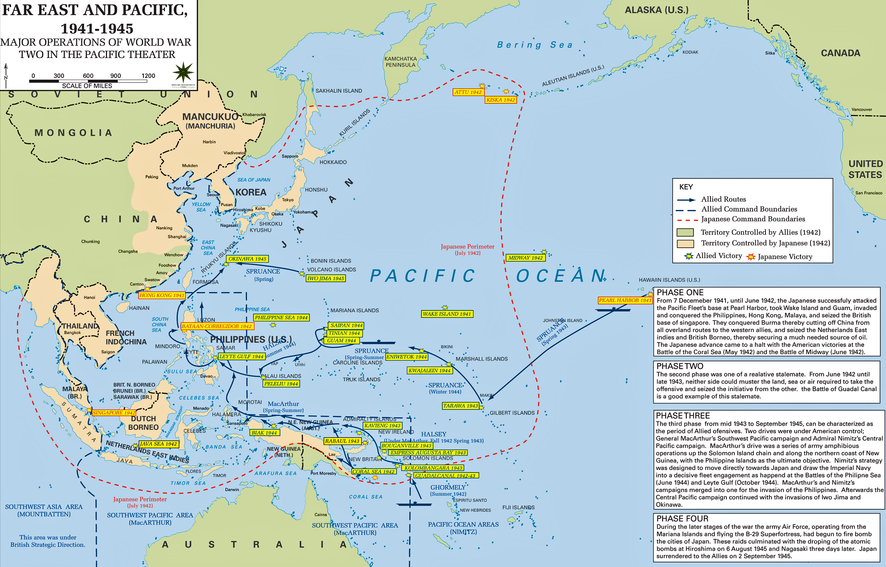
Notes:
http://www.emersonkent.com/map_archive/wwii_major_operations_asia.htm

Slide 64
3. The Colonial Legacy
European reoccupation and its failure
  European powers tried to reclaim their colonies after WWII.
  Indonesia and Vietnam became entangled in liberation wars:
    France was very resistant to losing Indochina.
    Question of national prestige lost during WWII (German occupation).
    Lost almost 100,000 soldiers between 1945 and 1954.
  Brunei, Hong Kong and Macao retained their colonial statuses.
  Reoccupation attempts failed:
    Colonies quickly became independent by the mid-1950s and early 1960s.

Slide 65
3. The Colonial Legacy
Decolonization
  Emerging Asian nationalisms and patriotisms.
  Influence of Marxism-Leninism in explaining past oppression.
  Nationalism was the driving force:
    Upheld by leaders such as Sun Yat-Sen (China), Mao Zedong (China), Ho Chi-Minh (Vietnam) and Sukarno (Indonesia).
  Created a wide variety of governments and ideologies.
  The United States encouraged de-colonization movements:
    As long as the involved countries remained in its sphere of influence.
    The Philippines; promise of independence granted in 1946.
    South Korea; partition after Korean War (1950-53).
    South Vietnam; partition.

Slide 66
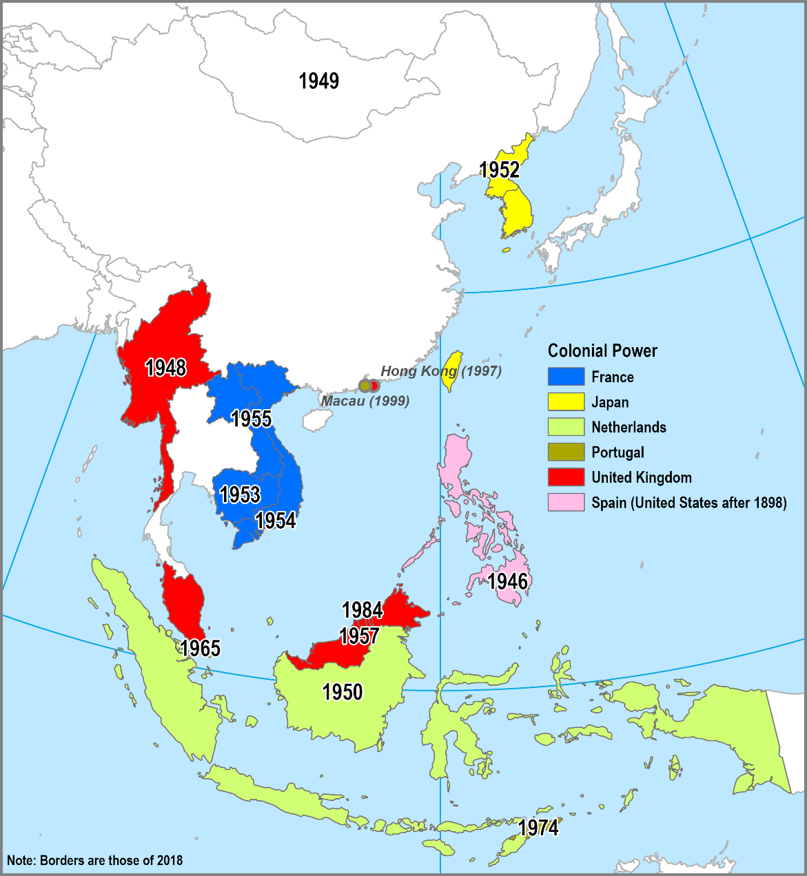
3. The Colonial Legacy
Political divisions
  Limited relevance with pre-colonial societies.
  “Balkanization”.
  The Malay world:
    Divided between Malaysia, Indonesia and the Philippines.
  Burma:
    Composed of different tribes, formed a single entity.
  New divisions based on political ideology (Korea, Vietnam and China).
Change in ethnic composition
  Migrations during the colonial era changed the ethnicity of several countries.
  Contract labor from India to Malaysia.
  Chinese immigration to Malaysia, Singapore, Burma and Indonesia.

Slide 67
3. The Colonial Legacy
Early Cold War
  Pacific Asia saw violent cold war clashes.
  Communism/capitalism ideological driven confrontations:
    Created artificial entities.
    Taiwan, North and South Korea, North and South Vietnam.
  Inhibited regional integration for 3 decades (1950s to 1970s).
  Korean War (1950-53):
    Korea became the first battlefield between communism and capitalism.
    Killed 1 million people, destroyed and divided Korea (North and South Korea).
  Taiwan:
    Became the refuge of the Kuomintang after the end of the Chinese Civil War (1949).

Slide 68
3. The Colonial Legacy
Territorial and economic changes
  Export structure:
    Imbalances between developed (global trade) and remote areas (subsistence).
    The structure of the territory was changed by mines and plantations.
    Transportation networks geared towards export (port / hinterland).
  Specialization in a limited amount of export goods:
    Subject to price fluctuations.
    Economies did not change much in the first years of their independence.
    Strategies aiming at import substitution.
  By 1970, the economic situation started to change.
  Japan was the first to recover.

Slide 69
Historical Evolution in Pacific Asia
Pre-colonial | Before the 16th Century | Several empires and societies. China as the dominant culture. Several regional cultures (Japan, Korean, Thai, Burmese, Khmer, etc.). Indian and Islam influences (state and social structures).
Mercantile Colonialism | 1500 -1800 | Limited colonial presence in existing ports (depots). Trade usually in natural products of local region.
Transitional Phase | 1800 - 1850 | Reduced European interests. Greater profits to be made in industrial revolution.
Industrial Colonialism | 1850 - 1920 | European need for cheap raw materials and food. Colonialism and new settlements.
Late Colonialism | 1920 - 1950 | European direct control over the major part of Pacific Asia. Dependency.
Early Independence | 1950 - 1970 | Emergence of national economies. Foreign aid. Rapid population growth.
Contemporary Era | 1970 - | Development of multinational corporations. Rapid urban growth.

