Slide 1
Topic 1 – The Pacific Asian Space
A – Pacific Asia as a Region
B – Physical Landscape of Pacific Asia
C – The Regions of Pacific Asia
D – East and Southeast Asia: An Overview

Slide 2
Conditions of Usage
For personal and classroom use only
  Excludes any other forms of communication such as conference presentations, published reports and papers.
No modification and redistribution permitted
  Cannot be published, in whole or in part, in any form (printed or electronic) and on any media without consent.
Citation
  Dr. Jean-Paul Rodrigue, Dept. of Global Studies & Geography, Hofstra University.

Slide 3
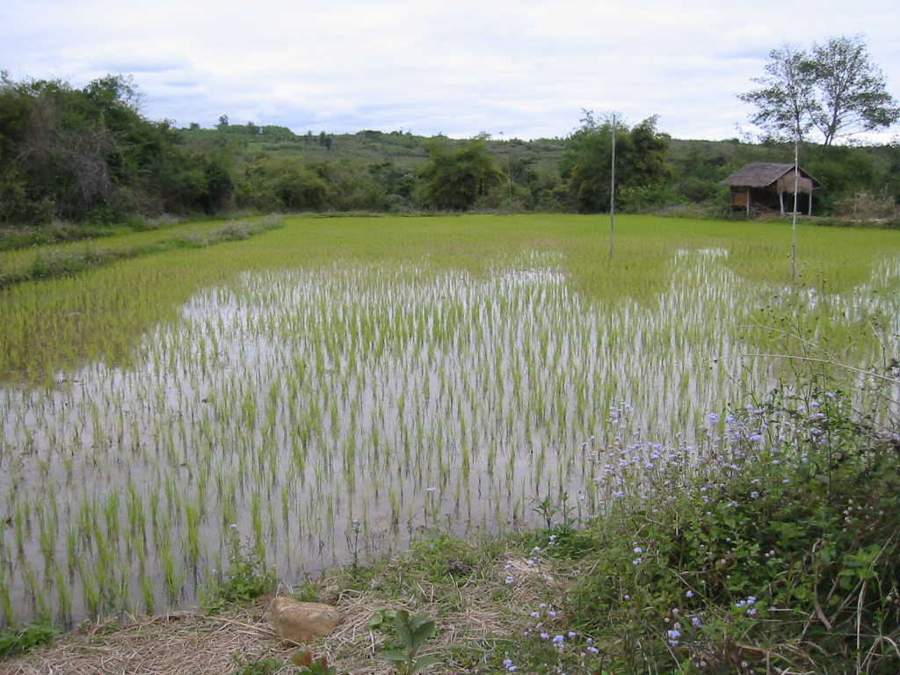
Padi Field, Laos

Slide 4
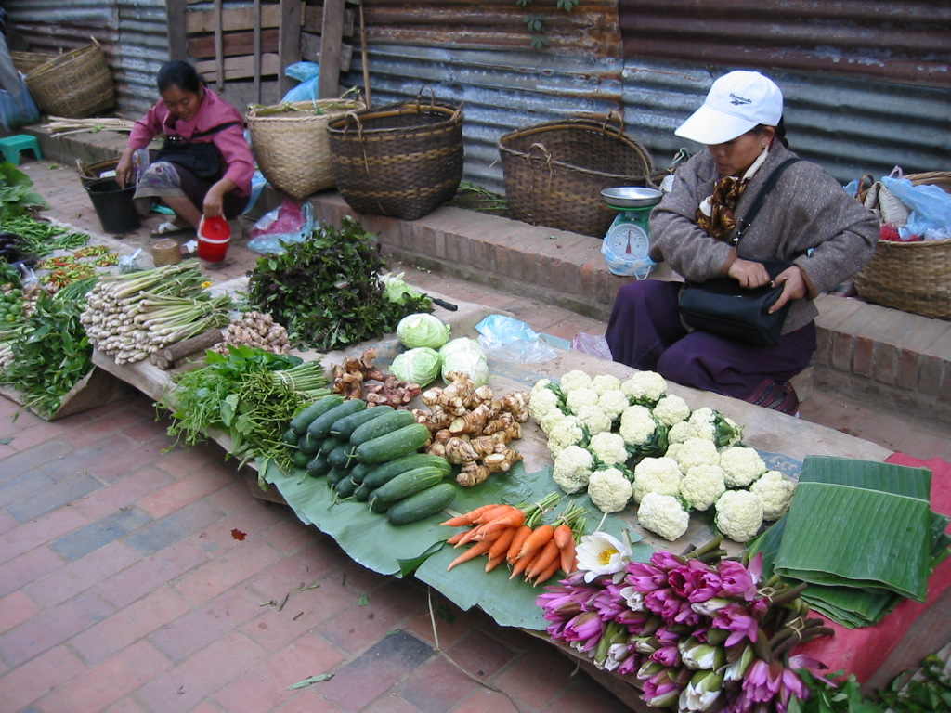
Outdoor Market, Luang Prabang, Laos

Slide 5
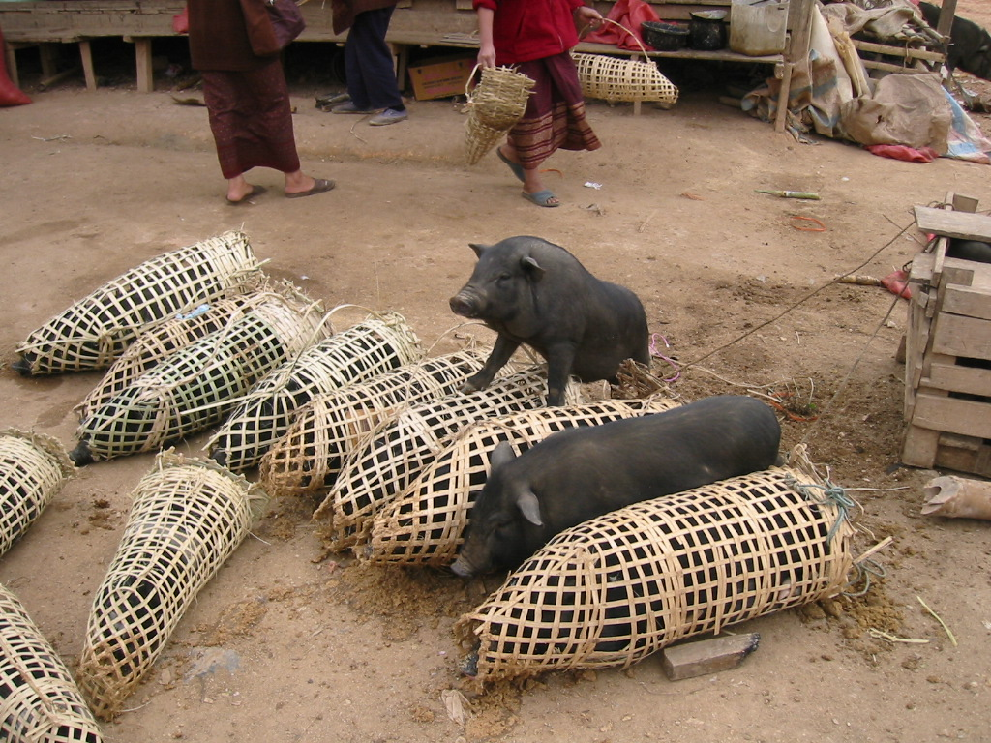
Market, Phosavan, Laos

Slide 6
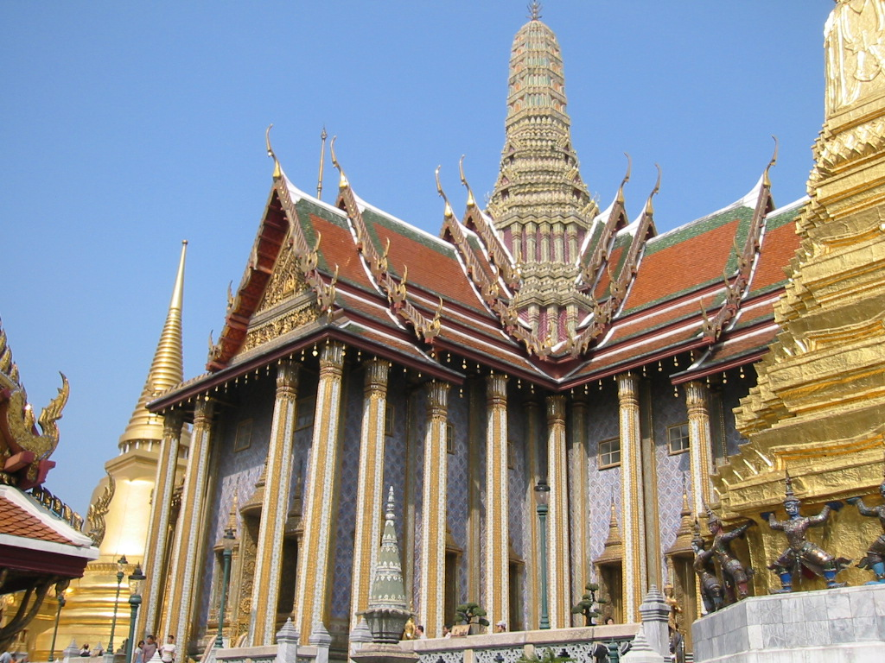
Buddhist Temple Complex (Wat), Bangkok, Thailand

Slide 7
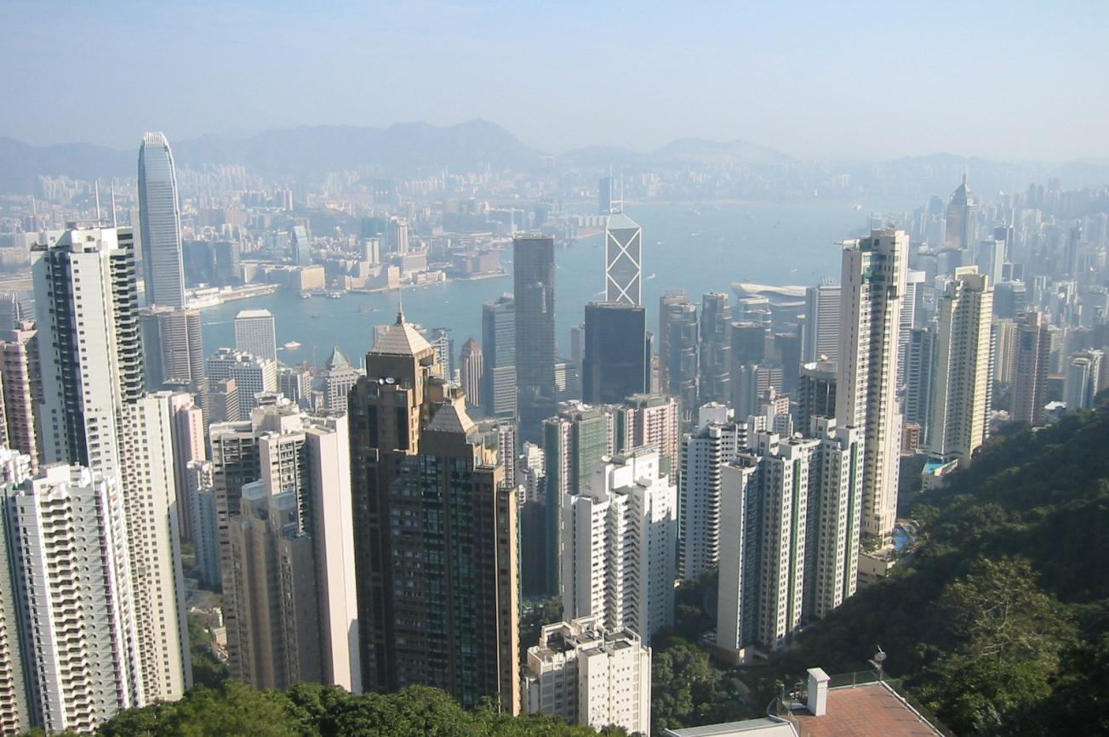
Hong Kong Skyline, China

Slide 8
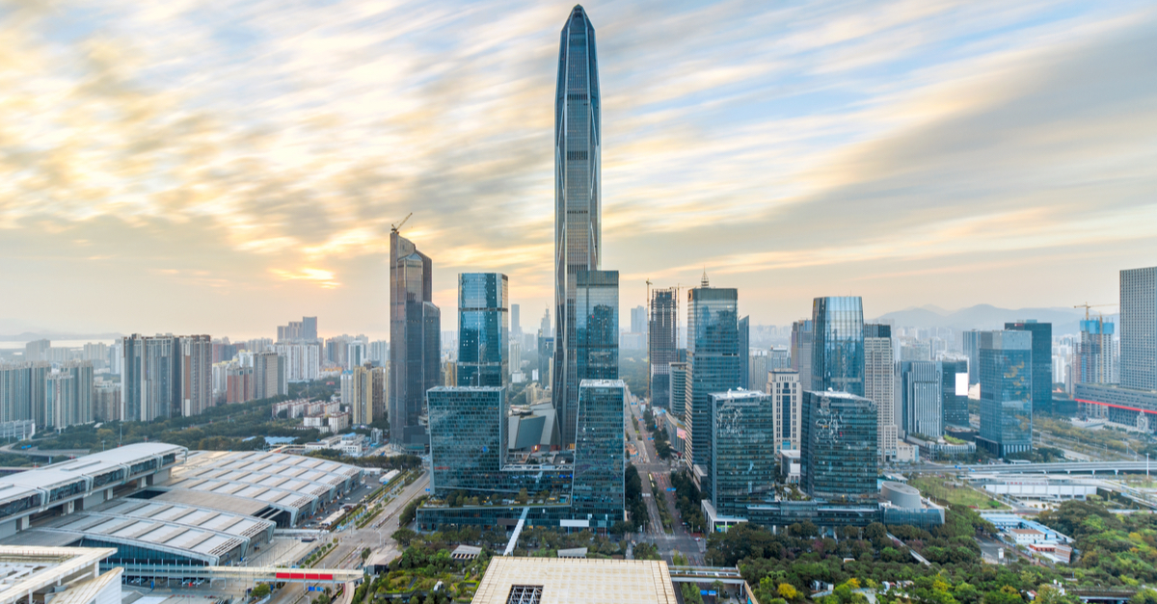
Shenzhen, China

Slide 9

Foxconn Assembly, Zhengzhou (Henan Province), China

Slide 10
Objectives
Introduction about the main regions of East and Southeast Asia in terms of their uniqueness.
Relationships between the global, the regional and the local, particularly how places are inserted in regional and global processes.
Historical, economic, cultural, social and physical characteristics of East and Southeast Asia.
Human activities and the regional environment interact within the region.

Slide 11
Objectives
The relevance of East and Southeast Asia
  The fastest growing region of the world.
  China; the world’s factory and a growing market.
  Other Asian countries such as Japan, Korea, Thailand, Malaysia and Indonesia are also of high importance.
Shift in the balance of power (economic and political):
  China increasingly assertive over global economic and political affairs.
  20th century; the American century. 21st century; the Pacific century.
Asia matters to your future welfare:
  Employment opportunities.
  Ranges of products (and some services).

Slide 12
Objectives
Value provided by the class
  Employers interested by a familiarity about the region.
  Geographical overview:
    Regional geography about East and Southeast Asia.
    Underlining the vastness, diversity and the complexity of the regions.
    Reliance on many media elements: maps, photos, films, charts.
  Country profiles:
    An inquiry on specific historical, economic, social, cultural and political environments related to each Pacific Asian country.
  Current issues, problems and prospects:
    Regional and national.
    Multidisciplinary perspective.

Slide 13
Course Outline
Background
1 – Pacific Asia
2 – Historical
Geography
3 – Economy and
Society
Regional Geography
4 – Japan
5 – China
7 – Southeast
Asia
6 – East Asian
Tigers
8 – The Excluded

Slide 14
A – Pacific Asia as a Region
1. What is Asia and Pacific Asia?
  How the term “Asia” came to be used? What are the major geographical elements of the region?
2. Significance of the Region
  Why and to what extent Pacific Asia is significant in the global economy?
3. Socioeconomic Diversity
  What are the main components behind the human geographical heterogeneity of Pacific Asia?

Slide 15
1. What is Asia and Pacific Asia?
Geographic realms
  Global neighborhoods/regions with combinations of environmental, cultural, economic and political properties.
    Human (cultural) properties.
    Physical (natural) characteristics.
  All regions have an area and boundaries.
Formal region
  People have one or more cultural traits in common (language, religion, livelihood).
  Area where one or more traits are dominant.
Functional region
  An area organized to function politically, socially, or economically as one unit. (A city, a state, a trade area).
  Tend to have clearly defined borders.
  Nodes: central points where the functions are coordinated and directed.

Slide 16
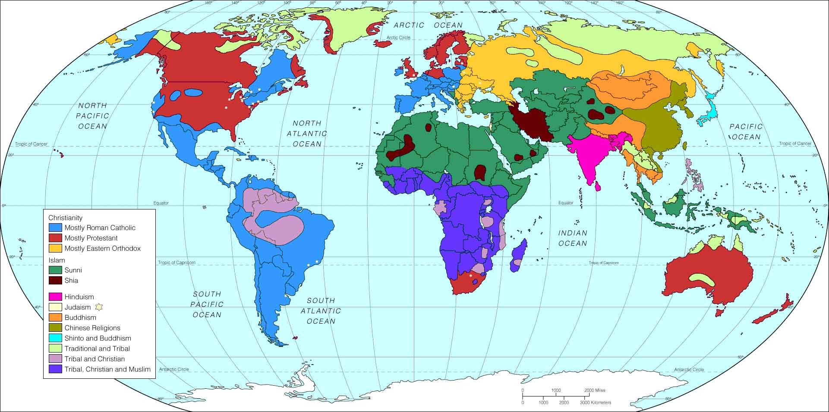
Main Cultural Regions of the World (Formal Regions)
Slavic-Orthodox
Western
Islamic
Confucian
Hindu
Latin American
African
Islamic
Western

Slide 17
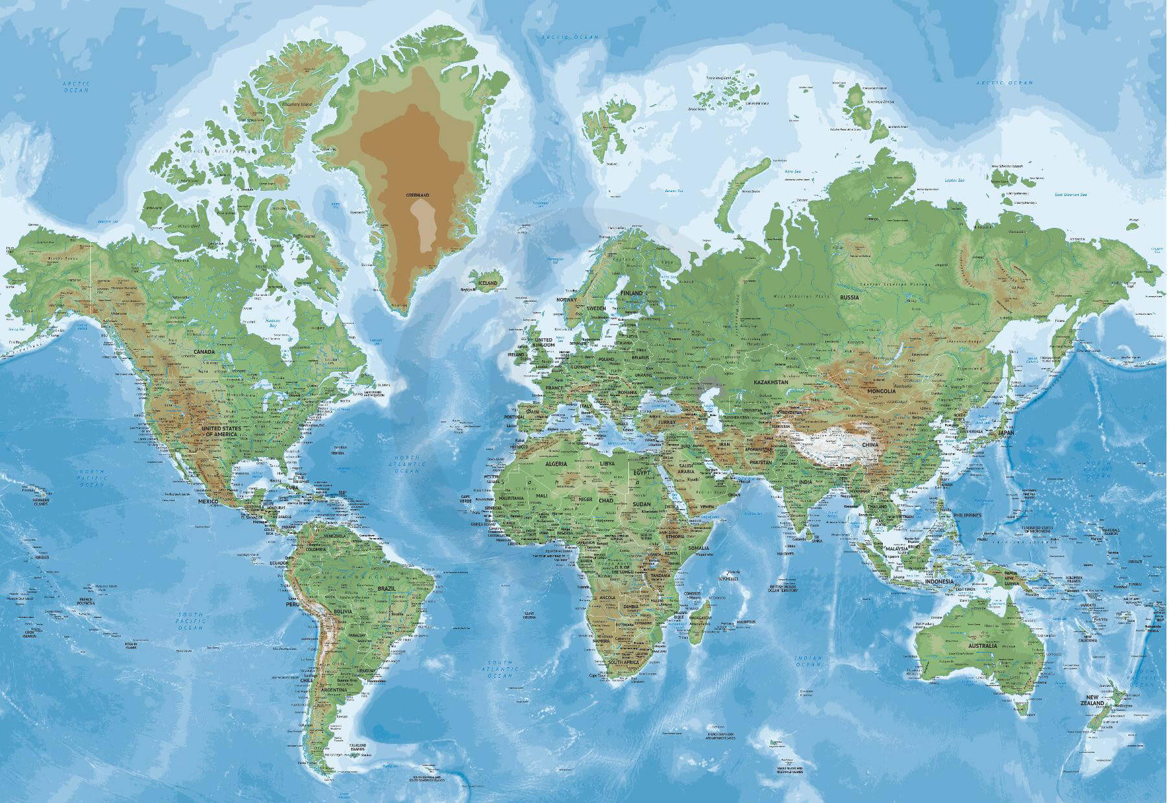
Europe-Centric Map of the World

Slide 18
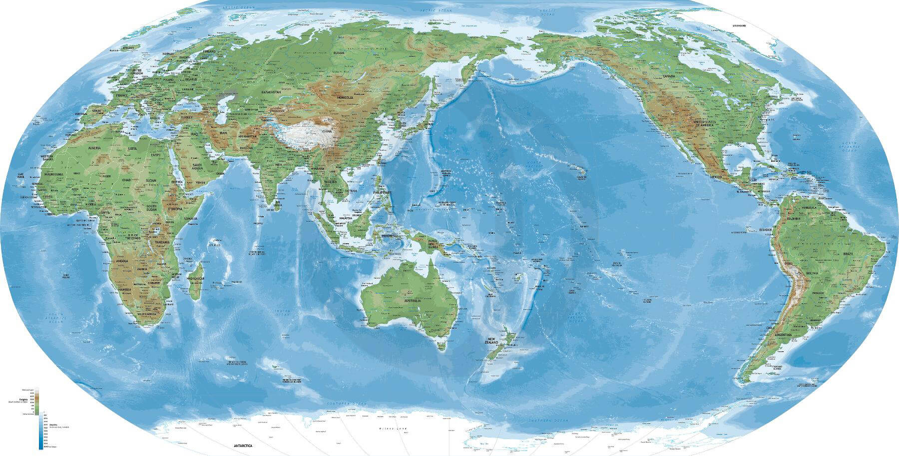
Asia-Centric Map of the World

Slide 19
1. What is Asia and Pacific Asia?
A geographical paradox
  A region such as Asia is more an idea than a reality.
  “Asia as a myth”:
    It makes no sense, geographically, politically, economically, culturally, linguistically or ethnically.
  No “Asian culture” or “Asian civilization”:
    Little political, cultural, ethnic or economic commonalities.
  Asia:
    A functional or a formal region?
    A functional region composed of formal regions.
  Who constructed Asia?
    External definition.
    European powers that colonized the region until the Second World War.
    The boundary between Europe and Asia (Ural mountains) was drawn by decree (Congress of Vienna in 1815).
    Asia is an occidental construct (externally and internally).

Slide 20
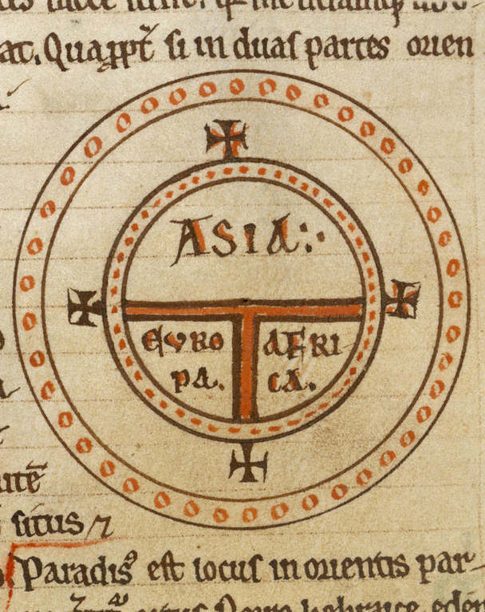
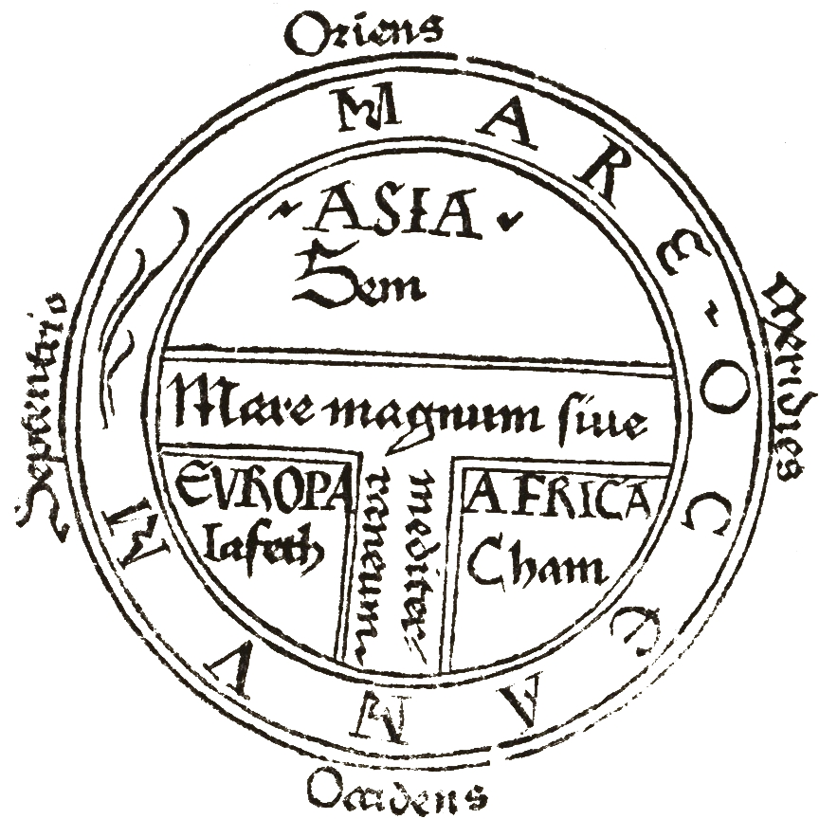
Early European Representations of the World

Slide 21
1. What is Asia and Pacific Asia?
Asia:
  The term emerged in Europe during Antiquity (Herodotus, 440 BC).
  Europe as a point of reference.
  130 B.C: Roman Province east of the Aegean sea (Turkey today).
Orient
  Synonym for east.
  Direction from which the sun and celestial bodies rise.
  First defined by the Greeks.
Far East
  Introduced by Britain in the 18th century.
  From Burma to Japan.
  Middle East: From Egypt to India. East of Suez.

Slide 22
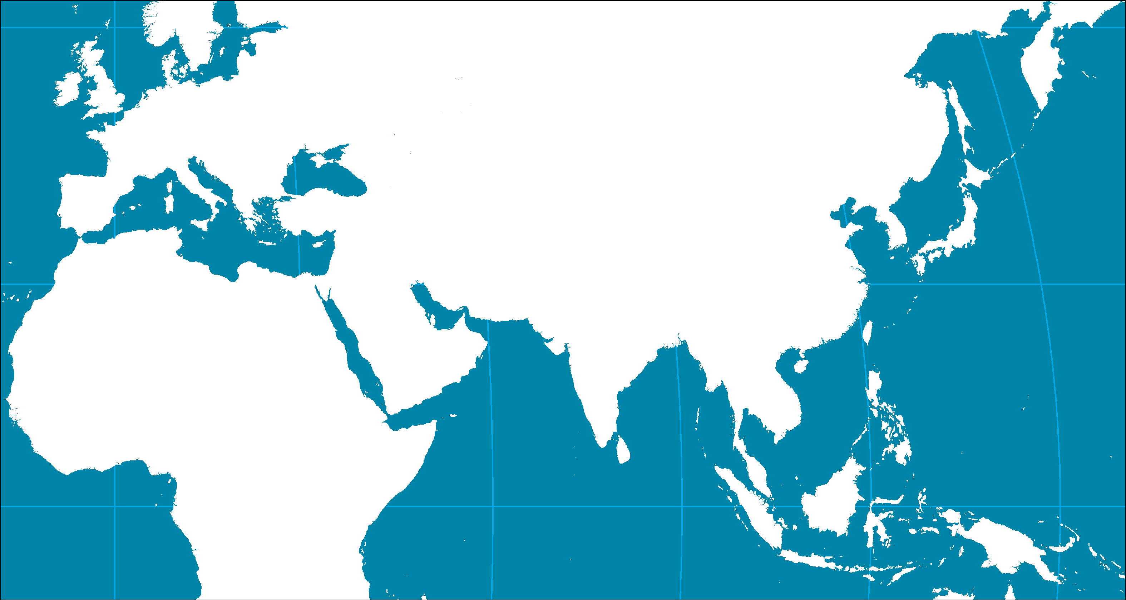
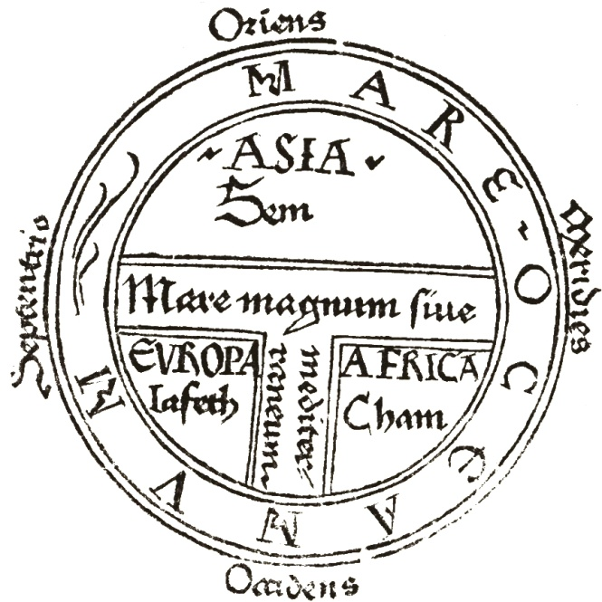
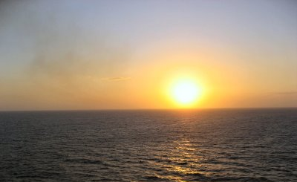

1. What is Asia and Pacific Asia?
Orient
Sunrise
Middle
East
Far East
Occident
Sunset
Notes:
Terms used to label the region
Asia: The term emerged in Europe during Antiquity (Herodotus, 440 BC). Europe as a point of reference. 130 B.C: Roman Province east of the Aegean sea (Turkey today).
Orient: Synonym for east. Direction from which the sun and celestial bodies rise. First defined by the Greeks. Somewhat a pejorative term.
Far East: Introduced by Britain in the 18th century. From Burma to Japan. Middle East: From Egypt to India. East of Suez.

Slide 23
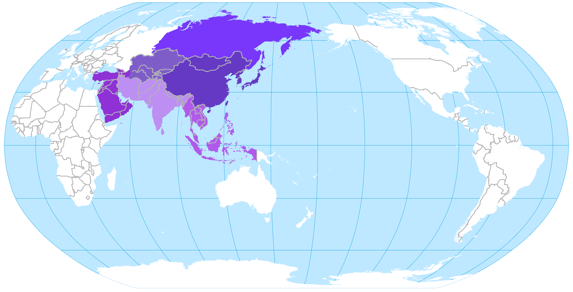
The Asian Continent and its Sub Regions
Russian Far East
Central Asia
South Asia
East Asia
Middle East
Southeast Asia
Notes:
The Asian continent: Largest landmass on earth (30% of the total land surface). 60% of the world’s population.

Slide 24
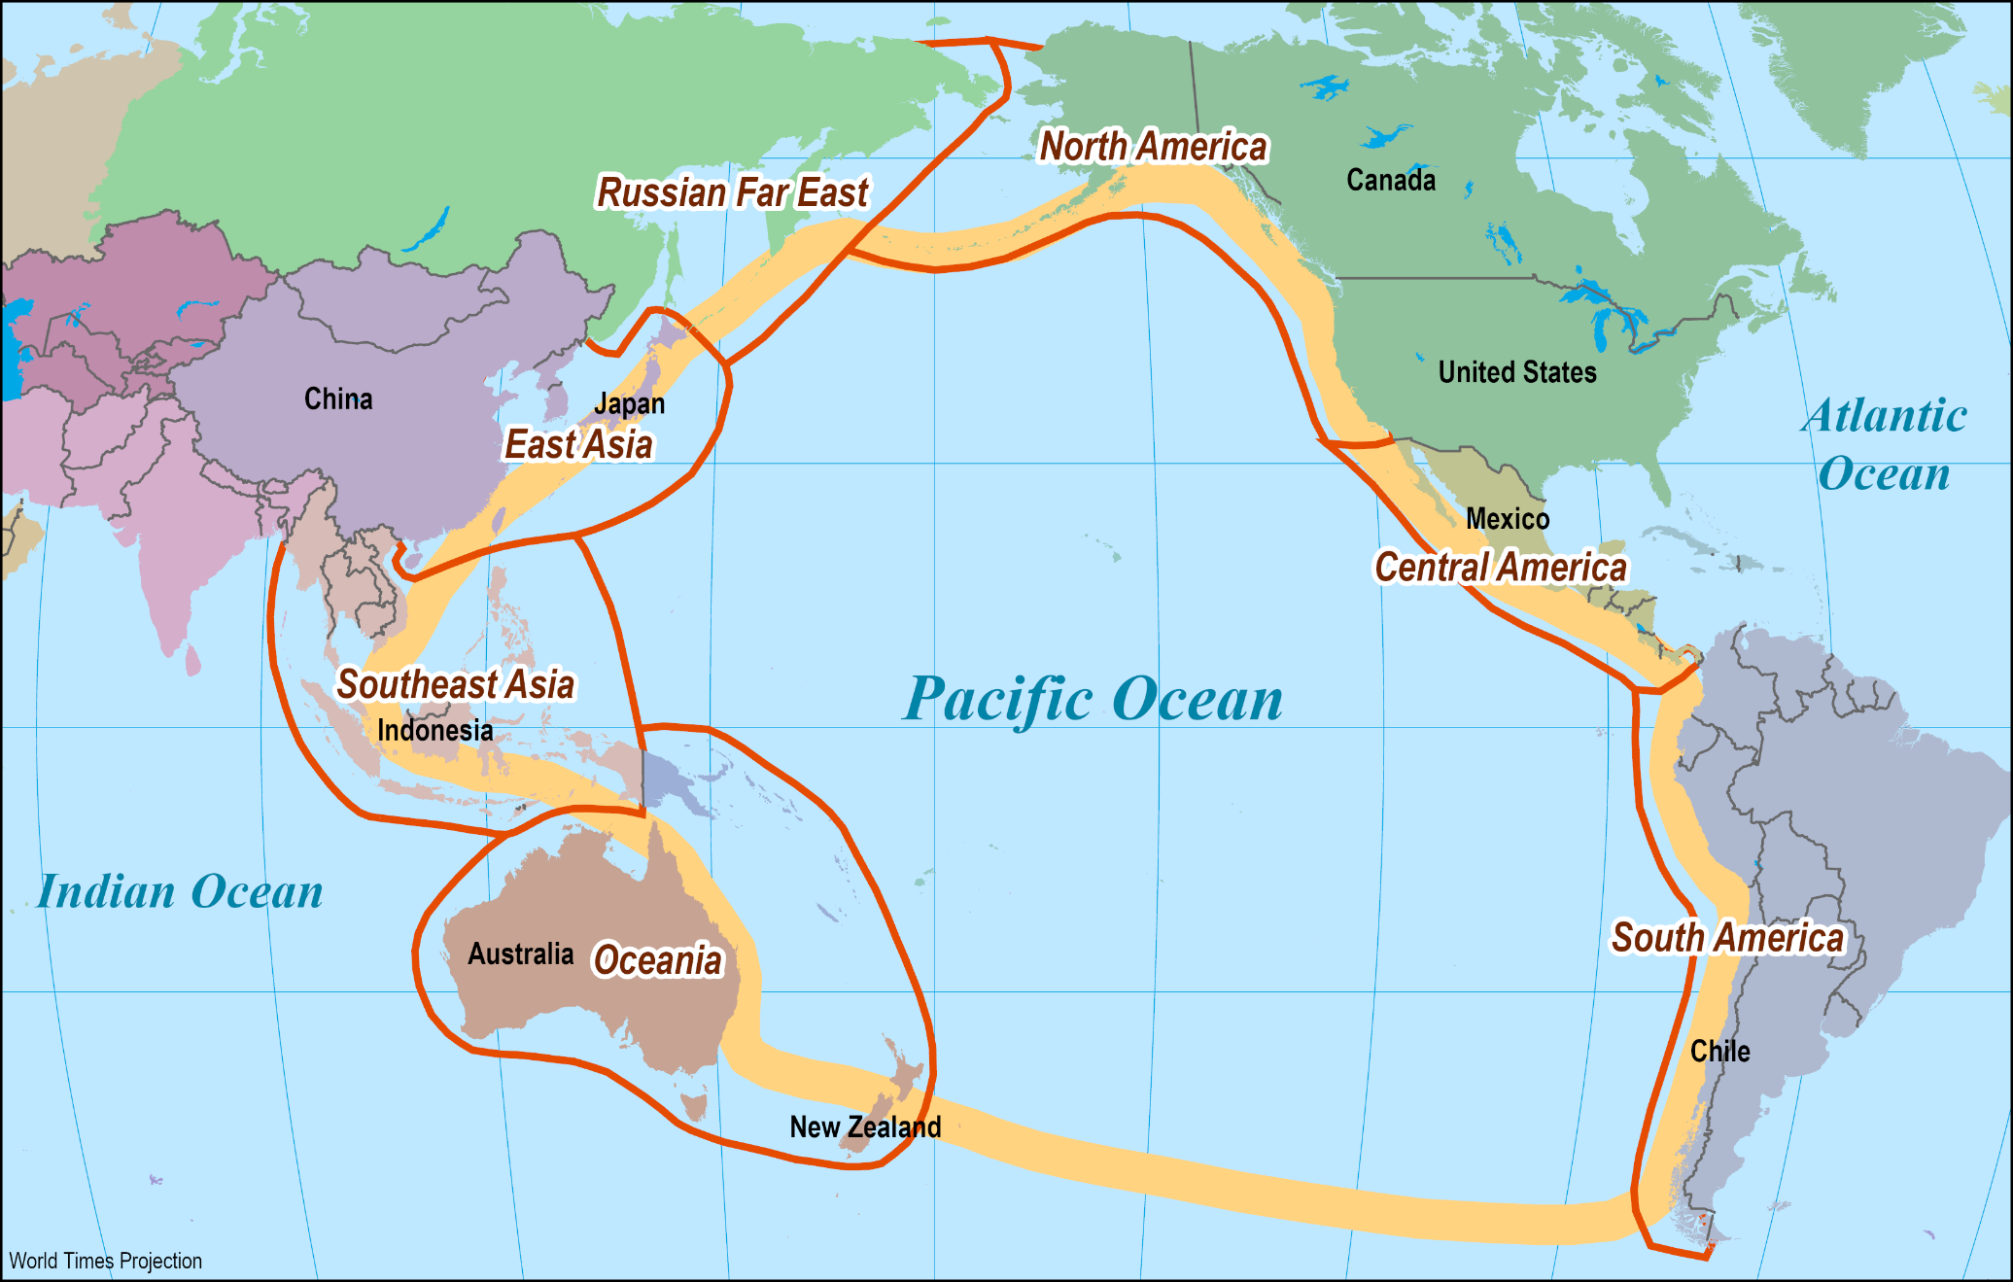
The Pacific Rim
Pacific Ocean
Largest ocean on earth.
The largest thermal regulator on earth.
Redistributes heat accumulated at the equator to higher latitudes.
Pacific Rim
States bordering the Pacific Ocean.
Pacific Asia
States of Asia bordering the Pacific Ocean.

Slide 25
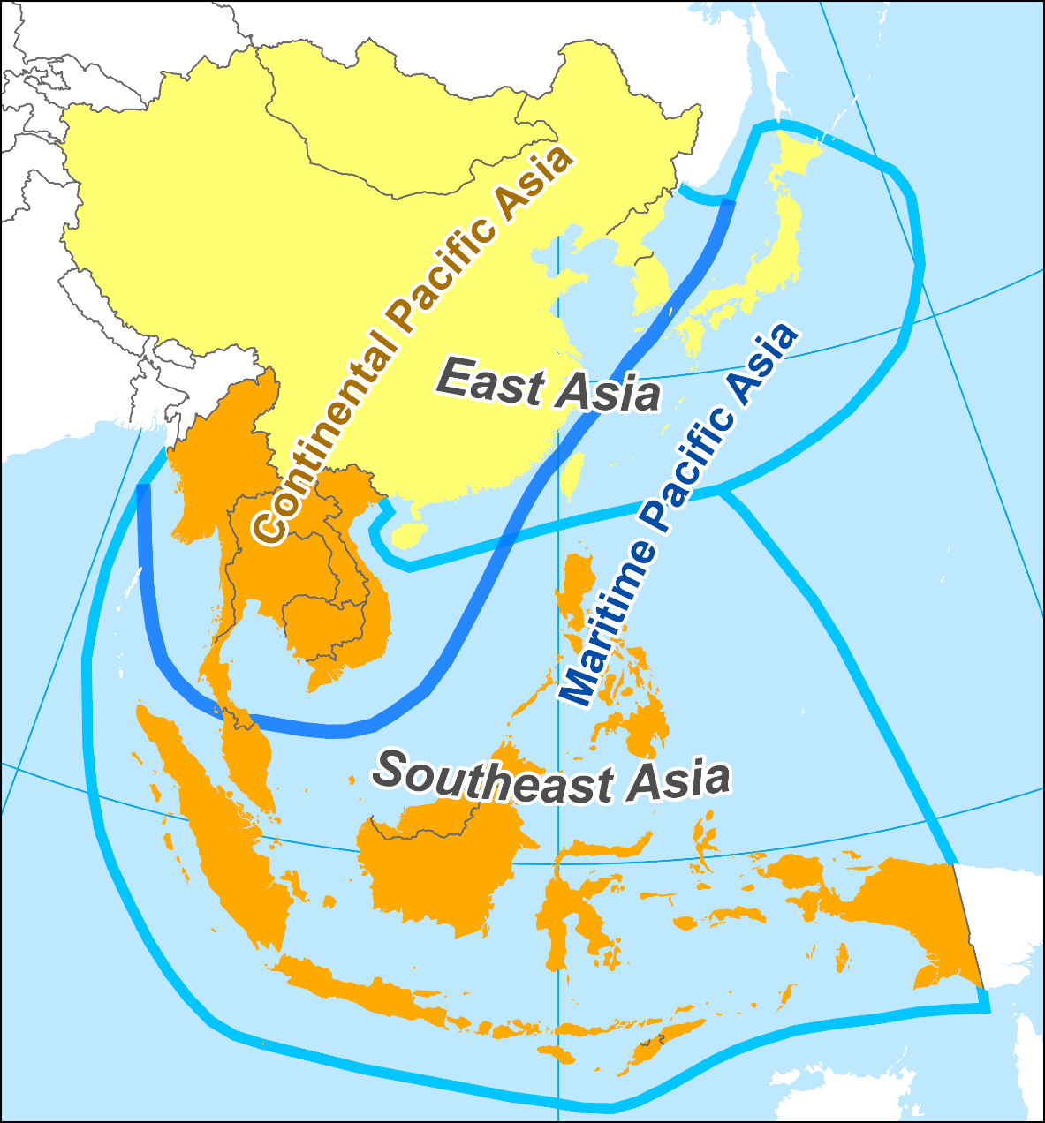
1. What is Asia and Pacific Asia?
Realms
  States of Asia bordering the Pacific Ocean:
    Also includes Burma and Laos.
  Two major realms:
    East and Southeast Asia.
  Two physiographical realms:
    Maritime and continental Pacific Asia.
  New definition of the region:
    More developed and more cohesive.
    Relation with the Pacific Ocean: a link.
Explain the fundamental differences between continental and maritime Pacific Asia.

Slide 26
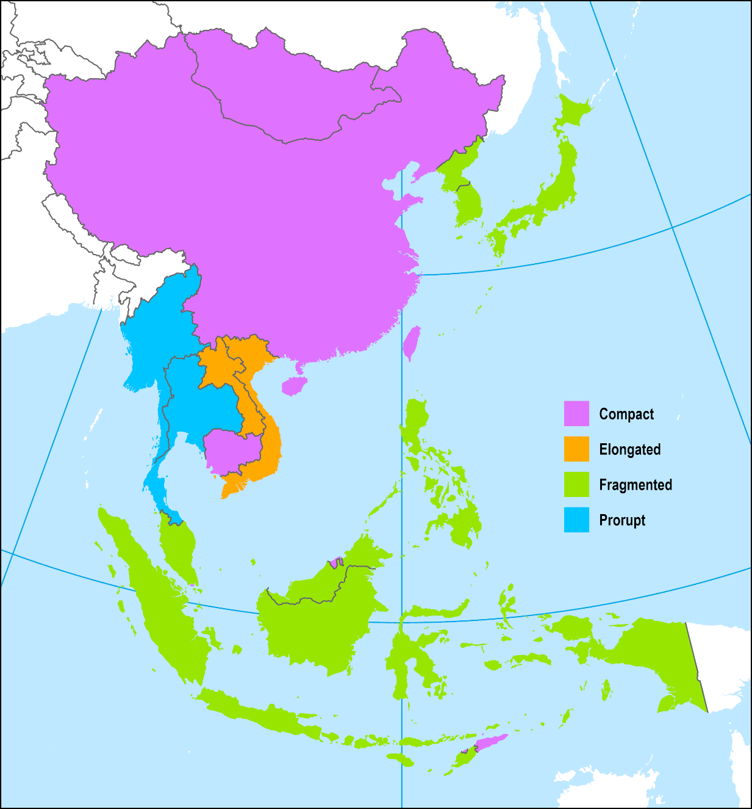
Types of Territorial Morphology
Compact: China, Taiwan, Singapore, Brunei, East Timor and Cambodia.
Relatively easy to administer.
Fragmented: Indonesia, the Philippines, Malaysia and Japan (Geographical). North and South Korea (political).
Elongated: More length than width. Vietnam and Laos. Unity and external influence issues.
Prorupt: Main territory and a narrow corridor leading from it. Difficulty of administering the extension.

Slide 27
2. Significance of the Region
Geography | Large continent with various landscapes. 30% of the total land surface. Spans two major oceans.
Demography | Large population with significant impacts on global consumption and migration. 64% of the world’s population.
History | Long and complex history (China: 4,000 years of recorded history). Major civilizations.
Culture & Religions | Major cultural and religious influence (Buddhism & Islam).
Economy | Export-oriented economies accounting for the world’s main manufacturers.
Technology | Major innovator in the past. Decline in the 19th and 20th centuries. Increasingly innovative.
Politics | Different political systems. Growing importance in global affairs.
Finance | Surplus capital invested in production and debt instruments.
Environment | Variety of ecosystems (subarctic to tropical). Significant environmental problems.

Slide 28
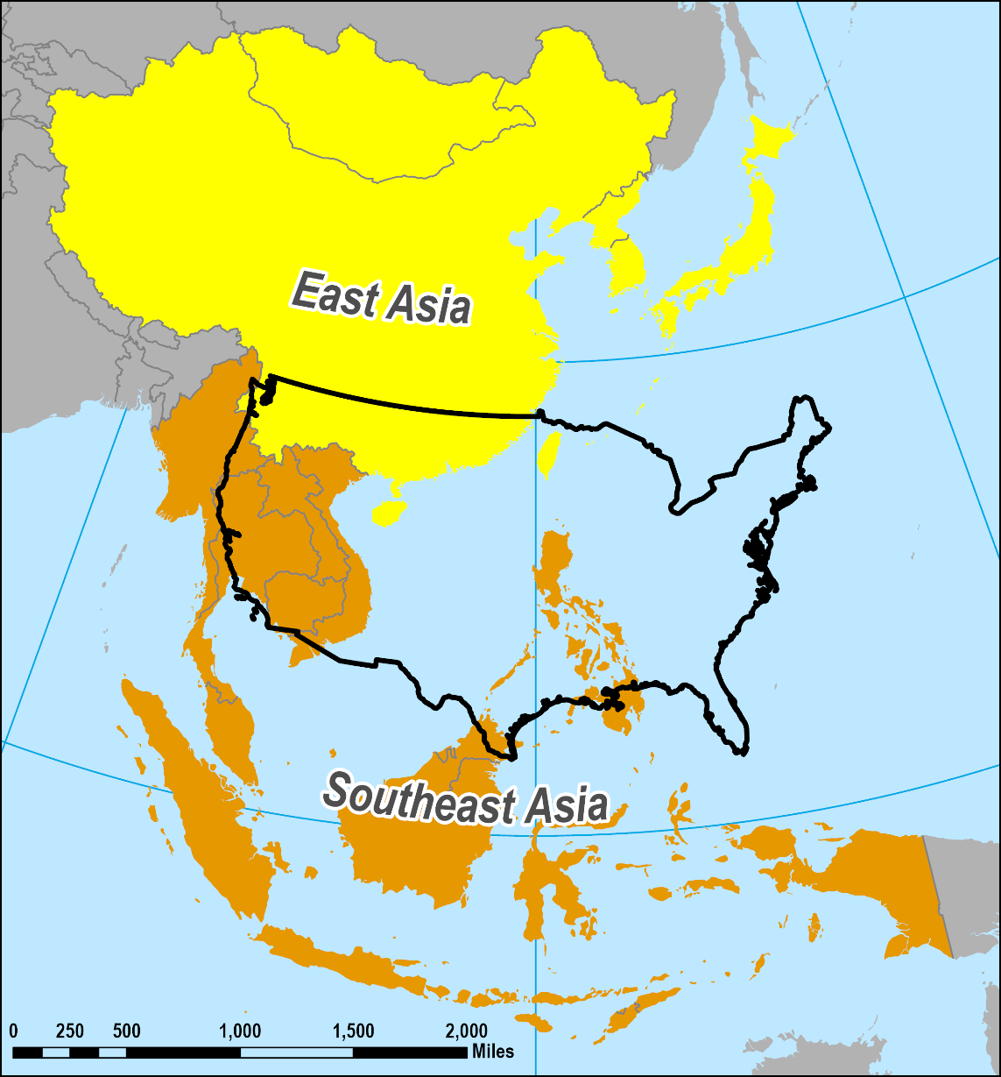
2. Significance of the Region
Geographical Scale
  A vast region with the dimensions of North America.
  About 4,400 miles north-south
  About 5,400 miles east-west.
  Continental USA is about 2,800 miles wide.
  60% maritime, 40% land.
  Access to two major oceans:
    Pacific (largest in the world).
    Indian.
    Limited passages; strategic importance to global trade.

Slide 29
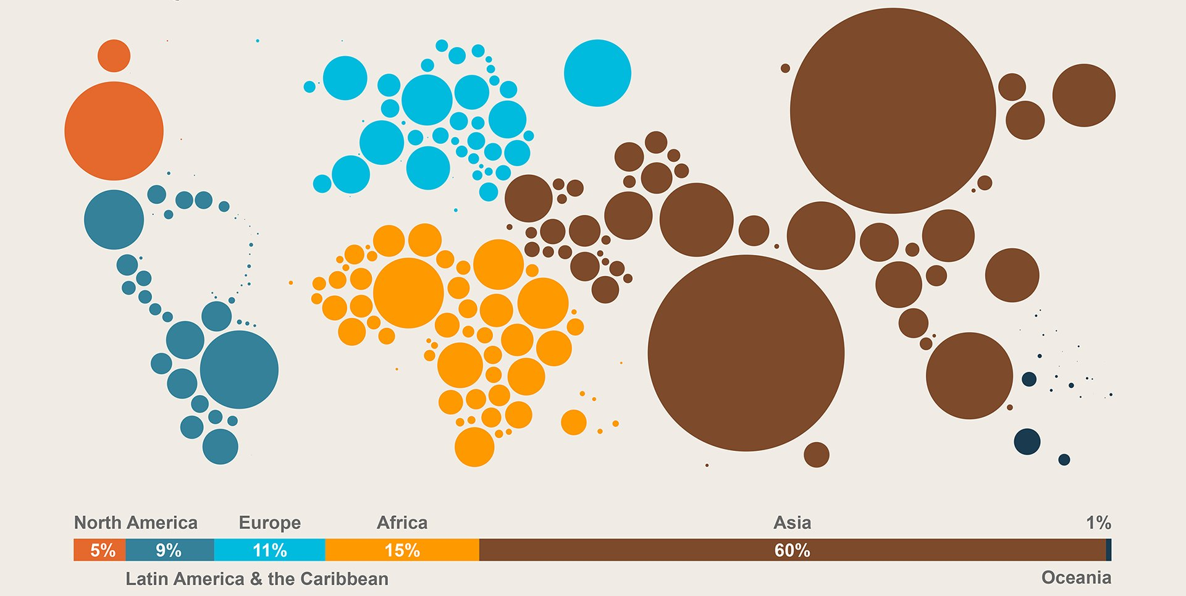
Distribution of the Global Population by Major Region

Slide 30
2. Significance of the Region
Demographic importance
  2.3 billion people were living in East Asia in 2018.
  64% of the global population.
  Expected to reach 2.4 billion in 2025.
  Share will remain unchanged.
Overpopulation
  China adds 1 million people per month.
  Most of the largest and most crowded cities in the world.
Notes:
Source: World Bank. https://data.worldbank.org/indicator/SP.POP.TOTL?most_recent_value_desc=true

Slide 31
15 Largest Countries, 2018, 2050 (in millions)
Notes:
Source: FAO Statistical Database

Slide 32
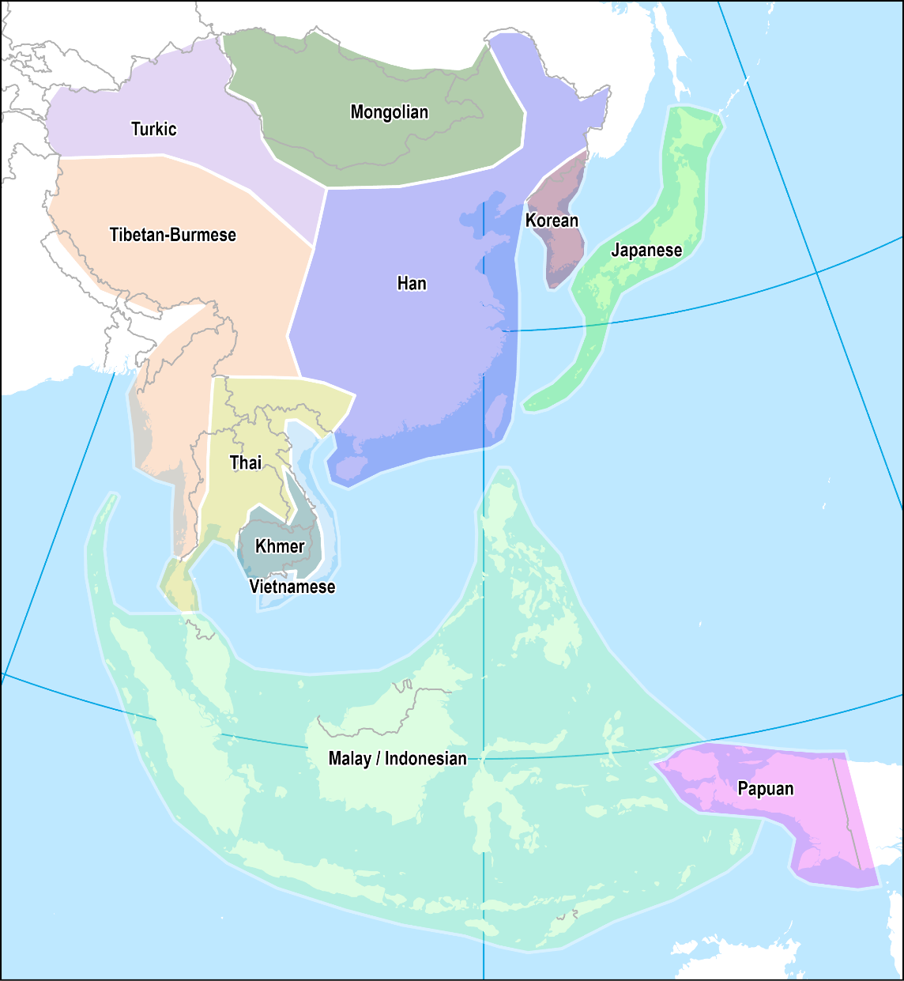
3. Socioeconomic Diversity
Cultural / Ethnic diversity
  Each culture has its ecumene:
    Inhabited (or inhabitable) area.
    Set of environmental conditions that impacted on the culture.
  Major ethnic groups:
    Chinese world (Han).
    Koreans / Japanese.
    Malays / Indonesians.
    Filipinos.
    Thais.
    Khmers.
    Tibetan-Burmese.
    Vietnamese.
  Many other minorities.

Slide 33
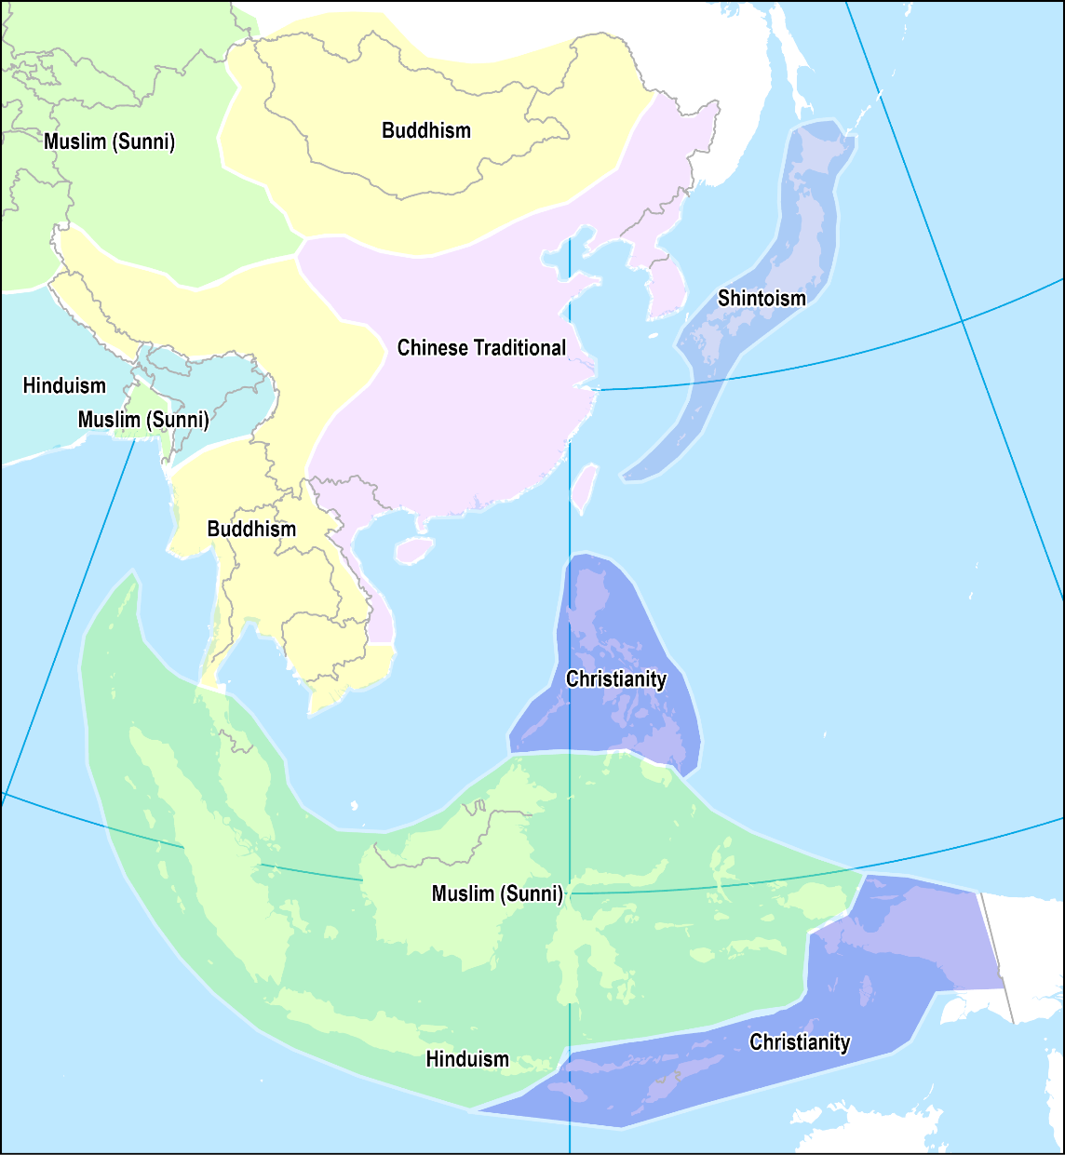
3. Socioeconomic Diversity
Religious diversity
  Simplistically: Buddhism in the north and Islam in the south.
  The outcome of endogenous and exogenous influences.
  Hinduism, Buddhism, Islam and Christianity are of external origins:
    Diffused the region under different eras and circumstances.
  Traditional Chinese (Confucianism) and Shinto:
    Indigenous regions with adaptations from Buddhism.
  Diversity does not necessarily mean tolerance.
Notes:
Re. Judaism. Mostly an ethnically based religion. Extension through reproduction. Limited proselytization.

Slide 34
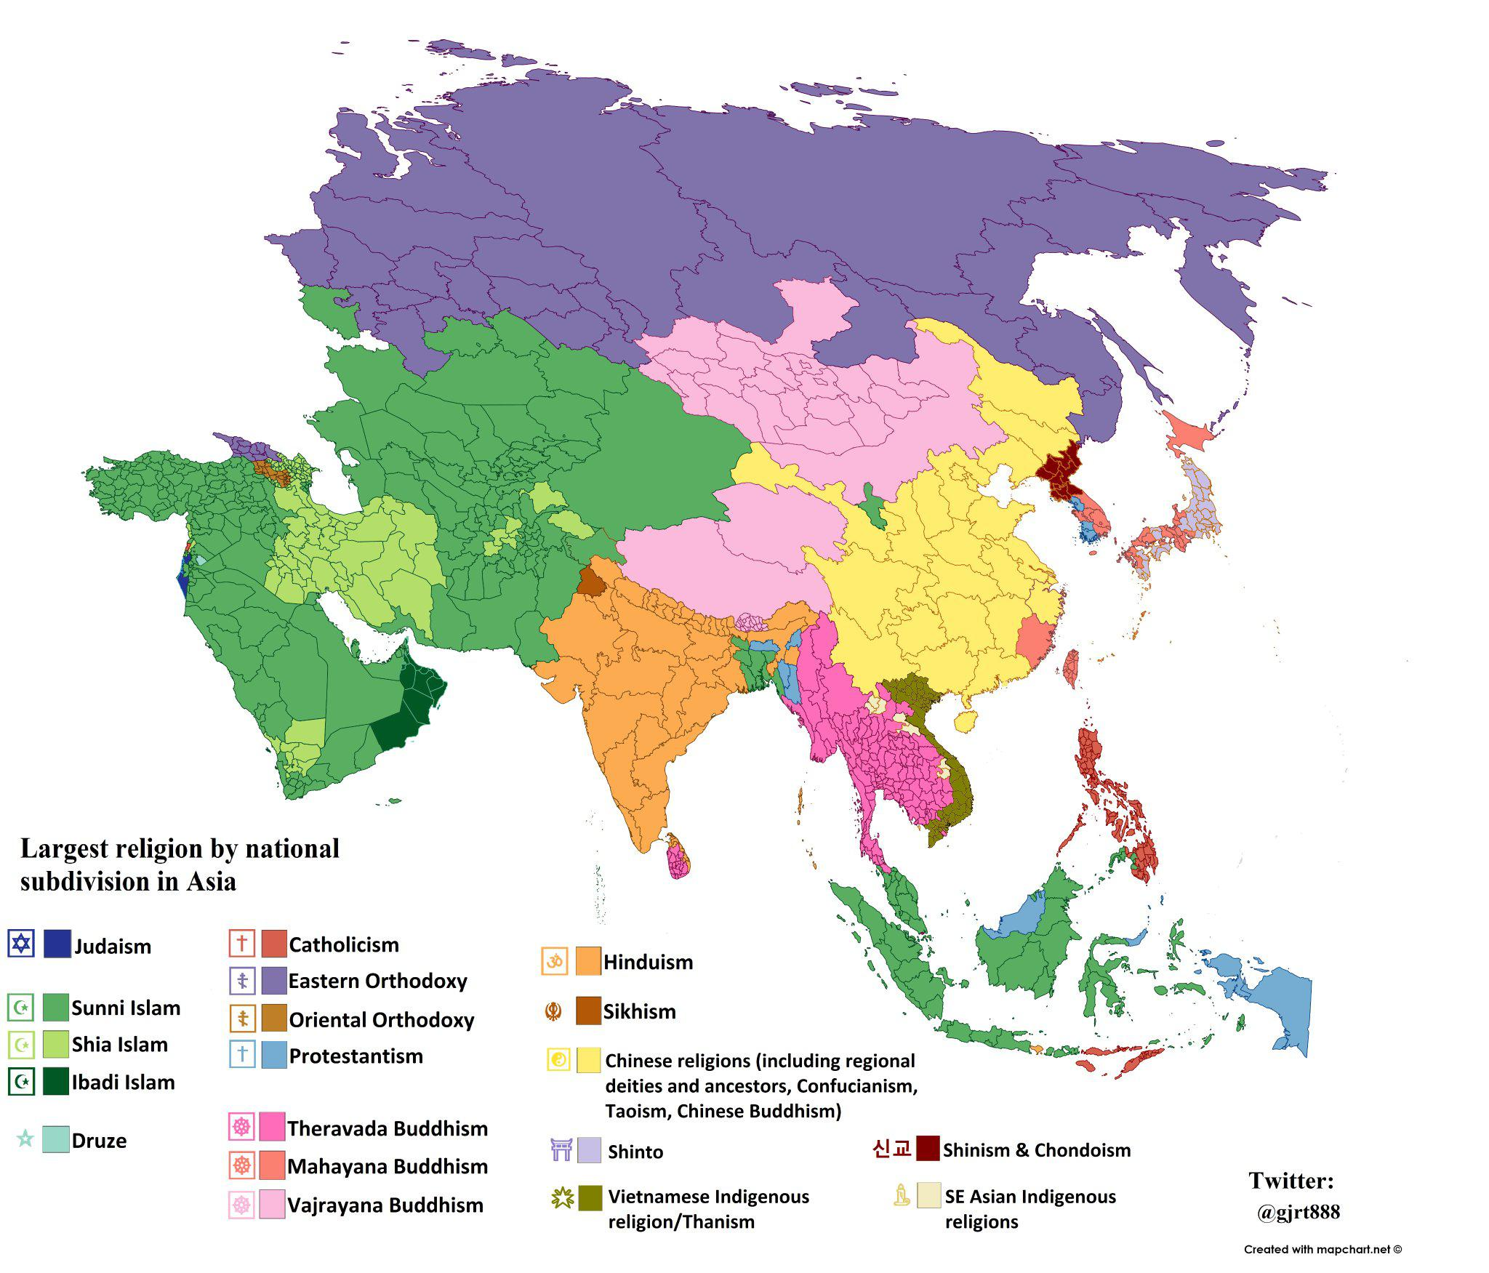

Slide 35
World’s Most Spoken Languages, 2017 (primary or secondary)
Notes:
Telegu is a language spoken in India. Wu Chinese around Shanghai. Yue Chinese (Cantonese). Lahnda is a dialect of Punjabi, mostly spoken in Pakistan. The most popular language is English. About 35% of the world's mail, telexes, and cables are in English.
Approximately 40% of the world's radio programs are in English. About 50% of all Internet traffic uses English.

Slide 36
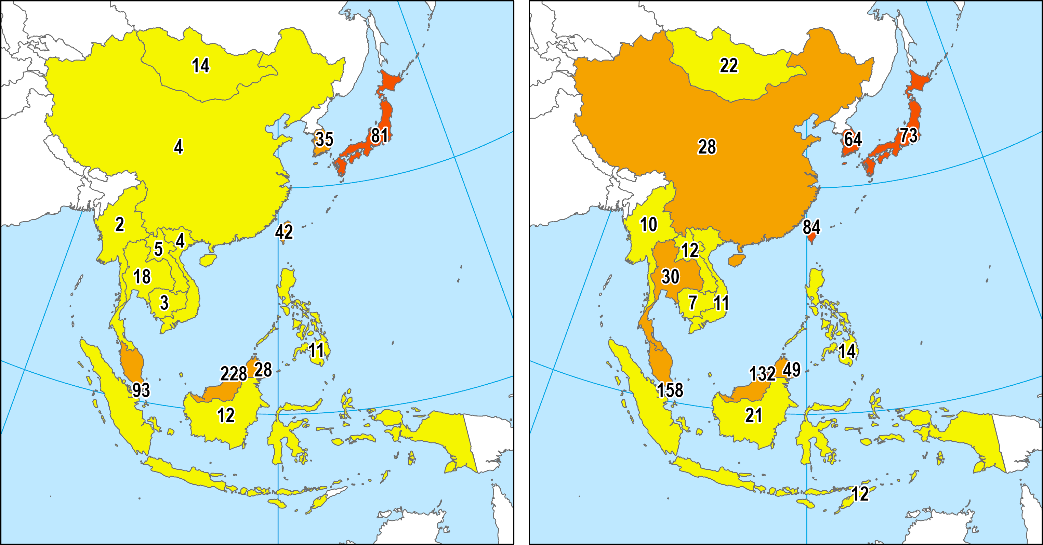
3. Socioeconomic Diversity
GPD per Capita (PPP) as % of the USA
1990
2017
Variety of development profiles and levels of achievement.
Export-oriented development prevails.
Among the poorest societies on earth (Laos, Cambodia, Burma).
Economic leaders: Japan, Taiwan, South Korea, Hong Kong and Singapore.

Slide 37
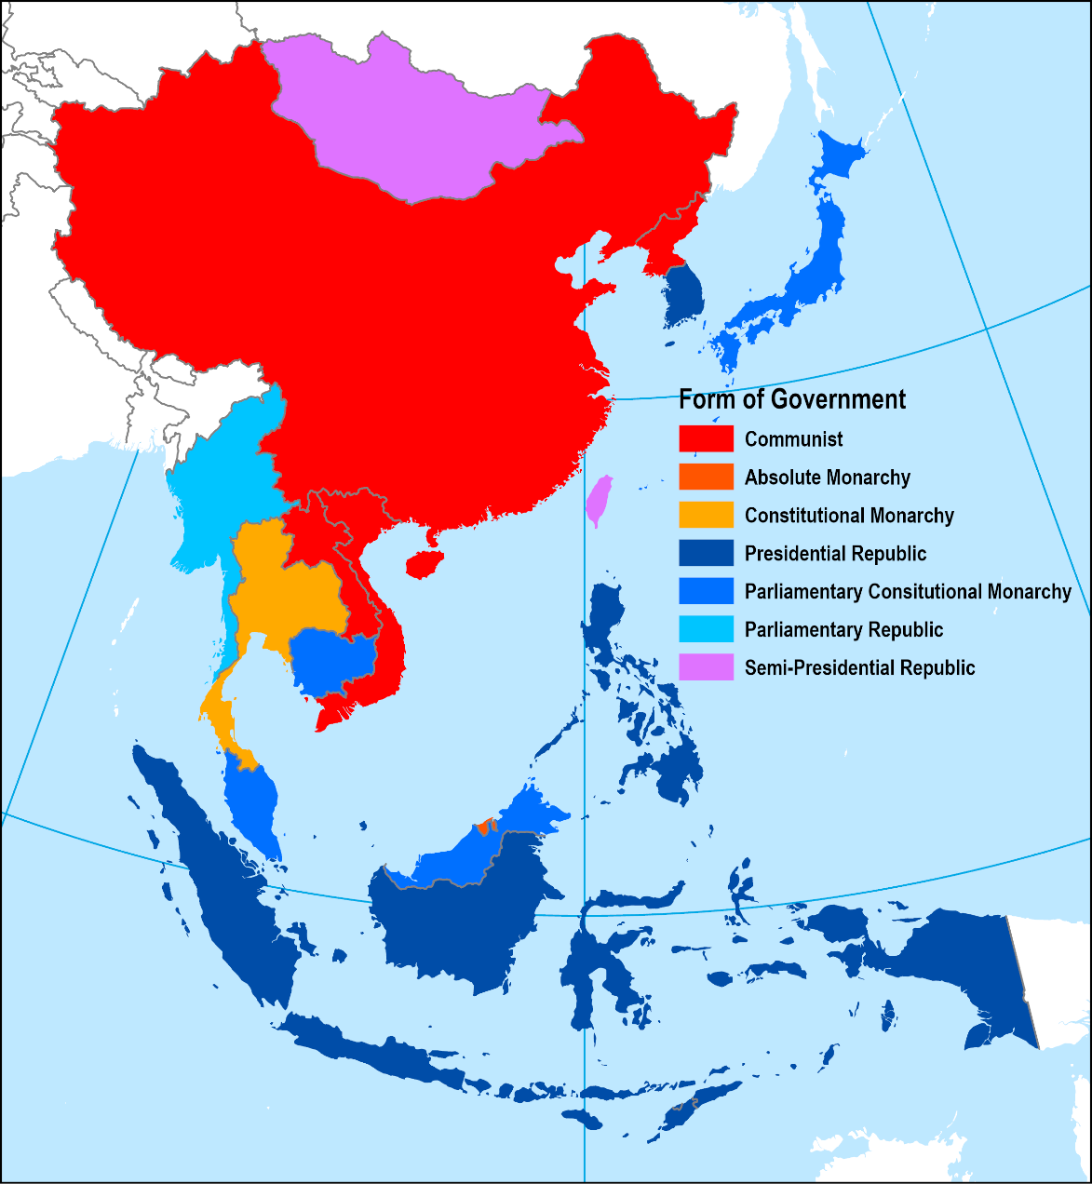
3. Socioeconomic Diversity
Political diversity
  Several political systems underlining heterogeneity.
  Centrally planned economies to market-driven economies.
  Tendency towards democracy.
  China: “a socialist market economy”.
  Korea: economically and politically divided country.
  Taiwan: Division of China.
Geopolitical importance
  Old regional power: Japan.
  Emerging regional power: China.
  External power: USA.
Notes:
Source: Classification from National Geographic.
Communist. A system where a single party exercises ultimate governing authority.
Absolute monarchy: A system where the monarch exercises ultimate governing authority as head of state and head of government.
Constitutional monarchy. The monarch's powers are limited by law or by a formal constitution, usually assigning them to those of the head of state.
Presidential republic. Republic with an elected head of state, where the head of state is also the head of the government.
Constitutional monarchy. A form of government where the monarch (and family) is an official ceremonial entity with no political power.
Parliamentary republic. Republic, with an elected head of state, but where the head of state and head of government are kept separate with the head of government retaining most executive powers, or a head of state akin to a head of government, elected by a parliament.
Semi-presidential republic. A system of in which a president exists alongside a prime minister and a cabinet, with the latter two responding to the legislature of the state.

Slide 38
B – Physical Landscape of Pacific Asia
1. The Pacific Ring of Fire
  What explains the high level of tectonic activity in the region?
2. A Maritime and Continental Space
  What are the basic features of the region’s physical landscape?
3. Monsoons
  What are the monsoons and what are their impacts on the region?

Slide 39
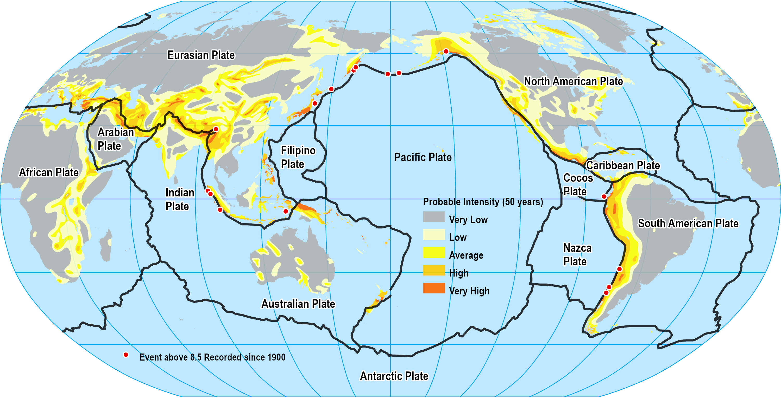
1. The Pacific Ring of Fire (40,000 km belt)
90% of the world’s earthquakes.
10 largest earthquakes of the last 100 years.
Tonga (Jan 22)
Explain why the Pacific Rim is also called the Pacific Ring of Fire. Also provide recent examples of what this implies for Pacific Asian coastal communities.
Notes:
Map location: plate_tectonics

Slide 40
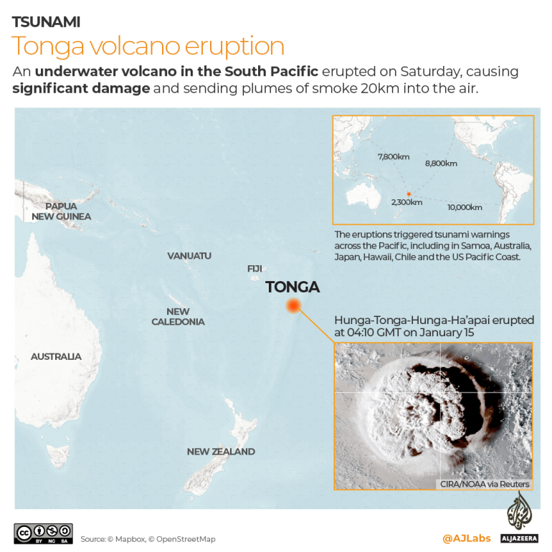
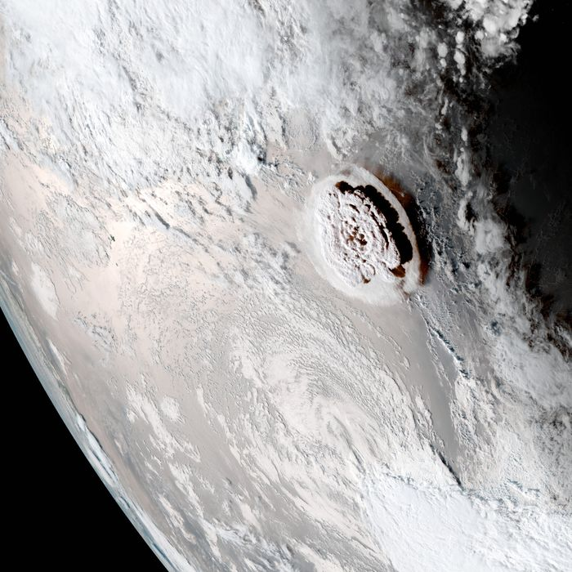
January 14, 2022

Slide 41
2. A Maritime and Continental Space
Continental space
  Continuous land mass.
  Including the Asian land mass (China, the Koreas, Vietnam, Cambodia, Laos, Thailand and Myanmar)
Maritime space
  A discontinuous space.
  Including islands (Japan and Taiwan) and archipelagos (Malaysia, the Philippines and Indonesia; over 25,000 islands).
Oriented along a corridor
  A significant share of the population lives along coastline.

Slide 42
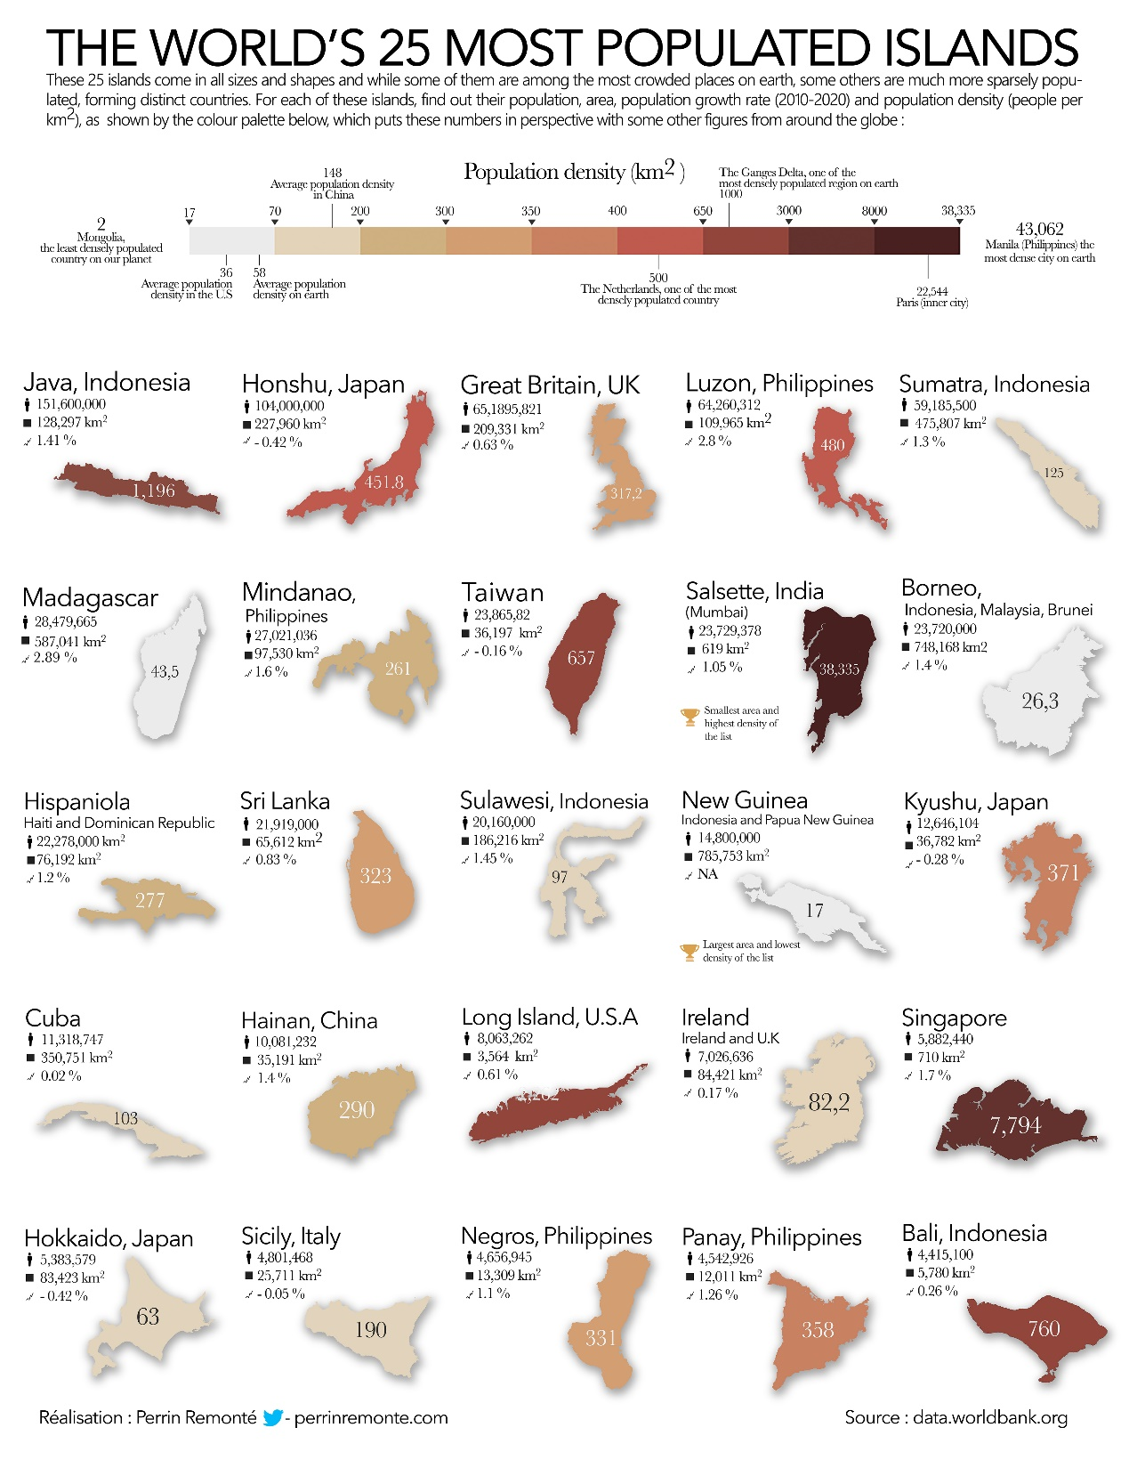

Slide 43
2. A Maritime and Continental Space
A highly constraining geography
  One of the most rugged topography in the world:
    Complex landforms created by tectonic activity.
    Permitted the creation of unique cultures (barrier effect).
    Interactions were possible.
  Limited flat land:
    Relative to the population.
    Creation of space for agriculture.
    Terracing and irrigation.
    Maximize agricultural productivity.
  Himalayas:
    Indian plate hitting the East Asian plate.
    Started 50 million years ago.
    Contains the highest mountains in the world.

Slide 44
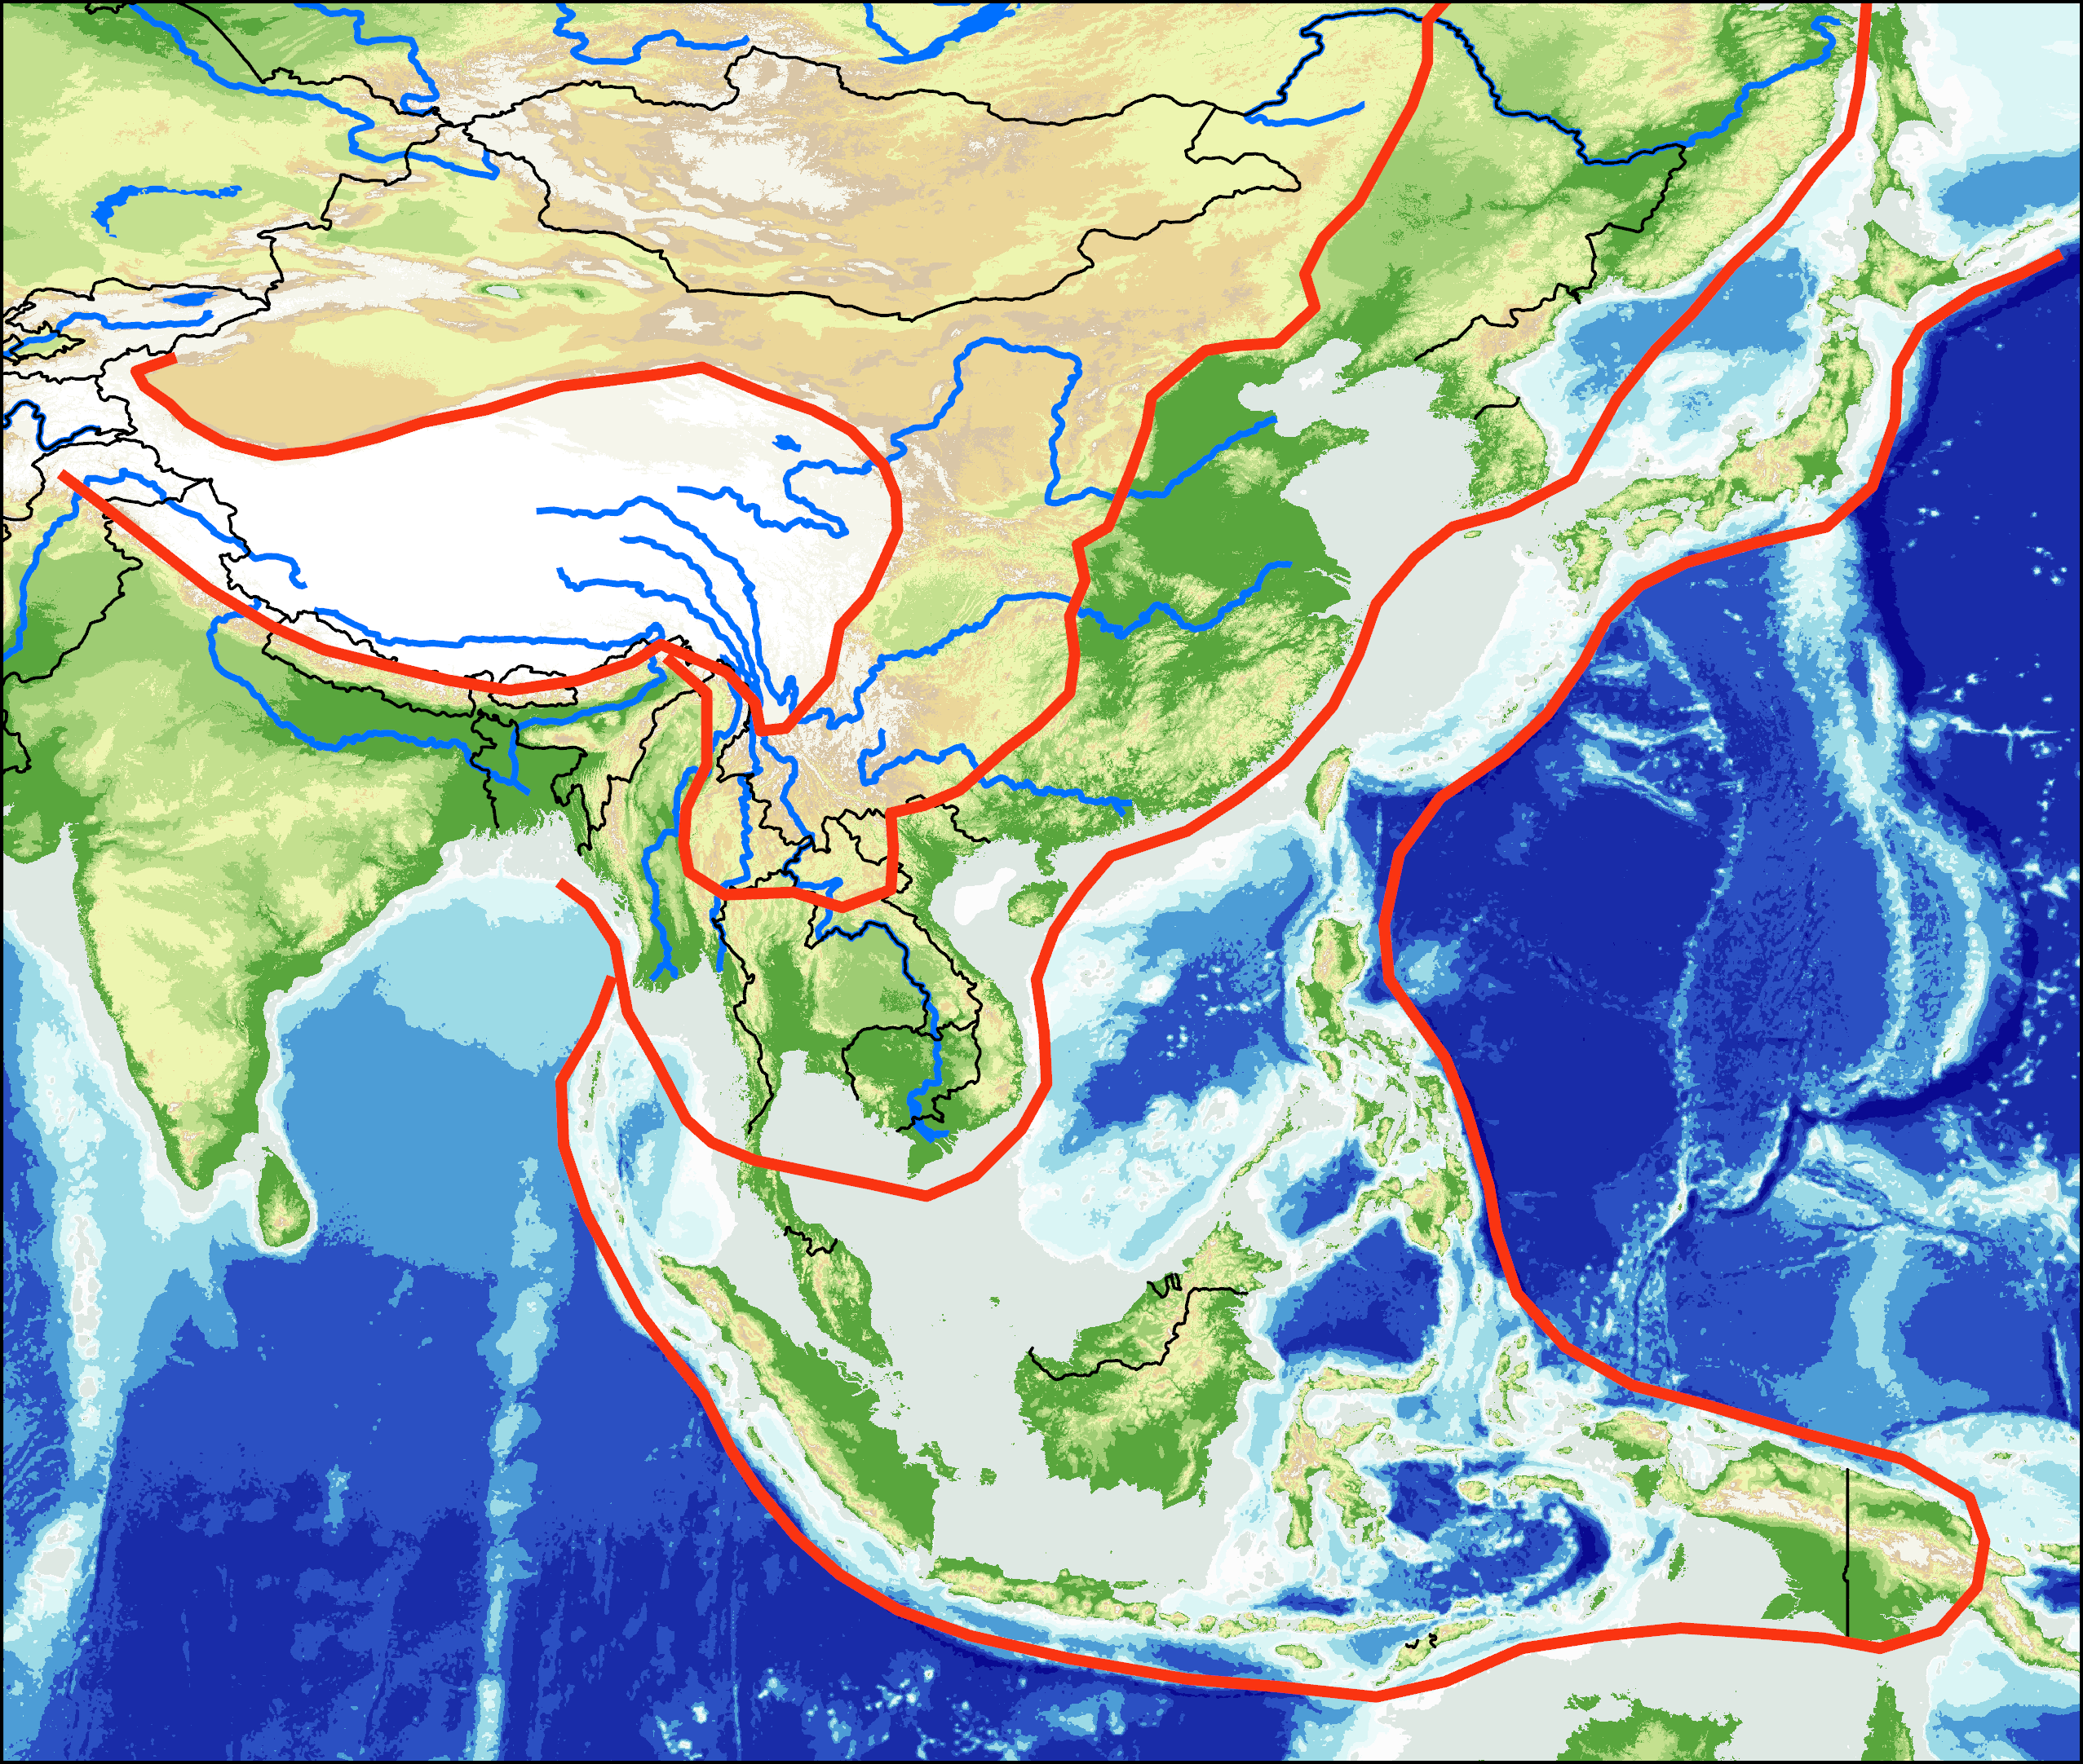
Physical Landscape of Pacific Asia
Himalayas (“abode of snow”) plateau
High altitude.
Limited agriculture
Step 2
Step 1
Yellow River
(Huang He)
Step 1
Basins, plateaus and low mountain ranges
Dry climate
Gobi Desert
Step 3
Step 2
Blue River
(Yangtze)
Pearl River
Plains and deltas
Major rivers (irrigated agriculture).
Irrawady
Mekong
Red River
Step 3
Tchao Praya
Step 4
Continental shelf and islands
Seismic and volcanic activity.
Step 4

Slide 45
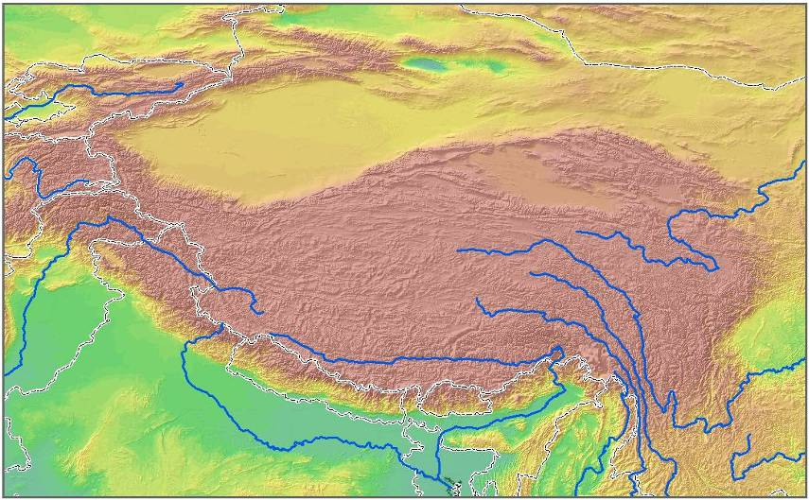
The Himalayan System
RUSSIA
MONGOLIA
Tien Shan
Takla Makan
Karakoram
Tibetan Plateau
(10,000 feet)
6
1
CHINA
PAKISTAN
3
2
Himalaya
5
NEPAL
4
INDIA
(1) Huang He (Yellow) (2) Yangtze (Chang Jiang) (3) Mekong (4) Brahmaputra (5) Ganges (6) Indus

Slide 46
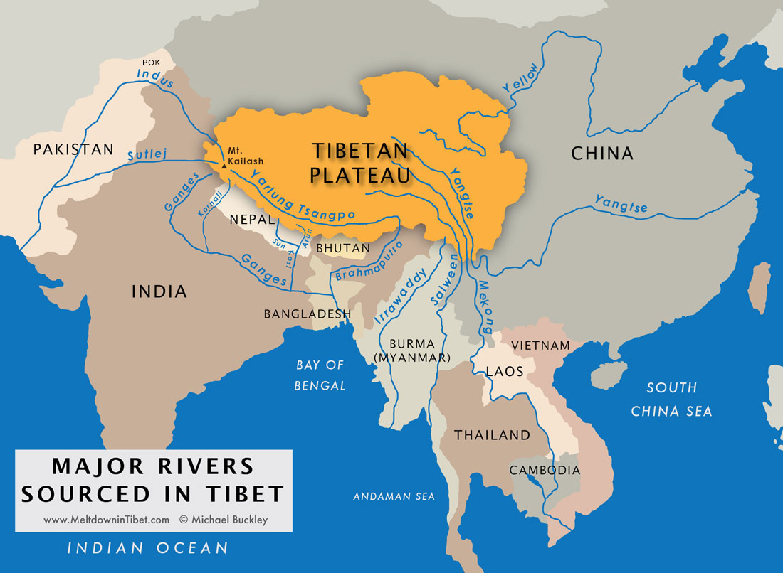

Slide 47
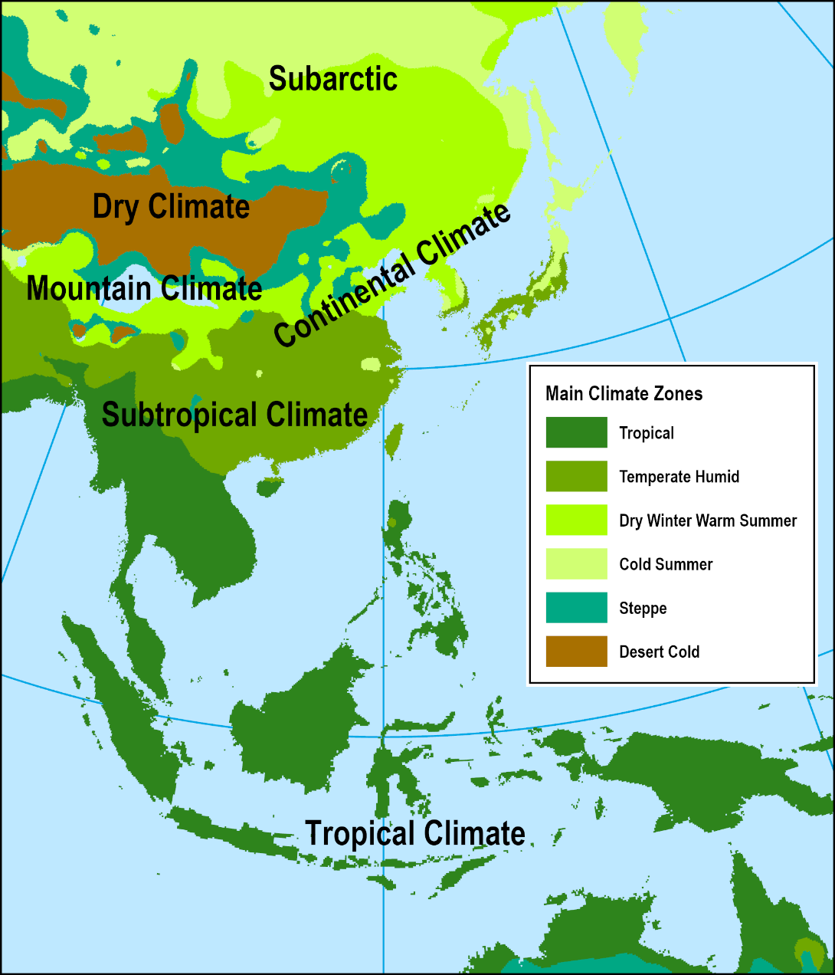
Physical Landscape of Pacific Asia
Climatic diversity
  Latitudinal and altitudinal effects.
  Tropical Climate (hot and humid).
  Subtropical Climate (warm and humid).
  Continental Climate (cold and humid).
  Dry Climate (Desert / steppe and arid)
  Mountain Climate.
  Influence on agriculture:
    Nomadic in the northwest.
    Paddy field / collective in the south.
  Monsoons a fundamental component of climate patterns.

Slide 48
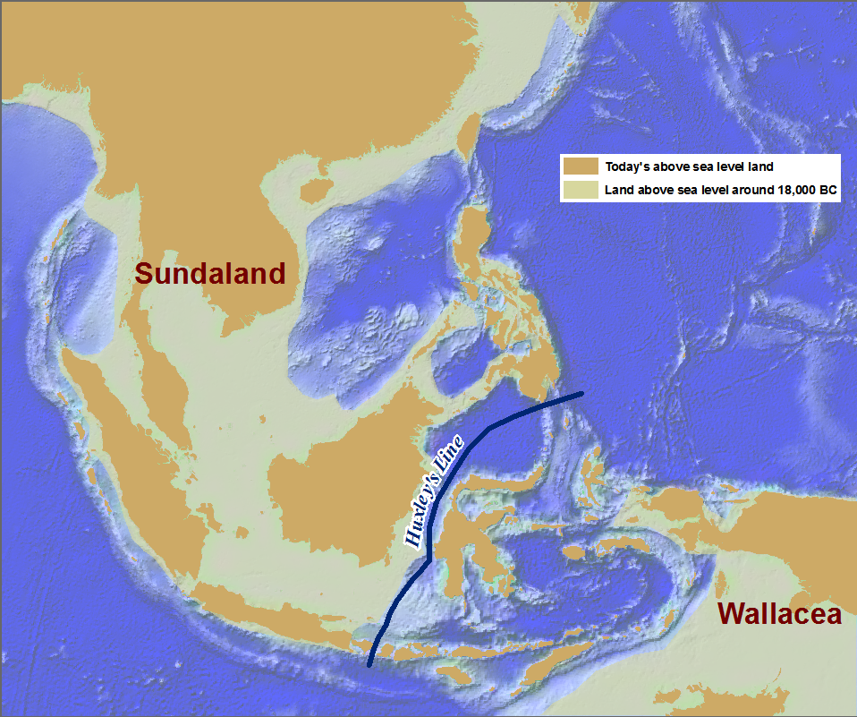
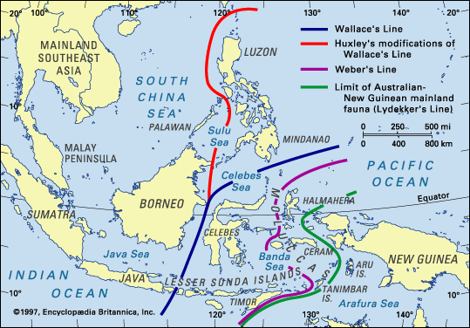
Southeast Asia: Land Above Sea Level Around 18,000 BCE
Sunda Shelf
World’s largest expanse of shallow ocean.
Up to 16,000 years ago: above water.
Deep ocean trench separating Southeast Asia in two. Division between the Asian and Australian ecosystems. Large mammals on western islands (tigers, bears, elephants, rhinoceros and orangutans).

Slide 49
3. Monsoons
Convectional rainfall
  Mostly during the summer, almost everyday around the tropics.
  Hot temperature causes rapid evaporation.
  As the humid air climbs, it cools and causes torrential rain falls.
Orographic rainfall
  Mostly during the monsoons.
  High mountain ranges force humid air masses to climb.
  Air temperature cools and rain falls.
  Rain shadow effect.
  Highest levels of precipitation are on the Indian side of the Himalayas (more than 30 feet of precipitation per year).
Condensation
Evaporation
Wind

Slide 50
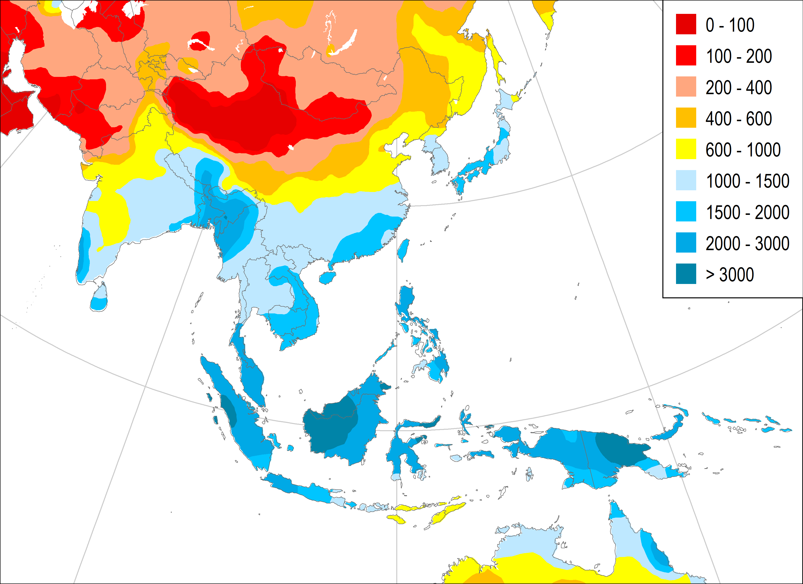
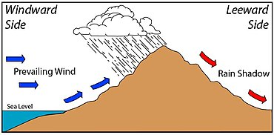
Average Annual Precipitations (in millimeters)
Dry continental
Driest desert on earth
Gobi Desert
Ganges Delta
Mawsynram, India (467” of rain per year; 11860 mm). Most precipitation on earth
Monsoon east
Borneo
Raining every day with no dry season

Slide 51
3. Monsoons
Monsoons
  From the Arabic word “mausim” which means season:
    Annual weather cycle within the tropical and subtropical continents of Asia, Australia and Africa and the adjacent seas and oceans.
  Most vigorous and dramatic cycles of weather events on earth:
    Torrential rains.
    Floods.
    Tropical cyclones.
  Blow from the southwest from April to October:
    Wet season.
    India gets more than 80% of its rainfall during the monsoon.
  Blow from the northeast from October to April:
    Dry season.
  Blocked and directed by Himalayas; Lasts for weeks.
What are the meteorological and economic impacts of the monsoon?

Slide 52
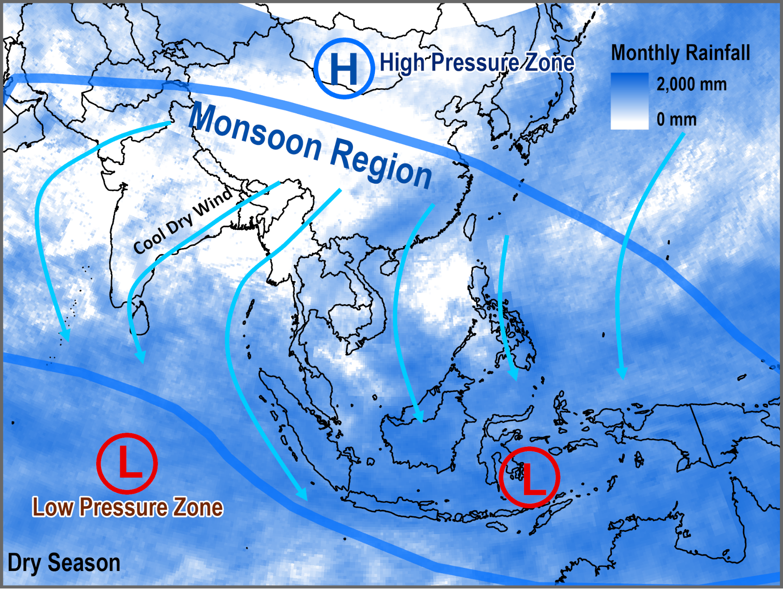
Dominant Wind Patterns in the Winter (October to April) – Dry Season
Notes:
Source: Rainfall dataset: NASA Earth Observations; http://neo.sci.gsfc.nasa.gov/Search.html
November precipitation.

Slide 53
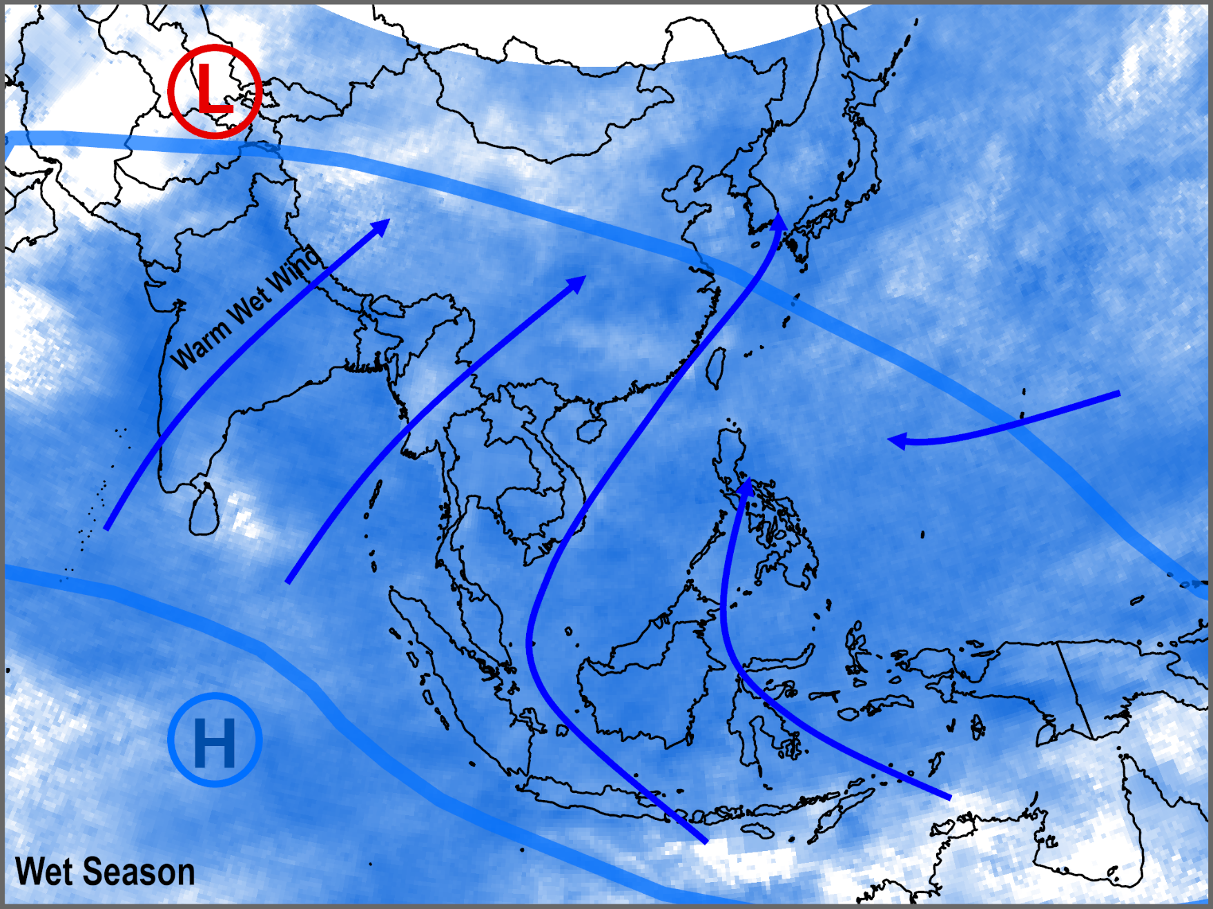
Dominant Wind Patterns in the Summer (April to October) – Wet Season
Notes:
June precipitation.

Slide 54
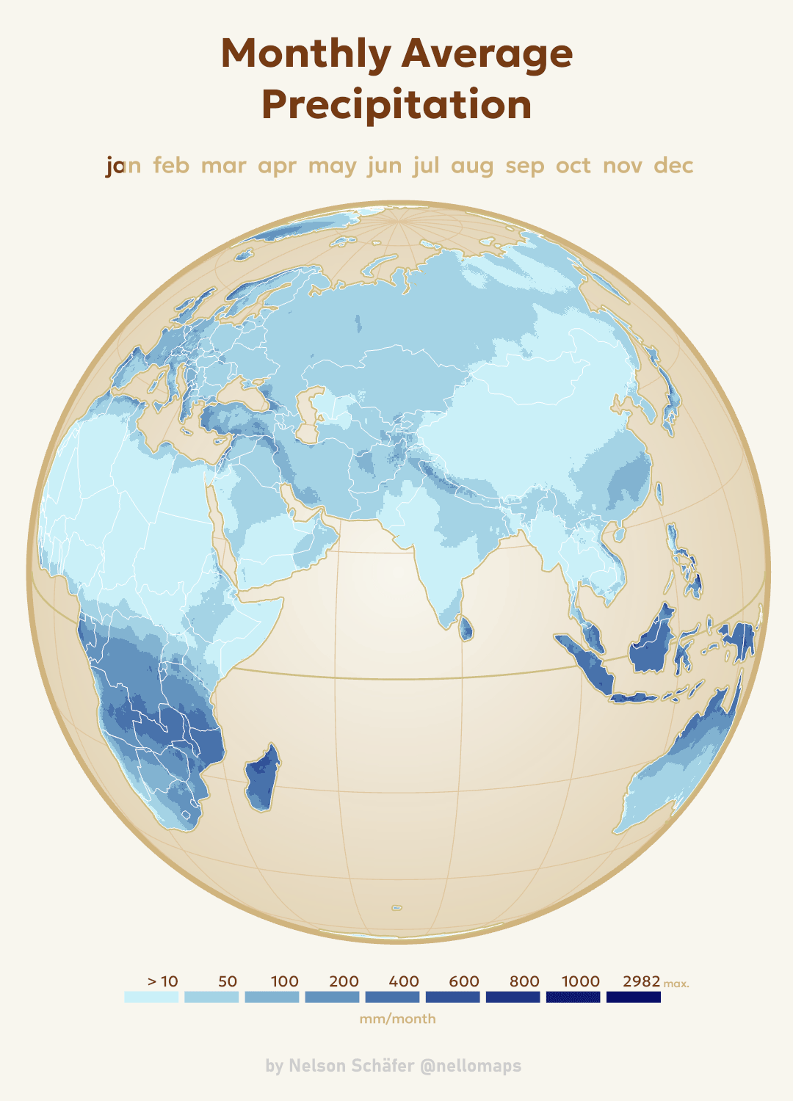
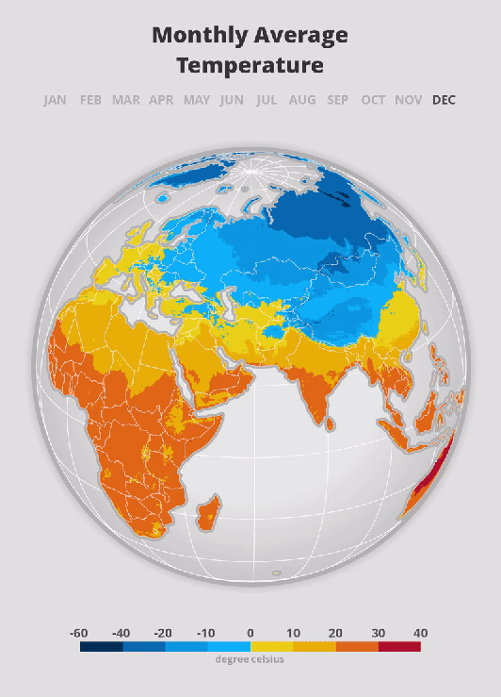

Slide 55
Monthly Precipitations (in mm)

Slide 56
C – The Regions of Pacific Asia
1. Regional Divisions
  What are the major geographical, economic, political and social divisions of Pacific Asia? How are the various levels of economic development of the region expressed in its geography?
2. The East Asian Context
  Which attributes are unique to East Asia?
3. The Southeast Asian Context
  Which attributes are unique to Southeast Asia?

Slide 57
1. Regional Divisions
East Asia:
  Temperate to subtropical climates.
  High population densities.
  Strong nation states / identity.
  Limited (Japan, Koreas) or highly strained (China) natural resources.
Southeast Asia:
  Subtropical to tropical climates.
  Lower population densities (except Java).
  Weak nation states / identity.
  Numerous natural resources (minerals, timber and petroleum).

Slide 58
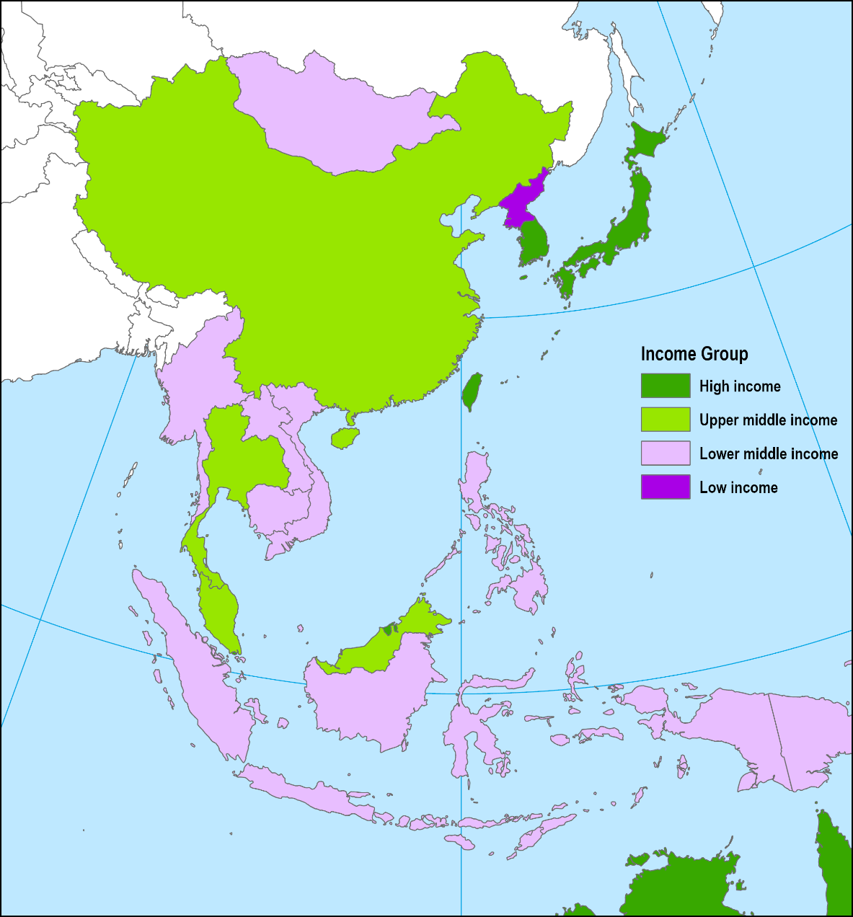
1. Regional Divisions
Japan (High Income)
The People’s Republic of China
NIEs (Newly Industrialized Economies)
  High income.
  South Korea, Taiwan, Hong Kong and Singapore.
  South Korea joined the rank of advanced economies in 2018.
ASEAN-5
  Middle to upper middle income.
  The five major powers of the Association of Southeast Asian Nations.
  Indonesia, Malaysia, Thailand, Vietnam and Philippines.
Transition Economies
  Low to lower middle income.
  The least developed of Pacific Asia
  North Korea, Laos, Cambodia, Burma.

Slide 59
1. Regional Divisions
Cultural divisions
  Japan, China (92% Han), Korea and Taiwan are ethnically homogeneous.
  ASEAN-5, Hong Kong and Singapore are multicultural.
National identity
  A new concept.
  Difficult to assert, especially in Southeast Asia.
  Multicultural archipelagos.
  More tribal and ethnic identity.
Political divide
  China, Vietnam and North Korea still have socialist development strategies.
  Border clashes with Russia, Vietnam and India.
  North Korea and South Korea.
  China and Taiwan.
  China and Hong Kong.
  The South China Sea.

Slide 60
1. Regional Divisions
Newly Industrialized Economies
  New because, Europe, North America and Japan were industrialized since the 19th century.
  South Korea, Taiwan, Hong Kong and Singapore.
  Using “Economies” instead of “Countries”:
    Artificial political entities.
    South Korea: created from the Korean War (1953).
    Taiwan: separated from China at the end of the Chinese Civil War (1949).
    Hong Kong: British colony from 1848 to 1997.
    Singapore: City-State which seceded from the Malaysian Federation in 1965.
  Also known as the “Four Dragons” or “Four Tigers”:
    They belong to the Chinese cultural sphere of influence (less so for South Korea).
    Very aggressive economic actors.
    At the forefront of Asian development.

Slide 61
1. Regional Divisions
Imbalances in distribution
  Japan had around 5% of the workforce of East Asia and generates 19% of the GDP.
  China has 62% of the workforce and generates 53% of the GDP.
Chinese world
  China has the bulk of population.
  City-states (Hong Kong and Singapore) have a combined population of 12 million.
Development
  Advanced economies versus developing economies.
  Labor versus knowledge intensive activities.
  Singapore and South Korea the most knowledge intensive.
  China the most labor intensive, but shifting rapidly.
  Divide linked to labor productivity and technology.

Slide 62
1. Regional Divisions

Slide 63
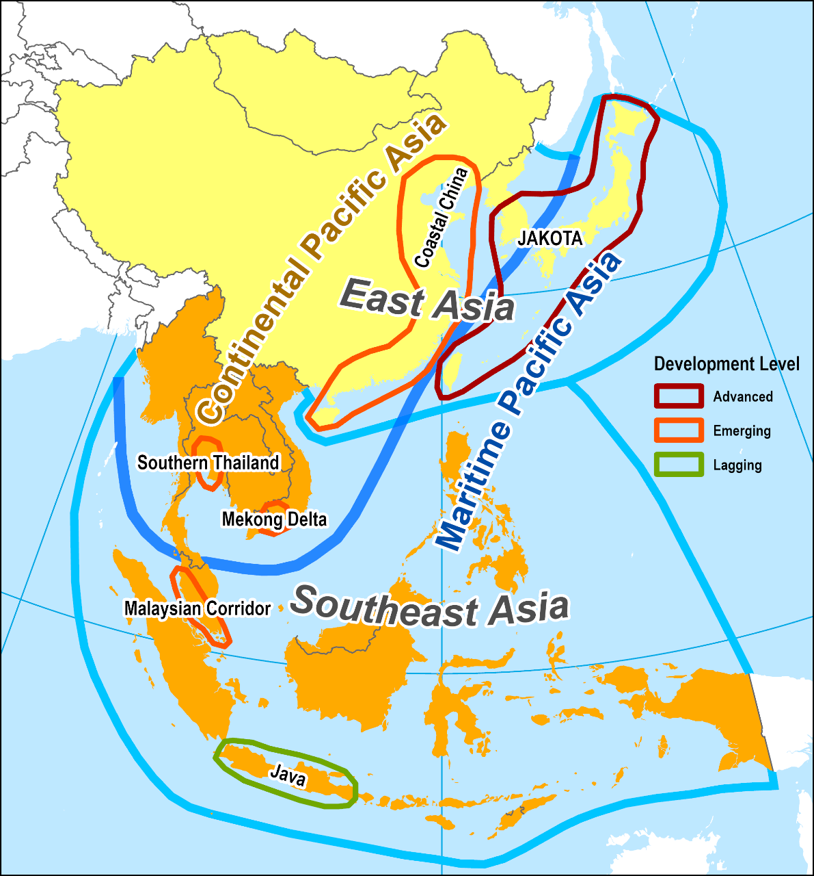
Political, Physiographical and Functional Perspectives
JAKOTA: Japan / Korea / Taiwan
Most advanced segment.
Coastal China: A fast growing segment with three major industrial poles (Beijing, Shanghai and Pearl River Delta).
ASEAN Core (Thailand, Malaysia and Singapore): The most advanced segment of Southeast Asia.
ASEAN Periphery: Less advanced segments of Southeast Asia.
North Korea & Burma: Trade sanctions and economic isolation

Slide 64
2. The East Asian Context
The “Core region” of Pacific Asia
  The tale of two giants (China and Japan) and a divided neighbor (Korea).
    Demographic giant: China.
    Economic giant: Japan.
    Mongoloid race.
  Also considered as the “Chinese Realm” and the “Japanese Realm”:
    Korea being a “zone of interaction” between China and Japan.
  Chinese culture area:
    Mother civilization.
    Japanese and Korean cultures strongly influenced by China.
  East of the Himalayan mountains.
Foreign influence
  Endogenous (mostly) cultural development.
  Both were not influenced from the outside until late 19th century.
  China was forced to open Treaty Ports (Hong Kong, Shanghai, Tianjin, etc.).
  Japan remained closed but reformed with foreign technology.

Slide 65
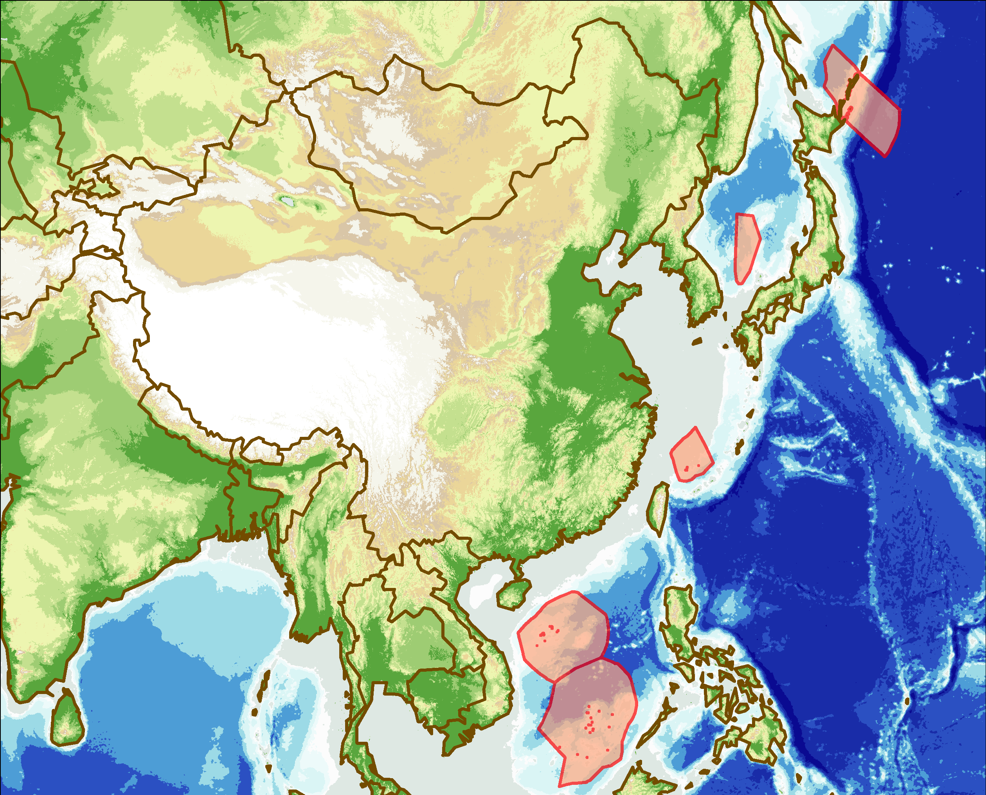
2. The East Asian Context
Growth and development.
Imbalances in the regional distribution of wealth.
Food supply.
Resources hungry China and Japan
Mongolia
N. Korea
China
S. Korea
Himalayas
and Tibetan Plateau
Hunan
Plateau
Coastal
Plains
Korea and its re-unification.
China and Taiwan.
Maritime Exclusive Economic Zone disputes (e.g. The South China Sea).
Pacific Ocean
Taiwan
Guangdong
Plains
South
China Sea

Slide 66
2. The East Asian Context
Demographic issues
  Overpopulation (receding).
  Urbanization and migration (China):
    Moving from a rural to an industrial society.
    Massive rural to urban migration.
  Missing female population.
  Aging of the population (Korea and Japan; beginning in China).
Environmental issues
  Strong focus on development.
  Air quality (urban and regional):
    16 of the world’s 20 most polluted cities are in China.
  Access to water (depletion of river systems and aquifers).
  Depletion of natural resources.

Slide 67
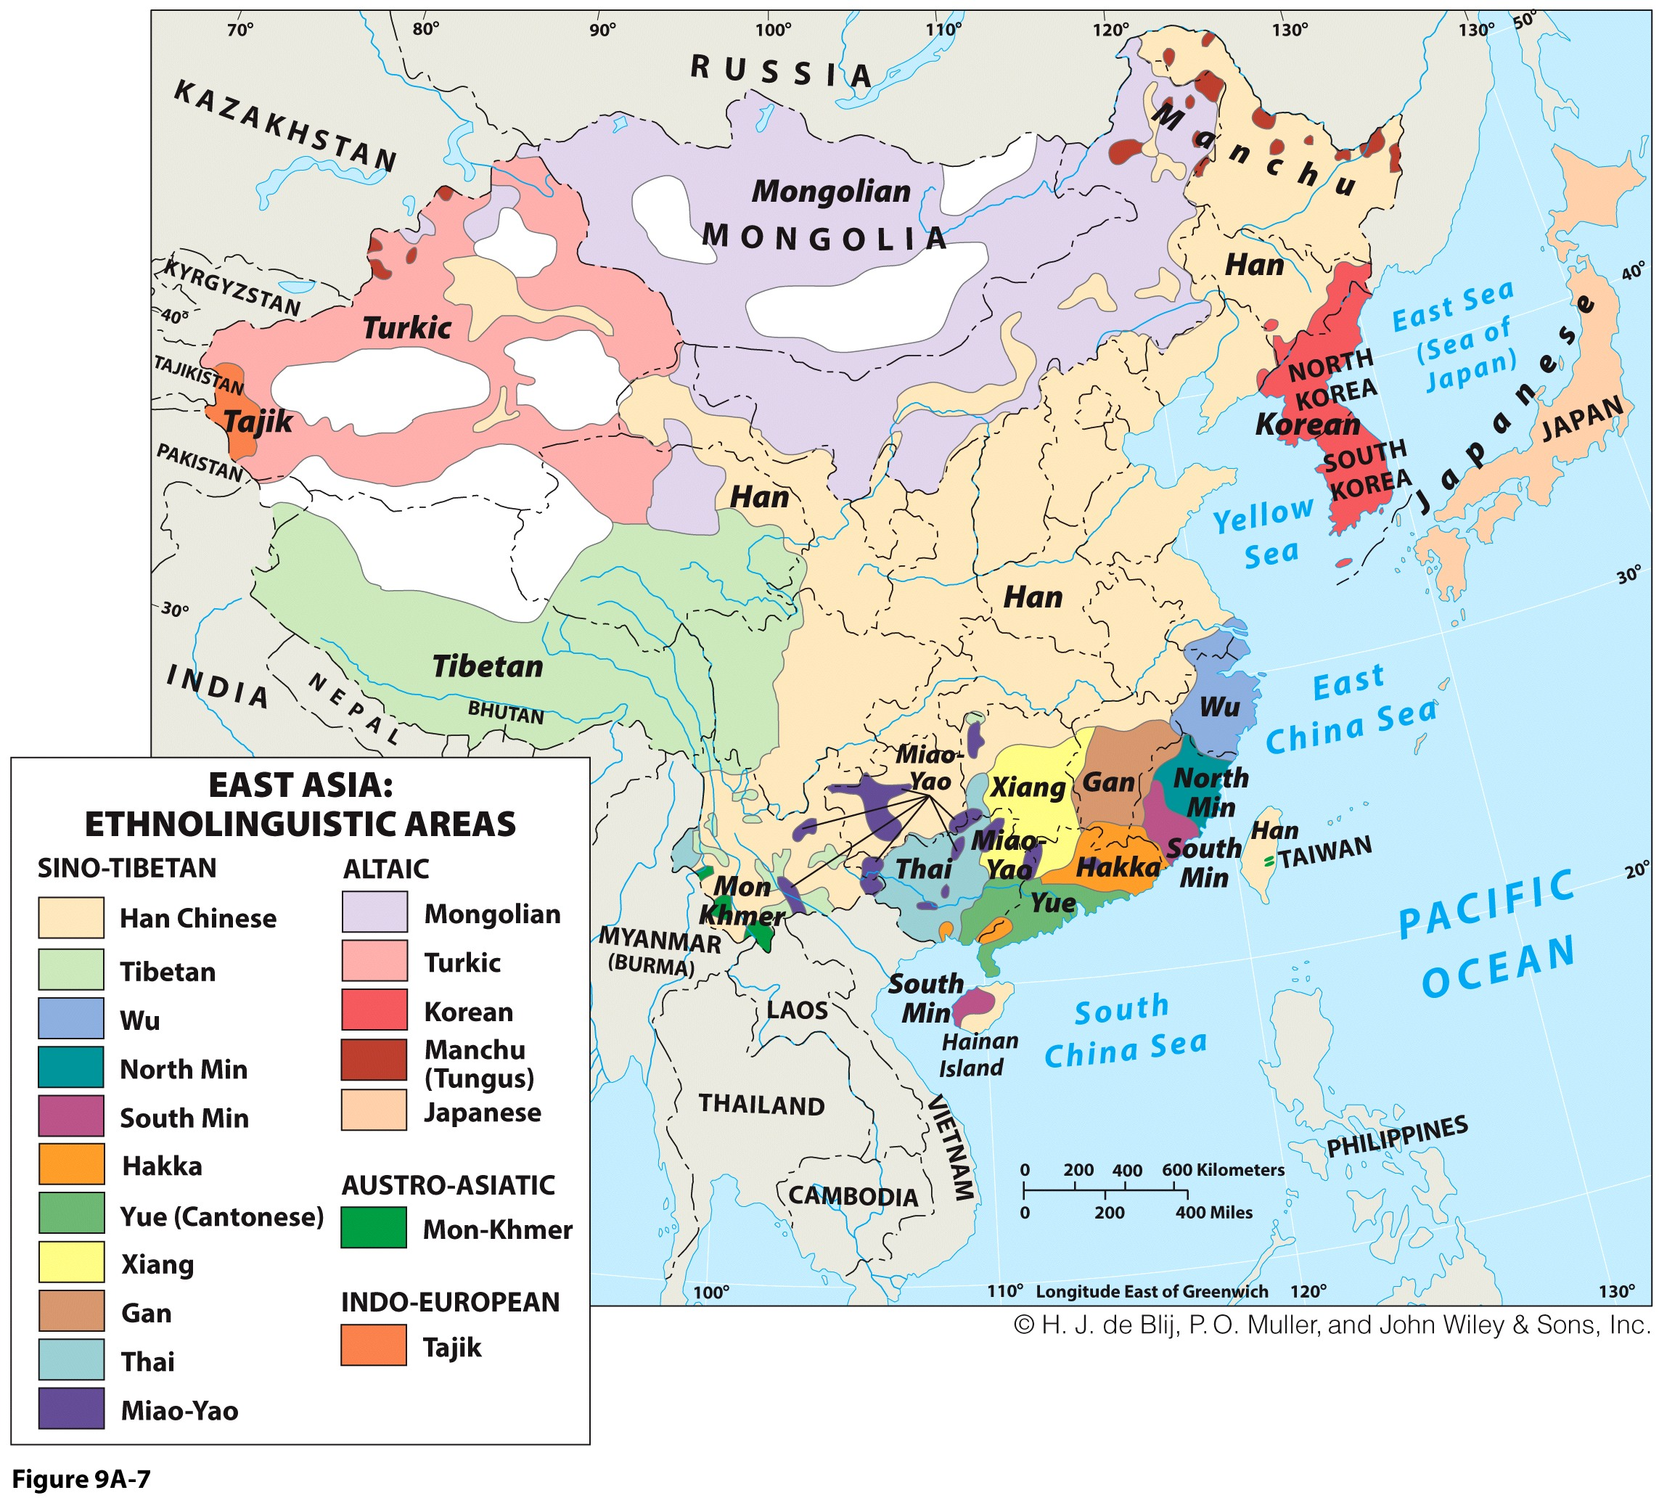

Slide 68
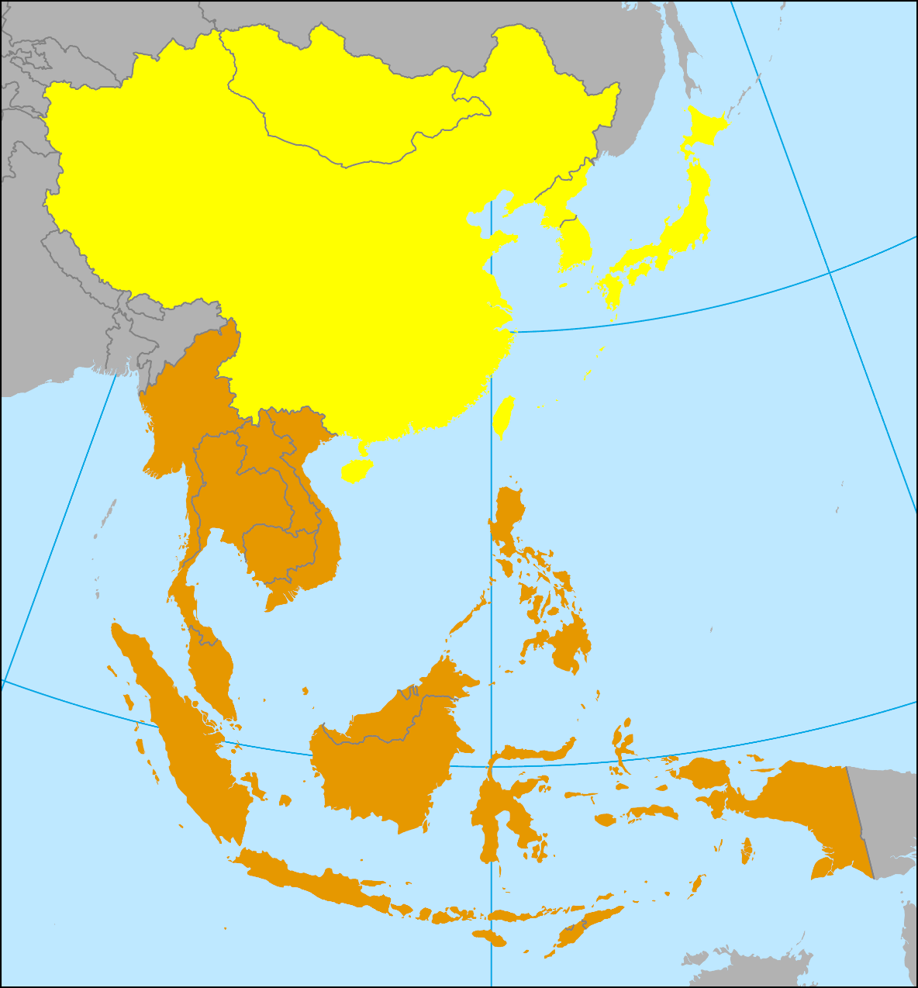
3. The Southeast Asian Context
A zone of interaction
  Have been stronger than internal influences.
  Defined during WWII:
    Political definition for a theater of operation.
  Multicultural (Malay-Indonesian dominance).
  Several political, economic and cultural forces:
    China (cultural and immigrants).
    India (cultural and immigrants).
    Middle East (Islam after the 10th Century).
    Europe (colonialism after the 16th century).
    Japan (occupation WWII; trade and investment from the 1980s).
    USA (Since 1898; Philippines as a colony).
Japan
South
Asia
East Asia
China
USA
India
Southeast Asia
Middle East
Europe

Slide 69
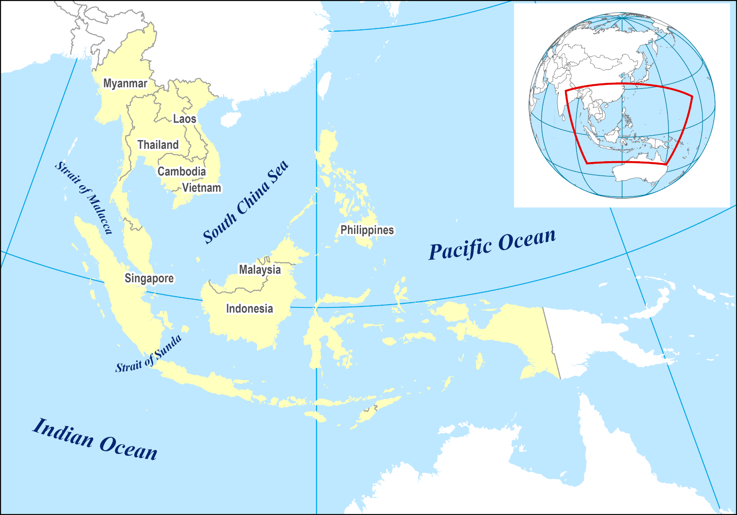
Southeast Asian Nations
Hint at the strong historical Chinese and Indian influence.
Former French colonies of Vietnam, Cambodia and Laos.
Indochina

Slide 70
3. The Southeast Asian Context
Shatter belt
  Caught between stronger colliding external forces, under persistent stress, and often fragmented by aggressive rivals.
  Historical and contemporary significance.
  Theater of conflict during the cold war (1945-1991).
  Vietnam Wars.
  Cambodian Genocide.
Variety of political, economic and cultural landscapes
  Least advanced economies of the region:
    Laos, Cambodia and Burma.
  Emerging nations:
    Malaysia, Indonesia, the Philippines, Thailand.
  The leader: Singapore.

Slide 71
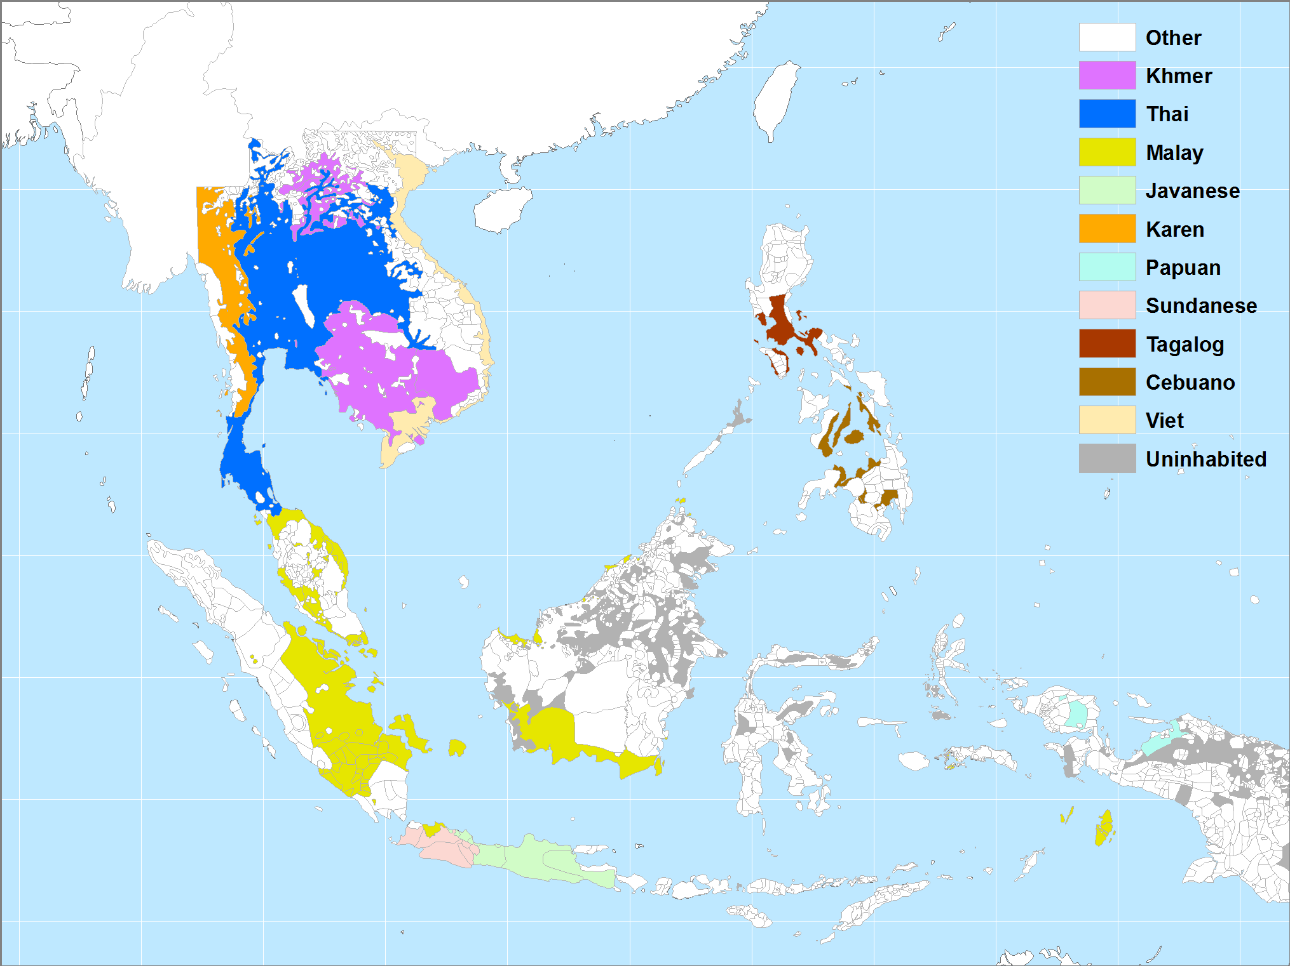
Main Languages of Southeast Asia

