Slide 1
Topic 5 – Maritime Transportation
A – Maritime Shipping
B – Ports

Slide 2
A – Maritime Shipping
Read this section containing detailed background information

Slide 3
Modal Shares of World Trade by Volume and Value, 2008
Read this content
Explain the differences between the importance in the volume and value of international trade by transportation mode.
Notes:
Source: IHS Global Insight, Inc., World Trade Service. Does not include intra-EU trade.

Slide 4
International Seaborne Trade and Exports of Goods, 1955-2020
Read this content
Notes:
Source: World Bank and United Nations, Review of Maritime Transport. Data in current USD.

Slide 5
Value of Containerized Trade, 2020
Read this content
Value of International Trade
$17.6 T
$5.3 T
Value of Maritime Trade
$12.3 T
Value of Containerized Trade
$4.2 T
Total containerized trade
$8.1312 T
$12.3 T
70%
Carried by
$54,493 per TEU
$8.1 T
66%
149.21 M TEUs
$108,986 per FEU
Notes:
Source: 2020 Figures. UNCTAD. Containerized trade in TEU from UNCTAD Review of Maritime Transport, 2021, Table 1.8.

Slide 6
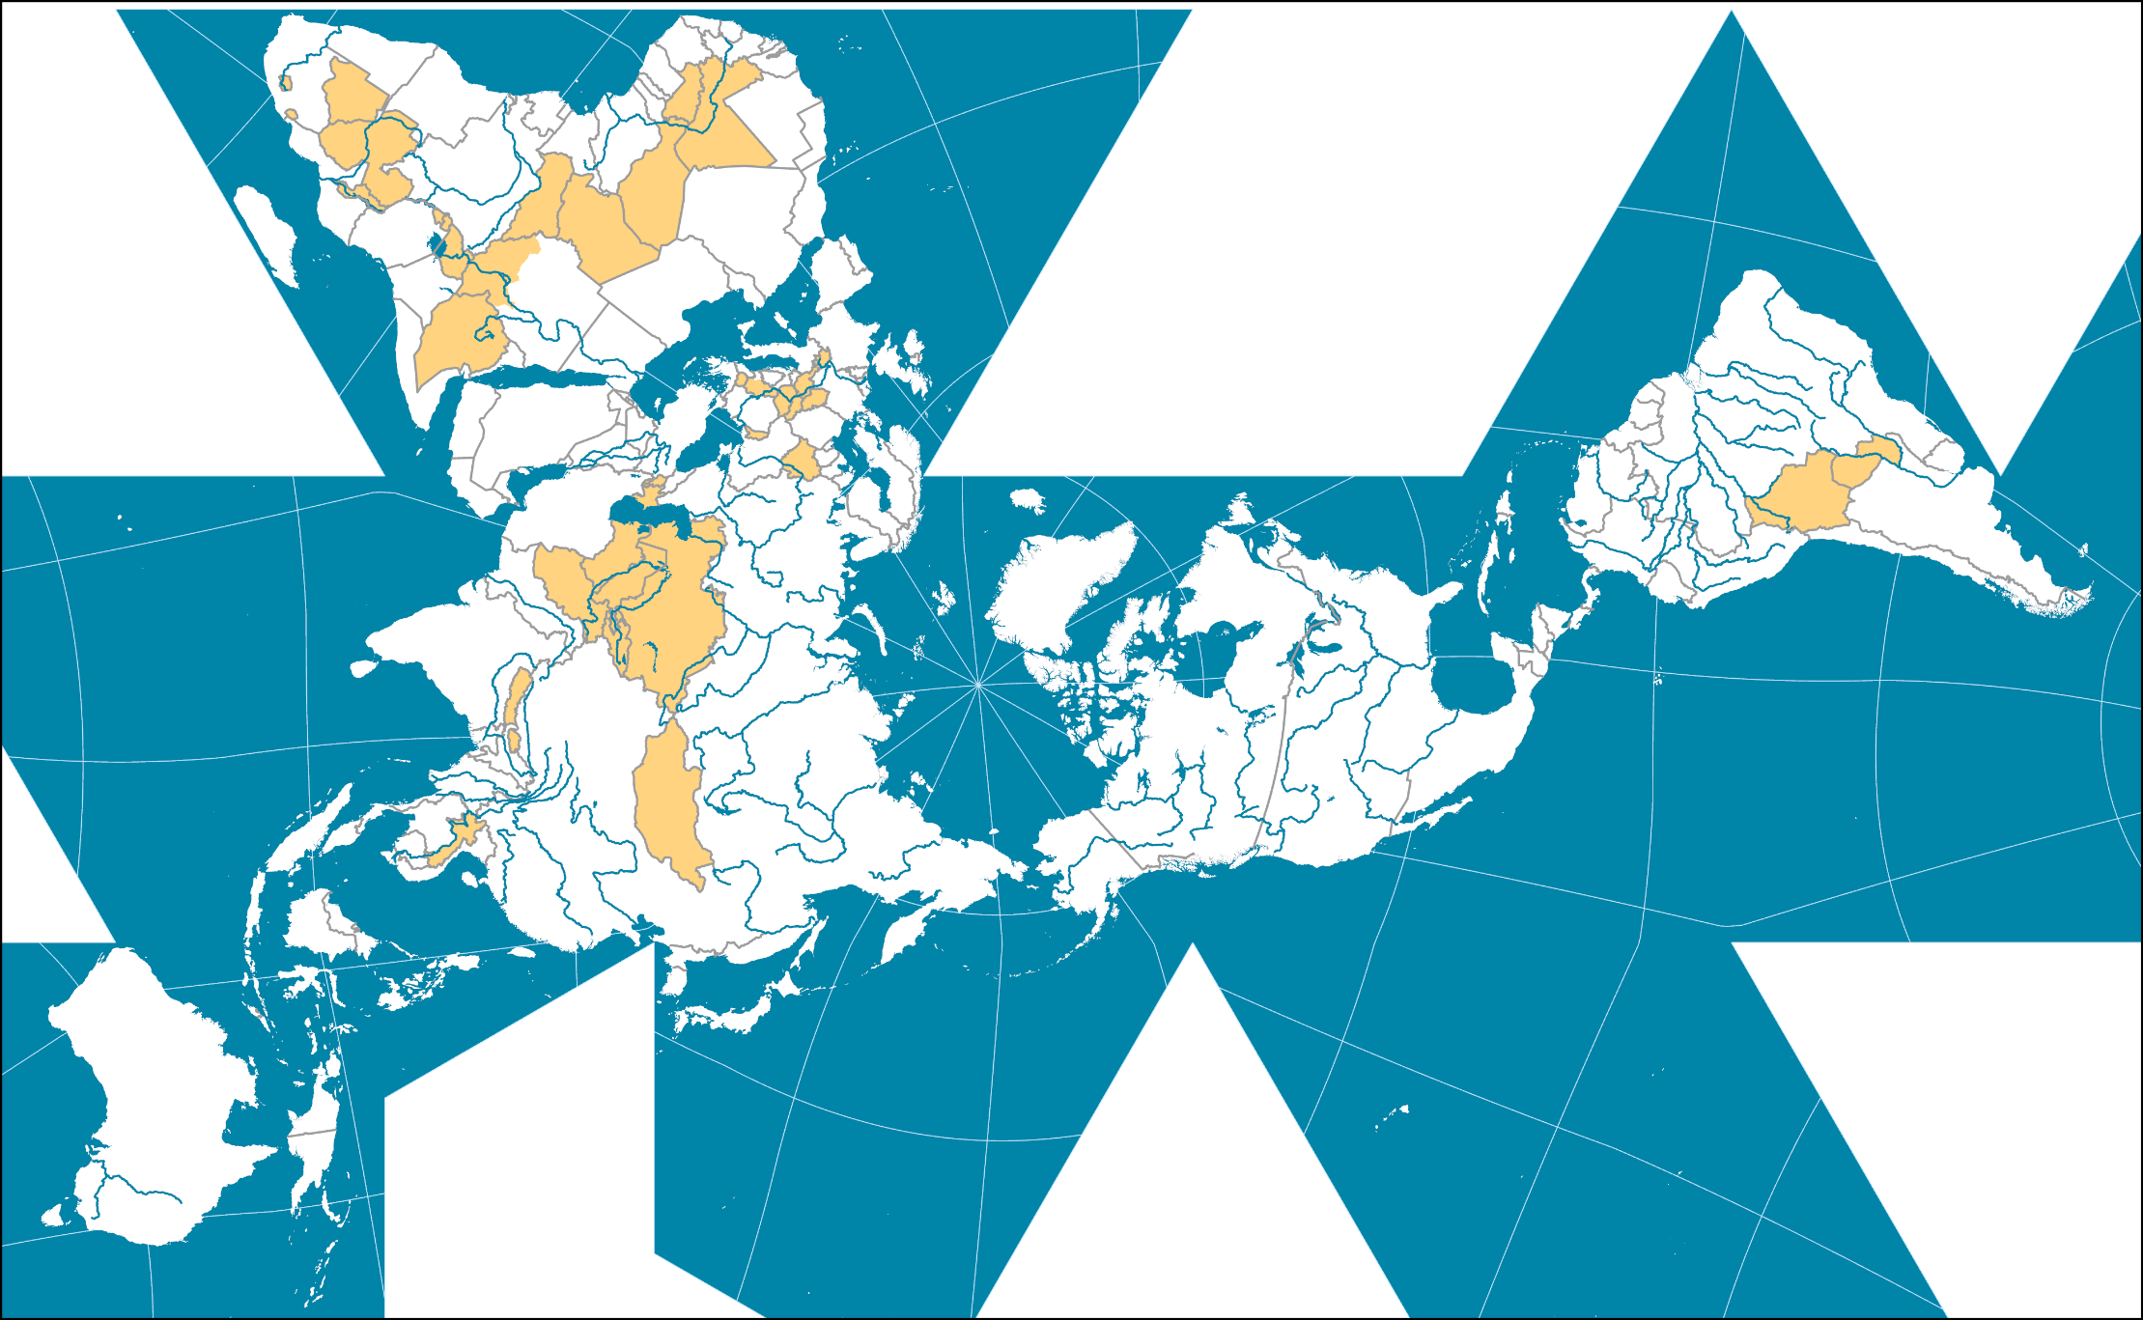
Maritime Enclaves (Landlocked Countries)
Read this content

Slide 7
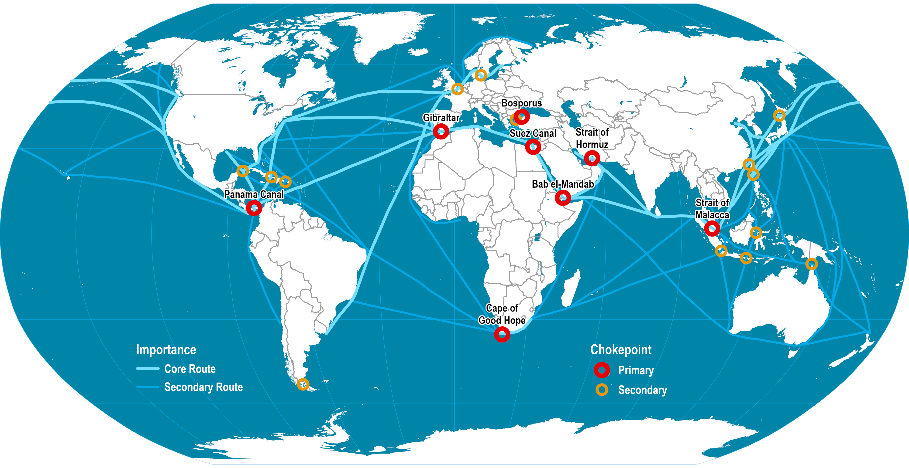
Main Maritime Shipping Routes and Chokepoints
Read this content
Why strategic passages are so important for maritime transportation?
Notes:
Map location: Strategic Maritime Passages

Slide 8
Capacity of Key Strategic Passages
Read this content
Panama
Suez
Malacca
Minimum depth
12 m (40 feet) / 15.2 (50 feet)
24 m (78 feet)
25 m (82 feet)
Length
64 km
193 km
800 km
Standard
Panamax / New-Panamax
Suez-max
Malacca-max
Ship capacity
65,000 dwt / 119,000 dwt
240,000 dwt
300,000 dwt
TEU equivalent
4,500 / 12,500
22,000
25,000
Transit capacity
45 / 57 per day
100 per day
800 per day
# transits (day | year)
36 | 14,000
47 | 18,000
210 | 75,000
Transit time
16.5 hours
14 hours
20 hours
Share of global trade
About 5%
About 15%
About 30%
© PEMP

Slide 9
Comparative Characteristics of the Panama Canal Expansion
Read this content
290x32x12.5
366x49x15.2
Panama Canal: Post Panamax
Panamax (1914-)
New-Panamax (2016-)
32 m (106 feet)
294 m (965 feet)
12.5 m (40 feet)
49 m (160 feet)
366 m (1,200 feet)
15.2 m (50 feet)
Beam / Length / Draft
TEU Capacity
4,500 TEU
12,500 TEU
Bulk capacity
52,000 DWT
119,000 DWT
Locks
Miter gates (lock access guidance by electric locomotives)
Three lock systems:
Gatun Locks (3 stages; 85 feet)
Pedro Miguel Locks (1 stage; 31 feet)
Miraflores Locks (2 stages; 54 feet)
Rolling gates (lock access guidance by tugboats)
Two lock systems:
Agua Clara Locks (3 stages)
Cocoli Locks (3 stages)
Cost
$387 million
$5.4 billion
Annual capacity
13,500 – 14,000 transits
16,000 transits
Notes:
Source: Panama Canal Authority.

Slide 10
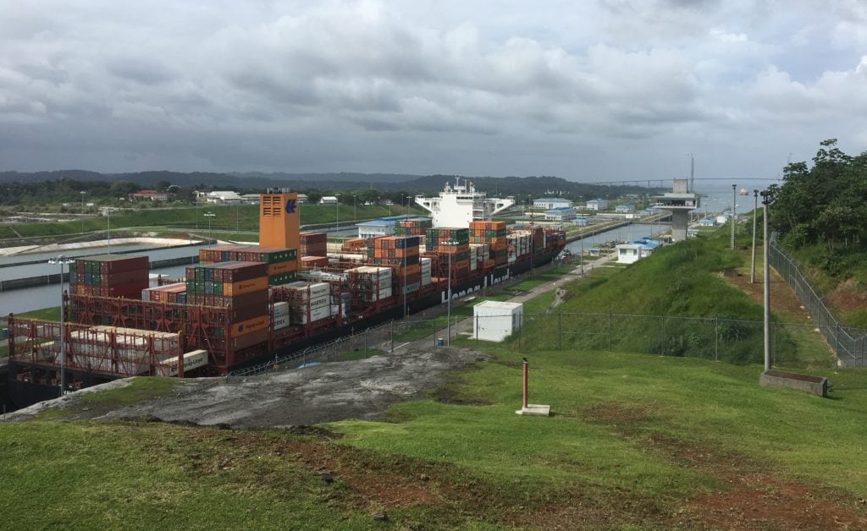
Containeriship Transiting Through the Agua Clara Locks, Panama
Read this content

Slide 11
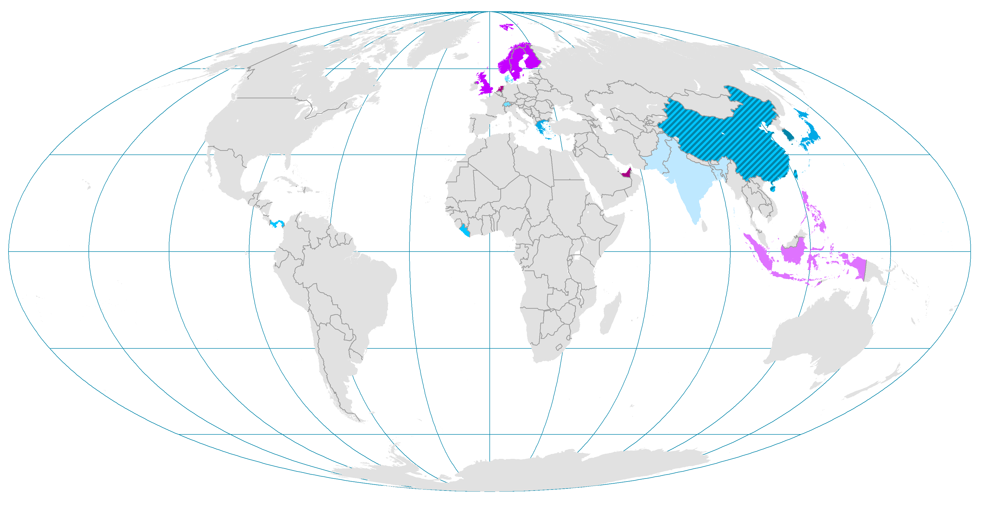
The Maritime Transport Life Cycle and Main National Actors
Read this content
Hong Kong, Netherlands,
Singapore & UAE (44%)
UK & Scandinavia
Philippines & Indonesia
Financing and Insurance
Global Terminal Operators
Seafarers
SUPPORT
CORE
1. Building
2. Ownership
3. Registration
4. Operations
5. Scrapping
China, South Korea & Japan (91%)
Greece, Japan &
China (38%)
Panama, Liberia
& Marshall Islands
(42%)
Denmark &
Switzerland (30%)
India, Bangladesh, China &
Pakistan (95%)
Notes:
Source: Adapted from UNCTAD, Review of Maritime Transport, various issues. J. Hoffmann (2014) “Who controls the world's fleet? Trends in the ship owning countries”, Maritime Money Geneva Forum.

Slide 12
Largest Ships by Category
Ever Ace (2021)
LOA: 399.9 m
Beam: 61.5 m
Draft: 16 m
TEU: 23,992
Containership
TI Europe (2003)
LOA: 380 m
Beam: 68 m
Draft: 24.5 m
DWT: 442,000 t
Ultra Large
Crude Carrier
LOA: 362 m
Beam: 65 m
Draft: 23 m
DWT: 402,000 t
MS Ore Brazil (2011)
Bulk Carrier
Oasis of the Seas (2009)
LOA: 362 m
Beam: 60.5 m
Draft: 9.3 m
Passengers: 5,400
Cruise Ship

Slide 13
Types of Vessels
Passenger ferries | Carried across relatively short bodies of water in a shuttle-type service. Tend to be small and fast vessels, except for high volume markets (e.g. English Channel, Greek islands, Japan, Philippines). Many are RORO vessels.
Cruise ships | Trips of various durations, usually over several days. Several amenities (restaurants, theaters, swimming pools, casinos). Usually very large capacity ships. Before air transportation, serviced by liner passenger ships, dominantly over the North Atlantic.
RORO vessels | Roll on – Roll off Allow cars, trucks and trains to be loaded directly on board. The largest are the car carriers that transport vehicles from assembly plants to main markets.
How The World's Largest Cruise Ship Makes 30,000 Meals Every Day
MEYER WERFT - Der Bau der Spectrum of the Seas (The making of the Spectrum of the Seas)

Slide 14
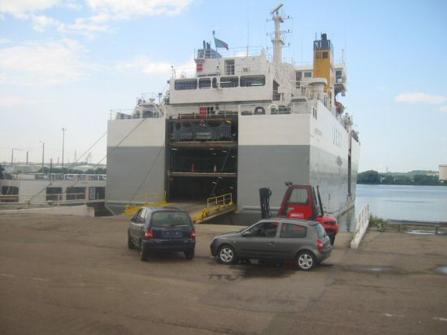
RO-RO Cargo Ship (Stern Ramp)
Read this content
Notes:
Photo: Dr. Jean-Paul Rodrigue, 2003

Slide 15
Types of Vessels
Bulk cargo | Freight, both dry or liquid, that is not packaged. Minerals (oil, coal, iron ore) and grains. Use of specialized ships such as oil and gas tankers. Specialized transshipment and storage facilities. Single origin, destination and client. Prone to economies of scale.
Break-bulk cargo | Cargo packaged in some way (bags, boxes or drums). Numerous origins, destinations and clients. Before containerization, economies of scale were difficult to achieve. Dominance of the containership.

Slide 16
Types of Maritime Cargo
Read this content
Break Bulk
Drums, bags, pallets, boxes
Lift-on/lift-off
7% of tonnage
General Cargo
Neo Bulk
Lumber, paper, steel, vehicles
Unitized Cargo
Lift-on/lift-off, roll-on/roll-off
5% of tonnage
Containerized
Containers
Lift-on/lift-off
13% of tonnage
Liquid Bulk
Petroleum, LNG, chemicals, vegetal oils
Bulk Cargo
Pumps and pipelines
35% of tonnage
Loose Cargo
Dry Bulk
Coal, iron ore, grains, bauxite, sand
Grabs / suction and conveyors
40% of tonnage

Slide 17
World Seaborne Trade by Cargo Type, 1970-2018
Read this content
5 Main bulk: Iron ore, grain, coal, bauxite/alumina and phosphate rock
Notes:
Source: UNCTAD Review of Maritime Transport, various years. http://www.unctad.org/
Major dry bulk are iron ore, grain and coal.

Slide 18
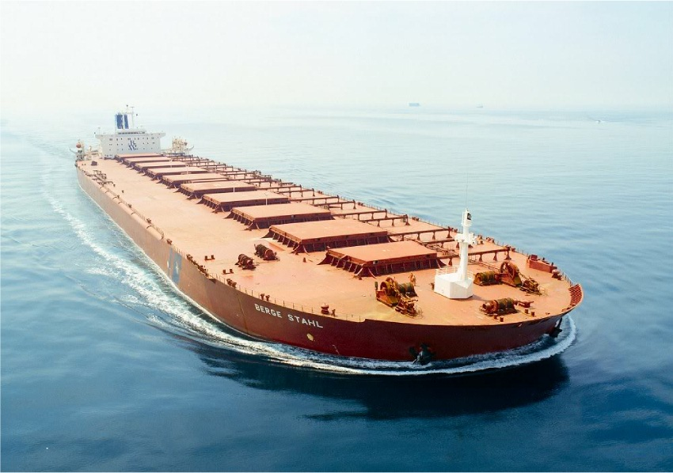
Ultra Large Ore Carrier, the Berge Stahl (Bulk)
Read this content
Notes:
Photo: BW Fleet Management Pte. Ltd., Singapore.

Slide 19
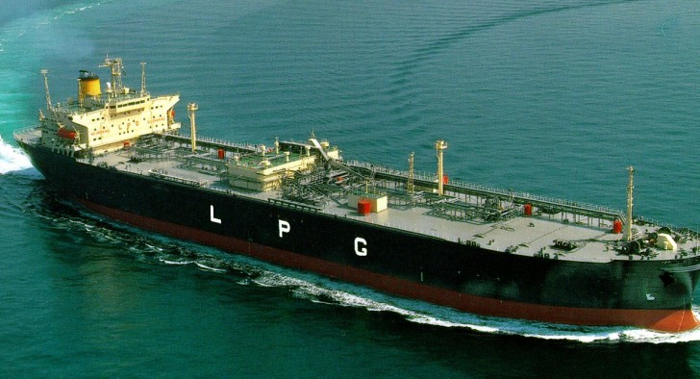
Liquid Petroleum Gas Carrier (Bulk; Mostly Propane)
Notes:
propane, butane, propylene and ethylene
LPG occupies 274 times less space as a liquid.

Slide 20
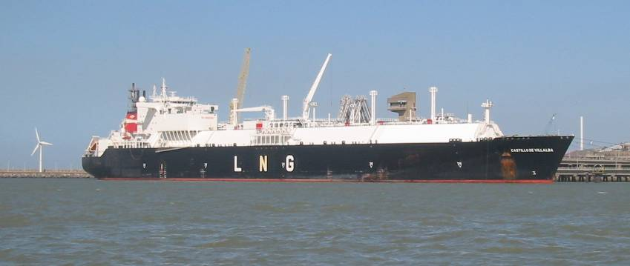
Liquid Natural Gas Carrier (Bulk; Mostly Methane)
Read this content

Slide 21
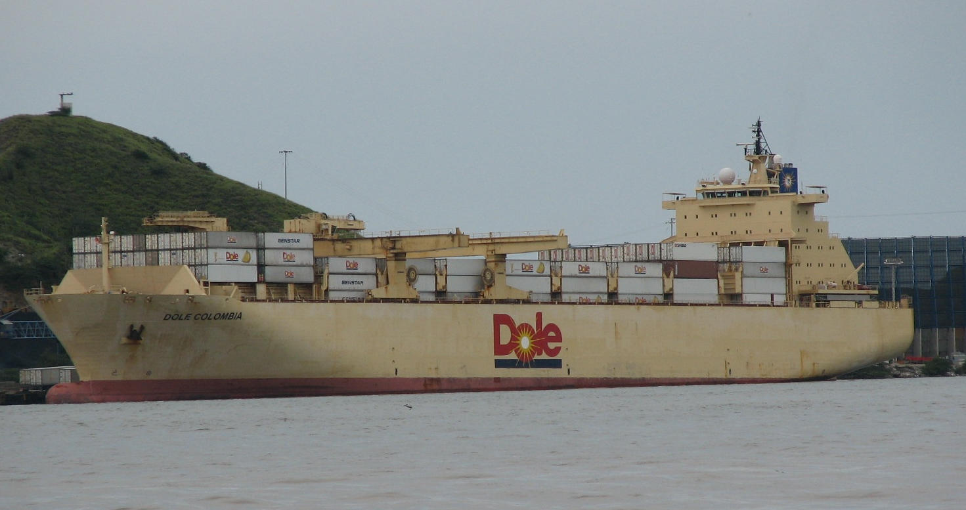
Reefer Ship (Break Bulk)
Read this content
Notes:
The Self-Sustaining Cellular Reefer Vessel (Banana Ship) Dole Chile and her sister vessel, the Dole Columbia, marked a new departure in reefer ship technology. Prior to their delivery, AP Moller’s large containerships were the world’s largest reefer ships with the ability to carry up to 700 refrigerated TEU. The two Dole self-sustaining fully cellular vessels combine a hatchcoverless configuration, with a record-breaking concentration of perishable cargo carrying capacity. Dole Chile has a capacity of 1,000 40ft containers or 2,000 TEUs. This equates to approximately 2m cbf, making the Dole sisters the largest cold storage vessels in the world. Dole Chile was built by Howaldtswerke-Deutsche Werft (HDW) in Kiel for Dole Fresh Fruit International, and delivered in 1999. The vessel is deployed primarily in transporting bananas from Costa Rica to the east coast of the USA.

Slide 22
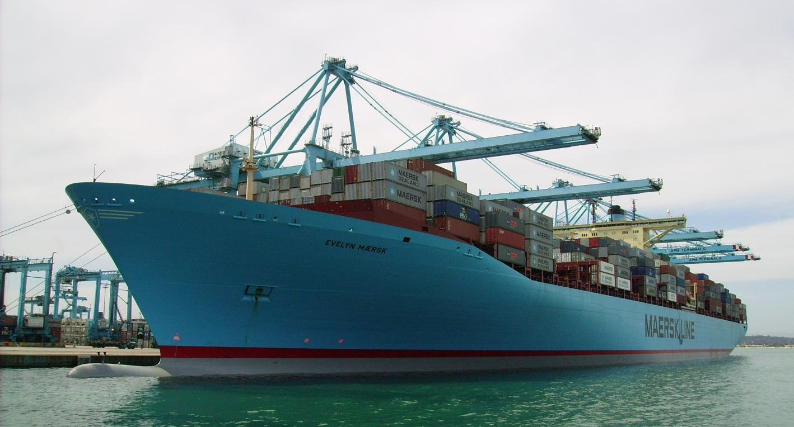
The Evelyn Maersk (Containership: break-bulk)
Read this content
Notes:
Photo: Dr. Theo Notteboom (Port of Algeciras, Spain).

Slide 23
Evolution of Containerships
Read this content
Early Containerships (1956-)
137x17x9
(LOA – Beam – Draft)
Containers across
6
500 – 800 TEU
meters
4
A
200x20x9
4
8
Fully Cellular (1970-)
10
1,000 – 2,500 TEU
215x20x10
Containers high on deck
5
Containers high below deck
4
13
Panamax (1980-)
6
3,000 – 3,400 TEU
250x32x12.5
5
B
Panamax Max (1985-)
8
3,400 – 4,500 TEU
290x32x12.5
17 bays
6
Post Panamax I (1988-)
15
4,000 – 6,000 TEU
300x40x13
17 bays
9
C
5
Post Panamax II (2000-)
17
6,000 – 8,500 TEU
20 bays
9
340x43x14.5
6
Notes:
Source: Ashar and Rodrigue, 2012. All dimensions are in meters.

Slide 24
Evolution of Containerships
22
VLCS (2006-)
23 bays
D
10
11,000 - 15,000 TEU
397x56x15.5
8
19-20
E
New-Panamax (2014-)
10
12,500 TEU
366x49x15.2
22 bays
6
23
24 bays
ULCS (2013-)
10
18,000 – 21,000 TEU
400x59x16
8
F
24
MGX-24 (2019-)
24 bays
10
21,000 – 25,000 TEU
400x61x16
8
Why containerships are getting bigger and what are the limitations to their size?
Tour of a Mega Container Ship

Slide 25
The Largest Available Containership, 1970-2020
Read this content
“Triple E” Class
(18,000 TEU)
F
E “Emma” Class
(14,000 TEU)
ULCS
S “Sovereign” Class
(8,000 TEU)
D
R “Regina” Class
(6,000 TEU)
E
VLCS
C10 Class
(4,500 TEU)
L “Lica” Class
(3,400 TEU)
C
Post Panamax (I & II)
A
B
Panamax
© PEMP
Notes:
“Triple E” Class (2013)
E “Emma” Class (2006)
S “Sovereign” Class (1997)
R “Regina” Class (1996)
C10 APL (1988)
L “Lica” Class (1981)

Slide 26
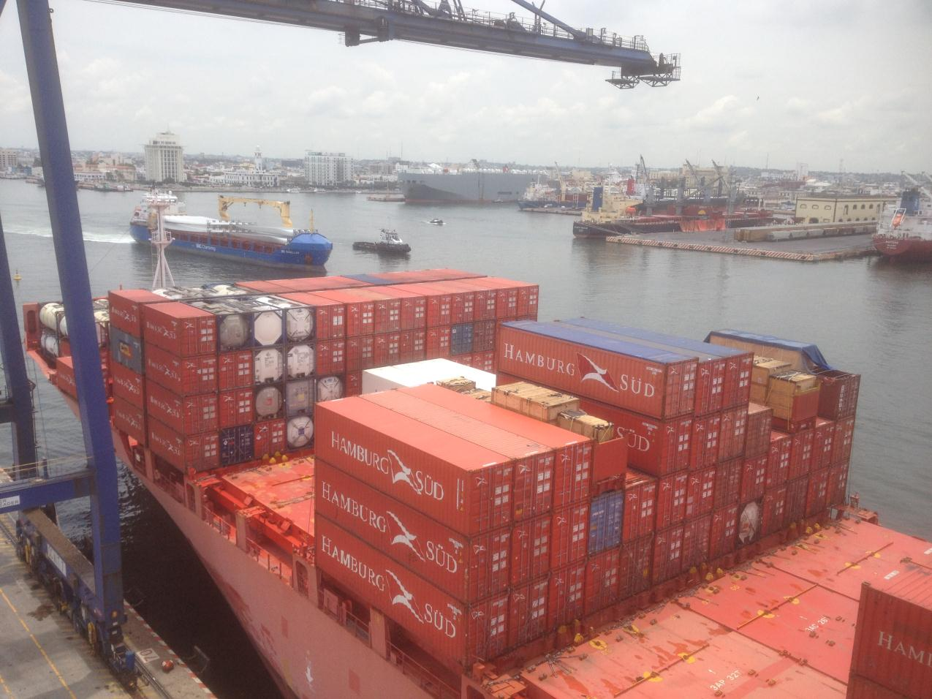
Stacked Upper Deck of a Containership
Read this content

Slide 27
World’s Largest Maritime Container Shipping Operators, 2020
Notes:
Source: Alphaliner. https://www.alphaliner.com/top100/

Slide 28
Types of Maritime Routes
Read this content
RTW
Pendulum
Port-to-Port
Inter-Range
Multi-Ranges
Point to point services.
Empty backhauls.
Common for bulk freight.
Sequential shipping service between two maritime ranges (seaboards).
Balancing the number of port calls and the frequency of services.
Can rely on transshipment hubs between ranges.
Servicing a sequence of ports along several ranges.
Pendulum services.
Round-the-world services.
Small number of ports per range are serviced.
A series of transshipment hubs connecting with regional services.

Slide 29
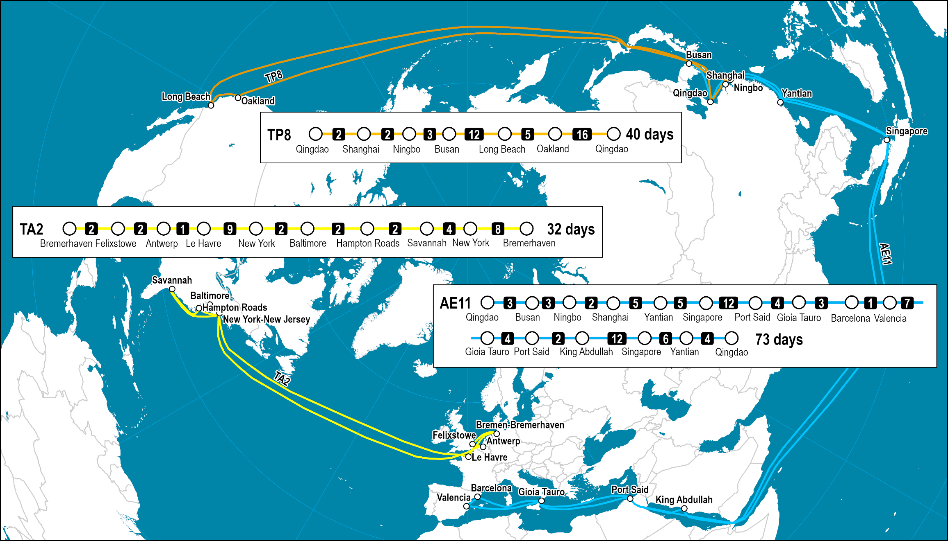
Three Major Inter-Range Routes Serviced by Maersk
Read this content
Notes:
Map location: Strategic Maritime Passages

Slide 30

Global Maritime Piracy, 2008-2009
Read this content
To what corresponds maritime piracy?
Notes:
Source: ICC International Maritime Bureau. Encoding of piracy events by William Moreto.

Slide 31
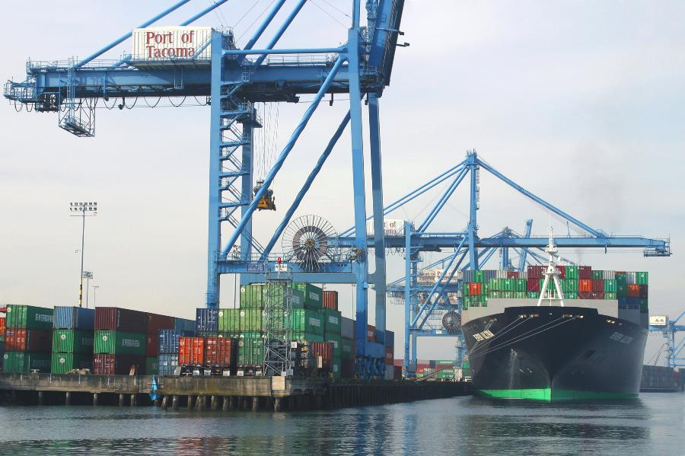

Short Assignment: Maritime Transportation
Provide an overview of the five main types of ships used by maritime transportation, notably in terms of their use and type of cargo.

Slide 32
B – Ports
Read this section containing detailed background information

Slide 33
Transport and Cargo Handling Functions of a Port
Read this content
PORT
Services to ships
Services to cargo
© PEMP
Industrial complexes
Logistics clusters

Slide 34
The Dimensions of a Port
Location
Operations
Governance
Function
Foreland
Hinterland
© PEMP
Site and situation
Capacity
Jurisdiction
Cargo handling
Scale
Efficiency
Management
Specialization
Read this content
What is a port and the functions it performs?
Notes:
Source: Adapted from P. De Landen (2006) “Stakeholders, conflicting interests and governance in port clusters”, Research in Transportation Economics 17, 457-477.

Slide 35
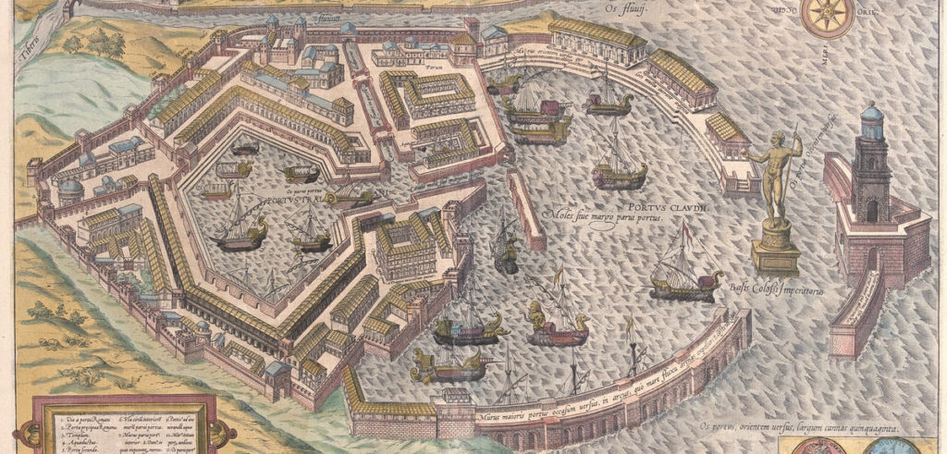
The Port of Portus, Ancient Rome
Read this content

Slide 36
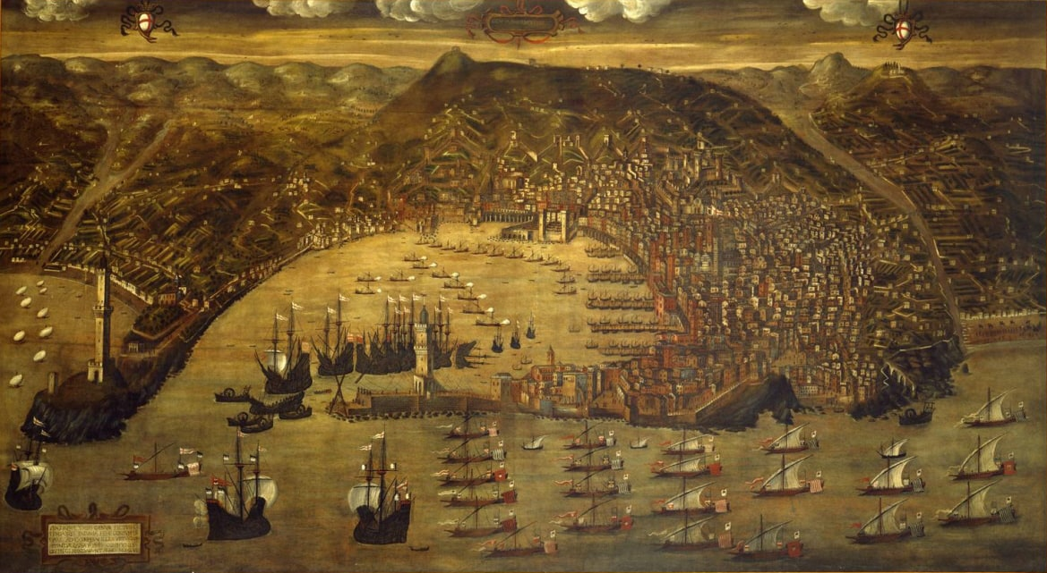
Port of Genoa, Late 15th Century
Read this content

Slide 37
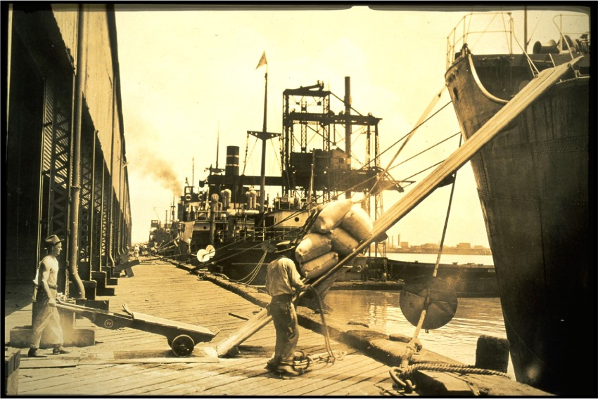
Loading Break-bulk Cargo, Port of New Orleans, early 20th Century
Read this content

Slide 38
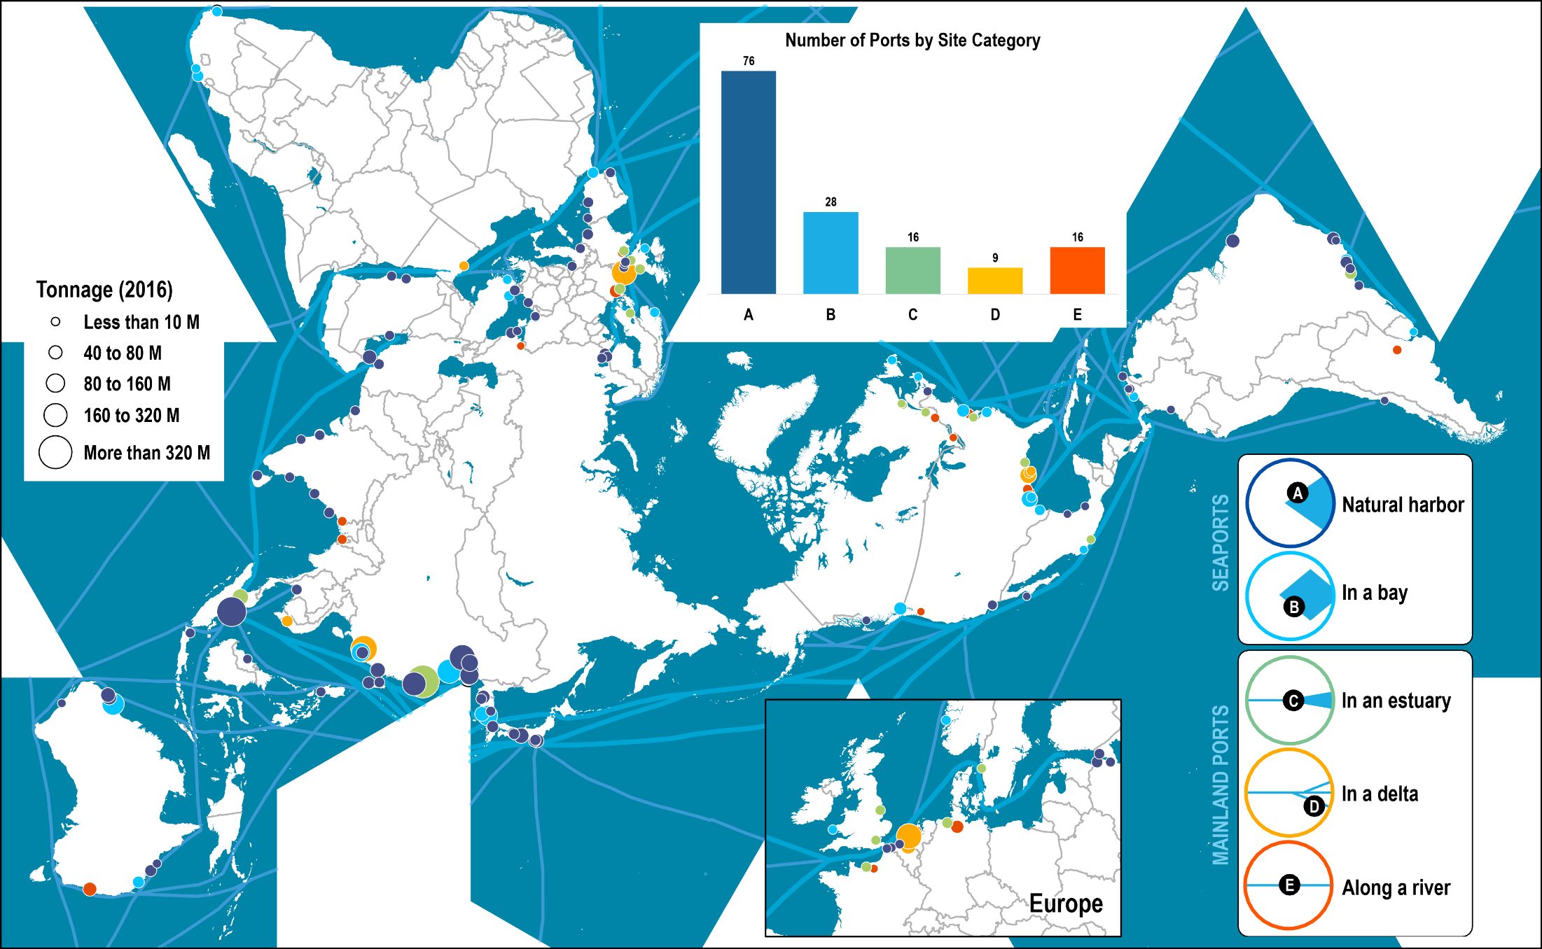
Port Sites
Read this content

Slide 39
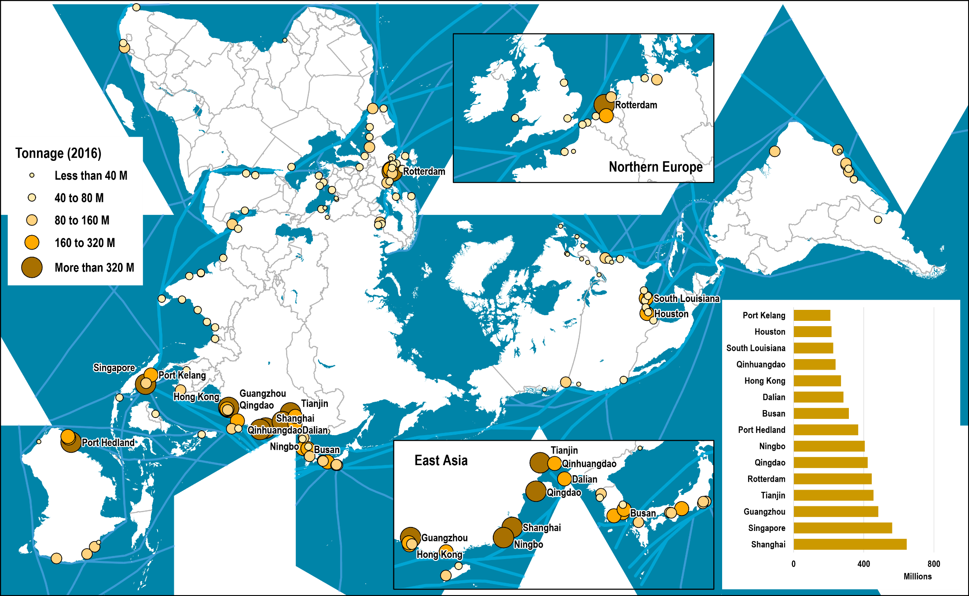
Tonnage Handled by the World’s Major Ports, 2016
Read this content
Notes:
Source: Adapted from the American Association of Port Authorities.
Map location: Global Container Ports

Slide 40
Types of Port Terminals
Read this content
General Cargo
Break Bulk
General warehouses (Drums, bags, pallets, boxes)
Lift-on/lift-off (1.0 day average port time)
7% of tonnage
Unitized Cargo
Neo Bulk
Parking spaces and warehouses (Lumber, paper, steel, vehicles)
Lift-on/lift-off, roll-on/roll-off (1.0 day average port time)
5% of tonnage
Containerized
Paved yards (Containers)
Lift-on/lift-off (0.9 days average port time)
13% of tonnage
PORTS
TERMINALS
Bulk Cargo
Liquid Bulk
Storage facilities (Petroleum, LNG, chemicals, vegetal oils)
Pumps and pipelines (1.1 to 1.3 days average port time)
35% of tonnage
Loose Cargo
Dry Bulk
Open or covered stacks (Coal, iron ore, grains, bauxite, sand)
Grabs / suction and conveyors (2.7 days average port time)
40% of tonnage
Passengers
Ferry & Cruise
Parking spaces, waiting queues, and terminals
Roll-on/roll-off, gangways (Less than 0.5 days average port time)
People and Vehicles

Slide 41
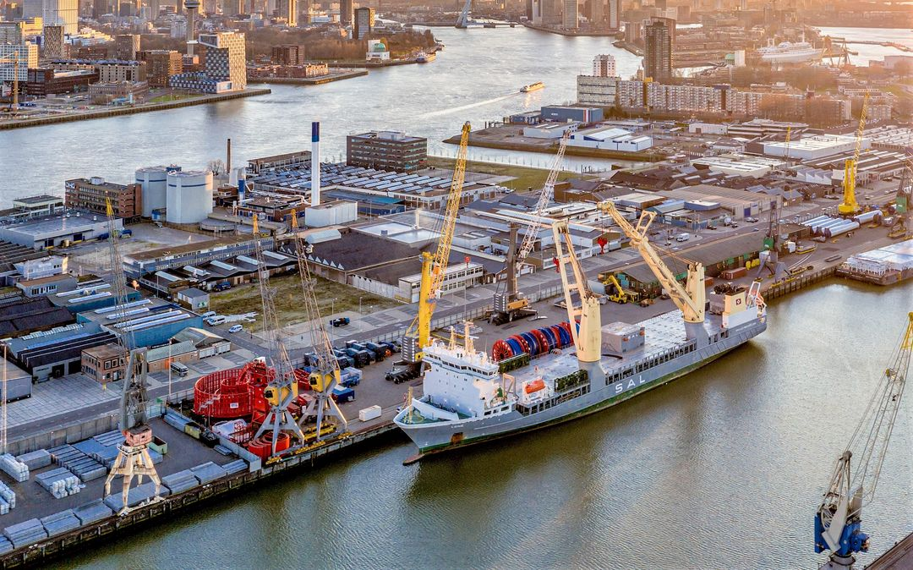
Break Bulk Terminal, Port of Rotterdam

Slide 42
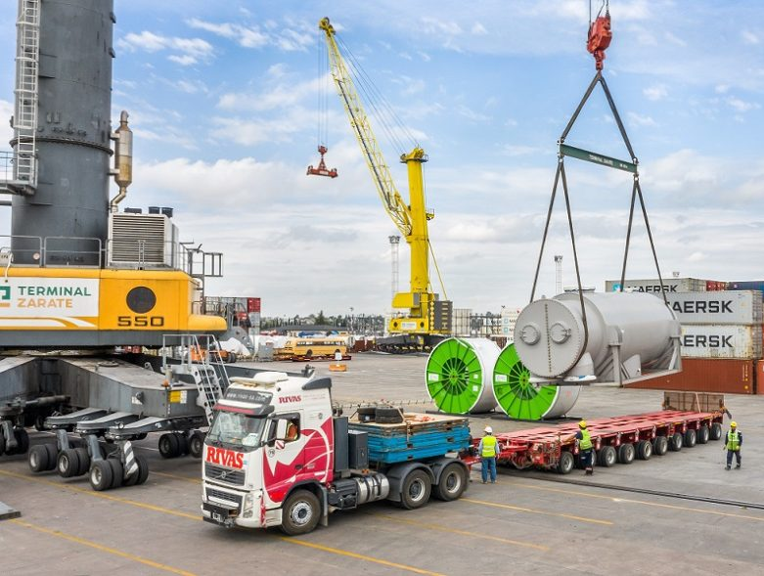
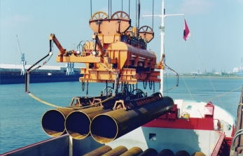
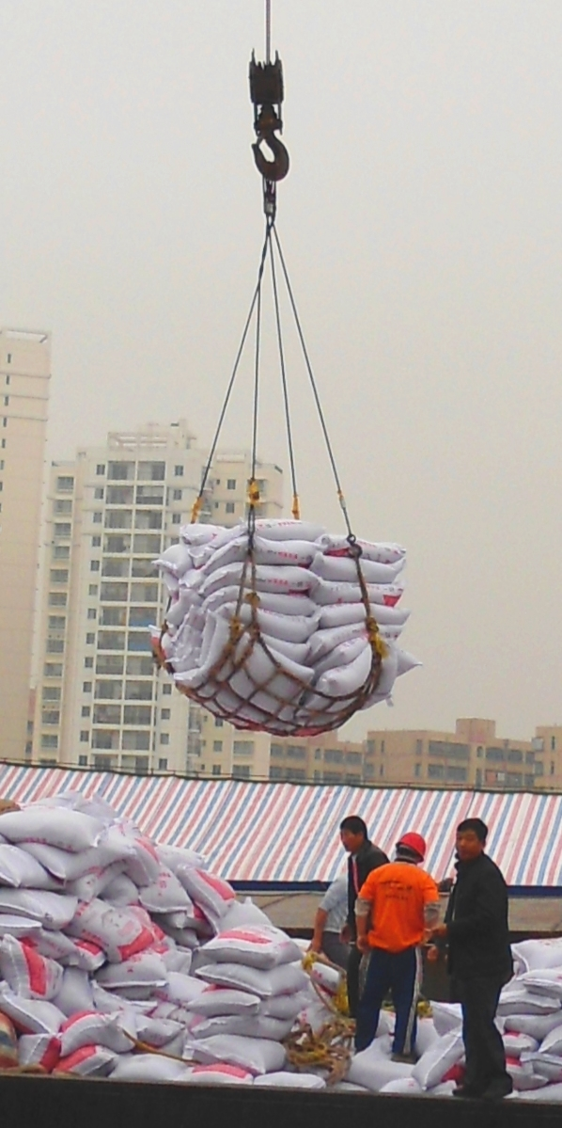
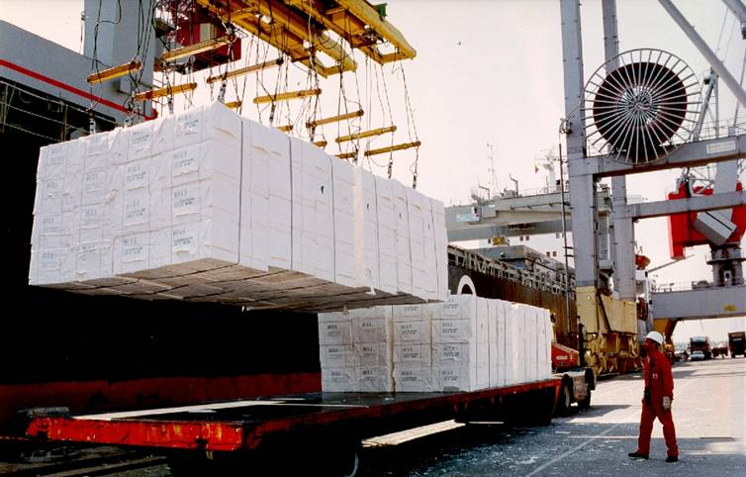
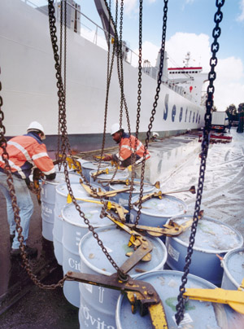
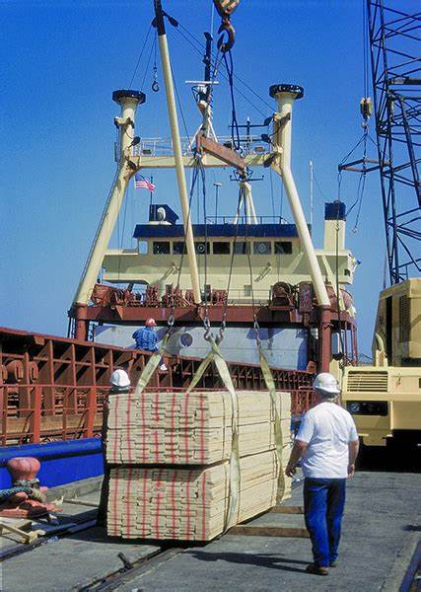
Sling for the handling of a heavy unit load using a mobile crane
Handling of steel pipes
Cargo net on hook
Handling of cellulose
© PEMP
Canvas slings on lifting beam
Barrel hooks

Slide 43
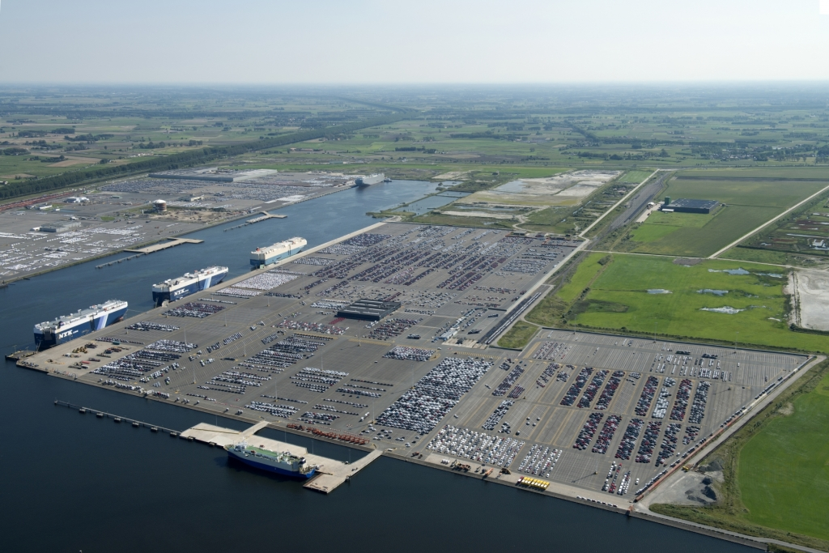
Bastenaken Car Terminal Zeebrugge (Largest in Europe)
Read this content

Slide 44
Largest Car Exporters and Importers, 2020
Notes:
Source: WTO.

Slide 45
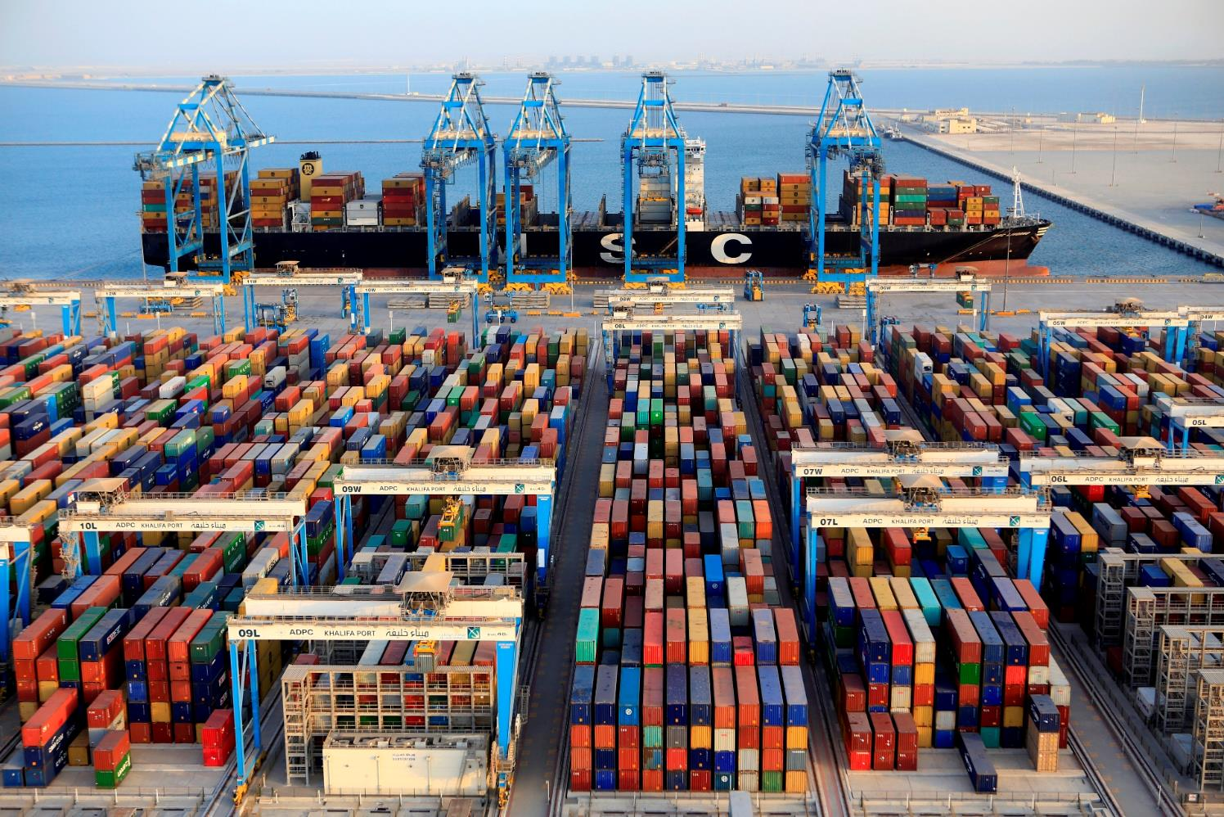
Container Terminal, Abu Dhabi

Slide 46
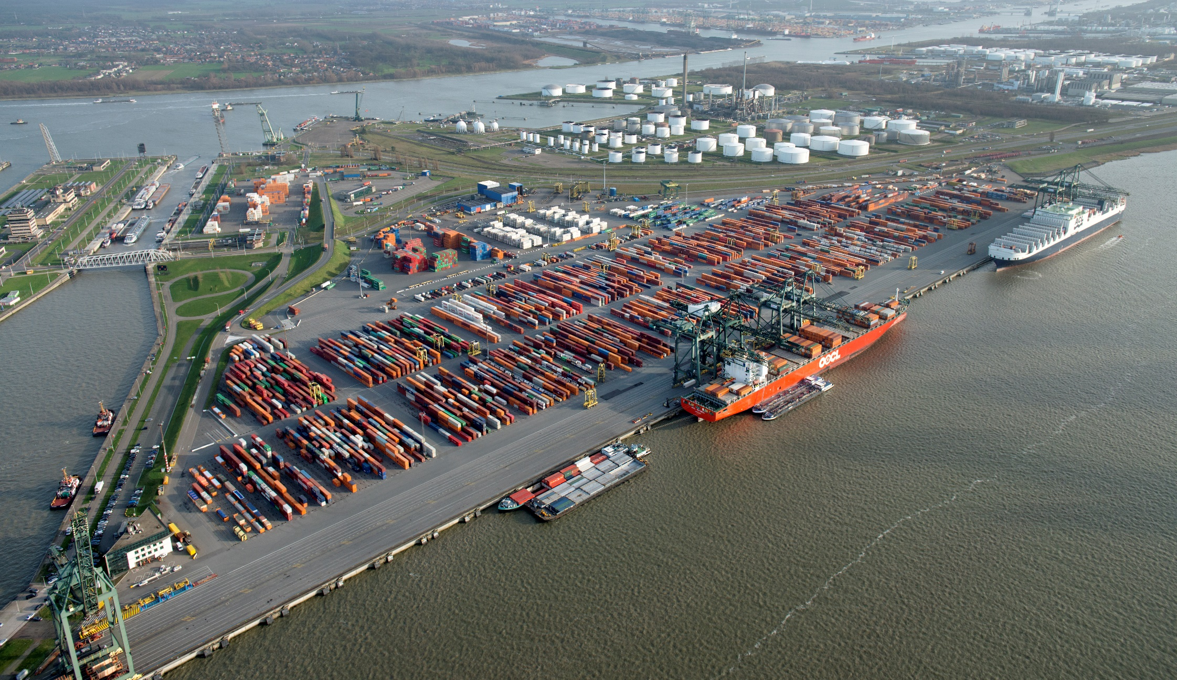
Modal Separation in Space: Europa Terminal in Antwerp
Read this content
Barges
Rail
Trucks
Deepsea services
Notes:
Source: Terminal photo from PSA Antwerp.

Slide 47
Conventional and Emerging Container Terminal Configurations
Read this content
Conventional
Emerging
Container
crane
Loading / unloading area
Container storage
Reefers
Gate
Empties
Reefers
Empties
Drop / Pick up
On dock rail terminal
Chassis
Straddle carrier
Rubber-tired gantry
Wide span gantry
Linear Layouts
Block Layouts

Slide 48
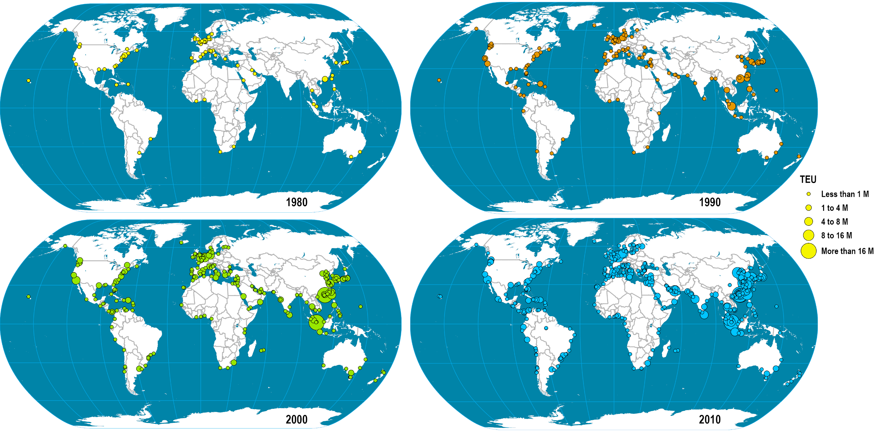
Evolution of Traffic Handled by Container Ports, 1980-2010
Read this content
Notes:
Map location: Global Container Ports

Slide 49
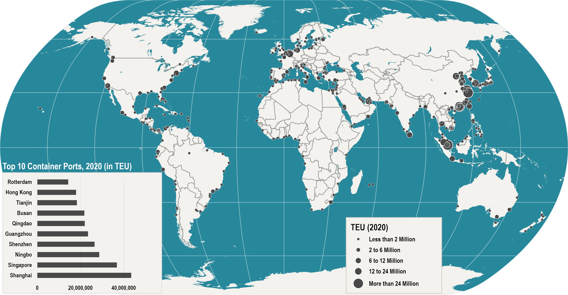
World’s Major Container Ports, 2020
Yangshan City Port. The world’s biggest container port opens new Silk Road for shipping
Read this content
Notes:
Map location: Global_Container_Ports

Slide 50
Monthly Container Traffic at the Port of Los Angeles, 1995-2021
Notes:
Source: Port of Los Angeles: http://www.portoflosangeles.org/maritime/stats.asp

Slide 51
Monthly Container Traffic at the Port of New York, 2005-2021
Notes:
Source: Port Authority of New York & New Jersey.
http://www.panynj.gov/port/monthly-loaded-containers.html

Slide 52
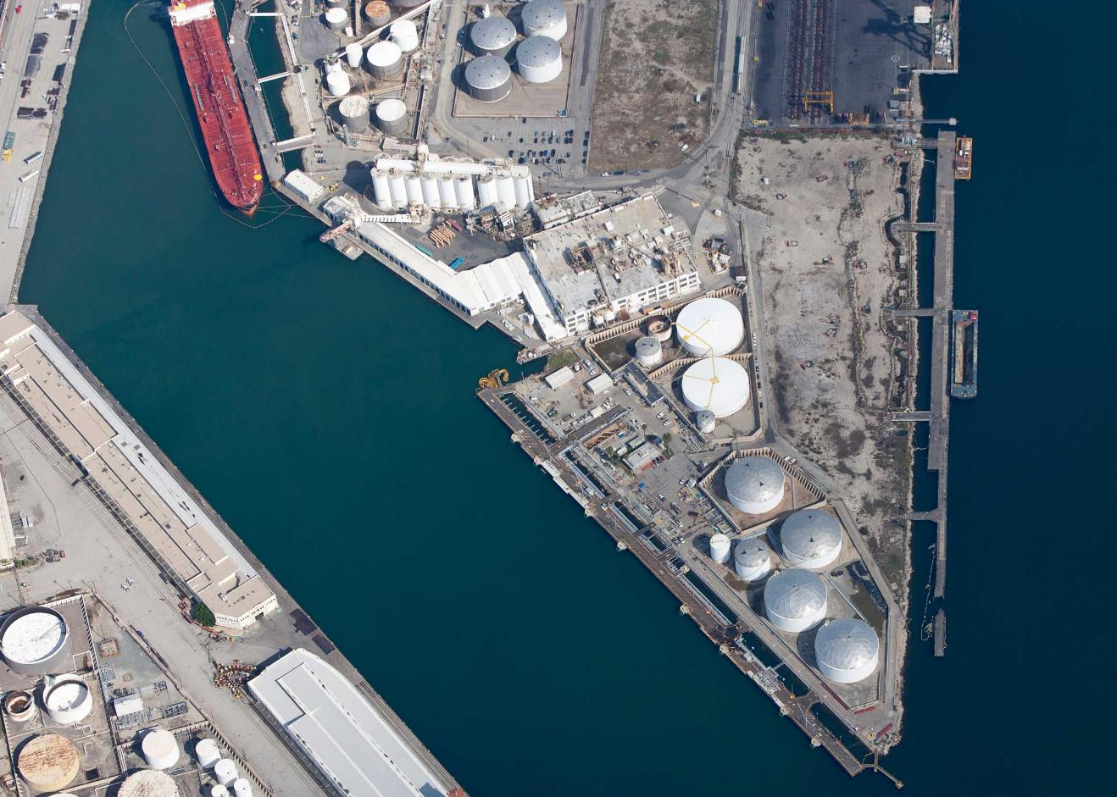
Liquid Bulk Terminal, Port of Los Angeles

Slide 53
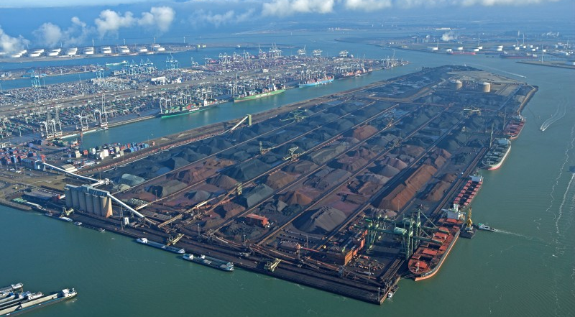
Dry Bulk Terminal: EMO Rotterdam
Read this content
Rail terminal
Yard with heaps
Conveyor system
Stackers/reclaimers
Deepsea quay
Blending
silos
Floating crane
Barge quay

Slide 54
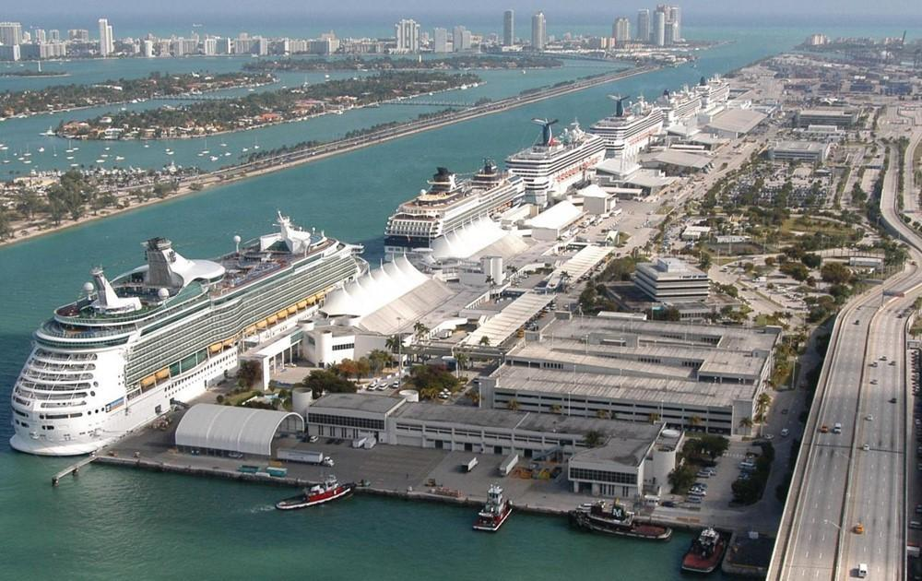
Miami Cruise Terminal

Slide 55
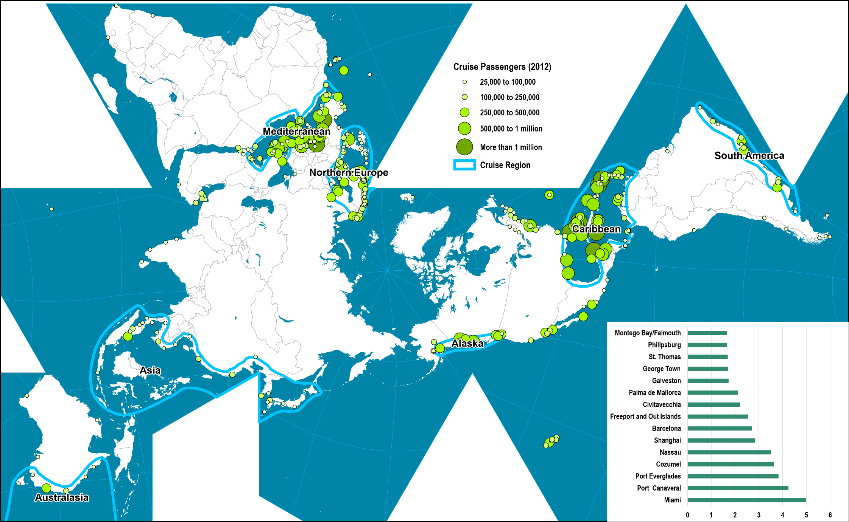
Global Cruise Port Activity, 2012
Notes:
Map location: Cruise_Ports

