Slide 1
Topic 1 – Global Transport and Logistics: Moving the Things We Buy
A – What is Transport and Logistics?
B – The Age of Interdependency
C – The Core Principles of Transportation
D – Mobility and Logistics

Slide 2
What is Transport and Logistics?
How can logistics be defined? What are its driving forces?

Slide 3


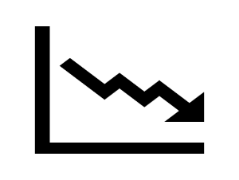
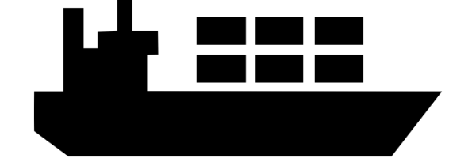

Generating added value through globalization
In which way globalization can generate value?
Research and Development
Finding better products and processes through innovation.
Input Costs
Using the advantages of locations (land, labor, capital, resources).
Transportation
Effectively transporting and distributing resources, parts and finished goods.
Sustainability
Improving resource, environmental and energy efficiency.
© GTS
Read this content

Slide 4
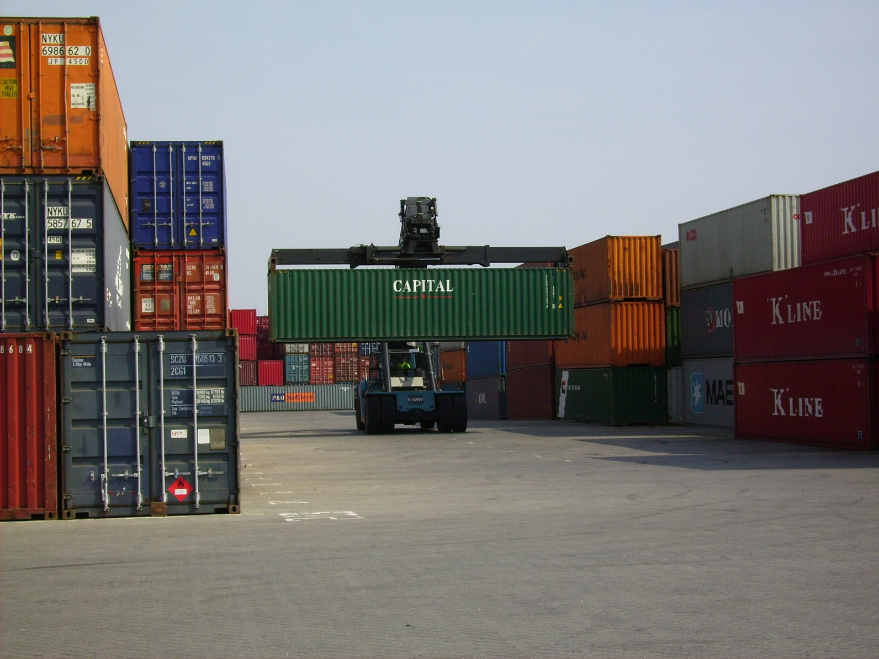
The World in a Box: Containers on the Move
Watch this video
Notes:
Most of the things we buy are transported in containers. Containers are standard load units that can be handled by ships, trains and trucks. On this photo, a forty foot container is moved from a storage area to be loaded into a truck and brought to a distribution center. From there, the container will be unloaded and its contents loaded on trucks to be delivered to retail stores. Global trade could not exist in its current form without the container.

Slide 5
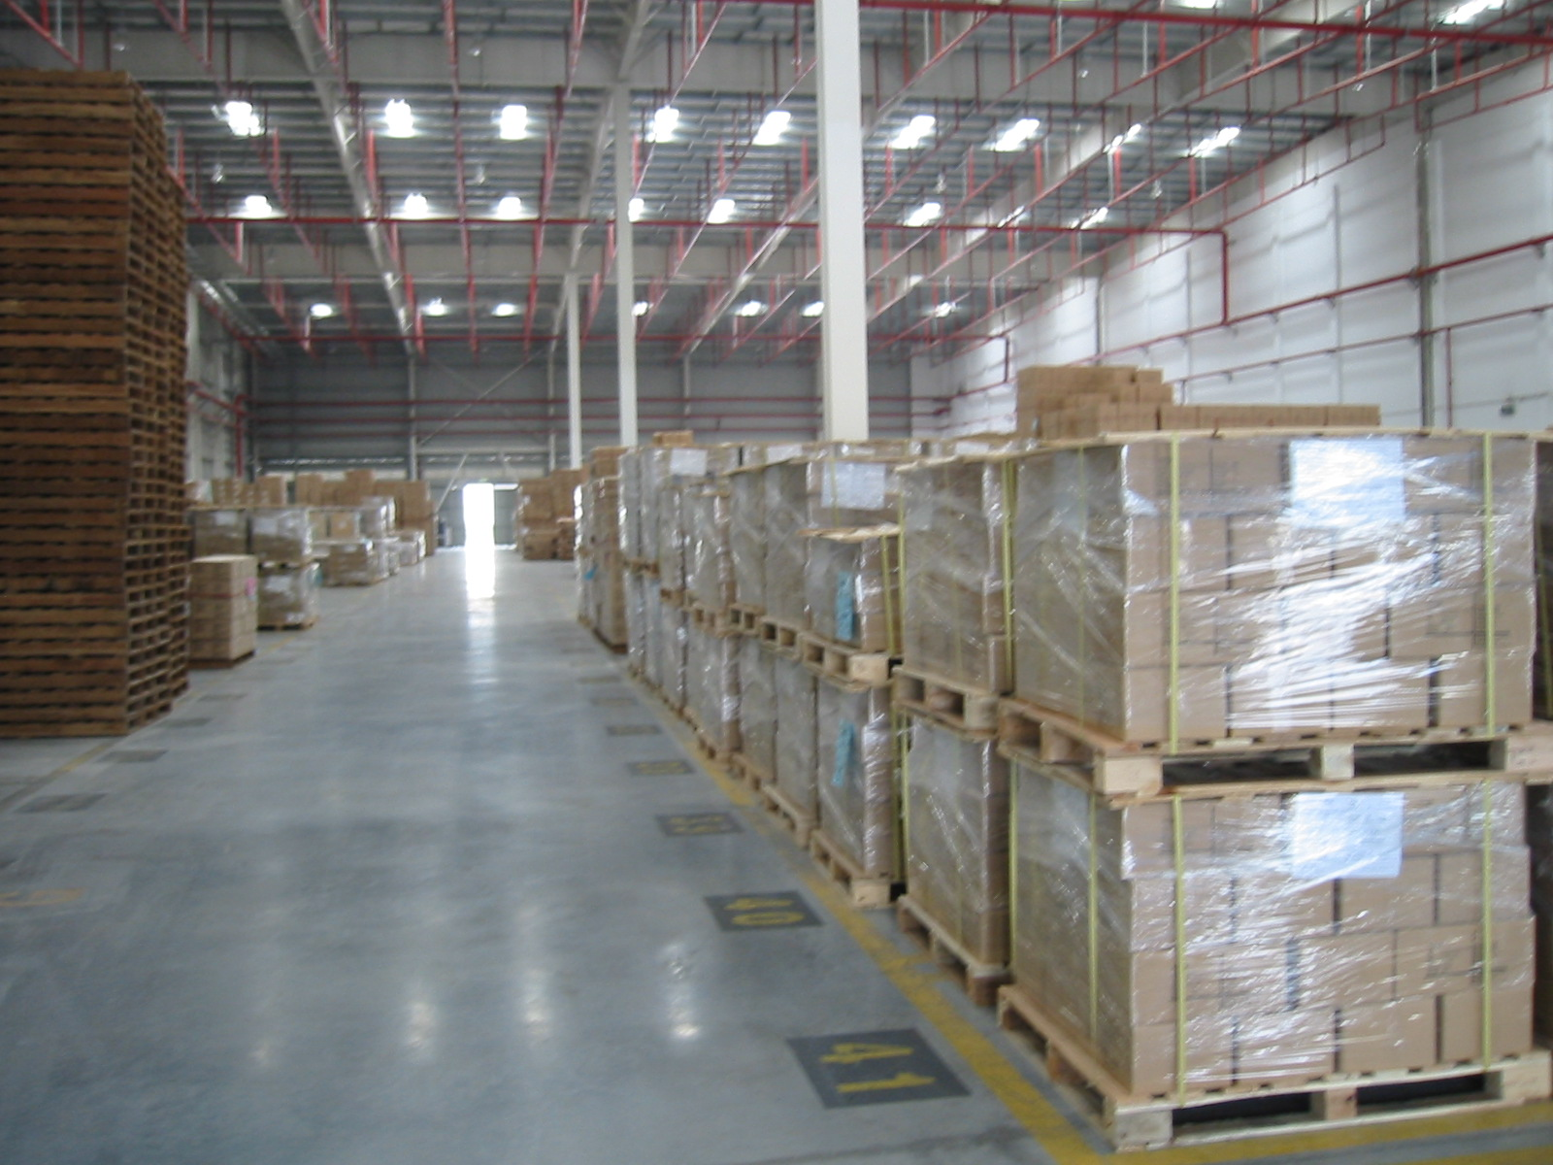
Pallets waiting to be loaded in a container, Shenzhen, China
Read this content

Slide 6
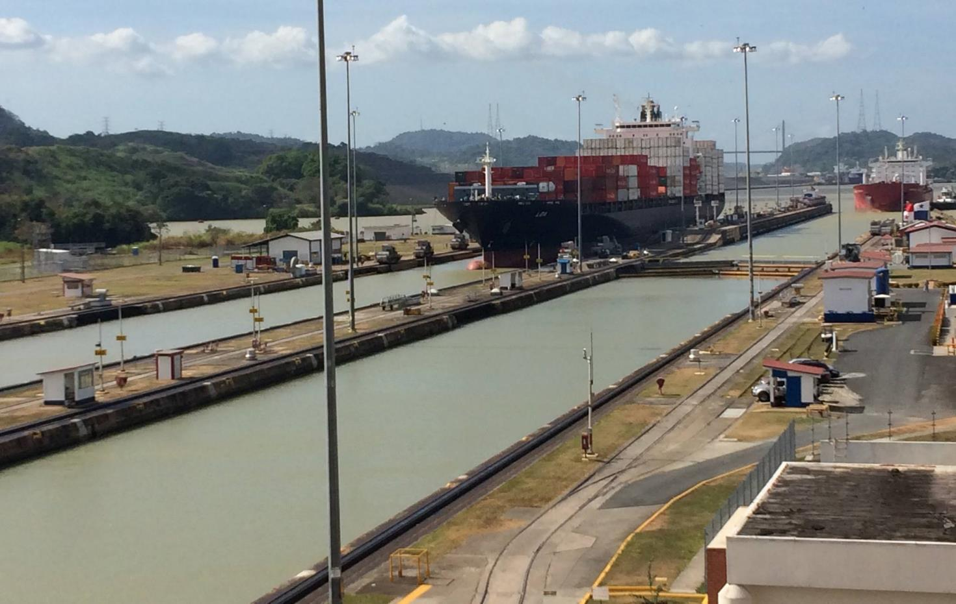
Container and Tanker Ships Crossing the Miraflores Locks at the Panama Canal (The Panamax Standard)
Read this content

Slide 7
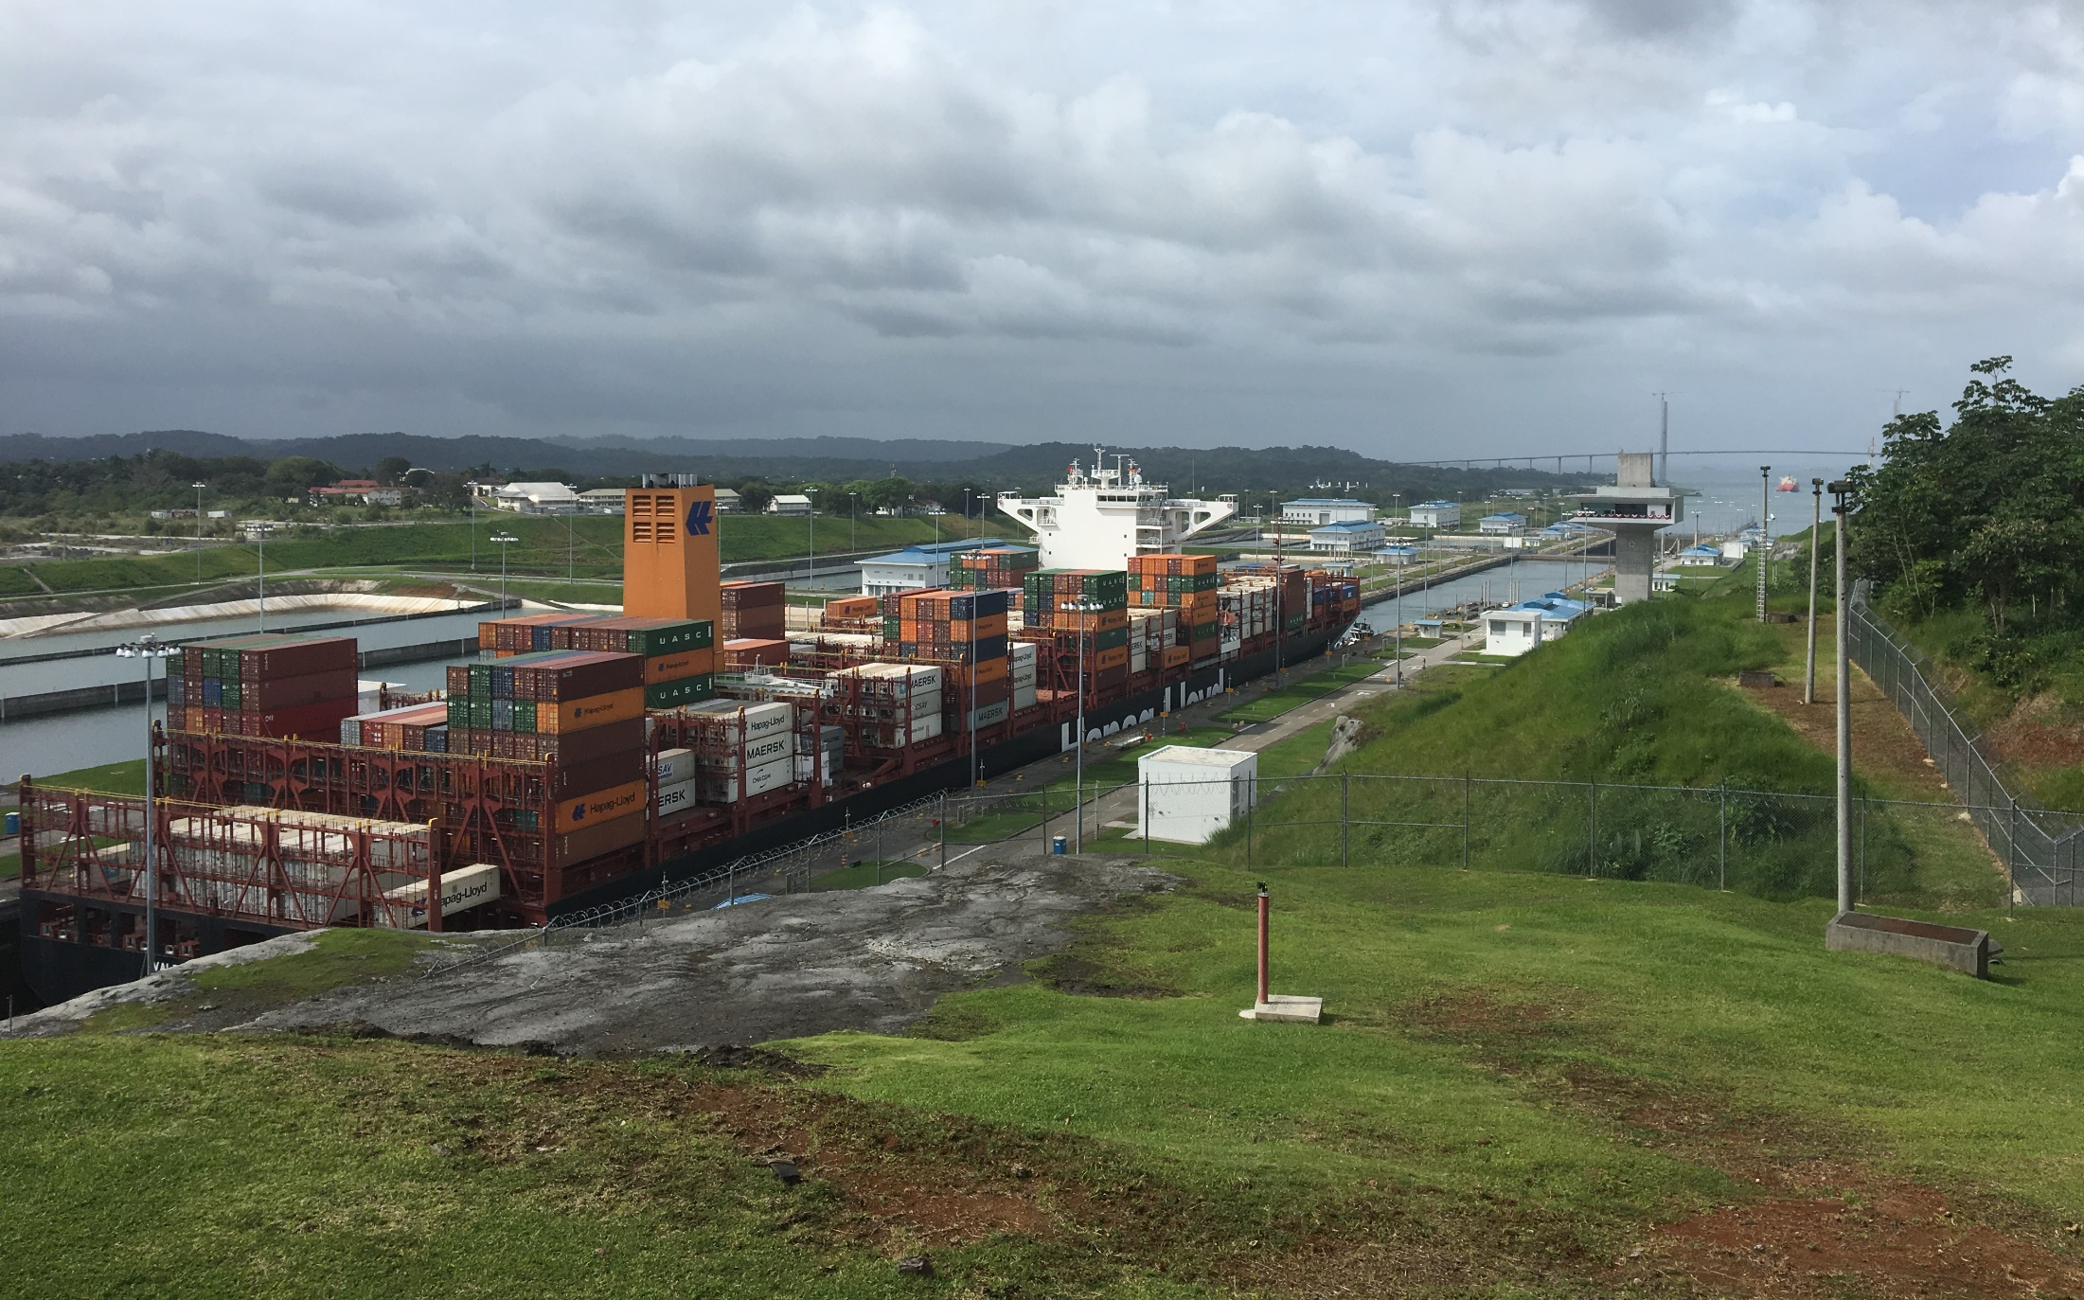
Containership Crossing the New Agua Clara Locks at the Panama Canal (New Panamax Standard)
Read this content

Slide 8
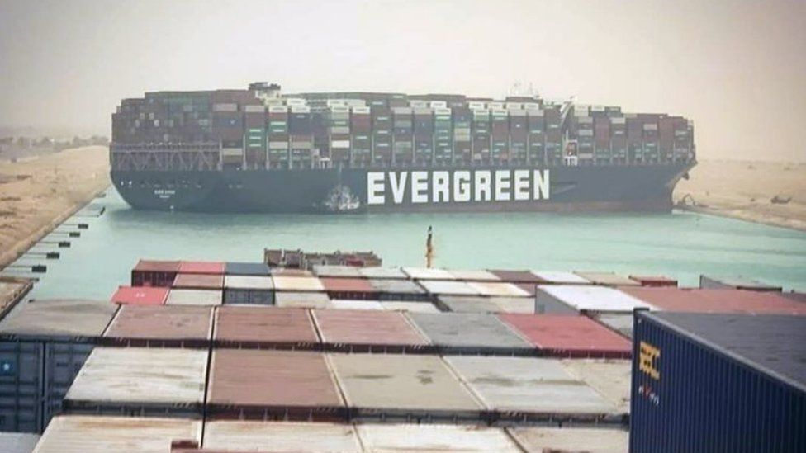
Suez Canal Blockage, March 2021
Read this content

Slide 9
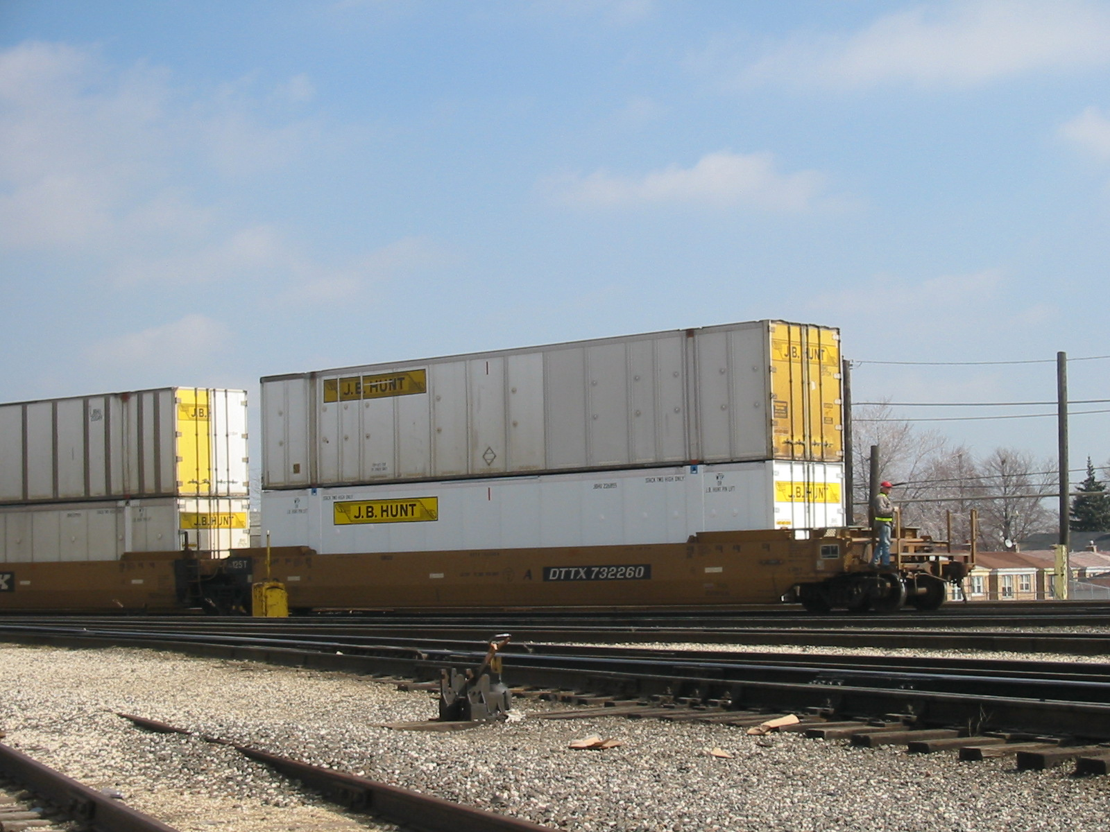
53 Footer Domestic Containers, Corwith Rail Yard, Chicago
Read this content

Slide 10
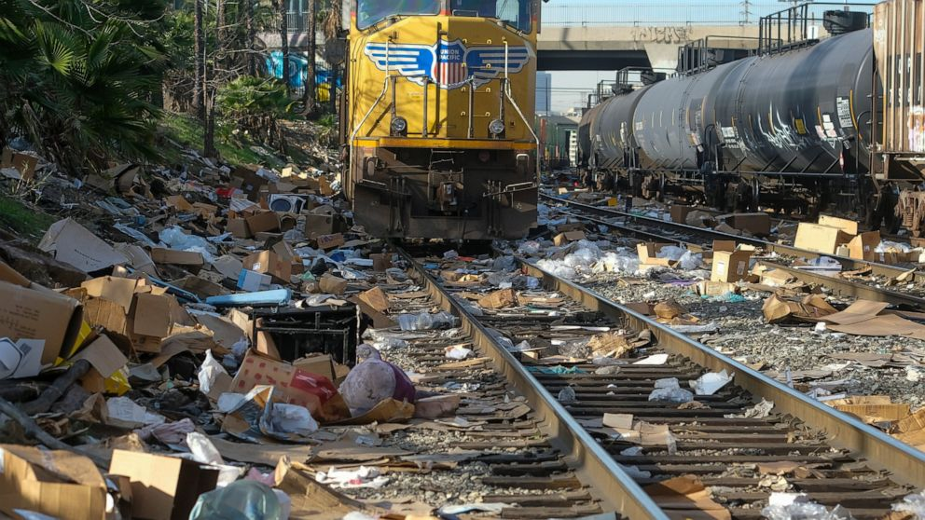
Rail Container Cargo Theft, Los Angeles

Slide 11
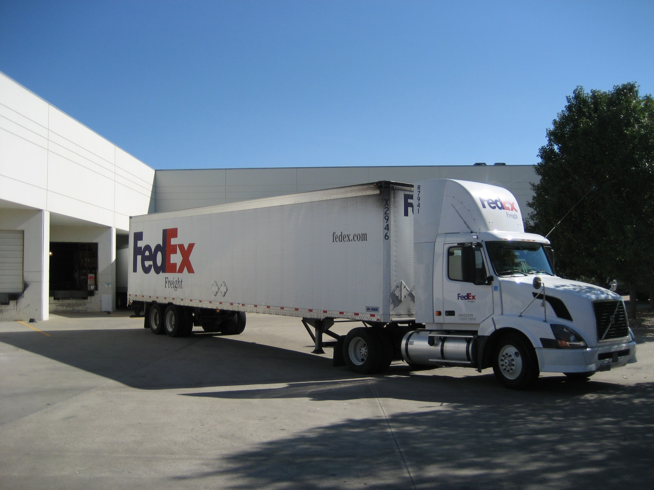
FedEx Freight Truck at Distribution Center, Kansas City
Read this content
FedEx is a third-party logistics provider, what does it means?

Slide 12
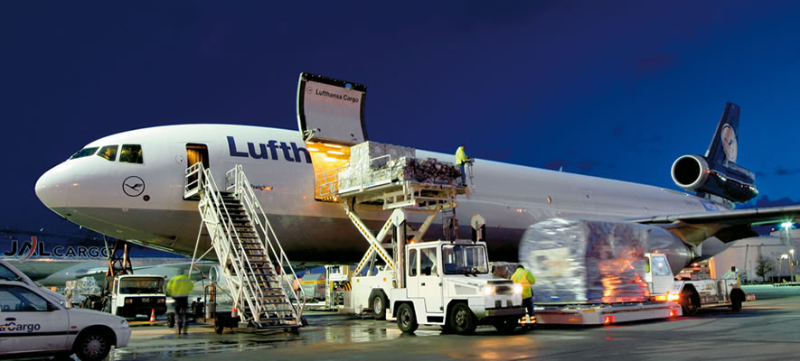
Dedicated Air Cargo Plane

Slide 13
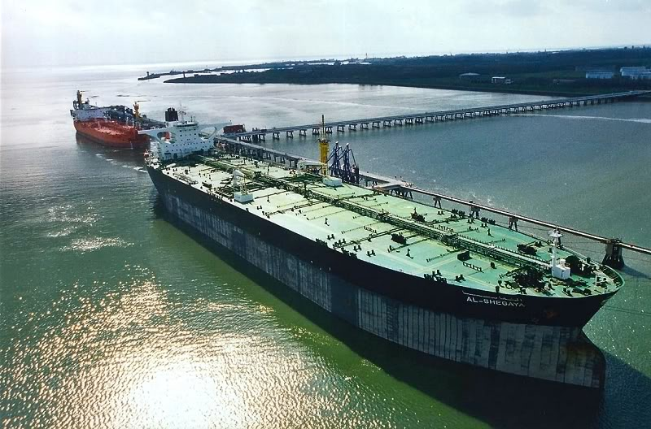
Economies of Scale: Ultra Large Crude Carrier (ULCC), Persian Gulf
What are economies of scale and how this ship represents them?
Read this content
Notes:
The Al Shegaya (Port of Registry: Kuwait) is an Ultra Large Crude Carrier (ULCC) built in 1998 by Hyundai Heavy Industries, Korea. The vessel is 335 meters long, 58 meters wide and has a maximum draught of almost 23 meters. With a deadweight of 310,000 tons, the Al Shegaya is one of the largest crude carriers currently sailing.

Slide 14
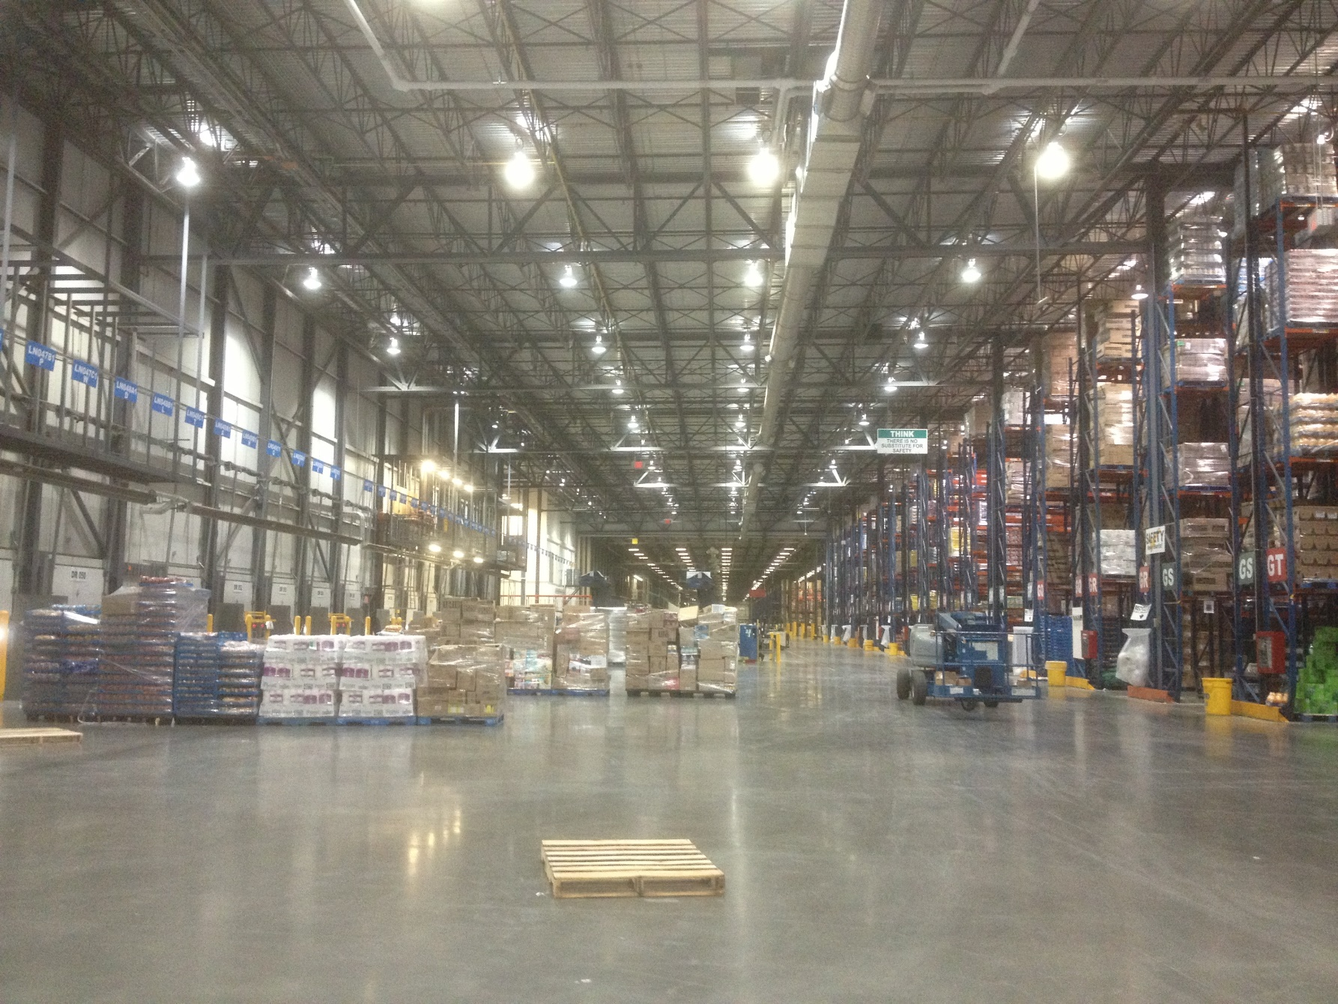
Grocery Distribution Center, Regina, Canada
Read this content

Slide 15
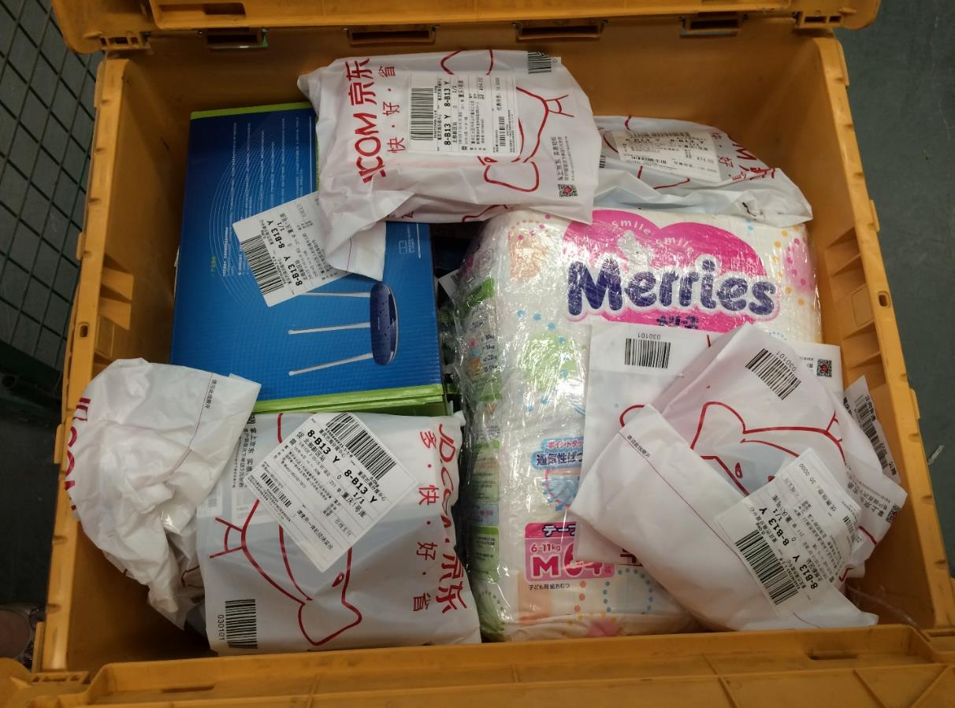
Delivery Bin Containing Mixed Orders (E-Commerce)
How ecommerce has changed retailing?
Read this content

Slide 16
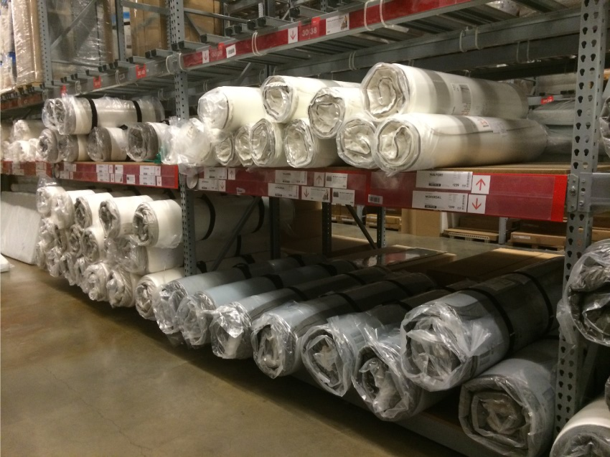
Ikea Rolled Foam Mattress: Product Design and Distribution Efficiency
Read this content

Slide 17






The Paradigms of the Dematerialization of the Economy
Read this content
(first section)
Platform Corporation
E-Commerce
Asset Management
Focus on core competencies.
Outsourcing low added value activities.
Lessen the footprint of retail stores.
Developing a network of distribution centers.
Manage existing assets more efficiently.
Developing platforms connecting the supply and demand of services.
Apple focuses on product design and retailing (Apple Store). Relies on a massive network of original equipment manufacturers.
Amazon owns a network of e-fulfillment centers (distribution centers) processing large volumes of cargo (orders). It also operates parcel delivery services.
Uber links users with individual car owners willing to provide a taxi service. Airbnb links users with property owners.
© GTS
Explain the main paradigms of a dematerialized economy.

Slide 18
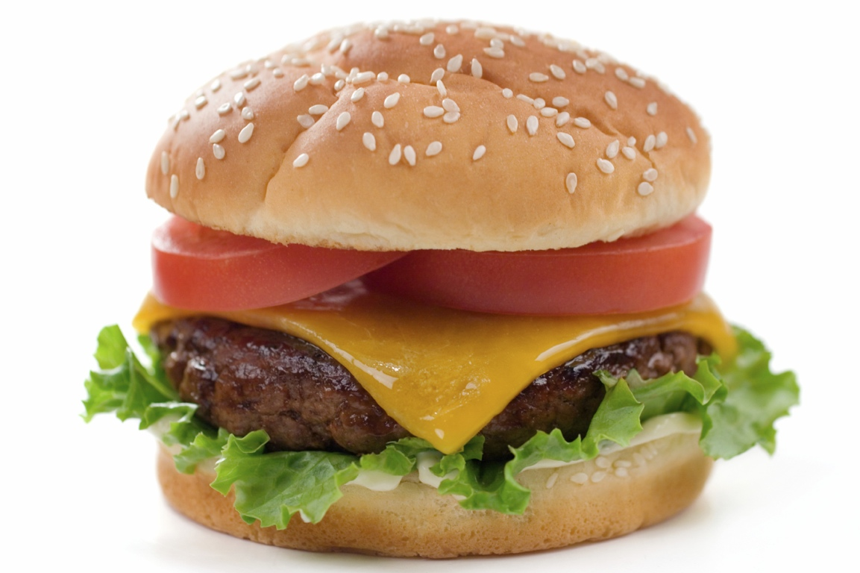
Short Assignment: Complexity and the Cheeseburger…
Read this background information
This simple product would have been impossible to create more than 100 years ago. Why?
Notes:
The impracticality of a cheeseburger
http://blogs.scientificamerican.com/plugged-in/2011/12/07/the-impracticality-of-a-cheeseburger/

Slide 19
The Age of Interdependency
What are the main relations holding the global economy?

Slide 20



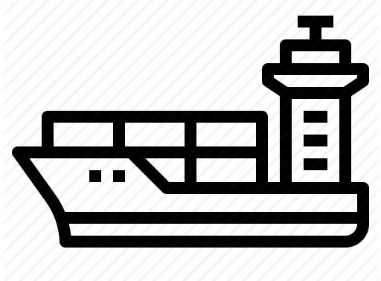
The Drivers of Economic Globalization: Connecting Different Chains
Explain the different chains supporting economic globalization.
Read this content
Integration
Production
Transportation
Transactions
Regulatory chains.
Harmonization of regulatory regimes.
Trade agreements.
Supply / value chains.
Offshoring.
Global production networks.
Transport chains.
Containerization.
Transborder transportation.
Information chains (ICT).
Investment capital.
Credit for transactions.
Standards
© GTS
Measures, voltage, telecommunications, containers, currencies

Slide 21
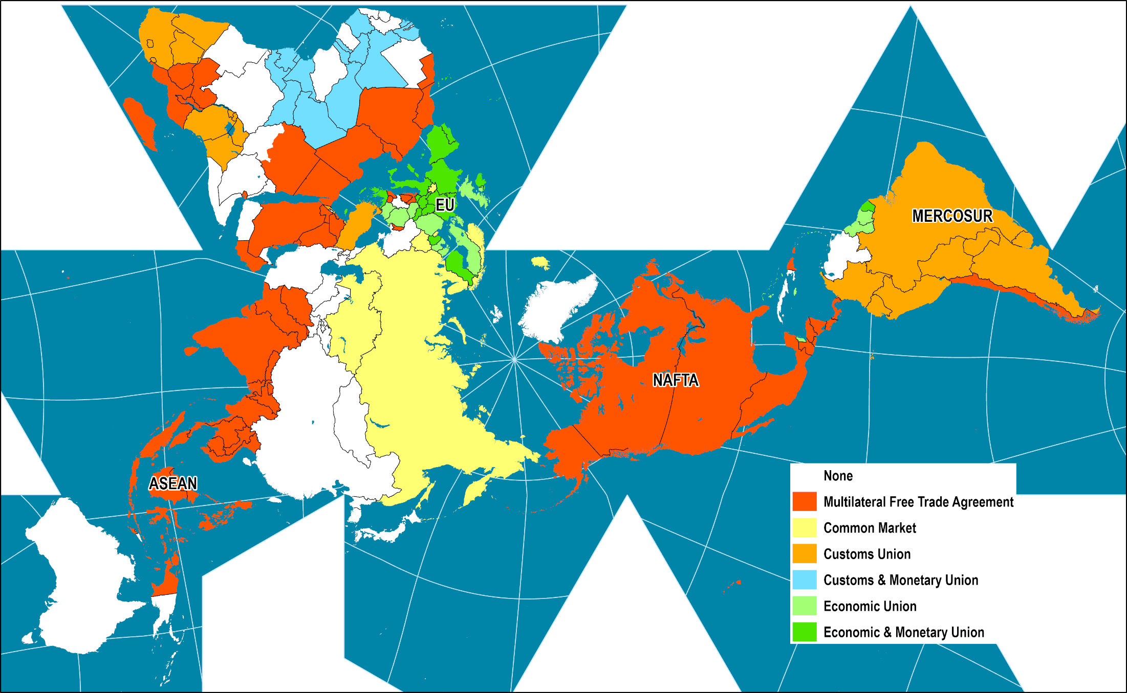
Economic Integration Levels, 2015
Integration
Regulatory chains.
Harmonization of regulatory regimes.
Trade agreements.
Read this content

Slide 22
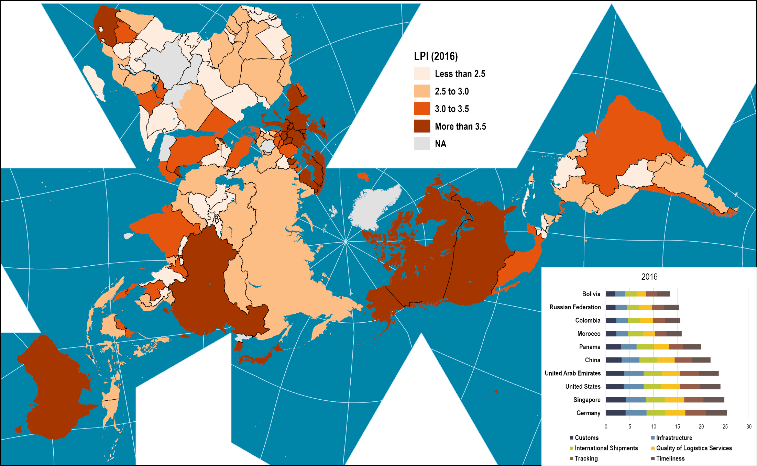
Logistic Performance Index, 2016
Production
Supply / value chains.
Offshoring.
Global production networks.
Read this content
Notes:
Map location: logistics_performance

Slide 23
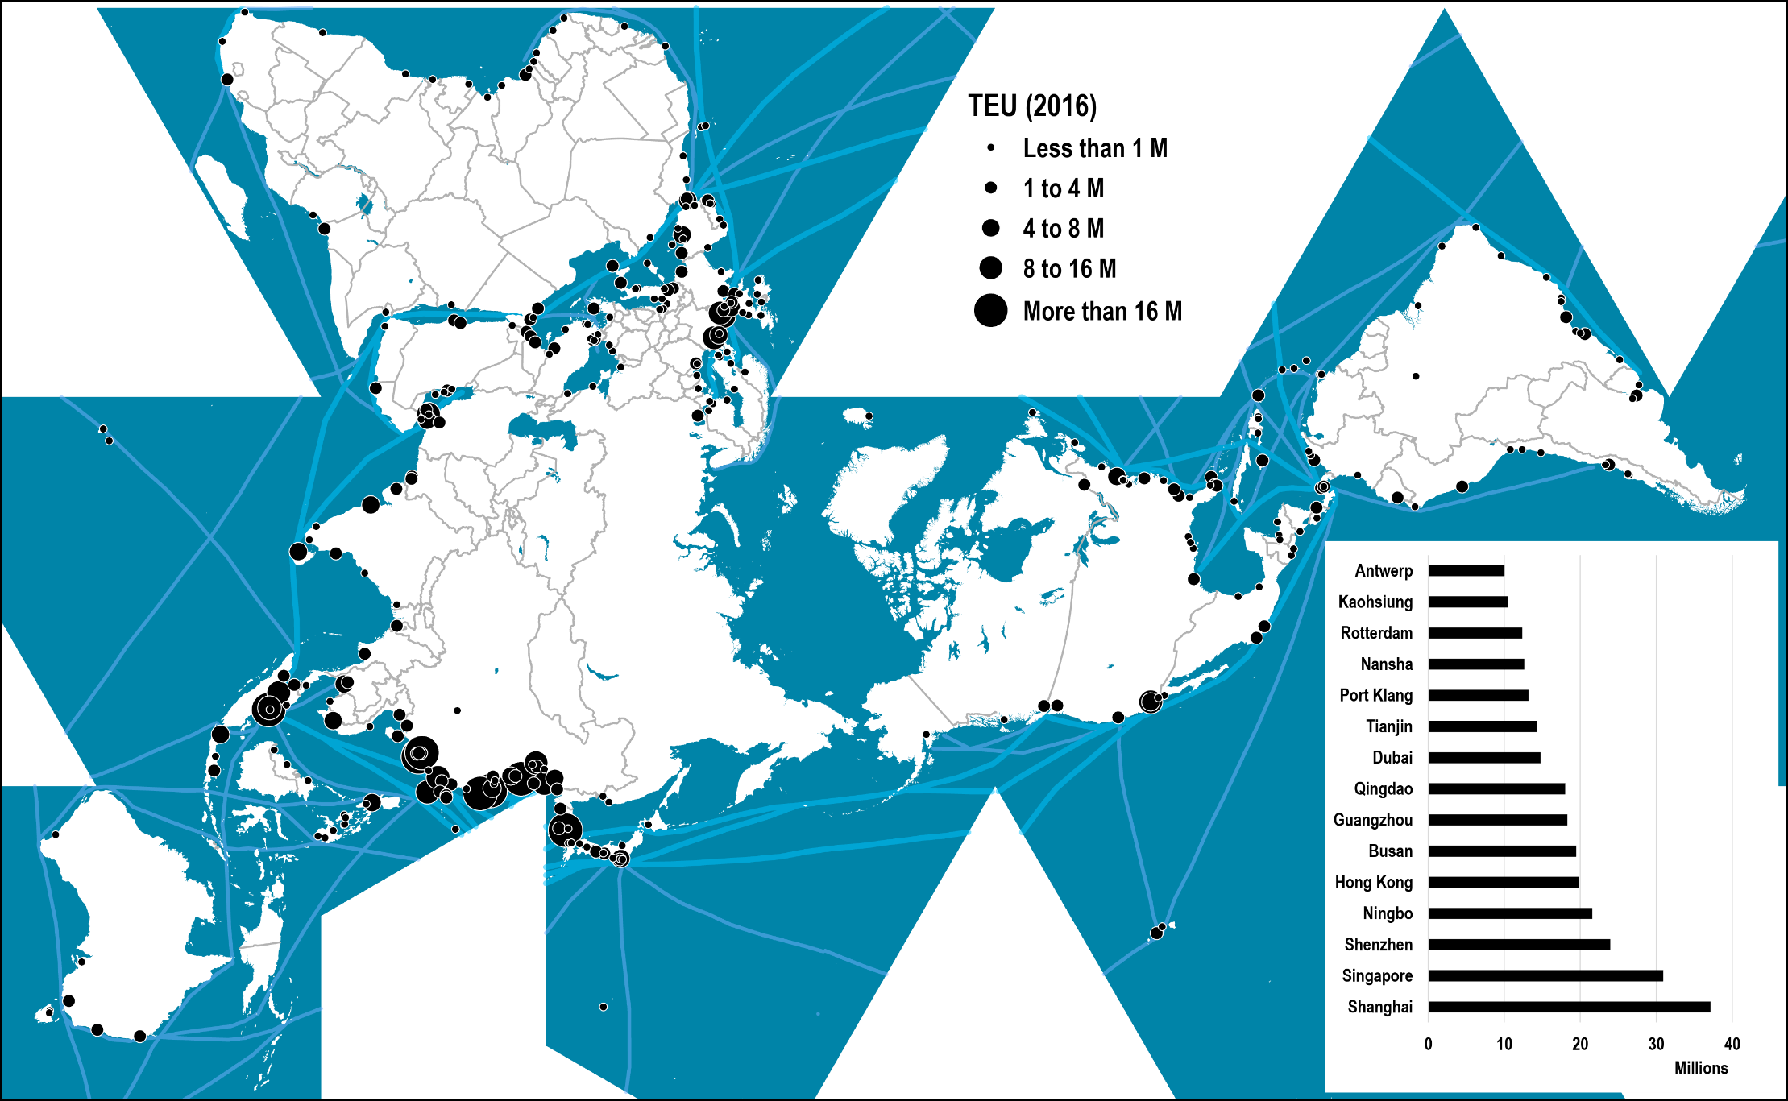
World’s Major Container Ports, 2016
Transportation
Transport chains.
Containerization.
Transborder transportation.
Read this content
Notes:
Source: Adapted from Containerization International, port authorities and port associations.

Slide 24
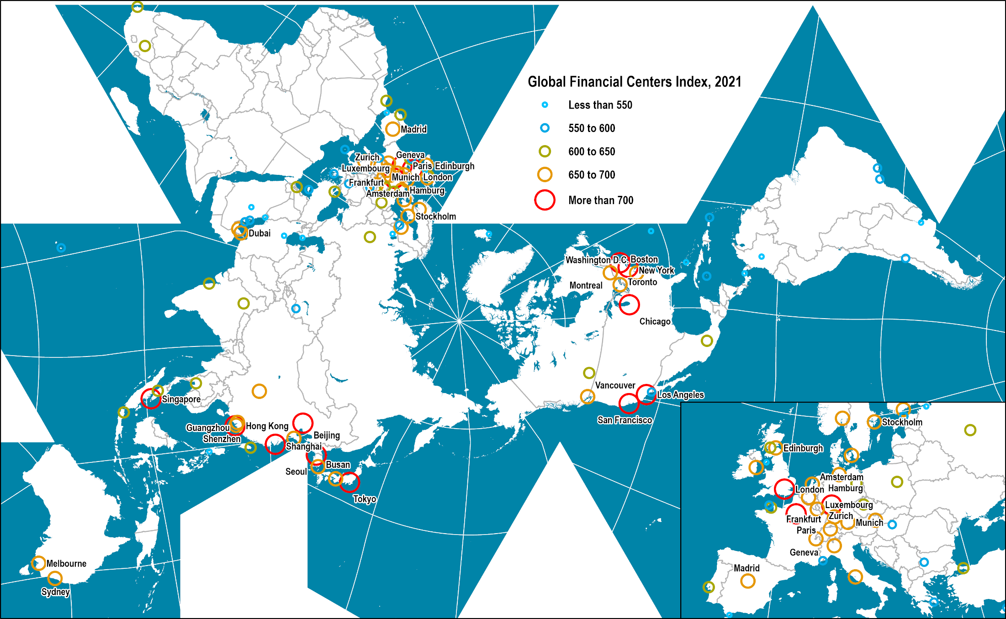
Global Financial Centers, 2021
Transactions
Information chains (ICT).
Investment capital.
Credit for transactions.
Read this content
Notes:
Source: Z/Yen Group, Global Financial Centers Index, 2021.
https://www.longfinance.net/programmes/financial-centre-futures/global-financial-centres-index/
Location: world_cities

Slide 25



The Flows of Globalization
What are the main flows supporting globalization?
Read this content
TRADE
MIGRATION
TELECOMMUNICATIONS
Flows of physical goods (mainly asymmetrical)
Flows of people (mainly symmetrical)
Flows of information
(mainly asymmetrical)
Nature
Types
Raw materials, energy, food, parts and consumption goods
Permanent, temporary (migrant workers), tourism, business transactions
Communication, power exchanges, symbolic exchanges
Telecommunication systems (postal, internet, telephone, radio)
Freight transport modes (maritime, rail, trucking)
Passengers transport modes (vehicles, air, rail)
Modes
Network
Interconnected hub-and-spoke networks
Interconnected hub-and-spoke networks
Interconnected and redundant hub-and-spoke networks
Hubs
Ports as main hubs
Airports as main hubs
Global cities as main hubs
© GTS

Slide 26
World Merchandise Trade, 1960-2020
Read this content
TRADE
Notes:
Source: WTO and World Bank. Current USD.
Merchandise Exports : http://data.worldbank.org/indicator/TX.VAL.MRCH.CD.WT
GDP: http://data.worldbank.org/indicator/NY.GDP.MKTP.CD?locations=1W

Slide 27
World Air Travel and World Air Freight Carried, 1950-2020
MIGRATION
Read this content
Watch this video
Notes:
Source: Airlines for America.
http://www.airlines.org/Pages/Annual-Results-World-Airlines.aspx

Slide 28
The Passport Index, 2011, 2018
Read this content
MIGRATION
Notes:
Source: Henley and Partners Holdings, https://www.henleypassportindex.com
The level of visa-free or visa-on-arrival access offered by each country’s passport.

Slide 29
Diffusion of Personal Computing Devices, 1977-2020
Read this content
TELECOMMUNICATIONS
Android (2009)
PC (1981)
iPhone (2007)
Tablet (2010)
Macintosh (1984)
Atari (1979)
Symbian (2001)
Blackberry (2003)
Commodore (1982)
What are the three stages in the evolution of personal computing devices?
Apple ][ (1977)
TRS-80 (1977)
© GTS
Notes:
Source: Pre 2000 data compiled by H. Dediu and J. Reiner. Recent data from Gartner, Inc.
https://jeremyreimer.com/rockets-item.lsp?p=137
http://www.asymco.com/2012/01/17/the-rise-and-fall-of-personal-computing/
PC includes desktops and laptops.

Slide 30
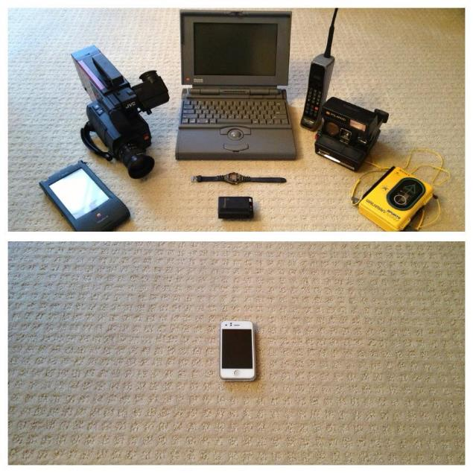


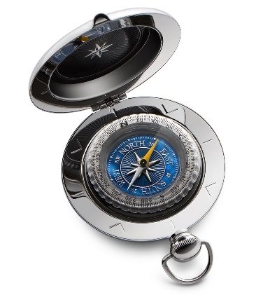
Technological Convergence, 1993-2013
Notes:
Source: Reddit.
Remote control + Gameboy

Slide 31
The Core Principles of Transportation
What are the core defining principles of transportation?

Slide 32

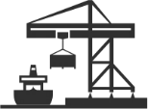





The Core Principles of Transport Geography
1
A
B
Transportation is the spatial linking of a derived demand
2
A
B
Distance is a relative concept involving space, time and effort (cost)
3
A
X
B
Space can be a generator, a support and a constraint for mobility
4
The relation between space and time can converge or diverge
5
A
B
C
A location can be a central or an intermediate element of mobility
6
To overcome geography, transportation requires a footprint
7
Transportation seeks massification but is constrained by atomization
8
Velocity is a modal, intermodal and managerial effort
© GTS

Slide 33
1. Transportation as a Derived Demand
1
Read this content
ACTIVITY
WORKING
VACATIONING
SHOPPING
MANUFACTURING
DIRECT
Commuting
Travel
Travel & Deliveries
Transport & Distribution
INDIRECT
Services
Warehousing
Energy
DERIVED DEMAND
© GTS
Transportation cannot exist on its own and cannot be stored.
Transportation is the spatial linking of a derived demand

Slide 34
Different Representations of Distance
2
Read this content
Euclidean Distance
A
B
Transport Distance
A
Pickup
Delivery
B
Mode 1
Transshipment
Mode 2
Logistical Distance
Order
A
Pickup
Delivery
B
Mode 1
Transshipment
Mode 2
Order Processing
Packing
Scheduling
Inventory Management
Unpacking
Sorting
Warehousing
Distance is a relative concept involving space, time and effort (cost)

Slide 35
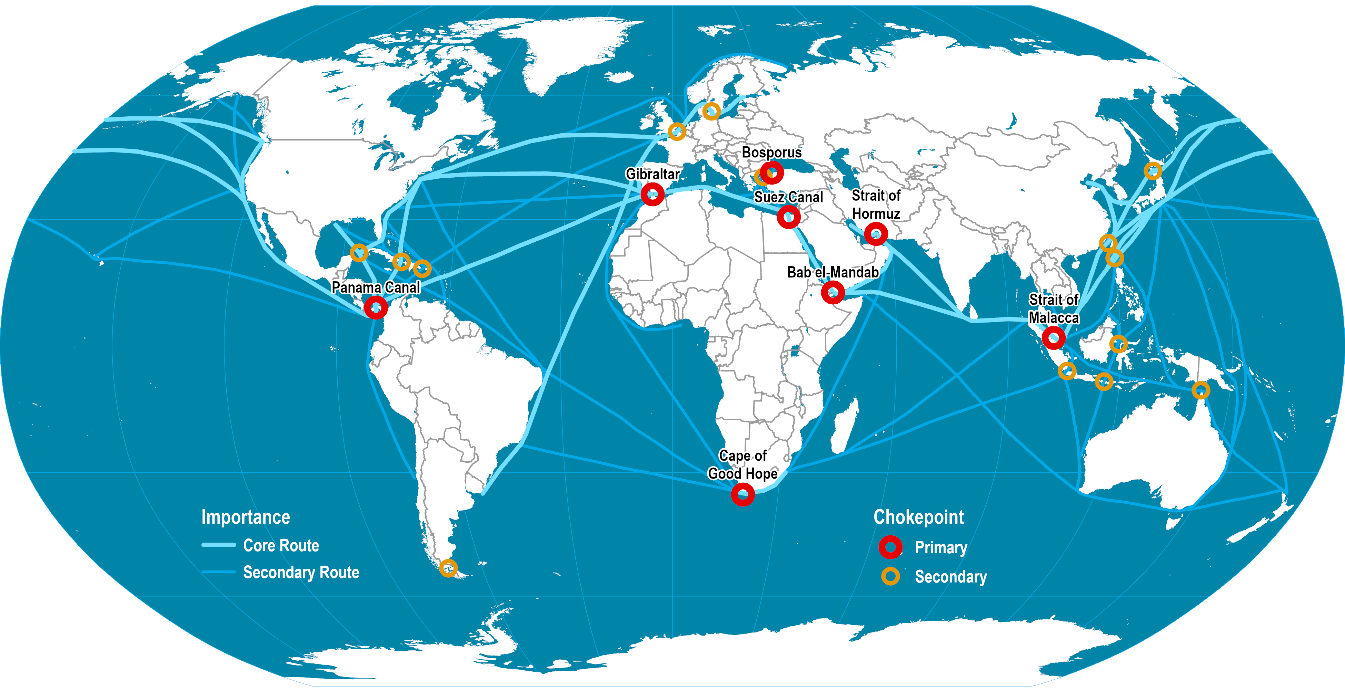
Domains of Maritime Circulation
3
Read this content
Space can be a generator, support and constraint for mobility
Notes:
Source: Shipping density data adapted from National Center for Ecological Analysis and Synthesis, A Global Map of Human Impacts to Marine Ecosystems.

Slide 36


Global Space / Time Convergence: Days Required to Circumnavigate the Globe
4
Read this content
Average speed of horse and cart: 4 km/hr
Average speed sailships: 16 km/hr
Average speed of trains: 100 km/hr
Average speed of steamships: 25 km/hr
Space / Time
Convergence
Average speed of airplanes: 480-640 km/hr
Average speed of jet planes: 800-1120 km/hr
Numeric transmission: instantaneous
© GTS
The relation between space and time can converge or diverge

Slide 37

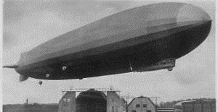
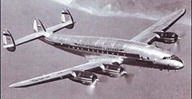


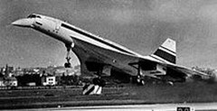
Better and Faster: Powered Transatlantic Passenger Modes
4
1900
1920
Jet Plane (1958-)
7-8 hours
1940
Dirigible (1931-1937)
80 hours
Sea Plane (1934-1946)
1960
15 hours
Ocean Liner (1830s-1960s)
Propeller Plane (1934-1960)
6-4 days
11 hours
1980
2000
Supersonic Jet Plane (1976-2003)
© GTS
3.5 hours
Read this content

Slide 38
Centrality and Intermediacy
5
Read this content
Intermediary airports (Anchorage, Gander)
Intermediacy
Ports
Centrality
Range
Gateway
Panama and Suez canals
Major airport hubs
Hub (Interception)
Hub (Transcalar)
A location can be a central or an intermediate element of mobility

Slide 39
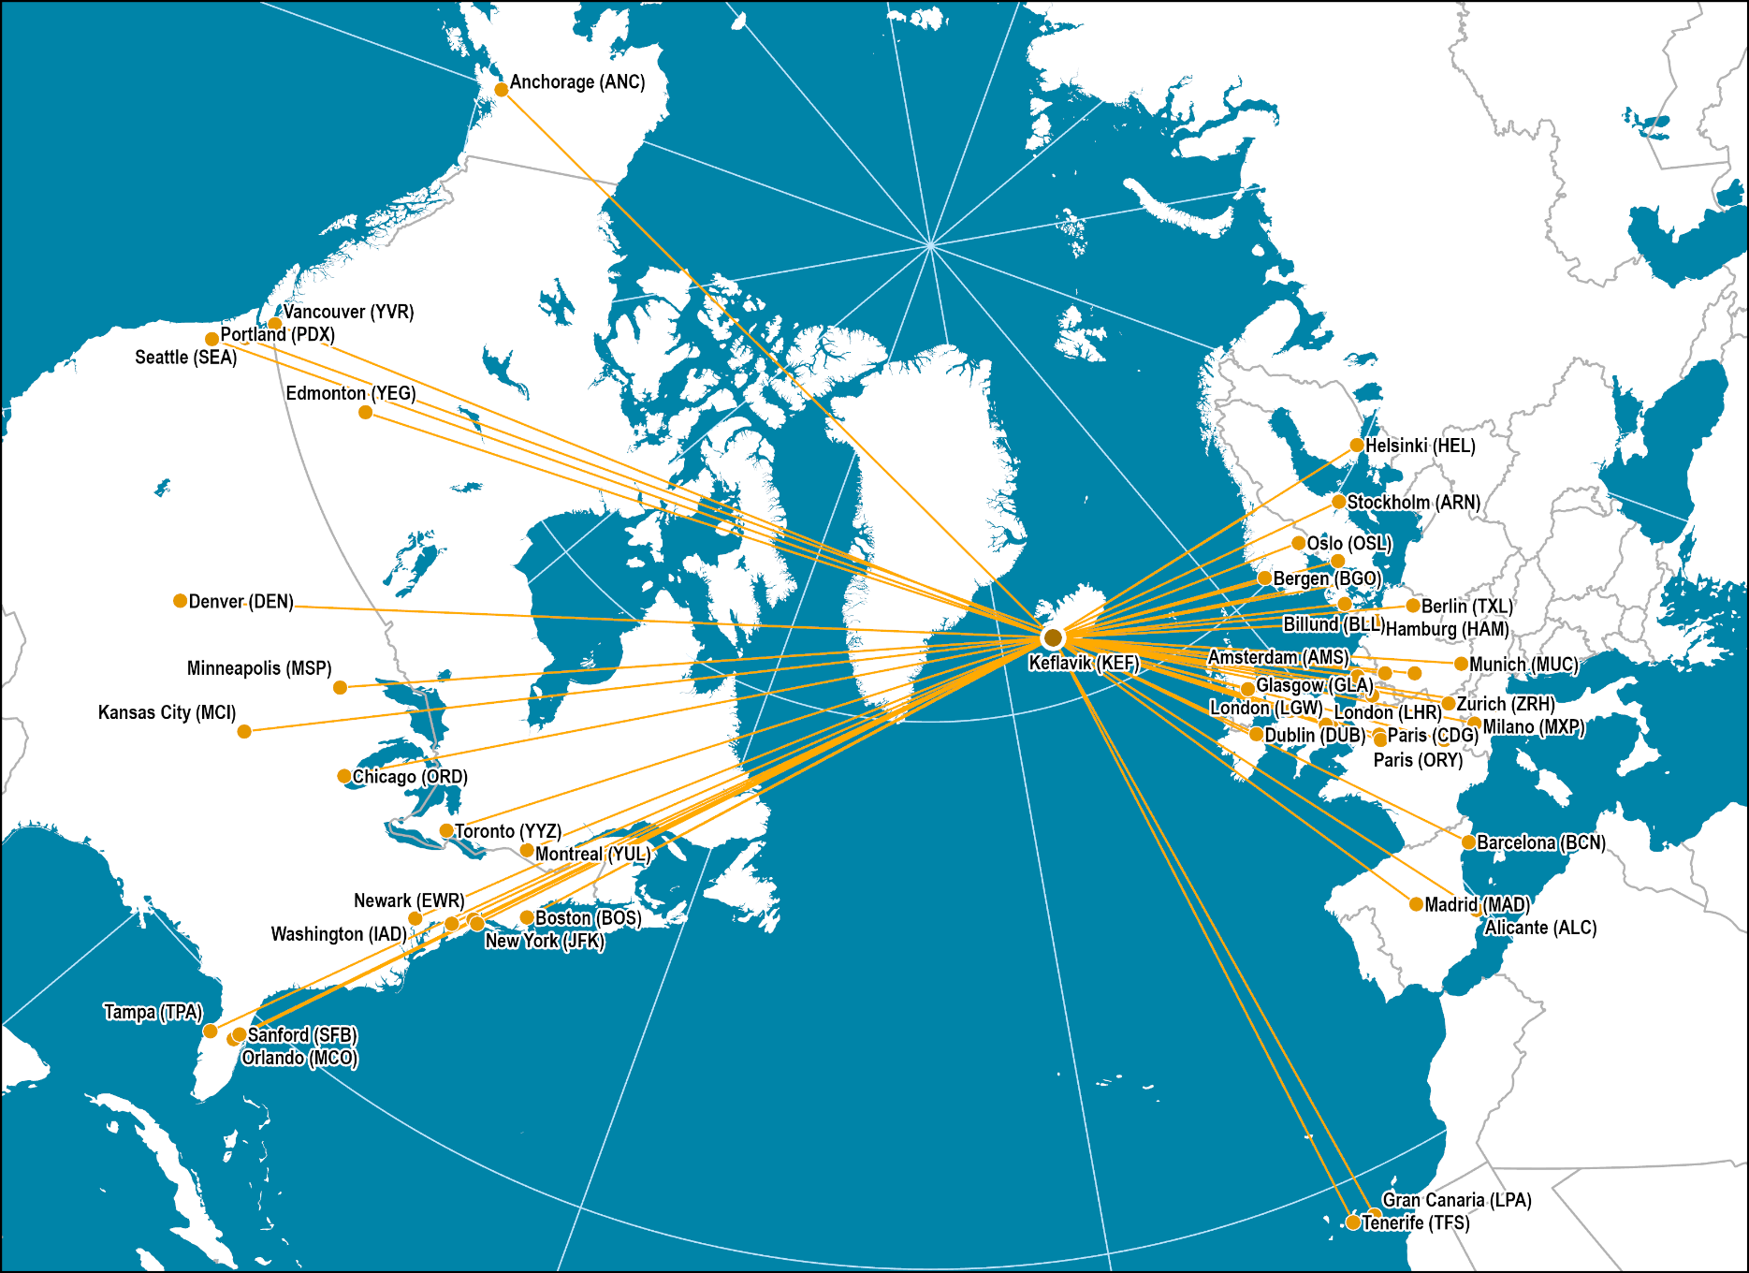
Longitudinal Intermediacy: Icelandair
5
Notes:
Source: Network from Icelandair Web Site.
Map location: air_transport

Slide 40
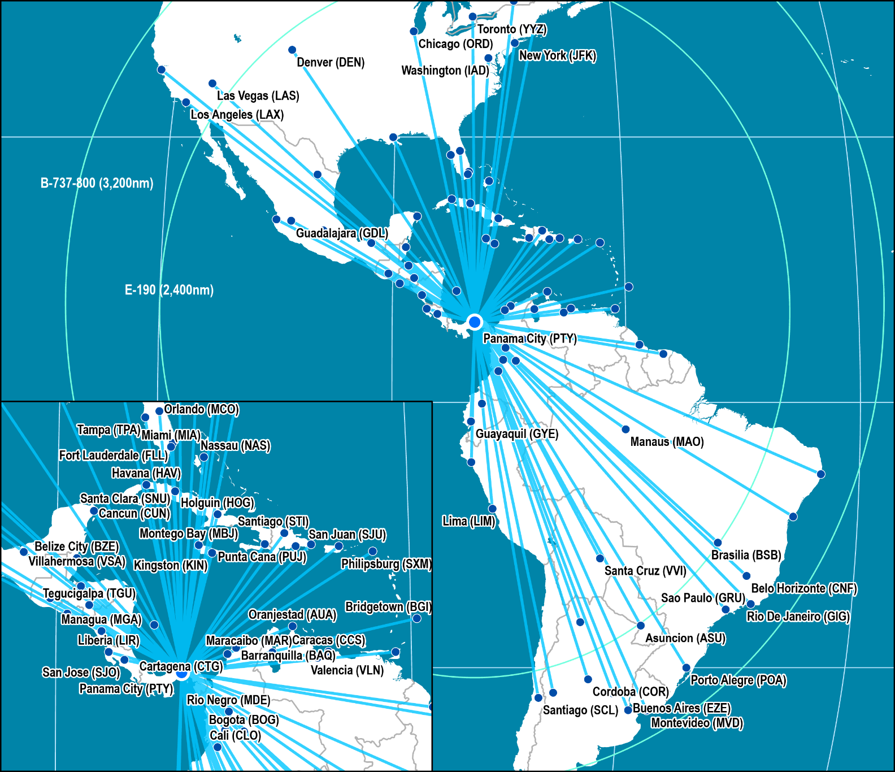
Latitudinal Intermediacy: COPA Airlines
5
Notes:
Source: Network from COPA Airlines Web Site.
Map location: air_transport

Slide 41
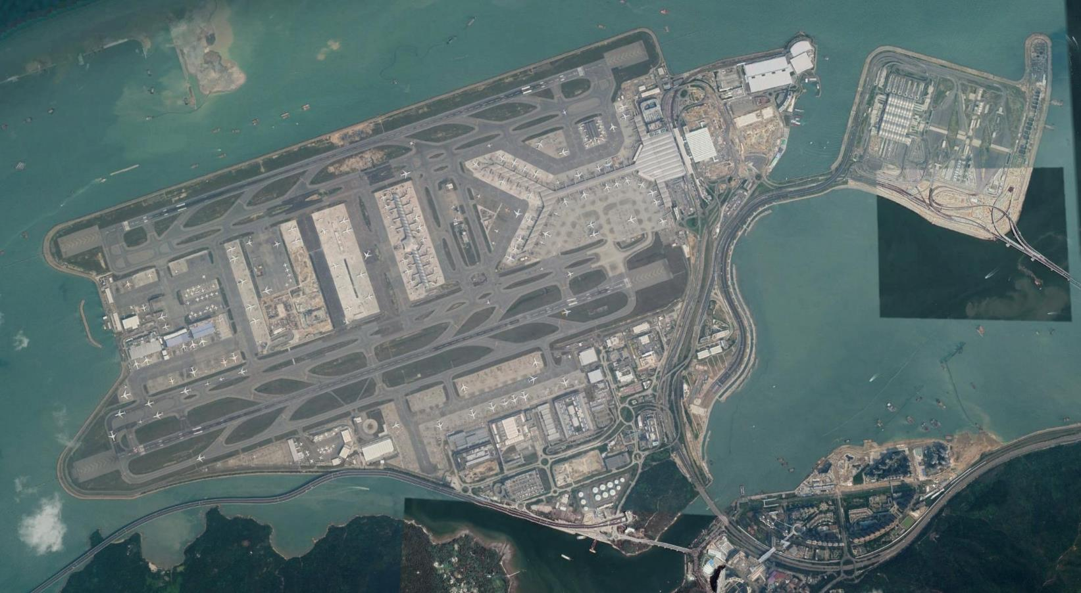
Hong Kong Chek Lap Kok Terminal
6
Read this content
Skycity
25R
North Satellite Concourse
Hong Kong Boundary Crossing Facilities
Main Terminal
07L
Terminal Expansion
(Midfield Concourse)
25L
Logistics and cargo area
07R
To Kowloon
and Hong Kong
Hong Kong–Zhuhai–Macau Bridge
To overcome geography, transportation requires a footprint

Slide 42
Atomization versus Massification in Transportation Modes
7
Ferry & Cruise ship
Passengers
Passenger train
Airplane
5,000
Bus
1,000
Car
50
500
ATOMIZATION
1
5
100
MASSIFICATION
Person
Parcel
Part
25
1,000
Container
10,000
Truck
100,000
Cargo plane
400,000
Freight train
Containership
Tons
Bulk carrier & Tanker
Read this content
Transportation seeks massification but is constrained by atomization

Slide 43
Number of Monthly Trips by for Hire Services, New York City, 2015-2019
8
Read this content
Velocity is a modal, intermodal and managerial effort
Notes:
Source: New York City, Taxi and Limousine Commission (TLC) https://data.cityofnewyork.us/Transportation/FHV-Base-Aggregate-Report/2v9c-2k7f

Slide 44
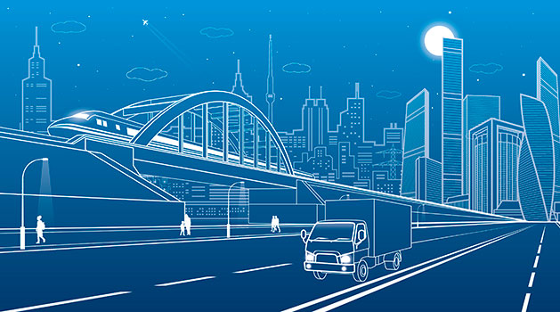
Essay: Core Principles of Transportation
Explain four main principles of transportation and for each provide an example.

Slide 45
Mobility and Logistics
What is the role and purpose of transportation? What are the relations between transportation and logistics?

Slide 46




Transportation as a Provider of Mobility
What are the core components of transportation and how they interact?
MODES
Conveyances used for the mobility of passengers and freight.
Mobile elements of transportation.
INFRASTRUCTURES
Physical support of transport modes, such as routes and terminals.
Fixed elements of transportation including superstructures.
NETWORKS
System of linked locations (nodes).
Functional and spatial organization of transportation.
FLOWS
Movements of people, freight and information over their network.
Flows have origins, intermediary locations and destinations.
Read this content

Slide 47
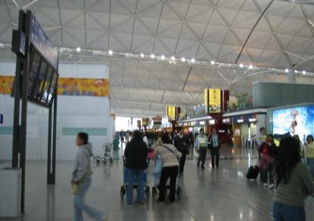
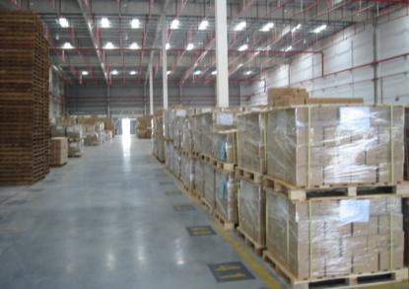
The Mobility of Passengers and Freight
Passengers
Board, get off and transfer without assistance.
Process information and act on it without assistance.
Make choices between transport modes without assistance but often irrationally.
Require travel accommodations related to comfort and safety.
Freight
Must be loaded, unloaded and transferred.
Information must be processed through logistics managers.
Logistics managers meet choices between transport modes rationally.
Require accommodations related to storage.
Read this content
Notes:
Source: adapted from EU-funded Urban Transport Research Project Results, www.eu-portal.net

Slide 48



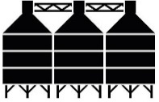



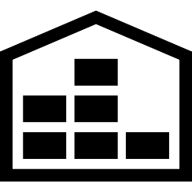




Mobility of Freight
Read this content
Weight
Storage
Fragility
Perishability
Ores
Heavy (0.83 g/cc)
Piling
None
None
Grain
Silos
Low
Low
Heavy (0.83 g/cc)
Petroleum
Heavy (0.88 g/cc)
Tanks
None
None
Apparel
Warehouse
Low
None
Average
Fruits & vegetables
Temperature controlled
warehouse
High
High
Average
Containers
Average (15-20 tons)
Stacks
Cargo dependent
Cargo dependent
© GTS
Notes:
g/cc: grams per cubic centimeter.

Slide 49
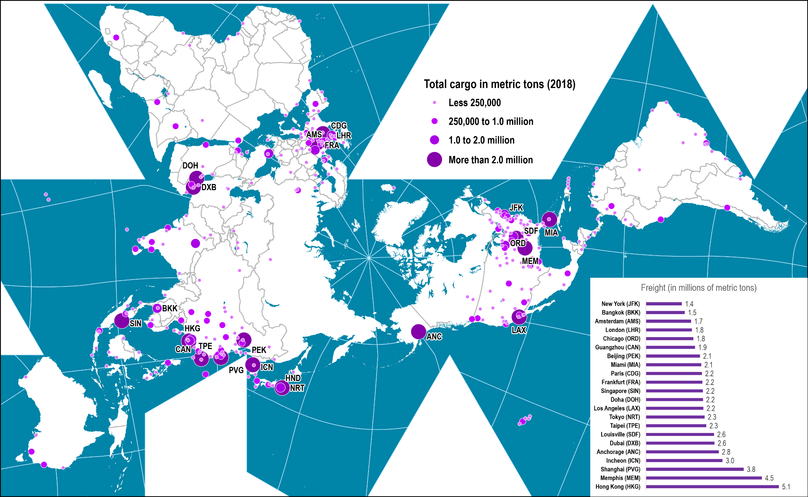
Freight Traffic at the World’s Largest Airports, 2018
Read this content
Notes:
Source: Airport Council International, http://www.airports.org

Slide 50
Logistics
Definition
  Activities related to the transformation and circulation of goods.
  All operations required for goods (material or nonmaterial) to be made available on markets or to specific destinations:
    Material supply of production.
    Distribution and transport function.
    Wholesale and retail.
Watch this video
Based on the video, how would you define logistics?

Slide 51
The Nature of a Supply Chain
In-process inventory
Parts or
raw materials
Parts or
finished goods
Inventory
Inventory
Manufacturer /
Distributor
Orders
Orders
Supplier
Customer
Transportation
Transportation
© GTS
Read this content

Slide 52

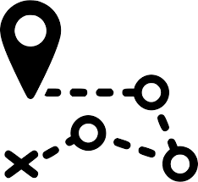


The Relevance of Logistics
Read this content
Costs
Friction of distribution
Geography
Spatial division of manufacturing
Efficient logistics has commercial benefits (costs, time and reliability).
Logistics cost 10-15% of national GDP.
Stages of production are spatially separated.
Final production and markets are spatially separated.
Growth
Growing material demand
Environment
Sustainability
Growth of global consumption and income.
Diversity of consumption patterns.
Energy and material efficiency.
Reverse logistics / recycling.
Complexity
Complex value chains
Goods are getting more complex (parts and processes).
Embededness of design, manufacturing, distribution and marketing.
Explain why logistics matters in a global economy.

Slide 53
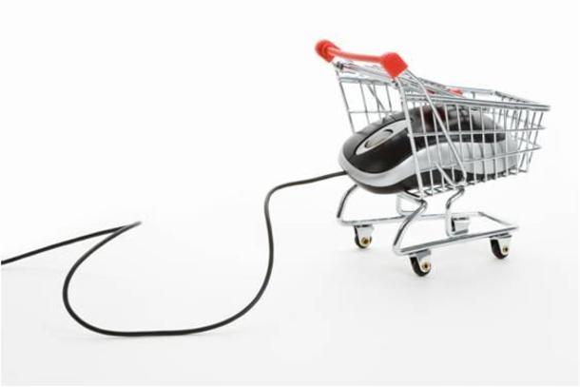
Logistical Distance and Online Purchases
Apply the concept of logistical distance to all the stages of an online
purchase.

