Slide 1
Topic 3 – The Challenges of Globalization
A – Economic Development
B – Inequalities
C – War, Conflicts and Terrorism
D – The Environment

Slide 2
Conditions of Usage
For personal and classroom use only
  Excludes any other forms of communication such as conference presentations, published reports and papers.
No modification and redistribution permitted
  Cannot be published, in whole or in part, in any form (printed or electronic) and on any media without consent.
Citation
  Dr. Jean-Paul Rodrigue, Dept. of Global Studies & Geography, Hofstra University.

Slide 3
A – Economic Development
The Notion of Development
Themes of Development
Waves of Development

Slide 4
The Notion of Development
What is development?
  Development is a process; a mean towards an end.
  Improvement of the welfare of the population:
    Development is about people, not necessarily the economy.
    Create an enabling environment for people; economic opportunities.
    Long term process; takes place over decades.
  Different societies can have different development goals:
    Promote private accumulation of wealth.
    National and collective interests.
    Reducing between groups and regions.
    “Hard” (e.g. infrastructure) versus “soft” (e.g. education) approaches.
Conditions
  Appropriate social, political, legal and economic conditions.

Slide 5
The Notion of Development
Physical Capital
Infrastructures and resources that can be used in a productive manner.
Human Capital
The total population and its qualification level.
Public utilities:
Energy, telecommunications, water supply and waste disposal.
Public works:
Roads, dams, irrigation canals.
Transport infrastructures:
Ports, airports, railways, public transit systems.
Development of human capital:
Supported by education systems.
Reproduce and improve the productivity of the labor force.
Information economy:
Human capital a resource that differentiates nations.
Not always because of wage differences, but because of differences in capabilities.

Slide 6


The Notion of Development
Explain the main conditions and outcomes of economic development
Conditions
Outcomes
Social
Political
Health
Education
Quality of life
Rights
Equality
Rule of law
Physical Capital
Economic
Employment
Surpluses
Human Capital
Development

Slide 7
Some Notable Development Outcomes
Infrastructure
Core physical support
Roads, bridges, ports, airports, railways, cities, transit systems, telecommunications, energy generation and distribution, waste collection, agriculture
Superstructure
Ancillary physical support
Vehicles, ships, planes, tools, equipment, servers
Housing
Individual physical comfort
Electricity, heating, air conditioning, running water, toilets, furniture, refrigerators, ovens, showers, windows, washing machines, soap, clothes and shoes, computers, televisions, smartphones
Health
Individual wellness
Vaccines, antibiotics, anesthesia, surgeries, hospitals and clinics, pharmaceutical drugs, ambulances

Slide 8
Some Notable Development Outcomes
Food
Individual survival
Sufficient and diversified food supplies, drinking water, fresh fruits and vegetables, meat and proteins, markets and supermarkets,
Knowledge
Individual improvement
Education system, schools, universities, research centers, libraries (physical and electronic), museums, scientific and vocational training, news
Social system
Individual safety and security
Legal system, policing, defense, social security, insurance, retirement, unemployment security, sick and disability leaves
Free time
Individual wellness
Sports, entertainment (movies, music), parks, resorts, toys and hobbies

Slide 9
The Notion of Development
Human Development Index (HDI)
  Composite indicator developed in 1990 by the United Nations Program for Development (UNPD).
  Comparative measure of development.
  Ranges from 0 to 1:
    The country having the highest score for a variable has a value of 1 and other countries are graded from how far they are from this best score.
  Three major sets of variables:
    GNI (Gross National Income) per capita.
    Health index.
    Education index.
Notes:
30
Gross Domestic Product is based on location, while Gross National Income is based on ownership.

Slide 10
Components of the Human Development Index
GNI per capita
GNI per capita adjusted to take account of the purchasing power parity.
Health index
Education index
Mean years of schooling.
Purchasing power parity considers the cost of living in each country and adjusts the GDP accordingly.
A good health system is likely to improve the life expectancy significantly in a nation.
Reflective of the standard of living.
Life expectancy at birth.

Slide 11
Share of the World GDP, 2017 (Current USD)
Notes:
Source: World Bank Development Indicators.

Slide 12
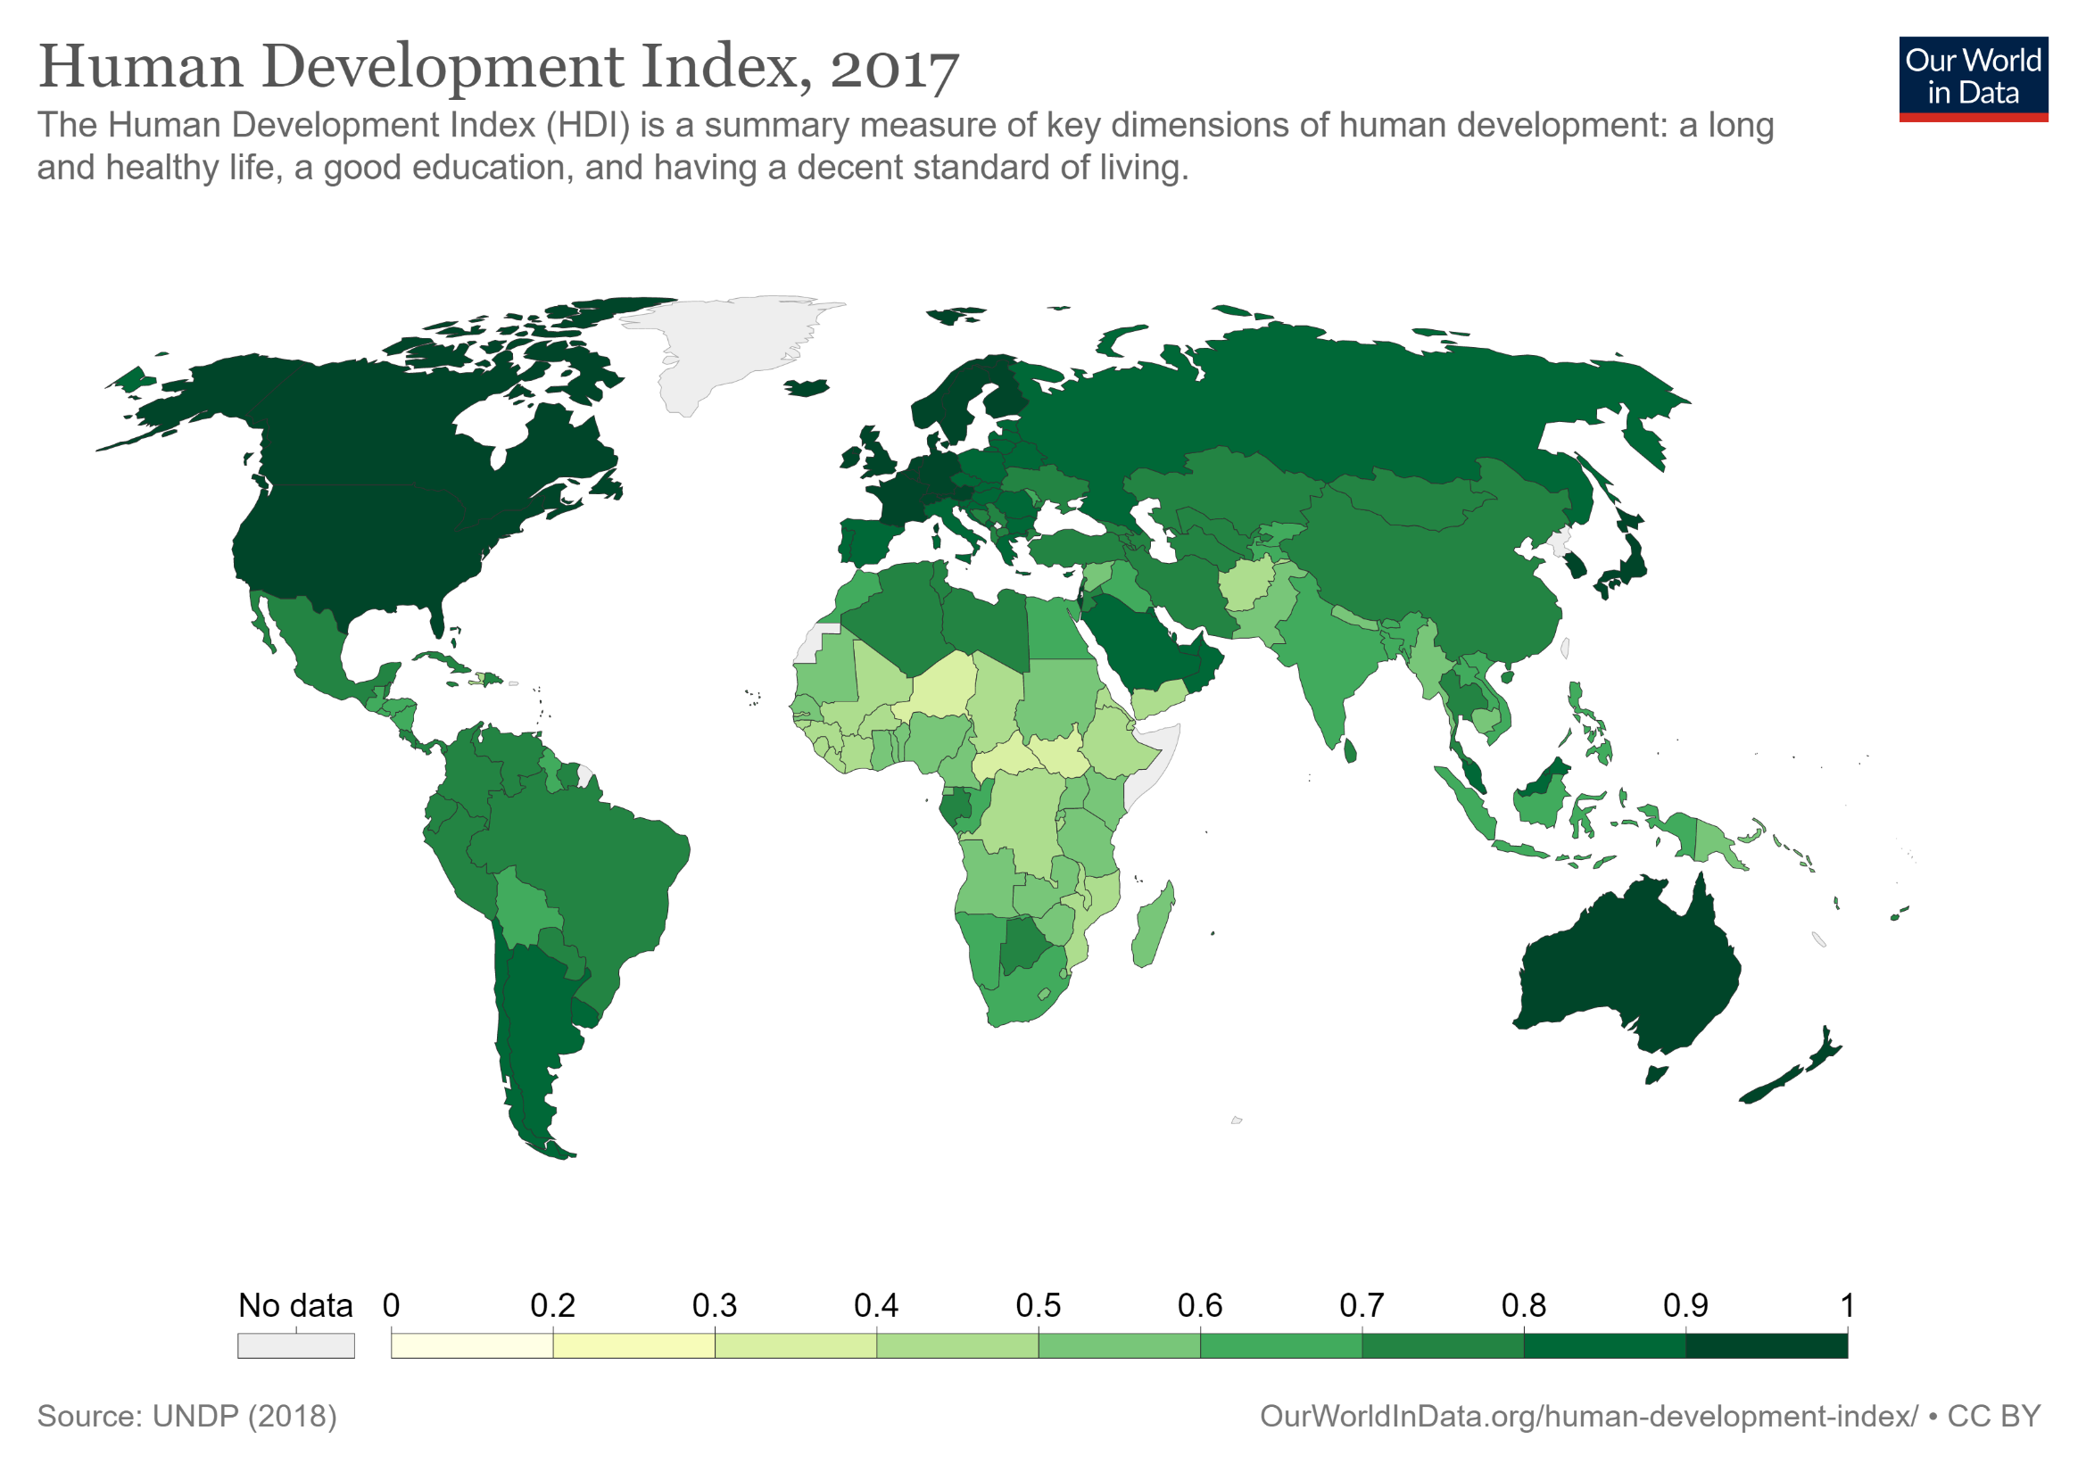
Read this content
Notes:
Source: Our World in Data.
https://ourworldindata.org/human-development-index

Slide 13
Measuring Development: Social Indicators
 | Definition | Globalization
Life expectancy | Number of years a person is expected to live. Based on current death rates. | Positive impacts (increase)
Fertility | Number of live births per female of reproductive age (15-49). Indicates population change over a long period of time. | Positive impacts (lower)
Infant mortality | Numbers of deaths of infants (below 5 years) year per 1000 live births of the same year. Reflects the quality of the health system. | Positive impacts (lower)
Adult literacy | People above 15 years able to read standard instructions. | Positive impacts (increase)
Child labor | Economically active children under the age of 14. Can combine work and education. | Mitigated impacts
Explain three social indicators of development

Slide 14
Life Expectancy Through Human History
Era | Life expectancy
Neanderthal (350,000 – 25,000 BC) | 20
Upper Paleolithic (40,000 – 10,000 BC) | 33
Neolithic (8,500 – 3,500 BC) | 28 to 33
Bronze Age (3,500 – 1,200 BC) | 26
Classical Greece and Rome (500 BC – 400 AD) | 20 to 30 (+30 years if survived 20)
Medieval Britain (400 – 1500 AD) | 33
Late 19th Century in Western Europe | 37
Average Global Life Expectancy (1950) | 48
Average Global Life Expectancy (2018) | 72.5 (gain of almost 25 years)

Slide 15
World Average Life Expectancy, 1960-2018
Notes:
Source: World Bank
http://data.worldbank.org/indicator/SP.DYN.LE00.IN

Slide 16
Life Expectancy at Birth, Selected Countries (Average for both sexes)
Notes:
Source: United Nations Population Division

Slide 17
Total Fertility Rate, Selected Countries, 1995-2015
Replacement rate (2.1)
Notes:
Source: World Population Prospects, the 2010 Revision

Slide 18
TFR among Developed Countries, 2005-2018
Notes:
Source: World Bank
https://data.worldbank.org/indicator/SP.DYN.TFRT.IN

Slide 19
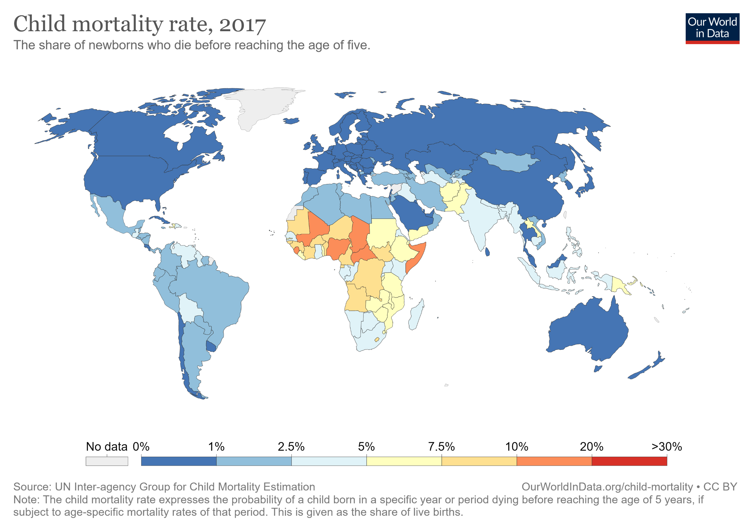
Infant Mortality Rate, 2008
Notes:
Source: Our World Data
https://ourworldindata.org/child-mortality

Slide 20
Adult Literacy Rate (% above 15 years), 2018
Notes:
Source: World Bank, World Development Indicators

Slide 21
Percentage of Economically Active Children Aged 7-14
Notes:
Source: World Bank

Slide 22
Waves of Development
Automation
Robotics
Digitalization
Sustainability
Digital networks
Software
New Media
Biotechnology
Petrochemicals
Electronics
Aerospace
Waterpower
Textiles
Iron
Mechanization
Commerce
Steam
Rail
Steel
Cotton
Electricity
Chemicals
Internal combustion engine
Pace of innovation
1st Wave
2nd Wave
3rd Wave
4th Wave
5th Wave
6th Wave
1785
60 years
1845
55 years
1900
50 years
1950
40 years
1990
30 years (?)
2020
25 years (?)
Read this content
Notes:
Source: Adapted from the Economist, Feb 20th 1999.

Slide 23
U.S. Goods and Services Related Jobs, 1950-2019
Notes:
Source: Bureau of Labor Statistics.
Goods-producing: https://www.bls.gov/iag/tgs/iag06.htm
Service producing: https://www.bls.gov/iag/tgs/iag07.htm#workforce

Slide 24
Male Labor Force per Economic Sector, Selected Countries, 2000-2004
Notes:
Source: World Bank, http://devdata.worldbank.org/wdi2006/contents/toc.htm

Slide 25
The Laws of Unintended Consequences
 | Socialism | Fundamentalism | Protectionism | Environmentalism
Concept | Redistribution of wealth through a variety of programs. | Retrenchment to religious beliefs. Characteristic of many religions. Mostly associated with Islam. | Belief that the national economy is harmed by trade or foreign interests. | Identification and mitigation of environmental issues.
Issue | Forced redistribution and the emergence of dependent class. “Looters and moochers”. The equity trap. | Refuse (sometimes violently) different forms of globalization (products or culture). | Impose higher duties or restriction on trade. | Dogmatism.
Consequences | Lead to growing involvement of the government in the economy. Misallocations. | Promotes isolation, economic and technological backwardness and a lack of skills. | Higher costs and limited opportunities. | Constraining legislation and regulation of activities.
Some policies can have unintended consequences on development. Explain.

Slide 26
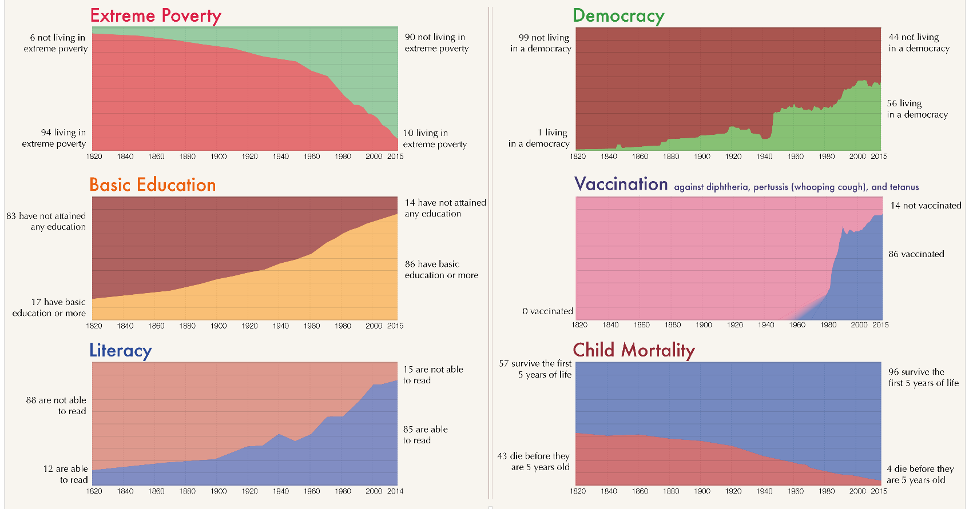
The ‘Oppression’ of Capitalism: The World as 100 People since the early 19th Century
Notes:
Source: Max Roser at Our World In Data - From the Our World in Data's publication A history of global living conditions in 5 charts, https://en.wikipedia.org/wiki/Our_World_In_Data#/media/File:The_World_as_100_People.png

Slide 27


Globalization and Economic Development
How can globalization be a factor for economic development? Can globalization prevent development?

