Slide 1
Topic 1 – What is Globalization?
A – Setting the Context
B – Representing the World
C – The Processes of Globalization

Slide 2
Conditions of Usage
For personal and classroom use only
  Excludes any other forms of communication such as conference presentations, published reports and papers.
No modification and redistribution permitted
  Cannot be published, in whole or in part, in any form (printed or electronic) and on any media without consent.
Citation
  Dr. Jean-Paul Rodrigue, Dept. of Global Studies & Geography, Hofstra University.

Slide 3
A – Globalization: Setting the Context
The Nature Globalization
When Did Globalization Began?
Imperialism, Mercantilism and Capitalism
Investigating Globalization: Global Studies

Slide 4
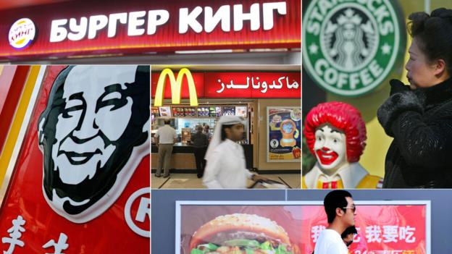
The Nature of Globalization
A multidimensional concept
  Is globalization economic, political, cultural, technological?
  Awareness:
    People, governments and corporations.
    The “world is getting smaller”; part of a “single place”.
    Geography is less constraining.
  A dynamic process (change):
    Accessibility (easier for people and freight to move).
    Telecommunications (easier to exchange information).
    Transactions (easier to negotiate, trade and settle transactions).

Slide 5
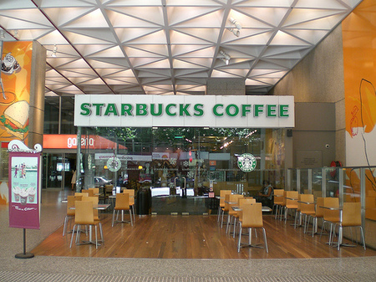
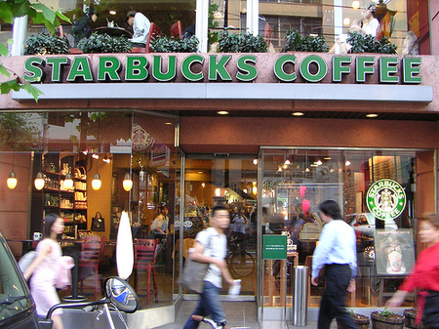
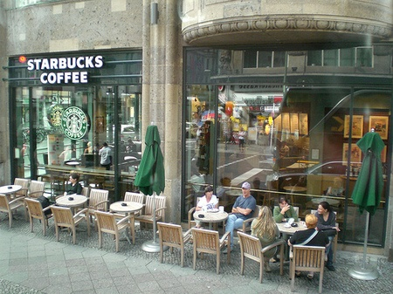

“Arabica Universalis”: One of the World’s Most Traded Commodity
Melbourne
Tokyo
Berlin
Notes:
“Coffee was first consumed in the 9th century, when it was discovered in the highlands of Ethiopia.[1] From there, it spread to Egypt and Yemen, and by the 15th century had reached Armenia, Persia, Turkey, and northern Africa. Noted as one of the world’s largest, most valuable, legally traded commodities after oil.”

Slide 6
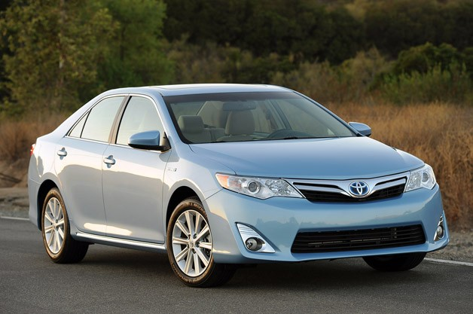
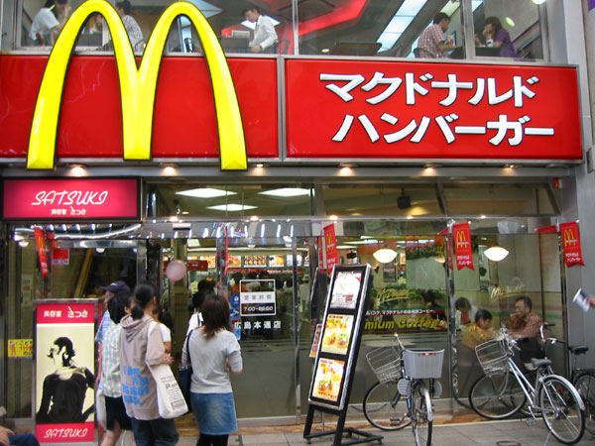
Ambiguity and Reciprocity
American fast-food outlet in Japan
Japanese car in the United States
What is better for the US, a Ford made in Germany or a Honda made in Kentucky?

Slide 7
The Nature of Globalization: A Series of Terms
1. International
3. Transnational
A relation that involves more than one country.
Based on interactions (International trade).
An event that transcend boundaries.
Based on processes (Transnational migration).
Nation A
Nation B
1
2. Multinational
2
3
2
4. Supranational
An activity taking place in more than one country.
Based on replication (Multinational corporation).
The delegation of authority at a level across nations.
Based on agreements (Supranational agreement)
4

Slide 8
Forms of Cultural Globalization
Homogenization
Emergence of a dominant global culture.
Diffusion
Transposition of some traits from one location to another.
Adaptation
Changes of traits to better fit local traits.
Co-existence
Global and local cultural traits independently taking place.
Stamping
Transposition of traits to a specific location (enclave).

Slide 9
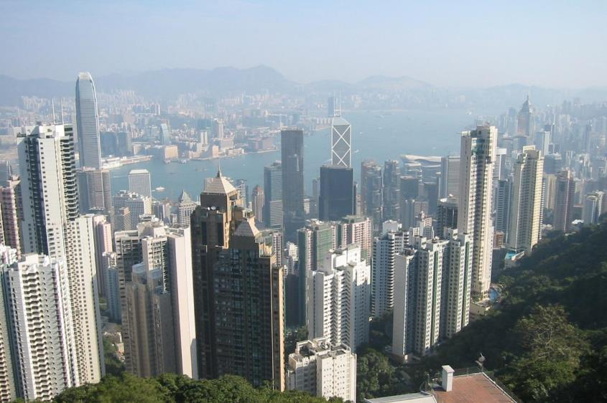
Hong Kong Skyline (China): Homogenization?
Notes:
Photo: Dr. Jean-Paul Rodrigue

Slide 10
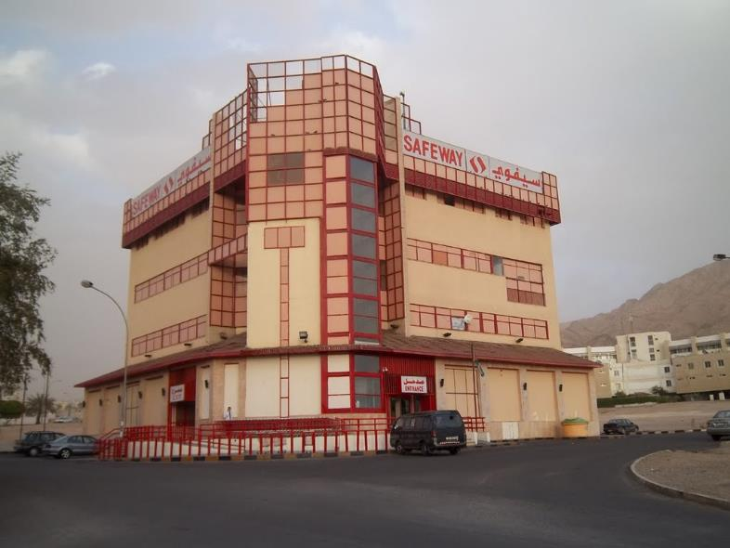
Safeway Grocery Store in Jordan: Diffusion?
Notes:
Help diffuse new consumption practices? Represent an adaptation to changing household consumption practices? Woman more involved in the regular workforce?
Photo: Dale Lightfoot, Oklahoma State University

Slide 11
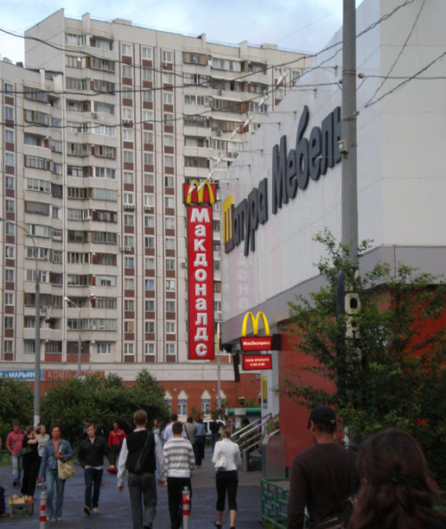
Suburbs of Moscow: Adaptation?
Notes:
Photo: Ugo Bardi.

Slide 12
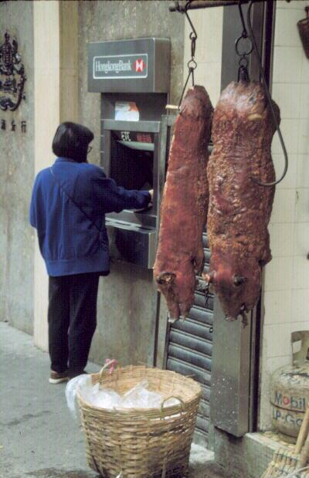
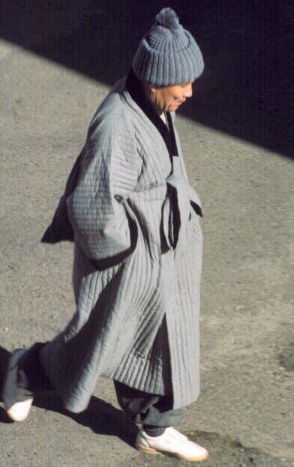
Hong Kong (ATM and roasted pig) and South Korea (Buddhist Monk): Co-Existence?
Notes:
Photo: Dale Lightfoot, Oklahoma State University

Slide 13
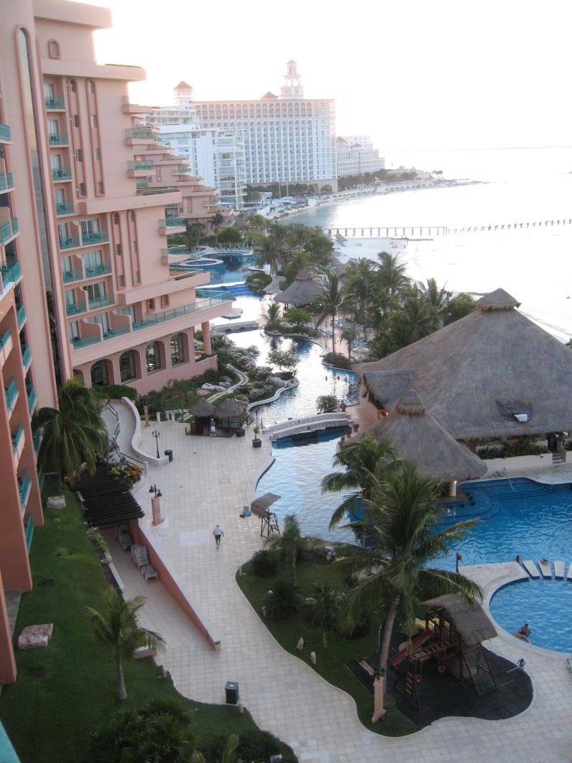
Cancun (Mexico):
Stamping?
For each of the forms of cultural globalization, provide a documented example.

Slide 14



Major Forms of Globalization
Form | Cultural / Social | Political | Economic
Nature | How globalization changed human behavior? | What forms of regulation or control are linked with globalization? | How globalization influences wealth creation and distribution?
Outcomes | Homogenization Hybridization Rejection | International agreements (global or regional). Multiple layers of governance. | Trade, new markets, new products
Issues | Is a global culture emerging? | Are forms of global governance suitable? Will supranationalism prevail? | Is globalization promoting inequalities?

Slide 15
Main Possible Factors of Globalization
Cause | Dimension
Technology | Transport technology (air transport, containerization). Communication technology (mass communication, internet, electronic translation). Scientific standardization (weights and measures, time zones).
Cultural | Spread of ideologies (religions, democracy). Development of global events (Olympics, World Cup). Consumerism (global brands).
Economic | Voyages of exploration (15th – 17th centuries). Commercial policy (free trade). Expansion of trade and markets (comparative advantages). Multinational corporations (global production).
Political | International regulations (institutions facilitating international exchanges). Environmental consciousness (climate change, pollution, endangered species).
Explain the main possible factors favoring globalization.

Slide 16
When Did Globalization Began?
Read this content
Antiquity
Modern Era
Post-Modern
Time Frame
Since the beginning of history
Nineteenth century
After World War II
Economic System
Imperialism / Mercantilism
Imperialism / Capitalism
Capitalism / Corporatism
Foundation
Exploration, war (expansion) and trade
Mass production and consumption
Trade liberalization
Acceleration
Age of exploration of colonialism (15-16th century)
Berlin Conference (1884)
Fall of the Soviet Union
Entry of China in world trade
Form
Empires
Nation-states
Economic blocs
Mobility
Trails and sailships
Mechanized (steamship and rail)
Air transport, containerization and telecommunications

Slide 17
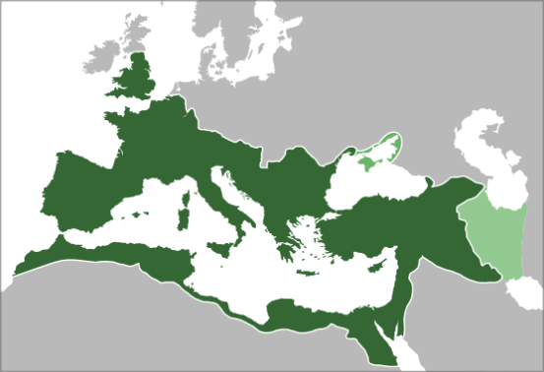
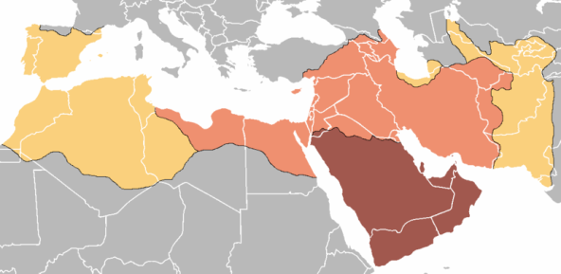
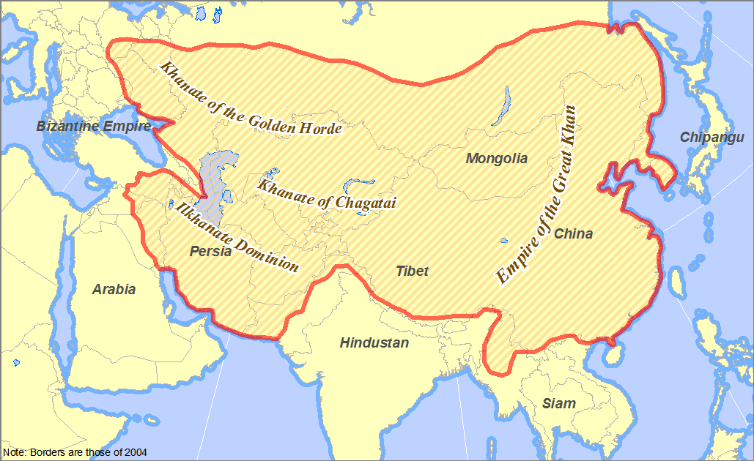
Early Forms of Globalization: Empires
Han Dynasty in China (2nd century BCE to 3rd century)
The Roman Empire (1st century BCE to 5th century)
Islamic Golden Age (8th century to 13th century)
Mongol Empire (12th century to 13th century)

Slide 18
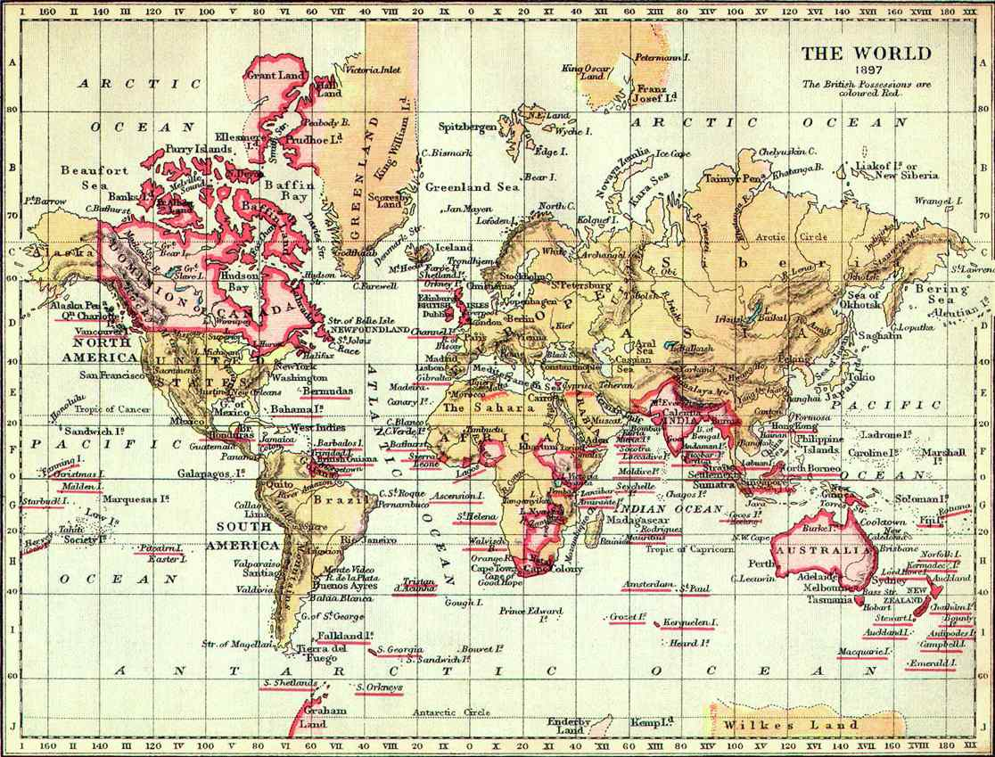
Intermediate Globalization: The British Empire, 1897
20% of the world’s surface
25% of the world’s population

Slide 19
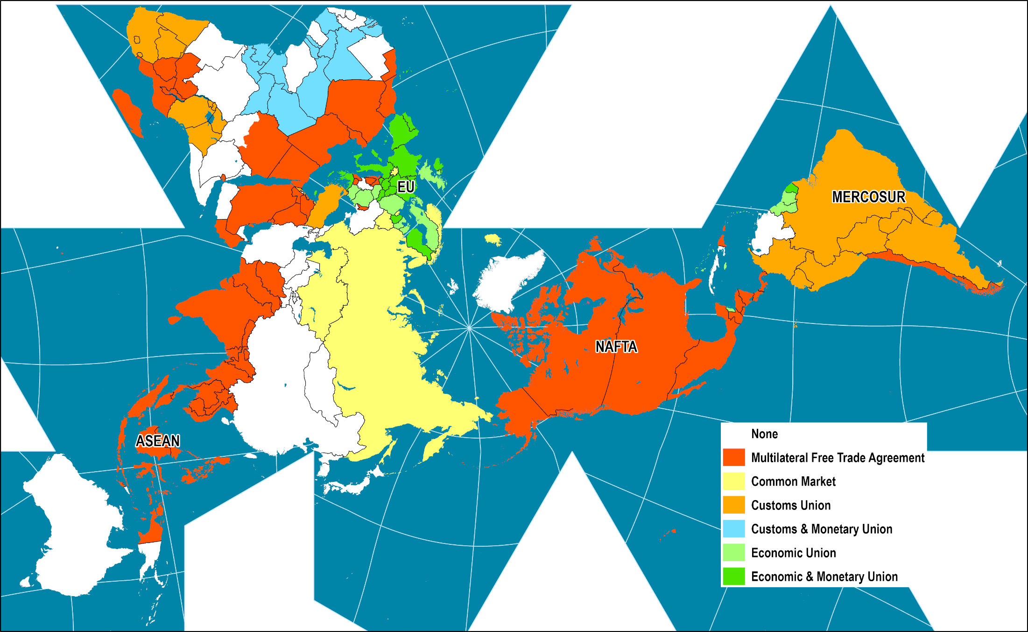
Economic Integration Levels, 2015
Explain the three perspectives about when globalization began.
Read this content

Slide 20



Imperialism, Mercantilism and Capitalism
 | Imperialism | Mercantilism | Capitalism
Definition | Expansion by territorial conquest | Control and monopoly of the trade of commodities | Generation and accumulation of capital through free exchange
Growth | Domination and subordination | Unequal trade | Productivity (profit)
Agent | Military | State | Corporation
Main relation | Tribute / trade | Trade / taxes | Transactions
Territories | Protectorates | Colonies | Markets
Example | Roman Empire | Dutch East India Company | Ford

Slide 21
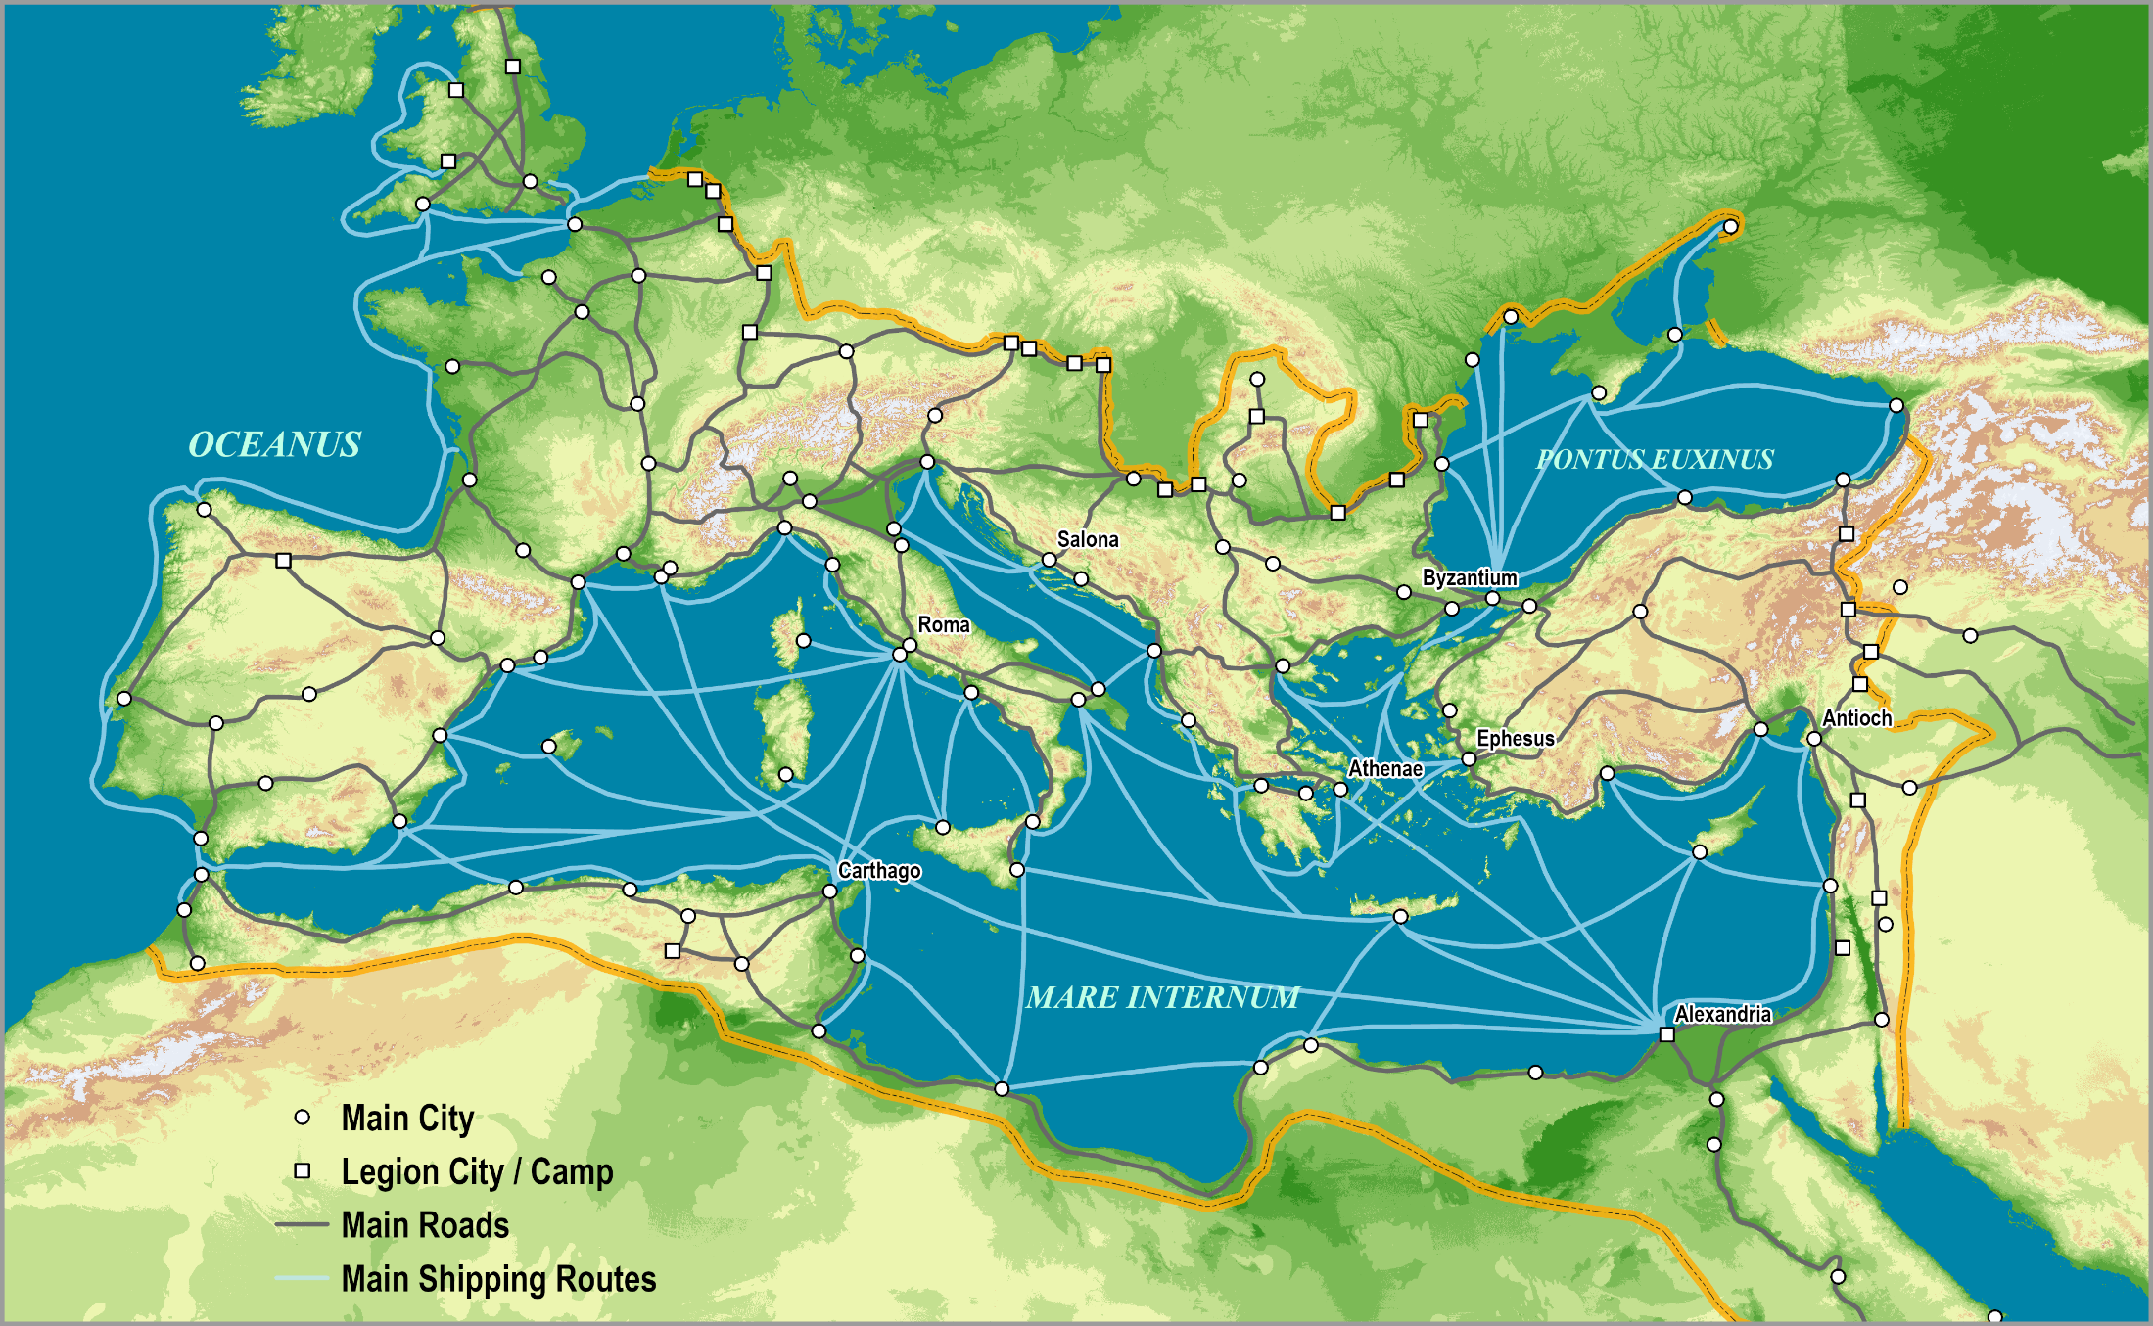
Roman Empire, c125AD
Empires collapse because of overstretch: resources to maintain hegemony exceed resources collected. Theft, plunder, taxation and (hyper)inflation (final phase).
Read this content

Slide 22
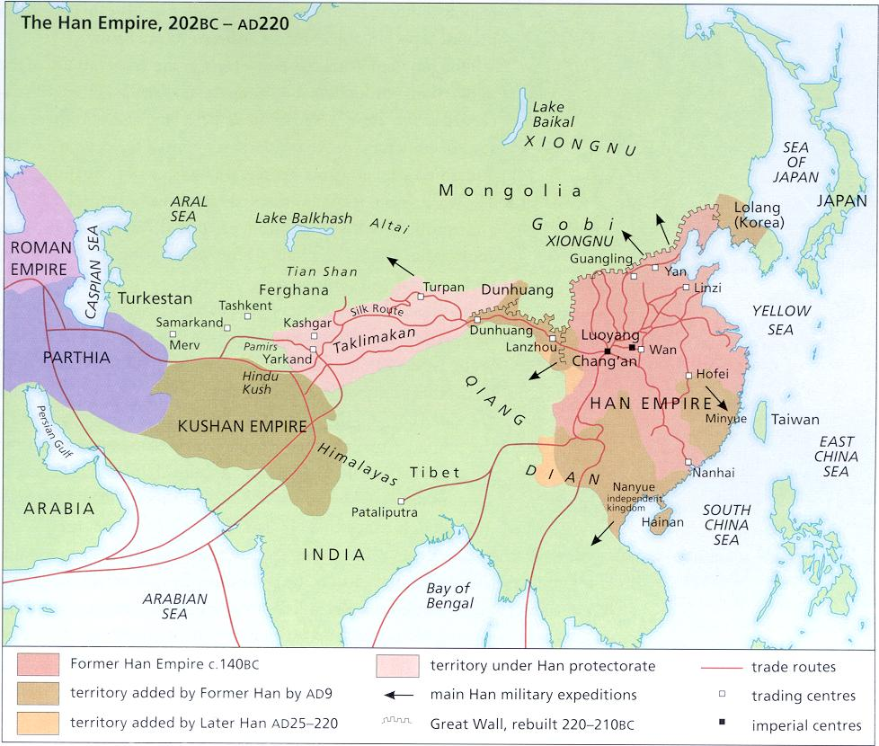

Slide 23
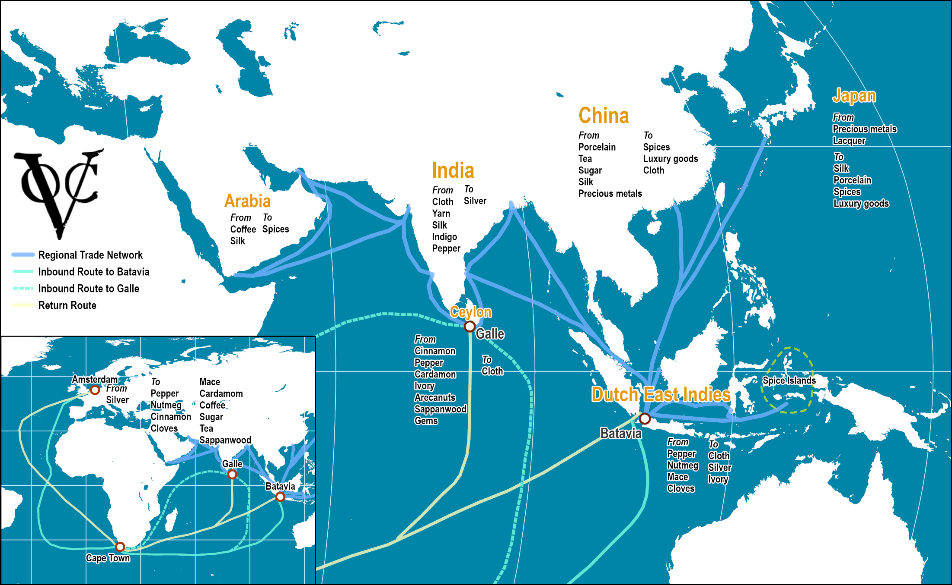
Dutch East India Company, Trade Network, 17th Century
Read this content
Notes:
Source: adapted from: http://cf.hum.uva.nl/galle/galle/voc_shipping.html

Slide 24
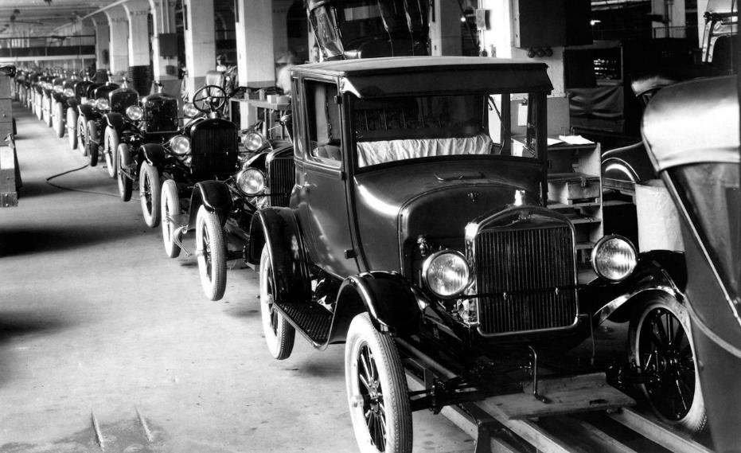
Assembly Line of a Ford Model T, 1924
Read this content

Slide 25
Investigating Globalization: Global Studies
Global Studies
  “The academic study of political, economic, ecological and cultural relations and processes that in some way bear upon the world.”
Some observations
  Globalization does not necessarily lead to homogenization.
  Globalization reinforces pluralism.
  Nation states tend to be part of transnational agreements.
  Governments are more challenged to manage their borders and economies.
  Globalization does not necessarily lead to less conflicts.
  Globalization is not a value (good or bad), it is a process which outcomes can be relatively positive or negative.
Notes:
Source for the definition: Wikipedia.

Slide 26
Globalization: Elements of the Debate
 | Positive outcomes | Negative outcomes
Trade | Free-trade / Fair-trade | Trade imbalances and dependency
Economic Growth | Creates prosperity and opportunities | Enduring inequalities between regions and within societies
Culture | Cultural fusion (promotion of positive cultural traits) | Erode traditional cultures and promotes homogenization
Relations | More multilateral agreements | More ground for disagreements
Environment | Lead to an efficient allocation of resources | Environmental issues such as climate change
Health and Welfare | Improvement in life expectancy and education | Epidemics and pandemics
Politics | Improve civil liberties and democracy | Governance subjugated by corporations
Security | Less violent societies. Less large-scale conflicts | Internationalization of conflicts and new threats (terrorism, refugees, cybersecurity, etc.)

Slide 27
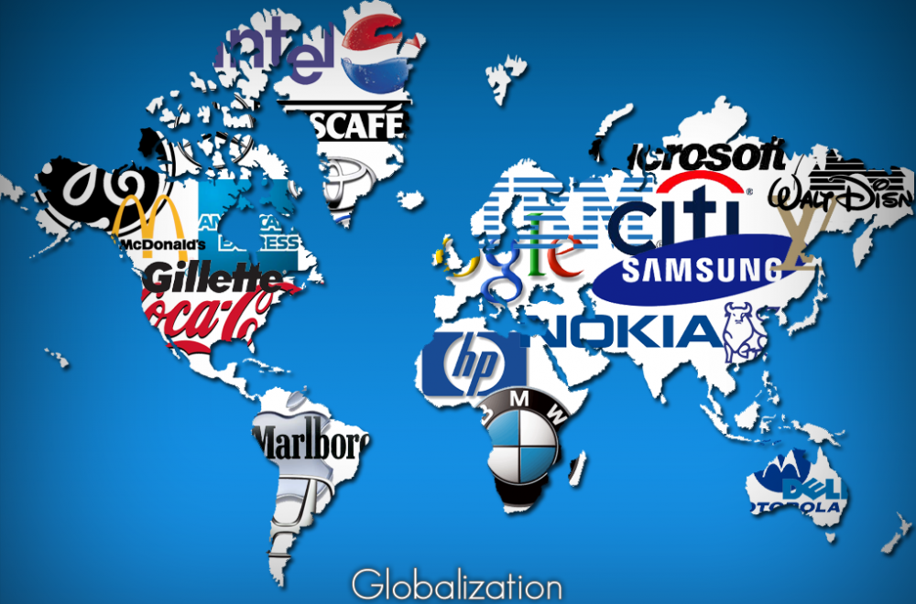

The Globalization Debate
Based upon the purpose of global studies, discuss the merits and flaws of the globalization debate?

Slide 28
B – Representing the World
Antiquity: Discovering Geography
Middle Ages: Retrenchment
The Age of Discovery: Drawing the World Map
Modern Era: A Finite World

Slide 29
B – Representing of the World
Knowledge about the world
  Information needs to be organized and stored so that it can be used and transmitted across space and generations.
  Knowledge is the organization of information for a useful purpose.
  Spatial thinking has always been present in human societies:
    The map was traditionally the main tool for such a purpose.
    Started with mental maps and developed into cartography (science and technique of mapping).
  Globalization:
    Growing quantity of information available.
    Easier to transmit this information (mass media, IT, language).
    Location and navigation technologies.
    Dynamic, customizable and updated.
Read this content

Slide 30
Non-Western Maps
Limited examples of non-western cartographic tradition
  Babylonian Imago Mundi (6th century BCE); oldest world map.
  Polynesian stick charts for navigation (timeframe uncertain; likely two thousand years).
  Precolonial Maya and Aztec registries of events (circa 10th century).
  Chinese cartography (focusing on mainland China).
  Arabic cartography (8th to 16th centuries):
    Mapping trade routes in North Africa / Middle East and South and Southeast Asia.
Main factors for a limited tradition
  Small scale maps/representations (many culture / empires were regional in scope).
  Unwilling or unable to be interested in affairs outside their realm.
  Heavy reliance on oral tradition.
  Maps recorded on medium that did not endure (ceramic, textiles, hides) and would disappear if not copied.
  The decline or collapse to the culture implied to loss of the cartographic tradition.

Slide 31
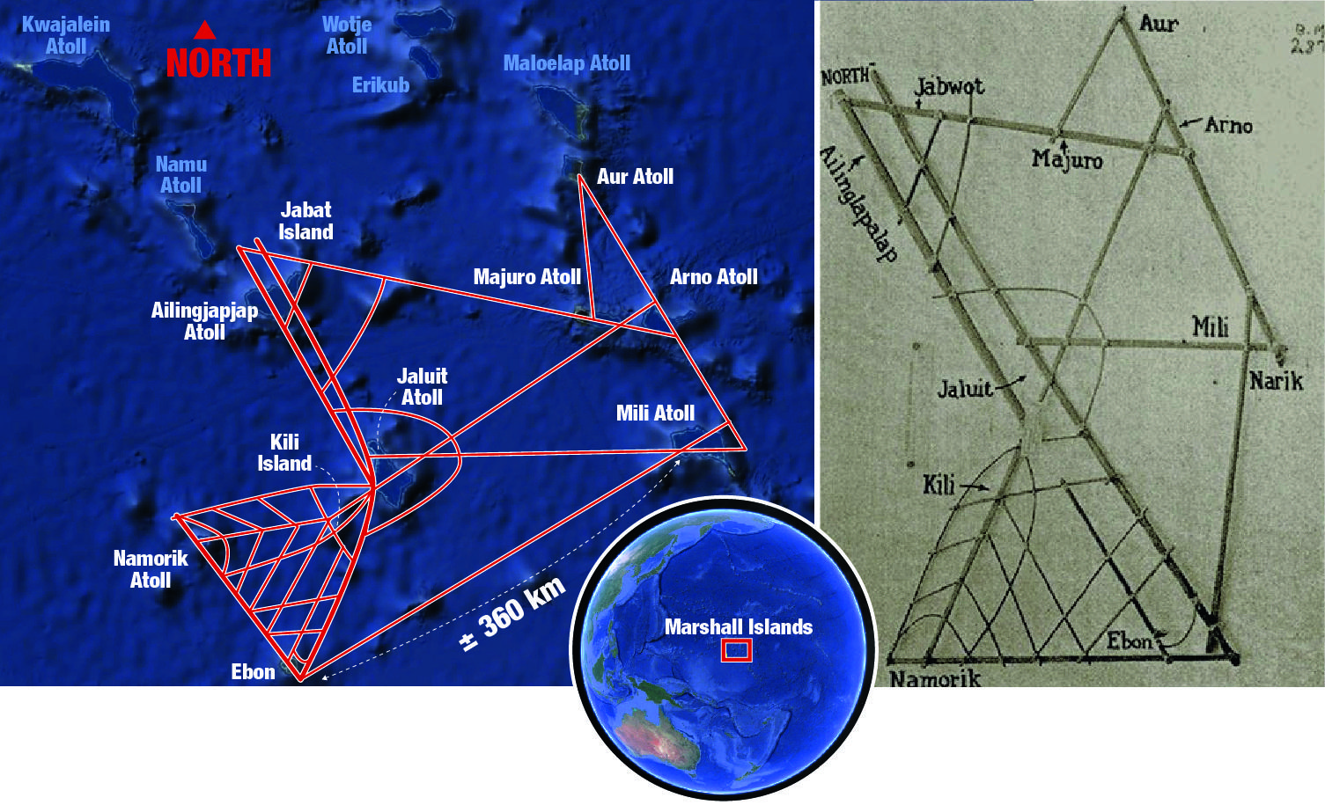
Polynesian Stick Map, Overlay with Contemporary Marshall Islands

Slide 32
The Four Major Phases in the Cartographic Representation of the World
Antiquity (up to 500 CE)
Middle Ages (5th to 15th Century)
Age of Discovery (16th to 19th Century)
Modern Era (20th Century onward)

Slide 33
Antiquity: Discovering Geography
Herodotus (circa 450 BCE)
  Inspired by Pythagoras (530 BCE) and his geometry.
  Founder of geography.
  Basic physical and human geography.
  Exploration and travel instead of geometry.
  Coined the terms Europe, Asia and Africa (Libya).
“Filling in the blank”
  Through reports, accounts and legends.
  Using one’s imagination.
Accuracy
Familiar
Distance
Accounts
Legends
“Terra incognita”
Trade route

Slide 34
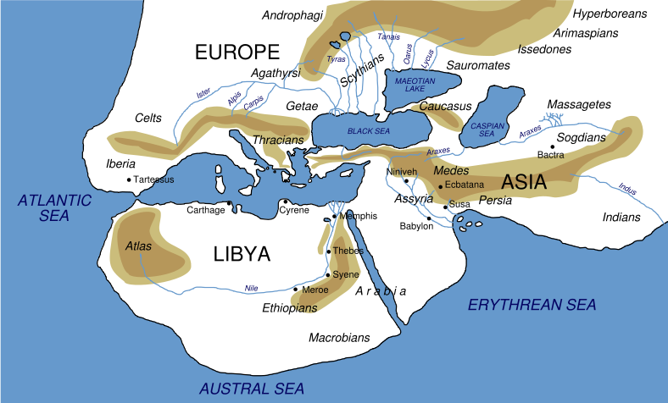
Herodotus (450 BCE) (recreation)

Slide 35
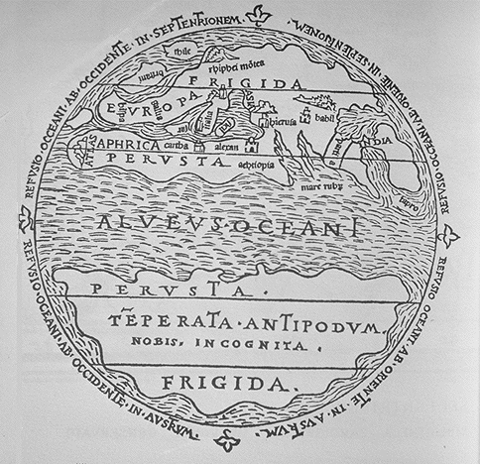
Antiquity
Aristotle (circa 350 BCE)
  Considered physical elements such as the temperature and winds as factors of the human habitat.
  Division of the world in 3 climatic zones.
  Relationships between the environment (temperature) and human habitat.
  One of the first physical geographer.
  Judged impossible to cross to torrid equatorial zone and reach the antipodes.
Frigid
Temperate
Torrid
Temperate
Frigid

Slide 36
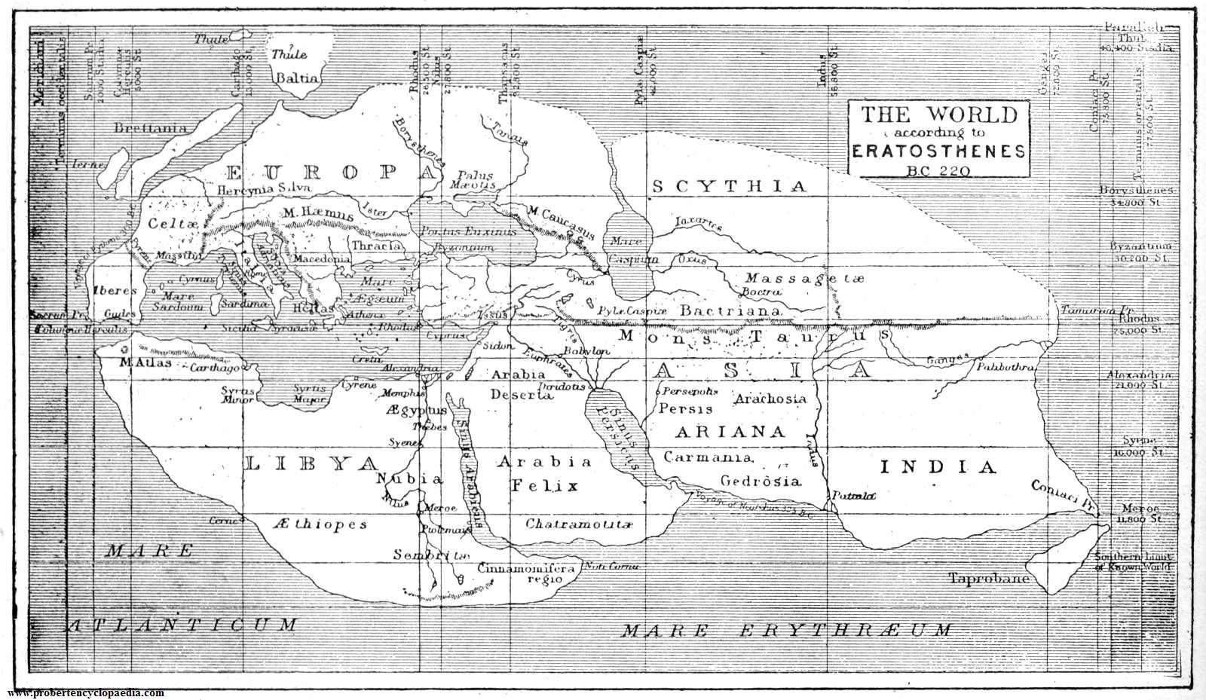
Eratosthenes (194 BCE) (reconstruction)
Formally assumed the earth was round: Calculated the circumference of the earth (40,572 km versus 40,091 km). Developed the concepts of parallel and meridian (geographical location). Created modern cartography (cartographic plane).

Slide 37
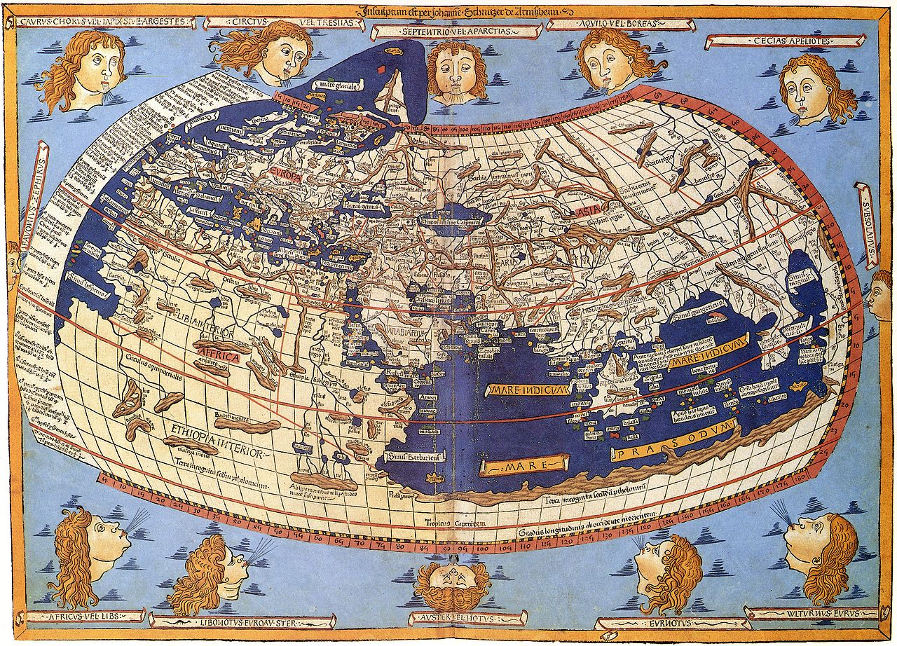
Ptolemy's (150 CE) Ulm edition world map, 1482
Refined the coordinate system. Created map projections.
Inventory of population and resources. Describing the world (8,000 entries).
Relationships between the physical and human elements.
His map would remain the most accurate until the age of discovery.

Slide 38
Middle Ages: Retrenchment
Period of decline in western tradition
  Cartographic and regional approach was lost in Europe:
    Representation of the world was “Christianized”.
    Orthodoxy replaced objective observation and analysis.
  “T and O” Maps (Orbis Terrae):
    T is the Mediterranean (+ Nile and Black Sea).
    O is the surrounding ocean.
    Placing Jerusalem at the center of the world.
  Greek and Roman knowledge kept by the Byzantine Empire and by the Arabs:
    E.g. Muhammad al-Idrisi (12th century).
    Expanded and corrected the geographical information, particularly in the Middle East and South Asia.
    The need to know the direction towards Mecca incited reliable cartography.

Slide 39
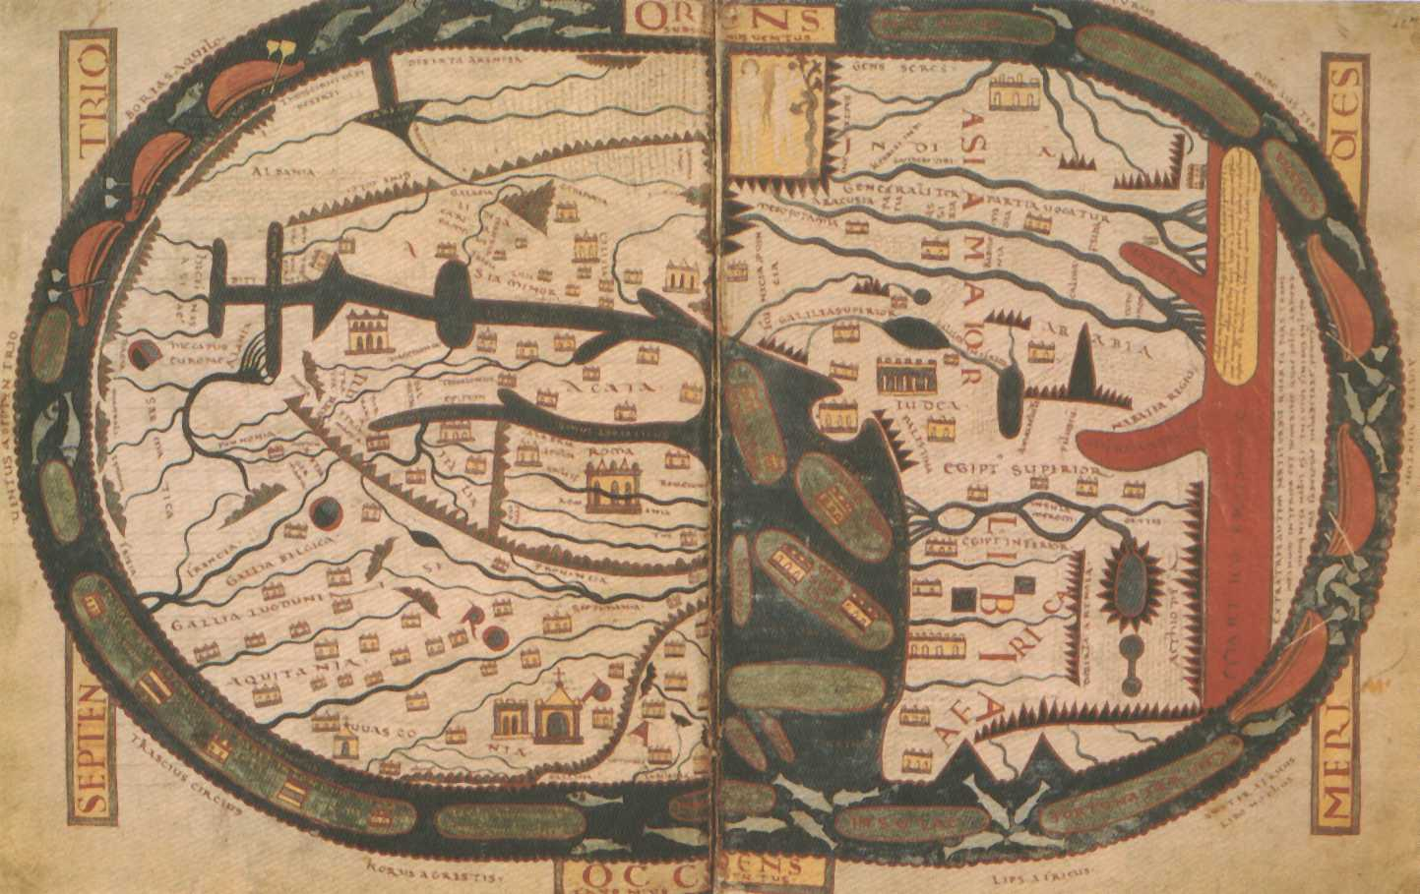
St. Sever World Map after Beatus, 1030 CE

Slide 40
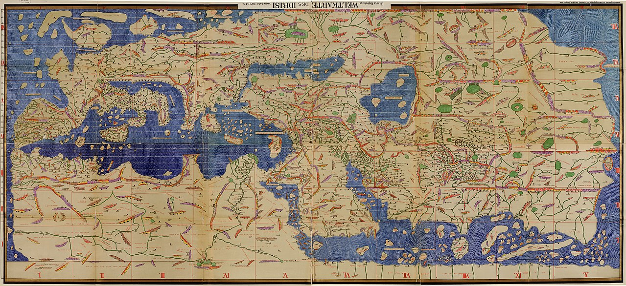
Tabula Rogeriana (Map of Roger); Muhammad al-Idrisi (1154)

Slide 41
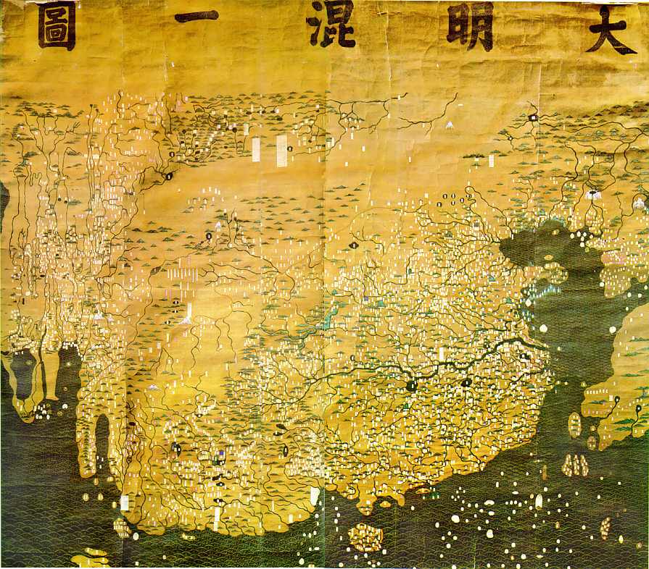
Da Ming Hunyi Tu (Map of the Ming Empire), circa 1389

Slide 42
The Age of Discovery: Drawing the World Map
Exploration and innovation
  The 15th and 16th centuries were characterized by numerous maritime explorations (Age of Exploration or Discovery).
  Correcting several errors that endured:
    Size of the earth.
    Distances between continents.
    Location of landmasses.
  A commercial expansion of European nations.
  Several technical innovations:
    The compass; more precise maps.
    Invention of the map projection; Mercator, 1569.
    Larger ships (from 200 to 600 tons during the sixteenth century), better shipbuilding and the rudder.
    Safer and faster maritime navigation.
    Less risk (better chances of finding investors).
  Creation of the first accurate world maps.

Slide 43
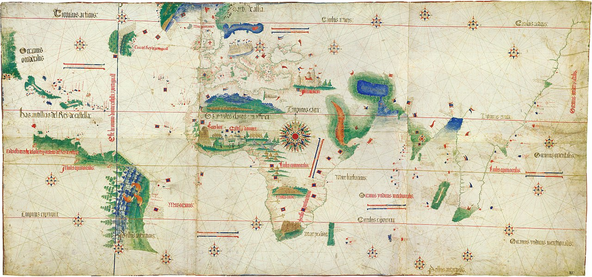
Cantino Planisphere, 1502

Slide 44
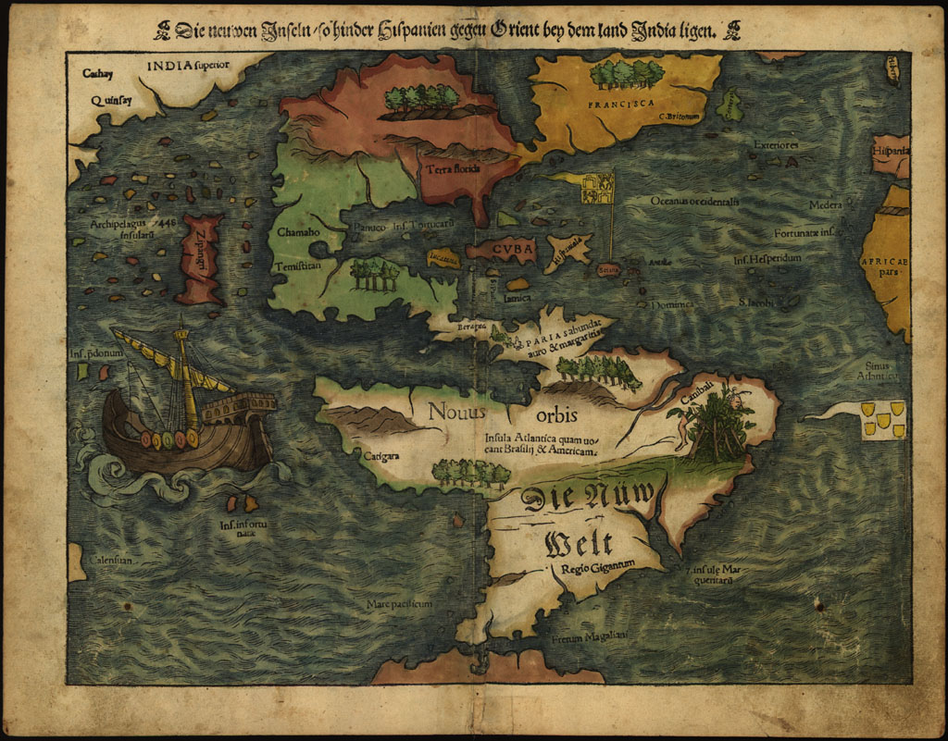
The Americas, 16th Century

Slide 45
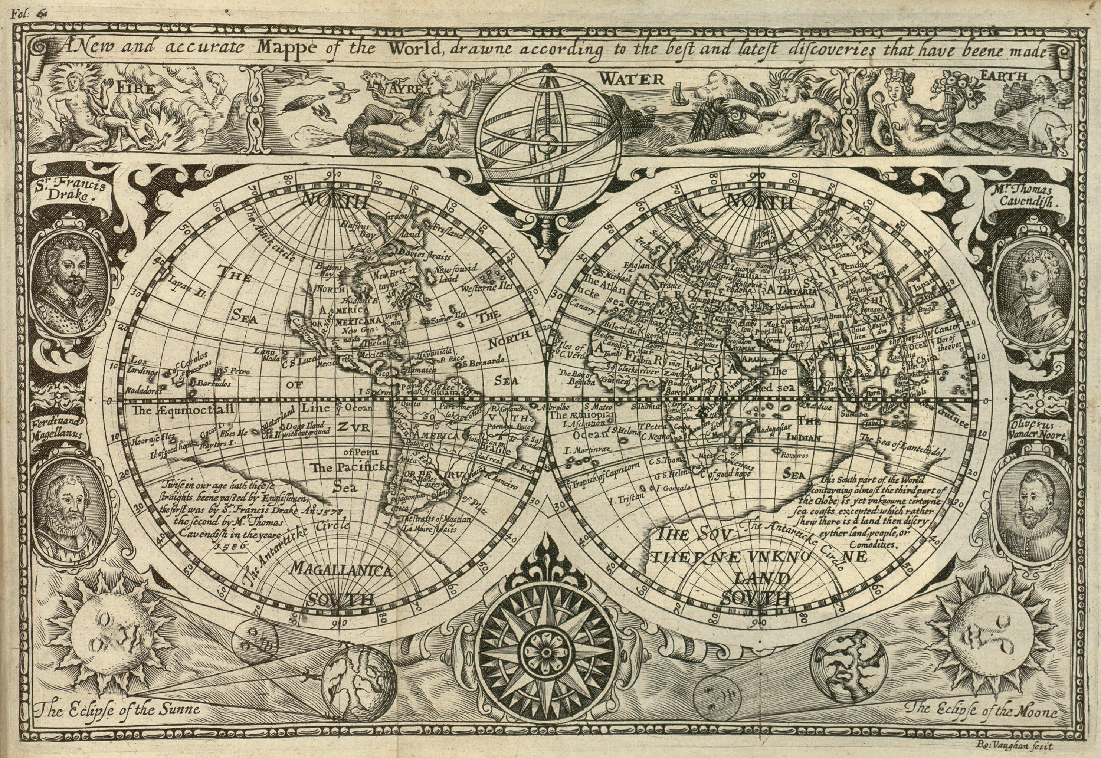
1628 World Map by Vaughan

Slide 46
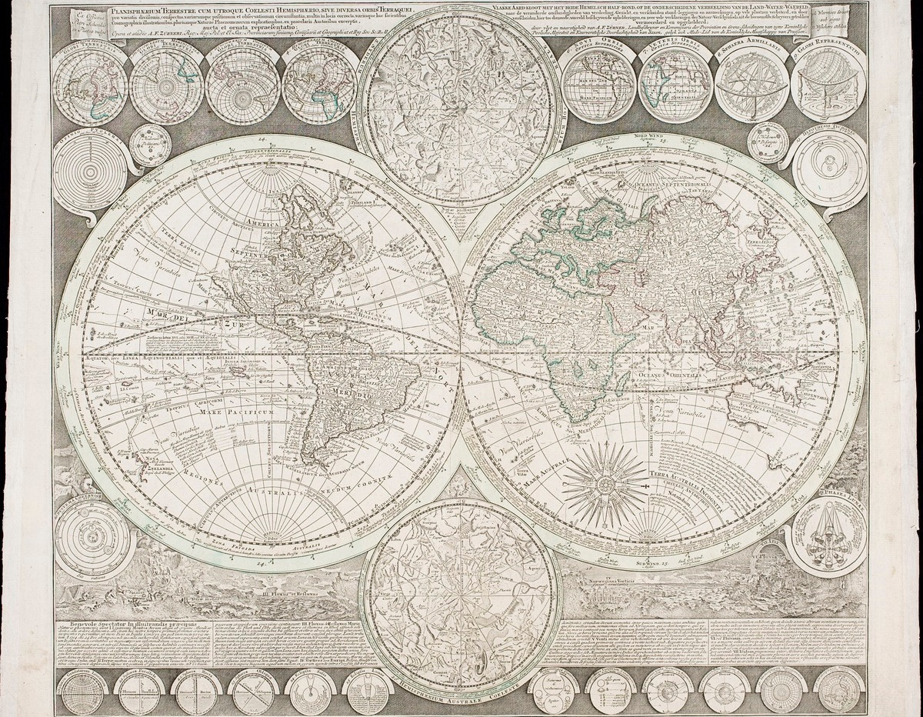
Planisphaerium terrestre cum utroque coelesti hemisphaerio, circa 1700
Notes:
Source: http://objects.library.uu.nl/reader/index.php?obj=1874-33148&lan=en#page//16/89/61/1689619818333540487290588526934054605.jpg/mode/1up

Slide 47
Modern Era: A Finite World
A complete world map
  Early 20th century.
  Complete and accurate view of the world.
  Coordinate systems.
  National inventories of resources.
  Widely available atlases.
Information technologies
  Use of remote sensing (aerial photographs and satellite images).
  Digital maps (storage and retrieval).
  Mass diffusion through online accessibility.
  Virtualization.
  Portable devices (GPS / smart phones).
  Google created the world first “complete” maps (Google Earth, Maps and Streetview).

Slide 48
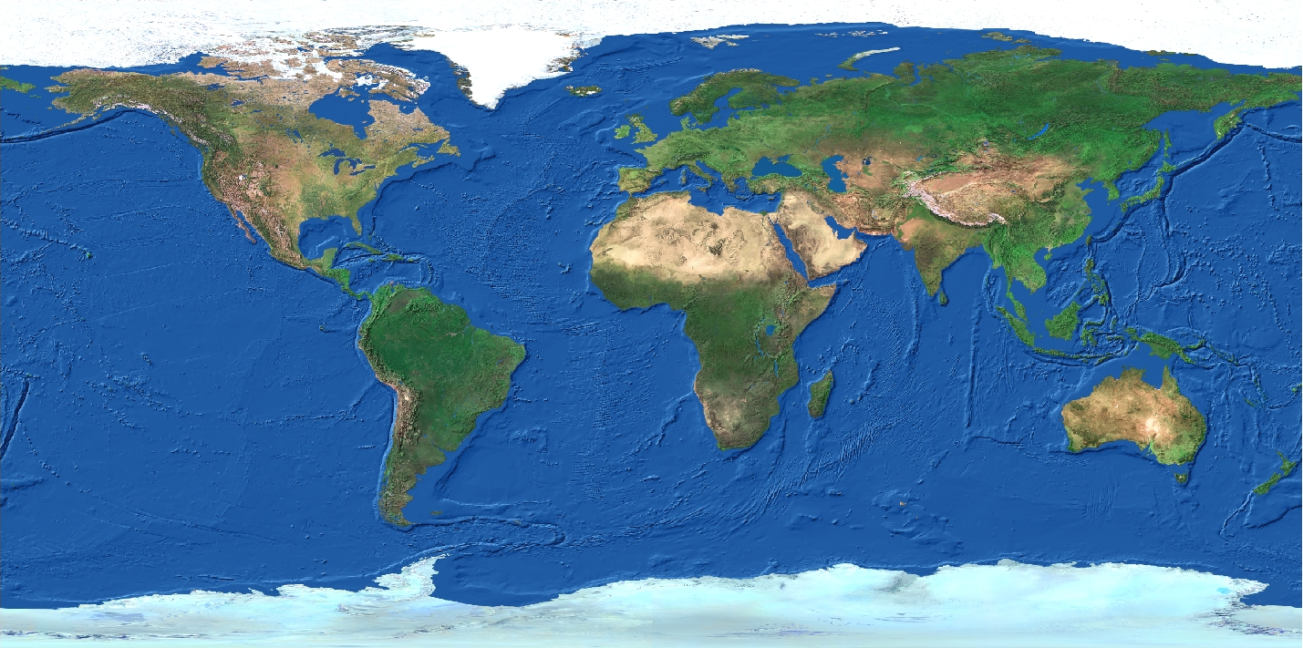
Satellite Composite Image with Bathymetry

Slide 49
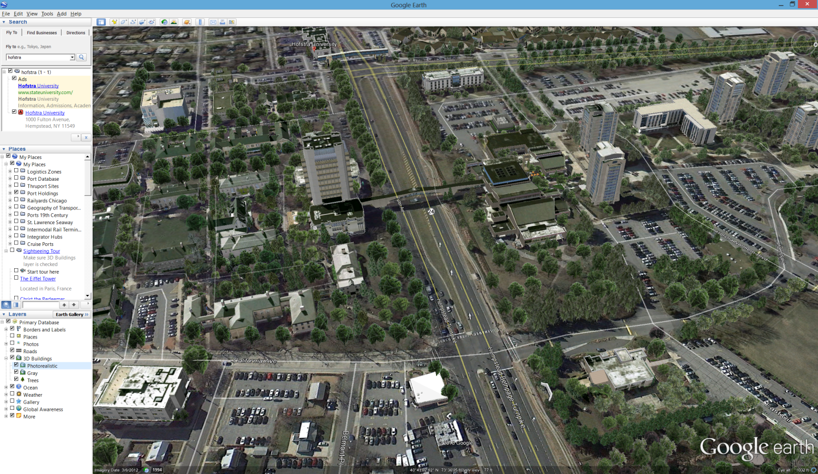
A Virtually Navigable World (Google Earth, 2005)

Slide 50
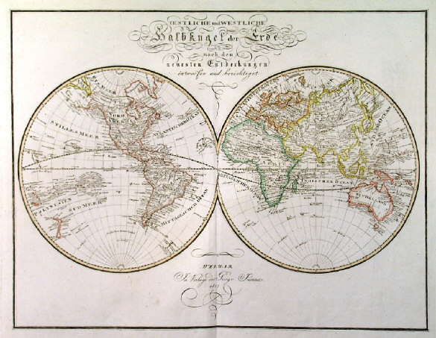
Globalization and the Evolution of the Map
Explain how globalization and the evolution of cartography are related.

Slide 51
C – The Processes of Globalization
Globalization and its Transformations
Global Convergence
Global Divergence

Slide 52



The Flows behind Globalization
What are the main types of flows supporting globalization?
Trade
Migration
Telecommunications
Flows of physical goods (mainly asymmetrical)
Flows of people (mainly symmetrical)
Flows of information (mainly asymmetrical)
Raw materials, energy, food, parts and consumption goods
Permanent, temporary (migrant workers), tourism, business transactions
Communication, power exchanges, symbolic exchanges
Telecommunication systems (postal, internet, telephone, radio)
Freight transport modes (maritime, rail, trucking)
Passengers transport modes (vehicles, air, rail)
Interconnected hub-and-spoke networks
Interconnected hub-and-spoke networks
Interconnected and redundant hub-and-spoke networks
Ports as main hubs
Airports as main hubs
Global cities as main hubs
Read this content

Slide 53
Value and Growth of Cross-border Flows, 2012 (2002-12)
Per year
Per year
Per year
Delta (2000-10)
Notes:
Source: McKinsey, 2014
People are measured by cross-border migrants; values from 2000 and 2010.

Slide 54


Global Space / Time Convergence: Days Required to Circumnavigate the Globe
(1500-1840) Average speed of horse and cart: 4 km/hr
Average speed sailships: 16 km/hr
(1850-1930) Average speed of trains: 100 km/hr
Average speed of steamships: 25 km/hr
Space / Time
Convergence
(1950) Average speed of airplanes:
480-640 km/hr
(1970) Average speed of jet planes:
800-1120 km/hr
(1990) Numeric transmission:
instantaneous
Read this content

Slide 55
World Merchandise Trade, 1960-2019
Read this content
Notes:
Source: WTO and World Bank. Current USD.
Merchandise Exports : http://data.worldbank.org/indicator/TX.VAL.MRCH.CD.WT
GDP: http://data.worldbank.org/indicator/NY.GDP.MKTP.CD?locations=1W

Slide 56
World Air Travel and World Air Freight Carried, 1950-2018
Read this content
Watch this video
Notes:
Source: Airlines for America. IATA.
http://airlines.org/data/

Slide 57
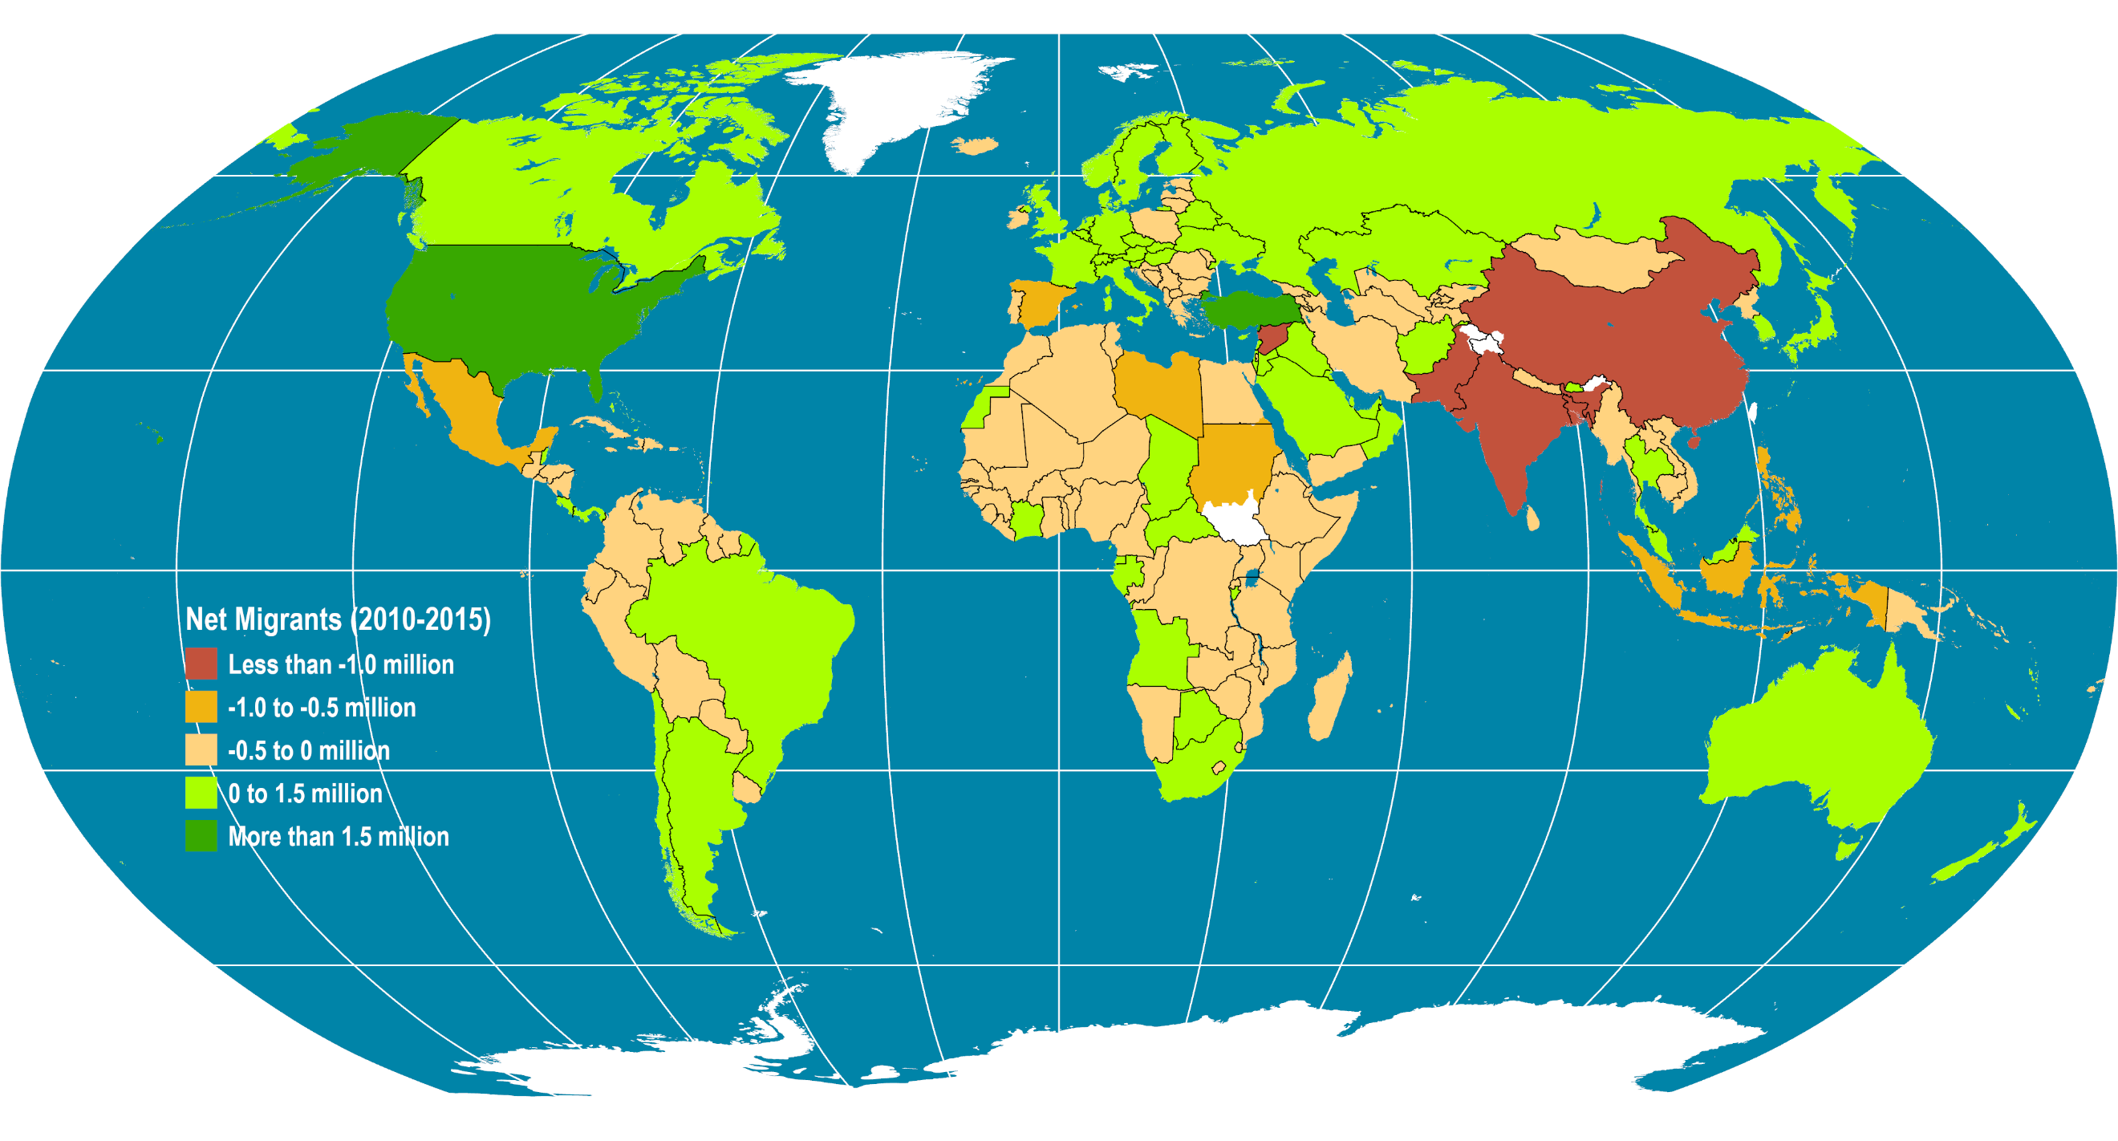
Global Net Migration (2010-2015)
Read this content
Notes:
Source: UNEP (2018): The UNEP Environmental Data Explorer, as compiled from World Population Prospects, the 2012 Revision (WPP2012), United Nations Population Division . United Nations Environment Programme. http://ede.grid.unep.ch.
Map location: global_socioeconomic

Slide 58
Some Can Travel, Some Can’t: The Passport Index, 2011, 2018
What are similarities between this chart and the migration map on the previous page?
Read this content
Notes:
Source: Henley and Partners Holdings, https://www.henleyglobal.com/citizenship/visa-restrictions/
The level of visa-free or visa-on-arrival access offered by each country’s passport.

Slide 59
Diffusion of Personal Computing Devices, 1977-2019
Read this content
Android (2009)
PC (1981)
iPhone (2007)
Tablet (2010)
Macintosh (1984)
Atari (1979)
Symbian (2001)
Blackberry (2003)
Commodore (1982)
Apple ][ (1977)
TRS-80 (1977)
Notes:
Source: Pre 2000 data compiled by H. Dediu and J. Reiner. Recent data from Gartner, Inc.
https://jeremyreimer.com/rockets-item.lsp?p=137
http://www.asymco.com/2012/01/17/the-rise-and-fall-of-personal-computing/
PC includes desktops and laptops.

Slide 60
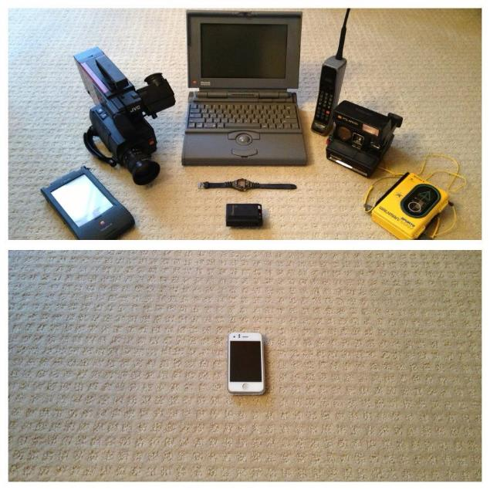


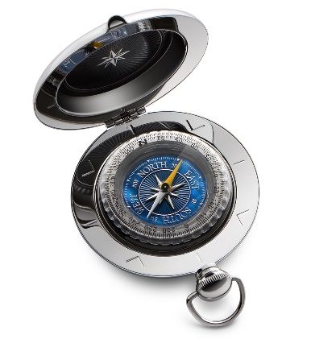
Technological Convergence, 1993-2013
Notes:
Source: Reddit.
Remote control + Gameboy

Slide 61
Global Convergence
Multinational corporations
Privatization
Industrial
Economic
Financial
Consumption goods
(brand names)
Global Economy
Liberalization
Free-trade agreements
Media
Social
Political
Labor market
Culture
Transportation and Telecommunication Networks
Containerization and ICT
Notes:
Converging factors
Transport and communication networks:
Information highway.
Containerization.
Transnational corporations and financial institutions.
Global free-trade agreements.
Market economies replace state-controlled economies.
Privatization replacing goods & services from governments
Globalized market for consumer goods:
Brand names.
Globalization of the labor market:
For all skill levels.

Slide 62
Global Convergence
Global Consumer Culture
  The setting of global common preferences:
    Food.
    Fashion.
    Media (movies, music).
    Electronics.
    Automotive.
  Many global goods originated from the western world:
    Many key technologies (e.g. the automobile, the personal computer).
    The United States has been a powerful influence on various other cultures.
  Multinational corporations have become key agents.

Slide 63
Global Divergence
Climate change, pandemics,
resource depletion
Environmental
Corruption
Poverty
Drugs, prostitution, gambling,
hacking, SPAM
Global Economy
Refugees,
illegal immigration
Crime
Inequalities
Social
Terrorism,
conflicts
Notes:
Converging factors
Transport and communication networks:
Information highway.
Containerization.
Transnational corporations and financial institutions.
Global free-trade agreements.
Market economies replace state-controlled economies.
Privatization replacing goods & services from governments
Globalized market for consumer goods:
Brand names.
Globalization of the labor market:
For all skill levels.

Slide 64
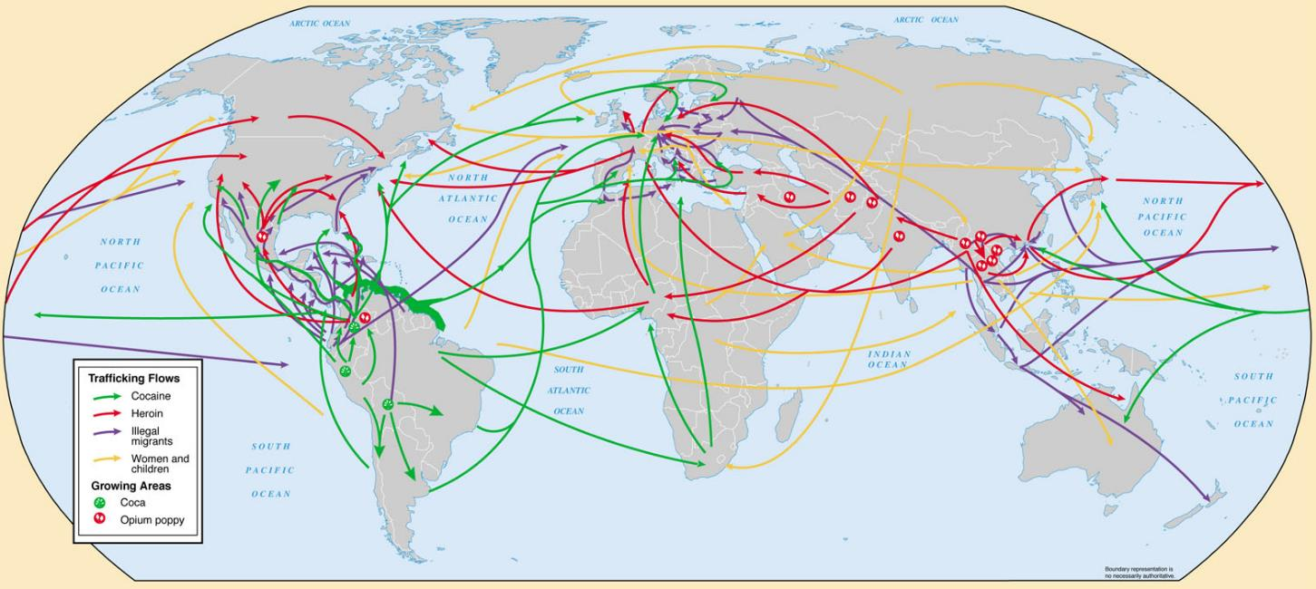
Current World Illicit Trafficking
Notes:
Source: Global Trends 2015: A Dialogue About the Future With Nongovernment Experts [page 51], National Intelligence Council, 2000

Slide 65

Ransomware

Slide 66
Coronavirus (COVID-19) Reported Daily New Cases, 2020 (As of August 12; 7 days moving average)
Read this content
Notes:
Source: European Centre for Disease Prevention and Control
https://www.ecdc.europa.eu/en/publications-data/download-todays-data-geographic-distribution-covid-19-cases-worldwide

Slide 67
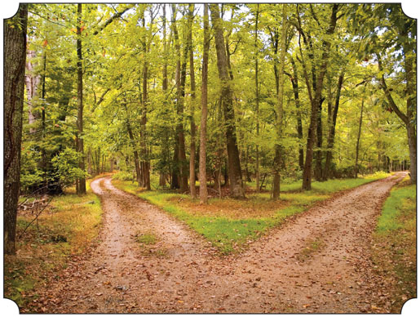
Globalization as a Convergence and Divergence
There are converging and diverging forces in globalization, explain what are the main forces and which are the most influential.

