Slide 1
Topic 5 – Hydroelectricity and Nuclear Energy
A – Water
B – Hydroelectricity
C – Nuclear Energy

Slide 2
Conditions of Usage
For personal and classroom use only
  Excludes any other forms of communication such as conference presentations, published reports and papers.
No modification and redistribution permitted
  Cannot be published, in whole or in part, in any form (printed or electronic) and on any media without consent.
Citation
  Dr. Jean-Paul Rodrigue, Dept. of Global Studies & Geography, Hofstra University.

Slide 3
A. Water
Sources of Water
Water Use
Water Development Projects

Slide 4
1. Sources of Water
Rivers, lakes, and streams
  Traditional sources of water.
  20% of the world’s reserves in the Great Lakes basin.
  50% of all major rivers are polluted and overused.
  700 million Chinese are drinking contaminated water.
Aquifers
  Important water sources, especially in many dry areas.
  Wells of various kinds tap into the water table to draw upon underground sources of water.
    51% of all the drinking water in the US.
  Many aquifers are re-charged:
    Receive water through percolation of rainwater through the overlying soil and rock structure.

Slide 5
1. Sources of Water
Fossil aquifers
  They lie under arid regions today.
  Formed in earlier geologic periods when the region may have received greater precipitation.
  Not being re-charged: a non-renewable resource.
    The aquifer underlying parts of Saudi Arabia falls into this category.
De-salinization of sea water
  Remains an expensive alternative.
  Not produced satisfactory results in many areas, at least as far as human consumption is concerned.
  Technologies for de-salinization are receiving greater priority.
    Moving from steam-process to filtration (osmosis).
    Pushed the price for desalted seawater down to $2 for a thousand gallons, compared with $6 around 1990.

Slide 6
1. Sources of Water (in cubic miles)

Slide 7
1. Cereal Production, Saudi Arabia, 1961-2009 (in tons)

Slide 8
1. World Fresh Water Supply by Source
Water source | Water volume, in cubic miles | Water volume, in cubic kilometers | Percent of fresh water | Percent of total water
Oceans, Seas, & Bays | 321,000,000 | 1,338,000,000 | -- | 96.5
Ice caps, Glaciers, & Permanent Snow | 5,773,000 | 24,064,000 | 68.7 | 1.74
Groundwater | 5,614,000 | 23,400,000 | -- | 1.7
Fresh | 2,526,000 | 10,530,000 | 30.1 | 0.76
Saline | 3,088,000 | 12,870,000 | -- | 0.94
Soil Moisture | 3,959 | 16,500 | 0.05 | 0.001
Ground Ice & Permafrost | 71,970 | 300,000 | 0.86 | 0.022
Lakes | 42,320 | 176,400 | -- | 0.013
Fresh | 21,830 | 91,000 | 0.26 | 0.007
Saline | 20,490 | 85,400 | -- | 0.006
Atmosphere | 3,095 | 12,900 | 0.04 | 0.001
Swamp Water | 2,752 | 11,470 | 0.03 | 0.0008
Rivers | 509 | 2,120 | 0.006 | 0.0002
Biological Water | 269 | 1,120 | 0.003 | 0.0001
Total | 332,600,000 | 1,386,000,000 | - | 100
Notes:
Source: Igor Shiklomanov's chapter "World fresh water resources" in Peter H. Gleick (editor), 1993, Water in Crisis: A Guide to the World's Fresh Water Resources (Oxford University Press, New York).

Slide 9
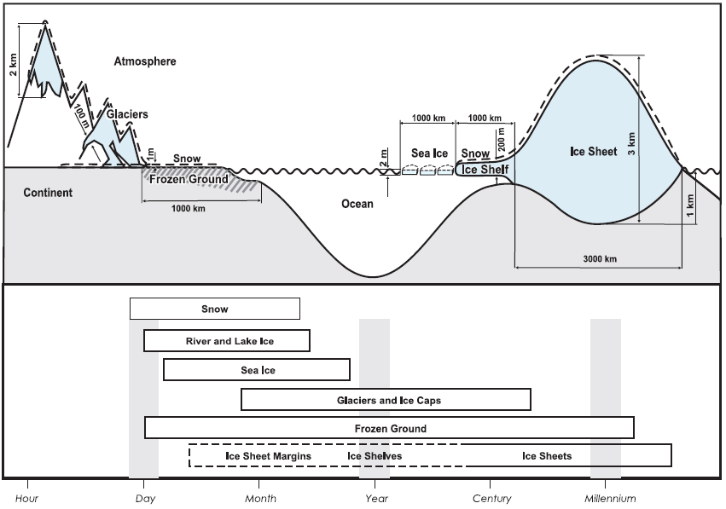
1. Forms and Duration of Frozen Water Accumulation
Notes:
Source: Intergovernmental Panel on Global Change. http://ipcc-wg1.ucar.edu/wg1/Report/AR4WG1_Print_Ch04.pdf

Slide 10
1. Comparing Two Liquid Resources
CHARACTERISTIC | OIL | WATER
Quantity of resource | Finite | Literally finite; but practically unlimited at a cost
Renewable or Non-Renewable | Non-renewable resource | Renewable overall, but with locally non-renewable stocks
Flow | Only as withdrawals from fixed stocks | Water cycle renews natural flows
Transportability | Long-distance transport is economically viable | Long distance transport is not economically viable
Consumptive versus non-consumptive use | Almost all use of petroleum is consumptive, converting high-quality fuel into lower quality heat | Some uses of water are consumptive, but many are not. Overall, water is not "consumed" from the hydro-logic cycle
Substitutability | The energy provided by the combustion of oil can be provided by a wide range of alternatives | Water has no substitute for a wide range of functions and purposes
Prospects | Limited availability; substitution inevitable by a backstop renewable source | Locally limited, but globally unlimited after backstop source (e.g. desalination of oceans) is economically and environmentally developed
Notes:
Source: Pacific Institute

Slide 11
1. Total Renewable Freshwater Supply, by Country
Country | Annual Renewable Water Resourcesa (km^3/yr)
Brazil | 8,233
Russia | 4,498
Canada | 3,300
United States of America | 3,069
Indonesia | 2,838
China | 2,830
Colombia | 2,132
Peru | 1,913
India | 1,908
Congo, Democratic Republic (formerly Zaire) | 1,283
Venezuela | 1,233
Bangladesh | 1,211
Myanmar | 1,046
Notes:
Source: Pacific Institute.

Slide 12
2. Water Use
Water use
  Tripled since 1950.
  Water use is increasing at a pace faster than population.
  Linked with rising living standards.
Roles
  Water has two primary contradictory roles:
    Key life support for all species and natural communities.
    A commodity to be sold and used for agricultural, industrial, and urban purposes.
  The overuse of water and the pollution, if allowed to proceed unchecked, render the first role unsustainable.

Slide 13
2. Global Water Withdrawal by Sector, 1900-2000 (in cubic km)
Notes:
Source: Igor A. Shiklomanov, "World fresh water resources," in P.H. Gleick, ed., "Water in Crisis" (New York, Oxford University Press, 1993).

Slide 14
2. Water Use
Agriculture
  Linked with population growth.
  Expansion of the land under cultivation.
  Irrigation necessary to render arable otherwise marginal land.
Industrial
  Used by heavy industry, notably mining.
  Industrialization is leading to rapid increases in water use.
Municipal
  Direct human consumption of water.
  Highly concentrated geographically due to urbanization.
  A human being needs 3-5 liters of water per day.

Slide 15
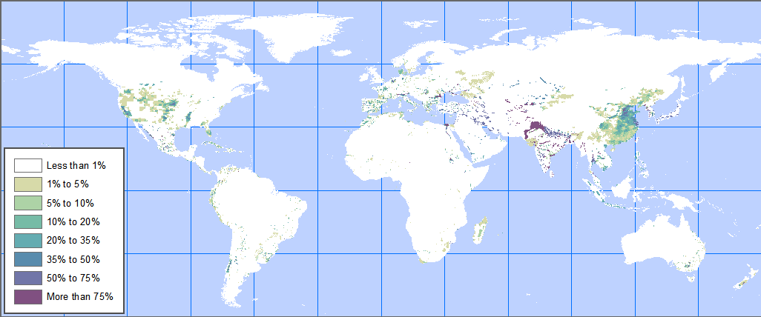
2. Percentage of Land Irrigated
Irrigated Area, Top 10 Countries, 1995 (in millions of hectares)
Notes:
Source: FAO.

Slide 16
2. Water Consumed to Supply 10 g of Protein, Selected Foods
Notes:
Source: State of the World 2004

Slide 17
2. Water Use
Water losses
  Loss of water before it can be used.
  Result of human activity and/or alteration of the environment.
  Such losses amount to just 5% of water use.
  Evaporation of still water from reservoirs.
  Inefficient irrigation practices.
  Infrastructure decay:
    Urban plumbing and sewer systems.
    Problematic in many developing countries that cannot afford better upkeep.
  Water pollution:
    20% of rivers in China are severely polluted.
    80% cannot sustain commercial fishing.

Slide 18
3. Water Development Projects
River diversion
  Re-channeling water in some areas to render it more readily available for use, especially in agriculture.
  Reduces water flow to downstream locations.
  Sometimes, international boundaries are crossed by rivers.
  Removal of water for purposes upstream means that less water is available in the country (or countries) that lies downstream.
Rivers no longer reaching the sea
  The Nile in Egypt.
  The Ganges in South Asia.
  The Yellow River in China.
  The Colorado River in North America.

Slide 19
3. Water Development Projects
The Nile
  The construction of the Aswan High Dam in southern Egypt.
  Interrupted the seasonal pattern of flooding along the Nile Valley.
  These floods throughout history have served to replenish the soils of the valley.
  The soils are now not receiving the necessary nutrients and may be depleted.
  Usage of fertilizers instead.
  Irrigation water from the dam also enabled Egypt to double agricultural production.
  Created increased soil salinity in the process.
Aswan High Dam

Slide 20
3. Water Development Projects
Colorado River
  Covers 7 states; a population of 25 million.
  No longer a river; a series of lakes.
  Competition between urban and agricultural use.
  Competition between cities:
    Los Angeles, Phoenix and Las Vegas.
  Fast growing region:
    Las Vegas is the fastest growing city of the United States.
  All the water is used before it reaches the Gulf of California:
    1993 was the last time water flowed in the Gulf.

Slide 21
3. Water Profile of the Colorado River
Evaporation from
lake Powell
Evaporation
from lake Mead
Diversion to
Los Angeles and
Phoenix
Usage by the Imperial
Valley
Green River
Grand Junction
Gulf of California

Slide 22
3. Flow of Colorado River Below All Major Dams and Diversions, 1905-92

Slide 23
B. Hydropower
Hydropower Generation
Hydropower Developments
Tidal Power

Slide 24
1. Hydropower Generation
Nature
  Generation of mechanical energy using the flow of water as the energy source.
  Gravity as source and sun as the “pump”.
  Requires a large reservoir of water (energy “storage”).
  95% energy efficiency.
  Considered cleaner, less polluting than fossil fuels.
  Cheapest source of energy: 1 cent per kWh.
Utilization
  Water wheels used for centuries (grinding flour).
  Used during the industrial revolution to power the first machines.
  First hydroelectric plant; Niagara Falls (1879).

Slide 25
1. Hydropower Generation
Sun
Evaporation
Water
Sufficient and regular precipitations
Precipitation
Rivers
Flow
Reservoirs
Suitable local site
Accumulation
Dam
Gravity
Turbine
Power loss due to distance
Electricity

Slide 26
1. World Hydroelectric Generating Capacity, 1965-2009 (in megawatts)
Notes:
Source: Worldwatch Institute.

Slide 27
1. Hydropower Generation
Controversy
  Require the development of vast amounts of infrastructures:
    Dams.
    Reservoirs.
    Power plants and power lines.
    Very expensive and consume financial resources or aid resources that could be utilized for other things.
  Environmental problems:
    The dams themselves often alter the environment in the areas where they are located.
    Changing the nature of rivers, creating lakes that fill former valleys and canyons, etc.

Slide 28
2. Hydropower Developments
Dam construction
  Assisted tremendously in achieving the increases registered in irrigation worldwide.
  Reaching the point where further increases will be difficult to realize.
  Relatively few remaining rivers and streams.
  More than 45,000 dams have been constructed worldwide.
  The rate of construction has declined recently.
  China is the most active.

Slide 29
2. Commissioning of Large Dams
Notes:
Source: World Commission on Dams.

Slide 30
2. Hydropower Developments
Problems with dams
  Exceptionally expensive to build:
    Large dams cost billions of dollars.
  Displace many people in areas to be flooded by the reservoir that is created behind the dam.
  The reservoir takes some land out of production.
  Dredging:
    The outcome of siltation.
    The volume of sediments deposited from upstream by the river that is dammed can outstrip the capacity to dredge.
    The reservoir may eventually fill in and the dam will become useless.
    The rate of sedimentation increases with population growth and the expansion of agriculture in the upstream locations.
    The flood control achieved by the dam is helpful in some ways.

Slide 31
2. Largest Dam Reservoirs

Slide 32
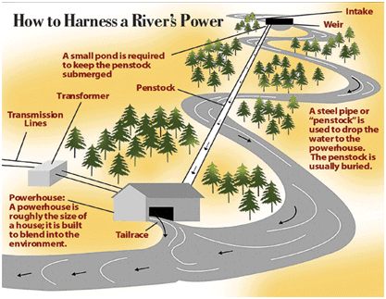
2. River Runs

Slide 33
3. Tidal Power
Tidal power
  Gravitational effect of the earth / moon rotation:
    Energy “pulled” from deceleration of the earth’s rotation speed.
    From 21.9 hours 600 million years ago to 24 hours today.
  Takes advantage of the variations between high and low tides:
    Tidal stream: turbine extracting energy (like a windmill); low environmental impacts.
    Tidal barrage: dam across a tidal estuary; capital intensive and significant environmental impacts.
  First tidal power station; 1966 in France (remains the world’s largest).
  Tidal stream offers good potential.

Slide 34
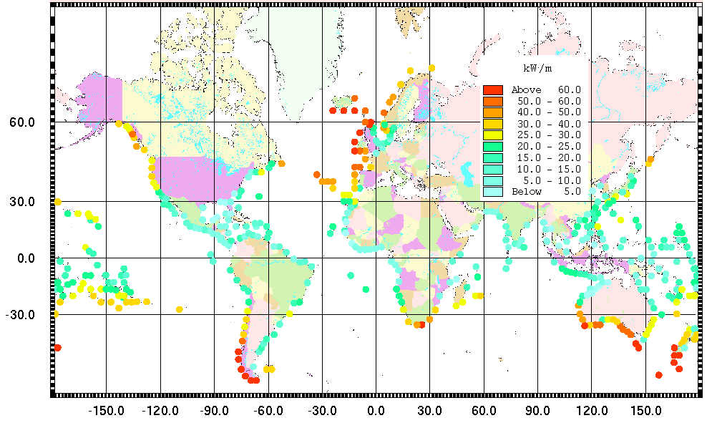
3. Global Tidal Energy Potential

Slide 35
C. Nuclear Power
Nuclear Power Generation
Nuclear Waste Disposal

Slide 36
1. Nuclear Power Generation
Nature
  Fission of uranium to produce energy.
  The fission of 1 kg (2.2 lbs.) of uranium-235 releases 18.7 million kilowatt-hours as heat.
  A nuclear power plant of 1,000 megawatts requires 200 tons of uranium per year.
  Heat is used to boil water and activate steam turbines.
  Uranium is fairly abundant.
  Requires massive amounts of water for cooling the reactor.
  Relatively cheap: 2 cents per kWh (4 cents for coal).

Slide 37
1. Nuclear Power Generation
Production and storage
Suitable site (NIMBY)
Large quantities
Uranium
Reactor
Water
Fission
Waste storage and disposal
Steam
Turbine
Electricity

Slide 38
1. Nuclear Power Generation
Nuclear power plants
  436 operating nuclear power plants (civilian) worldwide.
  Very few new plants coming on line:
    Public resistance (NIMBY syndrome).
    High costs.
    Nuclear waste disposal.
  30 countries generate nuclear electricity:
    About 15% of all electricity generated worldwide.
    Required about 77,000 metric tons of uranium.
  United States:
    104 licensed nuclear power plants; about 20% of the electricity.
    Licenses are usually given for a 40 year period.
    Many US plants will are coming up for 20 years license extensions.
    No new nuclear power plant built since 1979 (Three Mile Island incident).
    4-6 new units by 2018.
  China:
    11 nuclear power plants.
    Plans to add 13 new nuclear reactors per year until 2020.

Slide 39
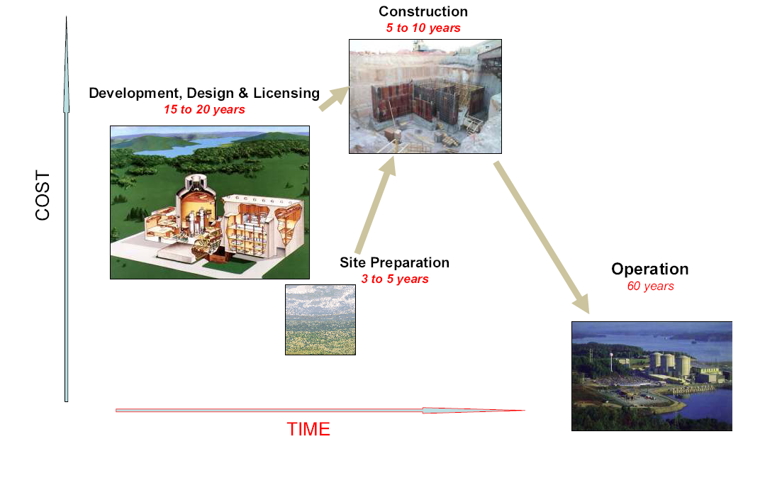
1. Life Cycle of a Nuclear Power Plant
Planning, Infrastructure

Slide 40
1. Nuclear Power Plants, 1960-2002 (in gigawatts)
Notes:
Source: Worldwatch Institute.

Slide 41
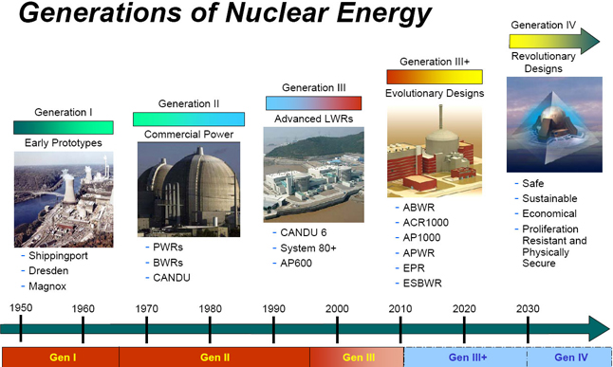
1. New Nuclear Power Reactors Designs
PWR: Pressurized water reactor.
BWR: Boiling water reactor.
LWR: Light water reactor.

Slide 42
1. Global Nuclear Energy Generation, 2003

Slide 43
1. 10 Largest Nuclear Power Users, 2009
Notes:
Source: BP.

Slide 44
1. Nuclear Power Generation
Uranium reserves
  Canada and Australia account for 43% of global reserves.
  The problem of “peak uranium”.
  20 years of reserves in current mines.
  80 years of known economic reserves.

Slide 45
1. Nuclear Power Generation
Reliance
  Some countries have progressed much further in their use of nuclear power than the US.
  High reliance:
    France, Sweden, Belgium, and Russia have a high reliance on nuclear energy.
    France has done this so as not to rely on foreign oil sources.
    It generates 75% of its electricity using nuclear energy.
    The need to import most fossil fuels provides an extra impetus to turn to nuclear energy.
  Phasing out:
    Nuclear energy perceived as financially unsound and risky.
    No new nuclear power plant built in Europe since Chernobyl (1986).
    The German parliament decided in 2001 to phase out nuclear energy altogether.

Slide 46
1. Nuclear Power as % of Electricity Generation, 2007
Notes:
Source: International Energy Outlook.

Slide 47
2. Nuclear Waste Disposal
Nuclear waste
  Nuclear fuel is made of solid pellets of enriched uranium.
  One pellet has an amount of energy equivalent to almost one ton of coal.
  Fuel will be used until it is spent, or no longer efficient in generating heat.
  Once a year, approximately one-third of the nuclear fuel inside a reactor is removed and replaced with fresh fuel.
  Temporarily put into a pool of water at the reactor site.
  Water is a radiation shield and coolant.
  Need to find safe, permanent disposal is becoming critical.
  At some nuclear power plants, the storage pools are almost full.

Slide 48
2. Nuclear Waste Disposal
Nuclear waste disposal
  Problem of nuclear waste disposal; radioactivity.
  Low level wastes:
    Material used to handle the highly radioactive parts of nuclear reactors .
    Water pipes and radiation suits.
    Lose their radioactivity after 10 to 50 years.
  High level wastes (spent fuel):
    Includes uranium, plutonium, and other highly radioactive elements made during fission.
    Nuclear wastes have a half-life about of 10,000 to 20,000 years.
    Requirements of long-term storage in a geologically stable area.
    Long Term Geological Storage site at Yucca Mountain.

Slide 49
2. Nuclear Waste Disposal
Permanent disposal
  About 95% of all radioactive waste comes from civilian source uses of nuclear energy.
  More than 50 years of experience using atomic energy.
  Lack any safe, permanent means for disposing its waste.
  Spent fuel is stored at more than 60 nuclear power plants across the country.
  By 2000, 40,000 metric tons of spent fuel have been produced.
  Isolate high-level radioactive waste for thousands of years.
  Safe for 10,000 years.
  The primary problem has to do with the radioactive half-life of nuclear fuels.
  A trans-generational issue into the realm of geologic time.

Slide 50
2. Nuclear Waste Disposal
Geologic burial
  Hollowing out a repository a quarter mile or so below the surface
  Drill holes in the host rock.
  Place wastes in specially designed containers.
  Place the containers in the holes in the rock.
  Surround the containers with an impermeable material such as clay to retard groundwater penetration.
  Seal the containers with cement.
  When the repository is full, seal off the entrance at the surface.
  Mark it with an everlasting signpost warning future generations of its deadly contents.

Slide 51
2. Nuclear Waste Disposal
Problems
  Groundwater motion.
    Groundwater seeps into the containers absorb the radioactive materials.
    Water tables shift over time so that today's situation can change dramatically long before the radioactivity has ceased.
  Tectonic activity.
    Can alter the geologic base within which the repository site is situated.
    Threaten the encasements of the radioactive materials.
  Terrorism.
    Unpredictable outcome but a very real threat in many countries.

Slide 52
2. Nuclear Waste Disposal
Reprocessing
  Most of the wastes can be reprocessed:
    95% of the fission products created in commercial power plants can be reprocessed and recycled.
  Spent fuel is dissolved in acid, separating the uranium, plutonium and other fission products.
  The uranium can re-enriched and recycled.
  The fission products are encased in glass and stored.
  The plutonium is recombined with uranium 238:
    Made into rods and put into reactors.
    Called “mixed oxide,” or “mox”, and essentially substitutes plutonium 239 for the fissile uranium 235 in first-generation fuel.
    Not permitted in the US since 1977.
  Only France, England and Russia reprocess their spent nuclear fuels.

