Slide 1
Topic 2 – Economic Role of Resources and Energy
A – History of Resource Use
B – The Economic Challenge
C – The Geopolitical Challenge
D – The Environmental Challenge

Slide 2
Conditions of Usage
For personal and classroom use only
  Excludes any other forms of communication such as conference presentations, published reports and papers.
No modification and redistribution permitted
  Cannot be published, in whole or in part, in any form (printed or electronic) and on any media without consent.
Citation
  Dr. Jean-Paul Rodrigue, Dept. of Global Studies & Geography, Hofstra University.

Slide 3
A. History of Resource use
The Agricultural Revolution
The Industrial Revolution
The Post Industrial Revolution

Slide 4
Three Resource Use Shifts in History
Agricultural Revolution
  Feudal society.
  Wealth from agriculture and land ownership.
  Limited resource use.
Industrial Revolution
  Wage labor society.
  Wealth from industry and capital ownership.
  Expansion of the resource base.
Post-Industrial Revolution
  Information society.
  Wealth from technological development.
  Massive consumption and trade of resources.
Agricultural
Revolution
12,000 years
Industrial
Revolution
200 years
Post-Industrial
Revolution

Slide 5
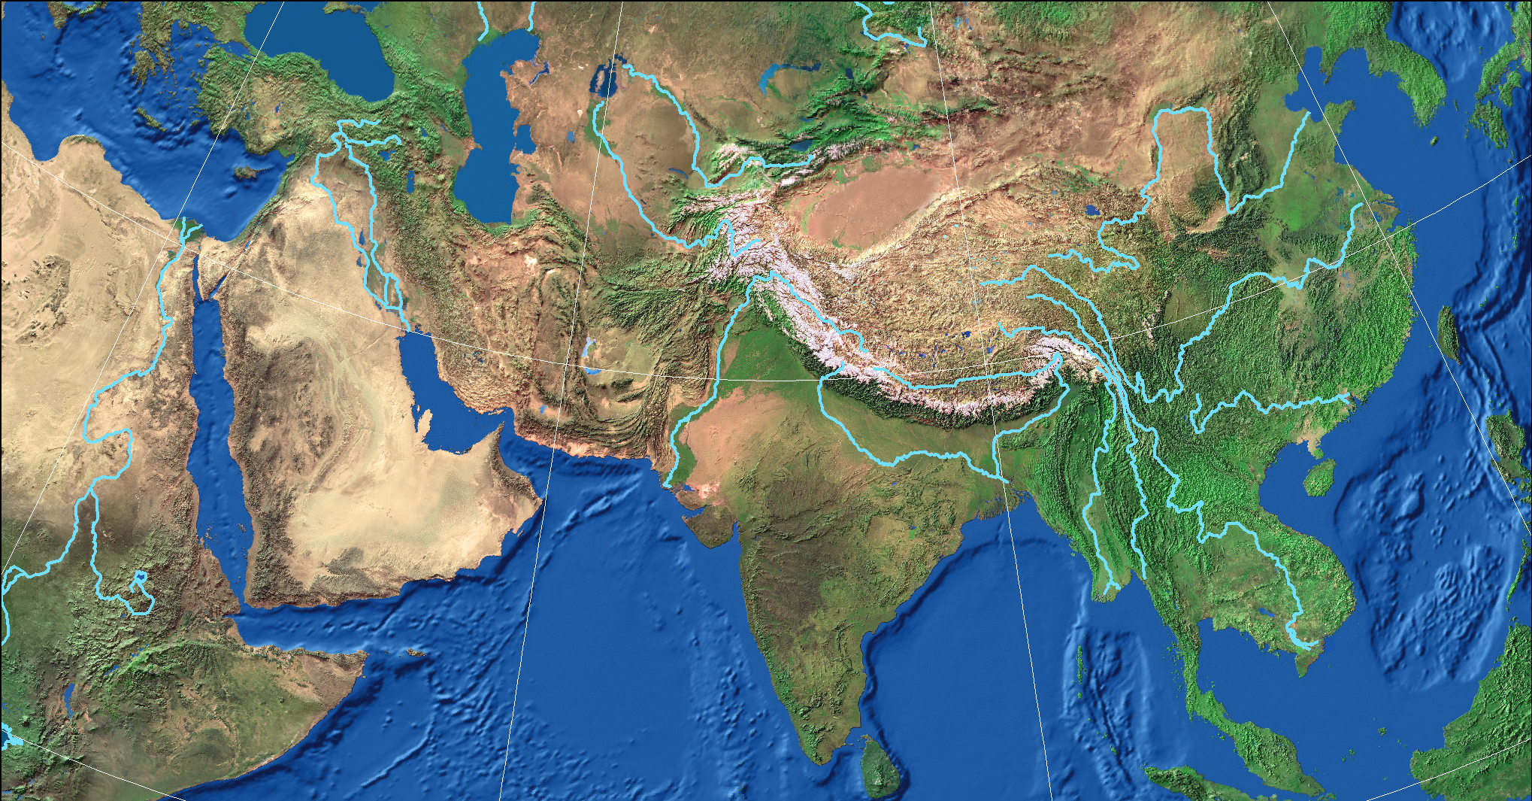
1. The Agricultural Revolution (Neolithic Revolution), 10,000 BC
Mesopotamia
(6,500 B.C.)
Huang He
(4,500 B.C.)
(“The land between rivers”)
Indus
(4,700 B.C.)
Ganges
(4,700 B.C.)
Nile
(5,000 B.C.)
Domestication (crops & animals)
Sedentary lifestyle (property)
Irrigated agriculture (collective effort)
Agricultural surpluses (specialization)
Governments (states / stratification)
Metallurgy (weapons, instruments)
Wheel (transportation)
Pottery (storage)
Writing and numbers (taxation)
World’s population (5-10 million mostly nomadic)
Notes:
Population went from nomadic to sedentary lifestyle.
Created private property, tools and the accumulation of wealth.
Subsequently the creation of the state.
By 1500, 20% of the world was composed of statehoods.
Farming allowed greater population densities and the generation of an agricultural surplus.
A growing share of the population was able to engage in non-agricultural activities.
Induced all sorts of innovations such as irrigation, craftsmanship, and metallurgy.
Centralization of power and resources
Led to the development of the state.
The elite developed laws and institutions to protect their wealth.

Slide 6
1. The Agricultural Revolution
Agricultural Innovation
Food Surpluses
Urbanization
Sedentary lifestyle
Division of Labor
Specialization
Stratification
Specialization
  Development of trade.
  Creation of the first cities.
Stratification
  An elite gained control of surplus resources and defended their position with arms.
  Centralization of power and resources:
    Led to the development of the state.
  The rich and powerful developed the institutions of the state to further consolidate their gains.

Slide 7
1. The Agricultural Revolution
The Feudal society
  A system of bonds and obligations:
    Administrative/legal (Lord) and religious (Church) control.
    Royalties from the serf to the lord (in kind or labor).
    Fixation of the productive forces (tools and labor) in agricultural production.
  Economy:
    Low levels of productivity (subsistence level).
    Profits taken away by the lord/church, inhibiting any increases in agricultural productivity.
    80 to 90% of the population was in agriculture while the other share were artisans and landowners.
  Different types of feudal societies (China, Japan, Europe).
  Basic trading network of luxury goods / resources.

Slide 8
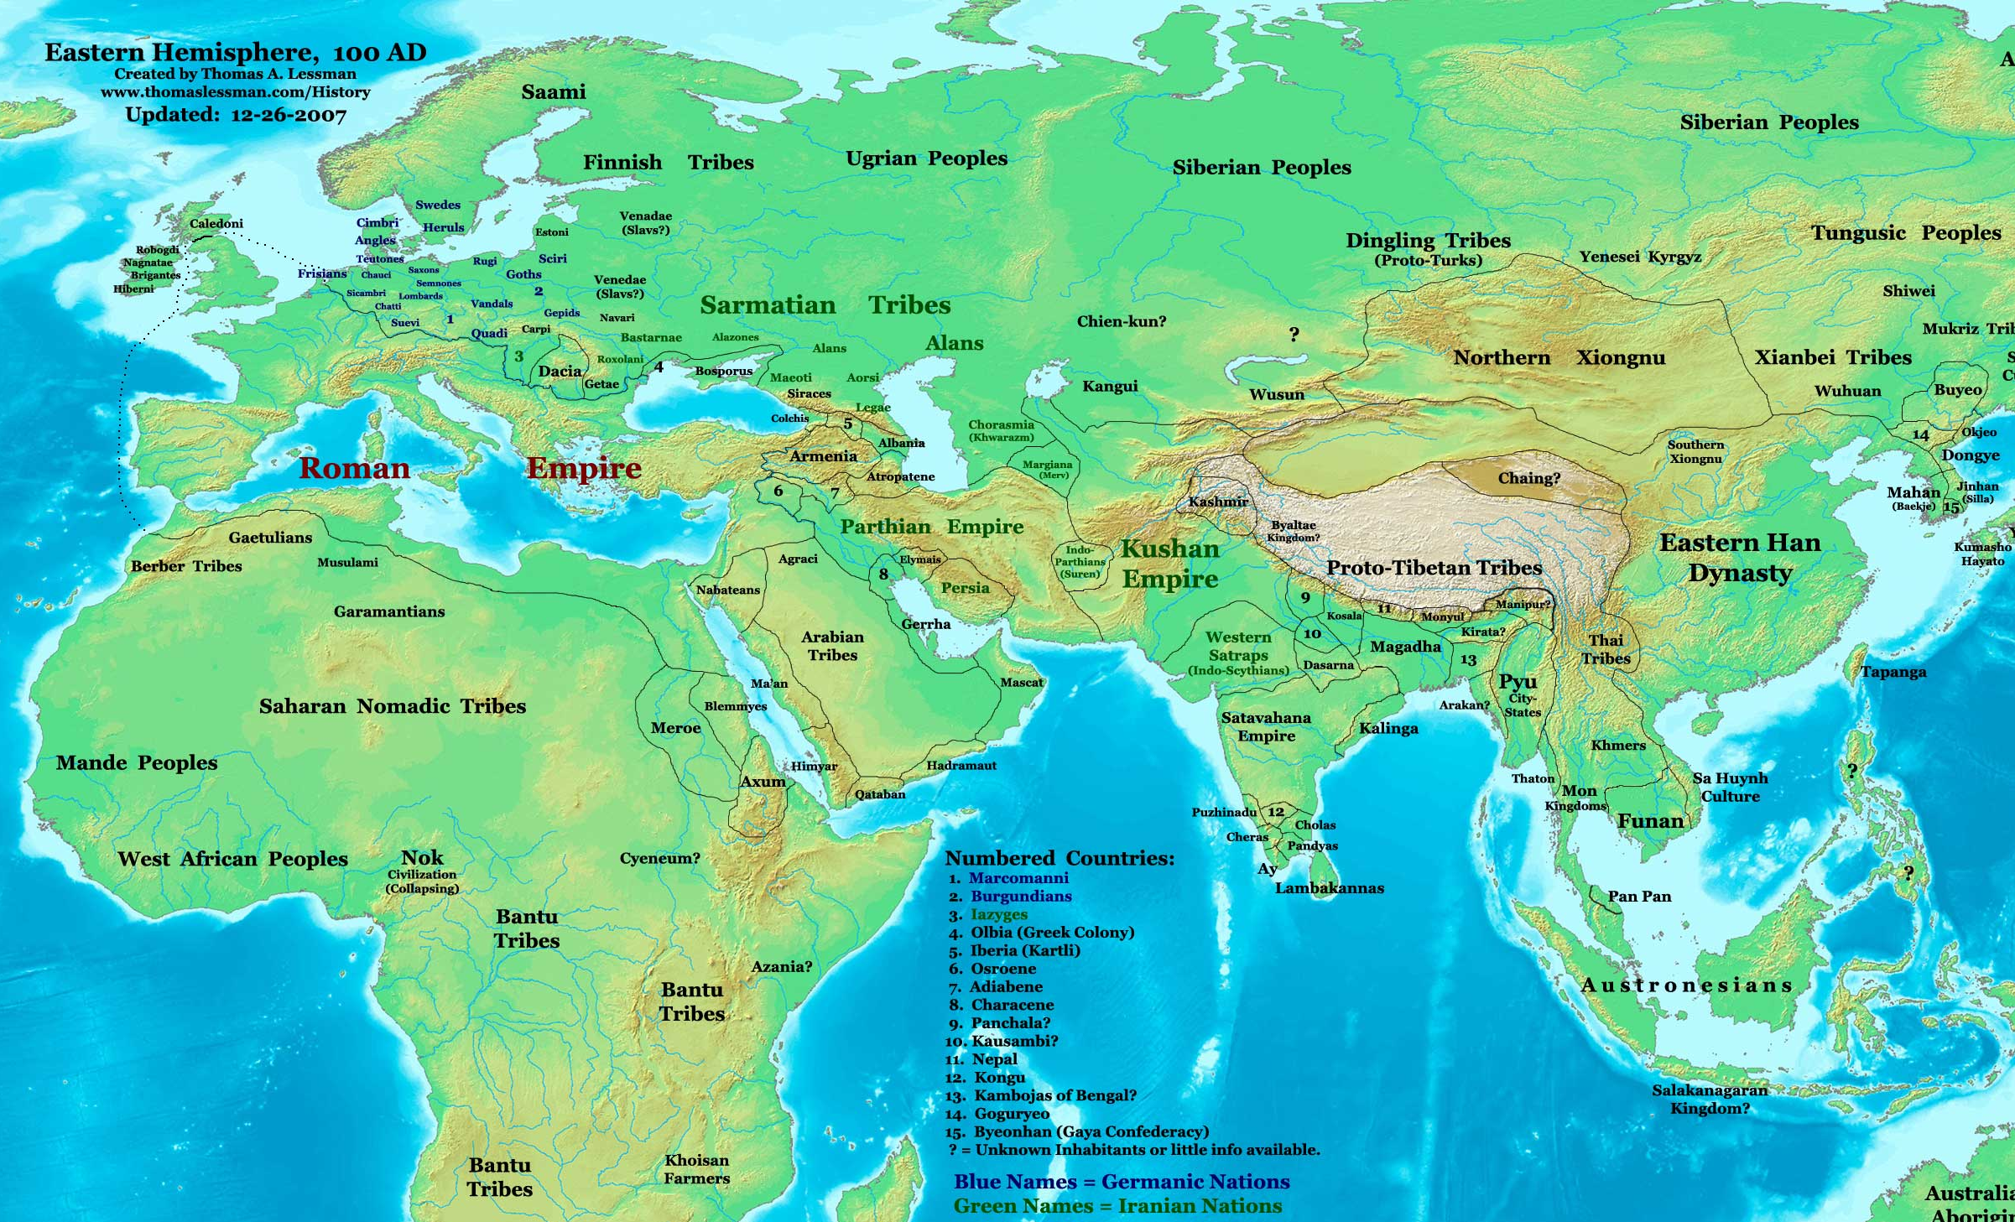
Empires and Trade Routes, Eurasia, 100AD
Limiting factors
Capacity and speed of inland transportation.
Few roads.
Lack of reliable knowledge (intermediaries).
Insecurity / piracy.
Tin
Amber
Iron
Grain
Wine
Olive Oil
Horses
Grain
Silk
Grain
Gems, Ivory
Myrrh
Pepper
Perfume
Nature of trade
High value commodities (Silk, spices, perfumes, gems, gold /silver, ivory).
When maritime transport was available, more bulky commodities could be traded (grain, wine, olive oil).
Spices
Rosin
Notes:
Source: Adapted from Thomas Lessman, http://www.worldhistorymaps.info/index.html

Slide 9
1. The Agricultural Revolution
Demographic consequences
  High birth rates:
    A feudal society required large families.
    Help agricultural activities that were very labor intensive.
    No contraceptives.
  High death rates:
    Wars between competing city-states.
    Frequent disruption of food supplies.
    Medicine almost non-existent.
    Epidemics: One famous plague, the Black Death, reduced European population by 25% between 1346 and 1348.
    Life expectancy around 30-35 years.
  The population growth rate remained low.
  Small cities of at most 25,000 people.

Slide 10
1. The Agricultural Revolution
The European origin of the global economy
  The fifteenth century marked the beginning of an expansion of European control throughout the world.
  Europe progressively assured the development of the global economy by an extension of its hegemony:
    Mercantilism was the first phase.
    The industrial revolution was the second.
  Over three centuries (1500-1800):
    Limits of the world were pushed away.
    A world where borders are drawn; a delimited world.
    Establishment of vast colonial empires.
    Waves of innovations and socio-economic transformations.

Slide 11
2. The Industrial Revolution
Nature
  Started at the end of the eighteenth century (1750-1780).
  Transformations first observed in England:
    Running out of wood resources.
  Demographic transition of the population:
    Fast growth rate.
Social changes
  Significant urbanization.
  Creation of a labor class.
  Work ethics, savings and entrepreneurship.
  Migration from the countryside to cities:
    By 1870 more of the half of the population of the first industrial nations was no longer in the agricultural sector.

Slide 12
2. The Industrial Revolution
Technological innovations
  New methods of production by trials and errors:
    New materials (steel, iron, chemicals).
    Substitution of machines to human and animal labor.
    Usage of thermal energy to produce mechanical energy.
  Changes in the nature production and consumption:
    Textiles.
    Steam engine.
    Iron founding.
  Production (factory):
    The first factories appeared after 1740.
    Division of labor.
    Increased productivity within a factory system of production.
    Location (initially waterfalls and then coal fields).
    Will eventually lead to mass production.

Slide 13
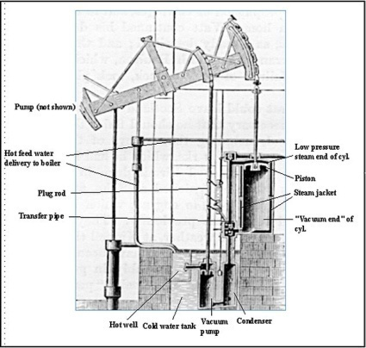
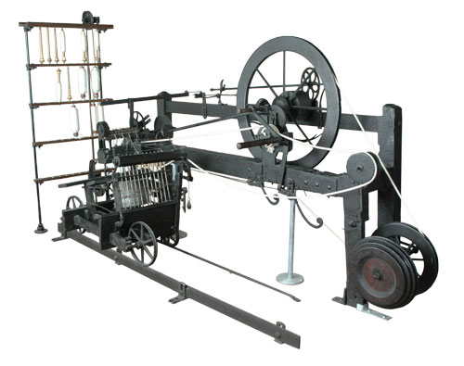
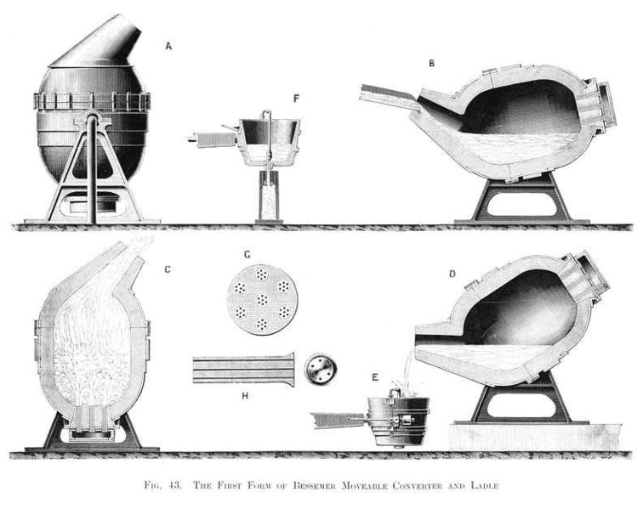
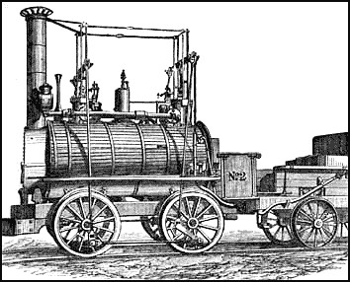
2. Major Technological Innovations of the Industrial Revolution
Power Generation | Textiles | Metallurgy | Transportation
Thermal energy used for mechanical energy | Mechanization of spinning and weaving | Mass production of steel (shipbuilding, rails, construction and machines) | Modern transport and telecommunication systems
First pump (1712) for water in mines. Watt (1769); significant improvements. Steam locomotive (1824). Electric generator (1831). Steam turbine (1884). | “Flying shuttle” (1733) doubled weaving productivity. “Spinning jenny” (1765). “Water frame” (1768); hydraulic power. “Spinning Mule” (1779); steam power. Sewing machine (1846). | Coke instead of coal for iron production (1709). Bessemer process (1855). | Railroads (1825). Telegraph (1834). Steamship (1838). Telephone (1876).
Notes:
Global steel production grew from 0.5 million tons in 1865 to 50 million tons in 1914.

Slide 14
2. Major Inventors of the Industrial Revolution
Inventor | Invention | Date
James Watt | First reliable Steam Engine | 1775
Eli Whitney | Cotton Gin, Interchangeable parts for muskets | 1793, 1798
Robert Fulton | Regular Steamboat service on the Hudson River | 1807
Robert Hall McCormick | Reaper | 1831
Samuel F. B. Morse | Telegraph | 1836
Elias Howe | Sewing Machine | 1844
Isaac Singer | Improves and markets Howe's Sewing Machine | 1851
Cyrus Field | Transatlantic Cable | 1866
Alexander Graham Bell | Telephone | 1876
Thomas Edison | Phonograph, Incandescent Light Bulb | 1877, 1879
Nikola Tesla | Induction Electric Motor | 1888
Rudolf Diesel | Diesel Engine | 1892
Orville and Wilbur Wright | First Airplane | 1903
Henry Ford | Model T Ford, Assembly Line | 1908, 1913

Slide 15
2. The Industrial Revolution
Agriculture
  A second agricultural revolution.
  Introduction of new food sources:
    The potato could account for 22% of the post-1700 increase in population growth.
  Less agricultural population.
  Growth of the production of food.
  Mechanization and fertilizers:
    Reaper (McCormick, 1831).
    Will eventually become the combine.
  Scientific and commercial agriculture:
    Crop rotation, selective breeding, and seed drill technology.
  Declining food prices.

Slide 16
Share of the Population in Agriculture, 1820-1910

Slide 17
European Control of the World, 1500-1950
1800 (37%)
1878 (67%)
1913 (84%)
System of trade: Raw materials and finished goods
Plantation system

Slide 18
3. Post-Industrial Revolution
Economic foundation | Relative shift from manufacturing to services. In absolute numbers, manufacturing increases.
Capital | Knowledge becomes a form of capital.
Growth | High reliance on innovation.
Labor | Declining importance of “blue collar” tasks. Increasing importance of technical and creative tasks.
Trade | Highly diversified trade.
Information technologies | Global telecommunication networks. IT embedded in products and services.

Slide 19
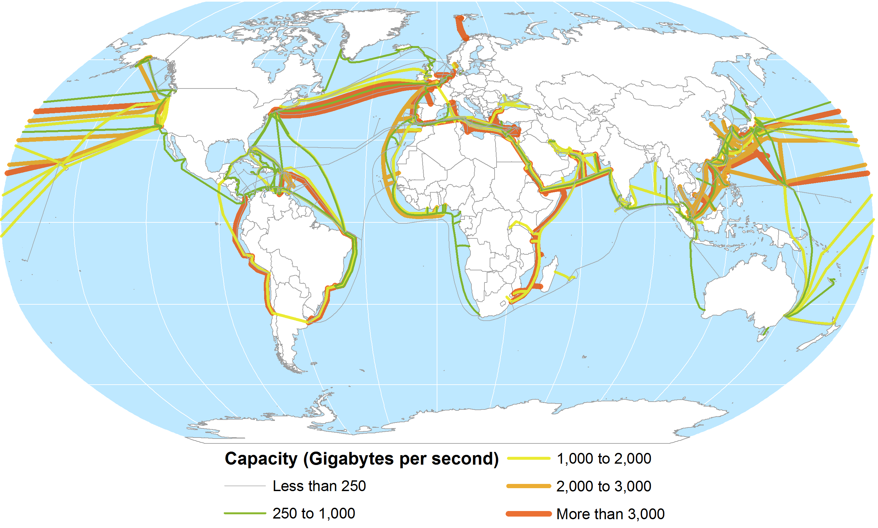
Global Submarine Cable Network
Notes:
Source: Dataset encoded by Greg Mahlknecht, http://www.cablemap.info/

Slide 20
World GDP, 1AD - 2008
Notes:
Note: In 1990 Dollars, purchasing power parity.
Source: Data compiled by A. Maddison, University of Groningen.

Slide 21
Long Wave Cycles of Innovation
Mass Production
Industrial Revolution
Post Industrial
Water power
Textiles
Iron
Steam
Rail
Steel
Electricity
Chemicals
Internal-combustion
engine
Petrochemicals
Electronics
Aviation
Digital networks
Software
New Media
Pace of innovation
1st Wave
2nd Wave
3rd Wave
4th Wave
5th Wave
1785
60 years
1845
55 years
1900
50 years
1950
40 years
1990
30 years
Notes:
Source: Adapted from the Economist, Feb 20th 1999.

Slide 22
Primary Energy Production by Source, United States, 1750-2009
Notes:
Source: Energy Information Administration, http://www.eia.gov/emeu/aer/overview.html

Slide 23
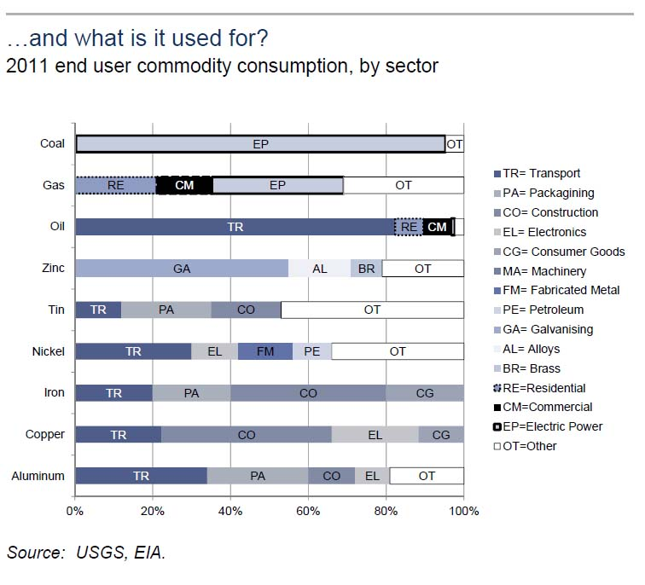

Slide 24
B. The Economic Challenge
Resources Availability
The Malthusian Trap
Escaping the Malthusian Trap

Slide 25
1. Resource Availability
Context
  A resource is not a fixed quantity.
  Resource availability is related to a number of factors.
Economic development
  A resource is useless if there is no demand for it.
  Each percentage of population growth requires about 3% of economic growth for support.
  Economic development expands the demand for resources and their exploitation:
    The development of the automobile industry has expanded several types of resources, notably oil and steel.
    The growth of the computer industry has expanded exponentially information-related resources.

Slide 26
1. Resource Availability
Technological development
  Enables the exploitation of resources that were not available.
  Climbing down the “resource pyramid”.
  Access to new types of resources:
    Mining technology.
    Depth and concentrations.
    Advances in agricultural techniques have led to increased yields.
  Access to lower quality resources:
    More abundant.
    Generally more polluting.
The Resource Pyramid
Technology
High quality
resources
Quality
Medium quality
resources
Low quality
resources
Quantity

Slide 27
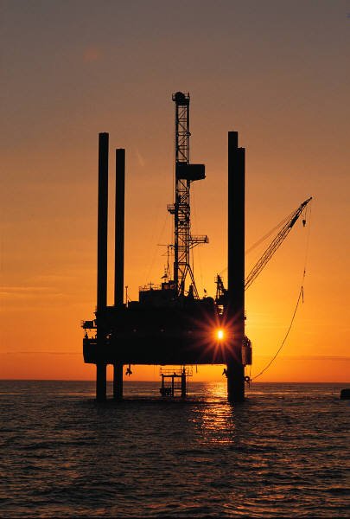
Types of Oil and Gas Reserves
High-Medium
Quality
Price and Technology
Quality
Low
Permeation Oil
Tight
Gas Sands
Gas
Shales
Heavy
Oil
Coal Bed
Methane
Gas Hydrates
Oil Shale
Quantity
Notes:
Source: adapted from M. Simmons (2008), www.simmonsco-intl.com

Slide 28
Concentration of Copper Needed to be Economically Mined, 1880-2010 (in %)
Notes:
Source: US Bureau of Mines.

Slide 29
Reserves and Total Resources (A Finite World)
Potentially Unrecoverable
Sub-economic
Price / Technology
Total Resources
Cost of Recovery
Available
Resources
Reserves
(Identified and recoverable)
Exploration
Unidentified
Uncertainty
Notes:
Reserves:
Known (with a reasonable certainty) quantity and quality of resources that can be economically recovered.
Total resources:
Potential amount of resources that can be exploited given sufficient levels of economic and technological development.
Some resources may be potentially unrecoverable.
In a closed world, the amount of material resources is finite.

Slide 30
1. Resource Availability
Major Causes of the Loss of Resources
Demand | Often lead to a related drop in the quantity of resources (e.g. horses, rubber, transistors). Business cycles (recessionary periods) often involve a drop in demand. Variations in prices (and thus demand) tend to be accompanied by a related drop of the production and of cultivated surfaces.
Usage | Resources are lost each time they are used. Oil: Can take several millions of years. Agricultural resources: Takes much less time to be replenished. Often on a yearly basis.
Non-usage | Resources can be lost if they are not used: Lumber and food. Fresh water is “lost” to the oceans.
Waste | Reduction in value or quantity without any real return.
Destruction | Resources purposely destroyed or damaged. War and terrorism.

Slide 31
Composition of Municipal Waste, United States 2008
Notes:
Source: EPA (2009) Municipal Solid Waste Generation, Recycling, and Disposal in the United States, Detailed Tables and Figures for 2008. http://www.epa.gov/epawaste/nonhaz/municipal/msw99.htm

Slide 32
2. The Malthusian Trap
Context
  Thomas Malthus (1766-1834) in his book “Essays on the Principle of Population” (1798).
  Relationships between population and food resources (area under cultivation).
  Growth of available resources is linear while population growth is often non-linear (exponential).
  Written during a period of weak harvests.
  Took notice of famines in the Middle Ages, especially in the early 14th century (1316).
  From the data gathered, population was doubling every 25 years.
  Over a century’s time, population would rise by a factor of 16 while food supply rose by a factor of 4.
Deficit
Demographic
growth
Resource
growth

Slide 33
2. The Malthusian Trap
Subsistence Economy
New Technology
Return to Subsistence
Equilibrium (Births = Deaths)
Higher incomes, higher births and
lower deaths
Populations growth, pressures on
resources less births and
more deaths
Death Rate
Births
Birth Rate
Deaths
Low
Income
Subsistence
Income
High
Income
Low
Income
Subsistence
Income
High
Income
Low
Income
Subsistence
Income
High
Income
Notes:
Source: New York Times, August 7 2007, “In Dusty Archives, a Theory of Affluence”

Slide 34
2. The Malthusian Trap
The “Malthusian crisis”
  Available agricultural land is limited.
  Technical progresses (machinery, irrigation, fertilizers, and new types of crops) are slow to occur.
  Increasing incapability to support population.
  If this persists, the population will eventually surpass available resources.
  The outcomes are “Malthusian crises”:
    Food shortages.
    Famines.
    War and epidemics.
  “Fix” the population in accordance with available resources.
  Necessity of a “moral restraint” on reproduction.

Slide 35
2. The Malthusian Trap
t3
Quantity
t2
Technological Innovation
t1
Resources
Population
Overexploitation
Time

Slide 36
3. Escaping the Malthusian Trap
The Malthusian Crisis has not occurred
  Malthus has been criticized on several accounts during the last 200 years.
  Religious view (Protestantism), racist and elitist.
  Did not foresee the demographic transition:
    Changes in the economy that changed the role of children in industrializing societies.
    Declining birth rates; population growth no longer exponential.
  Failed to account for improvements in technology:
    Enabled food production to increase at rates greater than arithmetic, often at rates exceeding those of population growth.
    Enabled to access larger amounts of resources.
    Enabled forms of contraception.

Slide 37
Global Growth in Population and Grain (Wheat and Rice) Production, 1961-2008
Notes:
Source: FAO

Slide 38
3. Escaping the Malthusian Trap
Creative pressure
  Opposed to the Malthusian perspective.
  Often labeled as the economic optimistic view.
  Brought forward in the early 1960s.
  Population has a positive impact on economic growth.
  Resources limited by humanity’s potential to invent.
  “Necessity is the mother of all inventions”.
  Scarcity and degradation are the sign of market failures.
  Population pressure forces the finding of solutions.
Demographic growth
Problem
Higher occupation
densities
?
Pressures to increase
productivity
Solution
Innovations
Productivity growth
Outcome

Slide 39
3. Escaping the Malthusian Trap
Mitigating Resource Depletion
Discovery | An entirely new class of resources is made available. Often adds to existing resources. Offers new economic opportunities.
Substitution | An alternative resource is used. Some mineral resources maybe substituted by other, more abundant resources. Composites replacing metals. Fish farming replacing fishing. Telecommunications substituting for travel.
Reduce consumption | Reducing demand through more efficient use. Reducing demand through coercion.
Recycling | The output (waste) becomes an input. Some commodities difficult to recycle.
Re-use | Some finished goods reused (e.g. clothing, engines, tires).

Slide 40
3. Escaping the Malthusian Trap
Technological innovation and agriculture
  Intensification of agriculture.
  New methods of fertilization.
  Pesticide use.
  Irrigation.
  Multi-cropping systems in which more than one crop would be realized per year.
Creative pressure and global population growth
  Would lead to new productivity gains.
  Humans don’t deplete resources but, through technology, create them.
  Resources will become more abundant.
  Help overcome shortage in food production and employment.

Slide 41
3. Escaping the Malthusian Trap
Limits of food production by environmental factors
  Substitution is not possible for many resources.
  Soil exhaustion and erosion.
  Evolutionary factors such as the development of greater resistance to pesticides.
  Climate change.
  Loss of productive soils due to land use conversion to other purposes, such as urbanization.
  Water shortages and pollution.
Limits by technology
  May be available but not shared.
  Maybe too expensive for some regions (e.g. desalination).

Slide 42
3. Escaping the Malthusian Trap
Carrying capacity
Environmental
degradation
Neo-Malthusianism
21st century
Creative
pressure
Resources
Malthusianism
19th-20th century
Population
Demographic transition

Slide 43
C. The Geopolitical Challenge
Resource Dependency
Resource Theft and Plunder
Resource Wars

Slide 44
1. Resource Dependency
Supply Dependency
  Importers of natural resources.
  Depend on foreign markets for some strategic resources.
Demand Dependency
  Exporters of natural resources.
  Often rely on a limited array of resources and/or a few major purchasers.
  Cash crops (bananas, coffee, cacao).
Risks
  Price fluctuations.
  Supply disruptions (political instability).

Slide 45
American Dependence on Foreign Mineral Supplies
Mineral | % Imported (2000) | Sources | Uses
Bauxite | 100 | Australia, Guinea, Jamaica | Aluminum production
Columbium | 100 | Brazil, Canada, Germany | Additive for steelmaking & alloys
Manganese | 100 | S. Africa, Gabon, Australia | Steelmaking, batteries
Mica | 100 | India, Belgium, Germany | Electronics & electrical equipment
Quartz crystals | 100 | Brazil, Germany, Madagascar | Electronics, Optics
Platinum | 83 | S. Africa, Russia, UK | Catalysts
Tantalum | 80 | Australia, China, Thailand | Capacitors, superalloys
Chromium | 78 | S. Africa, Russia, Kazakhstan | Steel, chemicals
Potash | 70 | Canada, Russia, Belarus | Fertilizers, chemicals
Tungsten | 68 | China, Russia, Bolivia | Electrical & electronic equipment
Zinc | 60 | Canada, Mexico, Peru | Galvanizing, alloys, brass and bronze
Nickel | 58 | Canada, Norway, Russia | Stainless steel, superalloys
Silver | 52 | Canada, Mexico, Peru | Electrical products, catalysts
Notes:
Source: US Geological Survey

Slide 46
Dependency of some Nations on Agricultural Exports (in % of Total Exports), 1997
Notes:
Source: WTO.

Slide 47
2. Resources Theft and Plunder
Economic systems and resources
  Market economies:
    Tend to use resources more efficiently.
    Incentives for better use of existing resources and finding new resources.
  Centrally-planned and socialists economies:
    Tend to waste resources.
  Dictatorships:
    Resources to support regimes.
Resources capture / looting
  Frictions and competition for access.
  A group secure / capture the resource and makes it unavailable to others.
  This capture either takes place through legislation or force.
  Leads to marginalization and risks of conflicts.

Slide 48
Types of Resource Conflicts
War / Coup d'état | Formal conflict between states. Algeria (gas), Angola (oil), Chad (oil), Iran-Iraq (oil), Iraq-Kuwait (oil), Liberia (iron ore, rubber), Nicaragua (coffee).
Secession | Separation from an existing state. Angola/Cabinda (oil), Caucasus (oil), Indonesia (oil, copper, gold), Nigeria/Biafra (oil).
Rebellion / rioting | Rejection of authority. El Salvador (coffee), Guatemala (cropland), Israel-Palestine (water), Mexico (cropland).
Warlordism | Informal control of a territory, mostly through force. Afghanistan (opium), Angola (diamonds), Burma (timber, opium), Caucasus (drugs), Cambodia (gems, timber), Columbia (cocaine), Liberia (timber, diamonds, drugs), Peru (cocaine), Sierra Leone (diamonds), Somalia (piracy, bananas).
Notes:
Source: Le Billon , Philippe, 2001. ‘The Political Ecology of War: Natural Resources and Armed Conflicts’, Political Geography 20(5): 561–584

Slide 49
Three Phases to Bankrupt a Country
Phase 1: Capture of the added value
  “Taxes” on a variety of activities.
  Cronies in key positions.
  Socialism (redistribution) as a marketing strategy.
Phase 2: Plunder of the physical capital
  Nationalization of assets, both domestic and foreign.
  Permanent emergencies and blaming foreign interests.
Phase 3: Inflation and hyperinflation
  No capital and resources left to plunder.
  Lost in confidence from the population / money printing.
  Destruction of the currency and the economy.

Slide 50
2. Resources Theft and Plunder
Mitigation
  Transparency:
    Information on royalties and taxes.
  Certification schemes:
    Animals.
    Timbers.
    Diamonds (prevent trade of conflict diamonds).
  Management of resources revenues:
    Independent trust fund.
    Redistribution schemes.
  Anti-Money laundering:
    Prevent the looters to store their stolen funds in international financial institutions.

Slide 51
3. Resource Wars
Context
  Conflicts based upon the capture / retention of resources to pursue national interests.
  Support growth, maintain quality of life or simply survival.
Core resource wars
  Energy:
    Conventional resource war (oil); many conflicts since the mid 20th century.
    Punctual locations.
  Food:
    Capture of cropland.
    Developing countries are particularly vulnerable.
    Diffuse locations.
  Water:
    Mostly for irrigation.
    Linearity (upstream / downstream).

Slide 52
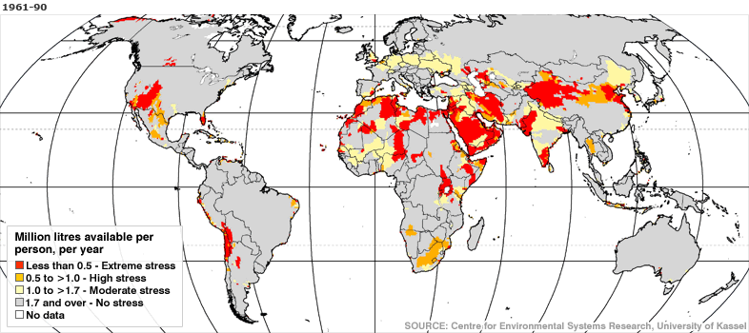
Global Water Scarcity: A Landscape for Present and Future Conflicts

Slide 53
3. Resource Wars
Exclusive economic zone (EEZ):
  Third United Nations Convention on the Law of the Sea (1982).
  Sea zone over which a state has rights to the exploration and use of marine resources:
    Fishing.
    Oil and mineral extraction.
  200 nautical miles (370 km) out from its coast.
  Cannot prevent free navigation.
  Several EEZ are contested:
    South China Sea.
    Sea formally controlled by Japan but taken by the Soviet Union after WWII.

Slide 54
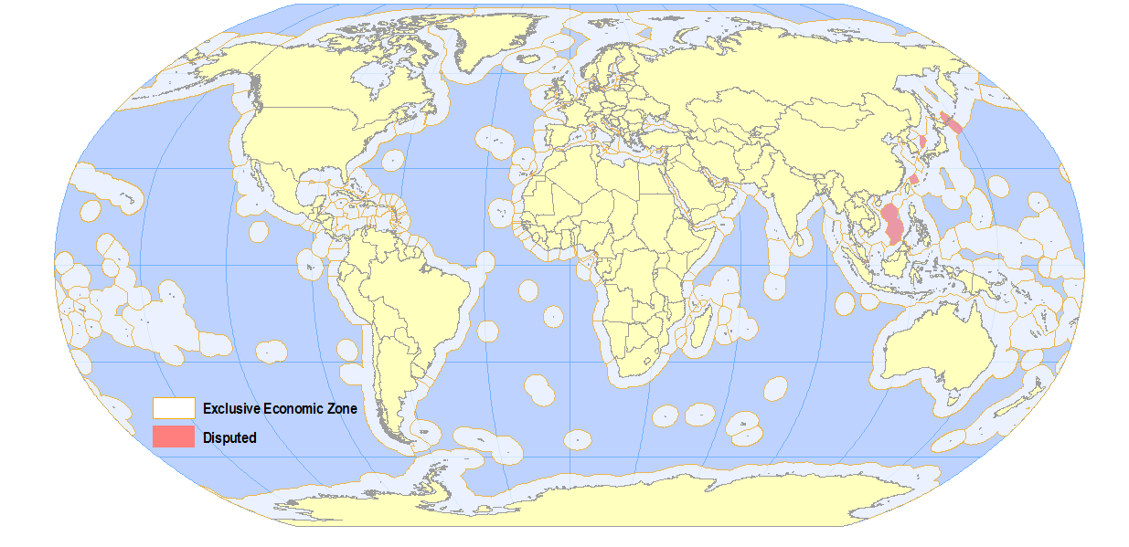
Exclusive Economic Zones
Notes:
Source: VLIZ (2005). Maritime Boundaries Geodatabase. Available online at http://www.vliz.be/vmdcdata/marbound.

Slide 55
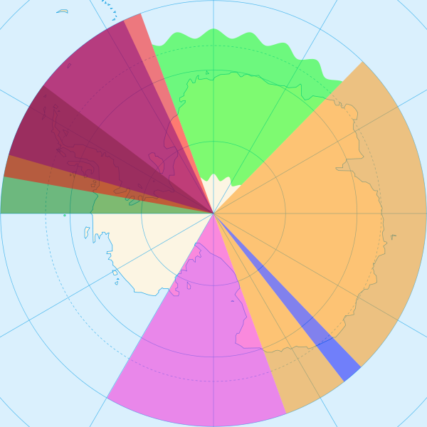
Superimposed Boundaries: Antarctic Treaty (1961)
Territorial claims
  Antarctica is the world’s largest unclaimed territory.
  Below 60o latitude south.
  Sectors defined by longitudes.
  Up to the South Pole.
  No mutual recognition of the claims.
  Ban on military activity and mining.
UK
Argentina
Norway
UK
Chile
Australia
New Zealand
France

Slide 56
D. The Environmental Challenge
The Tragedy of the Global Commons
Demographic Capacity

Slide 57
1. The Tragedy of the Global Commons
Definition
  Shared resources:
    Land and other inputs into the food production process.
    Oceans and their contents, particularly fish as a food source.
    The atmosphere.
    Sources of energy.
    Landscape for recreational purposes.
  Resources of the commons are in finite quantities:
    Access is free (in theory).
  Demographic growth:
    Can be considered part of the commons.
    Population consumes shared resources (education, health care).

Slide 58
1. The Tragedy of the Global Commons
Using the commons (example)
  Decision on whether to increase the size of herd that grazes on common lands.
  A rational being seeking to maximize his gain:
    Positive component of adding animals is additional income from additional animals.
    Negative component is the overgrazing caused by the additional animals.
    The costs are shared by those using the common grazing lands.
    Decision to add the extra animals to his herd.
    Unfortunately, all of the other villages will arrive at the same conclusion, do the same thing.
  The outcome is the ruin to the environment.

Slide 59
1. The Tragedy of the Global Commons
Village | 1 | 2 | 3 | 4
Cattle | 3 | 3 | 3 | 3
Commons | 14 – 12 = 2
Cattle | (+1) 4 | (+1) 4 | (+1) 4 | (+1) 4
Commons | 14 – 16 = -2 (overgrazing)
Village
4
1
Commons
(sustain 14)
3
2
Cattle (grazing)
Benefits: +1 each
Costs: -1 each

Slide 60
2. The Commons
The tragedy of the commons
  Freedom in a commons brings ruin to all.
  All the resources will be used.
Solutions
  Private property:
    Removes some of the Commons from access.
    Encourages conservation and wise management.
    Vested interest in maintaining it for future use.
  Collective property:
    Parts of the Commons not possible to divide into private segments - atmosphere, oceans, etc.
    Collective (global) ownership.
    Taxation and coercive laws as the primary means of preservation.
    The issue of redistribution.

Slide 61
World Fish Catch per Capita, 1950- 2001
Notes:
Source: FAO.

Slide 62
Commercial Harvests in the Northwest Atlantic of Some Fish Stocks, 1950-2008
Notes:
Source: Food and Agriculture Organization of the United Nations (FAO), Fishstat
http://www.fao.org/fishery/statistics/global-capture-production/en

Slide 63
Carbon Emissions from Fossil Fuel Burning, 1751-2007
Notes:
Source: WorldWatch Institute.

Slide 64
2. Demographic Capacity
Overpopulation
  Relationship between population and available resources:
    E.g. food, energy, water, etc.
    Relative to the support system.
  Population threshold:
    Theoretical level of maximal sustainable population.
    Additional numbers become a cause of declining standards of living and environmental degradation.
  Linked with level of consumption:
    Countries with low populations can thus be overpopulated.
    The United States could be more overpopulated than China.

Slide 65
The Concept of Overpopulation
Unsustainable
>1
Overpopulation
1
Sustainable
Population / Resources
0

Slide 66

2. Demographic Capacity
How many people can be sustained by the Earth?
  Based on human choices and natural constraints.
  Maximum density.
  Quantity of arable land.
  Agricultural technology.
  Harvesting the ocean.
  Human facilities.
  Availability of resources (energy, construction materials, etc.).
Space
Technology
Consumption
Resources

Slide 67
2. Demographic Capacity
Demographic capacity
  Studies about nature’s capacity to support human life go back many centuries.
  Leeuwenhoek (1679) extrapolated densities for Holland to the whole planet (13.4 billion capacity).
  Focus:
    Space.
    Energy requirements.
    Non-renewable resources.
    Photosynthetic potentials.
  All are based on the same principle:
    Tracing resource and energy flows through the human economy.

Slide 68
2. Demographic Capacity
Ravenstein in 1891
  Concept of carrying capacity.
  Focused on the earth’s cultivable areas, and their potential productivity given increases in yields over time:
    Fertile: 200 people / km2.
    Steppe: 10 people / km2.
    Desert: 1 person / km2.
  Figure of 6 billion people as the number Earth could sustain without lowering living standards.
  Reached this number in 1999.
Arable land
X
Agricultural
technology
/
Consumption
per capita

Slide 69
2. Demographic Capacity
Contemporary issues
  Events such as the Green Revolution were not foreseen:
    Managed to increase agricultural yields in many areas by quantities far greater than anticipated.
  Efforts to calculate carrying capacity have largely failed:
    Too many variables.
  Value ranges between 4 and 16 billion.
Level of consumption
  The issue is not resource supply, but resource demand.
  The world is producing only a finite number of resources for consumption.
  Demographic capacity is linked with level of resource consumption.

Slide 70
2. Demographic Capacity
American (lifetime)
  1 million kg of atmospheric waste.
  10 million kg of liquid waste.
  1 million kg of solid waste.
  700,000 kg of minerals.
  24 billion BTU of energy.
  25,000 kg of plants.
  2,000 animals (28,000 kg).

Slide 71
2. Demographic Capacity
Ecological footprint and biocapacity
  Try to assess the demand of human activities on the environment.
  Transformed over an unit of surface.
  Footprint (2003): 2.2 hectares per capita.
  Biocapacity (2003): 1.8 hectares per capita.
  Net deficit, in theory.
  May be overestimating the footprint because of CO2 sequestration assumptions.
Area
Population
X
X
Consumption per person
Bio-productivity
X
Footprint intensity
=
=
Biocapacity
(Supply)
Ecological Footprint (Demand)

