Slide 1
Topic 1 – What are Resources?
A – Definitions
B – Natural Resources
C – Economic Resources
D – Geographical Resources

Slide 2
Conditions of Usage
For personal and classroom use only
  Excludes any other forms of communication such as conference presentations, published reports and papers.
No modification and redistribution permitted
  Cannot be published, in whole or in part, in any form (printed or electronic) and on any media without consent.
Citation
  Dr. Jean-Paul Rodrigue, Dept. of Global Studies & Geography, Hofstra University.

Slide 3
A - Definitions
Types of Resources
The Renewable / Non-Renewable Dichotomy
Energy
Resources, Technology and Society
Notes:
What are the major types of resources and what do they imply?
What is the difference between a renewable and a non-renewable resource?
What is energy and what are its main sources?
In which way technology influences the quantity, quality and availability of resources?

Slide 4
1. Types of Resources
Natural
Context
  A resource is something held in reserve that can be used for a purpose.
  “Nature does not care”.
  Three major categories of resources.
Natural resources
  Derived from physiographical conditions.
Economic resources
  Derived from human activities.
Geographical resources
  Derived by spatial characteristics.
Minerals
Biological resources
Endowments
Geographical
Location
Human
Capital
Economic

Slide 5
1. Types of Resources
Economic | Human resources | Population and level of qualification. Commonly referred as the workforce.
 | Capital (money) | “Portable resource”. Measure the amount of resources available to an economy.
Geographical | Location | Grants access to markets and resources. Derive wealth acting as intermediary places (Panama, Singapore, Hong Kong, the Netherlands).
 | Endowments | Scenery, mountains, beaches and coral reefs. Resources when tourism is involved.
Natural | Biological resources | Used to sustain life. Can be converted. Soil, water, and forestry resources.
 | Mineral resources | Fossil fuels (coal, natural gas, oil), metallic minerals (iron, aluminum, copper) and non-metallic minerals (Nitrogen, calcium, potash, sulfur, salt, sand).

Slide 6
2. The Renewable / Non-renewable Dichotomy
Non-renewable Resources
Renewable Resources
Extraction Rate /
Replenishment Rate
Time Scale
Geological
Human
Formed over a time scale involving geologic time. Once consumed, they disappear forever (unless recycled).
Replenishment can occur on a human time scale (Years, decades, centuries).

Slide 7
2. The Renewable / Non-renewable Dichotomy
Infiniti
Minerals (unless recycled)
Millions
Fossil fuels (oil, coal)
Millennia
Soils: 200 years (permanent vegetation cover) - 1000 years (mature).
Erosion is extremely important because growing populations do not provide adequate time for soils to regenerate fully.
Centuries
Forests: In some areas, the rates of deforestation surpass the natural ability of the forest to regenerate. Rainforest: 65-100 years.
Years
Food: Very short growth cycle (reason why preferred as food source). Rice (3-6 months). Chicken (12 weeks).
Months
Water: Rivers. Rain water. Aquifers. Irrigation has increased in many dry areas.
Days

Slide 8
2. The Renewable / Non-renewable Dichotomy
CHARACTERISTIC | OIL | WATER
Quantity of resource | Finite | Literally finite; but practically unlimited at a cost
Renewable or Non-Renewable | Non-renewable resource | Renewable overall, but with locally non-renewable stocks
Flow | Only as withdrawals from fixed stocks | Water cycle renews natural flows
Transportability | Long-distance transport is economically viable | Long distance transport is not economically viable
Consumptive versus non-consumptive use | Almost all use of petroleum is consumptive, converting high-quality fuel into lower quality heat | Some uses of water are consumptive, but many are not. Overall, water is not "consumed" from the hydro-logic cycle
Substitutability | The energy provided by the combustion of oil can be provided by a wide range of alternatives | Water has no substitute for a wide range of functions and purposes
Prospects | Limited availability; substitution inevitable by a backstop renewable source | Locally limited, but globally unlimited after backstop source (e.g. desalination of oceans) is economically and environmentally developed
Notes:
Source: Pacific Institute

Slide 9
Non-Renewable Resources Curve
Resource Peak
Demand
Usage
Abandonment /
transition
Adoption
Technology
Time

Slide 10
3. Sources of Energy
Chemical
Fossil fuels (Combustion)
Nuclear
Uranium (Fission of atoms)
Non-Renewable
Movement
Stored (potential)
Kinetic (used)
Energy
Chemical
Muscular (Oxidization)
Nuclear
Geothermal (Conversion)
Fusion (Fusion of hydrogen)
Gravity
Tidal, hydraulic (Kinetic)
Indirect Solar
Biomass (Photosynthesis)
Wind (Pressure differences)
Direct Solar
Photovoltaic cell (Conversion)
Ordered (mechanical energy)
Renewable
Disordered (thermal energy)
World’s power consumption: 12 trillion watts per year (85% from fossil fuels)
Notes:
Fossil fuels are fuels that result from the fossilization process of living tissue after millions of years. The sun has a life expectancy of 10 billion years (we are halfway).

Slide 11
3. Chemical Energy Content of some Fuels (in MJ/kg)
Notes:
Source: adapted from C. Ronneau (2004), Energie, pollution de l’air et developpement durable, Louvain-la-neuve: Presses Universitaires de Louvain.

Slide 12
3. Energy and Work
Modification of the Environment | Appropriation and Processing | Transfer
Making space suitable for human activities (20% of electricity in the US used for AC). Clearing land for agriculture. Modifying the hydrography (irrigation). Establishing distribution infrastructures (roads). Constructing and conditioning (temperature and light) enclosed structures. | Extraction of resources (agricultural products and raw materials). Modifying resources (manufacturing). Disposal of wastes (Piling, decontaminating and burning). | Movements of freight, people and information. Attenuate the spatial inequities in the location of resources by overcoming distance. Growing share of transportation in the total energy spent.

Slide 13
Main Energy Challenges
Providing supply to sustain growth and requirements.
A modern society depends on a stable and continuous flow of energy.
Supply
Environment
Demand
Provide environmentally safe sources of energy.
Going through the energy transition (away from fossil fuels).
Generate more efficient devices (e.g. Transportation; Industrial processes; Appliances).

Slide 14
4. Resources, Technology and Society
Technology
  Definition:
    Processes according to which tools and machines are constructed.
    Insure a control of the physical environment.
    Comes from the Greek word teckne (manual expertise) and logia (field of knowledge).
    Therefore technology means the control, or the science, of manual expertise.
  The more it is developed, the further the control and the transformation of matter is possible.
  Concept of resource is tied to:
    Technology (extent of available resources).
    Technological change (growth in available resources and the efficiency of their use).
    Culture controlling the technology (level of consumption).

Slide 15
4. Resources, Technology and Society
Nuance
  Technology requires the systematic usage of science and especially of the scientific method.
  Relationship between science, technology and production (the market).
  Scientific research helps discover or improve a technology.
  Changes production while creating new goods available or permitting a more efficient way to produce.
Science
Comprehension of the laws of physical systems
Technology
Level of technical expertise over matter
Production
Practical use of a level of technical expertise
Research
Development

Slide 16
Potential Depletion of Non-Renewable Resources
Extract, use and discard
1
Recycle, technological improvements
2
Usage
Recycle, reuse, reduce consumption, technological improvements
3
Time

Slide 17
US Music Sales, 1975-2009
Notes:
Sources: www.worldalmanac.com, World Almanac 2007, RIAA, www.riaa.com

Slide 18
4. Resources, Technology and Society
Consumerism
  Consumption:
    Always existed (mostly essential needs).
    Part of social ideals; persona’s definition.
  Marketing:
    Department store (facility designed to incite consumption).
    Advertising (create wants and needs).
    Fashion (planned obsolescence).
  Buying power:
    Mass consumption requires mass production.
    Relative price reduction of consumption goods; “mass luxury”.
    Higher wages.
    Access to credit.

Slide 19
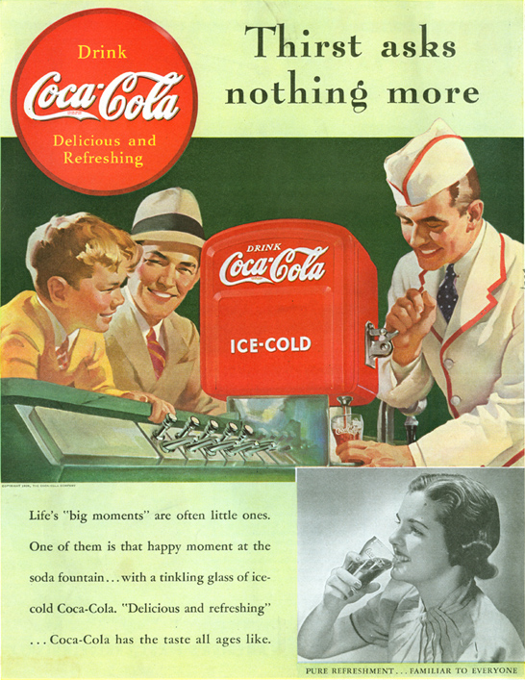

Advertising and Psychology

Slide 20
Material Stocks in Tons per Capita
Notes:
Source:
https://theconversation.com/the-20th-century-saw-a-23-fold-increase-in-natural-resources-used-for-building-73057

Slide 21
Comparative Use of Resources, c2000 (USA=100)
Notes:
Source: EIA (Energy Information Agency)

Slide 22
Annual Resource Consumption per Person, 2001-2002
Notes:
Source: www.wri.org

Slide 23
4. Resources, Technology and Society
The “Resource Curse”
  Paradox:
    Many resource-rich countries have the poorest population.
    Particularly for resources that have a high concentration level (e.g. oil, diamonds, gold).
  Resources as a power support structure:
    Prone to authoritarian rule, slow growth, corruption and conflict.
    Resources used to finance armies, corruption and patronage.
    Civil wars to gain control of resources.
  The “curse”:
    Instead of resources being a vector for development and capital accumulation, they become a factor of inequality.
    Under investment in infrastructures, utilities, health and education.
    Inverse relationship between natural resources and democracy.

Slide 24
4. Resources, Technology and Society
Resource loss due to destruction
  Natural and man causes can destroy resources.
  Natural hazards:
    Earthquakes.
    Weather hazards (hurricanes, tornadoes, flooding).
    Forest fires.
  Pollution:
    Reduces the quantity and quality of natural resources such as water.
  Conflicts:
    Destroyed huge quantities of resources, material and human alike, throughout history.

Slide 25
B – Natural Resources
The Atmosphere
The Lithosphere
The Hydrosphere
The Ecosphere
Atmosphere
Ecosphere
Hydrosphere
Lithosphere
Biosphere

Slide 26
1. The Environmental System
Atmosphere | Lithosphere | Hydrosphere | Ecosphere
Gas envelop surrounding the earth. | Thin crust between the mantle and the atmosphere. Around 100 km thick. | Accumulation of water in all its states (solid, liquid and gas). | Set of all living organisms, including animals and vegetal.
Nitrogen (78%), oxygen (21%), and traces (remaining 1%) of carbon dioxide, argon, water vapor and other components. | Oxygen (47%), silicon (28%), aluminum (8%), iron (5%), calcium (4%), sodium (3%), potassium (3%) and magnesium (2%) in a crystalline state. | Elements dissolved it in (sodium, magnesium, calcium, chloride and sulfate).
Fast circulation. Main determinant of climate. |  | Water covers around 71% of the earth’s surface: 97% in oceans; 2% in ice (north and south poles); 1% in rivers, lakes, ground water and atmospheric vapor. | Very complex set of relationships with the atmosphere, hydrosphere and lithosphere.

Slide 27
Global Wind Patterns
Polar
Cell
Principle
Polar Front
Ferrel
Cell
Cold
(Pole)
Horse Latitudes
Hadley
Cell
Warm (Equator)
Intertropical Convergence Zone
TRADE WINDS
Cold
(Pole)
WESTERLIES
Global Structure

Slide 28
Seasonal Variation of Global Wind Patterns
July
WESTERLIES
WESTERLIES
TRADE WINDS
TRADE WINDS
MONSOON
TRADE WINDS
TRADE WINDS
WESTERLIES
WESTERLIES
WESTERLIES
January
WESTERLIES
WESTERLIES
TRADE WINDS
TRADE WINDS
MONSOON
TRADE WINDS
TRADE WINDS
WESTERLIES
WESTERLIES
Notes:
Source: adapted from M. Tomczak and J.S. Godfrey (1994) Regional Oceanography: An Introduction, London: Pergamon.

Slide 29
1. Atmosphere: The World’s Climate
Nature
  Climate is mostly composed of precipitation and temperature.
  Classified according to similar attributes.
  The main impact of climate on population and resources is related to its influence on food production and on comfort.
  In extreme climatic conditions (hot or cold), large efforts must be made to support human life.
Precipitation
  Involves the amount of water, in all its forms (rain, snow, hail, fog, condensation), that falls on the ground.
  Influenced by many factors such as latitude, wind direction and altitude.

Slide 30
1. Atmosphere: The World’s Climate
Condensation
Convectional rainfall
  Mostly during the summer, almost everyday around the tropics.
  Hot temperature causes rapid evaporation.
  As the humid air climbs, it cools and causes torrential rain falls.
Orographic rainfall
  Mostly during the monsoons.
  High mountain ranges force humid air masses to climb.
  It cools and rain falls.
  Highest levels of precipitation are on the Indian side of the Himalayas (more than 30 feet of precipitation per year).
Evaporation
Wind

Slide 31
Mean Annual Precipitation
D
D
C
B
B
A
A
B
B
C
C
Equator: A band between 10 degrees north and 10 degrees south. The rainiest areas of the world (conventional rainfall).
Low latitudes: Between 10 and 30 degrees north and 10 and 30 degrees south.
Low precipitations
Middle latitudes: 20 to 50 degrees north and 20 to 50 degrees south.
High latitudes:
Low precipitations (little convection).
A
B
C
D

Slide 32
1. Atmosphere: The World’s Climate
Temperature
  Number of days without freezing:
    Important component of temperature.
    Rough indication of the growing season.
  For tropical regions, this figure is zero:
    Vegetation grows year long, while for middle latitudes, winter can be more or less long.
  Latitude, altitude and water masses and major factors influencing temperature.

Slide 33
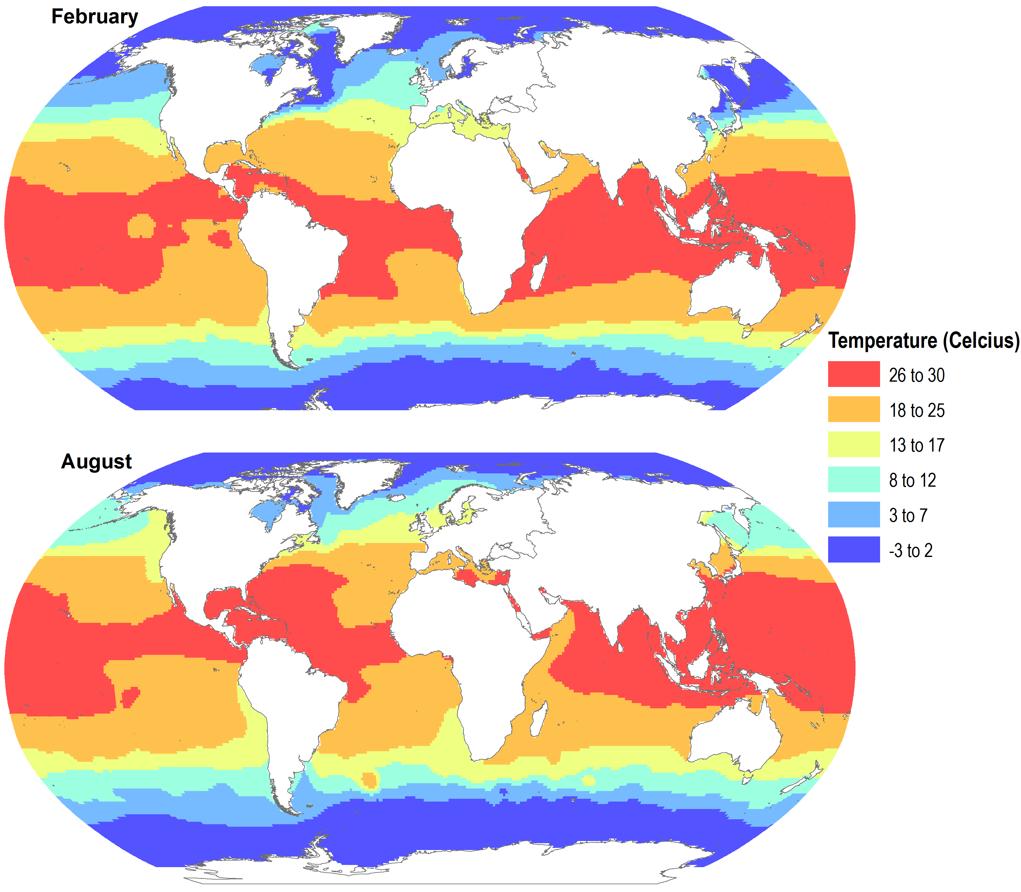
Average Sea Surface Temperature

Slide 34
Average Insolation by Month and by Latitude

Slide 35
2. The Lithosphere
The earth’s crust
  Contains metallic and non-metallic minerals.
  Unequal concentration and distribution because of geology.
Metals
  Dominant mineral resources.
Ore
  Rock in which a mineral can be mined.
  Two factors for ore mining:
    Market value of the mineral.
    Concentration level in the ore.
  There are ore rocks all over the world.
  Only a small portion can be economically mined.

Slide 36
2. Composition of the Earth’s Crust

Slide 37
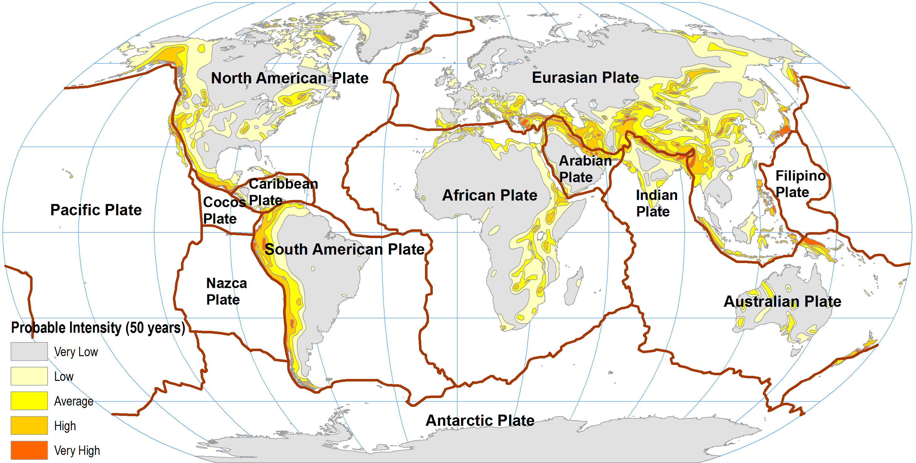
2. Plate Tectonics

Slide 38
2. The Lithosphere
Metals
  Iron:
    Most common and used metal.
    Iron deposits can easily be mined and smelted for the ore.
    Used to make steel, a highly versatile metal.
  Aluminum:
    Second most used metal.
    Light weight and strength.
    Third most common element in the crust, but difficult to extract in its most common form (silicates).
    Bauxite: easier form to extract aluminum but energy intensive (electricity).
Nonmetallic minerals
  Vary wide variety and use.
  Clay. Limestone. Potash (fertilizer). Silica sand.

Slide 39
Some Minerals Used in Household Goods
Good | Mineral components
Glass & ceramic | Silica sand, limestone, talc, lithium, borates, soda ash, feldspar
Fertilizers | Potash, phosphate, nitrogen, sulfur
Toothpaste | Calcium carbonate, limestone, sodium carbonate, fluorite
Lipstick | Calcium carbonate, talc
Caulking | Limestone, gypsum
Paint | Titanium dioxide, kaolin clays, calcium carbonate, mica, talc, silica
Concrete | Limestone, gypsum, iron oxide, clay
Pencil | Graphite, clay
Sport equipment | Graphite, fiberglass
Pots and pans | Aluminum, iron
Automobile | 15 different metals and minerals
Cell phone | 50 different metals and minerals

Slide 40
World Mineral Reserves (years of production left), 2002
Notes:
Source: World Resources Institute.
This is a very flexible concept as reserves are related to economic and technological factors. Such estimates have systematically been wrong in the past and are likely to continue to be inaccurate.

Slide 41
3. Hydrosphere: World Fresh Water Supply by Source
Water source | Water volume, in cubic miles | Water volume, in cubic kilometers | Percent of fresh water | Percent of total water
Oceans, Seas, & Bays | 321,000,000 | 1,338,000,000 | -- | 96.5
Ice caps, Glaciers, & Permanent Snow | 5,773,000 | 24,064,000 | 68.7 | 1.74
Groundwater | 5,614,000 | 23,400,000 | -- | 1.7
Fresh | 2,526,000 | 10,530,000 | 30.1 | 0.76
Saline | 3,088,000 | 12,870,000 | -- | 0.94
Soil Moisture | 3,959 | 16,500 | 0.05 | 0.001
Ground Ice & Permafrost | 71,970 | 300,000 | 0.86 | 0.022
Lakes | 42,320 | 176,400 | -- | 0.013
Fresh | 21,830 | 91,000 | 0.26 | 0.007
Saline | 20,490 | 85,400 | -- | 0.006
Atmosphere | 3,095 | 12,900 | 0.04 | 0.001
Swamp Water | 2,752 | 11,470 | 0.03 | 0.0008
Rivers | 509 | 2,120 | 0.006 | 0.0002
Biological Water | 269 | 1,120 | 0.003 | 0.0001
Total | 332,600,000 | 1,386,000,000 | - | 100
Notes:
Source: Igor Shiklomanov's chapter "World fresh water resources" in Peter H. Gleick (editor), 1993, Water in Crisis: A Guide to the World's Fresh Water Resources (Oxford University Press, New York).

Slide 42
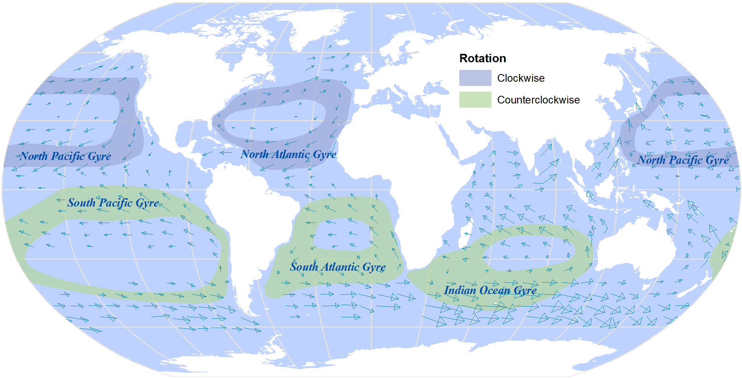
3. Major Oceanic Gyres

Slide 43
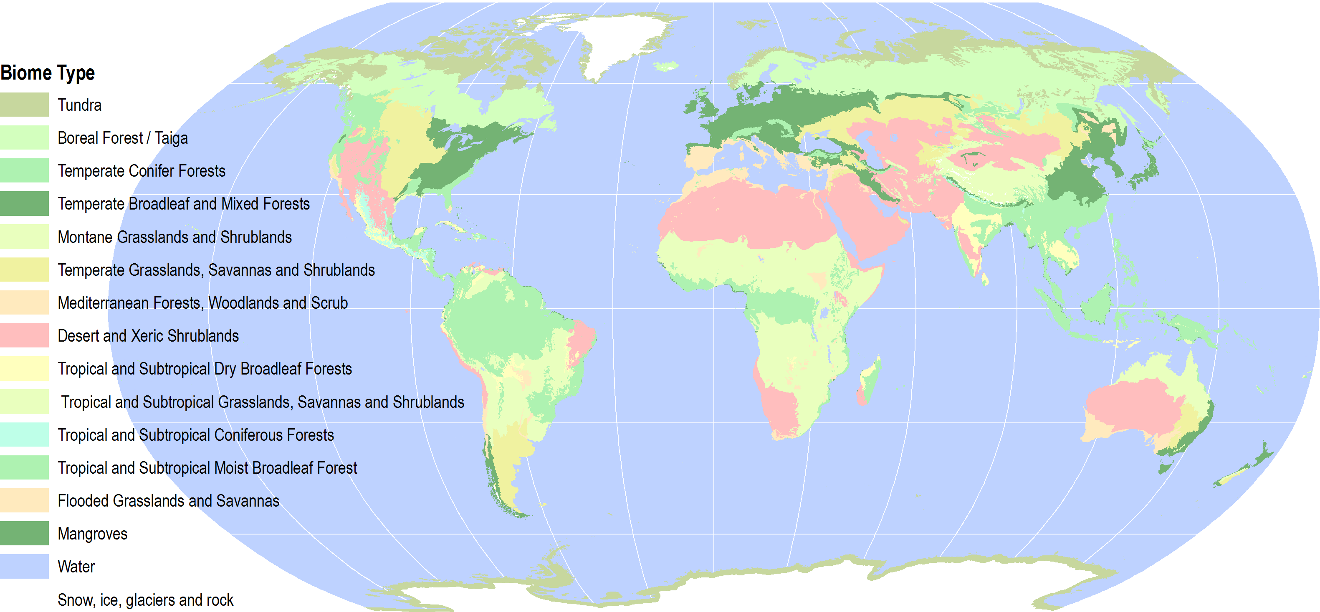
4. Biosphere

Slide 44
C – Economic Resources
Human Resources
Capital

Slide 45
1. Human Resources
Economic system:
  Production + distribution + consumption
Production side
  Population provides labor:
    Resource extraction.
    Resource transformation.
  Function of costs and qualifications.
Consumption side
  Population consumes resources:
    Food.
    Energy.
    Goods.
    Services (education, healthcare).
  Function of the level of income.

Slide 46
Share of the World GDP, 2008 (Current USD)
Notes:
Source: World Bank Development Indicators.

Slide 47
1. Human Resources
Evolution of the world’s population
  Long historical process:
    Has been very slow up to recently.
    300 million people around year 0.
    Remained small until the last 250 years.
  A new growth trend:
    Has increased almost exponentially.
    From 1.6 billion in 1900 to 6 billion in 1999.
    To what it can be linked?
Population “explosion”
  Defines a process of strong demographic growth.
  Started after the Second World War.
  About 80 million people added each year.
  The pool of human resources has thus considerably expanded.

Slide 48
World Population, 1000BC-2050AD (in billions)
Notes:
Source: WorldWatch Institute & United Nations, Population Forecast, 2006 Revision.

Slide 49
Population Added to the Global Population, 1950-2008 (in millions per year)
Notes:
Source: Worldwatch Institute.

Slide 50
15 Largest Countries, 2005, 2050 (in millions)
Notes:
Source: FAO Statistical Database

Slide 51
Adult Literacy Rate (%), 1980-2008
Notes:
Source: World Bank, World Development Indicators

Slide 52
Composition of the World’s Population, 1960-2008
Notes:
Source: World Bank, World Development Indicators

Slide 53
2. Capital
Factor of production
  For goods and services.
  No consumed (can depreciate).
  Different forms of capital (social, financial, infrastructure).
  Different ways to measure.
Gross National Income
  Total value produced within a country (i.e. its gross domestic product), together with its income received from other countries

Slide 54
World Gross National Income (GNI) and GNI per Capita, 1972-2008
Notes:
Source: World Bank, World Development Indicators.
Does not take into account inflation.

Slide 55
2. Capital
Money (theory)
  Unit of account (measure value).
  Medium of exchange (support transactions).
  Store of value (permanence in time).
Money (practice)
  Fiat currencies:
    Faith in the credit of government.
    A fraudulent tool supporting state expansion.
  Credit / debt driven:
    Credit created “out of thin air” as debt.
    Present consumption at the expense of future consumption.
  Inflation:
    Increase in the quantity of money/credit in relation to the pool of goods and services.
    The temptation of “just a little more” credit.

Slide 56
Value of a 2009 $100 Dollar, 1800 - 2009
Notes:
Source: (2010) Robert C. Sahr, Political Science Department, Oregon State University, Corvallis, OR 97331-6206. http://oregonstate.edu/cla/polisci/download-conversion-factors

Slide 57
D – Geographical resources
Location
Endowments

Slide 58
1. Location
Concept
  Absolute location (coordinate system).
  Relative location (referring to other locations)
Relevance for resources
  Location is a resource multiplier:
    Using resources more effectively.
    A city is a more effective production and consumption structure.
    Some locations have higher sale potential; they differ mainly because of their accessibility.
    Accessibility can be a proxy for the value of space.
  A location can be a resource in itself:
    Bottleneck rent effect on flows (canals, bridges, tunnels).
    Capturing rent for right of passage (plus construction and maintenance of infrastructure).

Slide 59
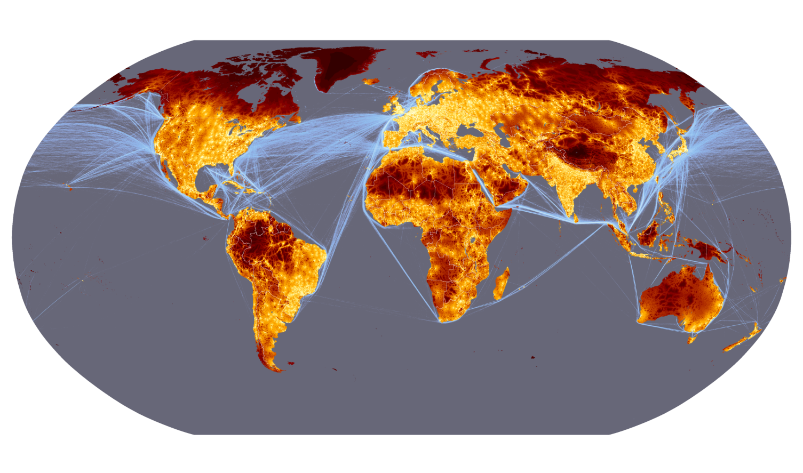
Global Accessibility: Time to the Nearest Large City
Notes:
Source: Nelson, A. (2008) Estimated travel time to the nearest city of 50,000 or more people in year 2000. Global Environment Monitoring Unit - Joint Research Centre of the European Commission, Ispra Italy. Available at http://bioval.jrc.ec.europa.eu/products/gam/
http://bioval.jrc.ec.europa.eu/products/gam/index.htm
Only 10% of the world is more than 48 hours away from a large city (50,000 people).

Slide 60
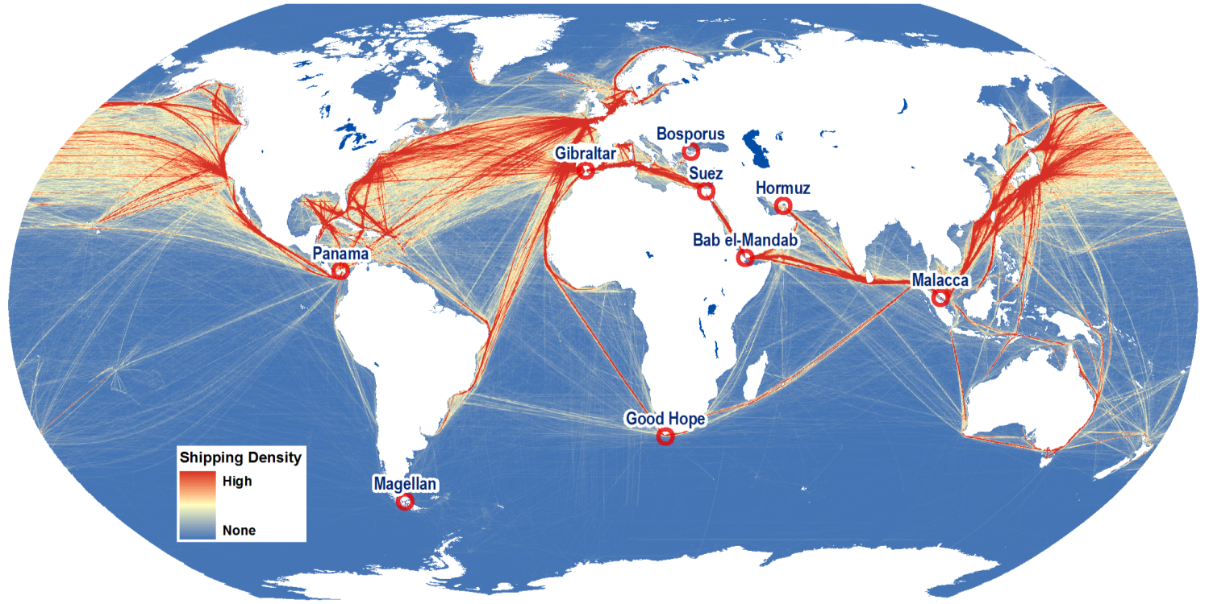
Maritime Shipping Routes and Strategic Locations
Notes:
Source: Shipping density data adapted from National Center for Ecological Analysis and Synthesis, A Global Map of Human Impacts to Marine Ecosystems. http://www.nceas.ucsb.edu/GlobalMarine/impacts

Slide 61
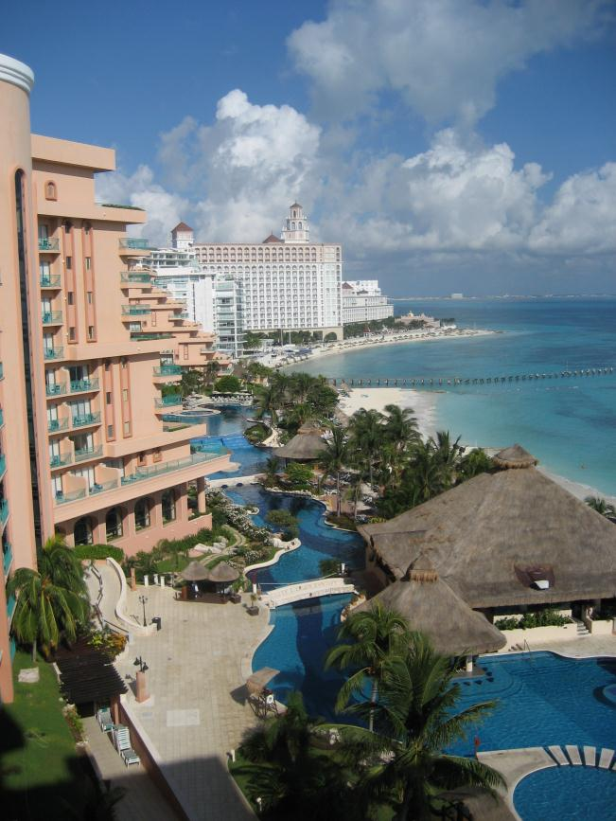
2. Endowments
Amenity resources
  Attributes other than factors of production (objective).
  Amenity (subjective):
    Climate and temperature.
    Physical characteristics of the site (beach, mountain, etc.).
  Requires infrastructure investment (Access and hospitality).
  Wealth extraction based on willingness to spend capital for enjoyment.
Cancun, Mexico

