Slide 1
Topic 9 – Transportation and Communications
A – Transport Networks and Costs
B – Transport Systems
Notes:
Source: Frederick P. Stutz and Barney Warf (2012) The World Economy: Resources, Location, Trade, and Development, 6th Edition. Prentice Hall, Saddle River, NJ.

Slide 2
Conditions of Usage
For personal and classroom use only
  Excludes any other forms of communication such as conference presentations, published reports and papers.
No modification and redistribution permitted
  Cannot be published, in whole or in part, in any form (printed or electronic) and on any media without consent.
Citation
  Dr. Jean-Paul Rodrigue, Dept. of Global Studies & Geography, Hofstra University.

Slide 3
A – Transport Networks and Costs
The Function of Transportation
Transportation Networks
Transportation Costs

Slide 4
The Economic Purpose of Transportation
Mobility is an economic activity and a support to other economic activities
The benefits of mobility are expected to be higher that its costs
Providing mobility requires substantial capital investments
  For infrastructures (roads, rails, ports, airports).
  For modes (trucks, cars, planes, ships, railcars).
Expanded transportation allows for expanded economic opportunities

Slide 5
Socioeconomic Benefits of Transportation
Read this content
Passengers
Freight
Direct
Users
Operators
Capacity and efficiency
Time and cost savings.
Income from transport operations.
Time and cost savings.
Income from transport operations.
Indirect
Employers & Retail
Customers
Accessibility and economies of scale
Access to labor or customers.
Rent income.
Goods and services to users.
Productivity and added gains.
Rent income.
Goods and services to operators.
Range of suppliers and markets.
SCALE
Induced
Society
Economy
Multipliers and opportunities
Improved mobility.
Increased social opportunities.
Formation of distribution networks.
Attraction of economic activities.
Increased competitiveness.
© GTS
SCOPE

Slide 6

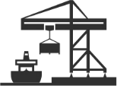

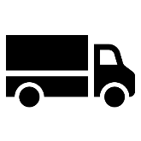



The Core Principles of Transportation
Read this content
1
A
B
Transportation is the spatial linking of a derived demand
2
A
B
Distance is a relative concept involving space, time and effort (cost)
3
A
X
B
Space can be a generator, a support and a constraint for mobility
4
The relation between space and time can converge or diverge
5
A
B
C
A location can be a central or an intermediate element of mobility
6
To overcome geography, transportation must consume space
7
Transportation seeks massification but is constrained by atomization
8
Velocity is a modal, intermodal and managerial effort
© GTS

Slide 7
1. Transportation as a Derived Demand
1
Read this content
Activity
Working
Vacationing
Shopping
Manufacturing
Direct
Commuting
Travel
Travel & Deliveries
Transport & Distribution
Indirect
Services
Warehousing
Energy
Derived Demand
Transportation is the spatial linking of a derived demand

Slide 8
Different Representations of Distance
2
Read this content
Euclidean Distance
A
B
Transport Distance
A
Pickup
Delivery
B
Mode 1
Transshipment
Mode 2
Logistical Distance
Order
A
Pickup
Delivery
B
Mode 1
Transshipment
Mode 2
Order Processing
Packing
Scheduling
Inventory Management
Unpacking
Sorting
Warehousing
Distance is a relative concept involving space, time and effort (cost)

Slide 9
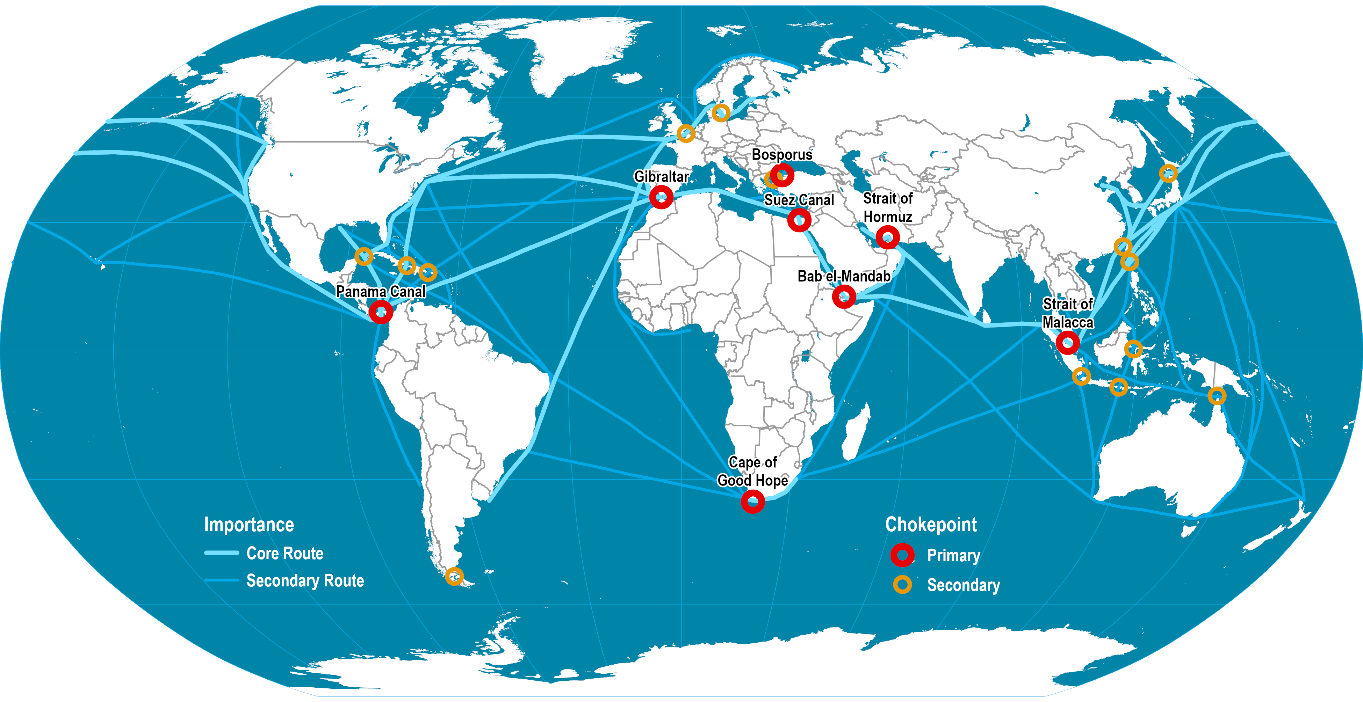
Maritime Shipping Routes and Strategic Locations
3
Read this content
Space can be a generator, support and constraint for mobility
Notes:
Source: Shipping density data adapted from National Center for Ecological Analysis and Synthesis, A Global Map of Human Impacts to Marine Ecosystems. http://www.nceas.ucsb.edu/GlobalMarine/impacts

Slide 10


Global Space / Time Convergence: Days Required to Circumnavigate the Globe
4
Read this content
Average speed of horse and cart: 4 km/hr
Average speed sailships: 16 km/hr
Average speed of trains: 100 km/hr
Average speed of steamships: 25 km/hr
Space / Time
Convergence
Average speed of airplanes: 480-640 km/hr
Average speed of jet planes: 800-1120 km/hr
Numeric transmission: instantaneous
© GTS
The relation between space and time can converge or diverge

Slide 11
Centrality and Intermediacy
5
Read this content
Intermediary airports (Anchorage, Gander)
Intermediacy
Ports
Centrality
Range
Gateway
Panama and Suez canals
Major airport hubs
Hub (Interception)
Hub (Transcalar)
A location can be a central or an intermediate element of mobility

Slide 12
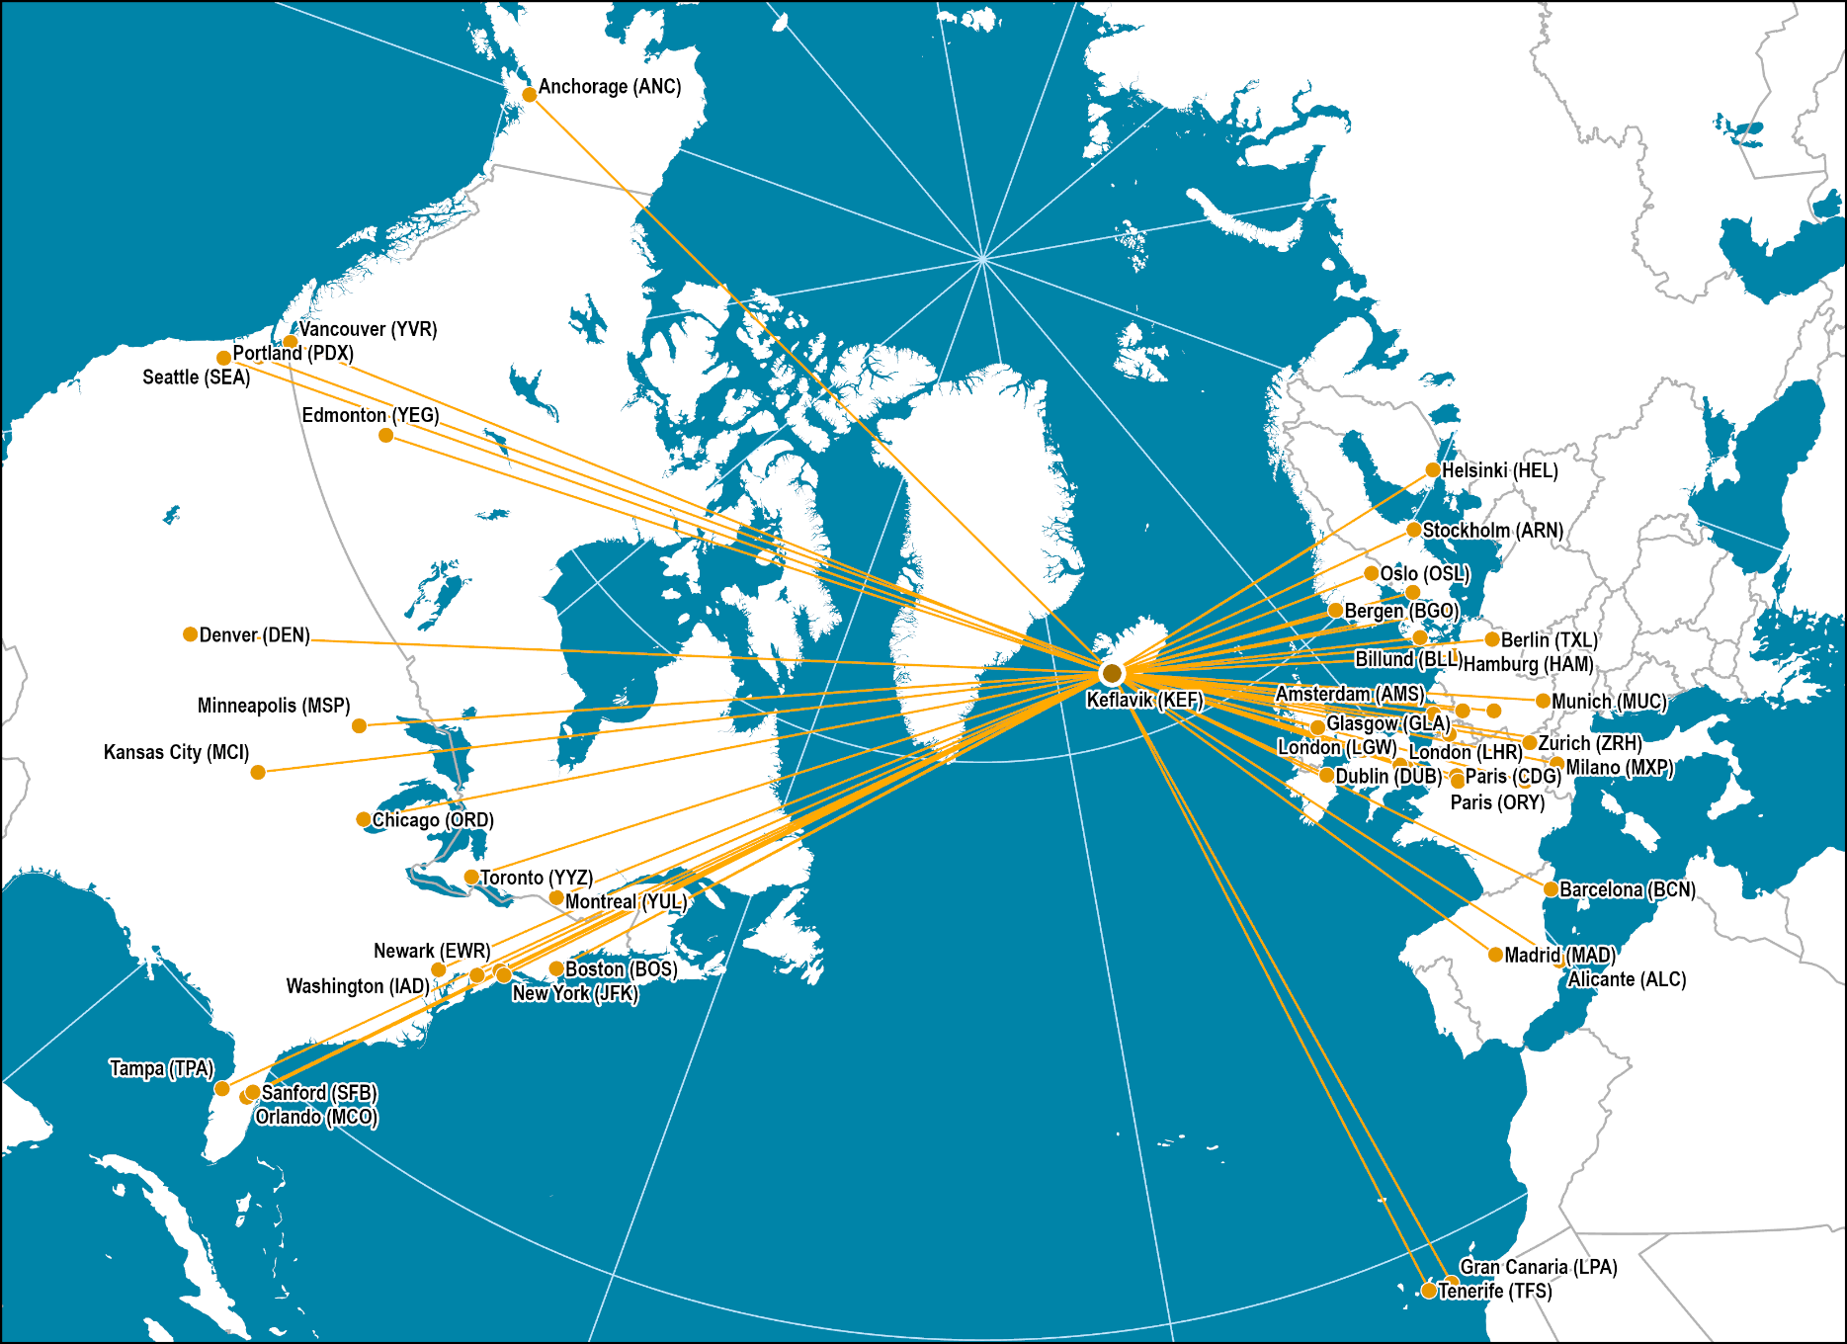
Longitudinal Intermediacy: Icelandair
5
Notes:
Source: Network from Icelandair Web Site.
Map location: air_transport

Slide 13
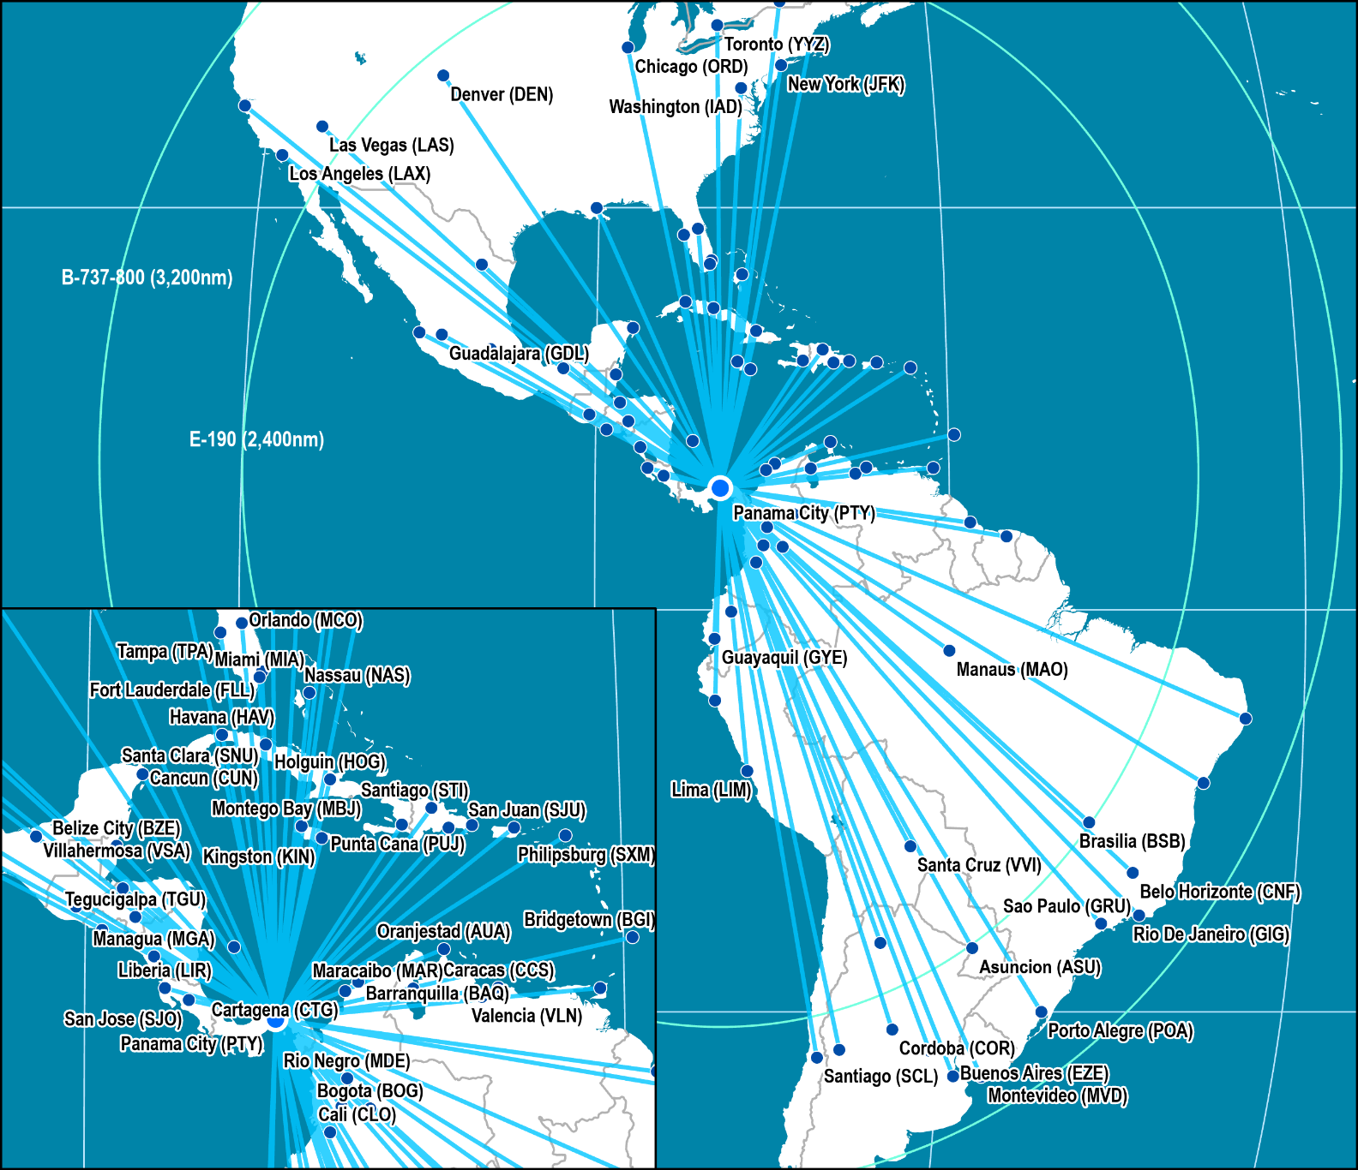
Latitudinal Intermediacy: COPA Airlines
5
Notes:
Source: Network from COPA Airlines Web Site.
Map location: air_transport

Slide 14
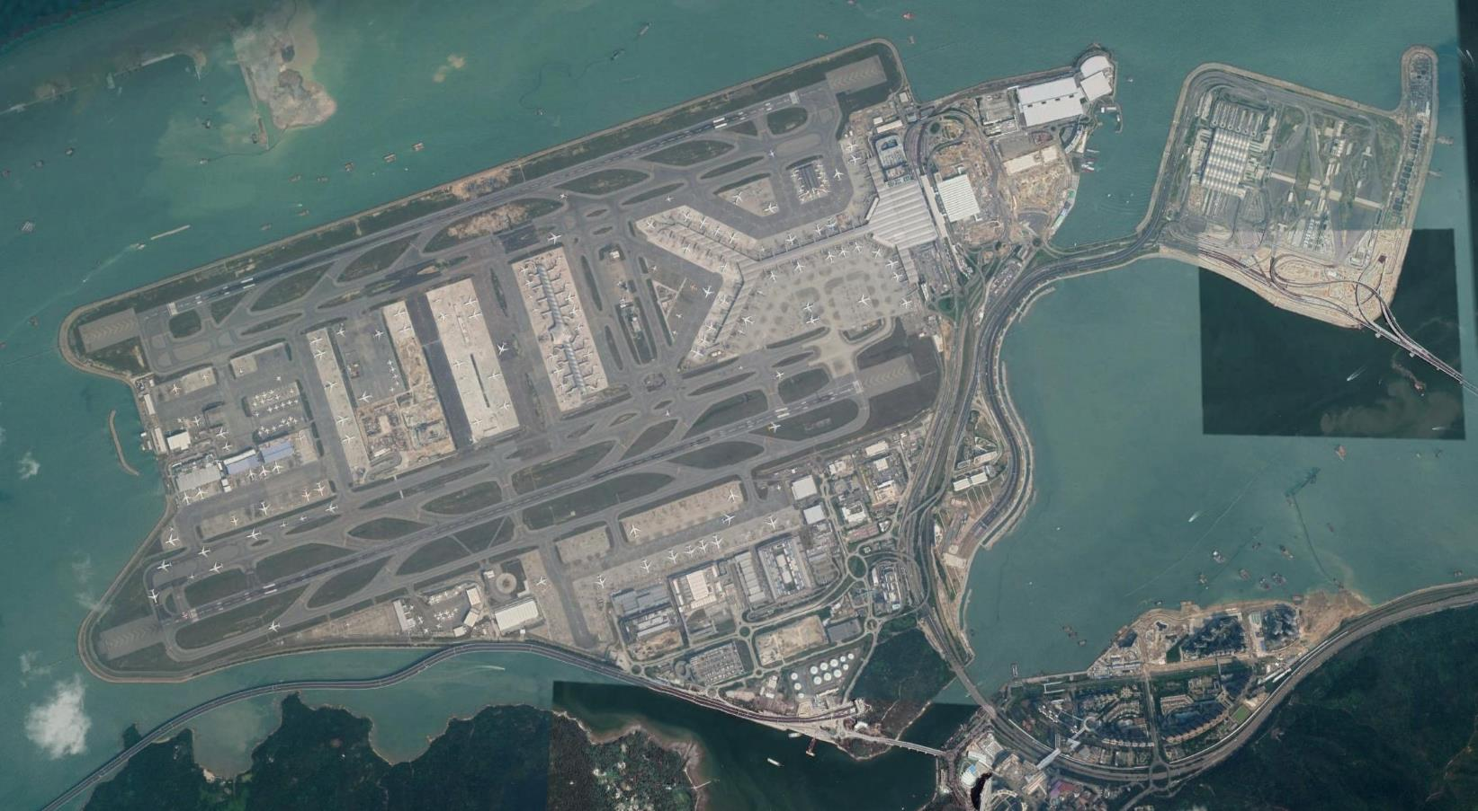
Hong Kong Chek Lap Kok Terminal
6
Read this content
Skycity
25R
North Satellite Concourse
Hong Kong Boundary Crossing Facilities
Main Terminal
07L
Terminal Expansion
(Midfield Concourse)
25L
Logistics and cargo area
07R
To Kowloon
and Hong Kong
Hong Kong–Zhuhai–Macau Bridge
To overcome geography, transportation requires a footprint

Slide 15
Atomization versus Massification in Transportation Modes
7
Read this content
Ferry & Cruise ship
Passengers
Passenger train
Airplane
5,000
Bus
1,000
Car
50
500
Atomization
1
5
100
Massification
Person
Parcel
Part
25
1,000
Container
10,000
Truck
100,000
Cargo plane
400,000
Freight train
Containership
Tons
Bulk carrier & Tanker
Transportation seeks massification but is constrained by atomization

Slide 16
Number of Monthly Trips by for Hire Services, New York City, 2015-2019
8
Read this content
Velocity is a modal, intermodal and managerial effort
Notes:
Source: New York City, Taxi and Limousine Commission (TLC) https://data.cityofnewyork.us/Transportation/FHV-Base-Aggregate-Report/2v9c-2k7f

Slide 17
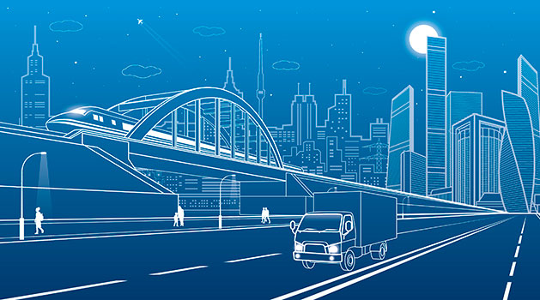
Essay: Core Principles of Transportation
Explain four main principles of transportation and for each provide an example.

Slide 18
2. Transportation Networks
Definition
  Framework of routes within a system of locations, identified as nodes.
  A route is a single link between two nodes.
  Tangible routes such as roads and rails.
  Less tangible routes such as air and sea corridors.

Slide 19
Network Options
LEAST COST TO USE
LEAST COST TO BUILD
HYBRID
A
B
A
B
A
B
C
D
C
D
C
D
Maximum connectivity
High travel costs: AC, BD
Compromise
Benefit-Cost Evaluation of Network Choice:
Benefits: relative travel cost (savings), interaction
Costs: investment, operations

Slide 20
Mode of Territorial Occupation by Transport Networks
Read this content
Air Networks
Maritime Networks
Logistical Networks
Parts
Assembly
Distribution
Nodal hierarchy (hub-and-spoke)
Circuitous nodal hierarchy
Sequential multi-nodal hierarchy
Road Networks
Rail Networks
Power Grids
Hierarchical meshes
Linear nodal hierarchy
Sequential linear hierarchy

Slide 21
Transportation Costs
Context
  Transport costs:
    Monetary measure of what the transport provider must pay to produce transportation services.
    Provision or use of infrastructure, modes, fuel, labor, taxes, etc.
    Often invisible to the user.
  Transportation rates:
    The price of transportation services paid by their users.
    Must negotiate or bid for transportation services.
    Rates are often visible to the consumers since transport providers must provide this information to secure transactions.
    May not express the real transport costs (e.g. subsidies).

Slide 22
Transport and Communication Costs Indexes, 1920-2015
Read this content
Notes:
Source: Airfare data from various web sources (full economy airfare). Computer storage data from John C. McCallum, http://www.jcmit.com/diskprice.htm. Sea freight rates data from The Eddington Transport Study (2006) and from UNCTAD (after 1980). Telephone call data from various sources.

Slide 23
Average Airfare (roundtrip) between New York and London, 1946-2015 (in 2012 dollars)
Read this content
Notes:
Source: Bowen, J. (2004) “World-Shapers: The Geographical Implications of Several Influential Jet Aircraft”, paper presented at the 2004 Conference of the American Association of Geographers.

Slide 24
Freight Transport Revenue per Ton-Mile (in 2006 dollars)
Read this content
Notes:
Source: U.S. Department of Transportation, Bureau of Transport Statistics, National Transportation Statistics, 2009.

Slide 25
B – Transport Systems
Passenger and Freight Options
Transport Modes
Telecommunications

Slide 26




1. Core Components of Transportation
Read this content
Modes
Conveyances (vehicles) used to move passengers or freight.
Mobile elements of transportation.
Infrastructures
Physical support of transport modes, such as routes and terminals.
Fixed elements of transportation including superstructures.
Networks
System of linked locations (nodes).
Functional and spatial organization of transportation.
Flows
Movements of people, freight and information over their network.
Flows have origins, intermediary locations and destinations.

Slide 27
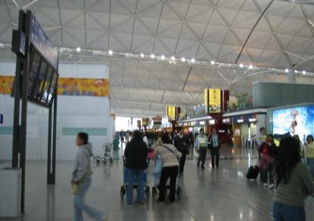
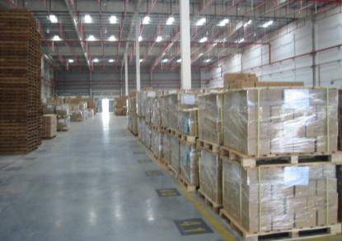
1. Operational Differences between Passengers and Freight Transportation
Read this content
Passengers
Board, get off and transfer without assistance.
Process information and act on it without assistance.
Make choices between transport modes without assistance but often irrationally.
Require travel accommodations related to comfort and safety.
Freight
Must be loaded, unloaded and transferred.
Information must be processed through logistics managers.
Logistics managers meet choices between transport modes rationally.
Require accommodations related to storage.
Notes:
Source: adapted from EU-funded Urban Transport Research Project Results, www.eu-portal.net

Slide 28
1. Main Passengers and Freight Modal Options
Passengers
Freight
Air
Road
Rail
Maritime
Air
Truck
Rail
Maritime
Inland / Coastal
Pipeline
Scheduled
Car
Intercity
Ferry
Package
Package
Unit Train
Break-bulk
River/Sea
Pipeline
Charter
Taxi
HSR
RoRo
Freighter
Less than truckload (LTL)
Carload
Liquid bulk
Tow
Oil
High Speed
Bellyhold
Gas
Van/Bus
Transit
Truckload (TL)
Boxcar
RoRo
Tank barge
Water
Cruise
Heavy
Tank car
Deck barge
Motorcycle
Subway
Dry van
Dry bulk
Flat car
Hopper barge
Commuter
Tank
Bicycle
Reefer
Container
Container
LRT
Flatbet
Hopper
Walking
Monorail
Curtainside
Gondola
Reefer
ISO Container
Hopper
Intermodal
Reefer
Read this content
Open top
TOFC
Flatrack
Read this content
Chassis
Domestic
Tank
Notes:
Source: adapted from W.J. DeWitt. Freight Transport & Modes in Global Logistics & Supply Chains.

Slide 29
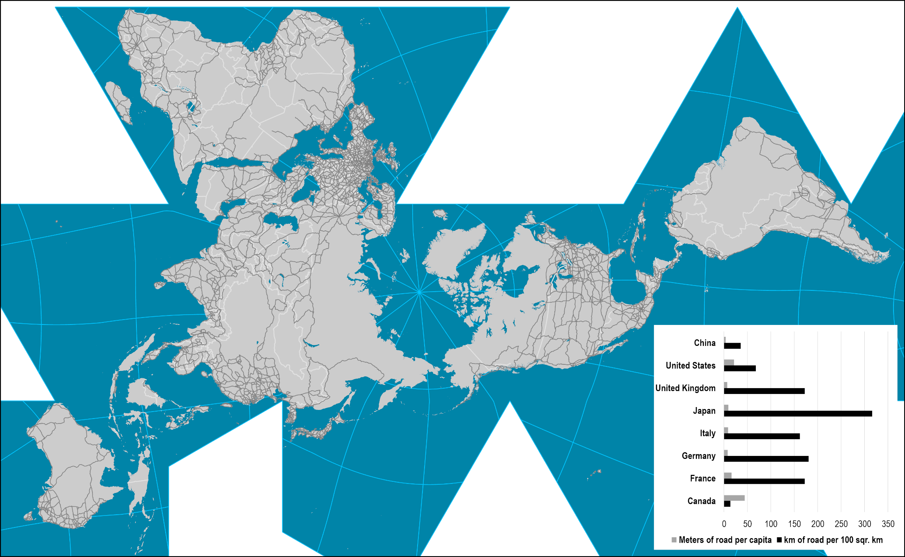
2. World Road Network
Read this content

Slide 30
Length of the Interstate Highway System and of the Chinese Expressway System, 1959-2018 (in km)
Read this content
Notes:
Includes Puerto Rico
Source: Federal Highway Administration. http://www.fhwa.dot.gov/policyinformation/index.cfm
National Bureau of Statistics of China, http://www.stats.gov.cn/english/statisticaldata/yearlydata

Slide 31
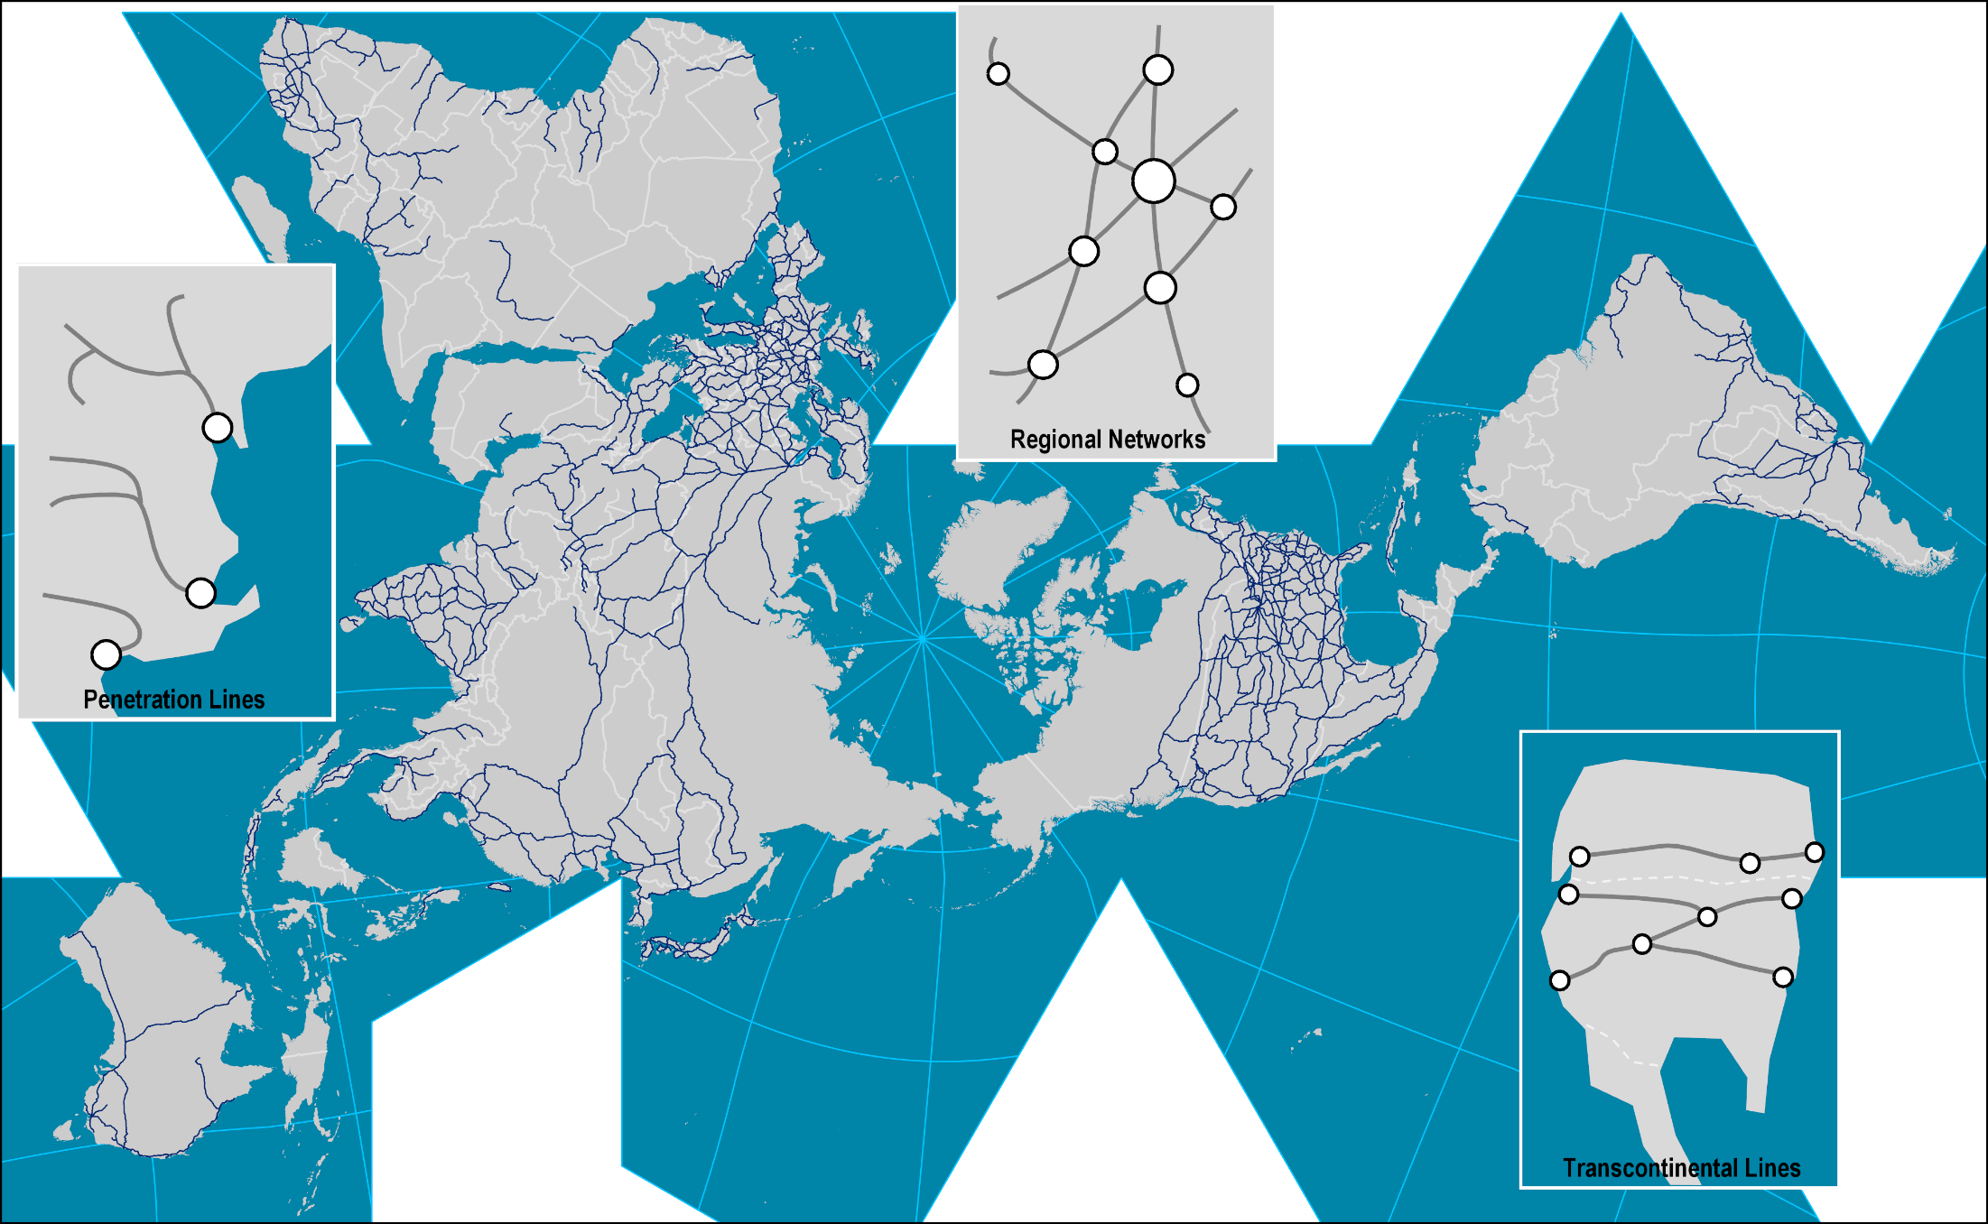
2. World Rail Network and Rail Systems
Read this content

Slide 32
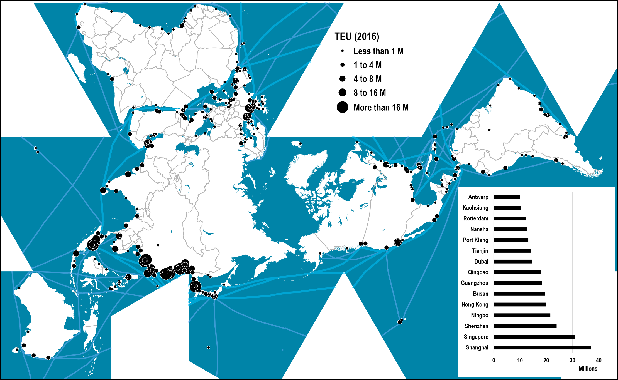
World’s Major Container Ports, 2016
Read this content
Notes:
Source: Adapted from Containerization International, port authorities and port associations.

Slide 33
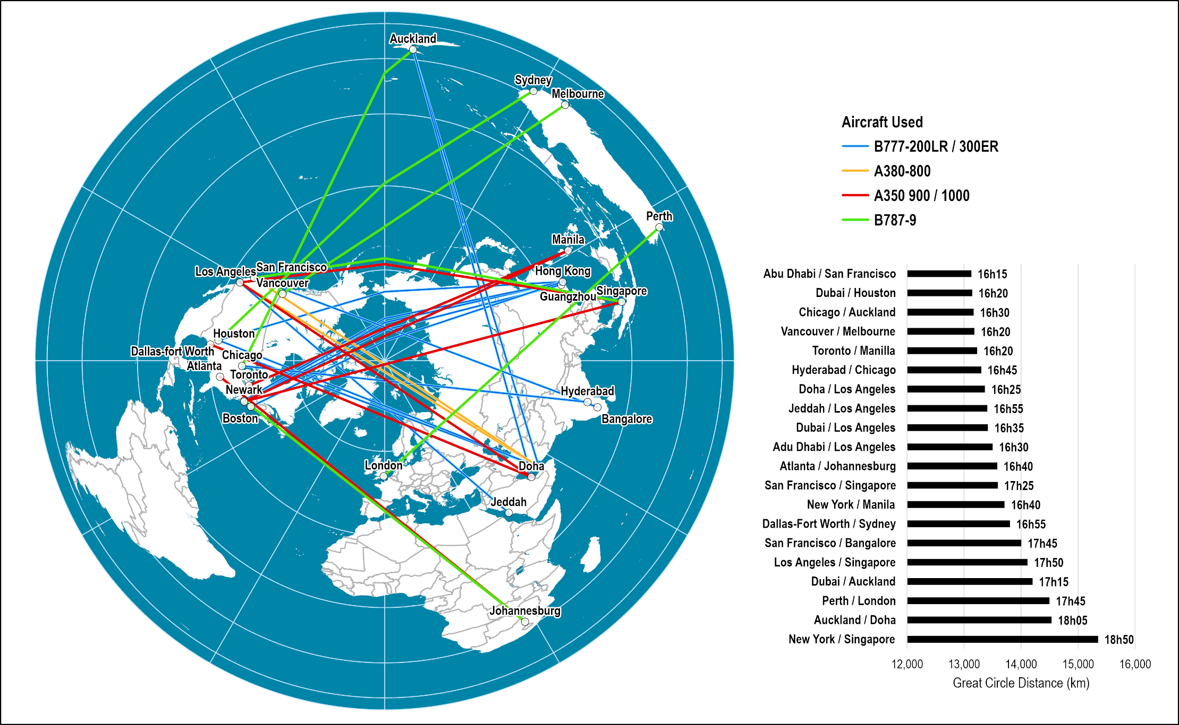
The World's Longest Nonstop Air Transport Routes, 2021
Read this content
Notes:
Map location: air_transport

Slide 34
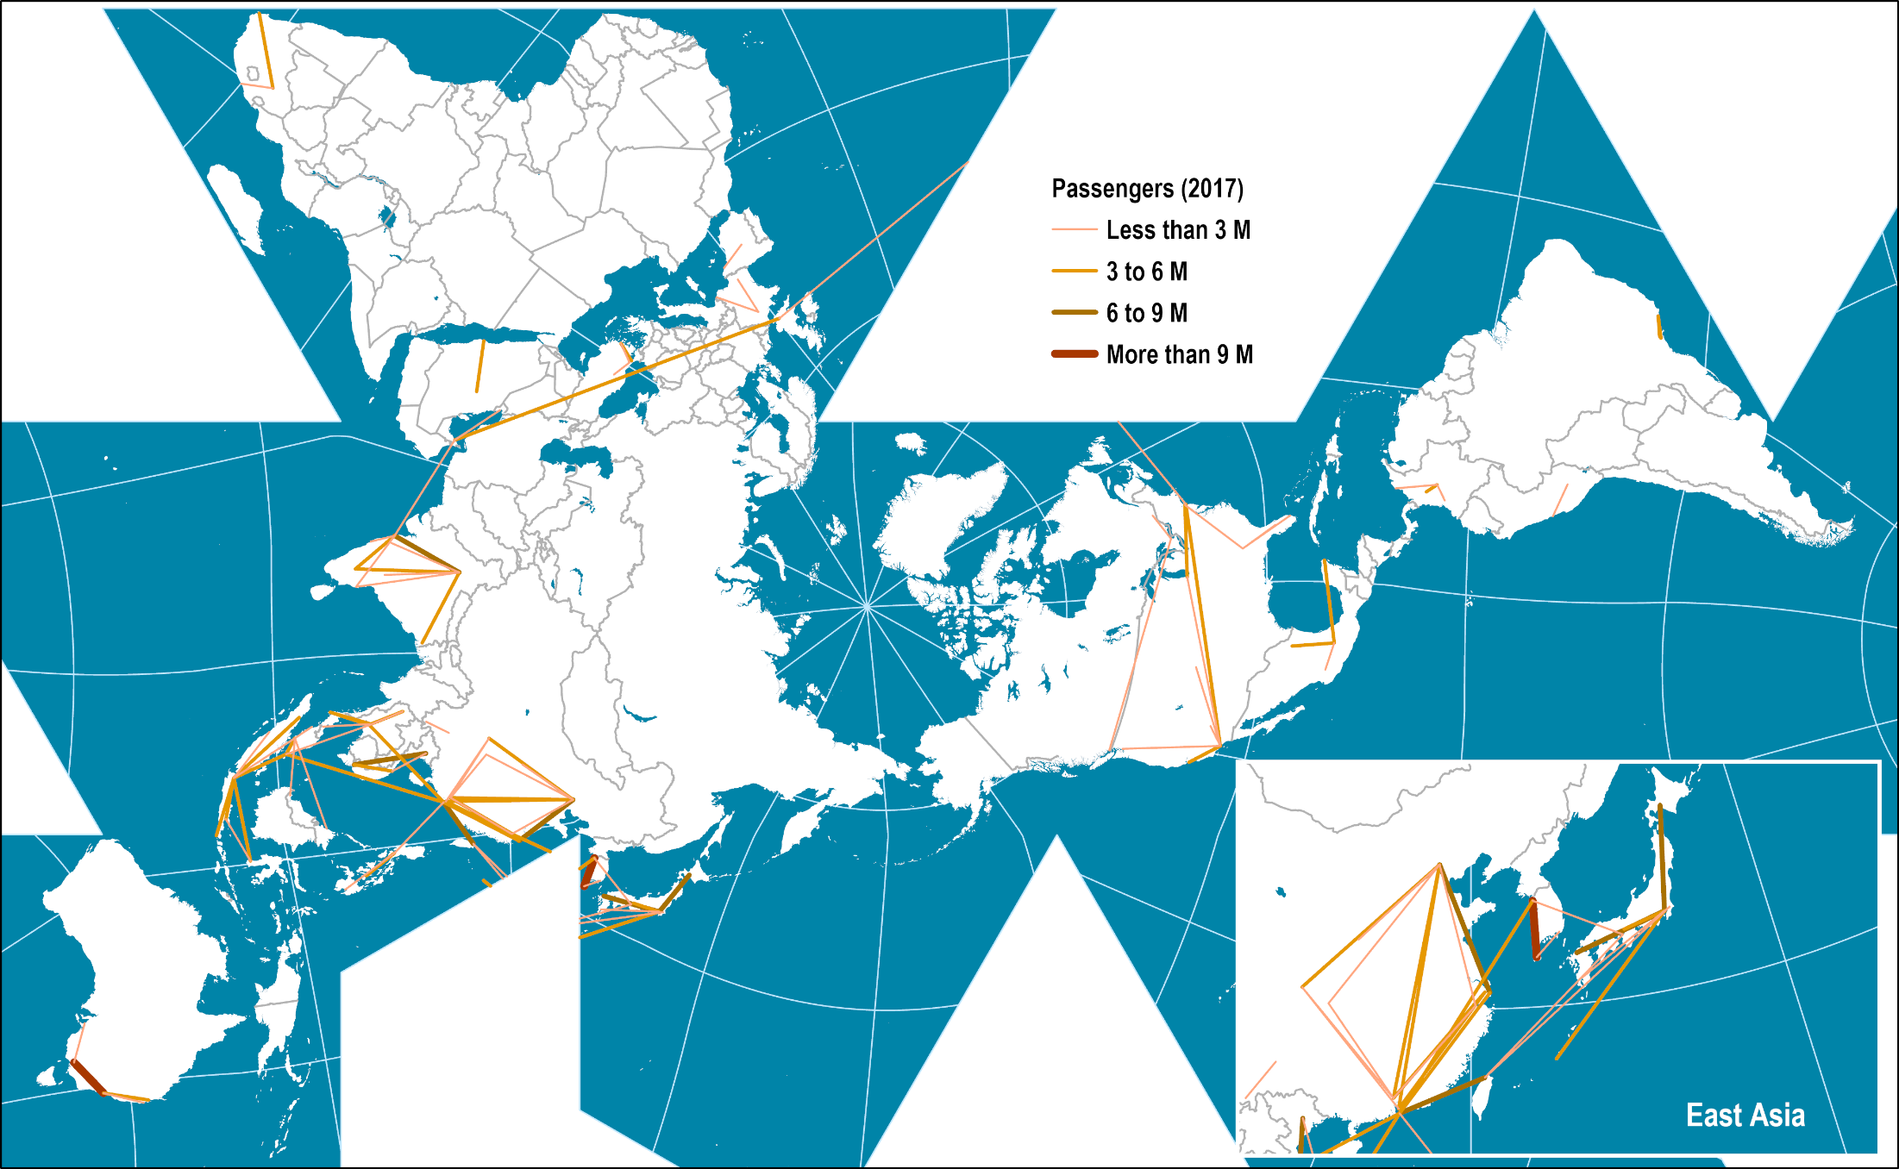
The World's Busiest Air Transport Routes, 2017
Read this content
Notes:
Source: Amadeus.

Slide 35
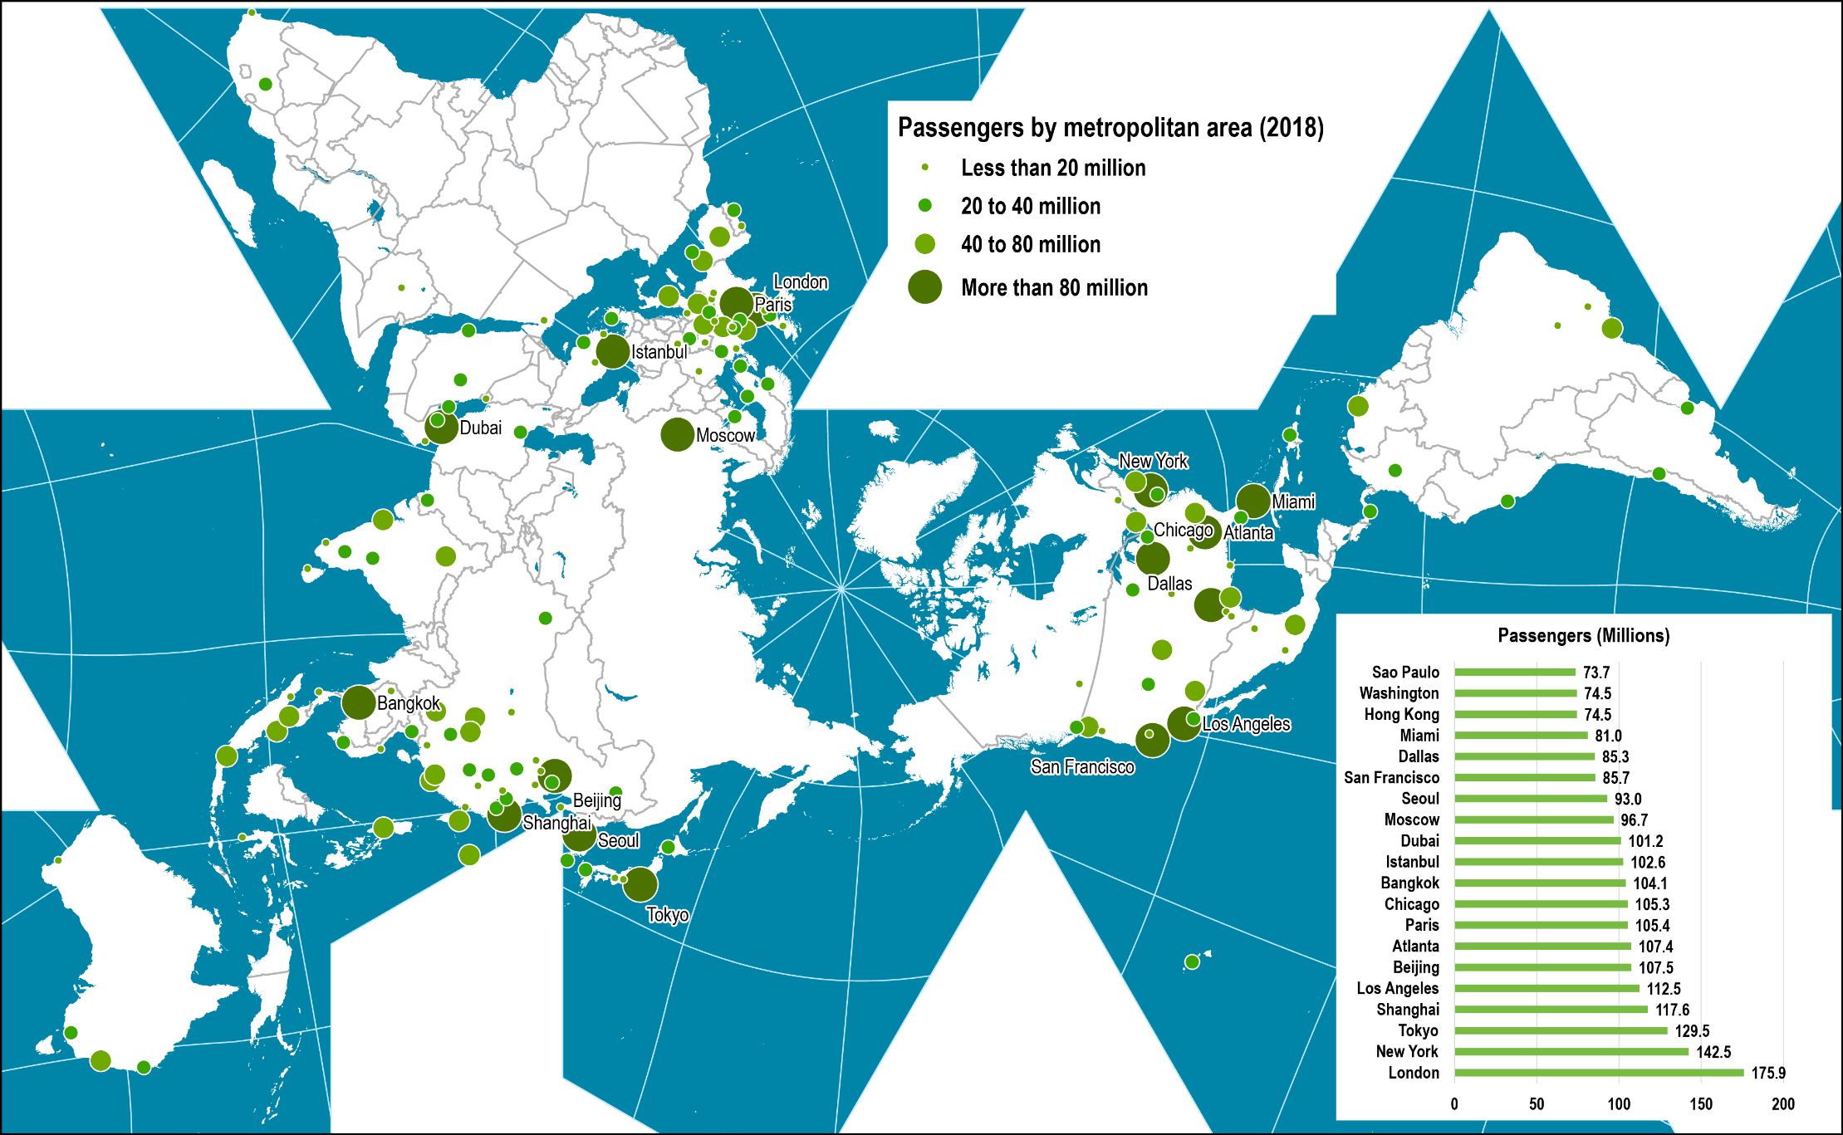
Airport Passenger Traffic by Metropolitan Area, 2018
Read this content
Notes:
Source: Airports Council International, http://www.airports.org
Note: Includes airports with an annual volume above 4 million passengers
Map location: airport_terminals

Slide 36
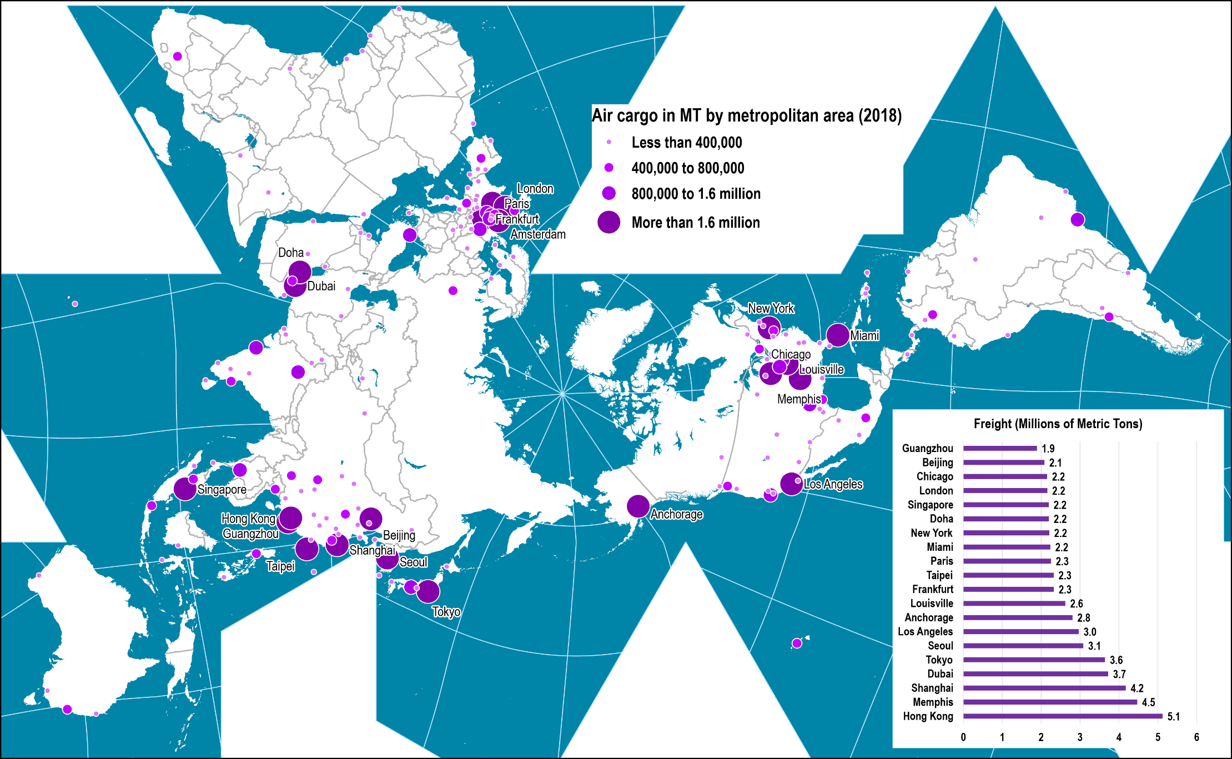
Air Cargo Traffic by Metropolitan Area, 2018
Read this content
Notes:
Source: Airports Council International, http://www.airports.org
Note: Includes airports with an annual cargo volume above 25,000 metric tons
Map location: airport_terminals

Slide 37
Diffusion of Telecommunication Services, 1985-2021
Read this content
Notes:
Source: International Telecommunication Union. http://www.itu.int/en/ITU-D/Statistics/Pages/stat/default.aspx

Slide 38
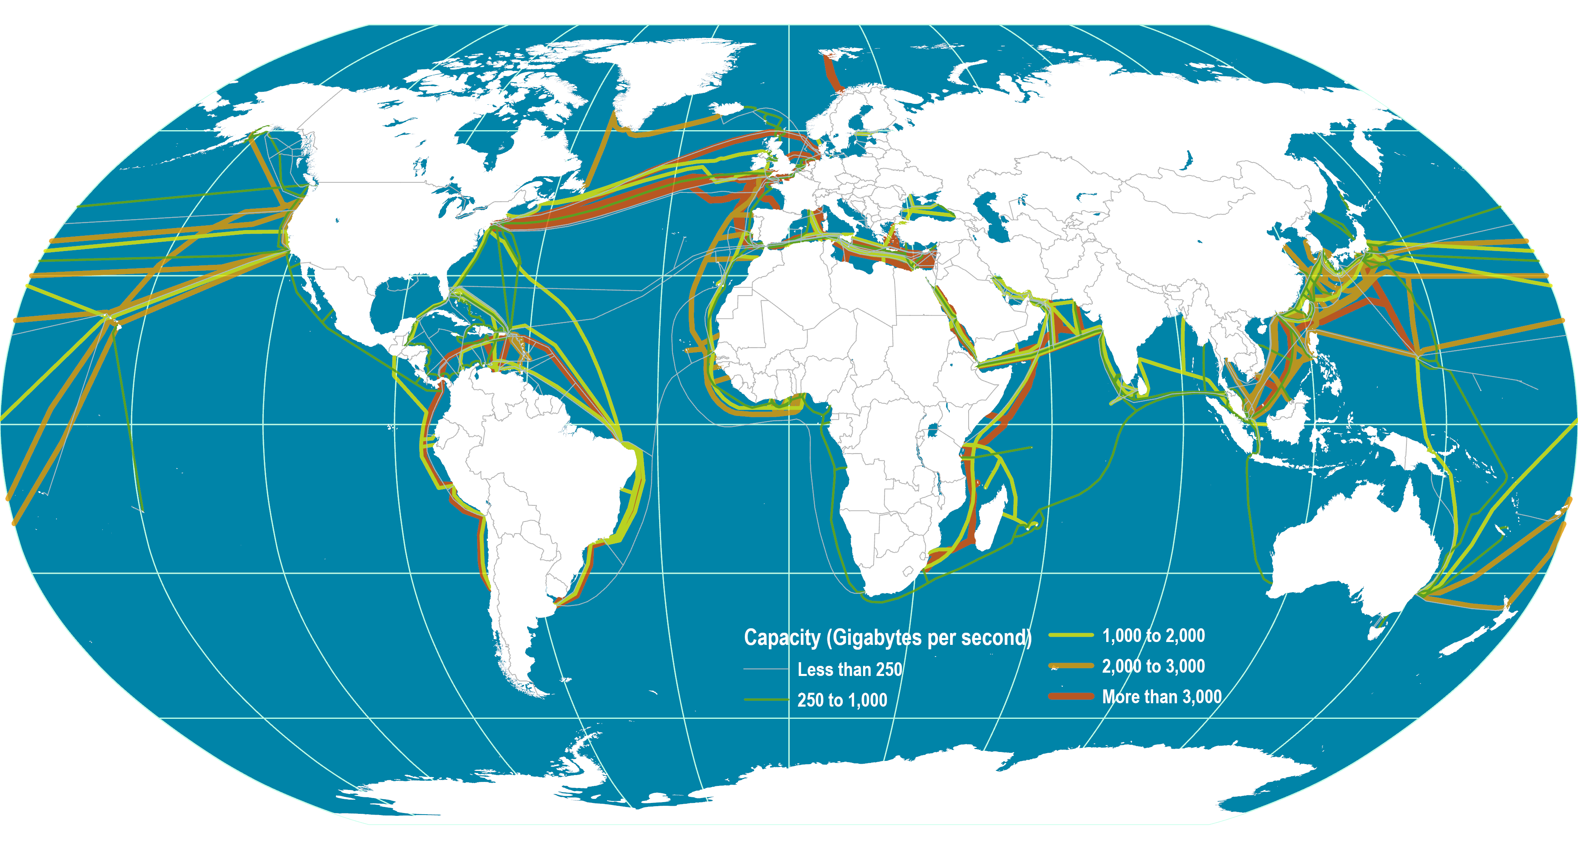
Global Submarine Cable Network
Read this content
Notes:
Source: Dataset encoded by Greg Mahlknecht, http://www.cablemap.info/

Slide 39
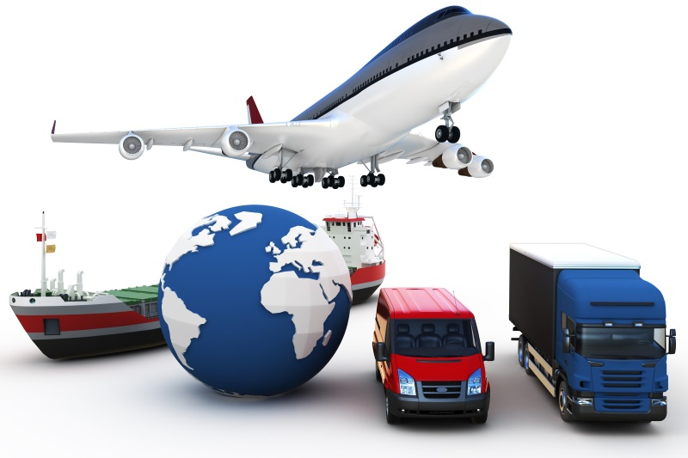
Essay: Transportation Systems
What the maps depicted in this section reveal about the global transport system?

