Slide 1
Topic 8 – Location of Services
A – The Emergence of a Service Economy
B – Labor Markets in the Service Economy
C – Service Sectors
Notes:
Source: Frederick P. Stutz and Barney Warf (2012) The World Economy: Resources, Location, Trade, and Development, 6th Edition. Prentice Hall, Saddle River, NJ.

Slide 2
Conditions of Usage
For personal and classroom use only
  Excludes any other forms of communication such as conference presentations, published reports and papers.
No modification and redistribution permitted
  Cannot be published, in whole or in part, in any form (printed or electronic) and on any media without consent.
Citation
  Dr. Jean-Paul Rodrigue, Dept. of Global Studies & Geography, Hofstra University.

Slide 3
A – The Emergence of a Service Economy
Defining Services
Factors Driving the Growth of Services
Market Areas and World Cities

Slide 4
1. Defining Services
A structural shift
  Changing division of labor.
  Post-industrial era associated with significant growth of service employment.
  Referred to as the tertiary sector.
  The provision of intangible goods; no goods are produced.
  A wide diversity of occupations and industries:
    Difficult to define services because of the wide variety of dimensions involved.
    Linked with more advanced economies.
    80% of employment in the United States.
    90% of job creation.

Slide 5
1. Defining Services
What are the main characteristics of a service?
Intangibility
  Services are not tangible.
  Users have difficulty understanding and evaluating services.
Inseparability
  The consumer must often be physically present.
  The consumer is the co-producer of the service.
Variability
  Quality and quantity of service may vary in time.
Perishability
  A service cannot be stored.
  Supply must match closely with the demand.
Heterogeneity
  Uneven demand and standards.
  Provide incentives to ‘off peak’ use.
Lack of ownership
  Fundamental difference between goods and services.
  A service is often ‘rented time’.

Slide 6
1. Types of Services
Production and consumption of intangible inputs and outputs
  Some services have tangible input and outputs (e.g. restoration).
  Almost all services require infrastructure (e.g. transportation).
Service industries
  Relate to a service economic sector (e.g. FIRE; Finance, Insurance, Real Estate).
  Employment figures are measured by industries.
Service occupations
  A service occupation in any economic sector.
Service functions
  How services are delivered to their consumers.
  Face to face; telecommunications.

Slide 7
1. Types of Services
Producer services
Finance, insurance and real estate (FIRE). Business services (legal, accounting, advertising).
Transportation and communication
Mobility of passengers, freight and information.
Wholesale and retail
Intermediaries between producer and consumers.
Support business and people to conduct their activities.
Notes:
Producer services: Services that help a business conduct its activities. Producer services are intermediate inputs to further production activities that are sold to other firms, although households are also important consumers in some cases.

Slide 8
1. Types of Services
What are the main service sectors?
Consumer services
Linked with population location, density and income. Restoration, personal services, entertainment, tourism.
Public services
Provision of public services (civil servants, military, police, education, healthcare).
Non-profit
Various charities, churches, museums, NGOs.

Slide 9
2. Factors Driving the Growth of Services
Rising incomes
Multiplying effects on the demand of services.
High elasticity for some services (entertainment, transportation, healthcare, fast food).
Demand for health care and education
Change in demographic composition (life expectancy).
Sophistication of the labor market (higher education).
Complex division of labor
Dealing with complex market and regulatory environment.
The collection and analysis of information.

Slide 10
Income Elasticity and Demand per Economic Sector
Quantity
Services
Manufacturing
Primary
Income per Capita

Slide 11
2. Factors Driving the Growth of Services
What are the main factors that favored the growth of the service sectors?
Growth of the public sector
Expansion of government employment.
Provision of public services and infrastructure.
Service exports
Locations export entertainment, financial, legal and marketing services to other locations (e.g. call centers).
20% of international trade includes services.
Externalization processes
Outsourcing of the service activity outside the corporate unit.
More cost effective to buy the service than produce it “in-house”.

Slide 12
2. Externalization Processes in the Producer Services
Transaction Costs
  Using an external service provider may be cheaper.
  No need for full time employees (+ benefits).
  Providers may be able to provide economies of scale.
Flexibility
  Use when required.
  Cope with instability and seasonality.
Risk Reduction
  Transferred to the subcontractor.
Concentration on core skills
  Acquisition of expertise that cannot be provided internally.

Slide 13
2. Externalization Processes in the Producer Services
Four pathways to the international trade of services
  Cross border supply:
    No movement of either buyer or supplier across border.
    Requires the transmission of information or goods.
    Digital downloads and international e-commerce.
  Consumption abroad:
    Purchaser goes across border to get service.
    Highly specialized services (e.g. healthcare).
    Tourism.
  Commercial presence:
    Supply services through cross-border affiliates.
    Opening stores or offices in a foreign country.
  Flow of service workers:
    Labor moves to place of consumption to provide the service.
    Consulting services.
    Guest workers (construction and agriculture).

Slide 14
3. The Spatial Setting of Market Areas
Read this content
Market area
  Surface over which a demand or supply offered at a specific location is expressed.
  Tributary area from which an activity draws its customers.
Market threshold
  Minimum demand necessary to support an economic activity such as a service.
Market range
  The maximum distance each unit of demand is willing to travel to reach a service.
Range
Threshold
3
Market
D(T)
D(R)
1
Distance
Customer
2

Slide 15
Conventional Distance Decay Curves for Retail Activities
Read this content
Department Store / Superstore
Customers
E-commerce
Grocery Store
Convenience Store
Distance

Slide 16
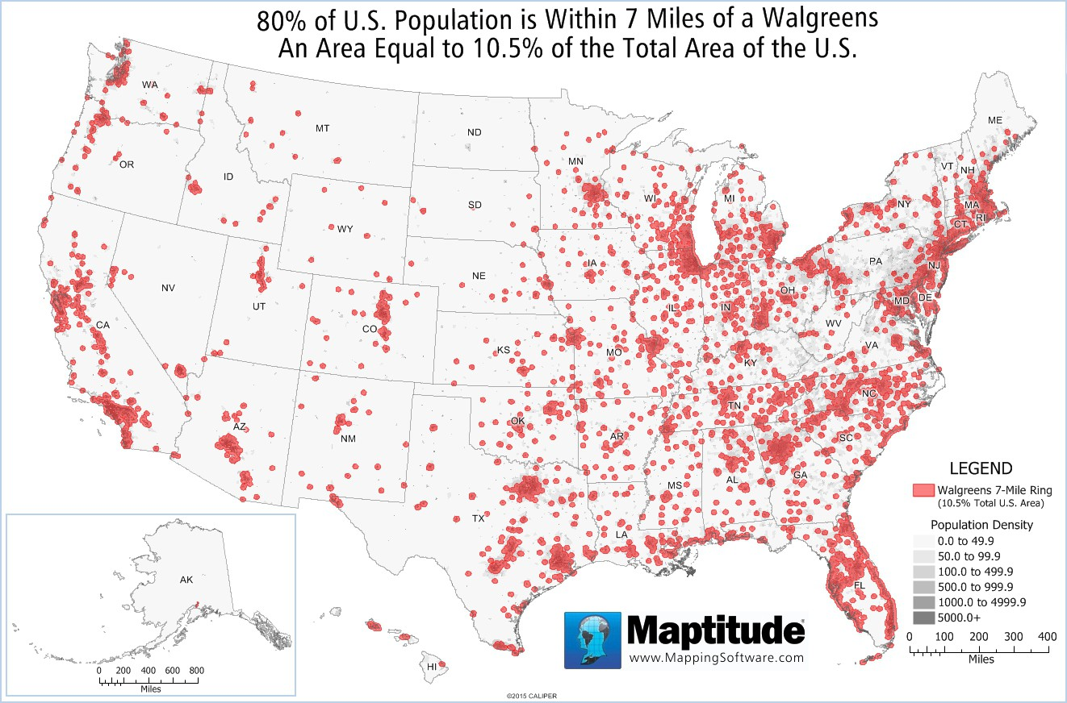

Slide 17
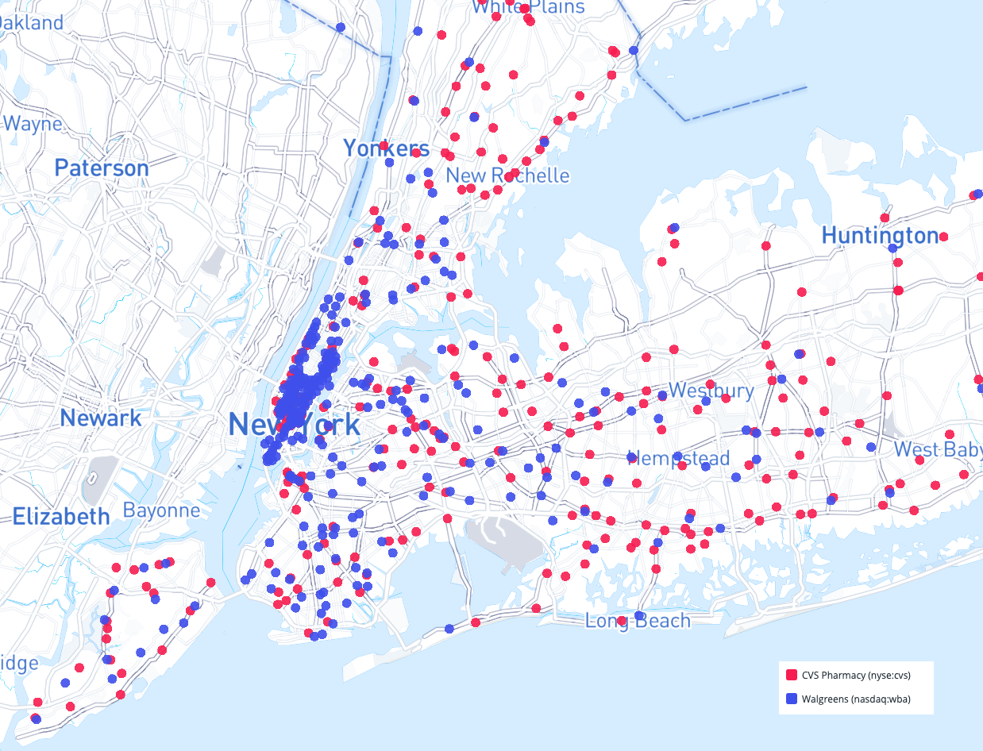

Slide 18
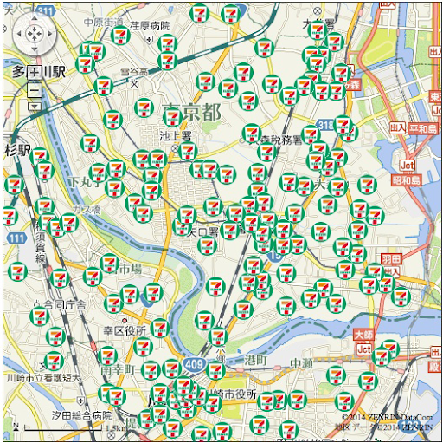
Location of 7 Eleven Convenience Stores, Central Tokyo

Slide 19
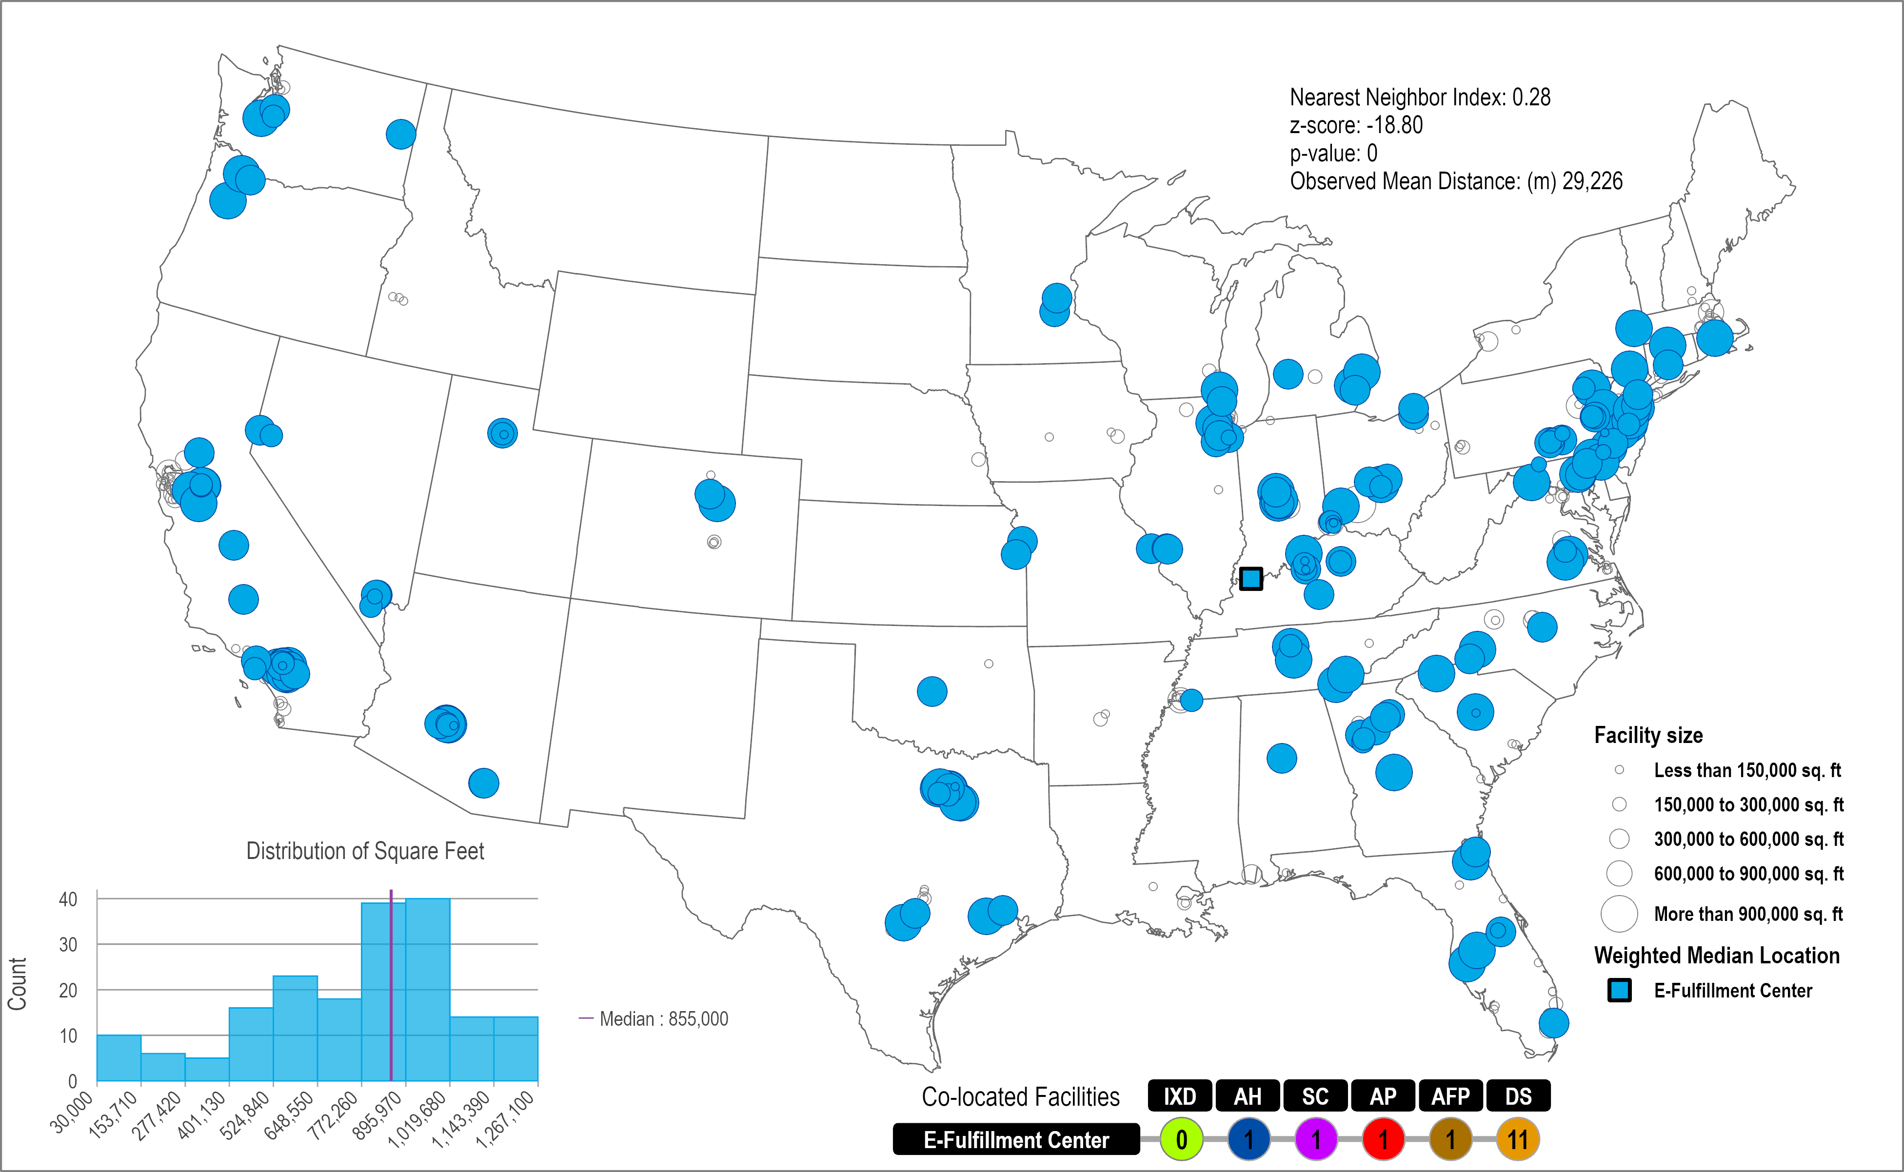
Amazon Fulfillment Centers Network, c2020
187 Facilities
Clustered
Random
0.28

Slide 20
3. The Spatial Setting of Market Areas
Read this content
A
B
C
20 km
10 km
D
E
17 km

Slide 21
3. Central Places Theory
Read this content
B
B
B
B
B
Order
A
A
A
B
C
Market area
B
B
B
B
B
Explain what market areas are and how they can have an impact on the spatial structure.

Slide 22
Non-Isotropic Conditions and the Shape of Market Areas
Read this content
Isotropic Condition
Non-Isotropic Conditions
Modified Market Areas
Low
Average
High
Road
Density

Slide 23
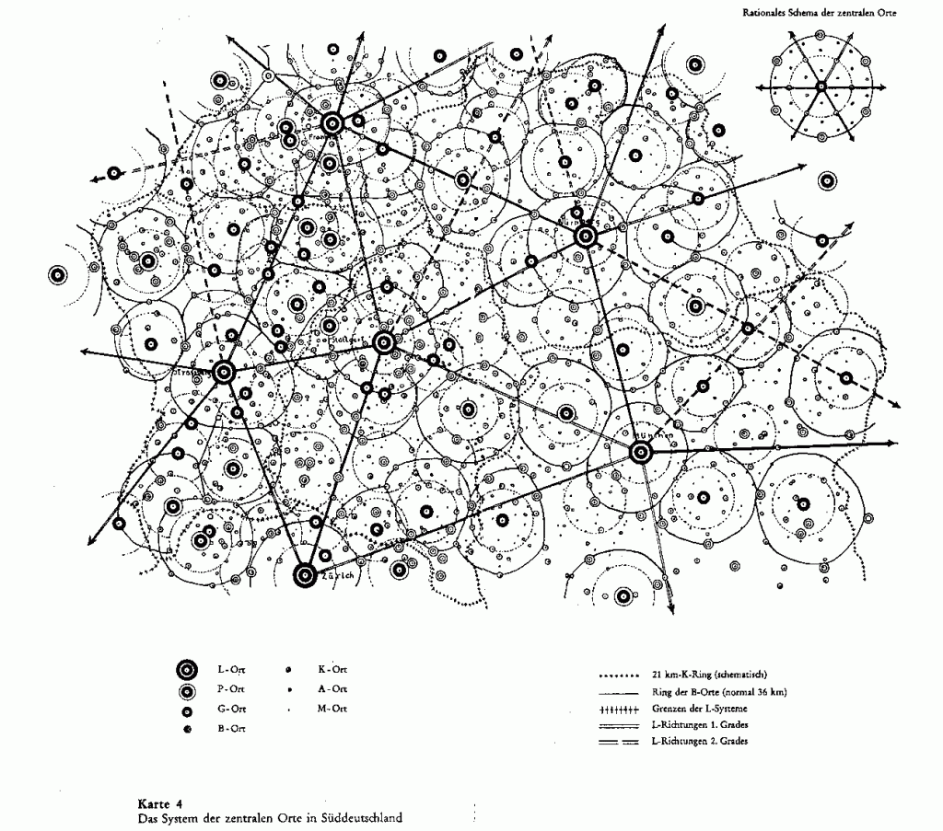
3. Central Places Theory
Frankfurt
Nuremburg
Strasburg
Stuttgart
Munich
Zurich

Slide 24
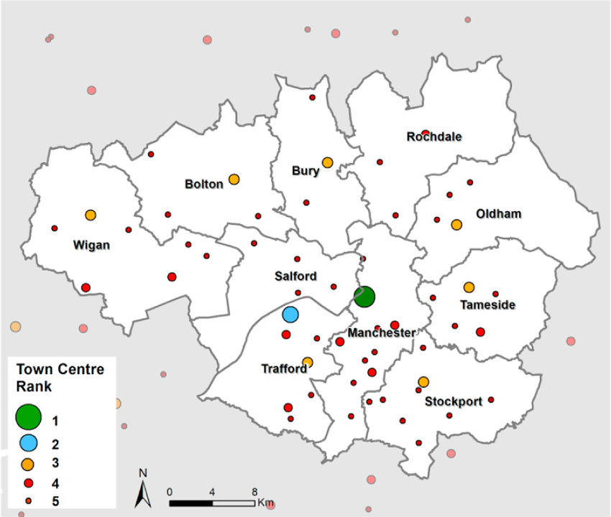
Central Places Distribution in the Manchester Area, UK
Notes:
Source: Dolega, Les & Pavlis, Michalis & Singleton, Alex. (2016). Estimating attractiveness, hierarchy and catchment area extents for a national set of retail centre agglomerations. Journal of Retailing and Consumer Services. 28. 78-90. 10.1016/j.jretconser.2015.08.013.

Slide 25
3. Criteria to be a World City
Business activity | The economic weight of the city; headquarters of major multinational corporations, locations of top business services firms, the value of capital (stock) markets, the number of international conferences, and the flow of goods through ports and airports.
Human capital | Capacity to attract and train talent; size of foreign-born population, quality of universities, number of international schools, international student population, and number of residents with university degrees.
Information exchange | The effectiveness of information flows; accessibility to major TV news channels, internet presence, number of international news bureaus, level of censorship and broadband subscriber rate.
Cultural influence | The cultural weight of the city; number of major sporting events, number of museums, performing-arts venues, culinary establishments, number of international travelers and number of sister-city relationships.
Political engagement | The level of influence on global politics; number of embassies and consulates, major think tanks, international organizations and local institutions with international reach, and the number of political conferences.
Notes:
Source: AT Kearney, 2012 Global Cities Index and Emerging Cities Outlook.

Slide 26
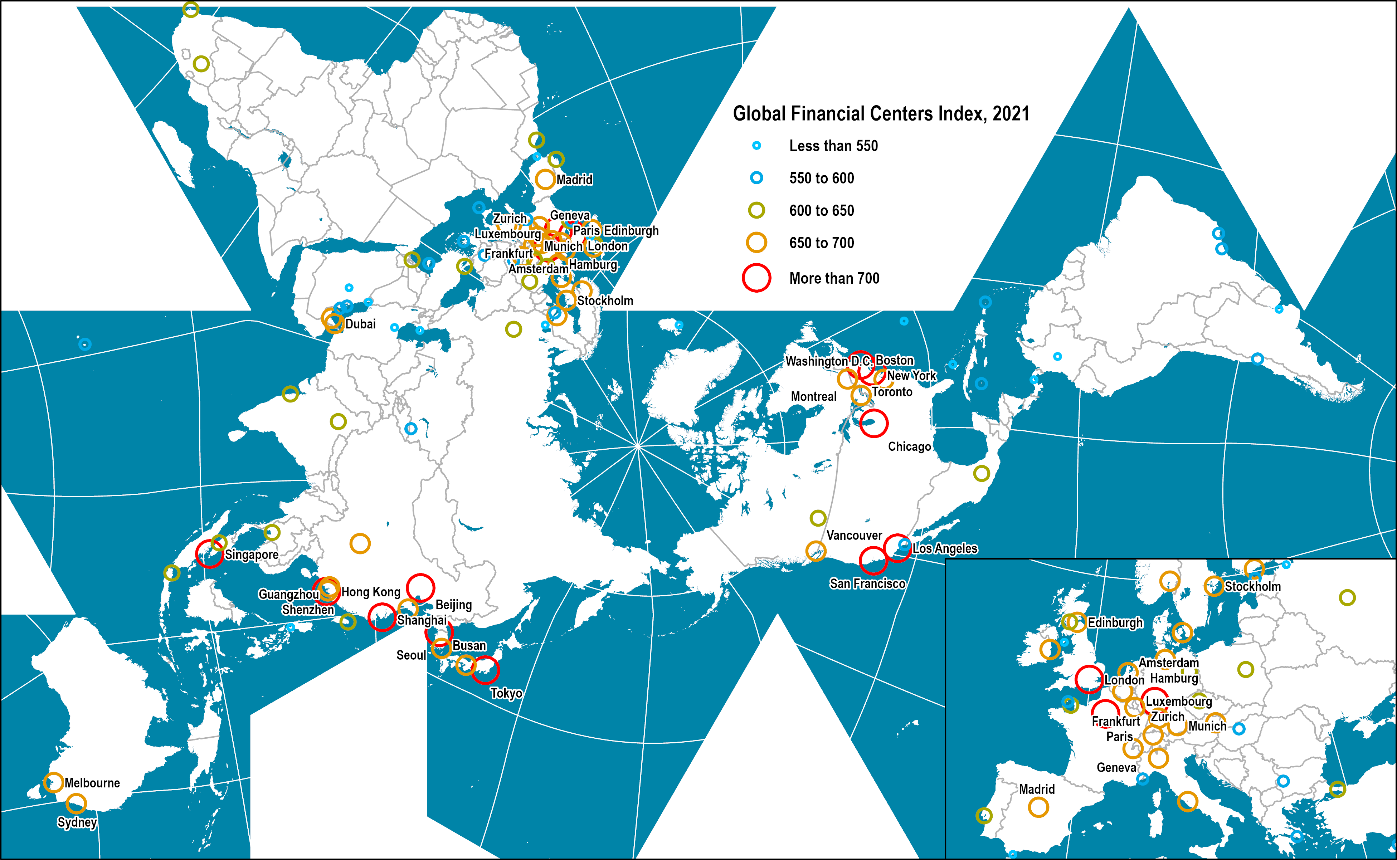
Global Financial Centers, 2021
Read this content
Notes:
Source: Z/Yen Group, Global Financial Centers Index, 2021.
https://www.longfinance.net/programmes/financial-centre-futures/global-financial-centres-index/
Location: world_cities

Slide 27
B – Labor Markets in the Service Economy
Productivity of the Service Sector
Income Distribution
Income Gaps

Slide 28
Productivity of the Service Sector
Are services productive?
  Assumption of low productivity in services compared to manufacturing.
  Difficulties in measuring services productivity:
    Output per unit of input.
    What is the output?
  Routine services vs. complex services.
Productivity constraints
  Personal (human) labor is necessary.
  Co-presence seller and buyers for many services (haircuts).
  Proximity requirements may grant monopolistic power to sellers, restraining productivity.
  Opacity in markets (buyer not knowledgeable about service).
  Relational characteristics of services (human interactions).

Slide 29
Productivity of the Service Sector
IT and Productivity
  Falling costs of IT equipment & software.
  Ubiquity (portable devices).
  The Internet as a medium for services transactions:
    Booking services.
    Paying for services.
    Receiving services.
  Integration of service providers in networks and platforms.
    Allowed innovations in services.
    Some services can be performed remotely.
    Creation of an online marketplace for services.
Explain the challenges of productivity in the service sector.

Slide 30
Productivity of the Service Sector
Labor intensity
  More labor per unit of output.
  The service sector is one of the most sensitive to labor costs:
    70 to 90% of total costs are labor costs in the service sector.
    5 to 40% in manufacturing.
  Changes in labor costs have an immediate impact on the delivery of services.
  Incentives to automate in some sectors (e.g. banking).
  Difficult to mechanize for some sectors (e.g. personal services).

Slide 31
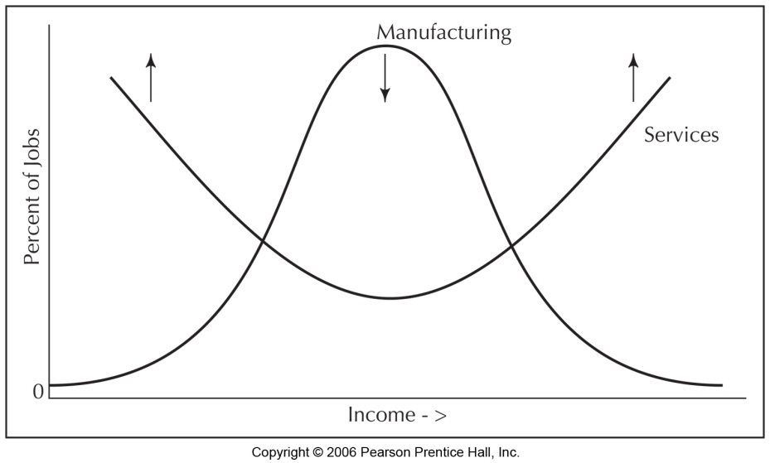
Income Distribution
Income distribution
  Distribution around economic sectors.
  Manufacturing generally associated with a middle class.
  Deindustrialization tends to result in higher levels of income inequality (“McDonaldization”).
  Growth of contingent labor (part time).

Slide 32
Income Distribution
Gender composition
  Manufacturing usually employed males.
  Services permitted a high participation level of females in the work force.
  Notable gender differences by profession (“pink-collar jobs”).
  The two-income paradigm; both parents required to work to maintain living standards.

Slide 33
Occupations by Gender Shares of Employment, United States 2010
Notes:
Source: US Department of Labor. https://www.dol.gov/wb/stats/occ_gender_share_em_1020_txt.htm

Slide 34
Income Distribution
Low unionization
  Decline from 45% in 1950 to 12% in 2010.
  Mostly related to the emergence of services.
Educational input
  Important for many service jobs.
  Income generally proportional to level of education.
  70% of high school graduates attend university.
  Education perceived to be fundamental to a knowledge-based economy.
Provide some of the main characteristics of the contemporary labor market.

Slide 35
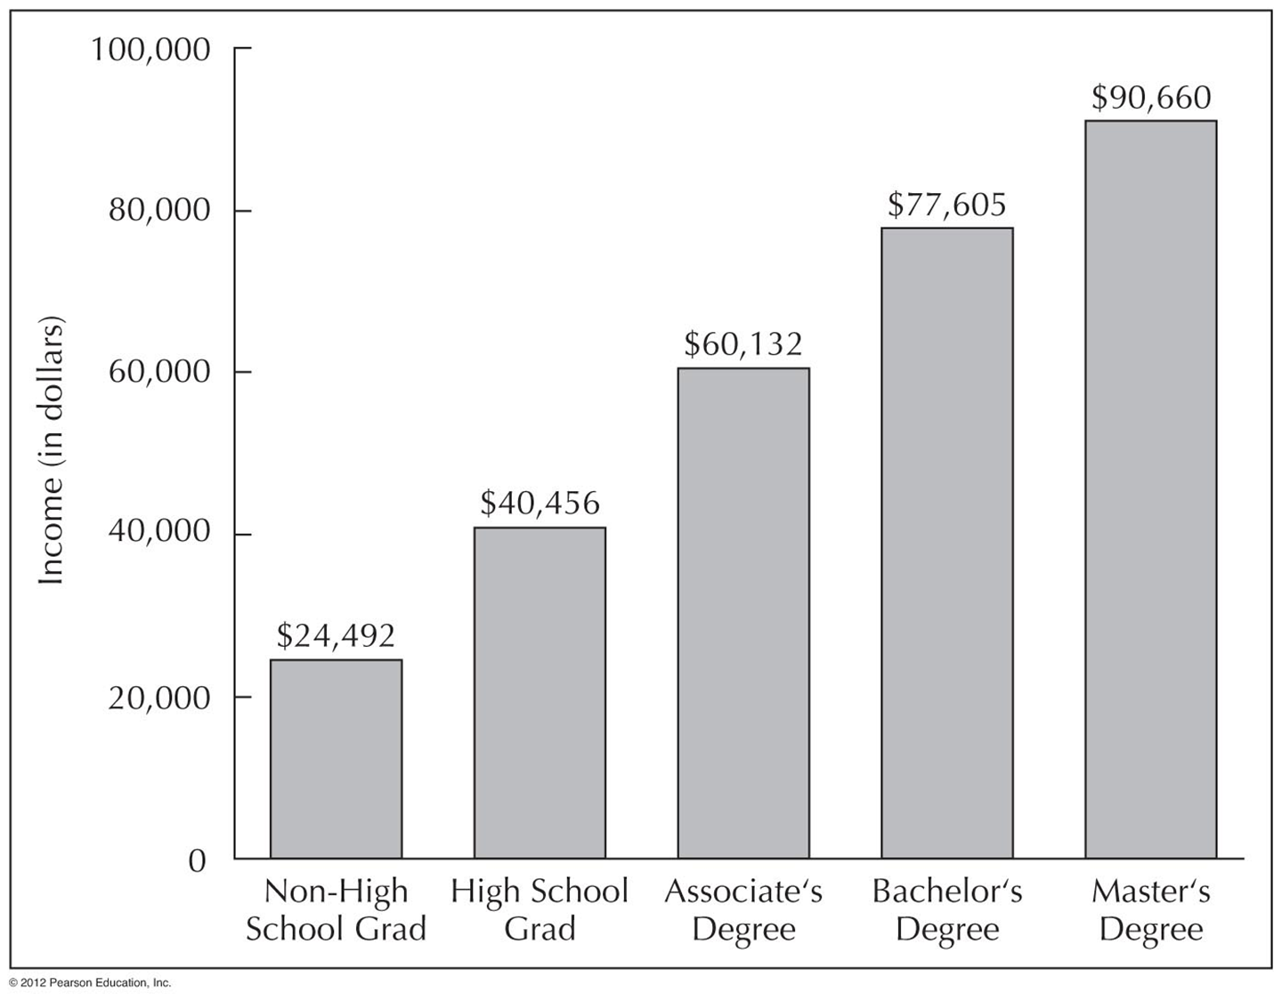
Education Levels & Income
Tendency for College Educated Labor to work
in the Service Economy

Slide 36
C – Service Sectors
Financial Services
Producer Services
Consumer Services

Slide 37
1. Financial Services
Formation of capitalism
  Requires the critical support of finance.
  Credit systems and banking.
  Intermediaries between borrowers and savers.
Commercial banking
  Involved in commercial loans.
  Provide capital for projects (e.g. real estate).
  Retail banking (savings and credit cards).
Investment banking
  Buying and selling securities (e.g. stocks and bonds).
  Expertise for international transactions and foreign exchange.

Slide 38
1. Financial Services
Savings and loans
  Mutually owned.
  Mainly for mortgages.
Insurance
  Commodification of risk.
  Different types of insurance products (property, life).
Sovereign Wealth Funds
  State-owned capital pools.
  Investments in assets such as stocks, bonds, real estate or private equity.
  Usually funded through exports of resources such as oil.
  Stabilize state fiscal revenue and save for future generations.

Slide 39
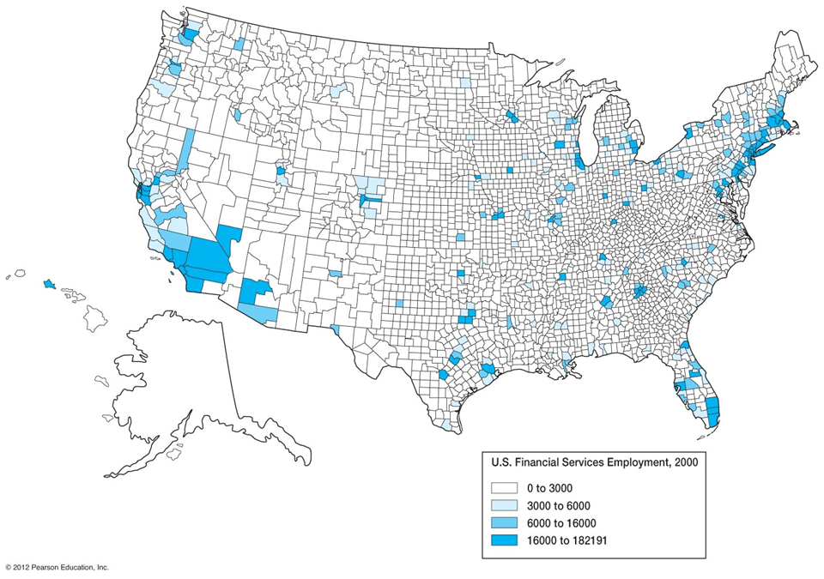
Financial Services Employment in the United States
Concentration
of Banking
Employment
Financial
Regulation
And
Deregulation

Slide 40
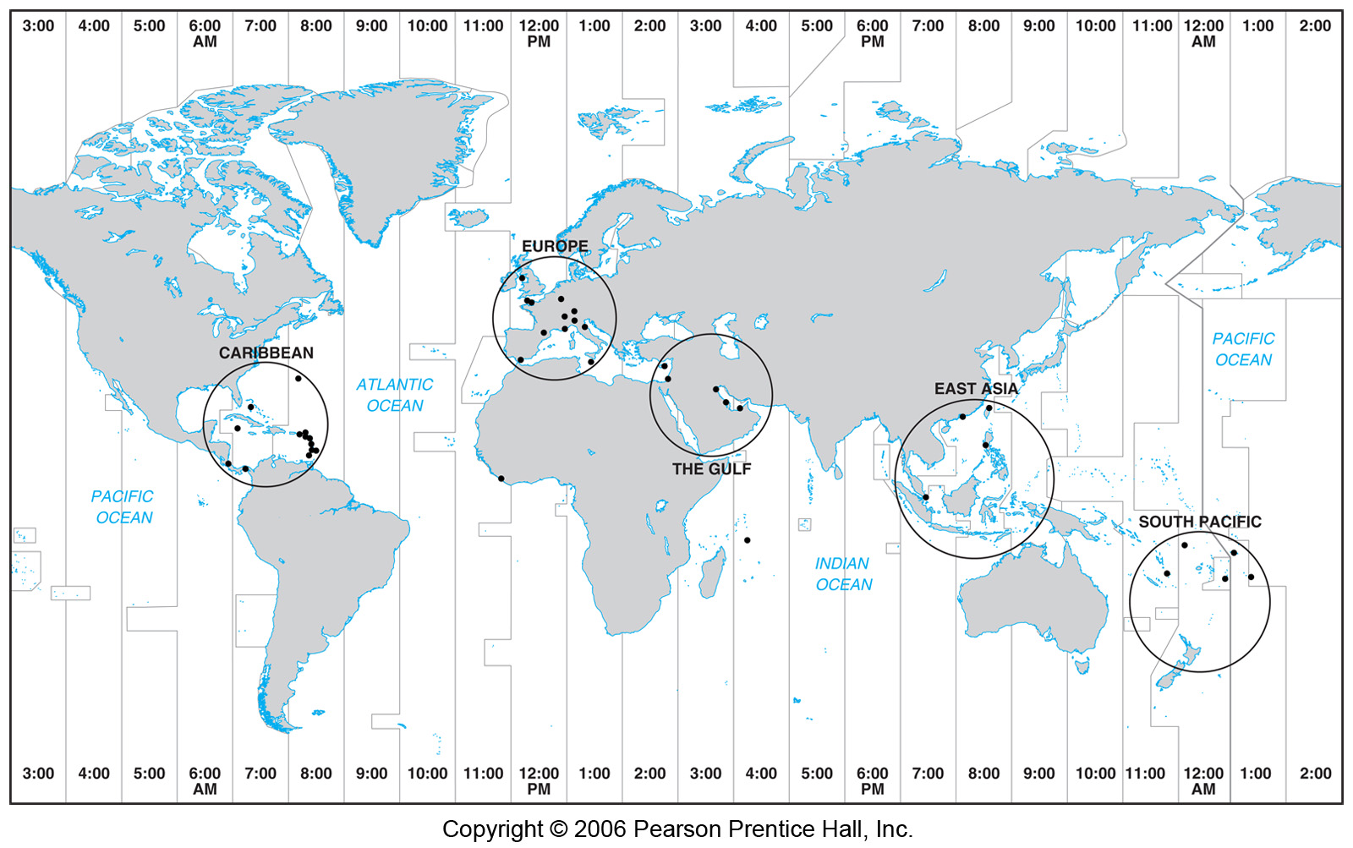
Offshore Banking

Slide 41
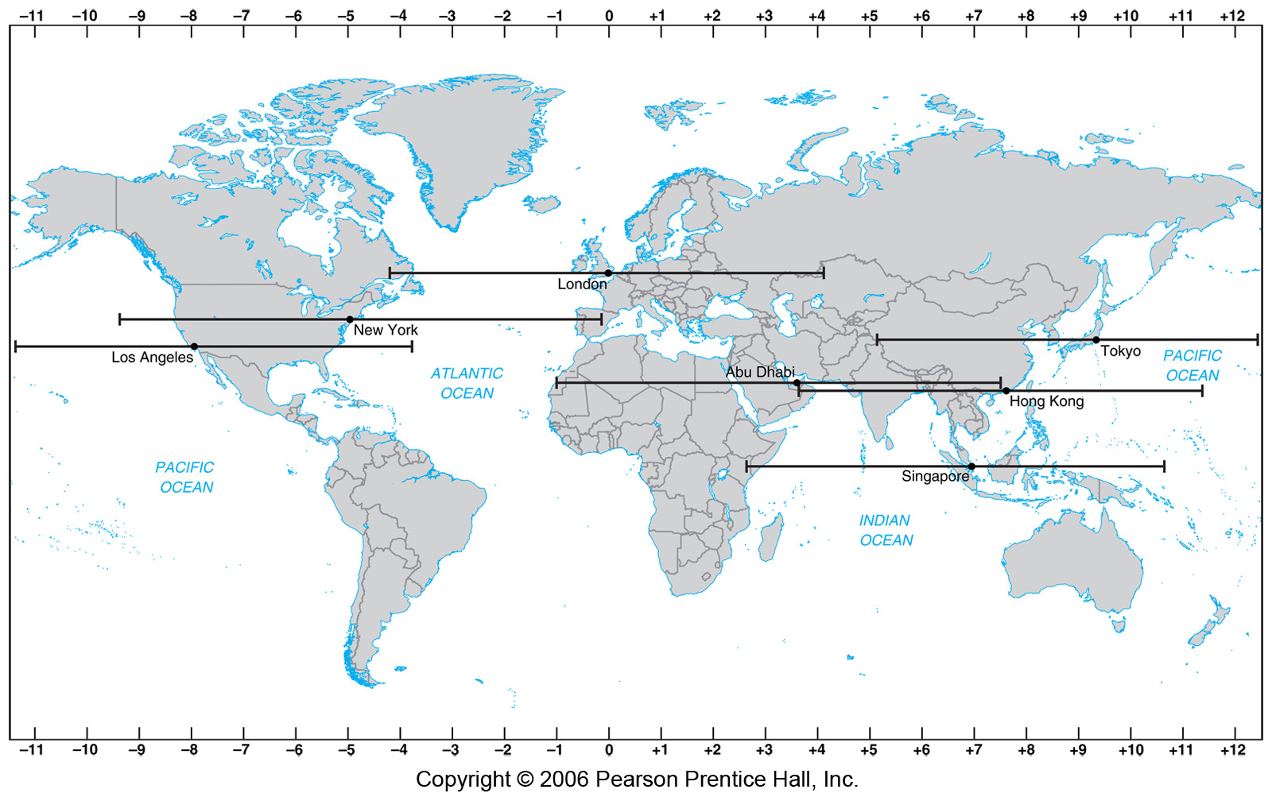
Technological Change & Electronic Funds Transfer

Slide 42
Ten Largest Sovereign Wealth Funds by Assets (2018)
Country | SWF Name | Assets (U.S. $ billions) | Inception | Origin
Norway | Government Pension Fund - Global | 1,035.2 | 1990 | Oil
China | China Investment Corporation | 900.0 | 2007 | Non-commodity
UAE – Abu Dhabi | Abu Dhabi Investment Authority | 828.0 | 1976 | Oil
Kuwait | Kuwait Investment Authority | 524.0 | 1953 | Oil
Saudi-Arabia | SAMA Foreign Holdings | 494.0 | 1952 | Oil
China-Hong Kong | Hong Kong Monetary Authority Investment Portfolio | 456.6 | 1993 | Non-commodity
China | SAFE Investment Company | 441.0 | 1997 | Non-commodity
Singapore | Government of Singapore Investment Corporation | 390.0 | 1981 | Non-commodity
Singapore | Temasek Holdings | 320.8 | 1974 | Non-commodity
Qatar | Qatar Investment Authority | 320.0 | 2005 | Oil & gas
Total top ten SWFs |  | 5,709.6
Other SWFs |  | 2,131.8
Total All SWFs |  | 7,841.4
Notes:
Source: Data compiled from Sovereign Wealth Fund Institute (April 2018). Of the more than $7.8 trillion held by SWFs, over $4.3 trillion was derived from oil and gas revenues and the rest ($3.5 trillion) from other sources.

Slide 43
2. Producer Services
Accounting
  The separation of ownership and control underlined the need for financial auditing.
  Often undertaken by an external firm.
Design and innovation
  Management consulting (improving productivity).
  Design products for marketability and efficiency.
Legal services
  Complexity of laws, negotiations, contracts, patents and regulations.
  Multiple jurisdictions.

Slide 44
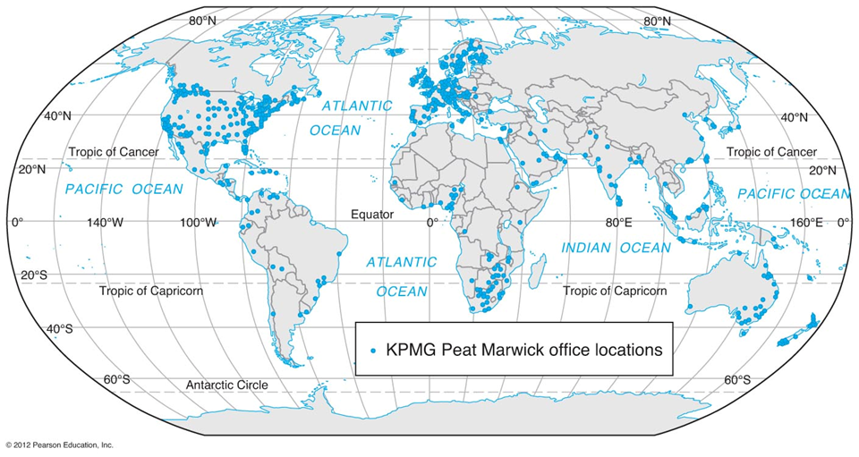
KPMG: A Globalized Service Firm
174,000 employees

Slide 45
3. Consumer Services
The role of the consumer
  Retail, personal services, restoration, tourism, sport, entertainment.
  Traditionally focused on the travel cost for their consumption (market areas).
Tourism
  Very large service industry of global reach.
  Business, personal and mixed trip purposes.
  Close to 1.2 billion arrivals (14% of the global population).
  Medical tourism (see later).
Consumer / store cards
  No interest financing that can only be redeemed for store products (no need for cash reserves against the liability).
  10% of the funds are not redeemed.
  0% interest + breakage - rewards + interchange savings + customer information.
  Starbucks had in 2019 $1.6 billion in stored value card liabilities.

Slide 46
International Tourists Arrivals and Receipts, 1950-2019
Read this content
Notes:
Source: World Tourism Organization.

Slide 47
Monthly International Tourist Arrivals, 2011
Read this content
Notes:
Source: World Tourism Organization.

Slide 48
Share of International Tourist Arrivals by Region, 1950-2015
Read this content
Notes:
Source: World Tourism Organization.

Slide 49
Passport Index, 2011, 2018
Read this content
Notes:
Source: Henley and Partners Holdings, https://www.henleypassportindex.com
The level of visa-free or visa-on-arrival access offered by each country’s passport.

Slide 50
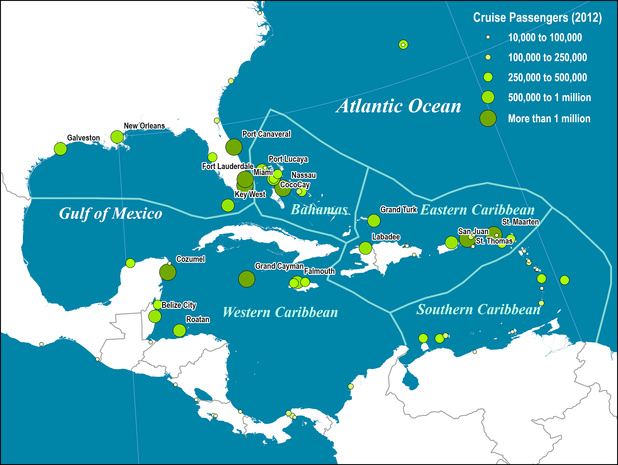
Cruise Passengers Visits, Caribbean, 2012
Read this content
Notes:
Source: data adapted from Cruise Market Watch.

Slide 51
3. Consumer Services
Main medical tourism destinations
  11 million Americans went offshore in 2016 to seek medical services.
  Seeking high quality and affordable healthcare (market failure).
  Cosmetic surgery, dental work, and orthopedic surgery are the most common.
  Some examples:
    India is the top medical tourism destination and can offer services 80% cheaper than in the US.
    Brazil is specializing in cosmetic surgery.
    Mexican border cities have specialized in providing dental services.

Slide 52
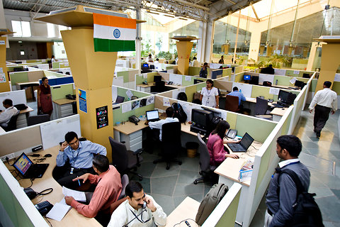
Essay: Globalization and Service Sectors
Explain how globalization is impacting service sectors and provide some examples.

