Slide 1
Topic 6 – Agriculture and Food Production
A – The Agricultural Landscape
B – Systems of Agricultural Production
C – Commercial Agriculture
Notes:
Source: Frederick P. Stutz and Barney Warf (2012) The World Economy: Resources, Location, Trade, and Development, 6th Edition. Prentice Hall, Saddle River, NJ.

Slide 2
Conditions of Usage
For personal and classroom use only
  Excludes any other forms of communication such as conference presentations, published reports and papers.
No modification and redistribution permitted
  Cannot be published, in whole or in part, in any form (printed or electronic) and on any media without consent.
Citation
  Dr. Jean-Paul Rodrigue, Dept. of Global Studies & Geography, Hofstra University.

Slide 3
A – The Agricultural Landscape
The Agricultural Process
Biophysical Conditions
Nutrition Transitions

Slide 4
1. The Agricultural Process
The role of agriculture
  The human activity that consumes the most space.
    About 37% of the world’s land devoted to agriculture.
  Core occupation:
    Historically; 95% of labor.
    Today; 2 to 40% of labor.
    World & Asia: 25 to 35%.
    North America and Europe: 2% to 4%.
    Latin America: 15%.
  Little output per worker up to the industrial revolution.
  Enduring famines.
  Contemporary changes:
    Large surfaces of land have been modified to suit agriculture.
    Food has become a commodity (market-oriented agriculture).
    Mechanization and capital intensiveness.

Slide 5
Share of the Population in Agriculture, Selected Countries
Notes:
Source: Berthold Herrendorf, Richard Rogerson and Akos Valentinyi (2014) – “Growth and Structural Transformation” Handbook of Economic Growth Vol. 2B.
World Bank, World Development Indicator,

Slide 6
Estimated Famine Victims since the Mid 19th Century
India and China
Read this content
WWII
Maoist Famines
China and Soviet Union
Sudan
Uganda
Cambodia
North Korea
Congo
Ethiopia
Somalia
Notes:
Source: Our World Data.
https://ourworldindata.org/famines#the-our-world-in-data-dataset-of-famines

Slide 7
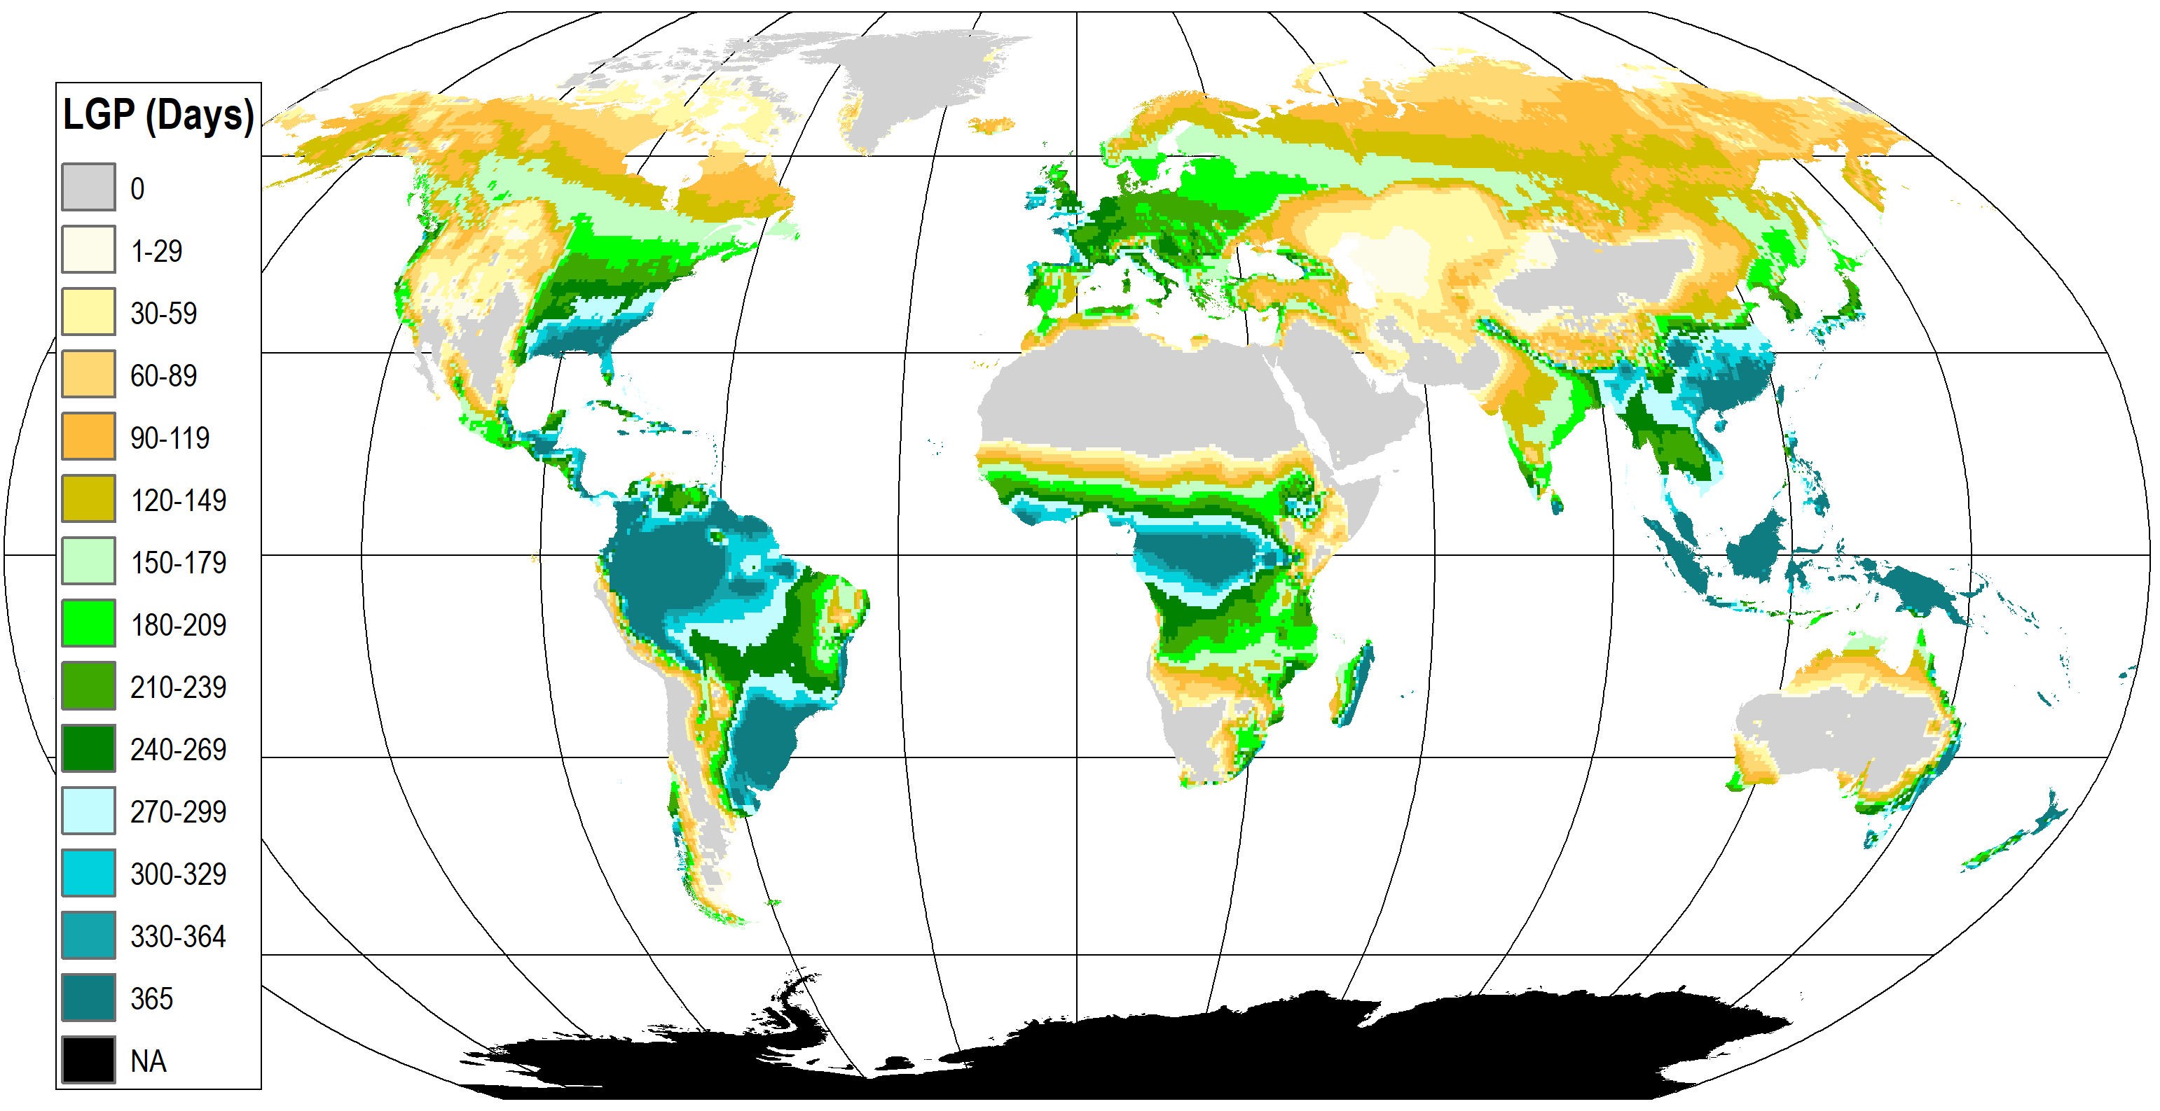
2. Length of Growing Period (LGP)
Read this content
Combines temperature and moisture considerations to determine the length of time crops are able to grow.
Number of days with temperatures above 5°C.
Excluding periods which are too cold or too dry or both.
Under rain-fed conditions.

Slide 8
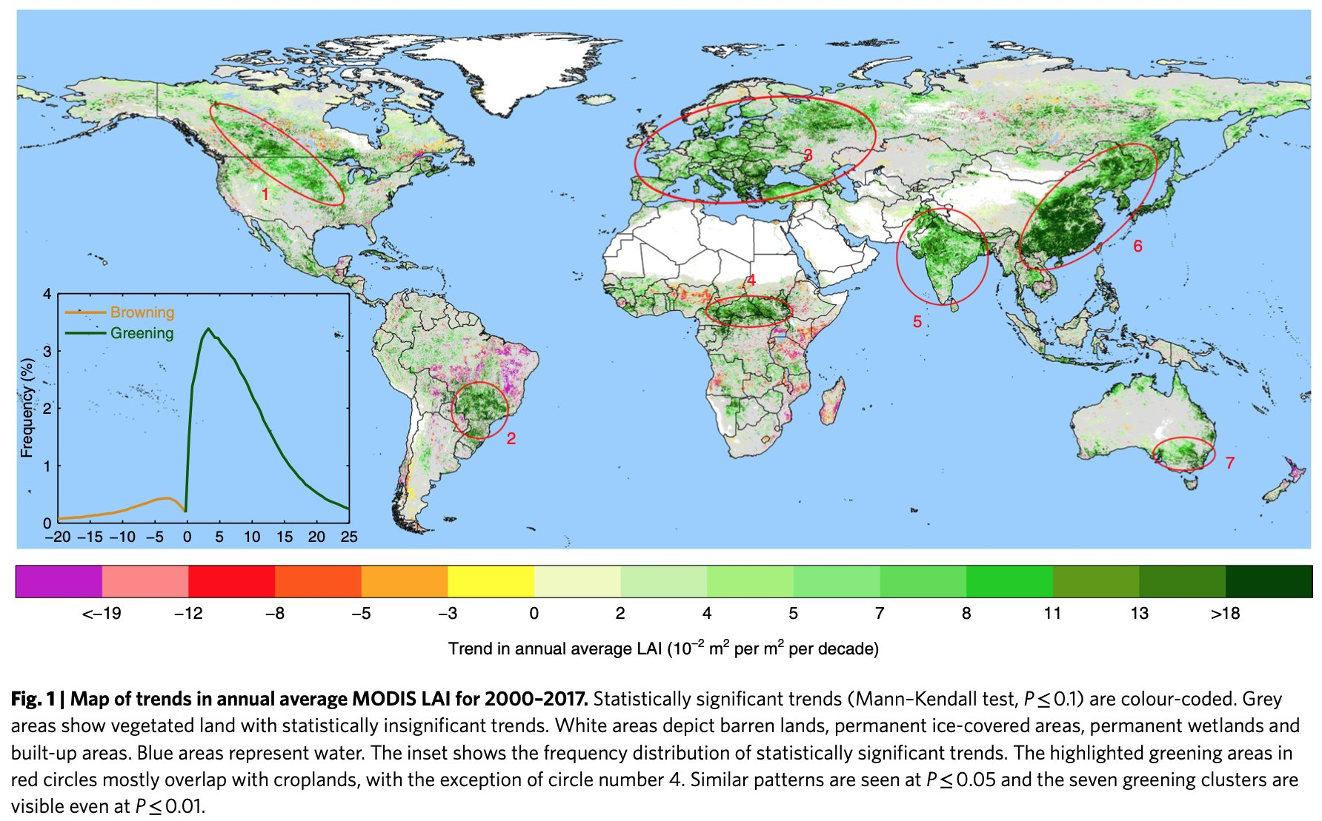

Slide 9
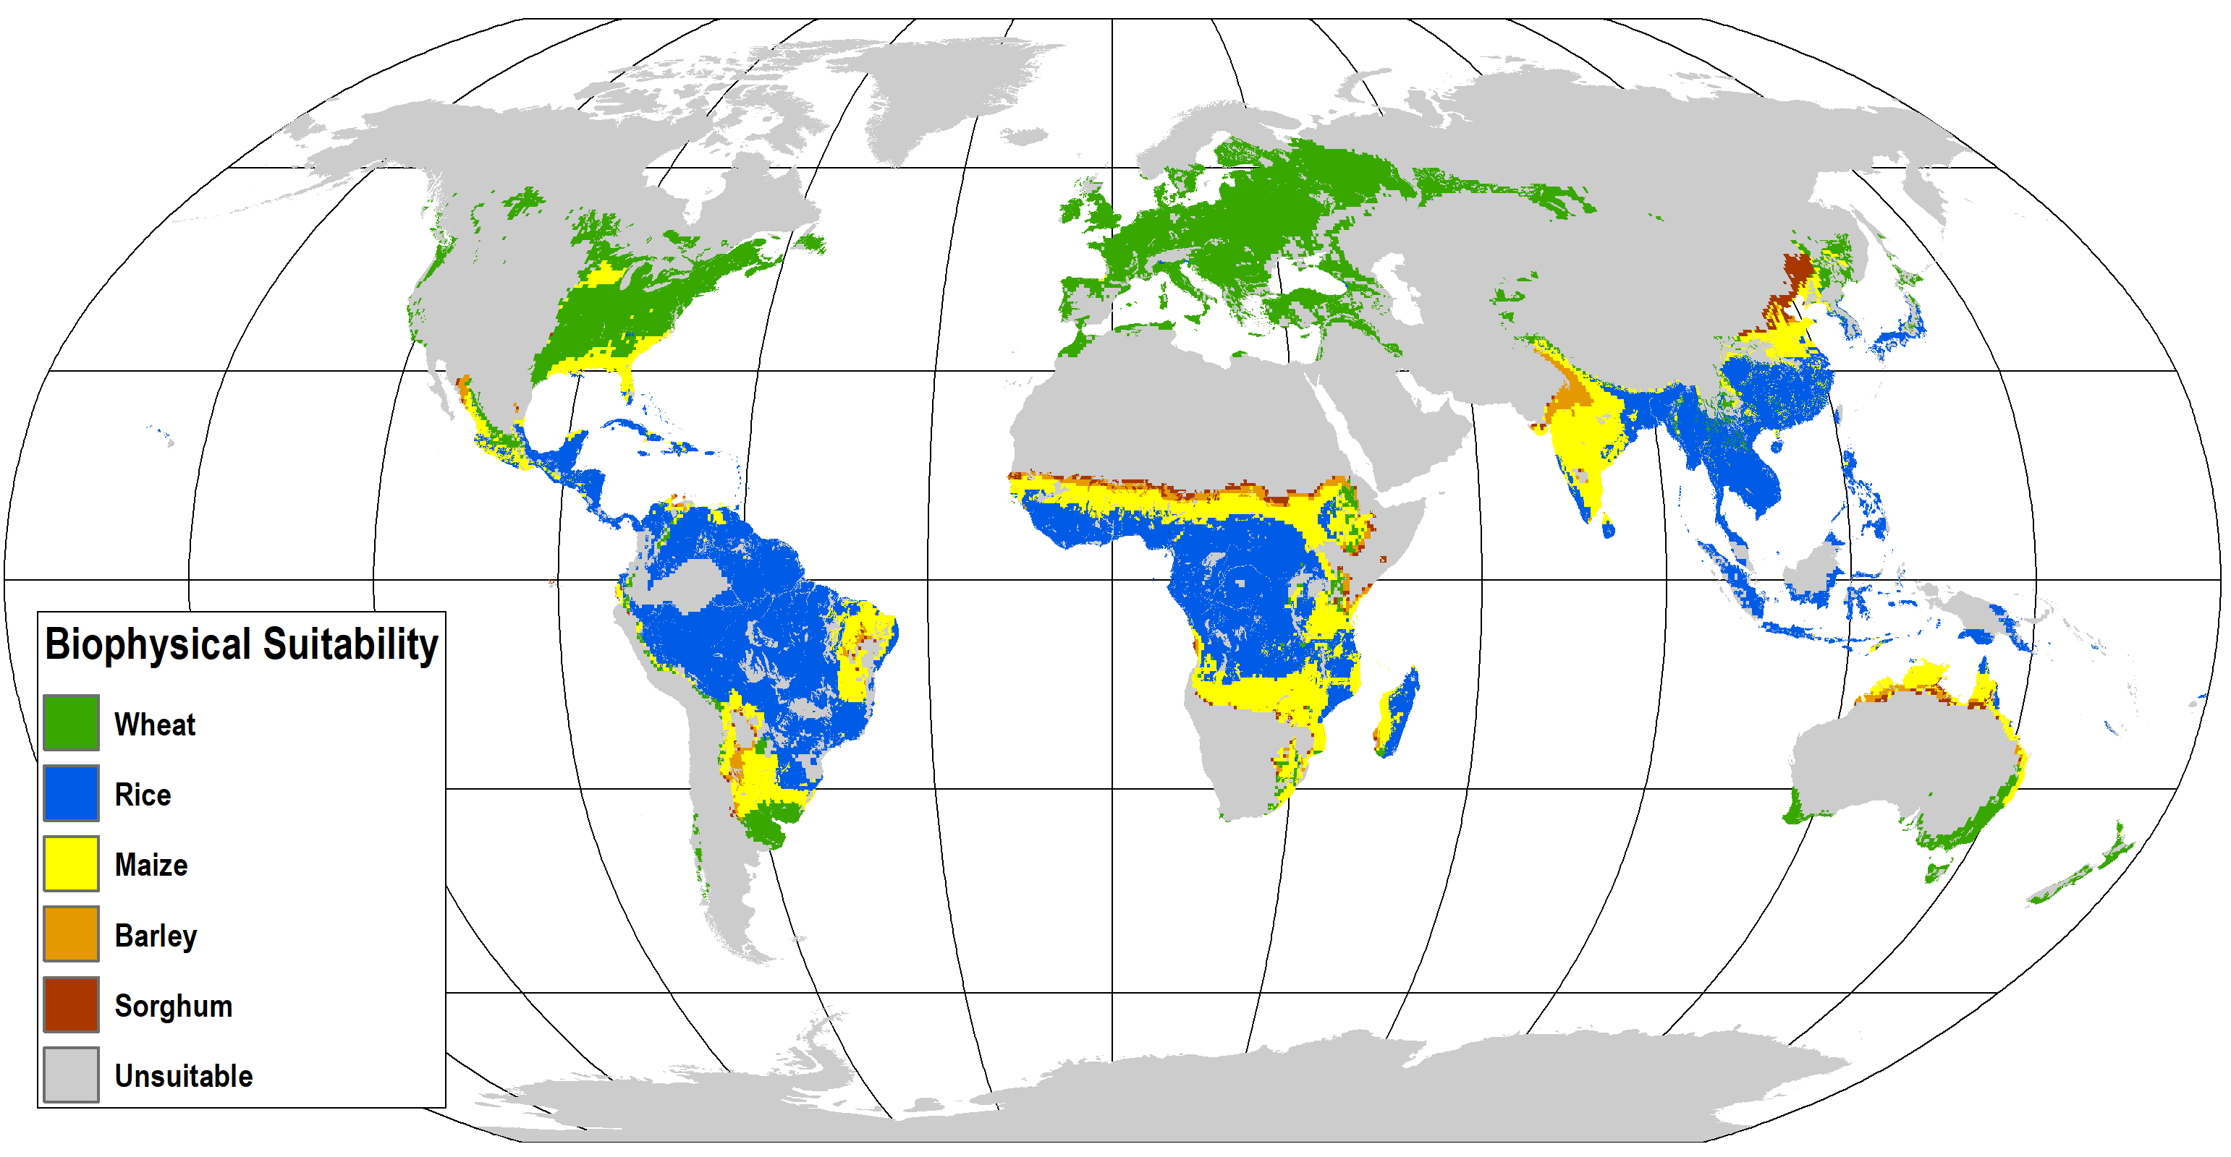
2. Most Suitable Cereal
Read this content
Explain the relationships between geography and agriculture
Notes:
Source: UNEP (2010): The GEO Data Portal, as compiled from FAO, TERRASTAT I Global GIS Databases Poverty and Food Insecurity Mapping Project. United Nations Environment Programme. http://geodata.grid.unep.ch.
In each area the biophysical suitability to grow 4 grain crops have been compared: rice, wheat, maize and sorghum and a yield estimate arrived at. This yield estimate was then weighted according to present market prices for the crop and the highest value arrived at was used to select the best suited cereal.

Slide 10
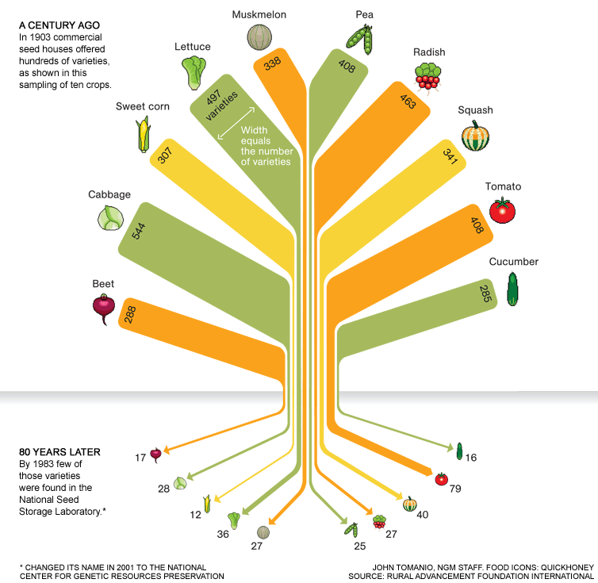
2. A Declining Food Variety
Notes:
About 93 percent of the varieties had gone extinct.
Source: http://ngm.nationalgeographic.com/2011/07/food-ark/food-variety-graphic

Slide 11
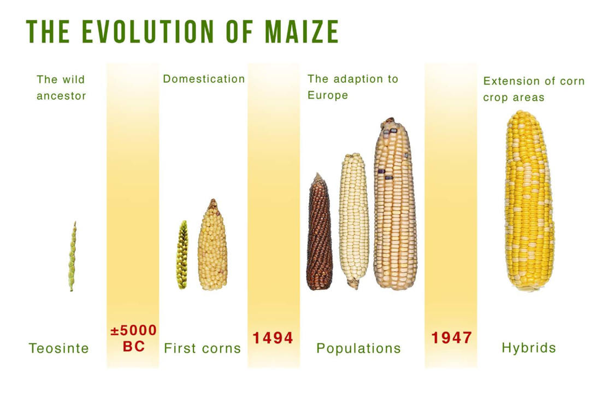
S

Slide 12
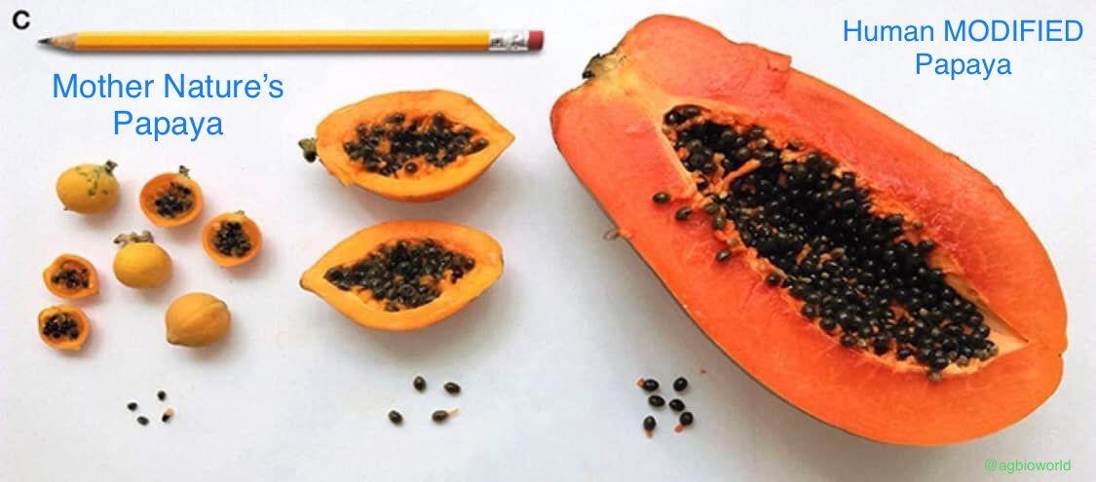

Slide 13
3. Nutrition Transitions
Nutrition Transition
  Urban and sedentary:
    People are more often away from home.
    1970: 75% of all food expenses spent to prepare meals at home.
    2000: 50% of all food expenses for restaurants.
  Element of available time to prepare food.
  More woman in the labor force:
    Away from the traditional role of food preparation.
    Both members of a couple are often working.
    Less preparation time available.
  90% of the money spent on food is spent on processed foods.
Notes:
Source: WHO.

Slide 14
3. Nutrition Transitions
Nutritional shift
  From a diet dominated by grains and vegetables to a diet dominated by fats and sugars.
  Natural human desire for fat and sugar (energy dense foods; low satiation).
  Between 1980 and 2000 calorie intake in the US has risen nearly 10% for men and 7% for women.
  Global average of 21% more daily consumption in calories than necessary.
  Rise in overweight and obese individuals.
Homogenization of global diets
  Global cultural diffusion.
  Outcome of trade.
  Fast food industry.
Explain the concept of a nutrition transition and how it is linked with socioeconomic changes

Slide 15
Food Consumed, (grams per capita per day)
Read this content
Notes:
Source: Overseas Development Institute (ODI), 2014. Derived from FAOSTAT. https://www.odi.org/sites/odi.org.uk/files/odi-assets/publications-opinion-files/8776.pdf

Slide 16
3. Evolution of the Japanese Diet (kg / capita / year)
Notes:
Source: MAFF, 1996 Food Charts, p. 64-68, Japan's Census Statistics, 97/98 CD-ROM

Slide 17
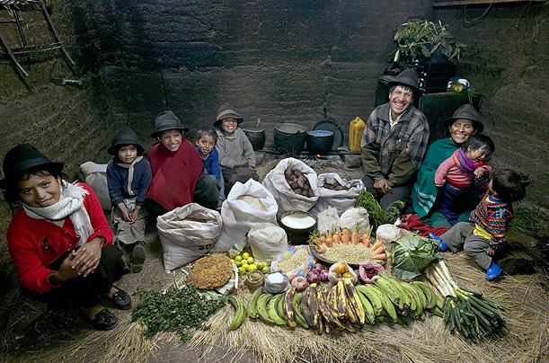
Ecuador: The Ayme family of Tingo
Food expenditure for one week: $31.55

Slide 18
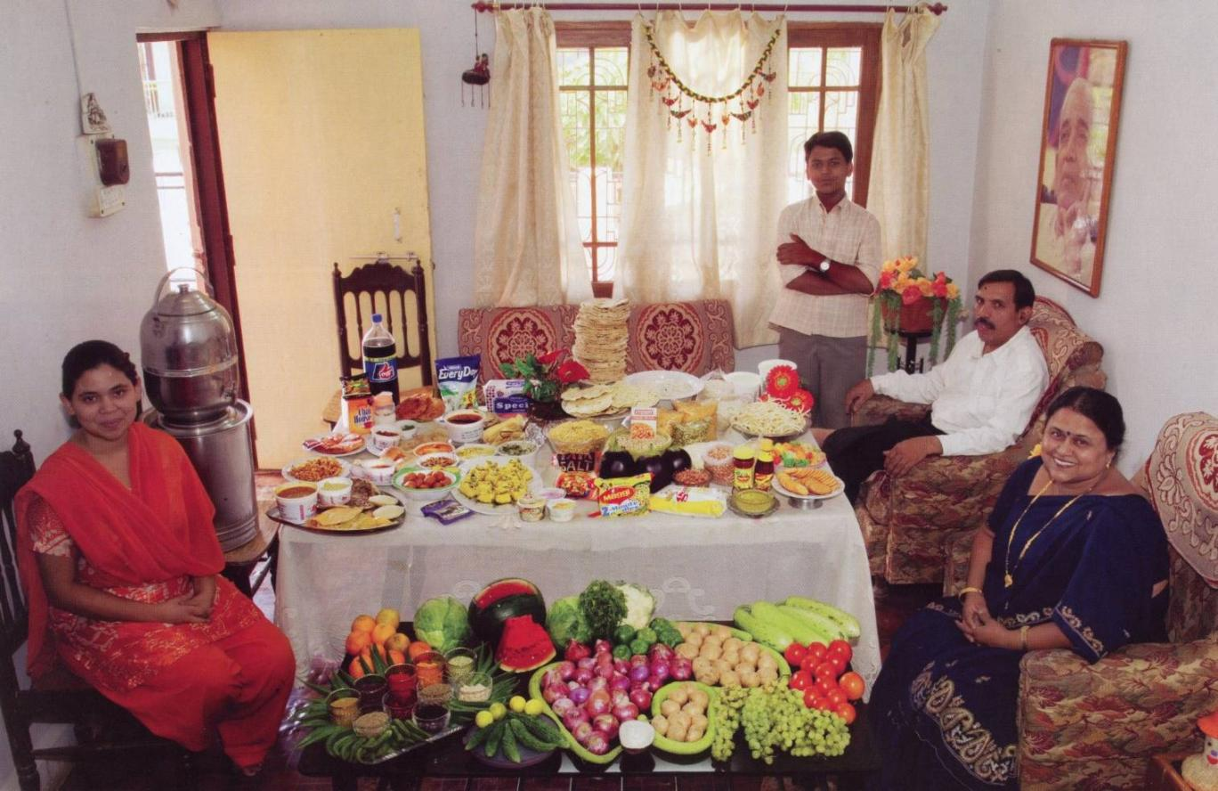
India: The Patkar family of Ujjain
Food expenditure for one week: 1,636.25 Rupees or $39.27

Slide 19
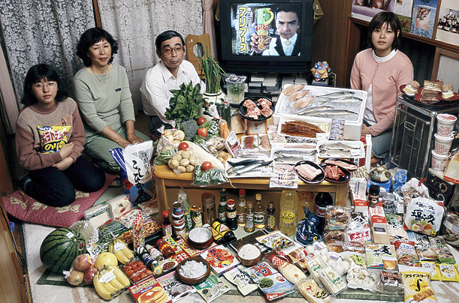
Japan: The Ukita family of Kodaira City
Food expenditure for one week: 37,699 Yen or $317.25

Slide 20
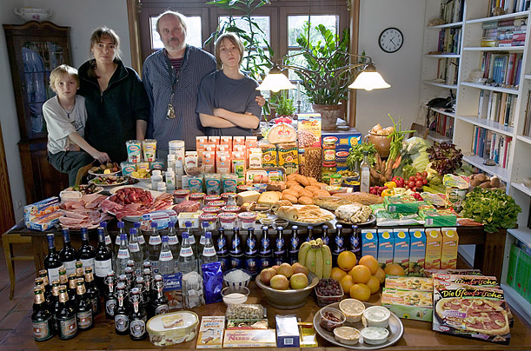
Germany : The Melander family of Bargteheide
Food expenditure for one week: 375.39 Euros or $500.07

Slide 21
3. Time Spent Preparing Food at Home, UK (1934-2010)
Traditional cooking
Modern appliances
Prepared food
Fresh and frozen food
Home deliveries
Notes:
Source: J.W. Grievink (2003) The Changing Face of the Global Food Industry http://ernaehrungsdenkwerkstatt.de/fileadmin/user_upload/EDWText/TextElemente/Handel/OECD_Food_Trade_Business_Trends-GrievinkPPT.pdf

Slide 22
2. Food expenditures by families and individuals as a share of disposable personal income, United States,1929-2020
Notes:
Source: USDA Economic Research Service.
http://www.ers.usda.gov/data-products/food-expenditures.aspx
Food CPI and Expenditures: Table 7

Slide 23
3. Overweight Rates in Selected OECD Countries (BMI>25)
Body Mass Index (BMI) is a person’s weight in kilograms divided by the square of height in meters.
Notes:
Source: OECD (2010) Obesity and the Economics of Prevention: Fit not Fat
http://www.oecd.org/document/31/0,3343,en_2649_33929_45999775_1_1_1_37407,00.html

Slide 24
B – Systems of Agricultural Production
Agricultural Models and Patterns
Global Output
International Food Trade
Global Challenges

Slide 25


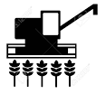
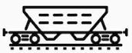





1. The Food System
Read this content
STAGES
BIOLOGICAL SYSTEM
RISKS
Nutrient Management
Soil conditions
Temperature Precipitation
BIOLOGICAL
ECONOMIC
SYSTEM
POLITICAL
SYSTEM
Biocapacity
Weeds
Pests and pathogens
Farm Inputs
Irrigation
Seeds
Fertilizers
Equipment
Regulation
Duties
Subsidies
Taxes
Ownership
NATURAL
Natural disasters
Floods & storms
Droughts
Production
Labor
Capital
TECHNOLOGICAL
Transportation / Storage
ICT disruptions
Infrastructure failures
Processing
Infrastructure
Facilities
Terminals
POLITICAL
Instability
Conflicts
Corruption
Trade restrictions
Theft and illicit trade
Distribution
Wholesalers
Grocers
Restaurants
Individuals
End Use
ECONOMIC
Price volatility
Commodity shortages
Demand shocks
Post-Use

Slide 26
1. Main Agriculture Models
Subsistence farming | Food mainly grown to support the family / community. Variety of plants and animals cultivated. Surpluses sold on local markets, often to pay taxes and buy simple goods. Limited level of technology and capital investment.
Commercial farming | Mostly owned by family interests (SME). Food mainly grown for local/national markets, with some exports. Specialization of crops (economies of scale). Average level of technology and capital investment. Temporary workforce usually hired during peak season.
Corporate farming | Owned by corporate entities that can be multinationals. Food grown for global markets, but in many cases regionally. Usage of subcontractors (commercial farmers). Emphasis on product development, branding and marketing. Specialized cash crops (coffee, bananas, cacao, sugar, etc.) for plantations. Often control several elements of the supply chain (seeds, transformation). High level of technology and capital investment.

Slide 27
1. Main Agriculture Models
Advantages of economies of scale
  Relies on specialization and mechanization (allow for agriculture in low population areas).
  Effective use of inputs (fertilizers and equipment).
  Can be professionally managed (full time workers).
  Lower storage and transportation costs.
  Limited by the distance farm equipment can move.
Constraints to the marketing of food
  Food as a commodity (low entry barriers, limited product differentiation).
  Temperate agriculture often limit to one crop per year.
  Various levels of perishability:
    Difficult to time market price.
  Asymmetry between producers (small) and purchasers (large firms).
  Demand pricing power.

Slide 28
Main Areas of Subsistence Agriculture

Slide 29
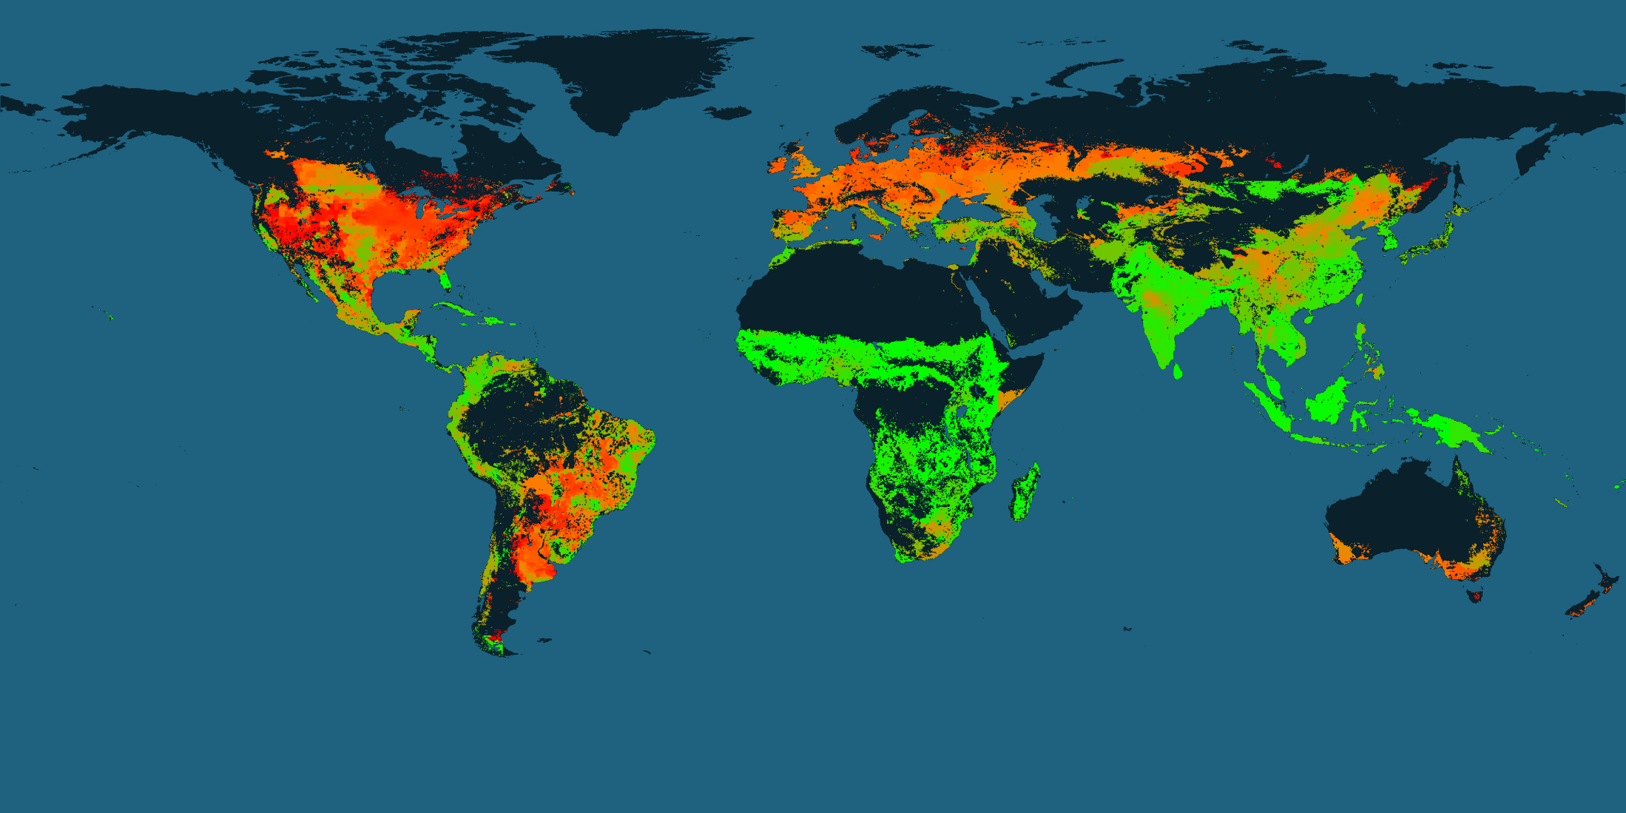
Dominance of Food versus Feed Agriculture
Green - crops consumed mostly by humans
Orange - crops consumed equally by humans and animals
Red - crops consumed mostly by animals
Notes:
Source: https://sos.noaa.gov/datasets/agriculture-food-vs-feed/

Slide 30
1. Patterns of Global Food Production
Globalization | Global markets. Exchange of food cultures. Long trade routes (food miles).
Non-renewable energy | Food production, transformation and distribution.
Market concentration | Large multinational agro-firms. Control of technical expertise (intellectual property). Retailers becoming grocers.
Monoculture | Improved yield. Increased dependency on fertilizers and irrigation. Biodiversity risk.
Aquaculture | Try to replace exhausted fish supplies. More rational use of oceanic resources.
Protein transition | Gradual shift to lower quality sources of protein. From beef to pork and poultry.

Slide 31
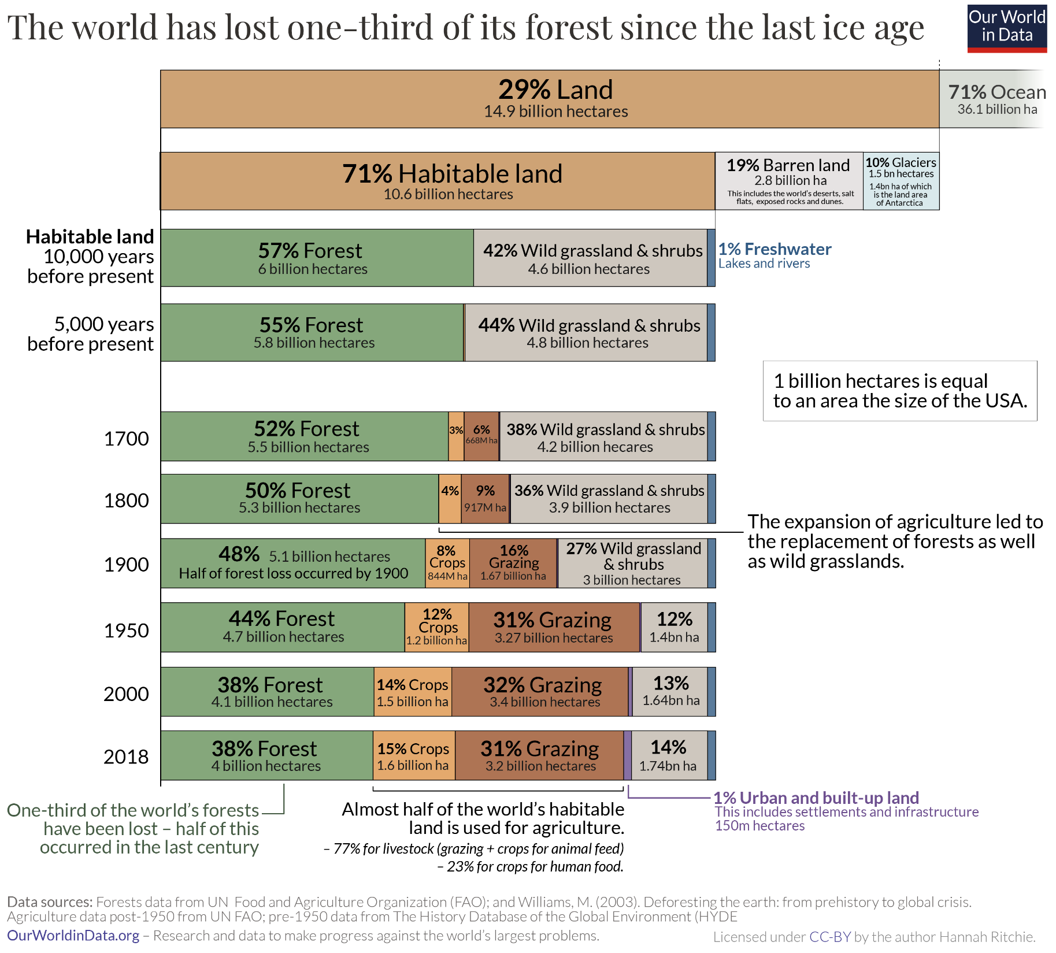

Slide 32
World Agricultural Area, 1961-2016 (1,000s of hectares)
Read this content
68% Pasture
32% Cropland
Notes:
Source: FAO. Agricultural area, this category is the sum of areas under “Arable land and Permanent crops” and “Permanent pastures”.

Slide 33
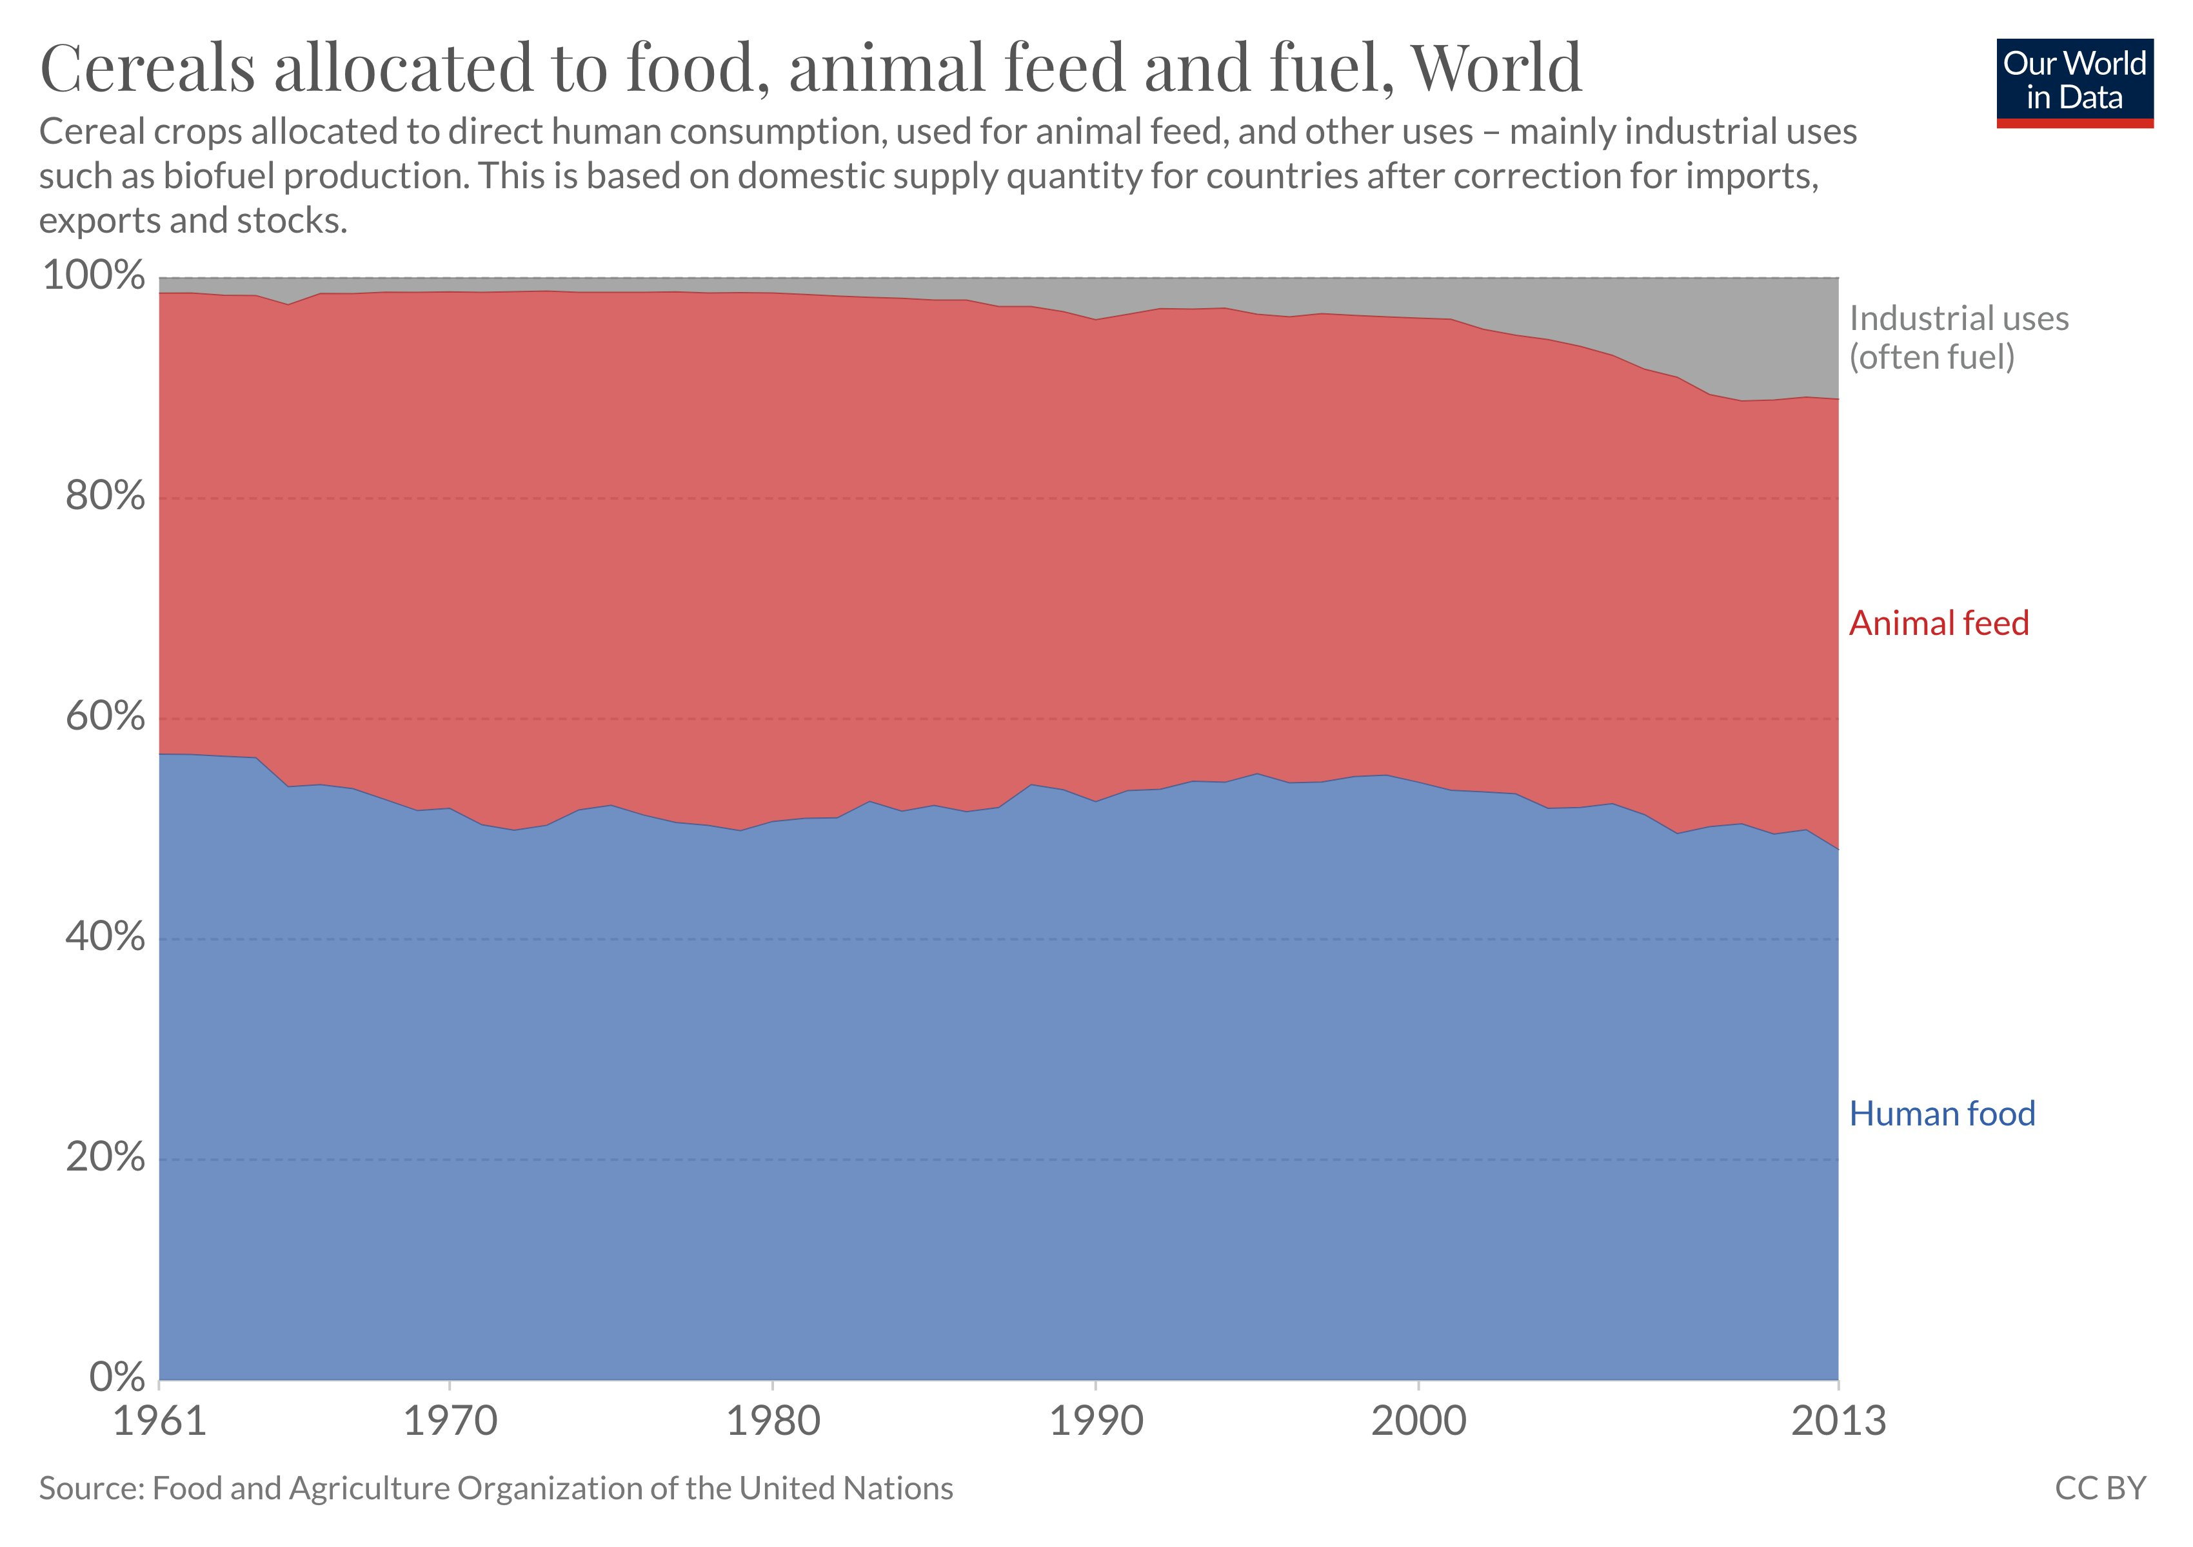

Slide 34
2. World Protein Production by Source, 1950-2014
Explain the changes in the world’s main sources of protein in terms of their respective price
Notes:
Source: FAO.

Slide 35
2. Energy Content and Food Production
Food | Calories / Lbs. | Energy (kWh) to Produce 1 Lbs. | Energy Efficiency
Corn | 390 | 0.43 | 102%
Milk | 291 | 0.75 | 45%
Cheese | 1824 | 1.67 | 31%
Eggs | 650 | 4 | 19%
Apples | 216 | 4.4 | 15%
Chicken | 573 | 6.75 | 15%
Pork | 480 | 12.6 | 8.5%
Beef | 1176 | 31.5 | 4.3%
Notes:
The data above indicate the huge difference in energy required from one end of the food spectrum to the other. Roughly twenty-five times more energy is required to produce one calorie of beef than to produce one calorie of corn for human consumption. Dairy products are actually fairly energy efficient, as they are very dense in calories. Vegans may indeed be able to boast that their diets use 90% less energy than the average American’s, and even those who eat only eggs and dairy can lay claim to significant energy efficiency.
At the same time, food production and consumption amounts to only about 10% of first-world energy consumption, so even the most parsimonious eater can reduce their total energy footprint by around 9% through diet alone. The big culprits remain transportation, heating, and cooling, and while diet modification can help, energy conservation efforts should focus most heavily on these areas.
[1] It’s possible to estimate the energy involved in corn production very accurately, since corn energy intensity has been closely scrutinized by both proponents and critics of the corn ethanol industry. This Berkeley study compares energy intensity estimates from two sources, one pro and one anti-ethanol. Using an average of the two studies’ data yields an estimate of 30,000 BTU energy consumed per gallon of ethanol produced. From the same study, about 2.75 gallons of ethanol are produced per bushel of corn, which means that one bushel of corn required 82,500 BTU. One bushel of corn is 56 pounds of corn kernels, so one pound of corn kernels requires 1473 BTU for production. This is equivalent to 0.43 kWh.
[2] For milk, the estimates provided in Without The Hot Air Chapter 13 are utilized, with this conversion used for fluid ounces of milk to weight. The estimates for cheese are also taken from the above chapter, with the numbers simply proportionally adjusted from kg to pounds.
[3] From Table 3 in this study in Nature, we see that the annual energy input for a hectare of apple trees is 500,000 MJ, or 56,230 kWh at 3.6 MJ per kWh and 2.47 acres per hectare. According to this article, 800 bushels of apples per acre appears normal, which is 33600 lb of apples at 42 lb of apples per bushel. This equals 1.67 kWh per pound of apples.
[4] Here are the estimates for eggs, taken from Without The Hot Air page 77. Using a standard of eight eggs to a pound, convert from metric to English measures and arrive at the 4kWh estimate.
[5] Chicken is examined in detail on Without The Hot Air page 79, and I use that estimate, converted to kWh per pound.
[6] For Pork, I use McKay’s estimates from page 77, and convert them for each animal. McKay estimates that a 65kg human burns 3kWh per day, or 0.0462 kWh / kg / day = 0.021 kWh / pound / day. McKay uses a pig lifespan of 400 days, and thus notes that if you want to eat a pound of pork every day, 400 lb of pig must be alive at any given time (one pound for each day, so that the rate of pig production matches the rate of consumption). McKay further estimates that only two-thirds of an animal can be used for meat, so we actually need 600 lb of pig to generate one pound of meat per day. 600lb * 1 day * 0.021 kWh / pound /day = 12.6 kWh for a pound of pork.
[7] Beef is calculated exactly as for Pork above, except that a cow lives for 1000 days instead of 400 days. 1000 lb / 0.66 (wastage factor) * 1 day * 0.021 kWh / pound / day = 31.5 kWh for a pound of beef.
[8] Calorie data was taken from caloriecount.about.com, and kcal (food calories) were converted to kWh for energy efficiency calcs. We simply convert the calories in one pound of each food into kWh, and then divide that number by the energy required for production of one pound of that food.
[9] How can corn have an energy efficiency higher than 100%? This means that the energy that human beings put into the process of growing, distributing, and eating corn is less than the energy provided to the human body by the corn. The hidden factor here is sunlight – corn plants are drawing energy from the sun for free, and storing that energy, which humans later consume.

Slide 36
2. Grain Equivalent to Produce Meat (in kg)
Using the amount of required energy and grain the produce, explain the price variations of meat

Slide 37
2. Meat Production, United States and China 1961-2020 (in tons)
African Swine Fever
Notes:
Source: FAO Database. Mainland China.

Slide 38
Food Prices Relative to Average Hourly Wages, United States, 1919-2019
Read this content
Notes:
Note: Hourly wage was $0.43 per hour in 1919 and $34.33 per hour in 2019.
Source: The Simon Project, Human Progress. https://humanprogress.org/article.php?p=1815

Slide 39
3. International Food Trade
International trade of agricultural goods
  About 9% of the value global exchanges in commodities.
  Nature, origin and destination of food trade:
    If the good is perishable.
    Consumption habits (cultural preferences).
    The profit that can be derived from trading food products.
    Highly linked to export crops that are produced strictly to generate income.
    Developing economies are massively involved in these types of crops.
  Subject to price fluctuations, particularly for trade commodities (e.g. sugar, coffee, cocoa).
  Overcome shortages:
    Import what is lacking in the national production.
    An economy needs to generate enough surpluses from other sectors.
    Purchase enough food to overcome the national production deficit.

Slide 40
FAO Food Price Index, 1990-2022 (real, 2016=100)
Notes:
Source: FAO.
http://www.fao.org/worldfoodsituation/foodpricesindex/en/

Slide 41
Share of Product Groups in World Merchandise Trade, 1900-2020
Read this content
Notes:
Source: adapted from WTO, World Trade Report.

Slide 42
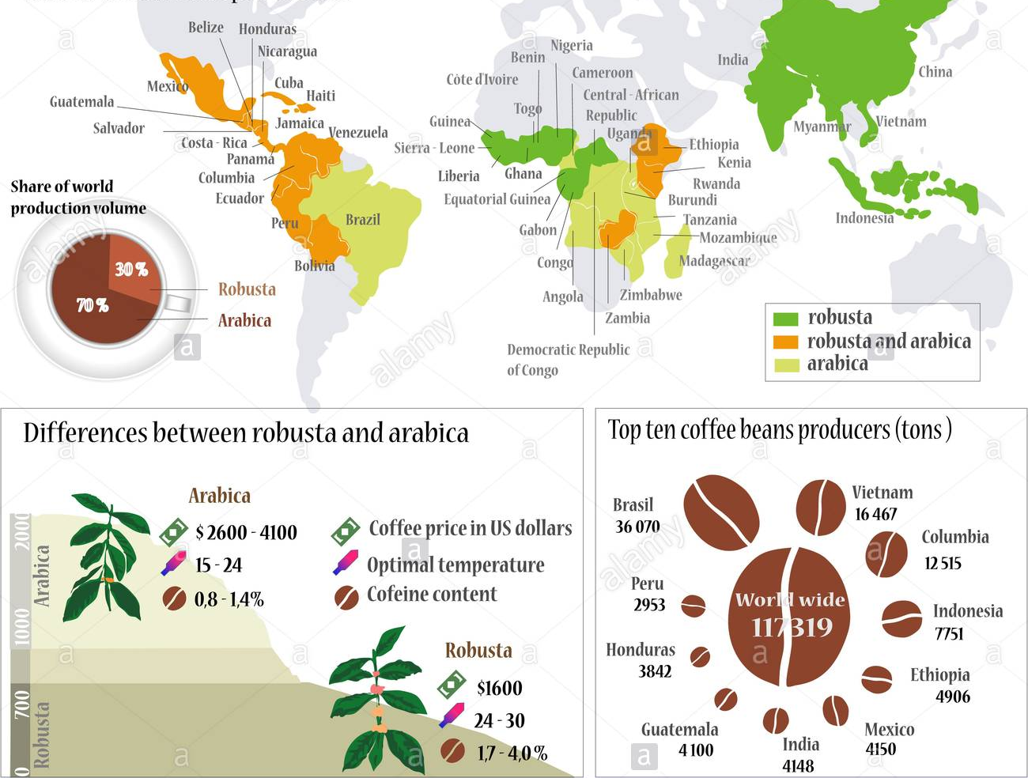
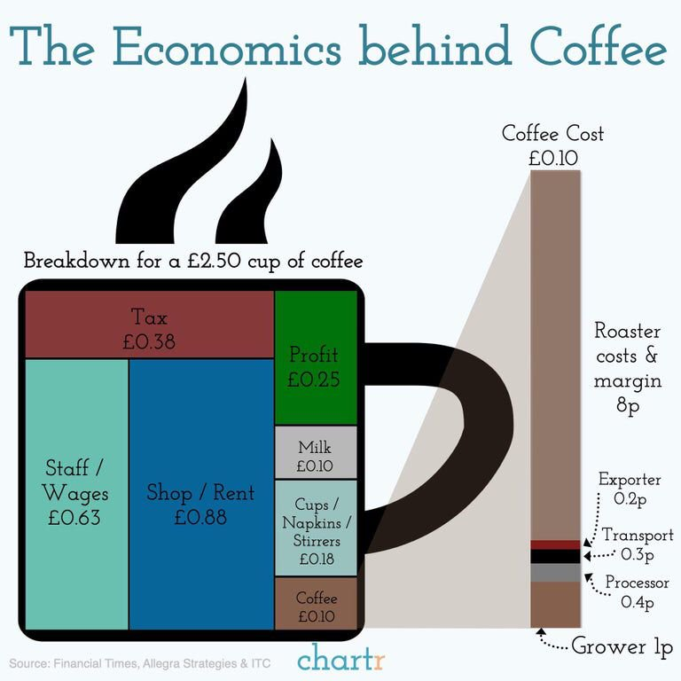
World Coffee Production
65% of supply from three countries (Brazil, Columbia and Vietnam)
Notes:
Source: FAO.

Slide 43
Retail Price of Coffee, 1980-2022
1) Demand constant and steadily increasing (2.5% PY).
2) Supply concentration (weather risk).
3) Hoarding when prices start to increase.
Notes:
Source: International Coffee Organization, http://www.ico.org/new_historical.asp
Note: ICO Composite is the price calculated based on the market share of exports of each group of coffee.
The calculation of the ICO composite indicator price is weighted as follows:
Colombian Milds: 15%
Other Milds: 30%
Brazilian Naturals: 20%
Robustas: 35%

Slide 44
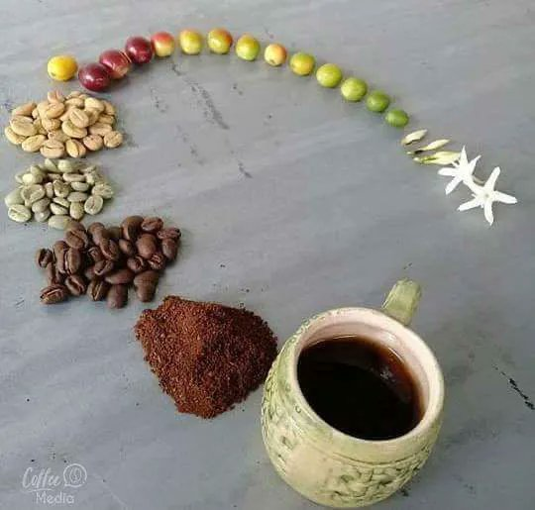

Slide 45
4. Global Challenges
Expansion potential
  Reserves still exist in the developing countries for expanding agricultural land.
  Urbanization:
    Removes agricultural land.
  Very unevenly distributed:
    Found mainly in Latin America and Sub-Saharan Africa.
    Asian countries, especially the most densely populated, have only slight expansion possibilities.
  Fishing:
    Was believed that the oceans provided an unlimited supply.
    “Peak fish” was reached around 1980.
  The potential of aquaculture remains uncertain:
    Conversion of grain.
    Waste generation.

Slide 46
4. Global Challenges
The Green Revolution
  New strains of hybrid seeds and fertilizers increased crop output.
  Began in the 1960s in the U.S. (wheat and corn).
  New hybrid strains of wheat, corn, and rice; higher yield.
  New fertilizers (Nitrogen; Haber-Bosch process) and pesticides to support the high yield.
  Global diffusion of higher-yielding crops as part of help programs.
Outcomes
  Mechanization removed the need for farm animals (less food consumed).
  Global grain production increased by 45% between 1945 and 1990.
  Food production was able to surpass population growth (avoiding the Malthusian trap).
  Asia increased its rice production by 66% by 1985.
  India was able to supply its own wheat and rice by the 1980s.

Slide 47
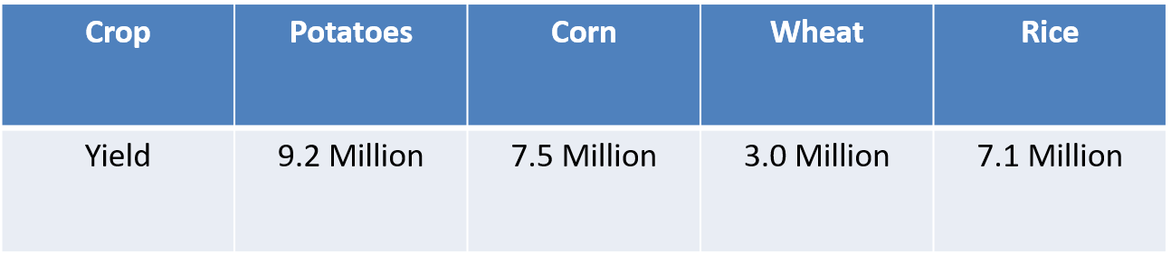
Yield of Rice (Paddy) and Wheat, 1960-2020 (kg per hectare)
Millions of calories per acre
Notes:
Source: FAO.
http://www.fao.org/faostat/en/#data/QC

Slide 48
4. Global Challenges
Some negative consequences
  Extended soil degradation:
    Nutrient depletion.
    Erosion.
    Salination.
  Dwindling availability of water resources:
    Agriculture accounts for 70% of all freshwater withdrawals.
    Exhaustion of aquifers.
    Water pollution by fertilizers (algae blooms) and pesticides.
  Methane emissions:
    Livestock may be responsible for 15% of greenhouse emissions.
  Loss of animal and plant species (biodiversity):
    20 to 30% of the world’s forest converted to agriculture.
    50% of all species are in danger of extinction.
    Threatening national parks and protected areas.

Slide 49
4. Some Challenges Facing Agriculture
 | Economic | Social | Environmental
Production | Conversion of farmland to other uses. Productivity of smaller operations. | Illegal workers (+ 50% of the agricultural workforce in the US). Aging of farmers. Land ownership. | Soil depletion. Aquifer depletion. Loss of biodiversity. Pests. Climate change.
Consumption | Costs of diet related diseases. | Overconsumption and obesity. | One quarter of food discarded. Packaging and waste.
Distribution | High marketing costs (80%). Industry oligopoly. 30% of food is lost during transport and distribution. | Less preparation time. More eating out. | Long distances to markets. 7 to 10 units of energy consumed to produce one unit of food energy.
Notes:
Source: adapted from Heller, M.C., Keoleian, GA. Assessing the sustainability of the US food system: A life cycle perspective. Agricultural Systems 2003;76:1007-1041

Slide 50
4. Some Challenges Facing Agriculture
Food waste
  About 30% of food produced for human consumption is lost or wasted globally.
  Lost or wasted throughout the supply chain, from initial agricultural production down to final household consumption.
  Medium and high-income countries:
    Most food is wasted at the consumption stage.
    Even if is still suitable for human consumption.
    Standards such as “best before” labeling have an impact.
  Low-income countries:
    Most food is wasted in the early and intermediate stages of the food chain.
    Limitations in harvesting techniques, storage and cooling facilities in difficult climatic conditions, infrastructure, packaging and marketing systems.

Slide 51
Global Average Food Losses by Food Type, 2010
Read this content
Notes:
Source: FAO (2011) Global Food Losses and Food Waste. http://www.fao.org/fileadmin/user_upload/suistainability/pdf/Global_Food_Losses_and_Food_Waste.pdf
Agricultural production: losses due to mechanical damage and/or spillage during harvest operation (e.g. threshing or fruit picking), crops sorted out post harvest, etc. For bovine, pork and poultry meat, losses refer to animal death during breeding. For fish, losses refer to discards during fishing. For milk, losses refer to decreased milk production due to dairy cow sickness (mastitis)
Postharvest handling and storage: including losses due to spillage and degradation during handling, storage and transportation between farm and distribution. For bovine, pork and poultry meat, losses refer to death during transport to slaughter and condemnation at slaughterhouse. For fish, losses refer to spillage and degradation during icing, packaging, storage and transportation after landing. For milk, losses refer to spillage and degradation during transportation between farm and distribution.
Processing: including losses due to spillage and degradation during industrial or domestic processing, e.g. juice production, canning and bread baking. Losses may occur when crops are sorted out if not suitable to process or during washing, peeling, slicing and boiling or during process interruptions and accidental spillage. For bovine, pork and poultry meat, losses refer to trimming spillage during slaughtering and additional industrial processing, e.g. sausage production. For fish, losses refer to industrial processing such as canning or smoking. For milk, losses refer to spillage during industrial milk treatment (e.g. pasteurization) and milk processing to, e.g., cheese and yoghurt.
Distribution: including losses and waste in the market system, at e.g. wholesale markets, supermarkets, retailers and wet markets.
Consumption: including losses and waste during consumption at the household level

Slide 52
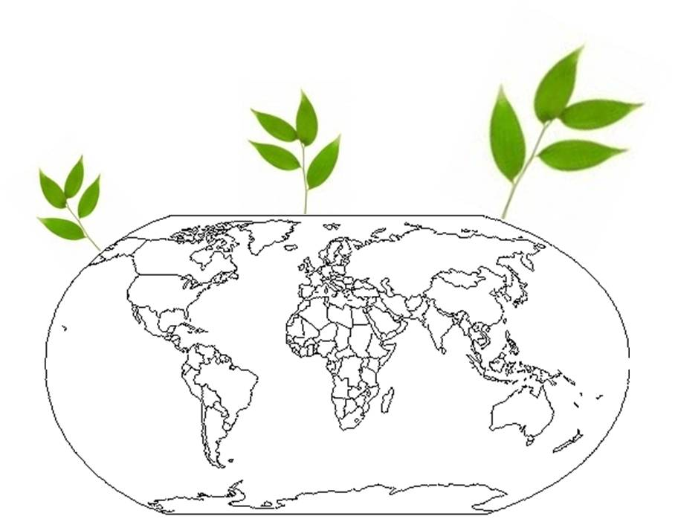
Essay: Global Challenges to Agriculture
Provide an overview of the main challenges that agriculture is facing

Slide 53
C – Commercial Agriculture
Spatial Organization
Types of Commercial Agriculture

Slide 54
1. Spatial Organization
Fundamentals
  The foremost expression of capitalism on the agricultural landscape.
  Feeding urban populations.
  Small labor force.
  Capital intensive (mechanization, fertilizers, seeds).
  Large farms (economies of scale).
  Production and distribution:
    Controlled by large agricultural firms; Vertical integration.
    Do not necessarily own the land but buy the output.
  Emerged in the late 19th century in the United States:
    Mechanized farming technology and chemical fertilizers.
    Railways permitted the development of land and the export of the agricultural output to national and global markets.

Slide 55
1. Von Thunen's Regional Land Use Model
Read this content
Isolated State
Modified Conditions
Sub-center
Central city
Navigable river
Market gardening and milk production
Firewood and lumber production
Crop farming without fallow
Crop framing, fallow and pasture
Three-field system
Livestock farming

Slide 56
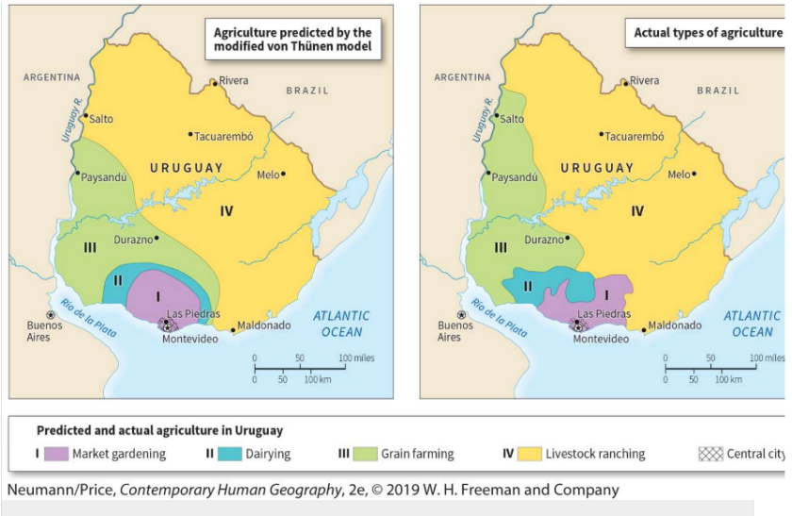
Ideal and actual distribution of types of agriculture in Uruguay

Slide 57
Inference of Von Thunen’s Model to the Continental United States
Read this content
Forest
Dairy
Wheat
Dairy
Forest
Wheat
Corn and
Soybeans
Vegetables
Beef Cattle
and Sheep
Vegetables
Beef Cattle
and Sheep
Corn and
Soybeans
Cotton and
Tobacco
Specialty
Crops
Cotton and
Tobacco
Assumptions
1. New York City the only market
2. Crops ranked by rent paying ability
3. No terrain variation
4. Climatic variation considered
Specialty
Crops
Assumptions
1. New York City the only market
2. Crops ranked by rent paying ability
3. No terrain or climatic variation
A
B
Explain the fundamentals of Von Thunen’s agricultural land use model and its correspondence to the American agricultural landscape
Notes:
Stutz, R. and A. de Souza (1998), "The World Economy: Resources, Location, Trade and Development." Third Edition, Toronto: Prentice Hall. P. 268.

Slide 58
2. Types of Commercial Agriculture
Truck farming
  Intense cultivation of fruits and vegetables that are trucked to nearby markets.
  Requires seasonal labor (migration).
Livestock farming
  Poultry ranches and egg factories.
  Mixed crops such as corn occupy most of the land but are used to feed livestock.
Dairy farming
  Close to main markets due to weight and perishability.
  Further distance from market; more cheese and butter.
  Relatively labor intensive.
Explain what commercial agriculture is and provide some examples.

Slide 59
2. Types of Commercial Agriculture
Grain farming
  Drier areas.
  High mechanization and yield increase:
    Combines.
    Grain elevators.
    Rail connections.
  Most grain bound for the consumption market (either domestic or exports).
  Low perishability.
  United States and Canada: The World’s breadbasket (25 to 30% of cereal exports).

Slide 60
Exports of Cereals, 1960-2020 (in 1000s of tons)
Notes:
Source: FAO.
http://www.fao.org/faostat/en/#data/TP

Slide 61
2. Types of Commercial Agriculture
Plantation agriculture
  An outcome of the colonial era.
  Export-oriented monocrops.
  Coffee, banana, sugar cane, cacao, tea, rubber, palm oil, tobacco.
  Large tracks of land for economies of scale.
  Usually close to the coastline.
Mediterranean agriculture
  Mix of activities; some for subsistence, local consumption and exports.
  Orchards (citrus and olives).
  Viticulture (grapes).
  Cereals and vegetables (lentils).

Slide 62
2. Types of Commercial Agriculture
Cattle (livestock) ranching
  The commercial raising of herd livestock on a large landholding.
  Emerged commercially during colonial times in the Americas.
  In drier areas where productive crops not commercially suitable.
  Extensive use of land (pasture).
  Raise two kinds of animals in large numbers: cattle and sheep.
  Sheep ranching is geographically concentrated to such a degree that only four countries— Australia, China, New Zealand, and the United Kingdom— account for 62%.

Slide 63
2. Types of Commercial Agriculture
Livestock fattening
  A commercial type of agriculture that produces fattened cattle and hogs for meat.
  Invented in the United States in the late nineteenth century.
  Became prevalent in the 1960s.
  Farmers breed many of the animals they fatten, especially hogs – feedlot system.
  Many feedlots purchase their grain from farmers in the region, although in the case of hogs many farmers feed animals with the corn cultivated on their own farms.
  In the Corn Belt of the U.S. Midwest, farmers raise corn and soybeans to feed cattle and hogs.
  Typically, slaughterhouses are located close to feedlots, creating a new meat-producing region, which is often dependent on mobile populations of immigrant labor.

Slide 64
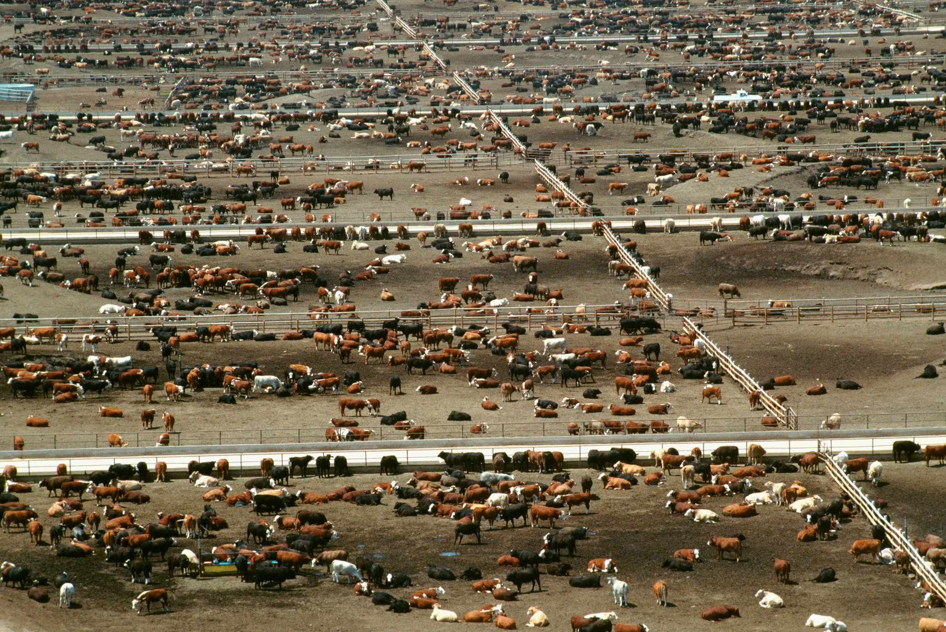
Cattle feedlot for beef production. This feedlot, in Colorado, is reputedly the world’s largest. (Glowimages/Getty Images.)

Slide 65
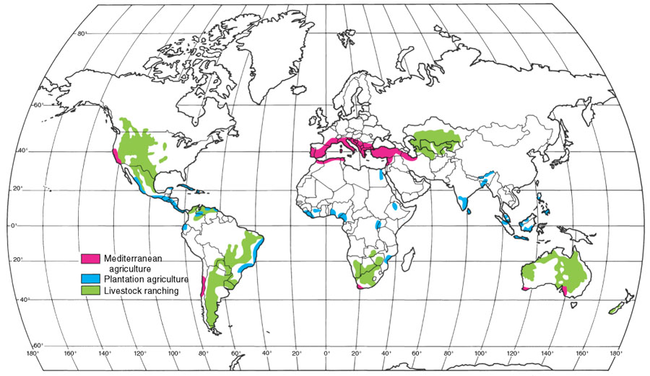
2. Types of Commercial Agriculture

Slide 66
2. Types of Commercial Agriculture
Shrimp farming
  Thailand is the world’s largest exporter and second largest producer.
  Shrimp is one of the most consumed seafood:
    Cheap; fast growth cycle.
    Can be grown using aquaculture.
  Marine shrimp:
    Southeast Asia very suitable; substantial tropical coastline.
    Grown in ponds along coastal areas.
    Filled with saltwater pumped from the ocean.
    Shrimp ready for harvest in 90 to 120 days.
  Ecological issues:
    Some mangrove forests cleared.
    Replace a diverse ecosystem with monoculture.
    Wastewater can be a source of pollution.

Slide 67
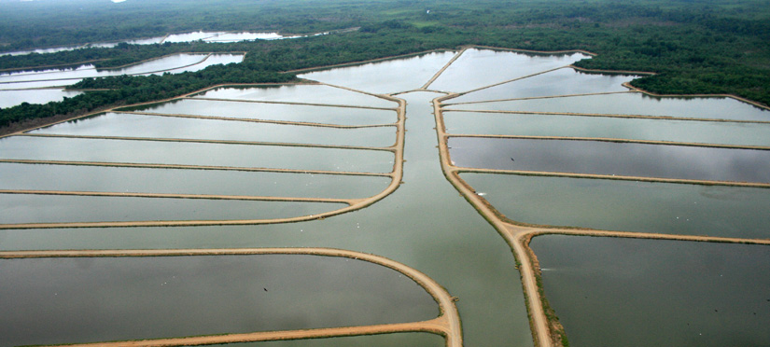
2. Types of Commercial Agriculture
Tilapia farming
  “The chicken of the seas”; 3.5 M tons produced.
  A fish that can handle more difficult conditions than shrimps (water temperature, oxygen content).
  Most farm raised in southern China.
Takes about 200-250 days to grow
Notes:
http://www.businessweek.com/magazine/content/10_44/b4201088229228.htm

