Slide 1
Topic 3 – Population and Labor
A – Population Distribution and Structure
B – Demographic Theory
C – Migration
D – Labor Markets

Slide 2
Conditions of Usage
For personal and classroom use only
  Excludes any other forms of communication such as conference presentations, published reports and papers.
No modification and redistribution permitted
  Cannot be published, in whole or in part, in any form (printed or electronic) and on any media without consent.
Citation
  Dr. Jean-Paul Rodrigue, Dept. of Global Studies & Geography, Hofstra University.

Slide 3
Objectives
Look at the distribution of the world’s population
Look at the causes and consequences of population change
Understand economic demographic perspectives
Understand the demographic transition theory
Look at the economic factors of migration
Look at the major changes in the labor market

Slide 4
A – Population Distribution and Structure
Global Population Distribution
Fertility and Mortality
Population Structure

Slide 5
World Population, 1000BC-2050AD (in billions)
Notes:
Source: WorldWatch Institute & United Nations, Population Forecast, 2006 Revision.

Slide 6
15 Largest Countries, 2018, 2050 (in millions)
Notes:
Source: FAO Statistical Database

Slide 7
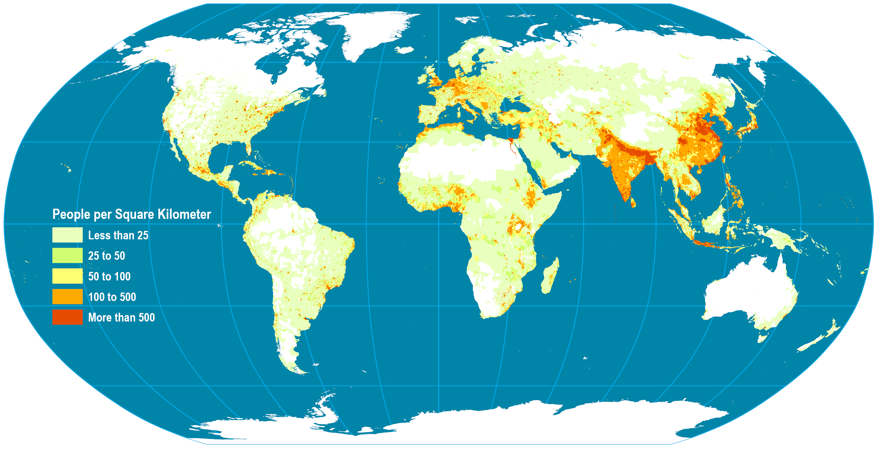
World Population Density and Distribution, 2005
Typical concentrations along major river systems.
Temperate flat land highly desirable.
Areas of large concentrations: South Asia, East Asia, Western Europe, Northeastern North America.
“Empty” areas are attributed to harsh physical landscapes and harsh temperatures.
To what factors may be attributable the distribution of the global population?

Slide 8
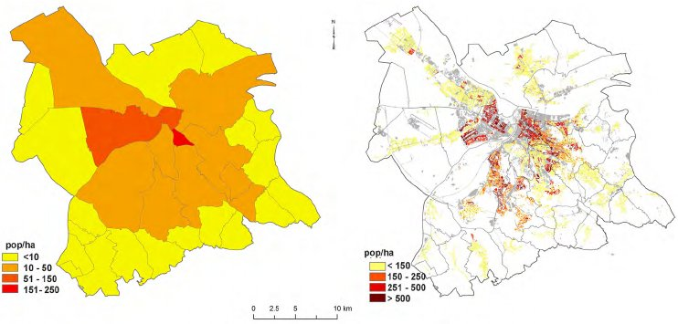
The Scale Issue in Population Density
Choropleth
Dasymetric
Using the lowest possible spatial unit
Notes:
Note: Belgrade.
Source: Bajat, Branislav & Krunic, Nikola & Samardzic-Petrovic, Mileva & Kilibarda, Milan. (2013). Dasymetric modelling of population dynamics in urban areas. Geodetski Vestnik. 57. 777-792.

Slide 9
Global Population Distribution
High density does not necessarily imply poverty
  Bangladesh, Singapore and the Netherlands have similar densities.
  Some low-density countries are poor.
  Variations in the distribution of the population within a country (e.g. Egypt, China, USA).
Factors impacting population density
  Physical environment among the most important.
  Most of the population lives along the coast and river valleys.
  Agricultural potential (fertility) that was later multiplied by trade potential (accessibility).
  Technology has expanded options (air conditioning, irrigation).
  Modern medicine increased life expectancy.
  Impact of demographic components (fertility and migration).

Slide 10
Share of Housing Units Equipped with Air Conditioning by Region in the United States, 1980-2015
Read this content
Notes:
Source: US Department of Energy. Residential Energy Consumption Survey. Table HC7.3 Air conditioning in U.S. homes by year of construction, 2015. https://www.eia.gov/consumption/residential/data/2015/

Slide 11
2. Population Distribution
 | High Density | Low Density
Relief (shape and height of land) | Flat low land (Ganges Valley in India) | Mountainous high land (Himalayas)
Resources | Resource rich areas (e.g. coal, oil, wood, fishing etc.) tend to densely populated (Western Europe) | Areas with few resources tend to be sparsely populated (The Sahel)
Climate | Areas with temperate climates tend to be densely populated (rain and temperature) (Belgium) | Areas with extreme climates of hot and cold tend to be sparsely populated (Sahara Desert)
Political | No link between political stability and density. | Politically unstable countries tend to lose populations.
Social | Groups of people want to live close to each other for security (e.g. USA) | Other groups of people prefer to be isolated e.g. Scandinavians
Economic | Job opportunities encourage high population densities, particularly in large cities | Limited job opportunities cause some areas to be sparsely populated

Slide 12
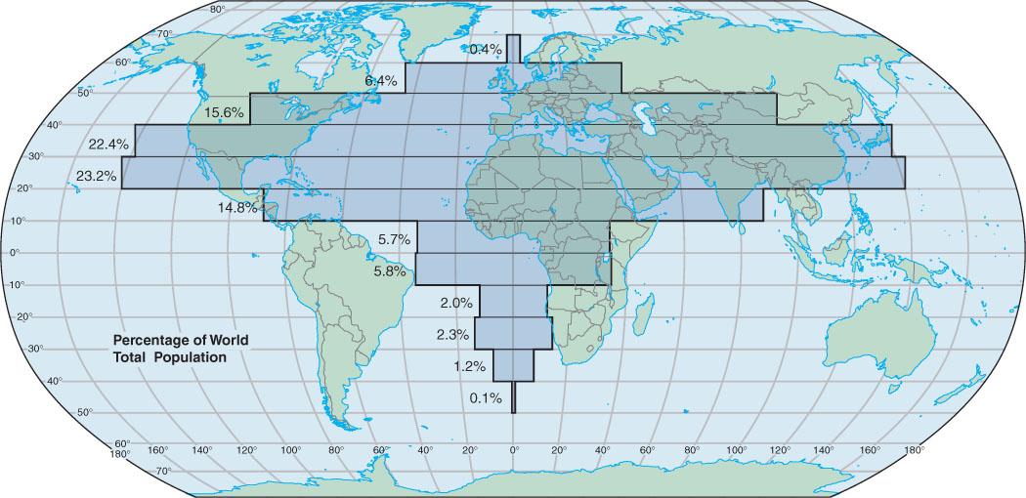
Population Distribution by Latitude

Slide 13
World Population 1804-2048 (in billions)
Doubling time = growth rate / 70
20 years
15 years
13 years
12 years
13 years
15 years
37 years
118 years
Notes:
Source: United Nations (1995b); U.S. Census Bureau, International Programs Center, International Data Base and unpublished tables.

Slide 14
2. Fertility and Mortality
Total Fertility Rate (TFR)
  Number of live births per female of reproductive age (15-49).
  Indicates population change over a long period of time.
  Instructive about societal norms in any given culture.
  A TFR of 2.1 is considered as being the replacement birth rate.
    Lower than 2.1 yields population decrease while rates greater than 2.1 yields population increase.
  Improvements in medical conditions lower the replacement rate (below 2.06 in many countries).

Slide 15
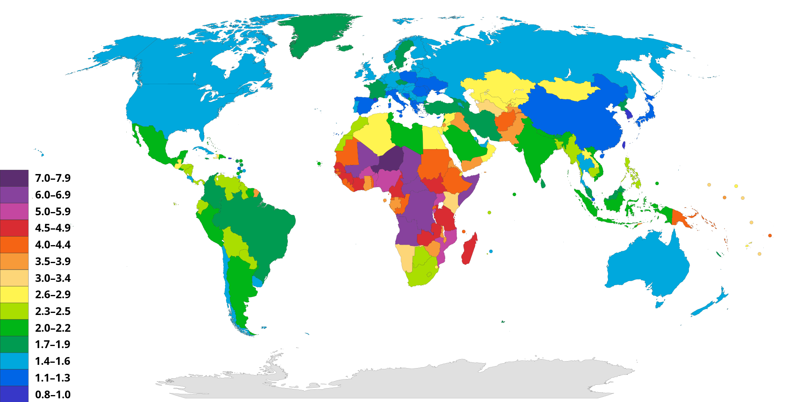
World Total Fertility Rate, 2020
Notes:
Source: Wikipedia.
UNEP (2015): The UNEP Environmental Data Explorer, as compiled from World Population Prospects, the 2012 Revision (WPP2012), United Nations Population Division . United Nations Environment Programme. http://ede.grid.unep.ch.

Slide 16
Total Fertility Rate, Selected Countries, 1995-2022
Replacement rate (2.1)
Notes:
Source: World Population Prospects, the 2010 Revision

Slide 17
TFR among Developed Countries, 2005-2022
Notes:
Source: World Population Prospects, the 2010 Revision

Slide 18
Relationship Between Fertility and GDP per Capita, Selected Countries, 2017
With is the relationship between TFR and GDP and to what this relation may be attributed to?
Notes:
Source: www.gapminder.org
Related to economic and social stability.

Slide 19
2. Fertility and Mortality
Causes of death
  Throughout most of history famine, epidemics, and wars have been the leading causes of death.
  Primary causes of death began to shift to degenerative problems related to aging.
  These include such factors as heart disease and cancer.
Death and welfare
  Used to be considered a sign of the health of a population.
  Different age structures among the populations of different countries.
  Possible for a nation with high living standards to have a higher death rate than a poorer nation.
  Reason: overall older population.

Slide 20
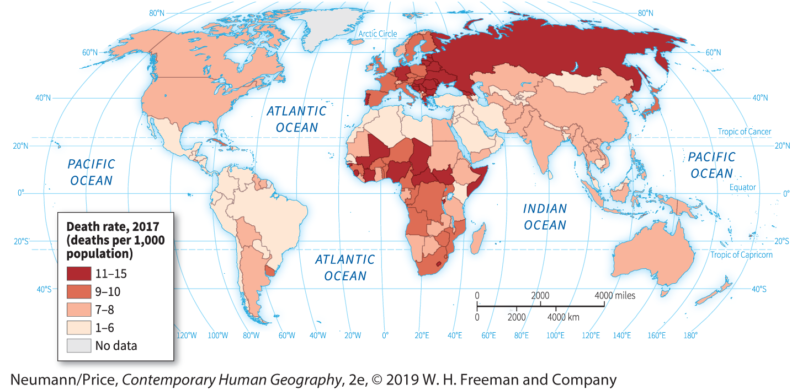
World Crude Death Rate, 2017
Notes:
Source: UNEP (2015): The UNEP Environmental Data Explorer, as compiled from World Population Prospects, the 2012 Revision (WPP2012), United Nations Population Division . United Nations Environment Programme. http://ede.grid.unep.ch.

Slide 21
2. Fertility and Mortality
Life expectancy
  Number of years a person is expected to live.
  Based on current death rates.
  Does not necessarily apply to current generation.
  May change due to ameliorations in standards of living.
Context
  Strong geographical variations in life expectancy.
  Half a century ago, most people died before the age of 50.
  Global average life expectancy reached 72 years in 2017.
  Several achievements and failures:
    Economic development has benefited human health.
    Improvement in diet and sanitation.
    Urbanization may have adverse effects.
Notes:
Countries with high infant mortality rates have a strong impact on life expectancy. Sometimes, to filter this impact life expectancy after the age of 5 is used.

Slide 22
Life Expectancy Through Human History
Era | Life expectancy
Neanderthal (350,000 – 25,000 BCE) | 20
Upper Paleolithic (40,000 – 10,000 BCE) | 33
Neolithic (8,500 – 3,500 BCE) | 28 to 33
Bronze Age (3,500 – 1,200 BCE) | 26
Classical Greece and Rome (500 BCE – 400 CE) | 20 to 30 (+30 years if survived 20)
Medieval Britain (400 – 1500 CE) | 33
Late 19th Century in Western Europe | 37
Average Global Life Expectancy (1950) | 48
Average Global Life Expectancy (2017) | 72.2

Slide 23
2. Fertility and Mortality
Factors behind higher life expectancy
  About 40 years was gained in the 20th century.
  90% of the reduction in the death rate occurred before the introduction of antibiotics or vaccines.
  It is our technology more than our medicine that accounts for extension of life expectancy.
  Major factors (33 years):
    Improved sanitation (for food and water).
    Reduction in crowding.
    Central heating.
    Sewer systems.
    Refrigeration.
  Improved health (7 years):
    Mainly medical technology.
    Small share attributed to drugs.

Slide 24
Life Expectancy at Birth, 1910 and 2015

Slide 25
World Average Life Expectancy, 1960-2019
Notes:
Source: World Bank
http://data.worldbank.org/indicator/SP.DYN.LE00.IN

Slide 26
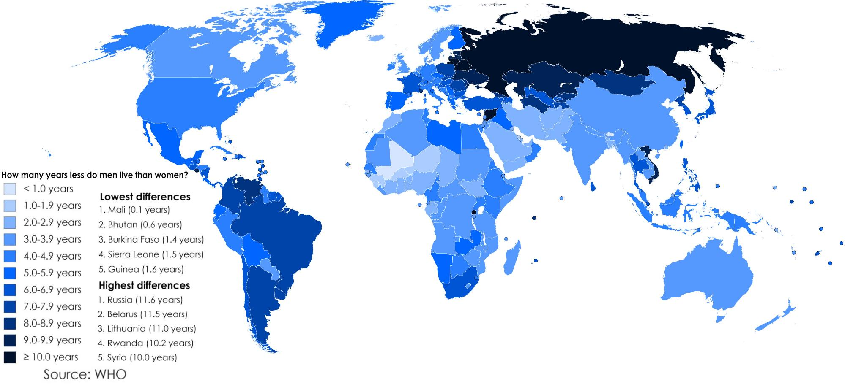
Differences in Life Expectancy between Males and Females

Slide 27
Monthly Rate of a $1M Life Insurance Premium, 2013
Explain the concept of life expectancy and how it is reflected in a life insurance premium across age and gender groups
Notes:
Source: https://www.northerninsuranceagency.com/rates.html

Slide 28
2. Fertility and Mortality
Optimum life expectancy
  Life expectancy is ultimately dictated by human physiology:
    At some points, organs cease to function properly.
    Limit on the lifespan of non-cancerous human cells.
    Lifespan is estimated to be 97 years.
  Nearing life expectancy limits:
    Even if age-related diseases such cancer, heart disease, and stroke were eradicated, life expectancy would only increase by 15 years.
    Currently around 80 years in high income countries.
    Expected to reach 85 years in most developed countries by 2030.

Slide 29
3. Population Structure
Population Pyramid
  Graph showing the breakdown of each sex by age group (cohort).
  Illustrates a nation’s population structure.
  Shows the male/female composition of the population.
  Most of the time, the breakdown involves 5 years periods.
  The structure of the population pyramid reflects economic development and social preferences.
Age group
75+
60-75
Males
45-60
Females
30-45
15-30
0-15
10
0
10
Percentage of the population

Slide 30
1. Population Pyramids
Progressive
Intermediate
Regressive
High birth rates
High death rates
Declining birth rates
Low death rates
Low birth rates
Low death rates
Explain why the population structure varies between countries.

Slide 31
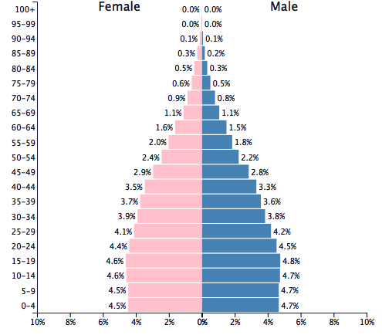
Progressive: Population Pyramid of Mexico, 2015
Mexican pyramid
  Much wider base than the others.
  Beginning of transition (declining base).
  Rapidly growing population where the percentage of people under 15 years of age is high.
Notes:
Source: US Census Bureau, International Database

Slide 32
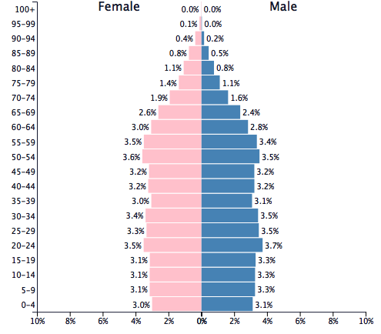
Intermediate: Population Pyramid of United States, 2015
USA pyramid
  Intermediate situation:
    Aging population.
    Large amounts of recent immigration.
    The baby boom generation.
    Low birth rates during the 1970s and early 1980s.
    Limited immigration.
  Preponderance of women at the top of the pyramid, an indication of their longer average life span.
Notes:
Source: US Census Bureau, International Database

Slide 33
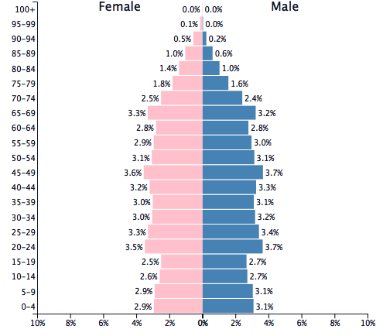
Regressive: Population Pyramid of Sweden, 2015
Sweden’s pyramid
  Does not appear to be a pyramid at all.
  Youngest component is smaller than its middle-aged population and only slightly larger than its aged population.
  No-growth situation, since some deaths occur from all age groupings.
  Sweden has a higher death rate than Mexico.
Notes:
Source: US Census Bureau, International Database

Slide 34
B – Demographic Theory
The Malthusian Trap
Demographic Transition Theory

Slide 35
1. The Malthusian Trap
Malthusian theory
  Based on demographic observations made in the late 18th century.
  Early phases of industrialization in Great Britain with fast population growth.
  Considers that population grows in an exponential fashion while resource (food supply) growth is linear.
  Agricultural output facing declining marginal returns:
    Available agricultural land is limited.
    New agricultural land being developed tends to be marginal (less suitable for crop production).

Slide 36
Diminishing Marginal Returns
Output
O2
O1
I1
I2
Inputs

Slide 37
1. The Malthusian Trap
The “Malthusian crisis”
  Differential growth:
    If growth persists, the population will eventually surpass available resources.
    An increase in inputs such as land and labor did not lead to an inconsistent growth in outputs.
  The outcomes are “Malthusian crises”:
    Food shortages.
    Famines.
    War and epidemics.
  “Fix” the population in accordance with available resources.
  Necessity of a “moral restraint” on reproduction.

Slide 38
1. The Malthusian Trap
Quantity
t3
t2
Technological Innovation
t1
Resources
Population
Overexploitation
Time

Slide 39
1. The Malthusian Trap
The Malthusian Crisis has not occurred
  Malthus has been criticized on several accounts during the last 200 years.
  Religious view (Protestantism).
  Did not foresee:
    Impacts of the industrial revolution on food production.
    The opening of mid latitude grasslands (North America, Argentina, Australia).
    That technology has a substantial impact on the availability of resources (non-linear growth).
    Changes in the economy that changed the role of children in industrializing societies.
    Declining birth rates; population growth no longer exponential.
Explain what is a Malthusian trap and why it has not occurred.

Slide 40
Global Growth in Population and Grain (Wheat and Rice) Production, 1961-2017
Notes:
Source: FAOSTAT
http://www.fao.org/faostat/en/#data/QC

Slide 41
1. The Malthusian Trap
Creative pressure
  Opposed to the Malthusian perspective.
  Often labeled as the economic optimistic view.
  Brought forward in the early 1960s.
  Population has a positive impact on economic growth.
  Resources limited by humanity’s potential to invent.
  “Necessity is the mother of all inventions”.
  Scarcity and degradation are the sign of market failures.
  Population pressure forces the finding of solutions.
Demographic growth
Problem
Higher occupation
densities
?
Pressures to increase
productivity
Solution
Innovations
Outcome
Productivity growth

Slide 42
1. The Malthusian Trap
Mitigating Resource Depletion
Discovery | An entirely new class of resources is made available. Often adds to existing resources. Offers new economic opportunities.
Substitution | An alternative resource is used. Some mineral resources maybe substituted by other, more abundant resources. Composites replacing metals. Fish farming replacing fishing. Telecommunications substituting for travel.
Reduce consumption | Reducing demand through more efficient use. Reducing demand through coercion.
Recycling | The output (waste) becomes an input. Some commodities difficult to recycle.
Re-use | Some finished goods reused (e.g. clothing, engines, tires).

Slide 43
1. The Malthusian Trap
Technological innovation and agriculture
  Intensification of agriculture (more output per unit of land).
  Genetically modified crops.
  New methods of fertilization; Nitrogen fertilizer (Haber-Bosch process feeds some 3.5 billion humans annually).
  Pesticide use.
  Irrigation.
  Multi-cropping systems in which more than one crop would be realized per year.
  Mechanization and automation.
  Monitoring of inputs with information technologies (weather, humidity, soil).
Technological limits
  May be available but too expensive for some regions (e.g. desalination).
  Limits to yield.

Slide 44
1. The Malthusian Trap
Limits of food production by environmental factors
  Substitution is not possible for many resources.
  Soil exhaustion and erosion.
  Evolutionary factors such as the development of greater resistance to pesticides.
  Climate change.
  Loss of productive soils due to land use conversion to other purposes, such as urbanization.
  Water shortages and pollution.

Slide 45
2. Demographic Transition Theory

Slide 46
Stages in Demographic Transition
Stage I: Preindustrial Society | Stage II: Early Industrial Society | Stage III: Late Industrial Society | Stage IV: Postindustrial Society
High birth rates | High birth rates | Falling birth rates | Low birth rates
No or little Family Planning. Parents have many children because few survive. Many children are needed to work the land. Children are a sign of virility. Religious beliefs and cultural traditions encourage large families. |  | Family Planning. Lower infant mortality rates. Industrialization means less need for labor. Increased desire for material possessions and less desire for large families. Emancipation of women. | Children as liabilities instead of assets (no economic contribution as labor). Cost more than $250,000 to raise a child.
High death rates | Falling death rates | Low death rates | Low death rates
Disease and plague (e.g. bubonic, cholera, kwashiorkor). Famine, uncertain food supplies and poor diet. Poor hygiene, no clean water or sewage disposal. | Improved medicine. Improved sanitation and waters supply. Improvements in food production in terms of quality and quantity. Improved transport to move food. Decrease in child mortality. |  | Modern medicine. Optimal life expectancy.

Slide 47
Survivorship of the British Population, 17th and 20th Centuries
Notes:
In the United States, by the 1850s, half the children did not reach the age of 5.

Slide 48
Total Fertility Rate, Selected Units, 1960-2019
Explain what is the demographic transition and how it impacts the world’s population.
Notes:
https://data.worldbank.org/indicator/sp.dyn.tfrt.in

Slide 49
Global Population (1950-2010) and Growth Scenarios, 2010-2050
Notes:
Source: Population Division of the Department of Economic and Social Affairs of the United Nations Secretariat,
World Population Prospects: The 2010 Revision, http://esa.un.org/unpd/wpp/index.htm

Slide 50
Cornucopians and Neo-Malthusians
Cornucopians
  Those who believe that science and technology can solve resource shortages.
  In this view, human beings are our greatest resource rather than a burden to be limited.
Neo-Malthusians
  Modern-day followers of Thomas Malthus.
  Argue that Earth’s support systems are being strained beyond their capacity by the widespread adoption of wasteful Western lifestyles.
  Remedy: Birth control and family planning.

Slide 51
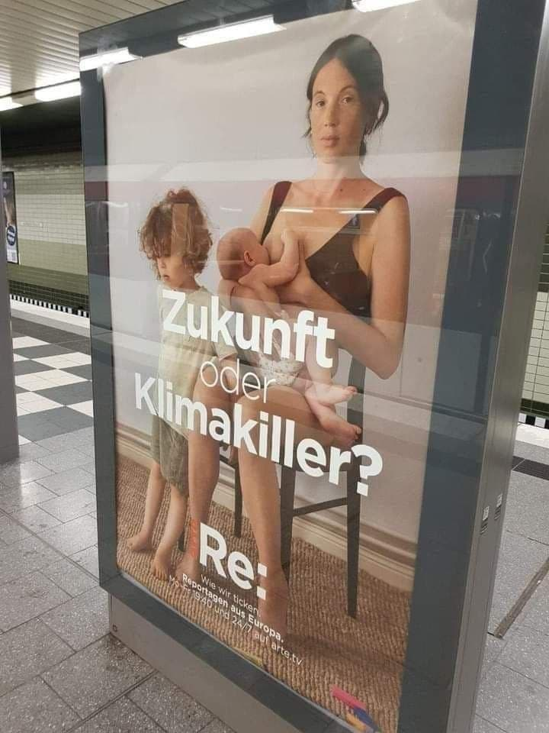
Neo-Malthusian Anti-Natalist Perspective
Neo-Malthusianism
  Enduring Malthusian view in the contemporary environmental movement:
    “every life saved this year in a poor country diminishes the quality of life for subsequent generations.” Paul Ehrlich (The Population Bomb).
Future or Climate killer?

Slide 52
C – Migration
Causes of Migration
Patterns of Migration

Slide 53
1. Causes of Migration
Context
  Migrations as the response of individual decision-makers.
  Negative or push factors in his current area of residence.
  Positive or pull factors in the potential destination.
  Intervening obstacles.
The problem of perception
  Assumes rational behavior on the part of the migrant:
    Not necessarily true since a migrant cannot be truly informed.
    The key word is perception of the pull factors.
    Information is never complete.
    Decisions are made based upon perceptions of reality at the destination relative to the known reality at the source.
  When the migrant’s information is highly inaccurate, a return migration may be one possible outcome.

Slide 54
1. Push - Pull Theory
Explain immigration to the United States from the push-pull theory perspective.
Push Factors | High unemployment and little opportunity. Poverty. High crime and corruption. Repression (political, religious). Recent disaster (drought, earthquake or war).
Pull Factors | High job availability and higher wages. More exciting lifestyle. Access to social services (healthcare and education). Greater safety and security.
Intervening opportunities | Migration costs / transportation. Immigration laws and policies of the destination country.

Slide 55
1. Causes of Migration
Labor shortages
High wages
Labor mobility
  The primary issue behind migration.
  Notably the case at the national level.
  Equilibrate the geographical differences in labor supply and demand.
  Accelerated with the globalization of the economy.
Remittances
  Capital sent by workers working abroad to their family / relatives at home.
  $73 billion in 2016 ($85 billion in 2000):
    2nd most important most important source of income for Mexico (after oil and before tourism).
    Now higher than official aid.
Migration
Surplus labor
Low wages
Notes:
One third of the population of Albania (total 3.2 million) has left to work abroad, mostly in Western Europe.

Slide 56
Remittances Received, 1970-2020 (US dollars)
Notes:
Source: World Bankhttps://data.worldbank.org/indicator/BX.TRF.PWKR.CD.DT

Slide 57
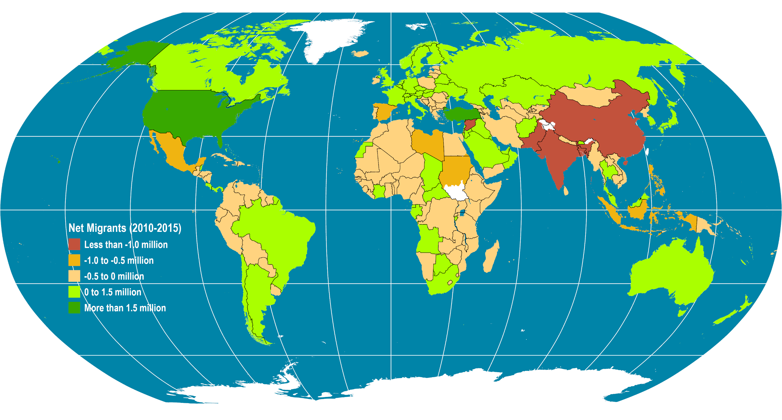
2. Global Net Migration (2010-2015)
Read this content
Notes:
Source: UNEP (2012): The UNEP Environmental Data Explorer, as compiled from World Population Prospects, the 2010 Revision (WPP2010), United Nations Population Division. United Nations Environment Programme. http://geodata.grid.unep.ch.

Slide 58
2. Major International Flows
Three types of flows
  Between developed countries:
    Dominated by professionals.
    Relative ease of movement for skills on demand.
  Between developing countries:
    Limited legal migration.
    Mostly involve forced migrations (refugees of conflicts).
  From developing to developed countries:
    The dominant flow.
    Highly controlled, resulting in an important illegal / refugees segment.
    Controlling number of migrants and the level of qualification.
    Humanitarian and family reunification allowances.
  A fourth more marginal: from developed to developing:
    Professionals.
    Retirees.
    Returning nationals.

Slide 59
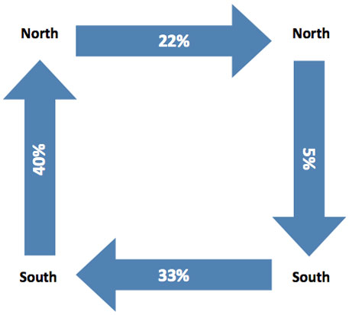
2. Major International Flows
World migration 2009–2011 (Gallup International)
South-North: Mexico to the United States (12.2 million, equal to 6% of the global migrants); followed by Turkey to Germany; and China, the Philippines and India to the United States.
South-South:
Ukraine to the Russian Federation (3.7 million) and vice versa (3.5 million); followed by Bangladesh to Bhutan; Kazakhstan to the Russian Federation; and Afghanistan to Pakistan.
North-North: Germany to the United States (1.3 million); followed by the United Kingdom to Australia; and Canada, the Republic of Korea and the United Kingdom to the United States.
North-South: From the United States to Mexico (0.6 million) and to South Africa (0.3 million); Germans to Turkey (0.3 million); and Portugal to Brazil (0.2 million).

Slide 60
2. Patterns of Migration
Growing level of temporary migration schemes
  Work permits.
  More in tune with seasonal and economic cycles.
Skilled migrants are increasingly sought after
  Lower costs.
  Cannot be easily recruited by another corporation.
Growing anti-immigration stance in many countries
  Health: carry endemic diseases (e.g. rise of diseases in California).
  Economic: depress wages and increase social burden.
  Nationalism: undermine the cohesion of nation-states.
  Environment: cause additional population burdens.

Slide 61
D – Labor
Changing nature of work and employment
Income gaps

Slide 62
Changing Nature of Work and Employment
Defining labor
  Work is an essential activity.
    Provides economic value and meaning (status).
  Substantial changes in the nature of work with economic and technological changes.
Division of labor
  Labor classes based on utility and skills.
  Advanced economies have laws concerning employment opportunities.
Major drivers
  Deindustrialization.
  Shift towards services.
  Increased automation.

Slide 63
Changing Nature of Work and Employment
Deindustrialization
  Shift in manufacturing employment in advanced economies.
  In part due to outsourcing and offshoring.
  Often accompanied with a shift towards service sector.
  Strong regional variations that mainly impacted regions with higher share of manufacturing.
  Lead to skill gaps and difficulties in labor transition (“learn to code”).
  Increasingly involves developing economies losing their competitiveness.

Slide 64
Changing Nature of Work and Employment
Shift towards services
  Less than 10% of the workforce in manufacturing (advanced economies).
  Will be further discussed in Topic 8 (Location of services).
  The assumption of a knowledge-based economy.
  Leads towards a prioritization of higher education, particularly STEM fields.
  Lead to a dichotomy in service jobs:
    Highly paid high added values service jobs (finance, engineering).
    Low paid service jobs in a highly competitive setting (retail, personal services).

Slide 65
Changing Nature of Work and Employment
Automation
  Robotic and information technologies replacing human labor.
  Substitution of labor by machines and processes.
  Took place since the industrial revolution.
  Used to be prevalent in the primary (resource) and secondary sectors (manufacturing).
  Impacting the service sectors with increasingly sophisticated tasks.
  Declining workforce participation rate.
What are the main factors explaining the changes in the nature of work in recent years and into the foreseeable future?

Slide 66
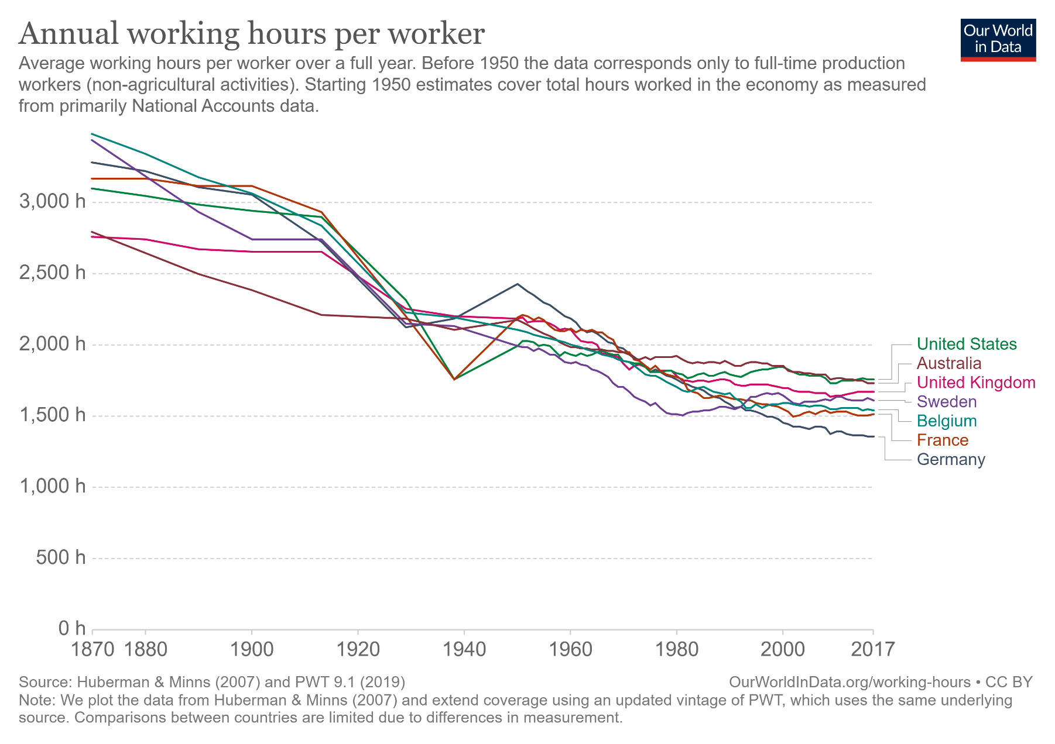
Less Work, More Productivity: Declining Number of Hours per Worker (manufacturing and services)

Slide 67
Probability of Automation by Occupation Group, United States, 2018-2030
Low
High
Notes:
Source: Adapted from Federal Reserve Bank of St. Louis.
https://www.stlouisfed.org/publications/regional-economist/third-quarter-2018/many-jobs-face-automation

Slide 68
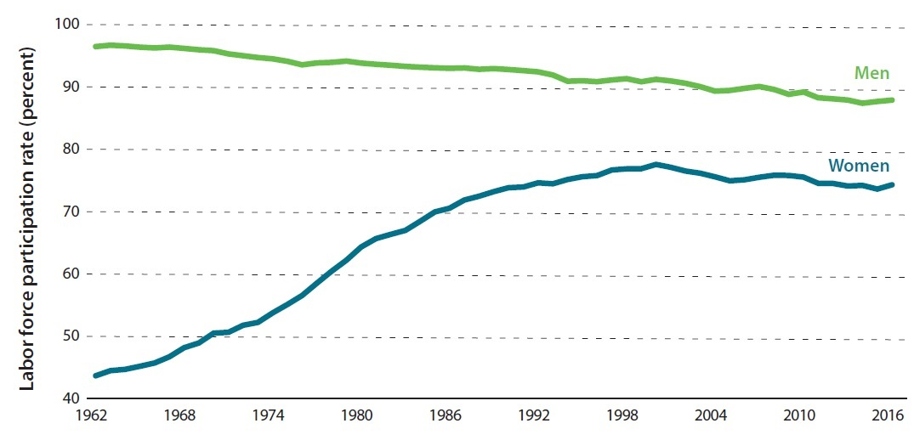
The Rising Role of Females in the Labor Force (United States)

Slide 69
Income Gaps
Gender income gaps
  Issue subject to misconceptions.
    Often used by feminist Marxist ideology to sell a narrative of victimhood.
  An income (earnings) gap is not a wage gap:
    Wage = earnings per unit of time worked; Equal Pay Act of 1963.
    Income = wage * time worked + overtime + all other income activities (extra work, investments).
    In 2017, men worked an average of 8.05 hours per day compared to 7.24 hours for women.
  Gap may be almost entirely the outcome of individual choices:
    Working less time, different careers, willingness to travel / relocate, choice of college major, willingness to do overtime.
    Having a child is a major factor in the income gap.
    Male income tends to be more scalable than female income.
  To remove the income gap, two outcomes must be achieved:
    Women and men must have the same employment structure.
    Women must stop having children.
    Not very practical…

Slide 70
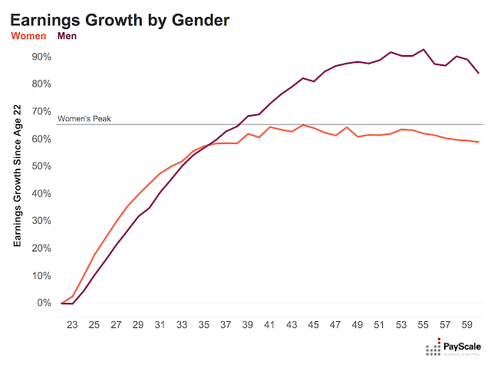
Income Gaps

Slide 71
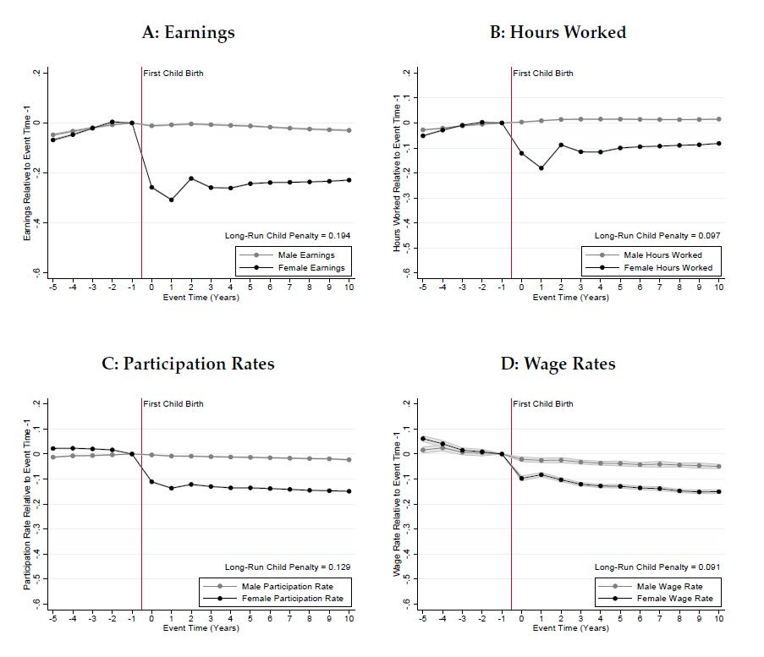
Notes:
Data is for Denmark.
Source: http://www.henrikkleven.com/uploads/3/7/3/1/37310663/kleven-landais-sogaard_gender_feb2017.pdf

Slide 72
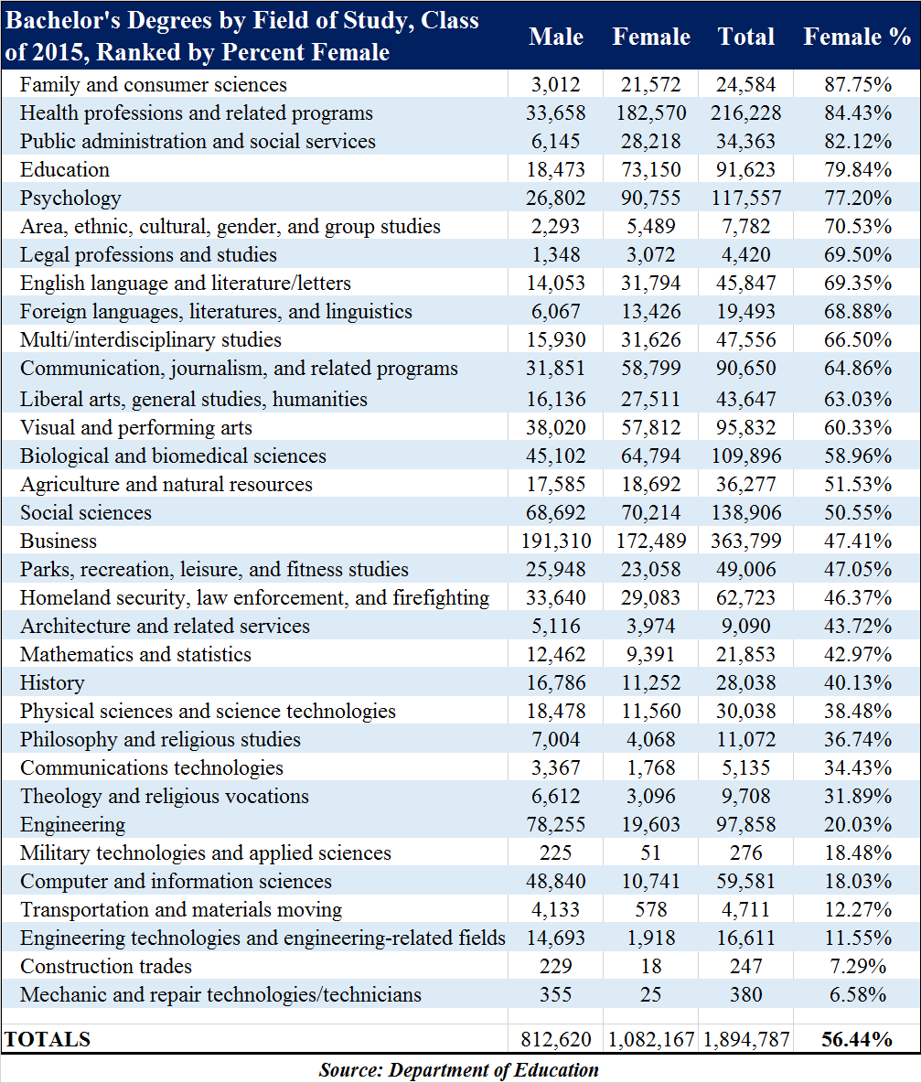
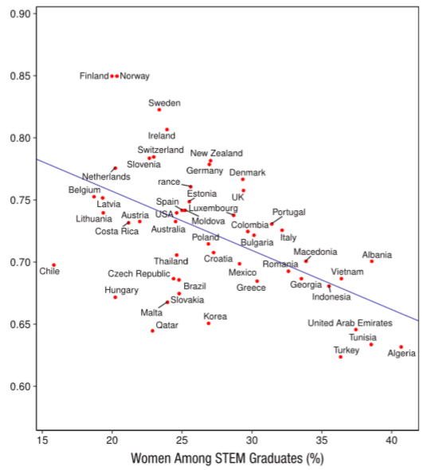
Number of Female STEM graduates and Global Gender Gap Index
Gender Gap Index
Notes:
Source: Stoet, G., & Geary, D. C. (2018). The Gender-Equality Paradox in Science, Technology, Engineering, and Mathematics Education. Psychological Science, 29(4), 581–593. https://doi.org/10.1177/0956797617741719
The Global Gender Gap Index:
Economic participation and opportunity – outcomes on salaries, participation levels and access to high-skilled employment
Educational attainment – outcomes on access to basic and higher level education
Political empowerment – outcomes on representation in decision-making structures
Health and survival – outcomes on life expectancy and sex ratio. In this case parity is not assumed, there are assumed to be fewer female births than male (944 female for every 1,000 males), and men are assumed to die younger. Provided that women live at least six percent longer than men, parity is assumed. But if it is less than six percent it counts as a gender gap.

Slide 73
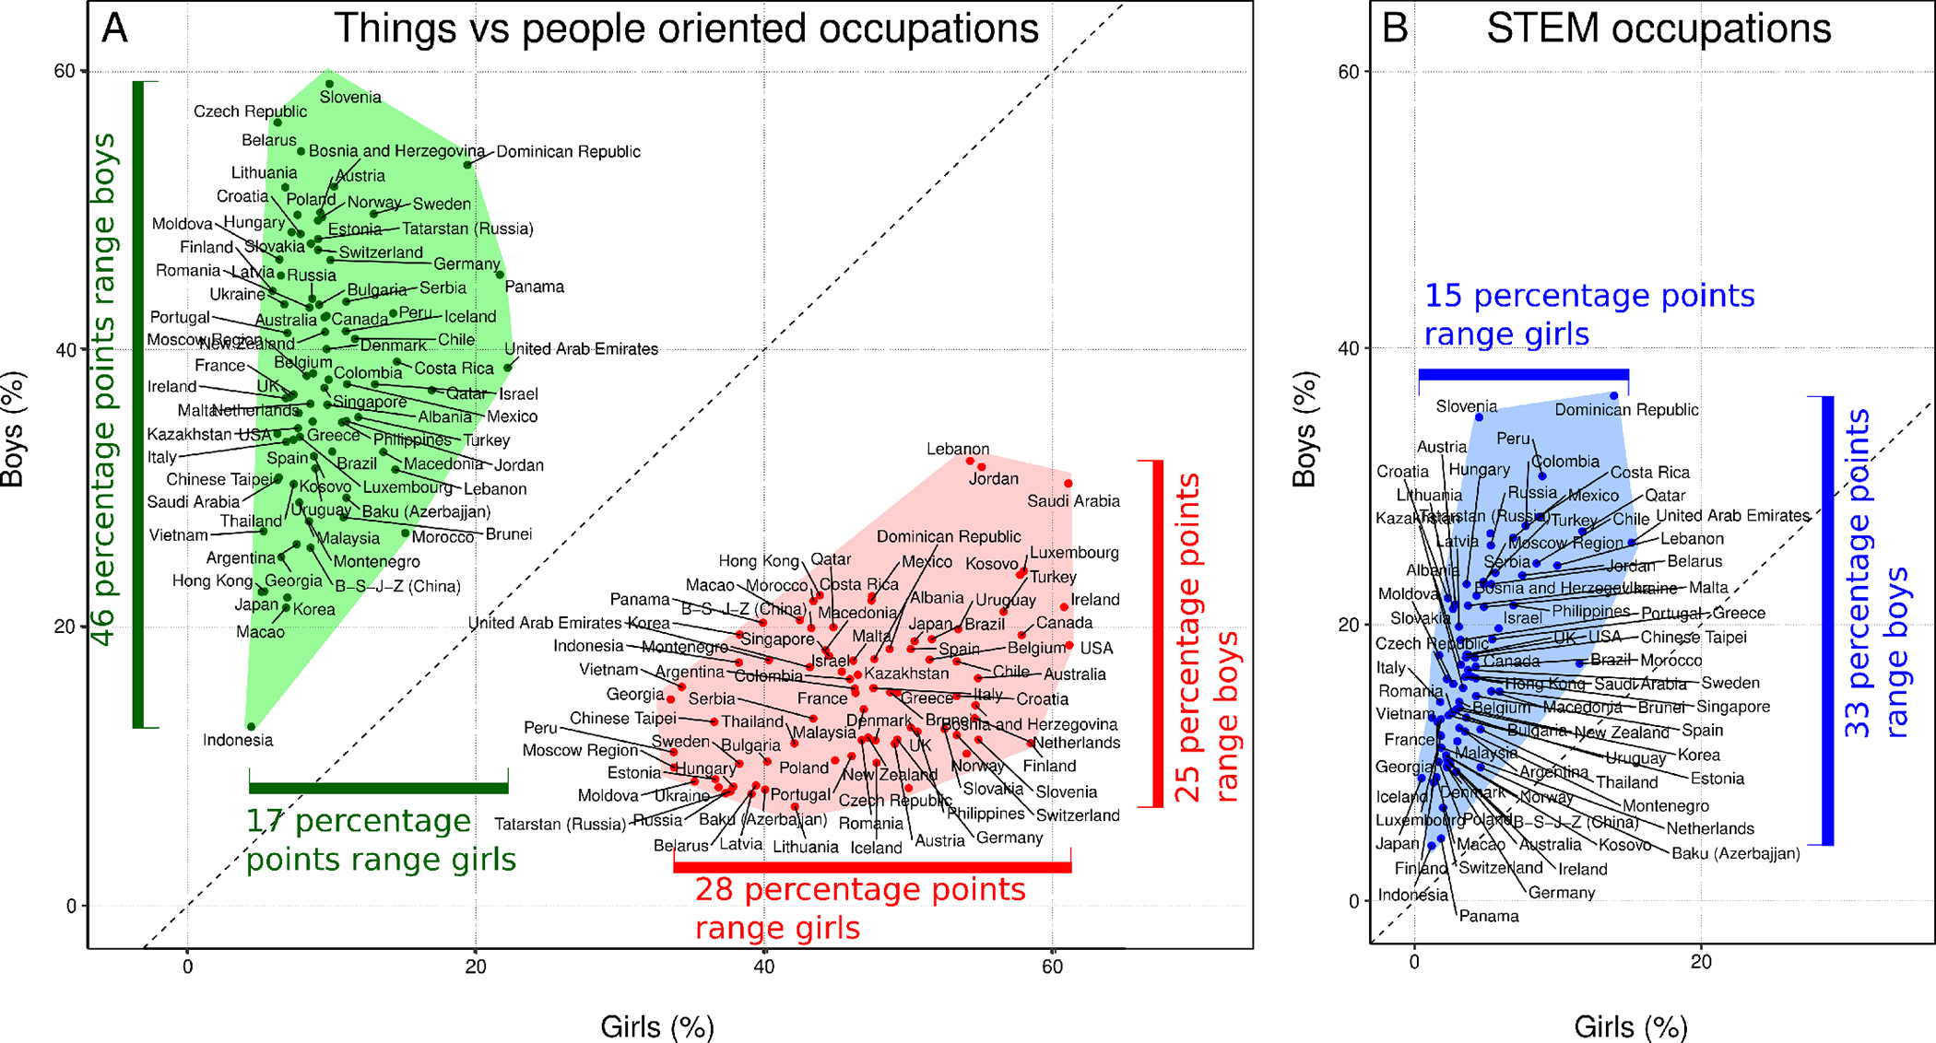
Gender Preferences in Occupation
Things-oriented occupations are heavily focused on using or designing a tool or machinery
People-oriented occupations are centered around interacting with clients, customers, or children.
Notes:
Source: Stoet, G., & Geary, D. C. (2022). Sex differences in adolescents’ occupational aspirations: Variation across time and place. PLoS ONE, 17, e0261438.
Things-oriented occupations are heavily focused on using or designing a tool or machinery. These include blue-collar and white-collar occupations, such as welding, civil engineering, or application programmer. People-oriented occupations are centered around interacting with clients, customers, or children. These include all teaching and instructor occupations as well as professions that involve helping patients (e.g., physician, nurse). Occupations that did not fit either of these categories, such as biologist, legislator, or accountant, were classified as "other." We also separately analyzed aspirations for entry into things-oriented STEM occupations (e.g., engineer).

Slide 74
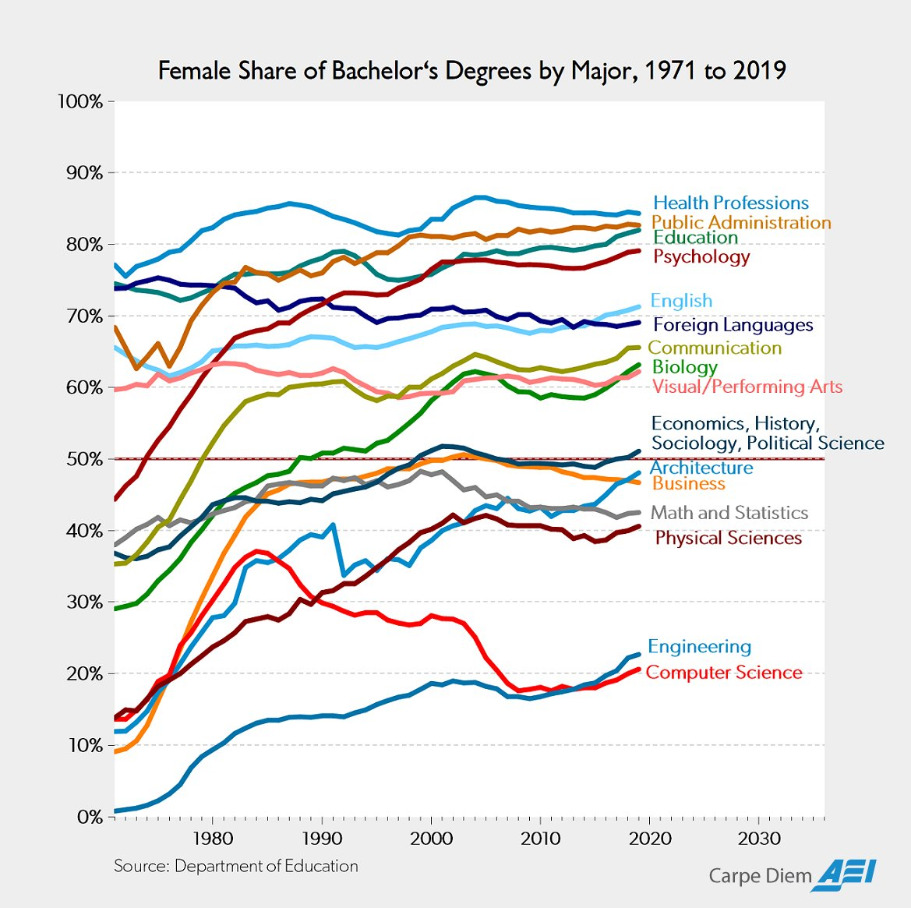
Gender Disparities in Education are the Main Outcome of Preferences

Slide 75
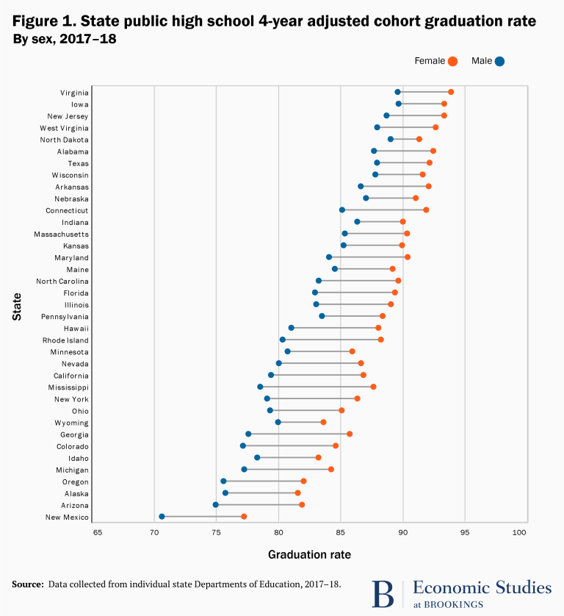
The New Norm in Gender Discrimination

Slide 76
Occupations by Gender Shares of Employment, United States 2010
Notes:
Source: US Department of Labor. https://www.dol.gov/wb/stats/occ_gender_share_em_1020_txt.htm

Slide 77
Additional Reading
An Introduction to Economic Geography
  Chapter 6 (Introducing Economic Geography), pages 167-196.

