Slide 1
Topic 2 – Historical Developments of Capitalism
A – Feudalism and Capitalism
B – The Industrial Revolution
C – Colonialism and its Demise
D – Waves of Economic Change

Slide 2
Conditions of Usage
For personal and classroom use only
  Excludes any other forms of communication such as conference presentations, published reports and papers.
No modification and redistribution permitted
  Cannot be published, in whole or in part, in any form (printed or electronic) and on any media without consent.
Citation
  Dr. Jean-Paul Rodrigue, Dept. of Global Studies & Geography, Hofstra University.

Slide 3
A - Feudalism and Capitalism
The Feudal System and its Demise
Mercantilism

Slide 4
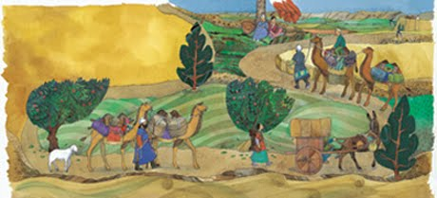
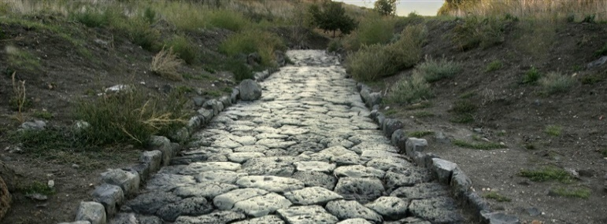
Ancient Trade Issues
Nature of Trade
Limited market size geared to the elite.
High-value commodities (silk, spices, perfumes, gems, gold, silver, ivory).
Bulk commodities could be traded when maritime transport was available (grain, wine, olive oil).
Many intermediaries.
Limiting Factors
Limited capacity and speed of inland transportation.
Diversity of currencies and units of measure.
High tariffs.
Unreliable navigation.
Insecurity / piracy.
Read this content

Slide 5
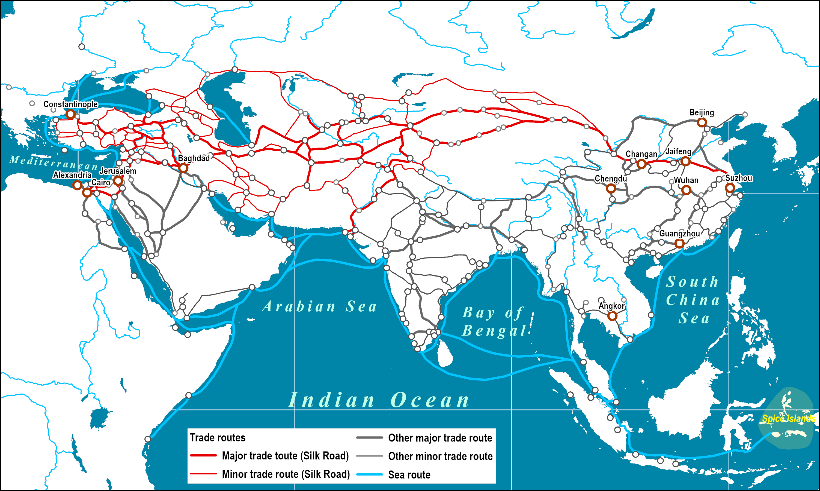
The Silk Road and Arab Sea Routes (11th and 12th Centuries)
Read this content

Slide 6
1. The Feudal System and its Demise
The Feudal society
  A system of bonds and obligations:
    Power in land ownership.
    Administrative/legal (Lord) and religious (Church) control.
    Rent/Royalties from the serf to the lord (in-kind or labor).
    Fixation of the productive forces (tools and labor) in agricultural production.
    Limited socioeconomic changes over centuries.
  Economy:
    Small local markets (fairs).
    Trade relatively limited.
    Low levels of productivity (subsistence level).
    Profits taken away by the lord/church, inhibiting any increases in agricultural productivity.
    80 to 90% of the population was in agriculture.
    Institutional barriers to innovation
  Different types of feudal societies (East Asia, Central Asia, Middle East, Europe).

Slide 7
1. The Feudal System and its Demise
The end of the Middle Ages
  The Plague of 1348 created labor shortages and social disruptions.
  Skewed wealth distribution by nobles and the Church:
    Bias towards the production and distribution of high-value luxury goods.
    Unrests asking for reforms and freedoms (e.g. Magna Carta, 1215).
  Market fragmentation:
    Diversity of currencies.
    Different units of measure.
    Tariffs imposed on goods moving between small kingdoms.
  The emergence of a merchant class (proto-capitalism):
    Commodification of goods and services.
    Hostility of the nobility and the Church towards merchants.
    Lack of prestige of crafts.

Slide 8
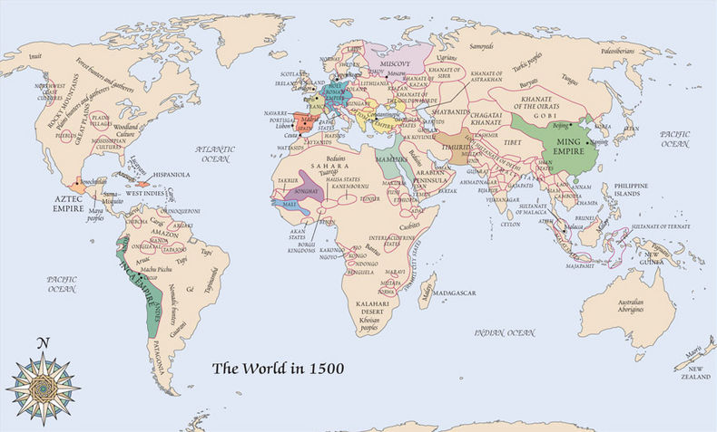
Feudal Empires and Main Tribes, 1500

Slide 9
1. The Feudal System and its Demise
The European origin of the global economy
  Until the 1500s, the world was dominated by feudal or tribal systems.
  The fifteenth century marked the beginning of an expansion of European control throughout the world.
  Europe progressively assured the development of the global economy:
    Extension of its hegemony.
    Mercantilism was the first phase.
    The industrial revolution was the second.
  Over three centuries (1500-1800):
    The setting of capitalistic systems.
    Limits of the world were pushed away.
    A world where borders are drawn; a delimited world.
    Establishment of vast colonial empires.
    Waves of innovations and socio-economic transformations.
Which role Europe played in the setting of the global economy?

Slide 10
The Pillars of Mercantilism
Nation-State
Promotion of national wealth and power.
Unequal Trade
Rise of merchants, markets and fairs.
Encourage domestic production and exports, discourage imports.
Techniques
Gunpowder and artillery.
Improvements in navigation, maritime shipping and transport.
Moveable type (mass production and marketing of books).
Mechanical clocks, instruments, increased skills of craftsmen.
Projection of national sea power to control foreign markets.
Discovery and setting of new markets through colonization.
Positive trade balance with other countries under control (zero sum game).
Wealth measured by the amount of bullion (gold or silver).
Treaty of Westphalia (1648); temporal authority of the state.
Setting of the first multinational corporations.

Slide 11
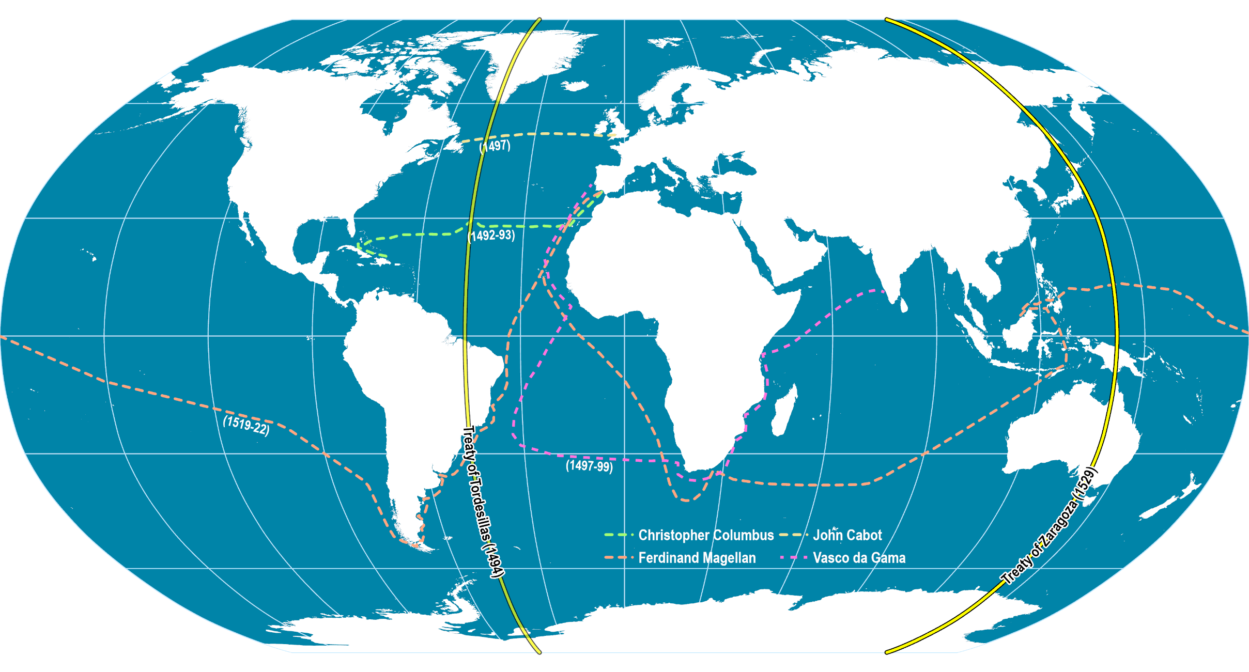
Early European Maritime Expeditions, 1492-1522
Exploration (inventory of territories and resources).
Setting of colonial empires (control of territories).
Setting of a global trade network.
Read this content

Slide 12
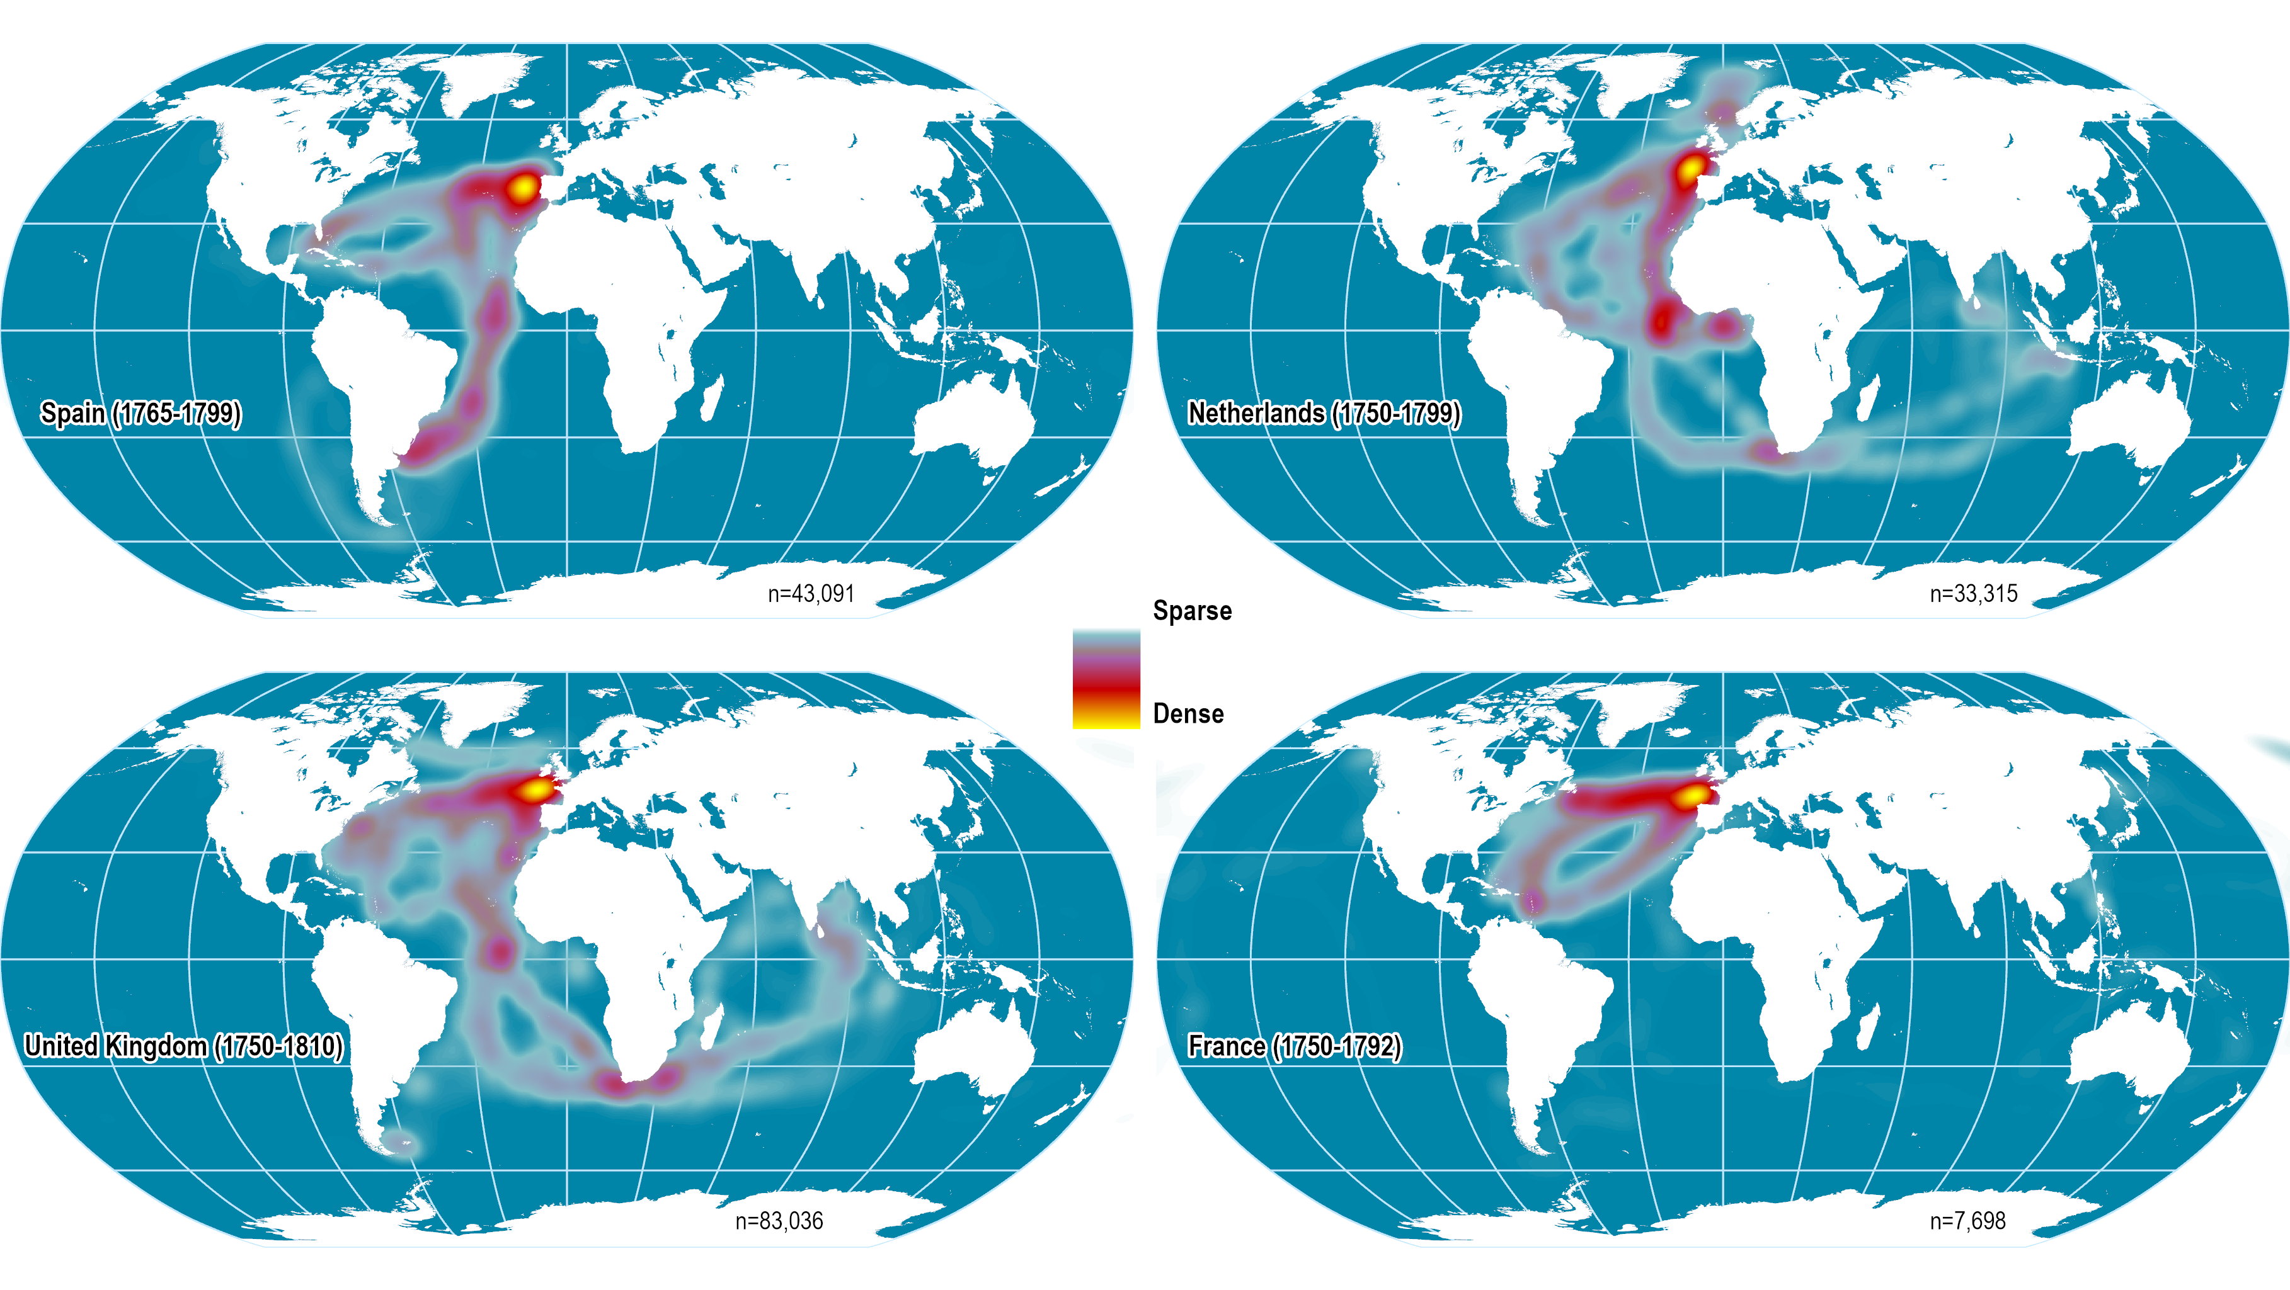
Density of Ship Log Entries, 1750-1810
Read this content
Notes:
Source: CLIWOC Project. Data geocoded by David Hopp.

Slide 13
2. Long Distance Trade
Trading companies: Private mercantilist tools
  From the 17th to the 18th century trading companies acted on behalf of European governments in East Asia.
  Joint stock companies.
  Guarantied trade monopoly:
    Rights paid to their respective governments.
  Almost states in themselves:
    Had their own ships (military and merchant) and military forces.
    Could acquire and manage a foreign territory.
  Developed trade links for commodities such as pepper.
  Increasingly involved in the control and development of their respective territories.
  Faced lack of interest from European governments.
Explain the role trading companies played in the setting of a mercantilist trade system.

Slide 14
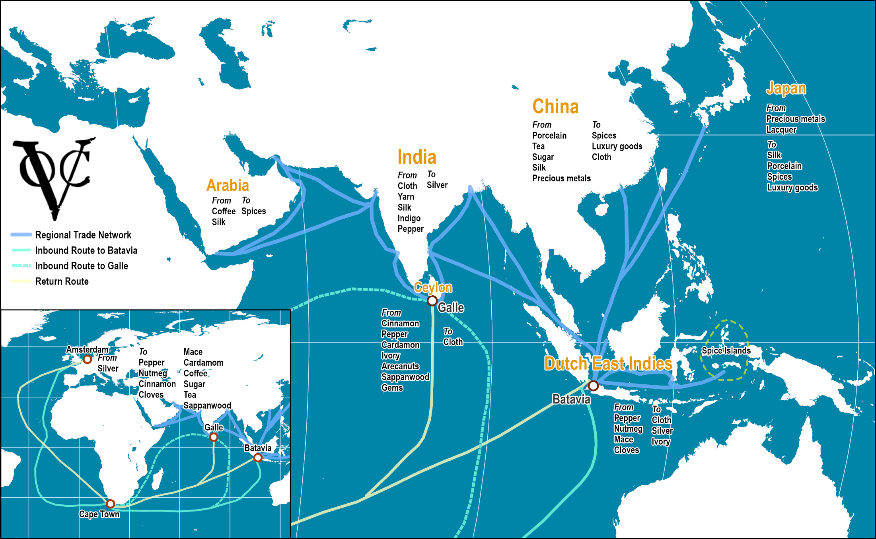
Dutch East India Company, Trade Network, 17th Century
Read this content
Notes:
Source: adapted from: http://cf.hum.uva.nl/galle/galle/voc_shipping.html

Slide 15
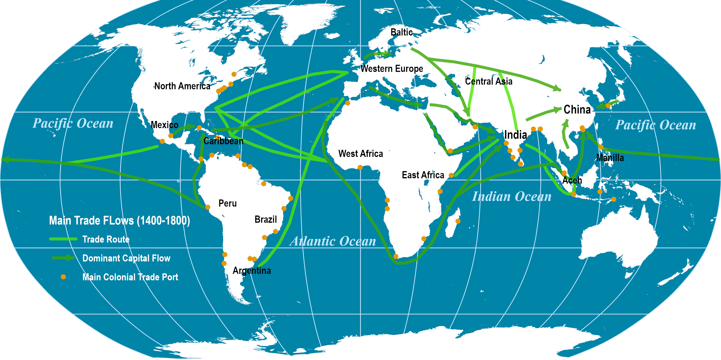
Major Global Trade Routes, 1400-1800
Read this content

Slide 16
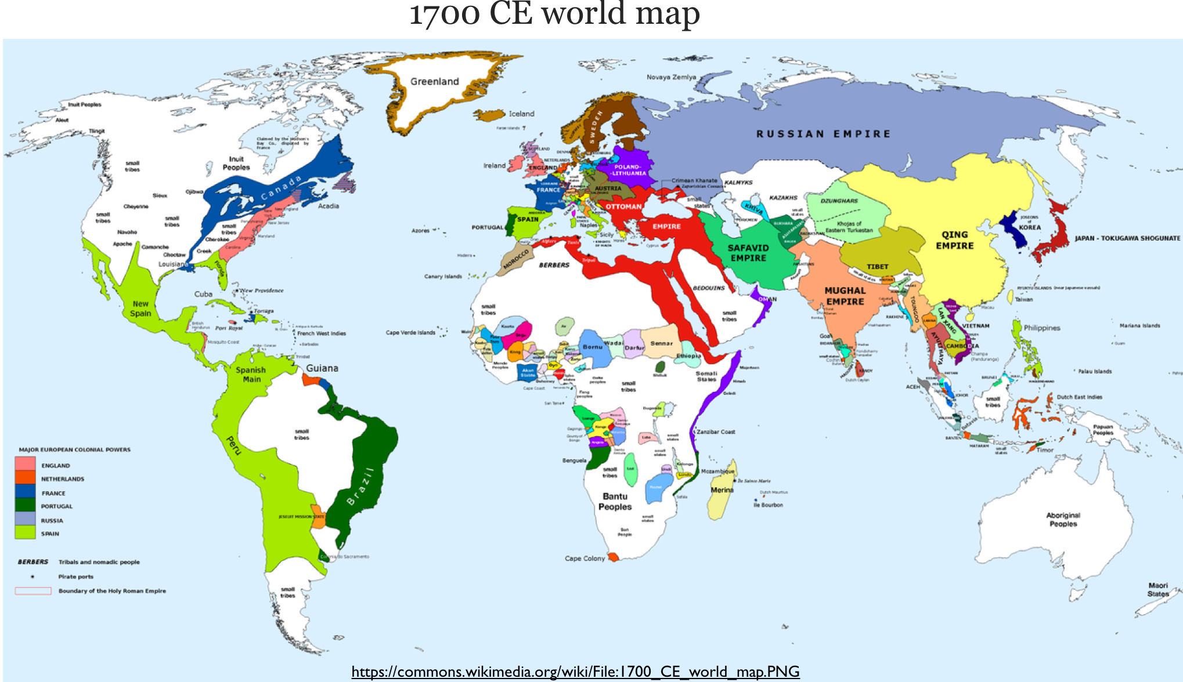

Slide 17
B - The Industrial Revolution
The European Origins of the Industrial Revolution
A “Revolution” in Industry

Slide 18
2. A “Revolution” in Industry
Emergence
  Started at the end of the 18th century (1750-1780).
  Economic and social transformations first observed in England.
  Demographic transition of the population:
    Fast growth rate of the European population.
    Improvements in sanitary conditions and hygiene.
  Why speak of “revolution” for a process occurring over on more than 150 years?
    At the scale of the world’s economic history, the industrial revolution radically changed the foundations of economic systems.
    It established the foundations of the global of the economy.
    Most of the technical innovations took place on a short period, mainly between 1760 and 1800.

Slide 19
1. The European Origins of the Industrial Revolution
Competition
Political fragmentation (monarchies and republics).
The Scientific Revolution
17th century breakthroughs in mathematics, astronomy, physics, chemistry and biology (Age of Enlightenment).
The Rule of Law and Representative Government
Private property rights.
Divided into competing corporate entities (early multinationals).
Representation of property owners in elected legislatures.
The scientific method.
Individualism and freedom.

Slide 20
1. The European Origins of the Industrial Revolution
Modern Medicine
Breakthroughs in health care (19th and 20th centuries).
Capitalism
Supply of productivity-enhancing technologies.
Work Ethic
Combine more extensive and intensive use of labor.
Decline in death rates and increase in life expectancy.
Demand for more, better, and cheaper goods.
Higher savings rates; sustained capital accumulation.
Clearly defined work schedules.

Slide 21
1. The British Origins of the Industrial Revolution
Geographical Setting
Availability of coal and iron resources.
Island setting: access to commerce, short inland distances.
Demographic changes
Population growth and urbanization.
Availability of capital
Colonial empire as a source of surplus.
Commercial activities to funnel capital surplus.
High wage economy inciting mechanization.

Slide 22
2. A “Revolution” in Industry
Technological innovations
  New methods of production by trials and errors:
    New materials (steel, iron, chemicals).
    Substitution of machines to human and animal labor.
    Usage of thermal energy to produce mechanical energy.
  Changes in the nature production and consumption:
    Textiles.
    Steam engine.
    Iron founding.
  Production (factory):
    The first factories appeared after 1740.
    Division of labor.
    Increased productivity within a factory system of production.
    Location (initially waterfalls and then coal fields).
What are the main economic foundations of the industrial revolution?

Slide 23
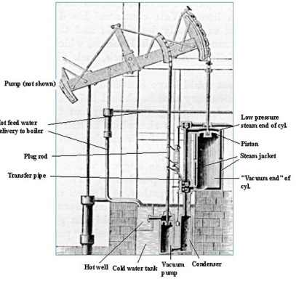
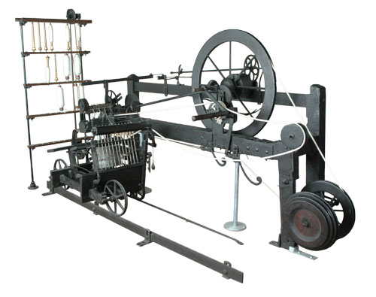
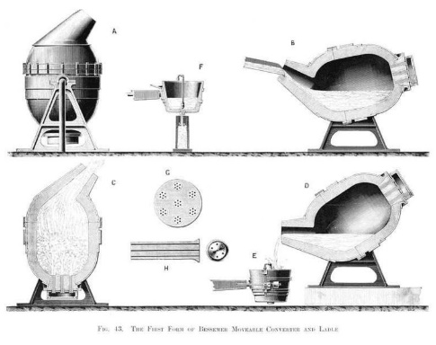
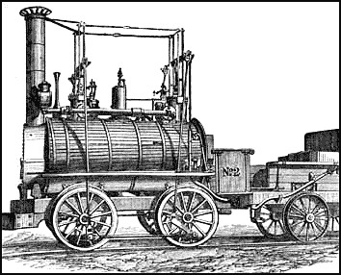
Major Technological Innovations of the Industrial Revolution
Power Generation | Textiles | Metallurgy | Transportation
Thermal energy used for mechanical energy | Mechanization of spinning and weaving | Mass production of steel (shipbuilding, rails, construction and machines) | Modern transport and telecommunication systems
First pump (1712) for water in mines. Watt (1769); significant improvements. Steam locomotive (1824). Electric generator (1831). Steam turbine (1884). | “Flying shuttle” (1733) doubled weaving productivity. “Spinning jenny” (1765). “Water frame” (1768); hydraulic power. “Spinning Mule” (1779); steam power. Sewing machine (1846). | Coke instead of coal for iron production (1709). Bessemer process (1855). | Railroads (1825). Telegraph (1834). Steamship (1838). Telephone (1876).
Notes:
Global steel production grew from 0.5 million tons in 1865 to 50 million tons in 1914.

Slide 24
Annual Energy Consumption in England and Wales, 1560s to 1850s (MJ)
Read this content
Notes:
Source: adapted from Wrigley, E.A. (2010), Energy and the English industrial revolution, Cambridge University Press.

Slide 25
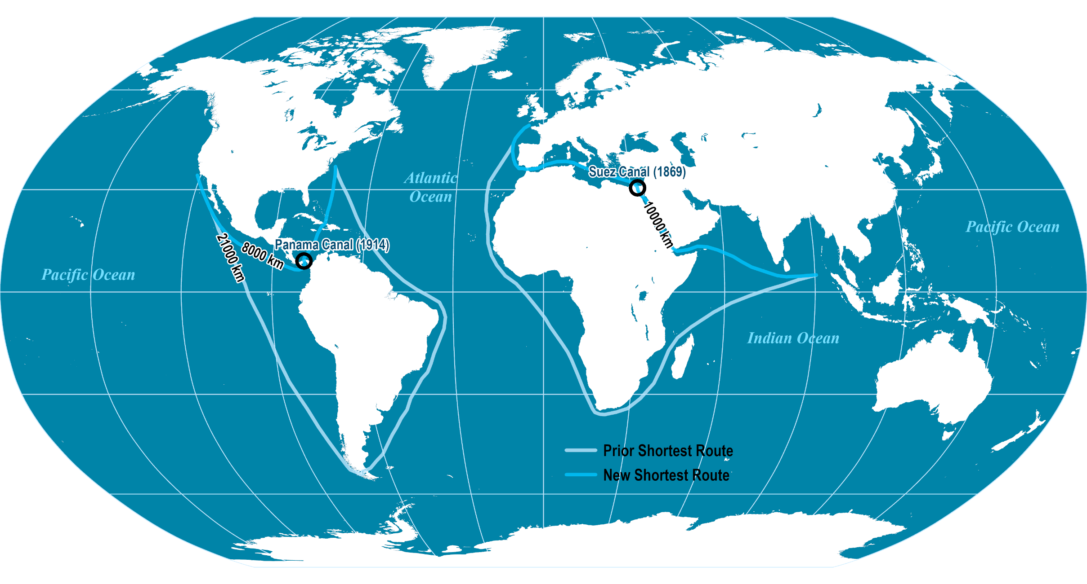
Geographical Impacts of the Suez and Panama Canals
Read this content

Slide 26
Productivity in the Textile Industry, Great Britain , 1829-1882
Notes:
Source: Rioux, J-P (1989) La révolution industrielle 1780-1880, Paris: Éditions du Seuil, p. 70.

Slide 27
Turnpikes in Great Britain, Late 18th and Early 19th Century
Read this content
Notes:
Source: adapted from D. Bogart (2004) "Turnpike Trusts and the Transportation Revolution in Eighteenth Century England", http://orion.oac.uci.edu/~dbogart/transportrev_oct13.pdf

Slide 28
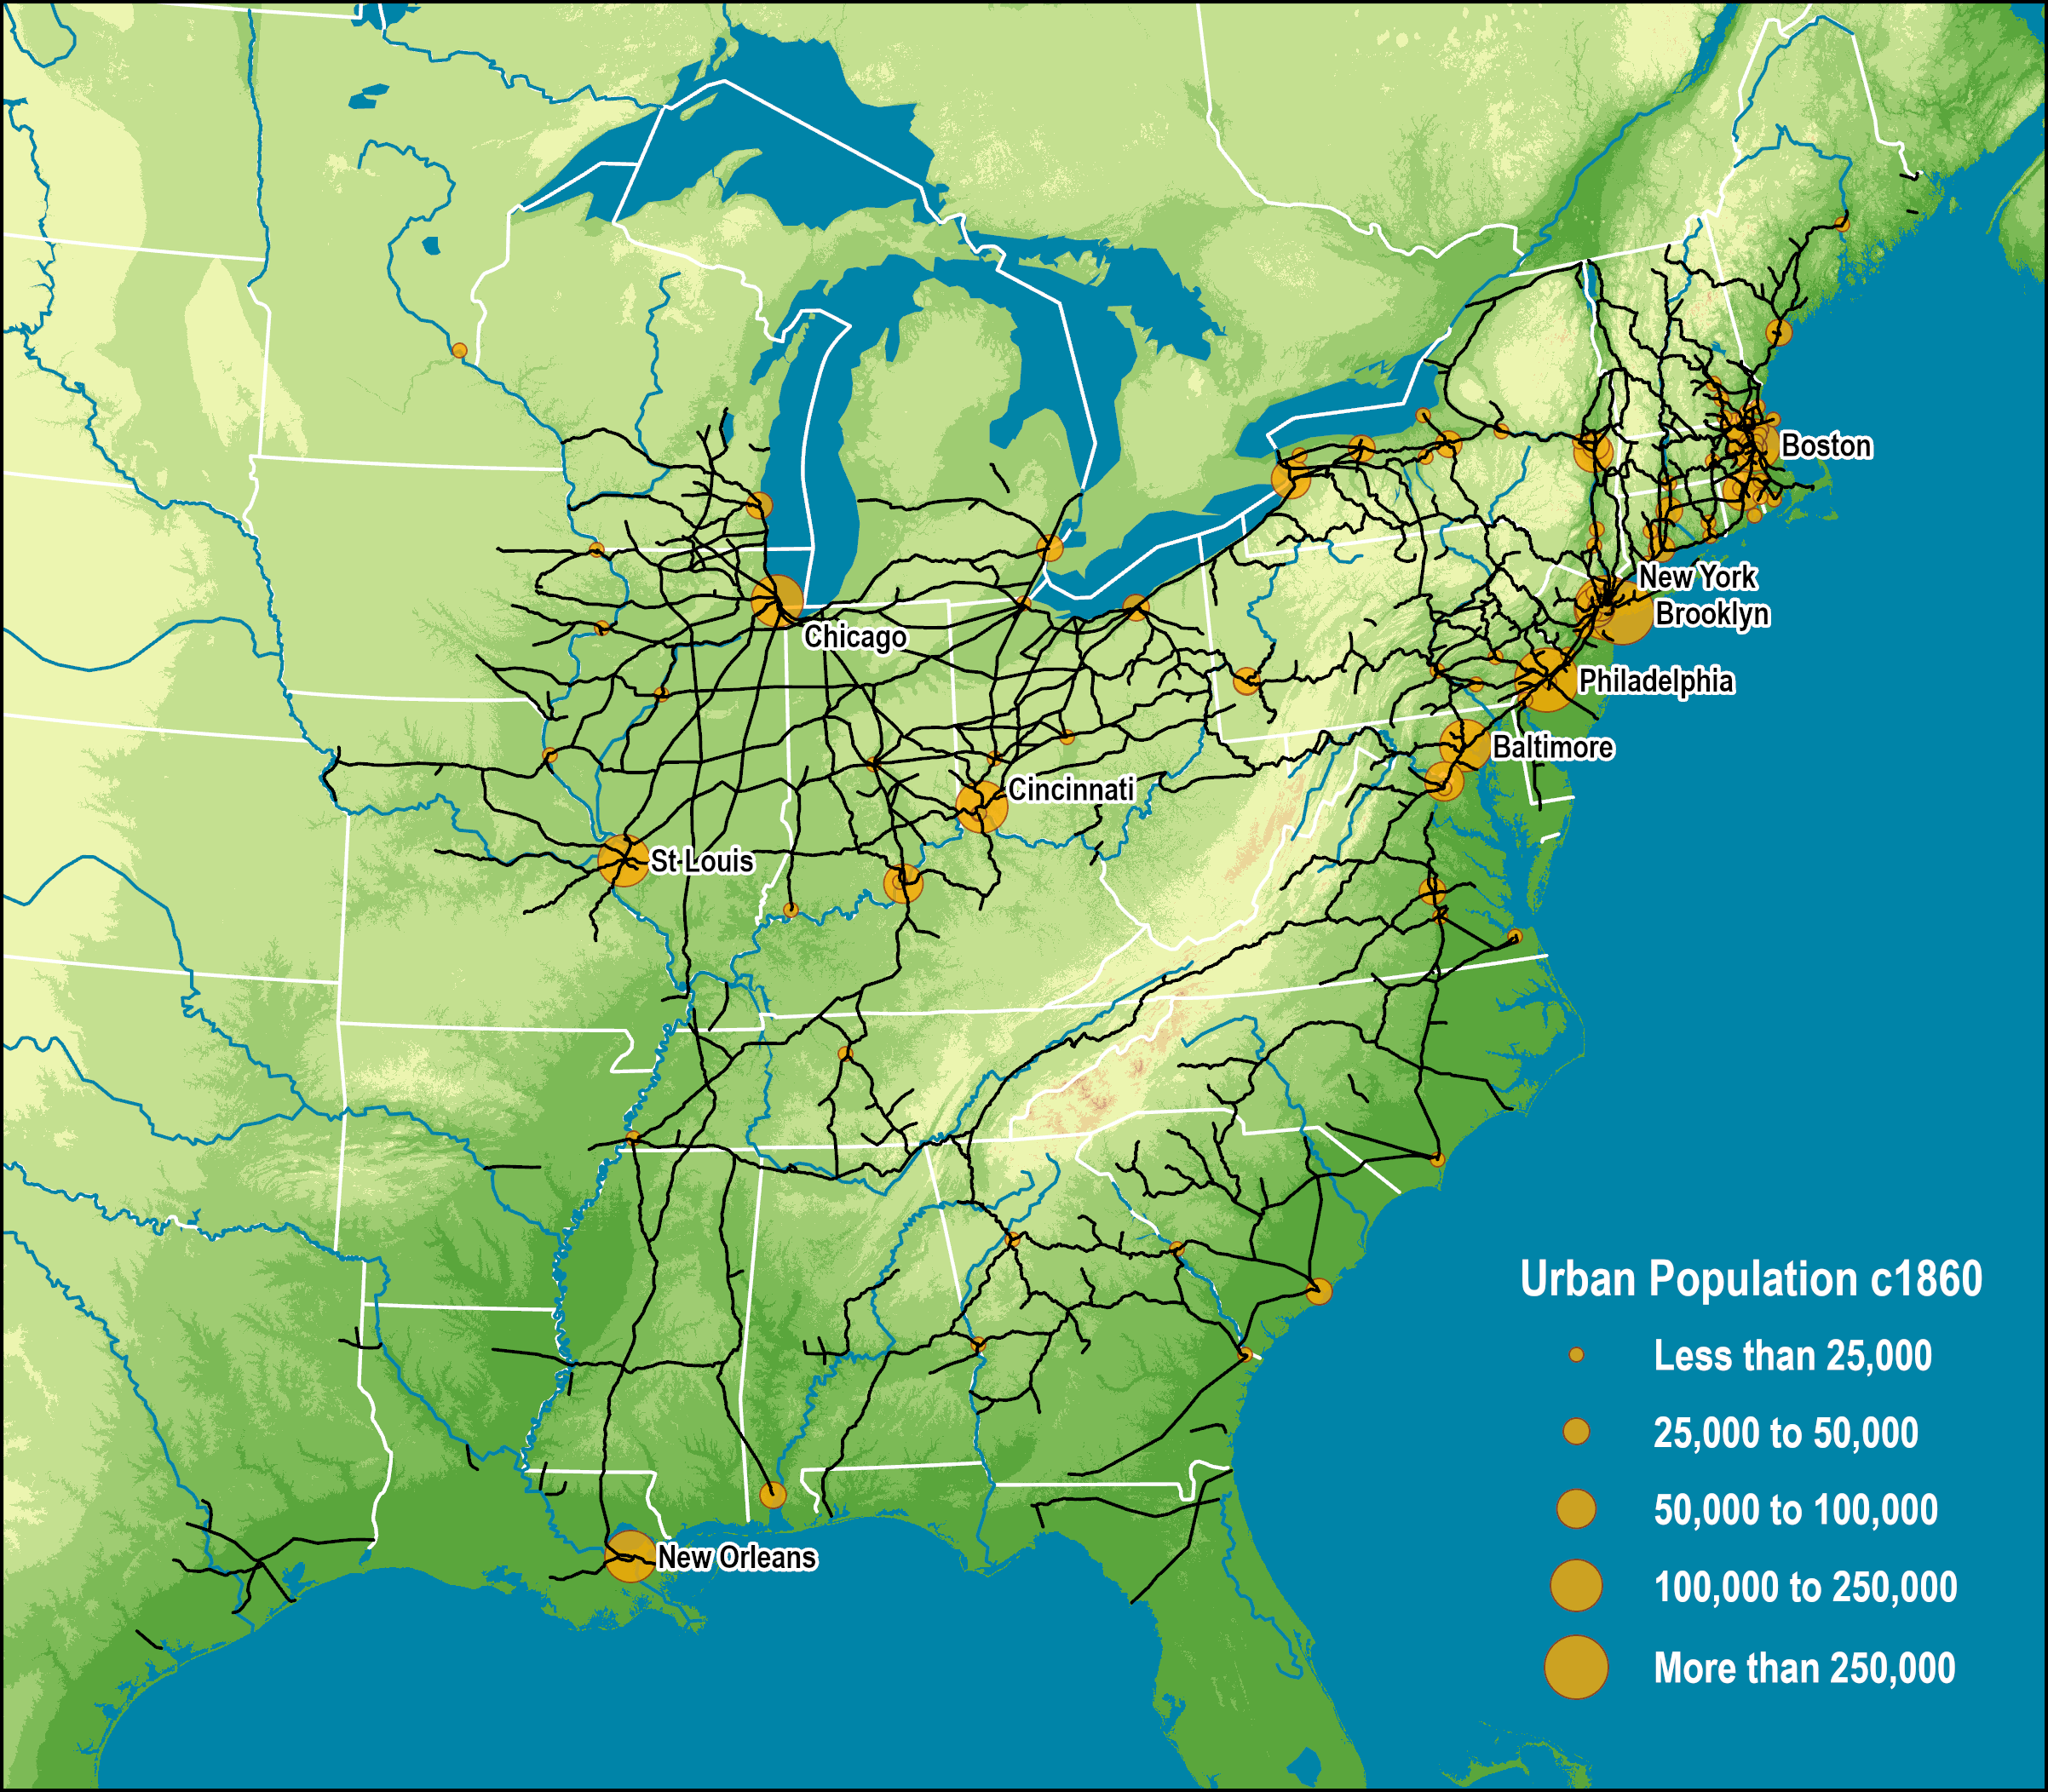
American Rail Network, 1861
Read this content
Notes:
Sources: Railroads and the Making of Modern America, University of Nebraska, Lincoln (Rail Network). US Census Bureau (Urban Population).

Slide 29
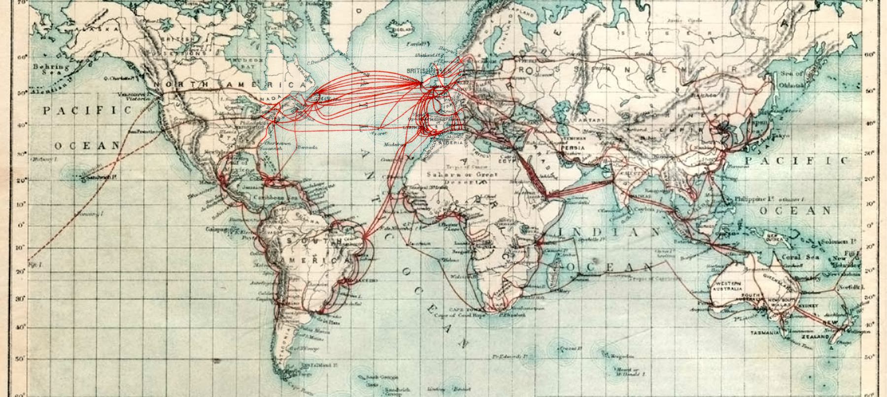
Global Telegraph System, c1901 (the Victorian Internet)
Notes:
Source: www.atlantic-cable.com/Maps/
1901 Eastern Telegraph Company System Map from A.B.C. Telegraphic Code 5th Edition

Slide 30
2. A “Revolution” in Industry
Agriculture
  A second agricultural revolution.
  Introduction of new food sources:
    The potato could account for 22% of the post-1700 increase in population growth.
  Crop rotation (four field system), selective breeding, and seed drill technology.
  Less agricultural population.
  Growth of the production of food.
  Mechanization and fertilizers:
    Combine (McCormick, 1831).
  Scientific and commercial agriculture (crop rotation).
  Declining food prices.

Slide 31
2. A “Revolution” in Industry
Consequences of the industrial revolution
  Laissez-faire economics:
    Business operating with limited government regulation.
  Emergence of large corporations.
  Large scale urbanization.
  Development of modern transport systems:
    Setting of high capacity maritime and inland (rail) transport systems.
  Improved standards of living.
  Consolidation of colonialism:
    Scramble to capture remaining territories.
    First Opium War in 1839.
    Opening of Japan in 1853.
    Consolidation of British Raj in 1858.
    “The Scramble for Africa” in 1890s.

Slide 32
2. A “Revolution” in Industry
Social changes
  Significant urbanization:
    Migration from the countryside to cities.
    By 1870 more of the half of the population of the first industrial nations was no longer in the agricultural sector.
    England had reached this stage since 1820.
    Towards 1901, 75% of the English population lived in cities.
  Creation of a labor class:
    Exchange of labor for a wage.
    Initial harsh working conditions and significant improvements afterwards (late 19th century).
  London:
    Counted for half a million inhabitants in 1700.
    Reached a million during the first English census of 1801.
Explain the main socioeconomic changes brought by the industrial revolution.

Slide 33
Share of the Population in Agriculture, Early Industrial Countries, 1820-1910
Read this content
Notes:
Source: Rioux, J-P (1989) La révolution industrielle 1780-1880, Paris: Éditions du Seuil, p. 197.

Slide 34
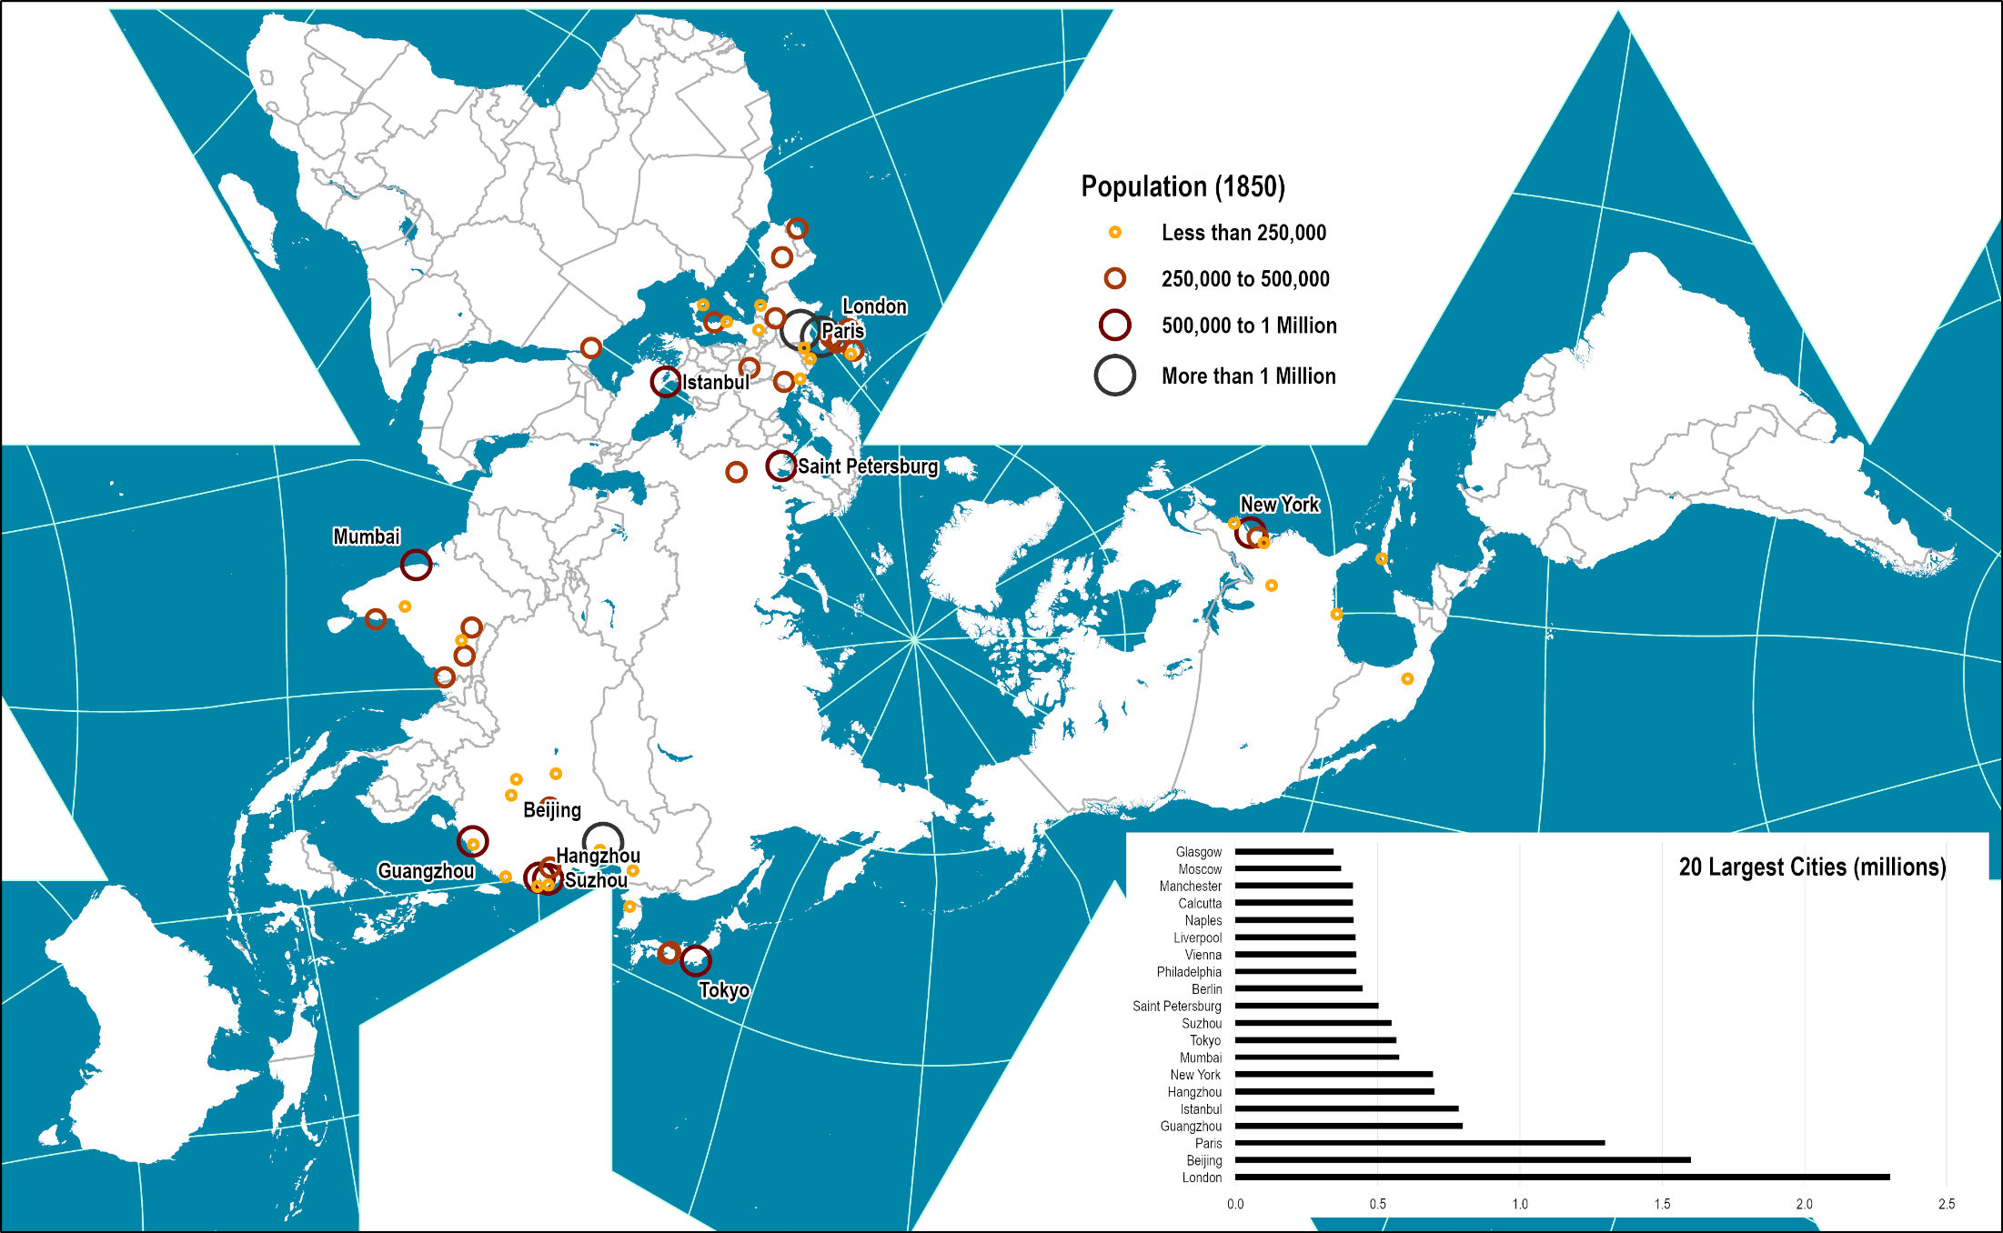
World’s Largest Cities, 1850
Read this content

Slide 35
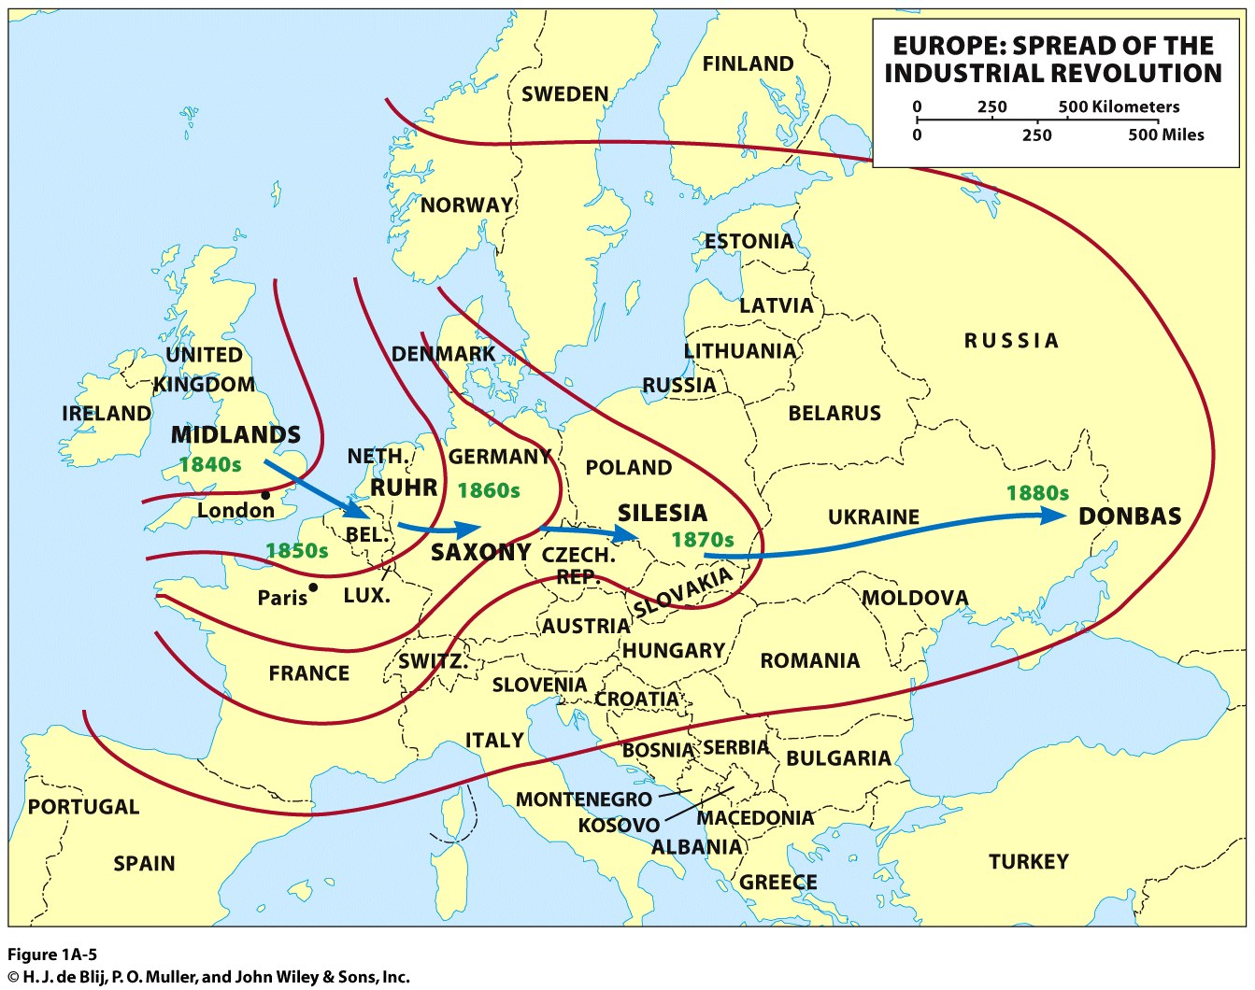
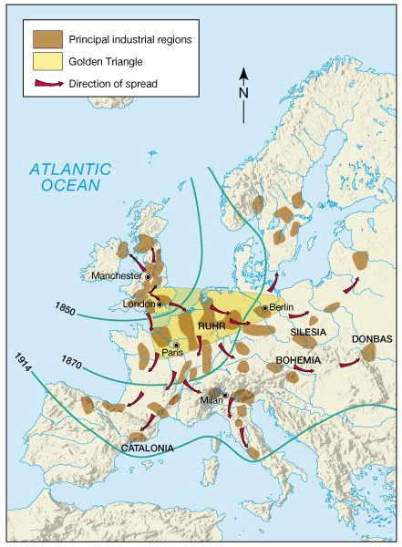
Along the coal and iron ore fields

Slide 36
C – Colonialism and its Demise
Colonial Economic Systems
The Demise of Colonialism

Slide 37
1. Colonial Economic Systems
Colonialism
  Economic incentives:
    Search for raw materials (‘colonial’ commodities; tea, coffee, sugar, cocoa, minerals).
    Expansion of national market into monopolistic areas.
    New territories for capital investments in infrastructure (ports, railways, roads).
    Territories for European migration (demographic transition).
  Political and strategic factors:
    National prestige and manifest destiny (proof of success and power).
    Control of strategic locations for trade benefits (Suez, Malacca, Gibraltar, Malta, Hong Kong).
  Cultural:
    The drive for discovery (territories, biology).
    Spread of religion and culture.
  Technological factors
    Scientific advantages.
    Military superiority.

Slide 38
1. Colonial Economic Systems
Two waves of colonialism:
  First wave: Mercantilism (1415 – 1815); independence of the Americas.
  Second wave: Industrial revolution (1815-1969).

Slide 39
Impacts of Colonialism
Demographic impact
Economic
Export-oriented plantations (sugar, cotton, tea, coffee, fruits, rubber, tobacco, etc.).
Dual society
Concentration of power and wealth in a ruling elite class (sometimes a minority).
Artificial boundaries
“Balkanization”.
Forced long distance migration through slavery (Africa) or contract workers (Southeast Asia).
Some indigenous population decimated because of diseases (e.g. smallpox), wars and relocations.
Economic dependency; Suppressing industrialization.
Population in servitude (e.g. taxation).
Land expropriation (limited concept of land ownership in many pre-colonial societies).
40% of the world’s international boundaries traced by the UK and France.

Slide 40
1. Colonial Economic Systems
On the positive side…
  Incited the development of long-distance transportation (maritime, then air) and telecommunications.
  Favored global economic growth, integration and migration.
  Created resources that did not exist before (coffee, sugar, minerals, oil).
  Formation of nation states and national identities.
  Diffusion of science and technology in societies that would not have provided innovation.

Slide 41
Colonies Controlled by Main Colonial Powers, 1500-2000

Slide 42
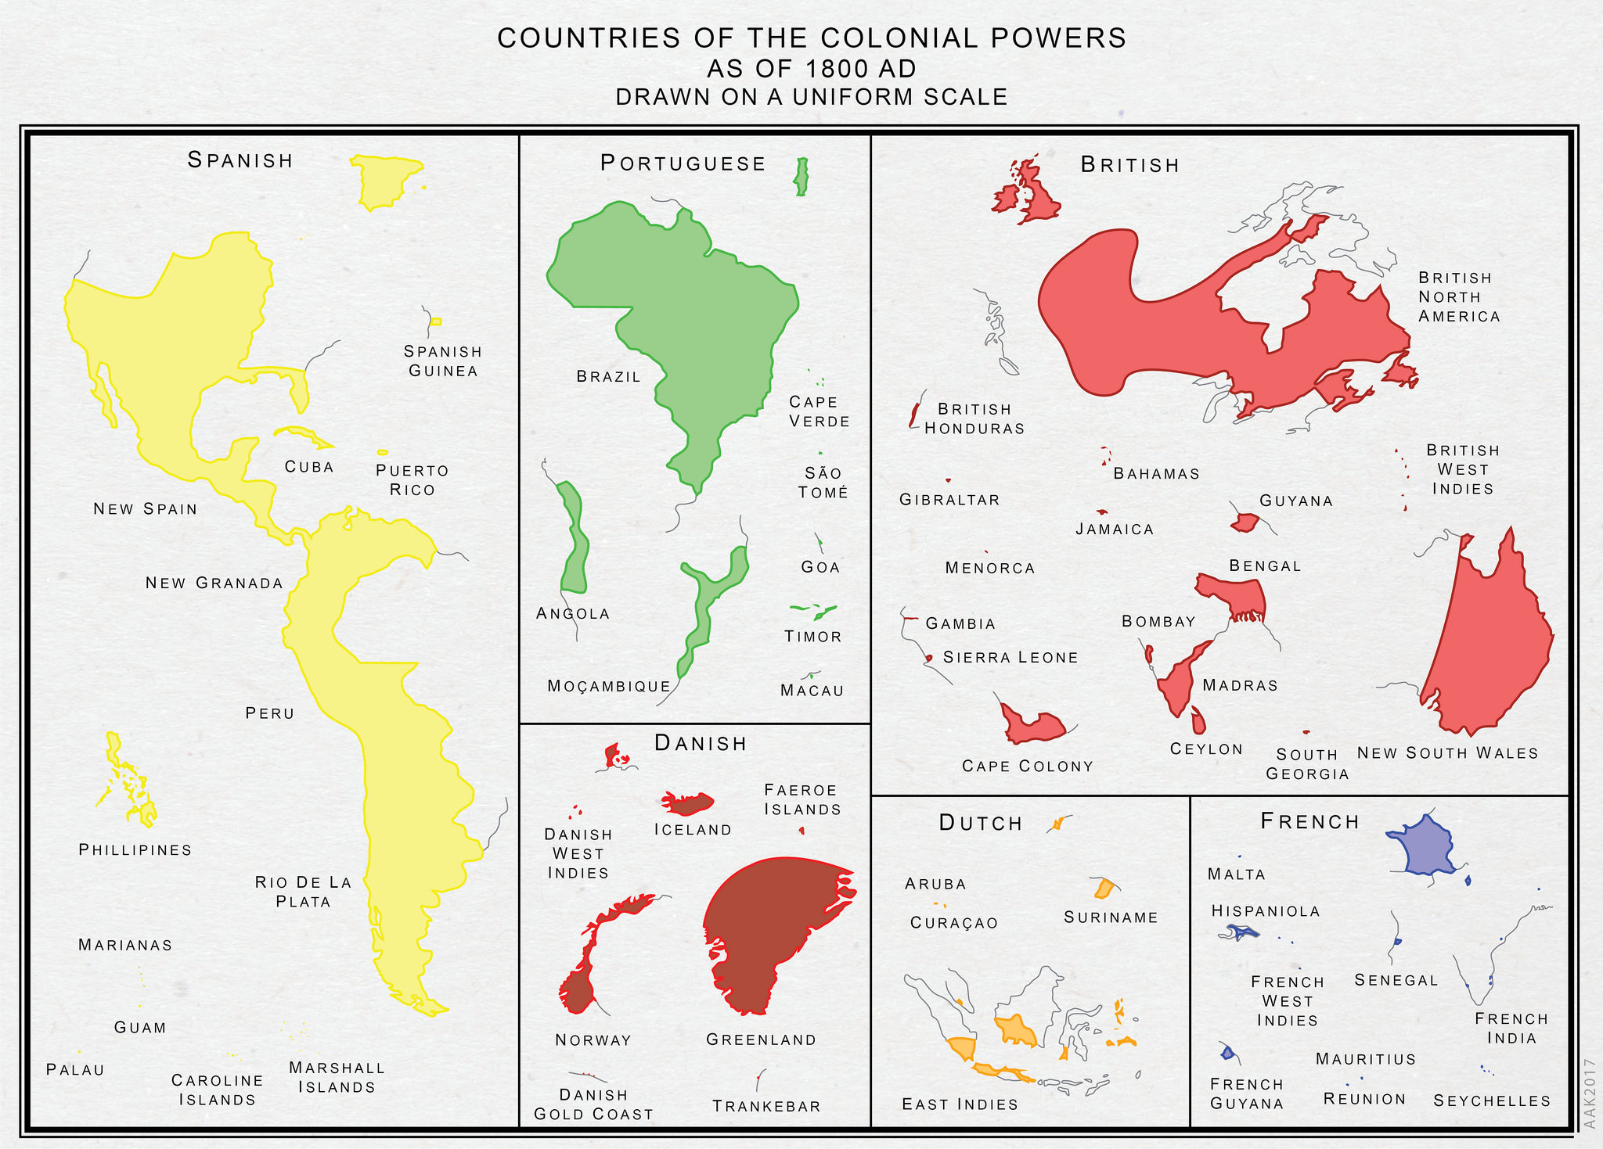

Slide 43
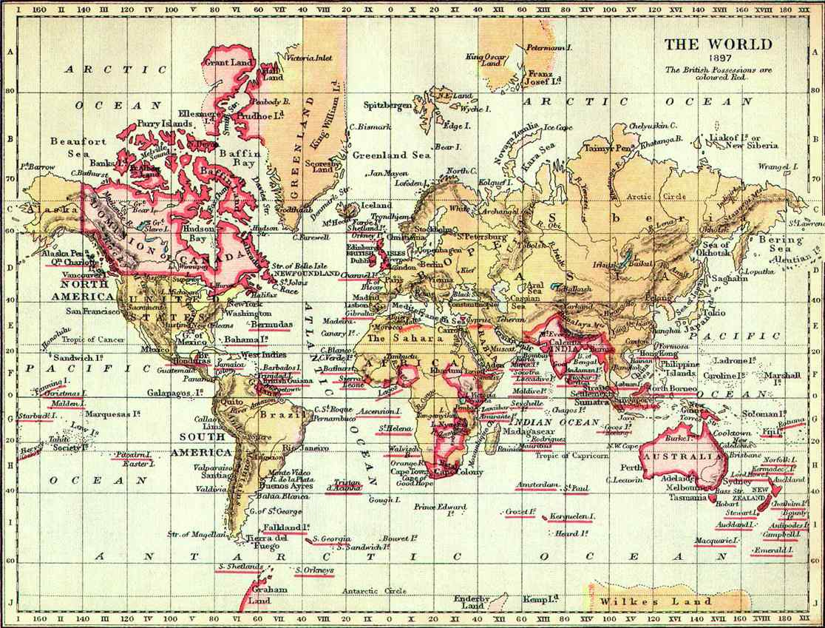
The British Empire, 1897
20% of the world’s surface
25% of the world’s population

Slide 44
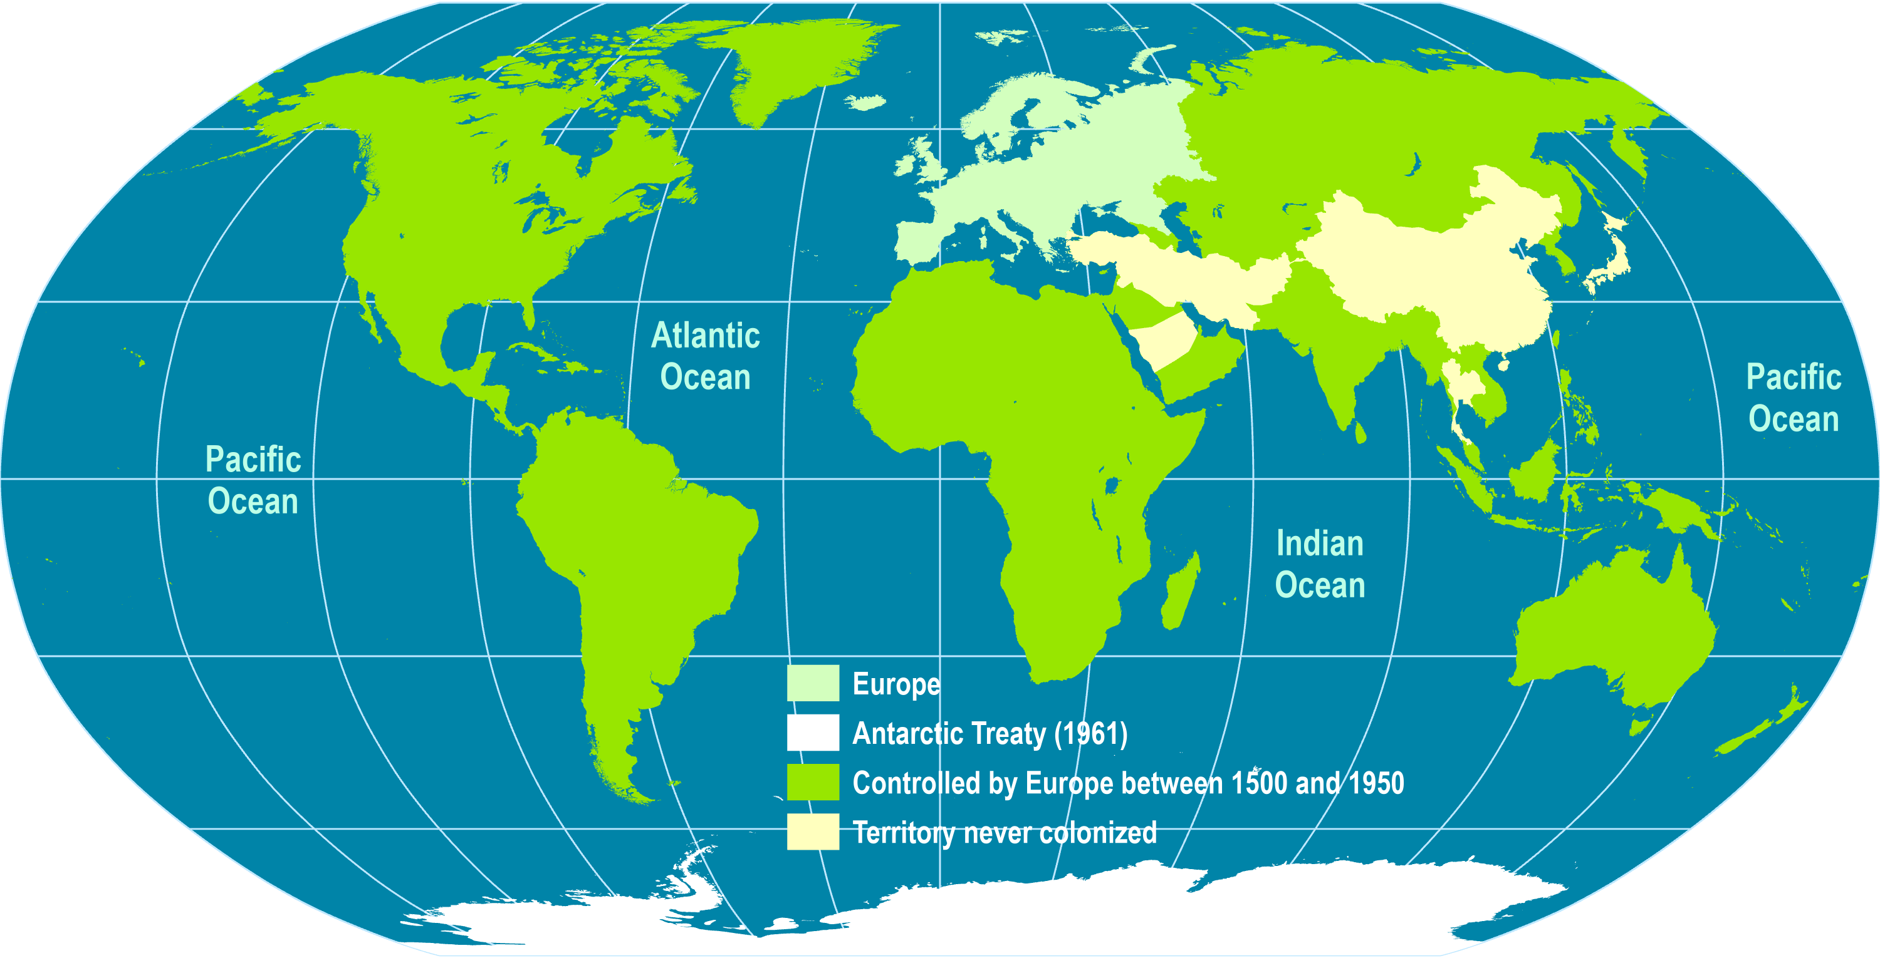
European Control of the World, 1500-1950
1800 (37%)
1878 (67%)
1913 (84%)
40% of the world’s international boundaries traced by the UK and France.

Slide 45
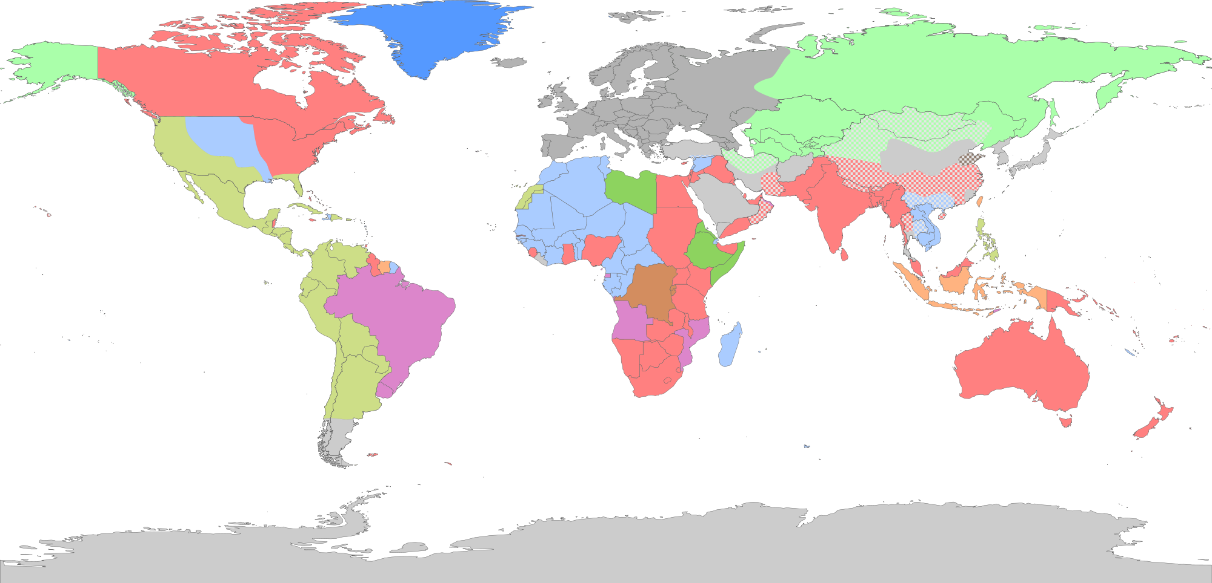
Territories that Belonged to a Colonial Empire
Belgian
British
Danish
Dutch
French
Italian
Portuguese
Russian
Spanish
What were the main impacts of colonialism on the world economic geography?
Notes:
Source: http://en.wikipedia.org/wiki/File:European_Empires.svg

Slide 46
2. The Demise of Colonialism
Decolonization
  Emerging nationalisms and patriotisms:
    Successful first wave of independence in the Americas after the Napoleonic Wars (late 18th, early 19th century).
    Second wave upheld by leaders such as Bolivar (Latin America), Sun Yat-sen (China), Mao Zedong (China), Ho Chi-Minh (Vietnam) and Sukarno (Indonesia).
  Increasing democratic views were making the concept of colonies morally untannable.
  WWII:
    Japan’s impact in Pacific Asia during WWII.
    WWII left European countries without the means and will to maintain colonial empires.
  High costs of maintaining colonies.
  Created a wide variety of post-colonial governments and ideologies.

Slide 47
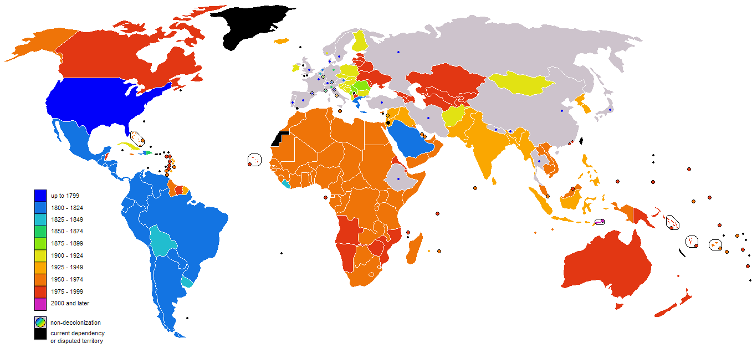
Decolonization
Notes:
Source: Wikipedia

Slide 48
D – Waves of Economic Change
Socioeconomic Changes
Technological Changes

Slide 49
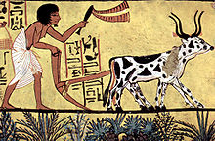
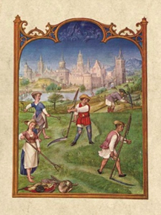
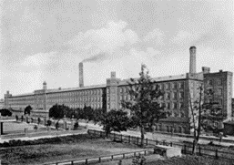
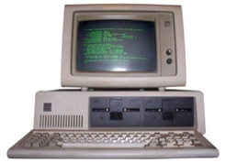
Towards a Global Economic Landscape: Major Phases of Socioeconomic Change
Neolithic
Feudalism
Industrial
Global
Tribe / Village
Hunting and gathering
Language
City-state, Kingdom
Settled agriculture
Writing
Nation-state
Industrial system
Printing
Global governance
Post-industrial
Information technologies
Demography
Slow growth
Fast growth
Slow growth
Wealth
Agriculture and land ownership
Industry
Technology
Notes:
Source: adapted from Raskin, P. et al (2002) Great Transition: The Promise and Lure of the Times Ahead, Boston: Stockholm Environment Institute, p. 3. http://www.tellus.org/seib/publications/Great_Transitions.pdf

Slide 50
Long Wave Cycles of Innovation
Automation
Robotics
Digitalization
Sustainability
Digital networks
Software
New Media
Biotechnology
Petrochemicals
Electronics
Aerospace
Water power
Textiles
Iron
Mechanization
Commerce
Steam
Rail
Steel
Cotton
Electricity
Chemicals
Internal combustion engine
Pace of innovation
1st Wave
2nd Wave
3rd Wave
4th Wave
5th Wave
6th Wave
1785
60 years
1845
55 years
1900
50 years
1950
40 years
1990
30 years (?)
2020
25 years (?)
Read this content
Notes:
Source: Adapted from Hargroves and Smith (2005).

Slide 51
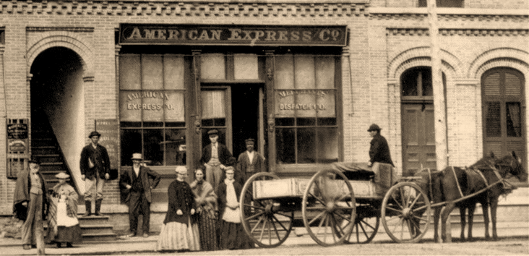
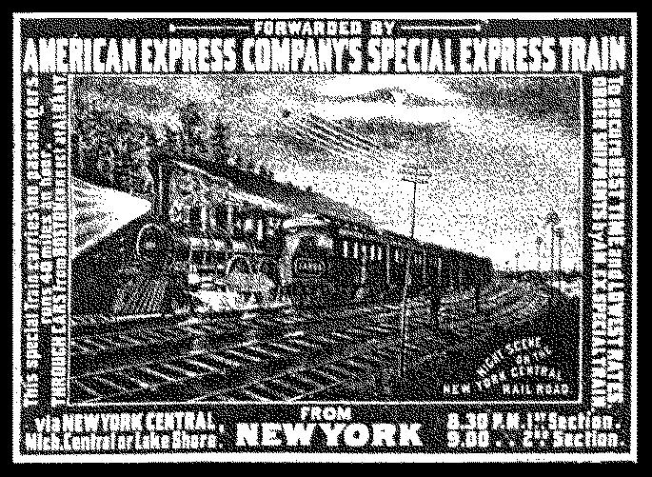
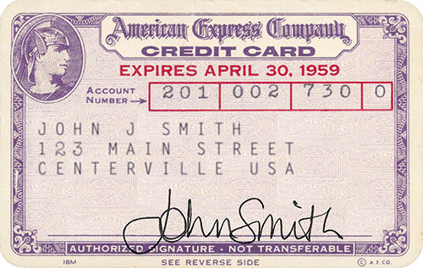
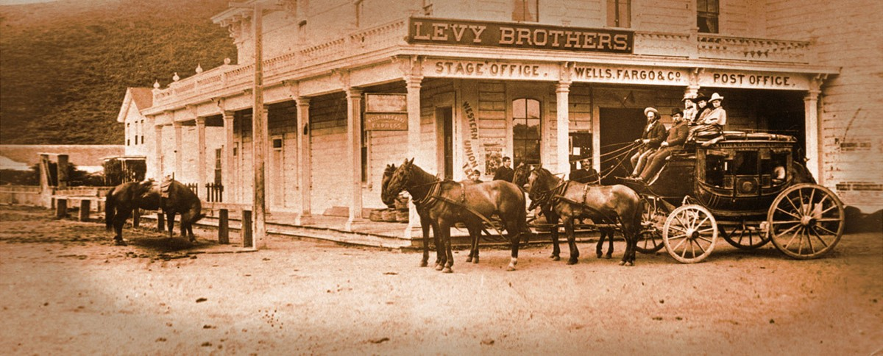
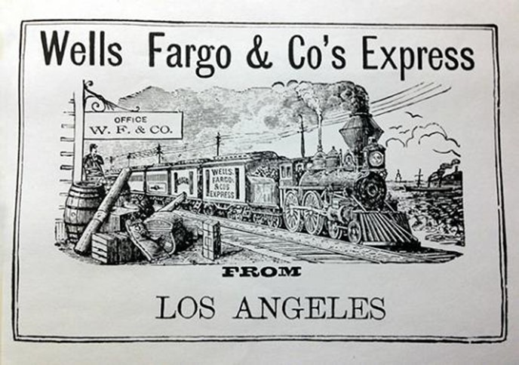

Corporate Adaptation to Innovations: American Express and Wells Fargo
Interstate Wagon Services
Rail Services
Financial Services
American Express
1850: Established in Buffalo, NY
1883: Express trains
1918: Exiting the express business
1857: Money orders
1891: Traveler's cheques
1958: Credit cards
Wells Fargo
1852: Established in San Francisco, CA
1866: Stagecoach services
1888: Express trains
1905: Wells Fargo Bank
1967: Credit cards
1995: Web banking accounts
© GTS
Read this content

Slide 52
Cumulative Waves of Transport Development
5
Global mobility systems
AIR
Airports
2
3
4
LAND
Canals
Railways
Highways
Punctual inland access
Inland and national accessibility
National mobility systems
1
3
5
MARITIME
Sailships
Steamships
Containerships
Empires and global trade networks
International trade and mobility
Global distribution systems
© GTS
Read this content
17-18th Century
19th Century
20th Century
21st Century

Slide 53
Primary Energy Production by Source, United States, 1850-2020
Notes:
Source: Energy Information Administration. Renewables include biomass.
http://www.eia.gov/emeu/aer/overview.html

Slide 54

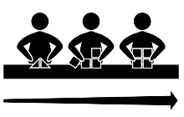

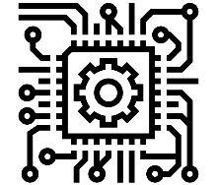
The Four Industrial Revolutions
Late 18th – early 19th Century
1.0
Industrial cities
Substitution
Mechanization
Steam engine and mechanical production
Late 19th - mid 20th Century
2.0
Industrial regions
Scale economies
Mass Production
Electricity and division of labor
Second half of 20th Century
3.0
Global production networks
Input costs
Automation
Electronics and information technologies
Early 21st Century
4.0
Global value chains
Added value
Robotization
Cyber-physical systems
Read this content

Slide 55
Key Technological Innovations since 2000
Smartphones (2007)
Flash Drives (2000)
Skype (2003)
Google (late 1990s)
Google Map (2005)
Human Genome Project (2003)
YouTube (2005)
Graphene (2004)
Bluetooth (1999)
Facebook (2004)
Curiosity Mars Rover (2011)
Electric cars (2000s)
Driverless cars (2012)
Large Hadron Collider (2013)
Artificial heart (2001)
3D printing (2000s)
Amazon Kindle (2007)
Stem Cell Research (2000s)
Multiuse rockets (2015)
Gene editing (2012)
Notes:
From HumandProgress
Commonplace items like clocks and watches were once luxuries, owned by ~2–3% of the population. Today, almost 70% of people have a pocket supercomputer, for which telling the time is the most basic of functions.

Slide 56

Short Essay: Capitalism and Cycles
Socioeconomic and technological changes come in waves. Provide some examples.

